Slide 1
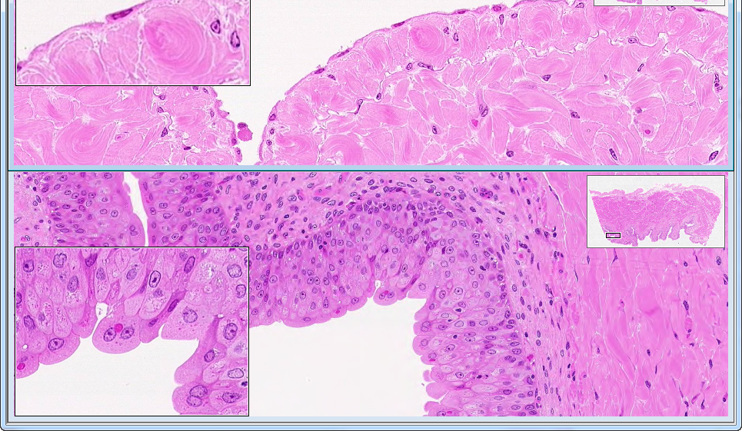
WebSlide 0098_G: Bladder

Slide 2
Slide UMich 9N-1: Kidney, simple cuboidal epithelium

Slide 3
Slide UMich 9N-1: Kidney, simple cuboidal epithelium (coiled tubes in various planes of section)

Slide 4
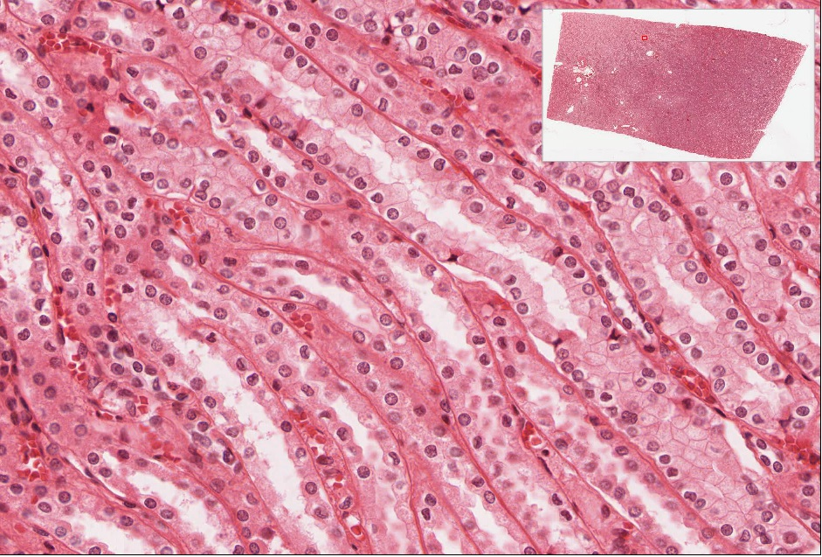
Slide UMich 9N-1: Kidney, simple cuboidal epithelium (tubes mostly in longitudinal section)

Slide 5
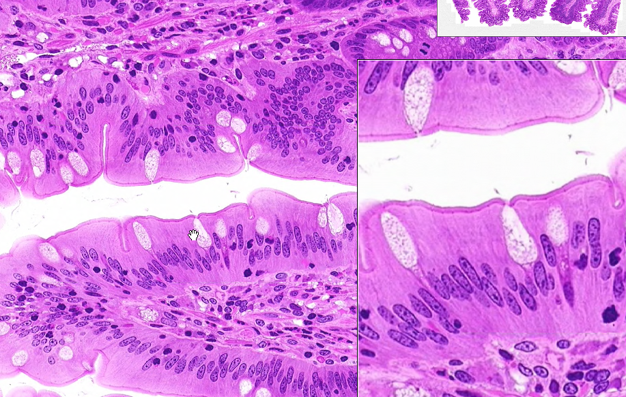
WebSlide 0032_G: Ileum

Slide 6
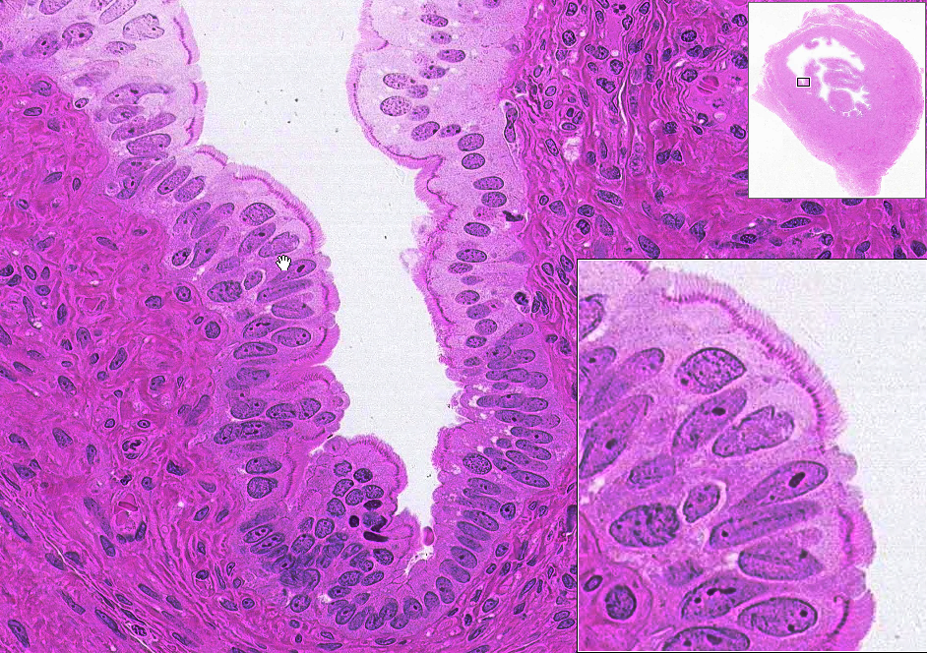
WebSlide 0051_G: Uterine Tube

Slide 7
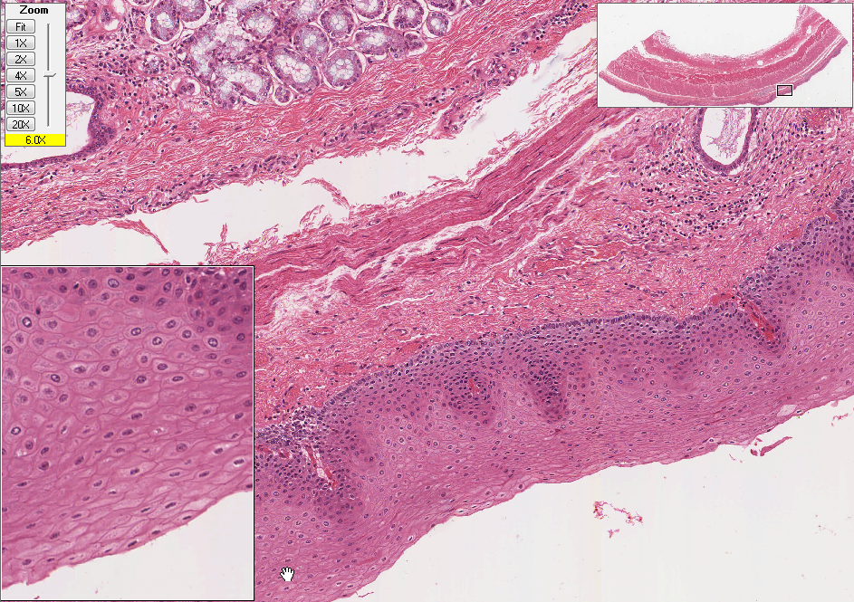
Slide UMich 153: Esophagus, stratified squamous non-keratinized epithelium

Slide 8
Slide UMich 106: Thick Skin, stratified squamous keratinized epithelium
Deep fascia
Blood vessel
Superficial Fascia
Epithelium (epidermis)
Spinous cells
Keratin

Slide 9
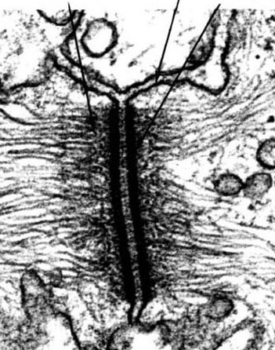
Macula Adherens (desmosomes) and Intermediate Filaments
Desmosomes are NOT visible at the light microscope level.

Slide 10
#40 Respiratory epithelium
Cilia
Basal bodies
Goblet cell
Basement membrane

Slide 11
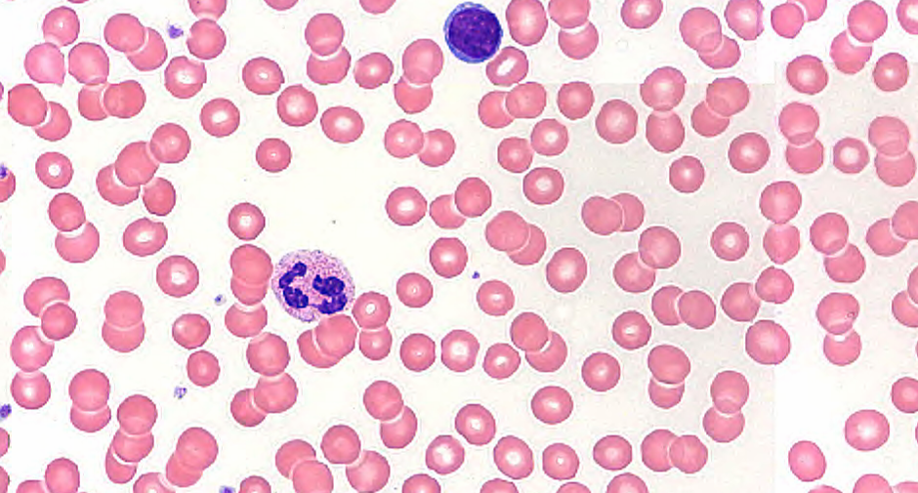
Normal Blood Smear 86X
Lymphocyte
Neutrophil

Slide 12
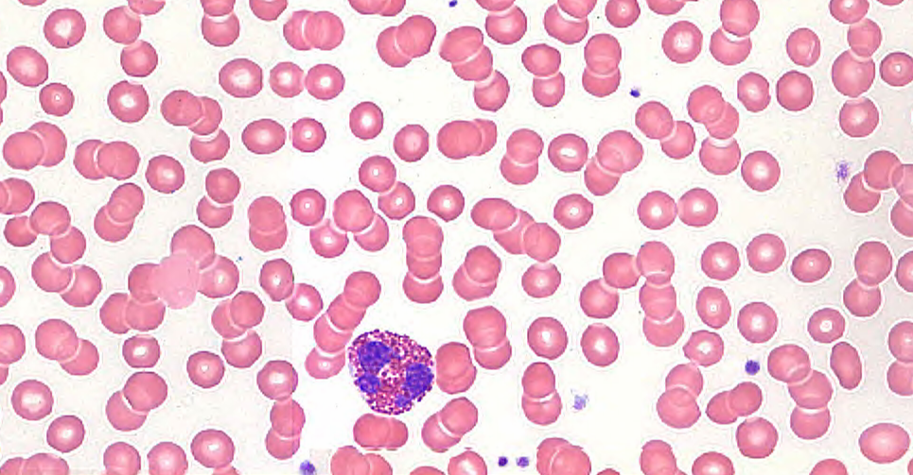
Normal Blood Smear 86X
Neutrophil
Eosinophil
Platelets

Slide 13
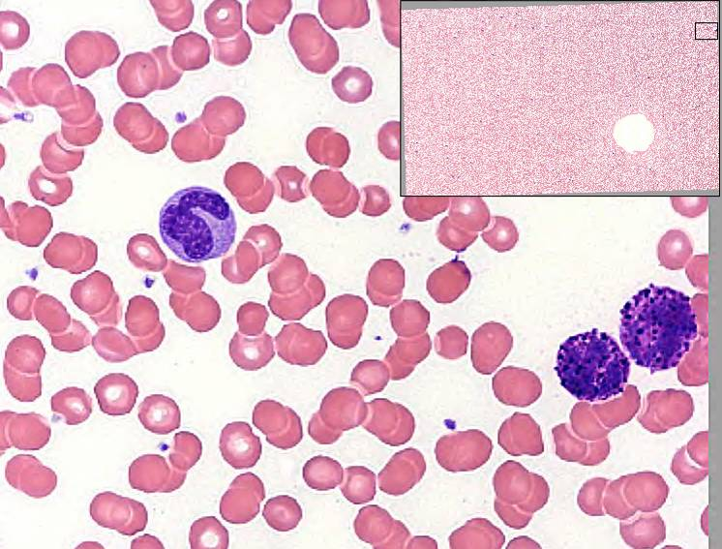
Normal Blood Smear 86X
Basophils
Monocyte

Slide 14
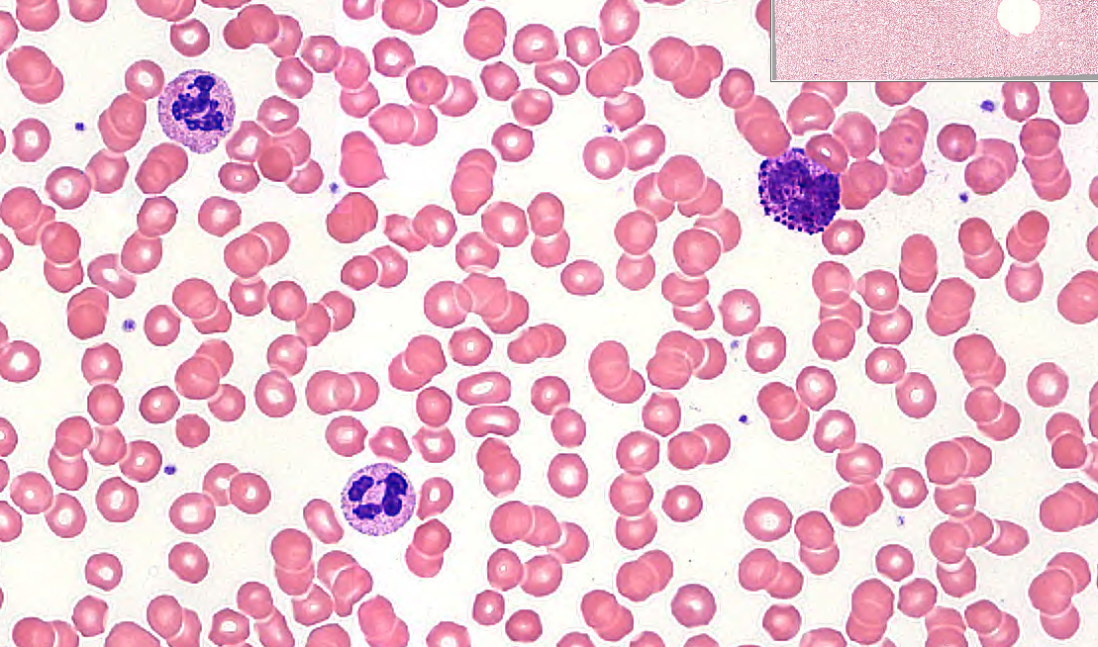
Slide: Pathology Normal Blood Smear 86X
Neutrophils
Basophil
Platelets

Slide 15
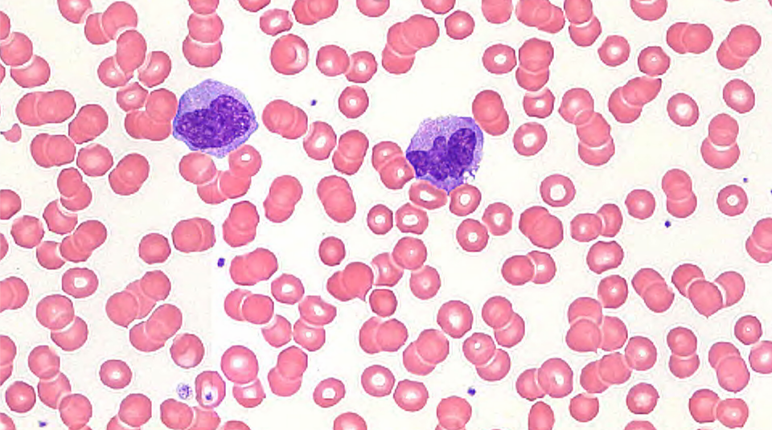
Slide: Pathology Normal Blood Smear 86X
Monocyte

Slide 16
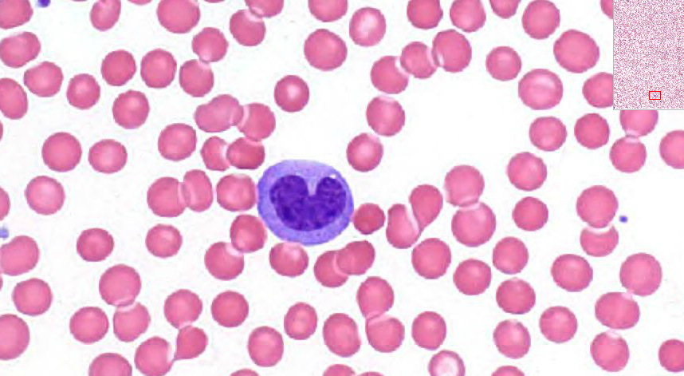
Slide: Pathology Normal Blood Smear 63X
Monocyte

Slide 17
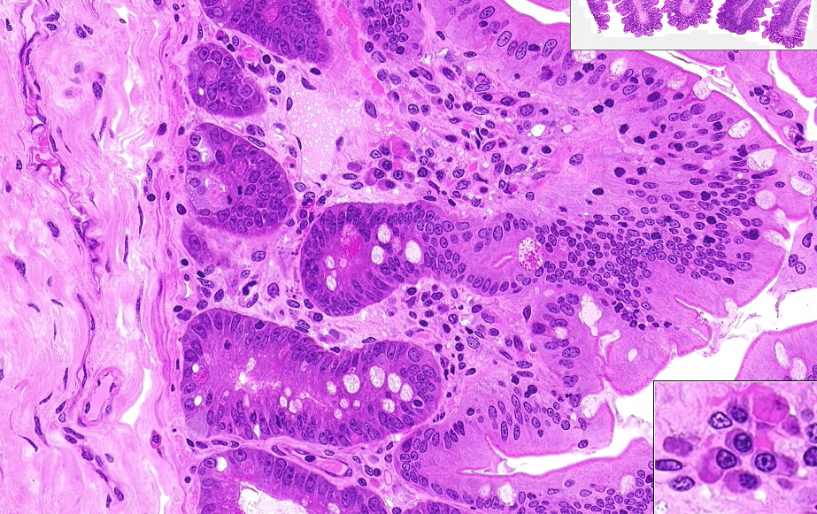
WebSlide 0032_D: Ileum, loose & dense connective tissue

Slide 18
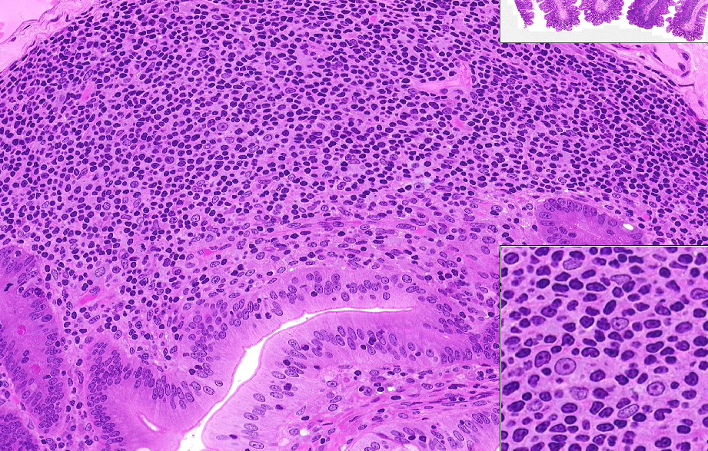
WebSlide 0032_D: Ileum, loose connective tissue

Slide 19
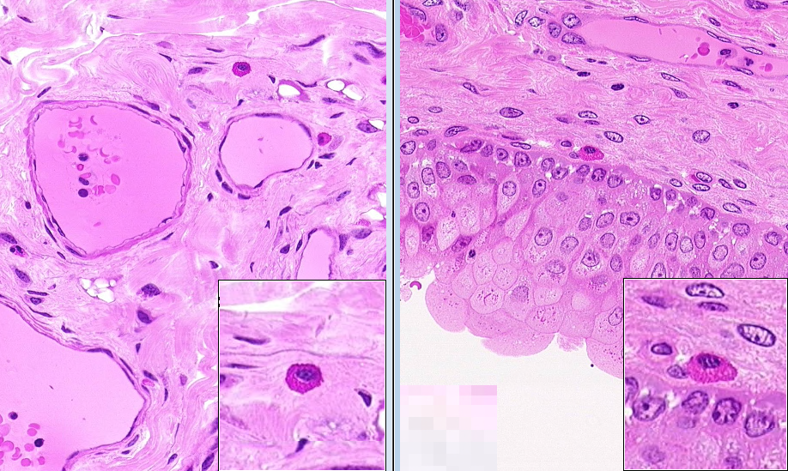
Mast Cells: WebSlide 0032_D & WebSlide0098_G

Slide 20
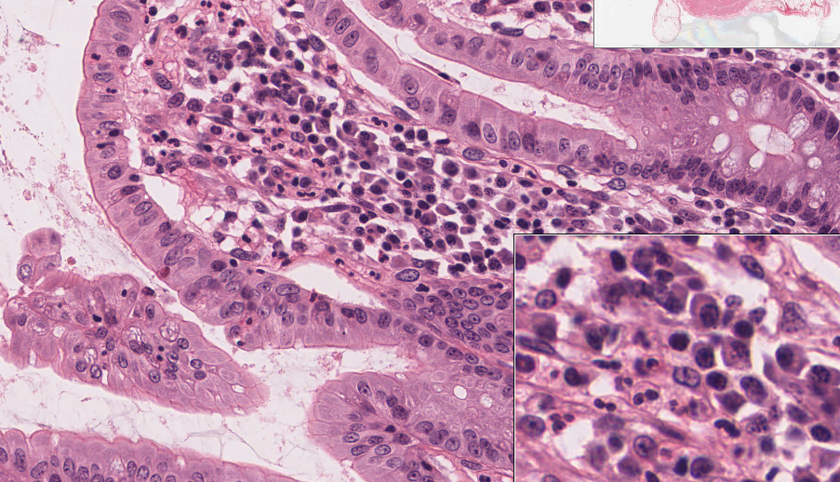
Slide UMich 29: neutrophils & plasma cells

Slide 21
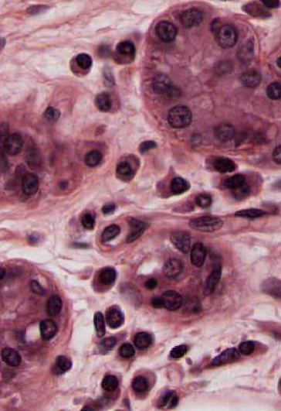
Plasma cells
Eccentrically located nucleus Cartwheel appearance of nucleus Basophilic cytoplasm Egg-shaped cell with clear outline

Slide 22
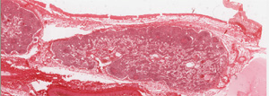
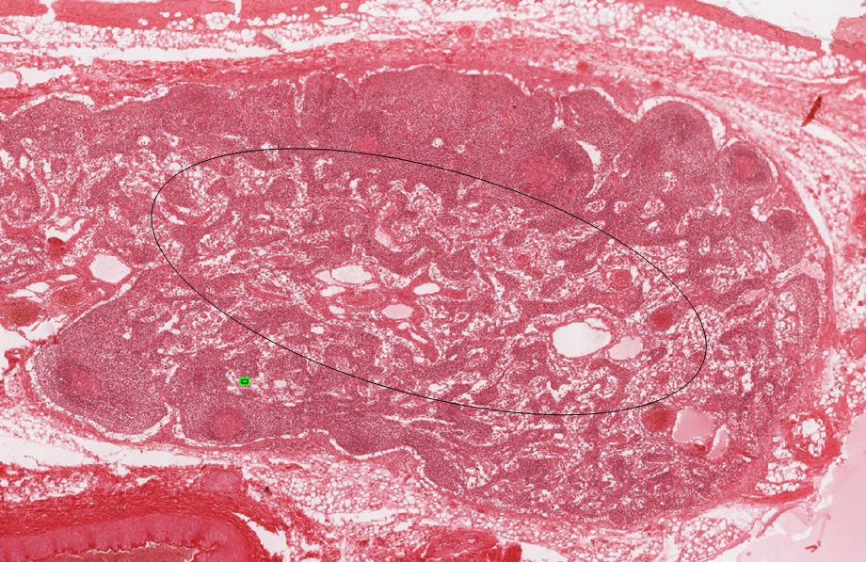
#26 lymph node
Look for macrophages in this lightly stained area

Slide 23
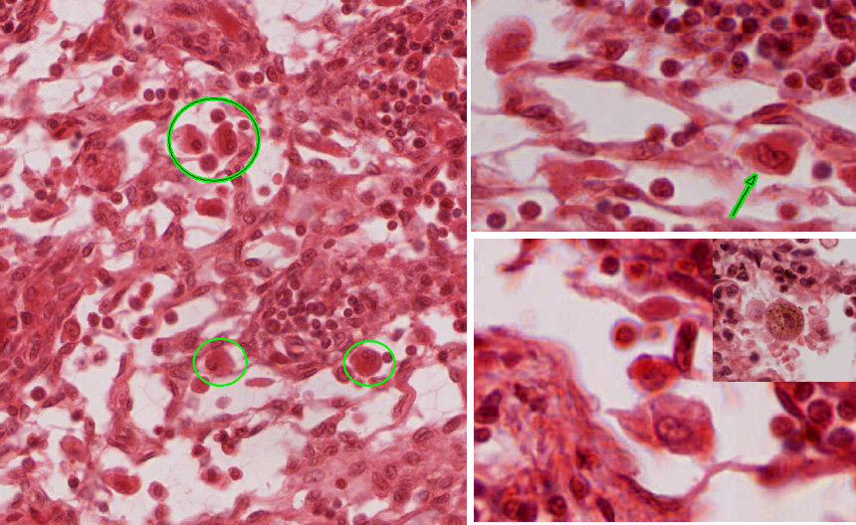
Macrophages
Kidney bean shaped nucleus (indented)
Eosinophilic cytoplasm with bubbly appearance
Ingested materials in the cytoplasm
Fuzzy cell border (outline)

Slide 24
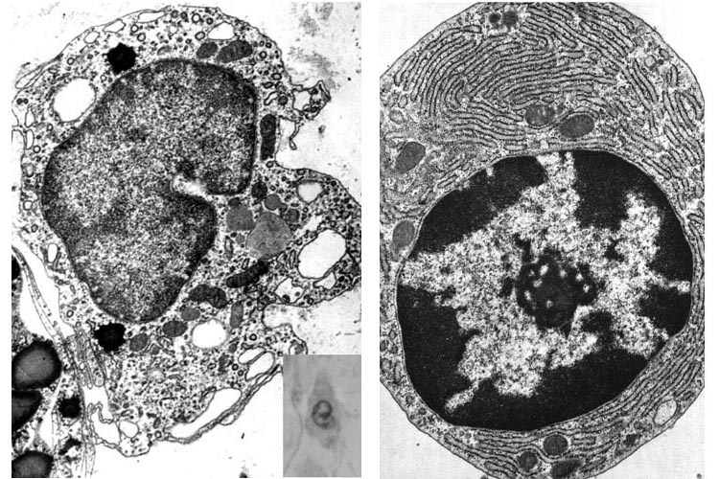
Macrophage Plasma Cell

Slide 25
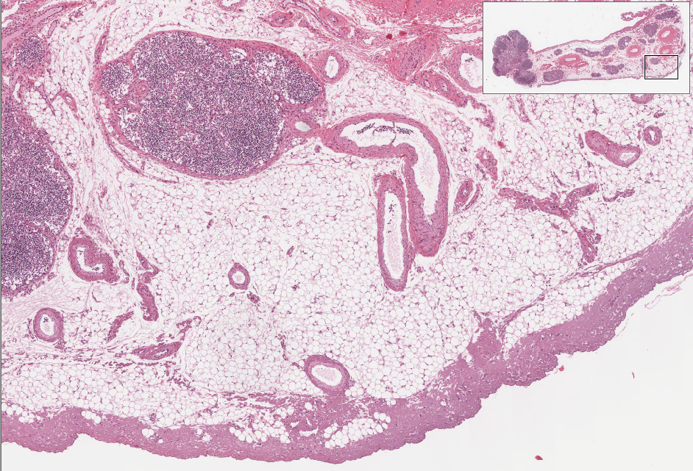
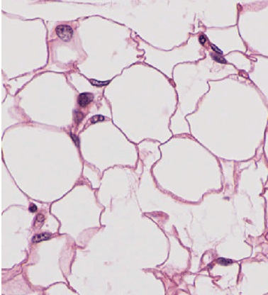
Slide UMich 30: mesentery, white adipose tissue
-Unilocular adipose tissue
-displaced flattened nuclei

Slide 26
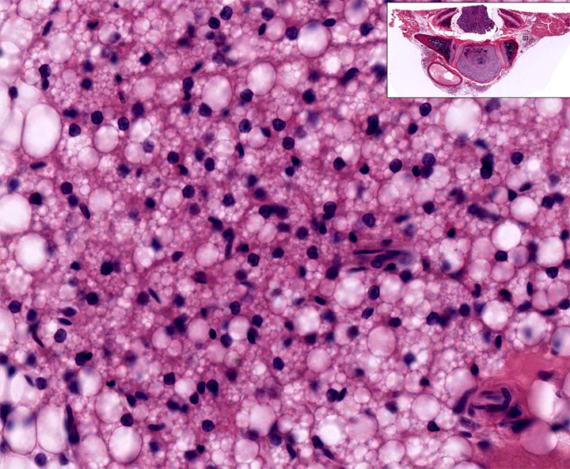
Slide UMich H2: Fetal thorax, Brown Fat
-Multilocular adipose tissue
-Spherical nuclei

Slide 27
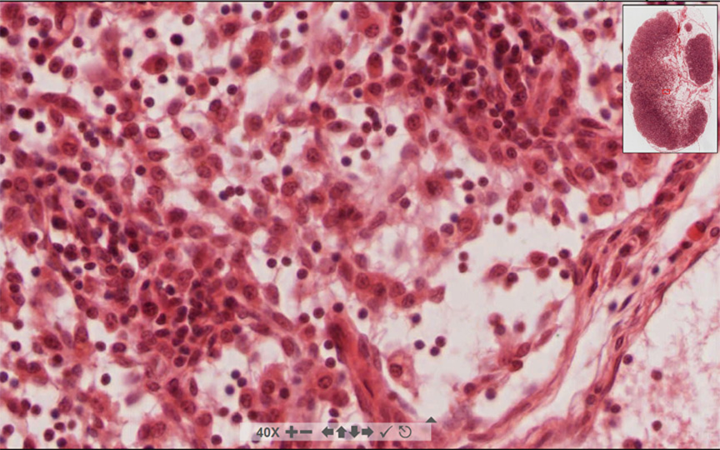
#27 Lymph node stained with H & E – Reticular connective tissue

Slide 28
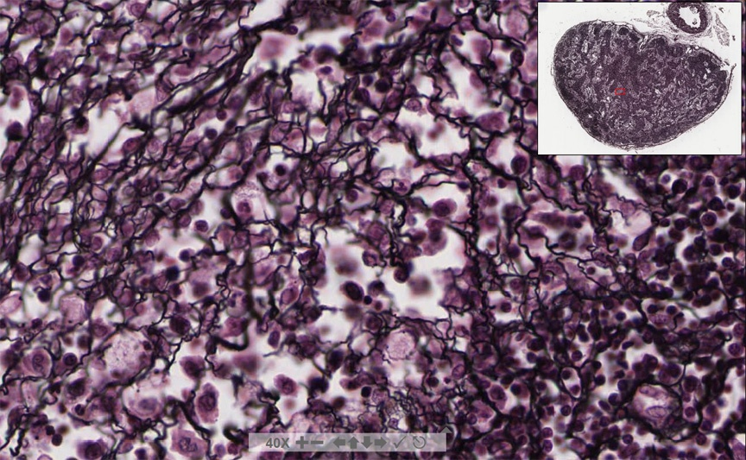
#28 Lymph node stained with silver – Reticular connective tissue

Slide 29
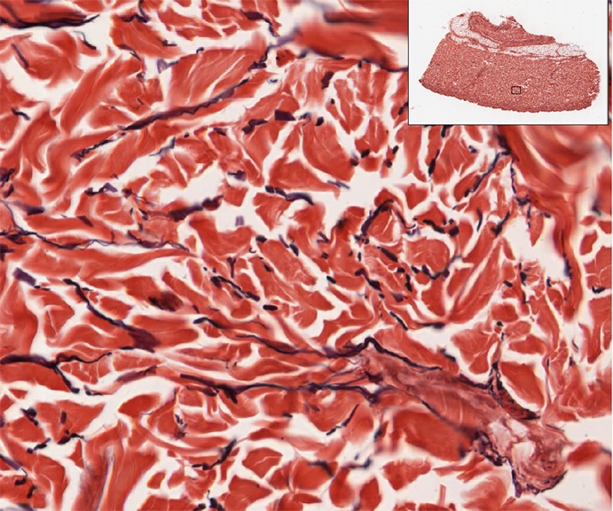
#33 Dermis of skin (aldehyde Fuchsin stain) Dense irregular connective tissue with elastic fibers

Slide 30
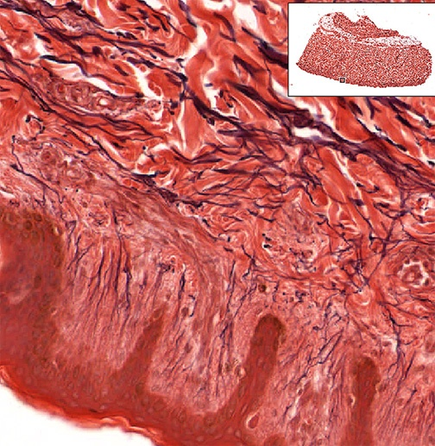
Elastic Fibers in dense irregular CT - slide 33 (Verhoeff stain)

Slide 31
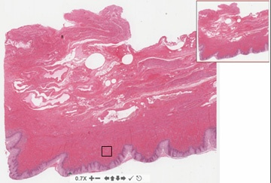
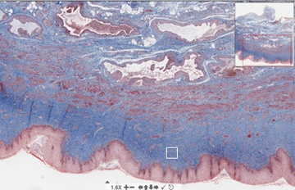
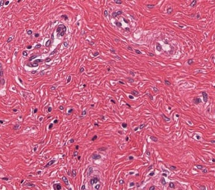
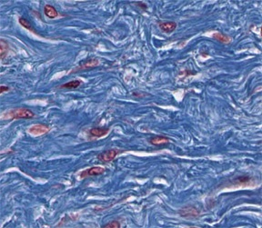
#250 Vagina (Dense irregular CT) H & E Trichrome

Slide 32
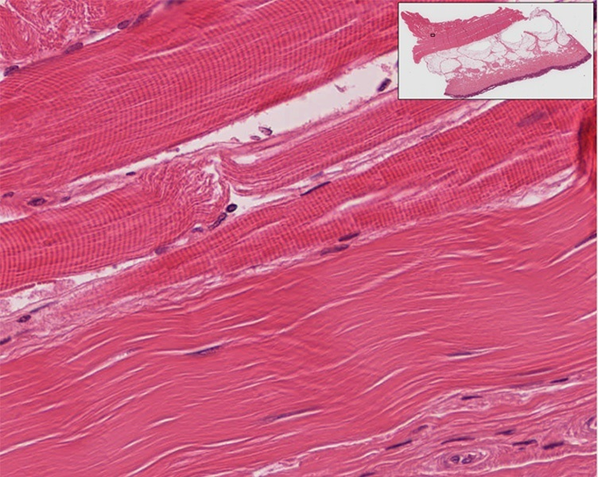
Dense regular CT #112 (or #106) Musculo-tendon junction
Skeletal muscle
Dense regular CT (tendon)

Slide 33
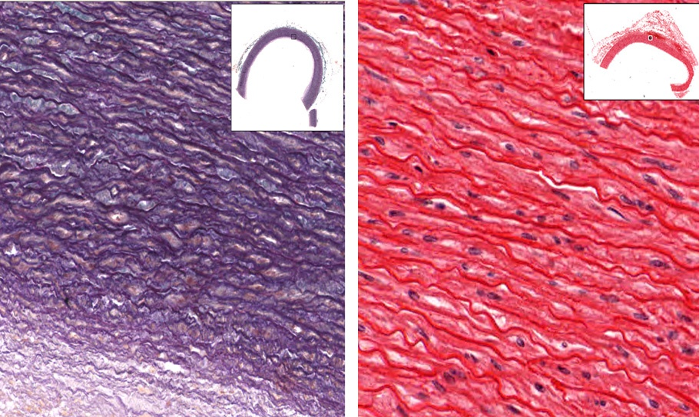
Elastic connective tissue
Slide #36, aorta, aldehyde fuchsin
Slide 88, aorta. H & E

Slide 34
Cartilage & Bone

Slide 35
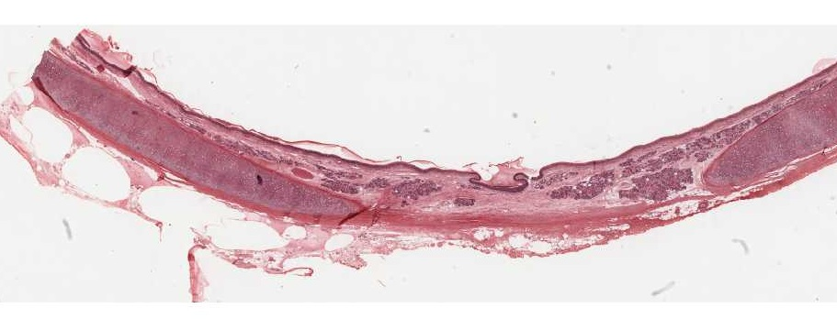
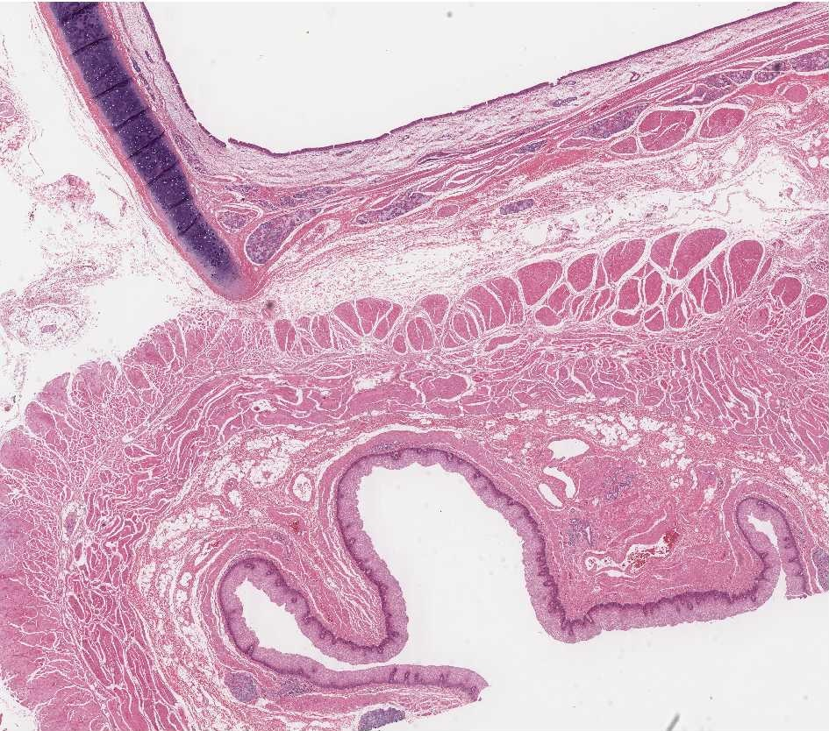
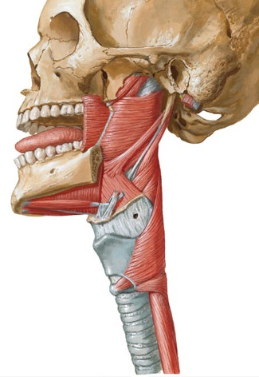
#40 Trachea
Slide 40: Trachea
Slide 126: Esophagus & Trachea
Trachealis Muscle
Trachea
Esophagus
#126

Slide 36
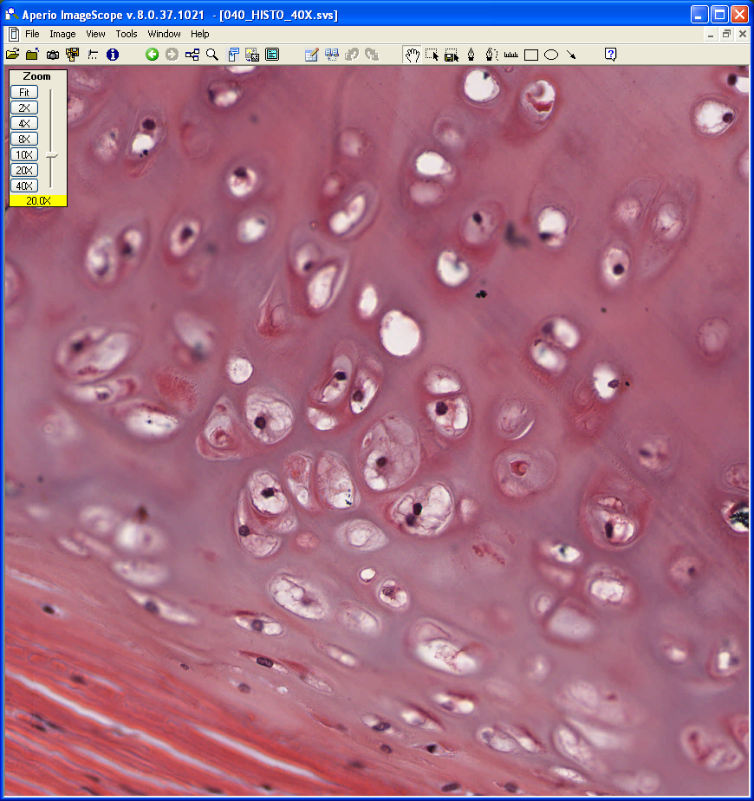
#40 Hyaline Cartilage
Interterritorial Matrix
Chodrocytes
Territorial Marix
Chondroblasts
Perichondrium

Slide 37
#44 (pinna) Aldehyde fuchsin & trichrome
#44H (epiglottis) H&E

Slide 38
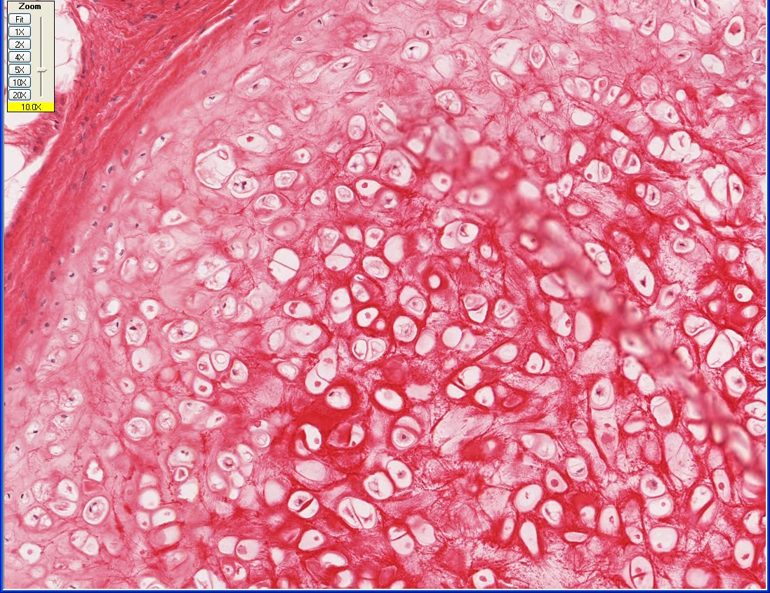
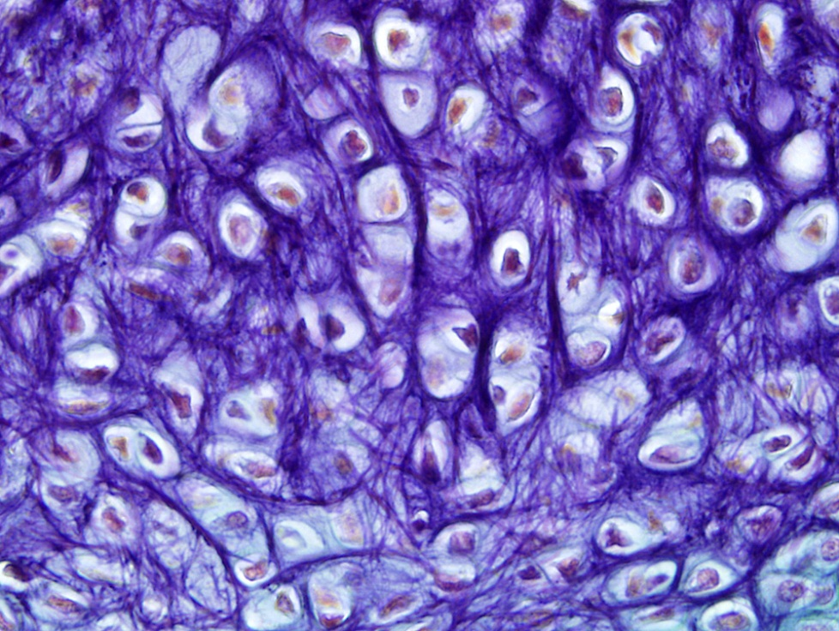
#44H Epiglottis—Elastic Cartilage, H&E
Perichondrium
Elastic Fibers (Elastin)
#44: Ear, aldehyde fuchsin & Masson

Slide 39
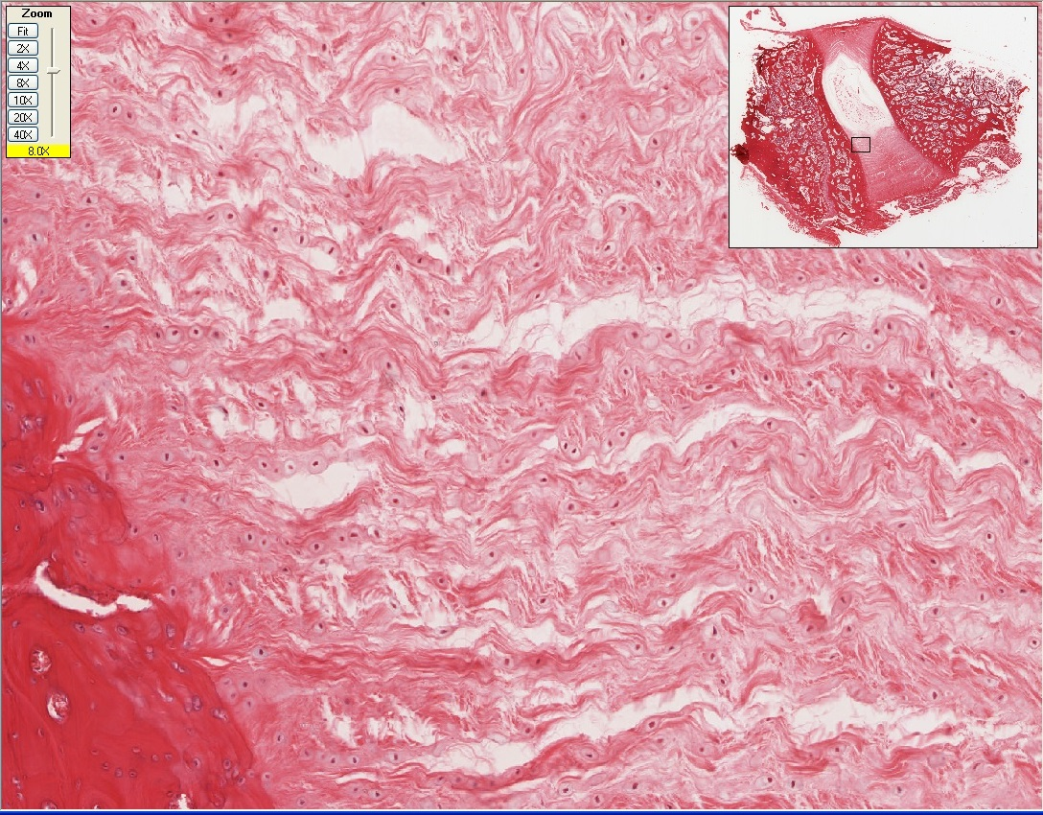
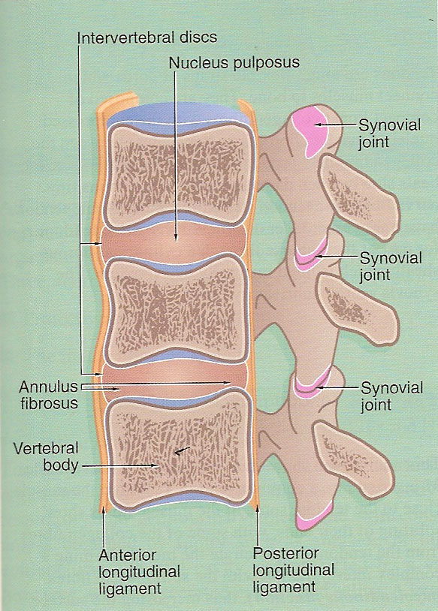
#45 Fibrocartilage
Intervertebral Disk
Bone
Fibrous Matrix
(Dense Regular CT)
Nucleus Pulposus
Annulus Fibrosus
Chondrocytes
Bone

Slide 40
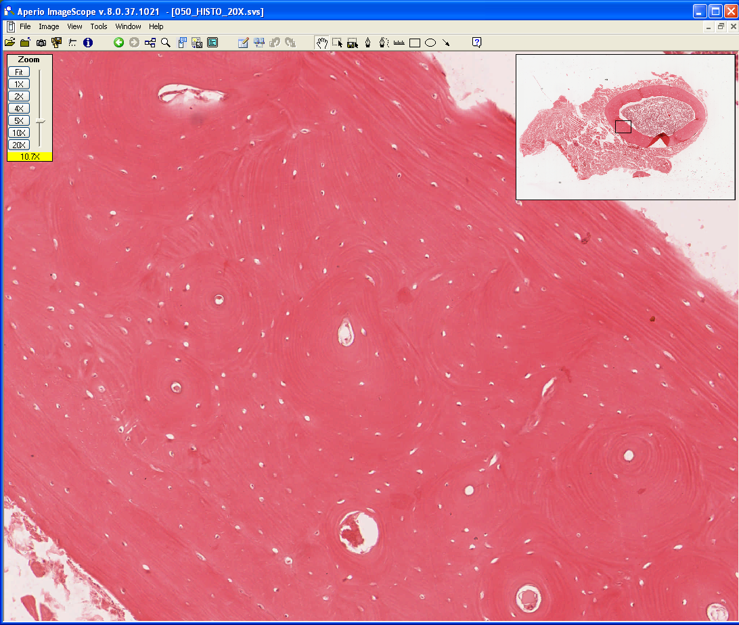
#50 Compact Bone
Skeletal Muscle
Compact Bone
Bone Marrow
Concentric
Lamellae
Lacunae
(containing osteocytes)
Inner Circumferential
Lamellae
Haversian
Canal
Osteon
Outer Circumferential
Lamellae

Slide 41
Slide UMich 48: Tibia & fibula, x.s., H&E
Periosteum

Slide 42
Slide UMich 48: Tibia & fibula, x.s., H&E
Fibula
Periosteum
(Fibrous)
(cellular)
Tibia
Osteoblasts
Osteoid

Slide 43
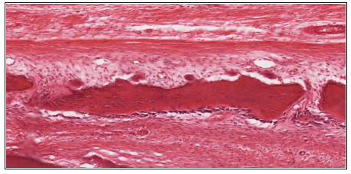
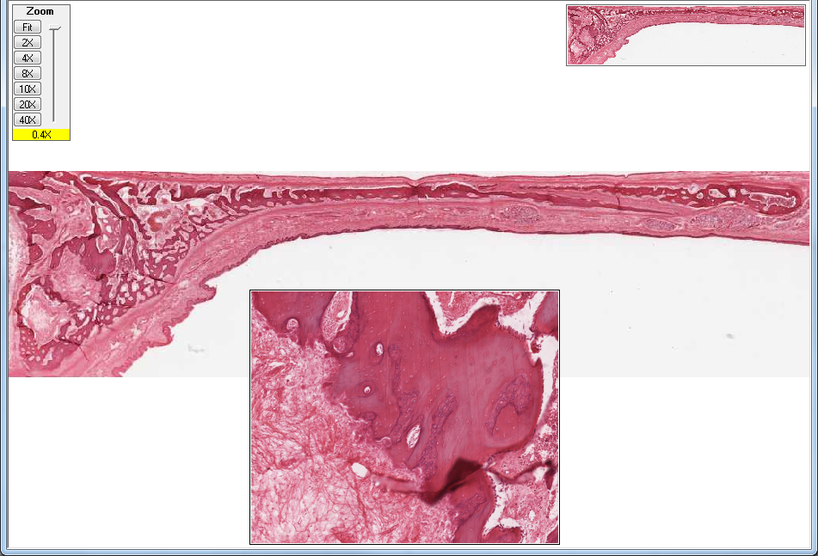
Slide 115: Developing Palate

Slide 44
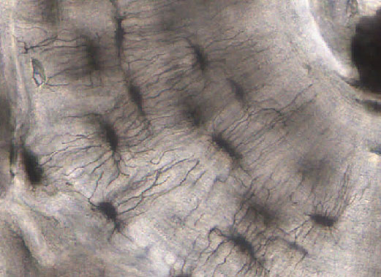
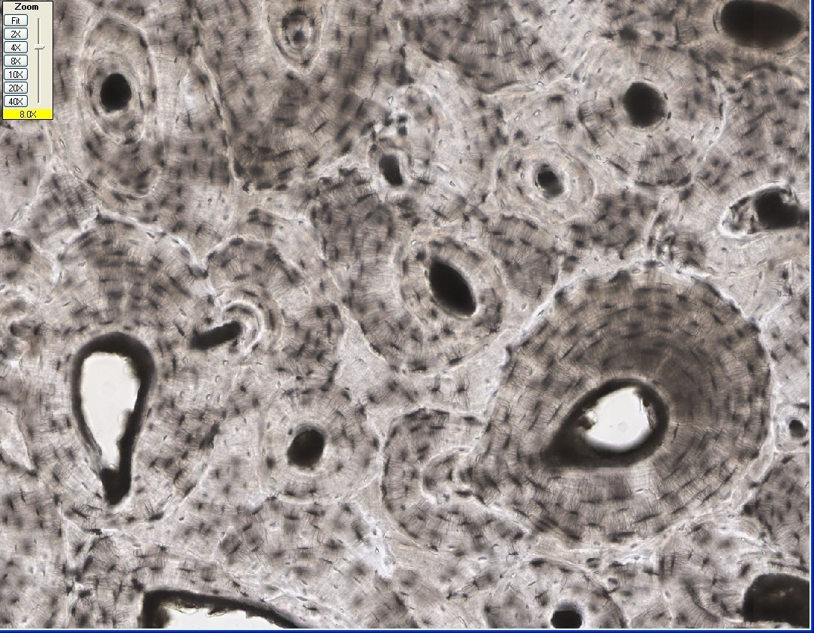
#51xc Ground Bone
HC
Lacunae
Osteon with
Concentric
Lamellae
Canaliculi
Interstitial
Lamellae
HC
Volkmann’s Canal

Slide 45
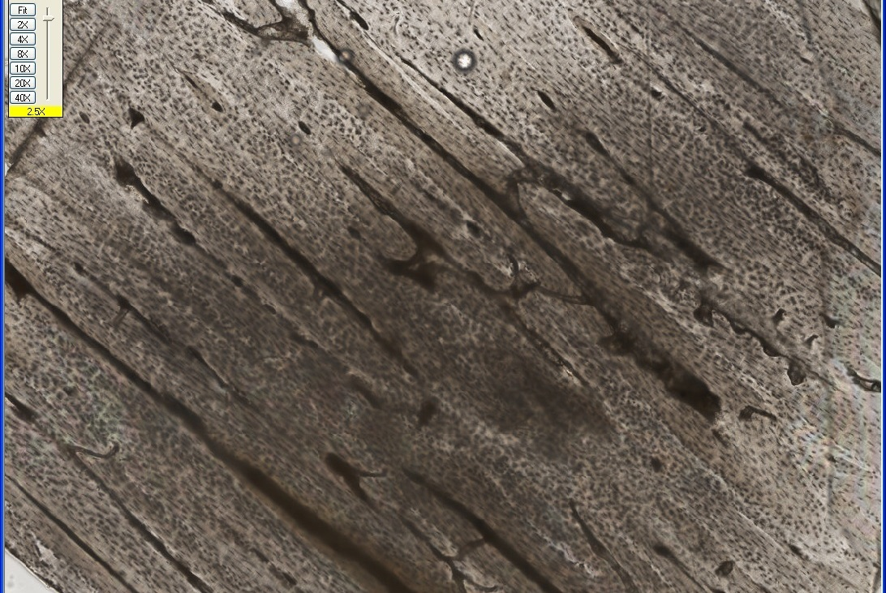
Slide 51L ground bone, longitudinal section)
Concentric Lamellae
of an Osteon
HC
Volkmann’s Canals

