Slide 1
Basic Tissues II Lab Orientation muscle nerve
J. Matthew Velkey
454A Davison
matt.velkey@duke.edu

Slide 2
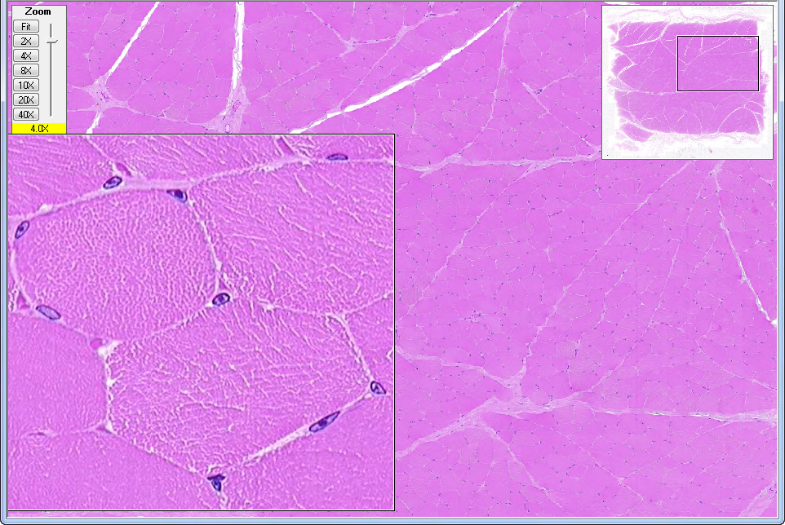
WebSlide 0013_N: skeletal muscle
myocyte nuclei
myofibrils
fascicle
endomysium
myofiber (cell)
perimysium
fibroblast
nucleus

Slide 3
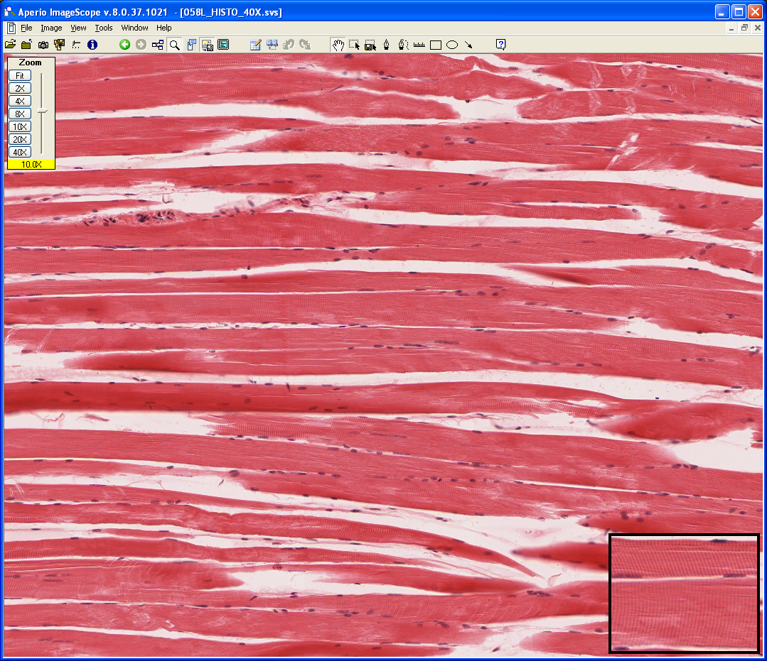
Slide 58L: Skeletal Muscle, longitudinal sect.
Striated Muscle Fiber (cell)
Endomysium
Striations
Peripheral Flattened Nuclei

Slide 4
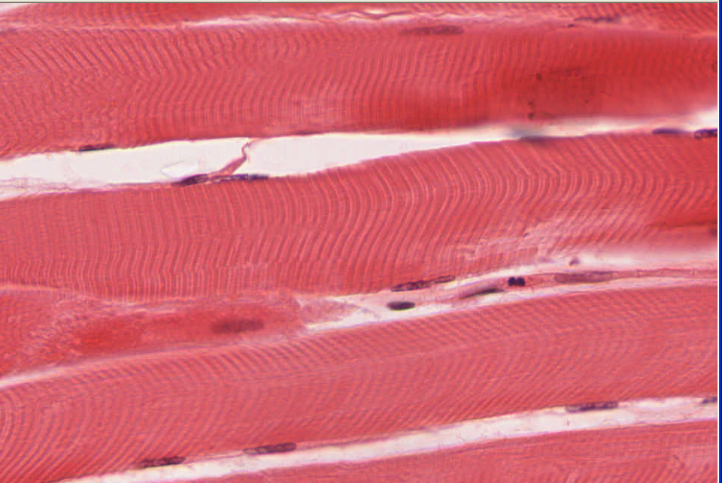
Slide 58L: Skeletal Muscle, longitudinal sect.
Dark A Band (myosin)
Light I Bands
(actin)
Divided by Z Line
2 consecutive Z line = Sarcomere

Slide 5
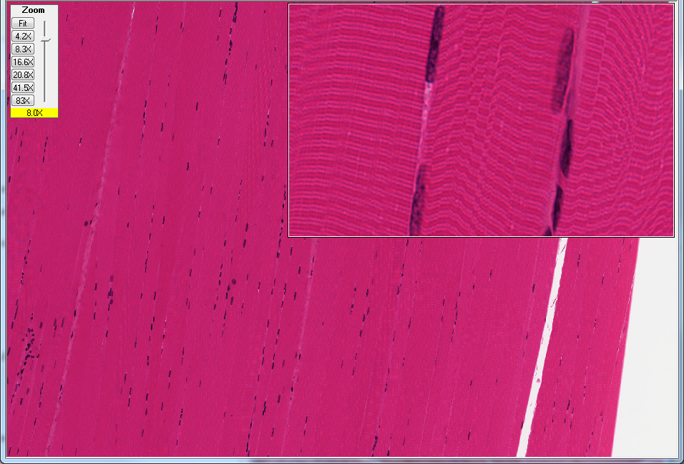
Slide 58thin: skeletal muscle, thin sect.
H
A
Z
I
sarcomere
(Z line to Z line
myofibrils
fiber (cell)

Slide 6
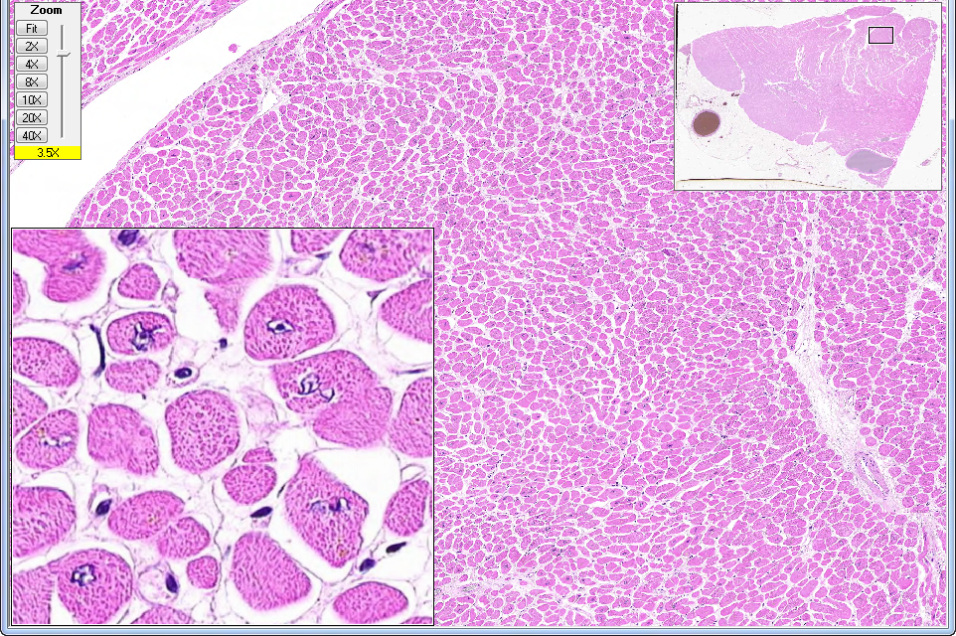
WebSlide 0036_S: heart
fiber (cell)
cap
nucleus
myofibrils
cap

Slide 7
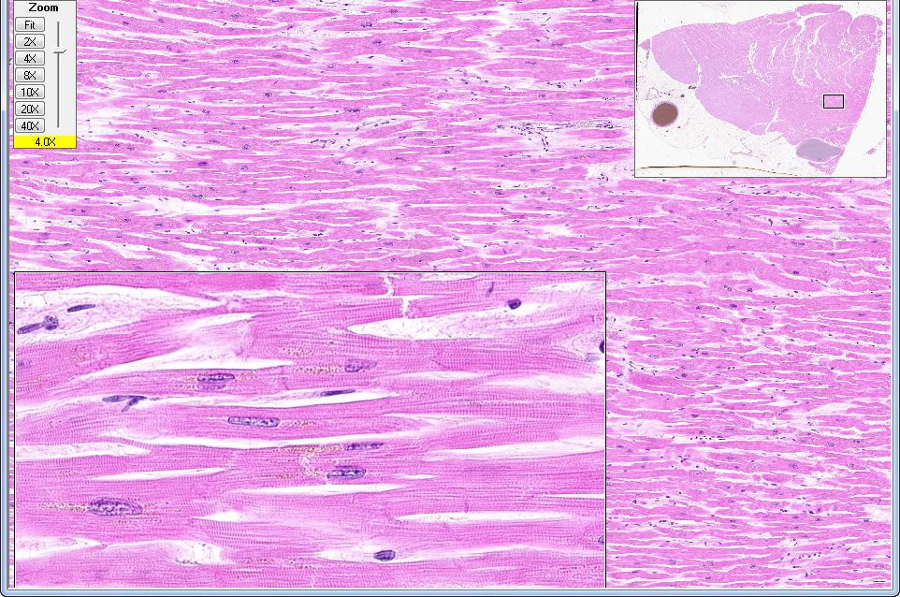
WebSlide 0036_S: heart
intercalated disk
lipofuschin (aging pigment)

Slide 8
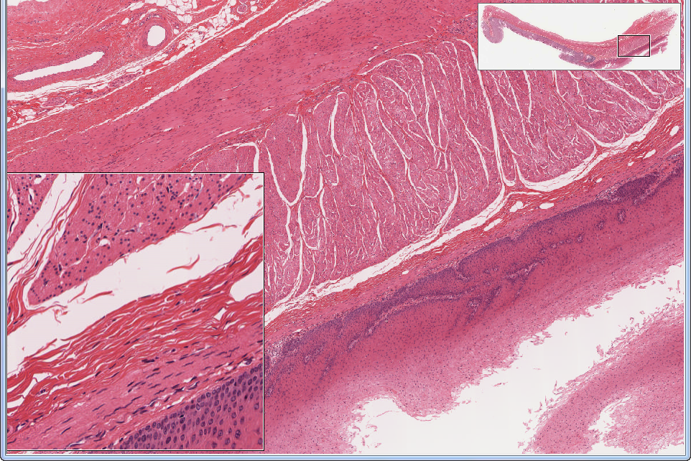
Slide UMich 155: esophagus & stomach (esophagus portion)
outer longitudinal layer layer
inner circular layer
inner circular layer
submucosa
muscularis mucosae
artificial space
submucosa
epithelium (mucosa)
muscularis mucosae
epithelium (mucosa)

Slide 9
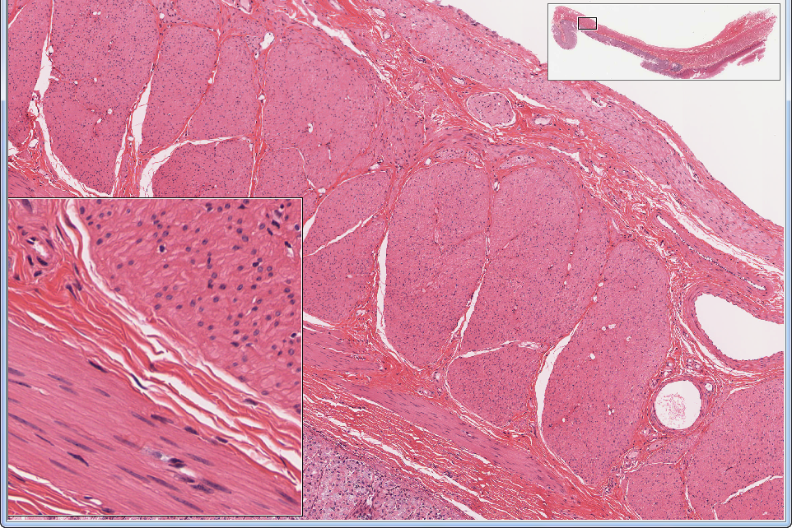
Slide UMich 155: esophagus & stomach (stomach portion)
outer oblique layer
middle circular layer
middle circular layer
inner oblique layer
inner oblique layer
submucosa
muscularis mucosae
epithelium (mucosa)

Slide 10
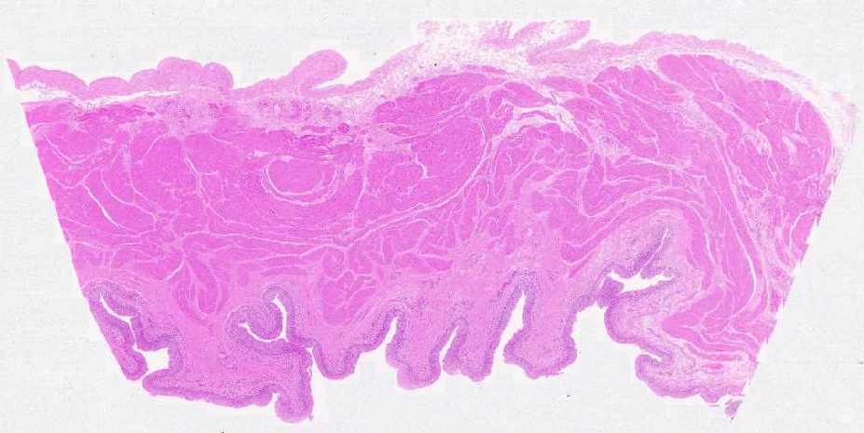
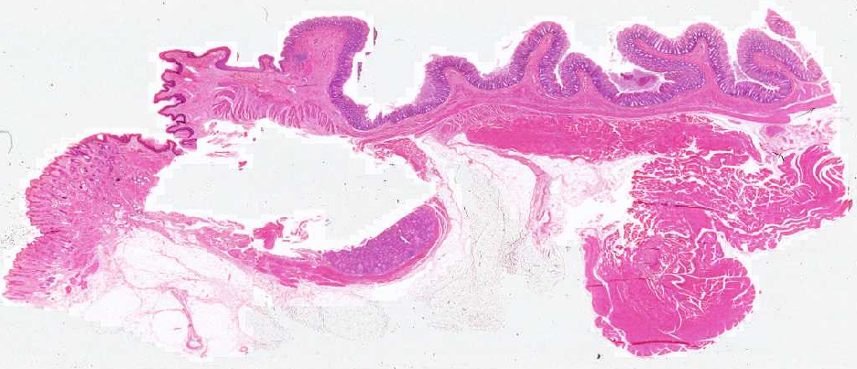
WebSlide 0098_N: bladder
smooth muscle layers
conn tissue
epithelium
WebSlide 0093_N: recto-anal junction
epithelium
smooth muscle
skeletal muscle

Slide 11
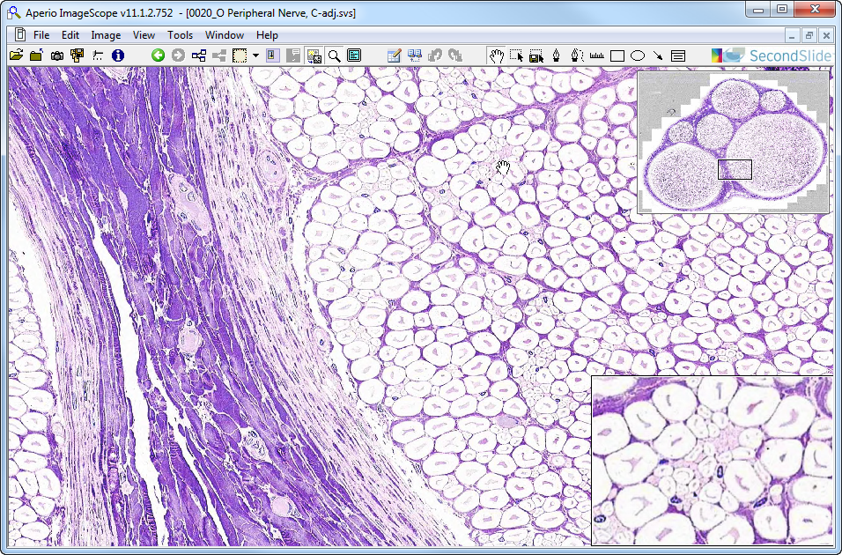
WebSlide 0020_O: peripheral nerve, c.s.
endo-
epi-
peri-
axon
mf
+
*
sc
Notes:
endo-=endoneurium epi-=epineurium mf=myelinated fiber peri-=perineurium
sc=Schwann cell (nucleus) +=lightly myelinated fibers *=unmyelinated fibers

Slide 12
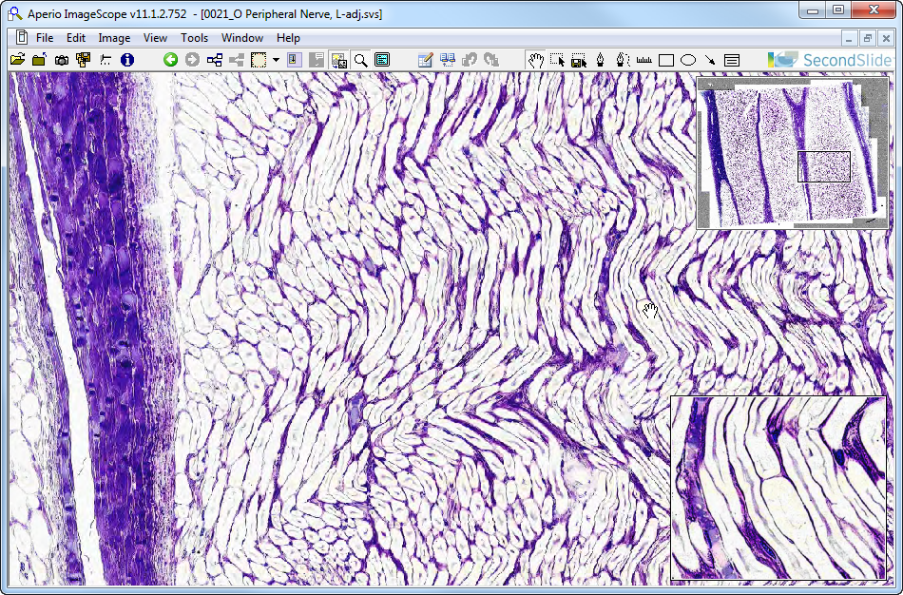
WebSlide 0021_O: peripheral nerve, l.s.
peri-
epi-
endo-
axon
nr
mf
Notes:
endo-=endoneurium epi-=epineurium mf=myelinated fiber nr=node of Ranvier peri-=perineurium

Slide 13
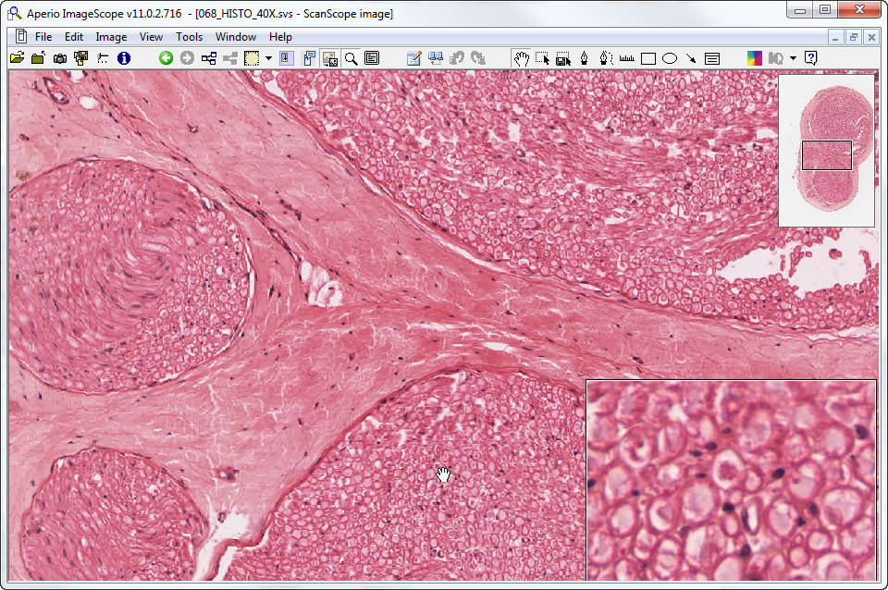
Slide UMich 68: nerve, c.s.
epi-
peri-
endo-
ma
sc
Notes:
endo-=endoneurium epi-=epineurium ma=myelinated axon sc=Schwann cell

Slide 14
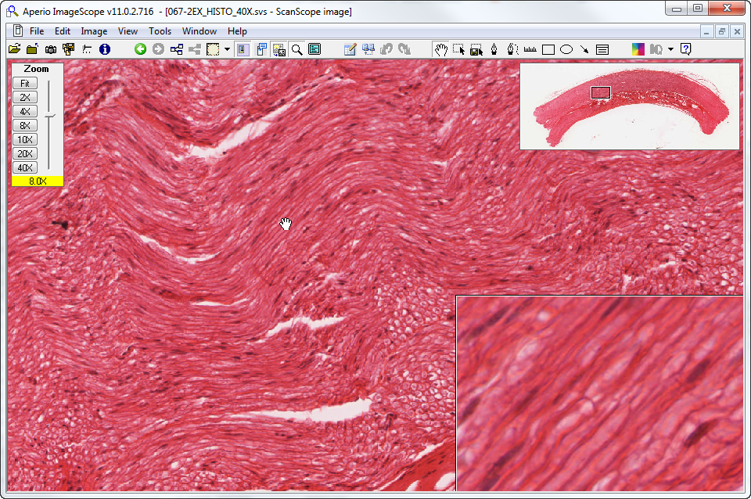
Slide UMich 68: nerve, l.s.
sc
nr
Notes:
nr=node of Ranvier sc=Schwann cell (nucleus)

Slide 15
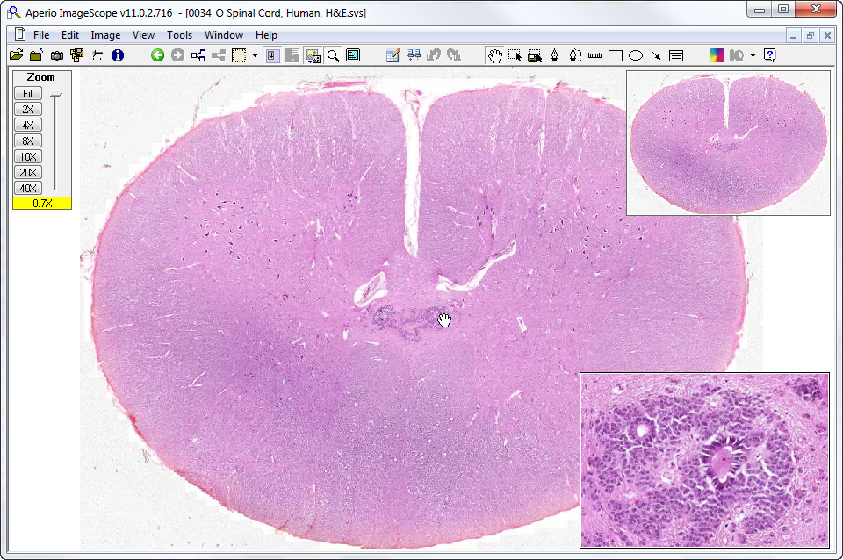
WebSlide 0034_O: spinal cord, c.s., h&e
VH
GM
WM
DH
*
*
ep
Notes:
DH=dorsal horn ep=ependymal cells GM=gray matter VH=ventral horn
WM=white matter *=lumen of central canal

Slide 16
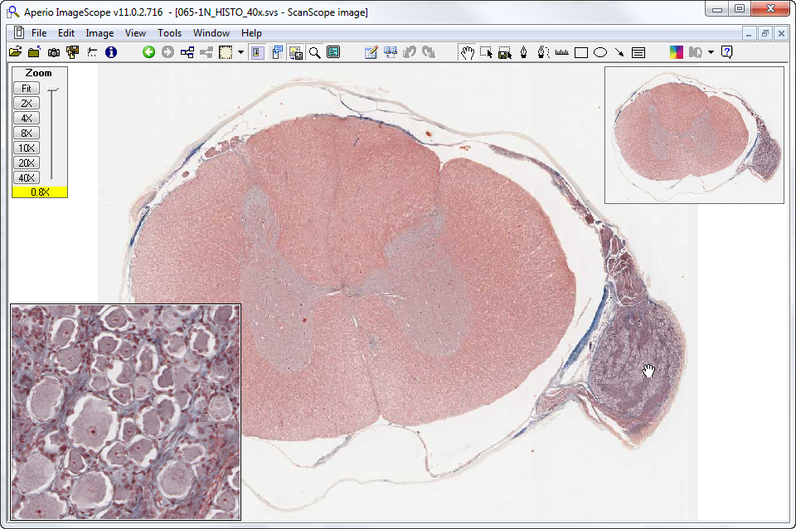
Slide UMich 65-1N: spinal cord, trichrome
WM
DH
sat
VH
DRG
gc
Notes:
DH=dorsal horn DRG=dorsal root ganglion gc=ganglion cell sat=ring of satellite cells
VH=ventral horn WM=white matter

Slide 17
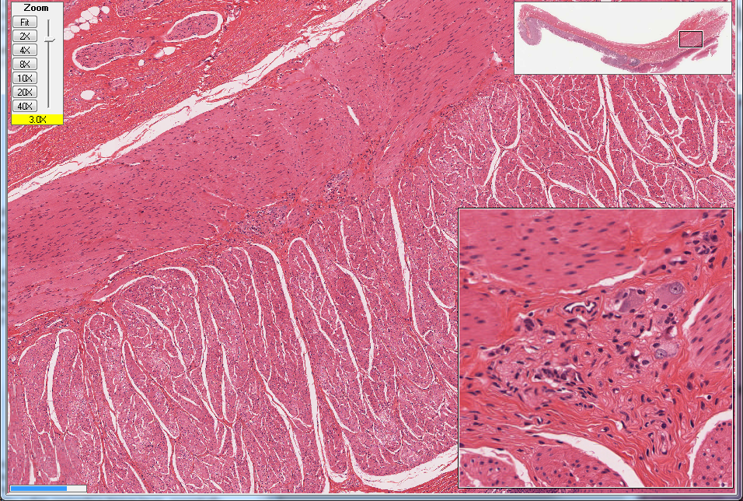
Slide UMich 155: Esophagus & stomach
outer longitudinal muscle layer
neuron
myenteric plexus
sat c.
inner circular muscle layer

Slide 18
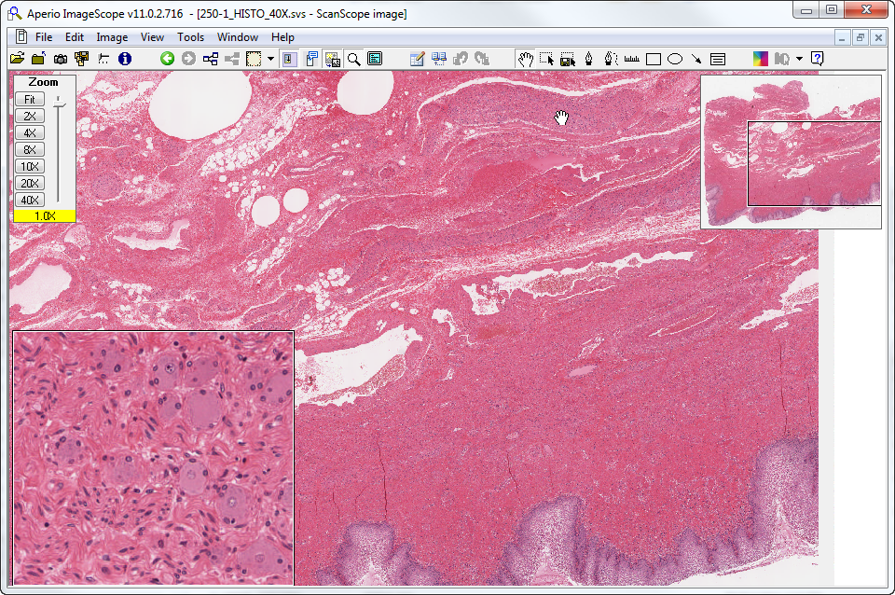
Slide UMich 250: vagina, h&e
ganglion
a
ct
bv
nerve
sat
pgc
ct (also some sm musc & nerve)
axons
epith
Notes:
a=adipose tissue bv=large blood vessel ct=connective tissue pgc=parasympathetic ganglion cell
sat=satellite cell (nucleus)

Slide 19
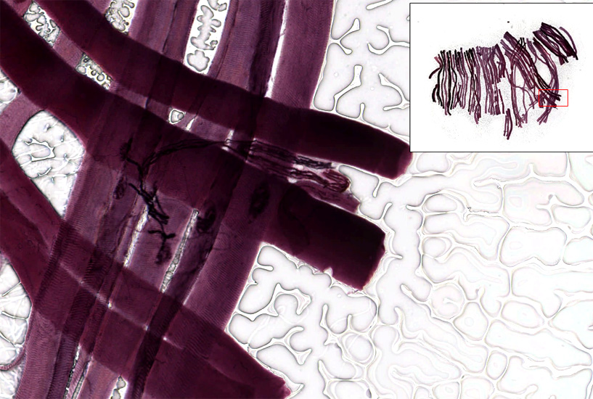
Slide UMich 71-2A: Motor end plate
Terminal bouton

Slide 20
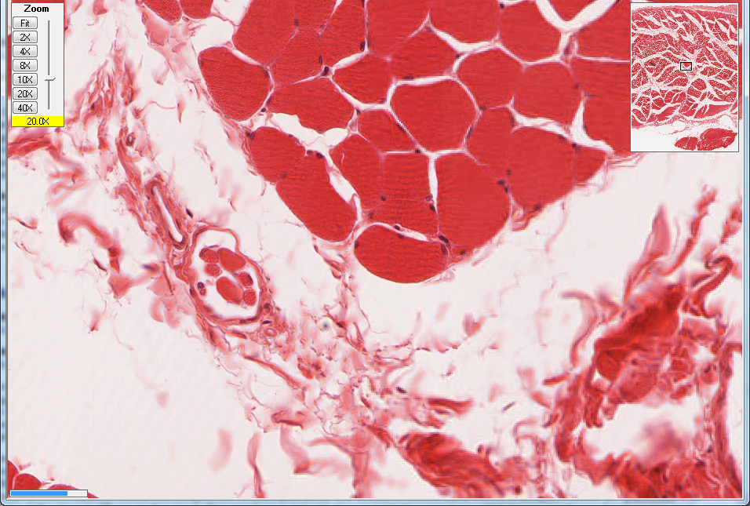
Slide UMich 71-1B: Neuromuscular spindle
extrafusal fibers
intrafusal fibers

