Slide 1
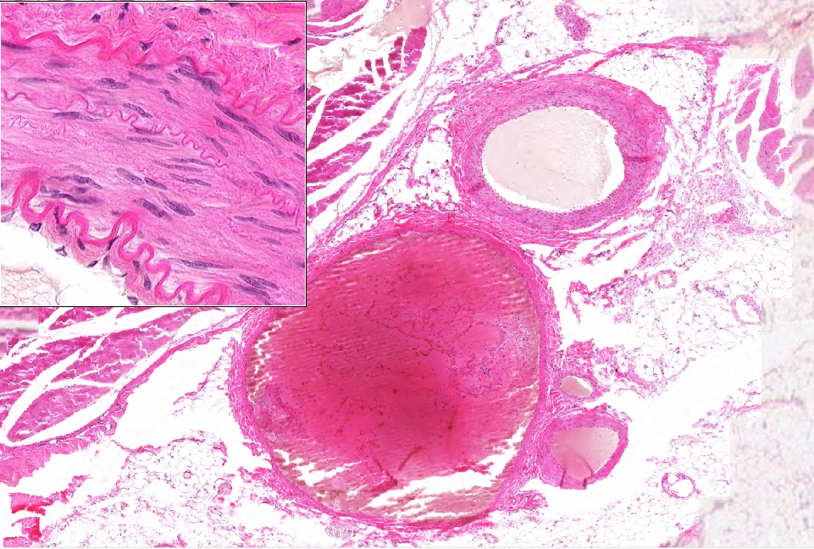
WebSlide 0174_B: artery & vein
adventitia
media
OEL
artery
IEL
intima
adventitia
vein
media
intima

Slide 2
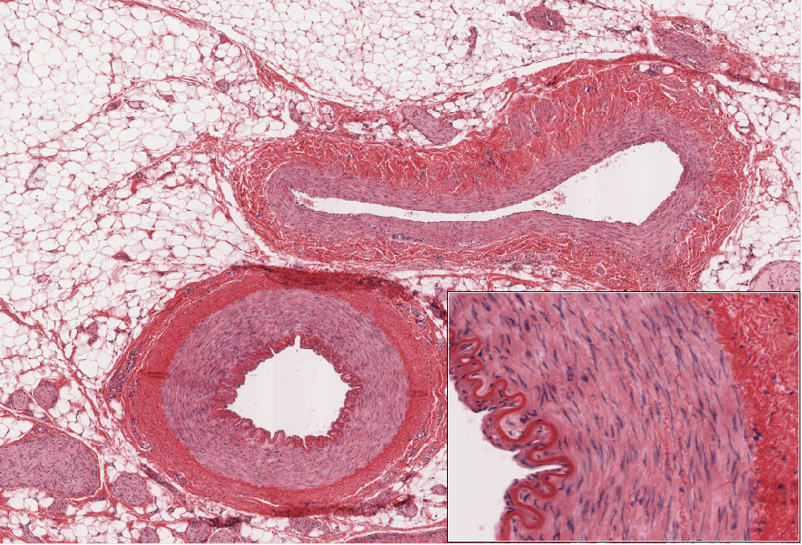
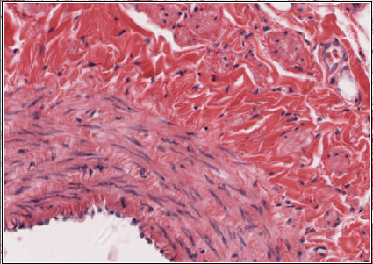
Slide UMich 042: mesentery (w/ arteries & veins)
smc
adventitia
media
vein
adventitia
media
artery
IEL
OEL
intima
intima

Slide 3
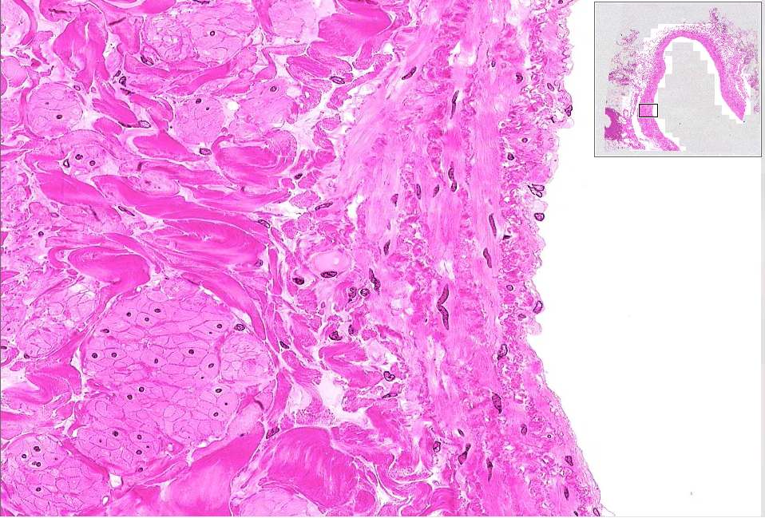
WebSlide 0023_B: artery & vein
adventitia
media
intima
smc

Slide 4
Aorta #36 (H&E), #88 (Aldehyde-Fuchsin)

Slide 5
Intima and media of the Aorta
Smooth muscle cells
Elastic laminae
(Subendothelial CT)
Intima
Endothelial cells

Slide 6
Vasa vasorum

Slide 7
#98-N (right chambers)
Coronary vessels
Atrium
Coronary sulcus
Cardiac (fibrous) skeleton
Epicardial fat
A-V (tricuspid) valve
Ventricle

Slide 8
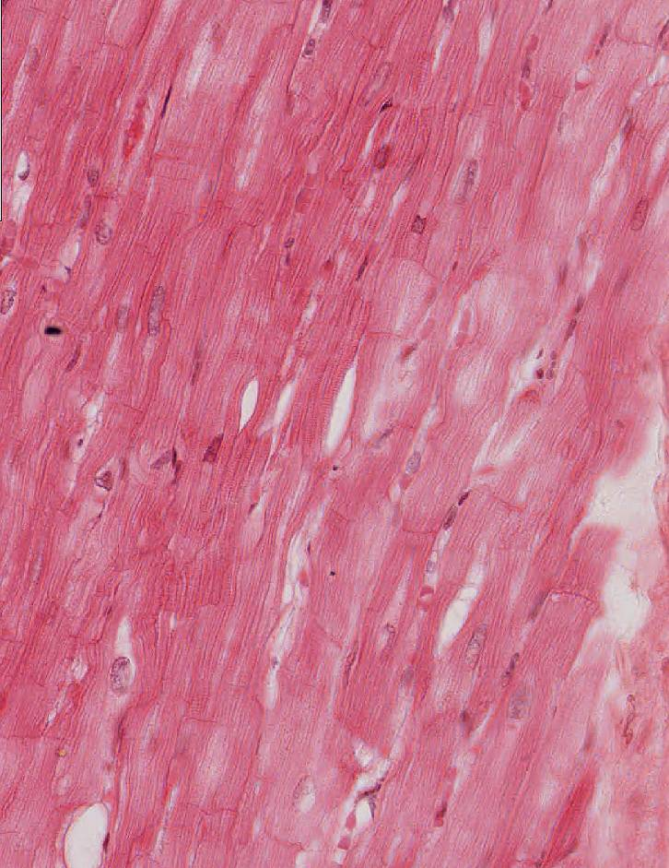
Purkinje fibers #98

Slide 9
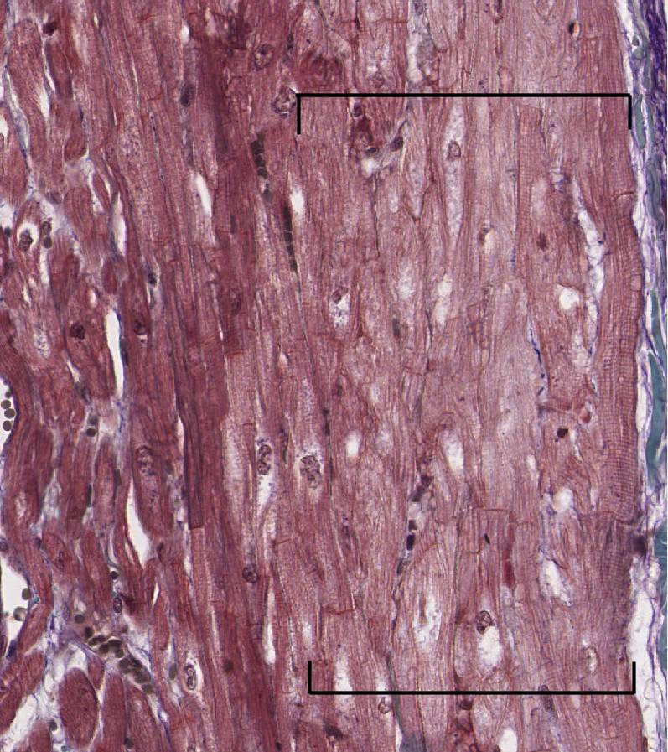
Cardiac muscle (fibers) and Purkinje fibers #99M longitudinal section Cross section

Slide 10
Capillaries #98 HE, -N; #102HE; #305

Slide 11
#99M
Bundle of His
#99HM

Slide 12
Bundle of His #99

Slide 13
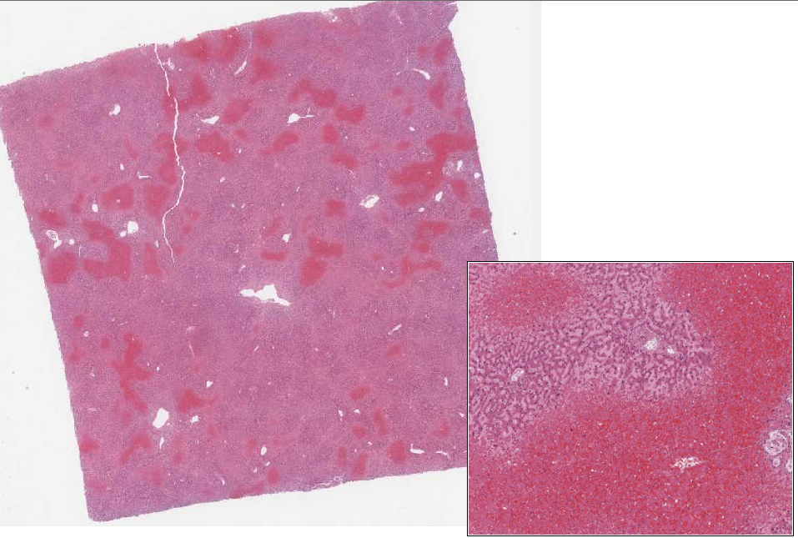
Slide 32: liver
viable tissue
necrotic tissue

Slide 14
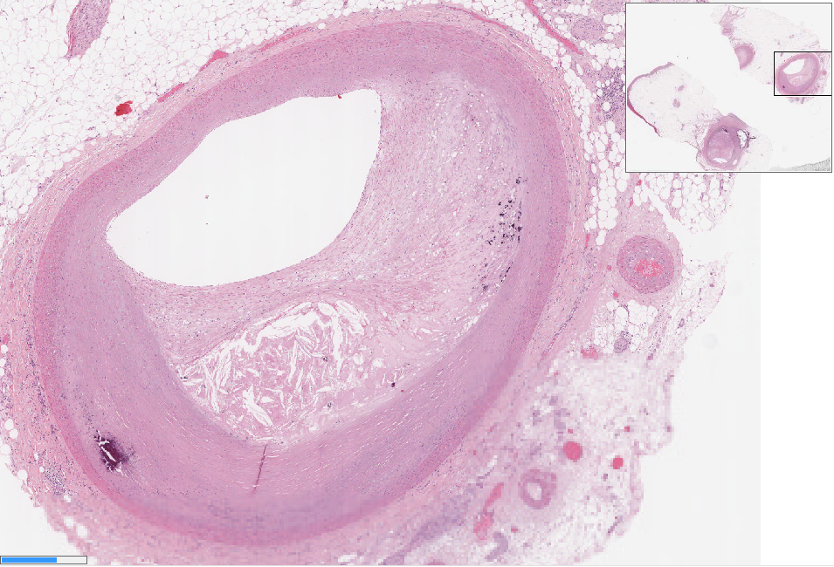
Slide 12: artery
lumen
atheroma

Slide 15
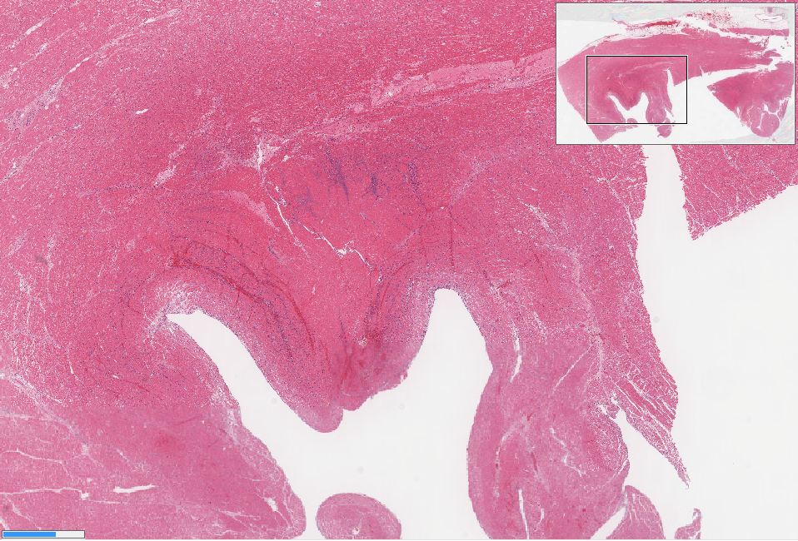
Slide 32: myocardial infarction
viable tissue
infarcted tissue

Slide 16
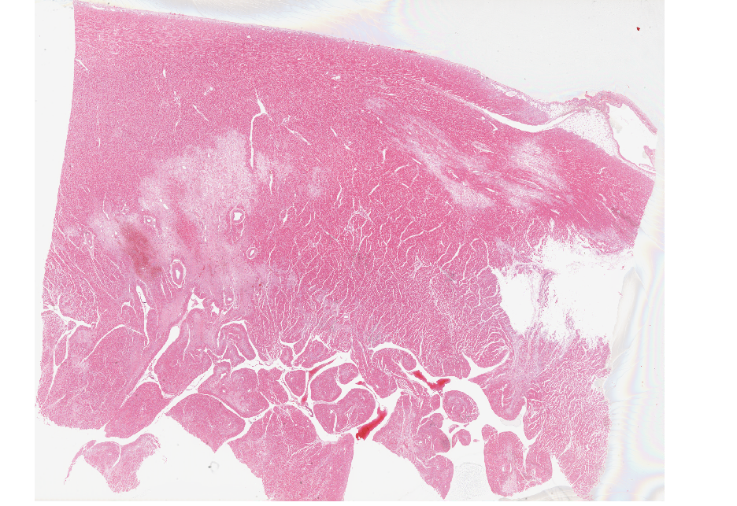
Slide 49: “remote” infarction

Slide 17
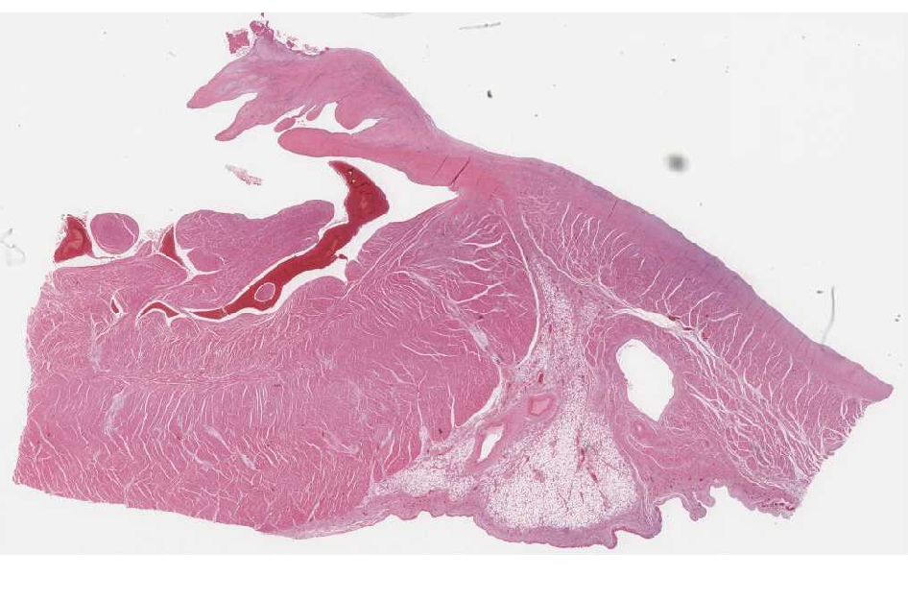
Slide 50: heart
endocardium
valve
atrial myocardium
ventricular myocardium
(note the ‘holes’)
epicardium

