Slide 1
Histology:
Introduction & Epithelial Tissue
J. Matthew Velkey
matt.velkey@duke.edu
452A Davison

Slide 2


Resources
For the STUDENT:
For the TEAM:
Textbook:
Junqueira’s Basic
Histology, 12th ed.
(each student should
have a copy)
Atlas:
Color Atlas of Histology,
5th ed. by Garter & Hiatt
(a copy is provided for each team
to use during “lab” sessions)
Online laboratory guide:
http://www.duke.edu/web/histology/DPT.html
When possible, lectures will be recorded and there may be notes for some lectures, but still NOT a substitute for reading the text.
Completing assigned reading prior to class is essential for sessions where a READINESS ASSESSMENT is scheduled

Slide 3
Overall Objectives
To understand:
  How cells and tissues are arranged in the normal organ system of the body, and
  How these cells and tissues are specialized to perform the function(s) most effectively.
The knowledge gained will hopefully provide a cellular and ultrastructural “framework” for all of the other topics (anatomy, physiology, biochemistry, etc.) that you’ll learn this year.
Histology is also, of course, a FUNDAMENTAL part of PATHOLOGY.

Slide 4
Correlate
Structure
and
Function

Slide 5
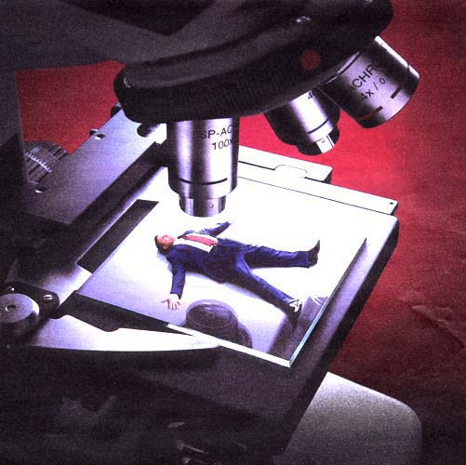
HISTOLOGY
The study of cells and tissues, a.k.a. micro-anatomy

Slide 6
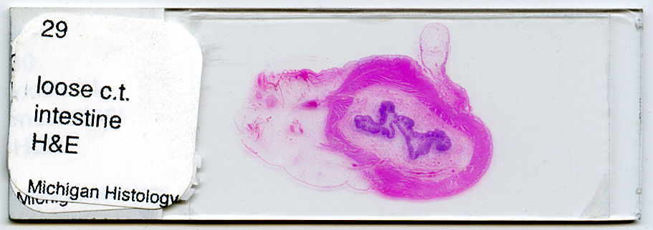

Slide 7
Tissue Preparation for Light Microscopy
Stabilize cellular structures by chemical fixation.
Dehydrate and infiltrate tissues with paraffin or plastic.
Embed fixed tissues in paraffin or plastic blocks.
Cut into thin slices of 3-10 micrometer thick; collect sections on slides.
Re-hydrate and stain with Hematoxylin (a basic dye): Stains basophilic structures (e.g. nucleic acids) blue/purple.
Counter-stain with Eosin (an acidic dye): Stains acidophilic or “eosinophilic” structures (e.g. proteins, membranes) red/pink.
“H & E” staining is routine, but other dyes and staining techniques may be used to visualize other structures.

Slide 8
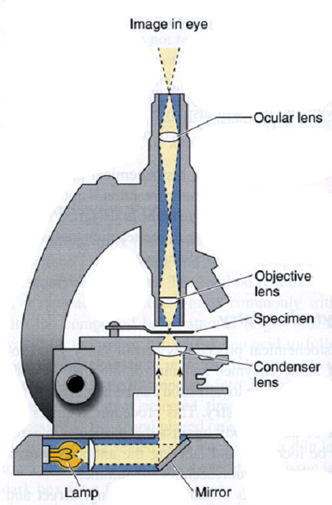
Light Microscopy
1. ILLUMINATION SOURCE
2. CONDENSER LENS
3. SPECIMEN STAGE
4. OBJECTIVE LENS
5. PROJECTION (OCULAR) LENS
6. OBSERVER
YIELDS A 2-DIMENSIONAL IMAGE CAPABLE OF 0.2 μm RESOLUTION.
CELLULAR FEATURES ARE STAINED DIFFERENTIALLY BASED PRIMARILY UPON CHEMICAL PROPERTIES.

Slide 9
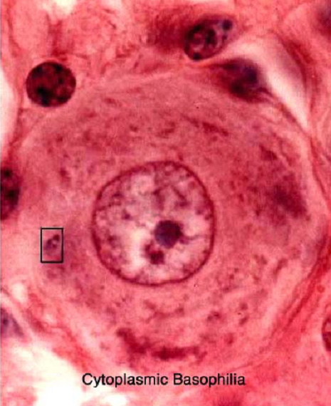
Light Microscopy
Eosin (red):
stains (+) charged structures, e.g. membranes and proteins
Hematoxylin (blue):
stains (-) charged structures, e.g. nucleic acids (DNA and RNA) and sulfated proteoglycans

Slide 10
Electron Microscopy
WHY? The resolution of a microscope (the smallest distance two points can still be seen as separate points) is directly proportional to the wavelength of the radiation used.
Radiation Wavelength Resolution
Visible light 700-400 nm 0.2 µm
Electrons 0.004 nm 0.1 nm
PROBLEM: how to view tissue with a 30kV electron beam
SOLUTION:
Tissues are fixed with glutaraldehyde (cross-links proteins) and osmium tetraoxide (cross-links lipids); OsO₄ is also an electron-dense “stain”
Dehydrate and infiltrate tissues w/ plastic.
Embed and block fixed tissues in plastic.
Cut into ultra-thin slices (50 nanometers thick); collect sections on slides.
Stain sections with heavy metal salts (lead citrate and uranyl acetate) that bind nucleic acids & proteins.
6. Visualize in TEM; heavy metal “stains” block electrons to create contrast

Slide 11
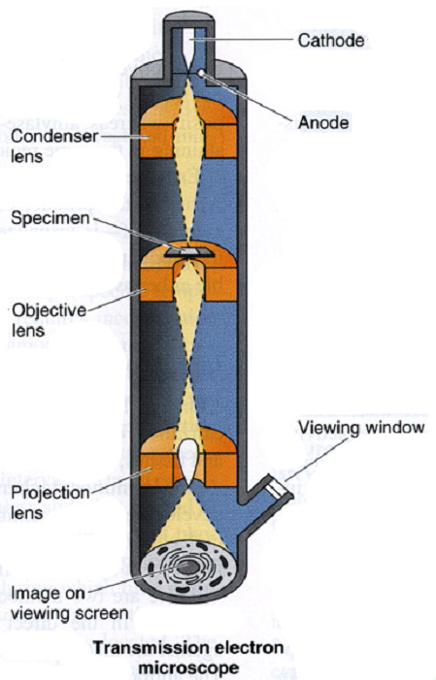
Transmission Electron Microscopy
1. ILLUMINATION SOURCE (generates electron beam)
2. CONDENSER LENS
3. SPECIMEN STAGE
4. OBJECTIVE LENS
5. PROJECTION LENS
6. FLUORESCENT VIEW SCREEN
7. VIEWING WINDOW & OBSERVER
YIELDS A 2-DIMENSIONAL IMAGE CAPABLE OF 0.2 nm RESOLUTION.
CELLULAR FEATURES ARE STAINED WITH ELECTRON-DENSE, HEAVY METAL STAINS YIELDING ONLY A BLACK AND WHITE IMAGE

Slide 12
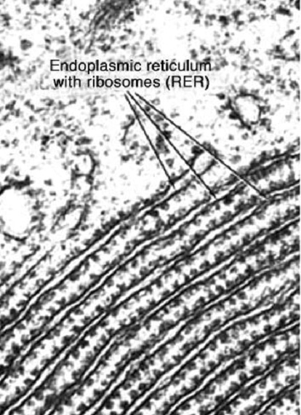

Slide 13
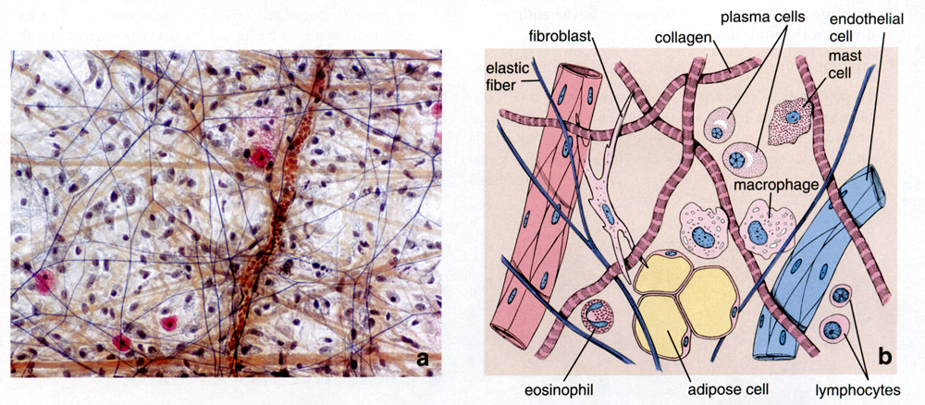
A given tissue may contain several different kinds of cells

Slide 14
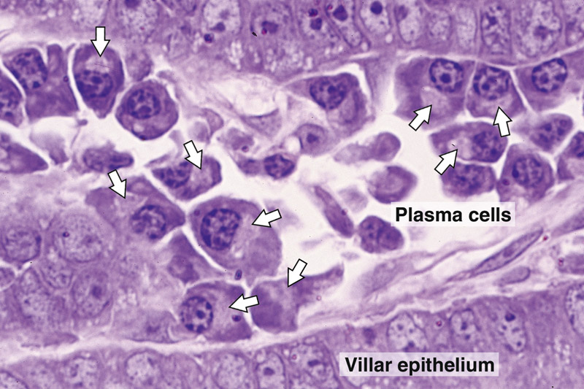
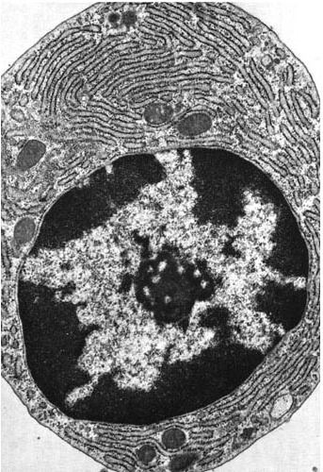
A cell’s form reflects its function
e.g., plasma cells: highly specialized for the secretion of antibodies (proteins).

Slide 15
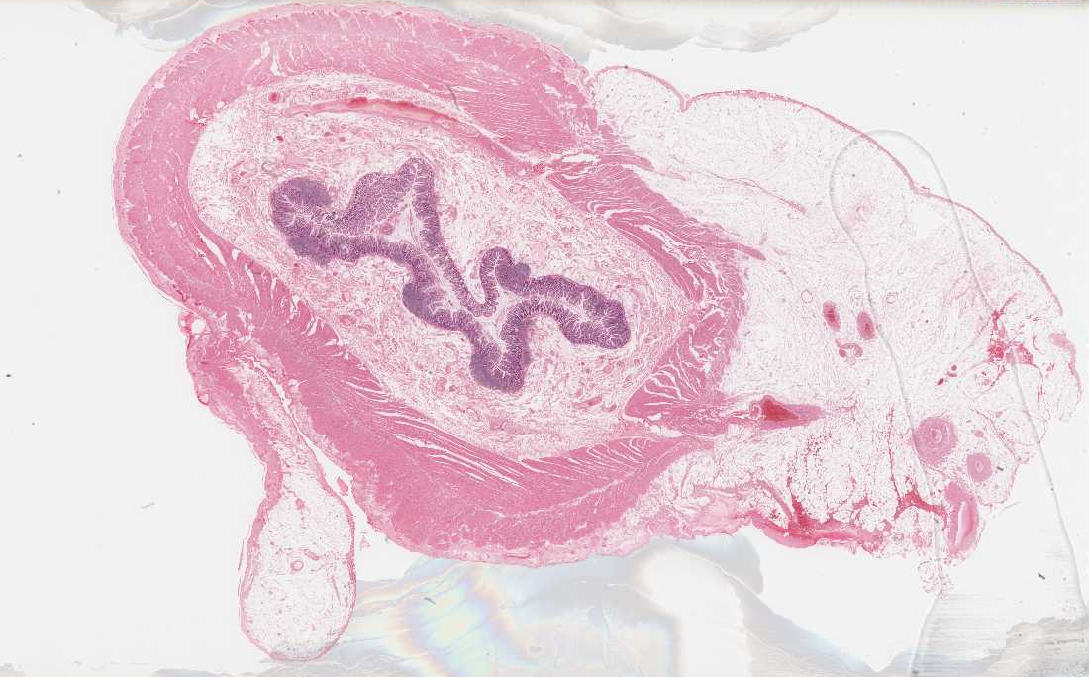
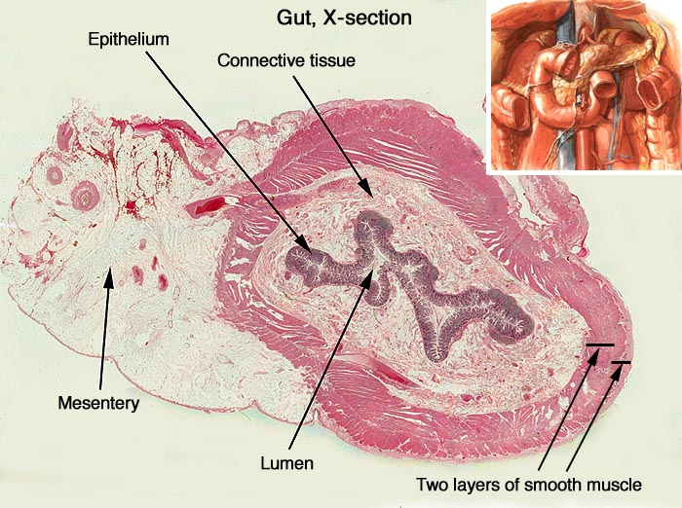
ORGANS are comprised of different TISSUES:
Epithelial tissue
Connective tissue
Muscle Tissue
Nerve Tissue
e.g., the intestine
Submucosa (connective tissue)
Mucosa (epithelium + ct)
Lumen
Mesentery (ct + epithelium)
Myenteric plexus (nerve)
Muscularis Externa (smooth muscle)

Slide 16
[ Fr. Tissu, woven ; L. texo, to weave ]
Tissues
A tissue is an organized aggregation of cells or groups of cells that function in a coordinated manner to perform one or more specific functions.
Tissues combine to form larger functional units, called ORGANS. Thus, the tissues are the basic functional units responsible for maintaining body functions.

Slide 17
BASIC TISSUES
Epithelium
Connective tissue
Muscle
Nervous tissue
[Blood]

Slide 18
Epithelial Tissue

Slide 19
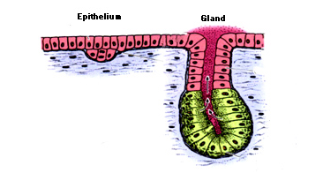
An epithelium is a cohesive sheet of cells that:
1. Covers the external surfaces and lines the internal surfaces of the body.
  Barrier:
  Protection (by withstanding wear and tear, from hydration and dehydration)
  Selective absorption: (Control the movement of substances between the outside environment and the internal compartments, or between compartments in the body.)
  Transport (ions, O₂ and C0₂)
  Secretion (secretory cells)
2. Forms endocrine and exocrine secretory glands.
duct
secretory portion
Junquueira & Carneiro 10th Ed. P. 82

Slide 20
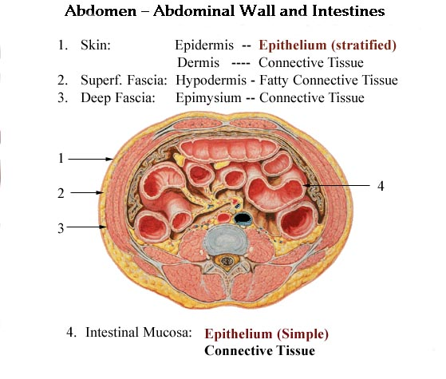
Netter pl. 328

Slide 21
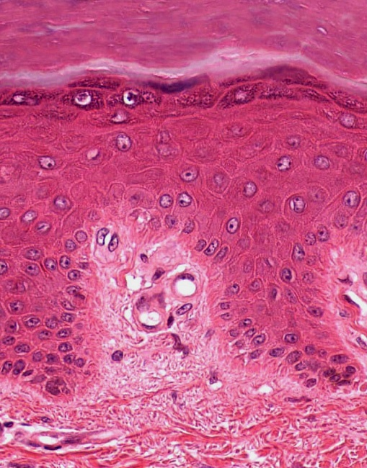
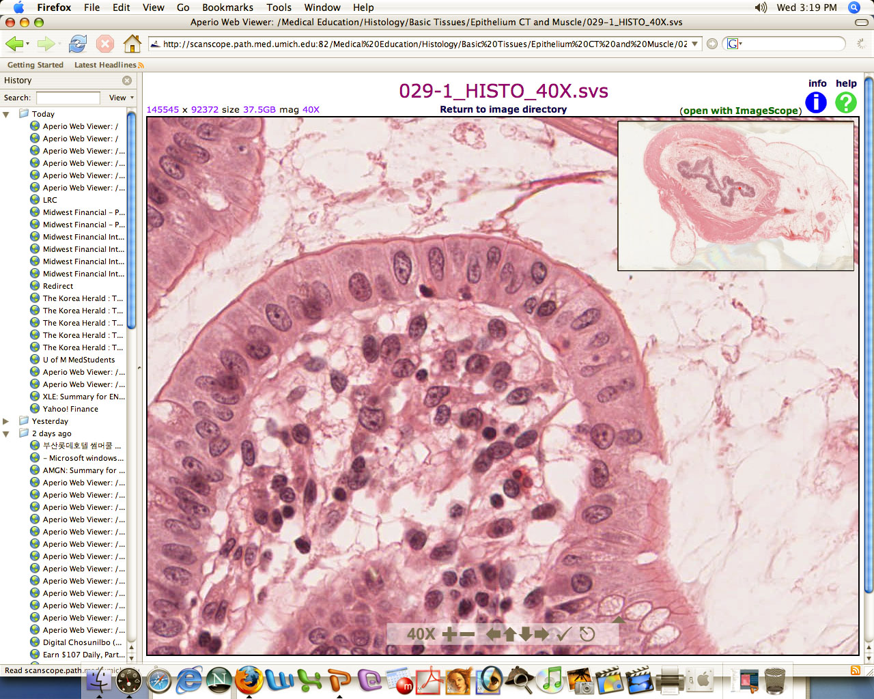
Epithelial lining cells of
Skin Intestine
Multiple layers of cells with different shapes
Single layer of tall (columnar) cells

Slide 22
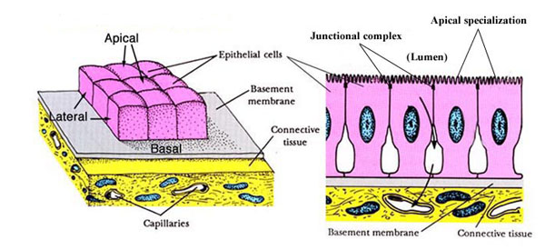
Epithelial cells:
1. Form avascular sheets that differ in number of cell layers, shape of the cells and structural specializations of the free (apical) cell surface, depending on the tissue function(s).
Are capable of renewal and regeneration.
non-specialized epithelium - all cells
specialized epithelium - stem cells
3. Are structurally and functionally polarized: Have apical, lateral and basal domains.
4. Are held together by several basolateral specializations, known as the intercellular junctions, and bind to the underlying connective tissue via the basement membrane (LM) or basal lamina (EM).

Slide 23
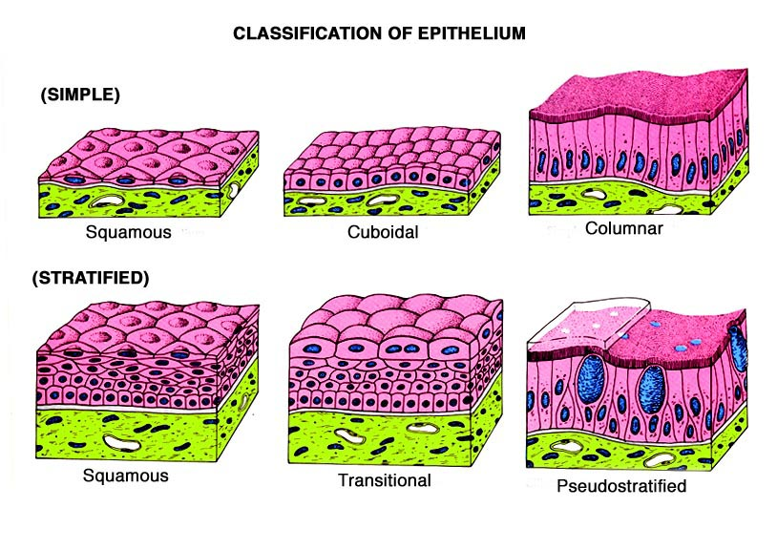
Classification of Epithelium
columnar
(Respiratory)

Slide 24
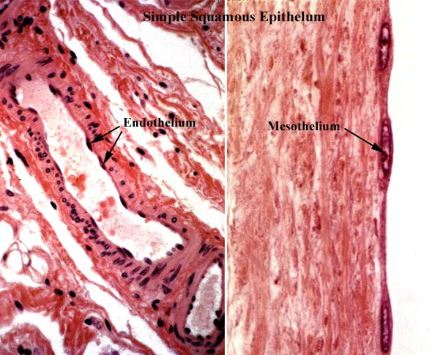
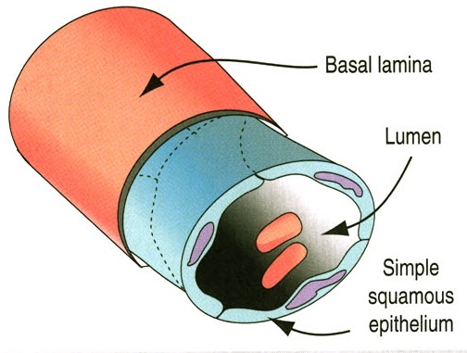
Simple squamous epithelium:
endothelium and mesothelium (non-specialized: renewal via mitosis)

Slide 25
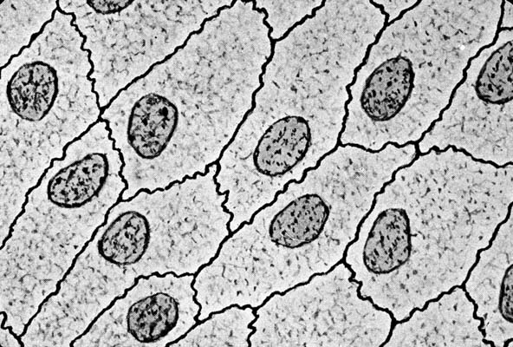
Endothelium/Mesothelium
(Simple Squamous Epithelium)

Slide 26
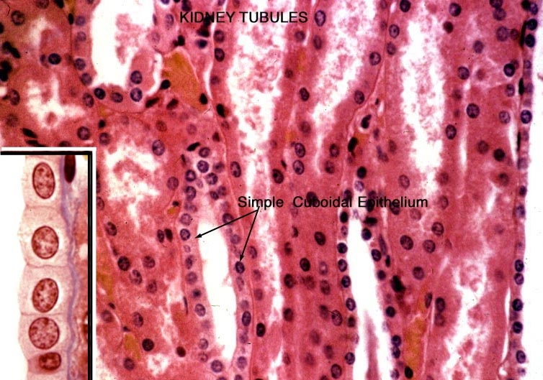
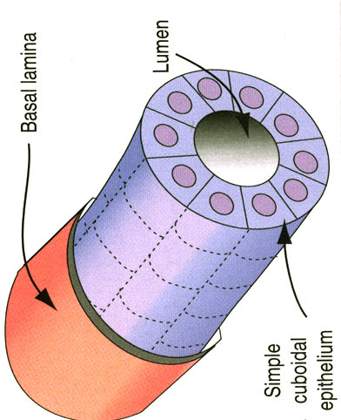
Simple Cuboidal Epithelium
kidney tubules (“non-specialized:” renewal via mitosis)

Slide 27
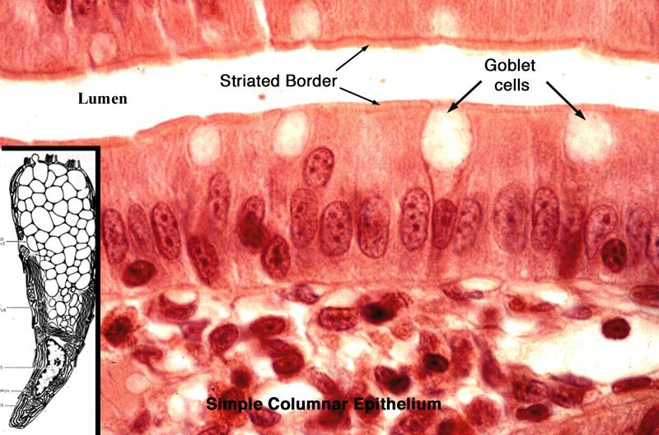
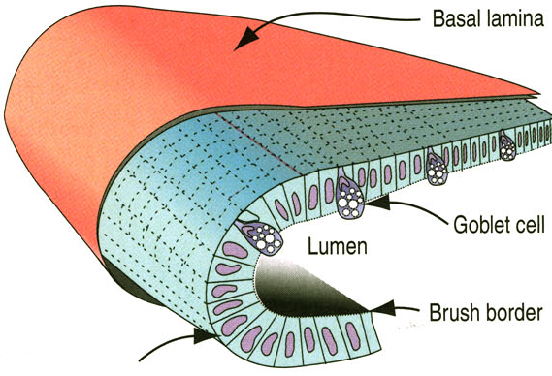
Simple Columnar Epithelium
Gut mucosa (“specialized:” renewal via stem cells)

Slide 28
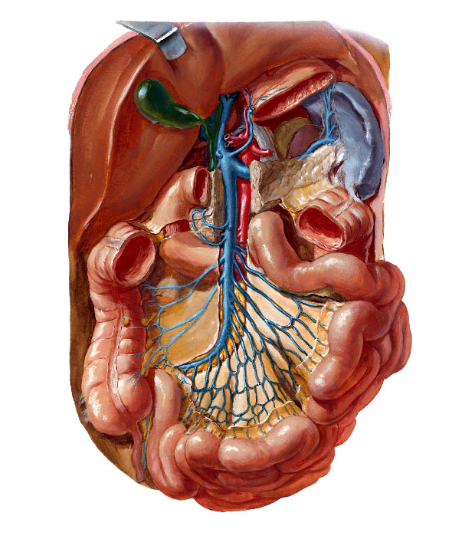
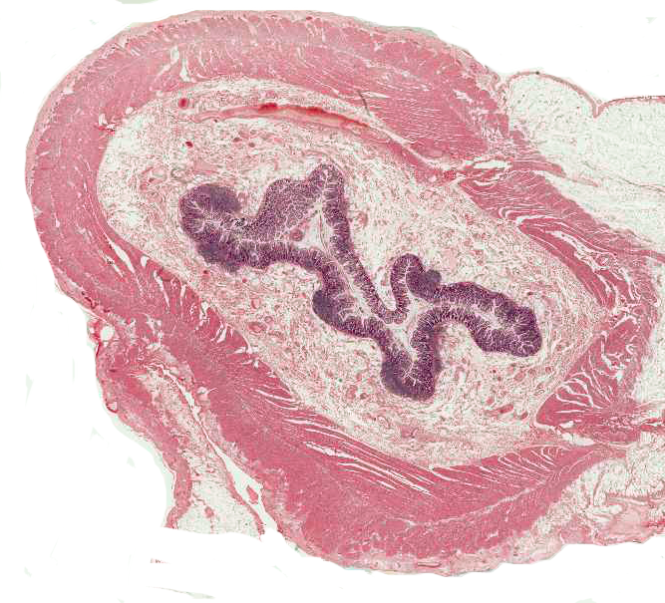
Simple columnar epithelium lining the gut lumen
lumen
Two layers of smooth muscle on the wall

Slide 29
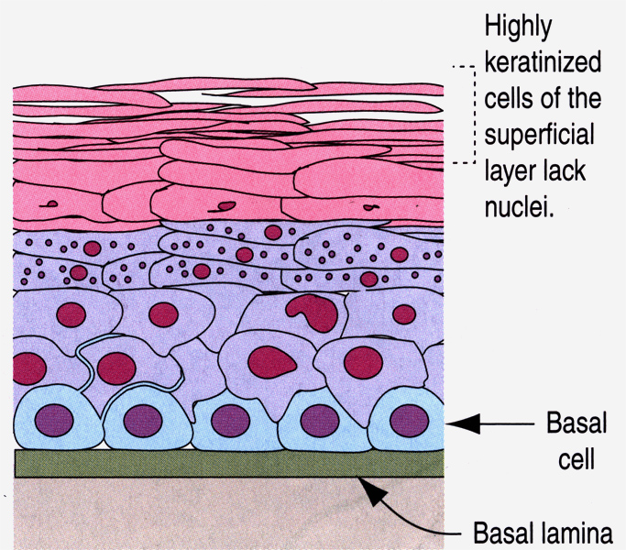
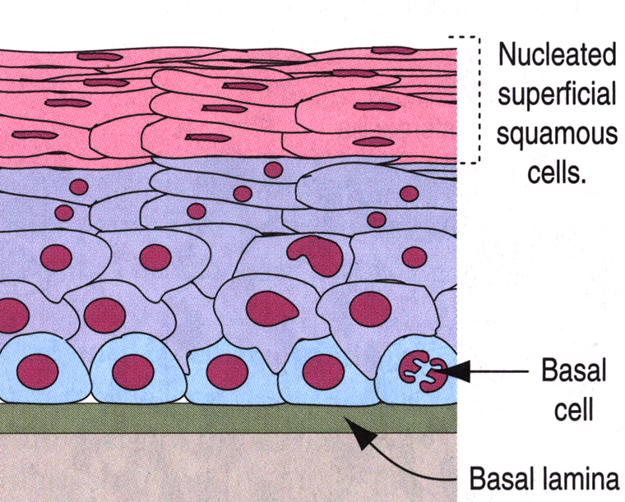
Stratified Squamous Epithelium non-keratinized keratinized
Kierszenbaum pg 5

Slide 30
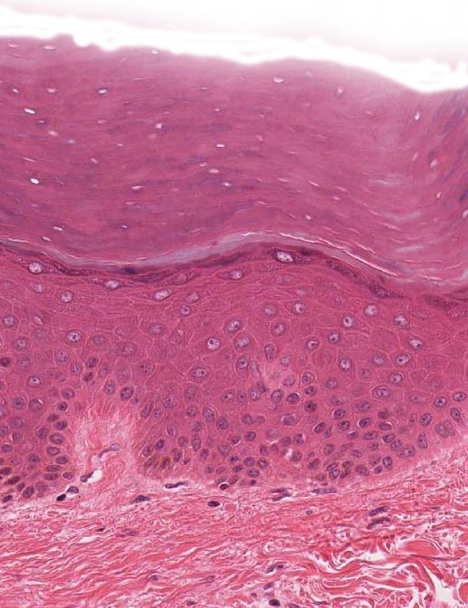
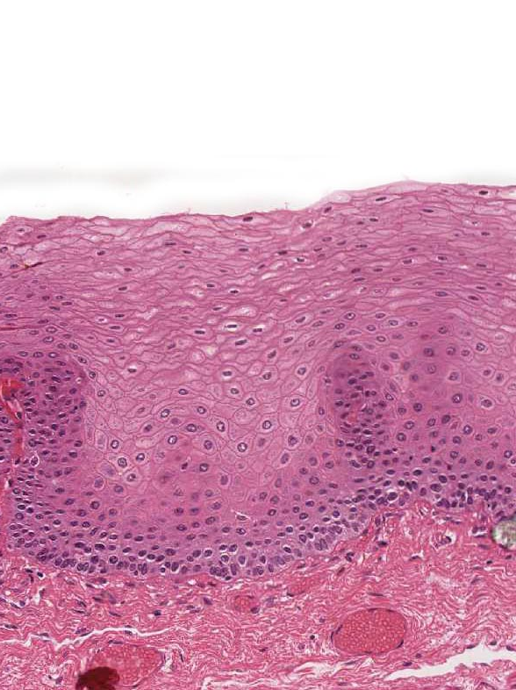
Stratified Squamous Epithelium
Non-keratinized
Keratinized
Lines esophagus, oral cavity, vagina…
Lines thick and thin skin

Slide 31
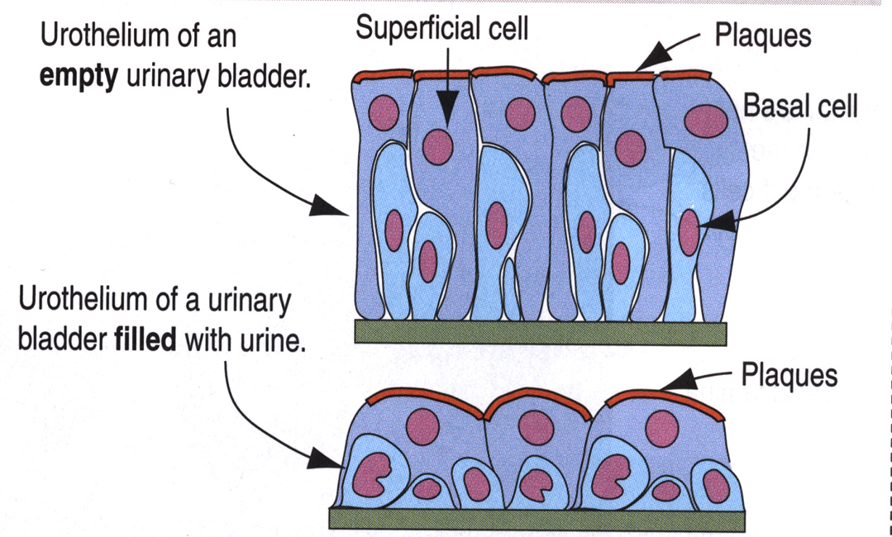
Transitional Epithelium
(urothelium)
Kierszenbaum pg 6

Slide 32
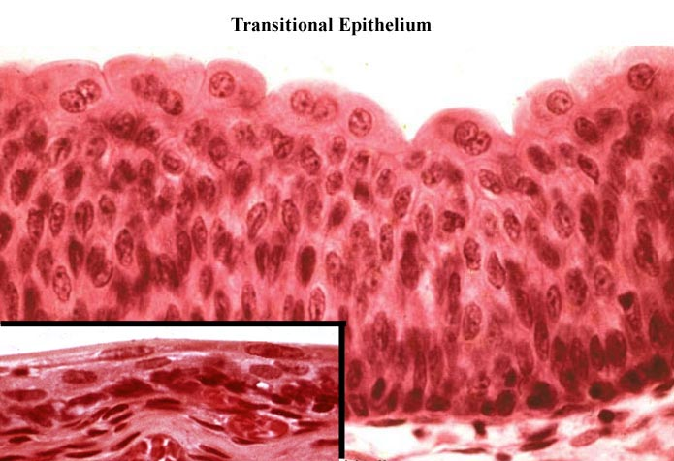
Transitional Epithelium (urothelium)
Lines the urinary tract, ureter, bladder and urethra
Cells on the surface are often dome (umbrella) shaped and some cells reveal two nuclei.

Slide 33
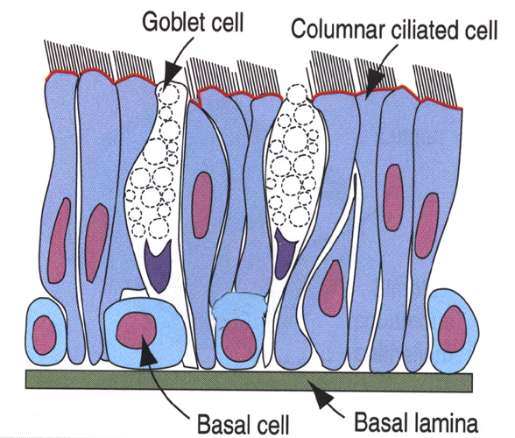
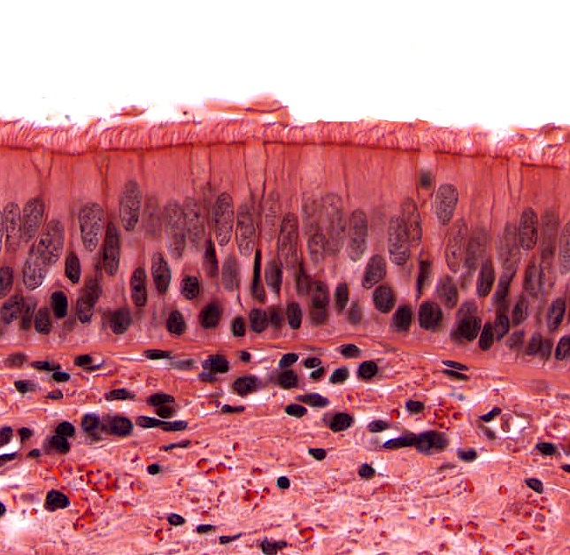
Pseudostratified Epithelium
Kierszenbaum pg 6

Slide 34
Epithelial cells:
1. Form avascular sheets that differ in number of cell layers, shape of the cells and structural specializations of the free (apical) cell surface, depending on the tissue function(s).
Are capable of renewal and regeneration.
non-specialized epithelium - all cells
specialized epithelium - stem cells
3. Are structurally and functionally polarized: Have apical, lateral and basal domains.
4. Are held together by several basolateral specializations, known as the intercellular junctions, and bind to the underlying connective tissue via the basement membrane (LM) or basal lamina (EM).

Slide 35
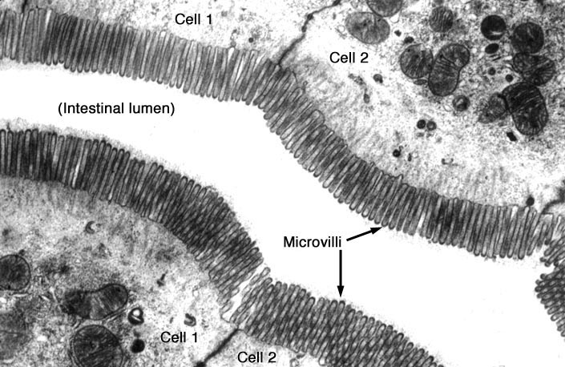
Apical Cell Surface Specializations – 1
Microvilli – aka “brush border” or “striated border”
G
G
G: goblet cell

Slide 36
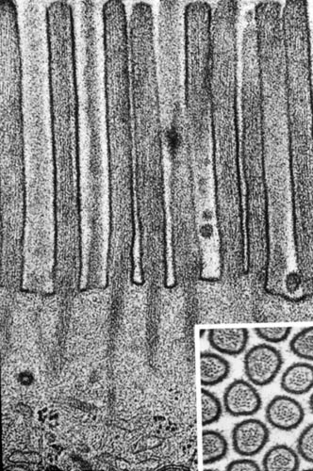
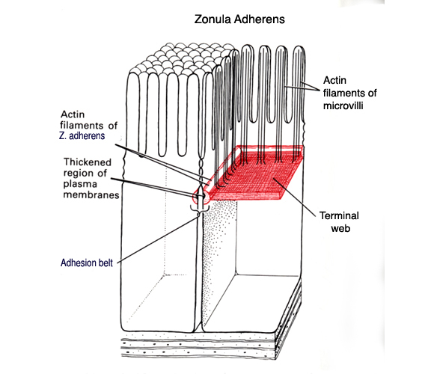
Microvilli
(Core of actin filaments)
NON-motile; serve to increase surface area

Slide 37
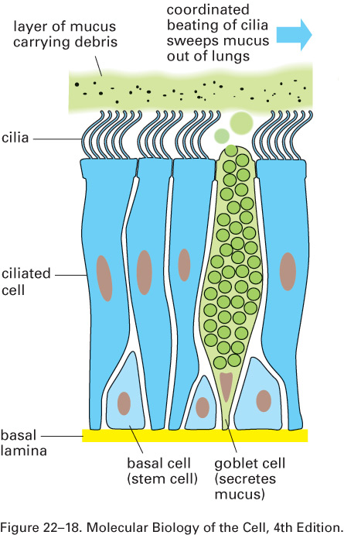
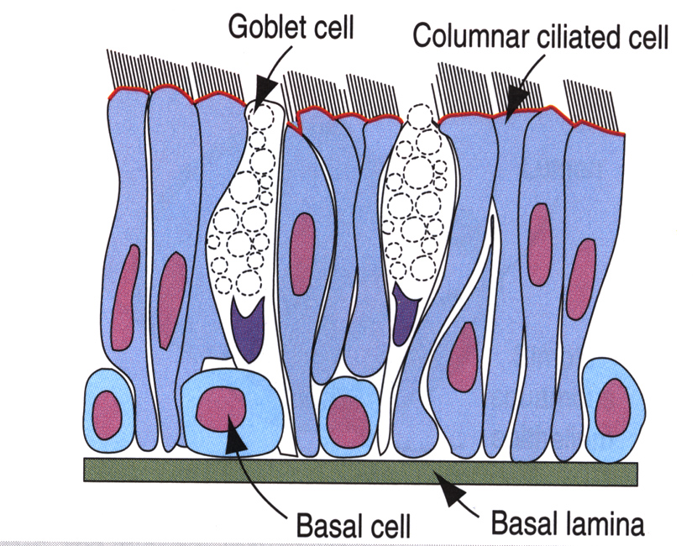
Apical Surface Specializations-2
Cilia on Pseudostratified Columnar Epithelium with Goblet cells (Respiratory Epithelium)
(from K. Verhey)

Slide 38
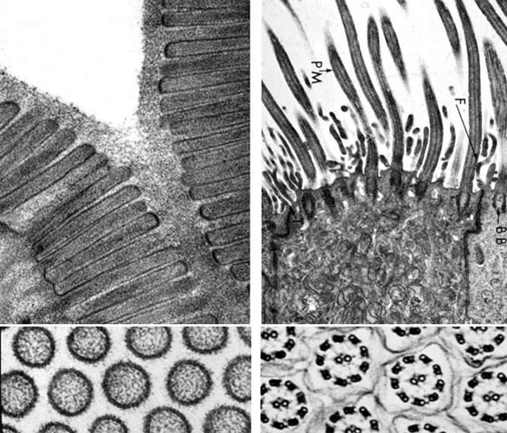
Cilia (Apical Cell Surface Specializations – 2) core of microtubules in 9+2 arrangement (axoneme)
cilia
Goblet cells
Basal bodies
Respiratory epithelium

Slide 39
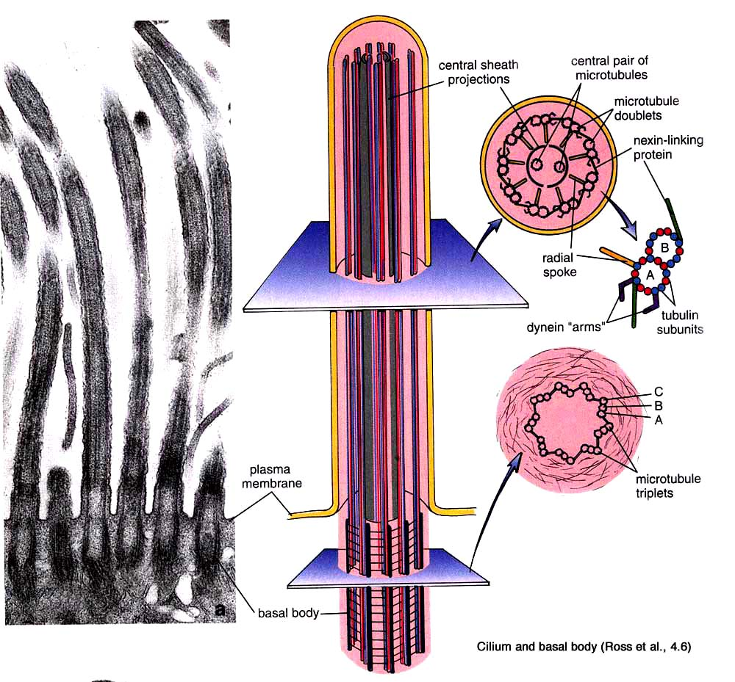
9 + 2
(Axoneme)

Slide 40
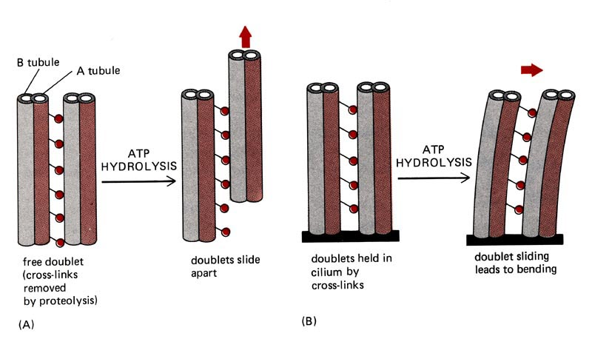
Dynein is responsible for the sliding.
Alberts et al., P. 648

Slide 41
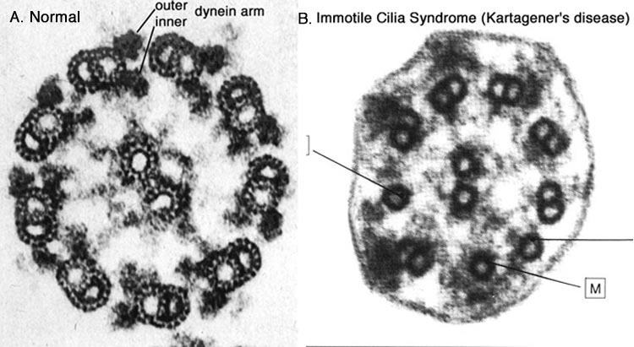
Dynein Defects in Immotile Cilia

Slide 42
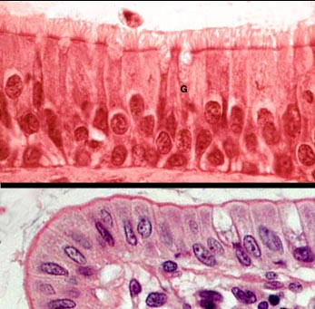
Two types of apical cell surface specializations:
Microvilli and cilia
Microvilli
Cilia

Slide 43
Epithelial cells:
1. Form avascular sheets that differ in number of cell layers, shape of the cells and structural specializations of the free (apical) cell surface, depending on the tissue function(s).
Are capable of renewal and regeneration.
non-specialized epithelium - all cells
specialized epithelium - stem cells
3. Are structurally and functionally polarized: Have apical, lateral and basal domains.
4. Are held together by several basolateral specializations, known as the intercellular junctions, and bind to the underlying connective tissue via the basement membrane (LM) or basal lamina (EM).

Slide 44
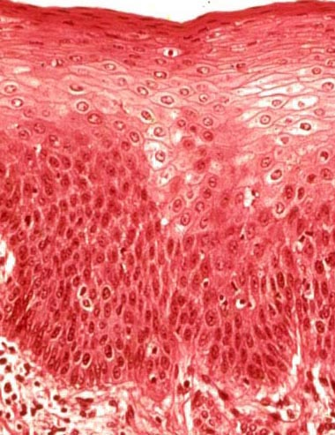
Basolateral Specializations
Structures that hold the cells together and attach the epithelium to the underlying connective tissue.
Intercellular junctions can only be observed at the electron microscope level and NOT at the light microscope level.
Basement membrane (basal lamina)

Slide 45
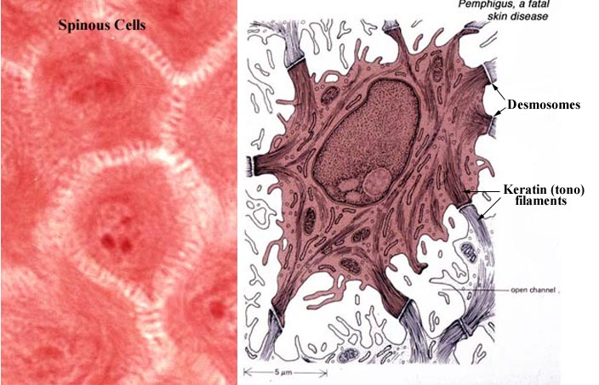
Macula adherens (desmosomes) and Intermediate Filaments
Desmosomes are NOT visible at the light microscope level.

Slide 46
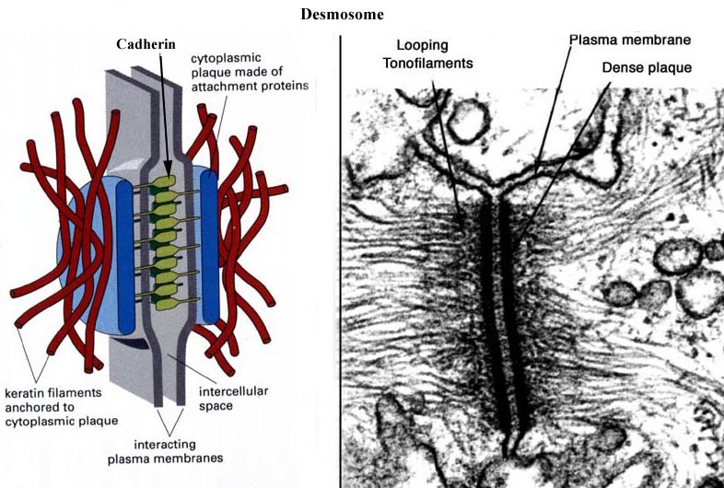
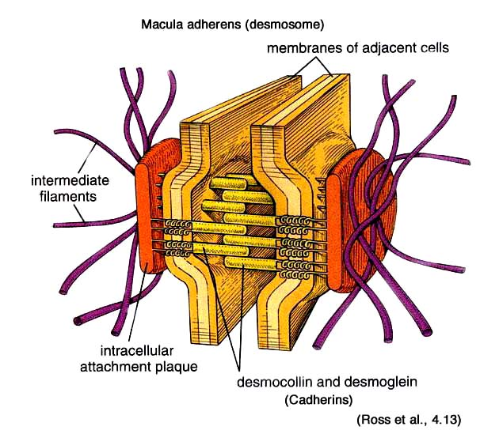
Macula Adherens (desmosome)

Slide 47
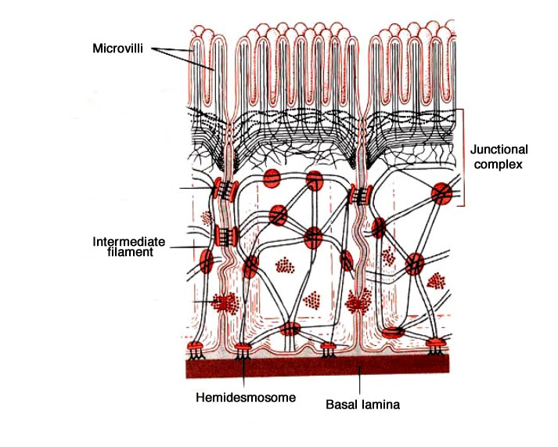
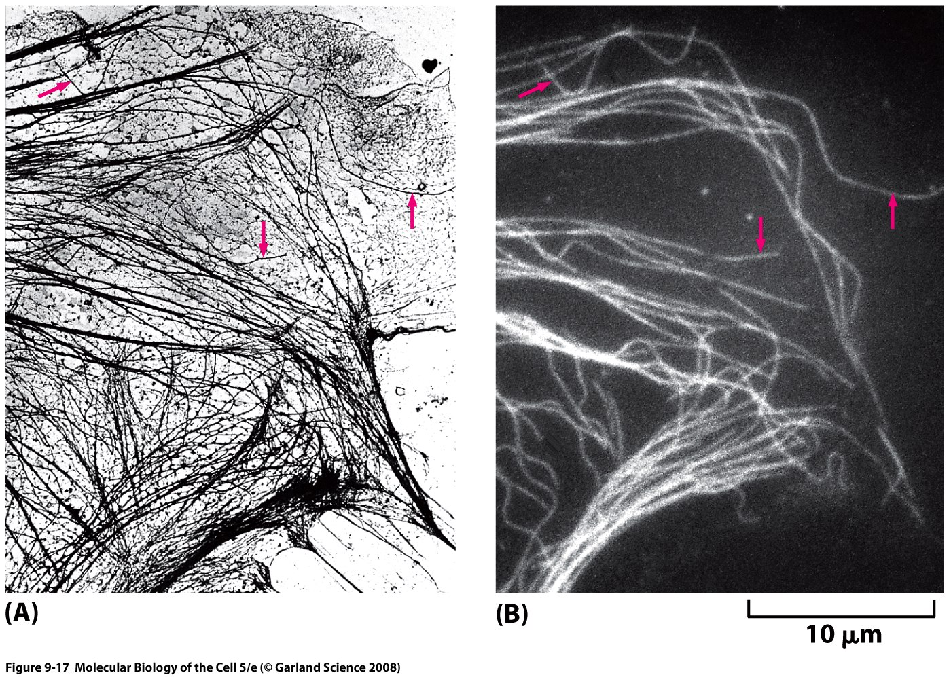
Desmosomes and Intermediate Filaments
Desmosomes serve as:
1. Spot attachment sites for adjacent cell membranes.
2. Anchoring sites for intermediate filaments.
(from K. Verhey)
Alberts et al., p. 802

Slide 48


Hemidesmosomes function to anchor epithelial cells to their basement membrane.
Basement membrane

Slide 49

Loss of desmosome functions cause
Blistering Skin Disorders
Pemphigus: Separation of epidermal cells from each other (acantholysis) caused by loss of desmosome functions.
Bullous pemphigoid: Separation of epidermis from the dermis due to blistering in the basement membrane caused by loss of anchoring filaments and hemidesmosomes.

Slide 50

Intercellular Junctions Junctional Complex

Slide 51

Zonula adherens (intermediate junction)
Ross, et al., 4.11

Slide 52
Zonula adherens Macula adherens
Intermediate junction
Adhering junction
Cadherins
Linked to actin filaments
Adhesion belt
Desmosome
Adhering junction
Cadherins
Linked to intermediate filaments
Spot adhering junction

Slide 53



Zonula Occludens (Tight Junction)
serves as a Selective Permeability Barrier
Junquueira & Carneiro 10th Ed. P. 82

Slide 54

Zonula occludens (tight junction)
Alberts et al., p. 794-5

Slide 55

Freeze-fracture preparation of zonula occludens

Slide 56


Nexus (gap Junction)
- communicating junction
Six Connexin subunits assemble to form a Connexon.

Slide 57


Gap Junction

Slide 58
Epithelium (summary)
Types - simple & stratified (pseudostratified)
Apical cell surface specializations
  Microvilli - actin filaments
  Cilia - microtubules (dyneins)
Intercellular junctions
  Zonula occludens (tight junction) - ridges and grooves,
  seal intercellular spaces - Selective permeability barrier
  Zonula adherens - actin filaments - cell to cell adhesion
  Macula adherens (desmosome) - intermediate filaments - attachment plaque (spot)
  Hemidesmosome - attaches epithelium to basal lamina
  Nexus (gap junction) - connexons - cell to cell communication

Slide 59
Epithelial cells form Secretory Glands
Glands: Groupings of cells specialized for secretion
Secretion is the process by which small molecules are taken up and transformed, by intracellular biosynthesis, into a more complex product that is then actively released from the cell.
Exocrine (ducts) and endocrine (ductless) glands

Slide 60
Secretory Epithelial cells

Slide 61

Development of Endocrine and Exocrine Glands
Junqueira & Carneiro 10th Ed. P. 82

Slide 62


Secretory Units and Glandular Cells

Slide 63

Two Secretory Pathways
Regulated Secretion: Secretory granules accumulate in cells and the granule content is released by exocytosis upon stimulation.
Constitutive Secretion: The secretory product is not concentrated into granules but is released continuously in small vesicles.
Exocytosis

Slide 64
Learning Objectives
After today’s session, the students are expected to:
1. Understand the differences between light and electron microscopy in terms of tissue preparation, resolution of structures, and appearance of the final image.
Be able to classify epithelia and identify each type.
Recognize four types of intercellular junctions and hemidesmosomes at the electron microscope level and know their functions.
Identify the apical specializations and know their functions.
Be able to correlate different types of epithelia to their functions and know where in the body each type occurs.
Know how specialized and non-specialized epithelial cells are renewed.
Know how exocrine and endocrine glands form and be able to recognize secretory cells.

