Slide 1
Histology:
Connective Tissue
J. Matthew Velkey
matt.velkey@duke.edu
452A Davison

Slide 2
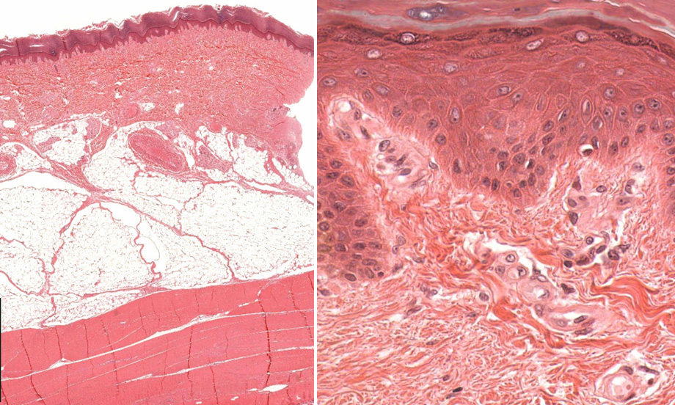
Connective Tissue
Epithelium
Epithelium
Connective Tissue
ridge (peg)
papilla
Connective Tisue
Muscle

Slide 3
General Properties of Connective Tissue
1. One of the four basic types of tissues (epithelium, connective tissue, muscle, and nervous tissue)
2. Composition:
  cells (fibroblasts and others),
  fibers and ground substance (extracellular matrix)
3. Functions:
  Architectural framework of the body
  Bind together and provide mechanical support for other tissue (metabolic, defense, transport, storage)
  Wound repair / inflammatory response

Slide 4
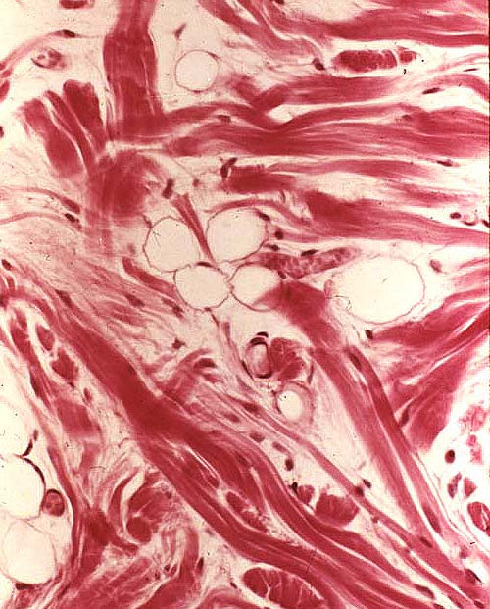
Connective Tissue
Extracellular Matrix
Fibers – collagen & elastic
“Ground substance”
Cells
Fixed:
Fibroblasts
Adipocytes
“Tissue macrophages”
Free:
  Immune cells
  (lymphocytes)
  Inflammatory cells (neutrophils & activated macrophages)

Slide 5
Fibers in Connective Tissue
Collagen
  most abundant protein in human body (up to 30% dry weight)
  multiple types: fibril-forming or fibril-associated (in skin, tendon, cartilage, bone, dentin, blood vessels); cross-linked networks (in all basement membranes)
Reticular Fibers – specialized type of collagen (Type III; reticulin) associated with smooth muscle in organs subjected to changes in volume, forms the stroma in lymphatic and hematopoietic organs
Elastic Fibers –thin fibers or fenestrated sheets composed of various glycoproteins, including the protein elastin, providing elastic properties to tissues that experience repeated deformation (in skin, blood vessels, lung, bladder)
Notes:
The proportion of different fiber types varies depending on the structural needs or function of the particular CT.
Collagen fibers are the most abundant fiber type. All connective tissues have collagen fibers, but the number and organization varies in different types. They are flexible and have a high tensile strength.
Reticular fibers are especially abundant in arteries, spleen, liver, uterus and intestinal muscle layers, and they form the primary framework for hematopoietic organs, the parencyma of cellular organs such as liver and endocrine glands. Reticular fibers are also associated with the lamina fibroreticularis of basement membrane. The word ‘reticular’ means ‘network’.
Elastic fibers are especially abundant in elastic ligaments (ligamenta flava of the vertebral column, ligamentum nuchae of the neck, and vocal folds of the larynx, and in the walls of arteries (where elastic fibers are produced by smooth muscle cells, not fibroblasts).

Slide 6
Major Collagen Fiber Types (out of at least 20)
TYPE LOCATION FUNCTION
Fibril-forming collagens (these are visible)
I (most abundant) Skin, tendon, bone, dentin Resistance to tension
II Cartilage, vitreous of eye Resistance to pressure
III (reticulin) Skin, blood vessels, organs Structural framework and stability
Network-forming collagens
IV All basement membranes Support and filtration
Fibril-associated collagens with interrupted triple helices (FACIT)
multiple types Assoc. w/ type I and II fibrils Fibril-fibril / fibril-ECM binding
Anchoring filament collagens
VII Epithelia Epidermis to basal lamina
Notes:
The other collagen fiber types are found in association with one or more of the major types. List of tissues in which these collagens are found is representative only.

Slide 7
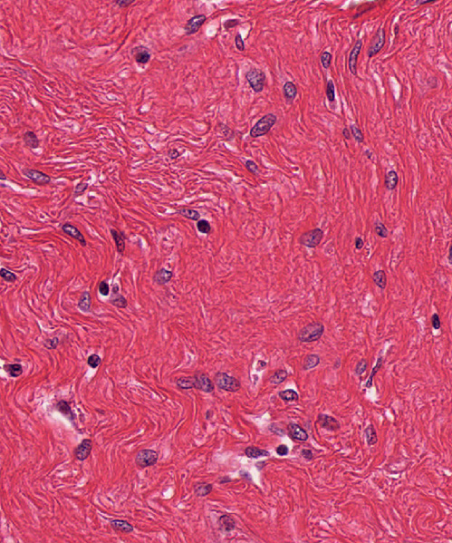
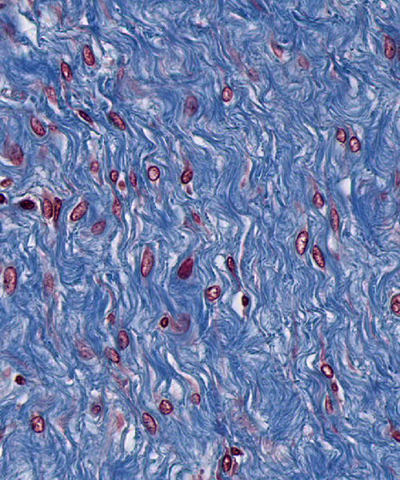
Collagen fibers viewed by light microscopy
H&E
Trichrome
Notes:
The specific staining method determines the color that the collagen fibers appear in histological slides.

Slide 8
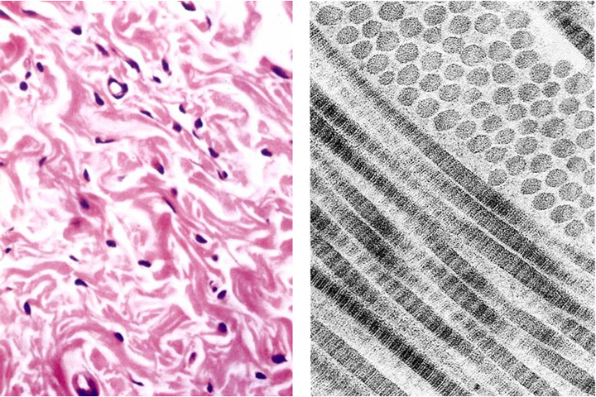
Collagen Fibers vs. Fibrils
H & E
fibrils
fibers

Slide 9
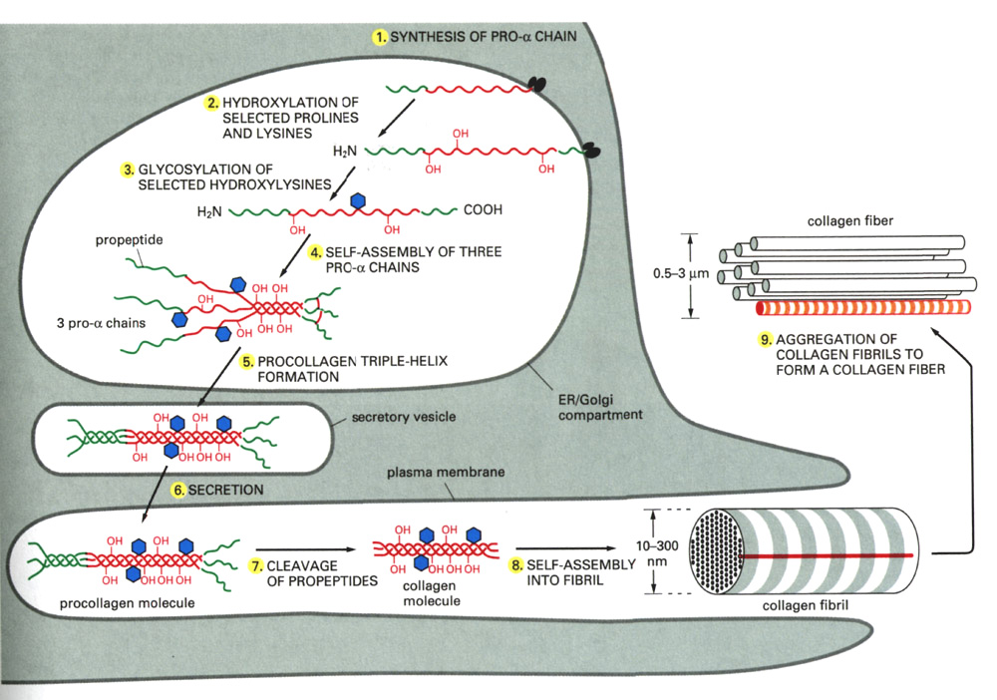
Collagen Synthesis
DISULFIDE
BONDS
ALDOL
CONDENSATION
(aka tropocollagen)

Slide 10
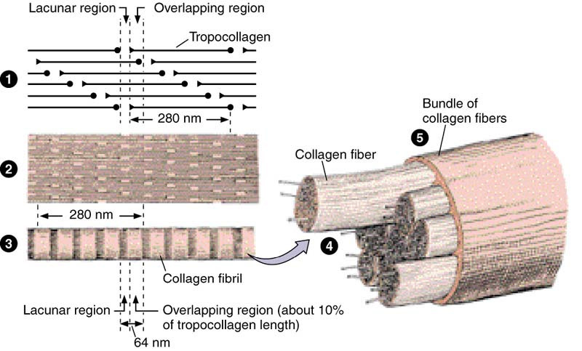
Assembly of collagen fiber bundles
Notes:
Stepped, overlapping arrangement of tropocollagen molecules in a head-to-tail arrangement produces the striations (repeat distance 64 to 67 nm). Osmium (an electron-dense heavy metal used in EM fixation) is deposited in the lacunar (open) spaces (also referred to as the ‘hole zone’). Tensile strength of collagen fibril is due to the covalent bonds between adjacent rows.
Collagen type III (reticulin) does not form bundles.

Slide 11
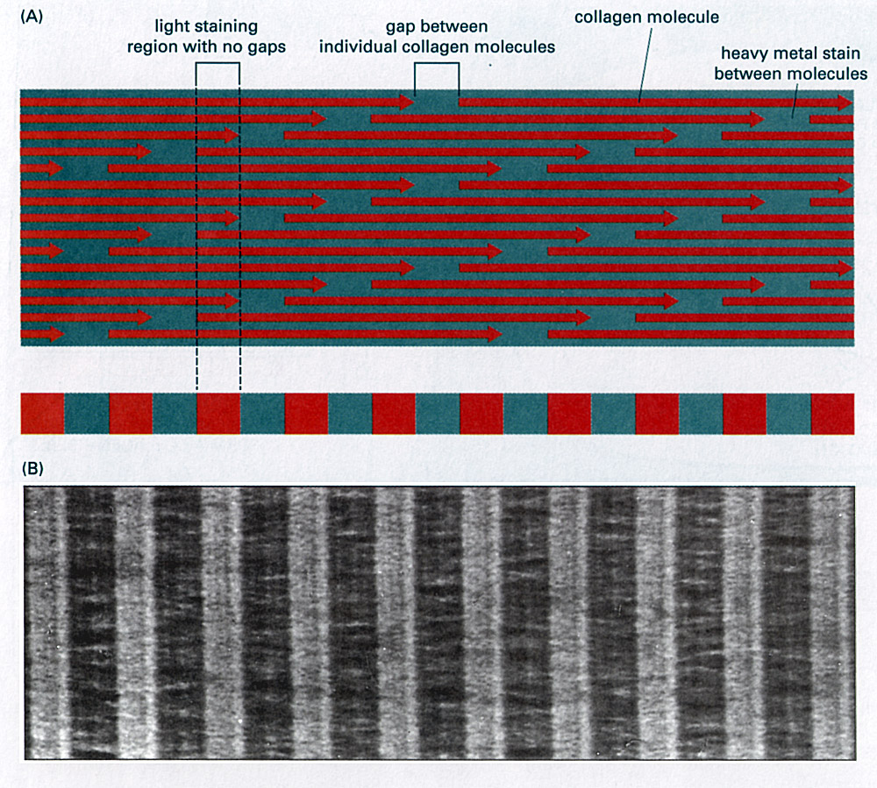
67nm banding caused by overlaps at ends of molecules
Site of Lys/OH-Lys aldol condensation (Lys only at ends of molecules)
Heavy metal stains preferentially fill gap regions

Slide 12
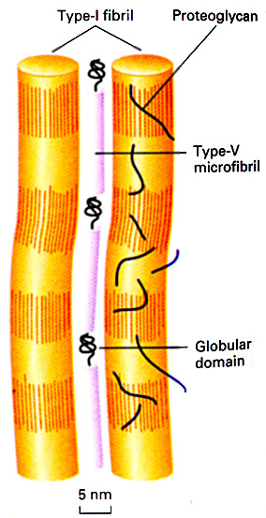
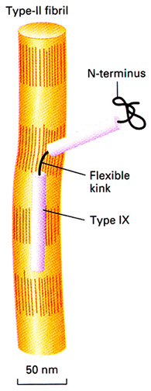
FACIT: Fibril-Associated Collagens with Interrupted Triple helices
Triple helices interrupted by non-helical domains
Retain propeptides at ends
Do not aggregate into large fibrils
Bind collagen fibrils to each other and/or the ECM
Type IX Collagen (left)
I
Binds type II Fibrils to the ECM
Globular N-terminus interacts with ECM
Heparin-SO₄ at kink interacts with ECM
Helical region interacts with type II fibril
Type VI Collagen (right)
Bundles type I fibrils into FIBERS
Binds fibrils via helical domains

Slide 13
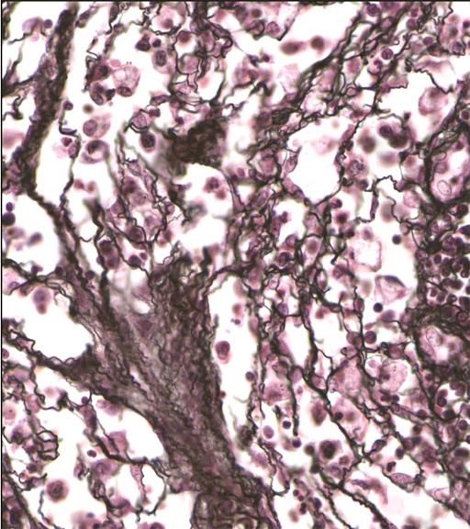
Reticular (Reticulin) Fibers
Form a delicate supporting framework for highly cellular tissues (endocrine glands, lymph nodes, liver, bone marrow, spleen, smooth muscle).
Composed mainly of Type III collagen, with a carbohydrate moiety that reduces Ag+ to metallic sliver = argyrophilic.
Special stain: silver impregnation to visualize.
Thinner than type I collagen (Type III fibrils are 30-40 nm diameter; type I fibrils are ~200 nm diameter)
Notes:
Reticular fibers are also mixed with collagen fibers in other CT types. However, they are difficult to visualize without special stains (they do not form fiber bundles).

Slide 14
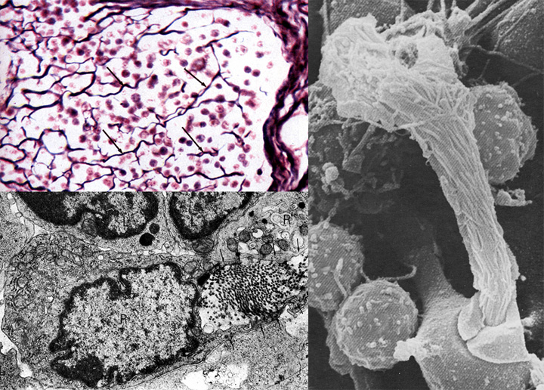
Reticular Fibers (type III collagen)
made by reticular cells (specialized fibroblasts) and vascular smooth muscle cells

Slide 15
Clinical disorders resulting from defects in collagen synthesis
Collagen Type | Disease | Symptoms
I | Osteogenesis imperfecta | Spontaneous fractures, progressive hearing loss, cardiac insufficiency
III | Ehlers-Danlos (type 4) | Hypermobility of digits, early morbidity/mortality from rupture of aorta or intestine
multiple | Scurvy (lack of vitamin C, a cofactor for prolyl hydroxylase) | Ulceration of gums, hemorrhages
Notes:
Many cases of osteogenesis imperfecta are due to deletions of all or part of the collagen alpha1 gene, or mutations that involve glycine. Glycine is present at every third position in order for the collagen triple helix to form.
Ehlers-Danlos Syndrome includes a cluster of genetic diseases involving various defects in collagen synthesis.
Some disorders result from an over-accumulation of collagen (fibrosis), e.g. progressive systematic schlerosis, in which the skin, digestive tract, muscles and kidneys become hardened and thereby functionally impaired.
Lack of vitamin C (ascorbic acid) leads to degeneration of CT and failure of wound healing. The tissues with the highest rate of collagen turnover are the most likely to be involved.

Slide 16
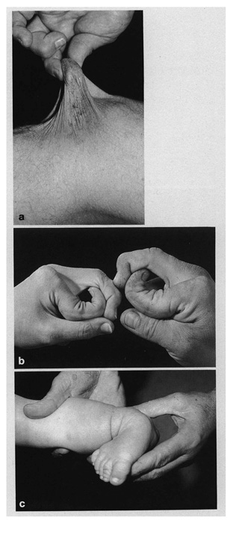
Ehlers-Danlos Syndromes
A series of genetic diseases with faulty assembly of collagens.
Hyperextensible skin and hypermobile joints
In some forms (e.g., type IV), weakness in blood vessels or intestines are life threatening.

Slide 17
Noncollagen Components of the Extracellular Matrix
Elastin
“Ground substance”
  Glycosaminoglycans (GAG’s)
  Proteoglycans
  Multiadhesive matrix proteins
    laminin
    fibronectin

Slide 18
Elastic Fibers
LM: Visualized by selectively staining with Weigert’s, resorcin-fuchsin, or aldehyde-fuchsin
EM: Consist of amorphous core of elastin surrounded by microfibrillar glycoprotein, fibrillin (8-10nm).
Elastin: is rich in glycine and proline, but it contains little or no hydroxyproline and hydroxylysine . uniquely contains desmosine and isodesmosine, which are thought to cross-link the molecules into a network of randomly coiled chains. This cross-linking is responsible for its rubber-like properties.
Confers elasticity: present in large amounts in ligaments, lung, skin, bladder, and walls of blood vessels.
Marfan Syndrome: defect in elastic fiber synthesis; reduced elasticity in skin and lungs, skeletal defects (bones are longer and thinner than usual), cardiovascular complications (aneurism, valve prolapse)

Slide 19
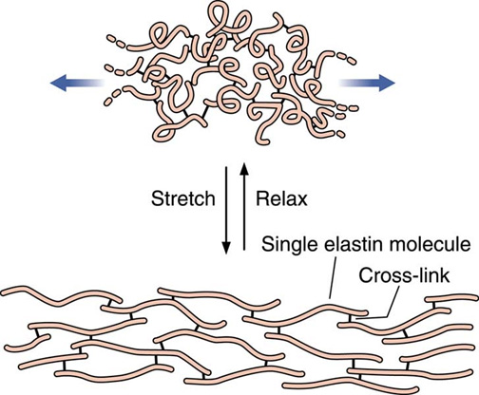
Network of elastin molecules can stretch and recoil like a rubber band
Notes:
An unusual polypeptide backbone causes random coiling, which allows the elastic fiber to be stretched and then recoil to its original state. The elastin molecules are covalently bonded to form a cross-linked network.

Slide 20
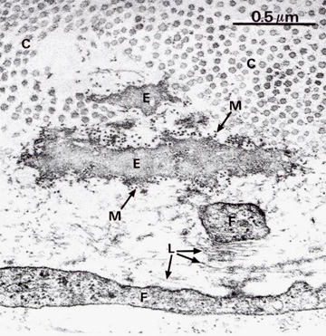
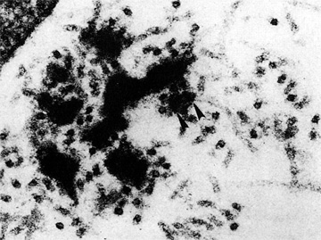
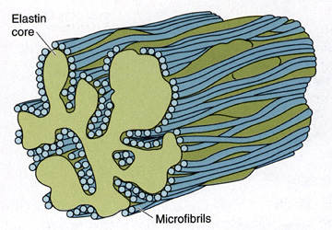
Elastin appears amorphous (not fibrillar) in the electron microscope
E=elastin C, collagen fibrils
M/L=microfibrils of fibrillin, a scaffolding glycoprotein involved elastin deposition
Marfan Syndrome: defect in fibrillin gene, results in weakened elastic fibers
Notes:
Elastin is synthesized by the same pathway as collagen, but the extracellular assembly is distinct.
Marfan’s syndrome is a complex, autosomal dominant connective tissue disorder in which expression of the fibrillin gene (FBN1) is abnormal.

Slide 21
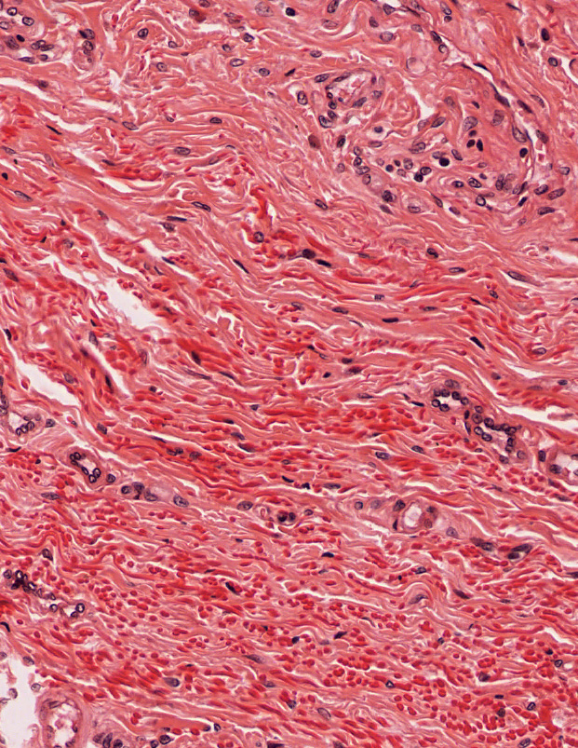
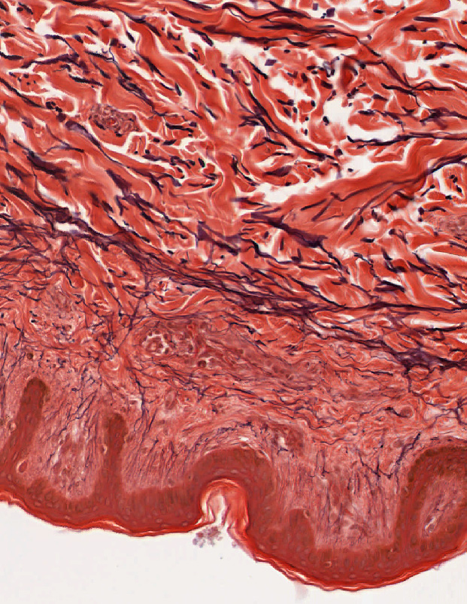
Elastic and Collagen Fibers
H&E stain: collagen stains orange/pink; elastic fibers stain glassy red (generally only visible if in HIGH abundance)
elastin stain (“Weigert’s”, “aldehyde fuchsin”, “Verhoeff”): elastic fibers are purple/black
collagen fibers stain orange/pink or blue/green depending on other stains used (von Gieson’s or trichrome, respectively)

Slide 22
Ground Substance of the
Extracellular Matrix (ECM)
Glycosaminoglycans (GAG)
  linear (unbranched) polysaccharides, e.g. heparan sulfate, condroitin sulfate, keratan sulfate, hyaluronic acid
  very hydrophilic due to abundant negative charges (e.g. SO₄⁻ groups).
  except for hyaluronic acid, are usually bound covalently to protein core as part of a proteoglycan
Proteoglycans
  core protein + GAG side chains (like a bottle brush)
  bind cells, other proteins, and/or ECM components
Multiadhesive glycoproteins
  small glycosylated proteins containing NUMEROUS binding sites to cells, signaling molecules, and other ECM components
  e.g. fibronectin and laminin: important for adhesion of epithelial cells to the basal lamina via transmembrane integrin receptors.
Notes:
Gel-like, viscous, clear and slippery; high water content; lost in normal tissue preparation (extracted during fixation and dehydration)

Slide 23
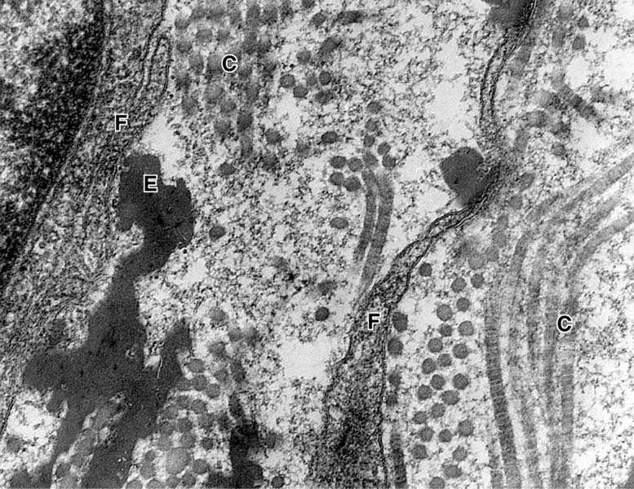
Ground Substance
Notes:
Ground substance is fine, granular material between collagen (C) and elastic (E) fibers and surrounds fibroblast (F) cell processes. Tannic acid fixation. x100,000

Slide 24
Basement Membrane –
Collagen Types IV, VII, and III
Basement membranes are sheets of extracellular matrix proteins located at the interface of parenchyma (epithelia, endothelia, muscle, nerves, adipocytes) and connective tissue / ECM.
Main constituents are glycosaminoglycans (heparan sulfate), fibrous proteins (collagen types IV, VII, III), structural glycoproteins fibronectin, laminin and entactin.
This is NOT a plasma membrane.
Notes:
The basement membrane was so named because it appeared like a membrane to early histologists. The basement membrane is especially well visualized by periodic acid Schiff (PAS) stains, due to its high content of proteoglycans (a core protein associated with a glycosaminoglycan: heparan sulfate).

Slide 25
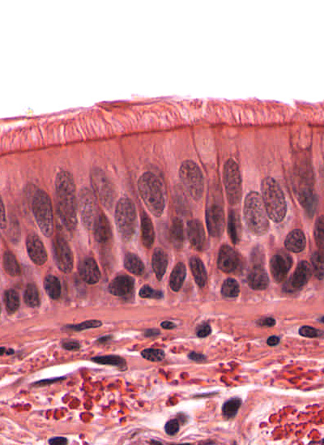
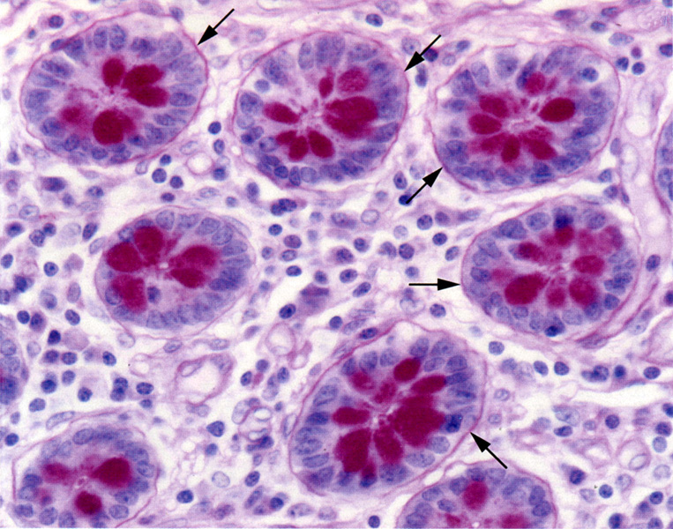
Basement membranes vary in thickness
Thick
Thin -- requires special stain to visualize
BM
BM
BM
trachea, H&E
Intestinal glands, PAS
PAS reacts with carbohydrate-rich molecules such as perlecan, laminin and type III collagen associated with the basement membrane.
Notes:
Trachea (pseudostratified columnar ciliated epithelium) has unusually thick basement membrane – pink with H&E.
PAS (periodic acid Schiff) stains complex carbohydrates and proteoglycans magenta (in the basement membrane (BM) and mucin at the luminal aspect of the crypt lining cells) .
Functions of basement membrane: structural attachment, compartmentalization, filtration, polarity induction, tissue scaffolding.

Slide 26
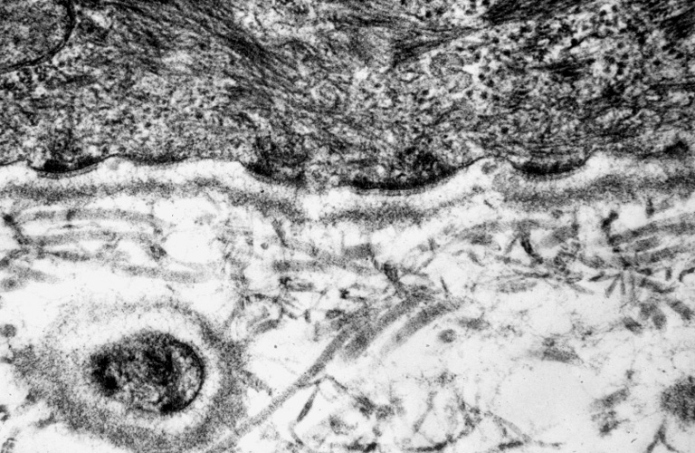
A closer look at the basement membrane:
What appears as ONE layer by LM is actually THREE layers when viewed by EM
hemidesmosomes
lamina lucida (LL) or rara 10-50 nm
lamina densa (LD) 20-300 nm (type IV collagen)
basal lamina
fibroreticular lamina
Fibroreticular lamina (FL) merges with underlying CT (type III* and type VII collagen fibrils)
LL
LD
FL
Connective tissue
*so, basement membranes can also be visualized with silver stain
So, the “basement membrane” is the basal lamina + the fibroreticular lamina
Notes:
Ep epithelial lining of trachea
F, fibroblast
E, elastic fibers
In, basal invagination
IS, intercellular space
This terminology is used somewhat inconsistently in text books.

Slide 27
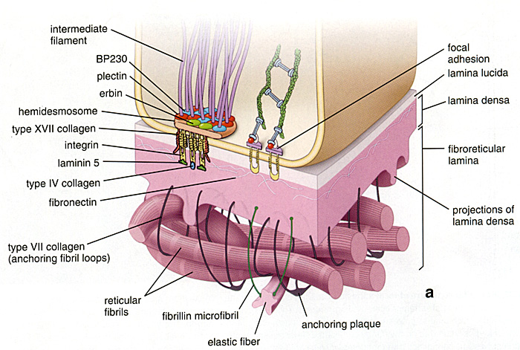
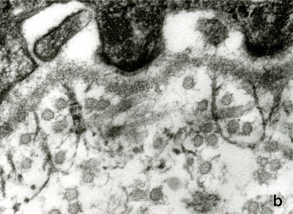
Tying it all together
Interactions of many proteins tether cell to the underlying connective tissue:
Cell to basal lamina…
Hemidesmosome
Type IV collagen
Integrin/laminin
Basal lamina to underlying connective tissue:
Type IV collagen
Type VII collagen
Fibrillin
Type III collagen
lamina
rara
lamina
densa
anchoring fibril
(collagen VII)
reticular fibril
(collagen III)

Slide 28
Cells in Connective Tissue
Fixed (permanent residents)
Fibroblasts
Adipose (fat) cells
Tissue Macrophages**
Mast cells**
Lymphocytes & Plasma Cells (differentiated B-cells) **
“Leukocytes”**
Free (transient residents)
(specifically, neutrophils, eosinophils, & basophils)
** derived from hematopoietic stem cells and involved in immune function and inflammation

Slide 29
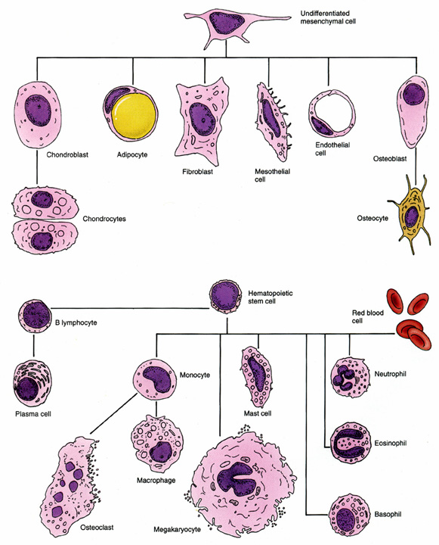
Connective Cell Lineages

Slide 30
Fibroblasts are the most common cells in connective tissue
Synthesize and secrete components of the ECM: fibers and ground substance.
Active and quiescent stages (when quiescent sometimes called fibrocytes or mature fibroblasts).
Synthesize growth factors.
Rarely undergo cell division unless tissue is injured, which activates the quiescent cells.
Play a major role in the process of wound healing and respond to an injury by proliferating and enhanced fiber formation.
Notes:
Myofibroblasts (which have some features of smooth muscle cells, including actin-based contraction) are important for wound contraction.

Slide 31
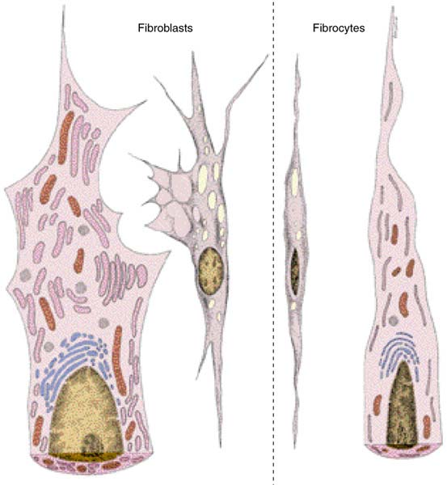
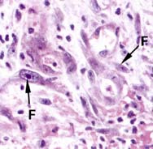
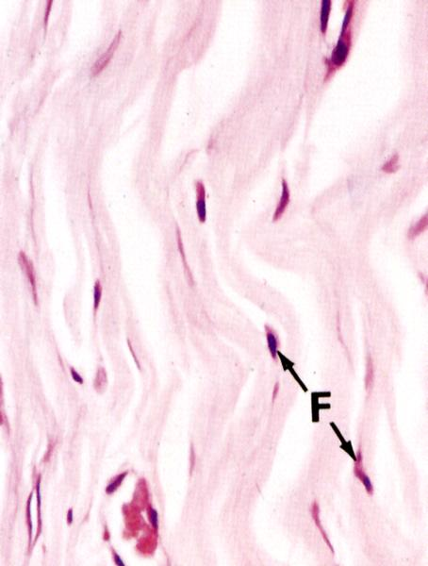
Active and inactive fibroblasts

Slide 32
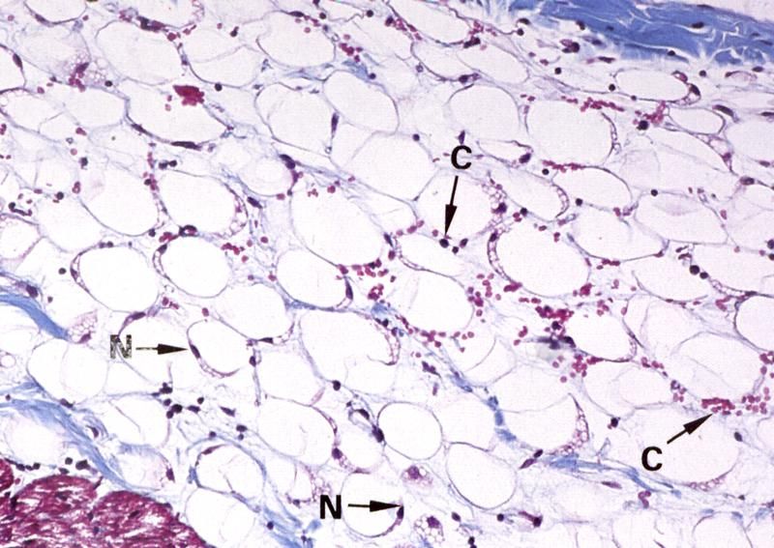
Adipocytes predominate in adipose tissue
Very active cells with many functions:
Triglyceride storage and glucose metabolism (insulin and glucagon receptors)
Secretion of many bioactive molecules:
leptin (regulates satiety) angiotensinogen (blood pressure) steroids (glucocorticoids & sex hormones)
growth factors (e.g. insulin-like growth factor, tumor necrosis factor α) cytokines (e.g. interleukin-6)
Single, large lipid droplet
White (common, yellow, unilocular) adipose tissue stained with Masson’s trichrome
Notes:
Distributed throughout the body, especially in hypodermis of skin, underlying abdomen, buttocks, axilla, thigh, breast. Age and sex determine density and distribution of subcutaneous layer of adipose tissue. Internally, preferentially located in mesentary and retroperitoneal space, around kidneys and in bone marrow.
Nucleus is compressed to one side by enormous lipid droplet. The lipid is extracted by histological processing, and appears as an empty space.

Slide 33
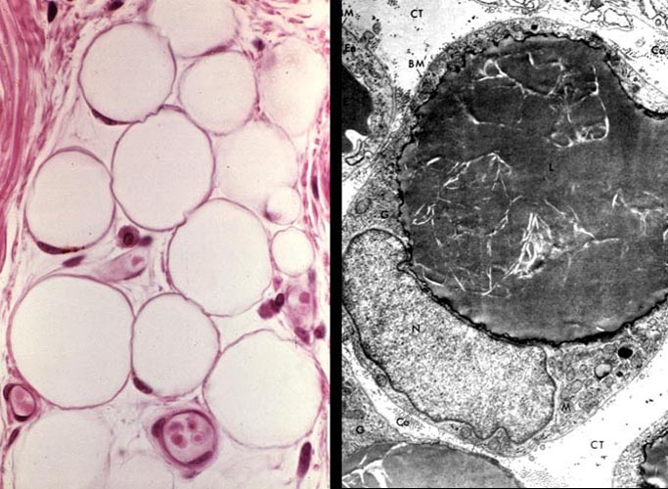
Adipocytes
Lipid (fat) droplet
Nucleus
Capillaries

Slide 34
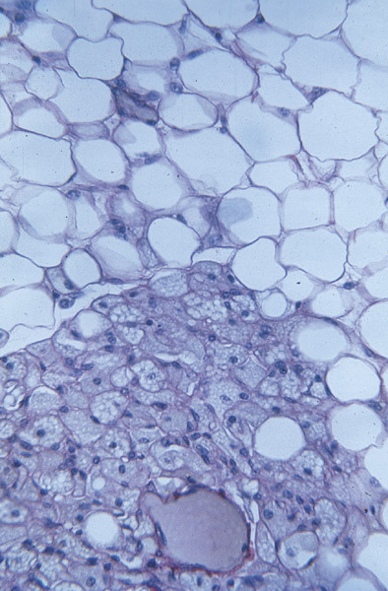
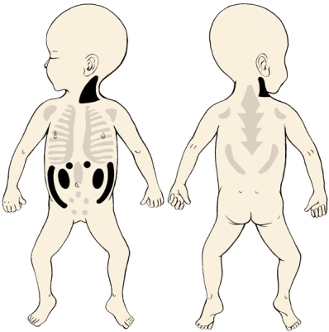
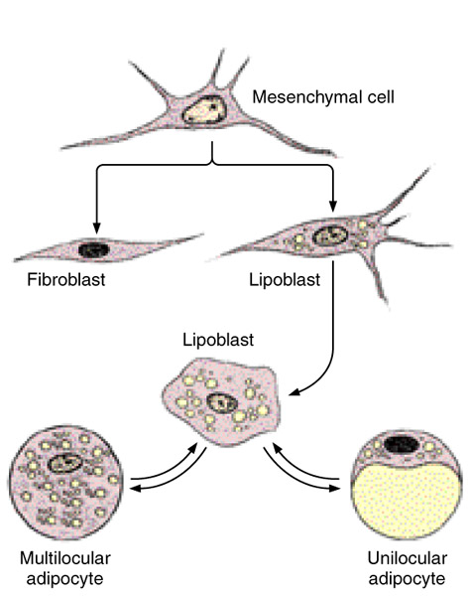
Brown (Multilocular) Adipose Tissue
Present in newborns (and hibernating mammals) and involved in thermoregulation
Mitochondria of brown fat cells express uncoupling protein (UCP), which “short circuits” the electron transport chain producing HEAT rather than ATP.
white
brown

Slide 35
Cells of the blood
Erythrocytes (red blood cells, RBC)
Leukocytes (white blood cells, WBC)
  Granulocytes (with specific granules)
    Neutrophil (~60% of WBC)
    Eosinophil (~5% of WBC)
    Basophil (<1% of WBC)
  Agranulocytes (without specific granules)
    Lymphocyte (B-cell, T-cell) (~25% of WBC)
    Monocyte (~10% of WBC)
(also in the blood are platelets, which are small, membrane-bound cell fragments involved in blood clotting… to be discussed later)

Slide 36
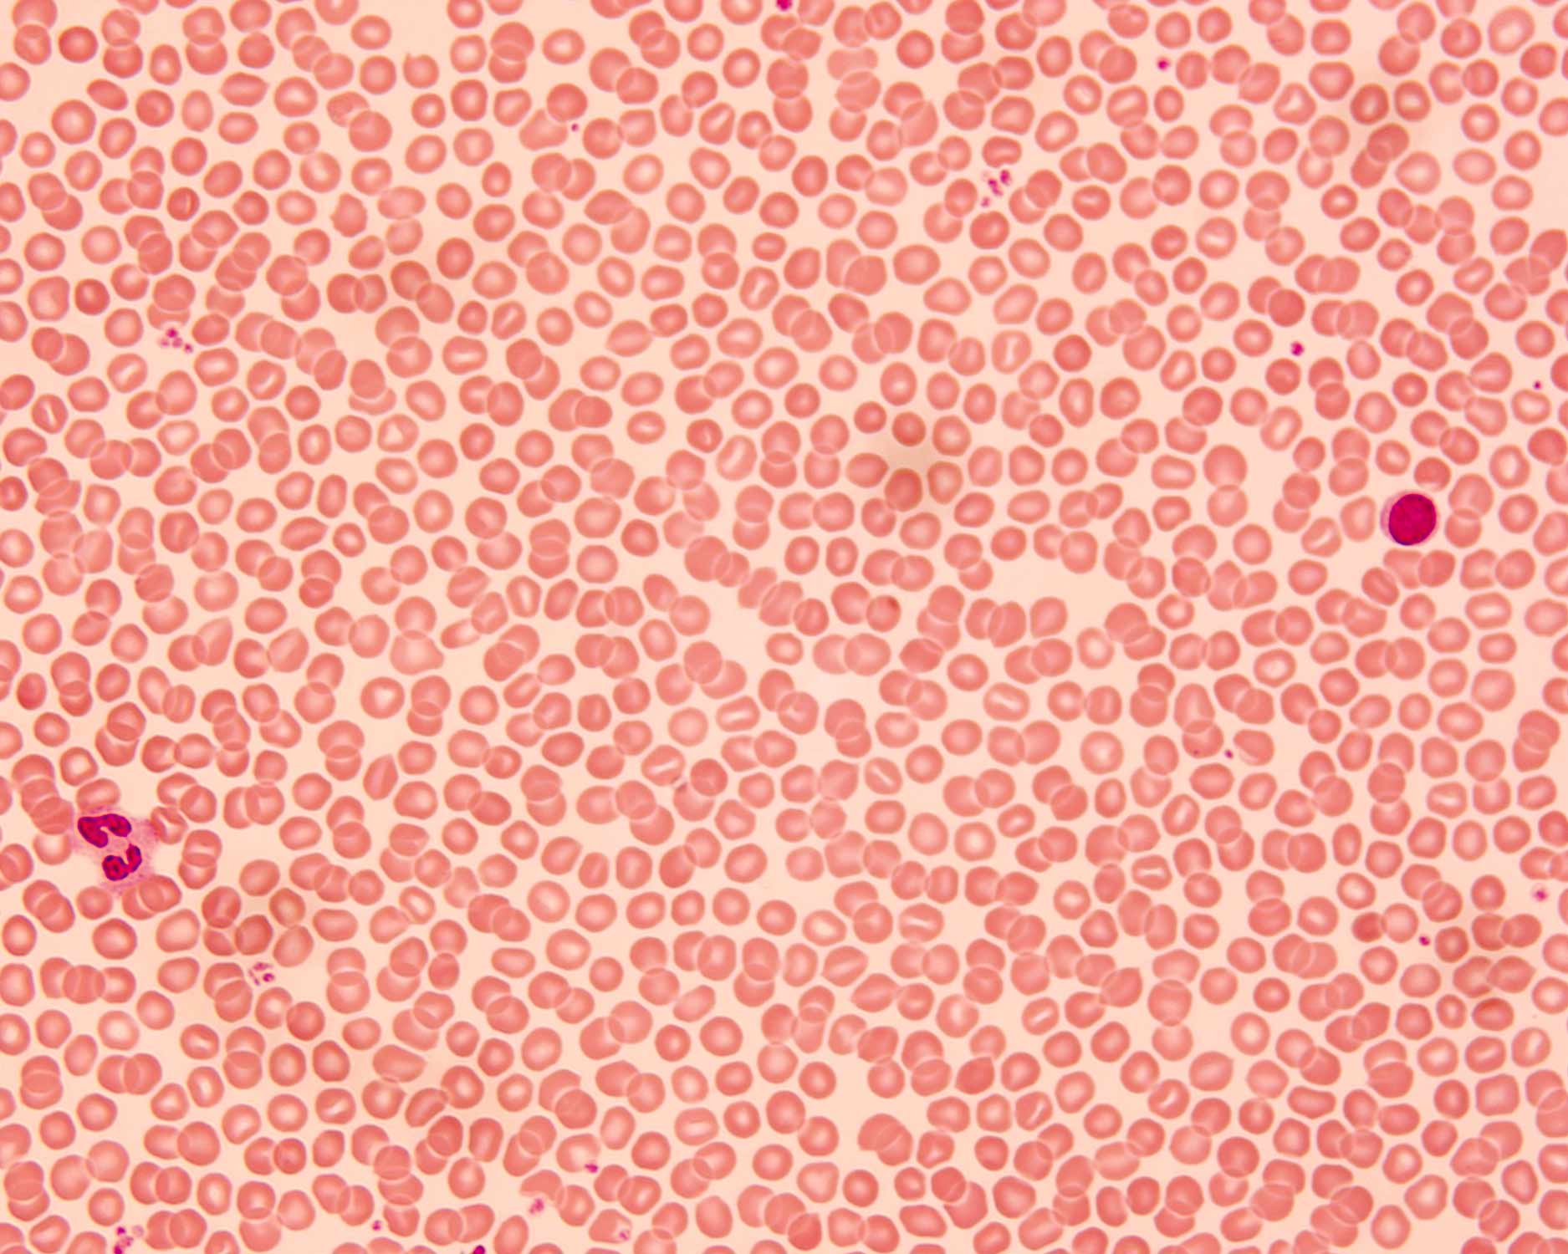
Human blood smear, with RBCs, WBCs and platelets
Platelets
RBC
Lymphocyte
Neutrophil
Notes:
Human blood smear at low magnification. The field is covered with red blood cells (RBCs = erythrocytes --note their light centers, since the biconcave shape makes the centers thinner). There are two white blood cells (WBC) in the field, a neutrophil at left, and a lymphocyte at right (the lymphocyte's cytoplasm appears reddish but should be light blue). Platelets occur as very small bluish clumps seen occasionally between the RBCs.
AKC. From "Misc" slide collection, 1x3" glass slide labeled "Blood, Man, May-Grunwald Giemsa" (of the two slide labeled that way, this label has two black spots). BloodSmear40x5-03I24.tif.

Slide 37
Erythrocyte (red blood cell, RBC)
Size and shape:
  biconcave disk, 8 µm diameter, 2μm at thickest point, 1 μm at thinnest
  flexible: RBC’s normally bend to pass through small capillaries
LM appearance in smear: Pink circle with light center (center is thinner because of the biconcave shape). No nucleus.
Function:
  Transport of oxygen and carbon dioxide
    bound to hemoglobin (oxyhemoglobin and carboxyhemoglobin)
    majority of CO₂ transported as HCO₃⁻
  pH homeostasis
    carbonic anhydrase: CO₂ + H₂O → HCO₃⁻ + H⁺
    HCO₃- / Cl- antiporter : exchanges HCO₃⁻ for extracellular Cl⁻

Slide 38
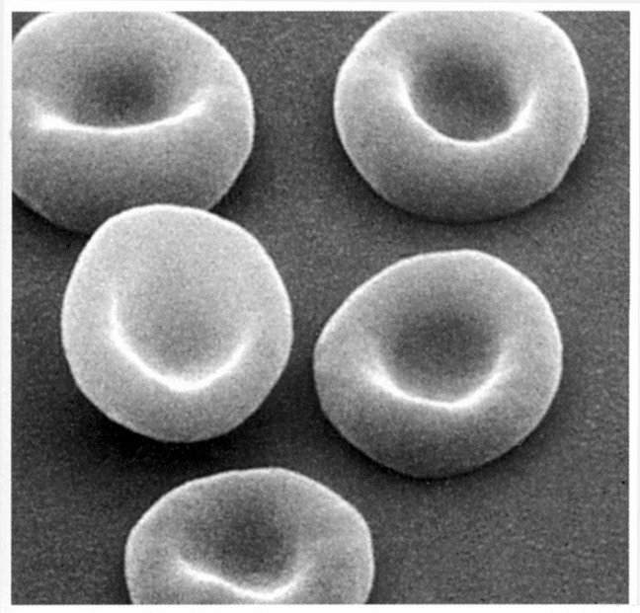
RBCs, scanning electron microscopy
Notes:
SEM of human red blood cells (erythrocytes), showing the biconcave shape.
From Junqueira's Basic Histology, 10th edition, page 235.

Slide 39
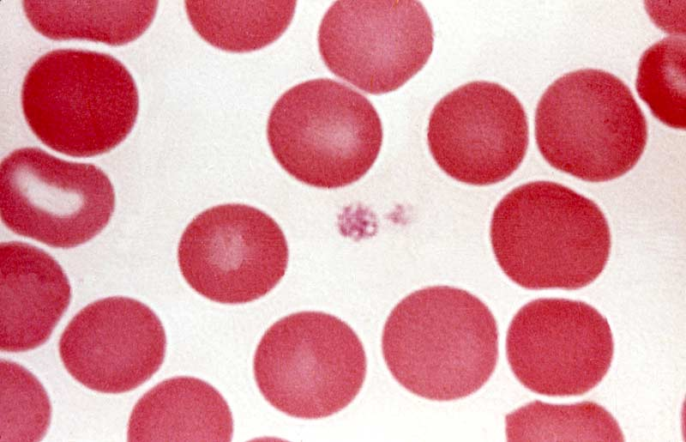
Red blood cells in a blood smear
RBC
Platelet
Notes:
Red blood cells (erythrocytes) in a human blood smear. A small group of platelets is in the center of the field. Giemsa stain.
From the Mizoguti slide collection (J). J-199. PlatRBC-J-199.tif.

Slide 40
Platelets (thrombocytes)
Shape, size, and origin: Small, biconvex disks, 2-3 µm in diameter. Non-nucleated cell fragments derived from cytoplasm of a very large cell, the megakaryocyte, in bone marrow. Platelets have a life span of about 10 days.
LM appearance in smears: Small basophilic fragments, often appearing in clusters.
Function: Platelets initiate blood clots.

Slide 41
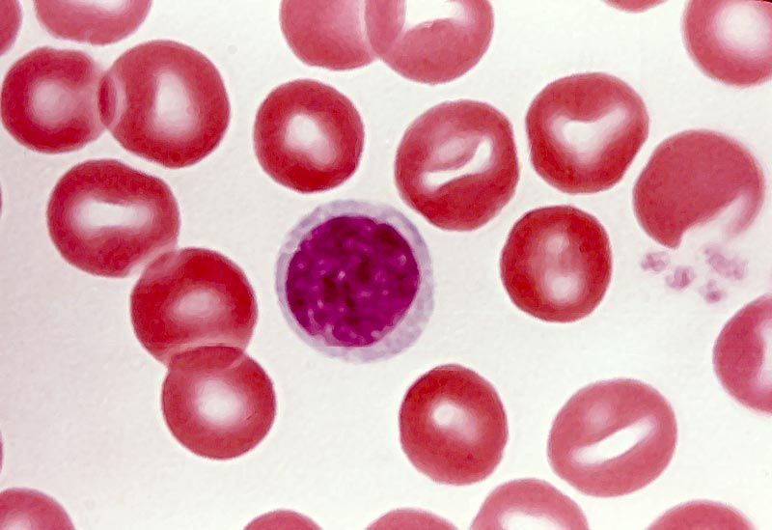
Platelets (at right) in a blood smear
Platelet
Notes:
Platelets in a human blood smear. Giemsa stain.
From the Mizobuti histology slide set (J). J-186. LymSm-J-186.tif.

Slide 42
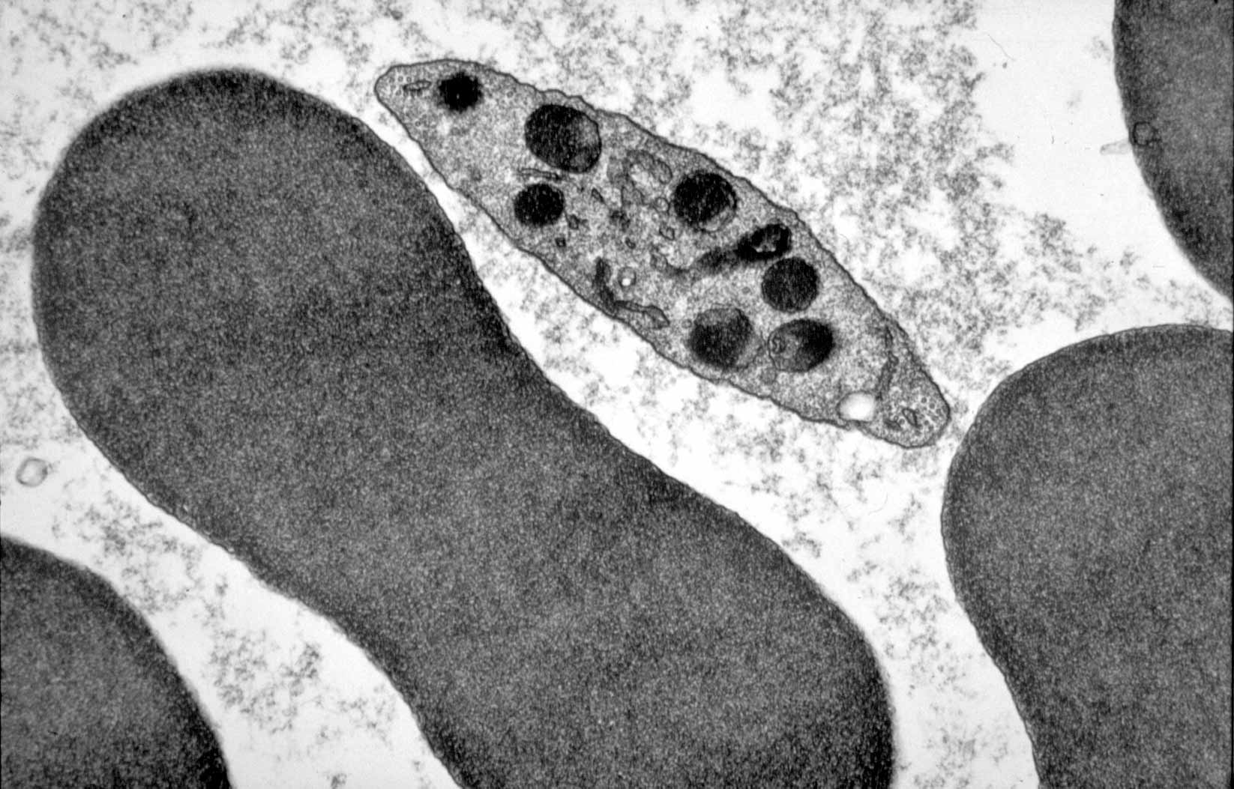
RBC & platelet, TEM
RBC
Platelet
Notes:
Electron micrograph of red blood cells and a platelet. Inside the red blood cells is a solution of hemoglobin so concentrated that it appears essentially solid and homogeneous in electron micrographs. The platelet contains dense granules, dense tubular system, and at the two ends (in this section) you can see cross sections of microtubules that form a ring around the periphery of the platelet disk (in 3 dimensions, rather than the 2 dimensions of this EM section).
From Erlandsen's slide set (MH). MH-2G3. RBCplateletEM-MH-2G3.tif.

Slide 43
Neutrophil
Granulocyte with specific and non-specific granules, ~60% of WBCs
LM appearance in smear: About 9-12 µm in diameter (thus larger than RBC). Nucleus long and multi-lobed (usually 2-4 lobes).
3. Cytoplasm has small, neutrally stained specific granules. Non-specific granules are azurophilic.
4. Function: Primarily antibacterial
  Neutrophils leave the blood and follow chemotaxic signals to sites of wounding or other inflammation, and phagocytose foreign agents such as bacteria. Pus is composed largely of dead neutrophils.
Specific granules
Type IV collagenase (aids migration)
Lactoferrin (sequesters iron)
Phospholipase A₂ (leukotriene synthesis)
Lysozyme (digests bacterial cell wall)
Non-specific granules (lysosomes)
Lysozyme
Acid hydrolase
Myeloperoxidase
Elastase

Slide 44
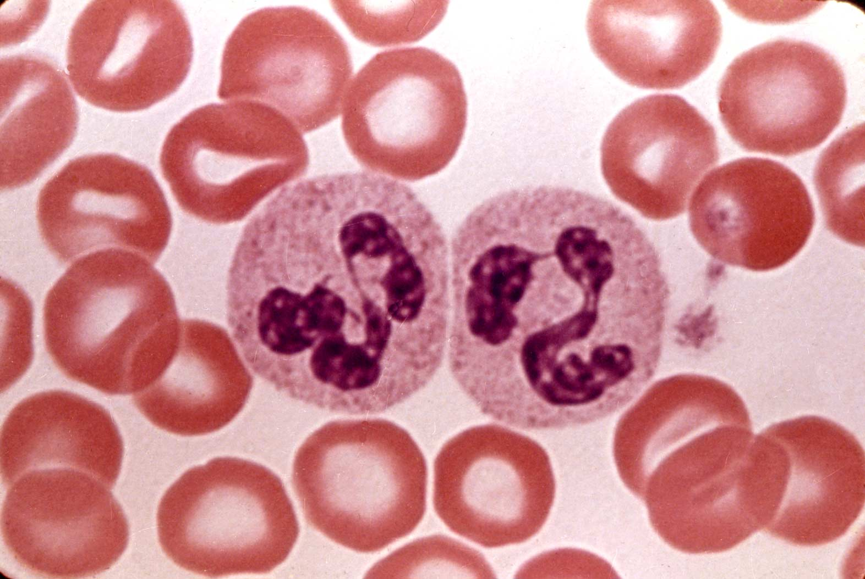
Two neutrophils in a blood smear
LM appearance in smear: About 9-12 µm in diameter (thus larger than RBC). Nucleus long and multi-lobed (usually 2-4 lobes). Cytoplasm has small, neutrally stained specific granules. Non-specific granules are azurophilic.
Notes:
Two neutrophils (polymorphonuclear leucocytes, PMN) in a human blood smear. Note that their diameter is larger that of red blood cells. The nucleus is long, and thins out ins some places, producing lobes (each of these cells has 2 lobes, but there are often 3 or 4). In the cytoplasm are indistict small granules that take the neutral stain (neither strongly basic nor acidophilic).
From the Mizoguti slide set (J). J-196. PMSs-J-196.tif.

Slide 45
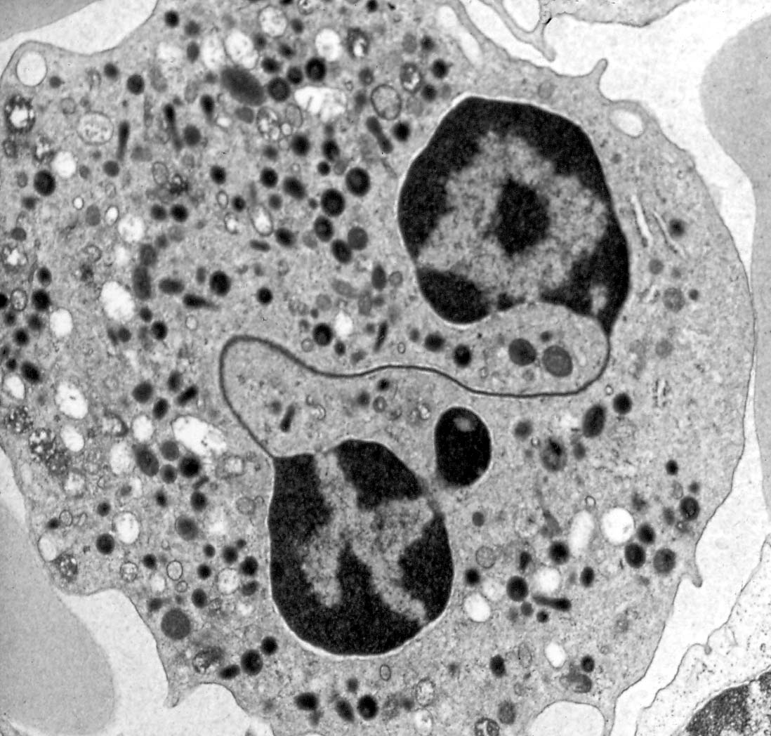
Neutrophil, transmission electron micrograph
TEM appearance: Multi-lobed nucleus and numerous specific granules and lysosomes (=azurophilic granules in LM).
Specific
granule
Lysosome
(=azurophilic granule)
Notes:
Electron micrograph of a neutrophil (polymorphonuclear leucocyte, PMN). The strand connecting two lobes of the nucleus is included in the section. Note the small specific PMN granules in the cytoplasm. The larger granules are lysosomes (="azurophilic granules"), while smaller ones are specific granules (contents including lysozyme and alkaline phosphatase).
From the Erlandsen's slide set (MH). MH-2F6. NeutrophEM-MH-2F6.tif.

Slide 46
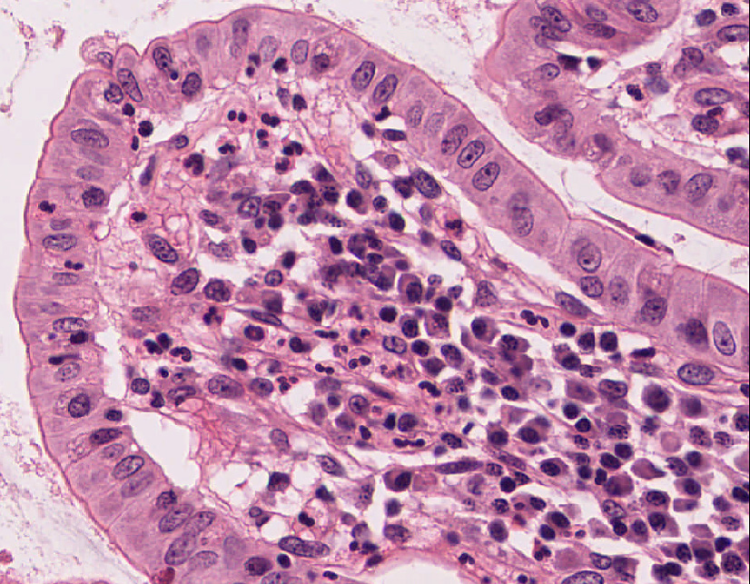
Neutrophils in tissue:
Enter connective tissue from blood vessels as the “first wave” in acute inflammatory responses
Small cells with multi-lobed, heterochromatic nuclei (aka “polymorphonuclear neutrophils”, “PMNs”, “polys”)
Primary function: anti-bacterial (are phagocytic like mphages, but SHORT-lived and NOT antigen presenting)

Slide 47
Eosinophil
Granulocyte with specific and non-specific granules, 3-5% of WBCs
LM appearance in smear: About 10-14 µm in diameter. Bilobed nucleus. The cytoplasm has prominent pink/red specific granules (stained with eosin dye). If the smear is not stained properly, the granules may be brownish.
Function:
  Anti-parasitic activity
  Mediators of inflammatory/allergic responses in tissues
    Inactivate leukotrienes and histamine secreted by basophils
    Engulf and sequester antigen-antibody complexes
    Inflammatory stimulus increases production/release of eosinophils from bone marrow, whereas inflammatory suppression decreases eosinophil numbers in peripheral blood.
    But, they also secrete PRO-inflammatory chemokines AND they can degranulate inappropriately to cause tissue damage (as in reactive airway disease)
Specific granules
Major basic protein
Eosinophilic cationic protein
Neurotoxin
Histaminase
Non-specific granules (lysosomes)
Lysozyme
Acid hydrolase
Myeloperoxidase
Elastase

Slide 48
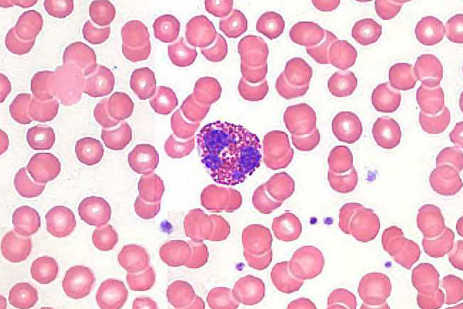
Eosinophil in a human blood smear
LM appearance in smear: About 10-14 µm in diameter. Bilobed nucleus. The cytoplasm has prominent pink/red specific granules (stained with eosin dye). If the smear is not stained properly, the granules may be brownish.
Notes:
Eosinophil in a human blood smear. The nucleus is bilobed. The cytoplasm is filled with reddish granules of relatively uniform size. If the smear is improperly stained, the granules may be brown.
Image from the 86X normal blood smear slide from University of Michigan Virtual Slide Collection

Slide 49
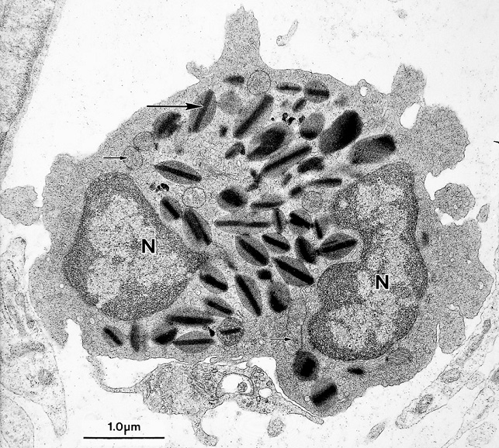
Eosinophil, transmission electron microscopy
externum
internum
TEM appearance: The specific granules are ovoid in shape, and contain a dark crystalloid body composed of major basic protein (MBP), effective against parasites. The rest of the granule contains other anti-parasitic substances and histaminase. The cytoplasm also contains lysosomes (=azurophilic granules).
Notes:
Electron micrograph of a human eosinophilic leucocyte. Note the large specific granules,each containing a dense crystalloid body. The crystals contain major basic protein (MBP), important in combatting parasites.
From Fawcett's Concise Histology, 2nd edition, page 49. EosinophEM-FawcConc2-49.tif.

Slide 50
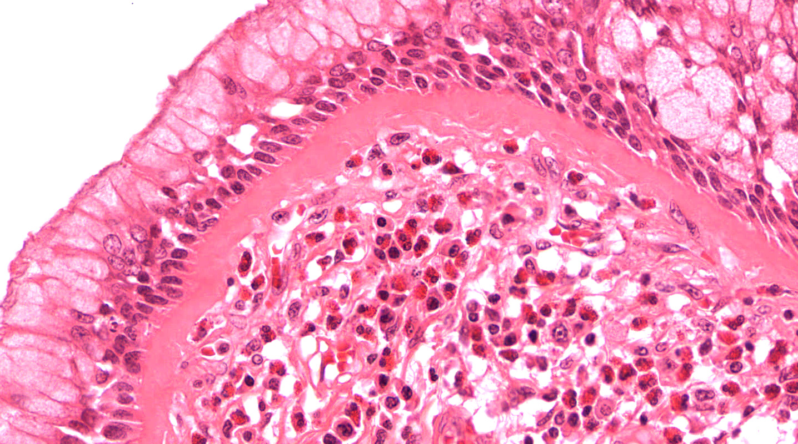
Eosinophils can also migrate into connective tissue
(often seen in chronic allergies or inflammatory diseases)

Slide 51
Basophil
Granulocyte with specific and non-specific granules, <1% of WBCs
2. LM appearance in smear: About 8-10 µm in diameter. The cytoplasm contains large, purple/black specific granules (stained with the basic dye) that are larger but not as numerous as those of eosinophils. The nucleus is usually bilobed, but usually is partially obscured by granules, which can lie over it.
3. Function: Allergies and anaphylaxis (hypersensitivity reaction)
    Binding of antigens to membrane-bound IgE antibodies induces degranulation of specific granules, which leads to allergic reaction.
    In hypersensitivity reaction, widespread vasodilation (arteriolar) and vessel leakiness induce circulatory shock. Bronchial spasms cause respiratory insufficiency; combined effect is anaphylactic shock.
4. Similarity to tissue mast cells: Tissue mast cells also have IgE receptors and similar (though not identical) granule content. Mast cells and basophils have a common precursor in bone marrow.
Specific granules
Histamine
Heparin
Eosinophil chemotactic factor
Phospholipids for synthesis of leukotrienes, e.g. slow-reacting substance of anaphylaxis ( SRS-A )
Non-specific granules (lysosomes)
Lysozyme
Acid hydrolase
Myeloperoxidase
Elastase

Slide 52
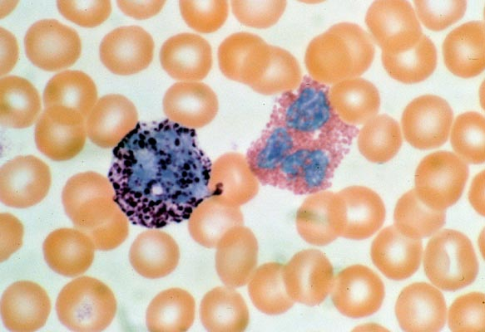
Comparison of basophil and eosinophil in a blood smear
Eosinophil
Basophil
Notes:
Basophil and eosinophil, with surrounding red blood cells, in a human blood smear. Wright's blood stain. Note that the basophil's granules are black or dark purple, large, scattered (some lying over the nucleus), and of somewhat variable shape. The eosinophil granules, on the other hand, are reddish, rather uniform in size, and are abundant, filling the cytoplasm. The nucleus of an eosinophil is usually bilobed, although the lower lobe in this one seems to have some subdivisions. The nucleus of a basophil appears large and of irregular shape, which can't be seen very well because of the granules.
Blood smear from a U-M Histology course set (I ran on to this one day teaching blood in the histology course, and subsequently photographed it). 1985C06CW.jpg.

Slide 53
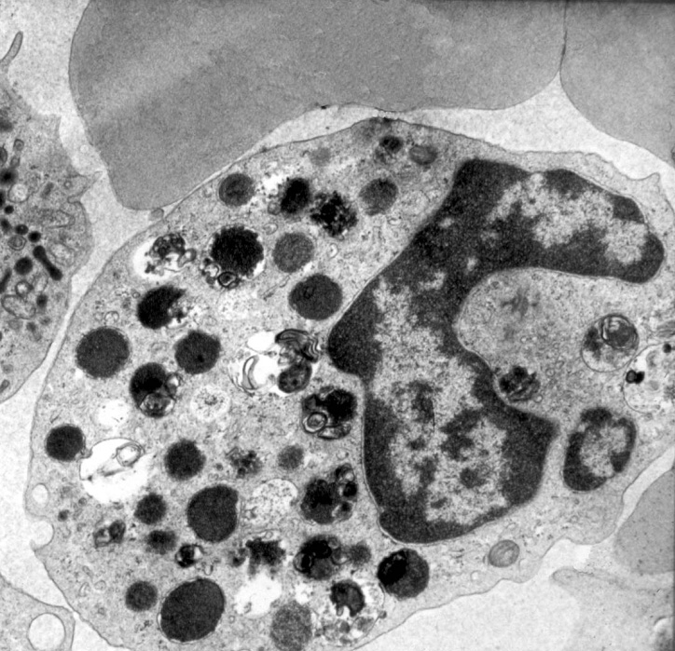
Basophil, transmission electron microscopy
Granule
Myelin
figure
TEM appearance: The specific granules vary in size and shape, and have occasional myelin figures (usually formed from phospholipids). The cytoplasm also has some lysosomes (non-specific granules).
Notes:
Human basophil seen by electron microscopy. Granules are large, and contain histamine and other strong vasoactive mediators. In some of the granules you can see myelin figures, which usually result from phospholipids in the granule).
From Erlandsen's slide set (MH). MH-2G2. BasophEM-MH-2G2.tif.

Slide 54
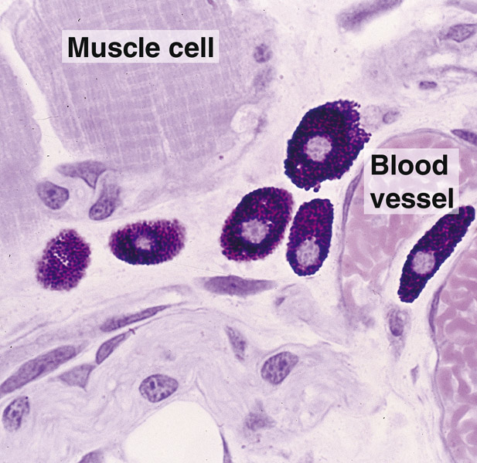
Mast Cells
Principal function is storage in secretory granules and REGULATED release (degranulation) of histamine and other vasoactive mediators of inflammation.
Responsible for the immediate hypersensitivity response characteristic of allergies, asthma and anaphylactic shock.
Connective tissue mast cells are found in skin (dermis) and peritoneal cavity; mucosal mast cells are in the mucosa of the digestive and respiratory tracts.
Metachromasia – when stained with toluidine blue, the granules bind the dye and change its color to red.
Notes:
From the German word “maesten”, or fattened. Oval to round, 20-30 μιχρομετερ διαμετερ, with small spherical central nucleus. Cytoplasm filled with basophilic secretory granules. Similar to circulating basophils, but recent evidence they actually arise from a unique progenitor.

Slide 55
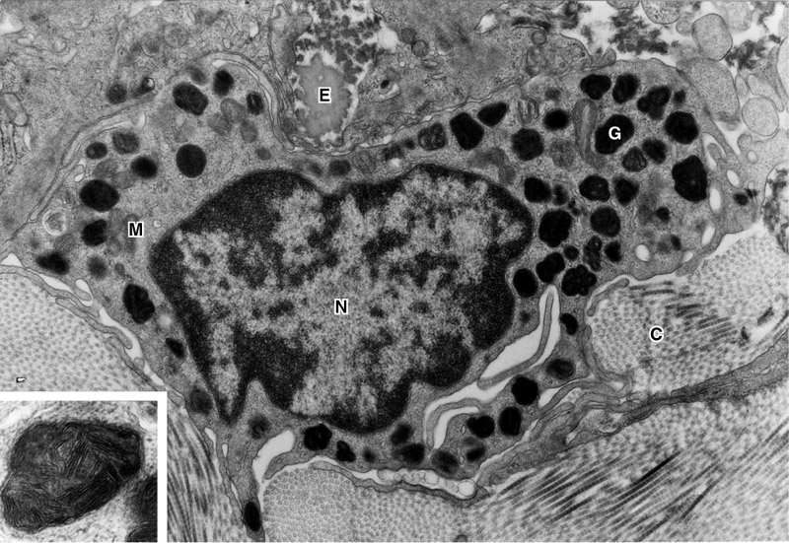
EM of a Mast Cell

Slide 56
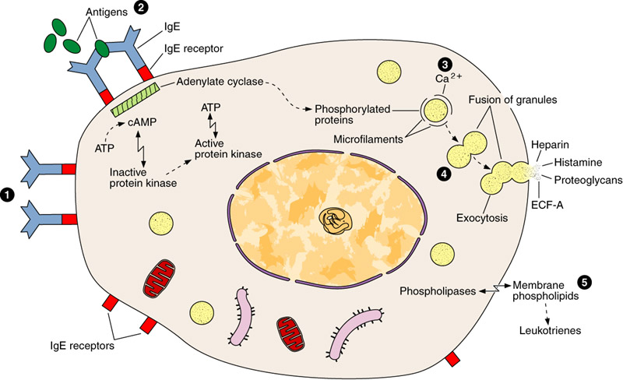
Mast Cell Secretion

Slide 57
Lymphocyte
Agranulocyte, ~25% of WBCs
LM appearance in smear: 8-15 µm in diameter. Round, dense nucleus (abundant heterochromatin). The cytoplasm of a small lymphocyte is a narrow rim around the nucleus, and when well stained is pale blue. T-lymphocytes and B-lymphocytes cannot be distinguished in a smear.
Function: Cellular and humoral immunity (more detail in the lecture and lab on lymphatic system histology). In general:
  B-lymphocytes (B-cells): may differentiate into tissue plasma cells which make antibodies. Some B-cells become memory cells.
  T-lymphocytes (T-cells): cytotoxic T cells and helper T cells.

Slide 58
Small lymphocyte in a blood smear
Small
lymphocyte
LM appearance in smear: Small lymphocyte (about 90% of lymphocytes you will see) are ~8 µm in diameter, while large lymphocytes may be up to about 15 µm. Round, dense nucleus (abundant heterochromatin). The cytoplasm of a small lymphocyte is a narrow rim around the nucleus, and when well-stained is pale blue.
Notes:
Small lymphocyte in a human blood smear. Note the dense nucleus and the pale blue cytoplasm. The cell is not that much larger than the surrounding red blood cells. There are also some platelets at right. Giemsa stain.
From the Mizobuti histology slide set (J). J-186. LymSm-J-186.tif.

Slide 59

Electron micrograph of a lymphocyte
Mitochondrion
Centriole
TEM appearance: The cytoplasm doesn't appear to be very active, containing mainly mitochondria and free ribosomes.
Notes:
Lymphocyte seen in an electron micrograph. The cytoplasm contains a few mitochondria, a centrioles, ribosomes (actually polysomes = ribosomes on mRNA) but few other organelles, and usually no granules.
Erlandsen slide set (MH). MH-2E7. LymphocyEM-MH-2E7.tif.

Slide 60


B lymphocytes migrate into connective tissues –when activated they differentiate into Plasma Cells that constitutively secrete antibodies
Black arrows indicate several plasma cells
White arrows = Golgi regions

Slide 61


EM of Plasma Cells

Slide 62
Monocyte
Agranulocyte, ~10% of WBCs in blood
LM appearance in smears: About 16-20 µm in smears, thus the largest leukocyte. Large, eccentric nucleus either oval, kidney-shaped or horseshoe-shaped, with delicate chromatin that is less dense than that of lymphocytes. Pale cytoplasm, often grayish, may contain occasional non-specific granules (actually lysosomes)
Function
  Migrate into tissues and constitute mononuclear phagocyte system that help destroy foreign bodies and maintain or remodel tissues:
    Tissue macrophages Kupfer cells (liver) Osteoclasts (bone)
    Dust cells (lungs) Microglia (brain)
  Mediate inflammatory response
  Antigen presenting cells: Dendritic Cells, Langerhans cells

Slide 63

Monocyte in a blood smear
LM appearance in smears: About 16 -20µm in smears. Large, eccentric nucleus either oval, kidney-shaped or horseshoe-shaped, with delicate chromatin that is less dense than that of lymphocytes. Pale cytoplasm, often grayish, may contain occasional stained granules (lysosomes)
Notes:
Monocyte in a human blood smear. The nucleus is large, relatively pale and is bean-shaped (it is often oval).
The cytoplasm is also pale, and some of the indistinct spots may be small lysosomes. Monocytes migrate from the blood into tissues and differentiate into various types of macrophages. Large lymphocytes may resemble monocytes, but the lymphocyte nucleus is usually darker. Giemsa stain.
From the Mizoguti slide collection (J). J-188. Mono-J-188.tif.

Slide 64

Monocyte, transmission electron microscopy
Lysosome
(=azurophilic
granule)
Mitochondrion
Centriole
Golgi
TEM appearance: Cytoplasm contains mitochondria and some small lysosomes.
Notes:
Electron micrograph of a human monocyte. The cytoplasm contains mitochondria, a Golgi element, a section through a centriole, and small lysosomal granules (= azurophilic granules). Monocytes migrate from the blood to tissues, where they differentiate into macrophages of various kinds.
From Erlandsen's slide set (MH). MH-2F3. MonocyEM-MH-2F3.tif.

Slide 65

Monocytes migrate from blood vessels into connective tissue where they differentiate into Macrophages
Primary function: phagocytosis and antigen presentation
Notes:
M, macrophage. Large phagocytic cells (10 to 30 μιχρομετερσ) with oval or kidney shaped nuclei.
F, fibroblast.
Tissue macrophages are relatively long-lived (survive for months).

Slide 66

Ultrastructural features of a Macrophage
secondary lysosomes
phagocytic vesicles
Notes:
Secondary lysosomes (L) and nucleolus (Nu). Arrows indicate phagocytic vacuoles.
Compared to monocytes, macrophages have increased Golgi, lysosomes, microtubules and microfilaments. They have an oval or kidney-shaped, eccentric nucleus, with prominent nucleolus. When activated, they have irregular cytoplasmic projections (ameboid movements) and prominent evidence of phagocytic ingestion of solid materials. Vital (living animal) injections of colloidal or particulate material will be injested by tissue macrophages.

Slide 67
Types of Connective Tissue Proper
Loose (areolar) connective tissue – delicate, vascularized, cellular; supports the epithelia of the major organs and glands and fills the space between muscle tissue. - not very resistant to stress
Dense connective tissue (many more fibers than cells)
  Dense irregular: meshwork of coarse fibers; dermis of skin, organ capsules, fascia - resists multi-directional forces
  Dense regular:
    collagenous: fibers aligned in defined pattern; tendons, ligaments, etc. - resists linear mechanical stresses
    elastic: elastin and microfibrils (fibrillin) - elasticity
Adipose - fat storage, glucose regulation, satiety
Reticular - argyrophilic fibers of type III collagen - forms stroma of highly cellular organs (e.g. liver, lymph nodes, spleen)

Slide 68


Loose connective tissue: delicate, vascularized, flexible; facilitates transport of cells and materials (secretion, absorption, immunity)
lamina propria
small intestine lamina propria
mammary gland intralobular connective tissue

Slide 69

Dense Irregular CT
Densely packed collagen fibers, often in perpendicular bundles; resists tension in many directions and provides mechanical support.
Collagen
Fibroblast nucleus
Skin dermis, H &E
Notes:
Collagen fibers predominate, and arranged in bundles without a definite orientation.

Slide 70

Dermis of Skin has both Loose and Dense Irregular CT
Loose CT
sweat gland
H & E

Slide 71

Dense Regular CT (collagenous)
Tendon, H & E
Notes:
Tendons are the most common example of dense regular CT. Tendons attach muscle to bone. Collagen fibers aligned in parallel in response to prolonged stresses in this direction: offer resistance to traction forces. Little gound substance (hence ‘dense’). Fibroblast nuclei are aligned with fibers.

Slide 72

Dense Regular CT (elastic)
Aorta: slide 36 , Weigert stain, 20x obj
wall of aorta

Slide 73

Adipose Tissue
Adipose tissue in mesentery; tang=adipocyte sectioned tangentially

Slide 74

Reticular connective tissue
Liver: slide 198 odd, silver stain, 40x obj
reticular fibers
arteriole
bile duct
portal vein

Slide 75
Learning Objectives
At the end of this session, you should be able to:
1. Describe the functions and identify the cells commonly found in connective tissue.
Recognize interstitial (fibrillar) collagens and elastic fibers at the light and electron microscopic levels.
Distinguish between elastic, type I collagen, type III (reticular) collagen, and elastic fibers when appropriately stained material is presented.
4. Recognize types of connective tissue (e.g., dense irregular, dense regular, loose, adipose) and their constituent cells and provide examples where different types of connective tissue are found in the body.
5. Recognize a basement membrane (or basal lamina) in sections or micrographs where the structure is conspicuously present and understand its functions.

