Slide 1
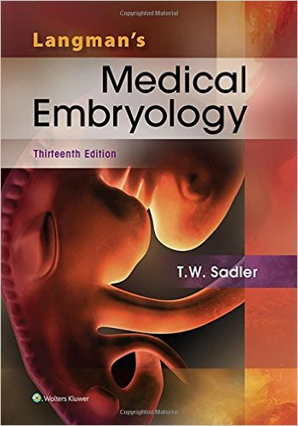
Embryology
J. Matthew Velkey, Ph.D.
matt.velkey@duke.edu
380 Medical Library (Seely Mudd Bldg),
Office of Curricular Affairs
Textbook: Langmans’s Medical Embryology, 13th ed.
Lectures are intended to complement the assigned readings. Many students watch the lecture first to get an overview and then read the text to solidify their understanding.
All embryology class sessions will entail a case-based application exercise, so adequate preparation is essential
Overall goal: understand the fundamental processes by which the adult form is produced and the clinical consequences that arise from abnormal development.

Slide 2
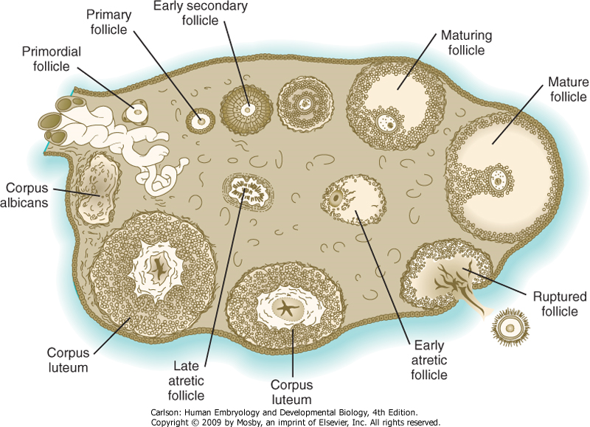
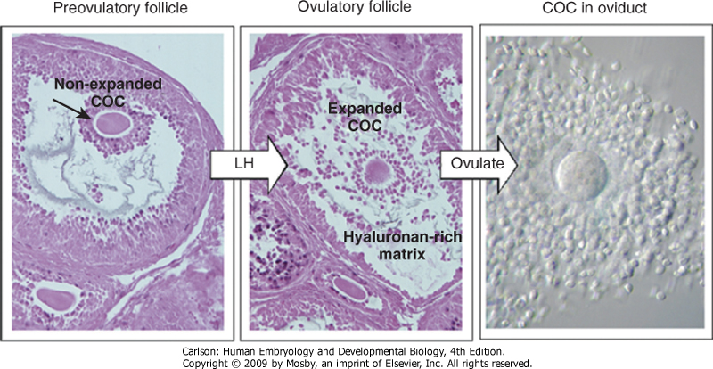
Follicle Maturation and Ovulation
Oocytes
~2 million at birth
~40,000 at puberty
~400 ovulated over lifetime
Leutinizing Hormone surge (from pituitary gland) causes changes in tissues and within follicle:
Swelling within follicle due to increased hyaluronan
Matrix metalloproteinases degrade surrounding tissue causing rupture of follicle
Egg and surrounding cells (corona radiata) ejected into peritoneum
Corona radiata provides bulk to facilitate capture of egg.

Slide 3
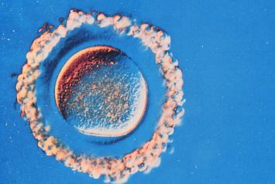
The egg (and corona radiata) at ovulation
Corona radiata
Zona pellucida
(ZP-1, -2, and -3)
Cortical granules

Slide 4
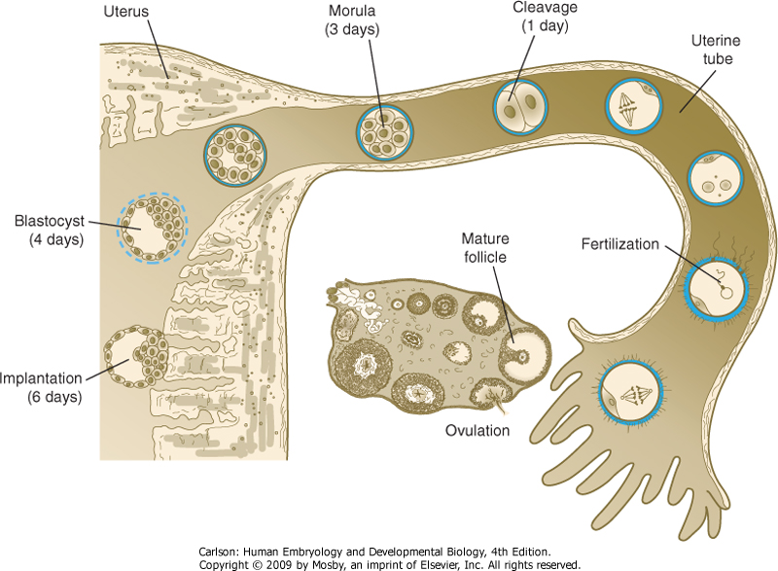
Transport through the oviduct
At around the midpoint of the menstrual cycle (~day 14), a single egg is ovulated and swept into the oviduct.
Fertilization usually occurs in the ampulla of the oviduct within 24 hrs. of ovulation.
Series of cleavage and differentiation events results in the formation of a blastocyst by the 4th embryonic day.
Inner cell mass generates embryonic tissues
Outer trophectoderm generates placental tissues
Implantation into the uterine wall occurs ~6th embryonic day (day 20 of the menstrual cycle)

Slide 5
Timing of
pregnancy
Embryologists
Fertilization age: moment of fertilization is dO
Division of pregnancy corresponding to development:
0-3 weeks –early development
3-8 weeks –embryonic period (organogenesis)
8 wks-term –fetal period
Total gestation time = 38 weeks
Clinicians
Menstrual age: last menses is dO
Division of pregnancy into trimesters
Total gestation time = 40 weeks

Slide 6
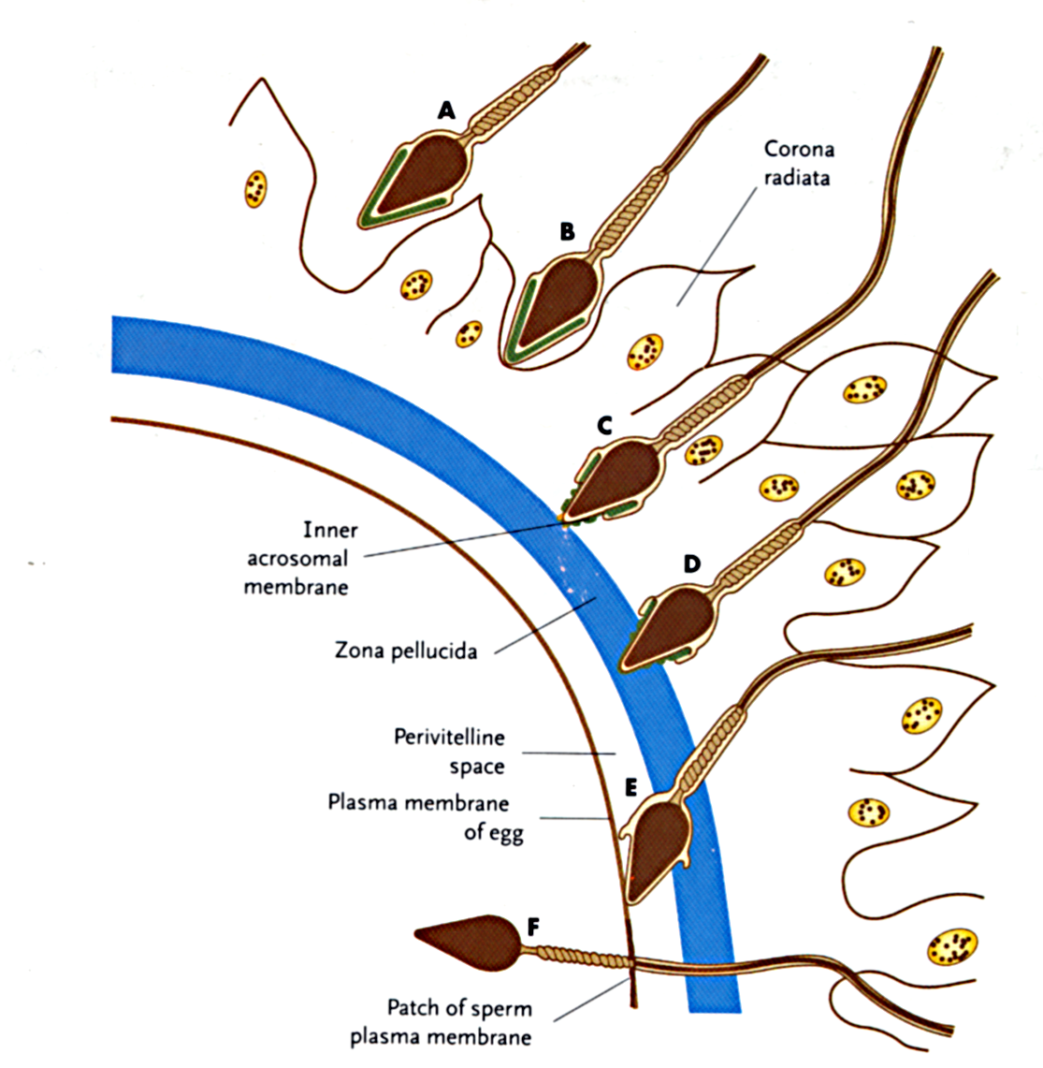
1. Acrosome Rx sperm bind to ZP proteins in the zona pellucida; this initiates the release of enzymes from the sperm allowing it to burrow through the zona pellucida. 2. Zona Rx binding of the sperm and egg plasma membranes initiates Ca+ influx into the egg and release of cortical granules from the egg that block other sperm from fertilizing the egg.
Fertilization is a multi-step process whereby multiple sperm bind to the corona radiata, but only a single sperm usually fertilizes the egg

Slide 7
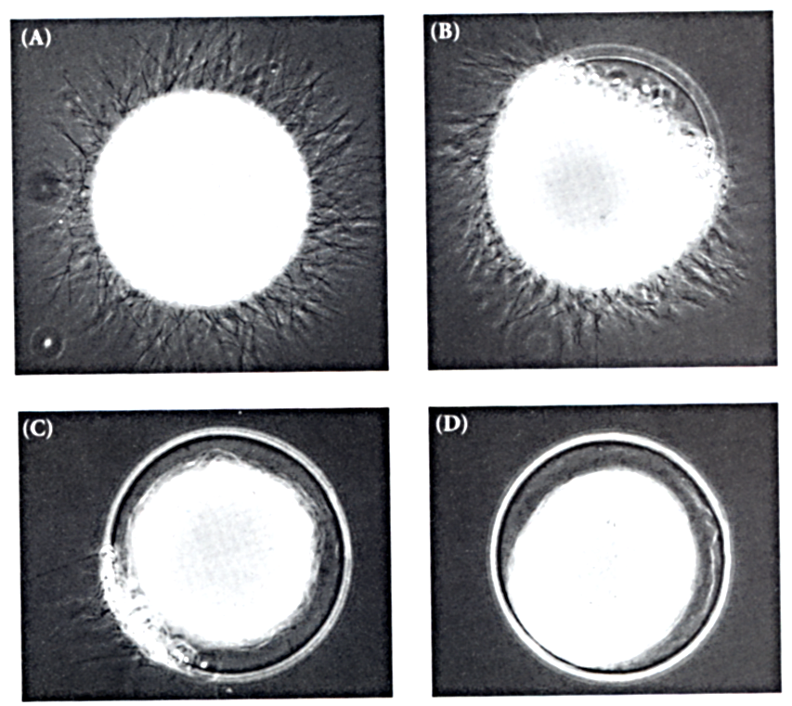
This so-called cortical reaction prevents other sperm from fertilizing the egg (aka “polyspermy”)
Cortical granule enzymes digest ZP proteins so other sperm can no longer bind.
Hyaluronic acid and other proteoglycans are also released that become hydrated and swell, thus pushing the other sperm away.

Slide 8
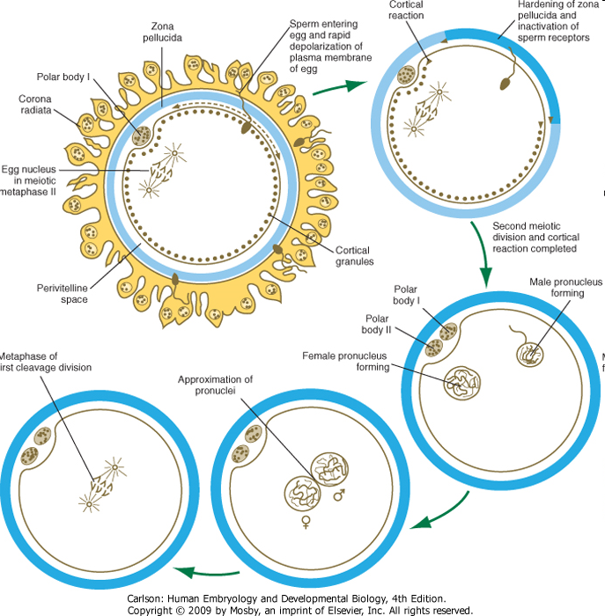
Fertilization
Meiosis II complete
Formation of male and female pronuclei
Decondensation of male chromosomes
Fusion of pronuclei
Zygote

Slide 9
Week 1: days 1-6
Fertilization, day 1
Cleavage, day 2-3
Compaction, day 3
Formation of blastocyst, day 4
Ends with implantation, day 6

Slide 10
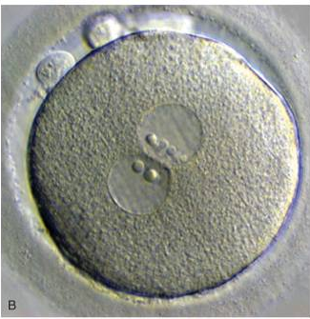
Fertilized egg (zygote)
Fertilized egg
2 polar bodies
2 pronuclei
Day 1
0.1 mm

Slide 11
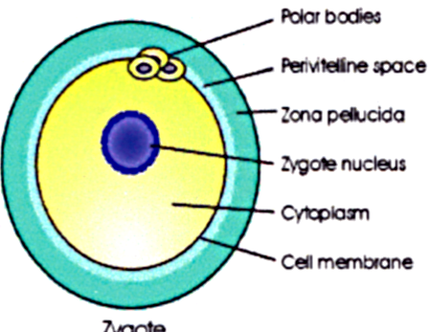
Cleavage
Cleavage = cell division
Goals: grow unicellular
zygote to multicellular embryo.
Divisions are slow: 12 - 24h ea
No growth of the embryo-
stays at ~100 um in diameter
Divisions are not synchronous
Cleavage begins about 24h after
pronuclear fusion

Slide 12
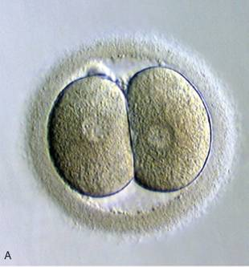
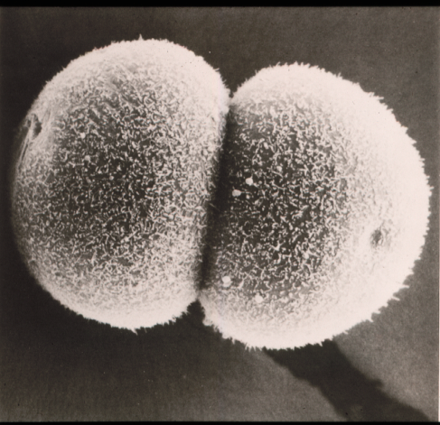
2 Cell Stage
Individual cells = blastomeres
Mitotic divisions maintain
2N (diploid) complement
Cells become smaller
Blastomeres are equivalent (aka totipotent).

Slide 13
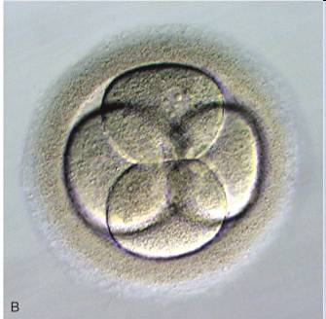
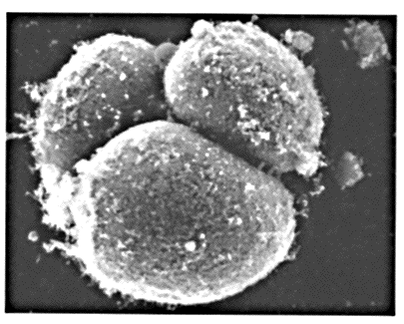
4 cell; second cleavage
4 equivalent blastomeres
Still in zona pellucida

Slide 14
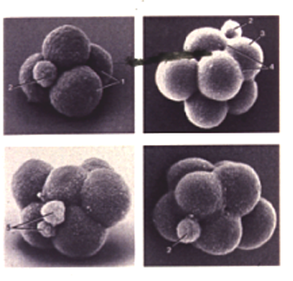
8 Cell; third cleavage Blastomeres still equivalent

Slide 15
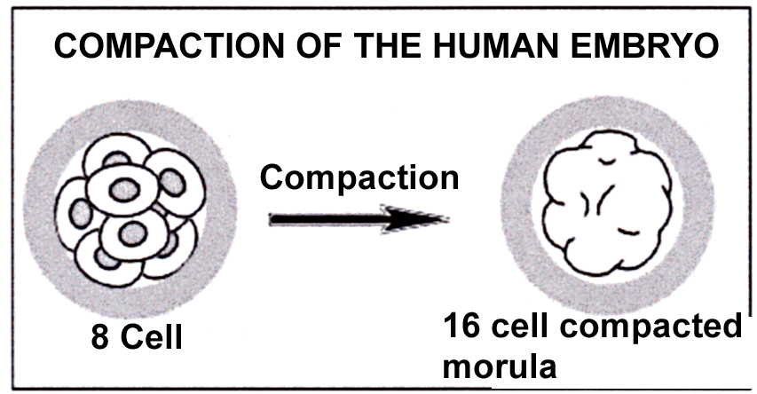
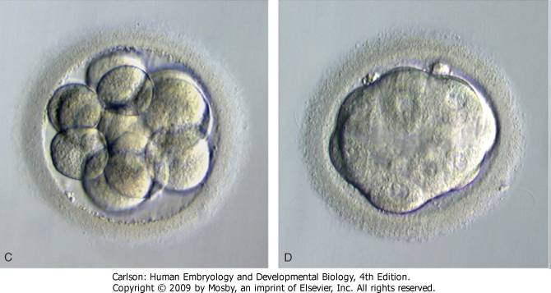
Embryo undergoes compaction after 8-cell stage: first differentiation of embryonic lineages
Caused by increased cell-cell adhesion
Cells that are forced to the outside of the morula are destined to become trophoblast--cells that will form placenta
The inner cells will form the embryo proper and are called the inner cell mass (ICM).

Slide 16
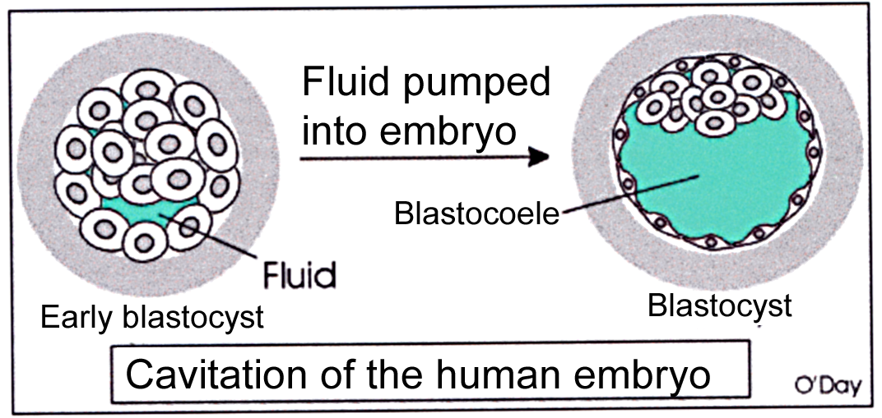
Formation of the blastocyst
Sodium channels appear on the surface of the outer trophoblast cells; sodium and water are pumped into the forming blastocoele. Note that the embryo is still contained in the zona pellucida.

Slide 17
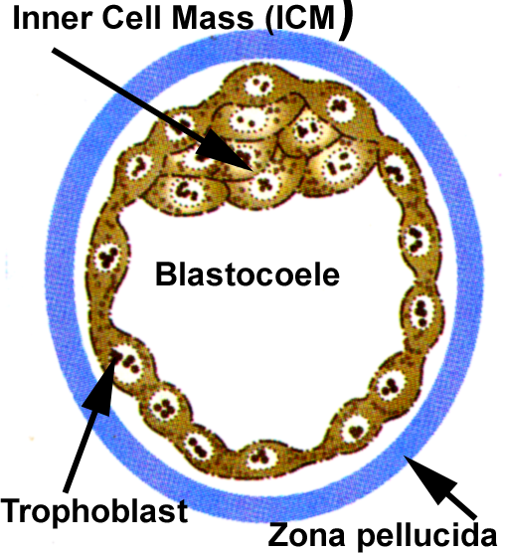

Slide 18
Early blastocyst
Day 3
Later blastocyst
Day 5
inner cell mass
blastocoele

Slide 19
Monozygotic twinning typically occurs during cleavage/blastocyst stages

Slide 20
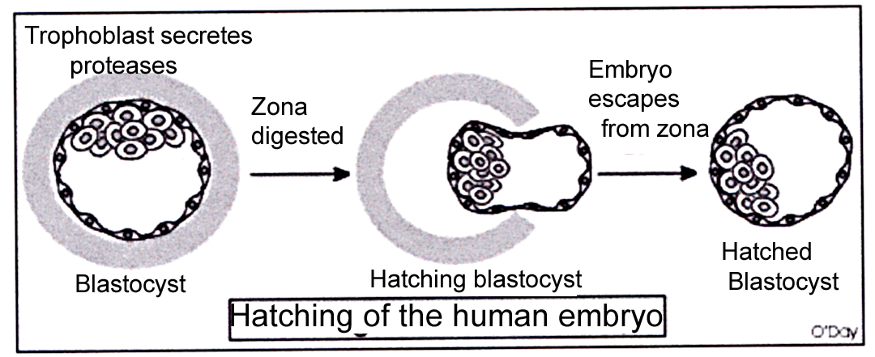
“Hatching” of the blastocyst: preparation for implantation
Hatching of the embryo from the zona pellucida occurs just
prior to implantation. Occasionally, the inability to hatch
results in infertility, and premature hatching can result in abnormal implantation in the uterine tube.

Slide 21
Ectopic Implantation
Implantation somewhere other than upper portion of uterus
“Rupture” can lead to life-threatening hemorrhage

Slide 22
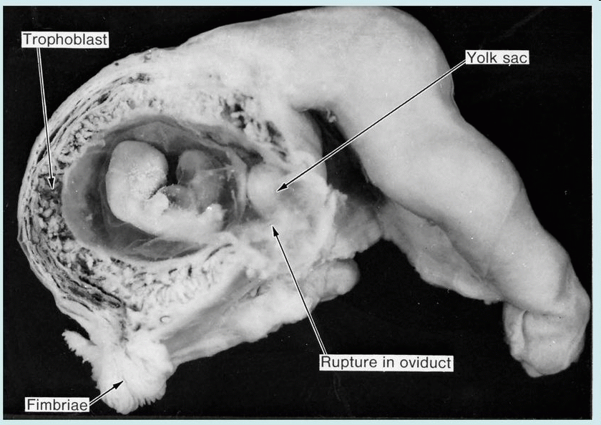
Tubal pregnancy
Notes:
Figure 4.9 from Langman’s 11th ed (Sadler, 2010)

Slide 23
Week 2: days 7-14 implantation
Implanted embryo becomes more deeply embedded in endometrium
Further development of trophoblast into placenta
Development of a bi-laminar embryo, amniotic cavity, and yolk sac.

Slide 24
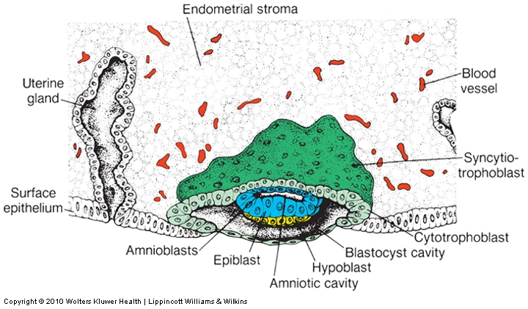
Implantation and placentation (day 8)
Trophoblast further differentiates and invades maternal tissues
Cytotrophoblast: stem cell population
Syncytiotrophoblast: invasive fused cells (syncytium) derived from cytotrophoblast
Breaks maternal capillaries, trophoblastic lacunae fill with maternal blood
Inner cell mass divides into epiblast and hypoblast:
Epiblast contributes to forming the overlying amniotic membrane and amniotic cavity
Hypoblast contributes to forming the underlying yolk sac.

Slide 25
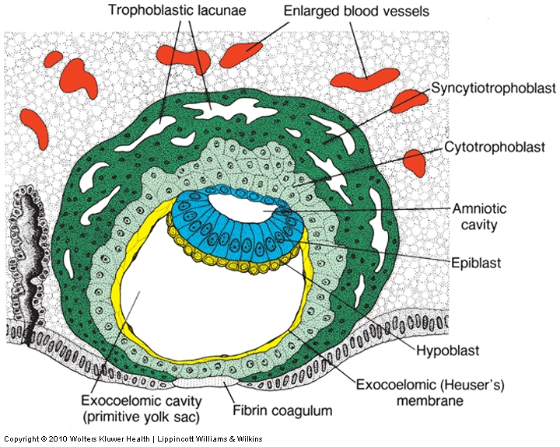
Implantation and placentation (day 9)
Trophoblast further differentiates and invades maternal tissues
Cytotrophoblast: stem cell population
Syncytiotrophoblast: invasive fused cells (syncytium) derived from cytotrophoblast
Breaks maternal capillaries, trophoblastic lacunae fill with maternal blood
Inner cell mass divides into epiblast and hypoblast:
Epiblast contributes to forming the overlying amniotic membrane and amniotic cavity
Hypoblast contributes to forming the underlying yolk sac.

Slide 26
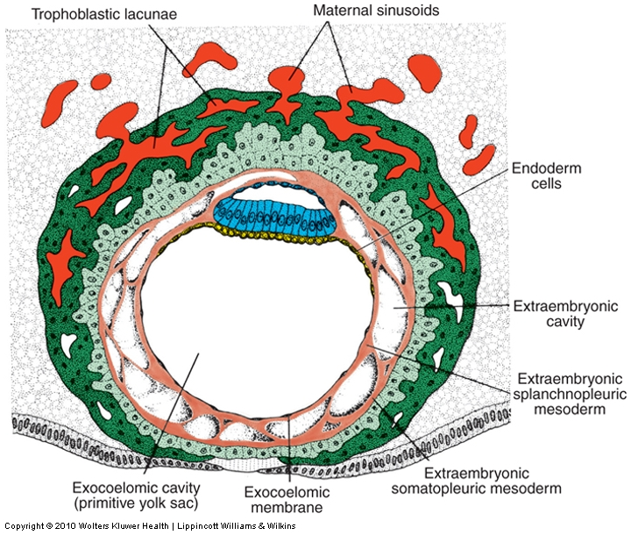
Implantation and placentation (day 12)
Trophoblast further differentiates and invades maternal tissues
Cytotrophoblast: stem cell population
Syncytiotrophoblast: invasive fused cells (syncytium) derived from cytotrophoblast
Breaks maternal capillaries, trophoblastic lacunae fill with maternal blood
Inner cell mass divides into epiblast and hypoblast:
Epiblast contributes to forming the overlying amniotic membrane and amniotic cavity
Hypoblast contributes to forming the underlying yolk sac.

Slide 27
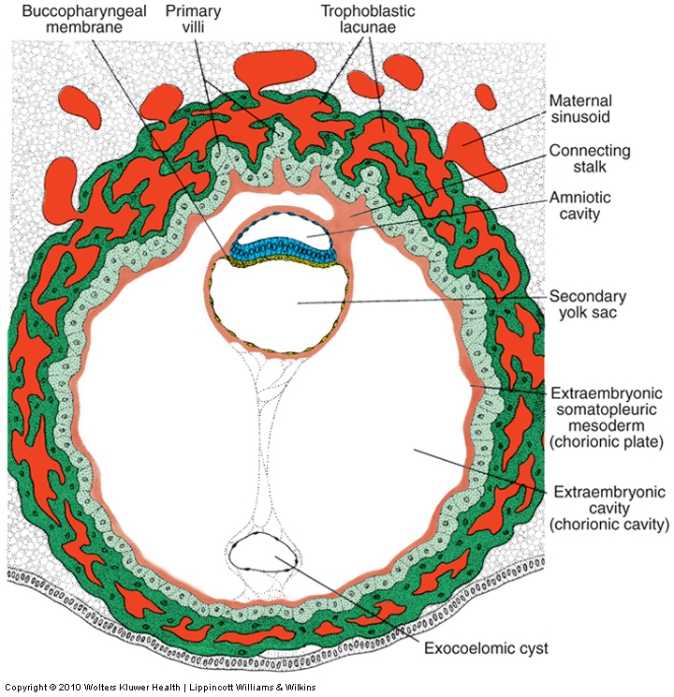
Implantation and placentation (day 13)
Trophoblast further differentiates and invades maternal tissues
Cytotrophoblast: stem cell population
Syncytiotrophoblast: invasive fused cells (syncytium) derived from cytotrophoblast
Breaks maternal capillaries, trophoblastic lacunae fill with maternal blood
Inner cell mass divides into epiblast and hypoblast:
Epiblast contributes to forming the overlying amniotic membrane and amniotic cavity
Hypoblast contributes to forming the underlying yolk sac.

Slide 28
Week 3: Days 14-21
Two layer germ disc
Primitive streak forms
Gastrulation forms tri-laminar embryo
Neural induction
Left-right asymmetry
0.4mm - 2.0mm

Slide 29
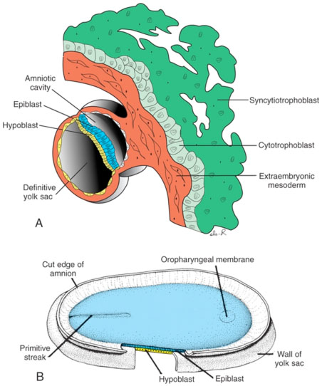

Slide 30
Gastrulation
At gastrulation the two layered epiblast is converted into the three primary embryonic germ layers:
Ectoderm: outside, surrounds other layers later in development, generates skin and nervous tissue
Mesoderm: middle layer, generates most of the muscle, blood and connective tissues of the body and placenta
Endoderm: eventually most interior of embryo, generates the epithelial lining and associated glands of the gut, lung, and urogenital tracts

Slide 31
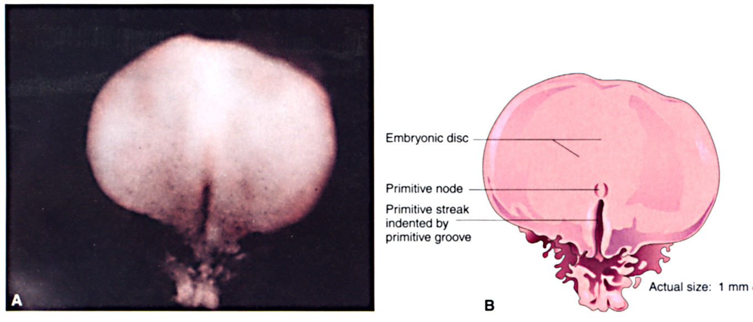
The human embryo at gastrulation

Slide 32
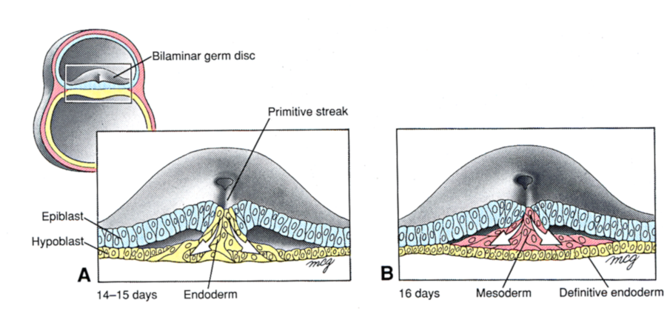
At gastrulation, primitive endoderm is replaced by definitive or embryonic endoderm then mesoderm is formed

Slide 33
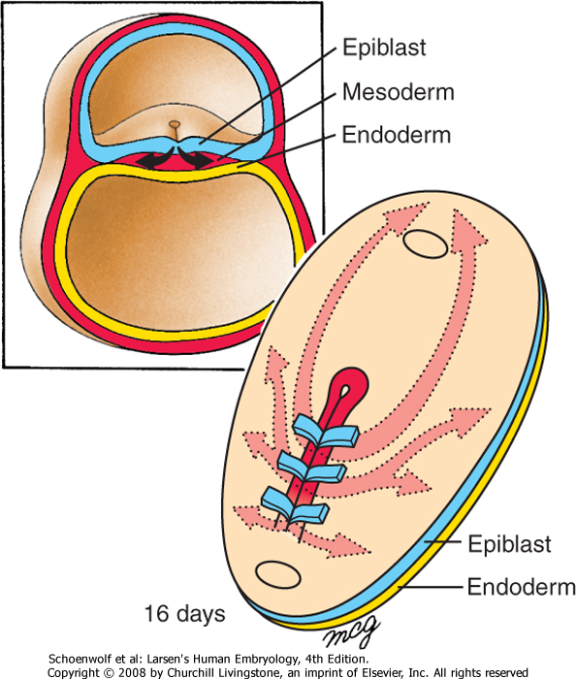
Cell movements during gastrulation

Slide 34
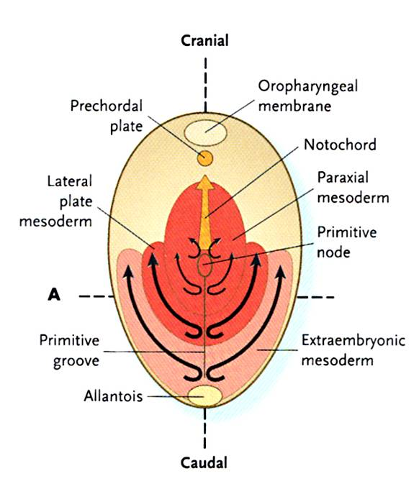
Mesoderm is patterned in a cranial to caudal gradient
Axial mesoderm: passes through the node and migrates along the midline –forms the notochord
Paraxial mesoderm: passes just caudal to the node and migrates slightly laterally –forms cartilage, skeletal muscle, and dermis
Lateral plate mesoderm: passes more caudal and migrates more laterally –forms circulatory system and body cavity linings.
Extraembryonic mesoderm: passes most caudal and migrates most laterally –forms extraembryonic membranes and associated connective tissue & blood vessels.

Slide 35
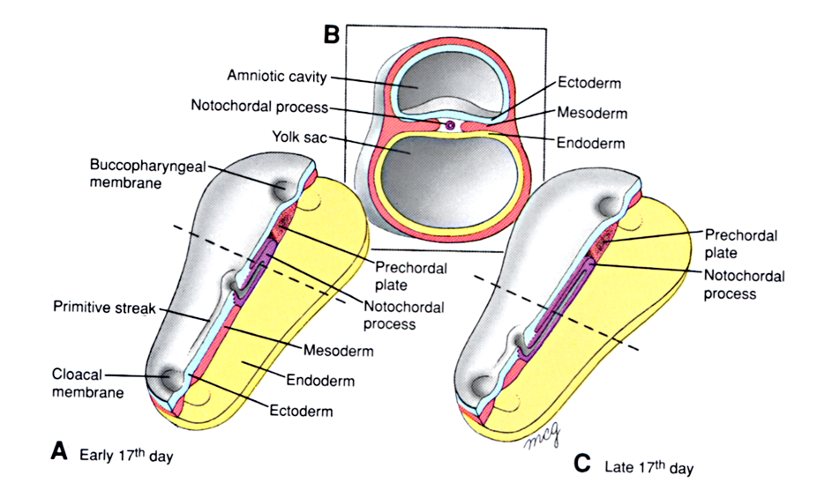
Fate of the “axial” mesoderm
The notochord and pre-chordal plate develops from mesoderm arising from cells that passed directly through the node and migrated cranially along the midline
The notochord and pre-chordal plate are important signaling centers that pattern the overlying ectoderm and underlying endoderm.

Slide 36
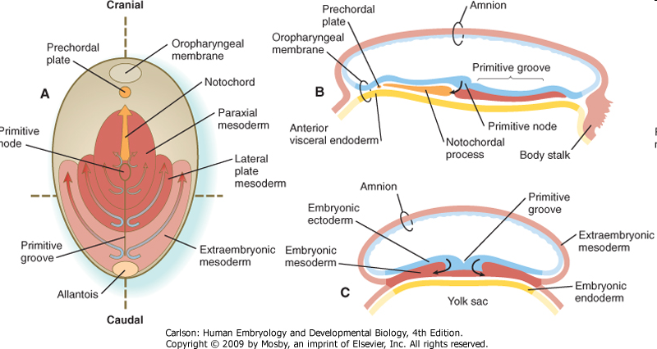
Major signaling centers at gastrulation: the node and the anterior visceral endoderm (AVE)
Primitive node positions primitive streak for gastrulation, induces neural differentiation
AVE from primitive endoderm secretes factors that position primitive streak in posterior, induce head formation

Slide 37
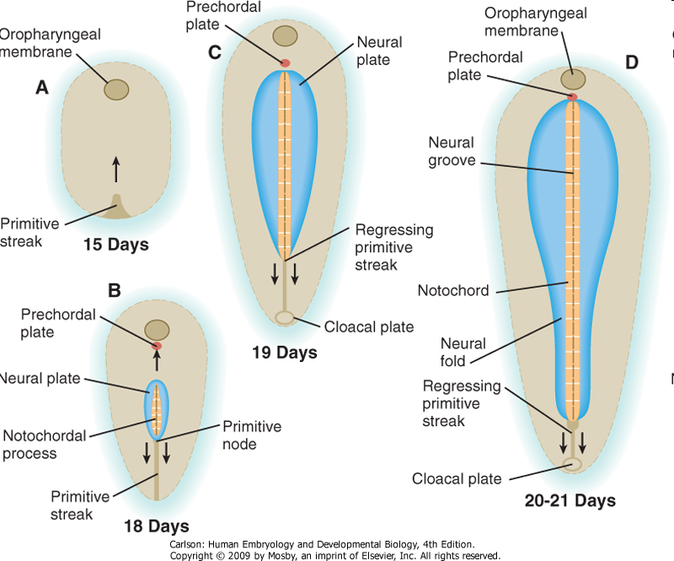
The node also sets up the neural plate

Slide 38
Head signaling centers
Prechordal plate~ early notochord

Slide 39
Left-Right asymmetry is established at gastrulation
Leftward beating of cilia at node moves secreted molecules sonic hedgehog (Shh) & FGF-8 to the left side of embryo.
Causes left side genes Nodal and Pitx2 to be expressed which then pattern developing organs.
If cilia are defective, Shh and Fgf8 can randomly end up on right side, resulting in reversal of symmetry, aka situs inversus
(liver on the left, spleen on the right, etc.)
Situs can be complete (everything reversed) or partial (only some organs reversed).

Slide 40
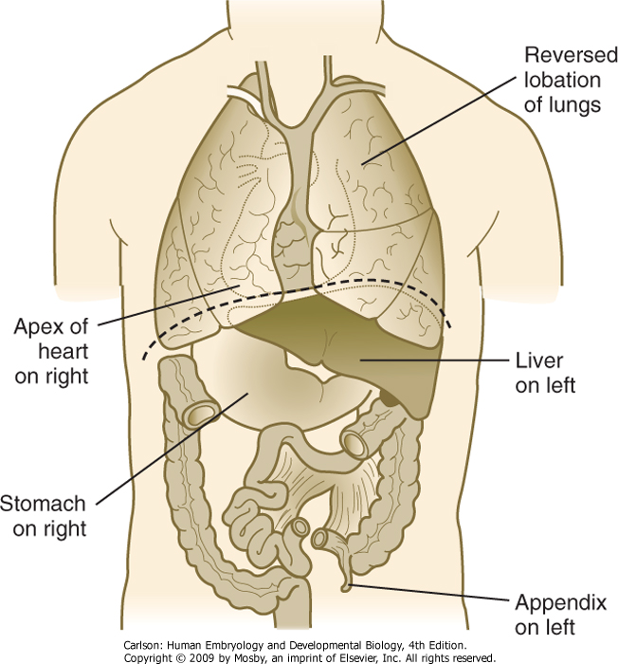
Situs Inversus

Slide 41
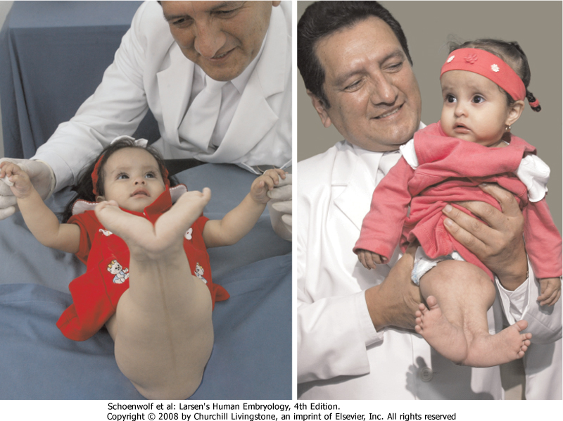
What happens if there is “not enough” gastrulation? Caudal agenesis (sirenomelia)
Premature regression of the primitive streak leads to widespread loss of trunk and lower limb mesoderm.
VATeR association:
Vertebral defects
Anal atresia
Tracheo-esophageal fistula
Renal defects
VACTeRL association:
those above plus…
Cardiovascular defects
Limb (upper) defects

Slide 42
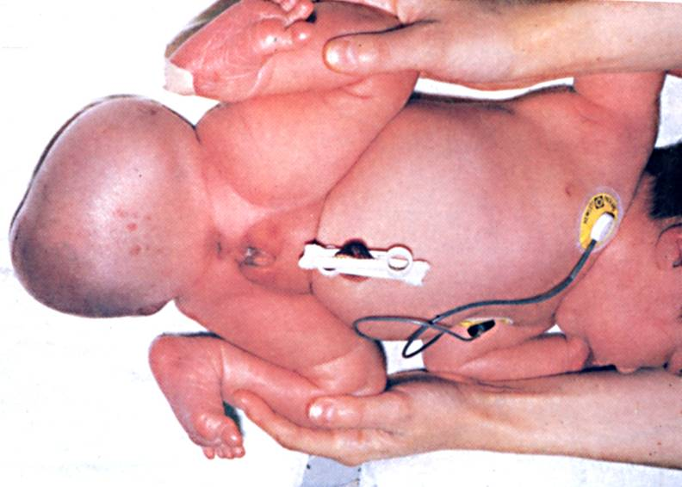
What happens if there is “too much” gastrulation? Sacrococcygeal teratoma
If the primitive streak fails to regress, multipotent primitive streak cells can develop into multi-lineage tumors (containing ecto-, meso-, and endodermal tissues).

