Slide 1
Limb Development
Matthew Velkey
matt.velkey@duke.edu
454A Davison, Duke South (Green Zone)

Slide 2
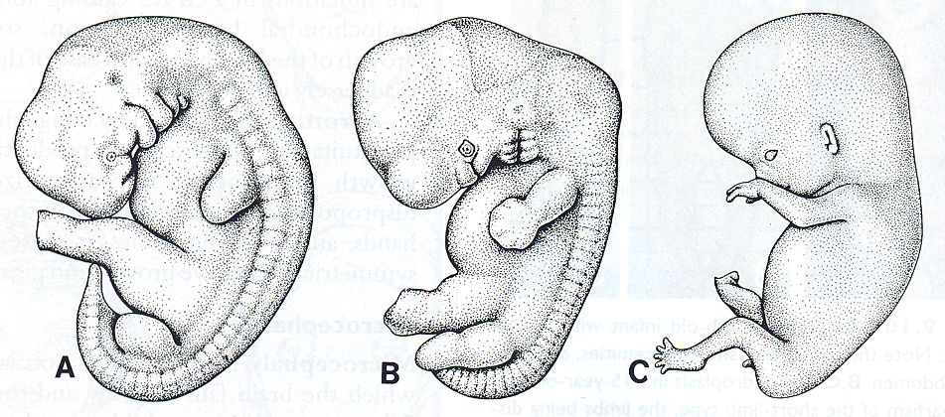
Human Limb Development
5 weeks
6 weeks
8 weeks

Slide 3
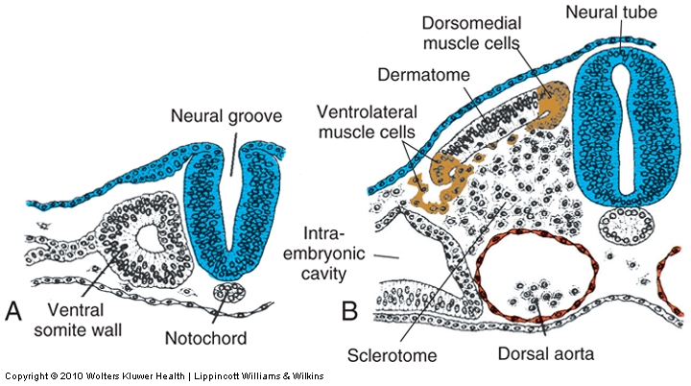
Limbs develop from paraxial (somitic) and lateral plate mesoderm
From somites:
Dermal connective tissue derived from dermatome
Limb muscles derived from ventrolateral (abaxial) myotome
From lateral plate mesoderm:
Bones, blood vessels, and associated connective tissue

Slide 4
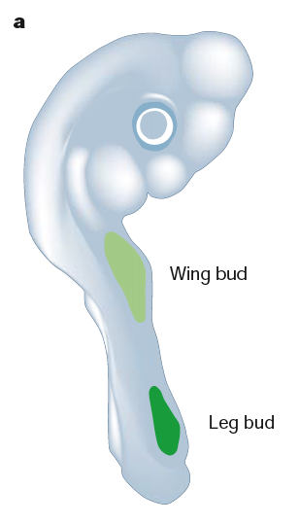
EARLY LIMB PATTERNING:
Limb formation initiates during the fourth week of development as the primary antero-posterior axis (AP) is still elongating. First the forelimb and then the hindlimb begin as protrusions from the lateral plate mesoderm at the sides of the embryo. Limb buds consist of a core of mesenchyme and an outer covering of ectoderm.
1 in 200 live human births display limb defects.
Forelimb bud
Hindlimb bud

Slide 5
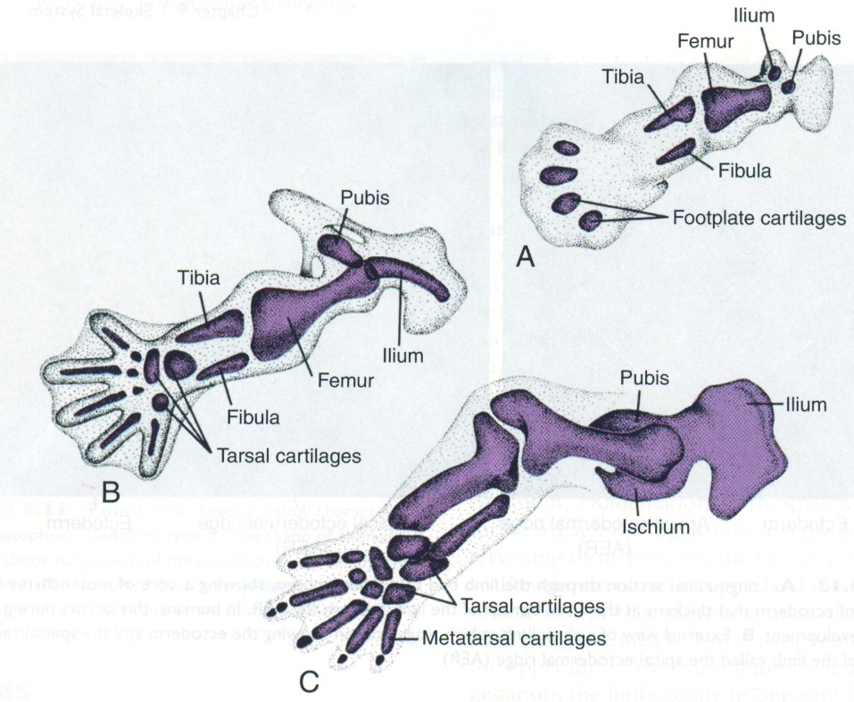
While external shape is being established, the mesenchyme begins condensing and chondrocyte differentiation ensues. The first cartilage models are formed in the sixth week of development. Joints form at regions of arrested chondrogenesis by cell death.
early 6 weeks
late 6 weeks
early 8 weeks

Slide 6
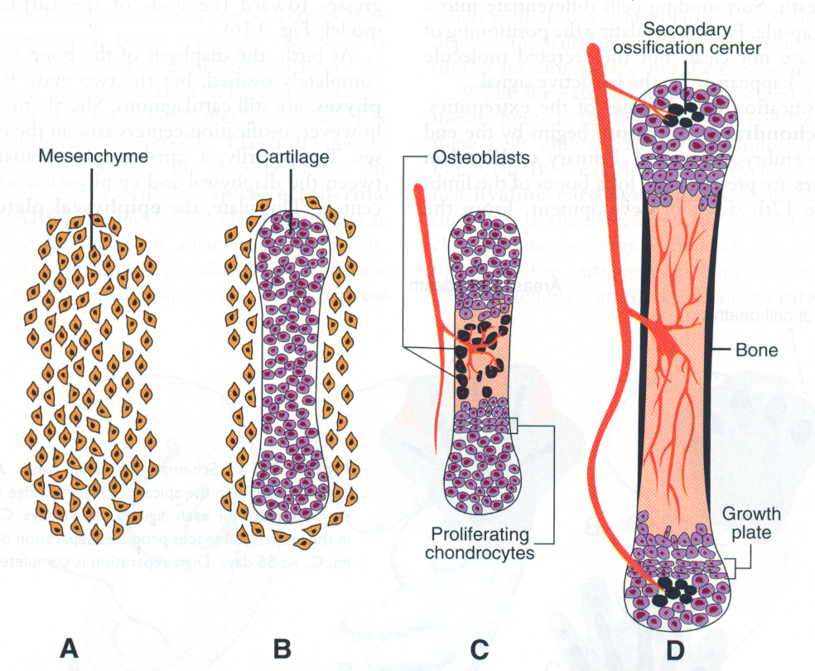
Endochondral bone formation:
Mesenchyme begins to condense into chondrocytes
Chondrocytes form a model of the prospective bone
Blood vessels invade the center of the model, where osteoblasts localize, and proliferation is restricted to the ends (epiphyses)
Chondrocytes toward the shaft (diaphysis) undergo hypertrophy and apoptosis as they mineralize the surrounding matrix.
12 weeks
Achondroplasia: defects in cartilage proliferation at the growth plate result in premature closure of the plate and shortened limb bones.
Growth of the long bones continues into early adulthood and is maintained by proliferation of chondrocytes in the growth plates (long bones have two growth plates, in smaller bones (phalanges), there is only one at the tip)

Slide 7
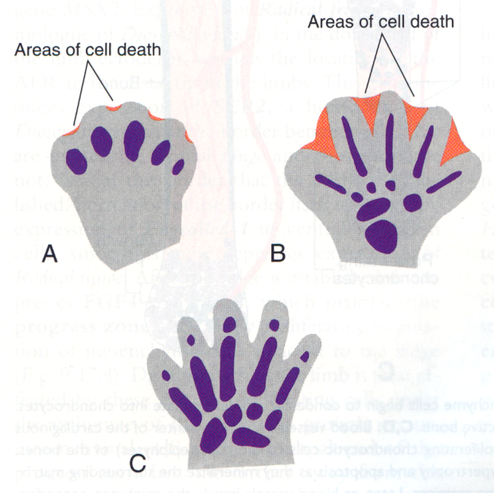
At 6 weeks, the terminal portion of the limb buds flatten to form hand- and footplates. Fingers and toes (digits) are formed when cell death in the AER separates the plate into five parts. Digits continue to grow and cell death in intervening mesenchymal tissue delineates the digits.
Bmp signaling
41 days
51 days
56 days

Slide 8
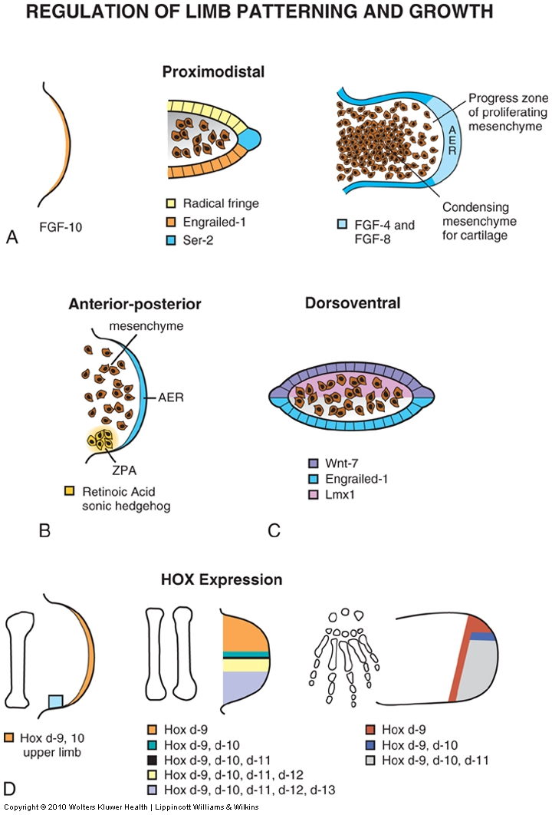
Limb patterning and growth is spatially and genetically regulated
Proximodistal: shoulder/hip to fingers/toes
Anteroposterior: thumb/big toe to pinky/little toe
Dorsoventral: dorsum to palm/sole
Bone “identity” regulated by HOX genes
Predictable limb defects arise when one or more of these mechanisms is disrupted.

Slide 9
Limb malformations
Amelia…………………Absence of an entire limb
(early loss of Fgf signaling)
Meromelia…..………Absence of part of a limb
(later or partial loss of Fgf signaling)
Phocomelia………….Short, poorly formed limb
(partial loss of Fgf, Hox disruption)
Adactyly……………….Absence of digits
(even later loss of Fgf)
Ectrodactyly…………Lobster-Claw deformity
(variant of adactyly –middle digit is lost)
Polydactyly ………….Extra digits
(disruption of Shh pathway)
Syndactyly……………Fusion of digits
(BMP disruption)

Slide 10
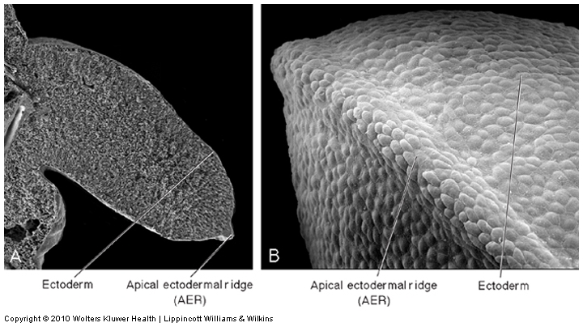
At the tip of the limb bud a signaling structure, the apical ectodermal ridge (AER) forms. It signals mesenchyme to proliferate and the limb grows.
Removal of the AER inhibits outgrowth of the limb
Transplantation of a second AER duplicates the limb; diplopodia.

Slide 11
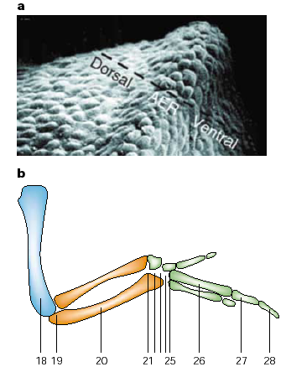
Proximodistal (PD) growth - regulated by AER (Fgfs):
Embryological manipulation in the developing chick limb established that the apical ectodermal ridge (AER) is necessary for maintenance of PD outgrowth in the limb bud. Removal of the AER at early stages causes severe truncations of the limb skeletal elements. Progressively later removal of the AER causes progressively more distal truncations of limb elements.
Removal of AER in chick at progressively later HH stages of development

Slide 12
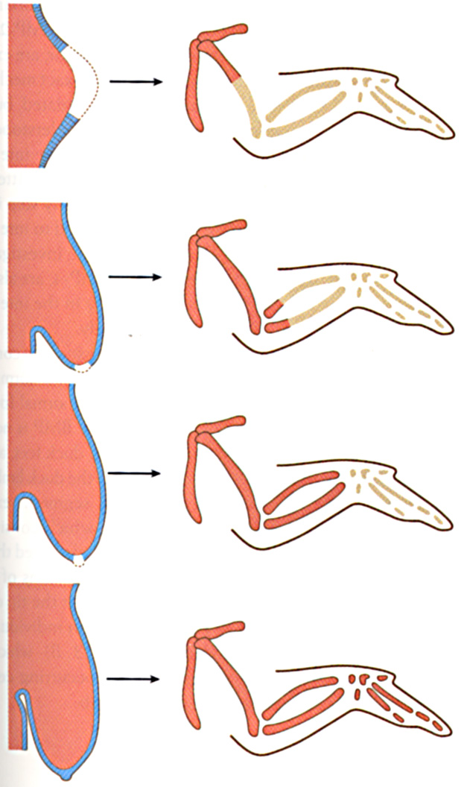
Removal of AER: arrests limb development at stage at which it was removed

Slide 13
Failure to develop a limb: amelia
Loss of AER or FGF signalling

Slide 14
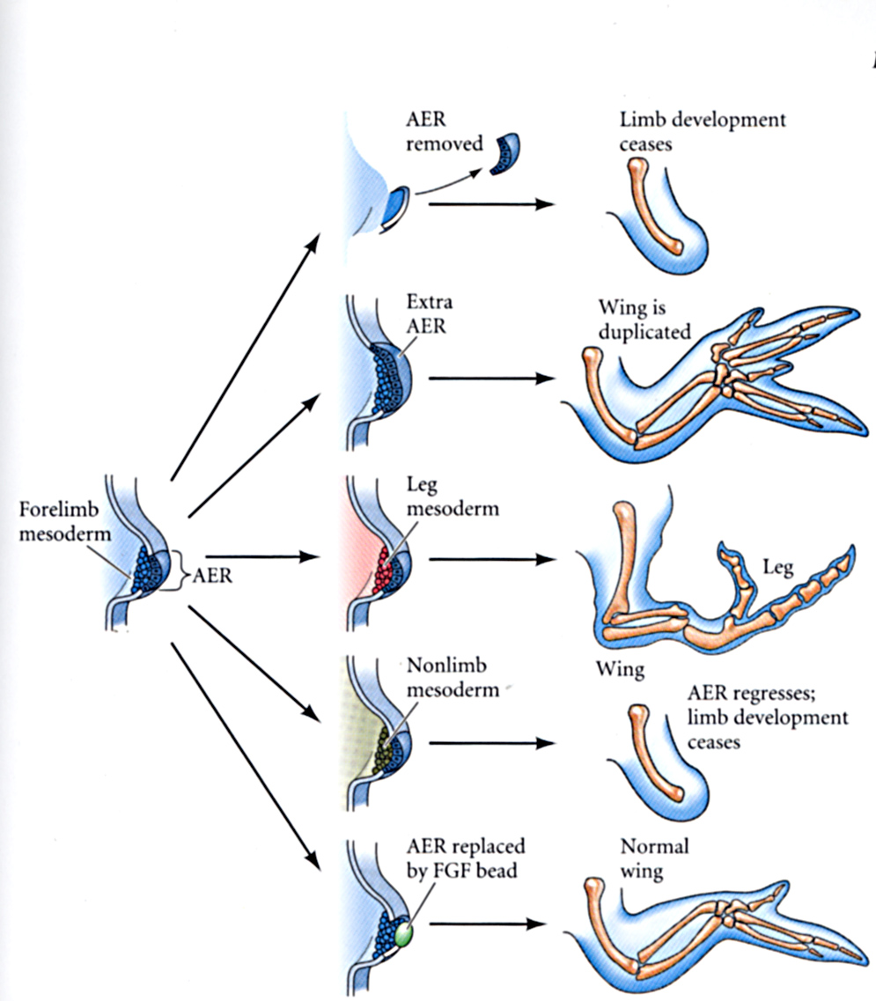
Forelimb-Hindlimb Identity: the ectoderm (AER) promotes outgrowth, but mesoderm controls limb identity.
ectoderm, which is FORELIMB-derived, differentiates to produce SCALES, not feathers

Slide 15
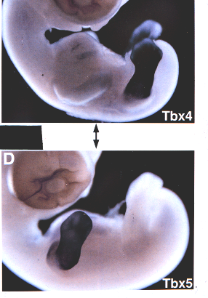
Post-specification: What molecular signals distinguish forelimb from hindlimb
are poorly defined
Expression of Tbx4
defines lower limb.
Expression of Tbx5
defines upper limb.

Slide 16
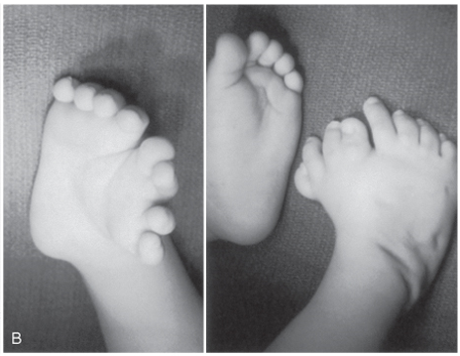
The Zone of Polarizing activity establishes POSTERIOR (caudal) identity (duplication results in a mirror image)
P₂
A₂
A₁
P₁
“make a thumb”
“make a pinky”

Slide 17
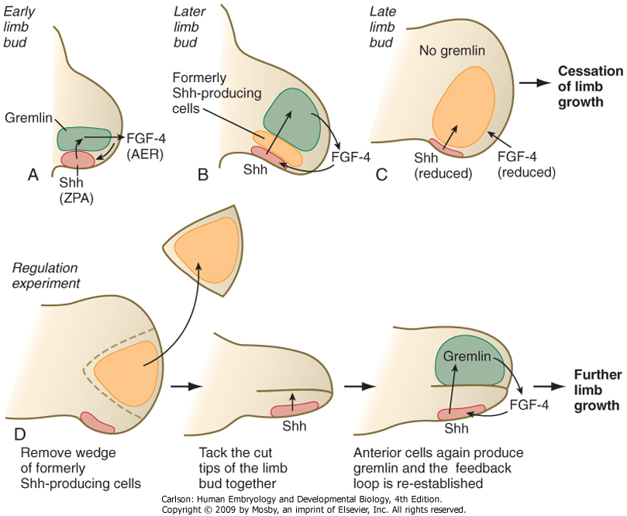
ZPA also controls proliferation at AER
Factors secreted by ZPA indirectly induce proliferation of the AER
Loss of the ZPA therefore not only affects A-P pattern (e.g. loss of ulnar structures in the forelimb), but will also result in shortened limbs

Slide 18
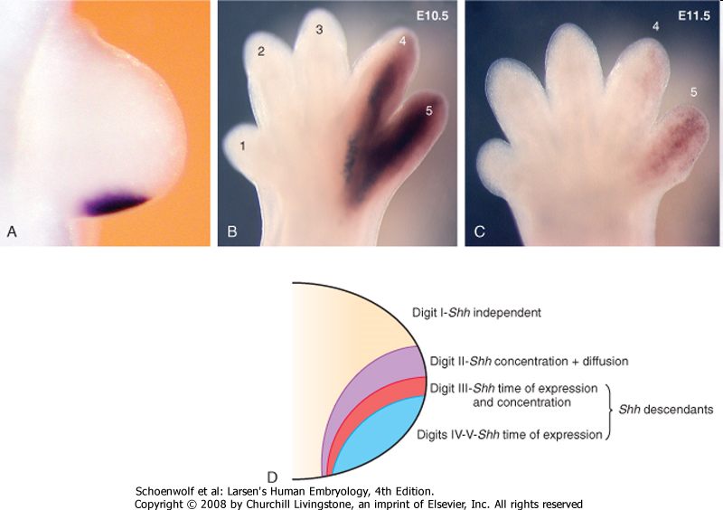
Digit identity is patterned by Shh

Slide 19
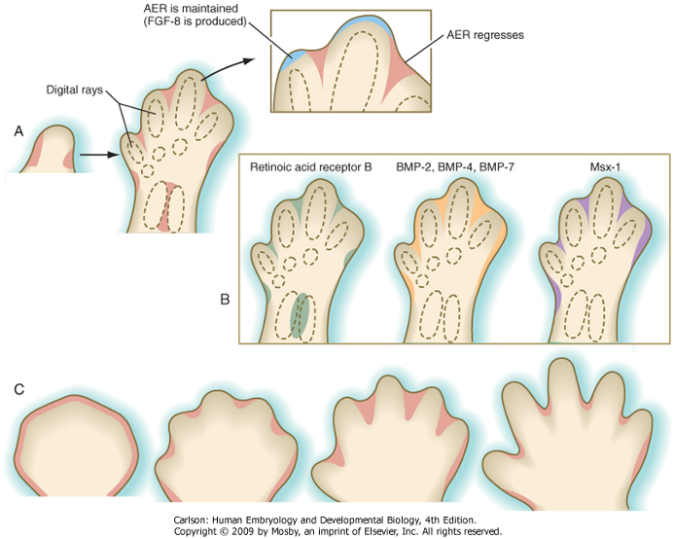
Formation of digits:
a balance between cell proliferation at AER maintained at digit tips versus cell death in interdigital regions where AER regresses.

Slide 20
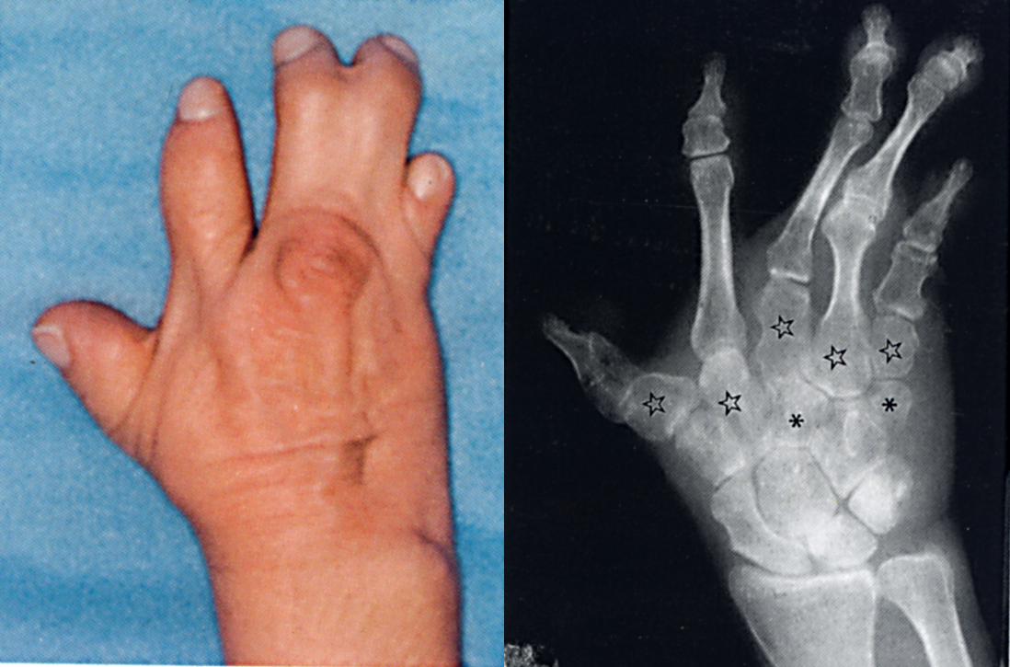
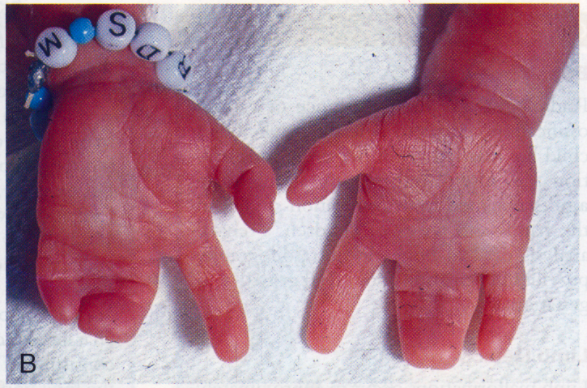
Syndactyly: fusion of fingers and toes due to inadequate cell death between digital rays
(probably also affected by Shh, note most
fusions involve digits 3,4, and/or 5)
Notes:
20

Slide 21
Polydactyly: duplication of digits (very often posterior)
Disrupted Shh/Gli3 function

Slide 22
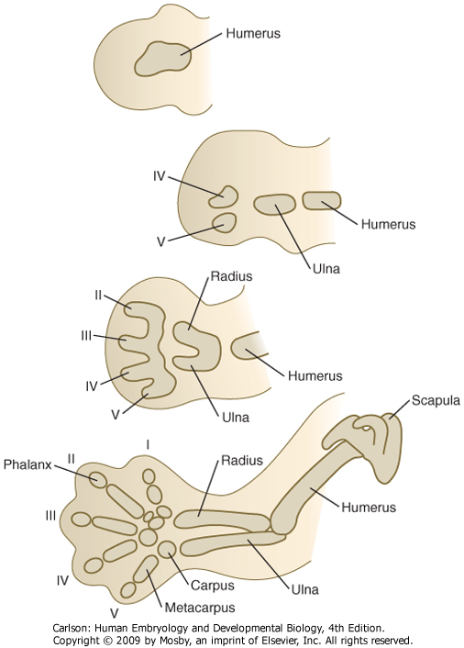
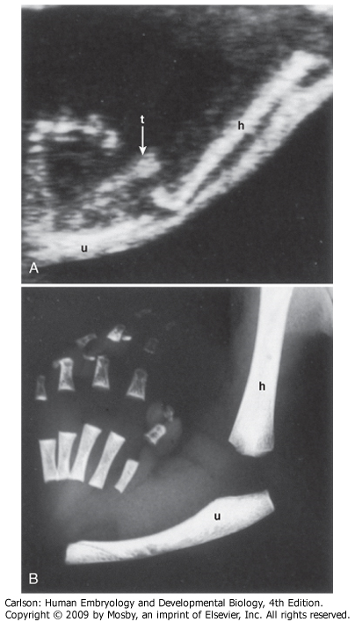
Maturation of limb elements
Sequence is proximo-distal (e.g. humerus before radius) and postero-anterior (e.g. ulna before radius)
humerus, ulna, d4, d5 are “posterior (post-axial)” elements
radius, d3, d2, d1 are “anterior (pre-axial)” elements
(radial hemiamelia)

Slide 23
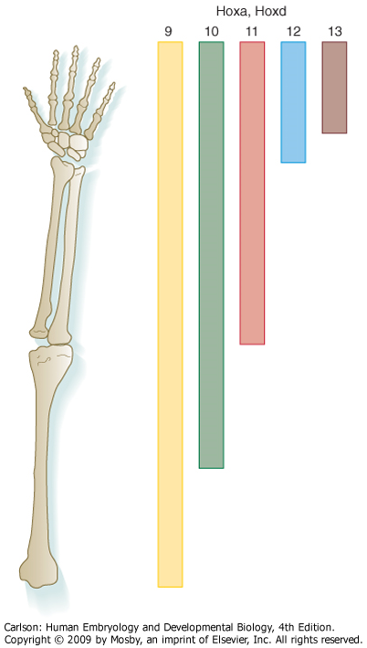
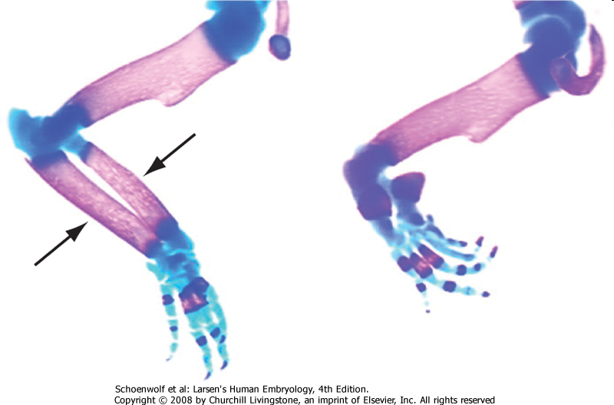
The Hox code is used for proximo-distal patterning of the limbs
knock out Hox11d: no radius or ulna
There are well known HOX mutations in humans, so some limb defects are genetic.
However, HOX gene expression is also influenced by exogenous substances (e.g. retinoic acid, ethanol) so environmental factors can also contribute.

Slide 24
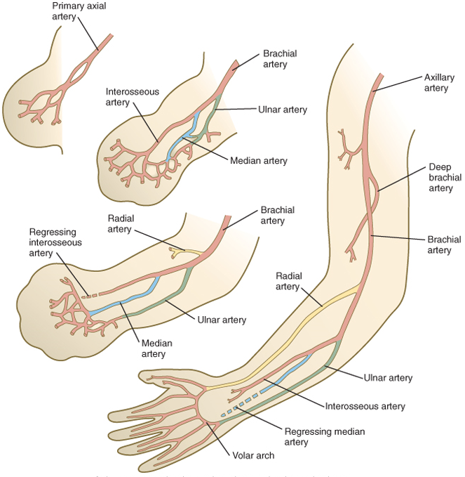
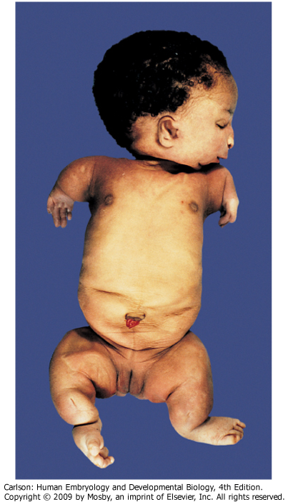
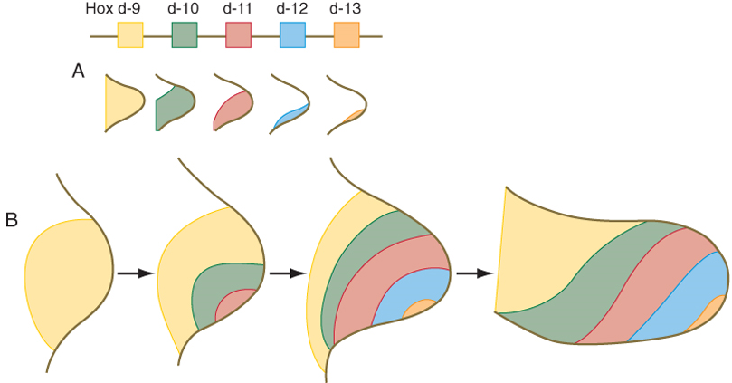
Phocomelia: partial loss of limb
Multifactorial: FGF disruption, HOX disruption, angiogenesis disruption (e.g. thalidomide)

Slide 25
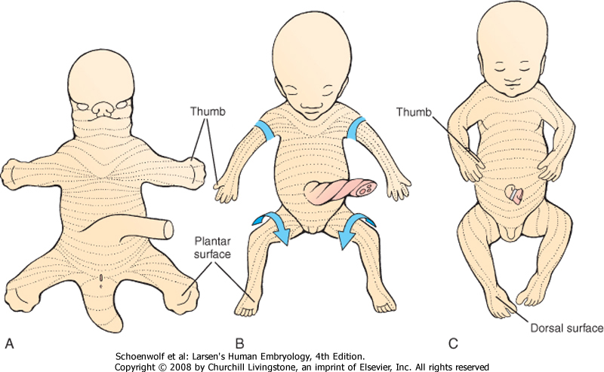
The limbs rotate inward: forelimb ~90 degrees hindlimb ~180 degrees

Slide 26
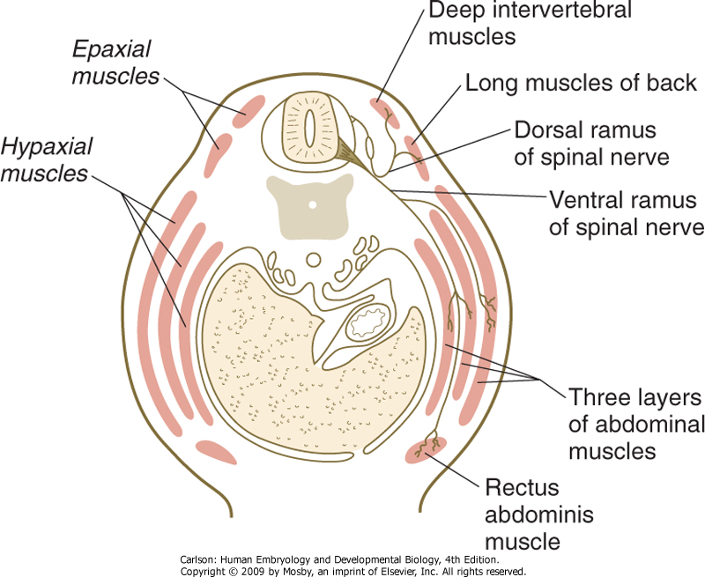
Development of body musculature
Primaxial myotome (dorsomedial portion closest to neural tube) cells are generally less migratory and therefore contribute to epaxial musculature and proximal hypaxial musculature (e.g. scalenes, geniohyoid, prevertebral, intercostals, rhomboids, levator scapulae, and latissimus dorsi).
Abaxial myotome (ventrolateral portion closer to lateral plate mesoderm) cells are more migratory and therefore go into limbs and ventral body wall.
The innervation of the adult muscle reflects the segment from which is was derived.
“primaxial”
myoblasts
“abaxial”
myoblasts

Slide 27
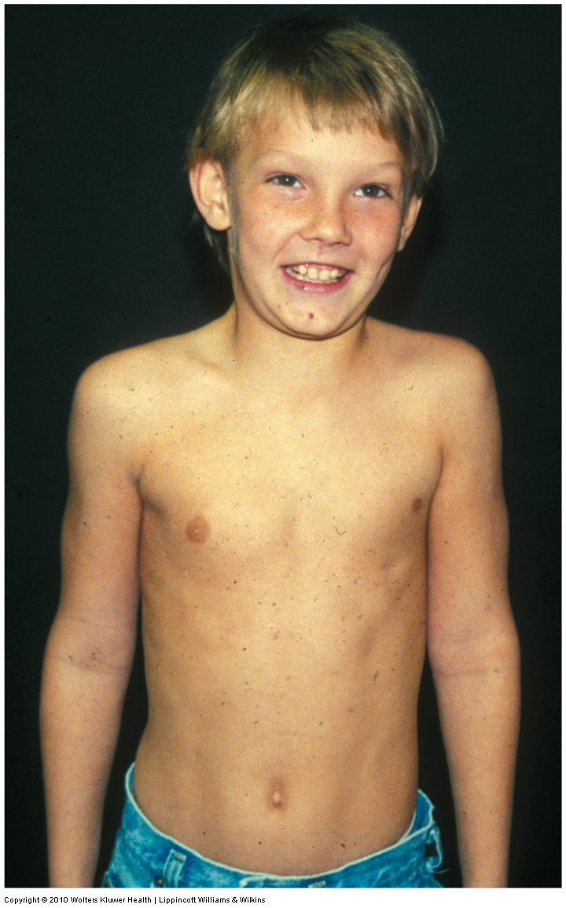
Abnormal muscle development
Poland Syndrome –absence/reduction of pectoralis minor/major muscles.
Unknown etiology, but often associated with subclavian artery anomalies (suggests that likely cause is ischemia during time of pectoralis muscle development).

Slide 28
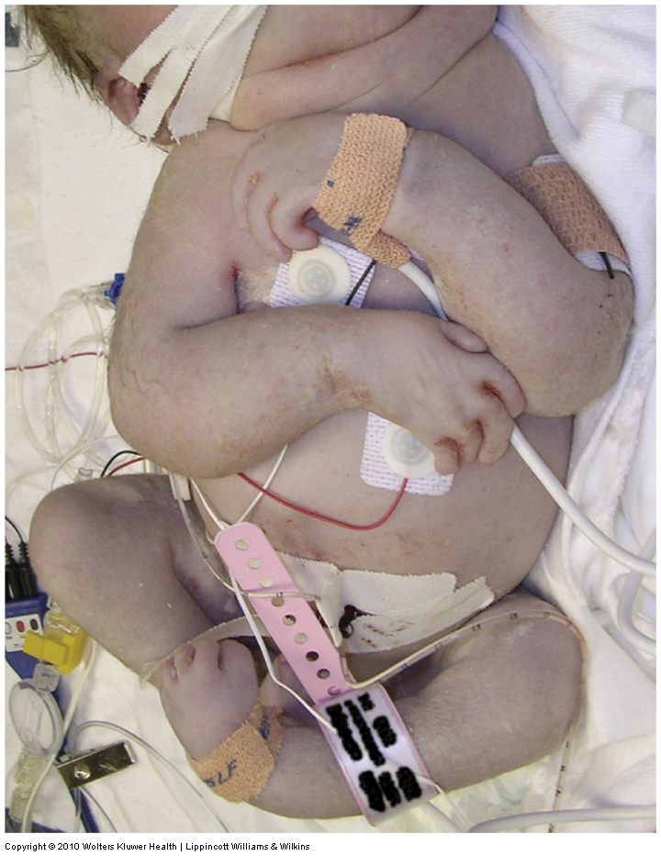
Abnormal muscle development
Prune belly syndrome --atrophy or lack of abdominal wall musculature
Congenital joint contracture –observed with in utero denervation or atrophy of muscle (suggests that proper joint/skeleton development requires force feedback from muscles)

Slide 29
Slides 25-29 from Embryology02 lecture
The next five slides are from the “Basic Body Plan” lecture for your review.
click here to play the accompanying video corresponding to these slides

Slide 30
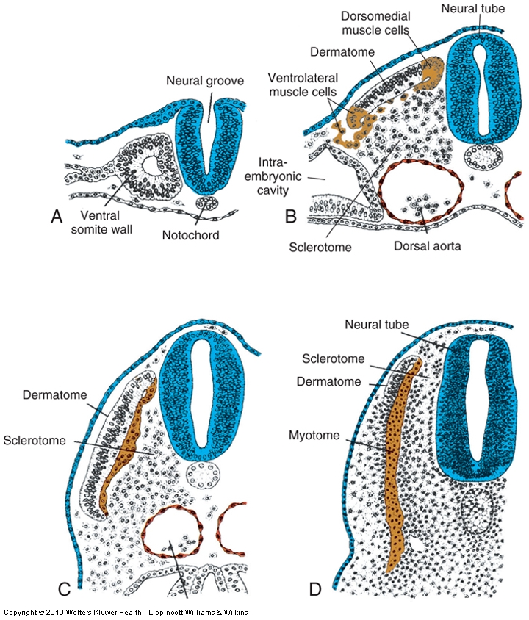
Dermamyotome forms dermis and muscle
BMP from ectoderm induces dermatome the remaining dorsomedial and ventrolateral cells become myotome.
Dorsomedial portion of dermomyotome sees Shh from notochord and Wnt from spinal cord and becomes muscle that can’t migrate very far (epaxial muscles of the back)
Ventrolateral portion of dermomyotome exposed to high levels of BMP from lateral plate mesoderm and becomes migratory muscle (goes into limbs also “hypaxial” muscles of the lateral and ventral body wall, e.g. “lats” and “abs”

Slide 31
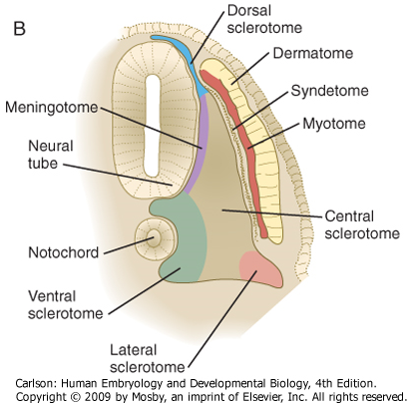
The sclerotome develops into vertebrae, ribs, and meninges
Dorsal sclerotome:
Dorsal arch & spinous processes of vertebrae*
Medial sclerotome:
Meninges*
Central sclerotome:
Pedicles & transverse processes of vertebrae, proximal portions of ribs
Ventral sclerotome:
Vertebral bodies and annulus fibrosis of intervertebral disks
Lateral sclerotome:
Distal portions of ribs
*failure of these associated w/ spina bifida

Slide 32
Somite (Paraxial mesoderm) forms:
1. Sclerotome
2. Dermamyotome
Sclerotome forms:
Meninges, vertebral bodies & ribs
Dermamyotome forms:
1. Dermis (from dermatome)
2. Muscles (from myotome)
(click here for QuickTime version)

Slide 33
Anterior and posterior portions of each sclerotome fuse to form vertebral bodies. This offsets the vertebral bodies and segmental muscles. i.e., the vertebrae (sclerotome) are out of phase with muscle (myotome) to form intervertebral joints. This allows the contracting segmental muscles to move the vertebral column laterally.
The sclerotome breaks into two parts…
Notes:
33

Slide 34
Anterior portion of one somite
fuses with the posterior portion
of the next somite; that way
The surrounding muscle bridges
sequential vertebral bodies.
(click here for QuickTime version)

