Slide 1
Cardiovascular Development
Matt Velkey
matt.velkey@duke.edu
0380 Seely Mudd
Readings from Langman’s Medical Embryology:
11th ed. Ch 12, pp. 165-200
12th ed. Ch 13, pp. 162-200

Slide 2
Learning Objectives
Understand the following processes of heart development in relation to adult anatomy and congenital malformations that may arise due to developmental errors:
specification and repositioning of the heart fields
formation and looping of the heart tube
partitioning the atrioventricular canal
septation of the atria, ventricles, and outflow tract
formation of atrio-ventricular, aortic, and pulmonic valves
Understand the development and eventual fate of the vitelline, umbilical, and arch arteries and congenital malformations that may arise due to errors in arterial development.
Understand the development and eventual fate of the vitelline and umbilical veins.
Understand the general processes by which the vena caval and azygous systems develop and the common anatomical anomalies that can be observed due to perturbations in their development.
Key words: heart development, neural crest, aortic arches, vitelline vessels, umbilical vessels, cardinal veins

Slide 3
The cardiovascular system is mesodermally derived
Specifically, lateral plate mesoderm…
Gilbert fig 14.1

Slide 4
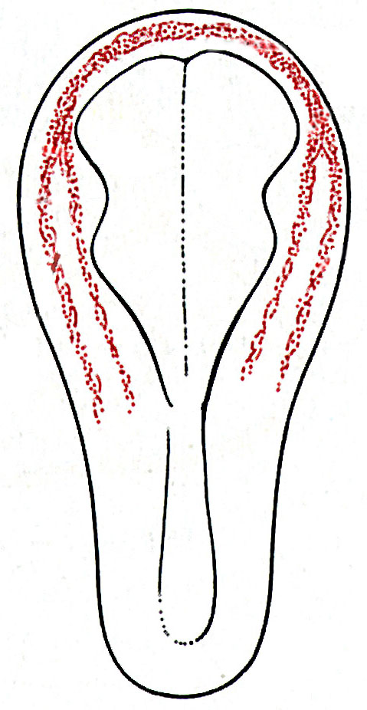
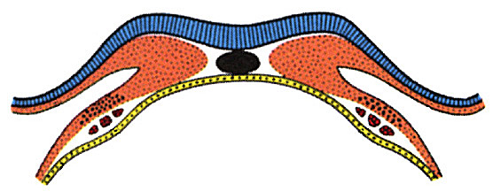
The cardiogenic field is established in the mesoderm just after gastrulation (~18-19 days) and develops into a fully functional, multi-chambered heart by the 8th week
angiogenic cell clusters (angioblasts/hemangioblasts)
(right endocardial tube)
(right dorsal aorta)
blood islands (developing blood vessels)
pericardial cavity
cardiogenic field
Langman’s fig 12-1

Slide 5
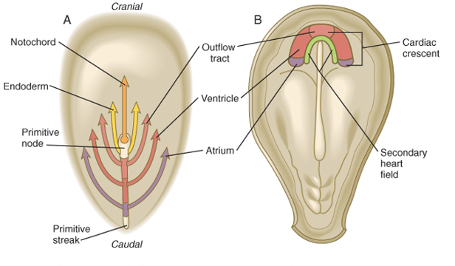
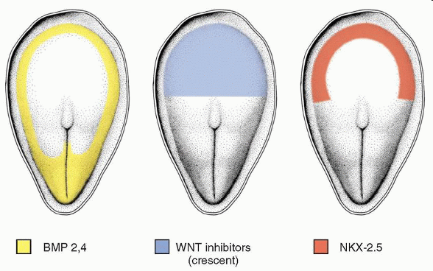
Establishment of the heart fields
Carlson fig 6-14
BMP2 & 4 in mesoderm
WNT inhibition (from “Anterior” Visceral Endoderm) in anterior mesoderm
BMP2,4⁺/Wnt⁻ expression pattern specifies cardiac tissue (evidenced by expression of NKX-2.5, aka tinman)
Langman’s fig 12-9
Notes:
5

Slide 6
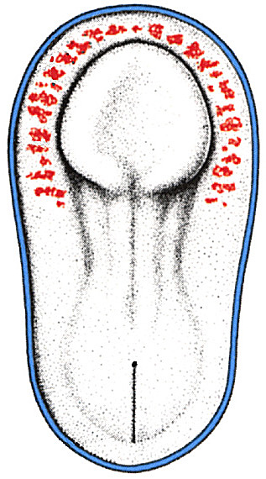
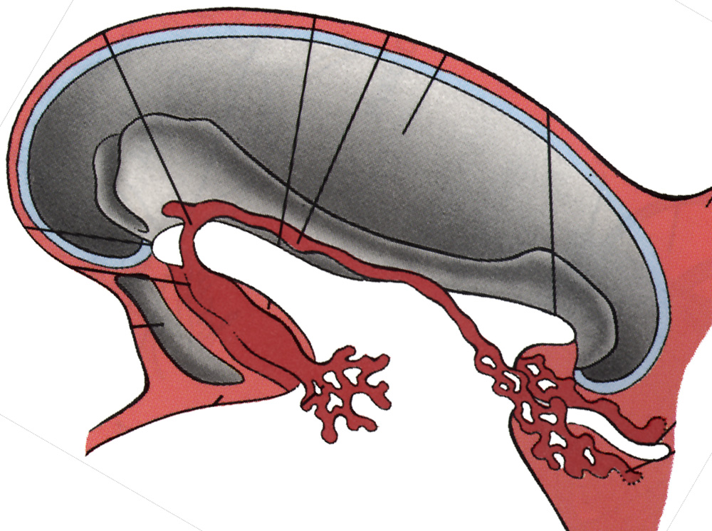
Repositioning the cardiogenic field
(mammals)
Larsen’s fig 12-6
Langman’s fig 12-6
~18 days, dorsal view
~20 days, sagittal view

Slide 7
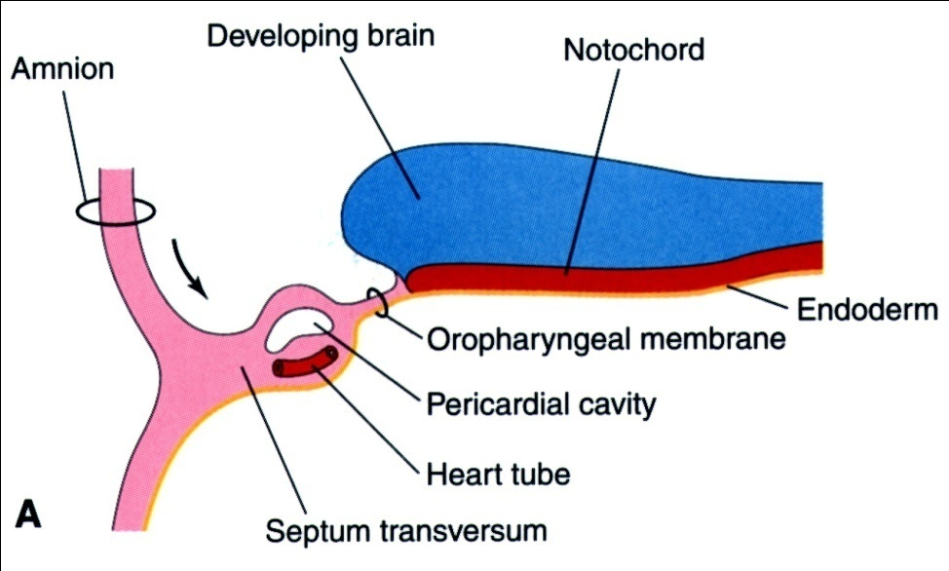
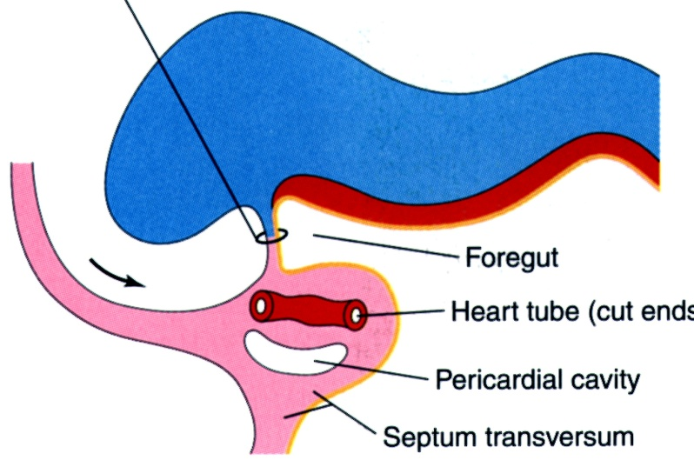
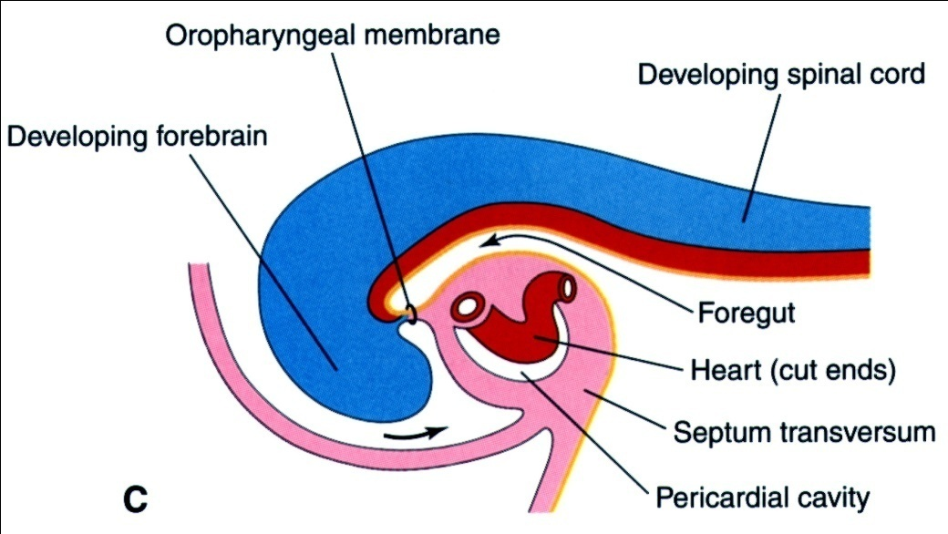
Cranial folding rotates cardiogenic area, moves it ventrally and caudally, and orients heart tube and pericardial cavity
Cranial folding
~18 days, sagittal view
~20 days, sagittal view
~21 days, sagittal view
Moore & Persaud fig 13-9

Slide 8
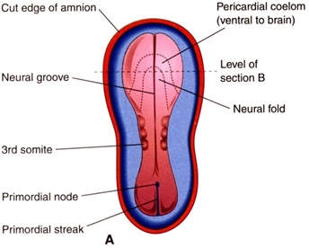
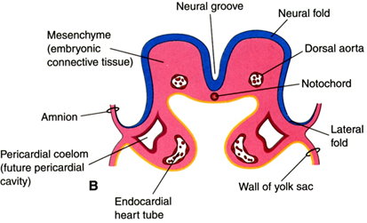
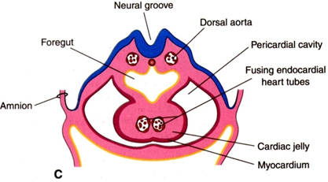
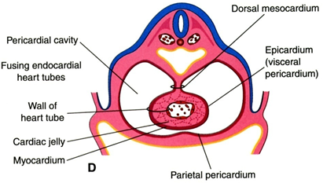
Lateral folding
~18 days, dorsal view
~18 days, axial view
~20 days, axial view
~22 days, axial view
Moore & Persaud fig 13-8
Lateral folding apposes paired heart tube primordia and brings dorsal aortae to midline
Heart primordia fuse to form tubular heart
~21 days, sagittal view

Slide 9
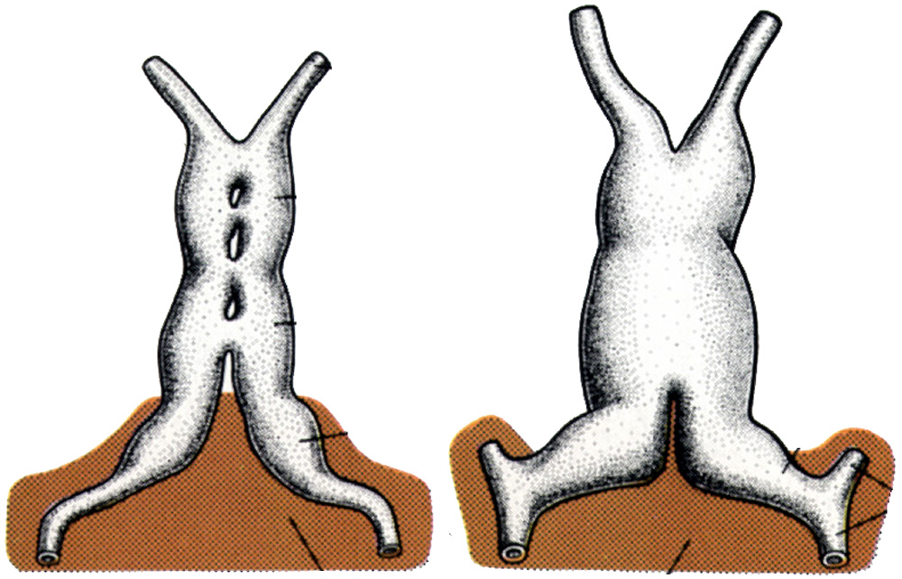
Fusing cardiac primordia
“conotruncus”
(outflow)
“bulbus cordis”
(R ventricle)
future L ventricle
future atria
21 days
22 days
Langman’s fig 12-7
septum transversum
(liver & diaphragm primordium)

Slide 10
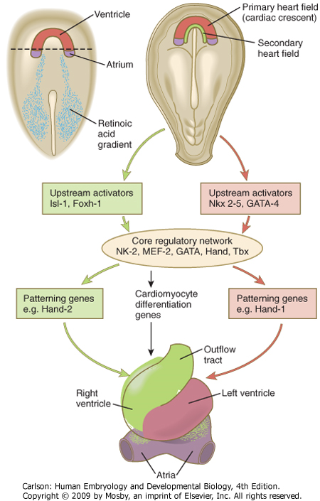
Retinoic acid (RA) and other factors determine the cranio-caudal axis of heart primordia
Primary heart field: left ventricle
Posterior segment of primary heart field: atria
Secondary heart field: right ventricle & outflow tract
EXOGENOUS RETINOIDS CAN INTERFERE WITH THIS PROCESS!
Carlson fig 17-17

Slide 11
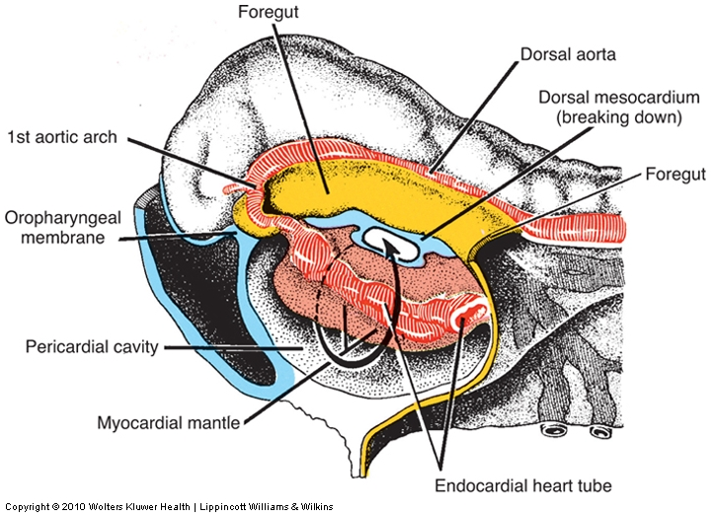
Heart tube and dorsal aortae in place
Transverse pericardial sinus
Langman’s fig 12-5
~22 days, sagittal view

Slide 12
Heart folding
How do you get from this…
22 days
Langman’s fig 12-7
30 days
Carlson fig 17-19
…to this?

Slide 13
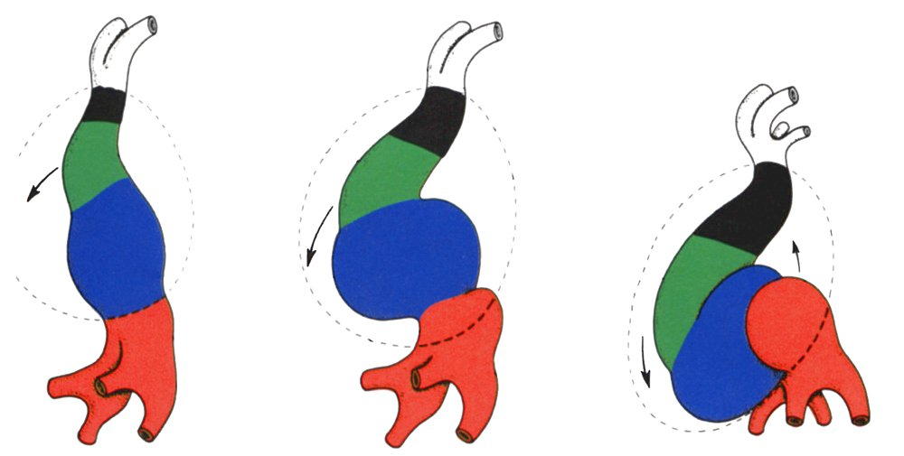
Folding and rotation of heart tube
aortic roots
truncus arteriosus
bulbus cordis
ventricle
atrium
sinus venosus
22 days
23 days
24 days
Langman’s fig 12-6
Future R Ventricle moves ventrally and to right
Atrium moves dorsally
and to left

Slide 14
Folding and rotation of heart tube
QuickTime version
Ventricle moves ventrally and to right
Atrium moves dorsally and to left

Slide 15
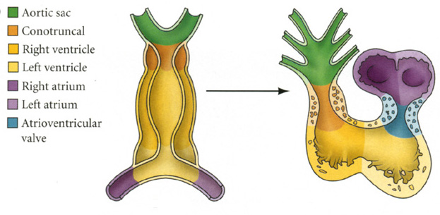
Looped heart anatomy
Carlson fig 17-18
~22 days,
frontal view
~24 days,
sagittal view

Slide 16
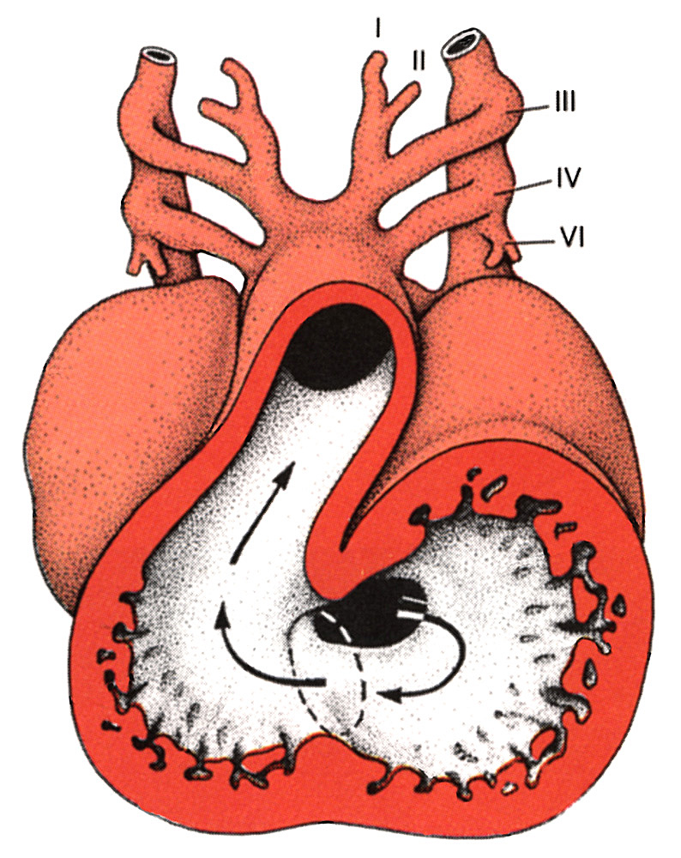
At 30 days…
Atrial partitioning just beginning to happen
Primary interventricular foramen undivided
Outflow tract (bulbus cordis/truncus arteriosus) undivided
Proximal portion of bulbus cordis becomes trabeculated and forms the right ventricle
Atrioventricular canal undivided
Langman’s fig 12-8
~d30, frontal view

Slide 17
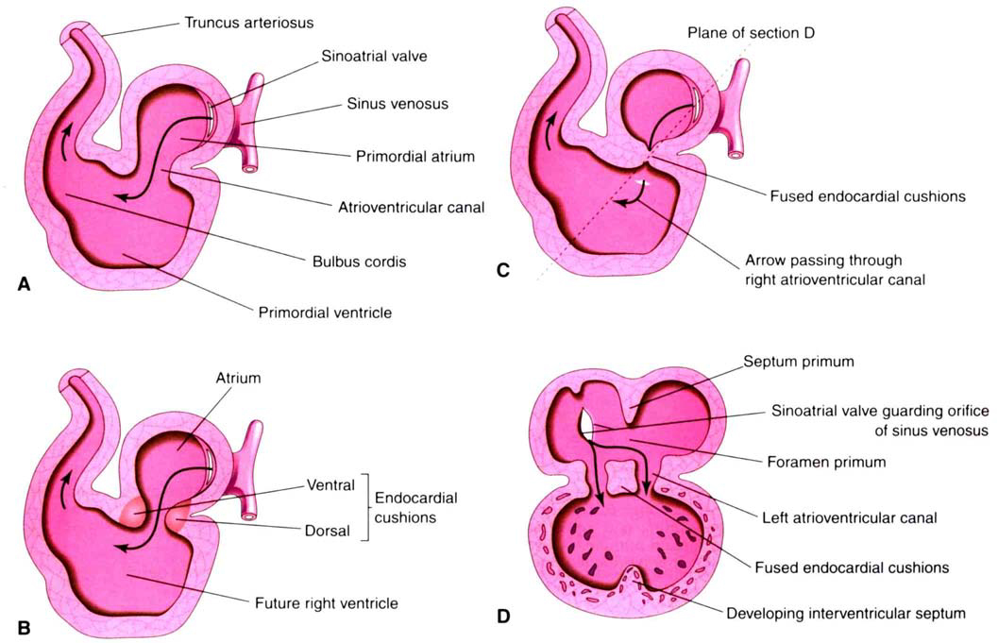
Partitioning the AV canal (days 30-35)
Moore & Persaud fig 13-11
Atrioventricular Endocardial Cushions
Retinoic acid (and many other factors) dependent* conversion of endocardial endothelium in the AV canal into mesenchyme that proliferates to form “cushions” of tissue
Dorsal and ventral cushions fuse in the middle to form a block of tissue that divides right and left AV canals
*can be disrupted by exogenous retinoids and/or in many genetic disturbances (e.g. trisomy 21 –aka Down Syndrome)

Slide 18
Partitioning the AV canal (days 30-35)
QuickTime version
based on Larsen’s fig 12-27
Atrioventricular Endocardial Cushions
Expansion of tissue around periphery of AV canal
Dorsal and ventral cushions fuse to form right and left AV canals divided by septum intermedium (failure of cushions to fuse causes “persistent AV canal”)
Remodeling brings right and left AV canals into alignment with future right and left ventricles –movement driven by differential growth (failure of this process leads to “double inlet” defects)

Slide 19
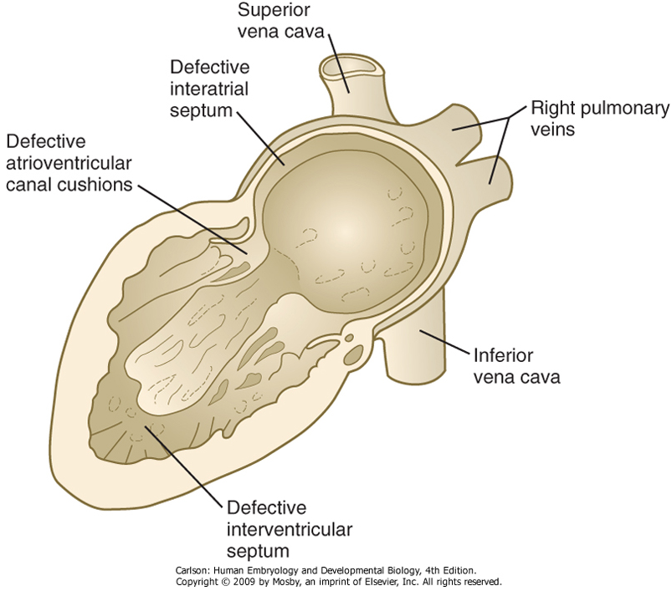
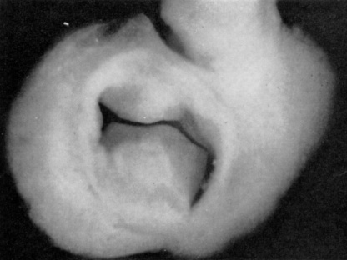
Persistent A-V canal
Failure of A-V endocardial cushions to fuse
Common in Down syndrome
View of A-V canal looking down into ventricles with atria removed
(e.g. at dotted line on left)
Carlson fig 17-32
Fig 174, Nishimura & Okamoto (1976)

Slide 20
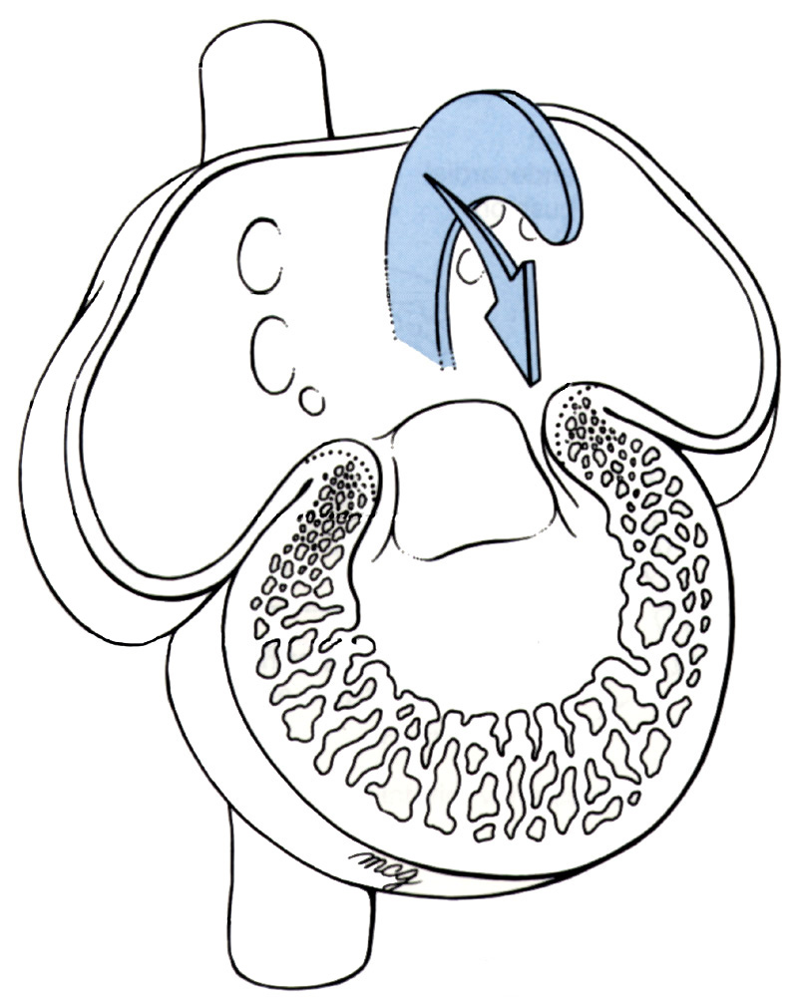
Atrial septum formation (days 28-35): essential for setting up respiratory and systemic circuits, but…
…need to make sure oxygenated blood is shunted to systemic circulation
Larsen’s figs 12-24, 12-25, 12-26

Slide 21
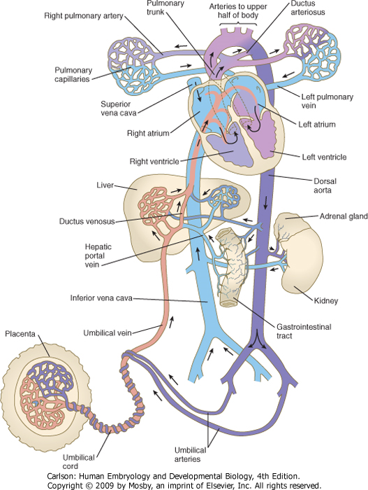
Why is a right-left shunt necessary?
In the fetus, blood is oxygenated in the placenta and delivered to the heart via the inferior vena cava:
Shunted to left atrium via foramen ovale
Also shunted from pulmonary outflow via ductus arteriorsus
Carlson fig 17-19

Slide 22
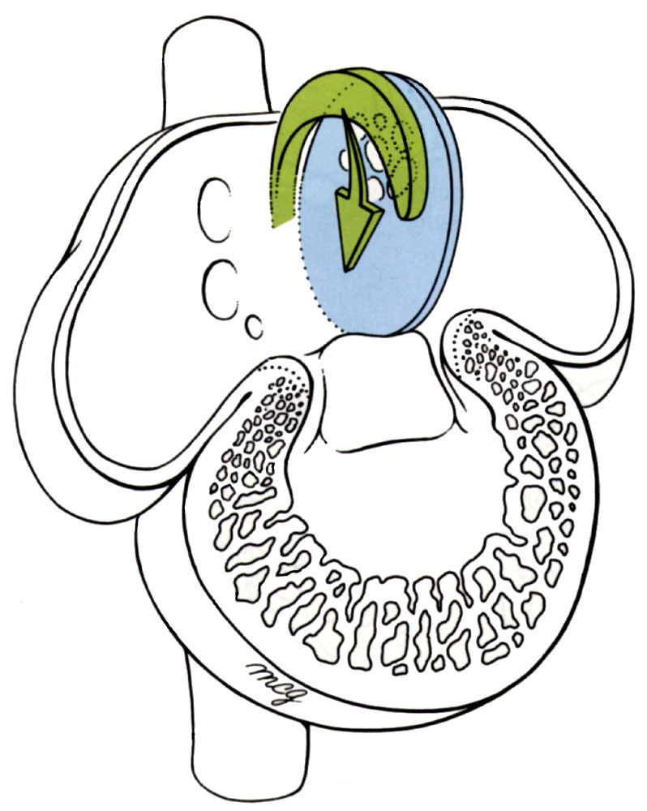
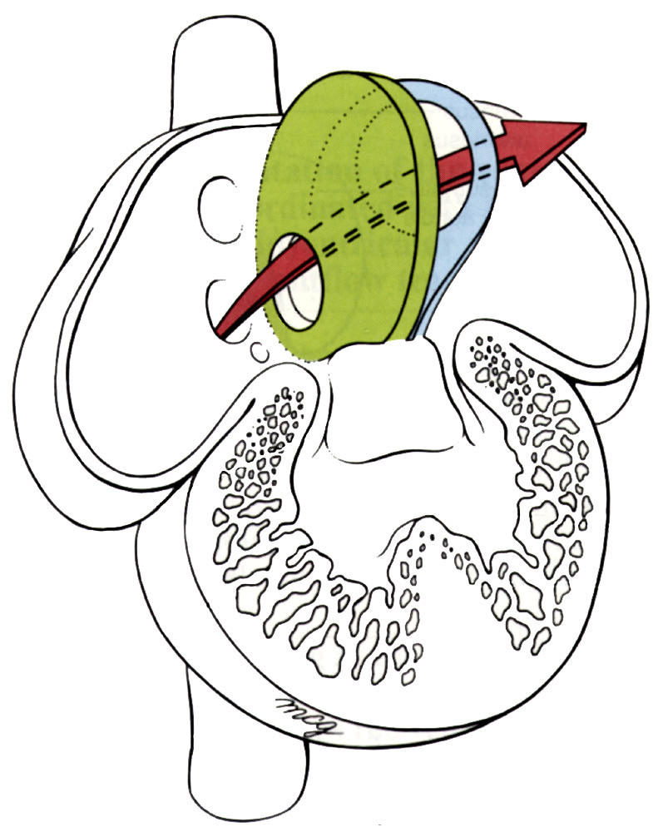
Atrial septum formation
~d28
septum primum
ostium primum
ostium secundum
septum secundum
foramen ovale
~d32
~d35
Frontal views
Larsen’s figs 12-24, 12-25, 12-26

Slide 23
Atrial septum formation (days 28-35)
and the left-to-right shunt
frontal view
Prenatal
Right side at higher pressure (high pulmonary resistance)
Oxygenated blood from IVC streams through foramen ovale
Valve of foramen ovale closes with left atrial contraction
Postnatal
Right side at lower pressure (low pulmonary resistance)
Left side at higher pressure
Pressure differential closes valve (physiological closure)
Valve eventually fuses in ~75% of people (anatomical closure)
In approximately 25% of adults, anatomical closure never happens, in which case the foramen ovale is said to be ‘PROBE-PATENT,’ meaning that it can be opened by mechanical force or reduced pressure on the left side of the heart.
QuickTime version
septum primum (blue)
ostium primum
ostium secundum
septum secundum (green)
foramen ovale
Notes:
animation based on Larsen’s figs 12-24, 12-25, 12-26

Slide 24
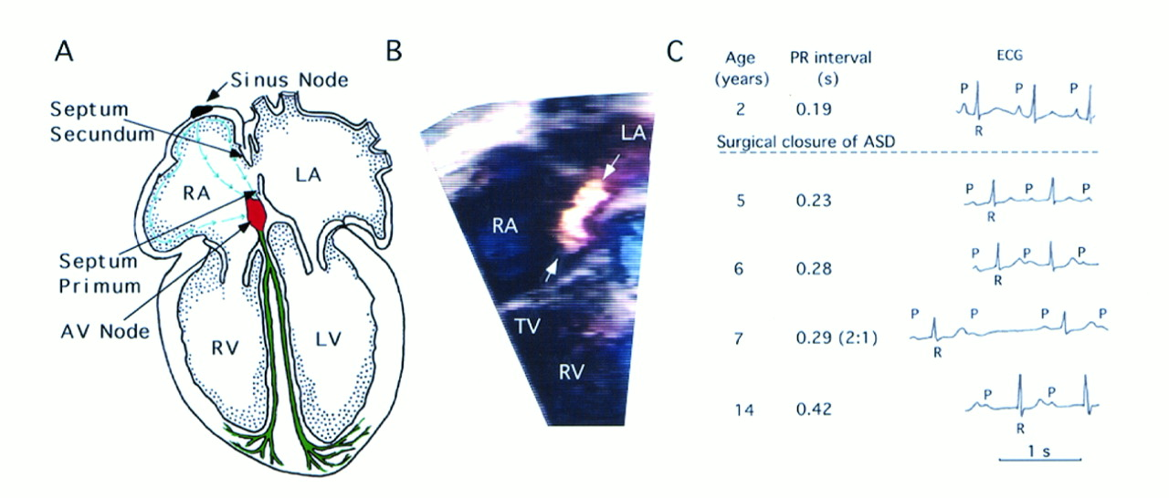
Atrial Septal Defects (ASDs)
True ASD is a lack of septal tissue as opposed to failure of the septal flaps to fuse (i.e. a ‘probe-patent foramen ovale)
Multi-factoral, so many etiologies, but one well-known example is mutation in NKX2-5 characterized by:
Incomplete septum secundum
AV “bundle block” (disruption of conducting fibers, evidenced by prolonged P-R interval on ECG) –typically worsens with age
B. Doppler flow echo-CG showing RA to LA shunt
C. ECG showing progressive AV block (normal P-R int. 0.13-0.2s)
Schott et al. (1998). Science. 281:108-111

Slide 25
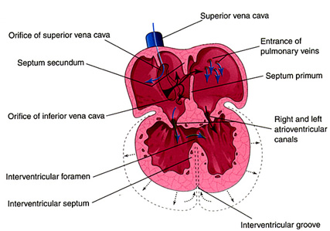
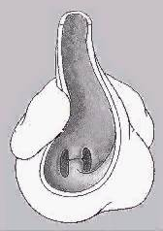
By the end of the 5th week…
A-V cushions almost fused
Atrium in process of septal formation
Interventricular septum still incomplete
muscular septum present (defects in ventricular myocardial development can cause so-called ‘muscular VSDs’ but this is rare)
membranous septum ABSENT (forming the membranous septum relies on multiple tissue, so ‘membranous VSDs’ are rather common)
Outflow tract still undivided
outflow tract
A-V cushions
muscular ventricular septum
Notes:
top figure: Moore & Persaud fig 13-17
bottom figure: Larsen’s fig 12-33

Slide 26
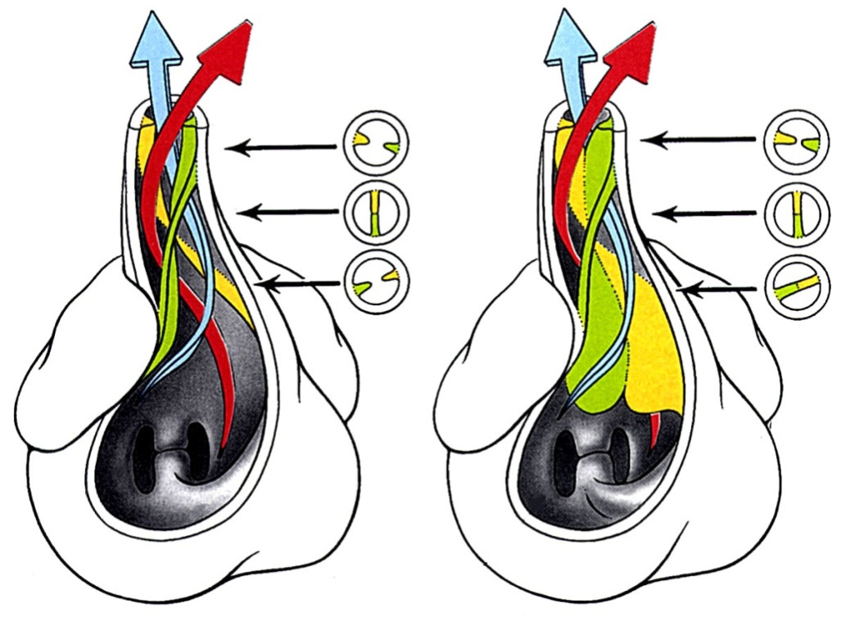
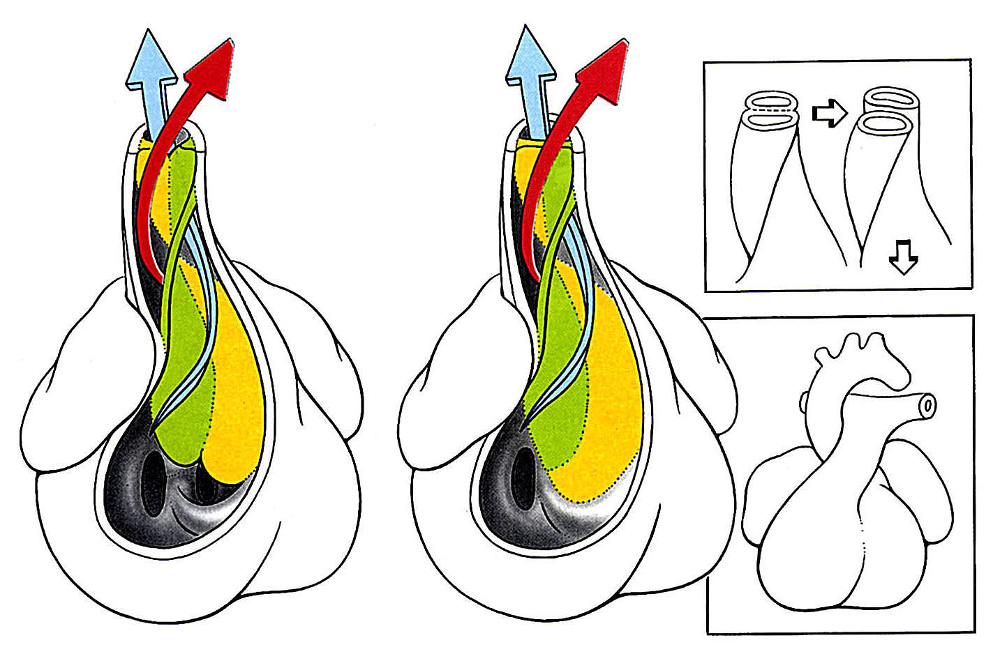
Outflow Tract Partitioning (wks 5-9)
Truncoconal ridges
Neural crest-derived endocardial cushions form in truncus arteriosis and conus (bulbus) cordis region
Fuse at truncoconal transition and “zip” proximally and distally to form aorticopulmonary septum.
R
L
Membranous septum formed by contributions from AV cushions, muscular ventricular septum AND truncoconal cushions.
5th wk
7th wk
oblique views, from right ventricle
8th wk
9th wk
QuickTime version
Larsen’s fig 12-33

Slide 27
Outflow Tract Defects
Typically due to failure of neural crest-derived conotruncal cushions
Associated with other disorders affecting neural crest: DiGeorge syndrome, fetal alcohol syndrome, chromosome 22 mutations (e.g. Tbx-1)
Can also arise due to defects in secondary heart field (e.g. Hand-2, retinoids)
Examples include: persistent truncus arteriosus, transposition of the great vessels, aortic and/or pulmonary stenosis (tetrology of Fallot)

Slide 28
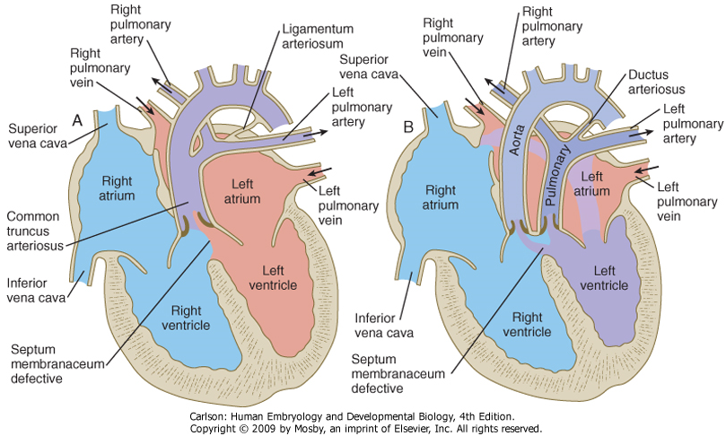
Persistent Truncus Arteriosus
Transposition of the Great Vessels
Carlson fig 17-31

Slide 29
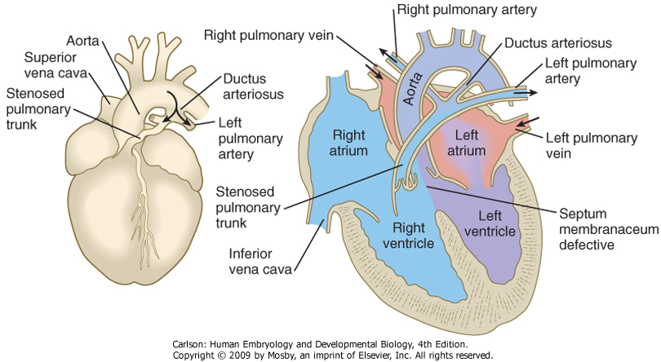
Pulmonary Stenosis: Tetrology of Fallot
Pulmonary stenosis
Overriding aorta
Intraventricular septal defect
Hypertrophy of right ventricle
(Patent ductus arteriosus)… so really a “pentology”
Carlson fig 17-40

Slide 30
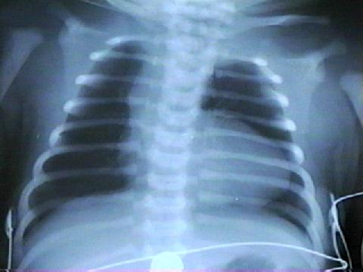
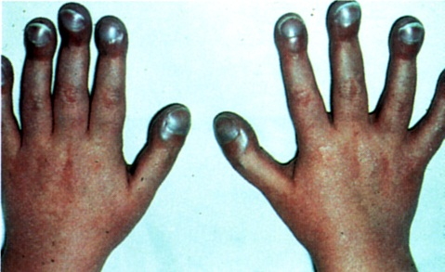
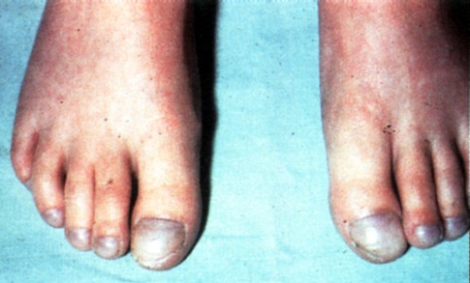
Other signs of Tetrology of Fallot
Respiratory distress (dyspnea), with rapid breathing
Characteristic squatting posture, at rest, to relieve dyspnea
Coeur en sabot (boot-shaped heart) in Xray
Cyanosis develops gradually, with intermittent severe “spells”
Clubbed fingers and toes with cyanosis

Slide 31
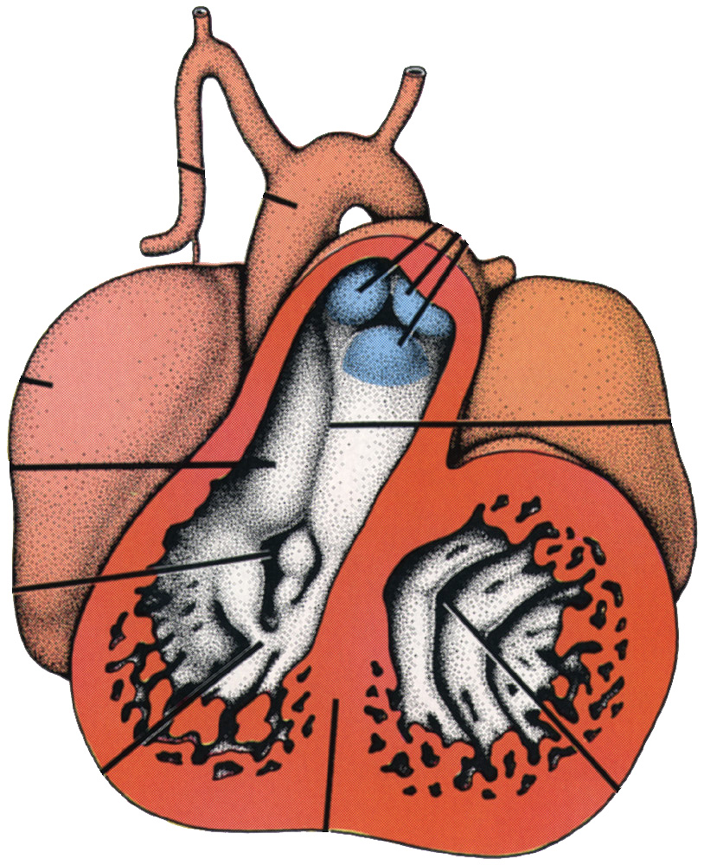
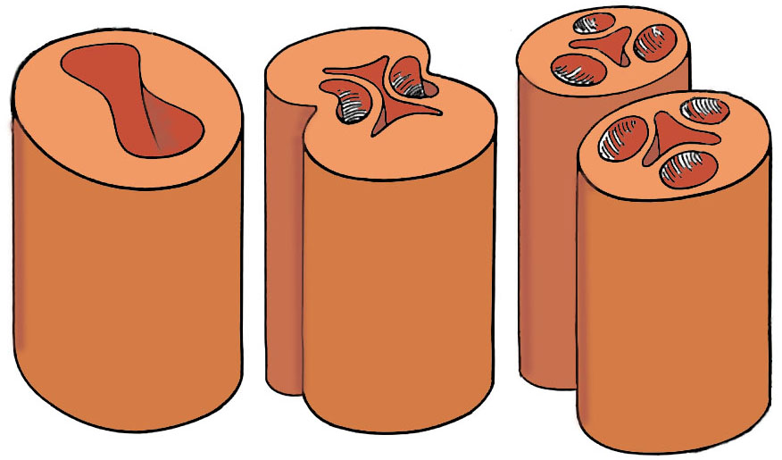
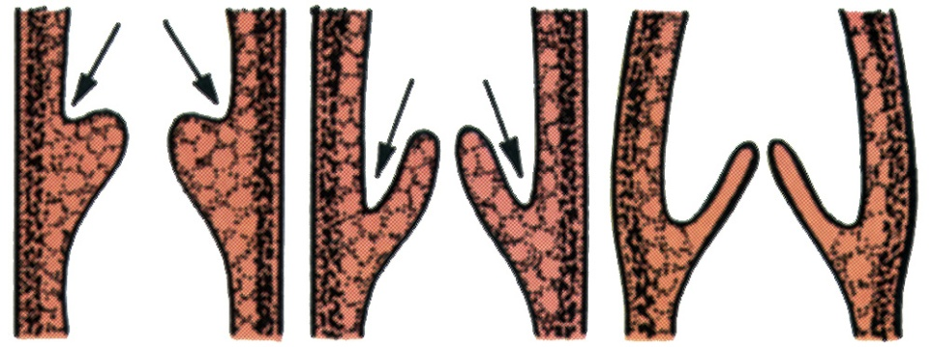
Formation of semilunar valves (wks 5-7)
also outflow cushion dependent…
P
L
Pulmonary valve tubercles
R
Aorta
A
Pulmonary
artery
Truncoconal septum
Larsen’s fig 12-34
Tricuspid valve
Langman’s fig 12-27
Mitral valve
Langman’s fig 12-23
wk5, frontal view

Slide 32
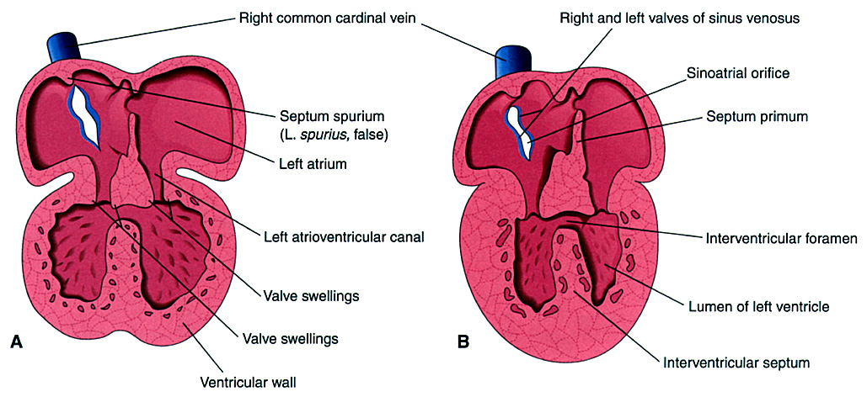
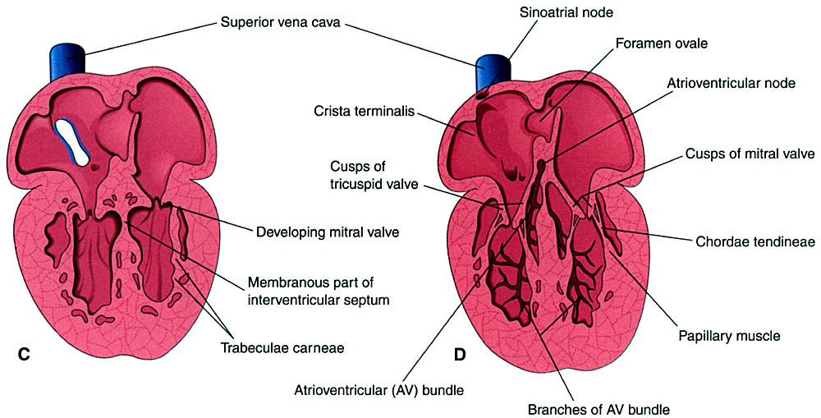
Formation of AV valves (wks 5-7)
dependent on AV cushions and ventricular myocardium…
wks 5-7, frontal views
Moore & Persaud fig 13-19

Slide 33
Mitral stenosis/hypoplastic left ventricle
Failure of left A-V valve (bicuspid valve) to form: LV and aorta becomes hypoplastic because of reduced load.
OK in embryo since oxygenated blood is coming from IVC and can be distributed systemically via ductus arteriosus.
But, this arrangement doesn’t work so well in a breathing infant since oxygenation occurs in the lungs.

Slide 34
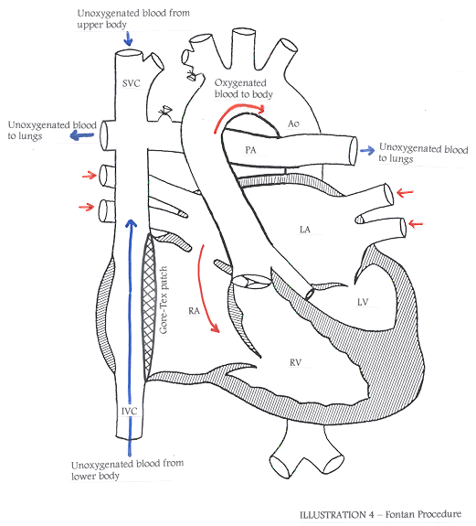
Fontan Repair of Single Ventricle
Reroute systemic venous blood to lungs for oxygenation
Reroute right ventricle outflow to aorta
Oxygenated blood from lungs flows from LA in RA via patent foramen ovale and RV pumps oxygenated blood out to body.

Slide 35
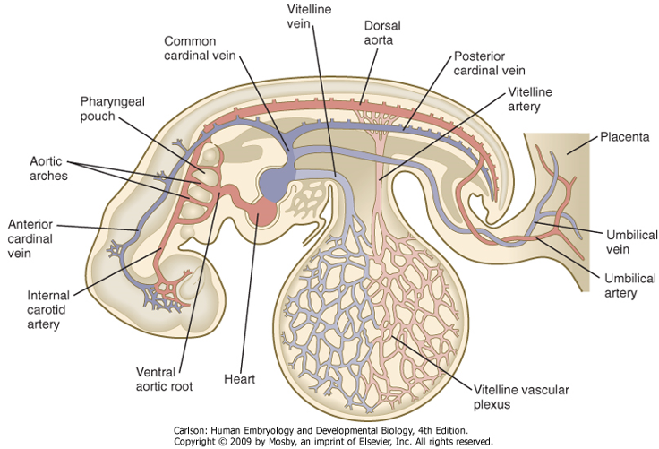
Blood Vessel Development
Embryonic circulation: 3 circuits
Systemic: aorta and cardinal veins
Placental: umbilical arteries and veins
Vitelline: vitelline artery and vein

Slide 36
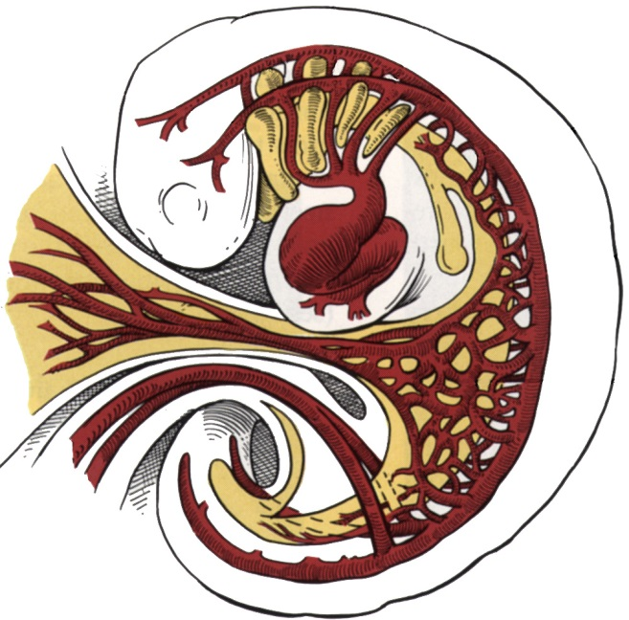
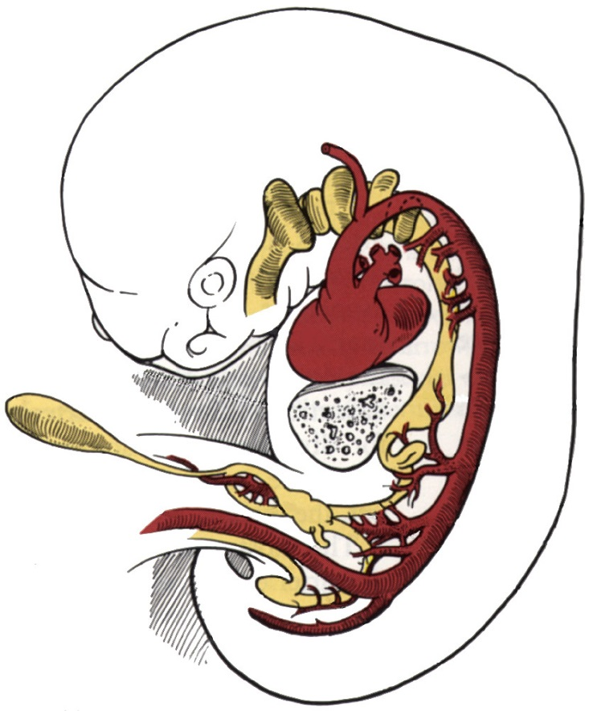
Vitelline and umbilical arteries
vitelline arteries and plexus –GI anlage secrete VEGF
celiac A
superior mesenteric A
umbilical arteries
inferior mesenteric A
placental cells secrete VEGF and leptin
umbilical AA make 2° connections with common iliac AA
proximal portions persist as internal iliac AA and superior vesical AA
distal portions become obliterated (medial umbilical ligaments)

Slide 37
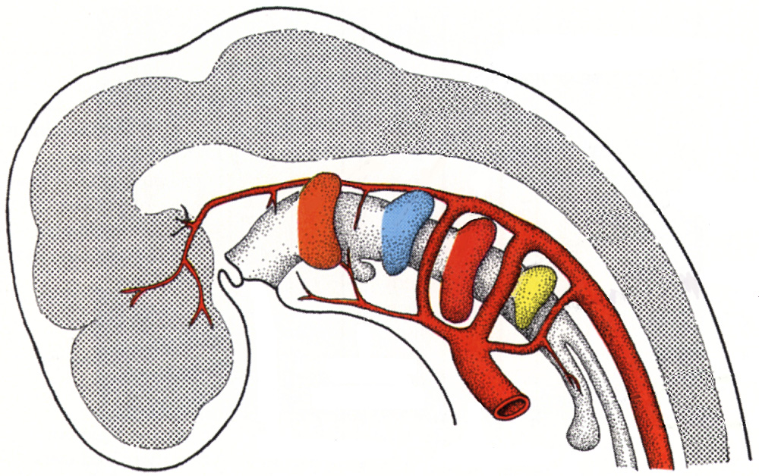
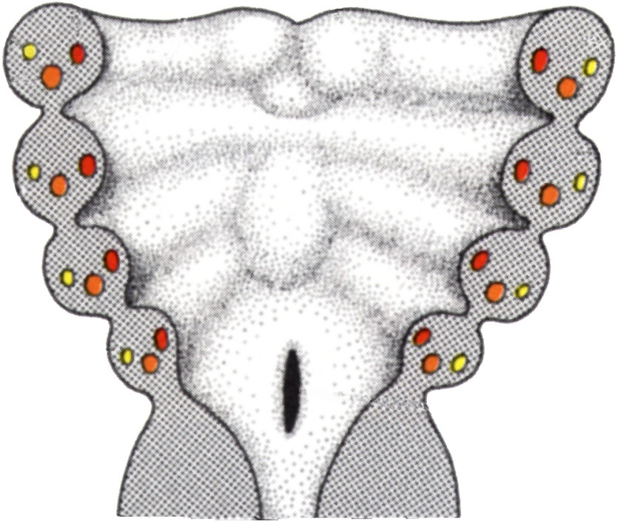
Development of the aortic arches
7 weeks
Each pharyngeal arch has aortic arch, cranial nerve, and cartilage components…
4th arch
6th arch
1
1st arch
2
2nd arch
3
Five aortic arches are forming during the 4th and 5th weeks.
5th arch fails to form; arches are numbered: 1, 2, 3, 4, and 6
4
3rd arch
6
“branchial” = pharyngeal
Langman’s fig 16-04

Slide 38
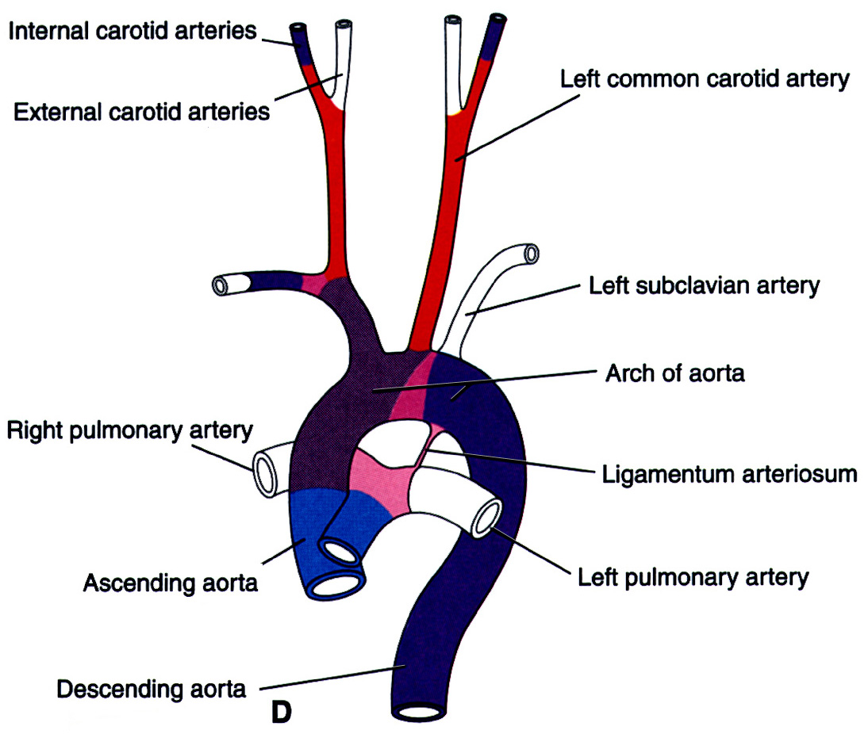
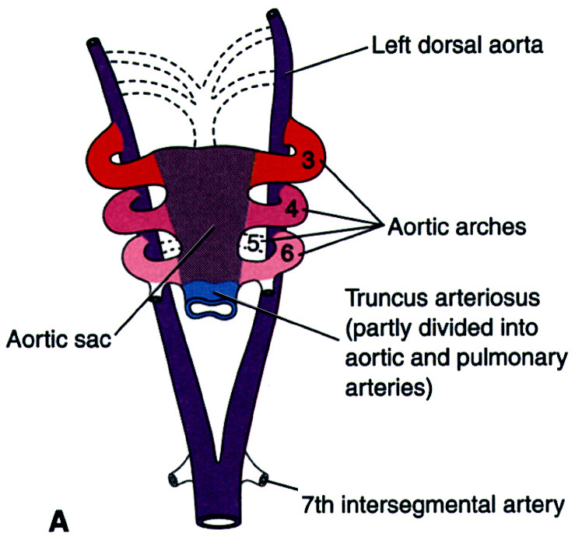
Changes in the aortic arch pattern
Animation: http://www.indiana.edu/~anat550/cvanim/aarch/aarch.html
6 months postnatal
6 weeks
From this…
…to this
Moore & Persaud fig 13-39

Slide 39
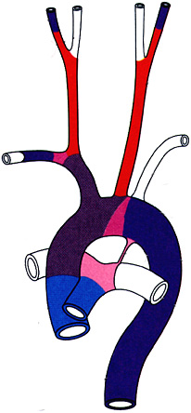
Changes in the aortic arch pattern (AS,1,2,3,5)
Animation: http://www.indiana.edu/~anat550/cvanim/aarch/aarch.html
Aortic Sac (AS):
proximal part of aortic arch
brachiocephalic a.
1st arch mostly disappears
maxillary a.
(part of external carotid a.?)
Aortic sac
2nd arch mostly disappears
stapedial a.
(hyoid a.?)
3rd arch:
common carotid a.
part of internal carotid a.
internal and external carotid aa. sprout from 3rd arch
Moore & Persaud fig 13-39
5th arch fails to form

Slide 40
Changes in the aortic arch pattern (4)
Animation: http://www.indiana.edu/~anat550/cvanim/aarch/aarch.html
4th arch on right:
proximal segment of right subclavian a. (rest of subclavian a. from 7th intersegmental a. and R dorsal aorta)
4th arch on left:
arch of aorta (from left common carotid a. to left subclavian a. only)
Moore & Persaud fig 13-39

Slide 41
Changes in the aortic arch pattern (6)
Animation: http://www.indiana.edu/~anat550/cvanim/aarch/aarch.html
(6th arch = pulmonary arch)
6th arch on right:
right pulmonary artery
distal segment regresses
6th arch on left:
left pulmonary artery
distal segment persists as ductus arteriosus
Moore & Persaud fig 13-39

Slide 42
Changes in the aortic arch pattern affect course of recurrent laryngeal nerves
6 wks
8 wks
postnatal
Arch derivatives are innervated by cranial nerves
Intrinsic muscles of larynx from 6th arch mesoderm --innervated by vagus nerve branches that originally run under the left and right 6th aortic arches.
With differential growth, the larynx moves superiorly, taking its innervation with it.
On the left, the 6th arch remains connected to the aorta (as the ductus arteriosus and later the lig. arteriosum), so the left recurrent laryngeal nerve hooks around the ligamentum arteriosum.
On the right, the distal half of the 6th arch regresses, but the 4th arch persists as the right subclavian artery, so the right recurrent laryngeal nerve is hooked around the right subclavian artery.

Slide 43
Closure of ductus arteriosus
Distal portion of sixth arterial arch; contains unique population of vascular smooth muscle cells. Under fetal conditions (↓O₂, ↑prostaglandin E2 (PGE2), ↑bradykinin, ↑NO), muscle is RELAXED
Functional closure at birth (i.e. within 1-2 hours): high O₂ and loss of PGE2, bradykinin, and NO signaling all result in potent vasoconstriction in the ductus.
Anatomical closure by 1-3 months
Patent Ductus Arteriosus (“PDA”):
In some infants (8 per 10,000 births), the ductus arteriosus fails to close and must be treated surgically or pharmacologically (prostaglandin E2 inhibitors, e.g. indomethacin or ibuprofen).
Conversely, a temporarily patent ductus arteriosus is sometimes desirable (e.g. in tetralogy of Fallot), in which case PGE2 agonists can be given to keep the ductus from closing.

Slide 44
PDA is associated with neurocristopathies AND, interestingly, congenital Rubella infection
Vascular smooth muscle cells of the ductus arteriosus are neural crest-derived
Rubella
virus that can cross placental barrier and disrupts mitosis in many tissues –specific mechanism not known
among the TORCH group of congenital infections that are teratogenic:
Toxoplasmosis
Other (varicella-zoster, parvovirus B19)
Rubella
Cytomegalovirus
Herpes
Notes:
Image from: http://reidhosp.adam.com/content.aspx?productId=39&pid=1&gid=001658

Slide 45
Aortic Arch Anomalies
Double aortic arch
abnormal persistence of right distal segment
~1:1000 incidence –often assoc. with dysphagia and/or dyspnea

Slide 46
Aortic Arch Anomalies
normally regresses
Right aortic arch
abnormal persistence of right distal segment & regression of left distal segment
(note also that the distal 6th arch abnormally regresses on the left and persists on the right)
~1:1000 incidence –usually asymptomatic

Slide 47
Aortic Arch Anomalies
Aberrant right subclavian (from aortic arch)
(abnormal regression of right proximal segment & persistence of right distal segment)
~1:100 incidence –often assoc. with dysphagia and/or dyspnea; also flow in R subclavian may be reduced so R radial pulse may be weak.

Slide 48
Coarctation of aorta
Collateral circulations can compensate for postductal coarctation
Enlarged intercostal arteries causes characteristic ‘notching’ of ribs on the left
Collateral circulation not perfect, so blood pressure in upper limbs is usually higher compared to lower limbs
Preductal coarctation is MUCH less common (5% of coarctations)
~1:3000 incidence overall, but commonly coincident w/ Turner’s syndrome (~20%) and neural crest disorders
Moore & Persaud, Fig 15-29; ref to Sadler, Fig 11-37

Slide 49
Venous system development
sinus venosus
cardinal veins
vitelline veins
umbilical veins
Langman’s fig 12-41
~d28, sagittal view

Slide 50
Vitelline and umbilical veins change during liver development
frontal views
sinus venosus
cardinal V
L hepatocardiac channel
L vitelline V
hepatic sinusoids
gut tube
umbilical V
hepatic portion of inferior vena cava
4 weeks
gut tube
R hepatic V
5 weeks
L hepatic V
yolk sac
Langman’s fig 12-42
ductus venosus
ductus venosus
R hepatocardiac channel becomes
hepatic portion of IVC
R umbilical V regresses
proximal L umbilical V regresses
distal L umbilical V regresses after birth to become
round ligament of the liver
ductus venosus regresses after birth to become the ligamentum venosum
portal V
6 weeks
umbilical V
8 weeks
Langman’s fig 12-43

Slide 51
Systemic venous development
anterior cardinal veins
posterior cardinal veins
Langman’s fig 12-41

Slide 52
Systemic venous development: shift to the right
5.5 weeks
6 weeks
5 weeks
Moore & Persaud

Slide 53
Systemic venous development: shift to the right
L. brachiocephalic anastomosis
7 weeks
Adult
Moore & Persaud
What if the brachiocephalic anastomosis fails?

Slide 54
Left superior vena cava
Double superior vena cava
Langman’s fig 12-46
viewed from behind

Slide 55
Double inferior vena cava
Absent inferior
vena cava
Langman’s fig 12-45

