Slide 1
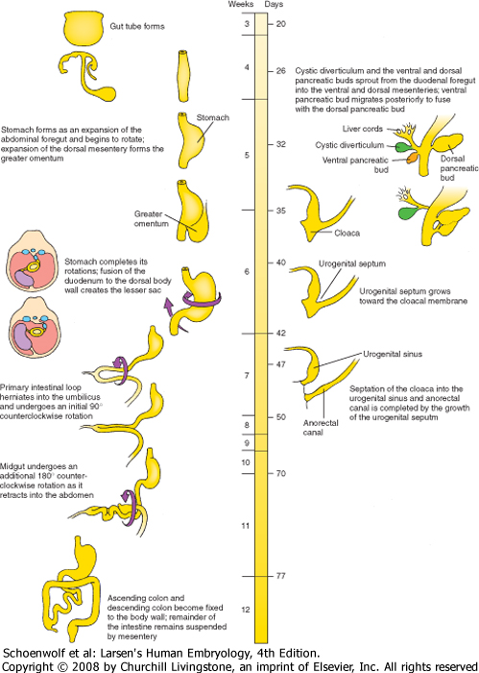
Gastrointestinal System Development
Suggested Reading:
Langman’s 11th ed. Ch. 14 (pp.209-231)
--OR--
Langman’s 12th ed. Ch. 15 (pp. 208-231)
Matt Velkey
matt.velkey@duke.edu
0380 Seely Mudd
Larsen’s fig 14-35

Slide 2
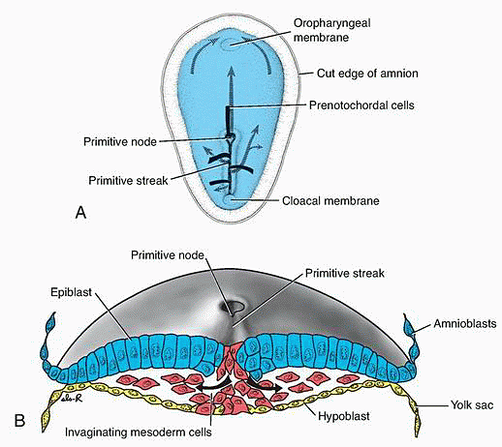
Gastrulation:
Epiblast cells
migrate through the
primitive streak.
Definitive (embryonic)
endoderm cells displace
the hypoblast.
Mesoderm spreads
between endoderm
and ectoderm.
Langman’s fig 5.3

Slide 3
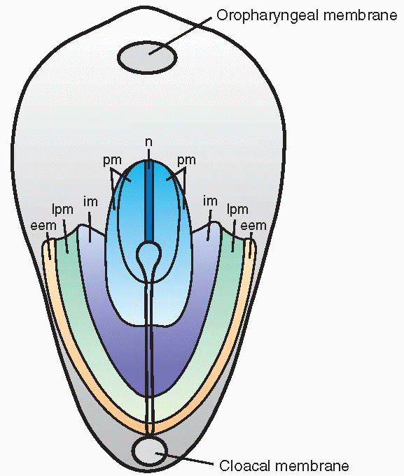
Early mesodermal patterning:
(buccopharyngeal membrane)
Specific regions of the epiblast migrate
through the streak at different levels
and assume different positions within
the embryo:
Cranial to caudal:
Notochord (n)
Paraxial mesoderm (pm)
Intermediate mesoderm (im)
*Lateral plate mesoderm (lpm)
Extraembryonic mesoderm (eem)
Langman’s fig 5-07

Slide 4
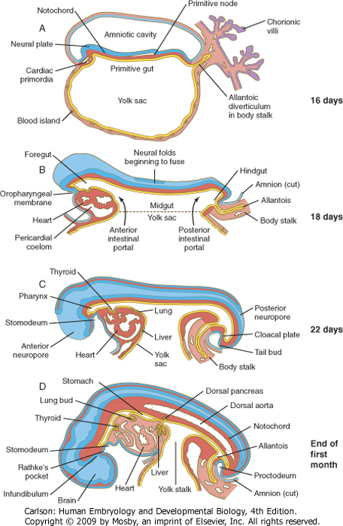
Endoderm
Carlson fig 6-20
The developing endoderm (yellow) is initially open to the
yolk sac (the cardiac region is initially most anterior)…
Cranio-caudal folding at both ends of the embryo and
lateral folding at the sides of the embryo
bring the endoderm inside and form the gut tube.

Slide 5
cloacal membrane
Carlson fig 6-20
Folding creates the anterior and posterior intestinal portals
(foregut and hindgut, respectively)
The cardiac region is brought to the ventral side of the
developing gut tube.
Juxtaposition of ectoderm and endoderm at:
Oropharyngeal (buccopharyngeal) membrane - future mouth
Cloacal membrane - future anus
Note: there actually isn’t much mesoderm in these membranes, which is important for their breakdown later in development to form the oral and anal orifices.

Slide 6
Carlson fig 6-20
Gut-associated organs begin to form as buds from the
endoderm: (e.g., thyroid, lung, liver, pancreas)
Midgut opening to the yolk sac progressively narrows

Slide 7
Carlson fig 6-20
By the end of the first month:
The stomach bulge is visible,
Dorsal pancreas has begun to bud
Connection of the midgut to the yolk sac is reduced to
a yolk stalk and then a very thin vitelline duct

Slide 8
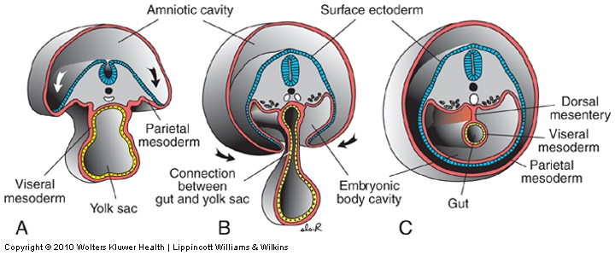
With lateral folding, mesoderm is recruited to gut wall
Carlson fig 6-20
Langman’s fig 6-18
Lateral folding of the embryo completes the gut tube
Mesodermal layer of the gut tube is called splanchnic (visceral) mesoderm - derived from lateral plate mesoderm
Somatic mesoderm lines body cavity
Notes:
Fig 13.3

Slide 9
Gut tube proper Derivatives of gut tube
Foregut: pharynx thyroid
esophagus parathyroid glands
stomach tympanic cavity
proximal duodenum trachea, bronchi, lungs
liver, gallbladder
pancreas
Midgut: proximal duodenum to
right half of
transverse
colon
Hindgut: left half of urinary bladder
transverse
colon to anus
(These three regions are defined by their blood supply)

Slide 10
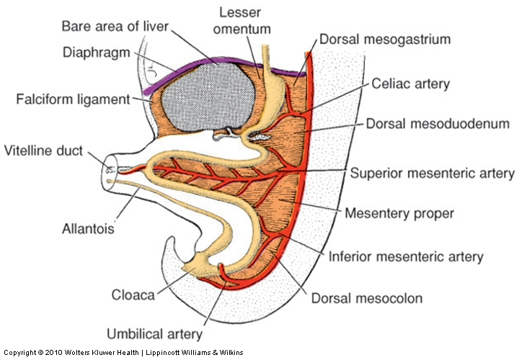
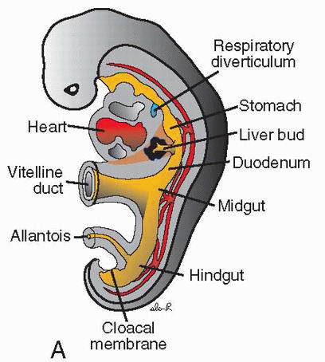
4th week
5th week
Langman’s fig 14-14
Langman’s fig 14-4
Celiac artery supplies the foregut
Superior mesenteric artery supplies the midgut
Inferior mesenteric artery supplies the hindgut
The figure on the right also shows the mesenteries; note also that the liver and stomach have dorsal and ventral mesenteries whereas the rest of the gut has only a dorsal mesentery.
Notes:
Fig 13.14

Slide 11
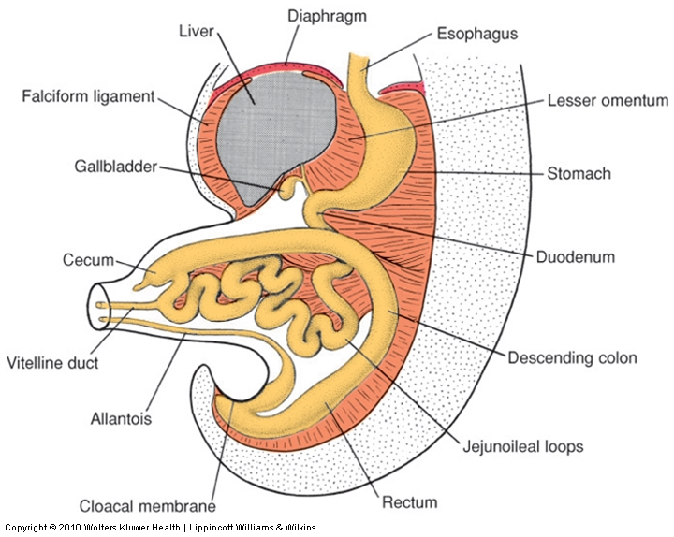
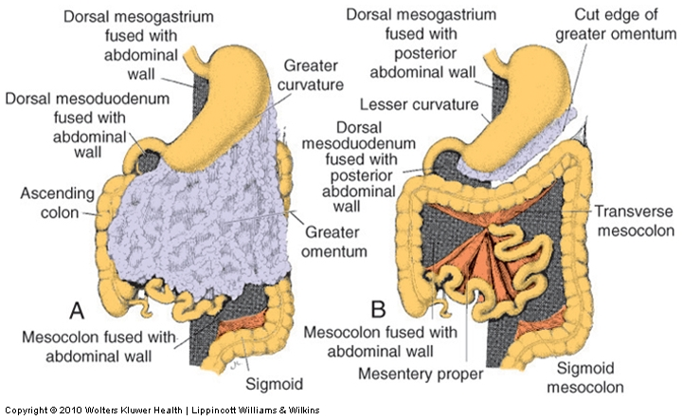
A closer look at the mesenteries
5 weeks
Last trimester
Langman’s fig 14-26
Langman’s fig 14-30
The stomach and liver are suspended in a mesentery that is attached to the dorsal AND ventral body walls
  Dorsal mesentery of stomach becomes the greater omentum
  Ventral mesentery of stomach/dorsal mesentery of the liver becomes the lesser omentum
  Ventral mesentery of the liver becomes the falciform ligament
The rest of the GI tract is suspended in a dorsal mesentery (mesodoudenum, mesocolon, etc.)

Slide 12
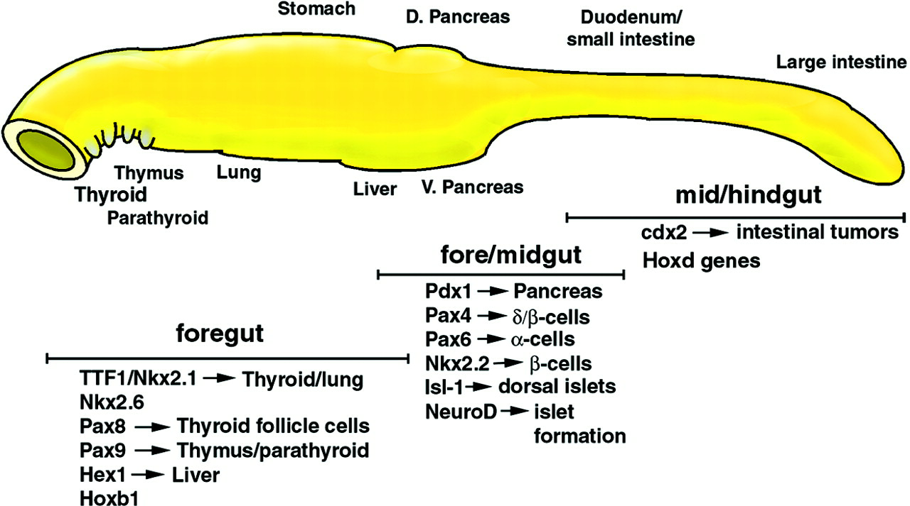
Regional patterning of the gut tube
Gut = bilayered tube (endoderm surrounded by mesoderm)
Regional gut tube patterning and organogenesis require
bi-directional endoderm-mesoderm cross-talk
and inductive signals from other nearby structures

Slide 13
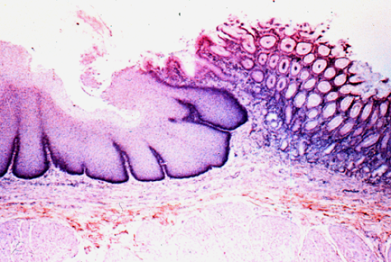
Cranial-caudal pattern of the gut tube is played out as regional organ differentiation. Positional identity is assigned and distinct borders form.
Esophageal/Gastric border
Esophagus
Stomach

Slide 14
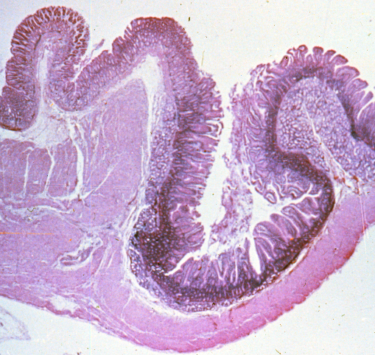
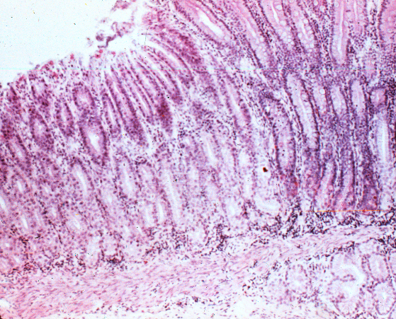
Pyloric border (gastric/duodenal)
Stomach
Duodenum
Stomach
Duod.

Slide 15
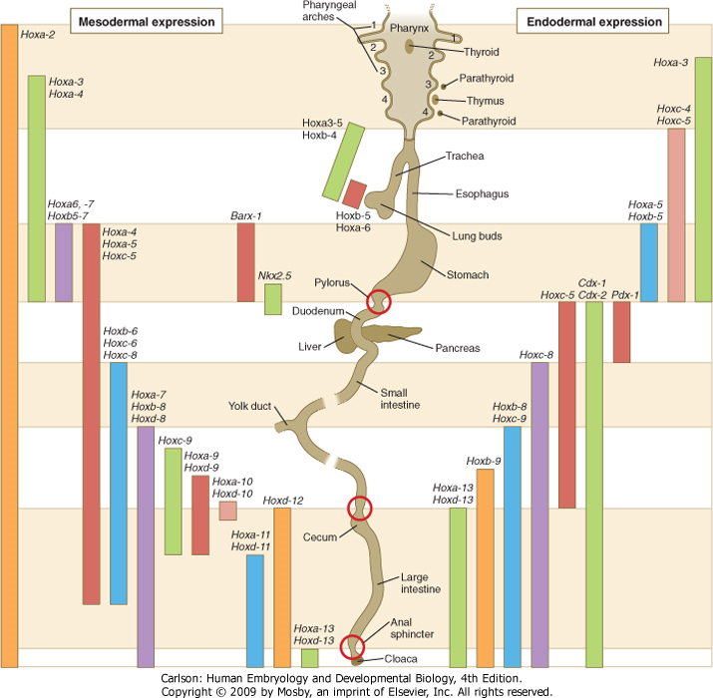
Regional patterning of the gut tube - the Hox code
Hox genes are evolutionarily conserved transcription factors that are used in regional patterning (flies to mammals).
The gut has an cranial-caudal Hox gene expression pattern (code) similar to that seen in neural tissue.
Some Hox genes are expressed in mesoderm, in overlapping patterns; some are expressed in endoderm.
Hox gene expression boundaries correspond to morphologically recognizable elements in the GI tract.
Hox gene expression is important for formation of major sphincters (red circles)
Carlson fig 15-01

Slide 16
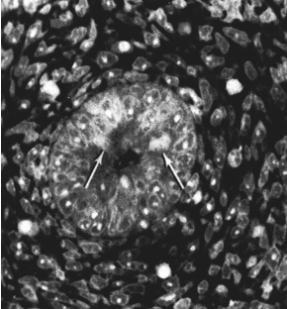
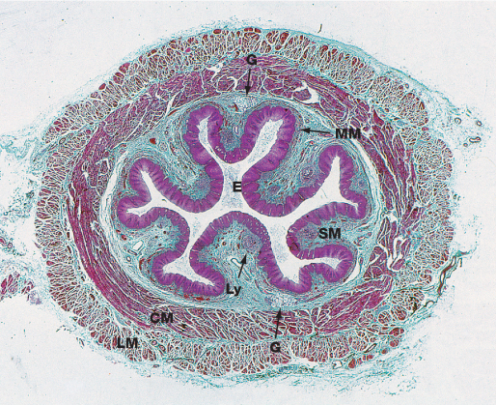
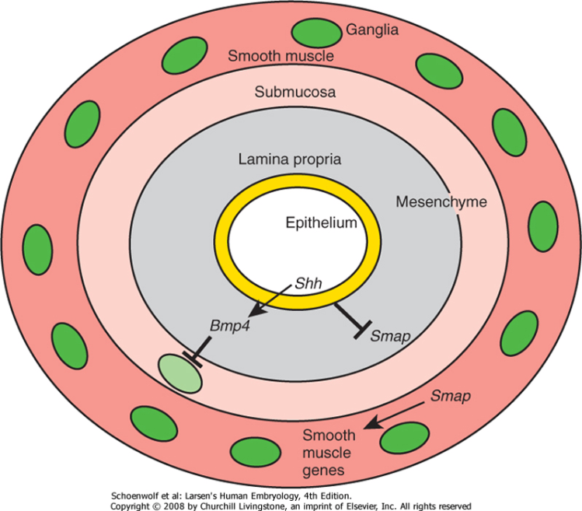
Hedgehog signaling is important for RADIAL (concentric) patterning of the entire gut tube
Adult Esophagus
Fetus
Larsen’s fig 14-27
Wheater’s fig 14-5
High hedgehog concentration directly inhibits smooth muscle differentiation (via repression of Smooth Muscle Activating Protein, or Smap)
Low Hedgehog concentration is permissive of muscle differentiation in the outer wall of the gut
High Hedgehog concentration also induces high BMP which inhibits neuron formation, thus limiting neurogenesis initially to the outer muscular wall of the gut (later in development, SHH goes away allowing development of the smooth muscle of the musularis mucosae and neurons of the submucosal plexus)
Morphogen: induces different cell fates at different concentrations of signal

Slide 17
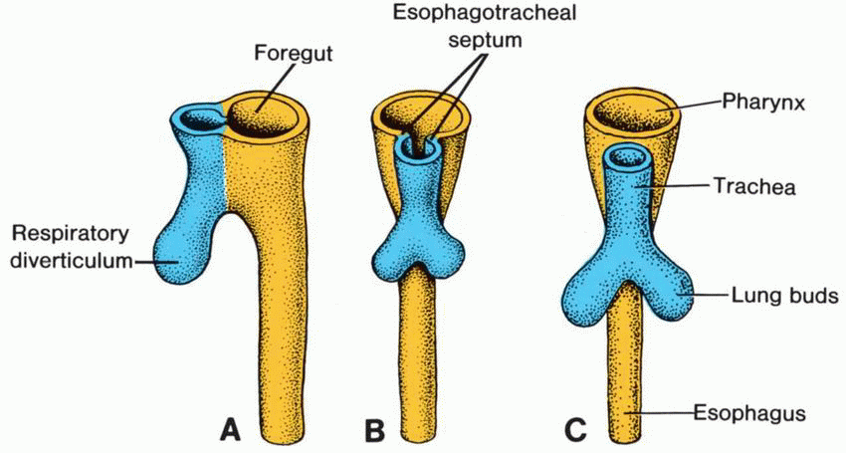
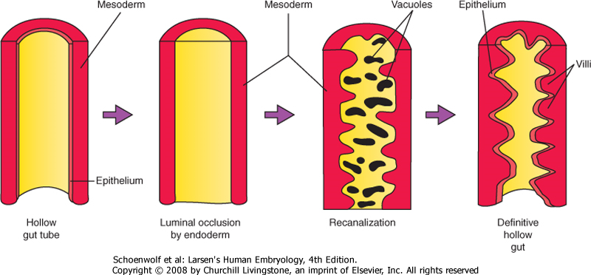
Regional Organogenesis: Esophagus
Region of foregut just caudal to lung bud develops into esophagus –errors in forming the esophagotracheal septa and/or re-canalization lead to tracheoesophageal fistulas and/or esophageal atresia, respectively.
Endodermal lining is stratified columnar and proliferates such that the lumen is obliterated; patency of the lumen established by re-canalization –errors in this process lead to esophageal stenosis
  NOTE: this process of recanalization occurs throughout the gut tube, so occlusion can occur anywhere along the GI tract (e.g. duodenal stenosis)
Tube initially short and must grow in length to “keep up” with descent of heart and lungs –failure of growth in length leads to congenital hiatal hernia in which the cranial portion of the stomach is pulled into the hiatus.
Langman’s fig 14-06
5th week
7th week
Larsen’s fig 14-22
9th week

Slide 18
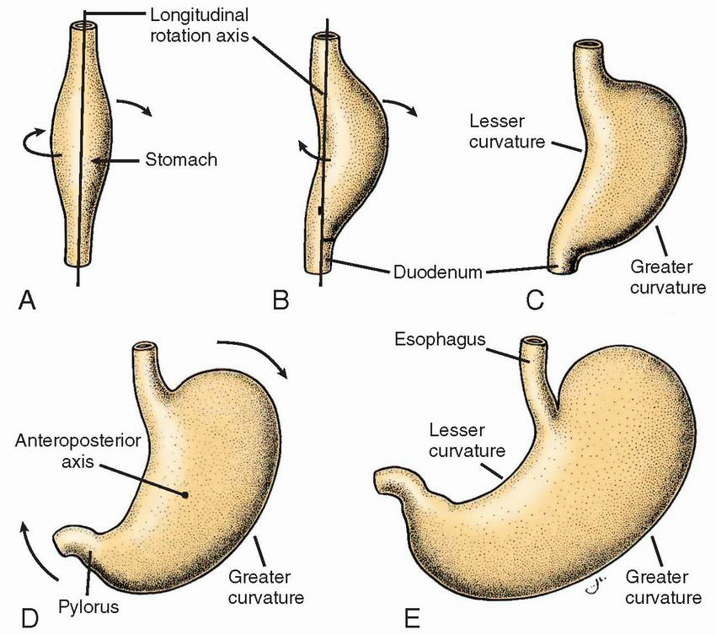
Regional Organogenesis: Stomach
4th week
3rd month
Langman’s fig 14-08
Stomach appears first as a fusiform dilation of the foregut endoderm which undergoes a 90° rotation driven by growth of the liver such that the left side moves ventrally and the right side moves dorsally (the vagus nerves follow this rotation which is how the left vagus becomes anterior and the right vagus becomes posterior).
Differential growth of the stomach borders establishes the greater and lesser curvatures; cranio-caudal rotation tips the pylorus superiorly.

Slide 19
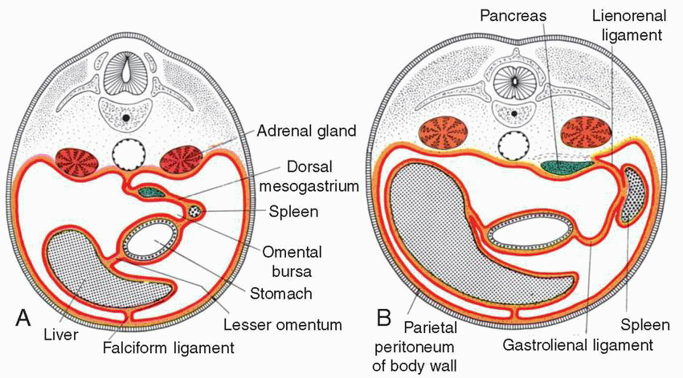
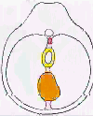
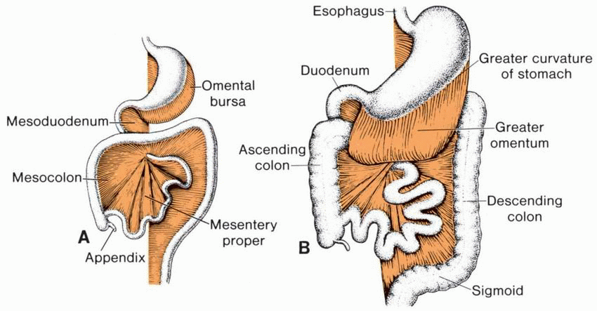
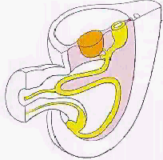
Regional Organogenesis: Stomach
5th week
6th week
(QuickTime version)
Greater omentum
3rd month
3rd month
Langman’s figs 14-11, 12
(QuickTime version)
90° rotation driven by growth of the liver such that the left side moves ventrally and the right side moves dorsally (the vagus nerves follow this rotation which is how the left vagus becomes anterior and the right vagus becomes posterior).
Dorsal AND ventral mesenteries of the stomach are retained to become the greater and lesser omenta, respectively
Caudal end of the stomach separated from the duodenum by formation of the pyloric sphincter (dependent on factors such as SOX-9, NKX-2.5, and BMP-4 signaling) –errors in this process lead to pyloric stenosis.

Slide 20
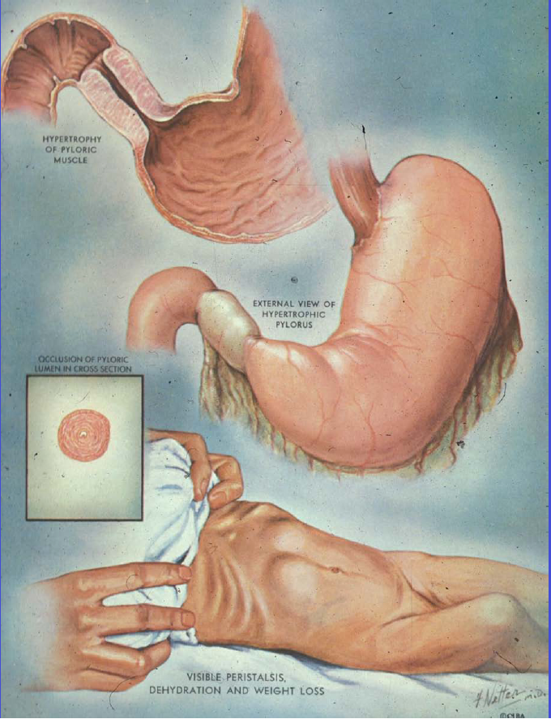
Pyloric Stenosis
Rather common malformation: present in 0.5% - 0.1% of infants
Characterized by very forceful (aka “projectile”), non-bilious vomiting ~1hr. after feeding (when pyloric emptying would occur).
  NOTE: the presence of bile would indicate POST-duodenal blockage of some sort.
Hypertrophied sphincter can often be palpated as a spherical nodule; peristalsis of the sphincter seen/felt under the skin.
Stenosis is due to overproliferation / hypertrophy of pyloric sphincter… NOT an error in re-canalization.
More common in males than females, so most likely has a genetic basis which is as yet undetermined.

Slide 21
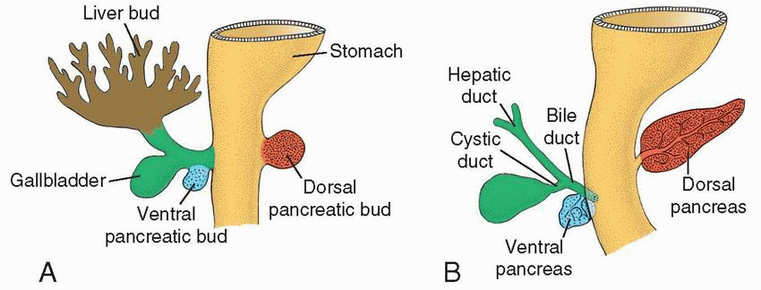
Regional Organogenesis: Liver & Pancreas
Langman’s fig 14-19
Liver and pancreas arise in the 4th week from foregut endoderm in response to signals from nearby mesoderm
Pancreas actually has ventral and dorsal components, each specified in a different manner

Slide 22
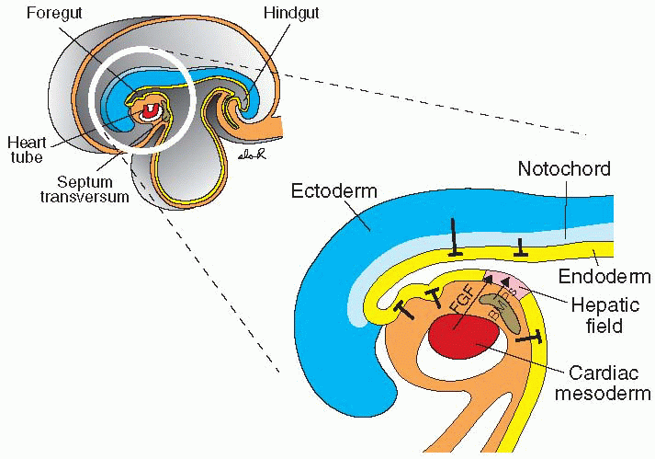
Cardiac mesoderm and septum transversum specifies liver and ventral pancreas (sort of…)
Wnt
Wnt
ventral pancreas
Langman’s fig 14-22
ALL foregut endoderm has the potential to develop into either liver or pancreas but local signals repress these fates (mesodermal Wnts ↓ Liver; mesodermal Wnts + endodermal Shh ↓ Pancreas)
FGFs and BMPs from cardiac mesoderm and septum transversum inhibit Wnt signaling, but the endoderm still expresses Shh and thus develops into liver.
Meanwhile, endoderm just caudal to liver bud is out of reach from the FGFs and BMPs but still sees Wnts, so the tissue does NOT become liver. Unlike the rest of the endoderm, it does NOT express Shh and so develops into the ventral pancreas.

Slide 23
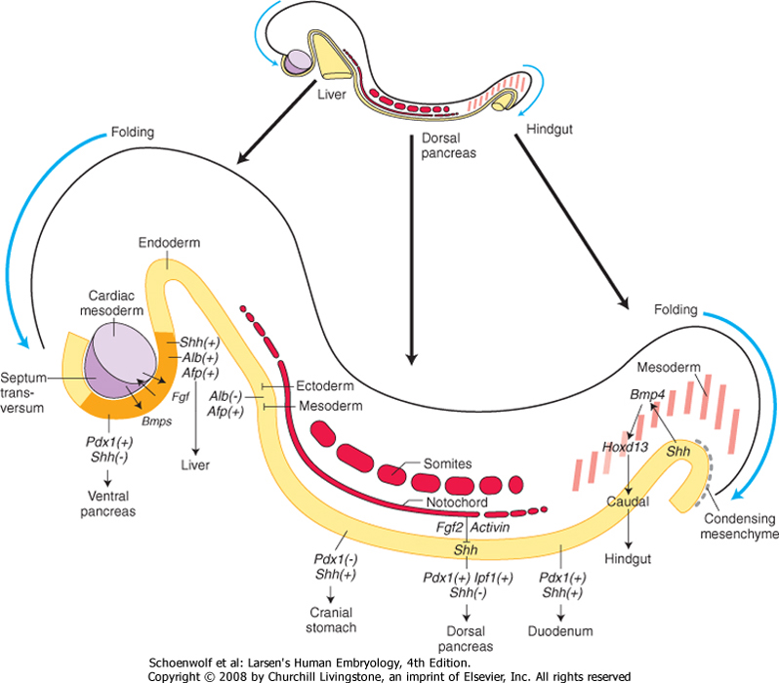
The dorsal pancreas is specified by signaling from the notochord
Larsen’s fig 14-05
Signaling from the notochord represses Shh in caudal foregut endoderm, which permits dorsal pancreatic differentiation.

Slide 24
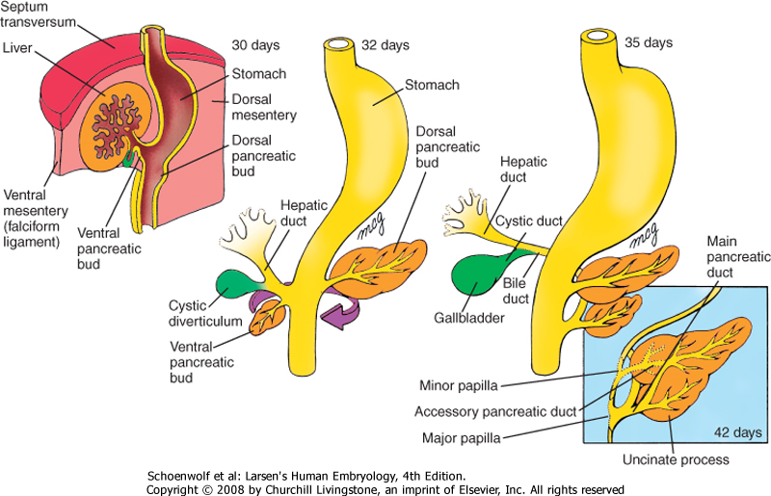
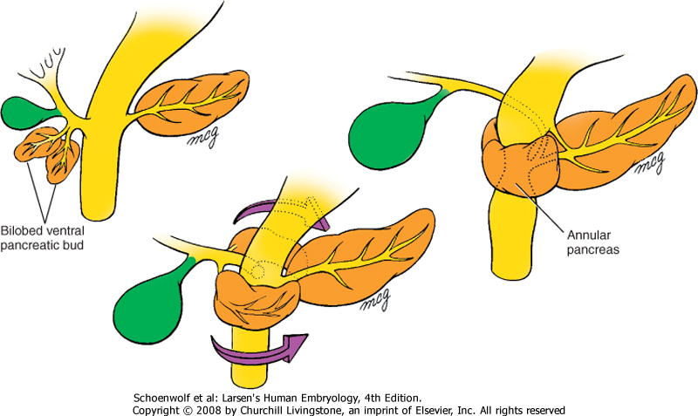
Rotation of the duodenum brings the ventral and dorsal pancreas together
Larsen’s fig 14-09
Aberrations in this process may result in an annular pancreas, which can constrict the duodenum.
Also, since the dorsal and ventral pancreas arise by different mechanisms, it’s possible that one or the other may be absent in the adult.
Larsen’s fig 14-10

Slide 25
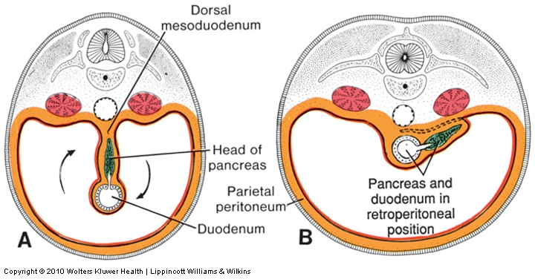
Rotation of the duodenum also causes it and the pancreas to become SECONDARILY retroperitoneal
5th week
3rd month
Langman’s fig 14-11
Secondarily retroperitoneal = a structure that was originally in the body coelom but then got pushed into the body wall during development

Slide 26
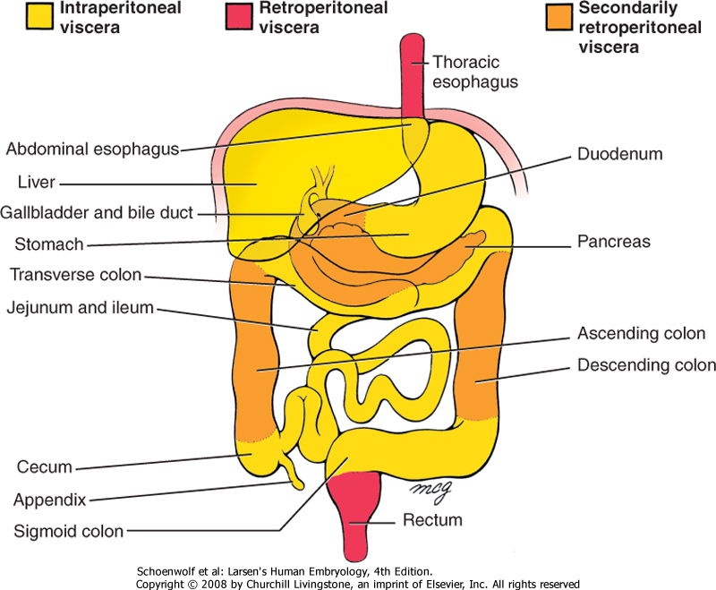
Intraperitoneal vs. retroperitoneal vs. secondarily retroperitoneal
Larsen’s fig 14-16

Slide 27
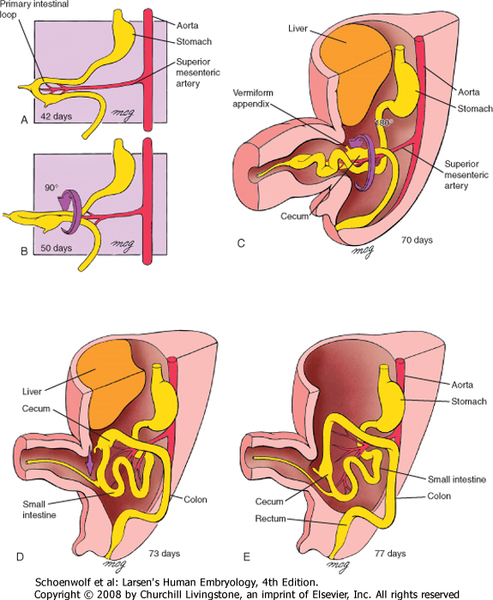
Development of the midgut and colon
Herniation and rotation:
  Growth of the GI tract exceeds volume of abdominal cavity so the tube herniates through umbilicus
  While herniated, gut undergoes a primary rotation (fig B) of 90° “counterclockwise” (when looking at the embryo); this corresponds with the rotation of the stomach, and positions the appendix on the left. The primary rotation also brings the left vagus n. to the FRONT (hence the change in its name to ANTERIOR vagus n.
  With the growth of the embryo, the abdominal cavity expands thus drawing the gut tube back within the abdominal cavity and causing an additional, secondary rotation (fig C) of 180° CCW (positioning the appendix on the RIGHT)
  Once in the abdominal cavity, the colon continues to grow in length, pushing the appendix to its final position in the lower right quadrant.
  Note the attachment of the vitelline duct to the gut at the region of the ileum. The duct normally regresses during development, but not always….

Slide 28
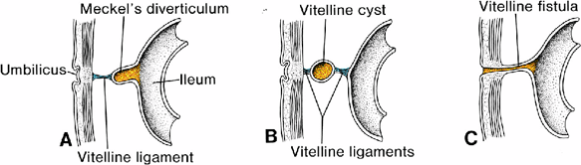
Defects associated with gut herniation and rotation: vitelline duct abnormalities
Langman’s fig 14-32
Vitelline duct abnormalities of some sort occur in ~2% of all live births. Note that these aberrant structures are almost always found along the ileal portion of the GI tract.

Slide 29
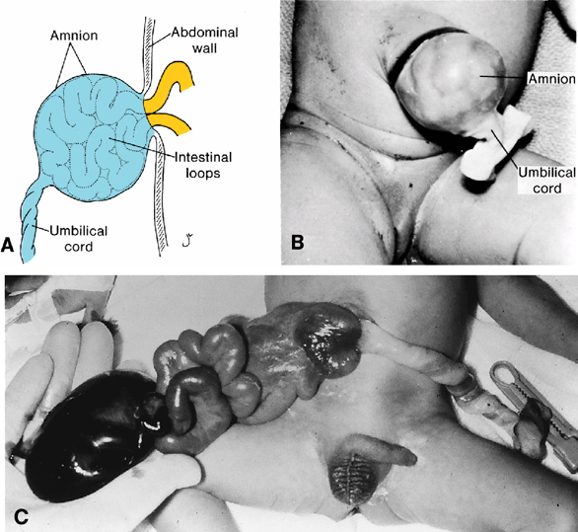
Defects associated with gut herniation and rotation: oomphalocoele
Langman’s fig 14-31

Slide 30
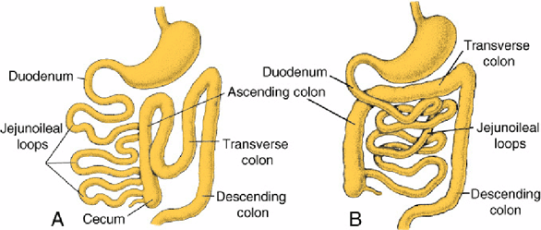
Defects associated with gut herniation and rotation: abnormal rotation
Langman’s fig 14-33
Absent or incomplete secondary rotation
Reversed secondary rotation
(90 CCW primary rotation occurs as usual but followed by abnormal 180 CW rotation. Net rotation is 90° CW; viscera are in their normal location, but note that the duodenum is anterior to the transverse colon)

Slide 31
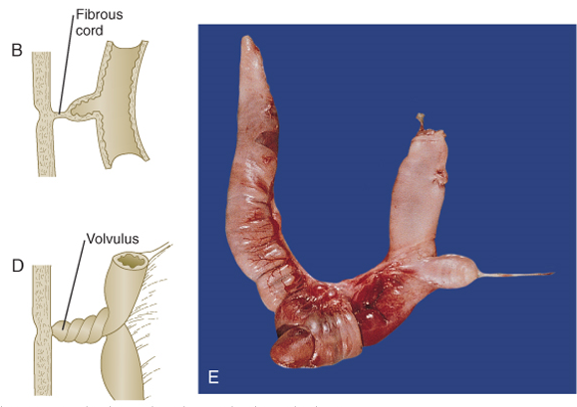
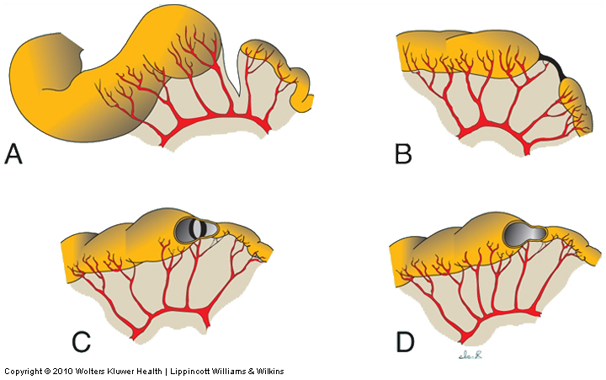
Defects associated with gut herniation and rotation: volvulus and ischemia/atresia
fibrous septum
Carlson fig 15-13
Langman fig 14-34
Volvulus (left figure) : fixation of a portion of the gut tube to the body wall; subsequent rotation twists and constricts the gut tube.
Ischemia/atresia (right figure): blood supply to a portion of the mid- or hindgut may become compromised during rotation or herniation leading to ischemia and loss (A), fibrosis (B), septation (C), or narrowing (D) of that portion.

Slide 32
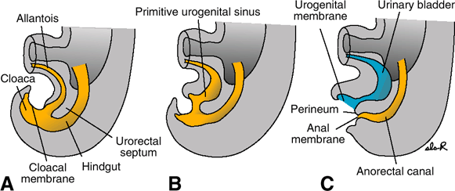
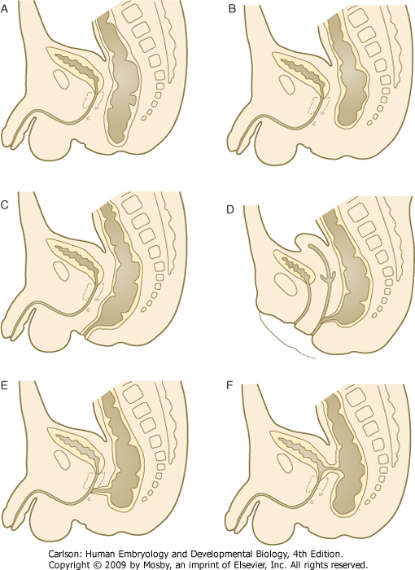
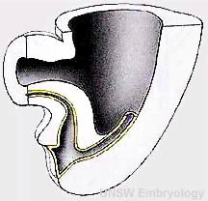
Development of the hindgut
Langman’s fig 14-36
imperforate anus
anal atresia
anoperineal fistula
rectovaginal fistula
(QuickTime version)
rectourethral fistula
rectovesical fistula
Derivatives of the hindgut include everything caudal to the distal 1/3 of the transverse colon.
At distalmost portion (sigmoid colon and rectum), urorectal septum derived from mesoderm divides cloaca into the anorectal canal and urogenital canals; cloacal membrane breaks down to form anal opening
2 potential problems can arise:
  “TOO MUCH” mesoderm – imperforate anus
  “NOT ENOUGH” mesoderm - atresia (B), and/or fistulas (C – F)
Carlson fig 15-18

Slide 33
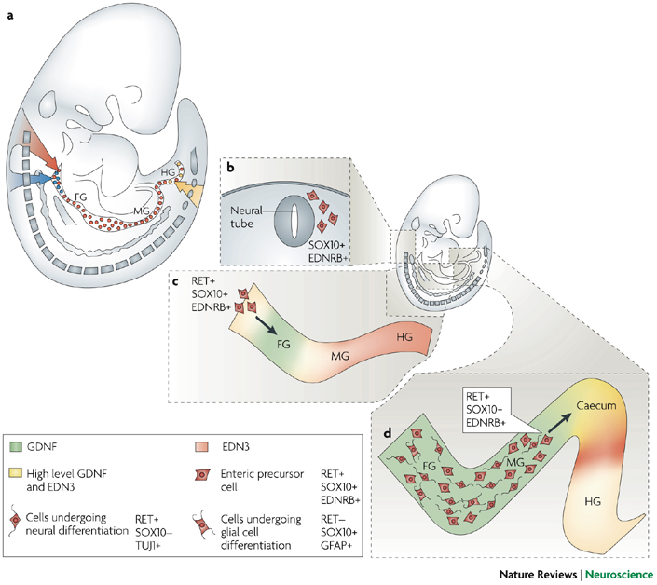
Neural crest cells from vagal and sacral regions colonize the gut and give rise to the enteric neurons of the myenteric and submucosal plexes:
Hirschsprung’s Disease: failure of vagal neural crest migration and/or survival, usually affecting distal hindgut (there are some sacral crest-derived cells there, but they cannot make up for loss of vagal crest-derived cells)

Slide 34
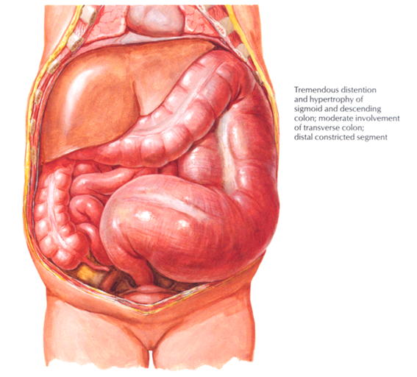
Hirschprung Disease (congenital megacolon)
Occurs in ~1:5000 births
Caused by failure of vagal neural crest cells to migrate into a portion of the colon
Aganglionic region tonically constricted (role of myenteric ganglia is largely INHIBITORY)
Signs and symptoms include:
  constipation or small, infrequent bowel movements
  bilious vomiting 3-4 hours after feeding (if totally obstructed)
  distension of upstream colon (“megacolon”)
Surgically repaired by removing affected region

