Slide 1
Development of the Urogenital System
Matt Velkey
matt.velkey@duke.edu
0380 Seely Mudd
Reading: Langman’s Medical Embryology, 11th ed., Ch15, pp. 235-263
--OR--
Langman’s Medical Embryology, 12th ed., Ch16, pp. 232-259

Slide 2
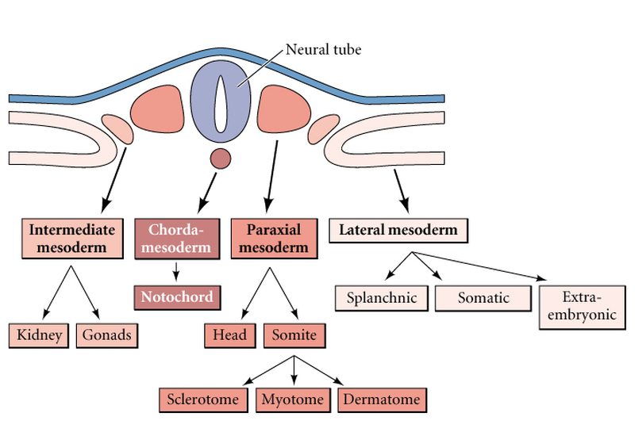
The urogenital system is derived from a longitudinal strip of “intermediate mesoderm” in the lumbar and pelvic regions of the embyo
Gilbert fig 14.1

Slide 3
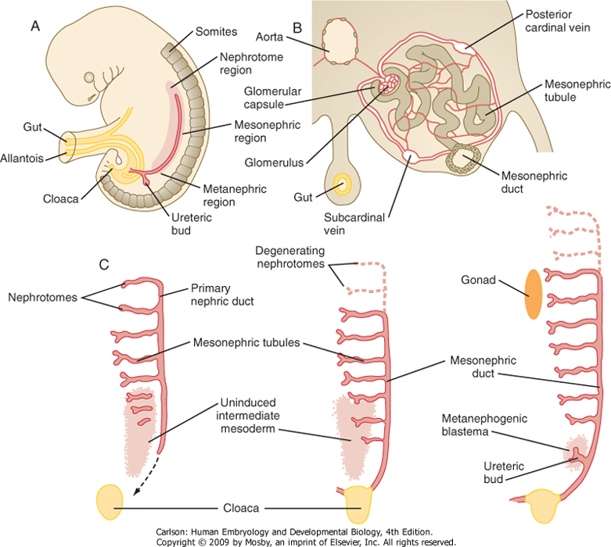
Intermediate Mesoderm Develops into Pro-, Meso-, and Metenaphric tubules
Carlson fig 16-01

Slide 4
Steps in Renal Development
Establishment of the “renogenic mesenchyme” and outgrowth of the ureteric bud from the mesonephric duct is the first critical step in the development of the adult kidney.
The ureteric bud epithelia and the adjacent metanephric blastema mesenchyme, are the two primordial cell types of the adult kidney.
Reciprocal inductive interactions between the ureteric bud epithelia and the metanephric blastema mesenchyme generate the nephrons, collecting ducts of the kidney.
Errors in these interactions may result in renal dysfunction/agenesis

Slide 5
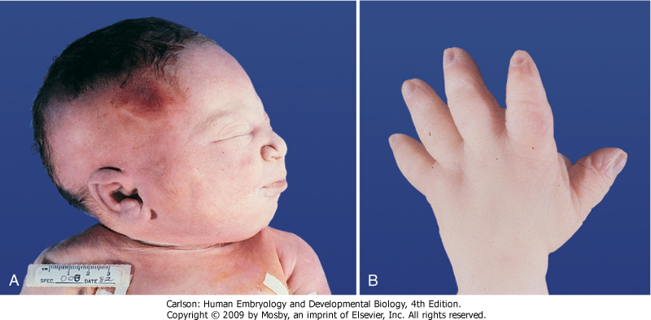
Effects of renal dysfunction: oligohydramnios and “Potter sequence”
Carlson fig 16-13
Amniotic fluid produced via activity of the kidneys; renal dysfunction therefore causes decrease in amniotic fluid production
Reduction in amniotic fluid results in increased mechanical pressure on fetus (e.g. from uterine musculature) thus affecting limbs, face, and even growth of internal organs, particularly the lungs.

Slide 6
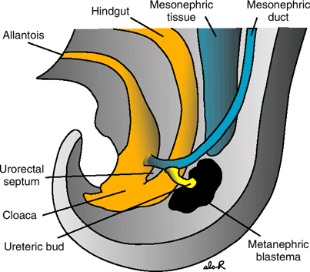
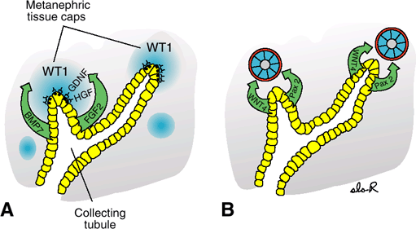
Overview of metanephric kidney induction
Langman’s fig 15-04
Langman’sfig 15-07
Cranial-caudal patterning by HOX genes (occurs very soon after gastrulation and is influenced by retinoid signaling) establishes a “renogenic” region within the intermediate mesoderm in the tail of the embryo –this renogenic mesoderm is the METANEPHRIC BLASTEMA
The METANEPHRIC BLASTEMA expresses a factor (WT1) that makes it competent to respond to signaling from epithelium of ureteric bud. The blastema also secretes factors (GDNF and HGF) that induce growth of the URETERIC BUD from the nearby mesonephric duct.
The URETERIC BUD expresses receptors to these factor (aka RET and MET) and responds by secreting BMP7 and FGF2, which stimulates proliferation and then differentiation of mesenchyme --i.e. reciprocal induction
Mesenchymal expression of WNT4 and PAX2 in response to ureteric bud signaling induces a mesenchymal-to-epithelial transition to form glomerular capsules and associated renal tubules.
Perturbations in these inductive events may cause inhibition of ureteric bud growth and renal agenesis OR, conversely, duplication or overproliferation of structures.

Slide 7
The expression of RET is regulated by retinoids through cell-cell signaling.
Stromal cells express retinoic acid receptors and relay a signal to the ureteric bud that maintains RET expression.
RA receptors
RET
Retinoic Acid
*Vitamin A deficiency leads to smaller kidneys with fewer nephrons resulting in renal hypoplasia or outright agenesis.

Slide 8
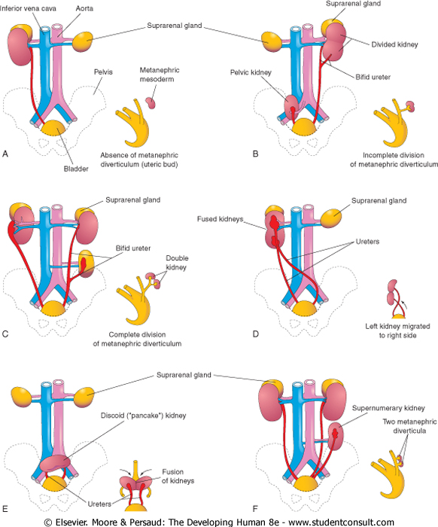
Perturbations in inductive signaling and/or branching morphogenesis can result in unilateral agenesis/hypoplasia OR duplications
Moore and Persaud, fig 12-12

Slide 9
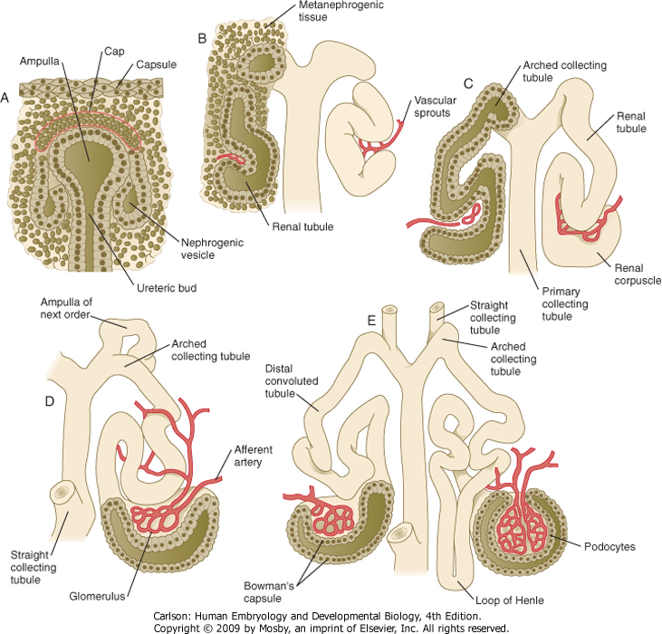
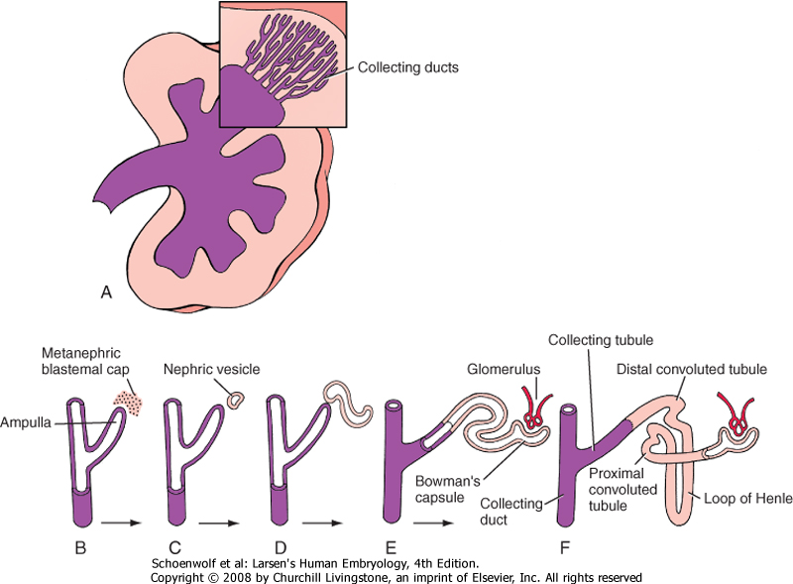
Mesenchyme of the Metanephric Blastema develops into NEPHRONS (podocytes, proximal tubules, loop of Henle, distal tubules)
EVERYTHING ELSE (i.e. downstream of the distal tubules) is from URETERIC BUD
Carlson fig 16-05
Purple indicates ureteric bud derivatives
Peach indicates mesenchymal derivatives
Larsen’s fig 15-05

Slide 10
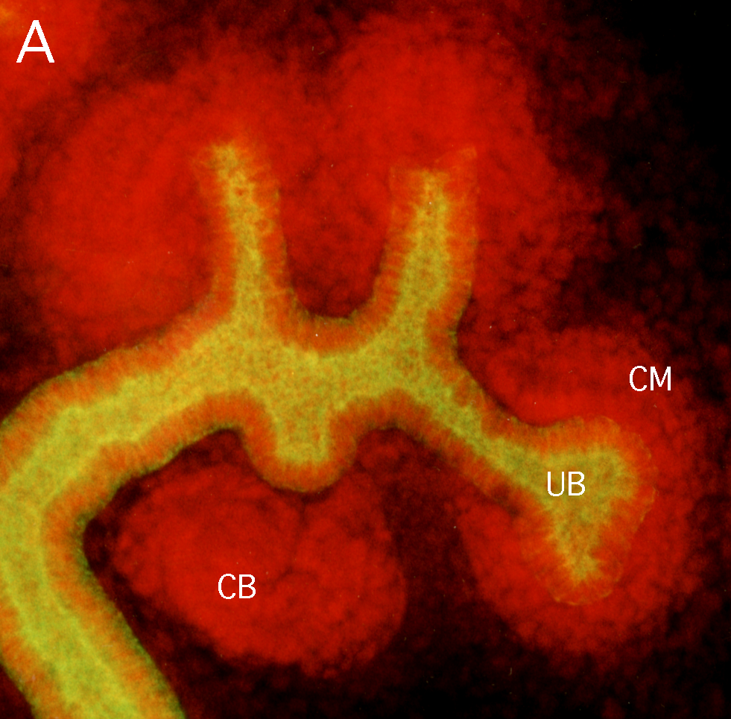
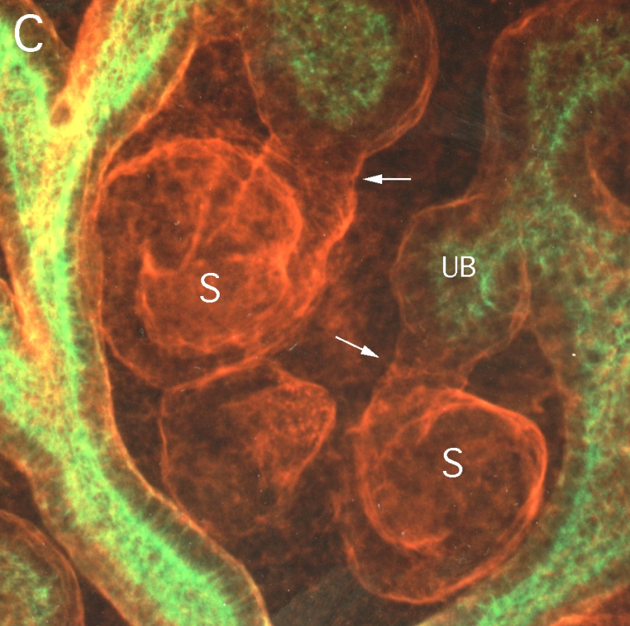
The PAX2 gene is a critical factor in the mesenchyme that controls the response to inductive signals
Cytokeratin Pax2
Cytokeratin Laminin
This response is a Mesenchymal-to-Epithelial Transition (MET) whereby the blastemal mesenchyme is transformed into epithelial structures (Bowman’s capsule, proximal and distal tubules, and loops of Henle)

Slide 11
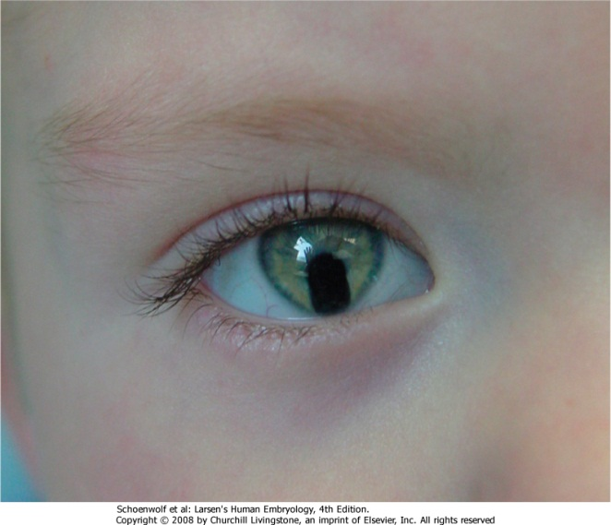
Loss of PAX2 function:
Renal-Coloboma Syndrome
The Pax2 gene essential for metanephric mesenchyme to differentiate into epithelial tubules in response to inductive signals from ureteric bud, so mutations (even if HETEROZYGOUS) can produce renal defects.
Patients typically exhibit at least these 3 symptoms:
1- Renal hypoplasia - due to reduced proliferation of the mesenchyme derived epithelia during development.
2- Vesicouretral Reflux - most likely due to improper connection of the ureter to the bladder or possibly due to inherent defects in epithelial cells of the mature ureter.
3- Colobomas (ventral fissures in iris, retina, and/or optic nerve) - due to failure of the optic fissure to fuse (expression of Pax2 is observed in ventral part of the optic cup and optic stalk).
Larsen’s fig 17-23

Slide 12
PAX2 Gain of Function
Pax2 Marks Proliferating Epithelia in a Variety of Renal Diseases.
These include: Renal Cell Carcinoma
Wilms’ Tumor
Juvenile Cystic and Dysplastic Kidneys
Polycystic Kidney Disease
Also, Pax2 is reactivated in regenerating proximal tubules after ischemia or toxic injury.
Thus, failure to suppress Pax2 during development or reactivation of Pax2 in the adult can lead to aberrant proliferation of the renal epithelia.

Slide 13
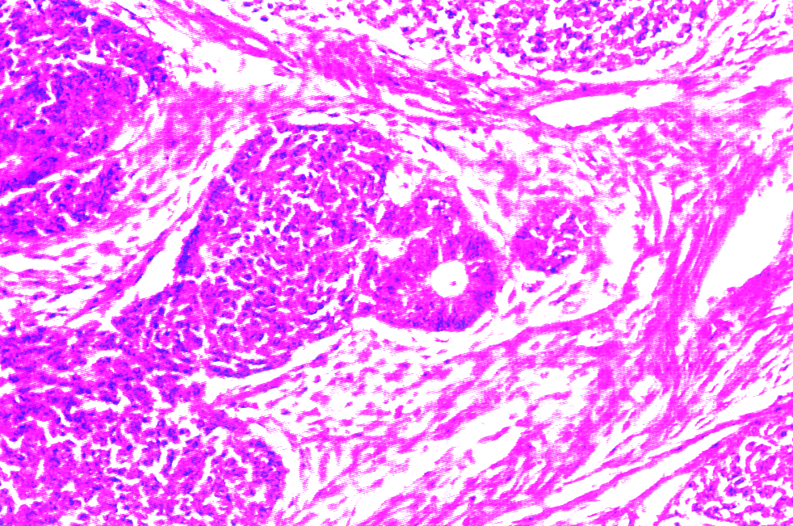
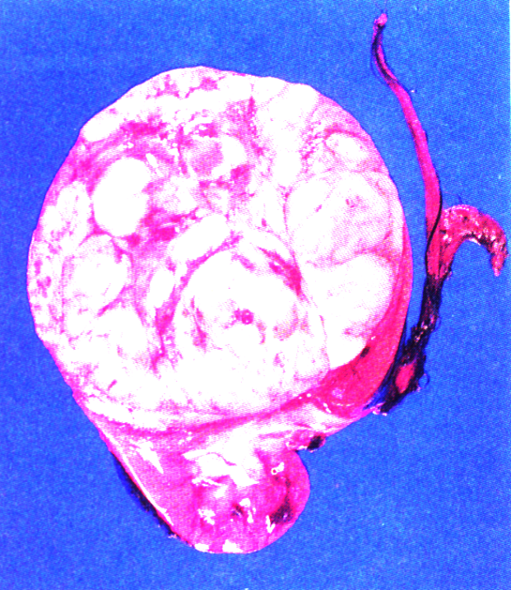
Wilms’ Tumor (Nephroblastoma)
found in infants from 0-24 months of age
consists of blastemal, epithelial, and stromal cell types
Given the age of onset and the differentiation potential of tumors, it is likely that they arise from mutations in one or more genes that function during kidney development.
There are both familial and sporadic forms of Wilms’ tumor
In addition to PAX2 mutations, deletions or mutations of WT1 gene are associated with 10-20% of sporadic Wilms’ tumors (WT1 is another gene involved in development of the metanephric blastema).

Slide 14
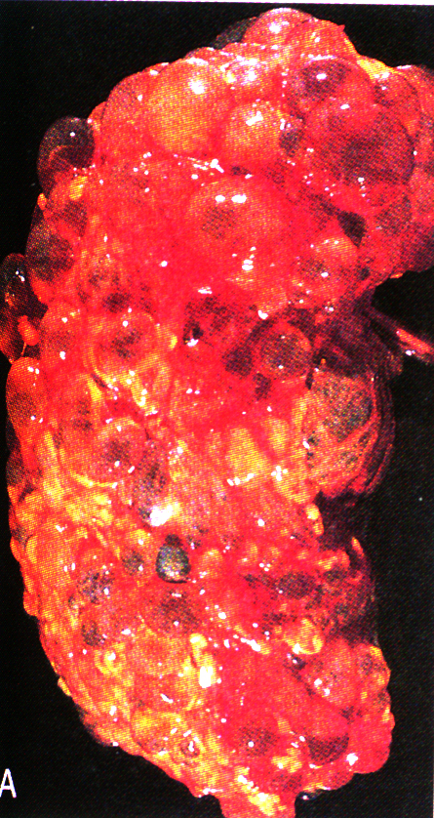
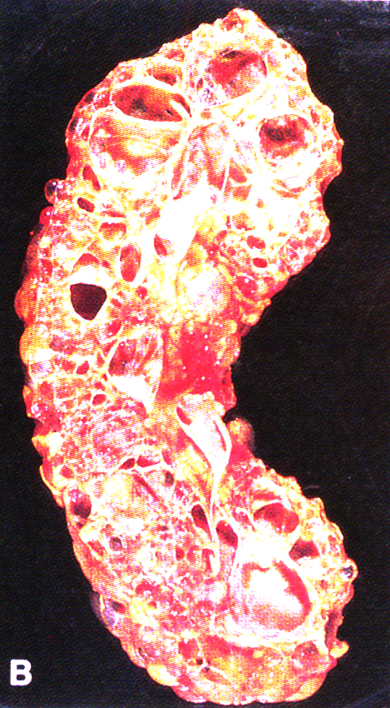
Polycystic Kidney Disease
Rather common: affects about 1/3000 individuals
There are dominant and recessive forms of PKD –the most common is autosomal dominant PKD (ADPKD).
Patients often present with renal and pancreatic cysts.
Cysts are large, fluid-filled epithelial spheres that ultimately can displace the normal tissue and lead to end stage renal disease.

Slide 15
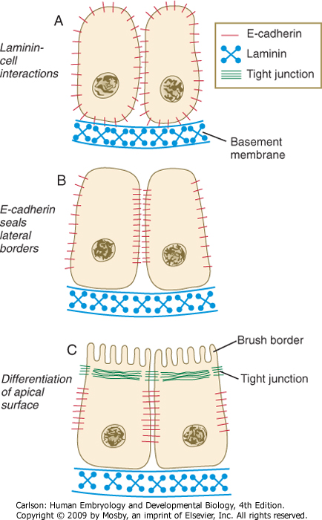
Failure to make or maintain polarized epithelia results in congenital renal cysts.
Polarization of the metanephric
mesenchyme is a step-wise process
that requires changes in cell-
adhesion molecule expression, the
formation of adherends junctions,
the deposition of a laminin containing
basement membrane, and the formation
of tight junctions.
This establishes the apical and baso-
lateral sides of the epithelial cell
Carlson fig 16-06

Slide 16
Mechanisms of Cyst Formation
Blockage & budding
Proliferation
Loss of Polarity
basal
EGF
apical
EGF receptor
Na,K ATPase

Slide 17
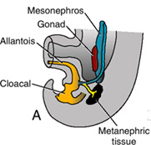
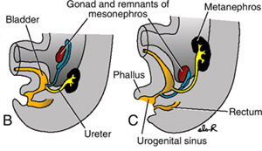
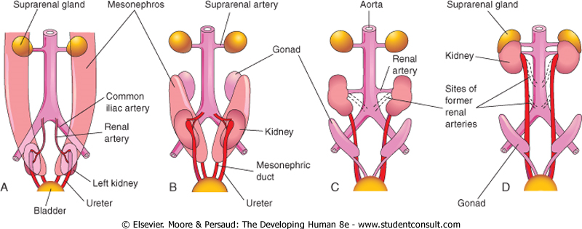
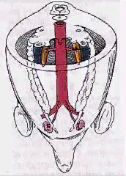
“Ascent” of the kidneys
The kidneys initially form near the tail of the embryo.
The arteries supplying the kidneys develop first as blind plexuses that invade the common iliac arteries.
Growth of the embryo in length causes the kidneys to “ascend” to their final position in the lumbar region.
Rather than “drag” their blood supply with them as they ascend, the kidneys send out new and slightly more cranial branches and then cut off flow to the more caudal branches, causing their regression.
Langman’s fig 15-10
Week 7
Week 8
Week 9
Week 6
Moore and Persaud, fig 12-10
(QuickTime version)

Slide 18
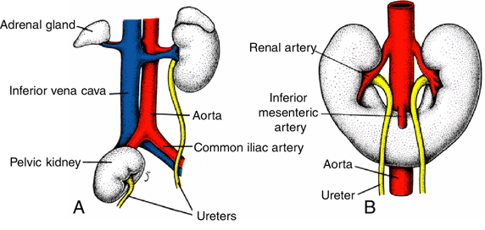
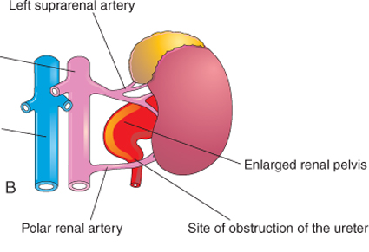
Malformations related to the ascent of the kidneys
Pelvic kidney
Horseshoe kidney
Hydronephrosis (ureteric distension)
Langman’s fig 15-11
Moore and Persaud, fig 12-11
In this case, the right kidney failed to ascend.
The right & left kidneys fused into a single, horseshoe-shaped organ, and their ascent was impeded by the inferior mesenteric artery.
The ureter is pressed up against a caudal supernumerary artery, causing partial obstruction and dilation.

Slide 19
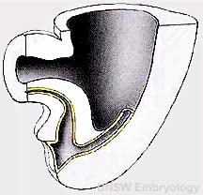
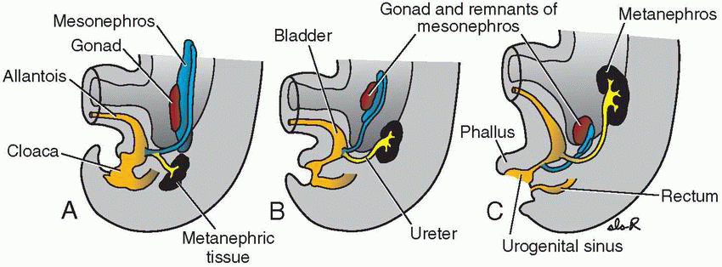
Development of the bladder
The terminal part of the hindgut ends in the CLOACA, which is an endoderm-lined chamber that contacts the surface ectoderm at the cloacal membrane and communicates with the allantois, which is a membranous sac that extends into the umbilicus alongside the vitelline duct.
The cloaca is then divided by the URORECTAL SEPTUM
  the DORSAL (inferior) portion develops into the RECTUM and ANAL CANAL
  the VENTRAL (superior) portion develops into the BLADDER and UROGENITAL SINUS
(QuickTime version)
Urorectal
septum
Langman’s fig 15-10

Slide 20
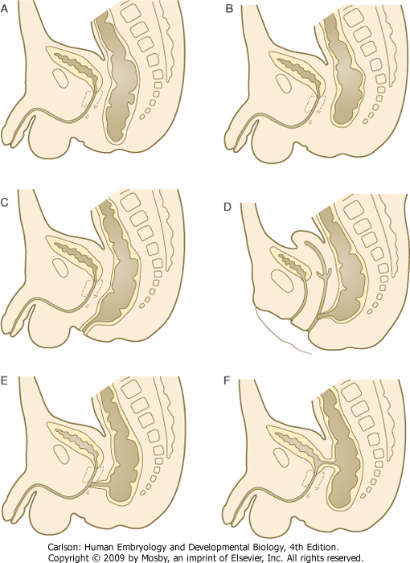
Cloacal Defects
imperforate anus
anal atresia
Development of the musculature of the anal sphincters is MESODERM dependent, so failure to produce enough mesoderm (gastrulation defects) can cause ANAL ATRESIA (b)
In the setting of anal atresia, the rectum may communicate via FISTULAS with the perineal body (c) or urogenital tract (d, e, and f)
In the condition shown in (a), there is actually TOO MUCH mesoderm such that the anal membrane cannot break down.
anoperineal fistula
rectovaginal fistula
rectourethral fistula
rectovesical fistula
Carlson fig 15-18

Slide 21
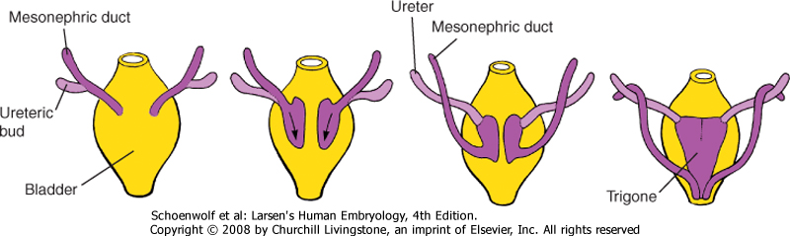
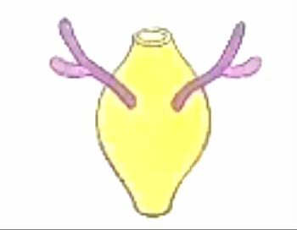
The trigone of the bladder is formed via the incorporation of a portion of the mesonephric ducts
mesonephric ducts
Viewed from the back:
Larsen’s fig 15-12
(QuickTime version)
ureteric bud & metanephric blastema
cloaca
The mesonephric duct connects to the cloaca (which becomes bladder). Recall that the ureteric buds grow from the mesonephric ducts.
As the bladder grows and expands, the distal ends of the mesonephric ducts are absorbed into the wall of the bladder, but the absorption STOPS at the point where the ureteric bud branched off the mesonephric duct. Thus, the opening of the ureters ends up dorsal and superior to opening of the mesonephric ducts
In females, most of the mesonephric ducts regress except for that which is within the trigone of the bladder.
In males, the mesonephric ducts are retained as the ductus deferens and ejaculatory ducts that convey sperm from the testes ultimately to the prostatic urethra.
As a MESONEPHRIC DUCT derivative, the trigone is sensitive to sex hormones and can undergo hormone-induced epithelial metaplasia, a condition known as TRIGONITIS which can lead to urinary symptoms.

Slide 22
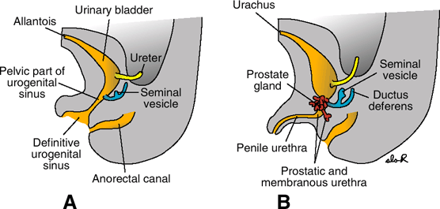
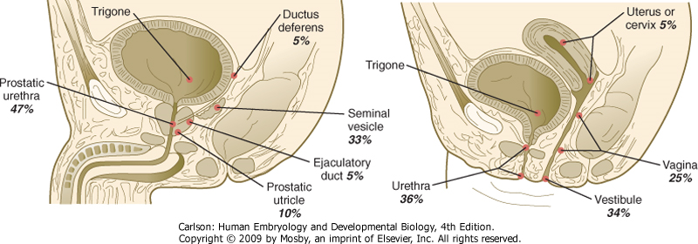
Abnormal attachment of the ureters
Relationship of mesonephric (Wolffian), paramesonephric (Müllerian), and metanephric (ureteric) ducts is such that the ureters can end up attached at sites other than the bladder.
Langman’s fig 15-13
Carlson fig 16-17

Slide 23
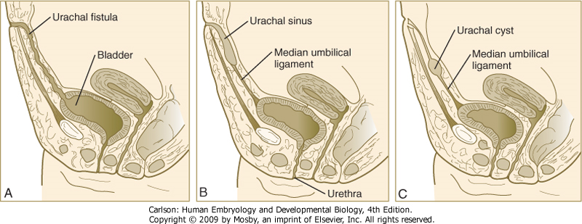
Other malformations: urachal cysts and fistulas
Langman’s fig 15-13
Carlson fig 16-18

Slide 24
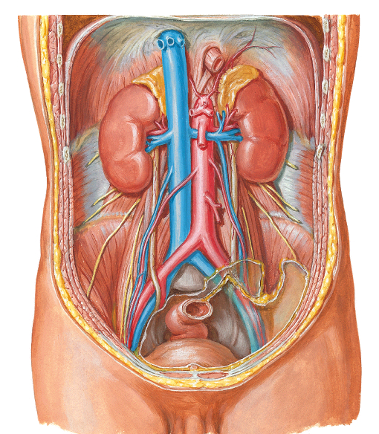
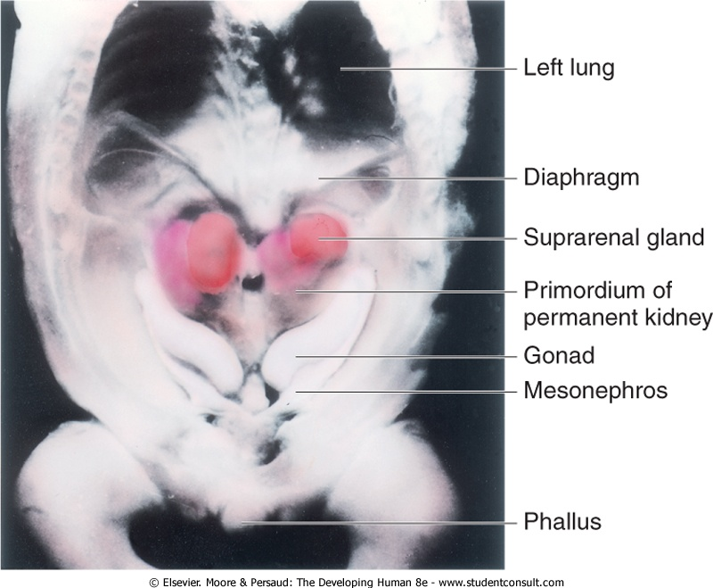
Development of the Adrenal Glands
10 weeks
adult
Moore and Persaud, fig 12-3
Netter’s plate 319

Slide 25
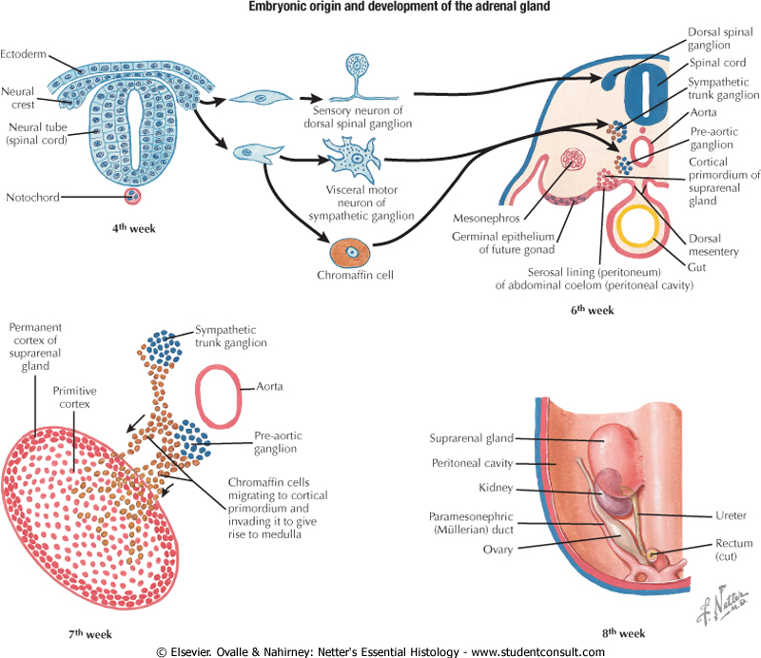
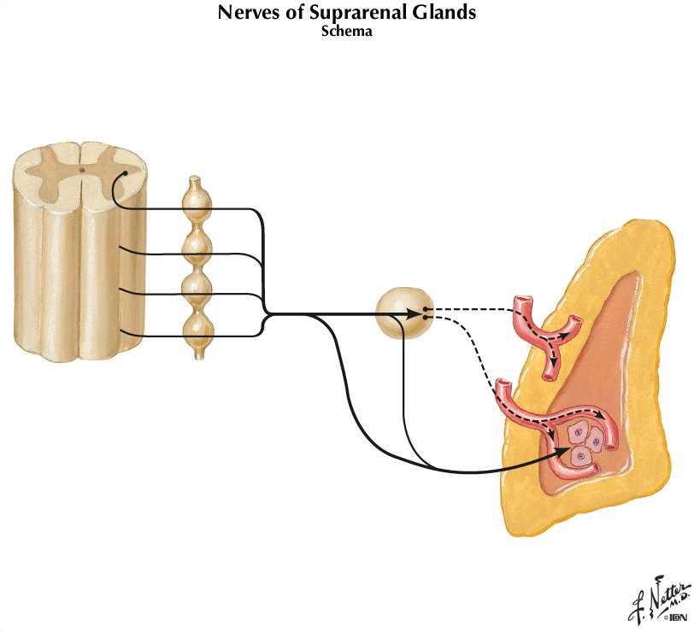
The adrenal gland develops from Intermediate Mesoderm AND Neural Crest
Netter’s plate 334
Pre-ganglionic neurons in lateral horn T10-L1 send fibers THROUGH sympathetic trunk to celiac and aorticorenal ganglia --post-ganglionic neurons from there then project to the adrenal medulla
Some fibers from lateral horn go directly to adrenal medulla
Net result is stimulation of adrenal chromaffin cells resulting in secretion of epinephrine and norepinephrine directly into the blood stream
Ovalle fig 10.20
Intermediate mesoderm in the lumbar region of the abdominal cavity develops into the ADRENAL CORTEX (first fetal, then definitive -the fetal cortex regresses such that the gland is smaller in adults compared to infants and toddlers)
NEURAL CREST cells migrate to that region and invade the interior of the gland to give rise to CHROMAFFIN CELLS of the ADRENAL MEDULLA
So, the adrenal medulla is basically made of post-ganglionic sympathetic neurons that secrete epinephrine or norepinephrine into the blood.

Slide 26
Development of the Male and Female Reproductive Systems

Slide 27
Gonadal Development
Sexual determination
  Genetic events that bring about male or female gonadal development
Sexual differentiation
  All subsequent morphogenetic and physiologic events that establish functional sexuality, sexual dimorphism, and secondary sex characteristics

Slide 28
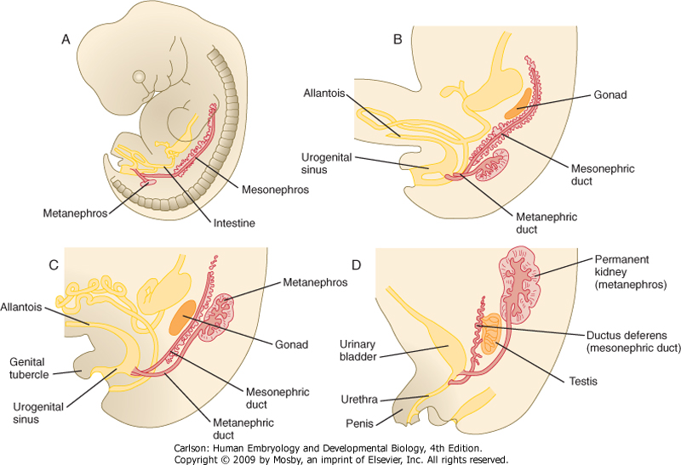
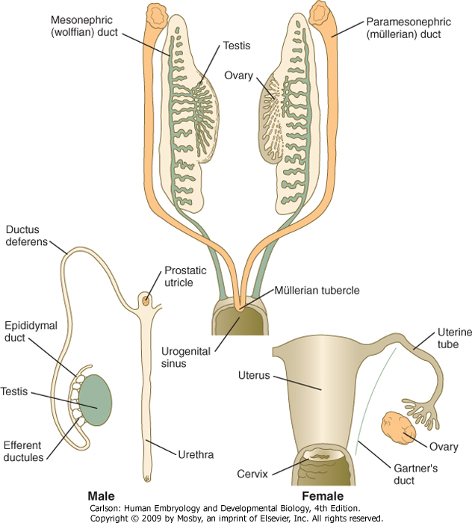
The gonads are “indifferent” up until ~7 weeks of gestation
Carlson fig 16-02
Carlson fig 16-24

Slide 29
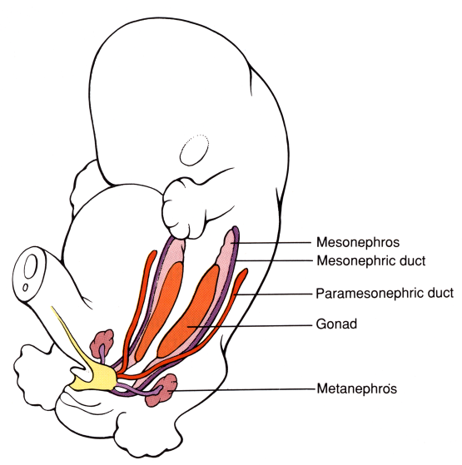
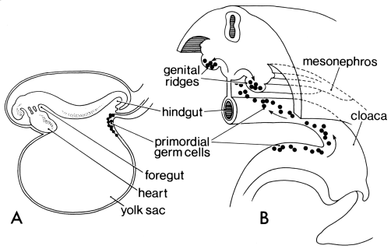
The gonads are populated by germ cells that move out into yolk sac very early in development and then migrate back into the fetus after gastrulation
Larsen’s fig 15-16
It is presumed the initial migration out of the fetus is so germ cells aren’t exposed to early patterning factors.
Around the 6th week, the germ cells migrate to the urogenital ridges in the intermediate mesoderm –incomplete migration causes “streak” gonads that may progress to multi-lineage tumors (teratomas).
Once in the gonads, the germ cells then start to pattern the gonads and their associated ducts.

Slide 30
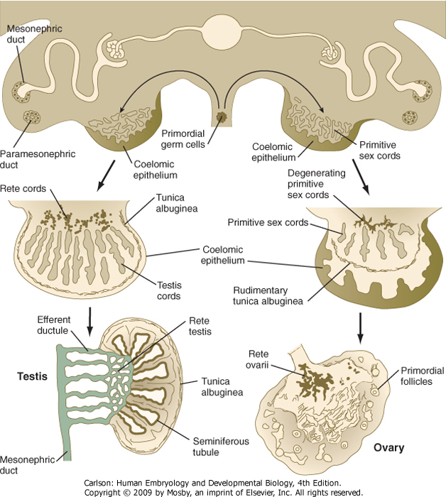
Gonadal differentiation
Determined (mostly) by presence (or absence) of SRY
If SRY+, then primitive sex cord develops into testis
If SRY-, then primitive sex cord develops into ovary
…actually a bit more complicated than this, but this will be discussed later in the course.
Carlson fig 16-23

Slide 31
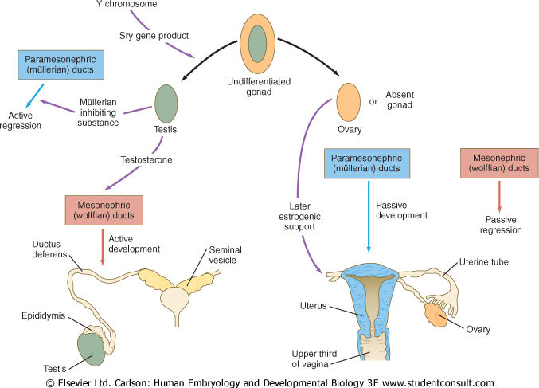
Sexual Determination
No MIS
No Testosterone
Sertoli cells
Leydig cells
Sexual Differentiation
Carlson fig 16-25

Slide 32
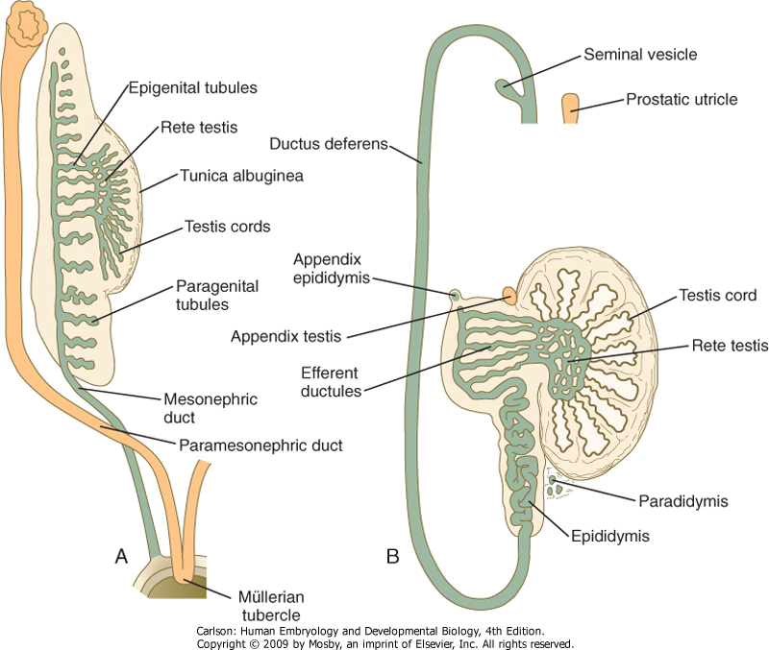

Development of the male genital tract:
Mainly mesonephric duct-derived and ANDROGEN-DEPENDENT
(QuickTime version)
Paramesonephric remnants:
Appendix testis
Prostatic utricle
Carlson fig 16-26

Slide 33
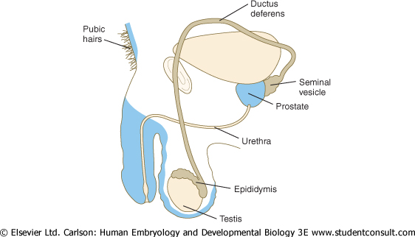
Male virilization
Blue = Dihydroxytestosterone (DHT)
Carlson fig 16-28
Brown = Testosterone

Slide 34
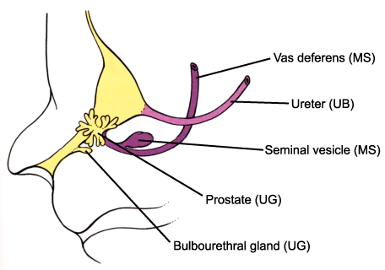
The prostate develops as an outgrowth of the urogenital sinus epithelium
Larsen’s fig 15-23
Urogenital sinus: prostate, bulbourethral gland
Ureteric bud: ureter
Mesonephric duct: seminal vesicle, vas deferens

Slide 35
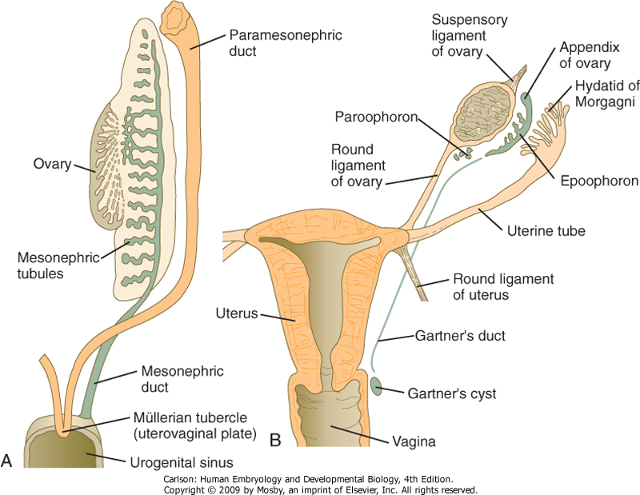

Development of the female genital tract:
Primarily paramesonephric duct-derived and BY “DEFAULT”
(QuickTime version)
mesonephric remnants:
appendix of ovary
Gartner’s duct
Carlson fig 16-29

Slide 36
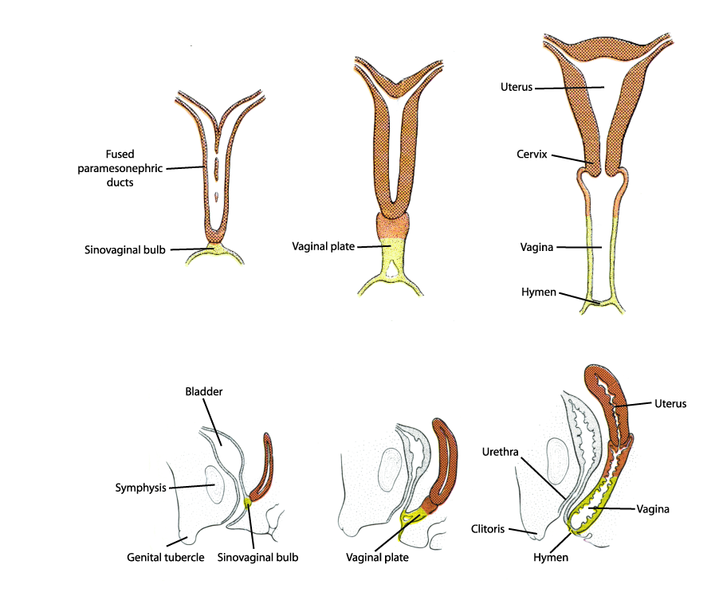
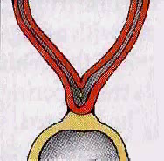
Formation of uterus and vagina
(QuickTime version)
Langman’s fig 15-29 & 30
Paramesonephric (Mullerian) ducts fuse to form uterus and upper 1/3 of vagina
Lower 2/3 of the vagina from the UROGENITAL SINUS

Slide 37
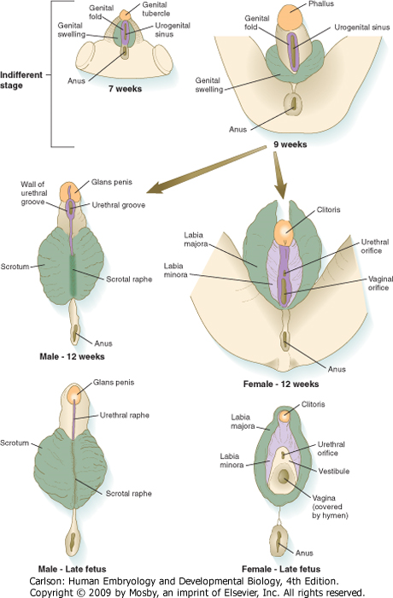
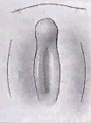
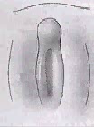
Formation of external genitalia
(QuickTime version)
(QuickTime version)
fate of MALE primordia
Genital Tubercle | Genital Folds | Genital Swellings
Body and glans of penis | Ventral penis & raphe | Scrotum & scrotal raphe
fate of FEMALE primordia
Genital Tubercle | Genital Folds | Genital Swellings
Clitoris | Labia minora | Labia majora
Carlson fig 16-35

Slide 38
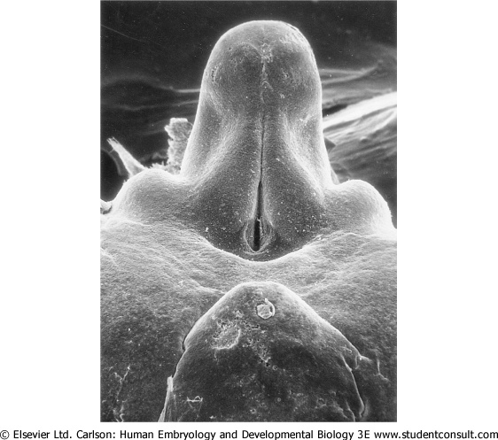

Formation of the penile urethra
Carlson figs 16-35 & 36

Slide 39



Hypospadias
Carlson fig 16-38
meatus
Normal midline raphe
Raphe off center

Slide 40


Testicular descent
2nd month
3rd month
term
7th month
(QuickTime version)
The testes arise in the lumbar region but then descend into pelvic cavity and through the inguinal canal to end up in the scrotum
Descent of the testis is due to tethering of the testes to the anterior body wall by the gubernaculum. With growth and elongation of the embryo coupled with shortening of the gubernaculum, the testes are pulled through the body wall, then the inguinal canal, and finally into the scrotum.
Carlson fig 16-33

Slide 41



Testicular Descent (frontal view)
11 weeks
(QuickTime version)
4 months
8 months
Netter’s plate 369

Slide 42
Factors that regulate sexual differentiation
SRY (normally on Y chromosome)
MIS/MIS-receptor
  Consider what happens if either is missing
Androgens/Androgen receptor (AR)
  Recall that testosterone works mostly on internal structures whereas DHT and other androgens work mostly on external genitalia
  Consider happens if the androgen receptor is lacking
  Consider what happens when there is an excess of steroid hormones (e.g. adrenal hyperplasia)

Slide 43

Persistent Müllerian Duct syndrome
(genetic male)
Normal male external genitalia
Presence of uterus and fallopian tubes; testes may lie either in the normal position for ovaries (i.e. within the broad ligament) or one or both testes may descend into inguinal hernial sac)
Usually undergo virilization at puberty
Mutation in MIS (~50%) or mutation in MIS-receptor (~50%)
Larsen’s fig 15-22

Slide 44

Androgen Insensivity Syndrome
Response to androgens requires functional androgen receptors (ARs). AR mutations can cause Complete or Partial Androgen Insensitivity Syndrome
  Lack of virilization due to inability of AR to bind testosterone, aka “testicular feminization”
  XY sex reversal with relatively normal female external genitalia but undescended testes
  Normal production of MIS from Leytig cells causes Mullerian duct regression, so no oviducts, uterus, or upper 1/3 of vagina
11 year old
17 year old
Biopsy sample of undescended testis
Larsen’s fig 15-40

Slide 45

5 α-reductase deficiency
(genetic male)
Lacking enzyme required to convert Testosterone to Dihydrotestosterone
Elevated Testosterone:DHT ratio
Testoterone less potent virilizer, especially for external genitalia, leading to ambiguous genitalia
Lack of virilization of male fetus usually accompanied by hypospadias
Normal production of MIS causes regression of Mullerian structures

Slide 46

Congenital adrenal hyperplasia
(genetic female)
Defect in 21-hydroxylase essential for cortisol synthesis –lack of feedback to pituitary causes overproduction of ACTH and oversecretion of the other adrenal hormones (e.g. androgens from zona reticularis)
Virilization of female fetus due to increased production of weak androgenic hormones from the adrenal (can’t make cortisol but can make androgens such as androstenedione)
  Enlarged clitoris
  Partial or complete fusion of labia majora
Testes absent (no SRY)
Very little mesonephric (male) ducts because there’s insufficient testosterone to support their development
Normal Müllerian (female) duct structures internally (no MIS)

Slide 47
Developmental Sex Disorders:
    Congenital conditions in which development of chromosomal, gonadal, or anatomic sex is atypical.
Nomenclature
  Moving away from terms such as “intersex” and “hermaphrodite”
  46, XY DSD
    Gonadal dysgenesis (SRY mutations)
    Androgen Insensitivity Syndrome (partial or complete)
    Androgen synthesis defects (5-alpha reductase deficiency)
  46, XX DSD
    Androgen excess (most common 21-hydroxylase Congenital Adrenal Hyperplasia)
  Sex chromosome DSD (usually caused by non-disjunction)
    Turner (XO) – phenotypically female, streak ovaries (sterile), short stature, web neck
    Klinefelter (XXY, XXXY) – phenotypically male, infertile, slender build, gynecomastia, impaired sexual maturation

Slide 48
Figures from the following texts:
Bruce M. Carlson, Human Embryology & Developmental Biology, 4th ed.
Scott Gilbert, Developmental Biology, 8th ed.
Keith Moore & Vid Persaud, The Developing Human, 8th ed.
Frank M. Netter, Atlas of Human Anatomy, 5th ed.
William Ovalle and Patrick Nahirney, Netter’s Essential Histology
Tom W Sadler, Langman’s Medical Embryology, 11th ed.
Gary Schoenwolf, et al., Larsen’s Human Embryology, 4th ed.

