Slide 1
Craniofacial and Pharyngeal Arch Development
Matthew Velkey
matt.velkey@duke.edu
454D Davison

Slide 2
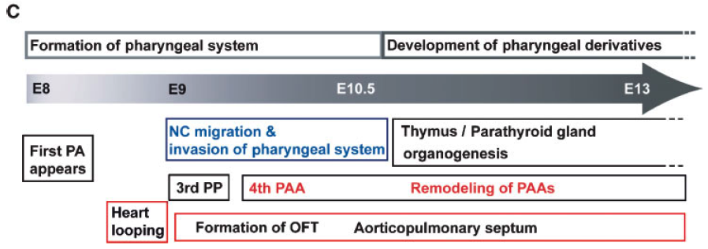
Two general phases of pharyngeal apparatus development
Wk 3.5
Wk 4.5
Wk 5.5
Wk 6.5
Disruptions to either phase can result in a broad spectrum of defects.

Slide 3
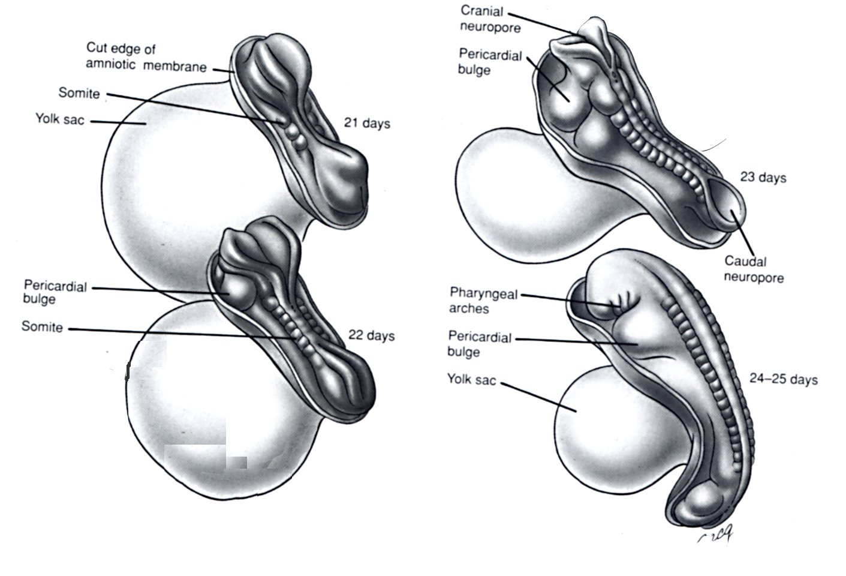
Pharyngeal aches emerge at neural tube closure
Notes:
Pharyngeal (branchial) arches = earliest primordia of face
Ectodermal pouches filled with mesenchyme.
Emerge just as NT closure is completed.
1st arch: splits into maxillary & mandibular processes and is one of primary relevance for face
Other arches: organization of neck & associated structures, much more the focus of this afternoon

Slide 4
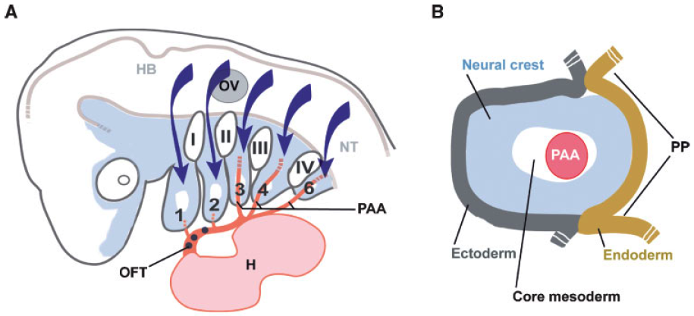
Early pharyngeal apparatus development
5 pairs arise in cranial to caudal direction
Arch 1 = Mandible
Arch 2-4, 6 = Neck
No Arch 5 in mammals
Notes:
5 pairs of arches arise cranial to caudal that get filled with migrating mesenchyme, particularly neural crest, but also from somitomeres
These are iterative structures --initially, they are all appear superficially the same
H=heart HB=hindbrain NT=neural tube OFT=outflow tract OV=otic vesicle
PAA=pharyngeal arch artery PP=pharyngeal pouch

Slide 5
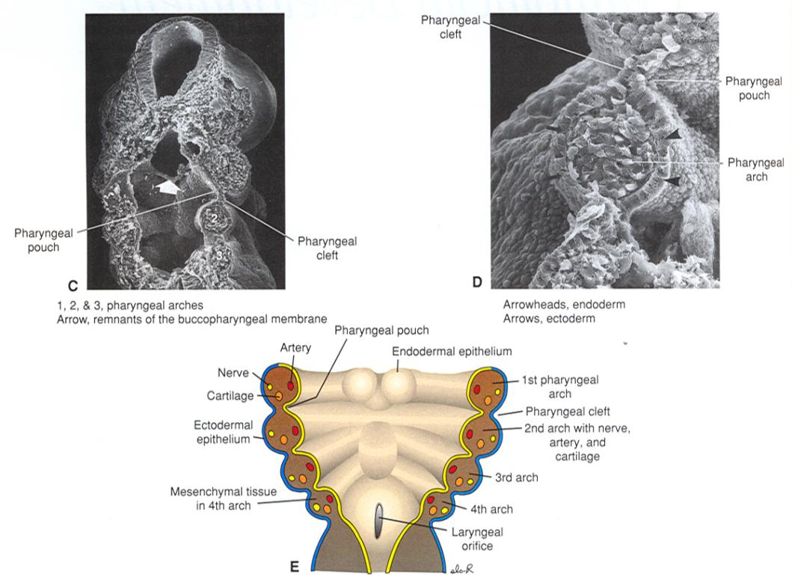
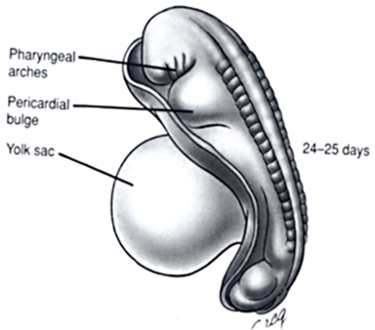
Organization & components of pharyngeal arches
plane of section
Notes:
Looking from behind at SEM for freeze-fractured embryo
HI & lo power
Landmarks: Mid/Forebrain, stomodeum
Arches are continuous, no gaps between
Outer layer = surface ectoderm
Inner layer = pharyngeal endoderm
Middle: neural crest (mostly) & mesoderm
Early arches are iterative: nerve, artery, & central rod of precartilagenous mesenchyme
Coincident

Slide 6
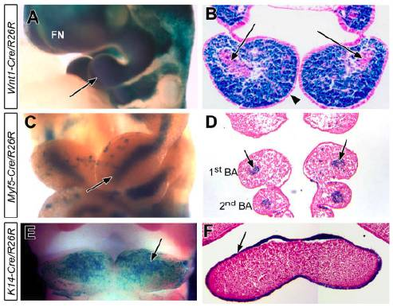
In vivo marking of pharyngeal arch components
Neural Crest
Mesoderm
Ectoderm

Slide 7
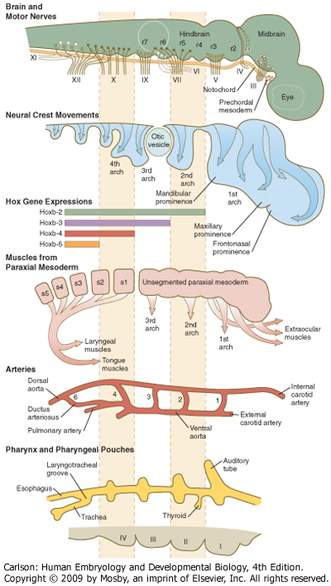
Coincident development of related structures within the pharyngeal apparatus
Significance:
Understanding the origins of developmentally-related structures
A genetic lesion affecting a particular pharyngeal arch will frequently affect multiple developmentally related structures
Notes:
Tissues often maintain their relationship with their original nerve as they migrate out or become displaced from their site of origin
Understanding coincident consequences of genetic lesion.
e.g. example later of lesion in PA3 & 4 gene affecting structures derived from associated pouches & arteries.

Slide 8
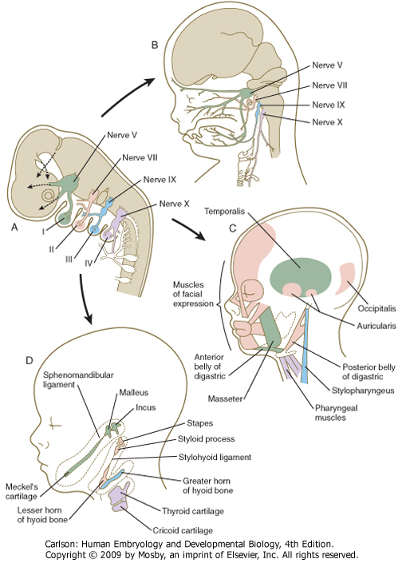
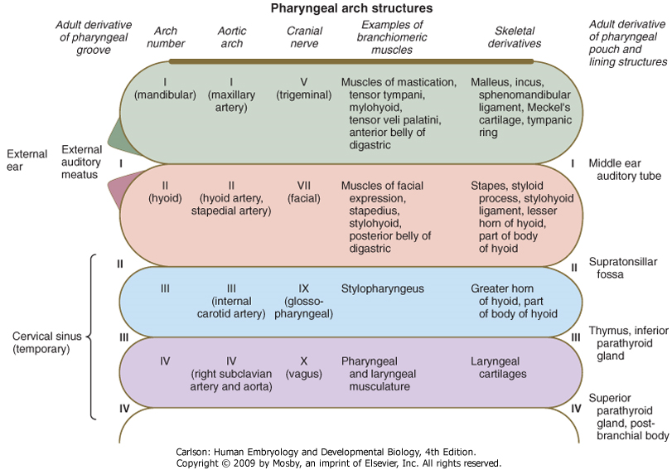
Pharyngeal arch derivatives (summary)
Notes:
Illustration of related developmental origins
Scorecard of pharyngeal arch derivatives for later reference
Focus for today; derivatives of clefts & pouches

Slide 9
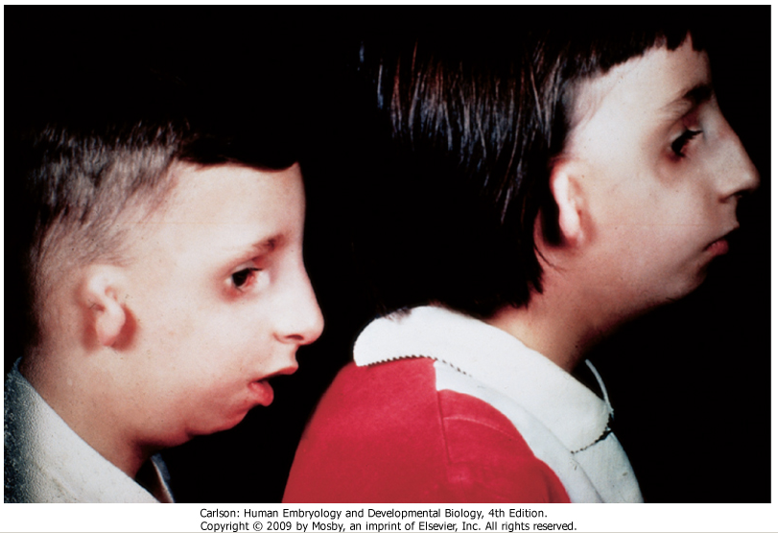
1st Arch Defects
Pierre Robin Syndrome: small mandible, cleft palate, middle ear defects, low-set ears
Treacher Collins Syndrome: mutation in Treacle gene, small mandible, middle ear defects, low-set ears, cleft plate, tooth defects

Slide 10
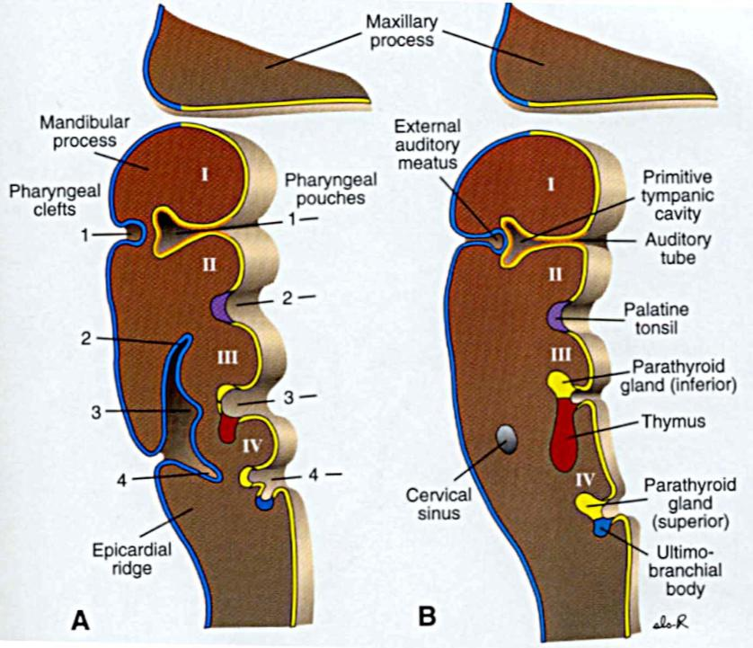
Fates of pharyngeal clefts/grooves
1st cleft
Develops into the external auditory meatus
Only cleft to yield a normal adult structure
2nd-4th clefts
Normally overgrown by 2nd pharyngeal arch and epicardial ridge
Ultimately degenerate and do not give rise to definitive mature structures in mammals
Notes:
Only 1st cleft persists as a recognizable adult structure: external auditory meatus
Invaginates inward until it meets 1st pouch, turns into external ear
Clefts 2-4 don’t persist
Caudal side of 2nd arch crows down to meet epicardial ridge, after which they fuse
Signaling center (FGF8, Shh, BMP-7) in 2nd arch drives downward growth

Slide 11
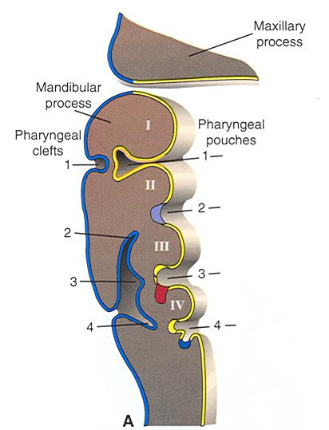
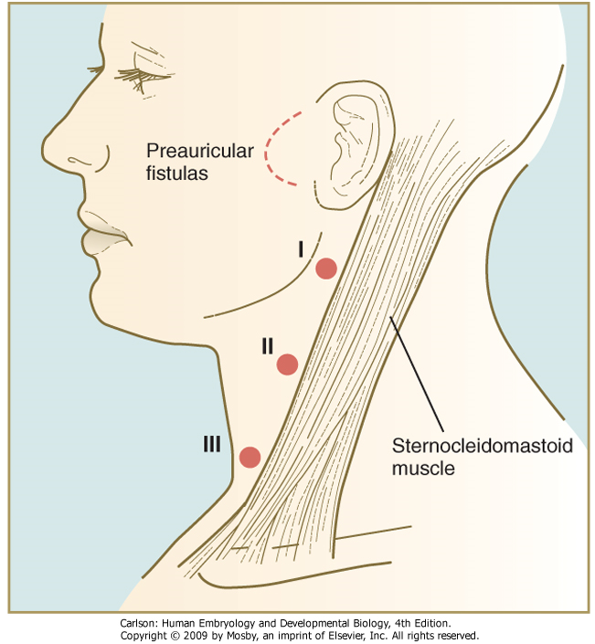
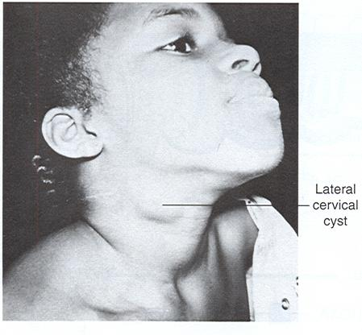
Dysgenesis of pharyngeal clefts
Fistula: epithelial tubes that open at both ends
Cyst: pocket because cleft didn’t completely degenerate
Preauricular cysts & fistulas: associated with defects in cleft 1 and/or pouch 1
Lateral cervical cyst: incomplete overgrowth of clefts 2-4
Branchial fistulas: defects in clefts 2-4 and/or pouches 2-4

Slide 12
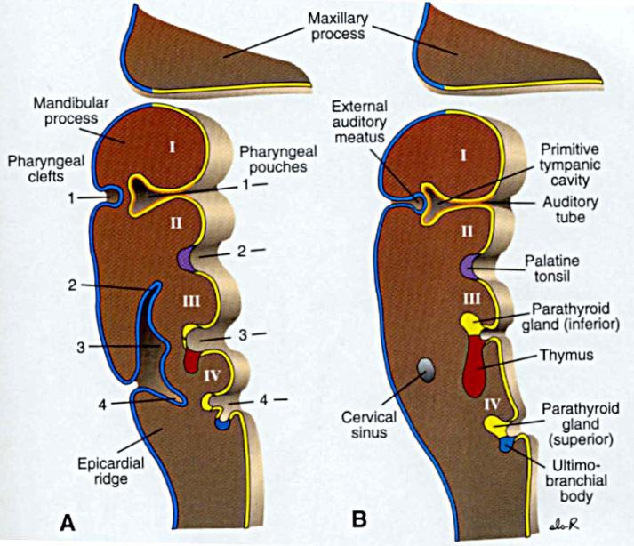
Pharyngeal pouches 1 & 2 have non-endocrine fates
1st pouch:
Proximal: auditory (eustacian) tube
Distal: tympanic (middle ear) cavity
Extreme distal: tympanic membrane (with mesoderm & ectoderm from 1st pharyngeal cleft)
2nd pouch:
Supratonsillar fossae of Palatine tonsil
Immune cells come from elsewhere!
Notes:
Moving inside to the pharynx itself…

Slide 13
Fates of pouches 3 & 4 include endocrine glands
3rd pouch
Solid superior epithelial mass: inferior parathyroid
Inferior elongation: thymus
4th pouch
Solid superior epithelial mass: superior parathyroid
Inferior mass: ultimobranchial body (neural crest origin): parafollicular (C) cells of thyroid
Each primordium (normally) detaches from site of origin and migrates to site of mature gland
Notes:
Early on 3rd & 4th pouches develop substructures that have distinct fates
Most of these ARE fated to become endocrine glands.
Parafollicular (C) cells: thyroid, calcitonin, reduces blood calcium levels
Parathyroid cells: parathyroid hormone, increases blood calcium levels
Primordia don’t originate at mature functional sites: need to migrate…

Slide 14
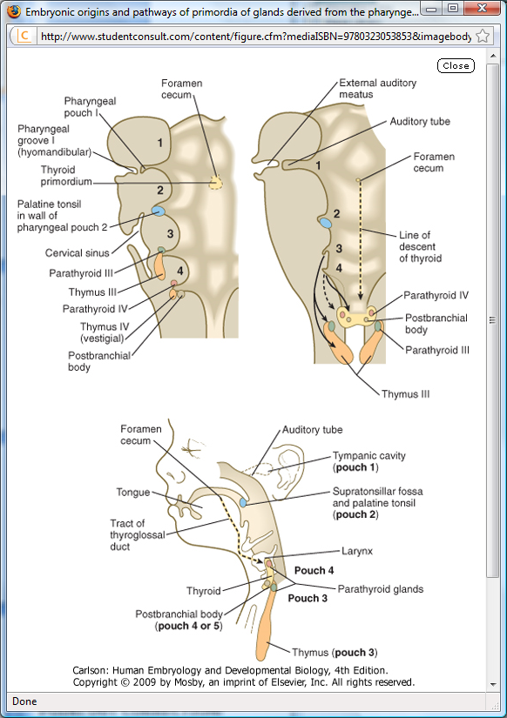
Migration of pouch 3 & 4 primordia to mature organ sites
Thymus:
Ends up inferior to thyroid
Parathyroid III:
Ends up inferior to parathyroid IV in thyroid gland
Parathyroid IV:
Ends up in thyroid, superior to parathyroid III
Postbranchial body (ultimobranchial body):
Migrates into thyroid

Slide 15
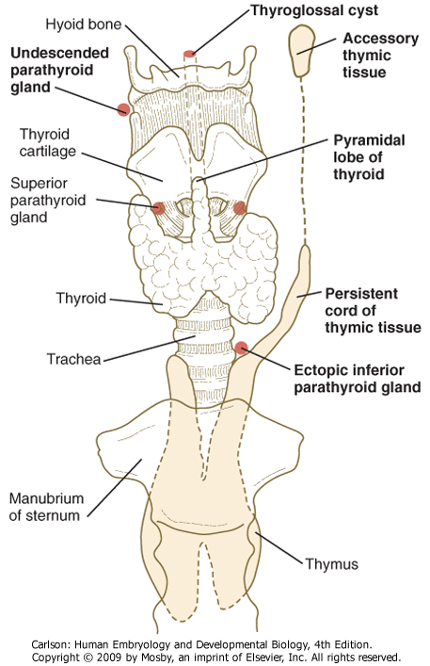
Ectopic parathyroid or thymic tissue
Typically benign anatomical anomalies, not accompanied by functional abnormalities

Slide 16
DiGeorge (del22q11) Syndrome (DGS)
1:4000 live births
Most common human genetic deletion syndrome
Loss of pharyngeal arch structures, particularly 2nd and 3rd arches
Clinical features
Thymic hypoplasia (immunodeficiency)
Hypoparathyroidism (hypocalcemia)
Congenital heart defects
Outflow tract, aortic arch
Velopharyngeal dysfunction +/- cleft palate
Developmental & behavioral problems
Psychiatric disorders

Slide 17
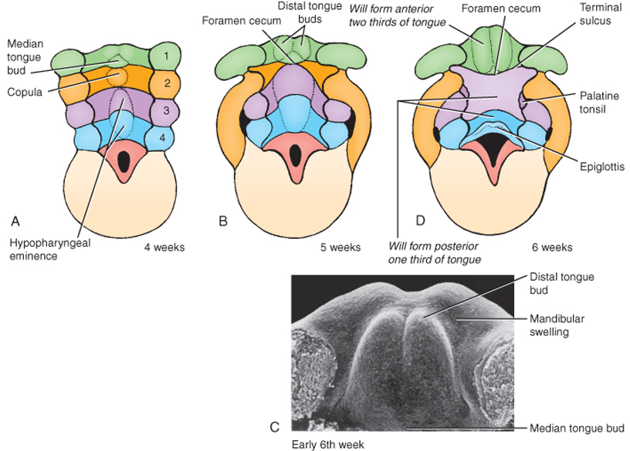
Development of the tongue
The tongue forms from ventral swellings in the floor of the pharynx at about the same time as the palate begins to form.
Lateral lingual swellings are first visible at about 5 wks, 1 medial swelling.
Growth of the tongue mostly by expansion of lateral lingual swellings, some contribution of tuberculum impar
Musculature derived from occipital myotomes
(QuickTime version)
Ant 2/3 of tongue is from 1st arch, posterior 1/3 mostly from 3rd arch

Slide 18
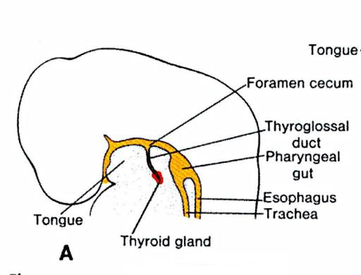
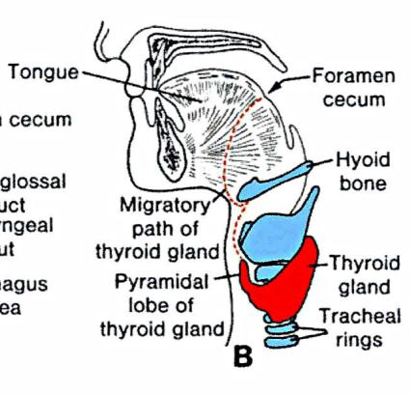
The thyroid gland IS NOT derived from pharyngeal pouches!
Starts as single placode (thickening) called the foramen cecum and located in the ventral pharynx just caudal to tongue bud
Elongates caudally as thyroid diverticulum
During migration, tip of thyroid diverticulum expands and bifurcates to form the thyroid gland itself
Developing gland remains transiently attached to site of origin by thyroglossal duct, which then (normally) degenerates
Notes:
Bifurcation produces normal 2 lobes of thyroid connected by isthmus
All of thyroglossal duct normally degenerates
In 50% of people: 3rd “pyramidal lobe” of thyroid resulting from persistence of distal thyroglossal duct.
Persistence of more proximal segments of thyroglossal duct: cysts & sinuses

Slide 19
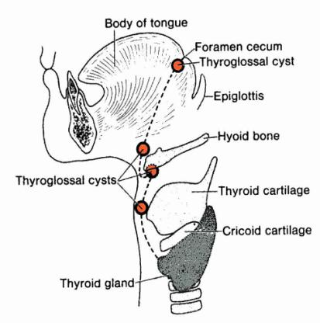
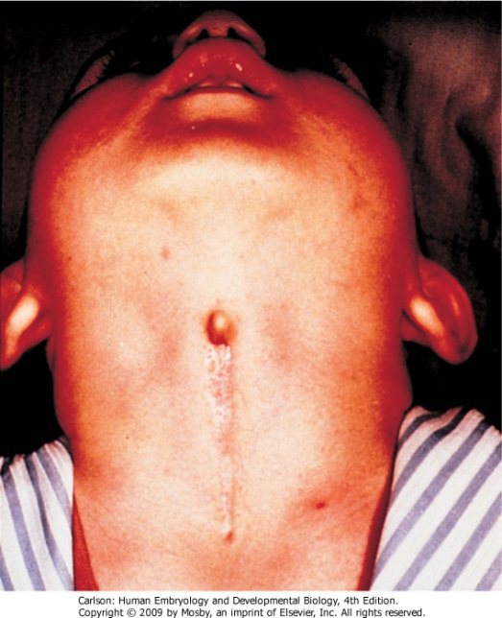
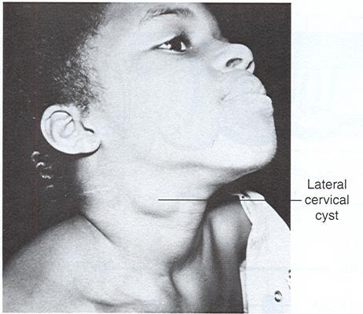
Thyroglossal cysts & sinuses
Origins: failure of the thyroglossal duct to completely pinch off & degenerate
Thyroid arrives at normal position and is usually normal functioning
Can usually be distinguished easily from lateral cervical cysts by their midline position
thyroglossal
sinus

Slide 20
Congenital hypothyroidism (CH)
Most frequent endocrine disorder in newborns (1:3000 live births)
High TSH levels due to reduced thyroid hormone levels
Clinical significance: effects on CNS development (cretinism) and lungs (low surfactant production)
85% of CH due to thyroid dysgenesis (TD) (disturbances in thyroid organogenesis)
Includes athyreosis (none), hypoplasia (too small), and ectopia (misplaced)

Slide 21
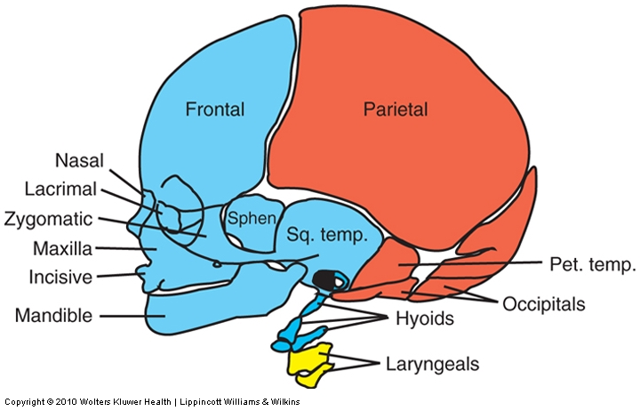
The bones of the skull, face, and pharynx are derived from either PARAXIAL mesoderm (orange) or NEURAL CREST (blue & yellow)
Cranial neural crest Paraxial/lateral plate mesoderm 3rd arch n. crest 4th arch n. crest
Notes:
Ultimately, 3 embryonic cell populations end up giving rise to distinct regions of the head.
Walk through each.
Anything that affects neural crest = frequently affects face

Slide 22
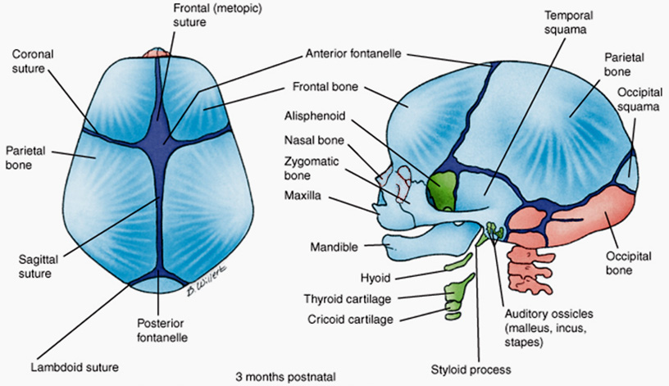
Some bones of the skull and face develop via INTRAMEMBRANOUS ossification; some develop via ENDOCHONDRAL ossification:
Base of skull (“chondrocranium,” orange) by endochondral ossification
Superior-anterior skull and face (“membranous cranium,” light blue) by intramembranous ossification
Cartilagenous viscerocranium (green) from neural crest that differentiates into cartilage and then undergoes varying degrees of ossification.
paraxial origin
neural crest origin
Notes:
Intramembraneous ossification: important distinction between head & other bones.
Distinct from e.g. long bones, where a cartilageneous model or framework is 1st laid down, then bone fills in.
In head: bone forms by condensation of mesenchyme within membranes without pre-existing cartilage

Slide 23
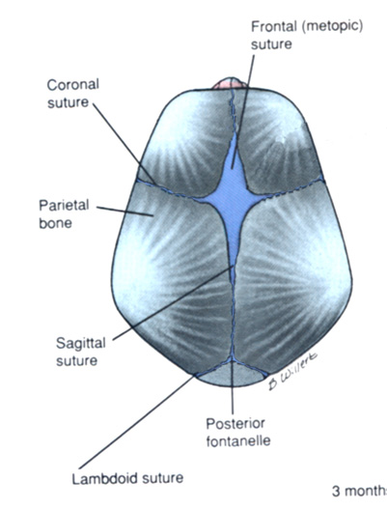
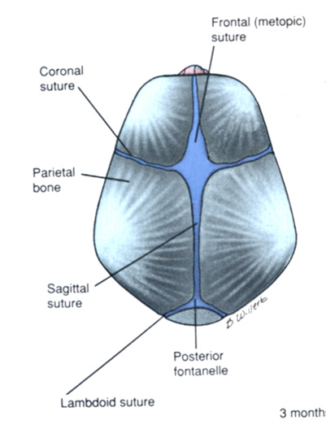
Bones are incomplete
At birth: fontanelles
Posterior: 3 mos
Anterior 1.5 years
Will bulge out with increased intracranial pressure (e.g. meningitis)
FGF/noggin/BMP signaling determines fusion
Disruption of FGF/Noggin/BMP can result in premature fusion (aka craniosynostosis)
FGF
Nog
BMP
BMP
BMP
Nog
Nog
FGF
FGF
Nog
Nog
Nog
BMP
BMP
BMP
BMP
FGF
BMP
Nog
Nog
FGF
BMP
FGF --|
Noggin --|
BMP → bone growth
BMP → bone growth
[i.e. local FGF allows BMP expression (bone growth) in sutures]
Notes:
Skull development is incomplete at birth: plates separated by sutures and fontanelles
Posterior fontanelle closes first, then anterior fontanelle
2 purposes:
Developmentally: allows room for symmetric postnatal growth
Clinically: estimate intracranial pressure by palpation
Rate of fusion ultimately regulated by BMP/noggin balance.
Too early: craniosynostosis

Slide 24
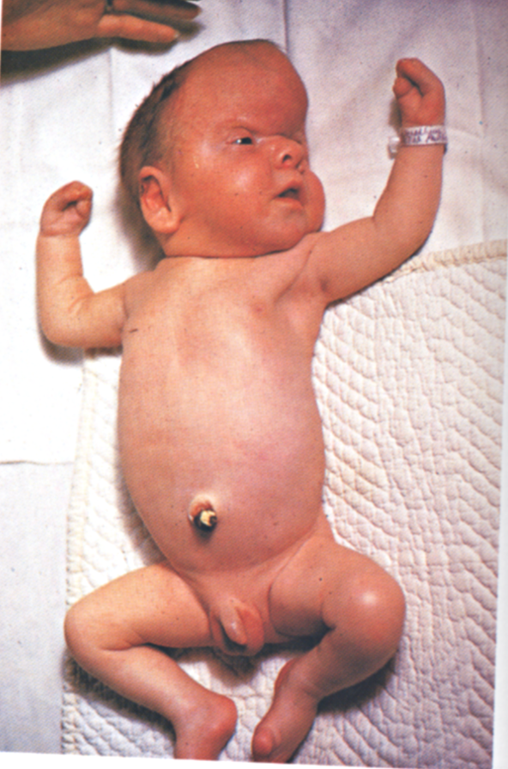
In Apert syndrome
the coronal sutures
fuse prematurely,
and the cranium is abnormally shaped to accommodate
the growing brain.

Slide 25
Development of the face
(QuickTime version)

Slide 26
Pharyngeal (branchial) arches: earliest primordia of the face
Notes:
Pharyngeal (branchial) arches = earliest primordia of face
Ectodermal pouches filled with mesenchyme.
Emerge just as NT closure is completed.
1st arch: is the one of primary relevance for face, splits into maxillary & mandibular processes
Other arches: organization of neck & associated structures

Slide 27
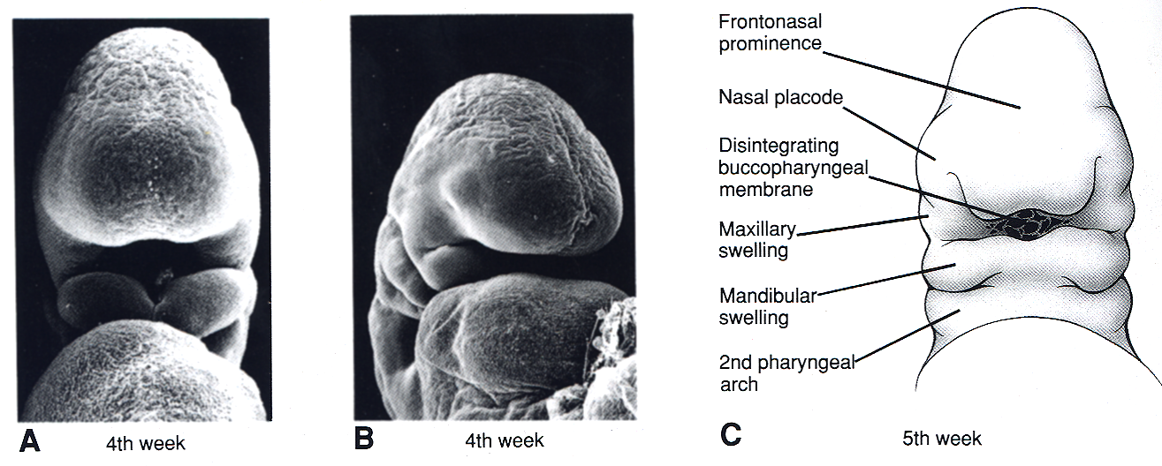
Facial Primordia
Frontonasal prominence (cranial neural crest)
Maxillary processes (1st arch neural crest)
Mandibular processes (1st arch neural crest)
Notes:
Orientation: face on & somewhat oblique view SEM & face on cartoon.
Just after NT closure
Major parts: FNP, nasal placodes, very early MNP & LNP, emerging Max & Mand “swellings”

Slide 28
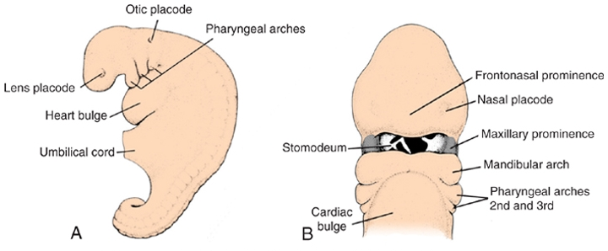
Embryos at end of 4th week showing pharyngeal arches/ prominences
5 mesenchymal prominences:
frontonasal, 2 mandibular, 2 maxillary
Notes:
Cartoon of slightly older embryo
Restate orientation & major parts.
Mx & Md “swellings” now processes/prominences
Again, both arise from 1st PA.
5 mesenchymal processes/prominences ultimately contribute to face.
“Growing” the face occurs through growth, migration, & fusion of these prominences
Source of many facial birth defects: lack of growth, migration, fusion

Slide 29
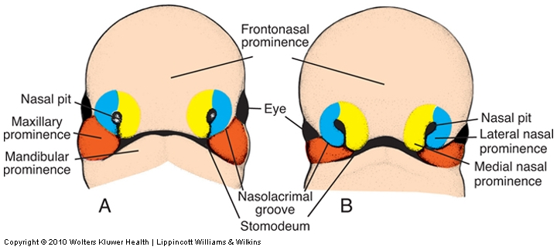
Face at 5 - 6 weeks: Nasal prominences gradually separate from the maxillary prominence by deep furrows.
Nasal pit invaginates forming lateral and medial nasal processes
Notes:
1 & 2 weeks later: increasing growth towards midline
Major points:
emergence of nasal pit, MNP, LNP
Mx & Md processes more prominent & distinct
formation of nasolacrimal groove (tear duct)

Slide 30
Facial appearance 7 and 10 weeks. Maxillary prominences have fused with the medial nasal prominences.
Upper lip: 2 MNP, 2 maxP Nose: FNP: bridge
Lower lip, jaw: mandibular process MNP: tip
Cheeks and maxillae: maxillary process LNP: sides
Notes:
Further growth & fusion of prominences:
2 MNP now met & fused
MxP, LNP, & MNP also met & fused
MdP also met & fused
Origins of major final structures

Slide 31
Development of the face
(QuickTime version)
White: Frontal nasal process Yellow: Maxillary process
Green: Medial nasal process Orange: Mandibular process
Purple: Lateral nasal process

Slide 32
Prominence Structure formed
Frontonasal Forehead, bridge of nose
Medial nasal Philtrum, nose
Lateral nasal Alae of nose
Maxillary Cheeks, lateral, upper lip
Mandibular Lower lip

Slide 33
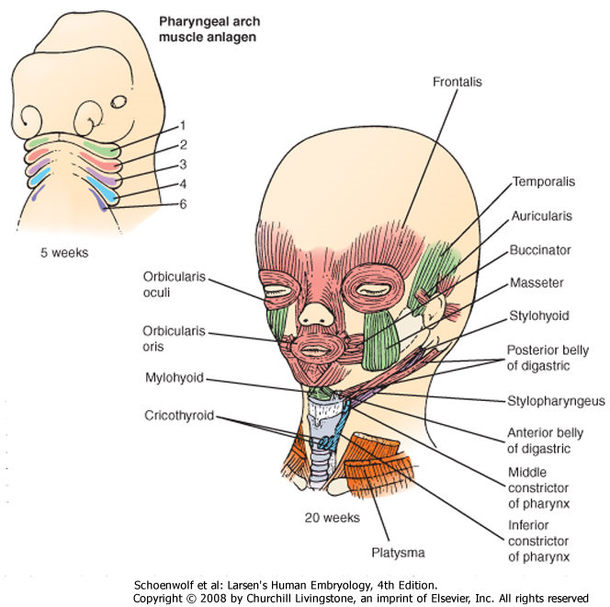
Craniofacial muscles
Most arise from unsegmented paraxial mesoderm that migrates into arches 1-3:
Arch 1: muscles of mastication, tensor tympani, tensor veli palantini, ant. belly of digastric (CNV)
Arch 2: muscles of facial expression, stapedius, stylohyoid, post. belly of digastric (CNVII)
Arch 3: stylopharyngeous (CNIX)
Some are from segmented (somitic) mesoderm that migrates into arches 4 and 6
Arch 4: pharyngeal constrictors, lev. veli palatini (sup. laryngeal br. of vagus)
Arch 6: intrinsic laryngeal muscles (recurrent laryngeal br. of vagus)
Some are from pre-somitic paraxial mesoderm that is rostral to the arches:
Extraocular muscles (CNIII, IV, VI)
Some are from somitic mesoderm that does not migrate into the arches:
Muscles of the tongue (CNXII)
Notes:
Fate maps of PA relative to muscles & nerves
correspondence between embryonic origins & innervating nerves
muscles form, then nerves follow.
2 important reasons for “getting” embryology of head/face:
understand origins of craniofacial birth defects
informs understanding of eventual gross anatomy & embryonic sources of facial structure innervation & blood supply
e.g.:

Slide 34
Formation of the palate (6-10 weeks) Separates oral and nasal cavities Derived from three structures
Medial nasal processes fuse forming primary palate (in adults the premaxillary component of maxilla –associated with upper incisors)
2 lateral palatine processes from maxillary prominences (6th week) grow downward on either side of tongue then turn medially and fuse to form the secondary palate.

Slide 35
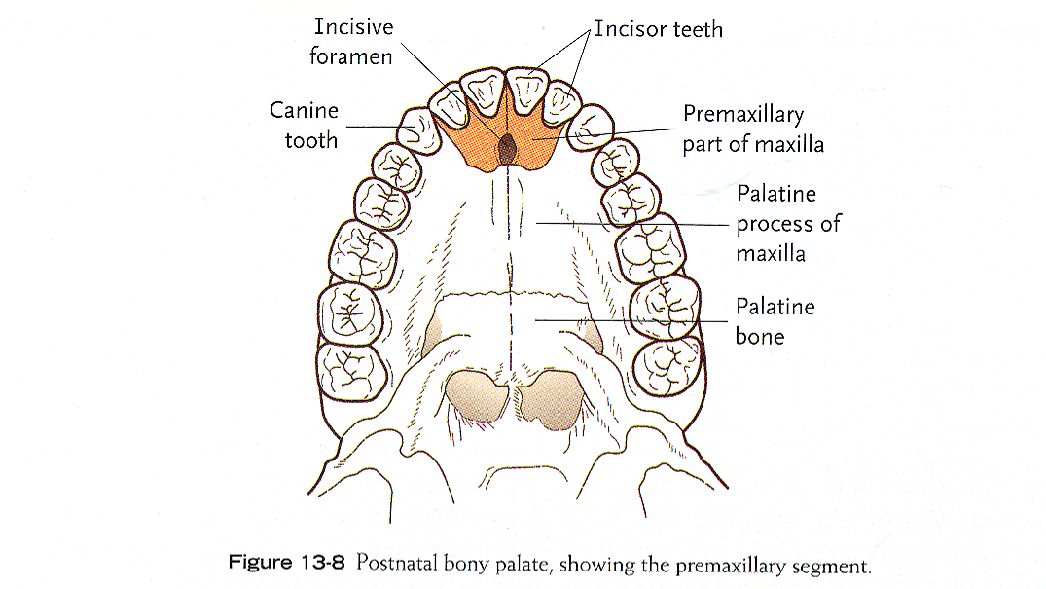
Mature (bony) palate

Slide 36
Intermaxillary segment (from MNPs) and the palatal processes (from max processes). The intermaxillary segment produces philtrum, triangular primary palate, four incisors

Slide 37
Frontal (AC) and ventral (BD) views of forming palate, week 6.5.
(QuickTime version)
(QuickTime version)
The tongue is located between the palatine shelves

Slide 38
Frontal (A,C) and ventral views (B,D) of 7.5 week embryo.
(QuickTime version)
(QuickTime version)
The tongue has moved downward and the palatal shelves are oriented horizontally.

Slide 39
Cleft lip/palate (CL/P) and isolated cleft palate (CP)
Very common
CL/P: 1-3 in 1000 live births
CP: 1 in 1500 live births
Can happen anywhere fusion needs to occur
CL/P and CP have distinct etiologies
CL/P: defective primary and secondary palate formation
CP: defective secondary palate formation
Usually can be repaired with surgery

Slide 40
Causes of CL/P or CP -- part I
Genetics:
Syndromic vs. nonsyndromic
400+ single-gene causes of CL/P or CP
Signaling pathays:
FGF, BMP, Shh, retinoic acid
Single-gene causes almost always syndromic
Repeated use of common molecular pathways
Non-syndromic CL/P or CP are genetically complex traits

Slide 41
Causes of CL/P or CP -- part II
Environment:
Nutrition, drugs, maternal infection, maternal smoking and alcohol use
Folic acid, exogenous retinoids
Genetics & environment can interact:
e.g. TGFβ mutation increases risk of CL/P or CP; maternal smoking perturbs TGFβ pathway and therefore further increases risk

Slide 42
What happened here? Bilateral cleft lip and palate
Caused by bilateral hypoplasia of the maxillary process, so there is insufficient tissue to merge with the medial nasal prominences on both sides

Slide 43
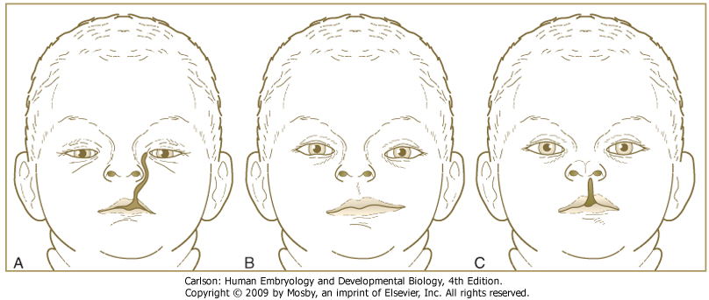
Varieties of facial clefts
Oblique facial cleft Macrostoma Median cleft lip
Poor merging of maxillary and mandibular processes -- large mouth toward ear
Failure of medial and lateral nasal processes to fuse with maxillary process
Incomplete fusion of two medial nasal processes.

Slide 44
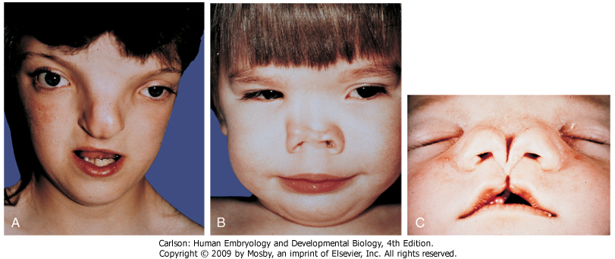
Frontonasal dysplasia
Too much tissue in frontonasal process (hyperplasia) or other errors cause incomplete fusion of medial nasal processes
Hypertelorism, broad nasal bridge, or even two external nares

