Slide 1
Development of the Nervous System
Matt Velkey
matt.velkey@duke.edu
454A Davison, Green Zone, Duke South

Slide 2
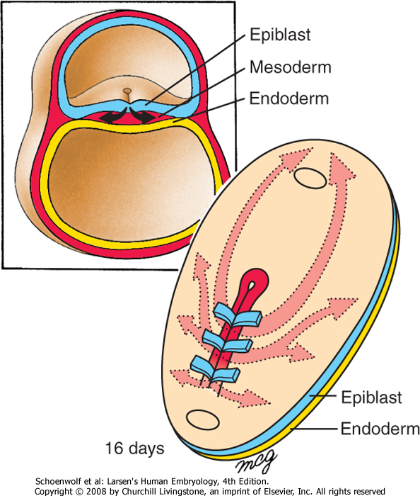
The three germ layers are formed at gastrulation
Ectoderm: outside, surrounds other layers later in development, generates skin and nervous tissue.
Mesoderm: middle layer, generates most of the muscle, blood and connective tissues of the body and placenta.
Endoderm: eventually most interior of embryo, generates the epithelial lining and associated glands of the gut, lung, and urogenital tracts.

Slide 3
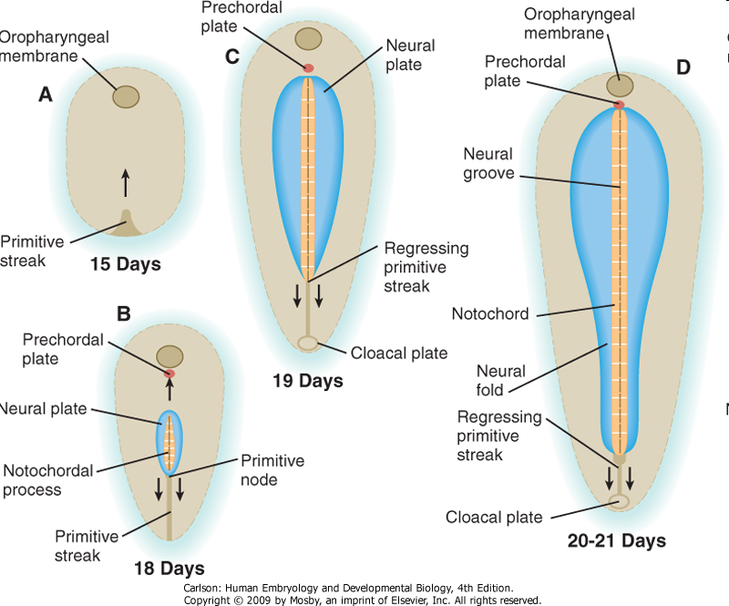
Neural Induction: In addition to patterning the forming mesoderm, the primitive node also sets up the neural plate
Ectoderm exposed to BMP-4 (from endoderm and mesoderm below), develops into skin
However, the node secretes BMP-4 antagonists: (e.g. noggin, chordin, & follistatin) that allow a region of the ectoderm to develop into nerve tissue.

Slide 4
Movie: neural induction
(click here for QuickTime version)

Slide 5
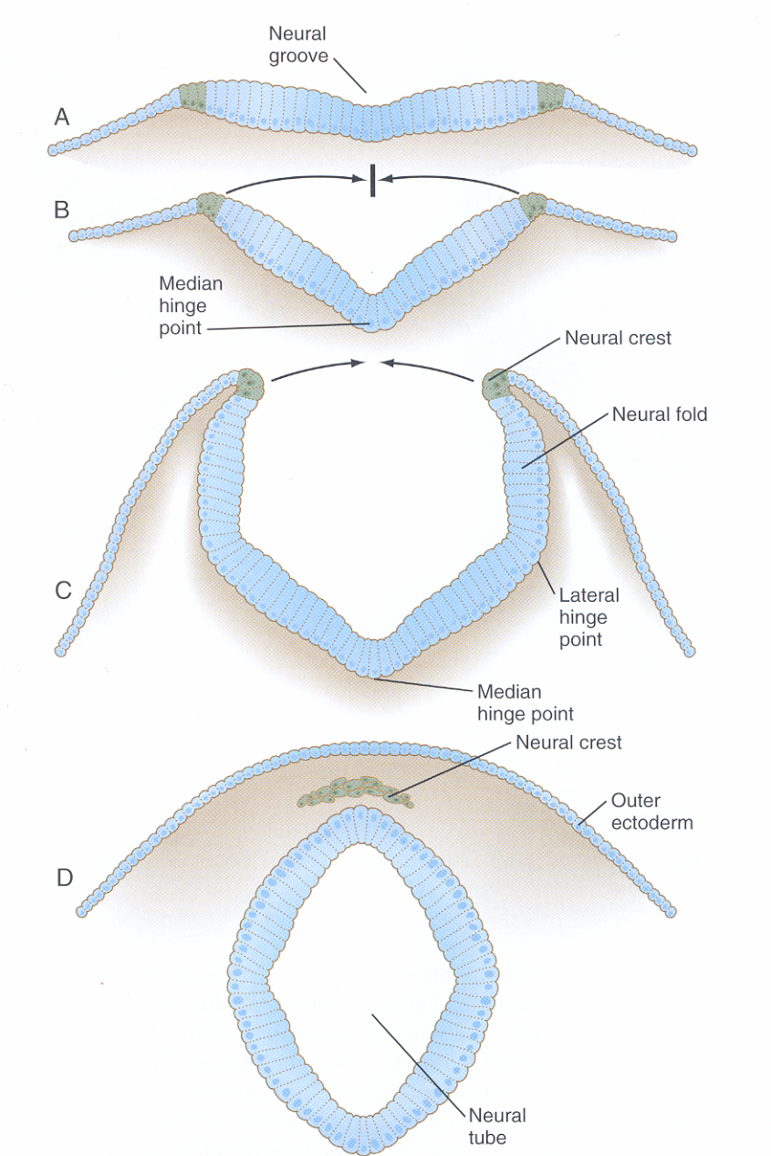
Neurulation: folding of the neural plate
Median hinge point forms (probably due to signaling from notochord) –columnar cells adopt triangular morphology (apical actin constriction, like a purse string)
Lateral hinge point forms by a similar mechanism (probably due to signaling from nearby mesoderm).
As neural folds close, neural crest delaminates and migrates away (more on that later…)
Closure happens first in middle of the tube and then zips rostrally and caudally.

Slide 6
Neurulation: folding and closure of the neural plate
Folding and closure of the neural tube occurs first in the cervical region.
The neural tube then “zips” up toward the head and toward the tail, leaving two openings which are the anterior and posterior neuropores.
The anterior neuropore closes around day 25.
The posterior neuropore closes around day 28.

Slide 7
Movie: Neurulation
(click here for QuickTime version)

Slide 8
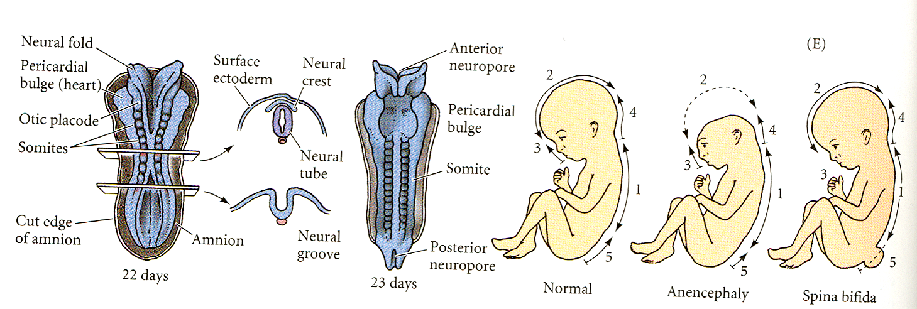
Failure of neuropores to close can cause neural tube defects anterior neuropore: anencephaly posterior neuropore: spina bifida

Slide 9
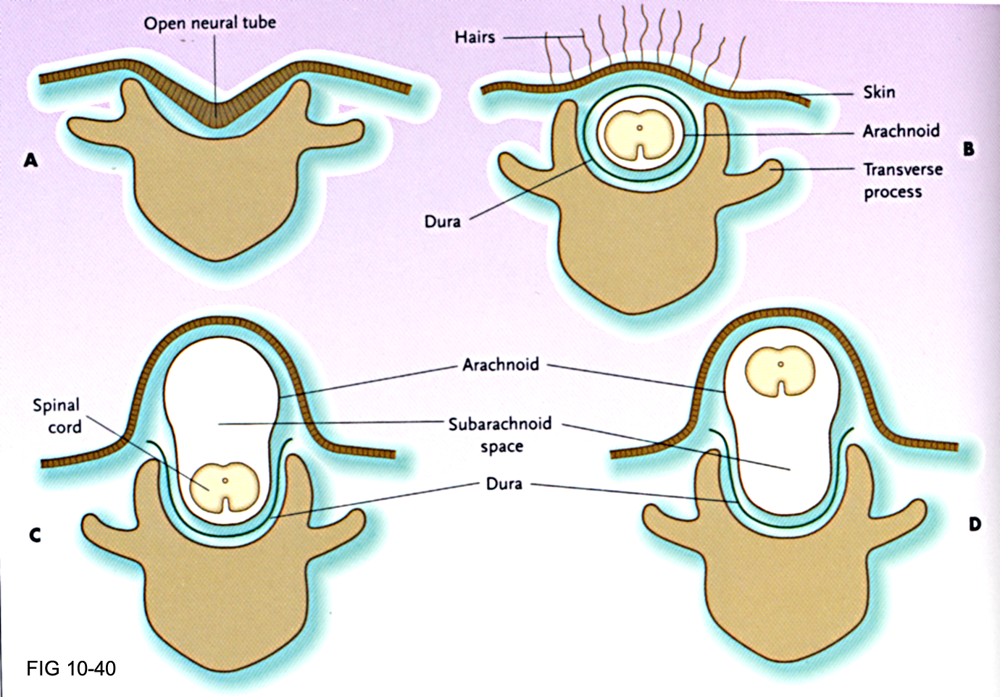
Neural tube closure defects A. Rachischisis, B. Spina bifida occulta, C. Meningocele, D. Myelomeningocele

Slide 10
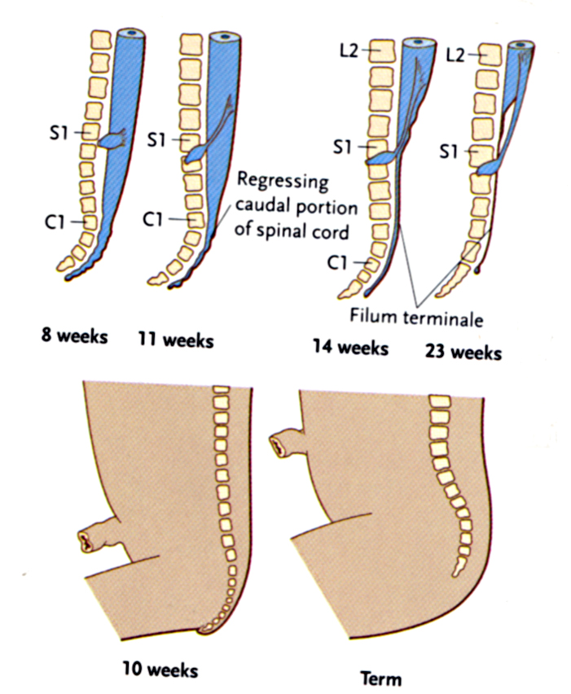
“Regression” of the spinal cord
The spinal cord and the vertebral column are the same length up until the 3rd month.
As each vertebral body grows thicker, the overall length of the vertebral column begins to exceed that of the spinal cord such that , in the adult the spinal cord terminates at L2 or 3 and the dural sac ends at about S2.
The tail end of the dural sac covering the spinal cord and nerve roots remains attached at the coccyx and becomes a long, thin strand called the filum terminale.
Sometimes, the spinal cord can become “tethered” or attached to the dural sac or filum terminale; this pulls on the cord and can obstruct flow of CSF thus causing swelling of the ventricles of thebrain (hydrocephalus),

Slide 11
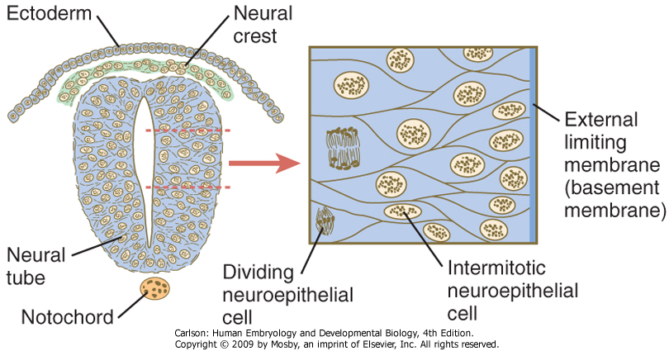
The early neural tube is a pseudostratified epithelium
The “apical” portion abuts the central canal
The “basal” portion abuts the surrounding tissue (e.g. somites, notochord, etc.).
Cell division occurs in the apical portion.

Slide 12
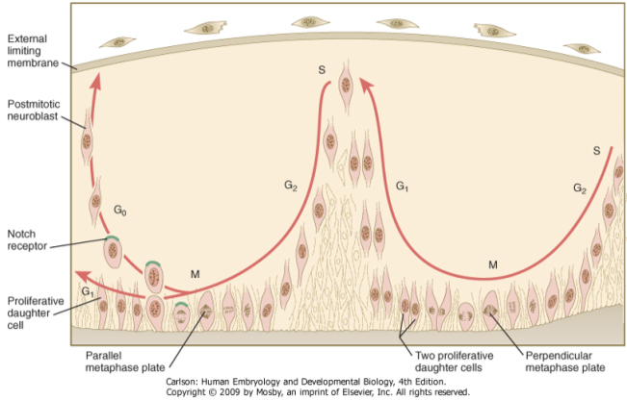
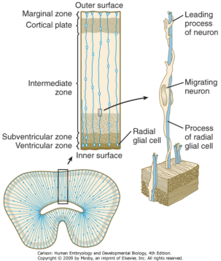
Histogenesis of the central nervous system: proliferation, migration, and differentiation
Replication of DNA in proliferative cells (progenitors) occurs at external limiting membrane
The nucleus of the progenitors migrate to apical portion to undergo either equal or unequal mitosis (depending on orientation of metaphase plate):
“Equal” generates two progenitors that migrate back to ELM to undergo another round of DNA replication
“Unequal” generates a progenitor and cell that will differentiate into a neuron
Appropriate development requires a delicate balance between proliferation and differentiation
Neurons migrate along radial glia to establish layers within the CNS that are very important for its function –disruption of this migration therefore has significant consequences

Slide 13
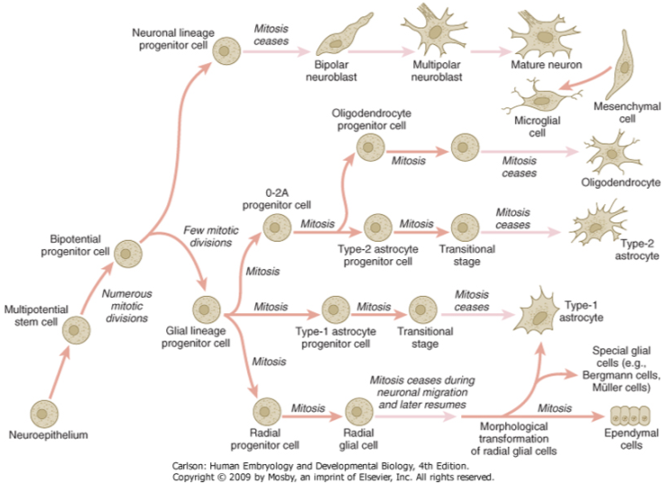
Neural cell lineages
1st major cell fate decision is glial vs. neuronal
If glial, then next decision is O-2A, 1A, or radial glia
Radial glia can also generate type 1 astrocytes and ependymal cells

Slide 14
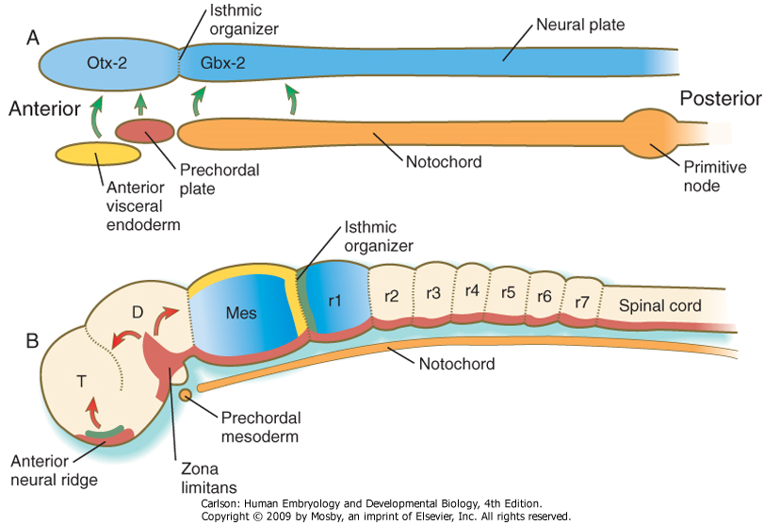
Setting up the major regions of the CNS
A, In response to signals (green arrows) from the anterior visceral endoderm, the prechordal plate, and the notochord, the neural tube expresses Otx-2 in the future forebrain and midbrain regions and Gbx-2 in the hindbrain and spinal cord.
B, Later in development, signals (FGF-8 [green] and Wnt-1 [yellow]) from the isthmic organizer induce decreasing gradients of En-1 and En-2 (blue) on either side. Another organizer-the anterior neural ridge-secretes sonic hedgehog (red) and FGF-8 (green and both the zona limitans and the ventral part (floor plate) of the neural tube secrete sonic hedgehog.
D=diencephalon; Mes=mesencephalon; r=rhombomere; T=telencephalon.

Slide 15
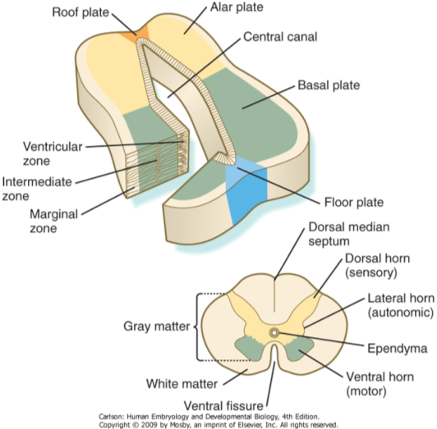
The developing neural tube is divided into 4 plates
Roof plate: signaling center (BMPs and Wnts)
Alar plate: sensory
Basal plate: motor
Floor plate: signaling center (Shh)

Slide 16
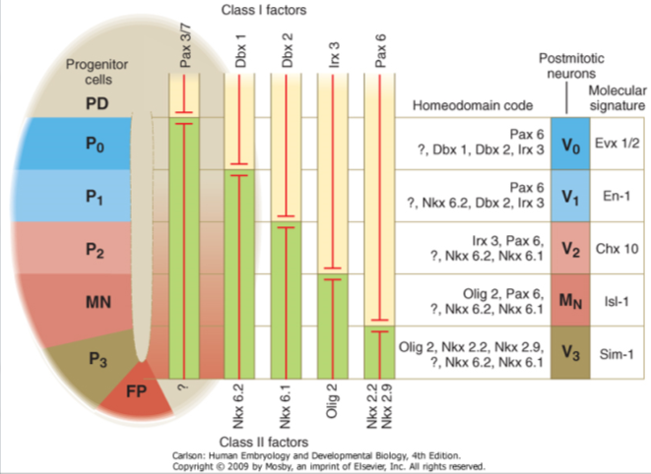
Dorsoventral patterning in the neural tube
Mediated by Shh from the floorplate and BMPs and Wnts from the roofplate
Specification of neuronal identity occurs according to a combinatorial code of gene expression.

Slide 17
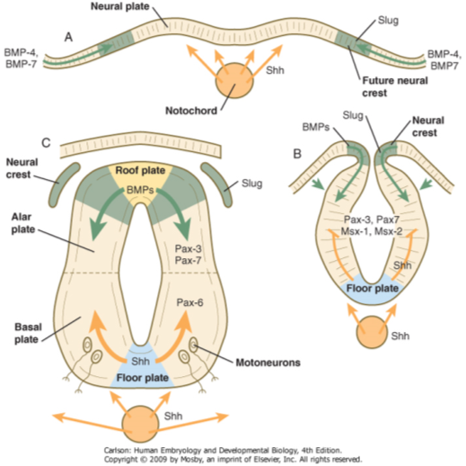
Early signaling establishes the neural crest, alar plate, and basal plate
Neural crest established in the intermediate zone between Shh from the notochord and BMPs from the skin
After neural tube closure, BMPs from skin induce expression of BMPs in roof plate, which largely patterns the alar plate.
Shh from the notochord induces expression of Shh in floor plate, which largely patterns the basal plate.

Slide 18
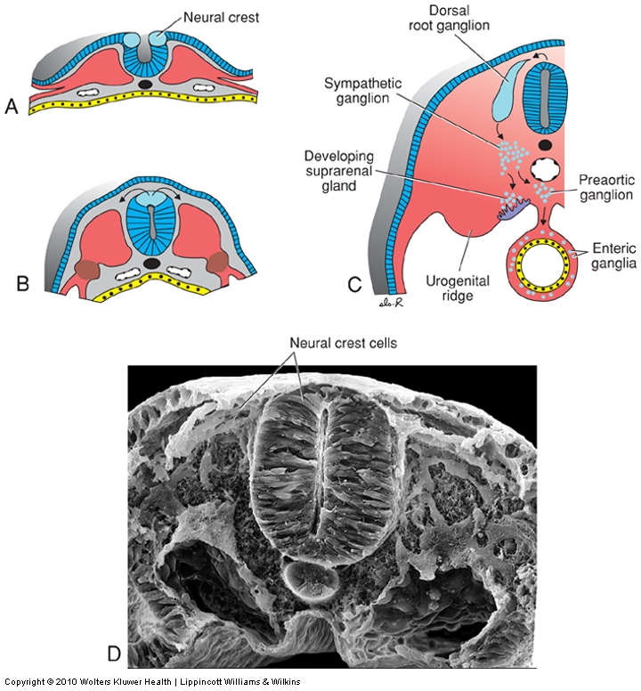
Neural Crest: the “4th germ layer”
At the time of neurulation, cells at the lateralmost edge of the neural plate are exposed to a unique combination of factors from the adjacent skin, underlying mesoderm, and from the rest of the neural plate and are induced to form neural crest.
The neural crest cells downregulate cadherin expression and delmainte from the neuroepithelium, i.e., they transform from epithelial cells into migratory mesenchymal cells that contribute to forming MANY tissues in the body.

Slide 19
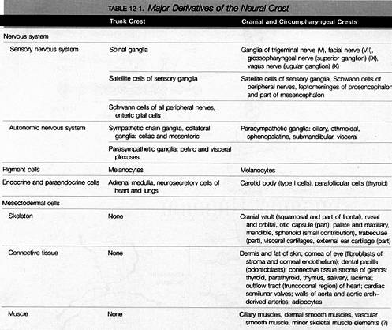
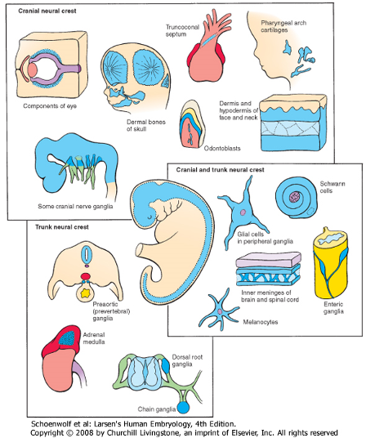
Major Derivatives of the Neural Crest

Slide 20
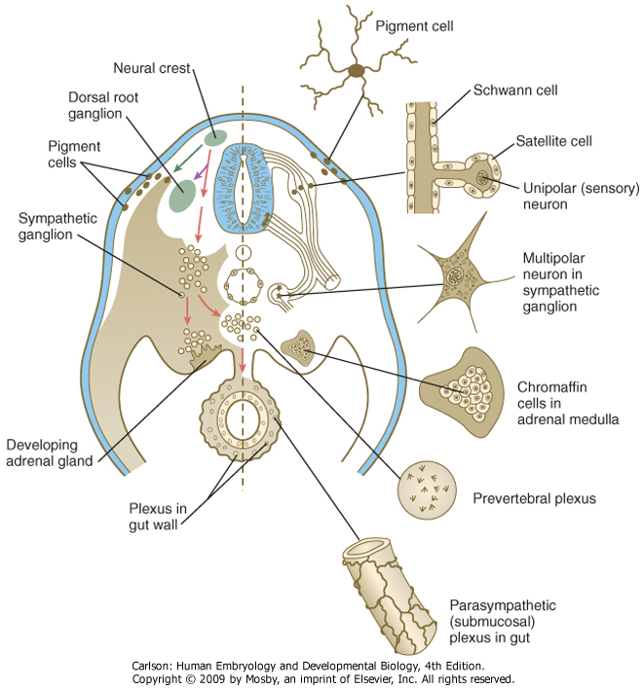
Trunk Neural Crest: sensory lineage
Migrate along ventrolateral stream and stop just medial to somite
Aggregate into dorsal root ganglia and separate into 2 general lineages:
Sensory neurons (Wnts, NGFs, bHLHs (Ngn1, etc.)
Glia (Schwann cells and satellite cells) via GDNF signaling
Sensory neurons extend processes in two directions: dorsomedially to neural tube and ventrolaterally into growing spinal nerve (established by outgrowth of motor neuron axons from the ventral horn)

Slide 21
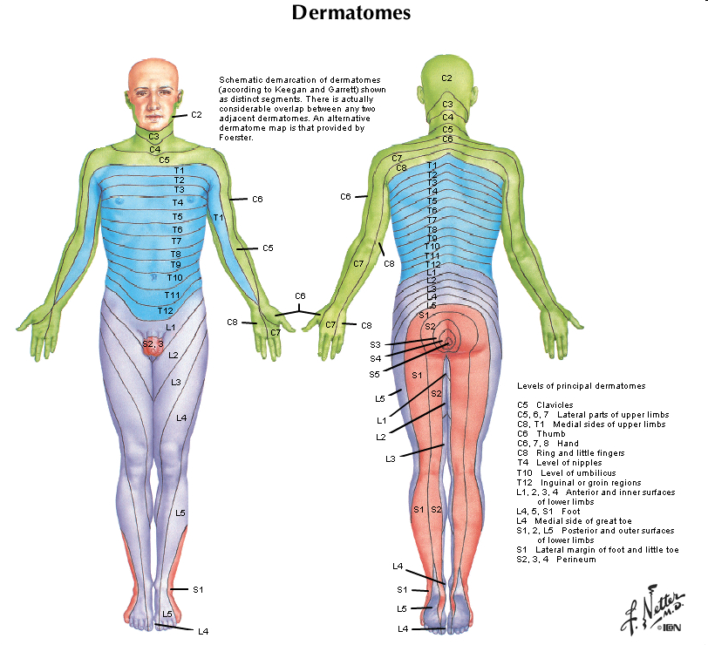
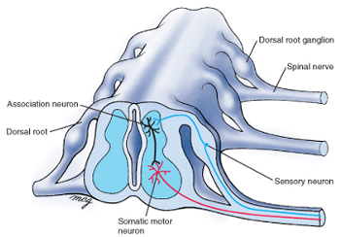
Innervation is segmental (dermatomes)

Slide 22
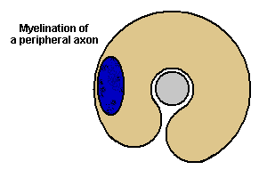
Sensory neurons send axons into dorsal horn. Motor neurons send axons out of vental horn.
Axons of peripheral nerves are myelinated by Schwann cells

Slide 23
Trunk Neural Crest: sympathoadrenal lineage
Migrate along ventral stream
Dependent on expression of Phox-2 and Mash-1
BMPs from aorta play further instructive role to specify bi-potential progenitors:
Sympathetic ganglion neurons: induced by presence of FGF and NGF in symp. Ganglia
Adrenal chromaffin cells: induced by glucocorticoids in adrenal gland

Slide 24
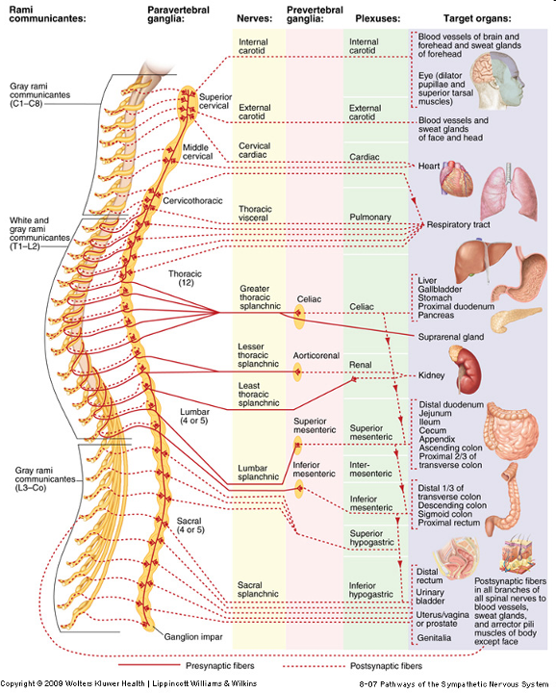
Trunk Neural Crest: sympathetic nervous system

Slide 25
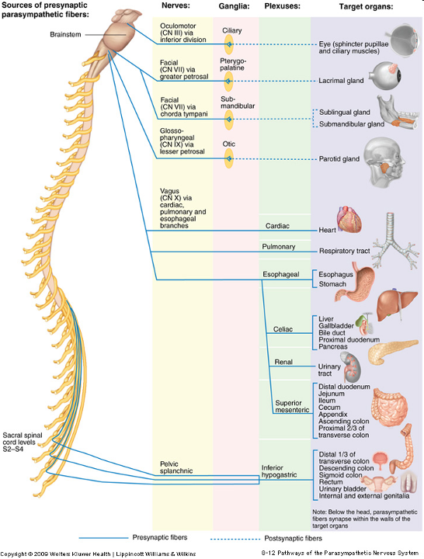
Parasympathetic Nervous System: derived from cranial, vagal, and lumbosacral crest

Slide 26
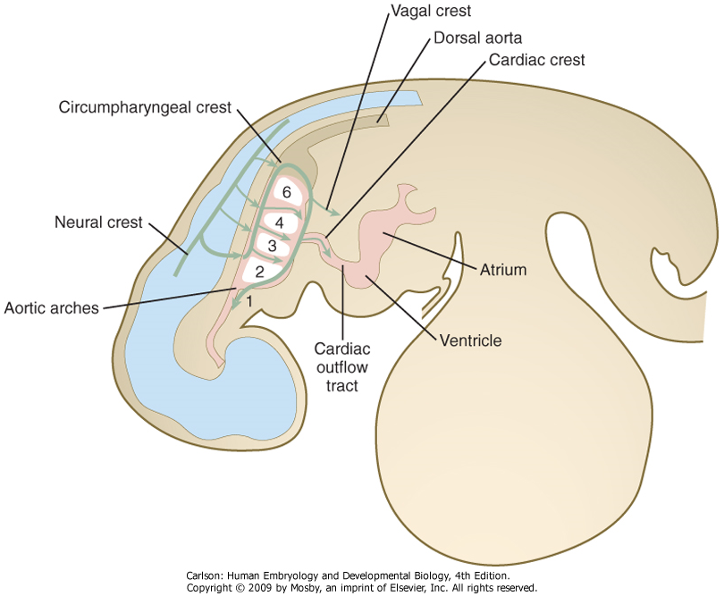
Circumpharyngeal Neural Crest: vagal crest
Migrate caudal to 6th arch and then become associated with wall of fore-, mid-, and proximal hindgut
Downregulate expression of Robo, a Slit-2 receptor, which allows them to invade the gut wall.
Hand2 influences differentiation into cholinergic phenotype

Slide 27
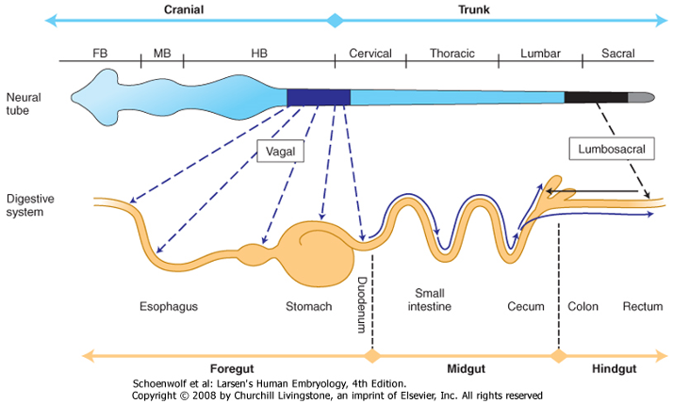
Innervation of the Gut: vagal and lumbosacral crest
Vagal crest: innervate gut wall from foregut to ~proximal 2/3 of transverse colon in hindgut
Sacral crest: innervate hindgut wall from ~distal 1/3 of transverse colon to rectum

Slide 28
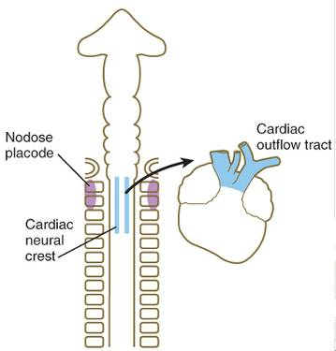
Circumpharyngeal Neural Crest:
Associated with arches 3,4,6
Contribute to thyroid, parathyroid, and thymus
Cardiac crest contributes to outflow tract cushions
Disturbances (e.g. DiGeorge syndrome, Hoxa-3 mutation) therefore have multiple effects: craniofacial (jaw) defects, glandular defects, & outflow tract defects

Slide 29
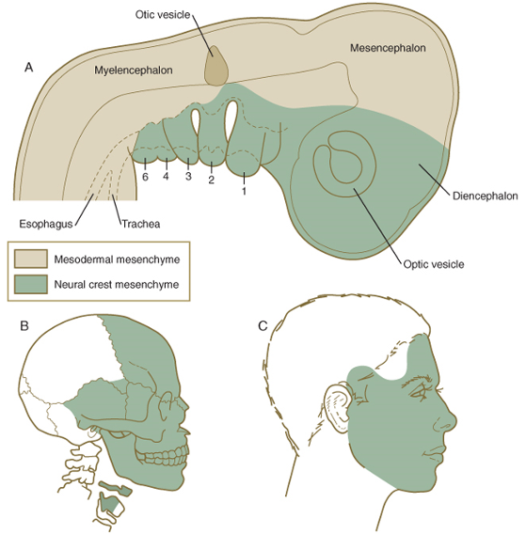
Cranial Neural Crest: Contribute to forehead, face, jaw, and pharyngeal arch derivatives

Slide 30
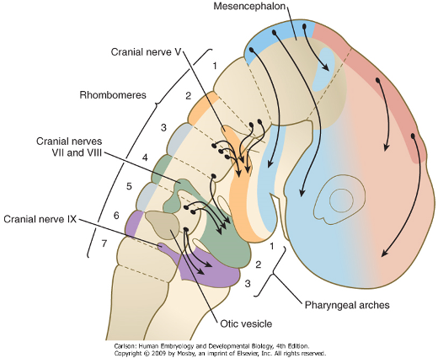
Cranial Neural Crest and Cranial Nerves
“pre-rhombomeric:” forehead, maxilla, and mandible as well as ganglia associated with occulomotor and trigeminal nerves
Rh1: cranial half of arch1
Rh2: caudal half of arch1
Rh3: caudal half of arch1 and arch2
Rh4: arch2
Rh5: arch2 & arch3
Rh6: arch3

Slide 31
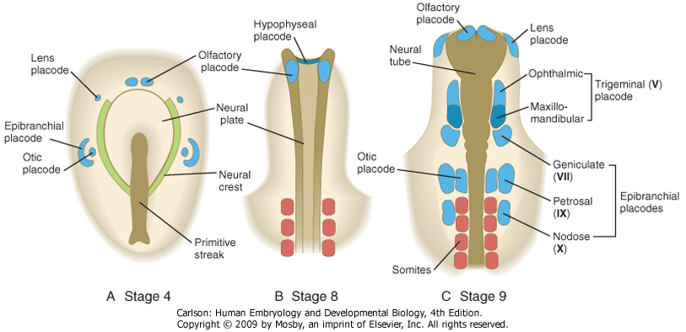
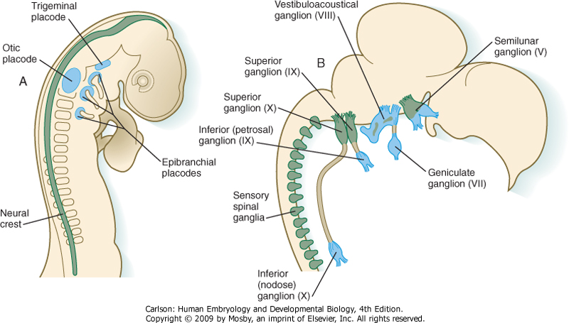
Cranial nerve ganglia arise from neural crest and ectodermal placodes
“proximal” or “superior” ganglia from neural crest
“distal” or “inferior” ganglia from ectodermal placodes
parasympathetic ganglia (ciliary, otic, pterygopalatine, and submandibular) from neural crest

Slide 32
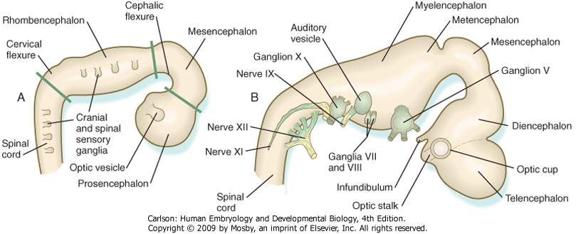
Major divisions of the developing brain: 3 parts, then 5 parts
3 parts: Prosen-, Mesen-, and Rhomencephalon
5 parts: Prosencephalon divides into telen- and diencephalon, Rhombencephalon divides into met- and myelencephalon

Slide 33
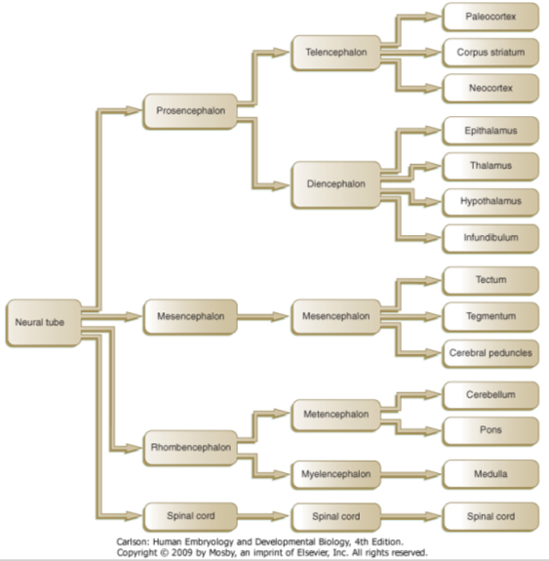
Major divisions of the developing brain: 3 parts, then 5 parts

Slide 34
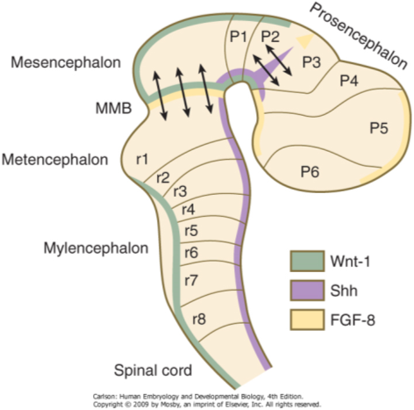
Additional signaling centers pattern the fore-, mid-, and hindbrain
Dorsoventral patterning by the floor (Shh) and roof (Wnts and BMPs) plates; e.g. Pax-6, a ventral marker, is induced by Shh and repressed by BMPs whereas Pax-7, a dorsal marker, is repressed by Shh and induced by BMPs.
Antero-posterior patterning by the isthmic organizer (FGF-8, at the midbrain-hindbrain boundary). Other genes involved in A-P patterning of the midbrain and hindbrain include En-1, En-2, Pax-2, and Pax-5
Patterning of the thalamus into future dorsal and ventral regions achieved by Shh expression in the zona limitans interthalamica

Slide 35
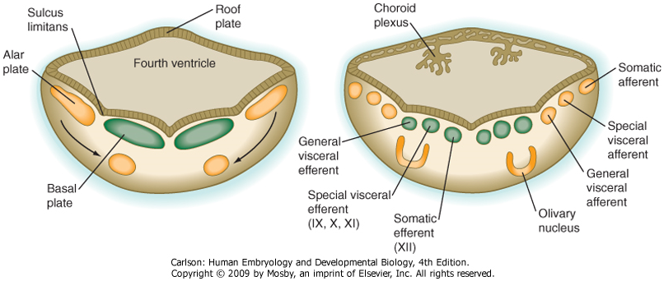
Development of the myelencephalon
Alar plate develops into 4 sensory tracts:
Olivary nucleus (cerebellar input)
Somatic afferent (general sensation from the face, via CN V, external ear, auditory meatus, and eardrum via CN IX, X)
Special visceral afferent (taste, CN IX, X)
General visceral afferent (autonomic input, CN IX, X)
Basal plate develops into 3 motor tracts:
General visceral efferent (autonomic output, CN IX, X)
Special visceral efferent (innervation of pharyngeal arch muscles of the larynx & pharynx, CN IX, X, XI) – aka “branchiomotor”
Somatic efferent (innervation of skeletal muscles of the tongue, CN XII)
(covered by ependymal cells that produce CSF)
Note: the final position of the SVE column is generally ventral (and slightly lateral) to the GSE column

Slide 36
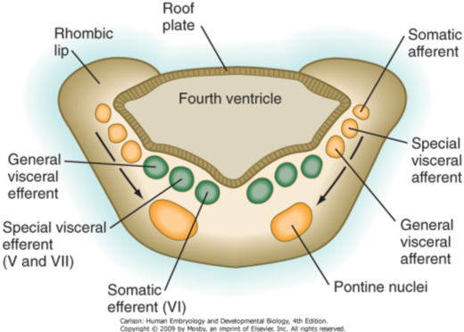
Development of the metencephalon
Rhombic lip develops into cerebellum
Alar plate develops into 4 sensory tracts:
Pontine nuclei (cerebellar input)
Somatic afferent (general sensation from the face, tongue, and extraocular muscles, CN V, VI, VII)
Special visceral afferent (taste, CN VII)
General visceral afferent (autonomic input from soft palate & pharynx, CN VII)
Basal plate develops into 3 motor tracts:
General visceral efferent (autonomic output to salivary and lacrimal glands, CN VII)
Special visceral efferent (innervation of muscles of the face, via CN VII, and of mastication, via CN V)
Somatic efferent (innervation of lateral rectus muscle of the eye, via CN VI)
Note: the final position of the SVE column is generally ventral (and slightly lateral) to the GSE column

Slide 37
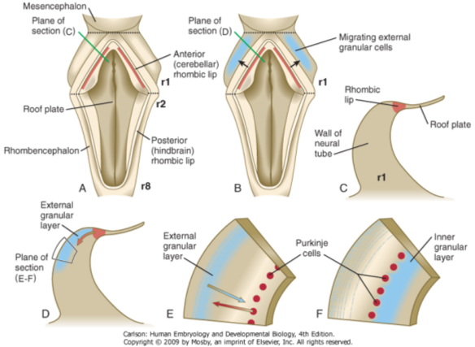
Development of the cerebellum
Develops mostly from Rh1, pontine and olivary relay nuclei from Rh2-8
Anterior rhombic lip generate Purkinje cells
Migratory neuroblasts from Rh1 establish external granular layer which then migrate deep to the Purkinje cells to establish the inner granular layer; this process continues until the 2nd post-natal year
Maturation of granule cells dependent on Shh from Purkinje cells; migration is dependent on radial glial cells (Bergmann glia)
Disruptions of cerebellar development result in ataxia, associated with several genetic disorders:
trisomy 18, trisomy 21, trisomy 13, 5p deletion (cri di chat syndrome), Friedrich ataxia, spinocerebellar ataxia (CAG trinucleotide repeat similar to Huntington disease)

Slide 38
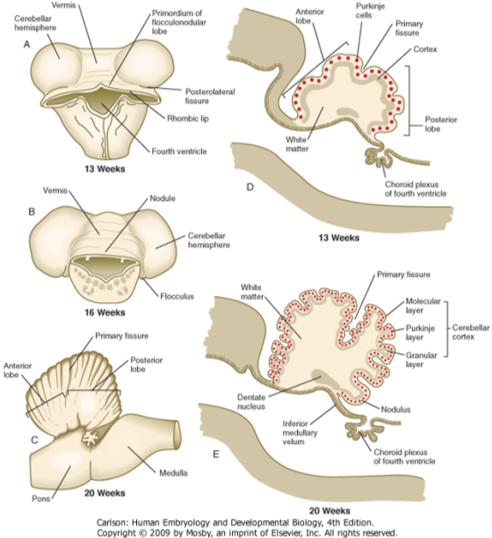
Anatomy of the developing cerebellum

Slide 39
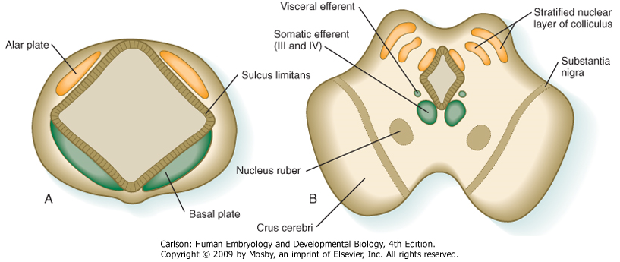
Development of the mesencephalon
Alar plate generates superior and inferior colliculi
Inferior colliculus: auditory relay
Superior colliculus: visual relay
Basal plate generates 4 motor tracts:
Somatic efferent (motor output to extraocular muscles, CN III, IV)
Visceral efferent (motor output to ciliary ganglion of the eye, CN III)
Red nucleus (motor relay to flexor muscles of the upper limb)
Substantia nigra (dopaminergic output to the basal ganglia of the telencephalon)

Slide 40
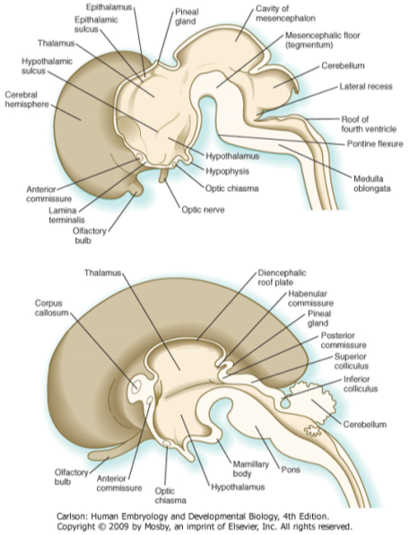
Development of the diencephalon
Pineal gland: sleep-wake cycle, secretes melatonin
Epithalamus: masticatory and swallowing functions
Thalamus: major relay of sensory input to cerebral cortex
Hypothalamus: master regulatory center (autonomic and endocrine) and also limbic system (emotion & behavior)
Hypophysis/infundibulum: posterior pituitary gland, secretes ADH and oxytocin
Optic cup: retina of eye

Slide 41
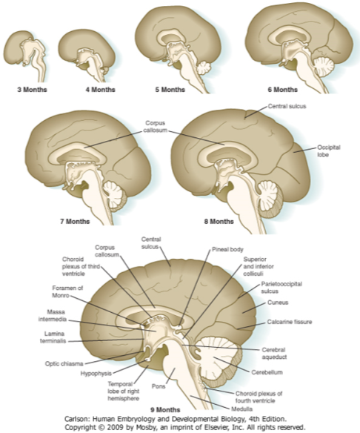
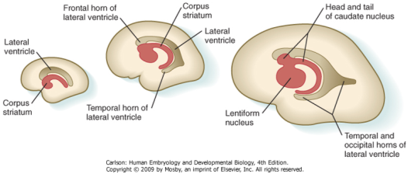
Development of the telencephalon
Generates cerebral cortex:
Neocortex: 6-layered cortex of frontal, temporal, parietal, and occipital lobes
Archicortex: 3-layered cortex of hippocampus and dentate gyrus
Paleocortex: olfactory cortex
Generates basal ganglia:
Caudate nucleus, lentiform nucleus, putamen, amygdala
Commissures interconnect the cerebral hemispheres:
Anterior commissure: interconnects olfactory structure and some of temporal lobes
Hippocampal commissure: interconnects the hippocampi
Corpus callosum: interconnects neocortex
Defects in telencephalic development:
Holoprosencephaly: failure of midline cleavage of the forebrain, so a single ventricular cavity; associated with trisomy 13, fetal alcohol syndrome
Schizencephaly: failure of corpus callosum; associated with mutations in EMX-2

Slide 42
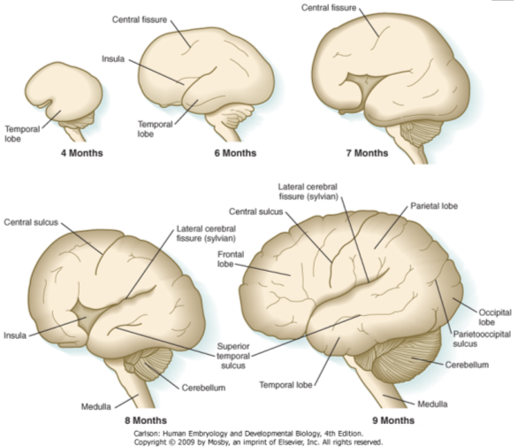
Anatomy of the developing cerebral cortex: sulci and gyri
Cerebral hemispheres expand greatly and eventually are limited by the size of the cranial vault –continued growth requires folding into sulci (grooves) and gyri (convolutions)
Disruptions in growth of the brain result in lissencephaly (smooth brain), e.g. premature differentiation of neural stem cells or insufficient proliferation of progenitors, many genes associated with this (LIS1, DOUBLECORTIN) relate to migration of neurons
Growth of the brain continues until ~7 years of age; lack of this growth is microcephaly, associated with mutations in ASPM (Abnormal Spindle Microcephaly Associated) gene which regulates mitotic spindle function.

Slide 43
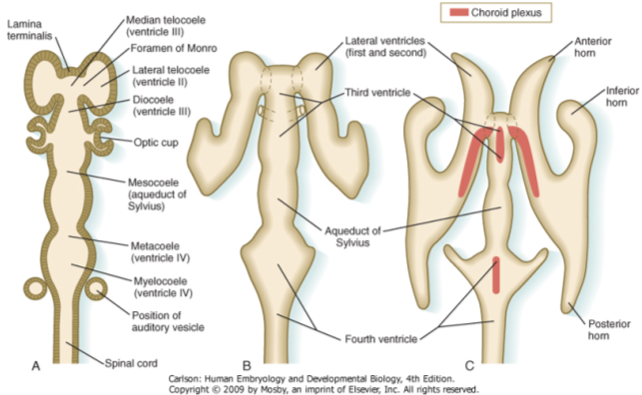
Development of the ventricles and choroid plexus
Derived from central canal of the neural tube
As regions of the brain take shape, the ventricles are shaped into dilated regions (e.g. lateral ventricle, 3rd ventricle, 4th ventricle) connected by channels (e.g. foramen of Monro, cerebral aqueduct)
Ependymal cells in the roof of the lateral, 3rd, and 4th ventricle become specialized for the production of CSF
Blockage of the communicating channels can cause dilation of the ventricles or hydrocephalus

Slide 44
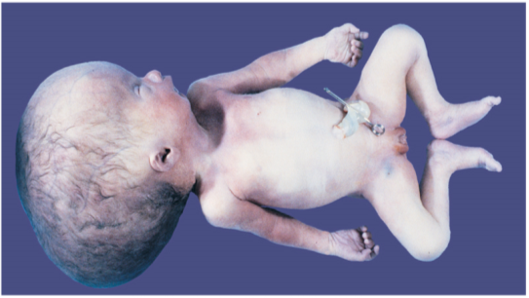
Hydrocephalus due to disruption of CSF flow
Disrupting flow of CSF causes it to accumulate within the ventricles of the brain –increased pressure leads to swelling of the entire cranium.

Slide 45
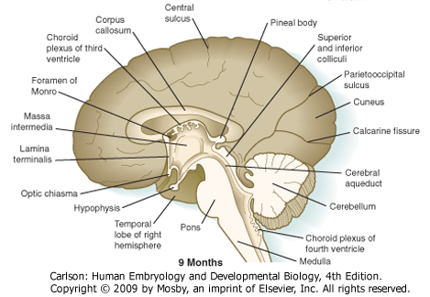
Arnold-Chiari malformation
Cerebromedullary malformation such that the cerebellum and medulla herniate through the foramen magnum thus obstructing the 4th ventricle resulting in hydrocephalus
Frequently associated with spina bifida and malformations of the occipitovertebral joint
May be accompanied by dysphonia (laryngeal paralysis) due to compression of vagus nerve.

