Slide 1
Cartilage / Mature Bone
J. Matthew Velkey, Ph.D.
matt.velkey@duke.edu
452A Davison, Duke South

Slide 2
Cartilage
Cartilage is a specialized form of firm and resilient connective tissue that can bear stresses without permanent distortion.
It consists of
cells (chondroblasts; chondrocytes)
fibers (type I, II collagen; elastic fibers)
ground substance (hyaluranan; proteoglycans; glycoproteins).
[fibers + ground substance = extracellular matrix]
It is an avascular tissue.
It serves as a precursor or model for the embryonic development and subsequent growth of many long bones.
(It is replaced by bone tissue in adult life, except for the surfaces that articulate with other bones.)

Slide 3
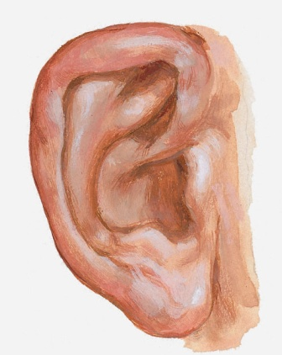
Cartilage
There are three types of cartilage:
Hyaline cartilage (Type II collagen)
Articular surfaces, Ephiphyseal plate, Tracheal wall, etc.
Elastic cartilage (Type II collagen, elastic fibers)
Pinna of the ear, Epiglottis, Eustachian tube, etc.
Fibrocartilage (Type I & Type II collagen)
Intervertebral disks, Pubic symphysis, insertion sites of tendons and ligaments

Slide 4
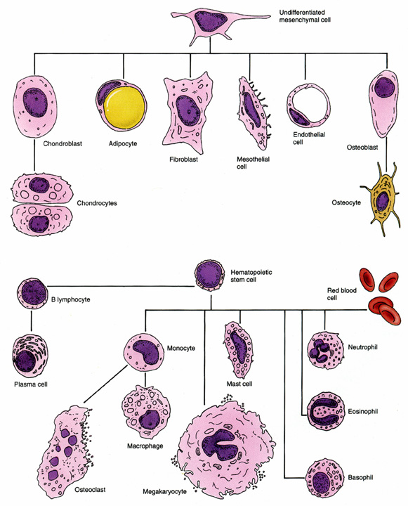
Chondrocytes arise from mesenchymal stem cells

Slide 5
Initiation of Cartilage Formation (embryonic mesenchymal cells)

Slide 6
Beginning of cartilage Formation
“pluripotent”

Slide 7
Differentiation of chondrogenic cells
Perichondrium
Lacuna
Isogenous group
Isogenous group

Slide 8
Formed Hyaline Cartilage

Slide 9
Growth of Hyaline Cartilage
Interstitial growth
Chondrocytes
Chondroblasts
Perichondrium
(Appositional growth)

Slide 10
Cartilage growth
Appositional Growth: Deposition of new cartilage on the surface of existing cartilage.
Interstitial Growth: Formation of new cartilage within an existing cartilage.

Slide 11
Hyaline cartilage
Most common type of cartilage.
Nasal septum, larynx, tracheal rings, sternal ends of ribs, most articular surfaces and forms the template for developing long bones.

Slide 12
Hyaline Cartilage
Chondroblasts
(
Chondrocytes
Chondrocytes
Chondroblasts
Perichondrium

Slide 13
Hyaline cartilage
chondrocytes
Synthesize collagen fibers and produce ground substance.

Slide 14
Other types of cartilage
Elastic cartilage: contains elastic fibers.
Pinna of the external ear, auditory canal, epiglottis, Eustachian tube.
Fibrocartilage: intermediate between cartilage and dense regular connective tissue.
intervertebral discs, pubic symphysis, etc.

Slide 15
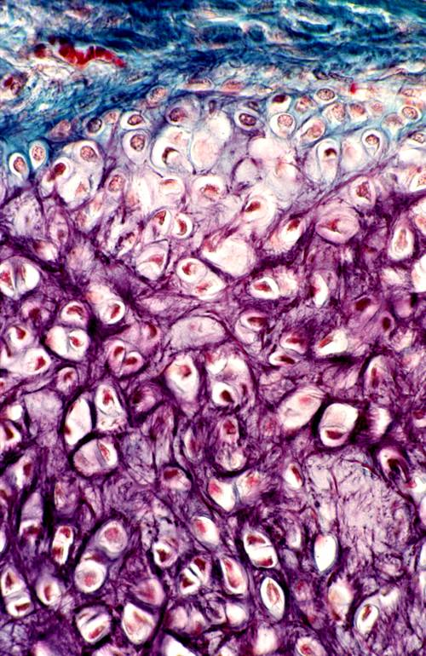
Elastic Cartilage
H&E stain
Weigert’s stain
Aldehyde Fuchsin

Slide 16
Fibrocartilage Type I and II collagen. No identifiable perichondrium
Vertebra
Vertebra

Slide 17
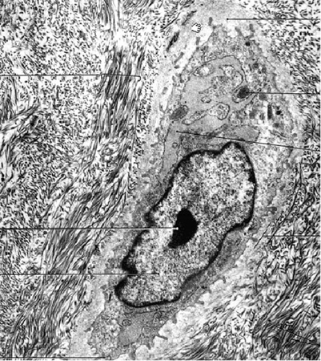
Elastic Cartilage and Fibrocartilage
Collagen I
Collagen II
Collagen II
Elastic fibers

Slide 18
Articular Cartilage (Specialized form of hyaline cartilage)
Femoral head
Articular cartilages
from Netter

Slide 19
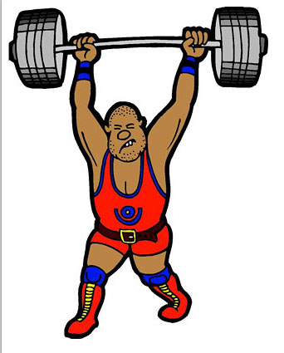
Articular (hyaline) Cartilage in Joints

Slide 20
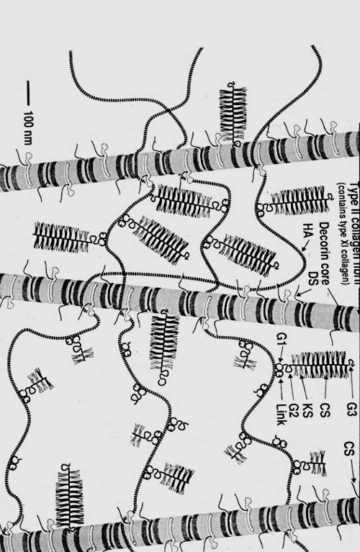
Cartilage Matrix
Type II collagen
Hyaluranan (hyaluronic acid) up to 8X10⁶ d
Proteoglycans (3.5X10⁶ daltons)
Aggrecan
Proetin Core
Glycosaminoglycans (GAGs)
Chondroitin sulfate
Keratin sulfate

Slide 21
Proteoglycan Aggregates
Consist of:
1. An axial hyaluronan(HU) molecule.
2. Core proteins attached to the HU molecule by a linker protein.
3. Glycosaminoglycans attached to a core protein.
EM view of spread preparation
Kierszenbaum, p. 108

Slide 22
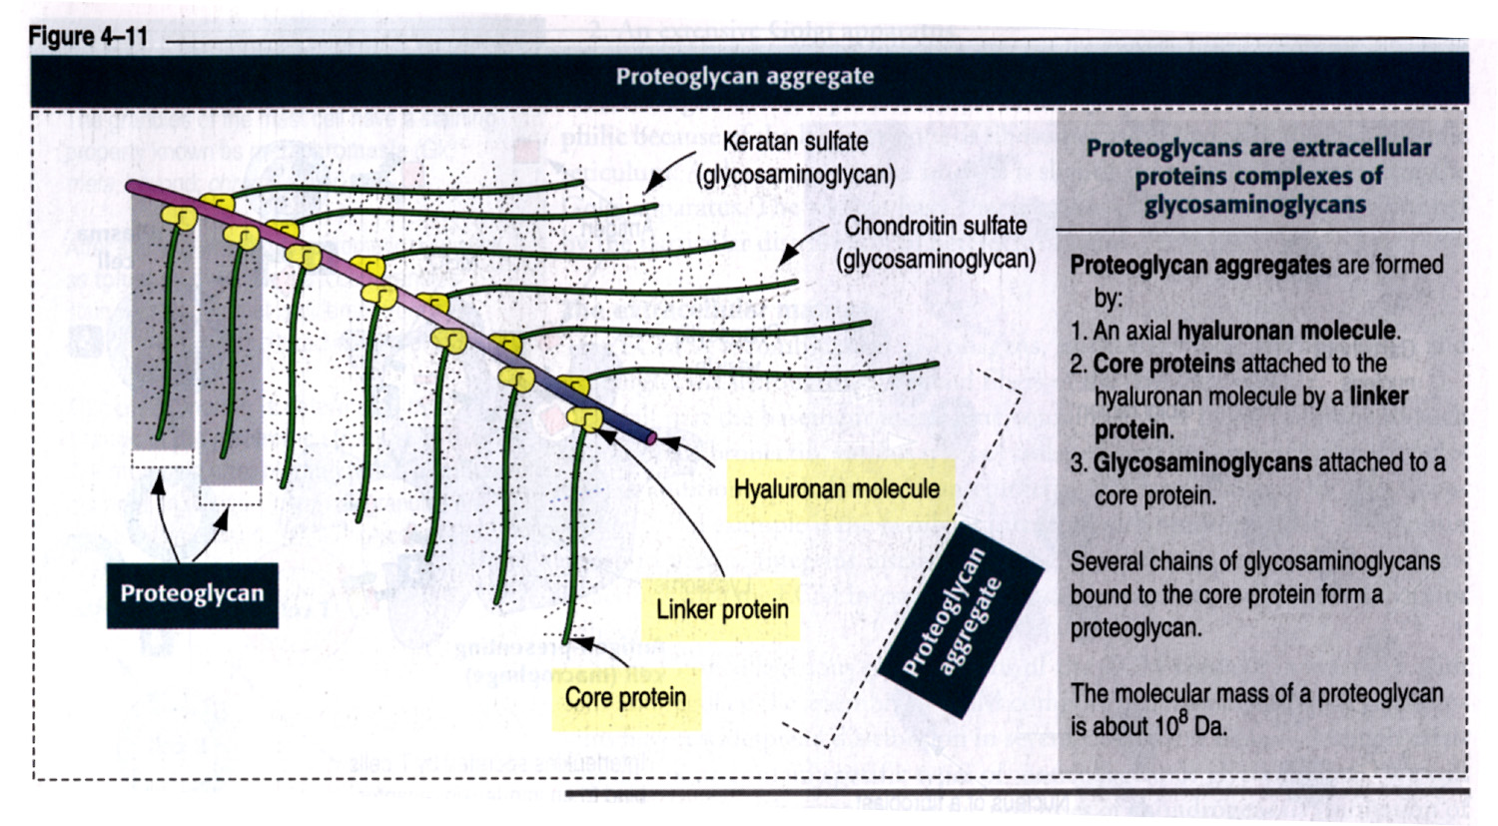
Glycosaminoglycans
Albert et al., 2nd ed. p. 804

Slide 23
Extended random coil conformation of a single molecule of hyaluronan
COO⁻SO₄⁻⁻
Albert et al., 2nd ed. p. 807
Albert et al., 2nd ed. p. 804

Slide 24
Basophilia in hyaline cartilage matrix
The basophilia in the matrix is due to the high density of negative charges in the GAG subunits, which attract the positive dye, hematoxylin.

Slide 25
Cartilage Matrix and its function
The glycosaminoglycans (GAGs) tend to adopt highly extended, “random coil” conformations due to repulsive forces of negative charges on each GAG.
The high negative charge attract cations, such as Na⁺⁺ that are osmotically active causing large amounts of water to be sucked into the matrix.
The net effect creates a swelling pressure or turgor, that enables the matrix to withstand compressive forces.
Collagen fibers within the matrix resist outward stretching forces imposed under load thus reducing deformation.

Slide 28
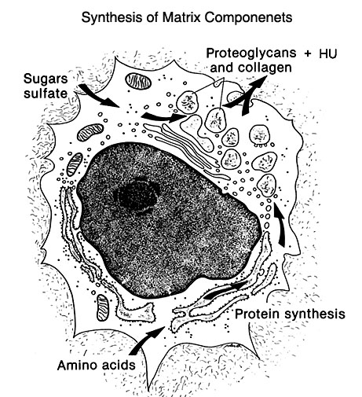
Hyaline Cartilage Matrix
Chondrocyte
Bloom & Fawcett, 12th ed. p. 189

Slide 29
Diarthrosis and Articular Cartilage
(synovial fluid)
Wheater p. 202
Bathed in synovial fluid.
Collagen fibers - arranged as gothic arches
Chondrocytes - in vertical rows. No perichondrium
Junqueira, p.157

Slide 30
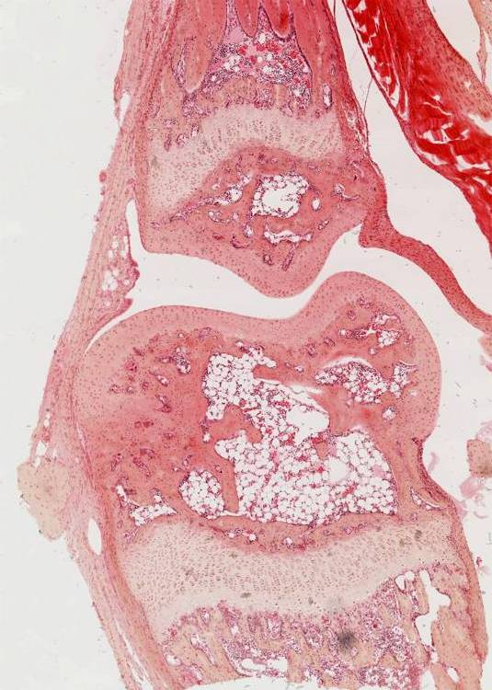
Articular cartilage
Perichondrium -absent. Chondrocytes - in vertical rows.

Slide 31
Cartilage Damage

Slide 32
Cartilage Changes with Aging
Not much changes with collagen.
The proteoglycans produced in older individuals are smaller with shorter chondroitin sulfate chains than in younger individuals.
These changes might reduce water contents in the matrix and make the cartilage less able to resist compressive forces.
These changes, in turn, would make matrix more vulnerable to injuries in weight-bearing, and the inflammatory response to injury would cause painful symptoms of arthritis.

Slide 33
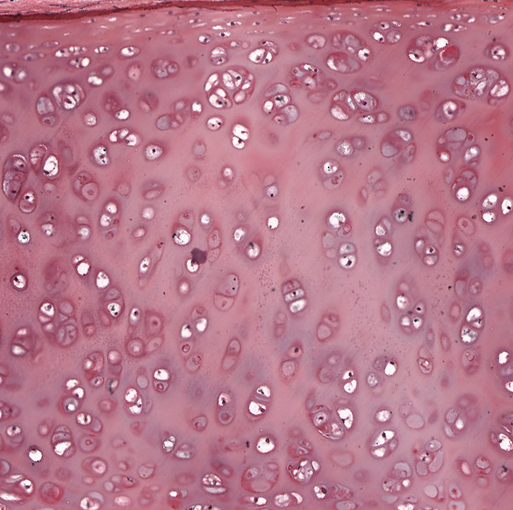
Differences in basophilic staining in cartilage matrix
The difference in basophilic staining reflects the relative matrix content of glycosaminoglycans (aggrecans).
The decrease in size of proteoglycans or the length of chondroitin sulfate chains will reduce the relative matrix content of glycosaminoglycans This, in turn, will reduce the intensity of basophilic staining in the cartilage matrix.

Slide 34
Bone
Cells: Osteoblasts, Osteocytes, Osteoclasts
Fibers: Type 1 Collagen
Bone Matrix:
Ground Substance
GAGs: Hyaluronan, Chondroitin & Keratan Sulfate
Proteoglycans: short core proteins and relatively fewer GAG side chains than in cartilage.
Hydroxyapatite crystals [Ca₁₀(PO4)₆(OH)₂]:
Calcium phosphate

Slide 35
Cartilage Bone
Water content: 25%
Collagen I: 90% of organic content.
Other Ground Substance
Osteonectin: anchor collagen to bone mineral.
Osteocalcin: Calcium binding protein involved in bone calcification.
Osteopontin: Binding of osteoblasts and osteoclasts to bone.
Grows only by apposition.
Highly vascular
Water content: ~70%
Collagen I or II: ~40% of organic content.
Grows interstitially and by apposition.
Avascular

Slide 36
Bone
Provides support for the soft tissues of the body.
Provides sites for attachment of the muscles and tendons essential for locomotion.
Protects the vital organs of the cranium and various body cavities.
Encloses blood-forming elements in the bone marrow.
Plays an important role as a mobilizable store of calcium and phosphate.

Slide 37
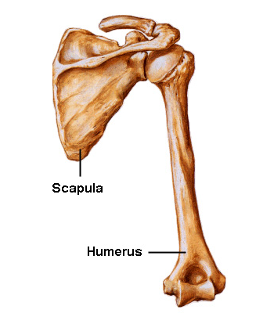
Types of Bone (Flat, long, short and irregular bones)
from Netter

Slide 38
Compact (dense) and Spongy (cancellous) Bone
Compact bone
Weiss, 6th ed., p. 218
Ross et al., 4th ed., p. 182

Slide 39
Long Bone
Ross et al., 4th ed., p. 182 & 185

Slide 40
Periosteum and Endosteum
Endosteum

Slide 41
Wall of a Long Bone
Junqueera & Carneiro, 10th ed. p. 144

Slide 42
Haversian system (osteon), Haversian canal (HC) and Volkmann’s canal (VC)
HC
Osteon
HC
VC
VC
Transverse section
Longitudinal section

Slide 43
Haversian system (osteon) /Harversian canal
HC
HC

Slide 44
Haversian Canal and Canaliculi

Slide 45
Osteocytes, Lacunae and Canaliculi

Slide 46
Osteocyte
Bloom & Fawcett, 12th ed. P. 208

Slide 47
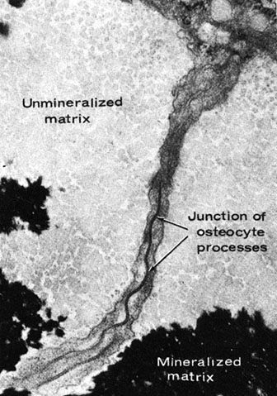
Osteocyte and its Process
(gap junctions)
Bloom & Fawcett, 12th ed. p. 206-7

Slide 48
Compact and Spongy Bone

Slide 49
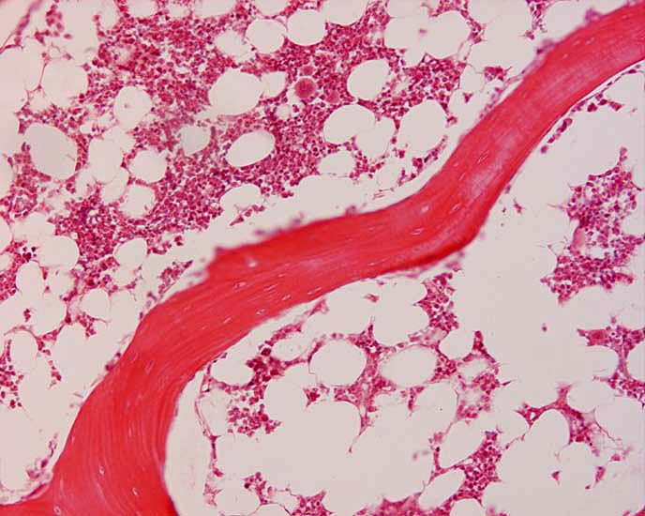
Spongy (cancellous) bone
Bone Marrow
Cancellous bone

Slide 50
Bone cells
Osteoblasts
Active
Inactive
Osteocytes
Osteoclasts
Howship’s lacuna (resorption bay)

Slide 51
Osteoblast
Matrix vesicles
Kierszenbaum p. 122

Slide 52
EM of Active Osteoblasts
steoid
Weiss, 6th ed., p. 225

Slide 53
Osteoclasts
Wheater’s 5th ed., p. 190
c
Howship’s lacuna

Slide 54
Osteoclast and Bone Resorption
Junqueira & Carneiro, 10th ed., p.143
Kierszenbaum, p. 124

Slide 55
Osteoclast (EM) Note the ruffled border of the cell and resorbing bone matrix
Ruffled border
Bloom & Fawcett, 12th ed., p. 210

Slide 56
Immature and Mature Bone (nonlamellar, bundle, or woven bone)

Slide 57
Learning Objectives
Cartilage
Be able to recognize the three major cartilage types in light microscopic sections and know where in the body each type occurs.
Be able to identify cells and structures in sections of cartilages (chondroblast, chondrocyte, lacuna, isogenous group, two type of matrix, perichondrium, etc).
Know the contents of cartilage matrix and understand the molecular basis for resilience of cartilage.
Be able to describe the process of chondrogenesis and know how cartilage grows.
Understand what changes occur with aging in the matrix.

Slide 58
Learning Objectives
Adult Bone
Be able to recognize compact and cancellous bone in conventional and ground sections and know the structural differences in the two types.
Be able to identify the component parts of adult bone and know their functions (e.g. periosteum, endosteum, osteon, canaliculus, lacuna, osteocyte, Haversian and Volkmann canal).
Be able to recognize the cells in adult bone at the light and EM level and know their functions (e.g. active and inactive osteoblasts, osteocytes, osteoclasts).
Know the major differences in matrix contents of cartilage and bone.

