Slide 1
Muscle Tissue
J. Matthew Velkey, Ph.D.
matt.velkey@duke.edu
452A Davison, Duke South

Slide 2
Muscle Tissue
I. Striated Muscle - regularly arranged contractile units
A. Skeletal Muscle - long, cylindrical multinucleated cells with peripherally placed nuclei. Contraction is typically quick and vigorous and under voluntary control. Used for locomotion, mastication, and phonation.
B. Cardiac Muscle - elongated, branched cells with a single centrally placed nucleus and intercalated discs at the ends. Contraction is involuntary, vigorous, and rhythmic.
II. Smooth Muscle - possesses contractile machinery, but it is irregularly arranged (thus, non-striated). Cells are fusiform with a central nucleus. Contraction is involuntary, slow, and long lasting.

Slide 3
Muscle Regeneration and Growth
Skeletal Muscle
Increase in size (hypertrophy)
Increase in number (regeneration/proliferation)
Satellite cells are proposed source of regenerative cells
Smooth Muscle
Increase in size (hypertrophy)
Increase in number (regeneration/proliferation)
Smooth muscle cells are proliferative
(e.g. uterine myometrium and vascular smooth muscle)
Vascular pericytes can also provide source of smooth muscle
Heart Muscle
Increase in size (hypertrophy)
Formerly thought to be non-proliferative
Post-infarction tissue remodeling by fibroblasts (fibrosis/scarring)
New evidence suggests mitotic cardiomyocytes and regeneration by blood or vascular-derived stem cells
Notes:
3

Slide 4
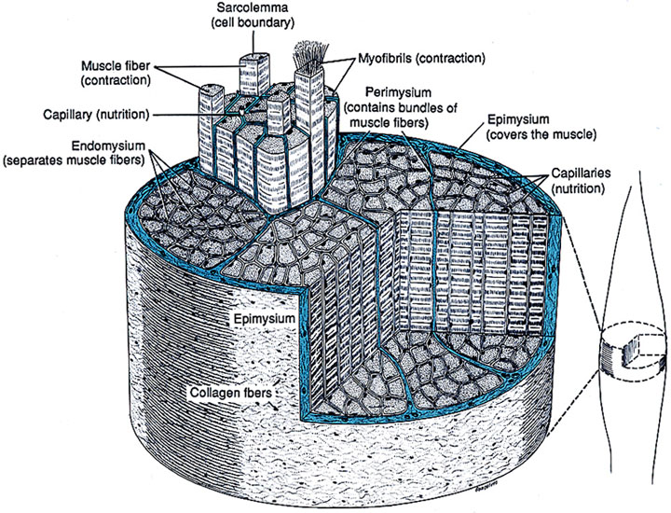
Skeletal Muscle Investments
Epimysium - dense irr. c.t.
Perimysium -
less dense irr. c.t.
Endomysium - basal lamina and reticular fibers
ALL MUSCLE CELLS HAVE BASAL LAMINAE!
Notes:
Figure 10-2 (p102) from Junquiera & Carniero, Basic Histology: text and atlas. 10th ed.

Slide 5
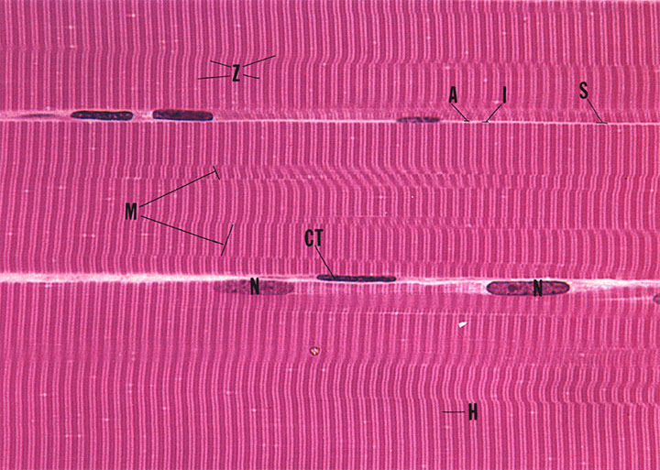
Skeletal Muscle as seen in longitudinal section in the light microscope...
Fiber = cell; multi-nucleated and striated
Myofibrils (M) with aligned cross striations
A bands - anisotropic (birefringent in polarized light)
I bands - isotropic (do not alter polarized light)
Z lines (zwischenscheiben, Ger. “between the discs”)
H zone (hell, Ger. “light”)
Notes:
5
Plate 6.1, Fig 1 (p105) from Gartner & Hiatt, Color Atlas of Histology, 2nd ed.

Slide 6
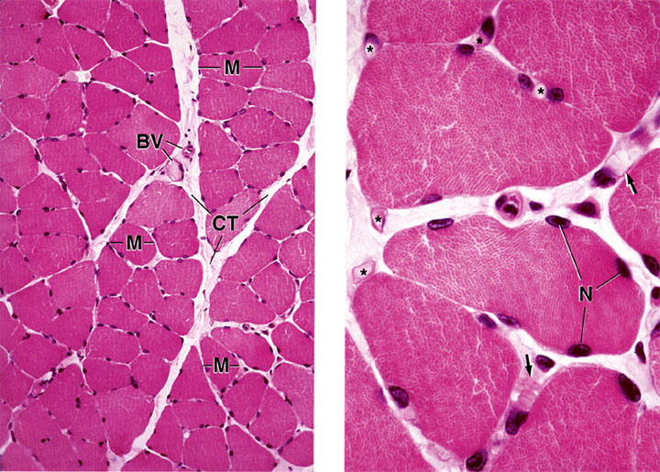
Skeletal Muscle as seen in transverse section in the light microscope...
Notes:
Left: Plate 18, Figure 2 (p309) from Ross & Pawlina, Histology: A Test and Atlas, 5th ed.
Right: Plate 18, Figure 3 (p309) from Ross & Pawlina, Histology: A Test and Atlas, 5th ed.

Slide 7
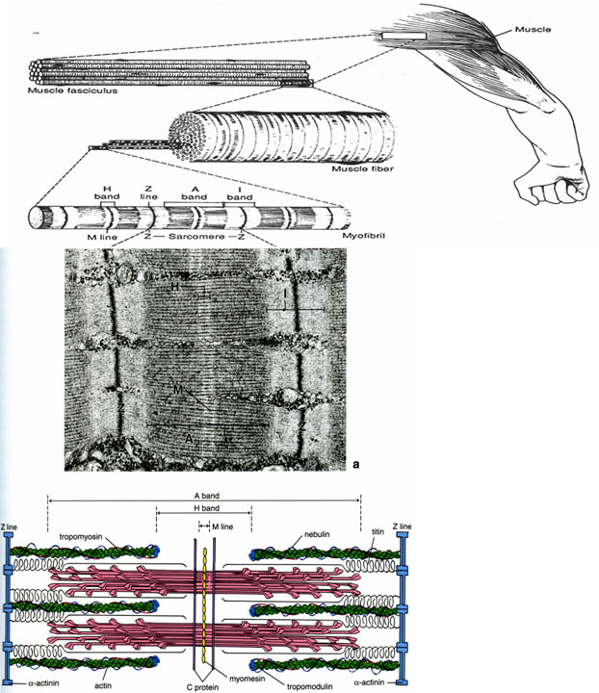
Organization of Skeletal Muscle Fibers THE SARCOMERE…
Contractile unit of striated muscle
Structures between Z lines
2 halves of I bands
A band
H zone
M line (mittelscheibe, Ger. “middle of the disc”)
Myofilaments
Actin
Myosin
Other structural proteins
Titin (myosin-associated)
Nebulin (actin-associated)
Myomesin (at M line)
α actinin (at Z line)
Desmin (Z line)
Vimentin (Z line)
Dystrophin (cell membrane)
Notes:
Top line drawing (going from muscle to myofibril) is from Fig 10-11 (p197) from Junquiera & Carniero, Basic Histology: text and atlas. 10th ed.
Bottom figure (TEM and diagram) is Fig 11.7 (p287) from Ross & Pawlina, Histology: A Text and Atlas, 5th ed.

Slide 8
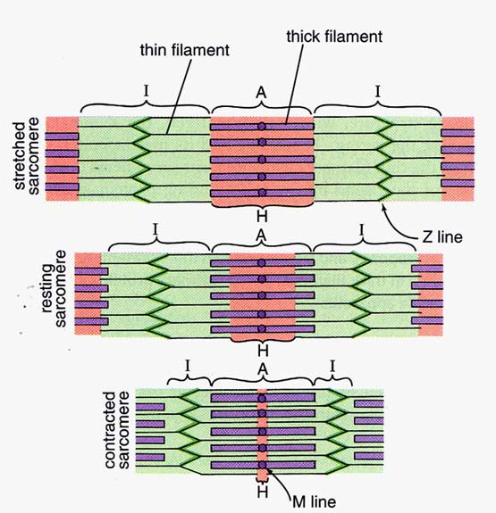
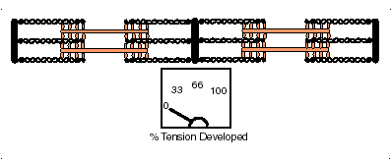
Sliding Filament Theory
Sarcomere
Muscle fibers are composed of many contractile units (sarcomeres)
Changes in the amount of overlap between thick and thin filaments allows for contraction and relaxation of muscle fibers
Many fibers contracting together result in gross movement
Note: Z lines move closer together; I band and H band become smaller during contraction
Notes:
Left figure: Fig 11.6 (p286) from Ross & Pawlina, Histology: A Test and Atlas, 5th ed.
Right figure: http://www.3dotstudio.com/zz.html

Slide 9
Contraction is Ca+ dependent
2
1
&
3
4
5
In resting state, free ATP is bound to myosin
ATP hydrolysis induces conformational change – myosin head cocks forward 5nm (ADP+P_{i} remain bound to myosin).
Stimulation by nerves cause release of calcium (green) into cytoplasm; calcium binds troponin (purple) and reveals myosin binding site (black) on actin (yellow)
Myosin binds weakly to actin, causing release of P_{i}
Release of P_{i} from myosin induces strong binding to actin, power stroke, and release of ADP
Cycle continues if ATP is available and cytoplasmic Ca+ level is high
Notes:
Modified from Alberts, et al., Molecular Biology of the Cell

Slide 10
Cardiac Muscle
Tissue Features:
Striated (same contractile machinery)
Self-excitatory and electrically coupled
Rate of contractions modulated by autonomic nervous system
innervation is neuroendocrine in nature (i.e. no “motor end plates”)
Cell Features:
1 or 2 centrally placed nuclei
Branched fibers with intercalated discs
Numerous mitochondria (up to 40% of cell volume)
Sarcoplasmic reticulum & T-tubules appear as diads at Z lines
Sarcoplasmic reticulum does not form terminal cisternae
T tubules are about 2x larger in diameter than in skeletal muscle
transport Ca²⁺ into fibers

Slide 11
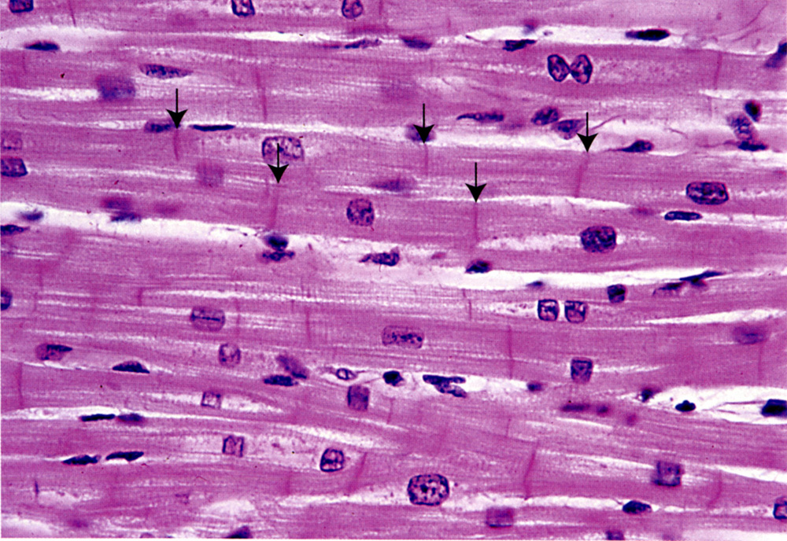
Cardiac Muscle (longitudinal section)
Central nuclei, often with a biconical, clear area next to nucleus –this is where organelles and glycogen granules are concentrated (and atrial natriuretic factor in atrial cardiac muscle)
Striated, branched fibers joined by intercalated disks (arrows) forms interwoven meshwork
Notes:
11
Fig 11.14 (p294) from Ross & Pawlina, Histology: A Test and Atlas, 5th ed.

Slide 12
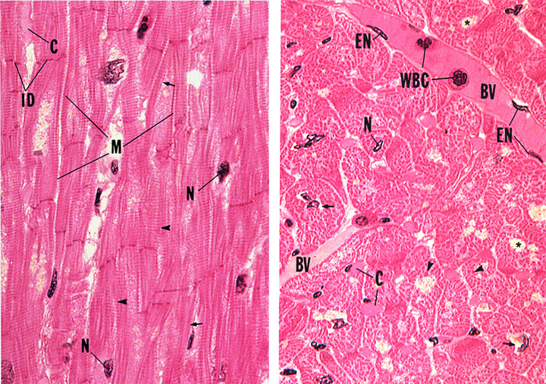
Cardiac Muscle (longitudinal section)
Cardiac Muscle (transverse section)
Notes:
12
Left: Plate 6.8, Figure 1 (p117) from Gartner & Hiatt, Color Atlas of Histology, 2nd ed.
Right: Plate 6.8, Figure 2 (p117) from Gartner & Hiatt, Color Atlas of Histology, 2nd ed.

Slide 13
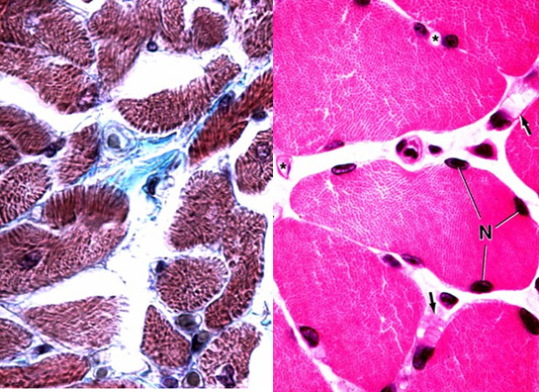
Transverse Section of Cardiac Muscle versus Skeletal Muscle
As with skeletal muscle, delicate, highly vascularized connective tissue (endomysium) surrounds each cardiac muscle cell. Fibers are bundled into fascicles, so there is also perimysium. However, there really isn’t an epimysium; instead, the connective tissue ensheathing the muscle of the heart is called the epicardium (more on that in a later lecture).
Notes:
13
Left:
Right: Plate 18, Figure 3 (p309) from Ross & Pawlina, Histology: A Test and Atlas, 5th ed.

Slide 14
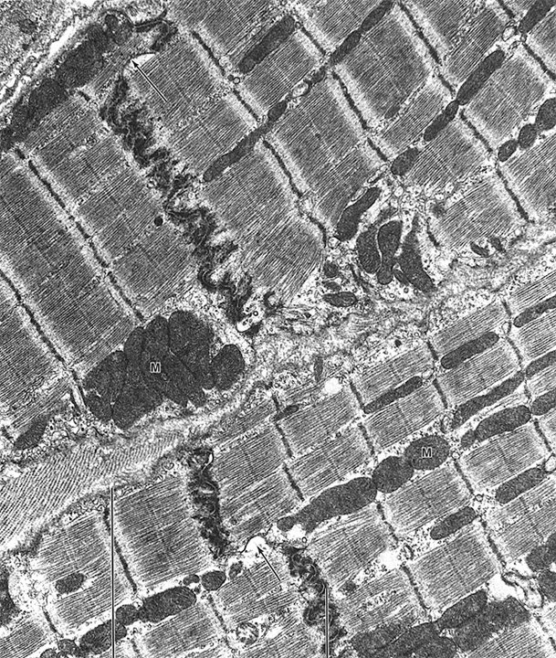
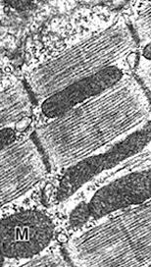
Cardiac Muscle (TEM)
T Tubule/SR Diads
Notes:
14
TEM on left is Fig 10-24 (p208) from Junquiera & Carniero, Basic Histology: text and atlas. 10th ed.

Slide 15
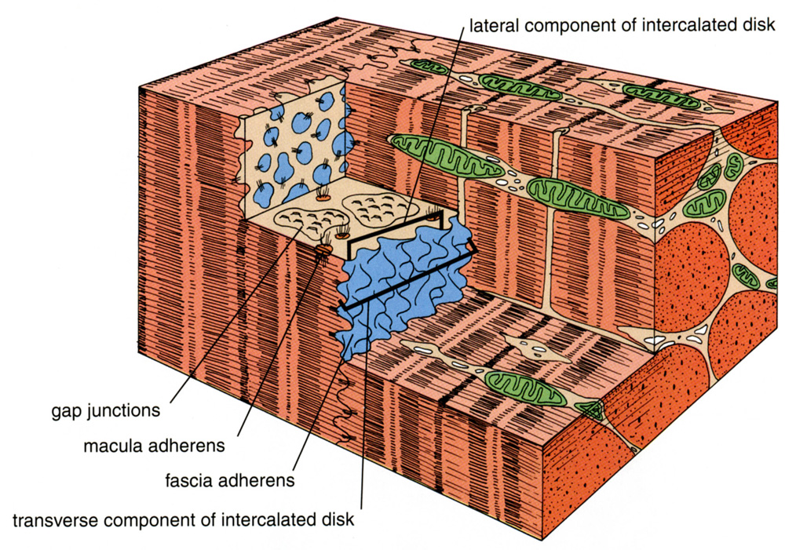
Intercalated Discs Couple Heart Muscle Mechanically and Electrically
Notes:
15
Fig 11.16a (p298) from Ross & Pawlina, Histology: A Test and Atlas, 5th ed.

Slide 16
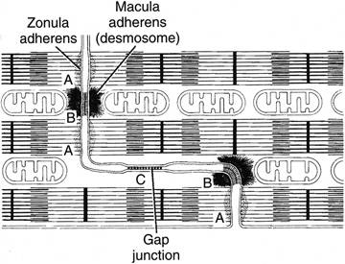
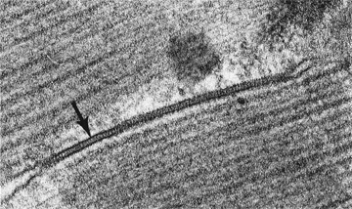
Transverse portion:
forms mechanical coupling
aka “Fascia adherens”
Lateral Portion:
forms electrical coupling
Notes:
16
Left:
Top right: line drawing is Fig 10-26 (grayscaled) (p209) from Junquiera & Carniero, Basic Histology: text and atlas. 10th ed.
Bottom right: inset image on p120 from Cross & Mercer, Cell and Tissue Ultrastructure: A Functional Perspective (1993)

Slide 17
Smooth Muscle
Fusiform, non-striated cells
Single, centrally-placed nucleus
Contraction is non-voluntary
Contraction is modulated in a neuroendocrine manner
Found in blood vessels, GI and urogenital organ walls, dermis of skin
Notes:
17

Slide 18
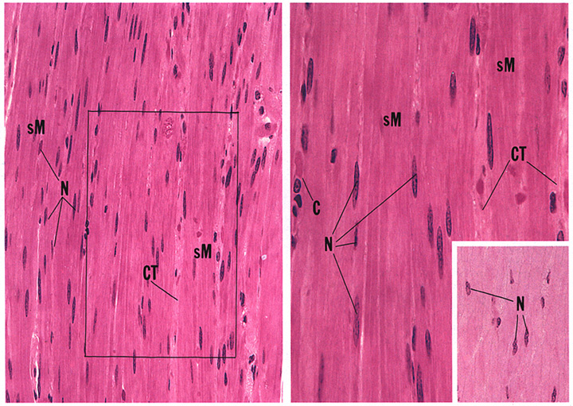
Smooth Muscle (longitudinal section)

Slide 19
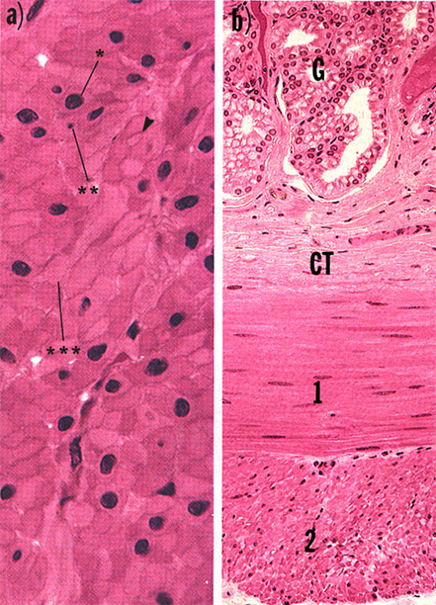
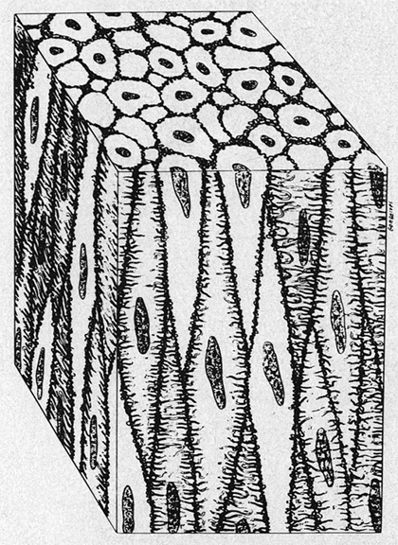
Smooth Muscle Viewed in Transverse and Longitudinal Section
Notes:
19
Left diagram is Fig 10-30 (grayscaled and rotated) (p211) from Junquiera & Carniero, Basic Histology: text and atlas. 10th ed.
Right figure is Plate 6.6, Fig 4 (p113) from Gartner & Hiatt, Color Atlas of Histology, 2nd ed.

Slide 20
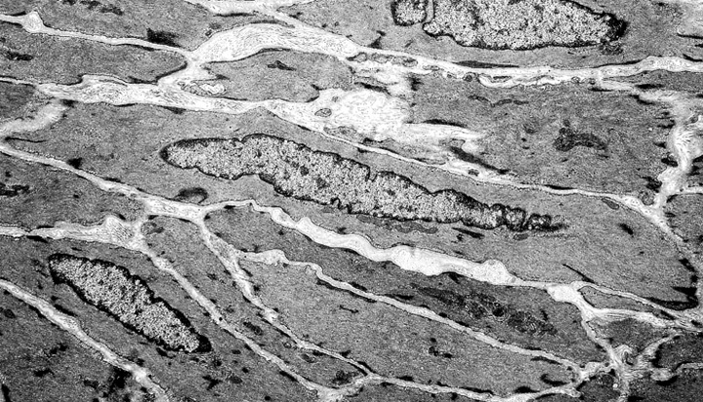
Ultrastructure of Smooth Muscle:
actin and myosin filaments
intermediate filaments of desmin (also vimentin in vascular smooth muscle)
membrane associated and cytoplasmic dense bodies containing α actinin (similar to Z lines)
relatively active nucleus (smooth muscle cells make collagen, elastin, and proteoglycans)
Notes:
20
From University of MS Medical Center Electron Micrograph collection

Slide 21
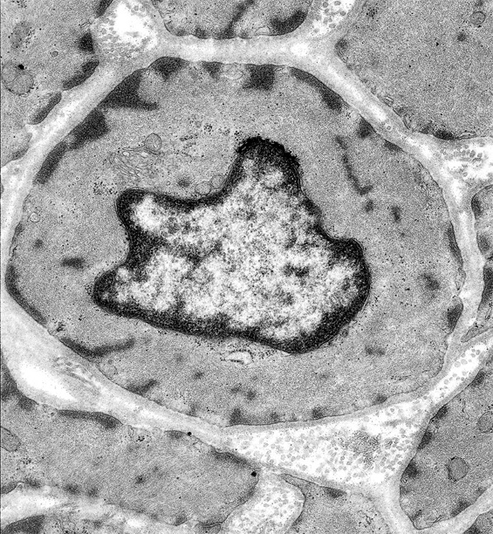
Smooth Muscle Viewed in Cross Section (TEM)
What is the structure marked by * ?
Also, note collagen –SMC secrete ECM:
collagen (I,III, IV), elastin, and proteoglycans
*
*
Notes:
21
From University of MS Medical Center Electron Micrograph collection

Slide 22
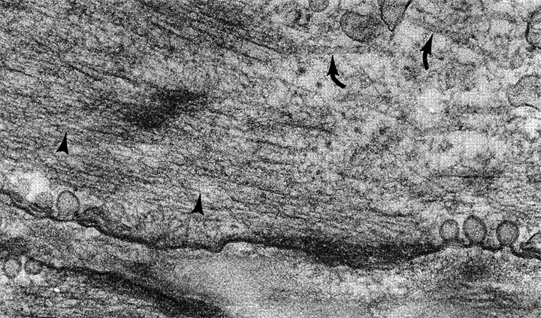
More Ultrastructure of Smooth Muscle Cells:
microtubules (curved arrows)
actin filament (arrowheads)
intermediate filaments
dense bodies (desmin/vimentin plaques)
caveoli (membrane invaginations & vesicular system contiguous with SER –functionally analogous to sarcoplasmic reticulum)
Notes:
22
Inset of image on p115 from Cross & Mercer, Cell and Tissue Ultrastructure: A Functional Perspective (1993).

Slide 23
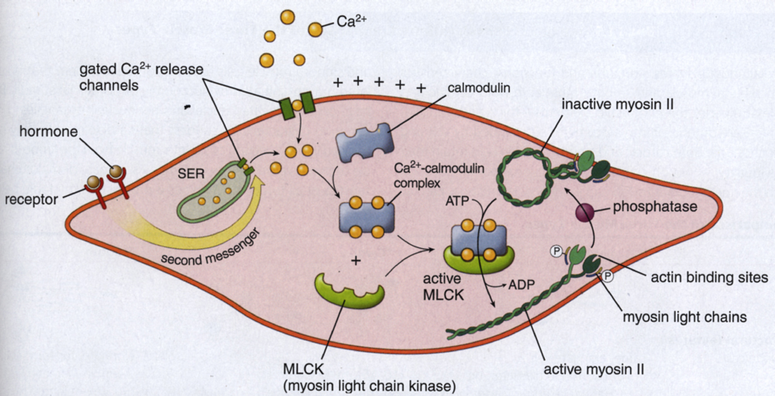
Smooth Muscle Contraction: also Ca+ dependent, but mechanism is different than striated muscle
1. Ca2+ ions released from caveloae/SER and complex with calmodulin
2. Ca2+-calmodulin activates myosin light chain kinase
3. MLCK phosphorylates myosin light chain
4. Myosin unfolds & binds actin; ATP-dependent contraction cycle ensues.
5. Contraction continues as long as myosin is phosphorylated.
6. “Latch” state: myosin head attached to actin dephosphorylated causing decrease in ATPase activity –myosin head unable to detach from actin (similar to “rigor mortis” in skeletal muscle).
7. Smooth muscle cells often electrically coupled via gap junctions
Triggered by:
Voltage-gated Ca+ channels activated by depolarization
Mechanical stimuli
Neural stimulation
Ligand-gated Ca+ channels
Notes:
23
Fig 11.23 (p305) from Ross & Pawlina, Histology: A Test and Atlas, 5th ed.

Slide 24
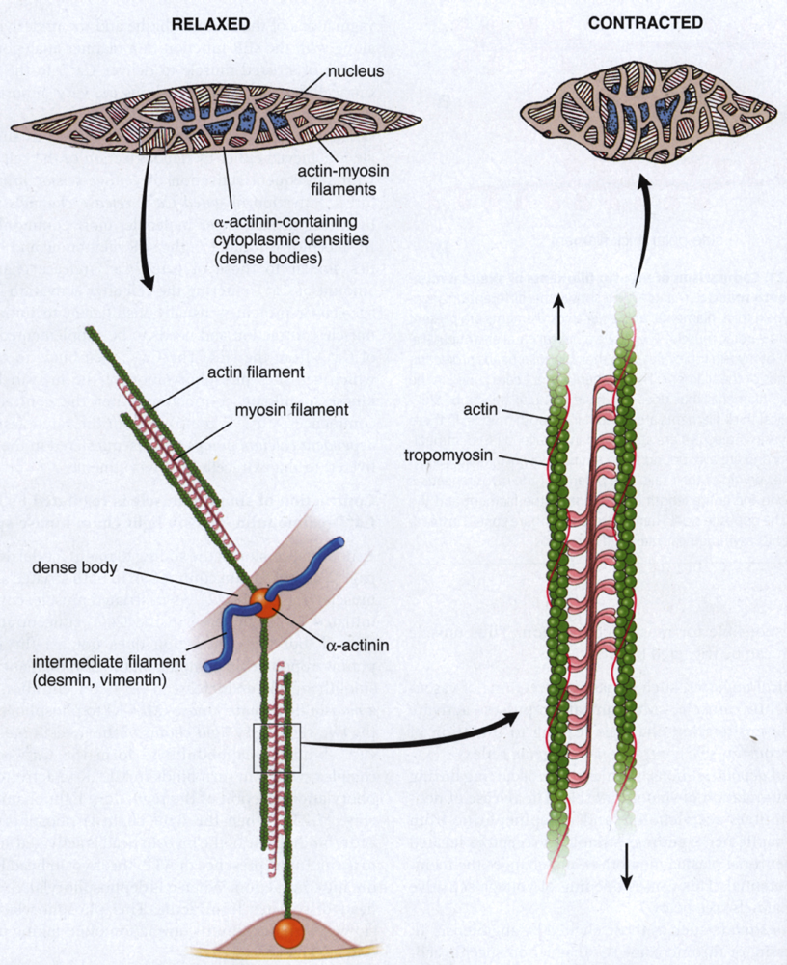
Mechanics of Smooth Muscle Contraction
Dense bodies are analogous to Z lines (plaques into which actin filaments insert)
Myosin heads oriented in “side polar” arrangement
Contraction pulls dense bodies together
Contraction is slow and sustained
Notes:
24
Fig 11.22 (p304) from Ross & Pawlina, Histology: A Test and Atlas, 5th ed.

Slide 25
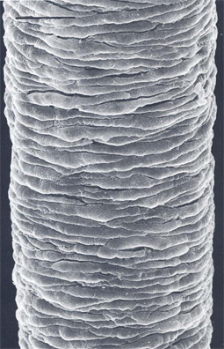
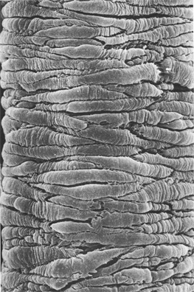
Smooth Muscle (vascular)
Relaxed
Contracted
Notes:
25

Slide 26
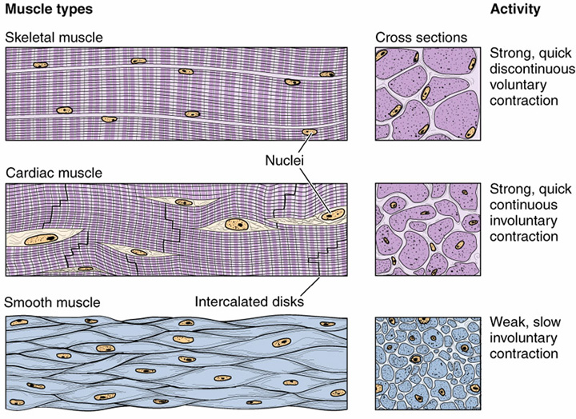
10-100μm in diameter
Up to 30cm in length
10-15μm in diameter
80-100μm in length
0.2-2μm in diameter
20-200μm in length
Notes:
26

Slide 27
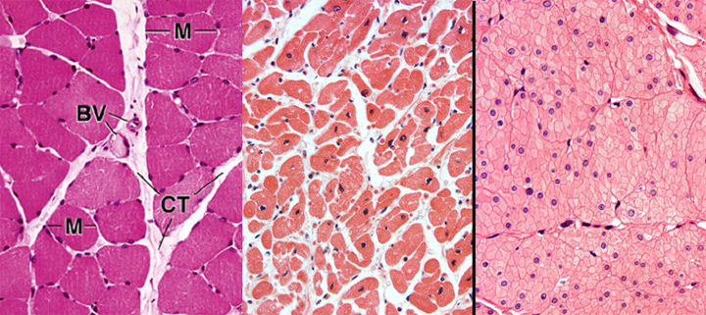
Skeletal Muscle
Cardiac Muscle
Smooth Muscle
Notes:
27
Left: Plate 18, Figure 2 (p309) from Ross & Pawlina, Histology: A Text and Atlas, 5th ed.
Middle:
Right:

Slide 28
Skeletal Muscle
Cardiac Muscle
Smooth Muscle
Notes:
28

Slide 29
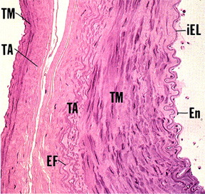
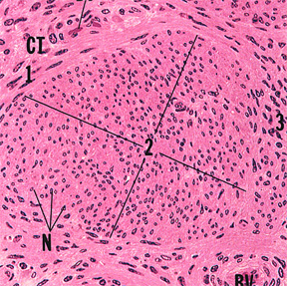
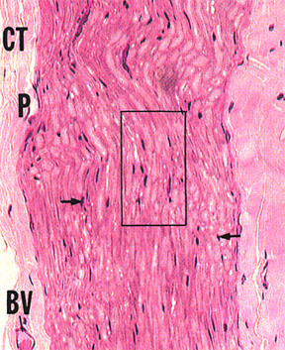
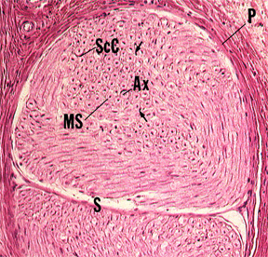
Smooth Muscle
VERSUS
Nerve
VERSUS
Connective Tissue
Notes:
29
Top left: Plate 8.2, Figure 1 (p151) from Gartner & Hiatt, Color Atlas of Histology, 2nd ed.
Top right: Plate 6.6, Figure 3 (p113) from Gartner & Hiatt, Color Atlas of Histology, 2nd ed.
Bottom left: Plate 7.5, Figure 1a (p135) from Gartner & Hiatt, Color Atlas of Histology, 2nd ed.
Bottom right: Plate 7.5, Figure 3 (p135) from Gartner & Hiatt, Color Atlas of Histology, 2nd ed.

Slide 30
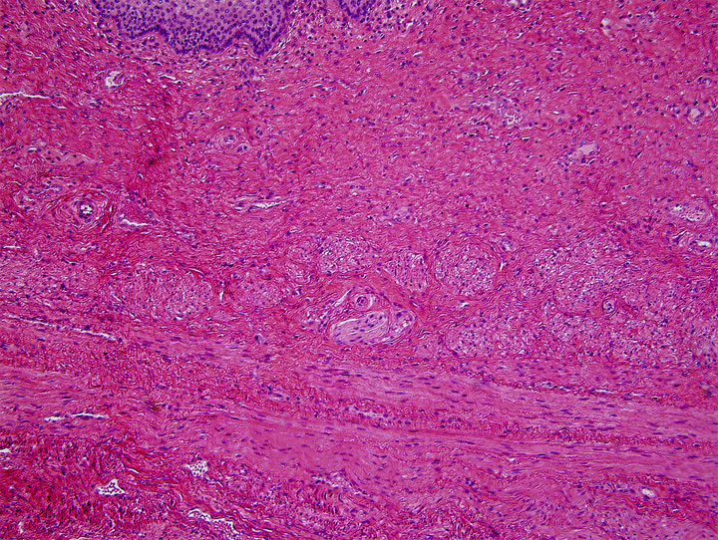
Epithelium
How these tissues actually appear…
Epithelium
CT
B.V.
B.V.
SM
CT
Nerve
CT
SM
SM
Notes:
30
Univ. Michigan glass slide collection (slide 250, collection 112), photomicrograph by Matt Velkey

Slide 31
Learning Objectives
1. Be able to identify the three types of muscle at the light and electron microscope levels, including distinctive features of each, such as the intercalated disk of cardiac muscle.
2. Be able to describe the structural basis of muscle striation.
3. Know the structural elements that harness muscle contraction (i.e., the shortening of myofibrils) to the movement of a body part (i.e., via connection to bone) as well as the mechanism by which muscle cells contract.
Understand the function and organization of the connective tissue in skeletal muscle (endo-, peri-, and epimysium).
Be familiar with the regenerative potential of each muscle type.
Notes:
31

