Slide 1
Histology of the Peripheral Nervous System
J. Matthew Velkey, Ph.D.
matt.velkey@duke.edu
452A Davison, Duke South

Slide 2
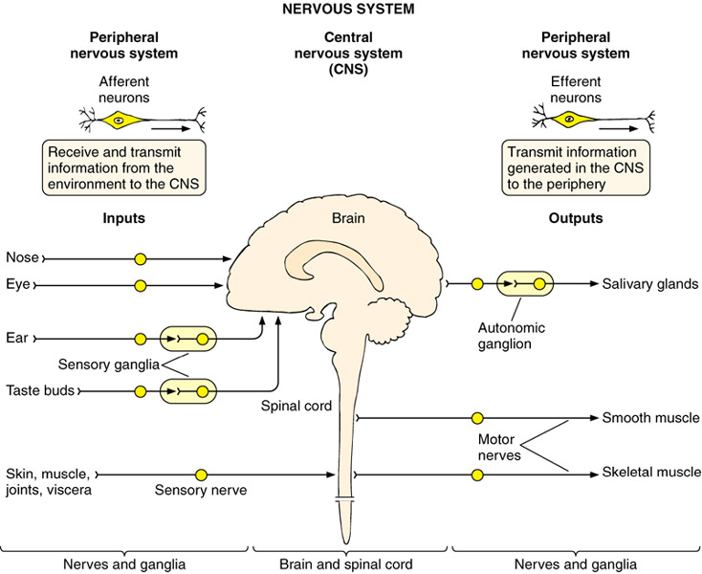
Structural Organization of the Nervous System
inputs
outputs
Cardiac & smooth muscle & glands
special senses
Motor nerve
Skeletal muscle
Notes:
Basic Histology – Text & Atlas; 10th edition, 2003; Junqueira and Carneiro, Lange McGraw-Hill, Fig 9-1
And
http://weblog.site5.com/images/photos/minime.jpg
The function of the nervous system is to receive stimuli (internal and external), to analyze and integrate these inputs and produce an appropriate, coordinated response in the effector organs (muscles and glands). The peripheral and central nervous systems are neither anatomically nor functionally separate units, but instead are components of a unified whole.

Slide 3
Functional Organization of the Nervous System
Somatic (conscious afferent* and efferent, voluntary motor control)
Autonomic (unconscious efferent, involuntary motor control of internal organs to maintain homeostasis)
Sympathetic – thoracolumbar division
Parasympathetic – craniosacral division
* Somatic afferents = sensory fibers from skin, muscle, joints, tendons.
Visceral afferents = sensory fibers from visceral organs; some result in conscious sensations, but others do not. However, they are not considered part of the autonomic nervous system, which is entirely efferent.
Notes:
These functional divisions of the nervous system are used to convey an organizational scheme that is based on certain neuroanatomical and neurophysiological properties, although the scheme is incomplete (visceral afferents are left out) and over simplified.

Slide 4
Spinal cord, DRG, Sympathetic and Parasympathetic Ganglia
Netter pl. 154
IX
X (vagus)
parasympathetic
Dorsal horns: Interneurons
Ventral horns: Motor neurons
Lateral horns:
Sympathetic neurons Parasympathetic (S2-4) neurons
DRG: Sensory (pseudounipolar) neurons
Autonomic ganglia: Post ganglionic neurons with unmyelinated axons. Sympathetic: paravertebral ganglia Parasympathetic: In organs
Somatic motor
sensory
Sympathetic: pre- & post-ganglionic fibers
Pelvic splanchnic (parasympathetic)

Slide 5
Spinal cord and Dorsal Root Ganglion
Dorsal median sulcus
Dorsal horn
(Lateral horn) if present
Ventral horn
Ventral median fissure
Dorsal root ganglion (DRG)

Slide 6
Cellular Components of the Nervous System
Neurons
Glia
(support cells)
Notes:
Wheater’s Functional Histology; 5th edition, 2006, Young, Lowe, Stevens and Heath; Churchill Livingstone Elsevier, Fig 7.4d
Nervous tissue is the third of the four basic tissue types. Neurons have many cytoplasmic processes, and are best appreciated with special stains that employ heavy metal impregnation. These classic neuronal stains were developed by the pioneers of neuroanatomy: Ramon y Cajal and Golgi. Both neurons and supporting glia arise from the embryonic neuroectoderm.

Slide 7
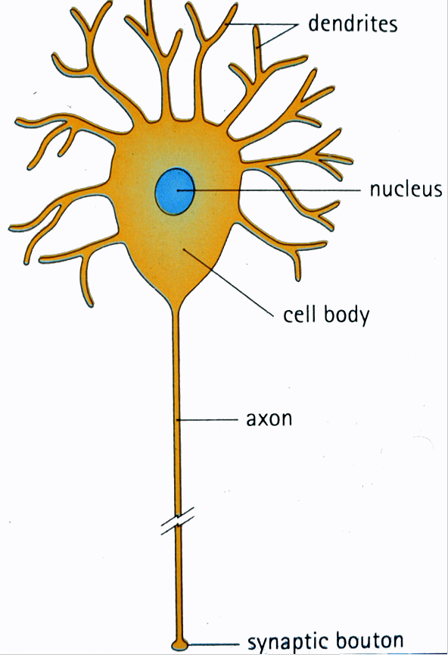
Generic neuron
Large cell body (aka soma or perikaryon)
Large, euchromatic nucleus (and usually a prominent nucleolus)
Extensive cytoplasmic extensions:
Dendrite(s): single or multiple extensions specialized for receiving input
Axon: single, large extension specialized for conveying output (in humans, can be up to 1.5m in length)
Notes:
Human Histology, 2nd edition, Stevens and Lowe, Mosby; Fig. 6-1

Slide 8
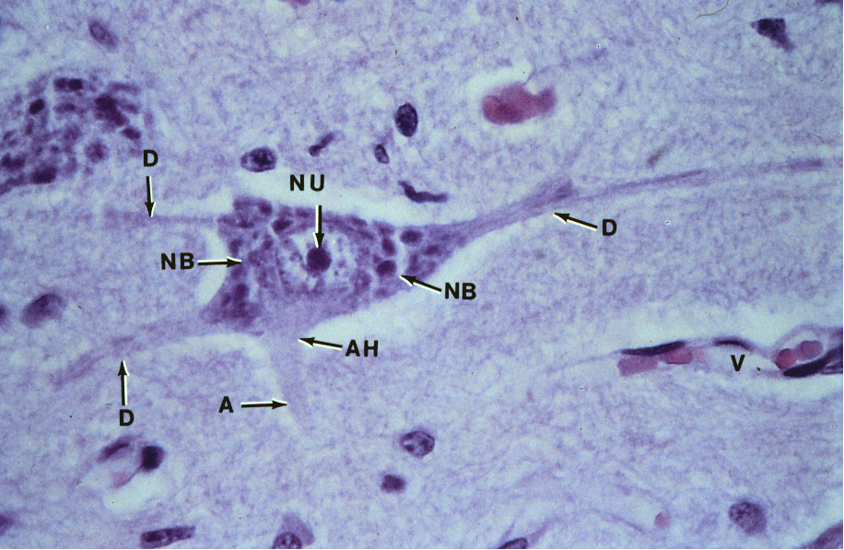
Motor neuron with Nissl bodies
D
NU
N
D
NB
NB
AH
V
D
A
A-axon D-dendrite N-nucleus NB-Nissl body
AH-axon hillock V-blood vessel NU-nucleolus
Notes:
Color Atlas of Basic Histology; 1993; Berman; Appelton and Lange; Fig 6-4

Slide 9
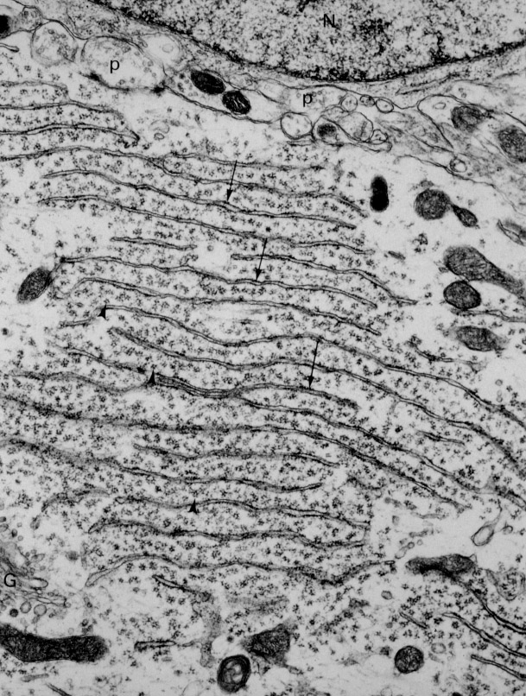
Nissl substance is rough endoplasmic reticulum
Notes:
Cell and Tissue Ultrastructure – A Functional Perspective; 1993; Cross and Mercer, Freeman and Co.; Page 127

Slide 10
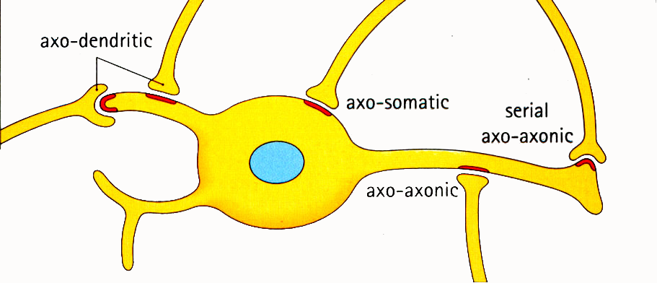
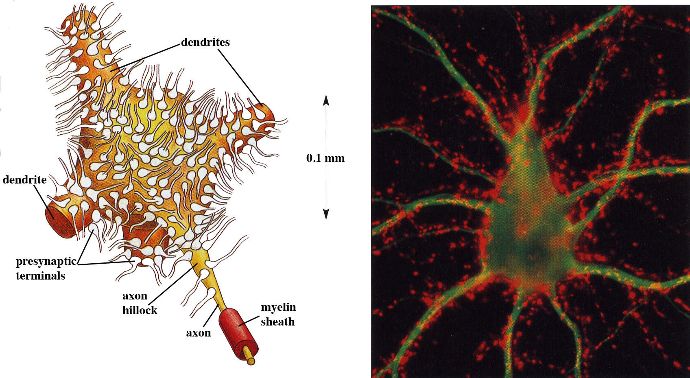
Synapses can form between many different parts of neurons and between a neuron and a non-neuronal cell, e.g., a muscle or a secretory cell.
A single neuron can receive activating or inhibiting inputs from thousands of synaptic connections.
Motor neuron cell body in the spinal cord
Notes:
Human Histology, 2nd edition, Stevens and Lowe, Mosby ; Fig 6.7
and
The Molecular Biology of the Cell by B. Alberts et al., 4th edition, 2002, Garland Science
Fig. 11-38 A motor neuron in the spinal cord. Panel B courtesy of Olaf Mundigl and Pietro de Camilli

Slide 11
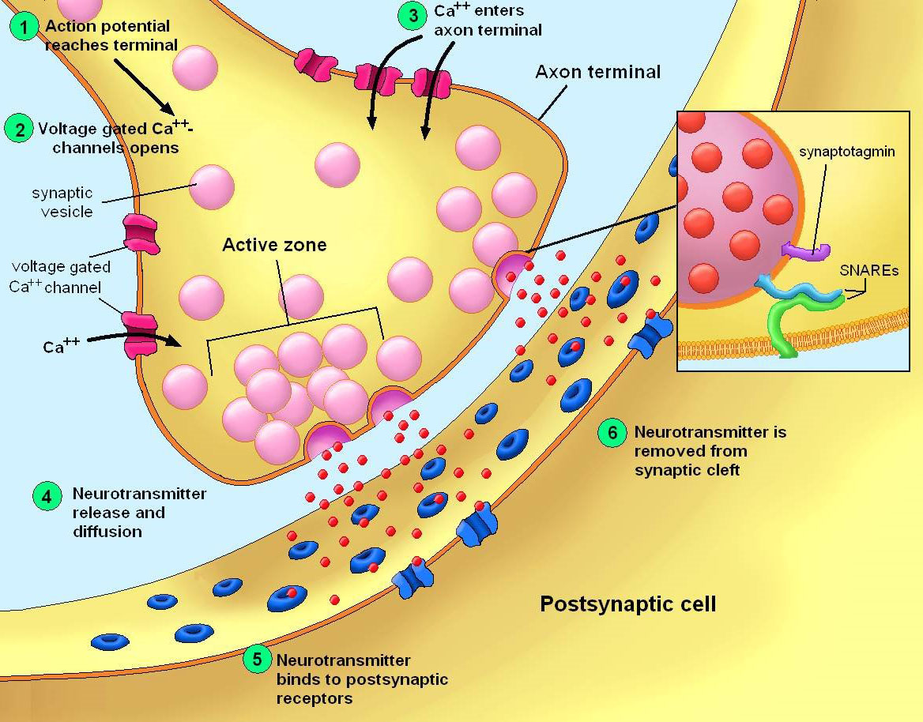
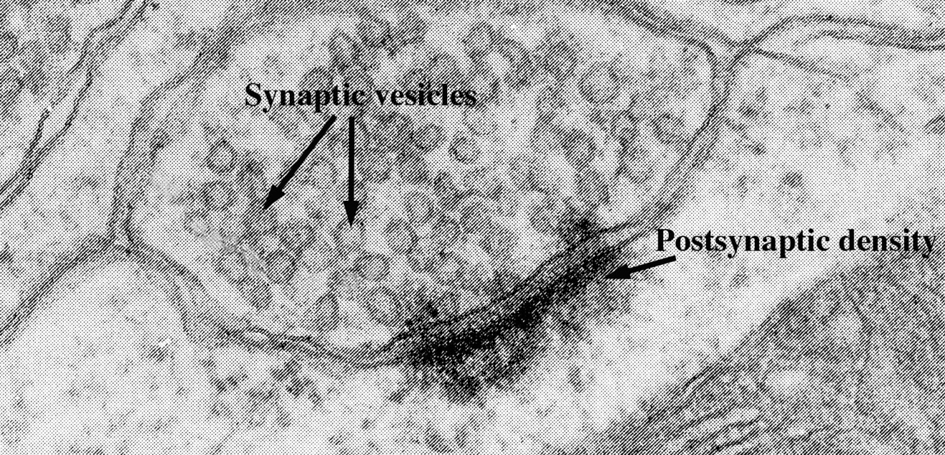
At a chemical synapse neurotransmitter release is triggered by the influx of Ca²⁺ and postsynaptic neurotransmitter receptors receive the signal.
Notes:
Diagram of synapse downloaded from http://fantastrid.googlepages.com/anatomydrawings
By Astrid Vincent Andersen baz_vincent@hotmail.com
Web page http://fantastrid.googlepages.com/homedk
And
EM image is partial excerpt of page 135 of Cell and Tissue Ultrastructure – A Functional Perspective by Cross and Mercer; 1993; Freeman and Co.

Slide 12
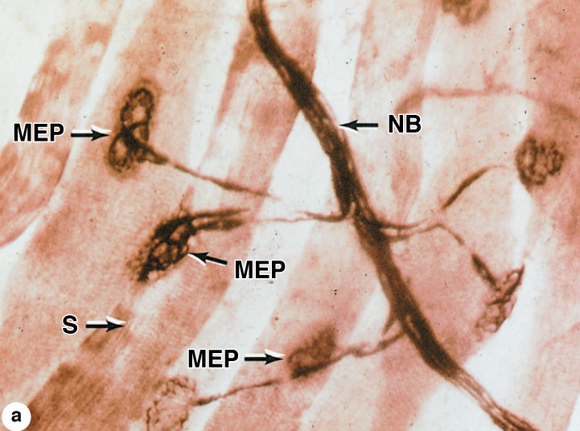
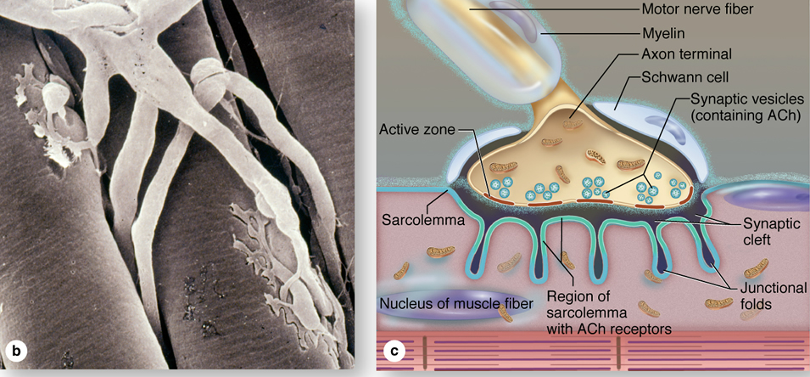
An example of a synapse:
The neuromuscular junction (motor endplate)
Notes:
Fig 10-13, Junqueira’s Basic Histology, 12th ed.

Slide 13
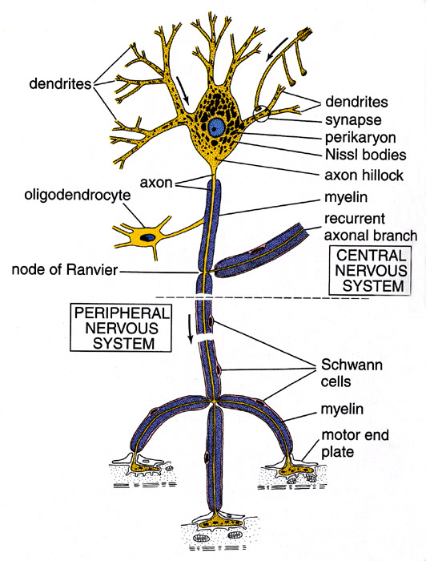
Conduction velocity in the axon is enhanced by myelination axons in the CNS are myelinated by oligodendrocytes axons in the PNS are myelinated by Schwann cells
Notes:
Diagram from Kelley, Kaye and Pawlina, "Histology, a Text and Atlas," 4th ed., page 284. Neuron-Ross4-284.tif.

Slide 14
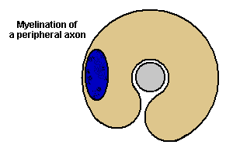
Myelination is a dynamic process, which involves the ensheathment of the the axon by the glial cell and subsequently the extrusion of cytoplasm from parts of the glial cell. Adhesive proteins on the cytoplasmic and the extracellular side of the plasma membrane contribute to a tight apposition of the lipid bilayers.
Notes:
Animation from Blue Histology, Copyright Lutz Slomianka 1998-2004

Slide 15
Myelinated Nerve Fiber
The increased lipid content of the myelin sheath provides electrical insulation for the underlying axon.
Myelin Sheath
Notes:
Wheater’s Functional Histology; 5th edition, Young, Lowe, Stevens and Heath; Churchill Livingstone, Fig. 7.6
A, axon; S, Schwann cell nucleus.
Demyelinating diseases result in decreased or lost ability to transmit electrical signals along nerve fibers. Guillain-Barre syndrome is the most common life-treatening disease of PNS. It is characterized by inflammatory response around nerve fibers (accumulation of plasma cells, lymphocytes, macrophages around and within nerves, consistent with a T-cell mediated immune response against myelin. Can be triggered by a respiratory or gastrointestinal viral infection, but the etiology is not known. The symptoms include tingling or crawling sensation, ascending weakness or paralysis, loss of muscle coordination and loss of cutaneous sensation.

Slide 16
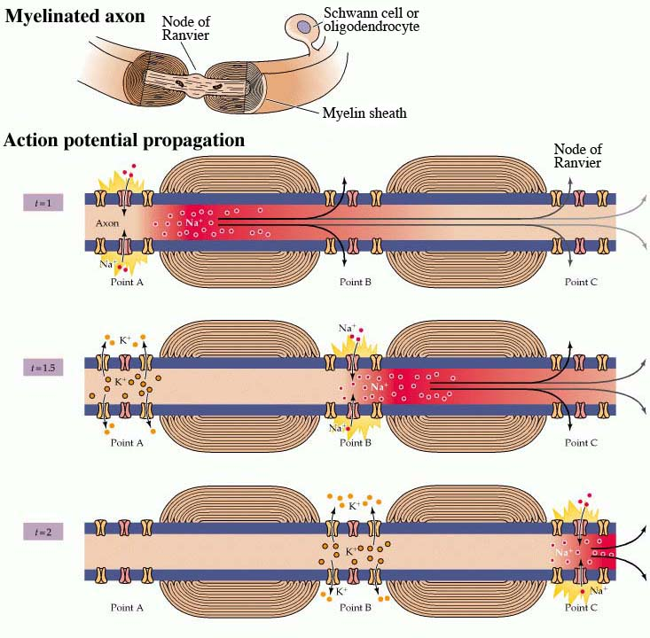
Ion channels are concentrated at the nodes of Ranvier and the myelin sheath acts as an electrical insulator. This allows for saltatory conductance of the action potential and increases the transmission speed of the nerve impulse. Depending on the diameter of the axon, myelination increases the action potential speed approximately 5 to 50fold (up to >110 m/sec).
Nodes of Ranvier are areas of the myelinated axon that are not covered by the myelin sheath.
Notes:
Downloaded from http://www.ncbi.nlm.nih.gov/books/bookres.fcgi/neurosci/ch3f13.gif
Neuroscience by D. Purves et al., 2001, 2nd ed., Sinauer
Modified from Fig. 3.13

Slide 17
Each Schwann cell myelinates a single internode
Internode length can be up to 1.5 mm in the largest nerve fibers
Notes:
A single Schwann cell produces a single segment of myelin sheath along an individual nerve fiber. In contrast, each myelinating glial cell in the central nervous system, called oligodendrocytes, can myelinate up to 50 individual axons.

Slide 18
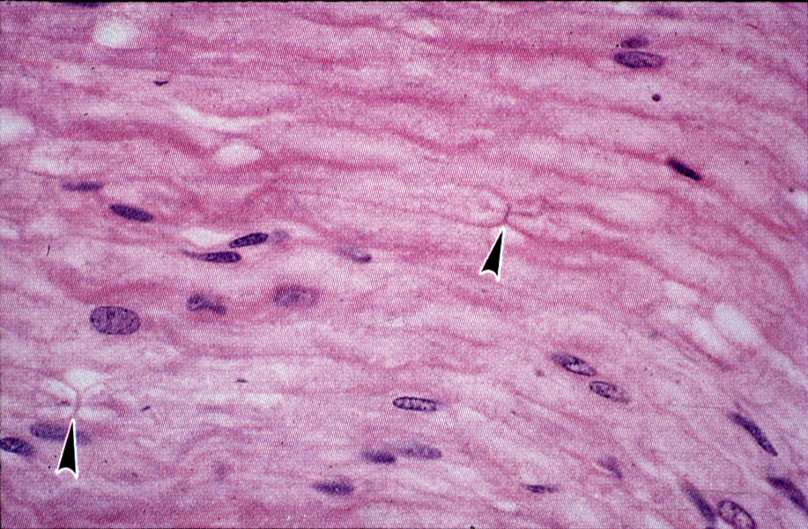
Nodes of Ranvier in a longitudinal nerve section
Notes:
Color Atlas of Histology; 1992; Erlandsen and Magney; Mosby Book; Fig. 9-13

Slide 19
One Schwann cell can ensheath multiple axons, but myelinates only one axon
Notes:
Human Histology, 2nd edition, Stevens and Lowe, Mosby ; Fig. 6.21

Slide 20
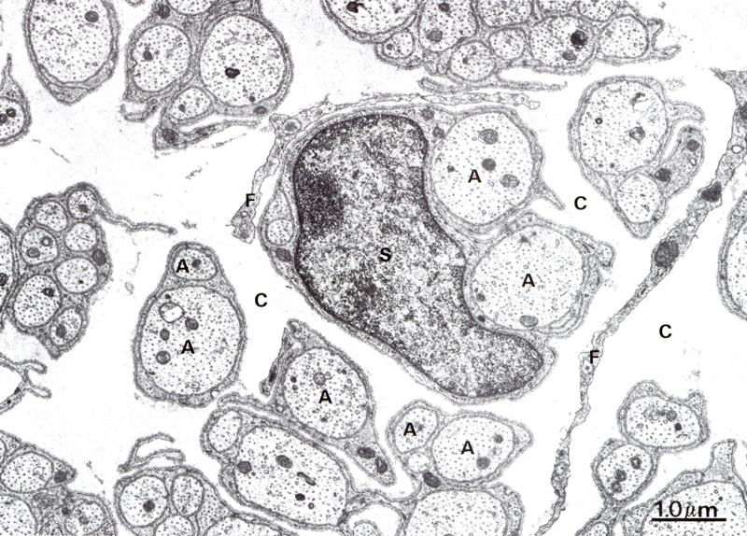
Small diameter nerve fibers are non-myelinated
Notes:
Wheater’s Functional Histology; 5th edition, 2006, Young, Lowe, Stevens and Heath; Churchill Livingstone Elsevier; Fig 7.5b
S, Schwann cell; F, fibroblast; A, axon; C, connective tissue (endoneurium). Unmyelinated (or non-myelinated) fibers include autonomic nerve fibers and sensory fibers carrying pain inputs. Each Schwann cell can enwrap several fibers.

Slide 21
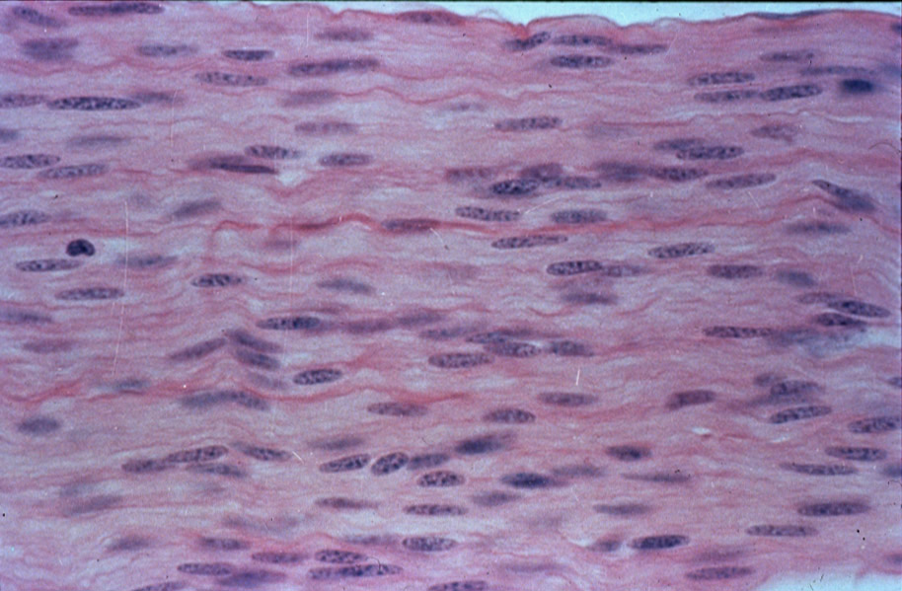
Longitudinal section of an unmyelinated nerve
Notes:
Japanese slide set (Humio Mizoguti, Department of Anatomy, Kobe University School of Medicine, Kusunoki-cho 7-5-1, Chu-o-ku, 650 Kobe, Japan)
Slide #1091

Slide 22
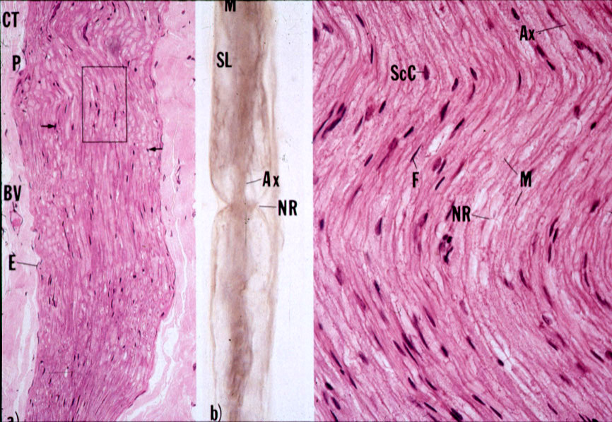
Wavy appearance of nerves
Notes:
Color Textbook of Histology; 2nd edition, 1994; Gartner and Hiatt; Williams and Wilkins; Fig 7.5

Slide 23
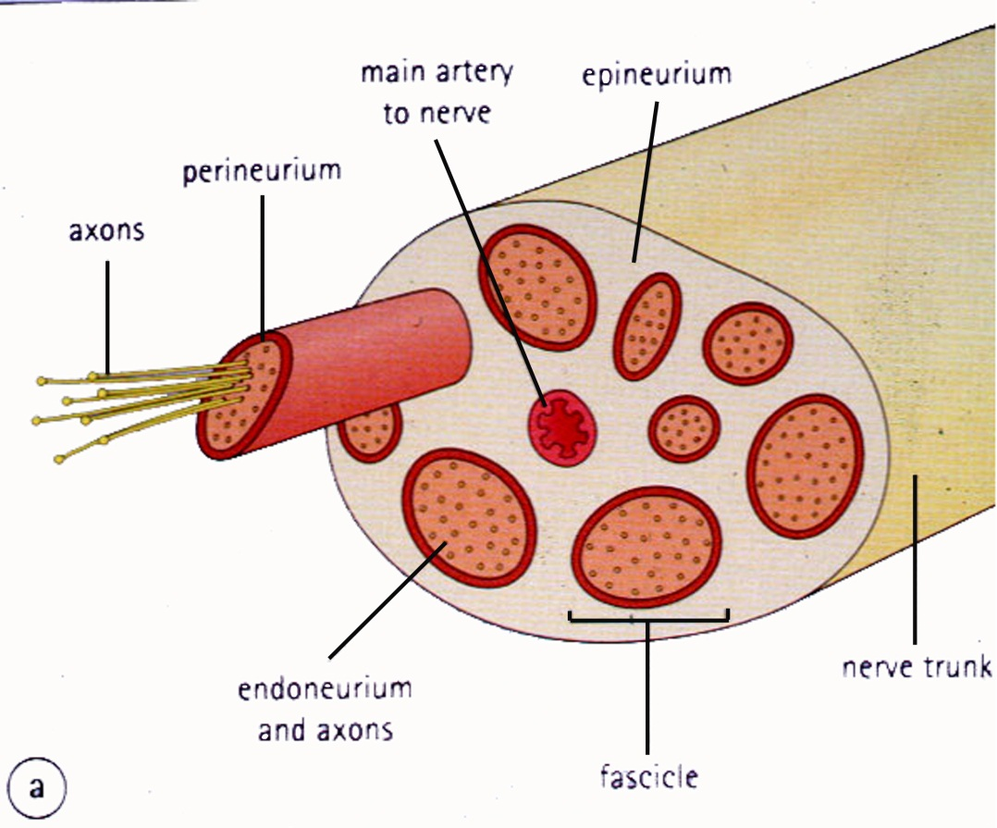
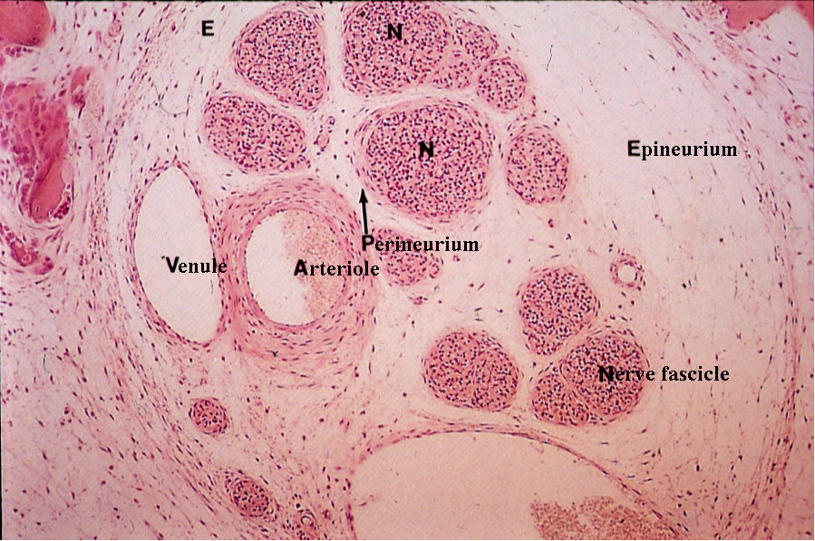
Connective tissue layers found in nerves: endoneurium surrounds axons, perineurium axon fascicles and epineurium the entire nerve
Notes:
Human Histology, 2nd edition, Stevens and Lowe, Mosby ; Fig. 6.20

Slide 24
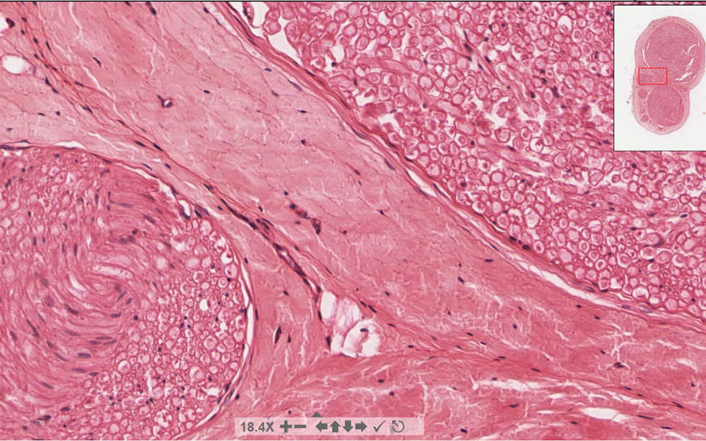
Connective tissue layers in a peripheral nerve. Tight junctions between perineurium cells form a important isolating barrier.
Epineurium
Perineurium
Notes:
Basic Histology – Text & Atlas; 10th edition, 2003; Junqueira and Carneiro, Lange McGraw-Hill; Fig 9-34
Endoneurium surrounds individual axons (nerve fibers) within a fascicle, perineurium surrounds bundles (fascicles) of nerve fibers, epineurium surrounds fascicles and forms a denser sheath around the entire nerve.
Perineurial cells are derived from fibroblasts.

Slide 25
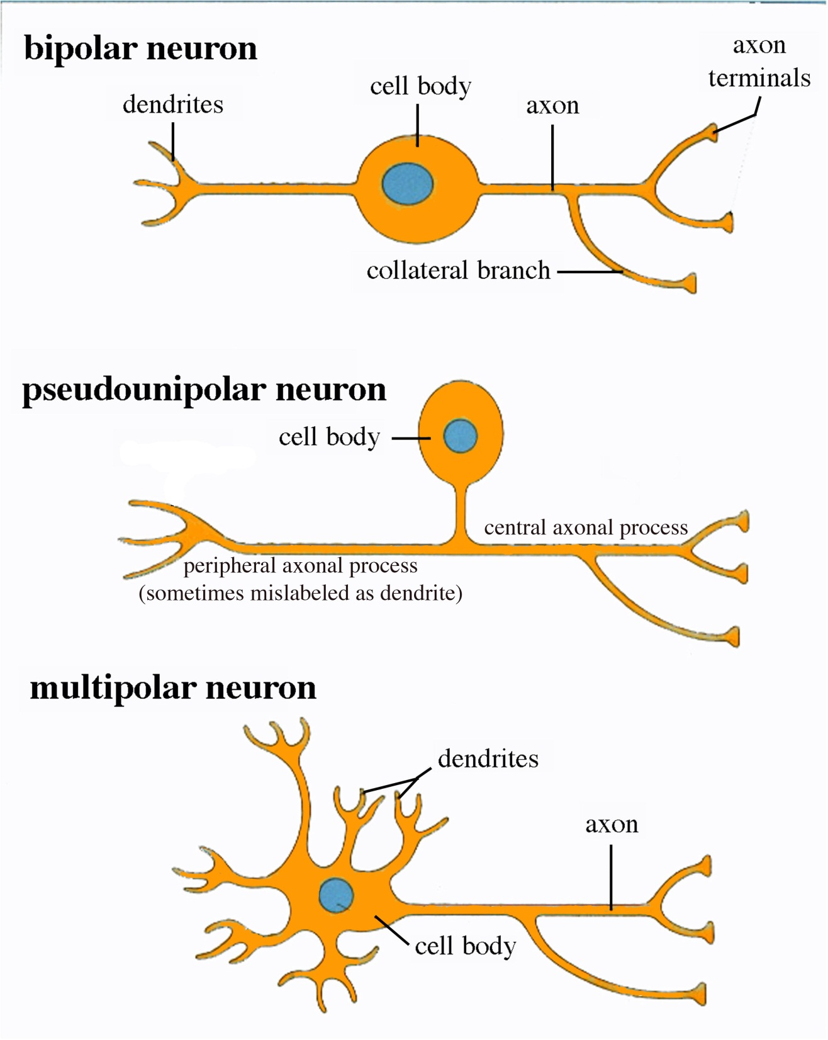
Three different basic types of neuronal structure
Notes:
Human Histology, 2nd edition, Stevens and Lowe, Mosby ; Fig.6.3

Slide 26
Sensory Ganglia
Two types: spinal (dorsal root) and cranial ganglia associated with spinal and cranial nerves, respectively
Contain large sensory neurons and abundant small glial cells, called satellite cells
Sensory neurons are pseudounipolar

Slide 27
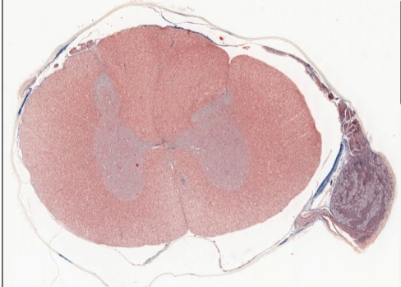
Dorsal root ganglion
Dorsal Root (Sensory) Ganglion Cells

Slide 28
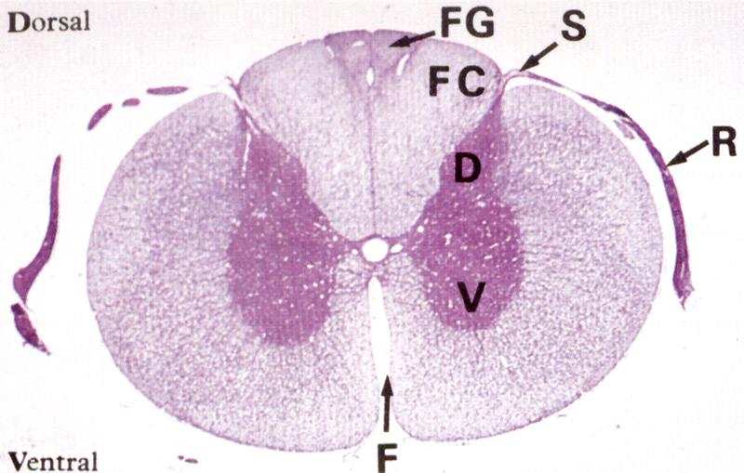
Somatic sensory neurons have components in both CNS and PNS
Note that the spinal cord is part of the CNS and therefore does not contain Schwann cells, but rather oligodendrocytes.
pseudounipolar sensory neuron in a dorsal root (spinal) ganglion
CNS
PNS
sensory input
Notes:
Wheater’s Functional Histology; 5th edition, 2006, Young, Lowe, Stevens and Heath; Churchill Livingstone Elsevier; Fig. 20.2a
FG, medial fasciculus gracilus; FC, lateral fasciculus cuneatus; S, dorsolateral sulcus; D, dorsal horn; V, ventral horn; R, dorsal nerve roots; F, ventral median fissure;

Slide 29
Somatic motor neurons of the spinal cord also have components in the CNS and PNS, but they are multipolar
Motor output: axon travels through peripheral nerve to reach target muscle

Slide 30
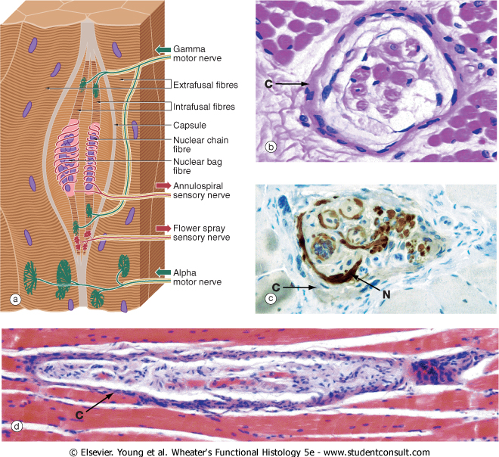
An example of sensory input: the muscle spindle
Specialized skeletal muscle fibers enclosed within a spindle-shaped capsule.
Depolarize in response to changes in muscle position, tension, and contraction velocity.
Synapse with sensory nerve endings to convey input to CNS

Slide 31
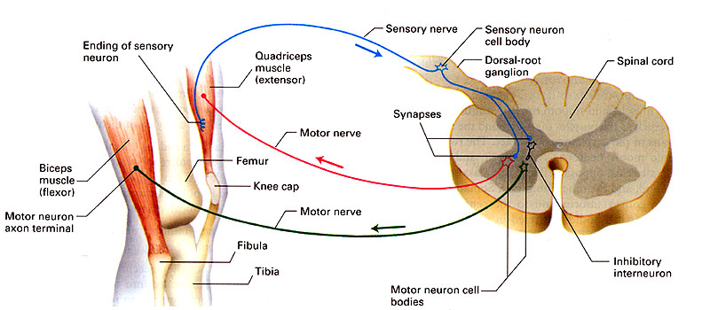
The somatic nervous system in action: the spinal stretch reflex
stretch receptor
Notes:
The physician evaluates the stretch reflex by tapping on a tendon, to stretch the attached muscle (e.g., the patella tendon attaches the quadriceps to the tibia).

Slide 32
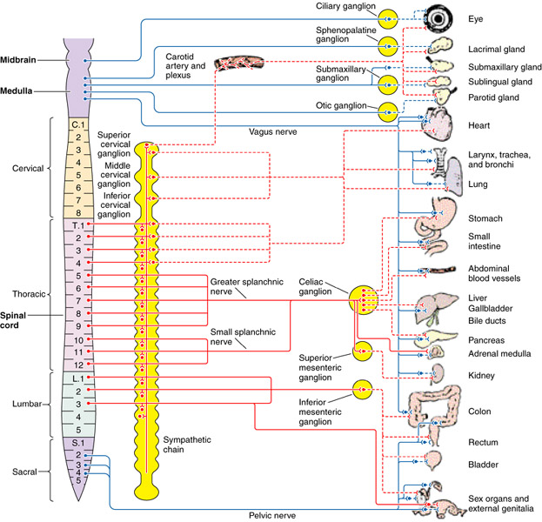
Efferent autonomic pathways
Sympathetic = thoracolumbar
Parasympathetic = craniosacral
Notes:
Modified from Basic Histology – Text & Atlas; 10th edition, 2003; Junqueira and Carneiro, Lange McGraw-Hill; Fig 9-38
Both sympathetic and parasympathetic preganglionic neurons use acetylcholine as a neurotransmitter, and are therefore called cholinergic fibers. Parasympathetic, postganglionic neurons also use acetylcholine. Sympathetic postganglionic neurons use norepinephrine (noradrenalin), and are called adrenergic fibers. An exception is the eccrine sweat glands, which are innervated by sympathetic postganglionics which are (uniquely) cholinergic instead of adrenergic, and which respond to heat and nervous stress. Internal organs receive both sympathetic and parasympathetic innervation, but the body wall and extremities have no parasympathetic outflow.

Slide 33
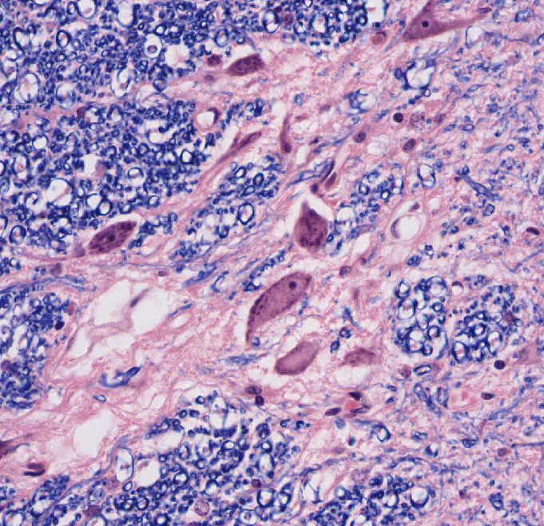
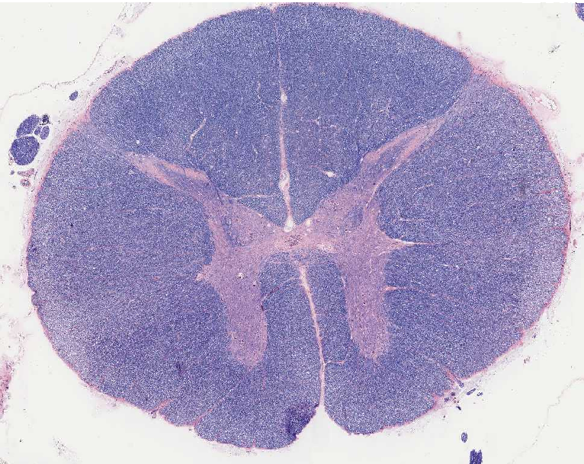
Pre-ganglionic motor neurons have components in the CNS and PNS and are also multipolar
Visceral motor output to post ganglionic neuron

Slide 34
Sympathetic ganglion cells: multipolar neurons that reside entirely within the PNS in sympathetic chain ganglia and “pre-aortic” ganglia

Slide 35
Parasympathetic ganglion cells: multipolar neurons that also reside entirely within the PNS in the wall of the innervated organ (shown here in the seminal vesicle)

Slide 36
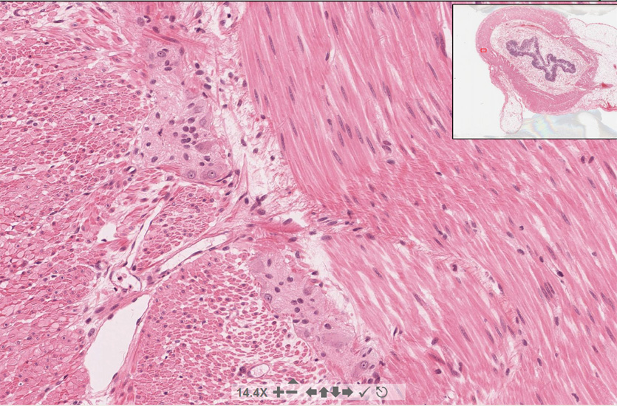
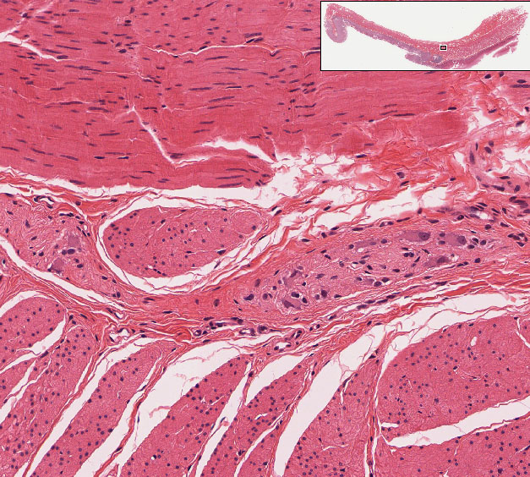
Parasympathetic ganglia in the wall of the gut
#155

Slide 37
Objectives of PNS Histology:
Discuss the general division/differences between CNS and PNS
Appreciate the subdivision into somatic and autonomic nervous system
Learn about the cellular components and the structural attributes of neuronal cells
Discuss synaptic connections, using the motor end plate as an example
Study the formation of the axonal myelin ensheathment
Compare the histological features of myelinated and unmyelinated axons/nerves
Recognize nerves in histological sections
Identify the different connective tissue layers that are associated with nerves
Understand the different organizational plans that are adopted by neuronal cells
Identify and compare autonomic and sensory ganglia
Learn about the basic histological features of the spinal cord

