Slide 1
Histology of the Cardiovascular System
Matt Velkey
matt.velkey@duke.edu
454A Davison, Duke South, Green Zone

Slide 2
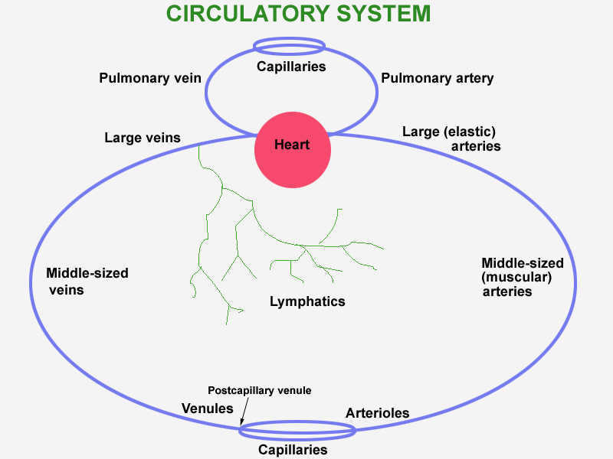
Circulatory system
Notes:
Diagram of the circulatory system.
AKC. CV-CircSystD.gif (originally SumCirculatory.jpg = 1997A21(2).jpg).

Slide 3
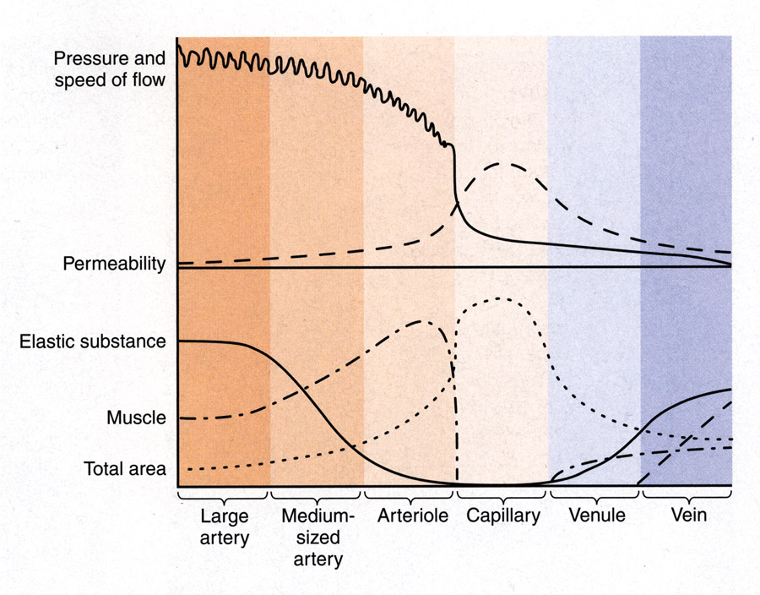
Graph physiology
Comparing biophysical and structural characteristics of vessels
Junqueira, 10th ed., page 225
Notes:
Graph showing the relationship between the biophysical characteristics of blood circulation (top) and the structure of the blood vessels (bottom). These two features can be compared for each part of the vascular circulation, listed below.
From Junqueira and Carneiro, 10th ed., 2003, page 225, fig. 11-15. CV-physiology.jpg.

Slide 4
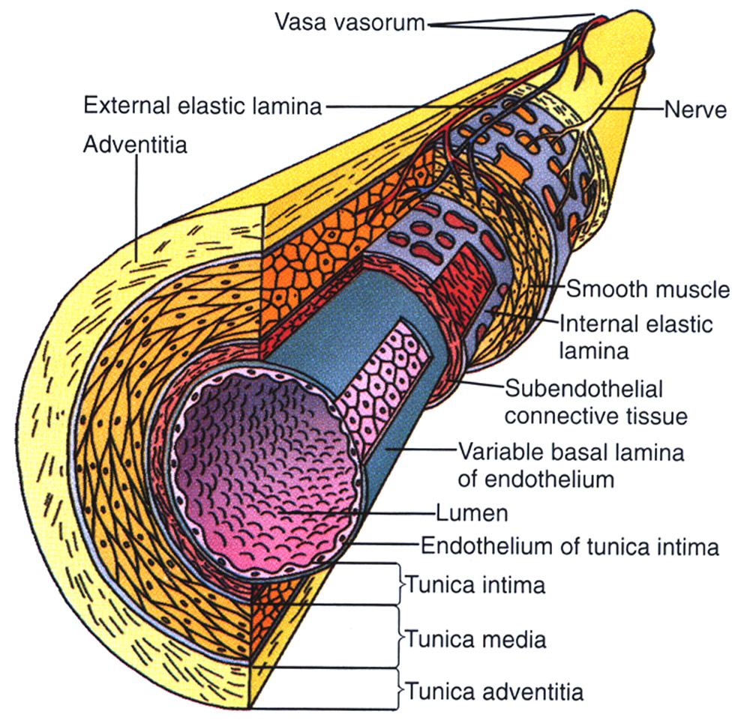
Vessel Tunics
A. Tunica Intima
endothelium
subendothelium
connective tissue
smooth muscle
(longitudinal fibers)
internal elastic lamina
B. Tunica Media
vascular smooth muscle
external elastic lamina
(circular fibers)
C. Tunica Adventitia
connective tissue
(longitudinal)
Blood Supply
Vasa vasorum
Innervation
Sympathetic
Parasympathetic

Slide 5
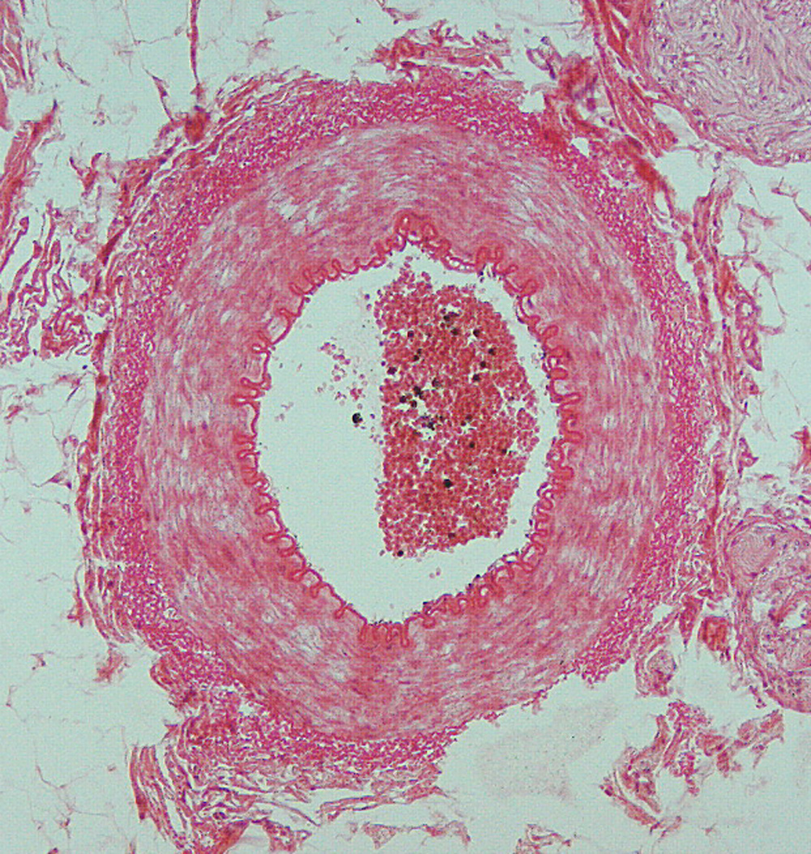
Muscular Arteries named arteries of the body
Distribute blood to organs and tissues
Regulate blood flow to organs and tissues (via smooth muscle contraction)
Characteristic Features
Tunica intima
thinner subendothelial layer
(compared to elastic arteries)
myoendothelial junctions
distinct internal elastic lamina
Tunica media
3-40 layers of VSMCs
elastic fibers are interspersed
external elastic lamina evident
Tunica adventitia
thinner than media
larger arteries have prominent vasa vasorum

Slide 6
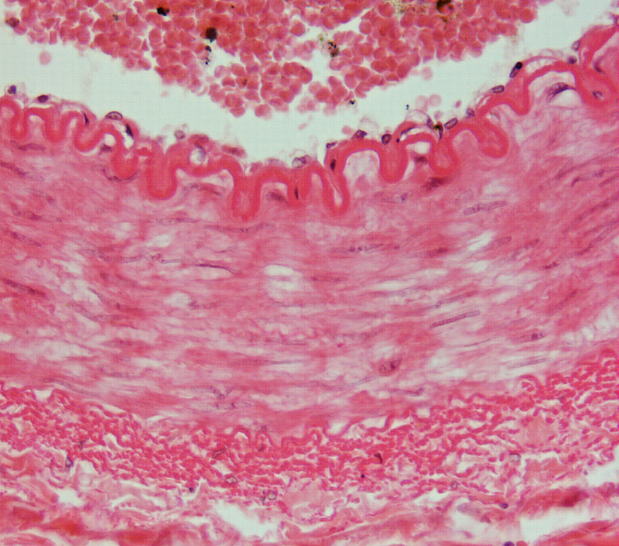
Vessel Tunics
A. Tunica Intima
endothelium
subendothelium
connective tissue
smooth muscle
(longitudinal fibers)
internal elastic lamina
B. Tunica Media
vascular smooth muscle
external elastic lamina
(circular fibers)
C. Tunica Adventitia
connective tissue
(longitudinal)

Slide 7
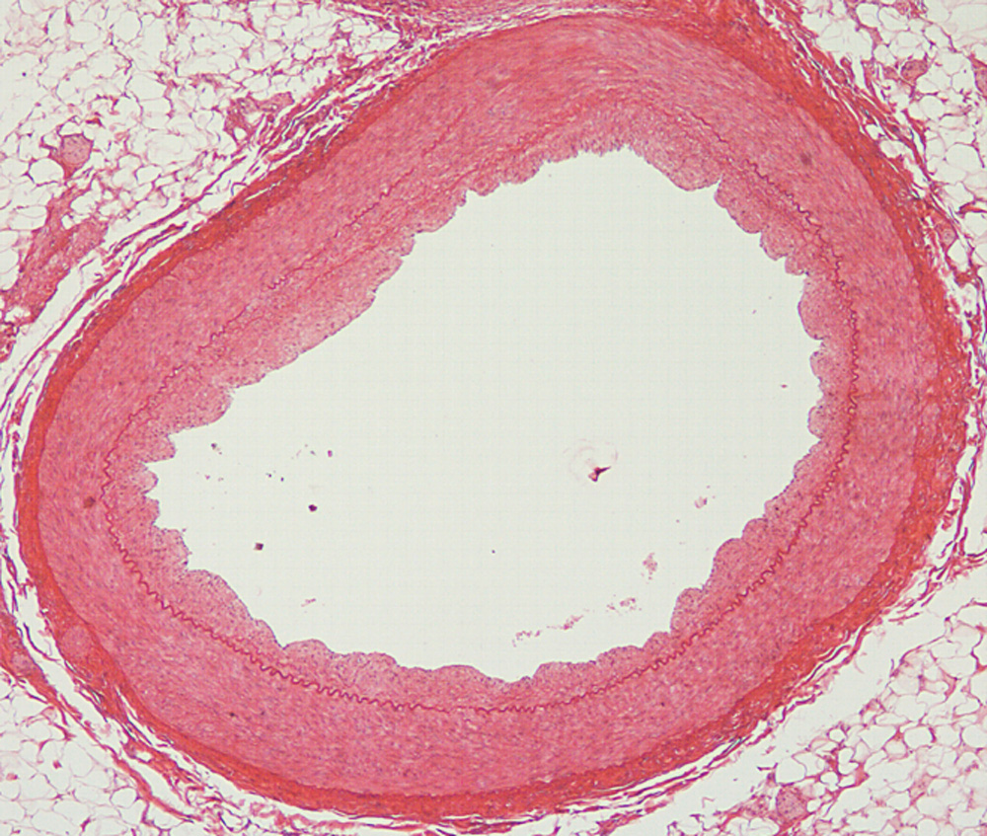
Arteries often exhibit intimal thickening

Slide 8
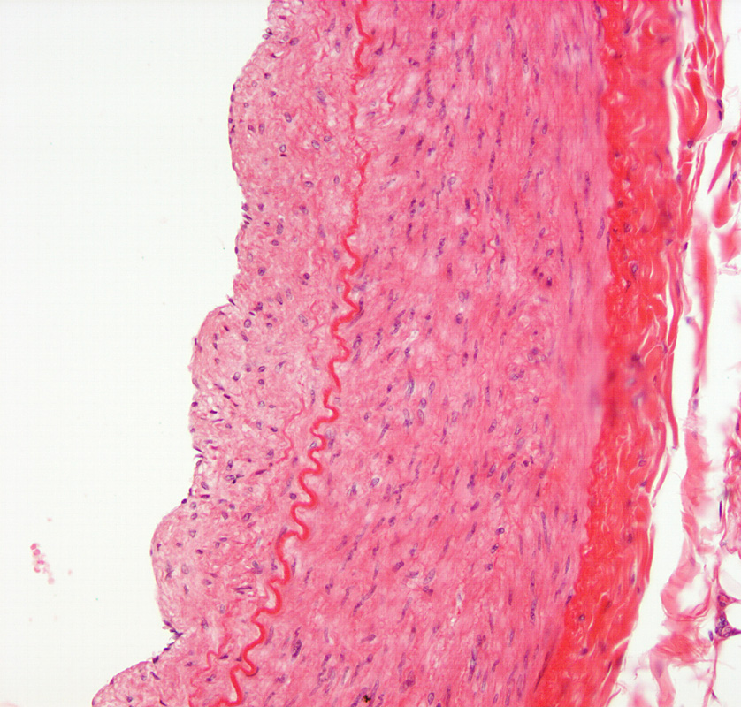
Intimal Thickening
Arteriosclerosis
“Normal” changes with age
Fibrosis
VSMC proliferation
Elastic fragmentation
Atherosclerosis
Pathological changes (often associated with cholesterolemia)
Eccentric fibrosis and SMC proliferation
Lipid deposition
“Foam” cells
Necrosis and calcification

Slide 9
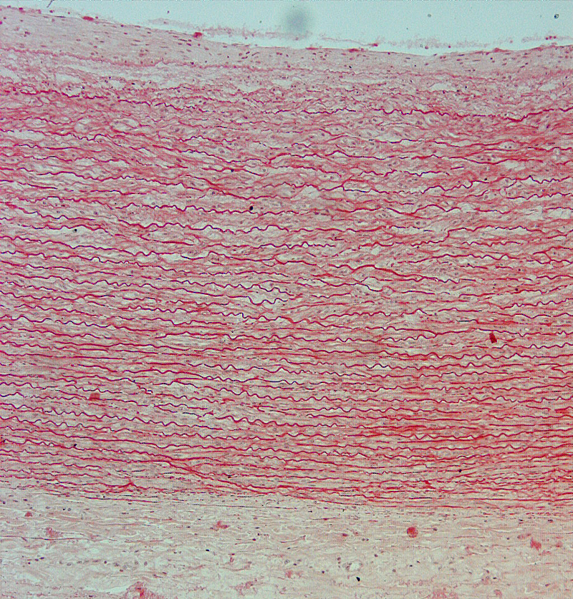
The largest arteries (aorta & pulmonary trunk) have the same general tunics, but very different media
Vascular smooth muscle cells in tunica media make concentric elastic lamina to allow vessel to stretch in response to systolic pulse of blood (allows constant rather than pulsatile flow of blood)
Characteristic Features
Tunica intima
thickened subendothelial layer
internal elastic lamella obscured
Tunica media
numerous elastic laminae and reticular fibers
(chief source is VSMCs)
Tunica adventitia
relatively thin (compared to vessel wall) with vasa vasorum and nerves
intima
media
adventitia

Slide 10
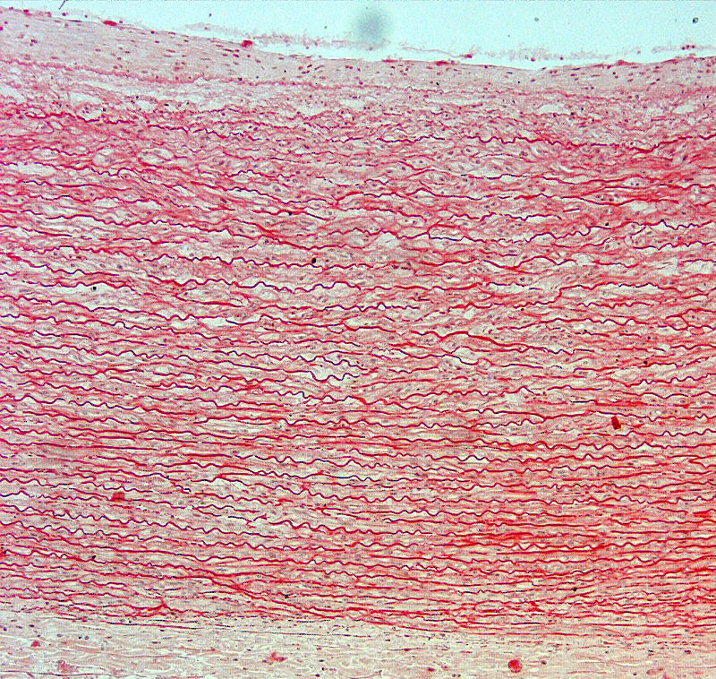
intima
media
adventitia

Slide 11
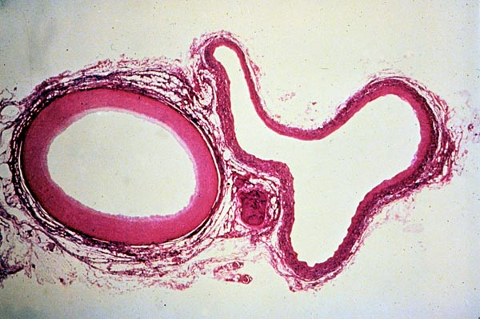
Arteries and veins (and nerves) are often seen together
Artery: smaller, round, thick wall Vein: Larger, irregular shape, thin wall
Femoral artery and vein
Notes:
Very low power LM of femoral artery and vein, stained with H&E. The artery has a much thicker wall and more stable oval shape. The vein, by comparison, is thin walled and "floppy," reflecting the fact that the blood it contains is under much lower hydrostatic pressure.
From Japanese slide set (Humio Mizoguti, Kobe Univ Sch Med), slide 235. Japan235.jpg.

Slide 12
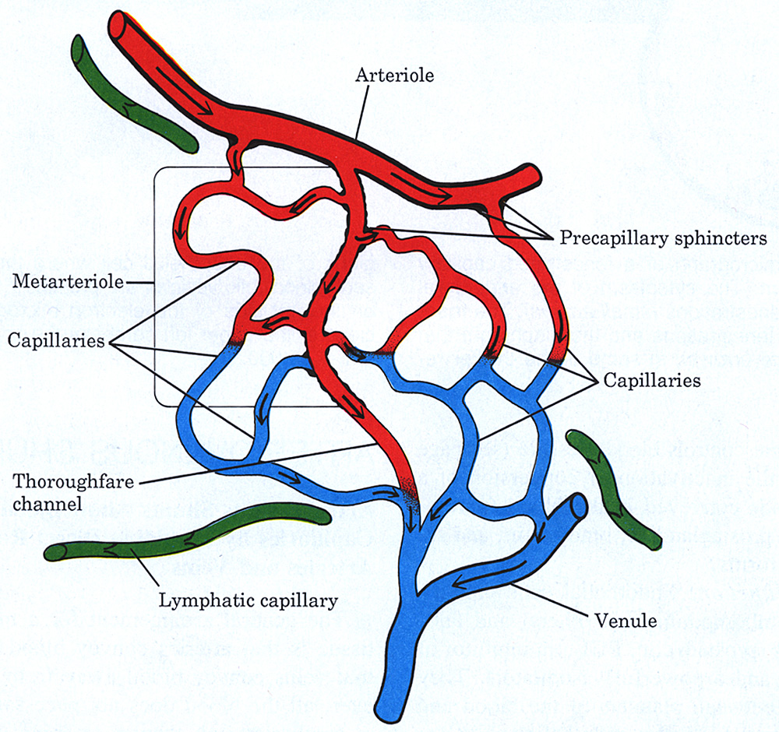
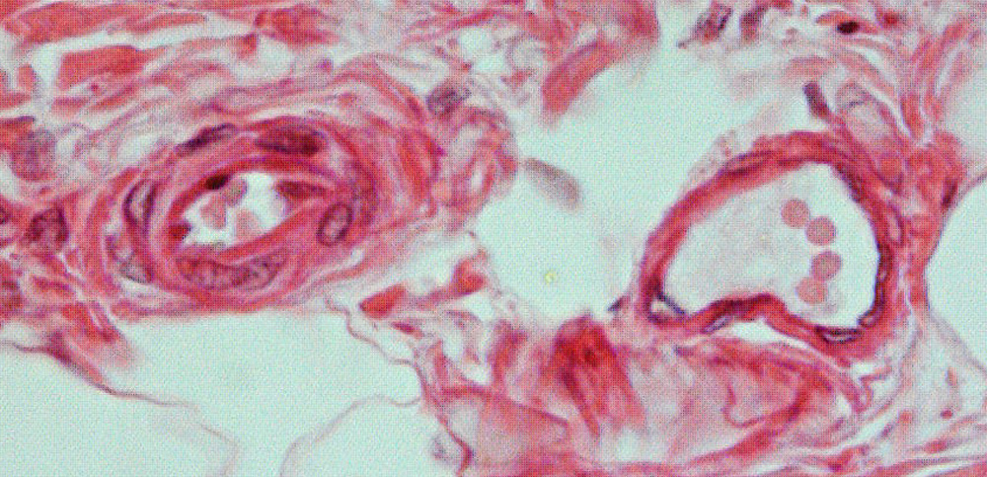
Arterioles
Regulate blood flow to capillaries in tissue beds
precapillary sphincters
metarterioles
A-V shunts
Characteristic Features
Tunica intima
very thin subendothelial layer
generally lacking distinct internal elastic lamina
Tunica media
1-3 layers of VSMCs
no external elastic lamina
Tunica adventitia
thin and ill-defined

Slide 13
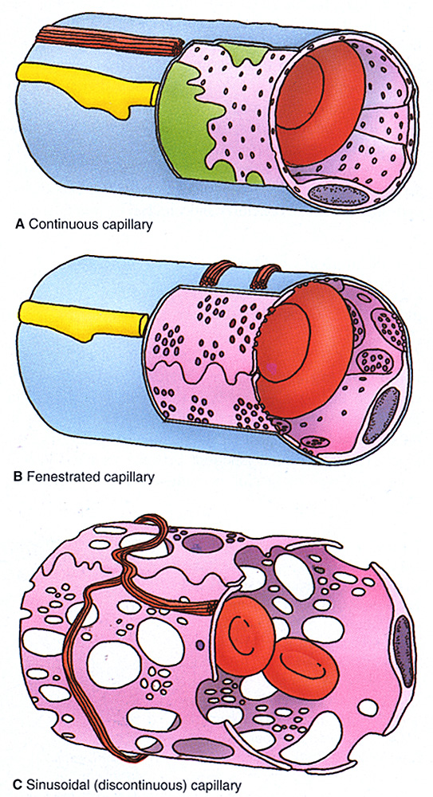
Capillaries
Different structures, different functions
Permeability barrier
regulate movement of blood cells and materials
Metabolic activity
ACE activity
breakdown of bioactive compounds
lipolysis
Antithrombotic function
produce anticoagulants and antithrombogenics
General Features
Tunica intima
endothelium
pericytes: share basal lamina with endothelium, possess actin and myosin, possible contractile function and source of muscle cells (?)
Tunica media
none
Tunica adventitia
none

Slide 14
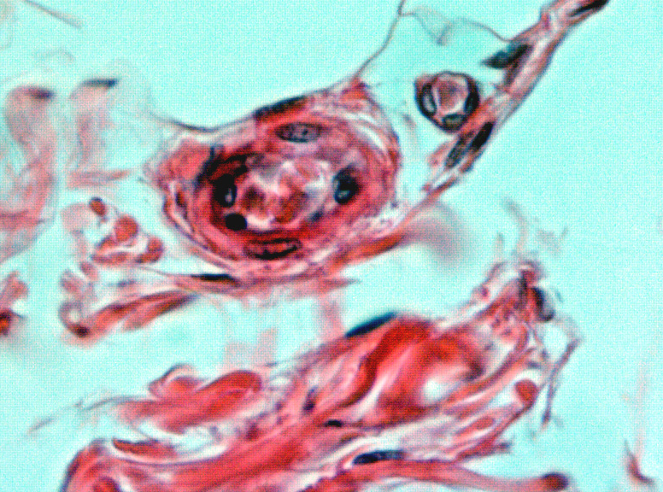
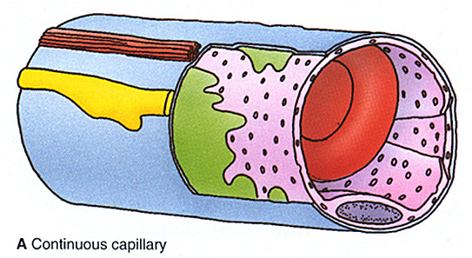
Continuous (somatic) capillary
Found in muscle, connective tissue, and exocrine glands
complete endothelium
complete basal lamina
cell-cell contacts (tight junctions) can be broken to allow diapedesis
transcytotic vesicles allow transport across vessel wall

Slide 15
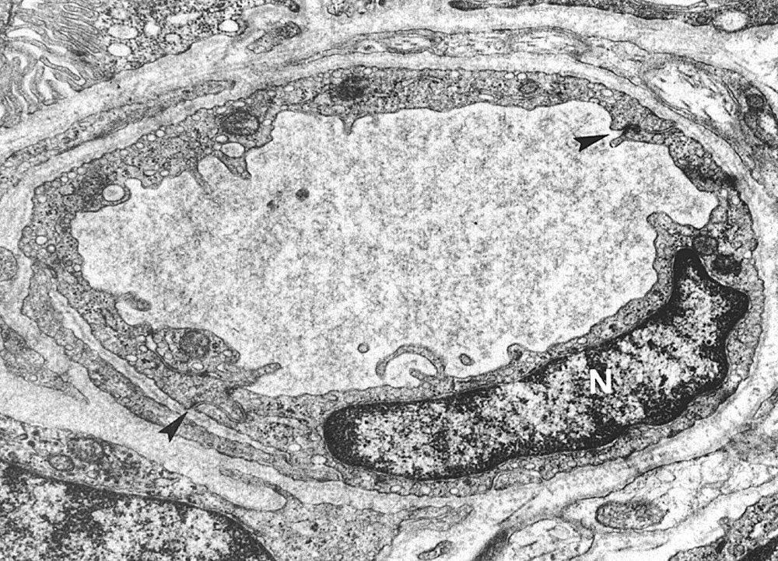
Continuous (somatic) capillary

Slide 16
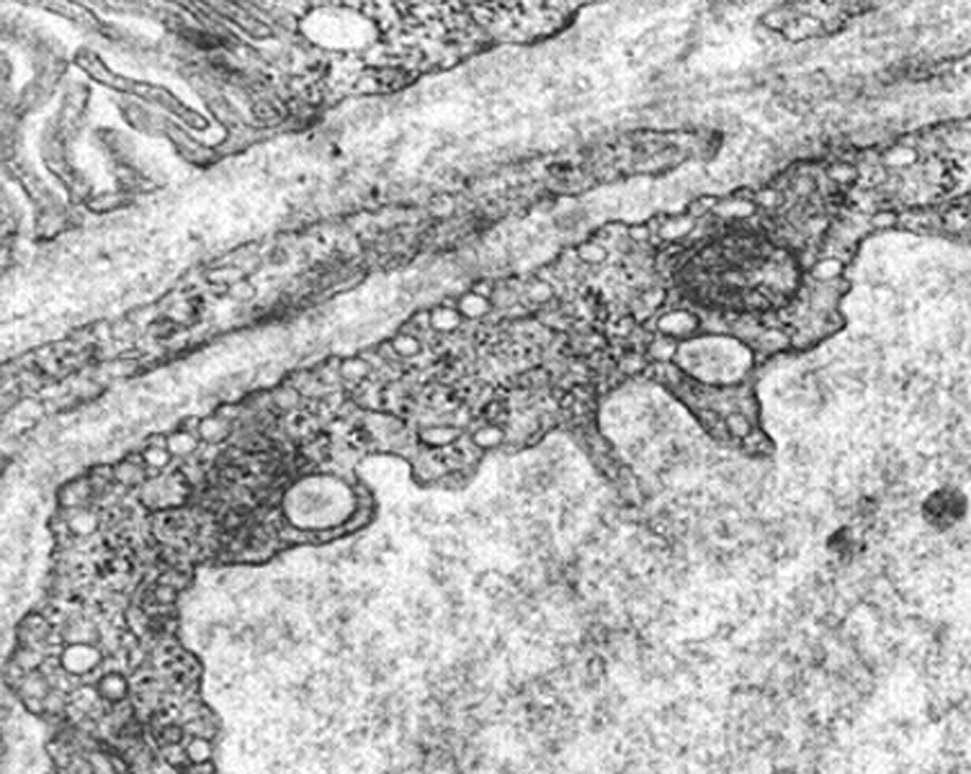
Transcytotic vesicles

Slide 17
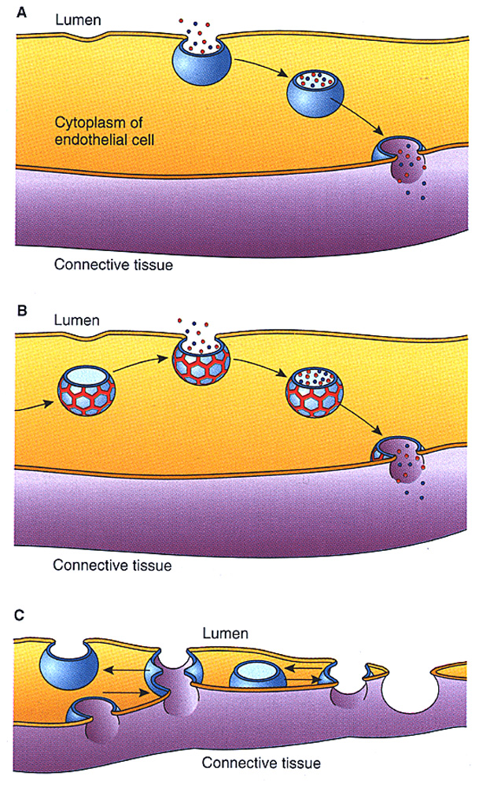
Endothelial Permeability
Via Transcytosis
Constitutive transport
Regulated transport
Transient pore formation

Slide 18
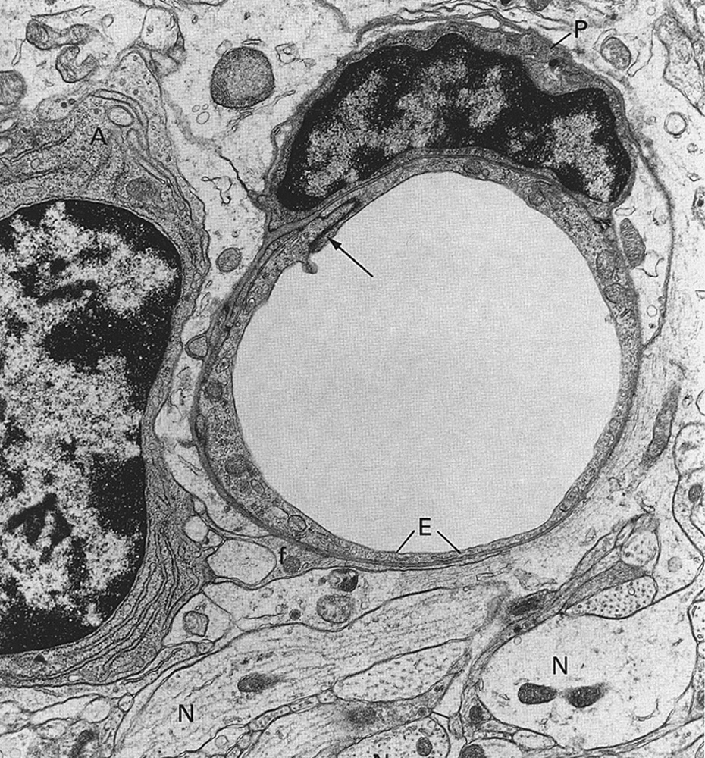
Blood-Tissue Barriers
Found in nervous system, thymus, and testes
Prevent exchange of cells and materials
Characteristics
complete endothelium
complete basal lamina
very tight cell-cell contacts
VERY FEW OR NO TRANSCYTOTIC VESICLES

Slide 19
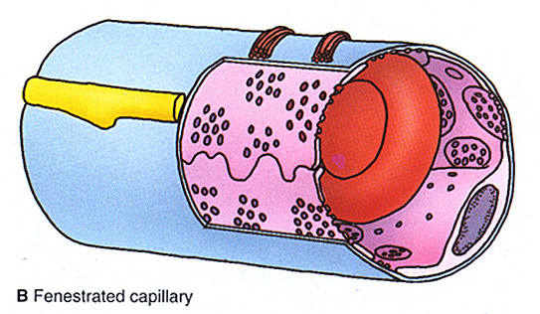
Fenestrated Capillary
Found in intestine, endocrine glands, and kidney
Allows rapid interchange of materials
fenestrated endothelium
with diaphragms (intestine and endocrine glands)
without diaphragms (kidney)
complete basal lamina

Slide 20
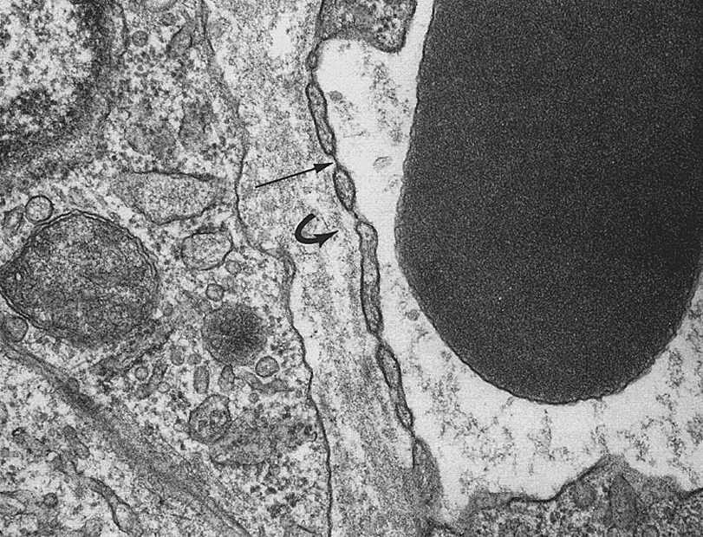
Fenestrated capillary

Slide 21
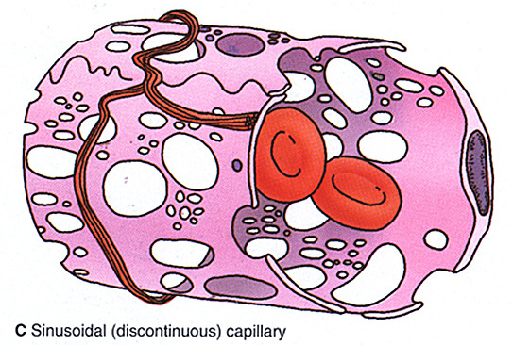
Sinusoidal Capillary
Found in liver, spleen, and bone marrow
Allows movement of cells (and materials)
enlarged diameter
fenestrated endothelium without diaphragms
fenestrae are about 3x larger
incomplete basal lamina

Slide 22
Liver Sinusoidal Capillary
Slide not in handouts

Slide 23
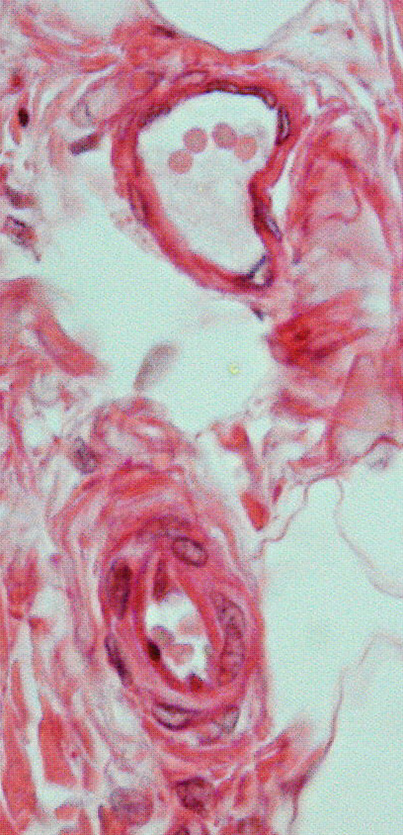
Venules
Collect blood from capillary beds
Site of diapedesis
Characteristic Features
Higher lumen:wall ratio compared to arterioles and often irregularly shaped
Tunica intima
endothelium
Tunica media
1-2 sparse layers of VSMCs
no external elastic lamina
Tunica adventitia
Unremarkable, merges with surrounding connective tissue

Slide 24
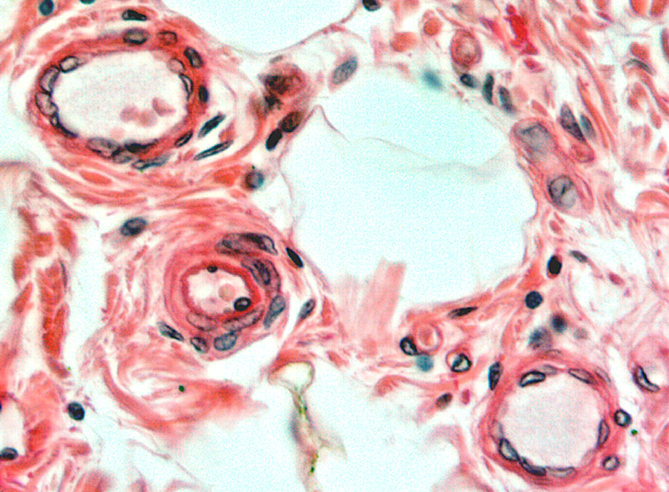
Comparison of venules and arterioles
V
A
V

Slide 25
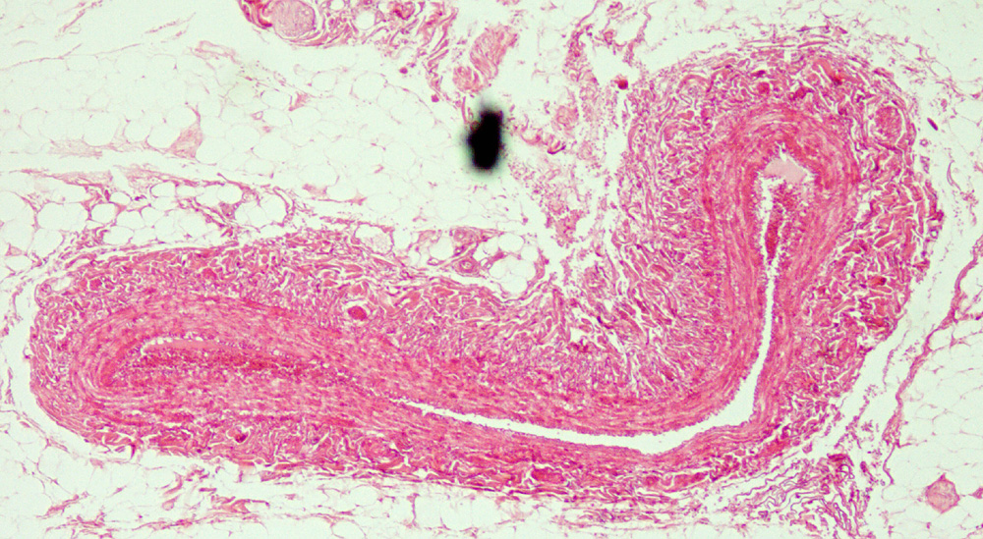
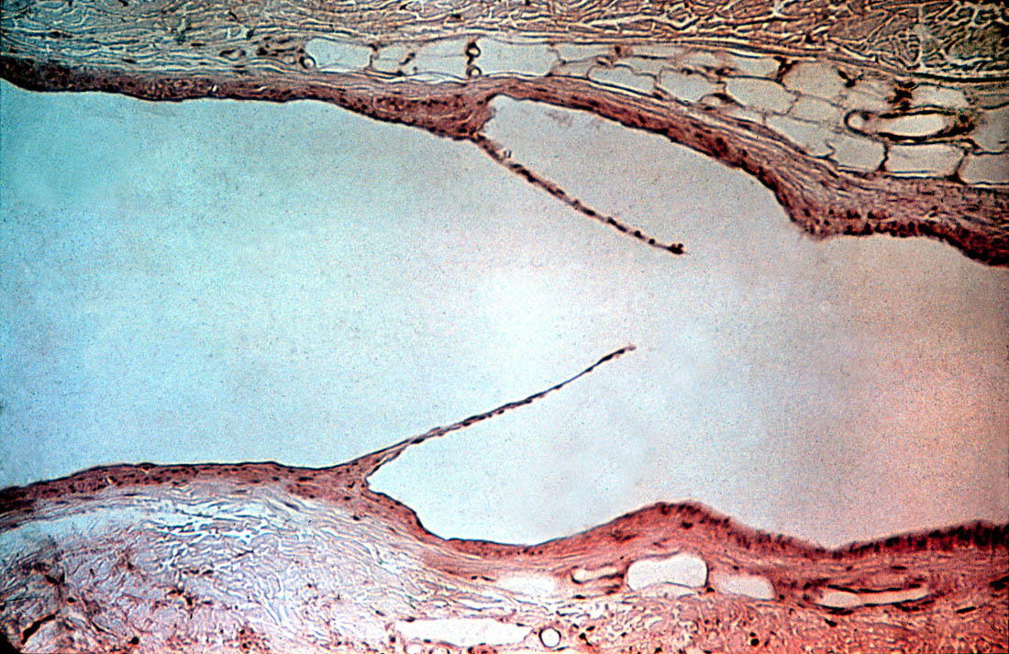
Veins
Return blood to heart
Possess valves
Characteristic Features
Tunica intima
valves: semilunar folds of endothelium & subendothelium
Variable internal elastic lamina
Tunica media
3-15 layers of VSMCs
no external elastic lamina
Tunica adventitia
thicker than tunica media
larger veins have longitudinal smooth muscle in adventitia (movement and support of blood column)
blood flow
valve cusp

Slide 26
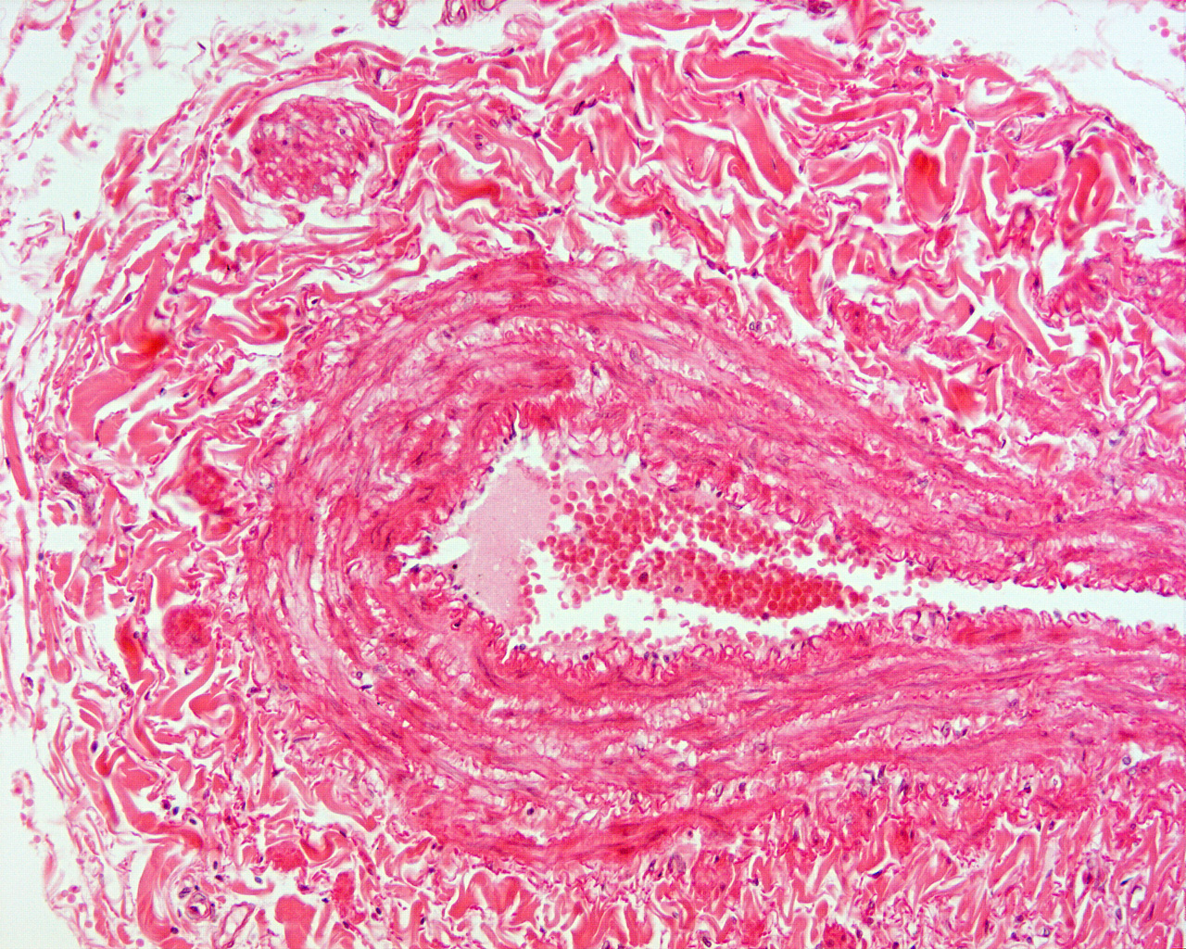
SMC
TA
TM

Slide 27
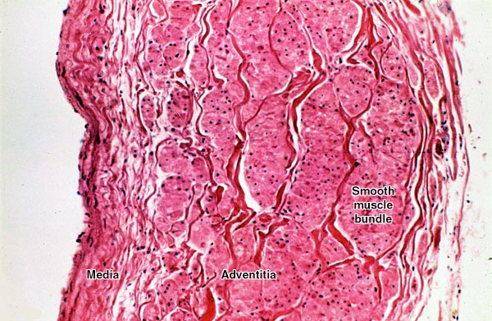
Wall of the vena cava, showing longitudinal smooth muscle in adventitia, LM
Lumen
Intima
Notes:
Wall of the inferior vena cava, in cross section. Most of the wall is tunica adventitia, composed of large, longitudinally-oriented bundles of smooth muscle (here seen in cross section). The tunica media is very thin, containing only scattered collagen fibers and a few strands of smooth muscle. Since the inferior vena cava is oriented vertically in the abdominal cavity, and is essentially a tall sack of relatively slow-moving blood, its walls need support in the longitudinal direction, which would be provided by the longitudinal bundles of smooth muscle in the adventitia.
From Japanese slide set (Humio Mizoguti, Kobe Univ Sch Med), slide 229 (=45-17). Japan 229.jpg.

Slide 28
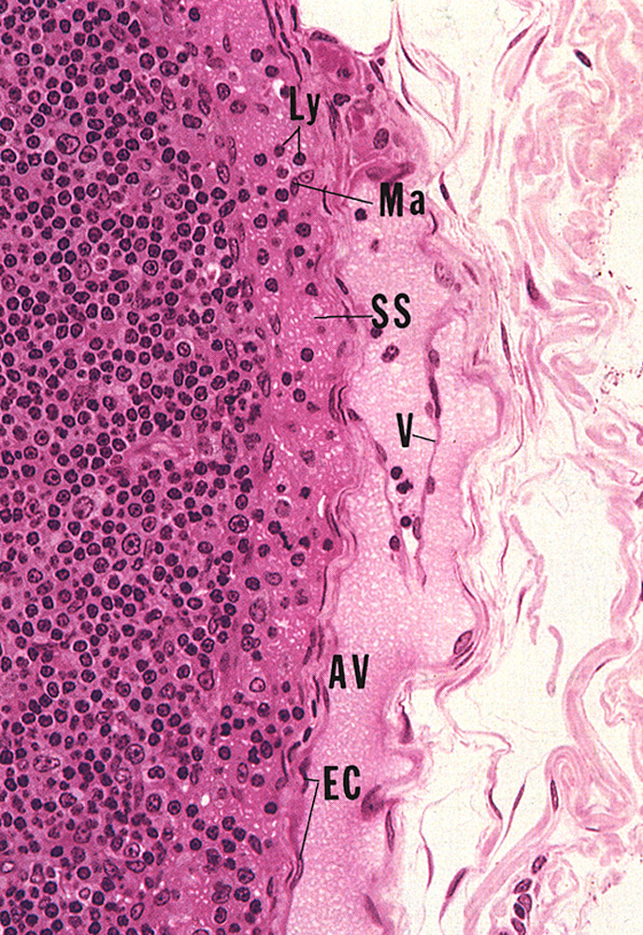
Lymphatic Vessels
Transport lymph (tissue fluid) to lymph nodes and systemic blood supply (eventually)
Possess valves
Generally contain NO RBCs
Characteristic Features
Tunica intima
valves: semilunar folds of endothelium and subendothelium
Tunica media
sparse VSMC layer (in larger vessels)
Tunica adventitia
sparse adventitia

Slide 29
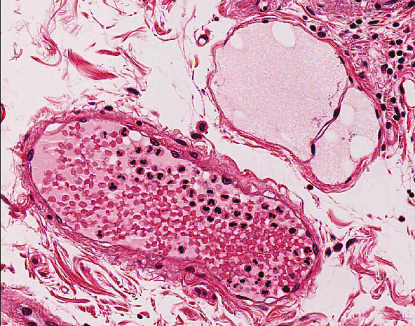
Comparison of a small vein and a lymphatic vessel
Lymphatic
Valve
Vein

Slide 30
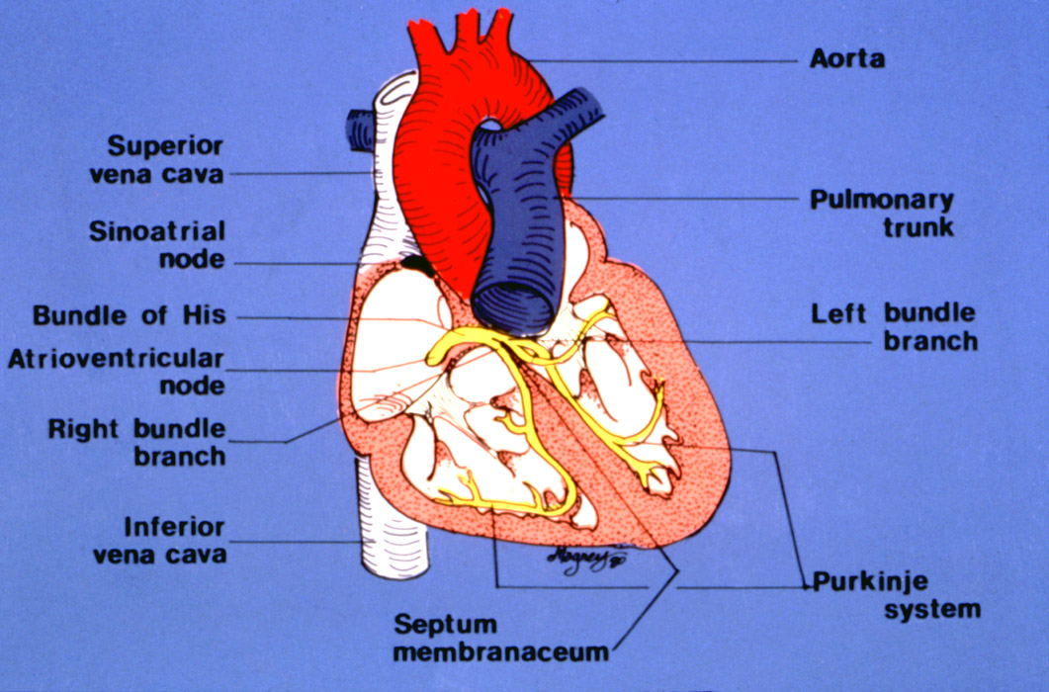
Heart, diagram
HEART WALL
Endocardium = endothelium +
connective tissue (like intima)
Myocardium = thick cardiac muscle (like media)
Epicardium = visceral pericardium = simple squamous epith + fatty connective tissue
Cardiac
fibrous skeleton
Atrium
Chorda tendinae
Valve
Papillary muscle
Ventricle
The AV valve margins are
supported by chorda tendinae and papillary muscles.
Notes:
Orientation diagram of the heart.
From Erlandsen slide set, slide 4/D/9. CV-heartMH.jpg

Slide 31
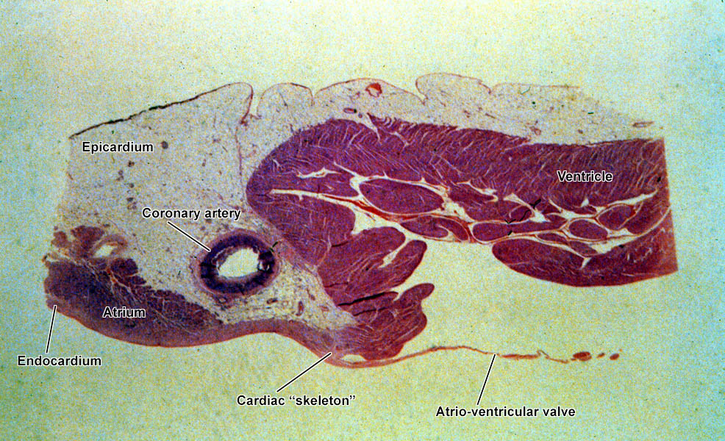
Wall of atrium and ventricle, heart, LM
Pericardium
Fat
Lumen
(fibrous)
Notes:
Very low power LM of heart wall, including atrium and ventricle. The fatty epicardium fills the atrioventricular sulcus, which also contains the coronary artery. The endocardium lines the inner surface of the wall, and is thicker in the atrium than the ventricle. The atrioventricular valve arises from the dense connective tissue ("cardiac skeleton") that lies between the atrium and the ventricle.
From Erlandsen slide set, slide 6/B/8. MH-6B8.jpg.

Slide 32
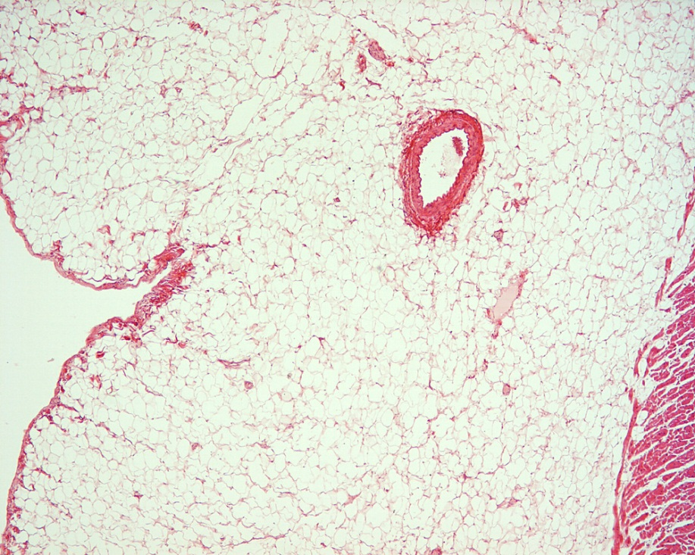
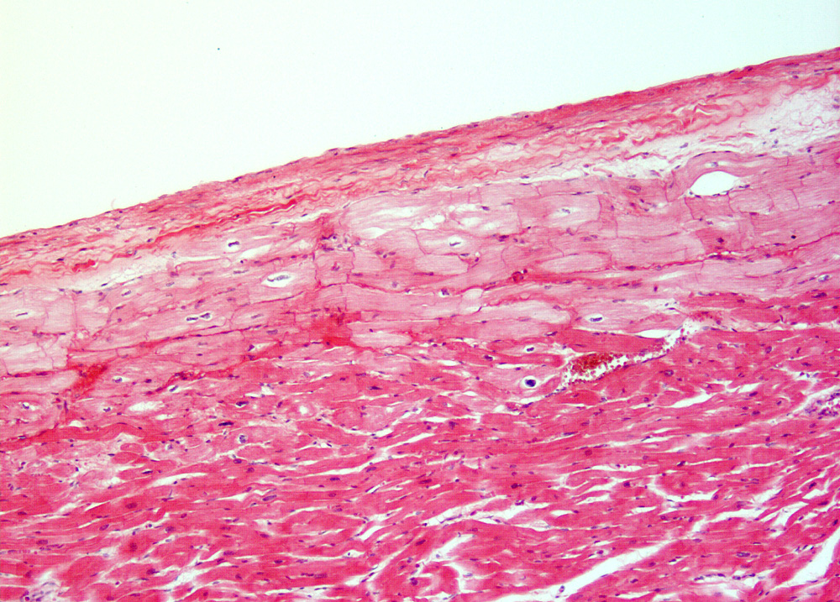
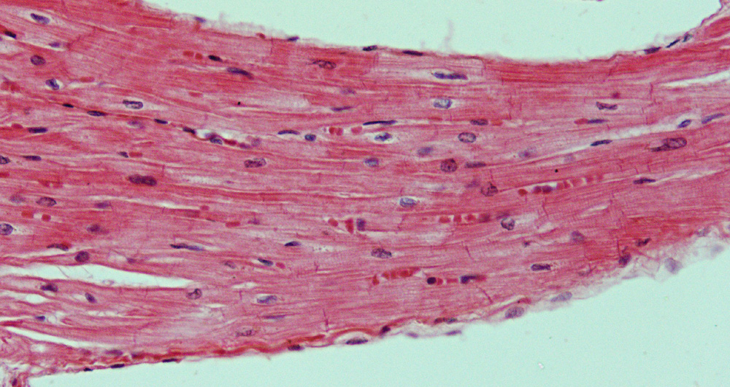
Heart Tunics
Epicardium (tunica adventitia)
visceral pericardium (mesothelium)
subepicardial connective tissue
coronary vessels and nerves
Endocardium (tunica intima)
endothelium
subendothelium (SEn)
connective tissue
smooth muscle cells
subendocardium (SEc)
Purkinje cells (P)
connective tissue
SEn
SEc
P
M
Myocardium (tunica media)
cardiac muscle

Slide 33
Endocardium (tunica intima)
endothelium
subendothelium (SEn)
connective tissue
smooth muscle cells
subendocardium (SEc)
Purkinje cells (P)
connective tissue
SEn
SEc
P
Myocardium

Slide 34
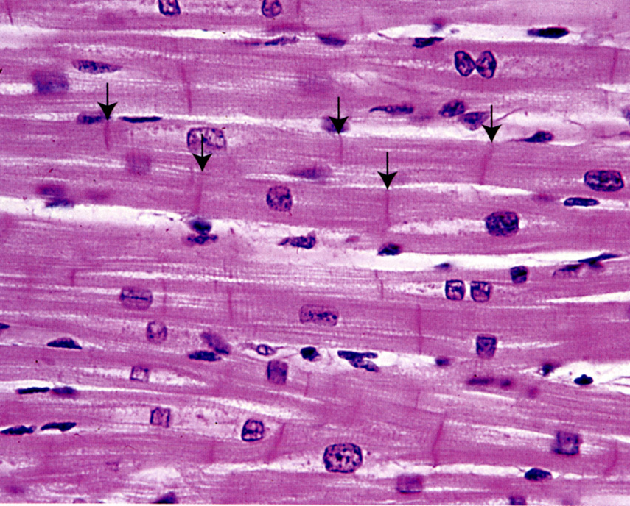
Myocardium – cardiomyocytes and associated connective tissue
longitudinal section
cross section
Central nuclei, often with a biconical, clear area next to nucleus –this is where organelles and glycogen granules are concentrated (and atrial natriuretic factor in atrial cardiac muscle)
Striated, branched fibers joined by intercalated disks (arrows) forms interwoven meshwork
Notes:
34
Fig 11.14 (p294) from Ross & Pawlina, Histology: A Test and Atlas, 5th ed.

Slide 35
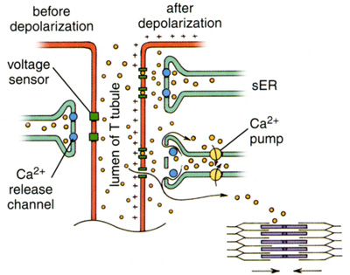
Cardiac muscle is striated, but quite different from skeletal muscle
T-tubules and SR arranged as “diads” (rather than triads) in cardiac muscle
T-tubules much larger compared to skeletal muscle
Convey wave of depolarization into cell AND transport Ca⁺ into cell (via voltage-gated channels)
Calcium influx stimulates SR to release MORE Ca⁺ (via Ca⁺-gated Ca⁺ channels
Notes:
35
Left: Fig 11.17 (p299) from Ross & Pawlina, Histology: A Test and Atlas, 5th ed.
Right: Fig 11.15 (p297) from Ross & Pawlina, Histology: A Test and Atlas, 5th ed.

Slide 36
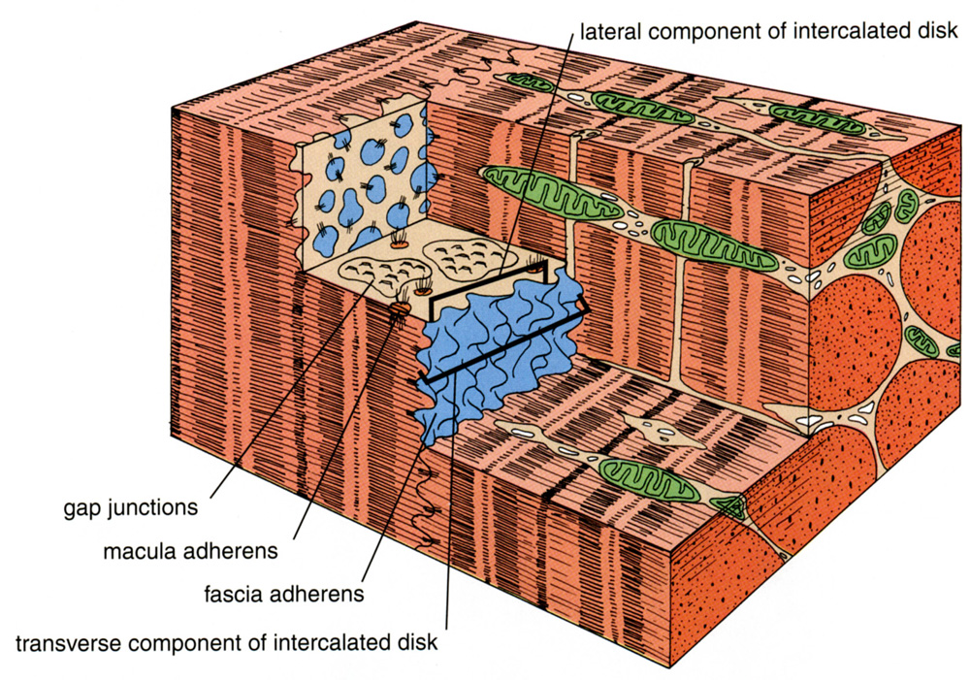
Intercalated Discs Couple Heart Muscle Mechanically and Electrically
Notes:
36
Fig 11.16a (p298) from Ross & Pawlina, Histology: A Test and Atlas, 5th ed.

Slide 37
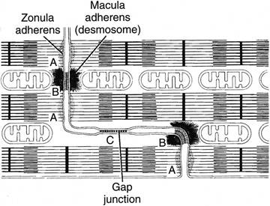
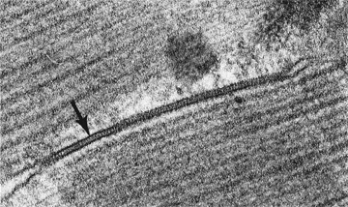
Transverse portion:
forms mechanical coupling
aka “Fascia adherens”
Lateral Portion:
forms electrical coupling
Notes:
37
Left:
Top right: line drawing is Fig 10-26 (grayscaled) (p209) from Junquiera & Carniero, Basic Histology: text and atlas. 10th ed.
Bottom right: inset image on p120 from Cross & Mercer, Cell and Tissue Ultrastructure: A Functional Perspective (1993)

Slide 38
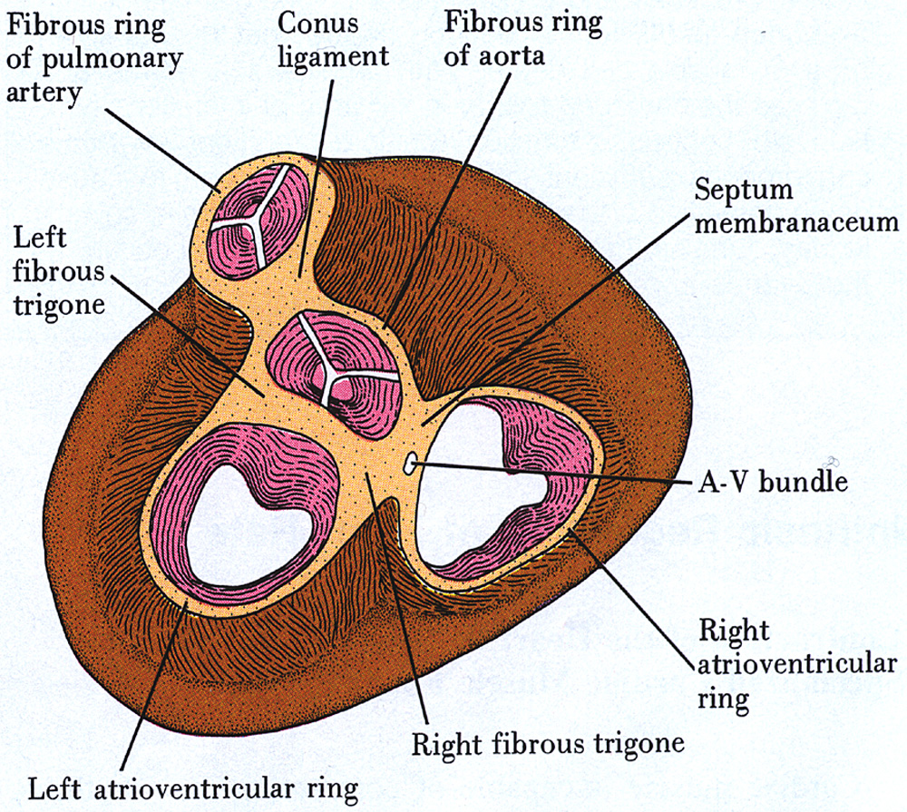
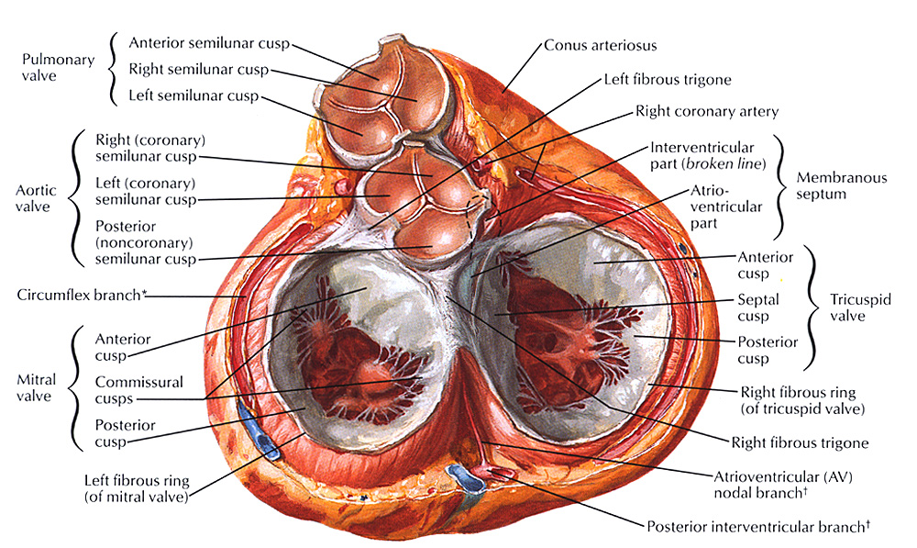
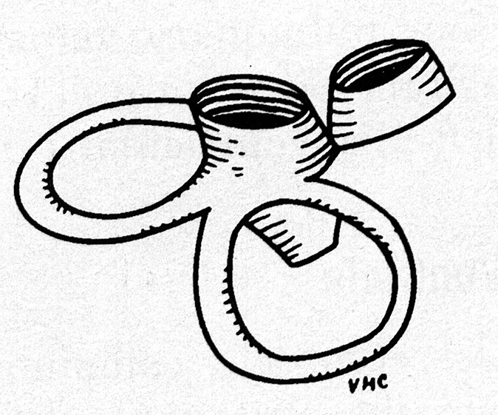
Heart Skeleton and Valves
Fibrous Skeleton
prevents valve stenosis
provides insertion for muscle
non-conductive A-V barrier
Valves
ensure one-way flow of blood
consist of endothelium and subendothelial connective tissue

Slide 39
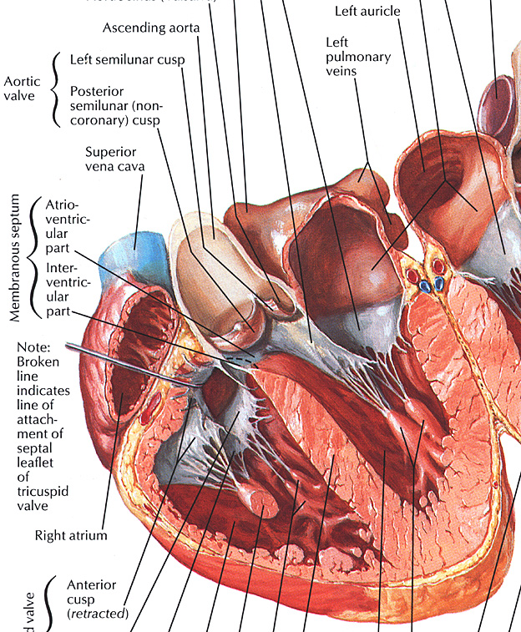
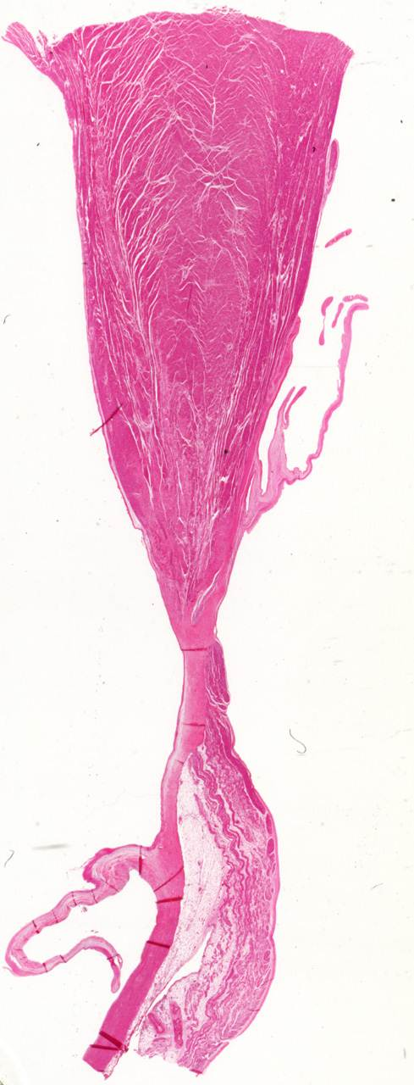
aorta
atrial wall
aortic valve
AV valve
IV
septum

Slide 40
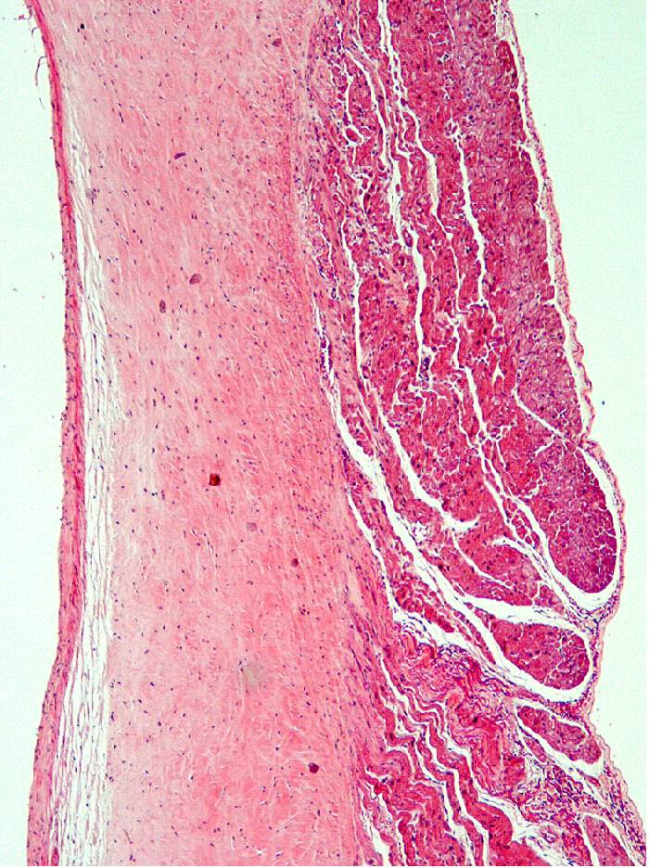
aorta
atrial wall
aortic valve
cardiac skeleton
AV valve
IV
septum

Slide 41
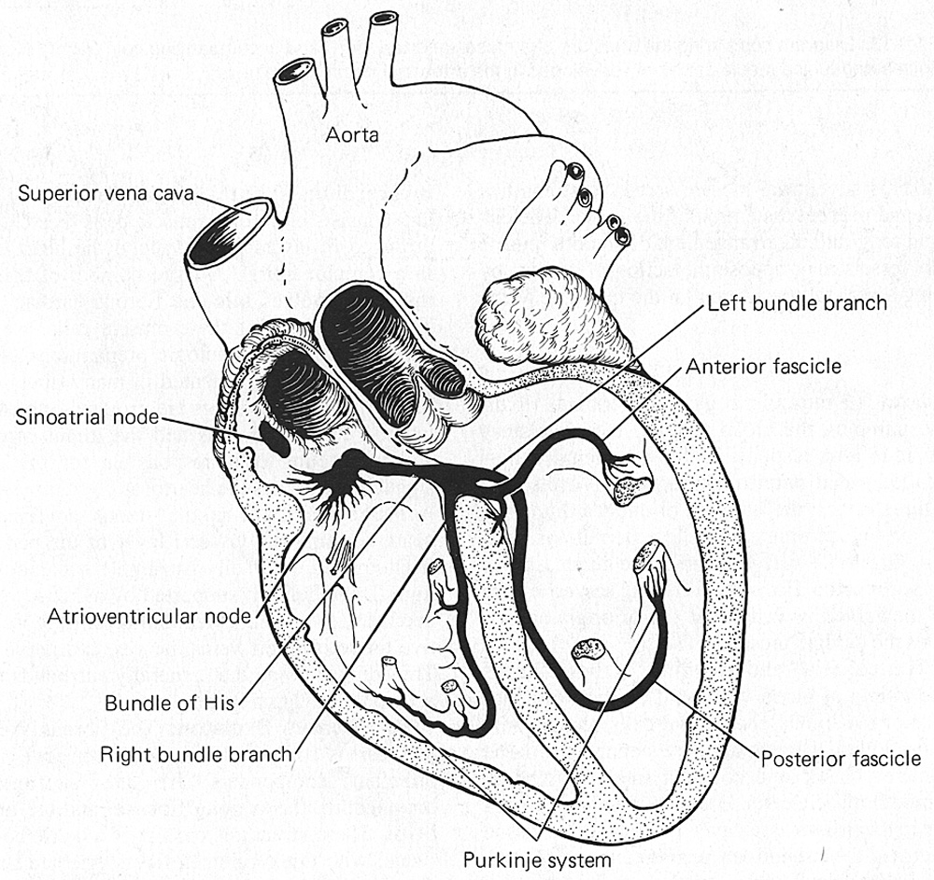
Control of Heartbeat
Impulse generation sets rhythm
Sinoatrial node
Impulse conduction system coordinates contraction
Atrioventricular node
A-V bundle (of His)
Bundle branches
Purkinje fibers
Autonomic innervation modulates heart rate
sympathetic (increases rate)
parasympathetic (slows rate)

Slide 42
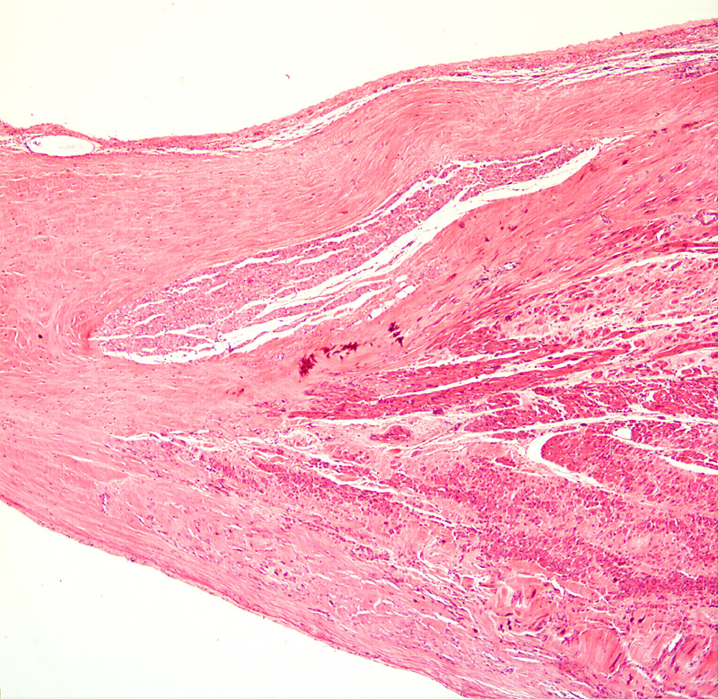
The atrioventricular bundle of His consists of modified cardiomyocytes
cardiac skeleton
bundle of His
Allows for conduction of atrial depolarization to ventricular myocardium

Slide 43
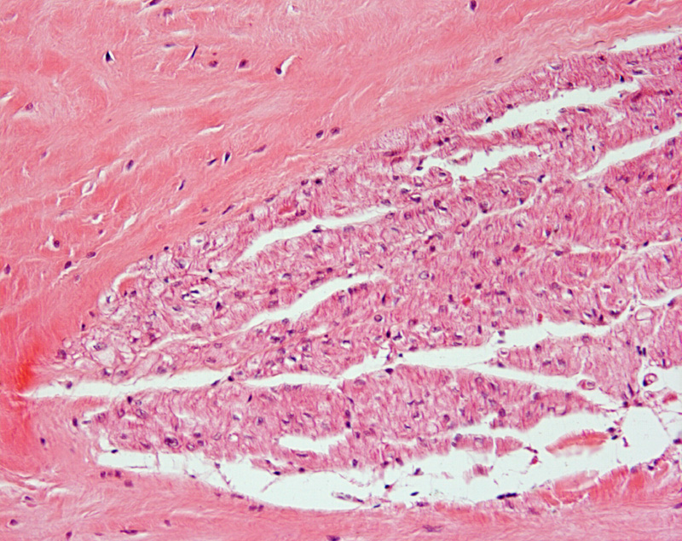
The atrioventricular bundle of His consists of modified cardiomyocytes
cardiac skeleton
bundle of His

Slide 44
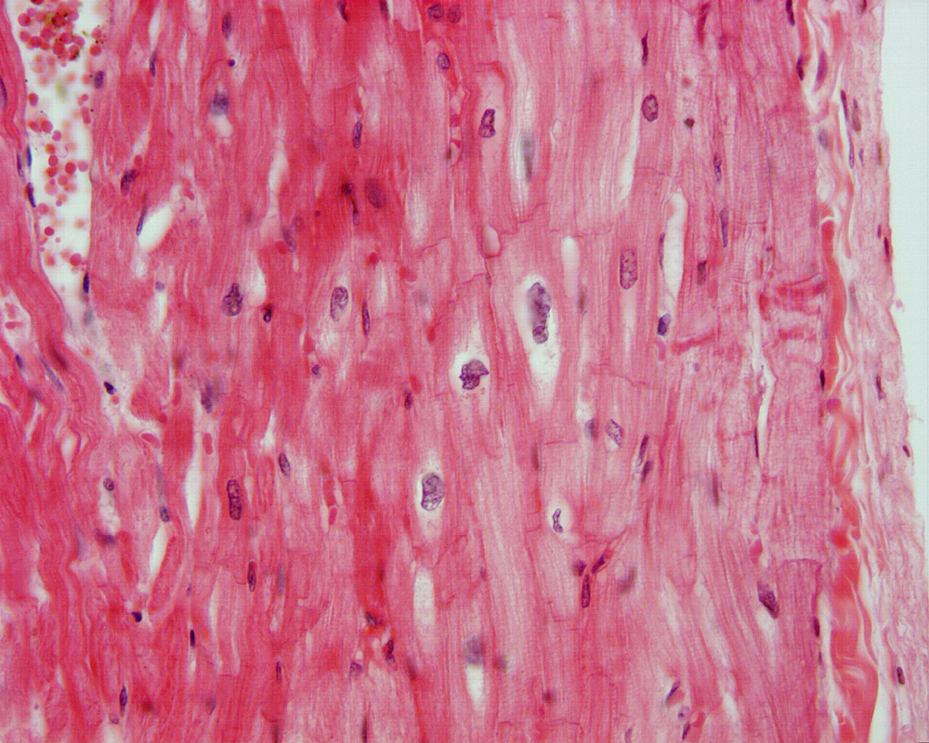
Purkinje Fibers are also specialized convey depolarization

