Slide 1
Neuropathology: General Patterns of Injury Cerebrovascular Disease Traumatic Brain Injury
J. Matthew Velkey
matt.velkey@duke.edu
0380 Sealy Mudd/Trent Semans Center

Slide 2
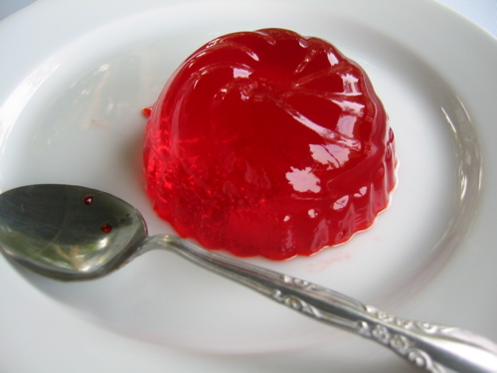
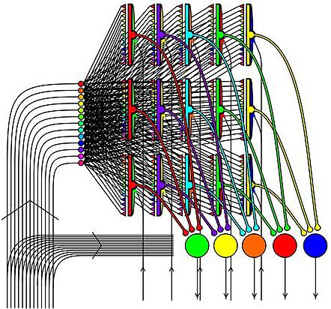
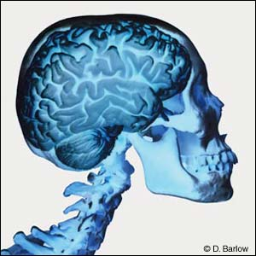
Unique features of CNS that
influence its response to injury
-cell types unique to CNS
-complex neural circuit architecture
-little internal structural support
-very limited room to expand
-no typical lymphatic drainage
joepastry.com
sensopac.org

Slide 3
Neuropathology
Cellular Responses to Injury
Cerebral Edema, Hydrocephalus, Increased Intracranial Pressure & Herniation
Cerebrovascular Disease
Trauma

Slide 4
The cells of the CNS
Neuroectodermal origin
Neurons
Glia (astrocytes, oligodendroglia, ependymal/choroid plexus cells)
Neural stem/progenitor cells
Mesodermal origin
Resident microglia
Meningial cells
Blood vessels and blood cells

Slide 5
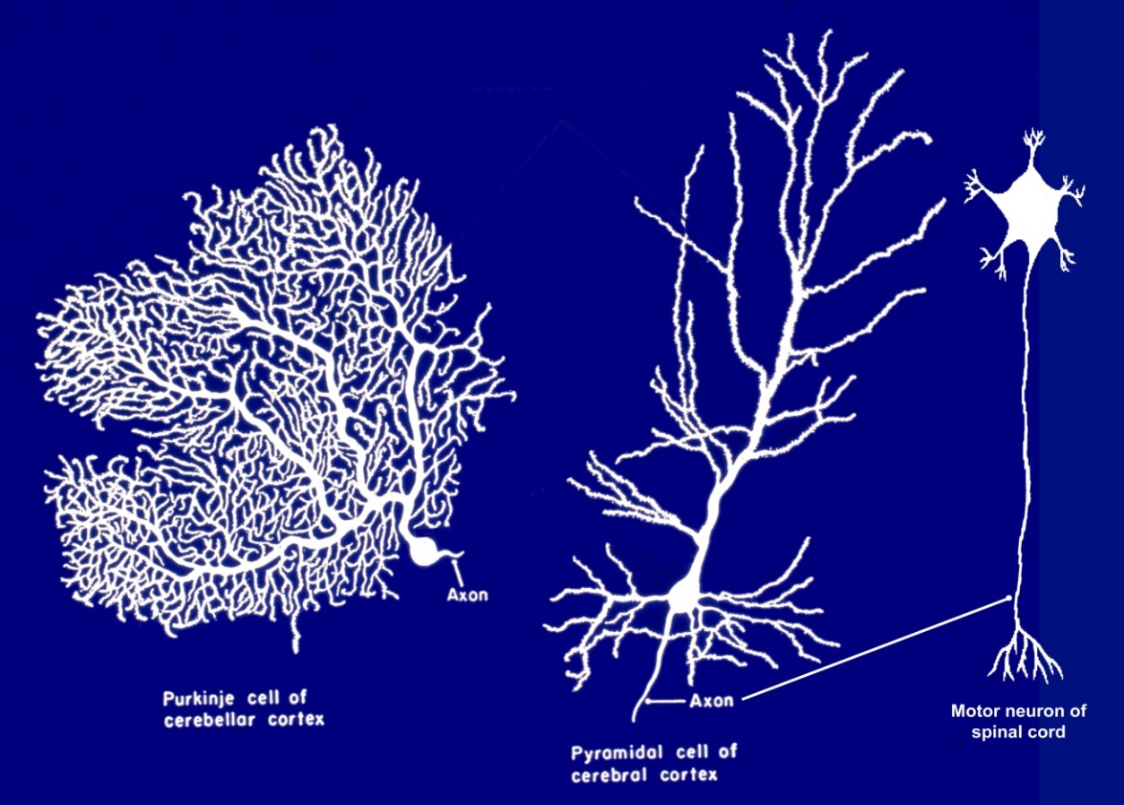
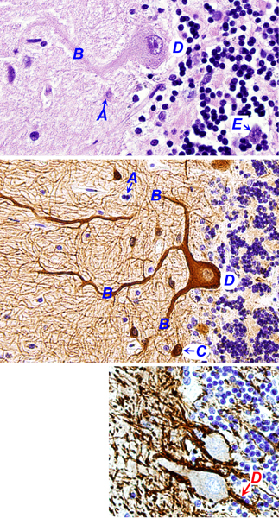
Neurons
H&E
Neurofilament
H&E
VandenBerg/missinglink@ucsf.edu

Slide 6
Neuronal reaction (acute)
“Red neurons” in hypoxia/ischemia
Selective vulnerability (Purkinje cells, CA1 pyramidal cells in hippocampus, upper motor neurons of motor cortex)
Normal cortical neurons
VandenBerg/missinglink@ucsf.edu

Slide 7
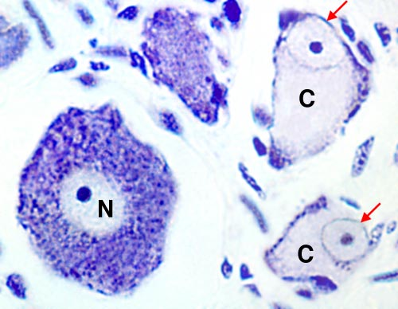
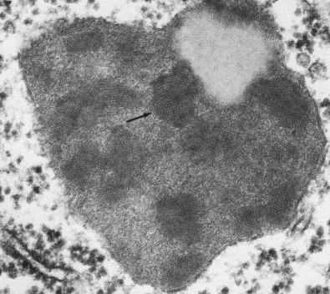
Neuronal reaction (subacute/chronic)
Apoptosis (in situ and trans-synaptic)
Regeneration: axonal reaction
(central chromatolysis)
Neuronal inclusions (lipofuscin)
vanat.cvm.umn.edu
Nissl stain (cresyl violet)
PAS
www.innovitaresearch.org
DAPI
ncbi.nlm.nih.gov
EM

Slide 8
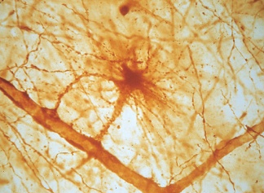
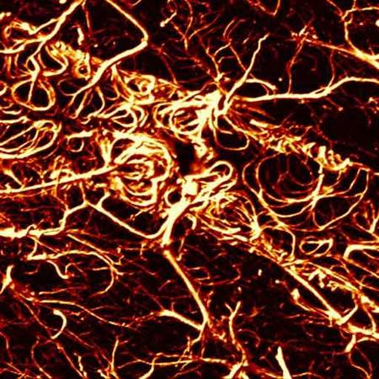
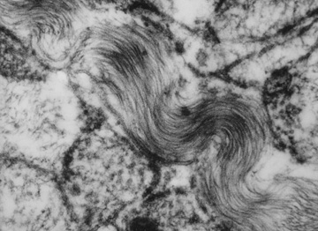
Astrocytes
GFAP immunostain, confocal laser scan)
astrocyte
podocyte
capillary
C. R. Green/The Biomedical Imaging Research Unit
Glial fibrillary acid protein (GFAP)
(Electron microphotograph)
VandenBerg/missinglink@ucsf.edu

Slide 9
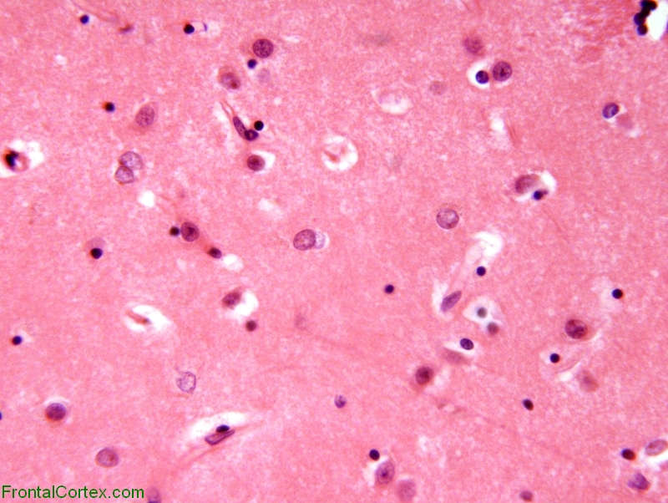
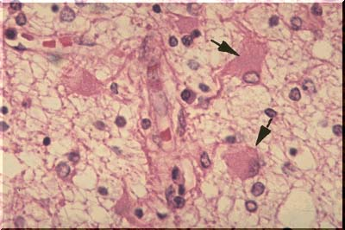
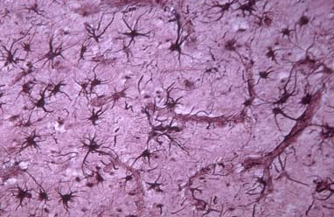
Alzheimer type II astrocytes (H&E)
Reactive astrocytes
Astrogliosis: hypertrophy
and hyperplasia
Gemistocytes (H&E)
Reactive astrocytes (silver stain)
pathology.vco.edu

Slide 10
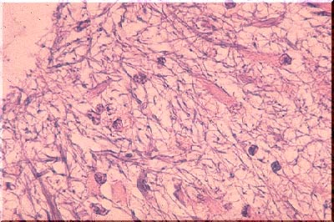
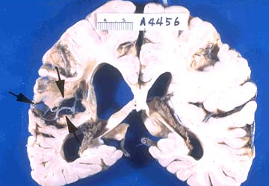
Corpora amylacea
Rosenthal fibers
Reactive
astrocytes
(chronic
gliosis)
Histology for Pathologists 3rd Ed
emedicine.medscape.com
Glial “scar”
pathology.vco.edu

Slide 11
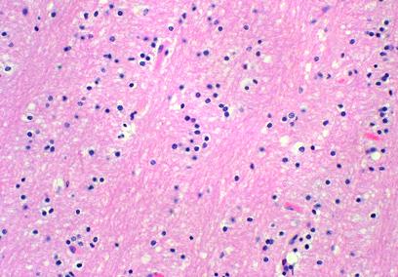
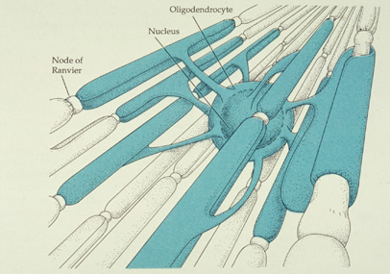
Oligodendrocytes
VandenBerg/missinglink@ucsf.edu

Slide 12
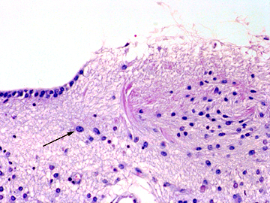
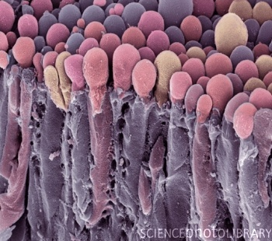
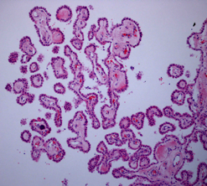
Ependymal cells & choroid plexus
Normal ependyma
Ependymal granulation
VandenBerg/missinglink@ucsf.edu
Normal choroid plexus
(Scanning EM)
immediart.com
wikimedia.org

Slide 13
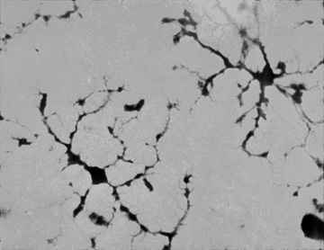
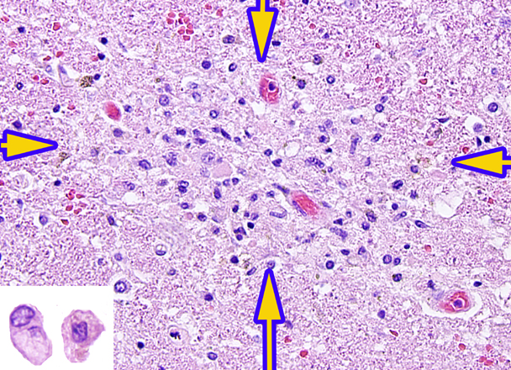
Microglia
Silver stain of
resting microglia
H&E stain of a microglial
nodule (viral encephalitis)
Rod cell
VandenBerg/missinglink@ucsf.edu
Amoeboid forms
VandenBerg/missinglink@ucsf.edu
Neuronophagia
in spinal cord (H&E)
Hsueh (2000) Mod Pathol13:1200

Slide 14
Meninges
Skull
Arachnoid surface
Pia mater
VandenBerg/missinglink.ucsf.edu

Slide 15
Neuropathology
Cellular Responses to Injury
Cerebral Edema, Hydrocephalus, Increased Intracranial Pressure & Herniation
Cerebrovascular Disease
Trauma

Slide 16
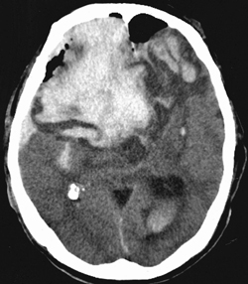
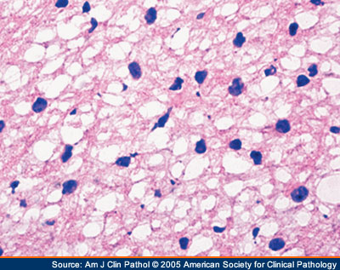
Cerebral (brain parenchymal) edema
Vasogenic: blood-brain barrier is compromised (e.g. trauma, tumor)
Cytotoxic: cellular injury (e.g. hypoxic or metabolic insult)
CT scan: hemorrhage
H&E frozen section: glioma
www.jkns.or.kr

Slide 17
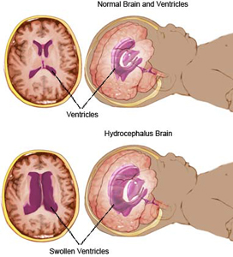
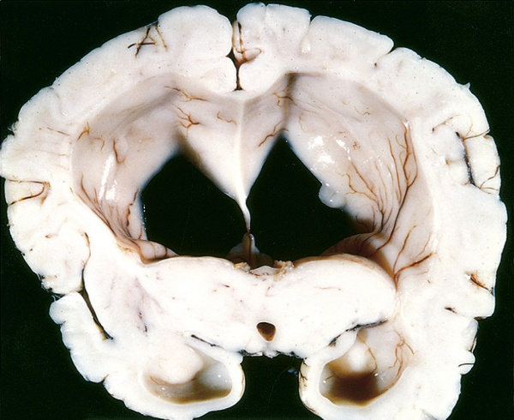
Hydrocephalus
(excess cerebrospinal fluid)
choa.org

Slide 18
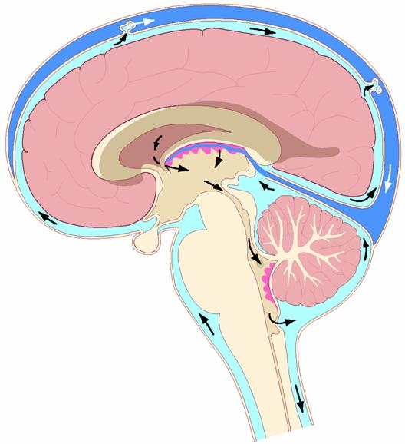
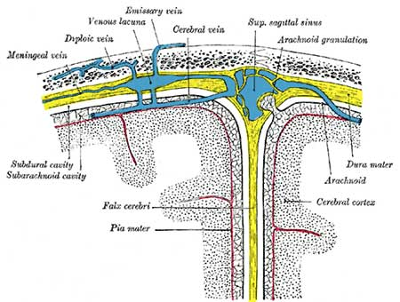
Cerebrospinal fluid flow
http://embryology.med.unsw.edu.au
Pressure hydrocephalus
communicating (impaired CSF absorption)
non-communicating (obstructive)
(versus hydrocephalus ex vacuo)
control.tfe.umu.se

Slide 19
Raised intracranial pressure due to:
Cerebral edema
Pressure hydrocephalus
Tumor
Hemorrhage
Abscess
Initial signs and symptoms of increased intracranial pressure:
headache
vomiting
altered mental status
papilledema (engorgement of the optic disk)

Slide 20
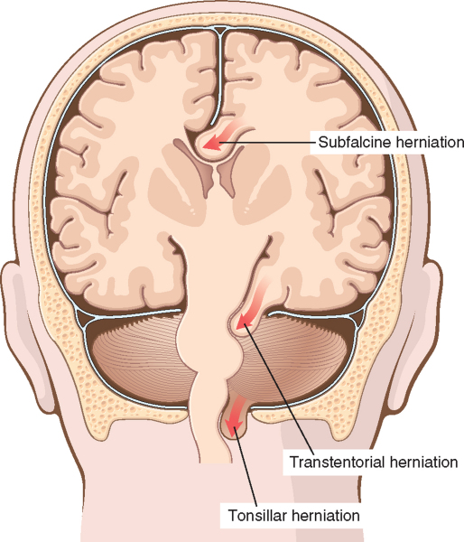
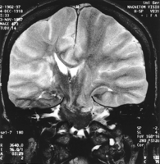
Endpoint of severe IIP: Herniation
Falx cerebri
Tentorium
cerebelli
Foramen
magnum
stroke.ahajournals.org

Slide 21
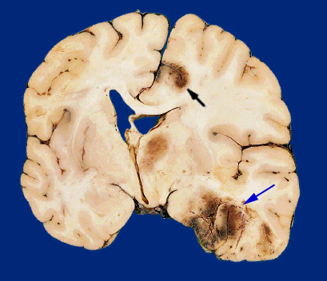
Example: herniation following trauma
subfalcine
herniation
3
hemorrhagic
infarction
4
inferior
temporal lobe
contusion
1
3
uncal
(transtentorial)
herniation
2
diffuse hemispheric
vasogenic edema
with midline shift
Neuropathology (1998) Ellison,Love et al

Slide 22
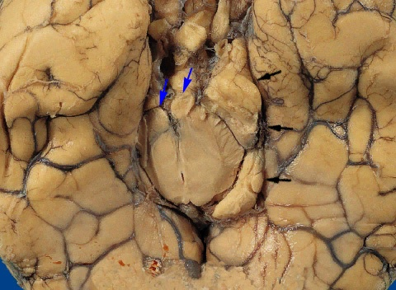
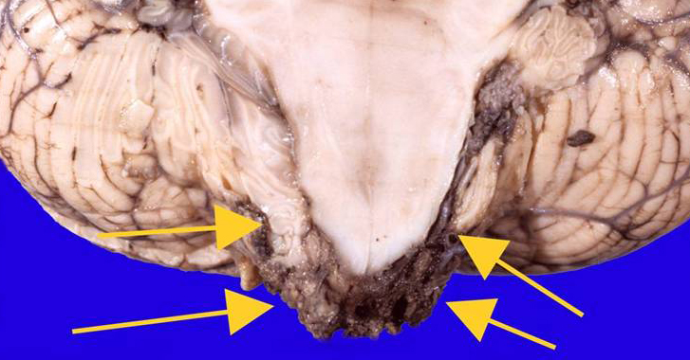
Uncal (transtentorial)
herniation
Neuropathology (1998) Ellison,Love et al
VandenBerg/missinglink@ucsf.edu
Tonsillar
herniation

Slide 23
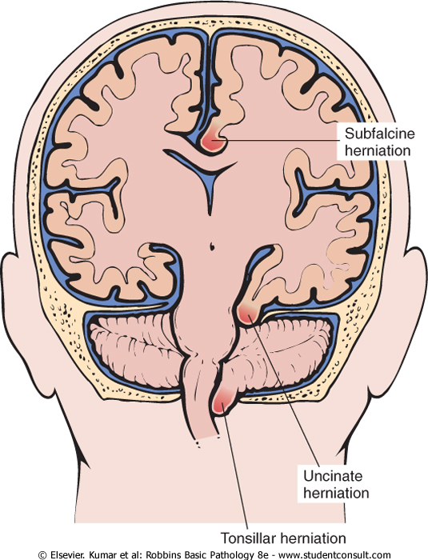
Site-specific consequences of herniation
can be clinically silent
ACA compression
PCA compression (visual field defect)
CNIII compression (blown pupil)
Cerebral peduncle compression (paresis)
Sylvian aqueduct occlusion (hydrocephalus)
Duret hemorrhages
compression of the medulla (cardiorespiratory arrest)

Slide 24
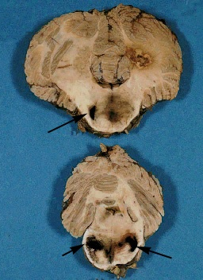
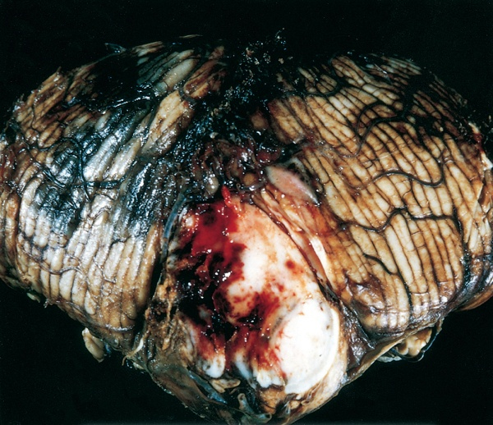
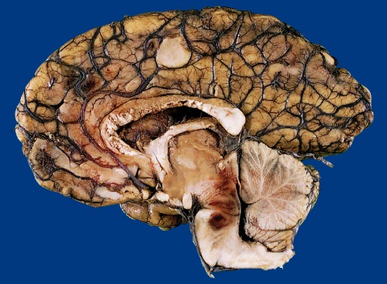
Duret (secondary brainstem)
hemorrhages
Sequela of transtentorial (uncal) herniation
Caused by stretching of the
penetrating branches of the basilar artery
as the midbrain descends
Neuropathology (1998) Ellison,Love et al

Slide 25
Neuropathology
Cellular Responses to Injury
Cerebral Edema, Hydrocephalus, Increased Intracranial Pressure & Herniation
Cerebrovascular Disease
Trauma

Slide 26
Cerebrovascular Disease (CVD)
Leading causes of death in the USA:
Heart disease
Cancer
Cerebrovascular disease
CVD is the leading neurological disorder in terms of morbidity and mortality

Slide 27
Mechanisms of Cerebrovascular Disease
Ischemia / Hypoxia
Impairment of blood supply and / or oxygenation of CNS tissue
Hemorrhage
Hypertension
Aneurysm
Vascular Malformation

Slide 28
Oxygen Deprivation
Functional hypoxia (an oxygen issue):
Low partial pressure of oxygen
Impaired oxygen carrying capacity of the blood
Inhibition of oxygen use by the tissue
Ischemia (a blood issue):
Interruption of the circulation
Hypotension
Vessel obstruction
Brain tissue survival is influenced by:
Duration of ischemia
Availability of collateral circulation
Magnitude and rapidity of the reduction in flow

Slide 29
Ischemic Injury
Global
Generalized reduction of cerebral perfusion
Cardiac arrest, shock, severe hypotension
Focal
Local reduction or cessation of blood flow
Atherosclerosis, thrombosis, emboli

Slide 30
Cerebrovascular Accident aka “Stroke”
Stroke is the clinical description of a CVA
Think of strokes as:
Ischemic
Hemorrhagic
Combined (delayed bleed into an ischemic site)
Acute therapeutic intervention with thrombolytic agents led to promotion of the term “brain attack”

Slide 31
Pathology of Infarcts
Gross
Microscopic
Acute (12 hours – 3 days)
Subacute (3 days – 2 weeks)
Chronic (weeks, months, years, decades)

Slide 32
Acute Infarct Gross Pathology
Brain swelling
Gyri are widened
Sulci are narrowed
Gray-white junction poorly demarcated

Slide 33
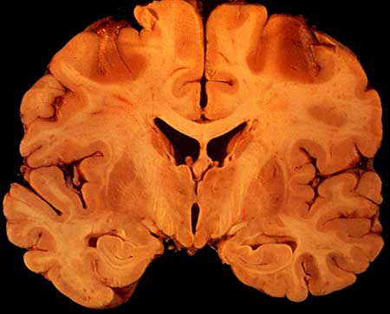
Watershed area infarct // Border zone of ACA // MCA

Slide 34
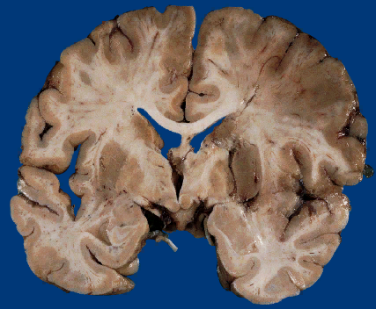

Slide 35
Acute Infarct Histology
12 hours – 3 days after infarction
Neutrophils
Red (eosinophilic) neurons
Nuclear pyknosis and karyorrexis
Vacuolation of the neuropil (edema)

Slide 36
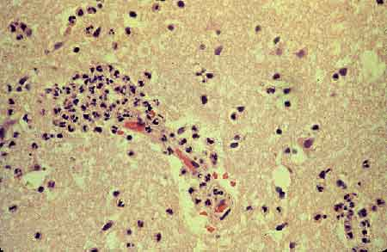
Neutrophils

Slide 37
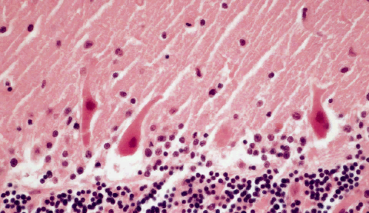
Red Neurons: Purkinje neurons, cerebellum

Slide 38
Subacute Infarct Pathology
3 days – 2 weeks after infarction
Gross:
Brain softening
Histology:
Macrophage infiltrate
Capillary proliferation
Gliosis (reactive astrocytes)
Necrosis

Slide 39
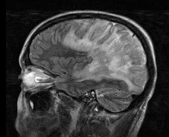
Sagittal FLAIR MRI brain, subacute infarct

Slide 40
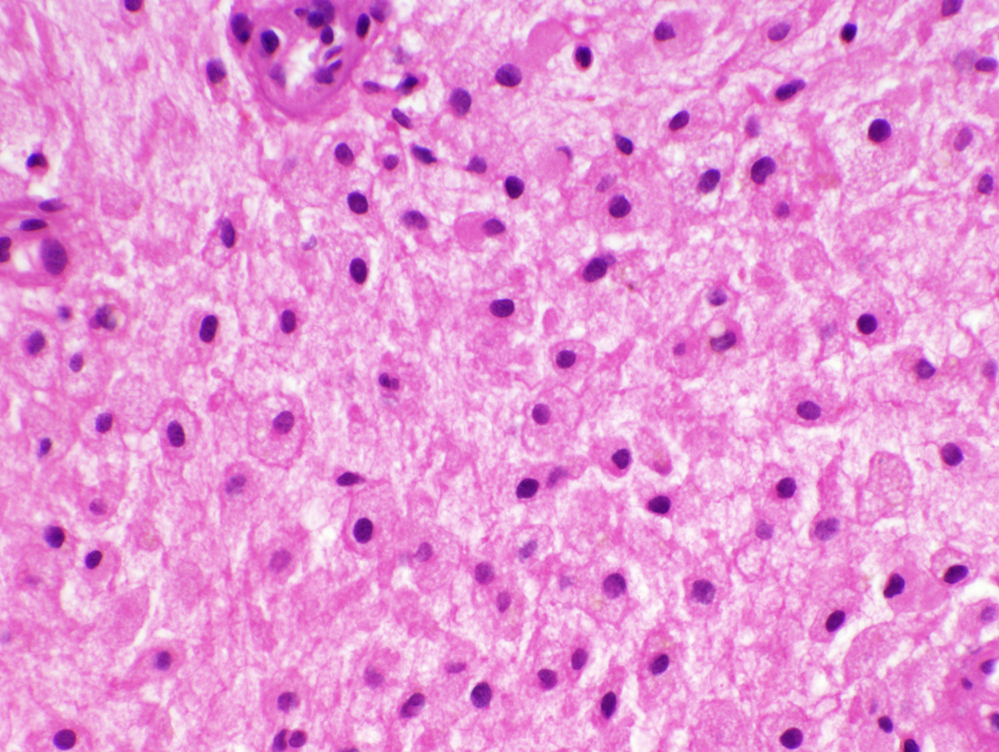
Macrophages

Slide 41
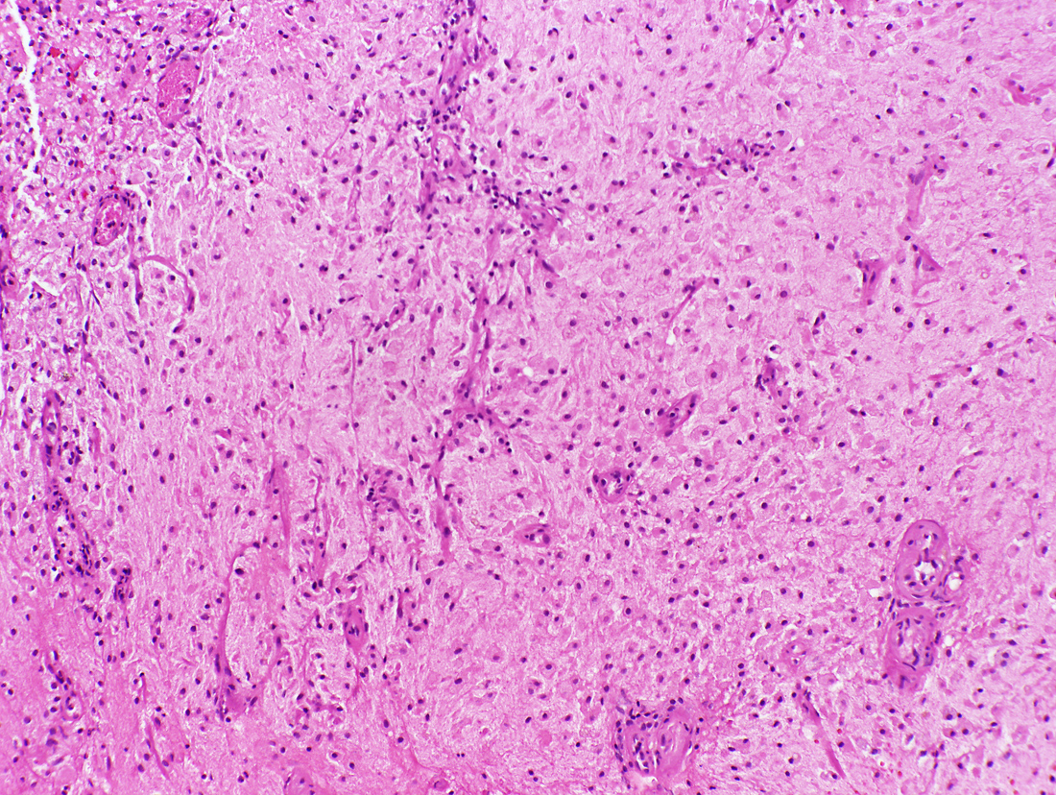
Capillary proliferation

Slide 42
Chronic Infarct Pathology
months, years, decades after infarction
Gross:
After removal of the necrotic tissue, a cystic fluid-filled cavity remains; this is known as encephalomalacia
Histology:
Gliosis, hemosiderin, and macrophages remain indefinitely

Slide 43
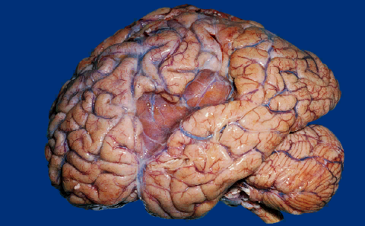
Chronic Infarct

Slide 44
Chronic Infarct:
Encephalomalacia

Slide 45
Embolic Infarcts
Cardiac mural thrombi
Atheromatous plaque: carotid artery
Fat: traumatic long bone fracture
Air: neurosurgical procedure
Intervertebral disc tissue
Tumor

Slide 46
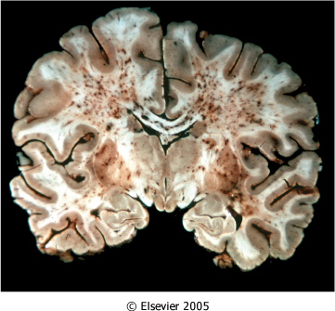
Bone marrow embolization

Slide 47
Arterial Dissection
Young adults
Internal carotid or vertebral artery
Intimal tear, media or subendothelial hematoma, vessel occlusion, infarction
Etiologies:
Spontaneous
Mild trauma
Fibromuscular dysplasia

Slide 48
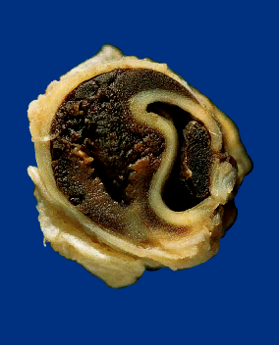
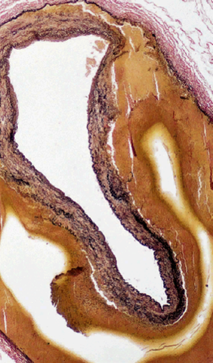

Slide 49
CNS Hemorrhage Classification // Location
Parenchymal
Basal ganglia (hypertension)
Lobar (amyloid angiopathy)
Subarachnoid
Aneurysm rupture (Circle of Willis)
Trauma (cortex)
Other:
Epidural – trauma
Subdural – trauma
Intraventricular: often secondary event (e.g. after a stroke has caused necrosis)
Combined

Slide 50
Hemorrhagic Stroke Mechanisms
Hypertension
Congophilic amyloid angiopathy
Aneurysms / Vascular malformations
Other mechanisms not covered in this lecture:
Bleeding diathesis
Trauma
Neoplasm

Slide 51
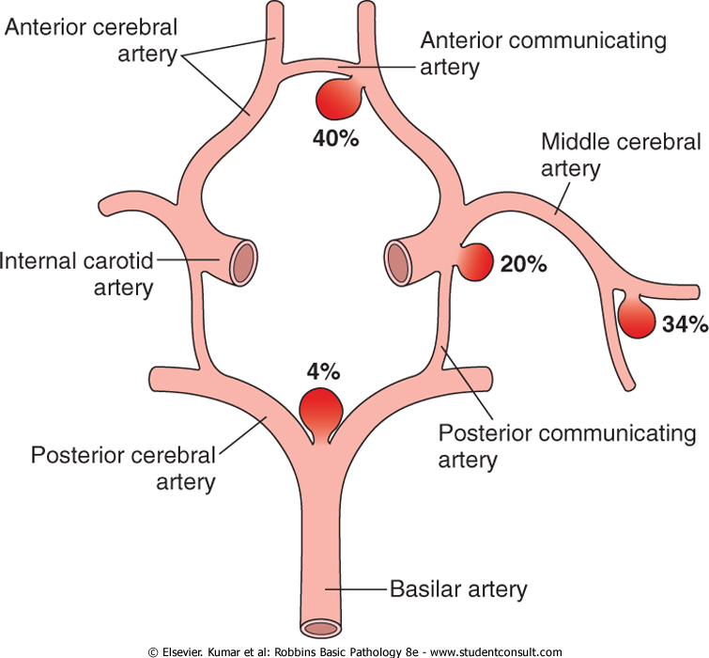
Intracranial Aneurysms
Usually present in 4th and 5th decades
75% occur in three sites (MCA, ACA, PCA), often at site of vessel bifurcation
Caused by defect in arterial wall, which can be congenital OR acquired (e.g. result of atherosclerosis, infection, etc.)
Rupture causes subarachnoid hemorrhage

Slide 52
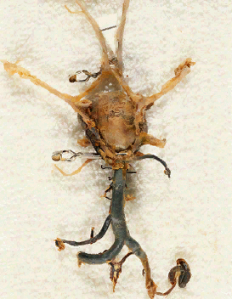

Slide 53
Giant MCA aneurysm, temporal lobe

Slide 54
Arteriovenous malformation (AVM)
Usually diagnosed in 10-30 year-olds
2x more likely in males
Tangled network of thin walled, artero-venous shunts (in newborns can result in heart failure)
Potentially devastating hemorrhage if ruptured
(AVM in occipital lobe)

Slide 55
AVM, gross and microscopic
AVM

Slide 56
Hypertensive Cerebrovascular Disease
Hypertensive hemorrhage
Lacunar infarcts
Hypertensive encephalopathy
Frequent associations:
Atherosclerosis
Diabetes mellitus

Slide 57
section of basilar artery shown in next slide

Slide 59
Hypertensive Hemorrhage
Usually occur in region of basal ganglia
Other sites are mid-pons and cerebellum

Slide 60
Lacunar infarcts
Hypertension, arteriolar sclerosis
Medial and lateral lenticulostriate arteries
Lenticular nucleus, thalamus, internal capsule, deep white matter, caudate nucleus, pons
Single or multiple; < 15 mm diameter
Clinically silent or devastating complications

Slide 62
CT Brain: Lacunar infarcts

Slide 63
Lacunar infarcts, caudate, putamen

Slide 64
Hypertensive Encephalopathy
Acute:
Headaches, confusion, coma
Chronic:
Vascular (multi-infarct) dementia
White matter (Binswanger disease)
Gray matter

Slide 65
Neuropathology
Cellular Responses to Injury
Cerebral Edema, Hydrocephalus, Increased Intracranial Pressure & Herniation
Cerebrovascular Disease
Trauma

Slide 66
Trauma
Skull fractures
Parenchymal injury
Vascular injury

Slide 67
Trauma: Skull fractures
Diastatic fractures
wikipedia.org
Displaced fracture
wikipedia.org
Emedicine.medscape.com

Slide 68
Trauma:
Skull fractures
wikipedia.org
Basal skull fractures
The CIBA collection Vol 1 Nervous System Part 2 1996

Slide 69
Trauma: Parenchymal injury
lacerations
contusions
diffuse axonal injury
acute
remote
Contusions

Slide 70
Diffuse axonal injury
(traumatic rotation, deep white matter stretching)
MRI: hyperintense signal
in the corpus callosum,
septum pellucidum,
and external capsule
img.medscape.com
White matter degeneration
Beta amyloid
precursor protein
(BAPP) stain
neuropathology.neoucom.edu
Axonal
swelling

Slide 71
Trauma: Vascular injury
Intra-axial: parenchymal hemorrhage
Extra-axial: subarachnoid hemorrhage
subdural hemorrhage
epidural hemorrhage

Slide 72
Parenchymal hemorrhage
-hypertension, vascular malformations, tumors, drugs, amyloid angiopathy
MRI: acute hemorrhage
with associated edema
Atlas &Thulborne (1998) AJNR Am J Neuroradiol 19:1471

Slide 73
Subarachnoid hemorrhage
-bleeding from corticomenigeal arteries into the CSF space
-rupture of a cerebral aneurysm in most cases
-sudden onset (“thunderclap headache”)
-poor prognosis (up to 50% death rate)
CT scan of SAH
emedicine.medscape.com
VandenBerg/missinglink.ucsf.edu

Slide 74
Epidural versus subdural hemorrhage
VandenBerg/missinglink.ucsf.edu

Slide 75
Review of Meningeal Layers
http://www.profelis.org

Slide 76
Epidural hematoma
-ruptured dural/meningeal artery
-rare in infants and elderly (intracranial)
-often associated with intoxication
-period of lucidity following trauma
-mortality rate up to 50% (varies with
level of conciousness at surgery)

Slide 77
Subdural hemorrhage
- bleeding from bridging veins or dural sinuses
- elderly (atrophy) and infants (thin vessel walls and larger space)
- Often slowly evolvingmay be subclinical
Stein et al Forensic Science International, Volume 163, Issue 1

