Slide 1
Neuropathology: Tumors of the Nervous System Infections of the Nervous System Demyelinating Diseases Degenerative Diseases Metabolic & Toxic Disturbances Peripheral Nerve Disease
J. Matthew Velkey
matt.velkey@duke.edu
0380 Sealy Mudd/Trent Semans Center

Slide 2
CNS TUMORS
Glial cells (most common “parenchymal” tumor, but still pretty rare: overall incidence ~3 per 100,000)
Astrocytomas
Oligodendrogliomas
Ependymomas
Neurons (rare in adults, more common in children)
Gangliogliomas
Medulloblastomas (~20% of childhood CNS tumors)
Neurocytomas
Others
Schwannomas
Meningiomas (also quite common, about as much as astrocytomas)

Slide 3
CNS Tumors tend to follow epidemiologic and anatomic patterns in children and young adults
Childhood locations:
Posterior fossa
Childhood tumors:
Cerebellum
Brainstem
IV Ventricle
Young Adult Locations
Midline or periventricular
Young Adults tumors (low grade)
Cerebellum
Brainstem
Hypothalamus
Temporal Lobes

Slide 4
Adult CNS Tumors Are More Variable
Regardless of age, outcome depends on the tumor “grade”
Metastatic tumors
Parenchymal
Ventricular
Dural
Spinal Cord
Intramedullary
Extramedullary
Lymphoma
World Health Organization (WHO) grading criteria rate neoplasms from I (best) to IV (worst).
For CNS tumors:
Grade I - > 10 year survival untreated
Grade II – 5 to 10 year
Grade III – 3 – 5 year
Grade IV - < 3 year

Slide 5
CNS Neoplasia: Pathologic and Clinical Effects
Mass Effects
Focal Neurologic Deficits
Seizures
Hemorrhage

Slide 6
Astrocytic Tumors
Circumscribed
Pilocytic Astrocytomas (WHO Grade I)
Diffuse
Well Differentiated (Grade II)
Anaplastic Astrocytoma (Grade III)
Glioblastoma (Grade IV)

Slide 7
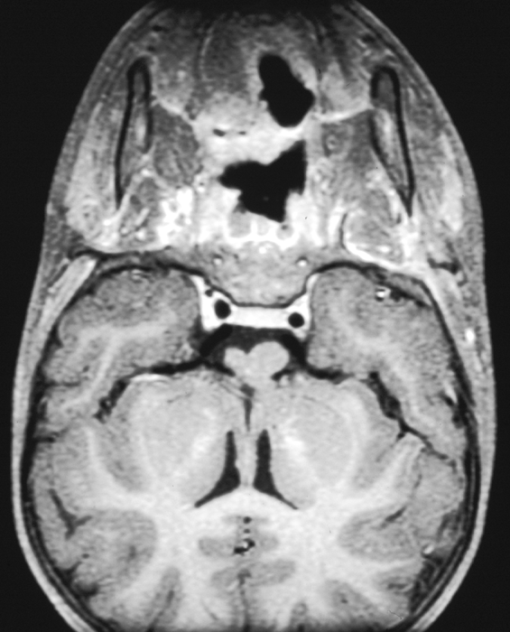
Pilocytic Astrocytoma
Pilocytic Astrocytomas (WHO Grade I)
Occur in the optic nerves, cerebellum, brain stem, or temporal lobes
Children and young adults
Well circumscribed with little tendency to infiltrate, and frequently cured by surgical excision.

Slide 8
Glioblastoma
Infiltrative
Poorly circumscribed
Necrotic
Crosses the corpus callosum
“butterfly glioma”
There are two types of glioblastomas recognized
Secondary GBM progress from lower grade tumors
Primary GBM arise de novo with no preceding history
There is mild prognostic benefit to having a secondary glioblastoma

Slide 9
Embryonal Tumors
Tumors composed of cells resembling embryonal cells that occasionally retain an ability for limited divergent differentiation
Medulloblastomas
Atypical Teratoid/Rhabdoid Tumors
Notable features include their high incidence in children and their tendency to seed the neuraxis.
The tumors are rapidly growing and lethal if left untreated, BUT they do respond well to therapy (up to 70% cure rate at some institutions).

Slide 10
Medulloblastoma
Tumor arising in the cerebellum and frequently protrudes into IV ventricle
Most common solid tumor in children
Occurs exclusively in the posterior fossa
The use of radiotherapy, especially when the entire neuraxis is included, has been associated with a cure rate of greater than fifty percent in many institutions.
Chemotherapy has increased this cure rate to approximately 70%.

Slide 11
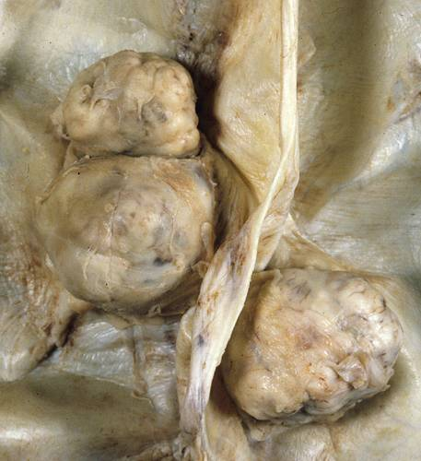
Meningioma
Most common primary tumor of the meninges
One of the most common of all intracranial neoplasms.
The neoplasm is ~3x more frequent in women
Most remain as discrete masses with a compressive rather than infiltrative relationship to the brain (benign)

Slide 12
Meningioma (Grade I)
Whorling spindle shaped cells often associated with psammoma body formation (“brain sand”)

Slide 13
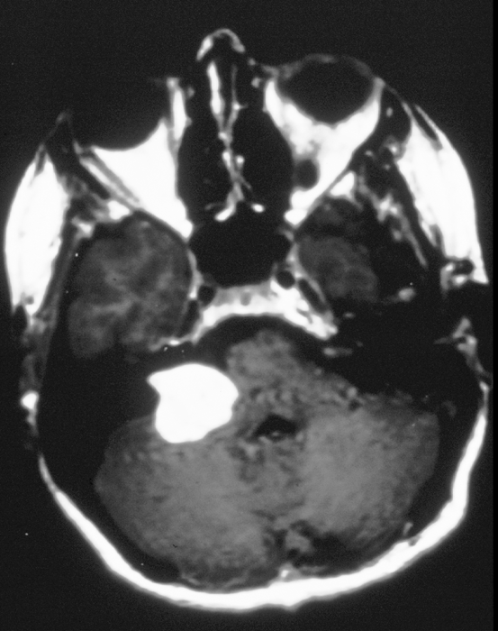
Acoustic Schwannoma
Any of the cranial nerves (with the obvious exception of CN 1 and 2), are potential sites
Acoustic ‘Neuroma’ CP angle tumor (CN VIII)
Schwannomas are almost always histologically benign, although the size and location of the lesion can present surgical problems.

Slide 14
Neuropathology: Tumors of the Nervous System Infections of the Nervous System Demyelinating Diseases Degenerative Diseases Metabolic & Toxic Disturbances Peripheral Nerve Disease

Slide 15
MENINGITIS
Inflammation of the meninges (arachnoid and pia).
Clinical presentation is with
Headache, vomiting, fever and stiff neck.
Seizures are common in children.
Symptoms are caused by inflammation of the meninges and the subarachnoid space. CSF fills this space.
CSF abnormalities are present which vary with the organism.
Bacteria cause a neutrophilic reaction, ↑protein, ↓glucose
Encapsulated organisms cause a granulomatous reaction, ↑↑protein, normal or ↓glucose.
Viruses cause a lymphocytic reaction, ↑protein, normal glucose
Syphilis cases a plasmacellular reaction.

Slide 16
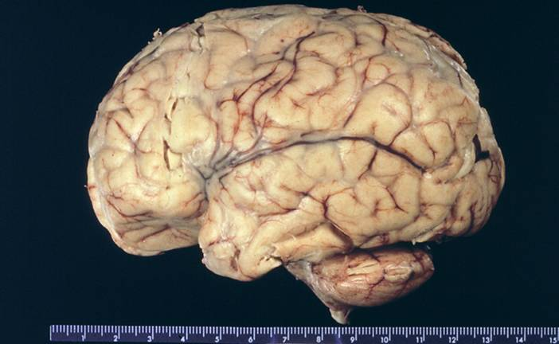
NEUTROPHILIC (BACTERIAL) MENINGITIS Neonates - E. coli and Group B Streptococcus Adolescents/young adults – Nesseria meningitides Elderly – S. pneumoniae or Listeria monocytogenes

Slide 17
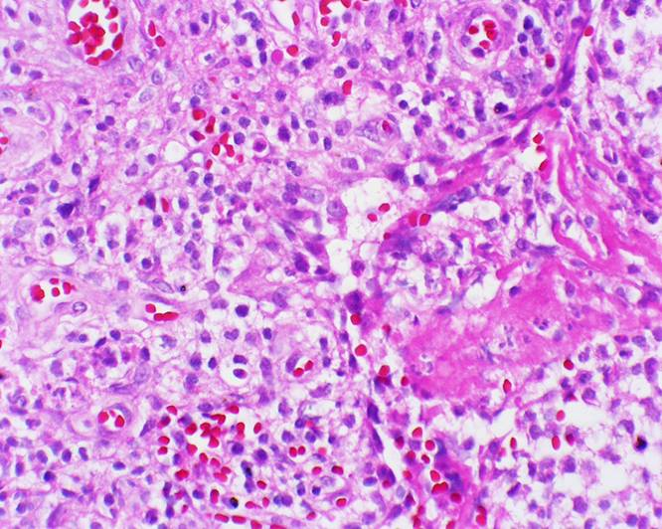

Slide 18
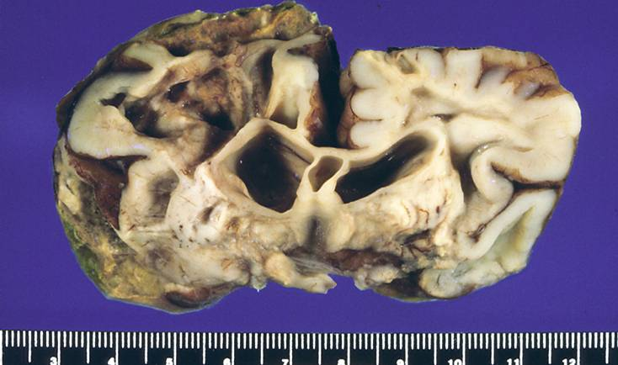
CEREBRITIS

Slide 19
ACUTE FOCAL SUPPURATIVE INFECTIONS
Brain Abscess
Clinical presentation is with focal neurological signs and raised intracranial pressure (which can go on to cause more generalized symptoms).
↑CSF pressure, WBC and protein. Glucose normal
Subdural empyema
Extradural abscess
Osteomyelitis
Surgical complication

Slide 20
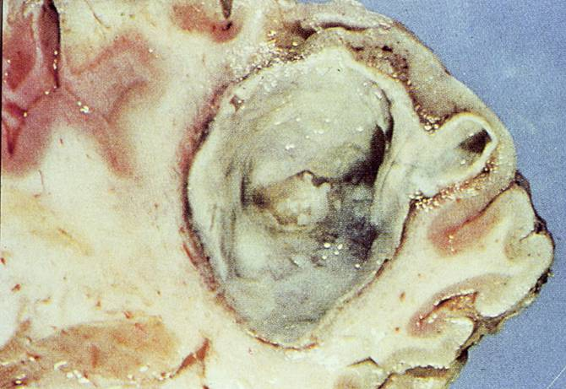
CEREBRAL ABSCESS

Slide 21
CHRONIC BACTERIAL MENINGITIS Mycobacterium tuberculosis
Organisms gain access to the CNS via blood stream.
Caseating granulomas form in the basal meninges.
Parenchymal spread of infection results in a “tuberculoma” which may be mistaken for a tumor.
The infection is indolent but fatal in 4 -6 weeks if it is untreated.

Slide 22
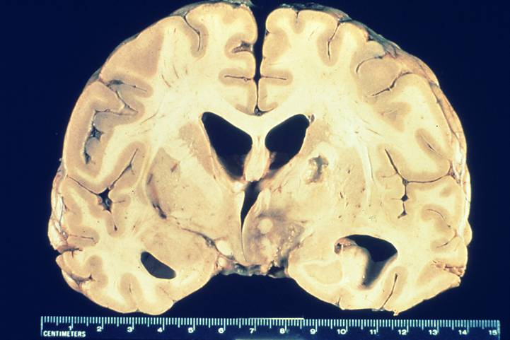
CHRONIC BACTERIAL MENINGITIS Mycobacterium tuberculosis “Tuberculoma”

Slide 23
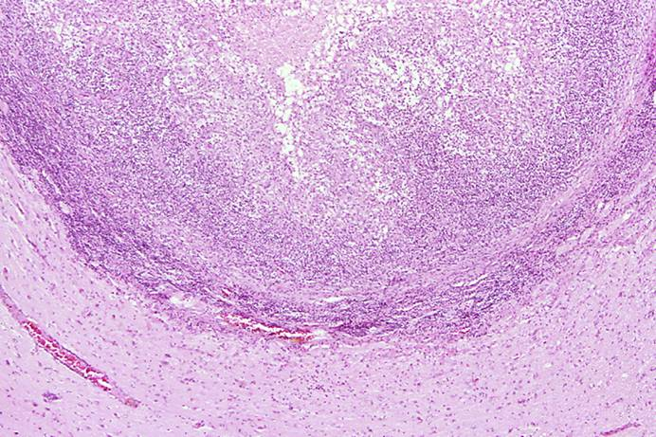
CHRONIC BACTERIAL MENINGITIS Mycobacterium tuberculosis Caseating granuloma

Slide 24
ACUTE ASEPTIC (VIRAL) MENINGITIS
Usually a benign illness of children and young adults.
There is CSF lymphocytosis, moderate ↑protein
Most common viruses
Coxsackie virus
Echo virus
Nonparalytic polio virus

Slide 25
VIRAL MENINGOENCEPHALITIS
Most commonly caused by Arboviridiae.
Eastern and Western equine, Venezuelan, St. Louis and La Crosse most common in US
Virus is transmitted by mosquitoes and ticks.
Clinical features vary with the virus.
Pathology varies from mild meningitis to severe encephalitis.
Perivascular and parenchymal mononuclear infiltrate and microglial nodules

Slide 26
VIRAL ENCEPHALITIS INCLUSION FORMING VIRUSES
These diseases are generally less common but they are important diagnostic considerations.
Herpes viruses
Herpes simplex
Herpes zoster
Cytomegalovirus
JC virus
Progressive multifocal leucoencephalopathy
Measles virus
Subacute sclerosing panencephalitis

Slide 27
VIRAL ENCEPHALITIS Herpes Viruses
HSV-1 causes “cold sores”.
Virus resides latent in the trigeminal ganglion.
Reactivation may cause Herpes encephalitis which is necrotizing and localized to the temporal lobes.
HSV-2 infects infants via birth canal.
It also causes a necrotizing encephalitis.
Herpes zoster (Shingles) affects older adults
Reactivation of chickenpox (Varicella) infection.
Causes a radiculopathy.
Cytomegalovirus
Causes encephalitis in fetuses infected in utero and in immunocompromised adults, especially AIDS patients.

Slide 28
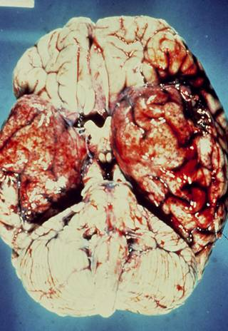
VIRAL ENCEPHALITIS Herpes simplex

Slide 29
PROGRESSIVE MULTIFOCAL LEUCOENCEPHALOPATHY
Polyoma virus (JC virus).
Occurs in immunocompromised hosts.
Clinical presentation is with dementia, weakness and ataxia.
Death ensues within 6 months.
Virus infects oligodendroglia and causes demyelination.

Slide 30
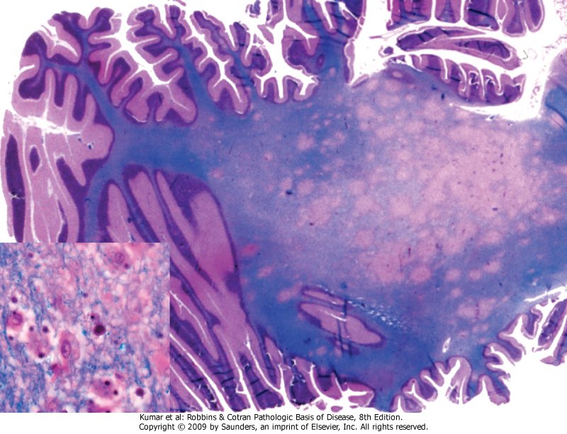
PROGRESSIVE MULTIFOCAL LEUCOENCEPHALOPATHY
Progressive multifocal leukoencephalopathy. Section stained for myelin showing irregular, poorly defined areas of demyelination, which become confluent in places. Inset, Enlarged oligodendrocyte nucleus represents the effect of viral infection by Polyoma virus

Slide 31
VIRAL ENCEPHALITIS Measles Virus Subacute Sclerosing Panencephalitis (SSPE)
Persistent measles virus infection.
The disease has largely disappeared due to vaccination programs.
However, it is a rare complication in live vaccine recipients.
Elevated measles virus antibody titer is found in the CSF.
p

Slide 32
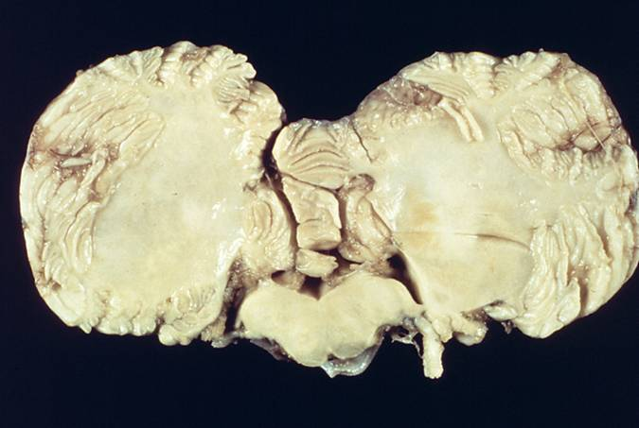
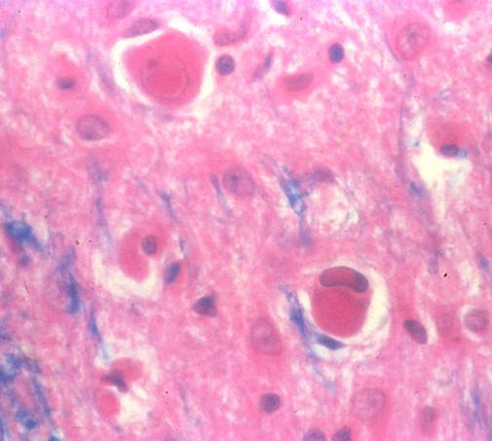
SUBACUTE SCLEROSING PANENCEPHALITIS Measles

Slide 33
POLIOMYELITIS Poliovirus
Disease is caused by a ssRNA virus which is a member of the picorna group of enteroviruses.
Virus is spread by the fecal-oral route.
Causes a mild gastroenteritis in most people.
In a few people, it invades the CNS.
Viral binding site is present on lower motor neurons.
Clinical presentation is with fever, malaise, headache, meningitis and subsequent paralysis.
Death results from respiratory failure with a mortality of 5-25%.
Lower motor neurons show chromatolysis and neuronophagia.
Vaccines have largely eliminated the disease.

Slide 34
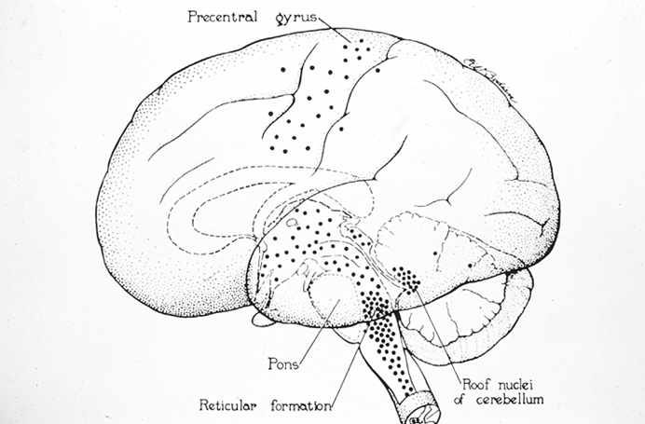
Motor neurons infected by Polio virus

Slide 35
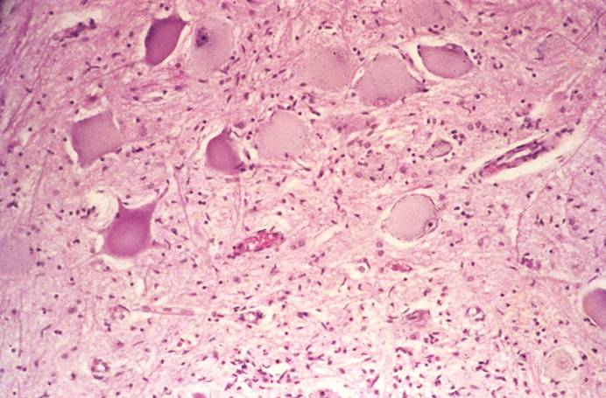
POLIOMYELITIS Spinal cord anterior horn cells infected by virus

Slide 36
HUMAN IMMUNDEFICIENCY VIRUS 1 (HIV-1)
60% of AIDS patients develop neurologic dysfunction.
Neuropathology is seen in 80-90% of AIDS patients.
The neuropathologic changes include direct effects of HIV-1 infection and indirect effects - opportunistic infection and CNS lymphoma.
Direct effect of HIV-1 infection
HIV-1 Meningoencephalitis.
Vacuolar myelopathy.
AIDS-associated myopathy and peripheral neuropathy.

Slide 37
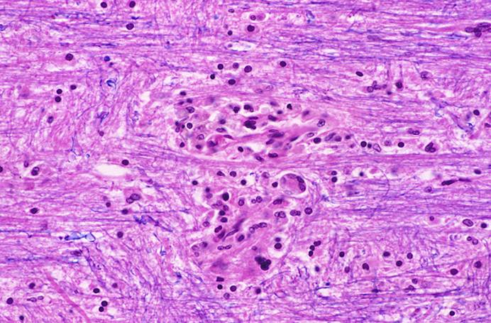
HIV-1 Meningoencephalitis
Manifests clinically with dementia referred to as “AIDS-related cognitve-motor complex”.
Neuropathologic findings include:
Multinucleated giant cells
Microglial nodules
Myelin pallor

Slide 38
HIV (AIDS) Indirect effects Opportunistic Infections Bacteria
Bacterial infections of the CNS in AIDS are uncommon but do occur.
Caustive organisms include:
Mycobacterium avium intracellulare
Mycobacterium tuberculosis
Treponema pallidum
rare

Slide 39
HIV (AIDS) Indirect effects Opportunistic Infections Viruses
Viral infections of the CNS are very common
Cytomegalovirus
Polyoma virus
Causes Progressive multifocal leucoencephalopathy (PML)
Herpes simplex
Herpes zoster
Causes radiculopathy
Epstein Barr virus
Causes B cell lymphoma

Slide 40
HIV (AIDS): Indirect effects Opportunistic Infections Fungi and protozoans
Fungal infections of the CNS are common
Cryptococcus
very common
Aspergillus
very common
Coccidiodes
residents of the Southwest
Histoplasma
residents of the Mississippi valley
Candida sp. (yeast)
Toxoplama gondii
Very common, often treated empirically.
The brain shows necrotizing focal infection with abscesses.
Acanthomoeba
Rare

Slide 41
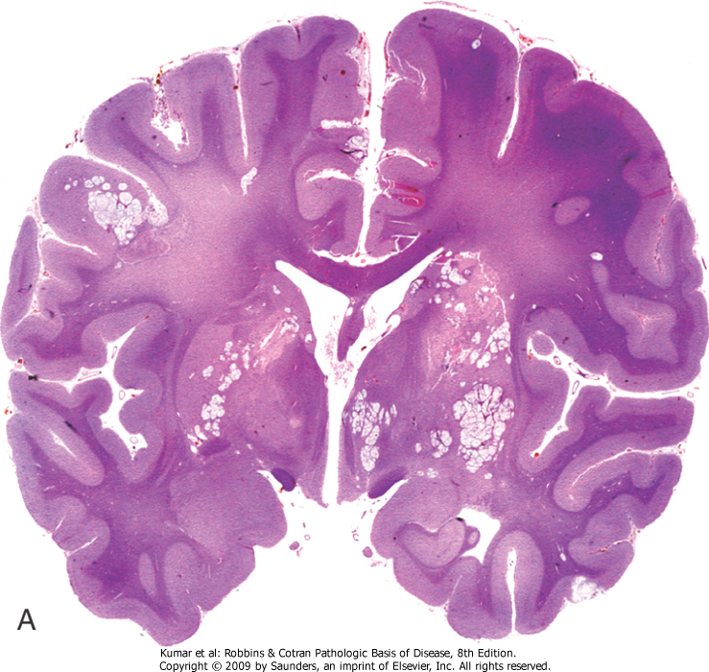
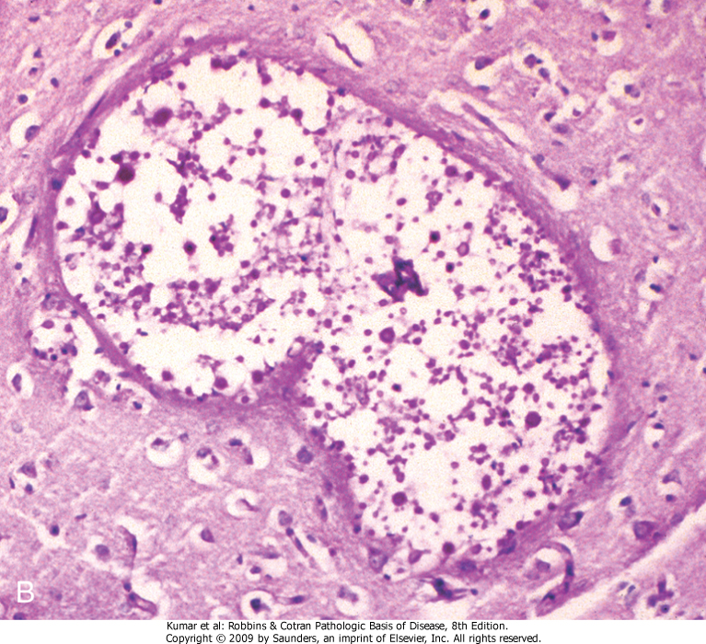
FUNGAL MENINGOENCEPHALITIS Cryptococcus neoformans
Cryptococcus organisms are encapsulated spheres 5 - 15 µ diameter.
Usually in immunocompromised host; can be indolent or rapidly progressing
There may be minimal tissue reaction or extensive reaction.
India ink examination of the CSF is used for diagnosis

Slide 42
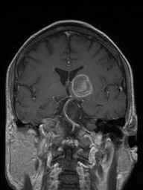
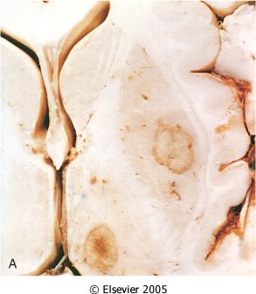
CEREBRAL TOXOPLASMOSIS
Very common in HIV infected patients
Symptoms develop over 1-2 weeks and may be focal or diffuse
CT and MRI show multiple ring enhancing lesion which must be distinguished from CNS lymphoma, TB and fungal infection

Slide 43
Neuropathology: Tumors of the Nervous System Infections of the Nervous System Demyelinating Diseases Degenerative Diseases Metabolic & Toxic Disturbances Peripheral Nerve Disease

Slide 44
MULTIPLE SCLEROSIS
T-cell mediated (aka type IV hypersensitivity) auto-immune destruction of CNS myelin
The onset is acute, at age 20 - 40 years, more common in women
Symptoms are separated in space and time:
Optic neuritis
Cranial nerve signs / opthalmoplegia
Motor / sensory loss, spasticity, bladder incontinence
Clinical course is quite variable with relapses and remissions
Risk factors
European descent
HLA haplotype A2, B7, DW2.
Prevalence is 1 per 1000 in US and Europe.
CONTRAST with acute disseminated encephalomyelitis and acute necrotizing hemorrhagic encephalomyelitis which are post-infective demyelinating diseases (due to cross reactivity with pathogen-associated antigens) usually in young adults and children and present with more global symptoms (headache, lethargy, coma)

Slide 45
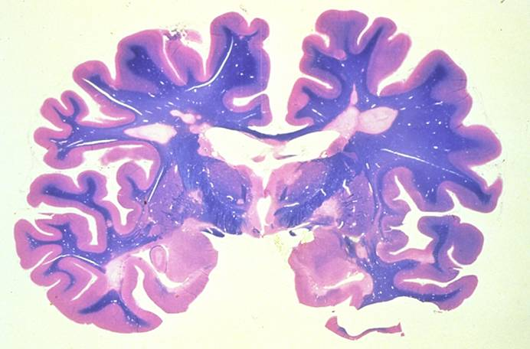
MULTIPLE SCLEROSIS White matter plaques

Slide 46
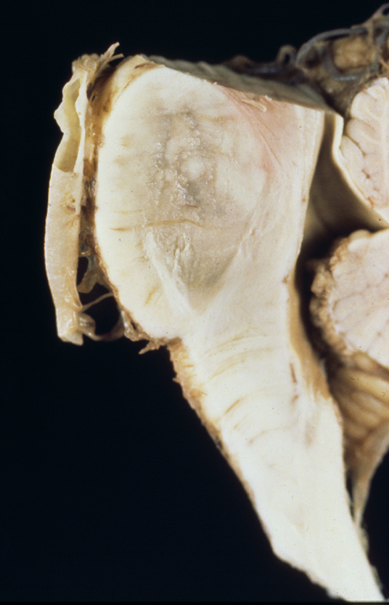
CENTRAL PONTINE MYELINOLYSIS
Caused by rapid correction of hyponatremia
Demyelination of corticospinal tracts resulting in rapidly evolving paralysis
Susceptible populations
Alcoholics
Debilitated patients

Slide 47
Neuropathology: Tumors of the Nervous System Infections of the Nervous System Demyelinating Diseases Degenerative Diseases Metabolic & Toxic Disturbances Peripheral Nerve Disease

Slide 48
ALZHEIMER DISEASE
Most common cause of dementia in the elderly.
Affects over 5 million Americans with an estimated annual cost of $172 billion.
2:1 Female predominance.
Duration 5 - 20 years.

Slide 49
OTHER (and treatable) CAUSES OF DEMENTIA
Thyroid deficiency
B12 deficiency
Drug reaction
Depression
Central nervous system neoplasm
Subdural hematoma
Cardiovascular disease

Slide 50
RISK FACTORS FOR AD
Family history
Head trauma
Hematologic malignancies
Down’s syndrome
Genes
Gene Chr inheritance onset
PS-2 1 auto dom 40-70 yrs
PS-1 14 auto dom 30-60 yrs
βAPP 21 auto dom 45-65 yrs
ApoE4 19 susceptibility > 60 yrs

Slide 51
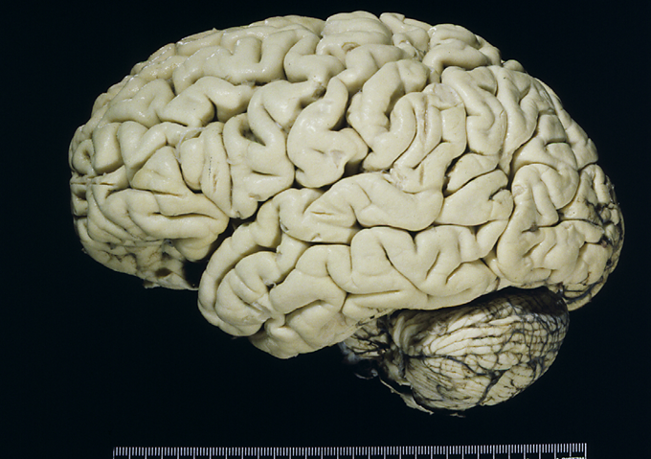
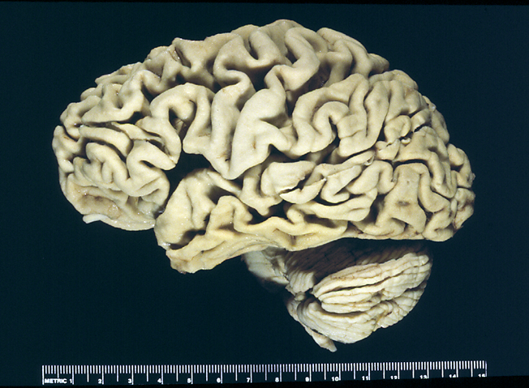
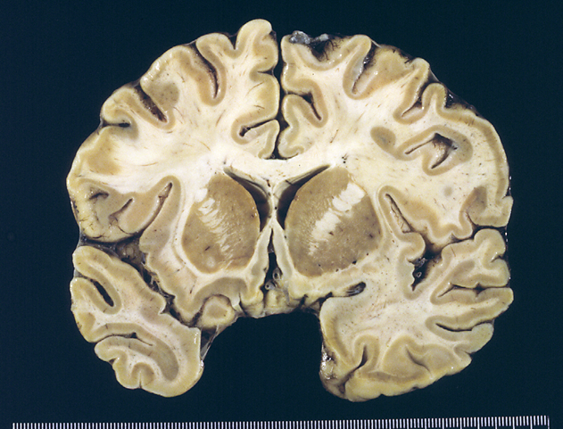
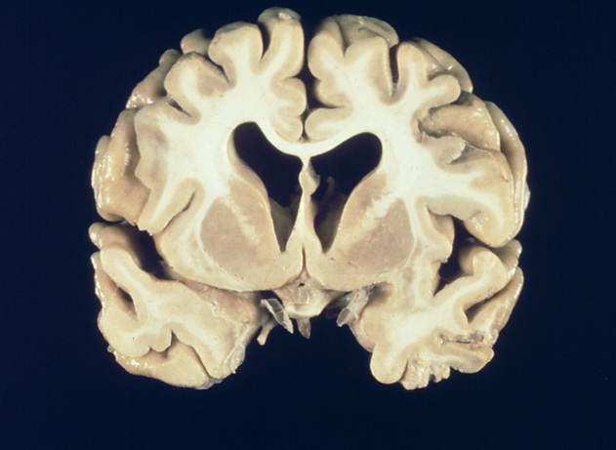
Gross appearance of the brain
NORMAL
ALZHEIMER DISEASE

Slide 52
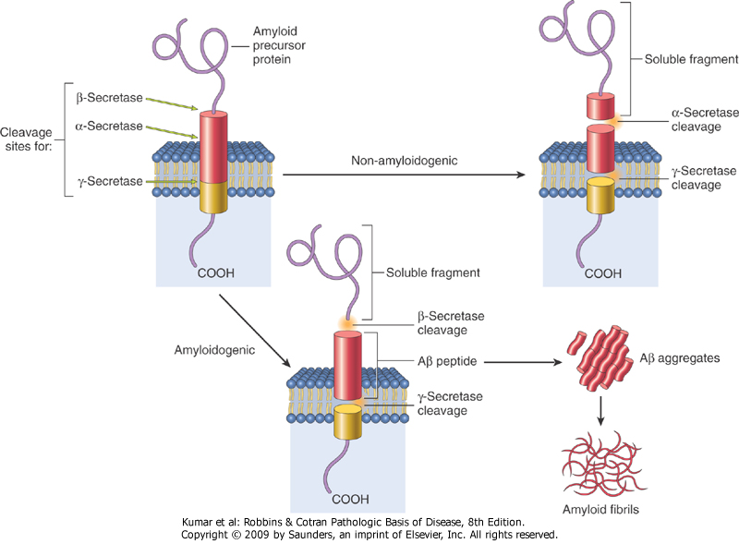
ALZHEIMER DISEASE NEUROPATHOLOGY
Inappropriate cleavage of Amyloid Precursor Protein (APP) leads to formation of insoluble amyloid fibers that induces neuritic reaction and eventual death.
Cortical atrophy and synapse loss
Neuritic plaques
Neurofibrillary tangles
Amyloid angiopathy
Granulovacuolar degeneration
“plaques”
“tangles”

Slide 53
PARKINSON DISEASE
Age of onset is generally after 60.
Early onset cases occur, especially in families.
More common in males
Affects 0.5 million Americans with an estimated annual cost of $5.6 billion.
Extrapyramidal motor symptoms.
20% of patients develop dementia.
Duration 5 - 15 years.

Slide 54
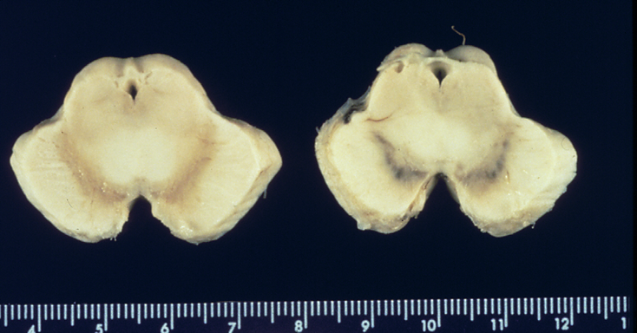
PARKINSON DISEASE
Defect is due to loss of dopaminergic neurons in the substantia nigra and brainstem.
75% of cases have Lewy bodies histopathologically.
Postencephalitic Parkinsonism is characterized by neurofibrillary tangles.
Rarely PD is caused by the neurotoxin MPTP
(methyl phenyl tretrahydro pyridine) Synthetic opioid contaminant 1976
Treatment is with L-Dopa and similar drugs.
Parkinson
Normal

Slide 55
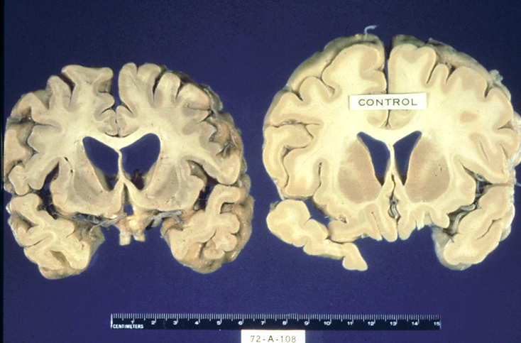
HUNTINGTON DISEASE
Age of onset is 35-45 years; duration is approximately 15 years.
Loss of basal ganglia, particularly caudate and putamen with secondary loss of globus pallidus
Chorea is most noticeable symptom, but there can be personality changes and dementia.
Inherited in an autosomal dominant fashion.
CAG repeats in “huntingtin” gene on chr 4

Slide 56
AMYTROPHIC LATERAL SCLEROSIS
Age of onset is in mid to late life.
Male predominance.
Duration 3 - 5 years
Symptoms are caused by degeneration of corticospinal tract.
Familial cases may be due to superoxide dismutase gene mutation on chr 21.

Slide 57
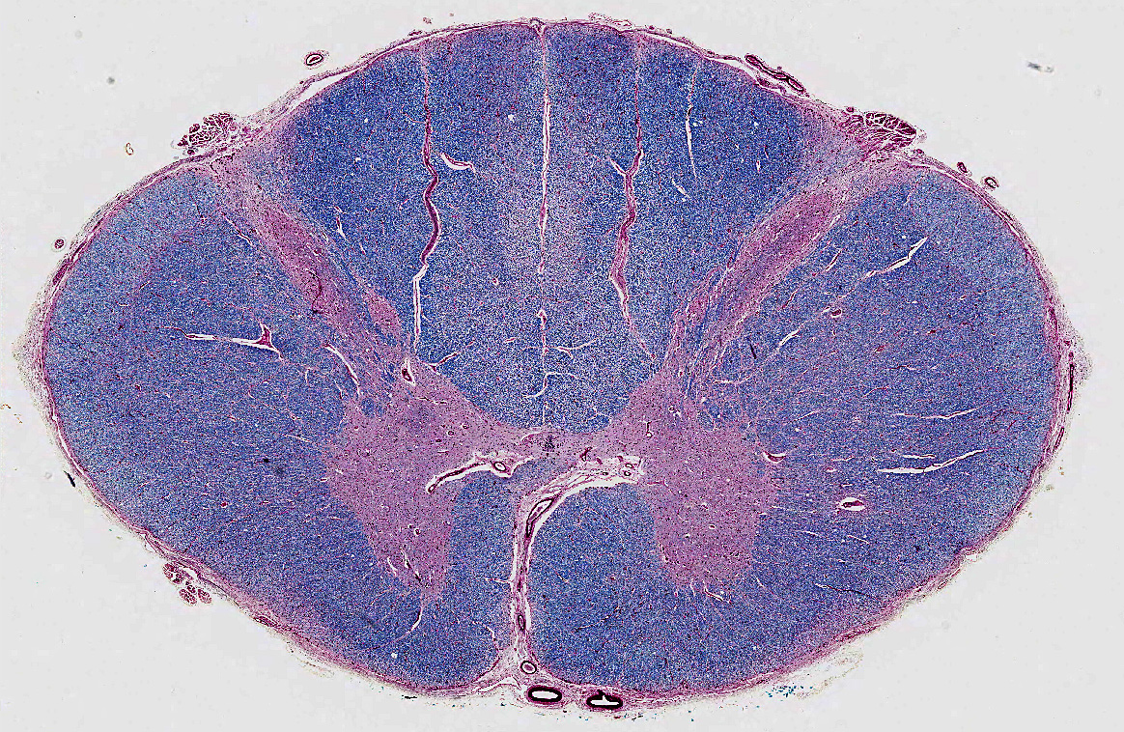
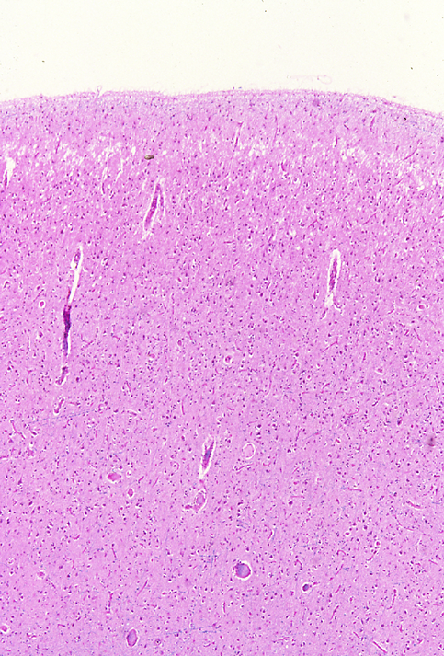
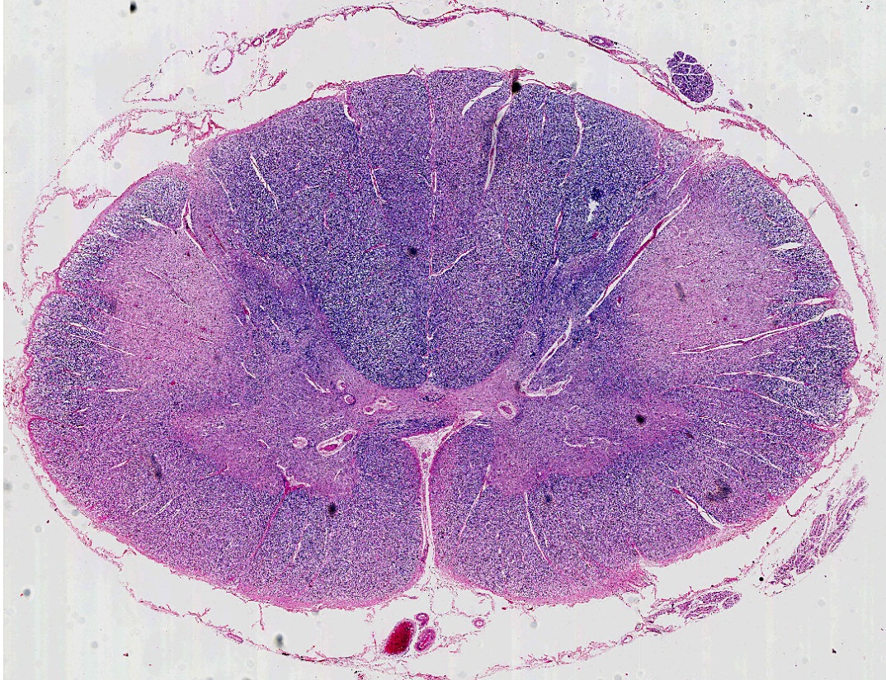
AMYOTROPHIC LATERAL SCLEROSIS
normal spinal cord
Motor cortex - ALS
ALS spinal cord

Slide 58
Neuropathology: Tumors of the Nervous System Infections of the Nervous System Demyelinating Diseases Degenerative Diseases Metabolic & Toxic Disturbances Peripheral Nerve Disease

Slide 59
VITAMIN DEFICIENCIES AFFECTING THE CNS
Thiamine deficiency caused by alcohol abuse or chemotherapy.
Wernicke encephalopathy – psychotic symptoms and opthalmoplegia
Korsakoff syndrome – memory disturbance and confabulation
Hemorrhage and necrosis in the mamilary bodies and periventricular regions

Slide 60
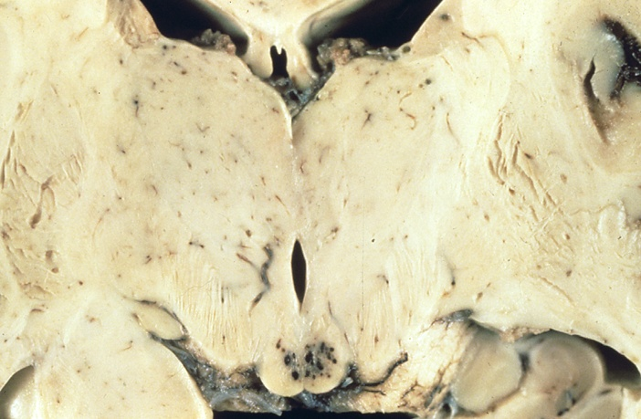
WERNICKE’S ENCEPHALOPATHY

Slide 61
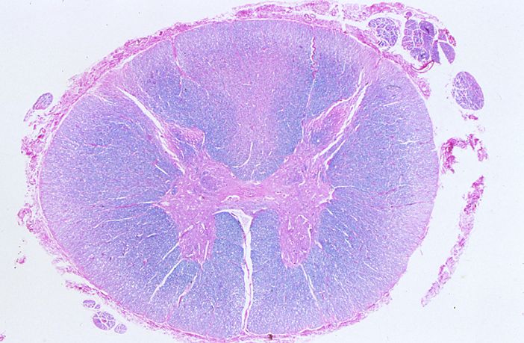
VITAMIN DEFICIENCIES AFFECTING THE CNS
Vitamin B₁₂ deficiency - gastric resection, pernicious anemia.
Ataxia, numbness and tingling in the lower extremities
Subacute combined degeneration of the spinal cord

Slide 62
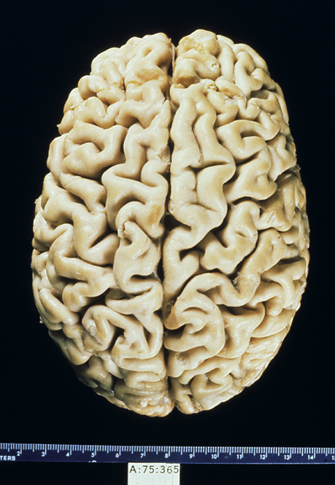
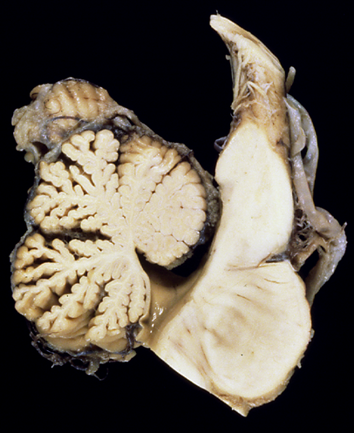
ETHANOL TOXICITY (chronic abuse)
Cerebral atrophy
Superior cerebellar atrophy

Slide 63
Neuropathology: Tumors of the Nervous System Infections of the Nervous System Demyelinating Diseases Degenerative Diseases Metabolic & Toxic Disturbances Peripheral Nerve Disease

Slide 64
PERIPHERAL NEUROPATHY
The causes of peripheral neuropathy are diverse.
Inflammatory/ Infectious
Hereditary
Nutritional and Metabolic
Toxic
Traumatic

Slide 65
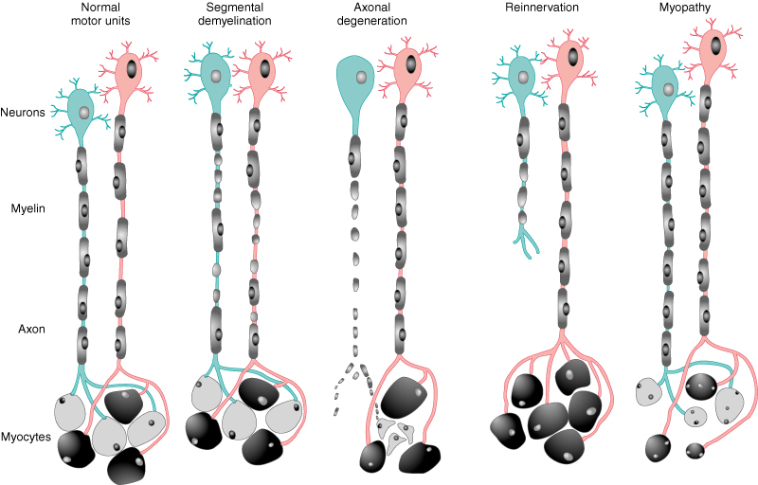
Peripheral Nerve Injury and Repair
Segmental Demyelination –Schwann cell injury
Remyelination – repair of injury to Schwann cells
Axonal Degeneration – injury to nerve cell body or axon results in muscle fiber atrophy.
Reinnervation – recovery from injury to axon (sprouts).
Myopathy – disease of muscle

Slide 66
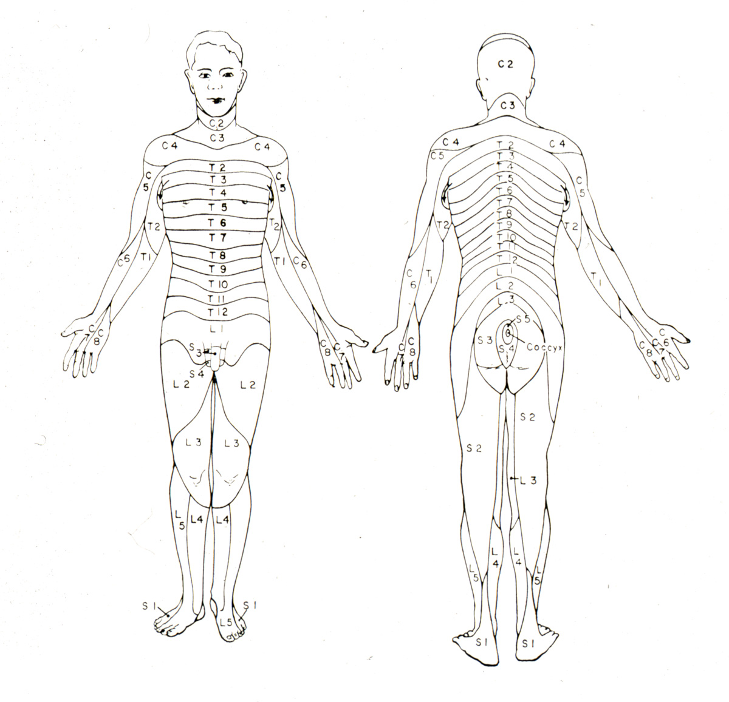
Clinical Presentation
Weakness
Numbness
Paresthesias
Loss of sensation
Symptoms correspond to dermatome

Slide 67
PERIPHERAL NEUROPATHY Inflammatory/ Infectious Causes
Guillain-Barré syndrome, acute
Chronic inflammatory demyelinating polyradiculoneuropathy (CIDP)
Leprosy
Diphtheria
Varicella-Zoster (Shingles)

Slide 68
Guillain-Barrè
Rapid, life threatening ascending paralysis
1-3 cases per 100,000 persons per year in US
Inflammation and demyelination of spinal and peripheral nerves.
Preceded by an acute flu like illness.
Idiosyncratic T cell mediated immune response to peripheral nerve myelin.
Usually resolves with support of respiratory function.

Slide 69
Chronic inflammatory demyelinating polyradiculoneuropathy (CIDP)
Chronic, slowly progressive form of Gullain-Barre
Inflammation with demyelination and remyelination of peripheral nerves.
Idiosyncratic T cell mediated immune response to peripheral nerve myelin.

Slide 70
Infectious Polyneuropathy
Lepromatous leprosy – Schwann cells invaded by M. leprae
Tuberculoid leprosy – inflammation associated with M. leprae injures the nerves
Diphtheria - exotoxin injures the sensory ganglia
Varicella-Zoster (shingles)- reactivated chicken pox virus leads to painful vesicles along the dermatome

Slide 71
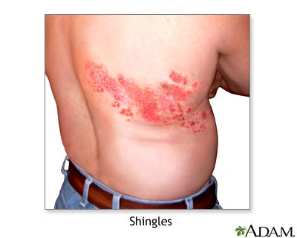

Slide 72
PERIPHERAL NEUROPATHY Hereditary Causes (rare)
Hereditary Motor and Sensory Neuropathies
HMSM I -Charcot-Marie-Tooth (hypertrophic neuropathy)– auto dom
HMSN II -autosomal recessive
HMSN III Dejerine-Sottas disease -auto rec
Hereditary Sensory and Autonomic Neuropathies
Neuropathy associated with inherited metabolic disease
Adrenoleucodystrohy
Refsum’s disease
Porphyria
Familial amyloid polyneuropathy

Slide 73
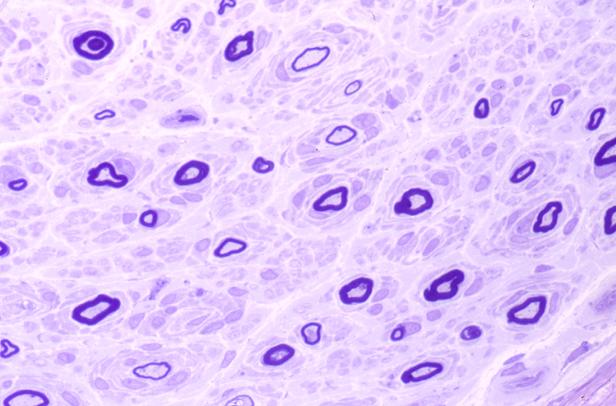
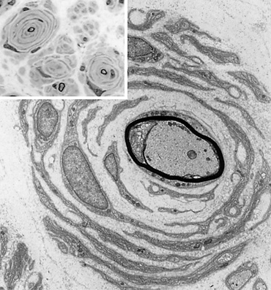
HEREDITARY NEUROPATHY Charcot-Marie-Tooth (HMSN I) “Onion bulbs” (layers of Schwann cells from repeated demyelination/remyelination)

Slide 74
PERIPHERAL NEUROPATHY Nutritional and Metabolic Causes (more common)
Diabetes
Most common cause
Renal failure
Thiamine (B₁) deficiency
Consequence of alcohol abuse
Chemotherapeutic agents
Other vitamin deficiencies
Cobalamin (B₁₂)
Pyridoxine (B₆)
α-tocopherol (E)
Ethanol

Slide 75
Diabetic Neuropathy
50% of diabetics will develop peripheral neuropathy after 25 years of disease
Distal symmetric sensory or sensorimoter neuropathy
Decreased sensation in the lower extremities (“stocking and glove” distribution)
Autonomic neuropathy

Slide 76
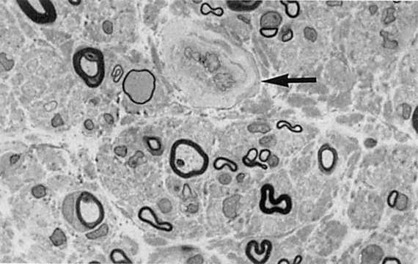
Diabetic Neuropathy

Slide 77
PERIPHERAL NEUROPATHY Toxic Causes
Lead
Arsenic
Chemotherapeutic agents
Cisplatin
Vincristine
Organic solvents
Glue sniffing
Industrial exposure

Slide 78
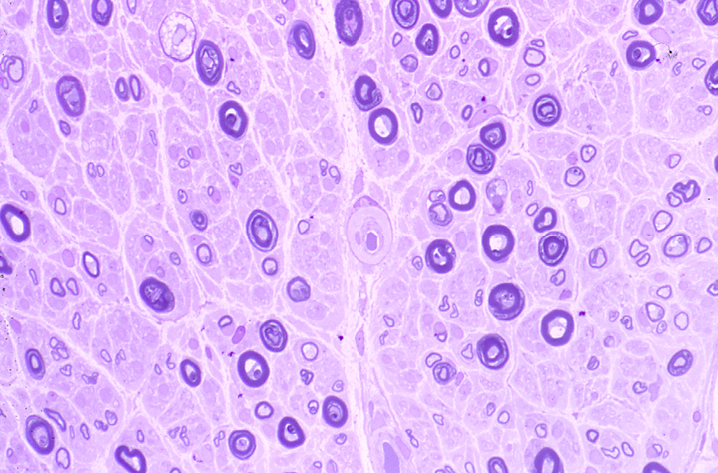
TOXIC NEUROPATHY Wallerian degeneration of individual axons

Slide 79
PERIPHERAL NEUROPATHY Traumatic
Lacerations
Wallerian degeneration
Avulsion
Traumatic neuroma, proliferation of nerve
twigs
Compression neuropathy
Carpal tunnel syndrome
Morton neuroma

Slide 80
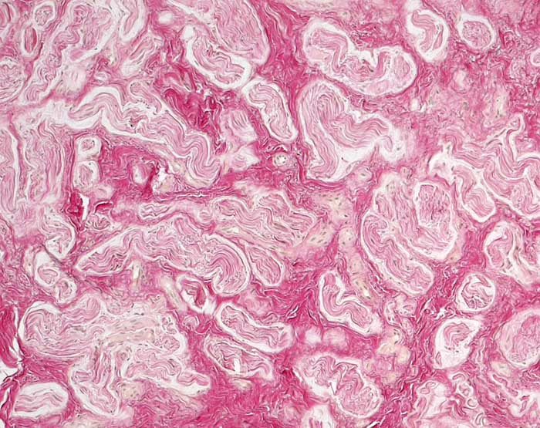
Traumatic neuroma Proliferation of small nerves encased in perineurium PathoPic image 7846

Slide 81
Carpal tunnel syndrome
Occupational hazard
Office workers
Can be treated with physical therapy and anti-inflammatory agents
Severe cases progress to neurological deficits which must be corrected surgically

