Slide 1
Cell Injury, Death, Inflammation, and Repair
J. Matthew Velkey
matt.velkey@duke.edu
454A Davison, Duke South (green zone)

Slide 2
Cellular Adaptation to Injury or Stress
Injury or Stress
Increased demand
Decreased stimulation or lack of nutrients
Chronic irritation
Adaptation
Hyperplasia or hypertrophy
Atrophy
Metaplasia

Slide 3
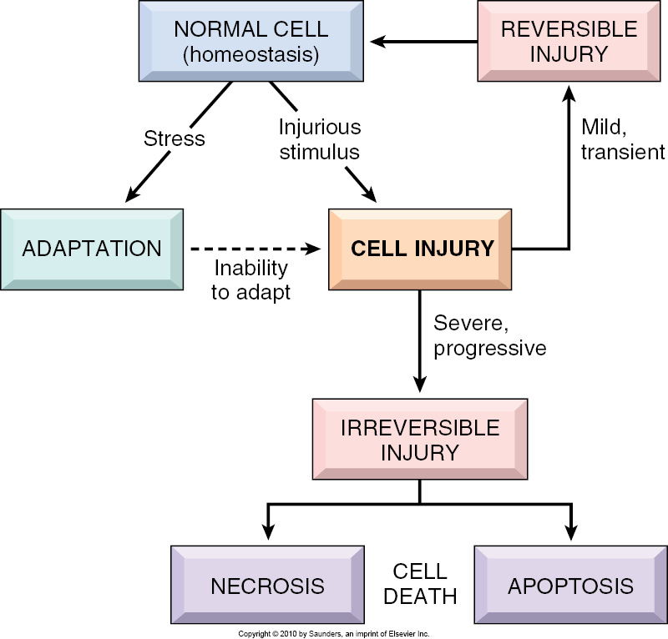

Slide 4
Adapted - Normal - Injured Cells

Slide 5
Adaptations
Hypertrophy
Hyperplasia
Atrophy
Metaplasia

Slide 6
Hypertrophy
Increase in the size of cells results
in increased size of the organ
May be Physiologic or Pathologic

Slide 7
Examples of Physiologic Hypertrophy
Increased workload - skeletal muscle
cardiac muscle
Hormone induced –pregnant uterus

Slide 8
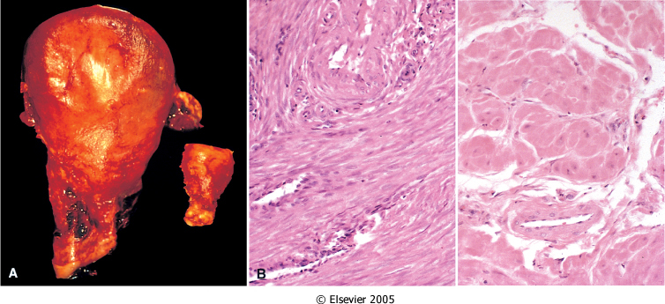
Physiologic hypertrophy Gravid uterus and Normal uterus

Slide 9
Hyperplasia
Increase in the number of cells
results in increase in size of the
organ.
May be Physiologic or Pathologic.

Slide 10
Physiologic Hyperplasia
Hormonal hyperplasia
Female breast; puberty and pregnancy
Compensatory hyperplasia
Prometheus
Unilateral nephrectomy
Erythroid hyperplasia of bone marrow
in chronic hypoxia (mountain climbers).

Slide 11
Pathologic Hyperplasia
Excessive hormone stimulation
Endometrial hyperplasia
Prostatic hyperplasia
Viral infections
Papilloma virus (warts)

Slide 12
Atrophy
Reduced size of an organ due to a decrease in cell size and number.
Physiologic atrophy – notochord, post partum uterus
Pathologic atrophy – local or generalized

Slide 13
Causes and Examples of Atrophy
Decreased workload (disuse atrophy)
Loss of innervation (denervation atrophy)
Diminished blood supply (ischemia)
Inadequate nutrition (marasmus, cachexia)
Loss of endocrine stimulation (menopause)
Aging (senile atrophy)
Pressure (enlarging benign tumor)

Slide 14
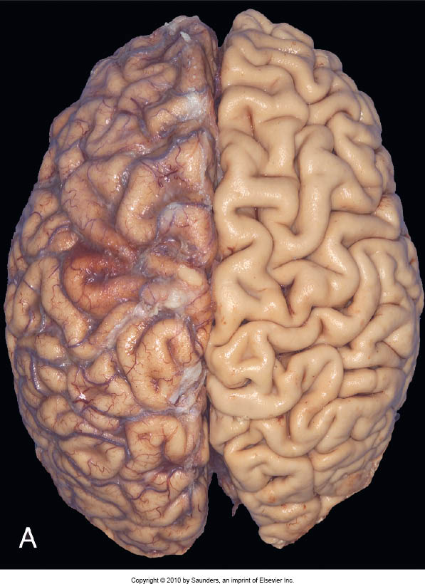
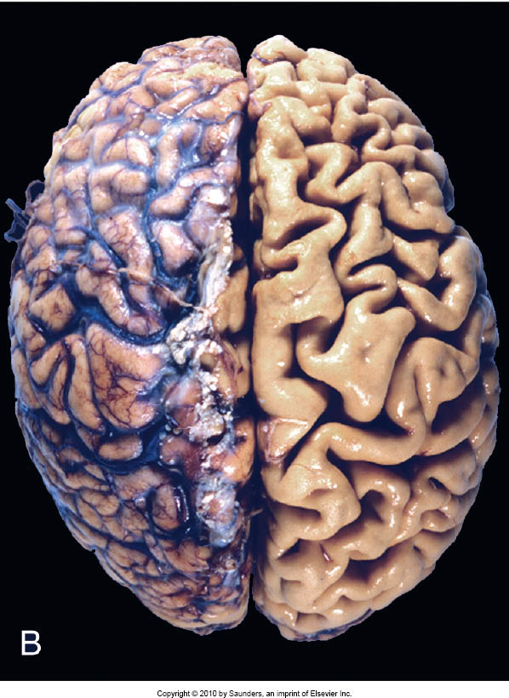
Normal Atrophy

Slide 15
Metaplasia
Reversible change in which one differentiated cell type (epithelial or mesenchymal) is replaced by another cell type.
Usually occurs in response to stress or chronic irritation.

Slide 16
Causes and Examples of Metaplasia
Tobacco smoke - Squamous metaplasia in the respiratory tract, most common.
Gastric acid reflux - Gastric metaplasia of distal esophagus; Barrett esophagus.
Repeated skeletal muscle injury with hemorrhage- muscle replaced by bone; myositis ossificans.

Slide 17
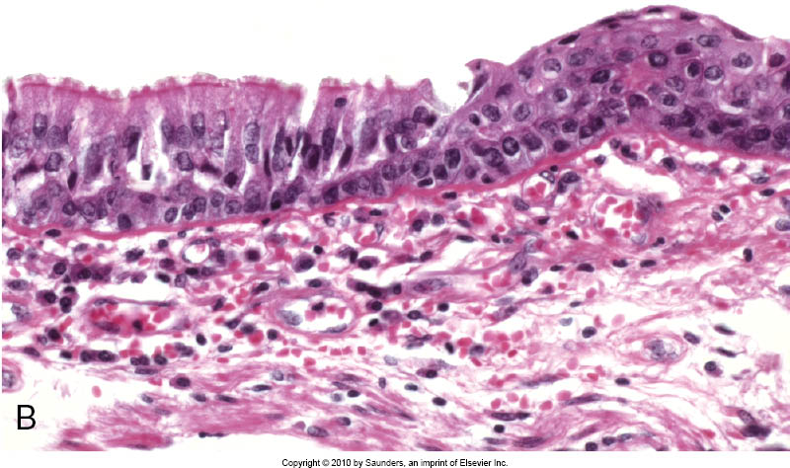
Bronchus with Columnar to Squamous Metaplasia

Slide 18
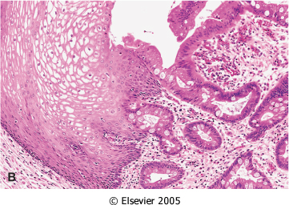
Esophagus with Squamous to Columnar metaplasia

Slide 19
Mechanisms of Metaplasia
Re-programing of stem cells that exist in normal tissue.
Induced by cytokines, growth factors and other environmental signals
Retinoic acid may play a role.
Exact mechanism is unknown.

Slide 20
Cell Injury and Death
Reversible – reduced ATP, cellular swelling
Irreversible – two types of cell death
Necrosis – always pathologic
Apoptosis – may be physiologic
or pathologic

Slide 21
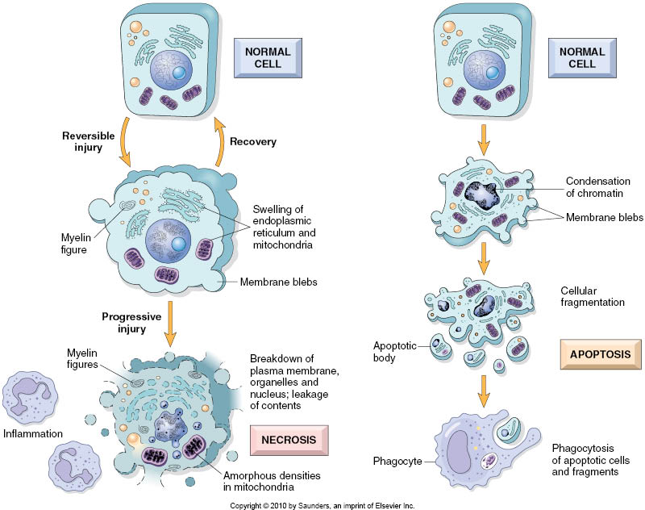
Necrosis vs. Apoptosis

Slide 22
Causes of Cell Injury
Oxygen deprivation (hypoxia or ischemia)
Physical Agents (trauma)
Chemical agents and Drugs
Infectious Agents
Immunologic Reactions
Genetic Derangements
Nutritional Imbalances

Slide 23
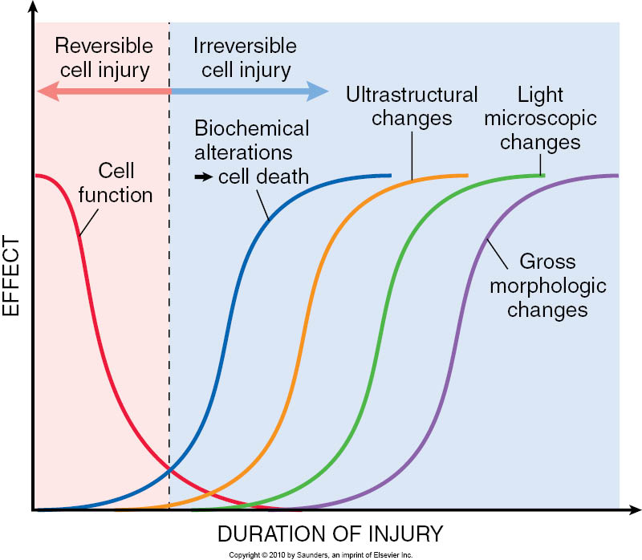

Slide 24
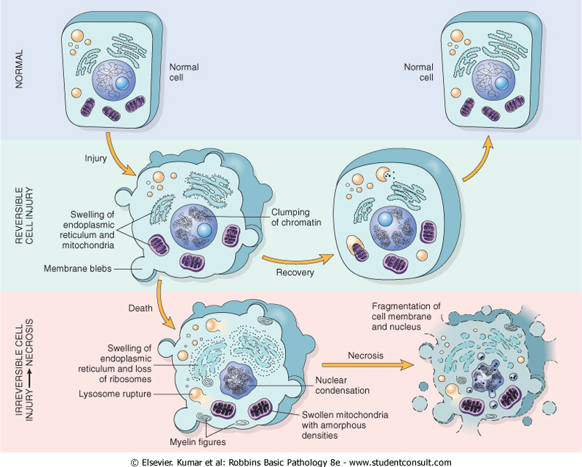
Reversible and Irreversible Cell Injury

Slide 25
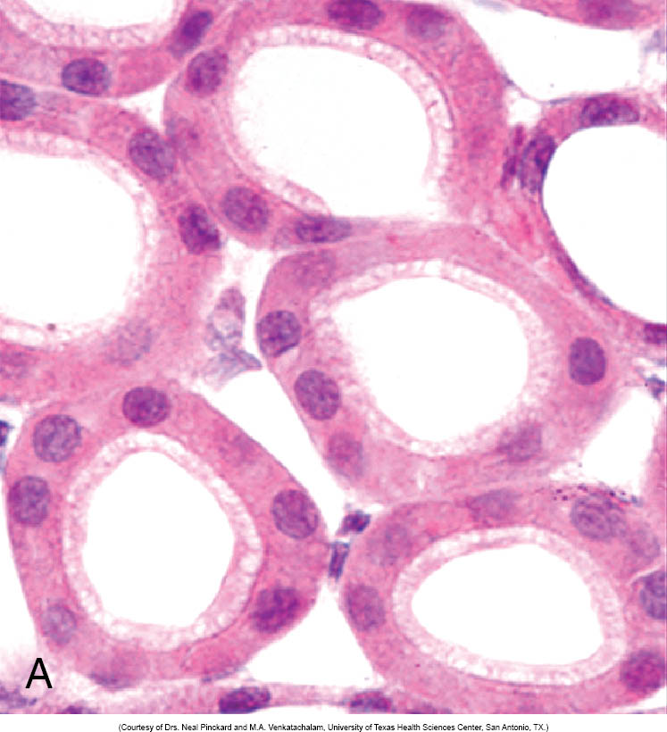
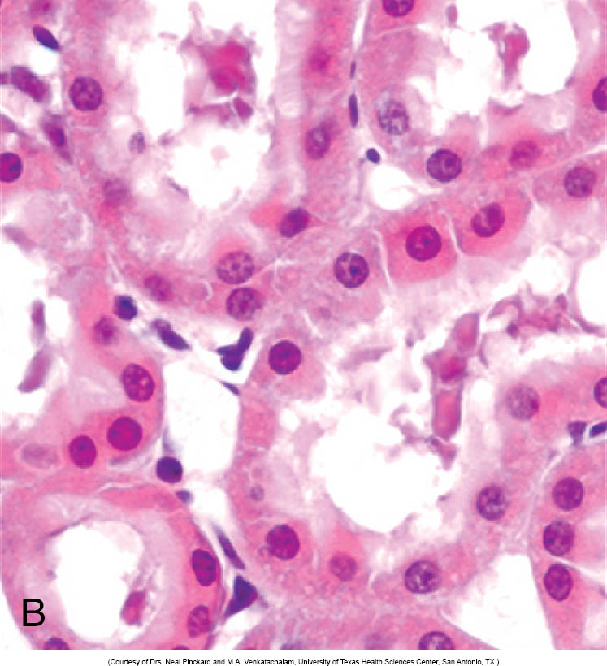
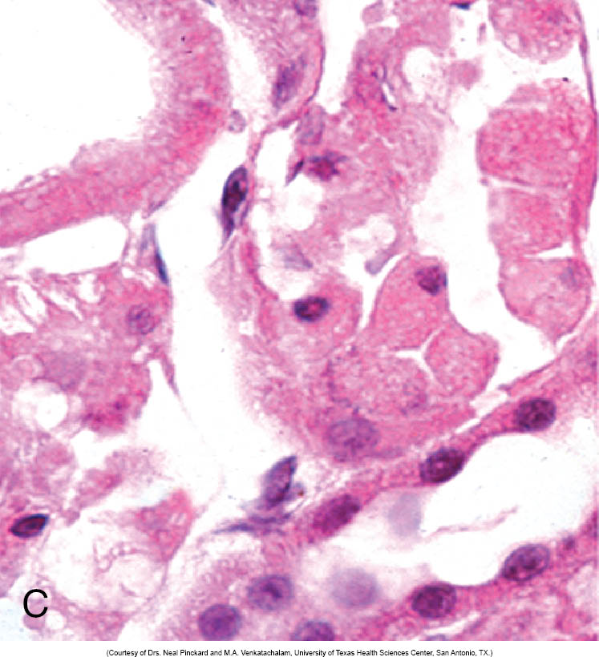
Reversible and Irreversible Cell Injury
normal kidney tubules
reversibly injured
kidney tubules
irreversibly injured
kidney tubules
Chromatin clumping
Membrane blebbing
Swelling of ER and mitochondria (slight eosinophilia)
Nuclear fragmentation and loss
Membrane disintegration
Swelling and rupture of ER, mitochondria, & lysosomes (marked eosinophilia)

Slide 26
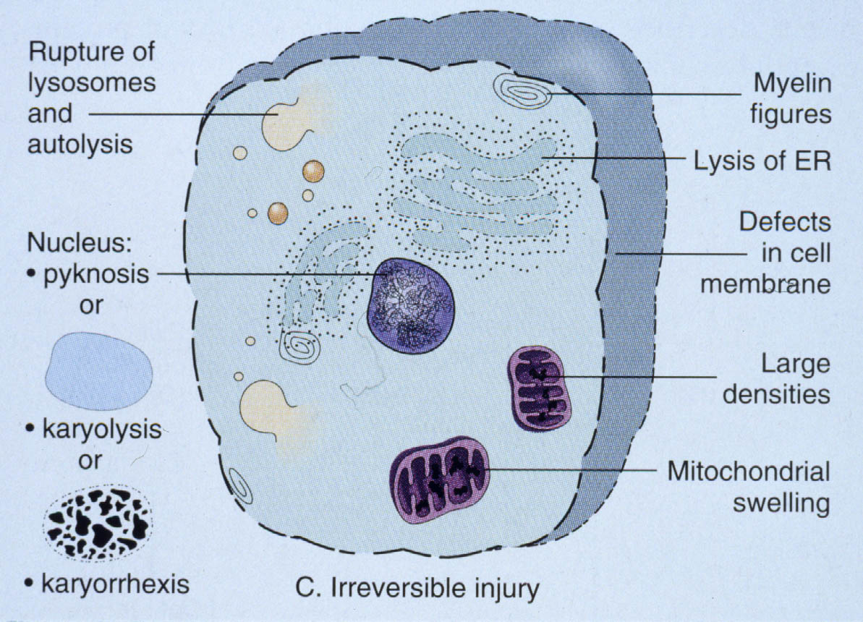
Morphologic Alterations in Irreversible Injury (Necrosis)
Cytoplasmic
Eosinophilia – denatured proteins and whorls of cytoplasm (myelin figures) stain strongly with eosin. Also, loss of ribosomes decreases overall basophilia.
Nuclear (3 patterns)
Karyolysis - nucleus becomes pale and eventually disappears
Pyknosis - nucleus shrinks, chromatin condenses, becomes deeply basophilic
Karyorrhexis – nucleus undergoes fragmentation
These nuclear patterns may occur together or separately and not necessarily in any particular order. Regardless of the pattern(s) observed, the net result is that nuclei in dead cells completely disappear after 1-2 days.

Slide 27
Patterns of Tissue Necrosis
Coagulative Necrosis
Liquefactive Necrosis
Fat Necrosis
Caseous Necrosis
Fibrinoid Necrosis

Slide 28
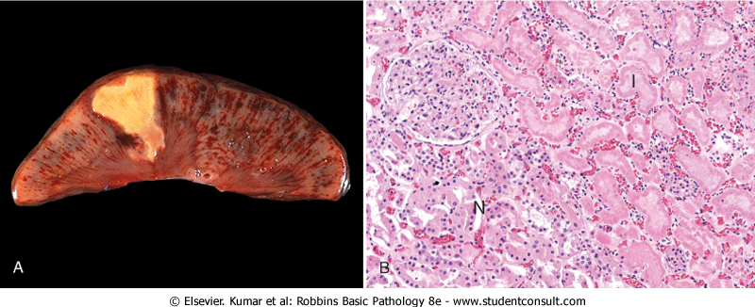
Coagulative Necrosis
Pattern of cell death characterized by progressive loss of cell structure, with coagulation of cellular constituents and persistence of cellular outlines for a period of time, often until inflammatory cells arrive and degrade the remnants.

Slide 29
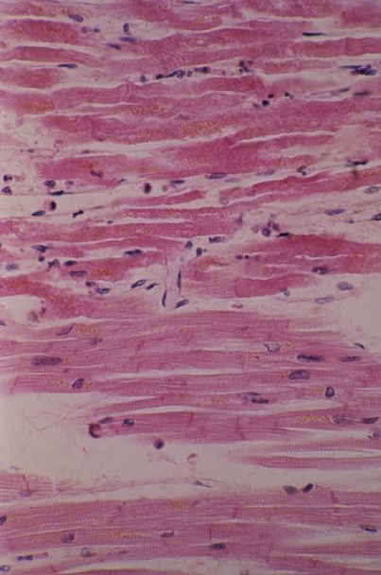
Myocardial infarction: another example of coagulative necrosis

Slide 30
Liquefactive Necrosis
Pattern of cell death characterized by dissolution of necrotic cells.
Typically seen in an abscess where there are large numbers of neutrophils present, which release hydrolytic enzymes that break down the dead cells so rapidly that pus forms.
Pus is the liquefied remnants of dead cells, including dead neutrophils.

Slide 31
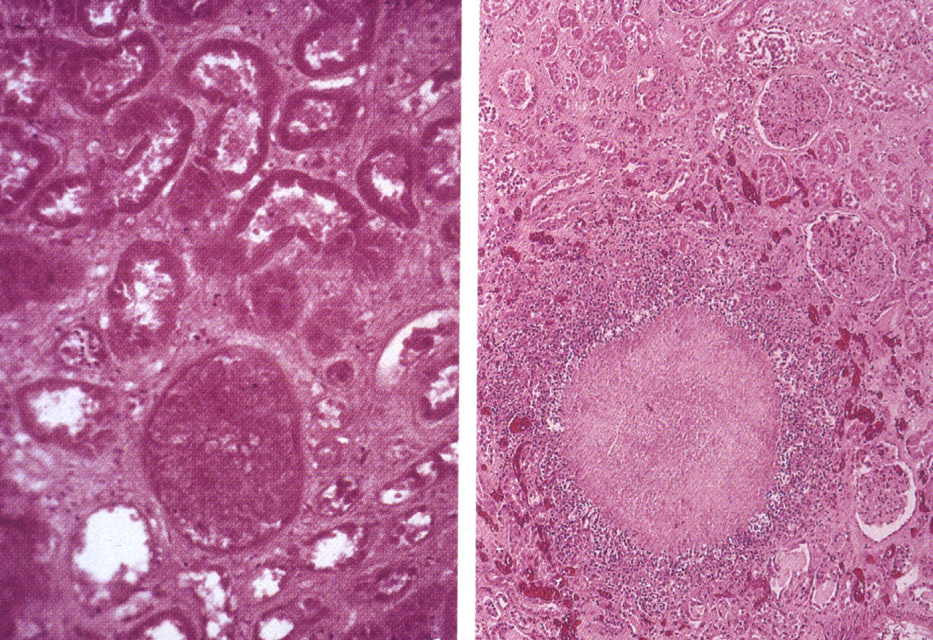
KIDNEY
Coagulative Necrosis Liquefactive Necrosis

Slide 32
Caseous Necrosis
The pattern of cell injury that occurs with granulomatous inflammation in response to certain microorganisms (tuberculosis). The host response to the organisms is a chronic inflammatory response and in the center of the caseating granuloma there is an area of cellular debris with the appearance and consistency of cottage cheese.

Slide 33
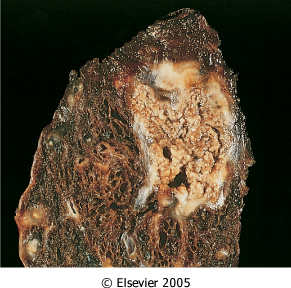

Slide 34
Fat Necrosis
When lipases are released into adipose tissue, triglycerides are cleaved into fatty acids, which bind and precipitate calcium ions, forming insoluble salts.
These salts look chalky white on gross examination and are basophilic in histological sections stained with H&E.

Slide 35
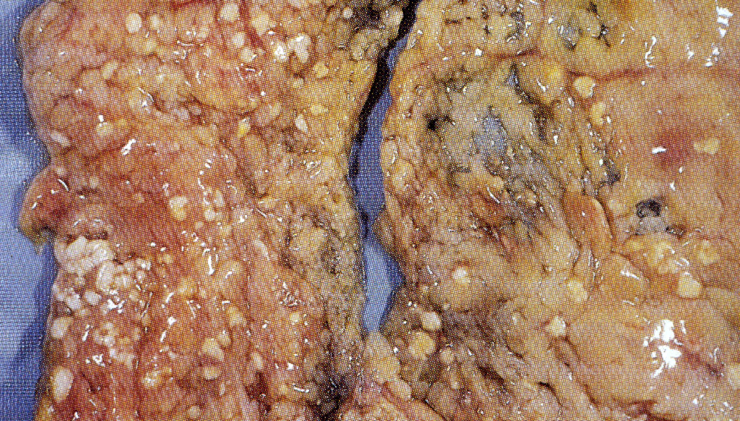
FAT NECROSIS

Slide 36
Fibrinoid Necrosis
The pattern of cell injury that occurs in the wall of arteries in cases of vasculitis. There is necrosis of smooth muscle cells of the tunica media and endothelial damage which allows plasma proteins, (primarily fibrin) to be deposited in the area of medial necrosis.

Slide 37
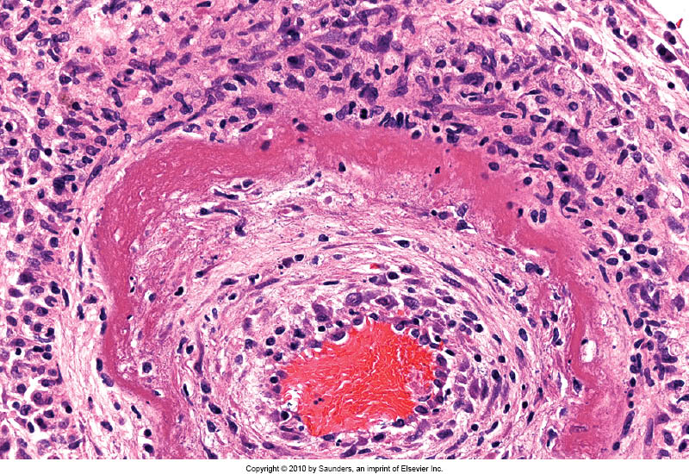
FIBRINOID NECROSIS
Fibrinoid necrosis

Slide 38
Mechanisms of Cell Injury
Cellular response to injury depends on nature, duration and severity of injury.
Consequences of injury depend on type, state and adaptability of the injured cell.
Cell injury results from different biochemical mechanisms acting on essential cellular components.

Slide 40
Mechanisms of Cell Injury
Depletion of ATP
Mitochondrial Damage
Entry of Calcium into the cell
Increase reactive oxygen species (ROS)
Membrane Damage
DNA damage, Protein misfolding

Slide 41
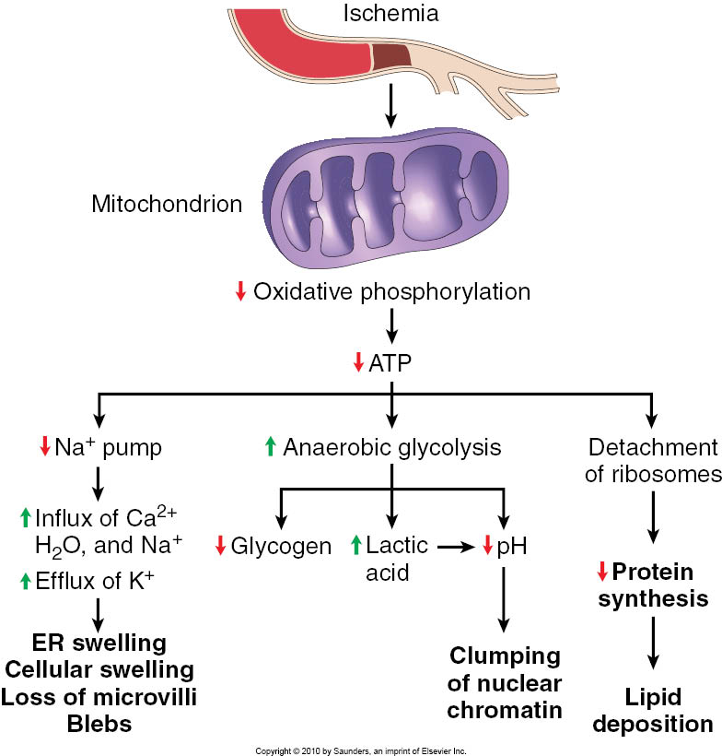

Slide 42
Depletion of ATP
ATP depletion and decreased ATP synthesis are common with both hypoxic and toxic (or chemical) injury, causing:
Reduction in Na⁺, K⁺- ATPase pump activity
Increase in anaerobic glycolysis (if possible)
Failure of Ca⁺⁺ export pump
Reduced protein synthesis

Slide 43
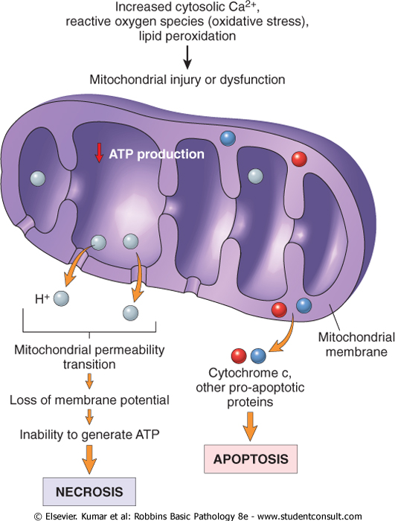
Consequences of Mitochondrial Damage
NECROSIS
Loss of membrane potential via membrane permeability transition. Results in failed oxidative phosphorylation and loss of ATP.
OR
APOPTOSIS
Membrane damage leads to leakage of Cytochrome c and other pro-apoptotic proteins.

Slide 44
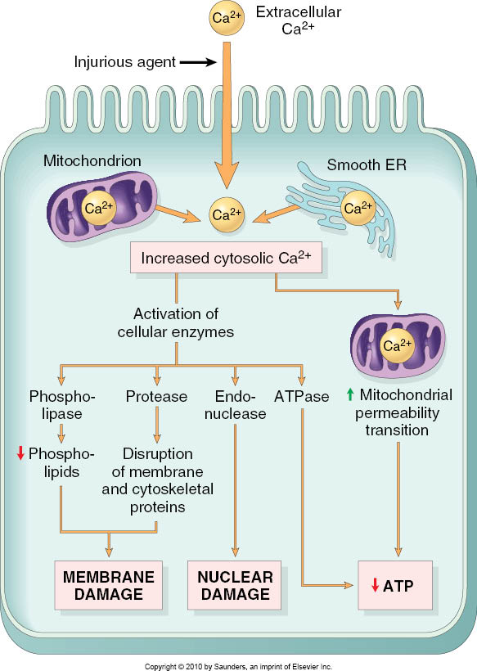
Calcium Influx
Intracellular Ca⁺⁺ is normally low and is sequestered in mitochondria and endoplasmic reticulum
Extracellular Ca⁺⁺ is high
Gradients are normally maintained by Ca⁺⁺ Mg⁺⁺ ATPase pumps
Increased cytosolic Ca⁺⁺ activates enzymes such as ATPases, phopholipases, proteases, endonucleases that can lead to cell injury and death.
Increased Ca⁺⁺ is also pro-apoptotic

Slide 45
Reactive Oxygen Species
Free radical is unpaired electron which makes the atom or molecule extremely reactive.
React with and modify cellular constituents.
Initiate self perpetuating processes when they react with atoms and molecules.
Electrons are frequently added to O₂ to create biologically important ROS.

Slide 46
Biologically Important ROS
Superoxide anion radical O₂ + e⁻ --> O₂⁻
Produced by phagocyte oxidase, damages lipids, proteins and DNA.
Hydrogen peroxide H₂O₂
Generated by SOD and by oxidases, destroys microbes, may act at distant sites (not a radical, per se, but very reactive).
Hydroxyl radical .OH
Generated from H₂O by hydrolysis, most reactive, damages lipids, proteins and DNA.

Slide 47
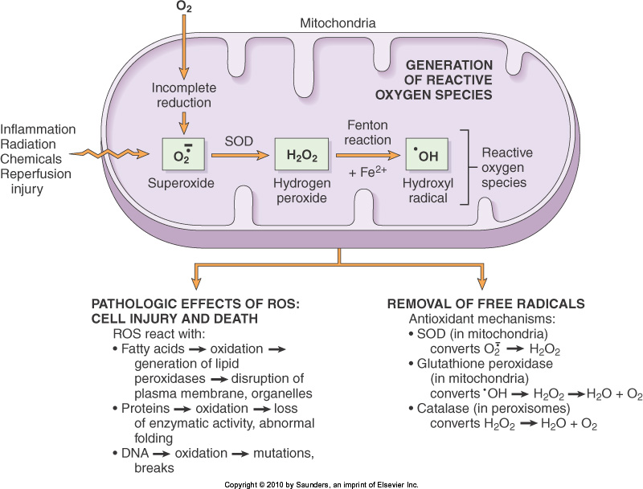
Reactive Oxygen Species
“NORMAL” ROS FUNCTIONS:
Normal metabolism and respiration
Absorption of radiant energy
Inflammation
Enzymatic metabolism of chemicals or drugs
Nitric oxide synthesis

Slide 48
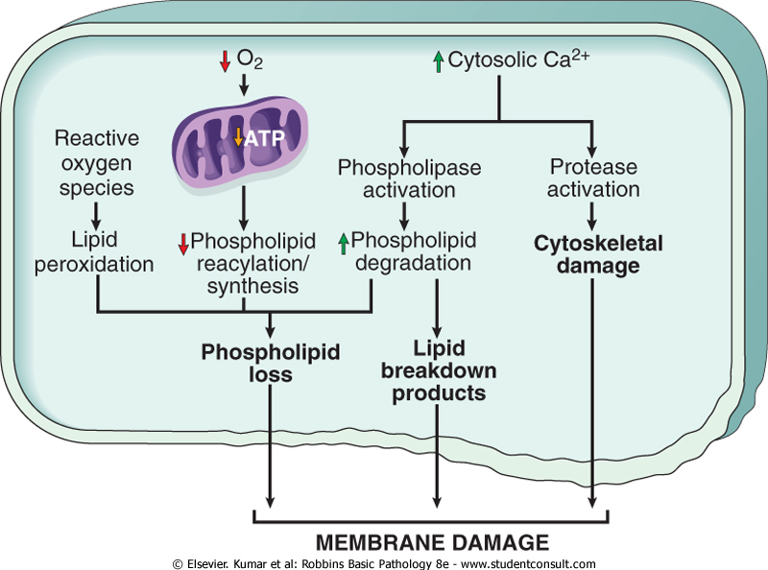
Membrane Damage
ROS → lipid peroxidation
↓ phospholipid synthesis
↑ phospholipid degradation (Ca influx activates phospholipases)
Cytoskeletal damage (Ca influx also activates proteases)
EFFECTS:
Mitochondrial membrane damage causes increased cytosolic Ca⁺⁺, oxidative stress, lipid peroxidation, phospholipase activity, loss of membrane potential, leakage of Cytochrome c
Plasma membrane damage causes loss of osmotic balance, loss of proteins, enzymes and nucleic acids.
Injury to lysosome membranes causes leakage of enzymes with destruction of cellular components.

Slide 49
DNA damage Protein misfolding
If DNA damage to cell is too severe, apoptosis is initiated.
Improperly folded proteins can also initiate apoptosis (to be discussed shortly...)

Slide 50
Several mechanisms of injury may be at play in any given situation
Types of cell injury:
Mechanisms of cell injury:
Ischemic and Hypoxic Injury (shutting off blood flow or deprivation of oxygen)
Ischemia-Reperfusion Injury
Chemical Injury
Radiation injury
Depletion of ATP
Mitochondrial Damage
Entry of Calcium into the cell
Increase reactive oxygen species (ROS)
Membrane Damage
DNA damage, Protein misfolding

Slide 51
Regardless of the type or mechanism, extensive cell injury results in death either by necrosis or apoptosis
Necrosis
Loss of functional tissue
Impaired organ function, transient or permanent
Apoptosis
Removal of damaged or unnecessary cells

Slide 52
General Characteristics
NECROSIS
“Accidental”
Usually affects large areas of contiguous cells
Cells and organelles swell
Control of intracellular environment is lost, cells rupture and spill contents
INDUCES INFLAMMATION
APOPTOSIS
“Programmed”
Usually affects scattered individual cells
Cells contract
Control of intracellular environment maintained, cytoplasm packaged as “apoptotic bodies”
DOES NOT INDUCE INFLAMMATION

Slide 54
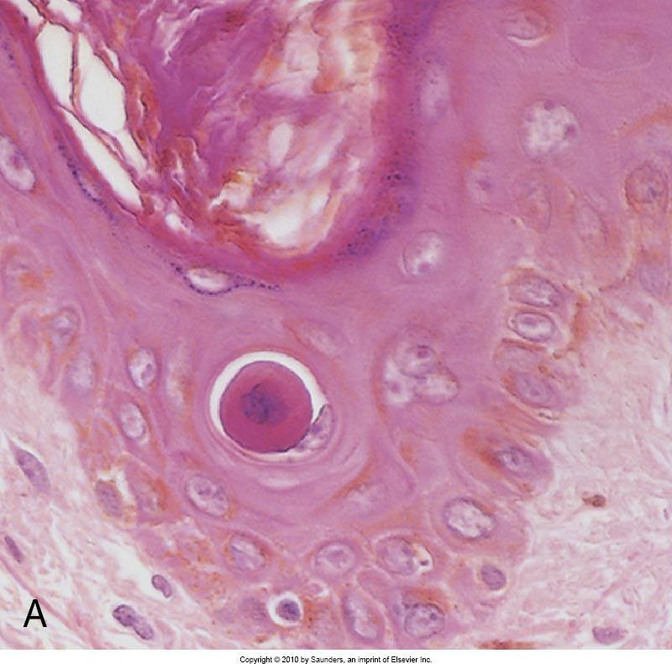
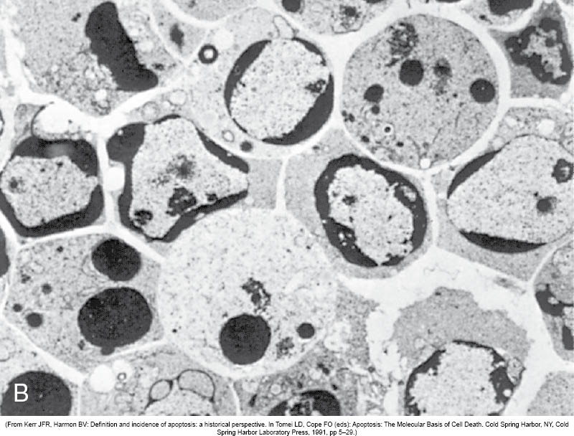
Apoptosis

Slide 55
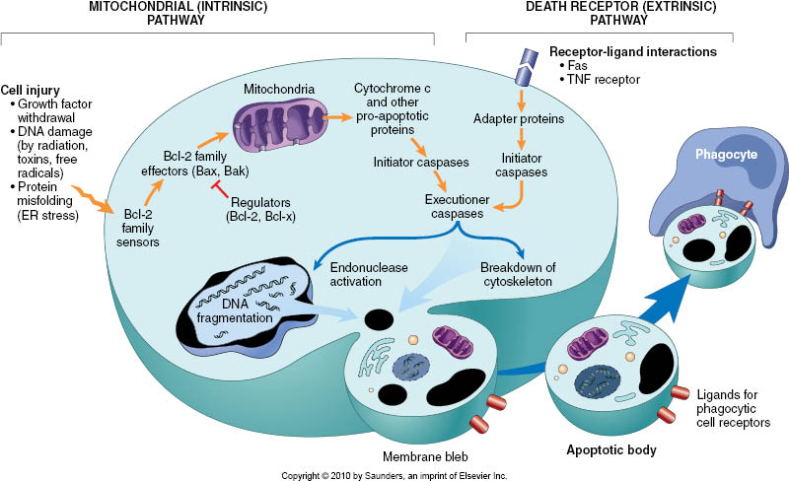
Apoptosis
Mitochondrial (intrinsic) induction –activation of pro-apoptotic proteins and/or downregulation of anti-apoptotic proteins leads to loss of mitochondrial membrane integrity and release of CytC and other pro-apoptotic factors
Death receptor (extrinsic) induction –cell receptors respond to signals (either secreted or by direct contact with other cells) to directly induce apoptosis
Convergent “execution” phase –caspases (cysteine-aspartic-acid-proteases) activate DNAses, cytoskeletal proteases, and phosphatidylserine “flippase”
Removal of dead cells –ligands expressed on surface membrane (e.g. phosphatidylserine and/or glycoproteins) signal phagocytosis by macrophages

Slide 56
Causes of Apoptosis may be Physiologic or Pathologic
Physiologic
Embryogenesis and fetal development.
Hormone dependent involution.
Prostate glandular epithelium after castration
Regression of lactating breast after weaning
Cell loss in proliferating cell populations.
Immature lymphocytes
Epithelial cells in the GI tract
Elimination of self-reactive lymphocytes.
Death of cells that have served their function.
Neutrophils, Lymphocytes
Pathologic
DNA damage due to radiation, chemotherapy.
Accumulation of misfolded proteins leads to ER stress which ends with apoptosis.
Cell death in viral infections that induce apoptosis such as HIV and Adenovirus or by the host immune response such as hepatitis.
Organ atrophy after duct obstruction.

Slide 57
Intracellular accumulations
Lipids
Steatosis
Cholesterol and Cholesterol Esters
Proteins
Glycogen
Pigments

Slide 58
Abnormal metabolism – Steatosis (Fatty change)
Abnormal protein folding – Alpha 1 antitrypsin deficiency
Lack of enzyme – Lysosomal storage disease
Indigestible material – Carbon or heme

Slide 59
Causes of Steatosis (Fatty Liver )
Alcohol is a hepatotoxin that leads to increased synthesis and reduced breakdown of lipids.
Nonalcoholic fatty liver disease is associated with diabetes and obesity.
CCl₄ and protein malnutrition cause reduced synthesis of apoproteins.
Hypoxia inhibits fatty acid oxidation.
Starvation increases mobilization of fatty acids from peripheral stores.

Slide 60
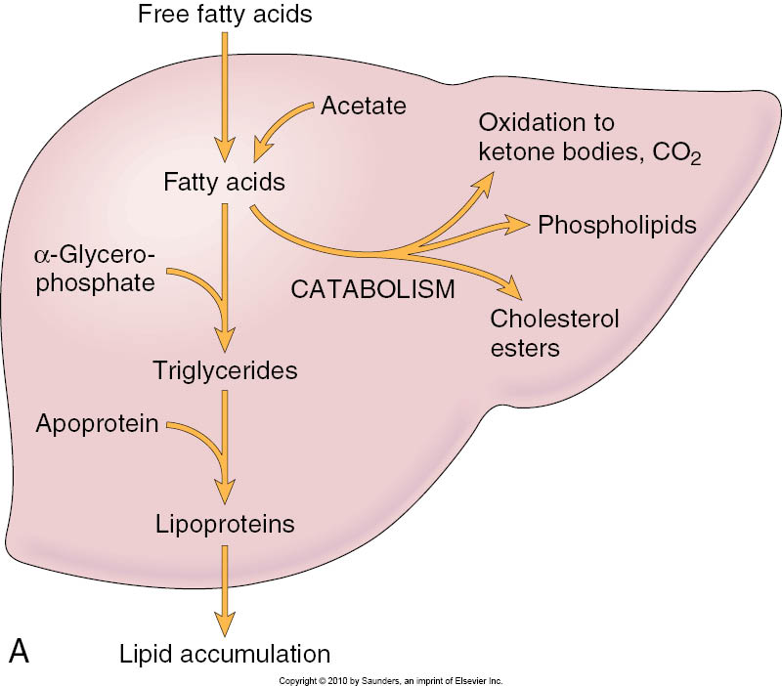

Slide 61
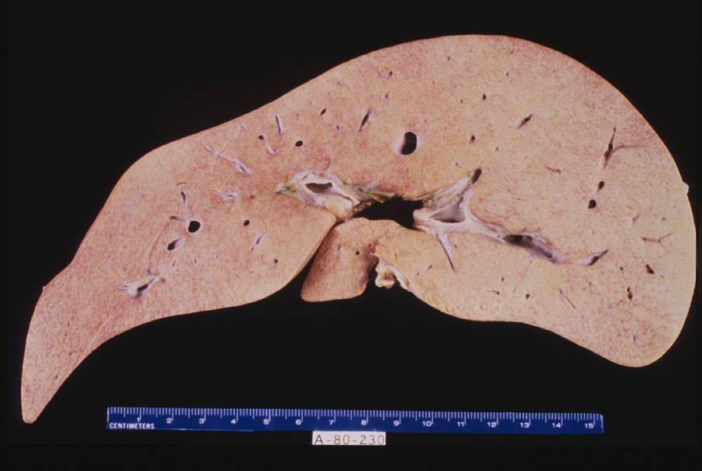
85-Fatty Liver (Gross)
85.1.pg.fattyliver

Slide 62
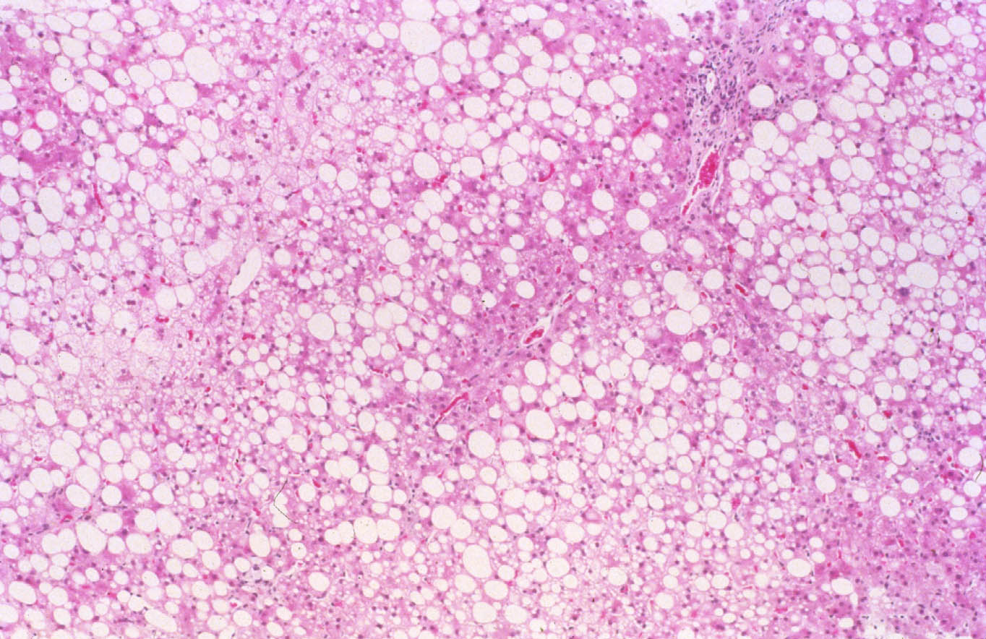

Slide 63
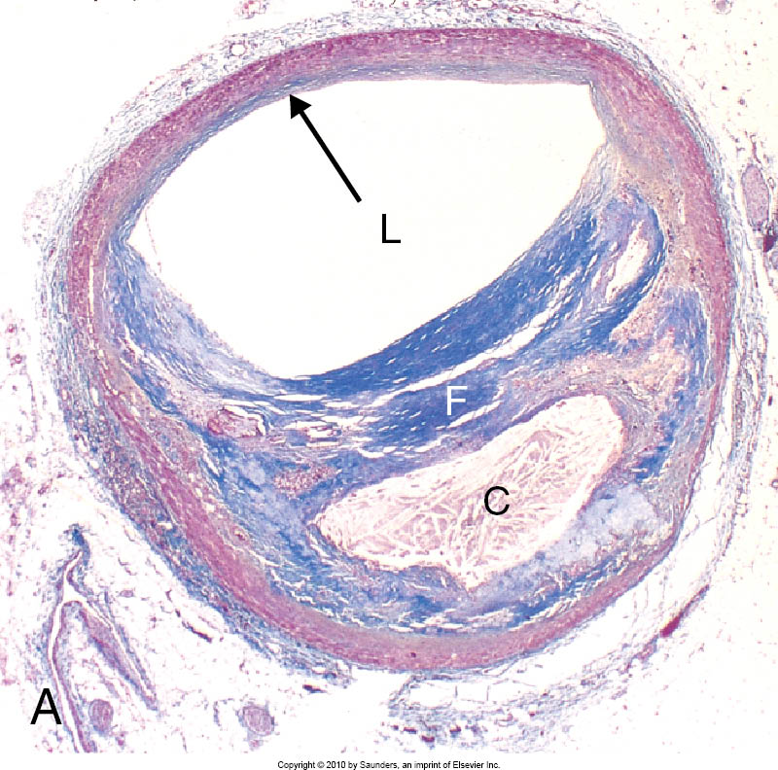
Intracellular lipid accumulation: atherosclerotic plaque

Slide 64
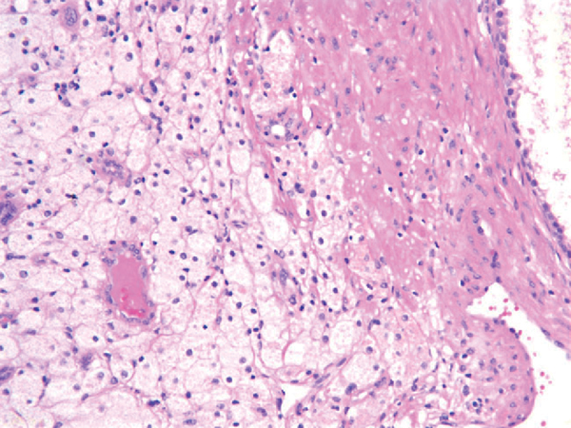
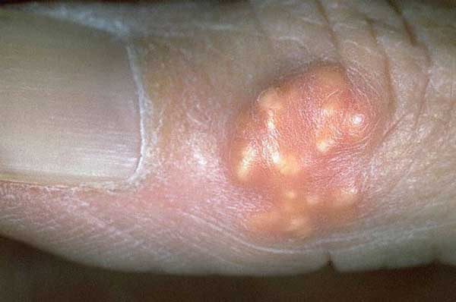
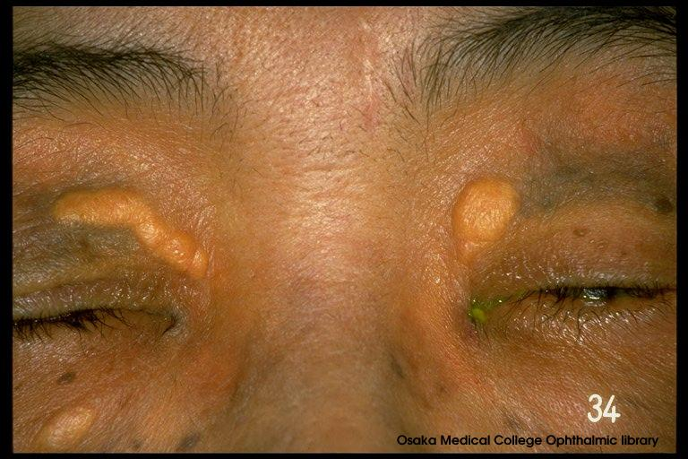
Intracellular lipid accumulation: xanthoma

Slide 65
Indigestible material: Pigments
Exogenous Pigment – Carbon in lung = anthracosis
Endogenous Pigments
Hemosiderin- multiple transfusions
Lipofuscin- aging pigment
Melanin- skin and neurotransmission
Bilirubin-hepatocytes

Slide 66
Exogenous pigment Anthracotic pigment in Lung

Slide 67
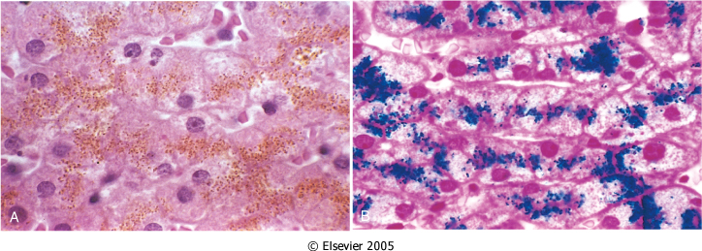
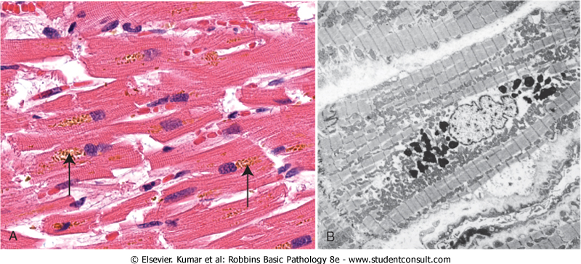
Endogenous pigments
Hemosiderin
Brown pigment
Breakdown product of hemoglobin
Contains ferrous iron (so turns blue when stained with K-ferrocyanide, aka Prussian blue stain)
Lipofuscin
Brown pigment
“wear and tear” pigment from peroxidation of membrane lipids
Does NOT contain ferrous iron (so does not react with Prussian blue stain)
Present in long-lived cells

Slide 68
Pathologic Calcification
Dystrophic Calcification – occurs in areas of necrosis and atherosclerosis.
Metastatic Calcification – occurs in normal tissues when there is hypercalcemia.

Slide 69
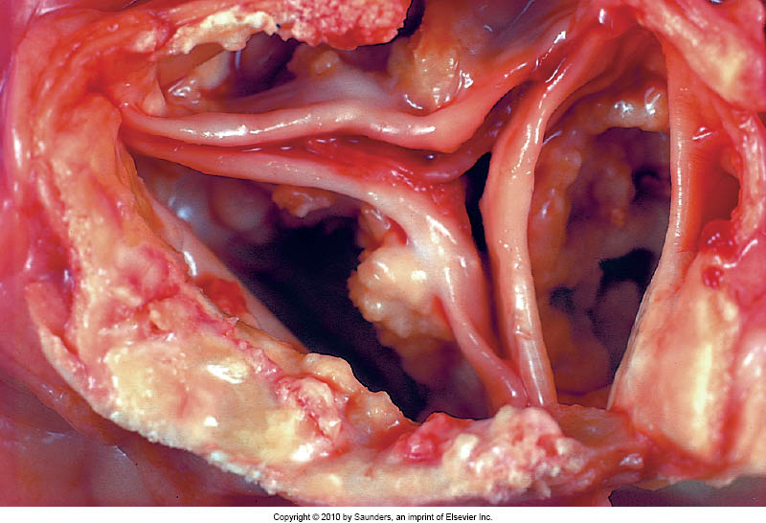

Slide 70
Metastatic Calcification
Excess Parathyroid hormone
Destruction of bone
Vitamin D disorders
Renal failure

Slide 71
Conclusions
Cell injury may occur by a variety of mechanisms and sources - endogenous (ischemia/inflammation) or exogenous (drugs/toxins)
Cell injury can be reversible or irreversible.
Reversible cell injury can result in changes which may recover when the cause is removed, or which may persist.
Irreversible (lethal) cell injury may cause only transient functional impairment if the dead cells can be replaced.
Alternatively, lethal cell injury may lead to permanent functional impairment if the dead cells can not be replaced.
Cell death (apoptosis) is a normal mechanism to remove damaged cells which can be activated in pathologic conditions.
Substances may be deposited within cells in response to cell injury.

Slide 72
Inflammation and Wound Healing

Slide 73
What is Inflammation?
Response to injury (including infection)
Reaction of blood vessels leads to:
Accumulation of fluid and leukocytes in extravascular tissues
Destroys, dilutes, or walls off the injurious agent
Initiates the repair process
Fundamentally a protective response
May be potentially harmful
Hypersensitivity reactions to insect bites, drugs, contrast media in radiology
Chronic diseases: arthritis, atherosclerosis
Disfiguring scars, visceral adhesions
Consists of two general components
Vascular reaction
Cellular reaction
Controlled by a variety of chemical mediators
Derived from plasma proteins
Derived from cells inside and outside of blood vessels

Slide 74
Historical Highlights
Celsus, a first century A.D. Roman, listed four cardinal signs of acute inflammation:
Rubor (erythema [redness]): vasodilatation, increased blood flow
Tumor (swelling): extravascular accumulation of fluid
Calor (heat): vasodilatation, increased blood flow
Dolor (pain)

Slide 75
Types of Inflammation
Acute inflammation
Short duration
Edema
Mainly neutrophils
Granulomatous inflammation
Distinctive pattern of chronic inflammation
Activated macrophages (epithelioid cells) predominate
+/- Multinucleated giant cells
Chronic inflammation
Longer duration
Lymphocytes & macrophages predominate
Fibrosis
New blood vessels (angiogenesis)

Slide 76
Acute Inflammation
Three major components:
Increase in blood flow (redness & warmth)
Edema results from increased hydrostatic pressure (vasodilation) and lowered intravascular osmotic pressure (protein leakage)
Leukocytes emigrate from microcirculation and accumulate in the focus of injury
Stimuli: infections, trauma, physical or chemical agents, foreign bodies, immune reactions

Slide 77
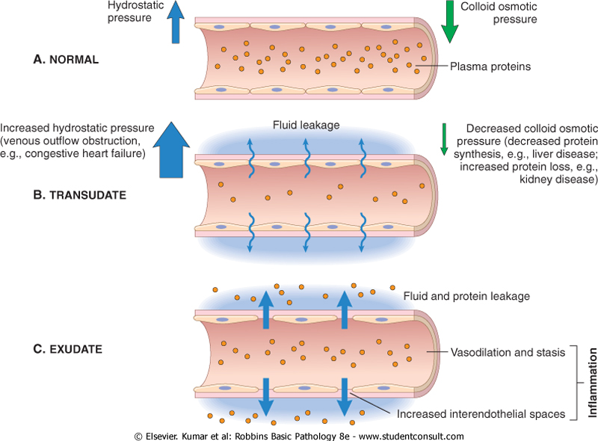
Edema in inflammation
Edema is a general term for swelling (usu. due to fluid)
Plasma proteins in blood maintain a “colloid osmotic pressure” to help draw fluid that leaks out into tissue bed via hydrostatic pressure
Dysregulation of hydrostatic pressure (e.g. heart failure) and/or colloid pressure (decresased protein synthesis/retention) pushes out more fluid (transudate) into tissue bed
Inflammation causes endothelial cells to separate, thus allowing fluid + protein (exudate) to enter tissue bed.

Slide 78
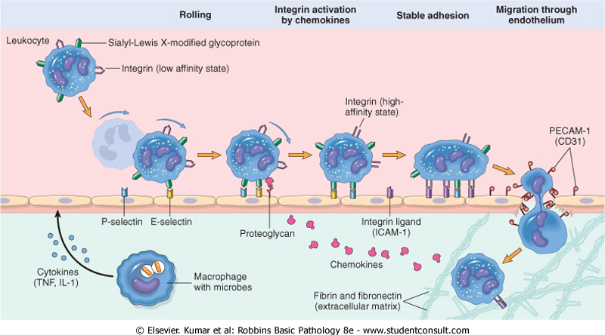
Leukocyte Extravasation
Extravasation: delivery of leukocytes from the vessel lumen to the interstitium
In the lumen: margination, rolling, and adhesion
Migration across the endothelium (diapedesis)
Migration in the interstitial tissue (chemotaxis)
Leukocytes ingest offending agents (phagocytosis), kill microbes, and degrade necrotic tissue and foreign antigens
There is a balance between the helpful and harmful effects of extravasated leukocytes

Slide 79
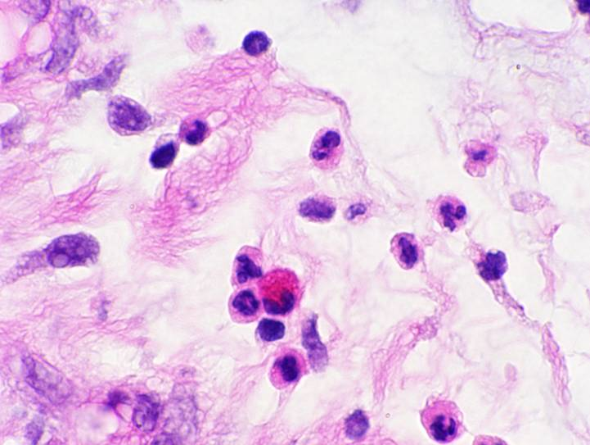
Neutrophil Morphology
Eosinophil
Neutrophils

Slide 80
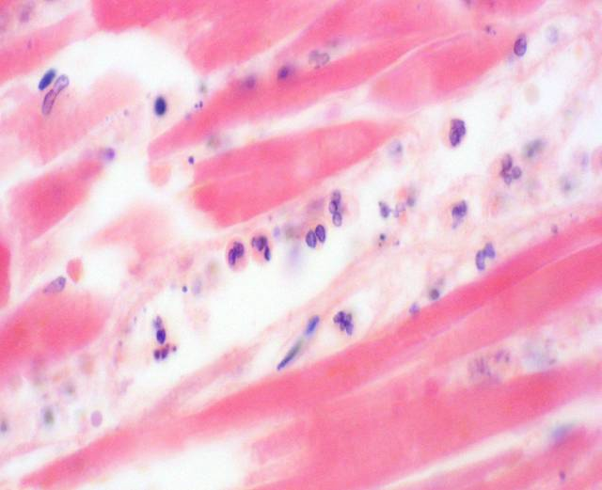
Leukocyte Margination
Photomicrograph courtesy of Dr. James G. Lewis

Slide 81
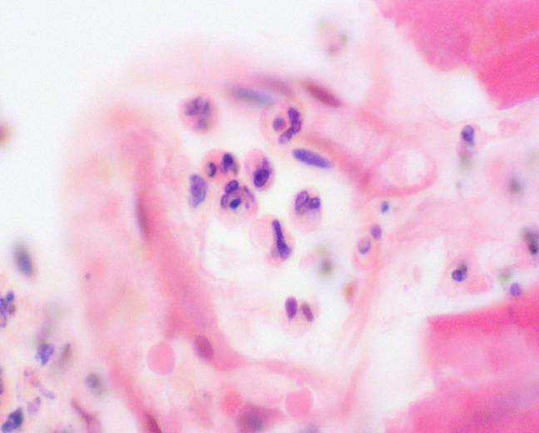
Leukocyte Diapedesis
Photomicrograph courtesy of Dr. James G. Lewis

Slide 82
Sequence of Leukocyte Emigration
Neutrophils predominate during the first 6 to 24 hours
Monocytes in 24 to 48 hours
Induction/activation of different adhesion molecule pairs and specific chemotactic factors in different phases of inflammation

Slide 83
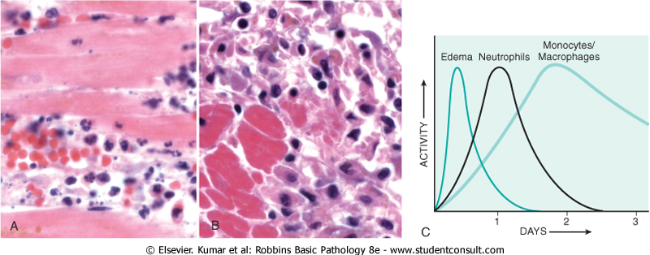
Sequence of Events - Injury

Slide 84
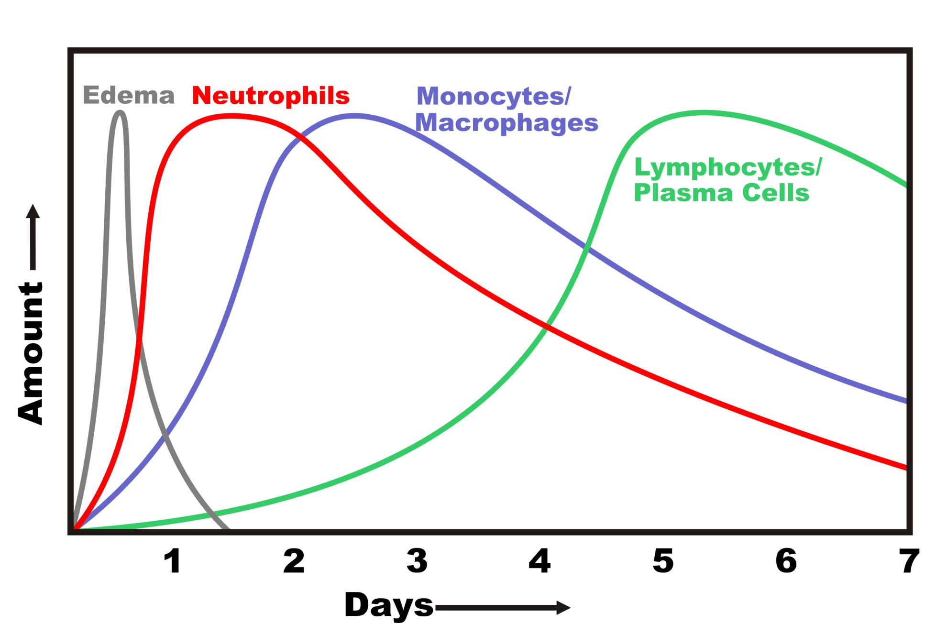
Sequence of Events - Infection

Slide 85
Outcomes of Acute Inflammation
Complete resolution
Abscess formation
Fibrosis
After substantial tissue destruction
In tissues that do not regenerate
After abundant fibrin exudation, especially in serous cavities (pleura, peritoneum)
Progression to chronic inflammation

Slide 86
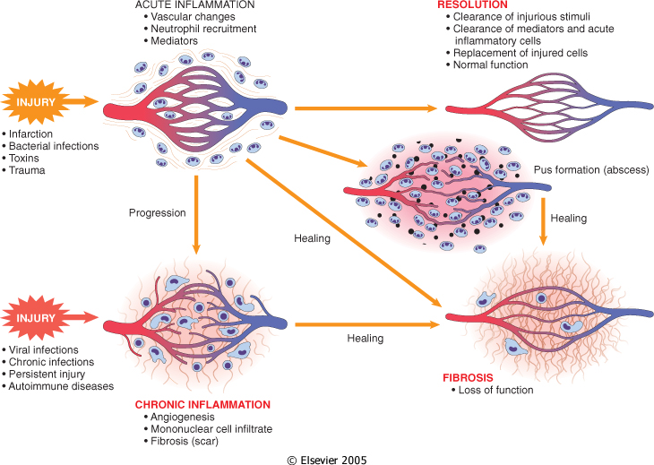
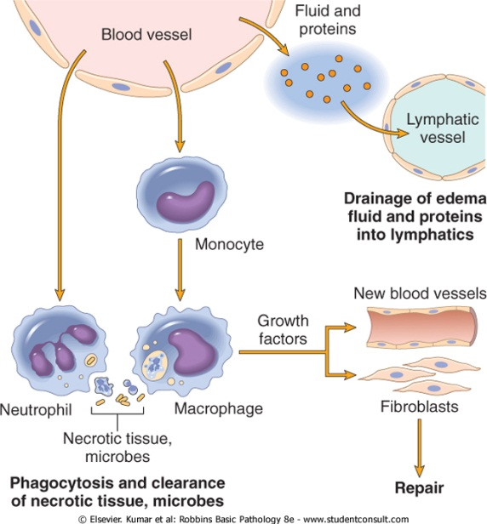
Types of Inflammation: acute vs. chronic Types of repair: resolution vs. organization (fibrosis)

Slide 87
Morphologic Patterns of Acute Inflammation
Serous inflammation: Outpouring of thin fluid (serous effusion, blisters)
Fibrinous inflammation: Body cavities; leakage of fibrin; may lead to scar tissue (adhesions)
Suppurative (purulent) inflammation: Pus or purulent exudate (neutrophils, debris, edema fluid); abscess: localized collections of pus
Ulcers: Local defect of the surface of an organ or tissue produced by the sloughing (shedding) of inflammatory necrotic tissue

Slide 88
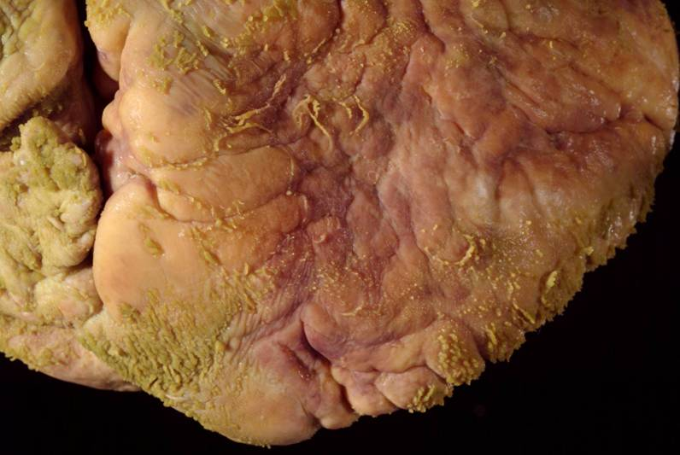
Fibrinous Pericarditis

Slide 89
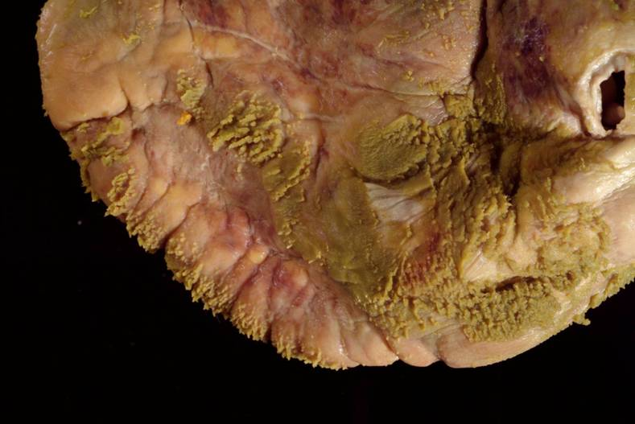
Fibrinous Pericarditis

Slide 90
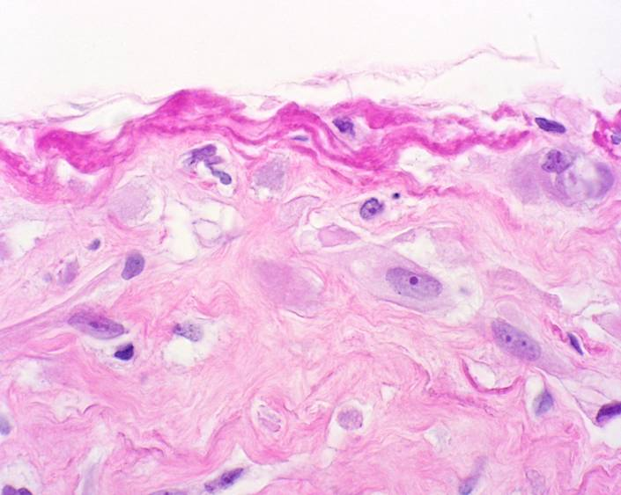
Fibrinous Pleuritis

Slide 91
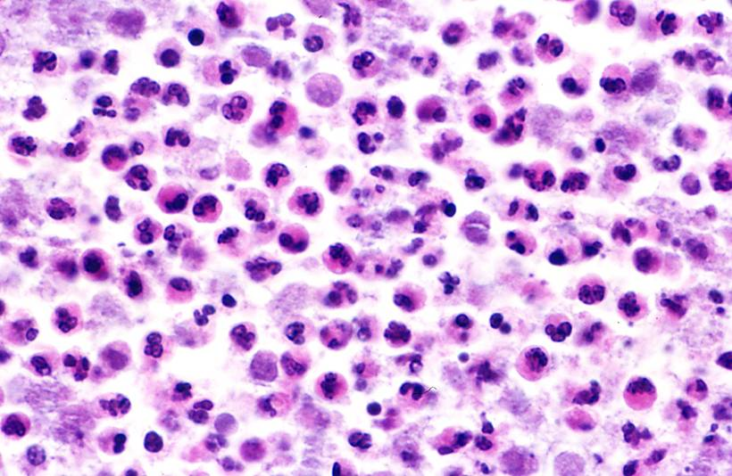
Suppurative (purulent) inflammation: Abscess

Slide 92
Gastric Ulcer

Slide 93
Gastric Ulcer

Slide 94
Systemic Manifestations
Endocrine and metabolic
Secretion of acute phase proteins by the liver
Increased production of glucocorticoids (stress response)
Decreased secretion of vasopressin leads to reduced volume of body fluid to be warmed
Fever
Improves efficiency of leukocyte killing
Impairs replication of many offending organisms

Slide 95
Systemic Manifestations
Autonomic
Redirection of blood flow from skin to deep vascular beds minimizes heat loss
Increased pulse and blood pressure
Behavioral
Shivering (rigors), chills (search for warmth), anorexia (loss of appetite), somnolence, and malaise

Slide 96
Systemic Manifestations
Leukocytosis: increased leukocyte count in the blood
Neutrophilia: bacterial infections
Lymphocytosis: infectious mononucleosis, mumps, measles
Eosinophilia: Parasites, asthma, hay fever
Leukopenia: reduced leukocyte count
Typhoid fever, some viruses, rickettsiae, protozoa

Slide 97
Chronic Inflammation
Inflammation of prolonged duration (weeks or months)
Active inflammation, tissue destruction, and attempts at repair are proceeding simultaneously
May follow acute inflammation or begin insidiously and often asymptomatically
Persistent infections, exposure to toxic agents such as silica (silicosis), or by autoimmunity

Slide 98
Chronic Inflammation
Persistent infections
Treponema pallidum [syphilis], viruses, fungi, parasites
Exposure to toxic agents
Exogenous: silica (silicosis)
Endogenous: toxic plasma lipid components (atherosclerosis)
Autoimmunity
Rheumatoid arthritis, systemic lupus erythematosus

Slide 99
Chronic Inflammation
Histological features
Infiltration with mononuclear cells (macrophages, lymphocytes, and plasma cells)
Tissue destruction (induced by the inflammatory cells)
Healing by replacement of damaged tissue by connective tissue (fibrosis) and new blood vessels (angiogenesis)

Slide 100
Chronic Inflammatory Cells
Lymphocytes
Macrophages

Slide 101
Chronic Inflammation

Slide 102
Chronic Inflammation

Slide 103
Macrophages
Monocytes begin to emigrate into tissues early in inflammation where they transform into the larger phagocytic cell known as the macrophage
Macrophages predominate by 48 hours
Recruitment (circulating monocytes); division; immobilization
Activation results in secretion of biologically active products

Slide 104
Macrophages

Slide 105
Other Cells in Chronic Inflammation
Lymphocytes
Produce inflammatory mediators
Participate in cell-mediated immune reactions
Plasma cells produce antibody
Lymphocytes and macrophages interact in a bi-directional fashion

Slide 106
Chronic Inflammatory Cells
Plasma cells
Russell bodies

Slide 107
Other Cells in Chronic Inflammation
Eosinophils
Immune reactions mediated by IgE
Parasitic infections
Eosinophil granules contain a protein that is toxic to parasites
Mast cells
Release mediators (histamine) and cytokines

Slide 108
Eosinophil Morphology

Slide 109
Chronic Cellulitis

Slide 110
Granulomatous Inflammation
Distinctive pattern of chronic inflammation
Predominant cell type is an activated macrophage with a modified epithelial-like (epithelioid) appearance
Giant cells may or may not be present
Granuloma: Focal area of granulomatous inflammation

Slide 111
Granulomatous Inflammation
Foreign body granulomas: Form when foreign material is too large to be engulfed by a single macrophage
Immune granulomas: Insoluble or poorly soluble particles elicit a cell-mediated immune response

Slide 112
Granulomatous Response to Suture

Slide 113
Chemical Mediators of Inflammation
General principles of chemical mediators
May be derived from plasma or cells
Most bind to specific receptors on target cells
Can stimulate release of mediators by target cells, which may amplify or ameliorate the inflammatory response
May act on one or a few target cells, have widespread targets, and may have differing effects depending on cell and tissue types
Usually short-lived
Most have the potential to cause harmful effects

Slide 114
Chemical Mediators of Inflammation
Vasoactive mediators
Histamine
Bradykinin
Complement (C3a, C5a)
Prostaglandins/leukotrienes
Platelet activating factor
Nitric oxide
Chemotactic factors
Complement (C5a)
Leukotriene (B4)
Platelet activating factor
Cytokines (IL-1, TNF)
Chemokines
Nitric oxide

Slide 115
Histamine
Mast cells (also basophils and platelets)
Release mechanisms
Binding of antigen (allergen) to IgE on mast cells releases histamine-containing granules
Release by nonimmune mechanisms such as cold, trauma, or other chemical mediators
Release by other mediators
Dilates arterioles and increases permeability of venules (wheal and flare reaction)

Slide 116
Complement
Proteins found in greatest concentration in the plasma
Require activation
Increase vascular permeability and cause vasodilation
Mainly by releasing histamine from mast cells
Increase leukocyte adhesion, chemotaxis, and activation
C3b attaches to bacterial wall and enhances phagocytosis by neutrophils & macrophages

Slide 117
Bradykinin
Small peptide released from plasma precursors
Increases vascular permeability
Dilates blood vessels
Causes pain
Rapid inactivation

Slide 118
Arachidonic Acid Metabolites
Prostaglandins
Vasodilators: prostacyclin (PGI₂), PGE₁, PGE₂, PGD₂
Vasoconstrictors: thromboxane A₂
Pain (PGE₂ makes tissue hypersensitive to bradykinin)
Fever (PGE₂)
Production blocked by steroids and nonsteroidal anti-inflammatory agents (NSAIDs)
Leukotrienes
Increase vascular permeability: leukotrienes C₄, D₄, E₄
Vasoconstriction: leukotrienes C₄, D₄, E₄
Leukocyte adhesion & chemotaxis: leukotriene B₄, HETE, lipoxins
Production blocked by steroids but not conventional NSAIDs

Slide 119
Figure 2-16 Robbins and Cotran Pathologic Basis of Disease, 7th Ed.

Slide 120
Platelet Activating Factor
Subclass of phospholipids
Synthesized by stimulated platelets, leukocytes, endothelium
Inflammatory effects
Stimulates platelet aggregation
Vasoconstriction and bronchoconstriction
Vasodilation and increased venular permeability
Increased leukocyte adhesion to endothelium, chemotaxis, degranulation, and oxidative burst
Increases synthesis of arachidonic acid metabolites by leukocytes and other cells

Slide 121
Cytokines
Proteins produced by many cell types (principally activated lymphocytes & macrophages)
Modulate the function of other cell types
Interleukin-1 (IL-1) and tumor necrosis factor (TNF) are the major cytokines that mediate inflammation

Slide 122
Figure 2-18 Robbins and Cotran Pathologic Basis of Disease, 7th Ed.

Slide 123
Chemokines
Small proteins that act primarily as chemoattractants for specific types of leukocytes (approximately 40 known)
Stimulate leukocyte recruitment in inflammation
Control the normal migration of cells through tissues (organogenesis and maintenance of tissue organization)
Examples: IL-8, eotaxin, lymphotactin

Slide 124
Nitric Oxide
Figure 2-19 Robbins and Cotran Pathologic Basis of Disease, 7th Ed.

Slide 125
Other Mediators
Neutrophil granules:
Cationic proteins increase vascular permeability, immobilize neutrophils, chemotactic for mononuclear phagocytes
Neutral proteases generate other mediators and degrade tissue
Oxygen-Derived Free Radicals:
Produced during phagocytosis by neutrophils (“respiratory burst”)
Tissue damage including endothelium

Slide 126
Summary of Inflammatory Mediators
Vasodilation
Prostaglandins
Nitric oxide
Histamine
Increased vascular permeability
Histamine, serotonin
Complement (C3a, C5a)
Bradykinin
Leukotrienes (C₄, D₄, E₄)
Platelet Activating Factor
Substance P

Slide 127
Summary of Inflammatory Mediators
Chemotaxis, leukocyte activation
Complement (C5a)
Leukotriene B₄
Chemokines
IL-1, TNF
Bacterial products
Fever
Interleukin-1
Tumor necrosis factor
Prostaglandins

Slide 128
Summary of Inflammatory Mediators
Pain
Prostaglandins
Bradykinin
Tissue Damage
Neutrophil and macrophage lysosomal enzymes
Oxygen metabolites
Nitric oxide

Slide 129
Wound Healing
A complex but orderly process involving many of the chemical mediators previously discussed, along with many other growth factors and cell-matrix interactions.
Occurs in the following steps:
Injury induces acute inflammation
Parenchymal cells regenerate
Both parenchymal and connective tissue cells migrate and proliferate
Extracellular matrix is produced
Parenchyma and connective tissue matrix remodel
Increase in wound strength due to collagen deposition

Slide 130
Wound Healing Time Course

Slide 131
Granulation Tissue
Hallmark of healing
Term comes from soft, pink, granular appearance when viewed from the surface of a wound
Histology: Proliferation of small blood vessels and fibroblasts; tissue often edematous

Slide 132
Granulation Tissue

Slide 133
Granulation Tissue

Slide 134
Healing by 1st intention vs. 2nd intention
By 1st intention:
“clean” incision
limited scarring or wound contraction
By 2nd intention:
ulcers or lacerations
often scarring and wound contraction

Slide 135
Ulcers: an example of healing by 2nd intention

Slide 136
Resolution of Inflammation: “Regeneration” vs. “Healing”

Slide 137
An example of healing by fibrosis: Myocardial Infarction
Edge of acute infarct
Notes:
AP-102106-19.jpg

Slide 138
Myocardial Infarct: healing (aka “remote”)
Healing (remote) infarct
Notes:
P2050029.jpg

Slide 139
Myocardial Infarct: healing (trichrome stain)
Masson trichrome stain for collagen
Notes:
P2050008.jpg

Slide 140
Variables affecting repair
Infection –prolongs inflammation, increases degree of tissue injury
Nutrition –protein or vitamin deficiency can impair synthesis of new proteins
Anti-inflammatory drugs –can impede fibrosis necessary for repair
Mechanical variables –tension, pressure, or the presence of foreign bodies can affect repair
Vascular disease –limits nutrient and oxygen supply required for repairing tissues
Tissue type –only tissues capable of renewing will regenerate, otherwise healing is by fibrosis
Degree of exudate removal –adequate removal of exudate allows RESOLUTION of the injury (general restoration of the normal tissue architecture); inadequate removal results in ORGANIZATION (abnormal, dysfunctional tissue architecture)
Regulation of cell proliferation –abnormal proliferation of connective tissue may inhibit re-epithelialization and/or raised scars (keloids)

