Slide 1
Diseases of the Immune System and Neoplastic Disease
J. Matthew Velkey
454A Davison, Green Zone, Duke South
matt.velkey@duke.edu

Slide 2
Innate vs. adaptive immunity
Innate
Anti-microbial
epithelial barriers
phagocytes
complement system
NK cells
Works via immediate recognition of pathogen-specific signals (e.g. bacterial lipopolysaccharide)
Adaptive
Works against pathogens that have evolved to elude innate immunity
TWO types of adaptive immunity:
Humoral (antibody-mediated)
Cellular (T-cell-mediated)
Notes:
Fig 5-1 from Robbins Basic Pathology, 8th ed.

Slide 3
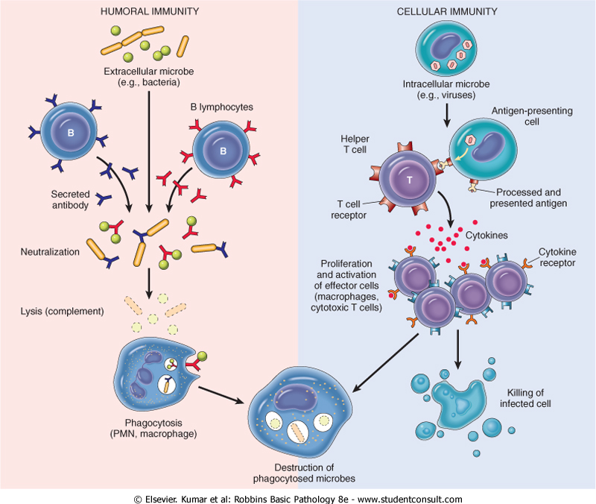
Humoral and Cell-mediated Immunity
Humoral Immunity
Involves B-cell production of antibodies that bind antigens resulting in either:
Neutralization
lysis (by the complement system), or
phagocytosis and destruction
Cell-mediated Immunity
Involves T-cell recognition of abnormal antigens on the surface of host cells (indicating viral infection or tumorigenic change) and the killing of infected cells.
Notes:
Fig 5-2 from Robbins Basic Pathology, 8th ed.

Slide 4
Cells of the Immune System
Lymphocytes
B lymphocytes: antibody production
T helper (CD4+) cells: “help” or stimulate B-cells to produce antibodies and macrophages to destroy ingested microbes
T cytotoxic (CD8+) cells: recognize and kill virus-infected or tumorigenic host cells
NK cells: recognize and kill bacteria immediately (part of innate immunity) also can recognize and kill virus-infected or tumorigenic host cells
Antigen-presenting cells
Capture, process, and present microbial or non-self antigens and present them to T-cells:
Dendritic cells (in lymph nodes and nodules)
Macrophages
B-cells
Effector cells
Carry out destruction of pathogens and/or infected cells:
NK cells
Plasma cells (differentiated B-cells)
T-helper and T-cytotoxic cells
Macrophages
Neutrophils, eosinophils, and basophils

Slide 5
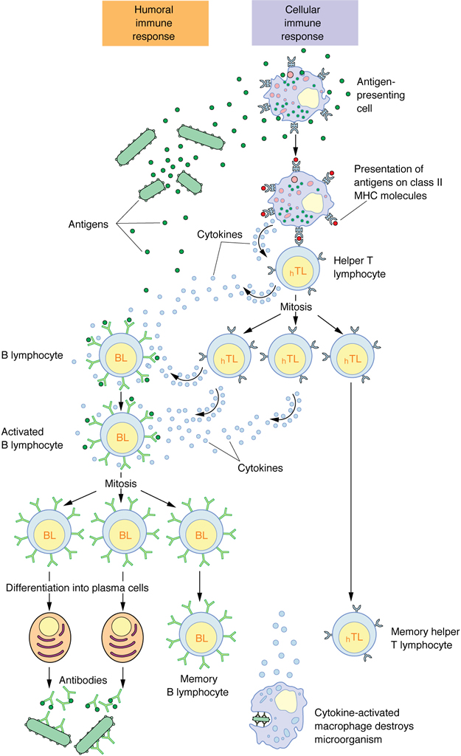
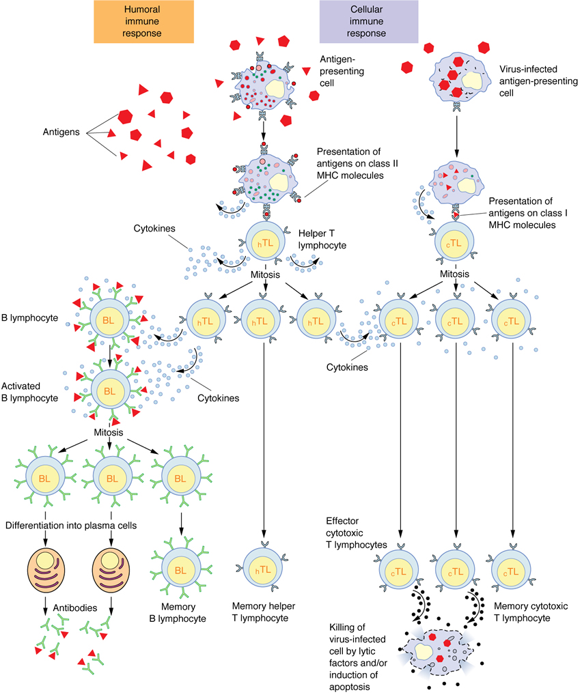
Overview of Immune Responses
Bacterial response
Viral response (and tumors)
Notes:
Figs 14-7 & 14-8 from Junqueira’s Basic Histology, 12th ed.
In the Bacterial Response, note that the B-cells also act as antigen-presenting cells (i.e. they internalize antigens bound onto their surface and present them to T-helper cells).
Note that aspects of the viral response also hold true for tumorigenic cells which present abnormal antigens on MHC I molecules to T-cytotoxic cells. Also, the antibodies produced by B-cells in response to virus-infected or tumorigenic cells can bind to the surface of affected host cells and elicit their removal by NK cells (as illustrated in figure 14.7 from Ross & Pawlina, Histology: a text and atlas, 6th ed.)

Slide 6
Hypersensitivity Immune Reactions
Inappropriate or inadequately controlled responses to antigens, caused by:
Autoimmunity – reaction of immune system to self
Reaction to microbes and viruses
Persistent infection (e.g. tuberculosis)
Immune complex formation (e.g. streptococcal glomerulonephritis)
Cross-reactivity with host tissue (e.g. rheumatic heart disease)
Cytotoxicity (e.g. viral hepatitis)
Reactions against environmental antigens (e.g. pollens, pet dander, bee venom, poison ivy, etc.)
There are FOUR general types of hypersensitivity reactions (type I, type II, type III, and type IV)

Slide 7
Immediate (Type I) Hypersensitivity
“Allergic” reaction
Involves initial activation of T_{H}2 cells and production of IgE from B-cells
IgE binds to mast cells
Secondary exposure of IgE-coated mast cells to antigen elicits degranulation
Notes:
Fig 5-8 from Robbins Basic Pathology, 8th ed. Sequence of events in immediate (type 1) hypersensitivity. Immediate hypersensitivity reactions are initiated by the introduction of an allergen, which stimulates T_{H}2 responses and IgE production. IgE binds to Fc receptors (FcεRI) on mast cells, and subsequent exposure to the allergen activates the mast cells to secrete the mediators that are responsible for the pathologic manifestations of immediate hypersensitivity.

Slide 8
Products released by mast cells elicit symptoms associated with allergies
Immediate reaction (histamine, prostaglandin, and leukotrienes):
Vasodilation
Vascular leakage (edema)
Smooth muscle spasm
Late-phase reaction (leukotrienes and other cytokines):
Leukocyte infiltration (particularly neutrophils and eosinophils)
Epithelial damage
Bronchospasm
Clinical manifestations may be local or systemic and may range from mild (sinusitis) to severe (anaphylactic shock). Also, may be acute or CHRONIC (e.g. asthma)
Notes:
Fig 5-9 from Robbins Basic Pathology, 8th ed. Mast cell mediators. Upon activation, mast cells release various classes of mediators that are responsible for the immediate and late-phase reactions. ECF, eosinophil chemotactic factor; NCF, neutrophil chemotactic factor (neither of these has been biochemically defined); PAF, platelet-activating factor.

Slide 9
Type II hypersensitivity Caused by antibodies directed against antigens on cell surfaces or other tissue components
Opsonization: Ab targets cells for direct destruction by phagocytes or complement system (e.g. thrombocytopenia)
Inflammation and tissue injury: via activation of leukocytes & complement system (e.g. streptococcal rheumatic heart disease)
Antibody-mediated cellular dysfunction: Bound Abs may interfere with cell function (e.g. myasthenia gravis) or may cause HYPERfunction (e.g. Graves disease)
Notes:
Figure 5-11 Effector mechanisms of antibody-mediated injury. A, Opsonization of cells by antibodies and complement components, and ingestion of opsonized cells by phagocytes. B, Inflammation induced by antibody binding to Fc receptors of leukocytes and by complement breakdown products. C, Antireceptor antibodies disturb the normal function of receptors. In these examples, antibodies against the thyroid-stimulating hormone (TSH) receptor activate thyroid cells in Graves disease, and acetylcholine (ACh) receptor antibodies impair neuromuscular transmission in myasthenia gravis.

Slide 10
Type III Hypersensitivity immune complex diseases
Phases of disease:
Formation of Ag-Ab complexes in the circulation
Deposition of immune complexes in various tissues
Inflammatory reaction and destruction of host tissues
Examples include:
Systemic lupus erythematosus
Streptococcal glomerulonephritis
Polyarteritis nodosa
Reactive arthritis
“Serum sickness” (reaction to foreign serum)
Notes:
Figure 5-12 Immune complex disease. The sequential phases in the induction of systemic immune complex-mediated diseases (type III hypersensitivity).

Slide 11
Type IV Hypersensitivity
Delayed-type hypersensitivity (e.g. tuberculin reaction, dermatitis) – T_{H}1 cells presented with antigen release IFN-γ and other cytokines causing inflammation and tissue injury
Direct cell cytotoxicity (e.g. T1DM, MS, RA) – T-cytotoxic cells react to antigens displayed by host cells
Notes:
Figure 5-13 Mechanisms of T-cell-mediated (type IV) hypersensitivity reactions. A, In delayed-type hypersensitivity reactions, CD4+ T cells (and sometimes CD8+ cells) respond to tissue antigens by secreting cytokines that stimulate inflammation and activate phagocytes, leading to tissue injury. B, In some diseases, CD8+ CTLs directly kill tissue cells. APC, antigen-presenting cell.

Slide 12
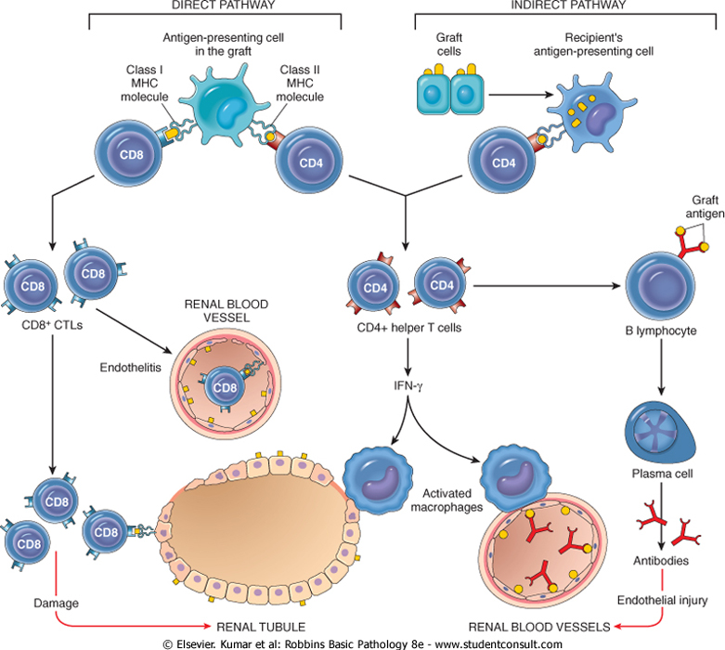
Graft Rejection
While it is the host that usually rejects the graft, note that the graft can “reject” the host (as in graft vs. host disease) – this happens when T-cells from the graft react against the host tissues
Notes:
Figure 5-16 Recognition and rejection of organ allografts. In the direct pathway, donor class I and class II MHC antigens on antigen-presenting cells (APCs) in the graft (along with costimulators, not shown) are recognized by host CD8+ cytotoxic T cells and CD4+ helper T cells, respectively. CD4+ cells proliferate and produce cytokines (e.g., IFN-γ), which induce tissue damage by a local delayed-hypersensitivity reaction. CD8+ T cells responding to graft antigens differentiate into CTLs that kill graft cells. In the indirect pathway, graft antigens are displayed by host APCs and activate CD4+ T cells, which damage the graft by a local delayed-hypersensitivity reaction and stimulate B lymphocytes to produce antibodies.

Slide 13
Autoimmunity: a loss of self-tolerance
Tolerance = unresponsiveness to self-antigens
Central tolerance: deletion of self-reactive B and T-cells during their development
Peripheral tolerance: squelching of self-reactive cells:
Anergy: Ag presentation without co-stimulatory B7 signal
Suppression: T reg cells secrete suppressive cytokines (IL-10) that dampen T_{H} and T_{C} responses
Apoptosis: T-cells activated by self-antigens usually activate apoptosis pathways
Notes:
Figure 5-18 The principal mechanisms of central and peripheral self-tolerance in CD4+ T cells.

Slide 14
Mechanisms of Autoimmunity
Genetic susceptibility: genetic variations in HLA (human leukocyte antigen) alleles linked to several autoimmune diseases
Stimulation by infections (e.g. streptococci or Klebsiella) or tissue injury (release of self-antigens)

Slide 15
Neoplasia: “new growth”
"an abnormal mass of tissue the growth of which exceeds and is uncoordinated with that of the normal tissues and persists in the same excessive manner after the cessation of the stimuli which evoked the change.“ (R.A. Willis)
5 Aspects of cancer to consider:
Nomenclature
Characteristics
Epidemiology
Carcinogenesis
Clinical aspects

Slide 16
Nomenclature
Benign: -oma Malignant: -sarcoma or -carcinoma

Slide 17
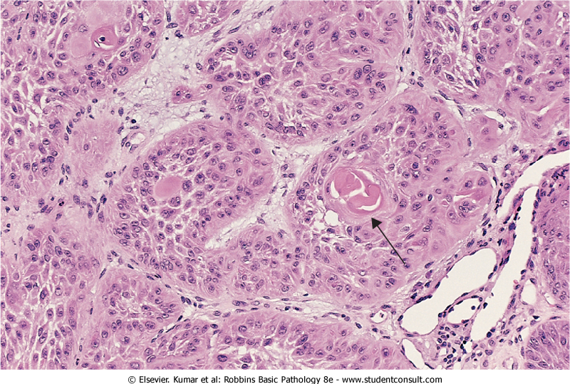
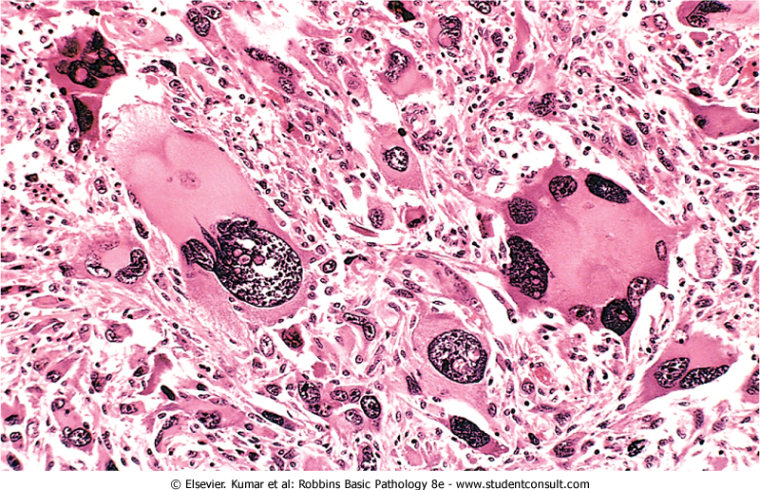
Characteristics to consider: differentiation vs. anaplasia
Benign tumors usually consist of differentiated cells, e.g. lipomas (fat) and leiomyomas (smooth muscle)
Malignant tumors can range from being well-differentiated to undifferentiated or anaplastic
Well-differentiated squamous cell carcinoma
Anaplastic rhabdomyosarcoma
Notes:
Left: Figure 6-3. Well-differentiated squamous cell carcinoma of the skin. The tumor cells are strikingly similar to normal squamous epithelial cells, with intercellular bridges and nests of keratin pearls (arrow). (Courtesy of Dr. Trace Worrell, Department of Pathology University of Texas, Southwestern Medical School, Dallas, Texas.)
Right: Figure 6-4. Anaplastic tumor of the skeletal muscle (rhabdomyosarcoma). Note the marked cellular and nuclear pleomorphism, hyperchromatic nuclei, and tumor giant cells. (Courtesy of Dr. Trace Worrell, Department of Pathology, University of Texas Southwestern Medical School, Dallas, Texas.)

Slide 18
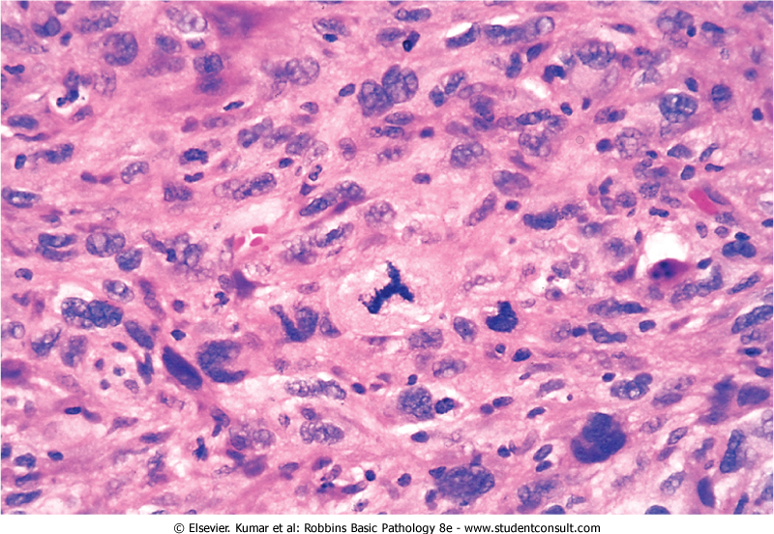
Hallmarks of anaplasia
Pleiomorphism (cellular and nuclear)
Hyperchromatic nuclei
Giant cells
Abnormal mitoses
Notes:
Figure 6-5. High-power detail view of anaplastic tumor cells shows cellular and nuclear variation in size and shape. The prominent cell in the center field has an abnormal tripolar spindle.

Slide 19
Other characteristics to consider:
Rate of growth – benign tumors tend to grow slowly whereas malignant tumors grow more rapidly
Local invasion – benign lesions are usually (but not always) encapsulated whereas cancers grow by progressive infiltration into surrounding tissue
Metastasis – development of secondary implants in remote tissue that is discontinuous with the primary tumor.
Spread by seeding occurs when tumors invade a space or cavity (e.g. peritoneum, pleura, cerebral ventricles, etc.)
Lymphatic spread occurs by tumor cells (usually –carcinomas) traveling via lymph vessels
Hematogenous spread occurs by tumor cells (usually –sarcomas) traveling via blood vessels. Favored sites are lung and liver

Slide 20
Benign vs. Malignant: a summary
Notes:
Figure 6-12. Comparison between a benign tumor of the myometrium (leiomyoma) and a malignant tumor of similar origin (leiomyosarcoma).

Slide 21
Cancer Incidence
~1.4 M new cancer cases in 2006:
~30% prostate(♂) /breast (♀)
~12% lung
10% colon
~565k cancer deaths in 2006:
~30% lung
9% prostate / 15% breast
10% colon
Notes:
Figure 6-13 Cancer incidence and mortality by site and sex. (Adapted from Jemal A, et al.: Cancer statistics, 2006. CA Cancer J Clin 56:106, 2006.)

Slide 22
Factors contributing to carcinogenesis
Age - In general, the frequency of cancer increases with age. Most cancer deaths occur between ages 55 and 75.
Heredity - genetic predisposition to cancer can give rise to hereditary cancers:
Inherited Cancer Syndromes – inheritance of a single mutant gene
Familial Cancers – observed familial clustering but NOT associated with any specific markers
Inherited Recessive Syndrome – associated with defective DNA repair gene
Preneoplasia - recognized tissue insults that can progress to cancer (e.g. liver cirrhosis, bronchial dysplasia, endometrial hyperplasia, esophageal dysplasia, leukoplakia)
Environmental Agents – exposure to agents that either damage cells or DNA increases cancer risk (chemicals, radiation, pathogens, biologically active compounds)

Slide 23
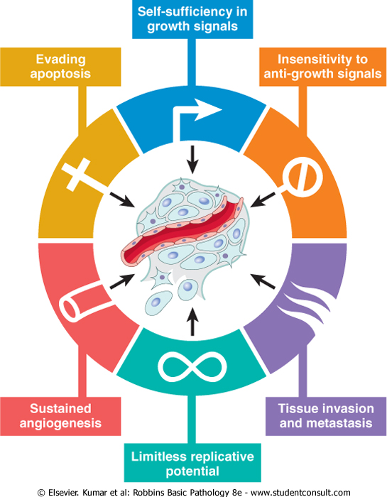
Carcinogenesis
Hallmarks of cancer:
Self-sufficiency in growth signals
Insensitivity to anti-proliferative signals
Evasion of apoptosis
Limitless replicative potential
Sustained angiogenesis
Tissue invasion
Mostly caused by mutations in genes that regulate these processes.
Proto-oncogene: genes that normally promote cell proliferation
Oncogene: mutant version of proto-oncogene that can function autonomously to promote growth
Notes:
Figure 6-17 Six hallmarks of cancer. Most cancer cells acquire these properties during their development, typically by mutations in the relevant genes. (From Hanahan D, Weinberg RA: The hallmarks of cancer. Cell 100:57, 2000.)

Slide 24
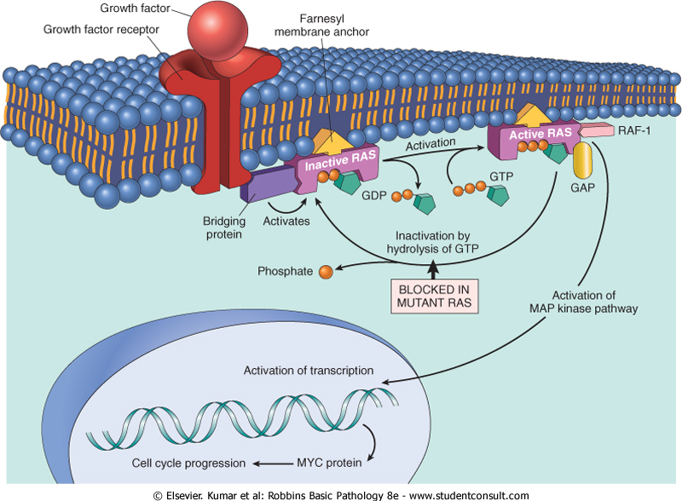
Self-sufficient Growth Signals
Alterations in any aspect of growth factor pathways can cause cells to proliferate uncontrollably (e.g. the FGF-RAS-MAP kinase pathway):
Growth factors themselves
Growth factor receptors
Signal transduction proteins
Nuclear transcription factors
Notes:
Figure 6-18 Model for action of RAS genes. When a normal cell is stimulated through a growth factor receptor, inactive (GDP-bound) RAS is activated to a GTP-bound state. Activated RAS recruits RAF-1 and stimulates the MAP-kinase pathway to transmit growth-promoting signals to the nucleus. MYC gene is one of several targets of the activated RAS pathway. The mutant RAS protein is permanently activated because of inability to hydrolyze GTP, leading to continuous stimulation of cells without any external trigger. The anchoring of RAS to the cell membrane by the farnesyl moiety is essential for its action, and drugs that inhibit farnesylation can inhibit RAS action.

Slide 25
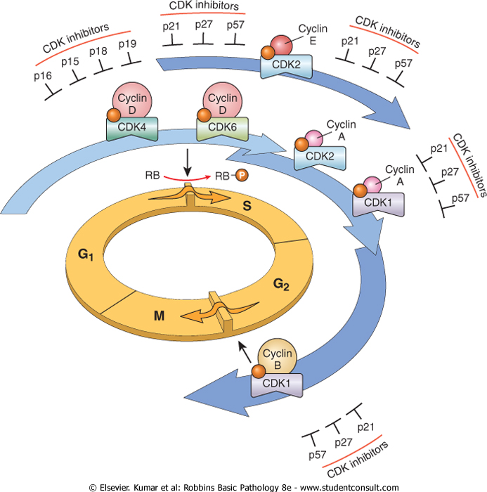
Self-sufficient Growth Signals
Alterations in cell-cycle control proteins can lead to unchecked proliferation:
Cyclins
Cyclin-depedent kinases
CDK inhibitors
Notes:
Figure 6-19 Schematic illustration of the role of cyclins, CDKs, and CDKIs in regulating the cell cycle. The shaded arrows represent the phases of the cell cycle during which specific cyclin-CDK complexes are active. As illustrated, cyclin D-CDK4, cyclin D-CDK6, and cyclin E-CDK2 regulate the G₁-to-S transition by phosphorylation of the RB protein (pRB). Cyclin A-CDK2 and cyclin A-CDK1 are active in the S phase. Cyclin B-CDK1 is essential for the G₂-to-M transition. Two families of CDK inhibitors can block activity of CDKs and progression through the cell cycle. The so-called INK4 inhibitors composed of p16, p15, p18, and p19, act on cyclin D-CDK4 and cyclin D-CDK6. The other family of three inhibitors, p21, p27, and p57, can inhibit all CDKs.

Slide 26
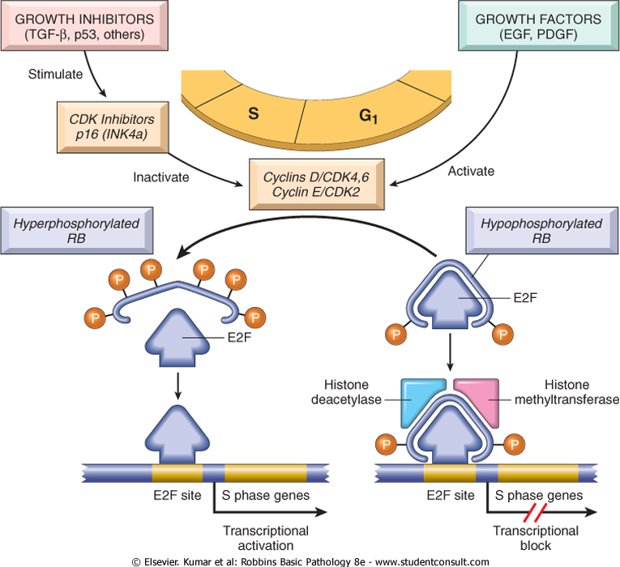
Insensitivity to Growth Inhibition: the RB gene, a tumor suppressor
The RB gene normally controls the G₁-to-S transition – in its active form, RB is hypo-phosphorylated and prevents expression of genes necessary for DNA replication, so cells are arrested in G_{1.} Mutations or alterations anywhere in the RB pathway can release this brake.
Notes:
Figure 6-21 The role of RB in regulating the G₁-S checkpoint of the cell cycle. Hypophosphorylated RB in complex with the E2F transcription factors binds to DNA, recruits chromatin remodeling factors (histone deacetylases and histone methyltransferases), and inhibits transcription of genes whose products are required for the S phase of the cell cycle. When RB is phosphorylated by the cyclin D-CDK4, cyclin D-CDK6, and cyclin E-CDK2 complexes, it releases E2F. The latter then activates transcription of S-phase genes. The phosphorylation of RB is inhibited by CDKIs, because they inactivate cyclin-CDK complexes. Virtually all cancer cells show dysregulation of the G₁-S checkpoint as a result of mutation in one of four genes that regulate the phosphorylation of RB; these genes are RB, CDK4, cyclin D, and CDKN2A [p16]. EGF, epidermal growth factor; PDGF, platelet-derived growth factor.

Slide 27
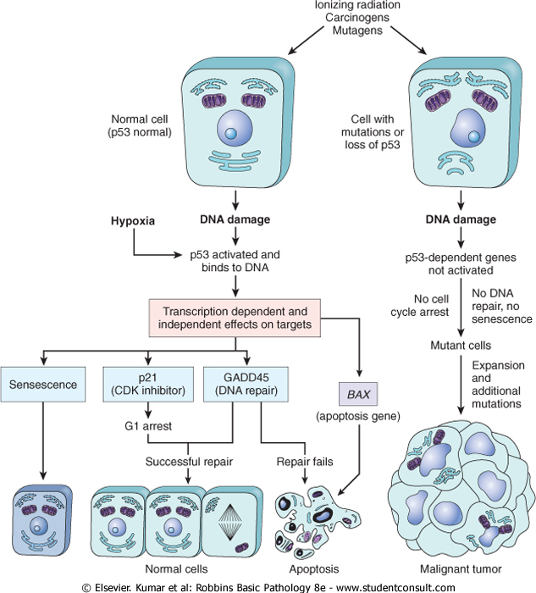
Insensitivity to Growth Inhibition: the p53 gene, another tumor suppressor
p53 normally monitors cellular stress and DNA damage. In the presence of damage, p53 arrests the cell to allow for repair.
If repair is unsuccessful, p53 elicits apoptosis.
Mutations or alterations in this pathway can lead to dysfunction of p53 and unchecked growth.
Notes:
Figure 6-22 The role of p53 in maintaining the integrity of the genome. Activation of normal p53 by DNA-damaging agents or by hypoxia leads to cell cycle arrest in G₁ and induction of DNA repair, by transcriptional up-regulation of the cyclin-dependent kinase inhibitor CDKN1A (p21) and the GADD45 genes. Successful repair of DNA allows cells to proceed with the cell cycle; if DNA repair fails, p53 triggers either apoptosis or senescence. In cells with loss or mutations of p53, DNA damage does not induce cell cycle arrest or DNA repair, and genetically damaged cells proliferate, giving rise eventually to malignant neoplasms.

Slide 28
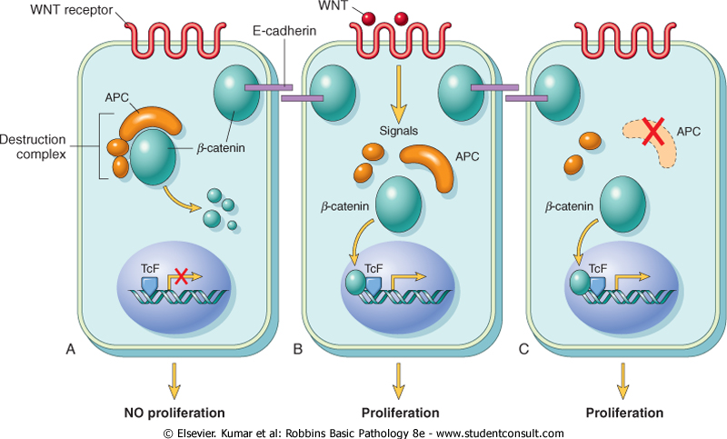
Insensitivity to Growth Inhibition: the APC gene, yet another tumor suppressor
APC normally inhibits the activity of β-catenin by targeting it for destruction. Alterations in APC or other aspects of the WNT pathway can lead to a release of this brake.
Notes:
Figure 6-23 A-C, The role of APC in regulating the stability and function of β-catenin. APC and β-catenin are components of the WNT signaling pathway. In resting cells (not exposed to WNT), β-catenin forms a macromolecular complex containing the APC protein. This complex leads to the destruction of β-catenin, and intracellular levels of β-catenin are low. When cells are stimulated by secreted WNT molecules, the destruction complex is deactivated, β-catenin degradation does not occur, and cytoplasmic levels increase. β-catenin translocates to the nucleus, where it binds to TcF, a transcription factor that activates several genes involved in the cell cycle. When APC is mutated or absent, the destruction of β-catenin cannot occur. β-catenin translocates to the nucleus and coactivates genes that promote the cell cycle, and cells behave as if they are under constant stimulation by the WNT pathway.

Slide 29
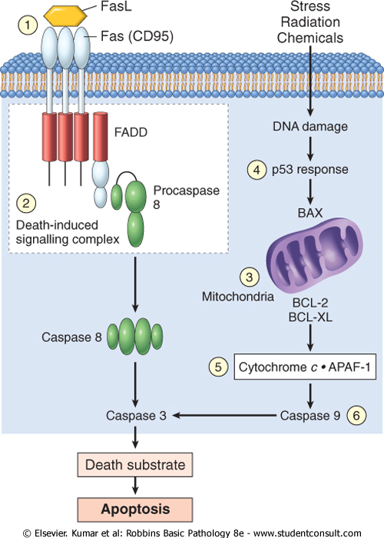
Evasion of apoptosis
Reduced expression of apoptosis signaling receptors (e.g. Fas)
Reduced expression of apoptosis signal transduction components (e.g. FADD)
Reduced expression of apoptosis effectors (e.g. caspase 8) or co-factors (e.g. APAF-1)
Upregulation of anti-apoptotic genes (e.g. BCL2)
Reduced p53-pathway activity
Notes:
Figure 6-24 Simplified schema of CD95 receptor-induced and DNA damage-triggered pathways of apoptosis and mechanisms used by tumor cells to evade cell death. (1) Reduced CD95 level. (2) Inactivation of death-induced signaling complex by FLICE protein. (3) Reduced egress of cytochrome c from mitochondrion as a result of up-regulation of BCL2. (4) Reduced levels of pro-apoptotic BAX resulting from loss of p53. (5) Loss of APAF-1. (6) Up-regulation of inhibitors of apoptosis.

Slide 30
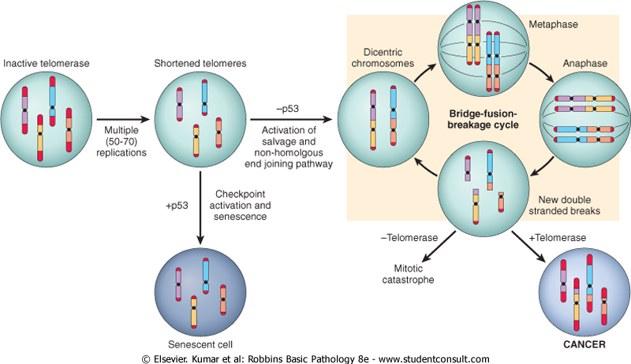
Limitless Replication
Chromosomes are capped by telomeres of finite length that shorten with each round of replication. Eventually, the telomeres become shortened enough to lead to senescence. Normal mature cells do not express telomerase (the enzyme required to maintain telomere length), but many tumor cells reactivate telomerase and therefore can grow indefinitely.
Notes:
Figure 6-25 Schematic illustration of the sequence of events in the development of limitless replicative potential. Replication of somatic cells, which do not express telomerase, leads to shortened telomeres. In the presence of competent checkpoints, cells undergo arrest and enter nonreplicative senescence. In the absence of checkpoints, DNA repair pathways are inappropriately activated, leading to the formation of dicentric chromosomes. At mitosis, the dicentric chromosomes are pulled apart, generating random double-stranded breaks, which then activate DNA repair pathways, leading to the random association of double-stranded ends and the formation, again, of dicentric chromosomes. Cells undergo numerous rounds of this bridge-fusion-breakage cycle, which generates massive chromosomal instability and numerous mutations. If cells fail to re-express telomerase, they eventually undergo mitotic catastrophe and death. Re-expression of telomerase allows the cells to escape the bridge-fusion-breakage cycle, thus promoting their survival and tumorigenesis.

Slide 31
Sustained Angiogenesis
Vascularization essential for the growth of solid tumors.
As tumors grow, they become hypoxic and release factors that cause blood vessels to grow into them - this can be further augmented by loss of function of regulatory components that regulate the release of pro-angiogenic factors (e.g. reduced activity of VHL, which normally antagonizes HIF induction of VEGF expression)
p53 activity normally leads to expression of anti-angiogenesis factors such as thrombospondin-1; loss of p53 will release this brake.
Also, many tumors secrete extra-cellular matrix proteases that further enable and promote angiogenesis.

Slide 32
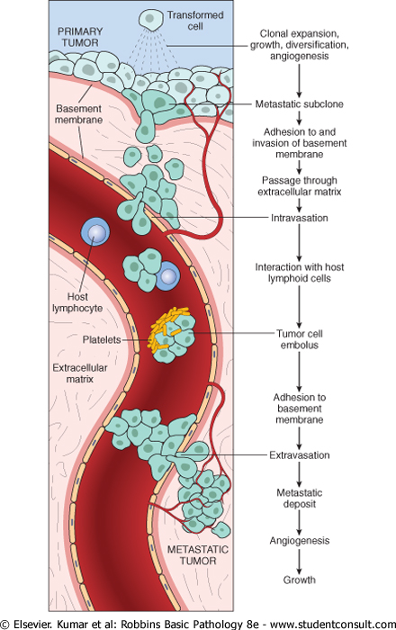
Metastasis
Invasion and passage through basement membrane
Migration through extracellular matrix
Migration into vessels (intravasation)
Adhesion to vascular endothelium (usually in lung or liver)
Extravasation and migration into tissue
Establishment and growth at new site
Notes:
Figure 6-26 The metastatic cascade. Schematic illustration of the sequential steps involved in the hematogenous spread of a tumor.

Slide 33
Effects on the patient
Impingement on nearby structures can alter their function (e.g. nerve compression, blockage of glandular ducts, dyspnea, dysphagia, etc.)
Internal bleeding or infarction
Paraneoplastic syndromes
Hypercalcemia due to PTH production by tumor cells
Cushing syndrome due to ACTH production by tumor
Hypercoagulability (production of coagulation factors by tumor?)
Cachexia: progressive loss of body fat and lean body mass accompanied by profound weakness and anemia
Likely mediated by TNF and other factors
Patients often have reduced appetite, but basal metabolic rate remains high in spite of starvation
Lipid mobilization is compromised so muscle wasting occurs
Only known “cure” is to remove the tumor
Estimated that ~33% of cancer deaths is due to cachexia

Slide 34
Staging Of Cancer
Standardized way of classifying disease progression
Critically important for:
Prognosis and treatment
Comparison to literature

Slide 35
Staging of Cancer
Stage is based on:
Size of the primary tumor and/or extent of local invasion
Extent of spread to regional lymph nodes
Presence or absence of distant metastases

Slide 36
Staging of Cancer
Two major systems:
UICC: Union Internationale Contre Cancer
AJCC: American Joint Committee on Cancer Staging

Slide 37
UICC: TNM System
T: Primary tumor size
T0 (in situ) to T4 (very large)
N: Lymph node involvement:
N0 (no nodal involvement) to N3 (multiple involved lymph nodes)
M: Distant metastases,
M0 (no distant metastases) to M1 and M2 (multiple metastases)

Slide 38
AJCC: STAGE I - IV
Stage I
Smallest tumors.
Stage II, III
Larger tumors, more local spread.
Stage IV
Metastases

Slide 39
“Stage Grouping” Each cancer has a table that “groups” TNM possibilities into the 4 AJCC stages
AJCC
UICC
Tumors with similar AJCC stage have similar survival

Slide 40
Cancer stage is critical for determining prognosis and therapy
Stage is usually the single most important predictor of survival

