Slide 1
Hemodynamic Disorders, Thrombosis, Shock
Matthew Velkey
matt.velkey@duke.edu
454A Davison, Duke South, Green Zone

Slide 2
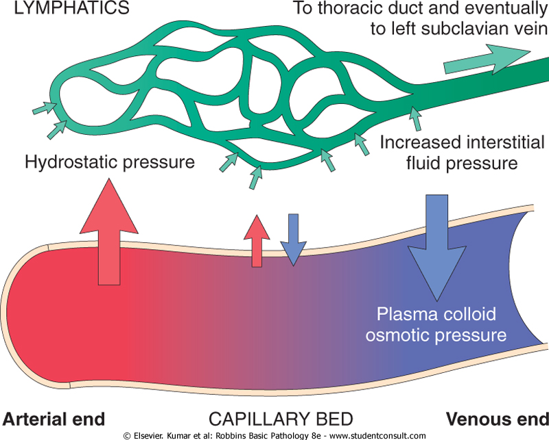
Fluid Homeostasis
Total extracellular tissue fluid volume
= hydrostatic pressure – [colloid osmotic pressure + lymphatic drainage]
Disruption in fluid homeostasis = edema

Slide 3
Localized Edema
Inflammatory
Combination of increased blood flow due to arteriolar vasodilation AND increased leakiness of capillary endothelium
Mechanical
Blockage of lymph vessels
Filariasis (nematode infection)
Neoplasia
Chemoterapy/radiotherapy damage to lymphatics

Slide 4
Systemic Edema
Increased hydrostatic pressure
Gravity
Congestive Heart Failure
Venous Obstruction
DVT, Vena cava obstruction
Cirrhosis –backs up blood in hepatic portal system
Constrictive Pericarditis –similar to CHF, heart can’t pump
Reduced Osmotic Pressure
Liver failure (not making enough albumin)
Nephrotic syndrome (losing too much albumin)
Sodium (and water) retention
Acute renal failure

Slide 5
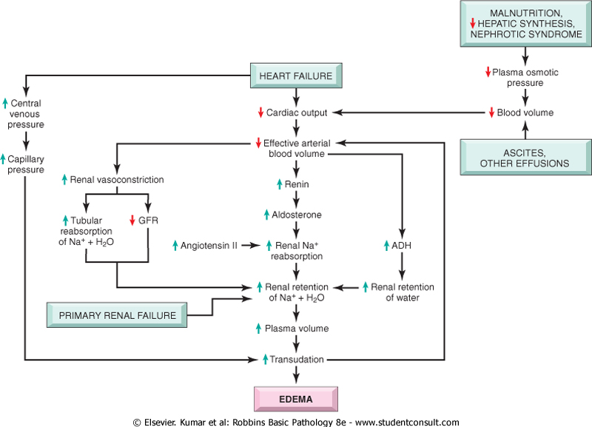
Pathways to systemic edema
Reduced Oncotic Pressure
Malnutrition
Liver failure/dysfunction
Can’t make enough albumin
Also causes hepatic portal congestion
Nephrotic syndrome
Glomerular capillaries too leaky and albumin is lost in urine

Slide 6
Pathways to systemic edema
Congestive Heart Failure
RV failure: blood backs up in vena cava
LV failure: blood backs up first in lungs, then vena cava
Low cardiac output stimulates Renin-Angiotensin-Aldosterone pathway and sets up vicious cycle in kidneys
AngII raises systemic BP
Aldosterone increases Na+ retention
ADH increases water retention

Slide 7
Edema in Congestive Heart Failure
Right-sided Heart Failure:
Right atrial pressure
Systemic venous pressure
Congestion where?
Increases
Increases
Systemic
- Centrilobular Liver Congestion (venous)
- Lower Extremity Edema

Slide 8
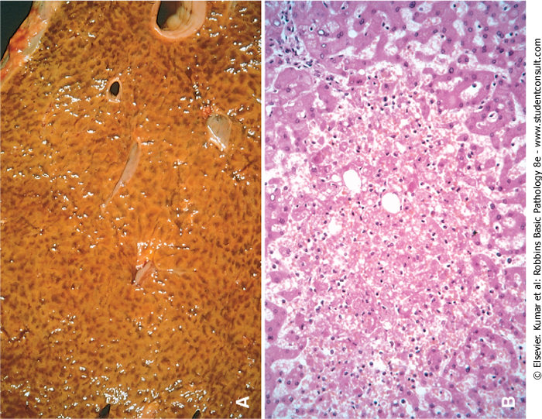
Centrilobular Hepatic Congestion
Blood backs up in liver and impedes flow of oxygenated blood into deepest zones (around central veins), thus causing “central” necrosis and giving the liver a mottled, “nutmeg” appearance.

Slide 9
Edema in Congestive Heart Failure
Left-sided Heart Failure:
Left atrial pressure:
Pulmonary venous pressure:
Pulmonary edema/congestion: Key feature of left heart failure, can lead to pulmonary edema
Right atrial pressure:
Increases
Increases
No initial change

Slide 10
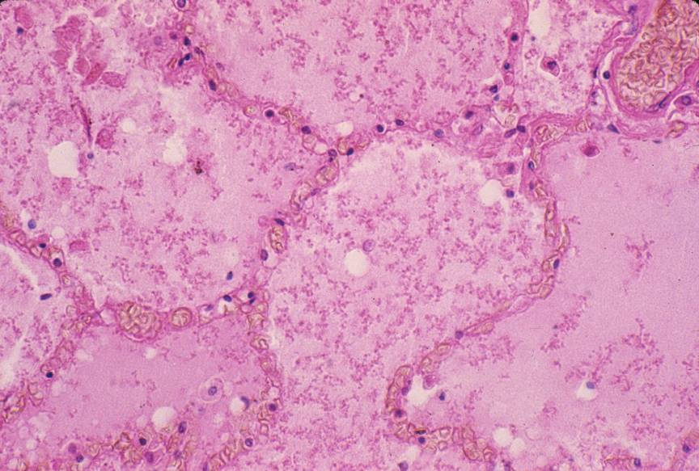
Pulmonary edema

Slide 11
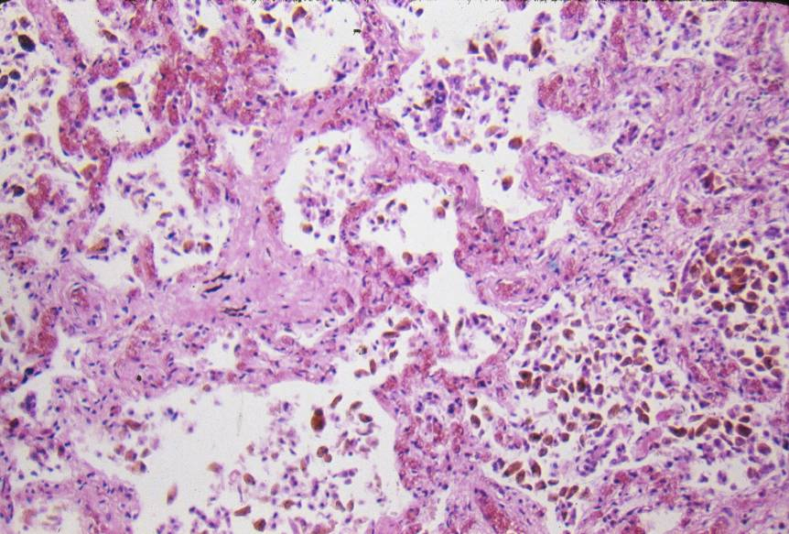
Chronic Pulmonary Congestion

Slide 12
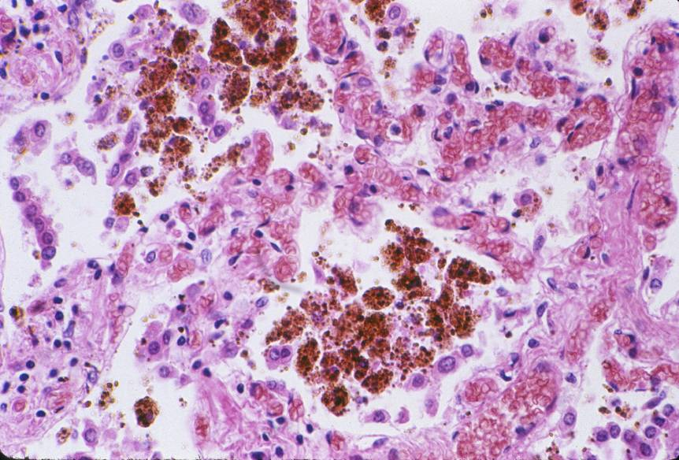
Chronic Pulmonary Congestion
Blood extravasates from capillaries and is taken up by resident macrophages that become engorged with hemosiderin at which point they are commonly referred to as “heart failure cells.”

Slide 13
Hemorrhage
In skin, mucous membranes, or serosal surfaces:
Petechiae - tiny (1-2 mm)
Purpura - medium-sized (> 3 mm & < 1 cm)
Ecchymoses - bruises (> 1 cm)
Hematoma = collection of blood in an organ or tissue:
Hemothorax: in the thorax
Hemoperitoneum: in the peritoneum
Hemopericardium: in the pericardium
Hemarthrosis: in joint

Slide 14
Hemostasis
Sequence of events following vascular injury that results in the formation of a clot (stasis)
Key regulators are endothelial cells and platelets

Slide 15
Platelets (thrombocytes)
Life Span: about 10 days
Shape, size, and origin: Small, biconvex disks, 2-3 µm in diameter. Non-nucleated cell fragments derived from cytoplasm of a very large cell, the megakaryocyte, in bone marrow. Platelets have a life span of about 10 days.
LM appearance in smears: Small basophilic fragments, often appearing in clusters.
TEM appearance: The platelet is bounded by a plasma membrane, and has a bundle of microtubules around the margin of the disk (which maintains the disk shape). There are three types of granules, containing fibrinogen, plasminogen, thromboplastin and other factors for clotting. There are also membrane tubules and glycogen.
Function: Platelets initiate blood clots.

Slide 16
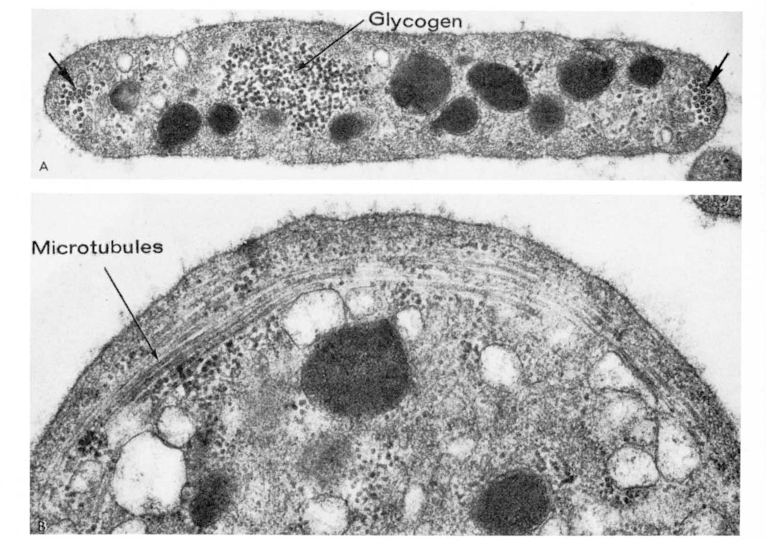
Transmission electron micrographs of a platelet seen in cross section (above) and in a section in the plane of the disk (below)
granule
membrane tubule
Notes:
A platelet is shaped like a biconvex disk. This figure shows two electron micrographs of the disk, one cut in cross section (above), and the other cut in the plane of the disk (below). See the legend for a description.
From Fawcett's Histology, 11th edition, page 118. PlateletEM-Fawc11-118.tif.

Slide 17
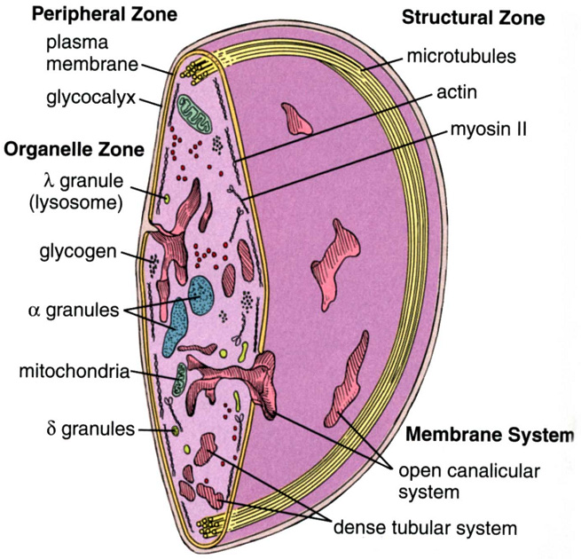
Cutaway diagram of a platelet
Peripheral microtubule bundle (maintains shape)
Actin and myosin (clot contraction)
Organelles facilitate clotting:
Mitochondria for ATP production
Granules contain clotting factors
Dense tubular system sequesters Ca⁺⁺ for signaling (similar to SR in skeletal muscle)
Open canalicular system facilitates signaling and secretion
(Ca++)
Notes:
Cutaway diagram of a platelet, showing its organelles and inclusions.
From Ross' Histology, 4th edition, page 230.

Slide 18
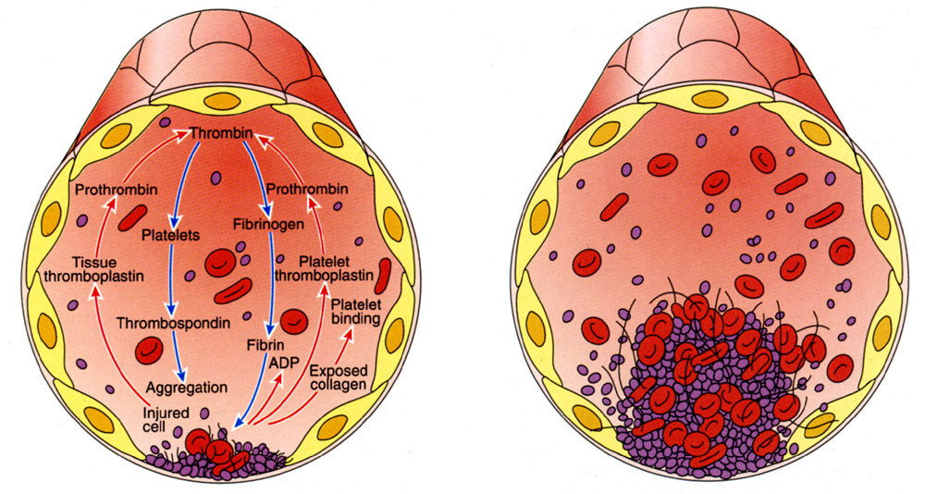
Platelets and blood clot formation
When a blood vessel wall is damaged, factors from the damaged endothelial cells and the ECM induce the clotting cascade. Platelets aggregate and release proteins for clot formation and resolution:
1. Vasoconstriction –via release of endothelin (from endothelium)
2. Further platelet aggregation –mediated via thromboxane A₂ and ADP
3. Fibrin polymerization –initiated by thromboplastin and free Ca⁺⁺
4. Clot contraction –via actin, myosin, and ATP released into the matrix of the clot
5. Clot resolution –platelet plasminogen activator (pPA, converts plasminogen into active fibrinolytic plasmin)
6. Tissue repair –platelet derived growth factor (PDGF, stimulates smooth muscle and fibroblast proliferation)
thromboplastin
thrombin
Prothrombin
Thrombin
Fibrinogen
Ca⁺⁺
Fibrin
Fibrin polymerization
Notes:
The role of platelets and other components in blood clot formation.
From Fawcett's Concise Histology, 2nd ed., page 45. BloodClot-FawcConc2-45.tif.

Slide 19
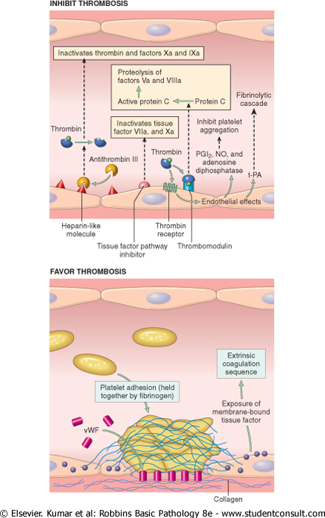
Endothelial modulation of clotting
Antithrombotic properties
Antiplatelet effects:
Endothelial prostacyclin (PGI₂) and Nitric Oxide inhibit platelet aggregation
ADPase: degrades ADP thus inhibiting platelet aggregation
Anticoagulant effects:
Heparin-like co-factors mediate antithrombin III inactivation of thrombin
Thrombomodulin binds and converts thrombin to an anticoagulant enzyme that activates protein (which then inactivates downstream clotting factors)
Fibrinolytic effects:
tissue plasminogen activator (tPA) activates plasmin which promotes lysis of clots

Slide 20
Endothelial modulation of clotting
Prothrombotic properties
von Willebrand Factor:
Cofactor made by endothelial cells and bound to underlying collagen; when exposed allows platelets to bind to collagen and start to aggregate
Tissue factor:
Activates clotting cascade
Induced by proinflammatory cytokines such as IL-1 and TNF
Plasminogen activator inhibitors (PAIs):
Prevents cleavage of plasminogen into active plasmin, thus inhibiting fibrinolysis

Slide 21
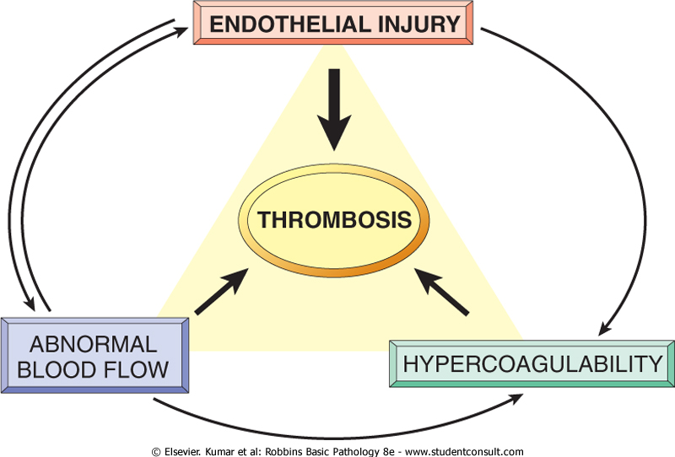
Perturbations in hemostasis result in thrombosis
Endothelial injury:
Direct injury
Depletion of anticoagulants (e.g. PGI₂ by Cox-2 inhibitors)
Upregulation of procoagulants (e.g. inflammation)
Abnormal blood flow:
Aneurismal dilation of vessels create local stasis
Hyperviscosity (too many erythrocytes in blood)
Sickle cell anemia
Turbulence at branchpoints
Virchow’s triad
Hypercoagulability:
Protease-resistant clotting factors (e.g. factor V Leiden): resistant to cleavage and therefore more active
Hormonal: estrogen increases production of clotting factors and reduces anticoagulant factors
Heparin-induced thrompocytopenia: administration of full-length heparin causes antibodies to develop that inactivate its antithrombotic activities
Antiphospholipid antibody syndrome: often seen in autoimmune disease (e.g. lupus), Abs activate platelets and inhibit PGI₂ synthesis, thus promoting hypercoagulable state.

Slide 22
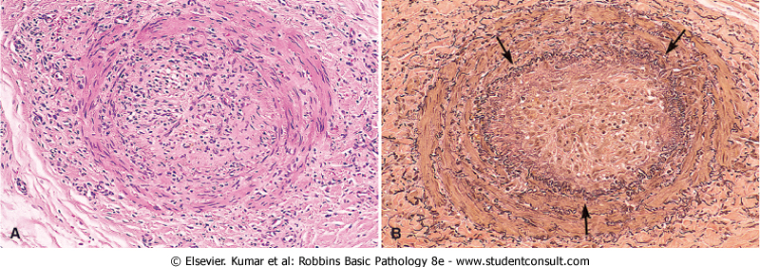
Fate of a thrombus
Dissolution: fibrinolytic activity completely clears thrombus
Organization and recanalization or incorporation: thrombi in vessels induce inflammation and fibrosis (organization); these can recanalize (shown below) or they can become incorporated into the vessel wall
Propagation: thrombus stimulates further platelet aggregation and growth that may eventually occlude vessel lumen
Embolization: thrombi may break off and plug a distant site

Slide 23
Venous vs. arterial thromobosis
Venous thrombosis
Superficial (varicosities): cause local edema, pain, and perhaps ulceration; rarely embolize
Deep (i.e. “DVT”): rarely cause local pain due to collaterals, but often embolize with significant consequences
Arterial thrombosis
Atherosclerosis: rupture of plaques induces clotting and occlusion of vessels
Mural thrombosis: post-infarction or post-infection damage to lining of heart induces formation of clots that can break off and plug a distant site.

Slide 24
Embolism
Embolus = detached mass that is carried to a site distant from its origin, for example:
Fat: bone marrow or soft tissue trauma releases adipocytes into blood that can plug distant sites
Air: rapid depressurization causes gas to bubble out of solution; these bubbles block blood vessels causing infarction in muscles, brain, and other organs
Amniotic fluid: trauma during childbirth may allow amniotic fluid (and its non-fluid contents such as dead skin cells, mucus, etc.) to enter maternal circulation and cause remote blockages.

Slide 25
Thromboembolism
Embolism causing blockage is derived from a thrombus
Pulmonary thromboembolism: thrombus (usually from a DVT) breaks off and goes to right ventricle. From there it is pumped out to the lungs and blocks pulmonary arteries. The problem at first is not the ischemia per se, but instead that this blood is not oxygenated and does not return to the heart (thus eventually causing systemic ischemia).
Systemic thromboembolism: thrombus originates in left ventricular wall or wall of aorta breaks off and causes infarction at a distant site (brain, kidney, spleen).

Slide 26
Infarction
Area of ischemic necrosis caused by occlusion of arterial supply or venous drainage. The nature and extent of damage is influenced by:
Nature of blood supply: tissues with dual or collateral blood supply (e.g. lungs, liver, and limbs) are less affected compared to end organs (muscles, brain, kidney, spleen)
Rate of development: slowly progressing occlusion tolerated because of development of collateral routes
Tissue vulnerability: neurons can withstand only 3-4 minutes of hypoxia, myocytes ~30 minutes, fibroblasts can survive many hours in low oxygen.

Slide 27
Shock
Systemic hypoperfusion caused by reduced cardiac output or reduced blood volume, resulting in 1) hypotension, 2) impaired tissue perfusion, and 3) cellular hypoxia.
General categories are:
Cardiogenic: reduced cardiac output
Hypovolemic: reduced blood volume
Hemorrhagic: blood loss
Neurogenic: vasodilation following nerve cord injury
Anaphylactic: systemic vasodilation and respiratory insufficiency
Septic: over-reactive inflammatory response to infection

Slide 28
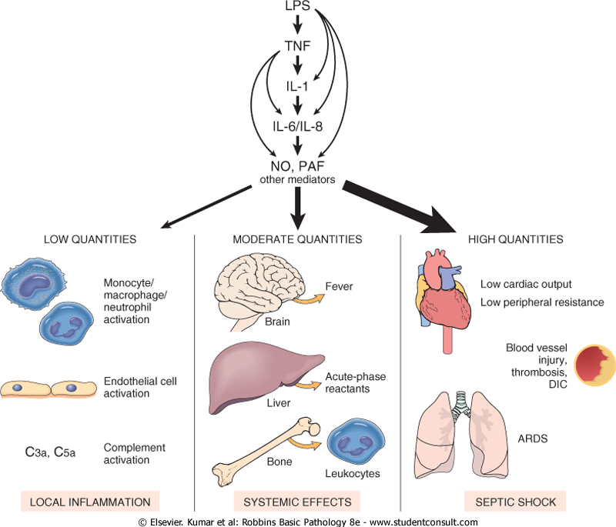
Septic shock
Cytokine storm of TNF, IL-1, and IL-6 in response to bacterial antigens (usu. lipopolysaccharides from gram-negative bacilli) resulting in:
Systemic vasodilation
Reduced cardiac contractility
Widespread endothelial injury and activation
Systemic activation of clotting cascade (Disseminated Intravascular Coagulation or “DIC”)

Slide 29
General stages of shock
Nonprogressive stage: reflex compensatory mechanisms (tachycardia, peripheral vasoconstriction, renal fluid retention) compensate for hypoperfusion.
Causes common symptoms associated with shock: weak, rapid pulse; shallow, rapid breathing; and cool, clammy skin (the exception is septic shock that may present with flushing due to widespread inflammatory response).
Progressive stage: metabolic lactic acidosis blunts vasomotor response and blood starts to pool in peripheral tissues (increasing hypercoagulative risk), vital organs perfused less and begin to fail.
Clinical symptoms associated with this phase are reduced urine output, acidosis, and electrolyte imbalances
Irreversible stage: widespread tissue necrosis induces systemic inflammatory response (vasodilation, etc.), reduced cardiac function, and acute renal failure.

