Slide 1
Respiratory Diseases
J. Matthew Velkey
matt.velkey@duke.edu
454A Davison, Duke South, Green Zone

Slide 2
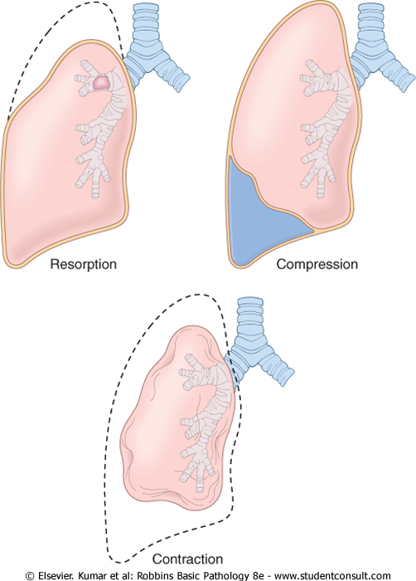
Atelectasis (collapse)
Resorption
  Obstruction (e.g. infection or inflammation or mucous plug in CF patients): air downstream of blockage is slowly resorbed
Compression
  Pneumothorax (air leak into pleural cavity)
  Hemothorax or other fluid
Contraction
  Localized fibrosis causes mechanical contraction and collapse of lung tissue

Slide 3
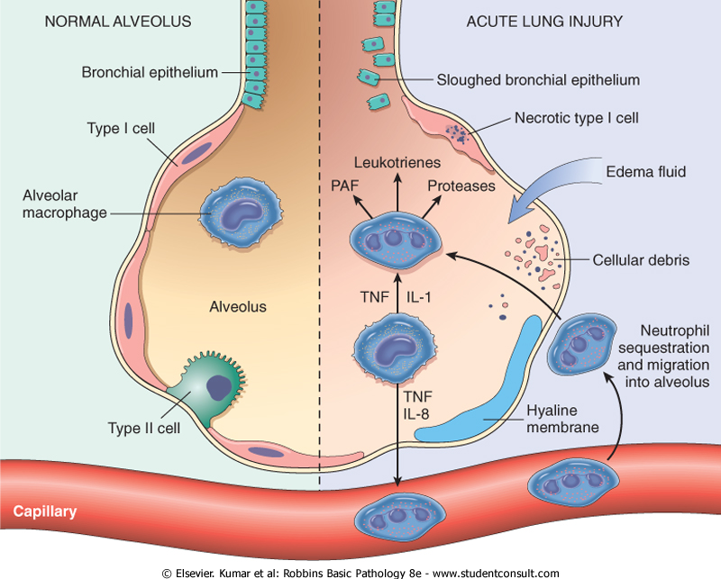
ARDS:
Acute Respiratory Distress Syndrome
Occurs in the setting of sepsis, severe trauma (smoke inhalation, drowning, etc.), and/or pulmonary infections
Imbalance in pro- and anti-inflammatory mediators
  NF-kB induces mphages to release TNF, Il-8, & Il-1 which recruits and activates neutrophils
  Activated neutrophils release factors that destroy tissue and recruit MORE inflammatory cells (positive feedback loop)
Results in diffuse damage to capillary and alveolar epithelium
  Effusion of blood and plasma due to capillary leakage
  Loss of surfactant due to type II pneumocyte damage

Slide 4
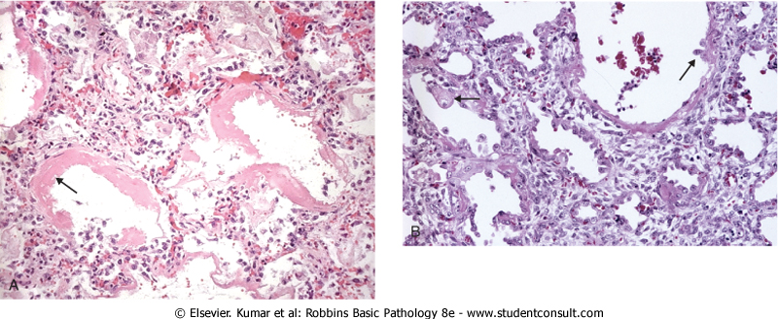
ARDS:
Acute Respiratory Distress Syndrome
Acute Phase: Capillary congestion Interstitial and intra-alveolar edema, Necrotic alveolar tissue Hyaline membranes: fibrin-rich edema fluid mixed with dead cells | Organizing Phase: Proliferation of Type II pneumocytes Organization and fibrosis Thickening of alveolar septa due to proliferating interstitial cells

Slide 5
Obstructive vs. Restrictive Pulmonary Diseases
Obstructive (e.g. emphysema, asthma, bronchitis)
  Limitation of airflow due to partial or complete airway obstruction
  Total lung capacity and forced vital capacity (FVC) are NORMAL, but Forced Expiratory Volume (FEV) is decreased (i.e. FEV:FVC ratio REDUCED)
Restrictive (e.g. fibrosis, asbestosis, sarcoidosis)
  Reduced expansion due to lung fibrosis
  FVC and FEV reduced proportionately

Slide 6
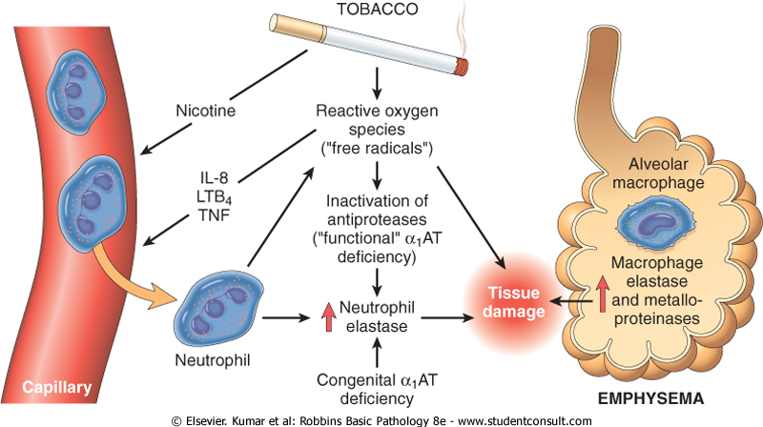
Emphysema
Chronic obstructive airway disease characterized by permanent enlargement of airways distal to bronchioles
Imbalance of protease/antiprotease activity and/or excess of reactive oxygen species activity
  Excessive activation of neutrophil and macrophage elastase associated with chronic smoking
  Hereditary α₁ anti-trypsin deficiency
Dyspnea and hyperventilation but with adequate gas exchange (until very late in disease), aka “pink puffers”

Slide 7
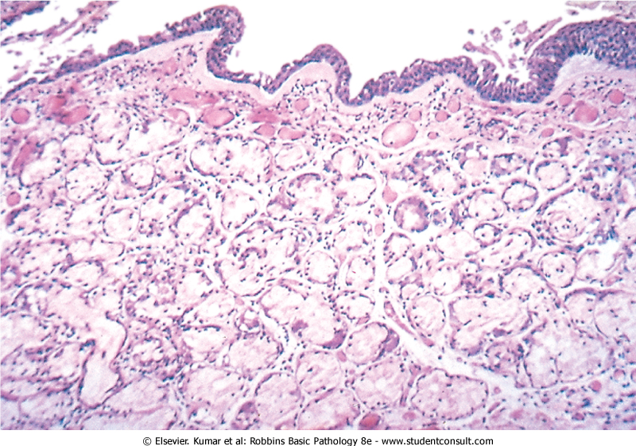
Chronic Bronchitis
Aka, “small airway disease”
Persistent productive cough for at least 3 months in at least 3 consecutive years
Hypersecretion of mucus, hypertrophy of mucous glands
Infiltrates of neutrophils, macrophages, and CD8+ T cells (IL-13 release stimulates mucus secretion)
Mucus plugging may completely occlude bronchiolar airways (bronchiolitis obliterans) and often results in opportunistic infections
Associated with hypoxia, cyanosis, and obesity, aka “blue bloaters”

Slide 8
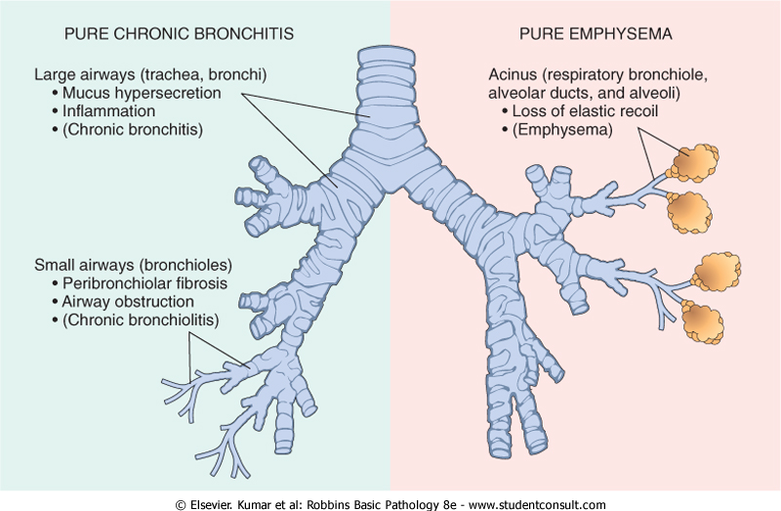
COPD
Chronic Obstructive Pulmonary Disease
Emphysema AND chronic bronchiolitis usually co-exist and are clinically grouped as “COPD”
Affects ~10% of US population, 4th leading cause of death
Irreversible airflow obstruction (vs. asthma in which obstruction is reversible) and (usually) pulmonary hypertension

Slide 9
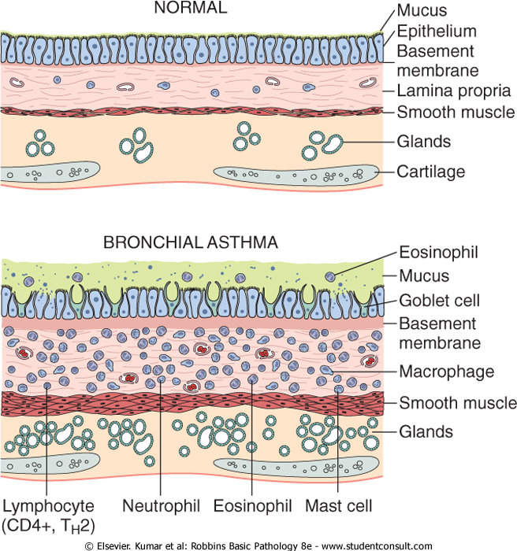
Asthma
Intermittent, reversible airway obstruction
Chronic eosinophilic bronchial inflammation
Bronchial smooth muscle hypertrophy and hyperreactivity
Usually extrinsic or “atopic” (immune hypersensitivity) but can be intrinsic or “non-atopic” (triggered by non-immune stimuli) –regardless of type clinical picture is the same

Slide 10
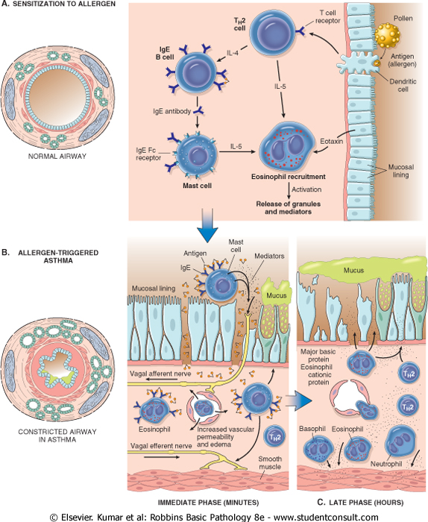
Asthma pathogenesis
Sensitization phase: antigens induce T_{H}2 cells
  T_{H}2 cells secrete factors that stimulate IgE production by Plasma Cells
  IgE binds to receptors on Mast Cells
  Mast Cells produce factors that recruit Eosinophils to tissue

Slide 11
Asthma pathogenesis
Reactive phases:
  Immediate: antigen binding to IgE on Mast Cells stimulates degranulation, releasing factors (e.g. leukotrienes, prostaglandin, histamine) that cause bronchoconstriction, edema, and mucus secretion AND recruit more inflammatory cells (particularly eosinophils).
  Late: Eosinophils degranulate, releasing factors that damage bronchial tissue

Slide 12
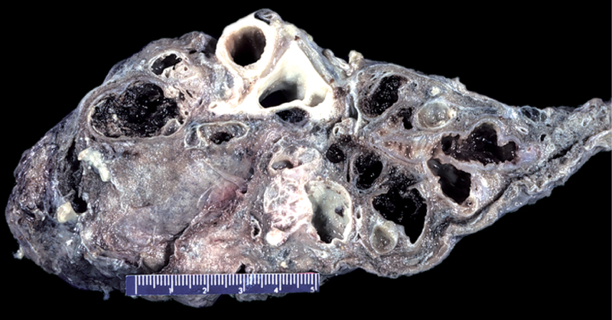
Bronchiectasis
Permanent dilation of bronchi and bronchioles caused by destruction of tissue secondary to chronic infections
  Bronchial obstruction: e.g. mucus plugs in CF patients, chronic bronchitis, asthma, or Kartagener syndrome facilitate infections
  Immunodeficiency (HIV, transplant).
Usually affects lower lobes
Characterized by markedly dilated bronchi and distal airways and intense acute inflammation within bronchi and bronchioles

Slide 13
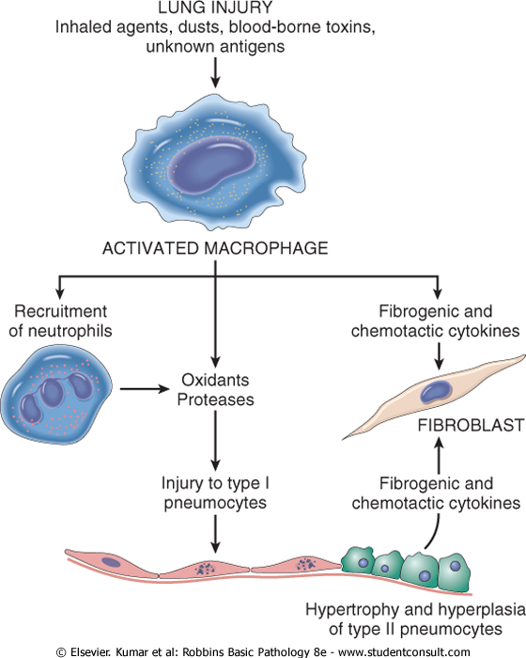
Diffuse Interstitial (Restrictive) Lung Diseases
Diffuse, chronic fibrosis of pulmonary connective tissue (i.e. the “interstitium”) surrounding alveoli
Stiffens and thickens lung tissue thereby reducing the airspace (FVC) AND the expiratory flow rate (FEV₁) proportionately
Activated macrophages are the key player:
  Damage alveoli and recruit neutrophils
  Secrete factors that induce fibrosis
  Damaged alveoli also induce fibrosis
Prototypical exemplars are Idiopathic Pulmonary Fibrosis, Pneumoconioses, and Sarcoidosis

Slide 14
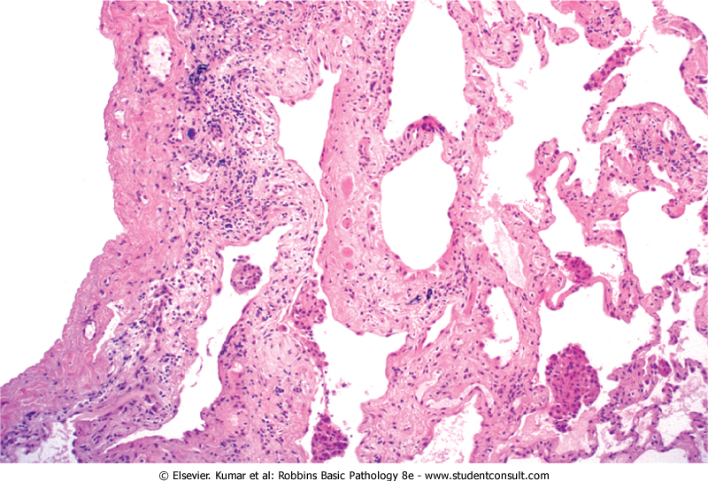
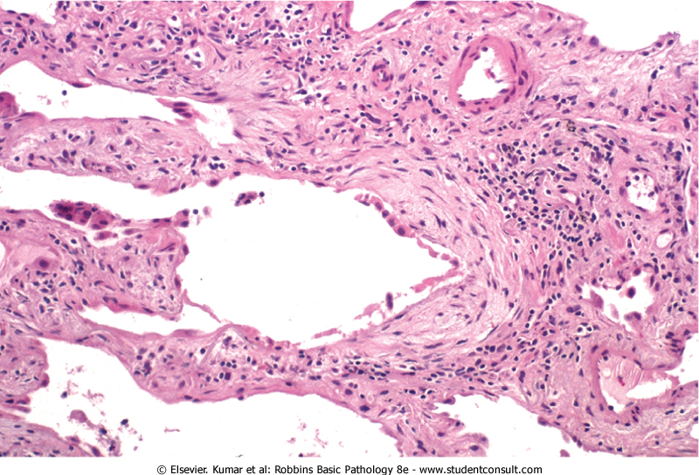
Idiopathic Pulmonary Fibrosis
Unknown etiology (hence idiopathic)
M > F, mostly > 60 years old
Presents with dyspnea and non-productive cough and progresses relentlessly
Characterized by patchy interstitial fibrosis
Eventually collapses alveoli and large, cystic spaces form giving the lung a honeycomb appearance

Slide 15
Pneumoconioses
Chronic fibrosing disease due to chronic exposure to particulates
Pulmonary macrophages play central role by promoting inflammation, alveolar damage, and fibrosis
Can progress to pulmonary dysfunction, pulmonary hypertension, and right-sided CHF
Examples include anthracosis (black lung), silicosis, and asbesosis

Slide 16
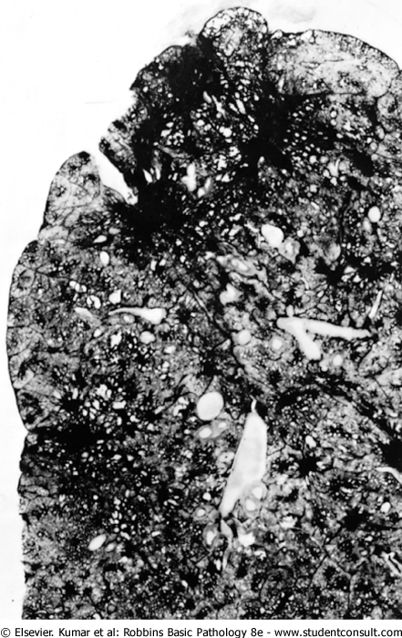
Anthracosis
(black lung)
Chronic exposure to coal dust
Tends to affect upper lobes first

Slide 17
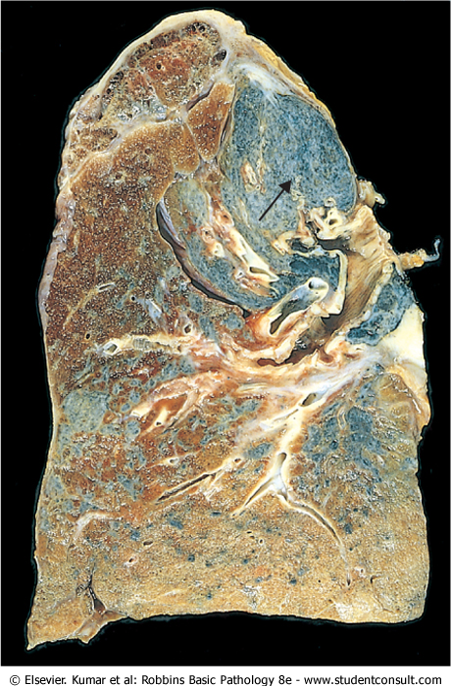
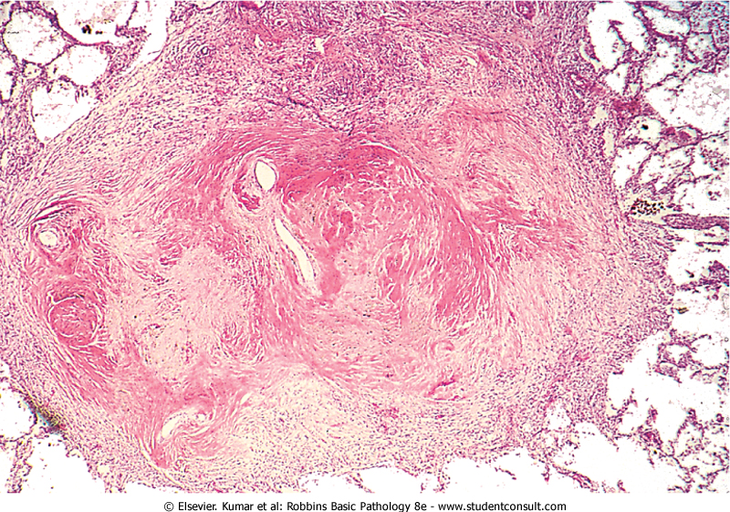
Silicosis
Chronic exposure to silica (sandblasting, drywall compound)
Characterized by silicotic nodules
Tends to affect upper lobes first

Slide 18
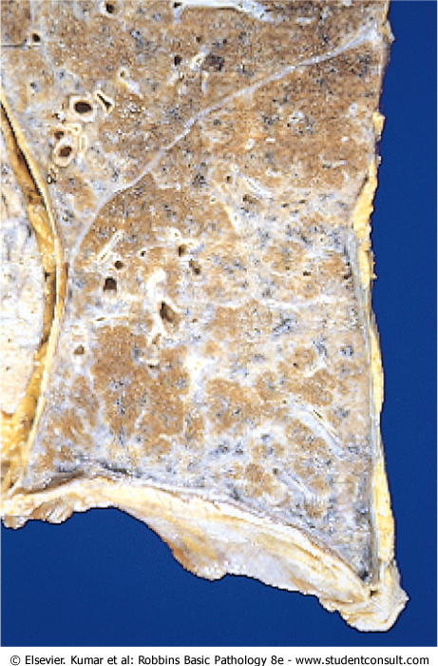
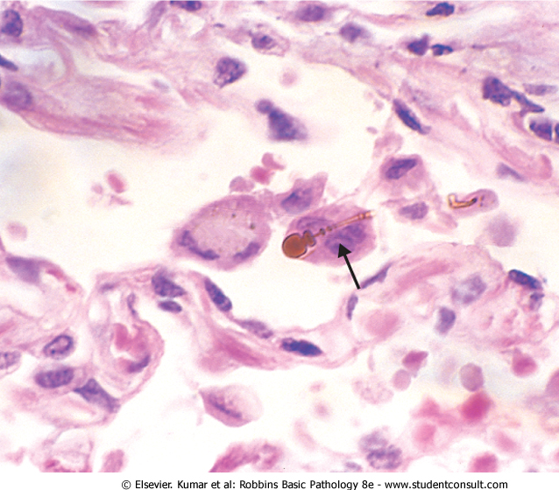
Asbestosis
Chronic exposure to asbestos
Characterized by asbestos bodies in the lung and fibrotic plaques in the parietal pleura
Tends to affect middle and lower lobes

Slide 19
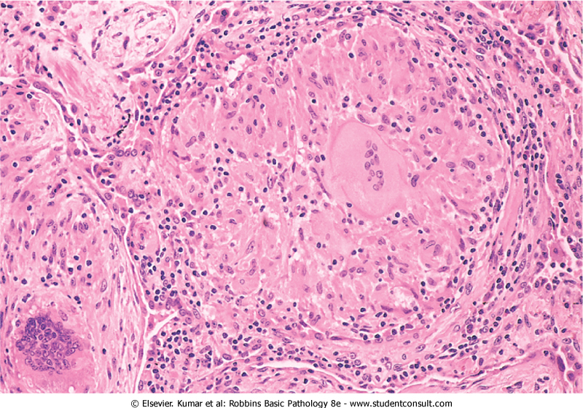
Sarcoidosis
Multisystemic disease of unknown etiology
Higher incidence in Scandinavian and African-American population, usually <40 yo
Lung tissuecontains high levels of CD4+ T_{H}1 cells and associated cytokines (IFNγ & IL-2)
Characterized by formation of non-caseating granulomas and interstitial fibrosis

Slide 20
Hypersensitivity Pneumonitis
Hypersensitivity reaction similar to asthma, however damage occurs in the ALVEOLI, so presents as a RESTRICTIVE lung disease rather than obstructive
Characterized by patchy mononuclear cell infiltrates and increased numbers of CD4+ and CD8+ T cells
Interstitial non-caseating granulomas may also be present

Slide 21
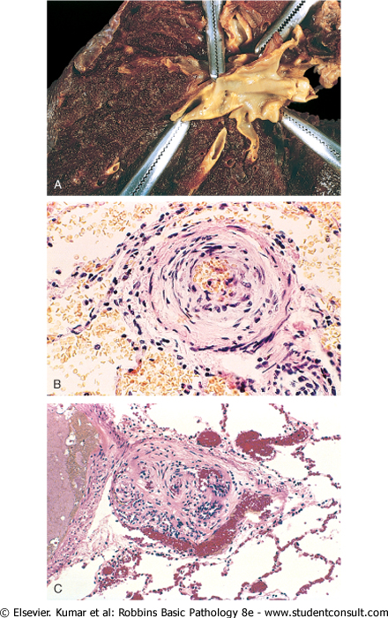
Pulmonary Hypertension
Often occurs with chronic obstructive or interstitial lung disease or secondary to cardiovascular disease
Can also be caused by recurrent embolization or mitral valve stenosis (blood can’t flow into LV as well so LA pressure increases and backs up into lungs
Often backs up blood into RV and may lead to right sided CHF
Vascular alterations in pulmonary arteries include:
  Atherosclerosis in distributing elastic arteries
  Medial and intimal thickening in muscular arteries
  Medial thickening and IEL disruption in small arteries, sometimes completely occluding lumen
  Plexogenic pulmonary arteriopathy: tufts of capillaries spanning small arteries

Slide 22
Pneumonia
Infection (usually bacterial) of the lung
Cause of one-sixth of all deaths
Two general patterns:
  Lobar: entire lobes are involved
  Bronchopneumonia: foci of inflammation corresponding to bronchial tree, usually bilateral and basal
Regardless of pattern, key to treatment is knowing what bug is causing the infection, the usual suspects are:
  Streptococcus pneumoniae (particularly w/ CHF, COPD, or Diabetes)
  Haemophilus influenzae (often in children or adults w/ chronic pulmonary disease)
  Moraxella catarrhalis (often in elderly or adults with COPD)
  Staphylococcus aureus (often after respiratory illness or associated with staph endocarditis)
  Klebsiella pneumoniae (often in malnourished individuals)
  Pseudomonas aeruginosa (often in hospital setting w/ neutropenic patients)
  Legionella pneumophila (often in transplant patients or those with chronic heart, renal, or blood disease)

Slide 23
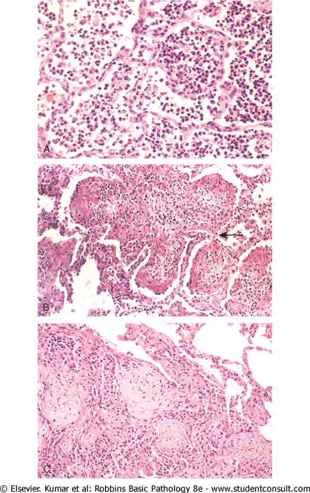
Pneumonia: clinical course
Congestion: affected lobes are congested, red, and boggy
Red hepatization: tissue is red and firm with a liver-like consistency; alveoli are packed with red blood cells, fibrin, and neutrophils
Gray hepatization: lung is gray due to lysis and ingestion of red blood cells and still firm and liver-like due to persistence of fibrinopurulent exudate within alveoli
Resolution: fibrinopurulent exudate mostly resorbed by macrophages but can also organize into fibrous scar
Possible complications include:
  Pleuritis: fibrinopurulent reaction in pleura may result in adhesions
  Abcess formation and cavitation (loss of alveoli)
  Empyema: accumulation of suppurative exudate within pleural cavity
  Fibrosis
  Bacteremic dissemination leading to meningitis, arthritis, or endocarditis

Slide 24
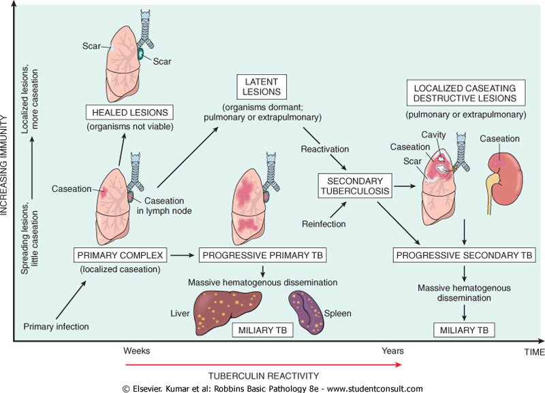
Tuberculosis
Chronic granulomatous disease caused by Mycobacterium tuberculosis, usually affecting the lung, but can affect any organ via hematogenous spread
  Initial exposure induces immune reaction that usually quells the infection and confers resistance, but foci of infection can harbor viable pathogens for years that can be reactivated in states of diminished immunity
  Primary exposure and/or secondary “reactivation” in immune compromised can result in massive, life-threatening systemic infections

Slide 25
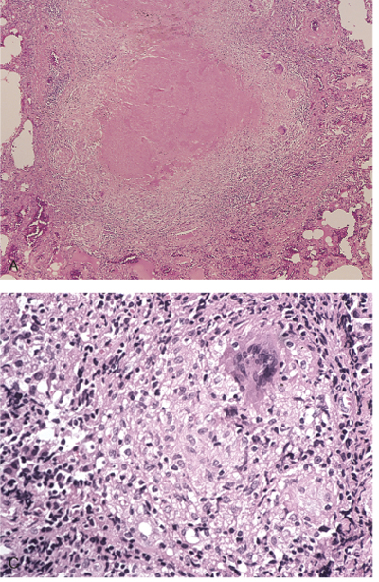
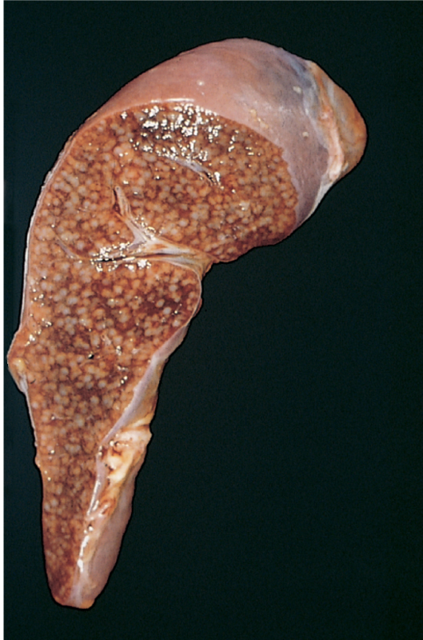
Tuberculosis features
Granulomas (often caseating but not always) ringed by epithelioid macrophages and giant cells
Hematogenous dissemination or “miliary” tuberculosis (so-called because of the millet seed appearance of infection foci)

Slide 26
Lung Cancers
#1 cause of cancer-related deaths
Peak incidence in 50s and 60s
At diagnosis, over 50% of patients already have metastatic disease.
Overall 5yr survival rate is ~15%
Often associated with paraneoplastic endocrine syndromes due to hypersecretion of various hormones such as PTH or ACTH
4 general types:
  Squamous cell carcinoma: more common in men, squamous metaplasia within major bronchi
  Adenocarcinoma: usually peripherally located, arise from mucous glands
  Large-cell carcinoma: undifferentiated, epithelial tumors (most likely started out as either squamous or adeno- but have de-differentiated such that they are no longer recognizable as such)
  Small-cell carcinoma: pale, gray, central masses; high mitotic index; likely derived from neuroendocrine cells; worst prognosis
  (5. Bronchial carcinoid: arise from Kulchinsky neuroendocrine cells, often resectable and curable)

