Slide 1
TBL in Normal Body
(separate from gross anatomy)
Physio Problems
In BlueDocs at 8:30 AM on most Fridays, 7 sets of questions
open book
take as an individual
questions vary in level of difficulty
continue to answer each question until you have chosen
the correct answer
keep up with the material!
contact either Dr. Jakoi or Dr. Carbrey if you have any questions
Team-Based Exercise (TBE) sessions - mandatory
just the Group Application Exercise portion of TBL
contact Drs. Carbrey or Jakoi if an excused absence
90% Group Application Exercise scores
10% peer assessment
each hour of the in-class TBE is worth 3 points in physiology
The materials from the TBEs are not allowed to be shared
with any future Duke or Duke-NUS students

Slide 2
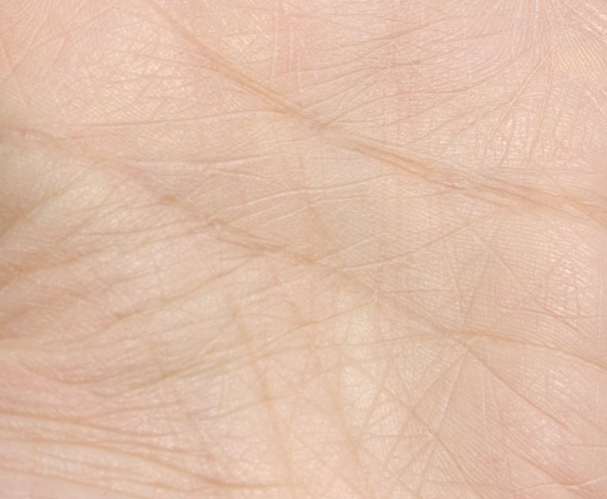
Microscopic Anatomy
Skin
(Integumentary System)
Jennifer Carbrey, Ph.D.
jennifer.carbrey@duke.edu
Department of Cell Biology

Slide 3
Goals
To Describe:
the basic functions and types of skin
the layers of the epidermis and how
their characteristics contribute to skin function
the cell types of the epidermis and their role
in skin function
the tissues of the dermis and hypodermis and how
they contribute to skin function
the morphology and function of nerve endings
of the skin
the morphology and function of epidermal appendages

Slide 4
Functions of Skin – largest organ
Protection – barrier against UV light, mechanical force, dehydration, microbes
Sensation – temperature, pressure, pain, touch
Thermoregulation – insulated by hair and adipose tissue, sweat, changes in blood flow
Metabolism – storage of fat in adipose tissue, vitamin D production, milk production
Communication – blushing, apocrine sweat glands, raising of hairs (animals)

Slide 5
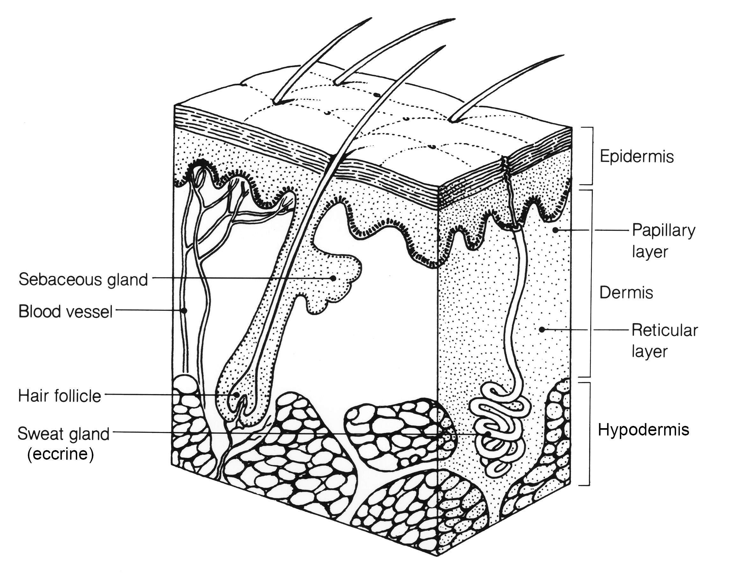
Layers of Skin
from ectoderm
from mesoderm
superficial fascia

Slide 6
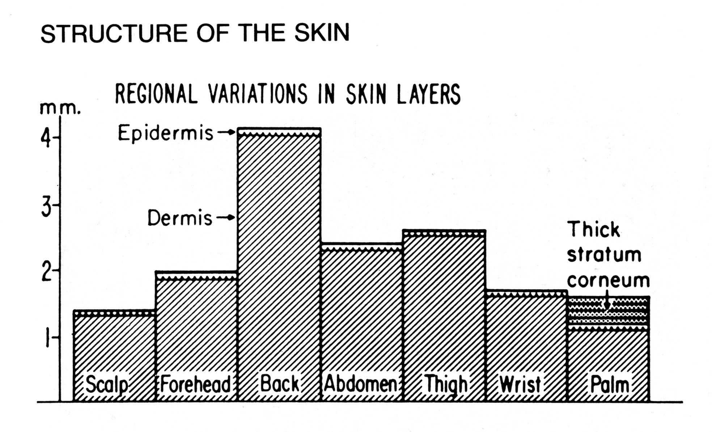
Thin (hairy) skin vs Thick (hairless) skin
thin skin
thick skin

Slide 7
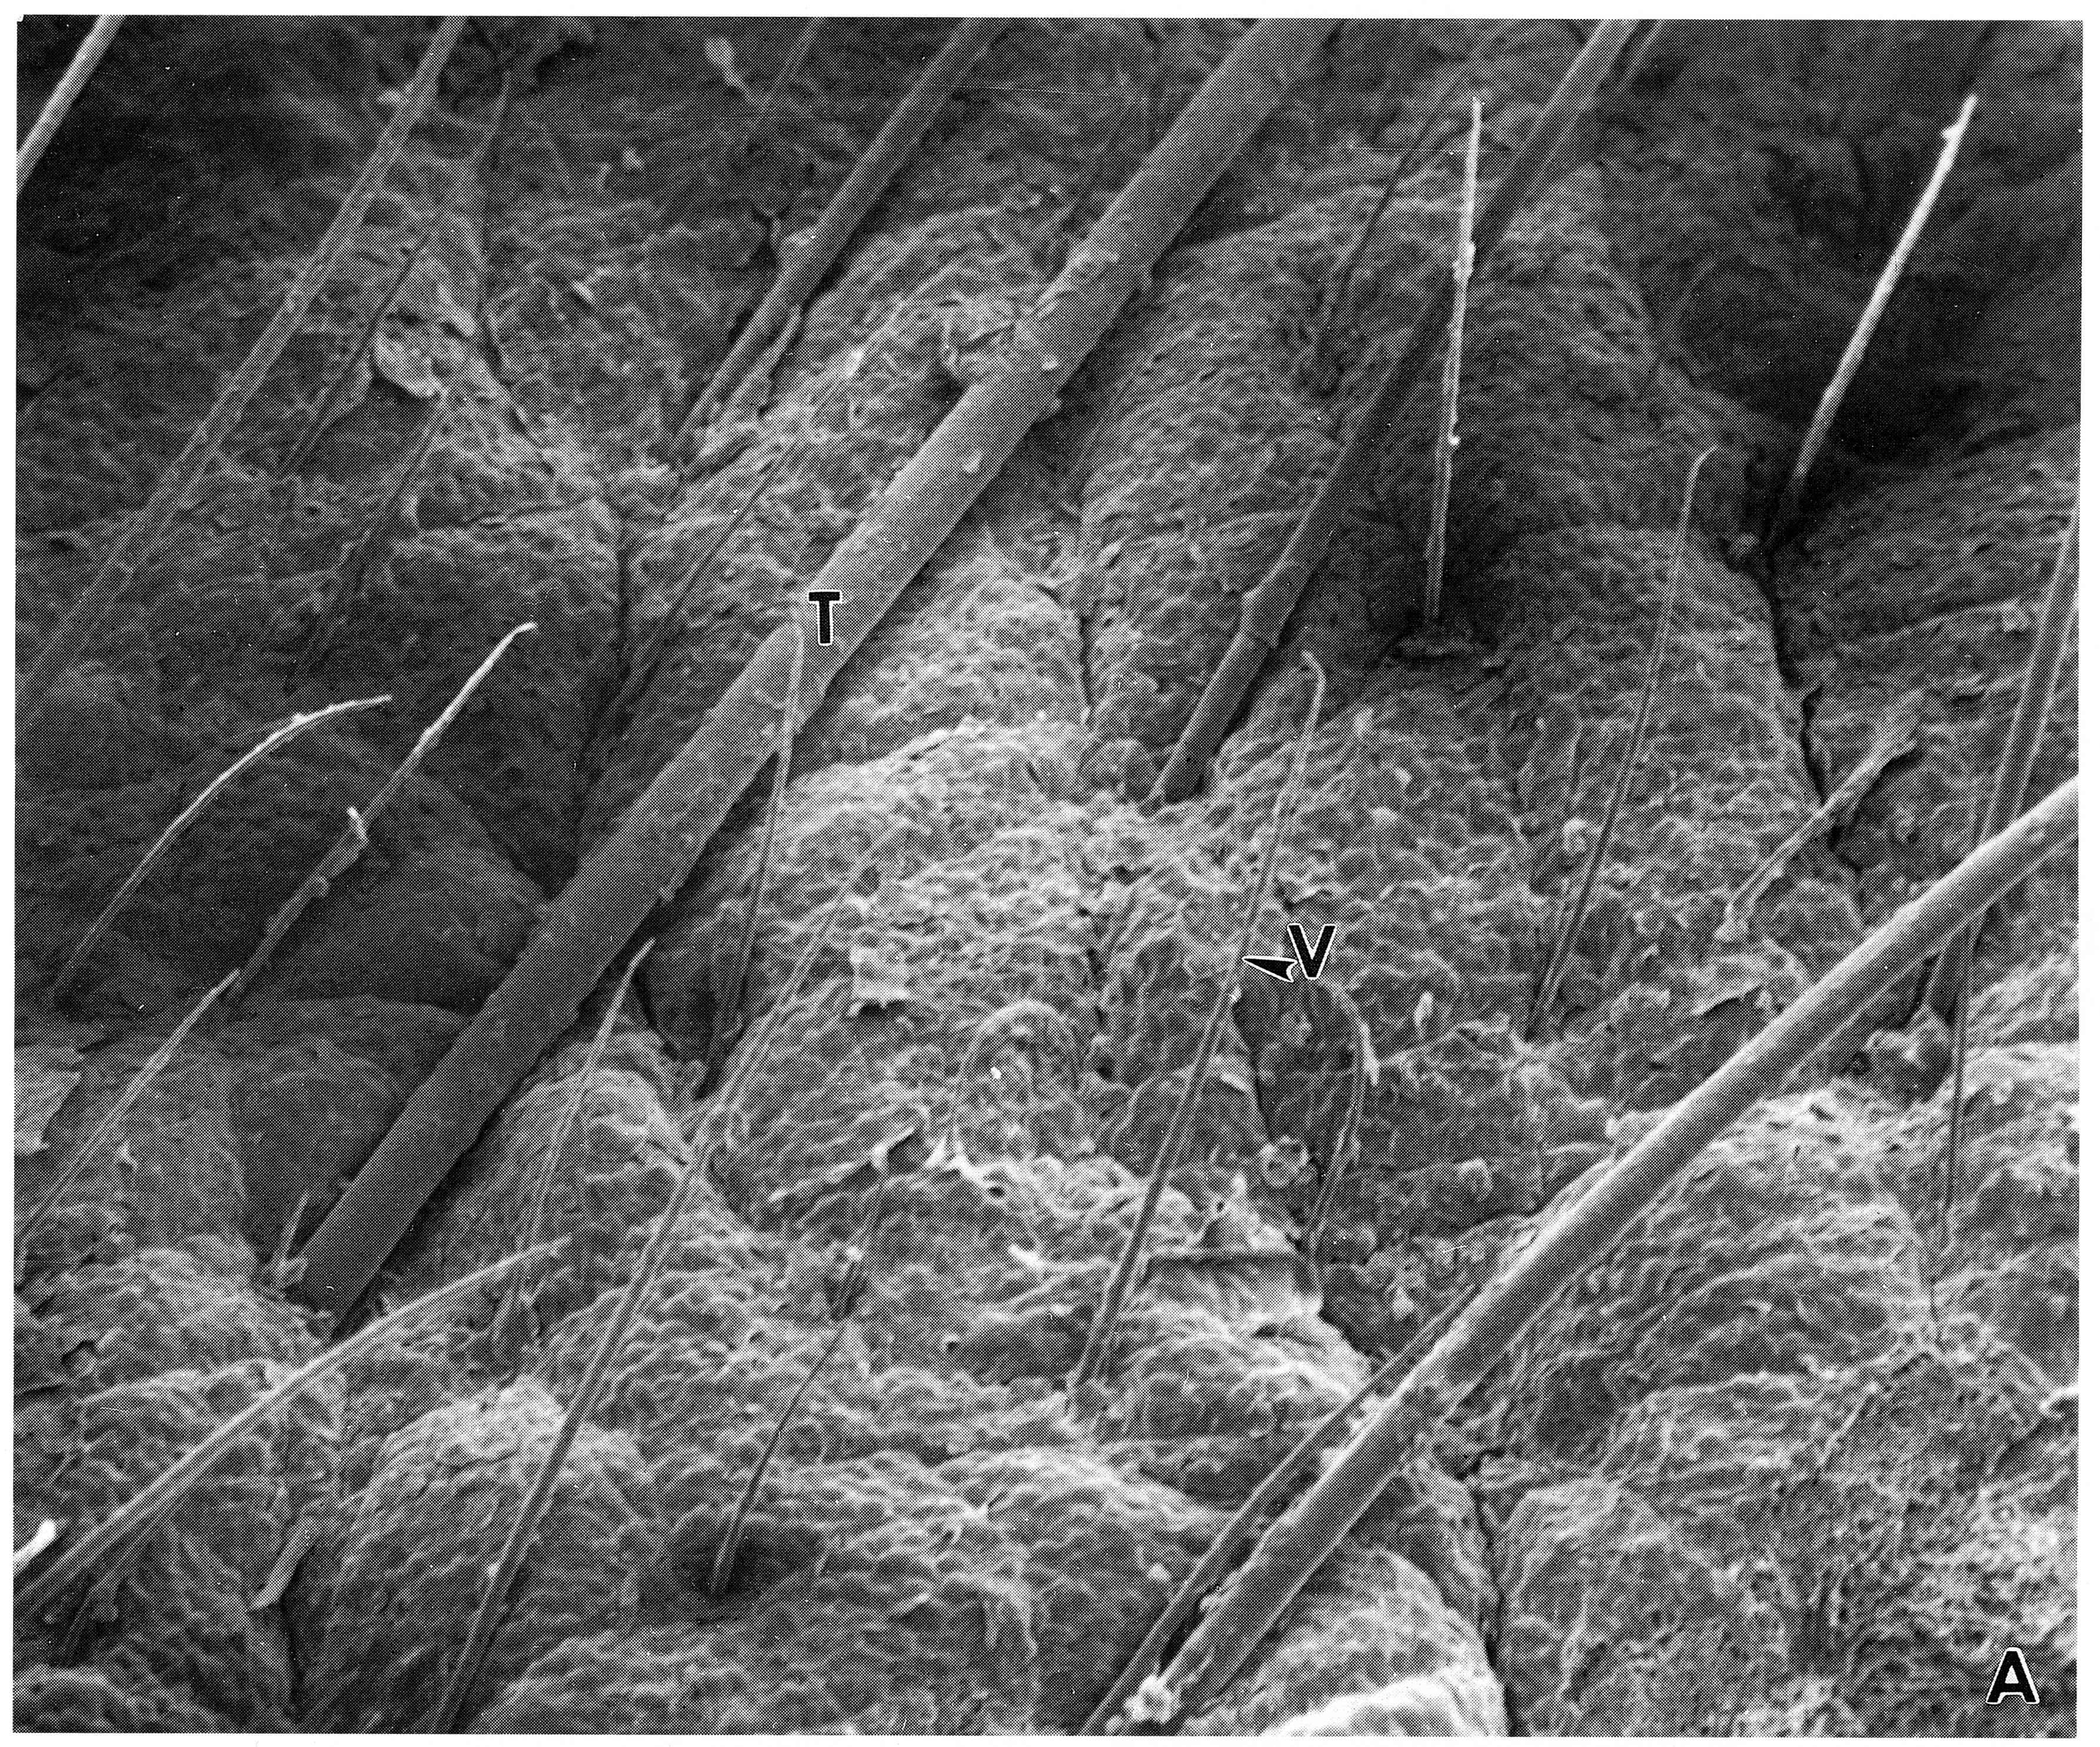
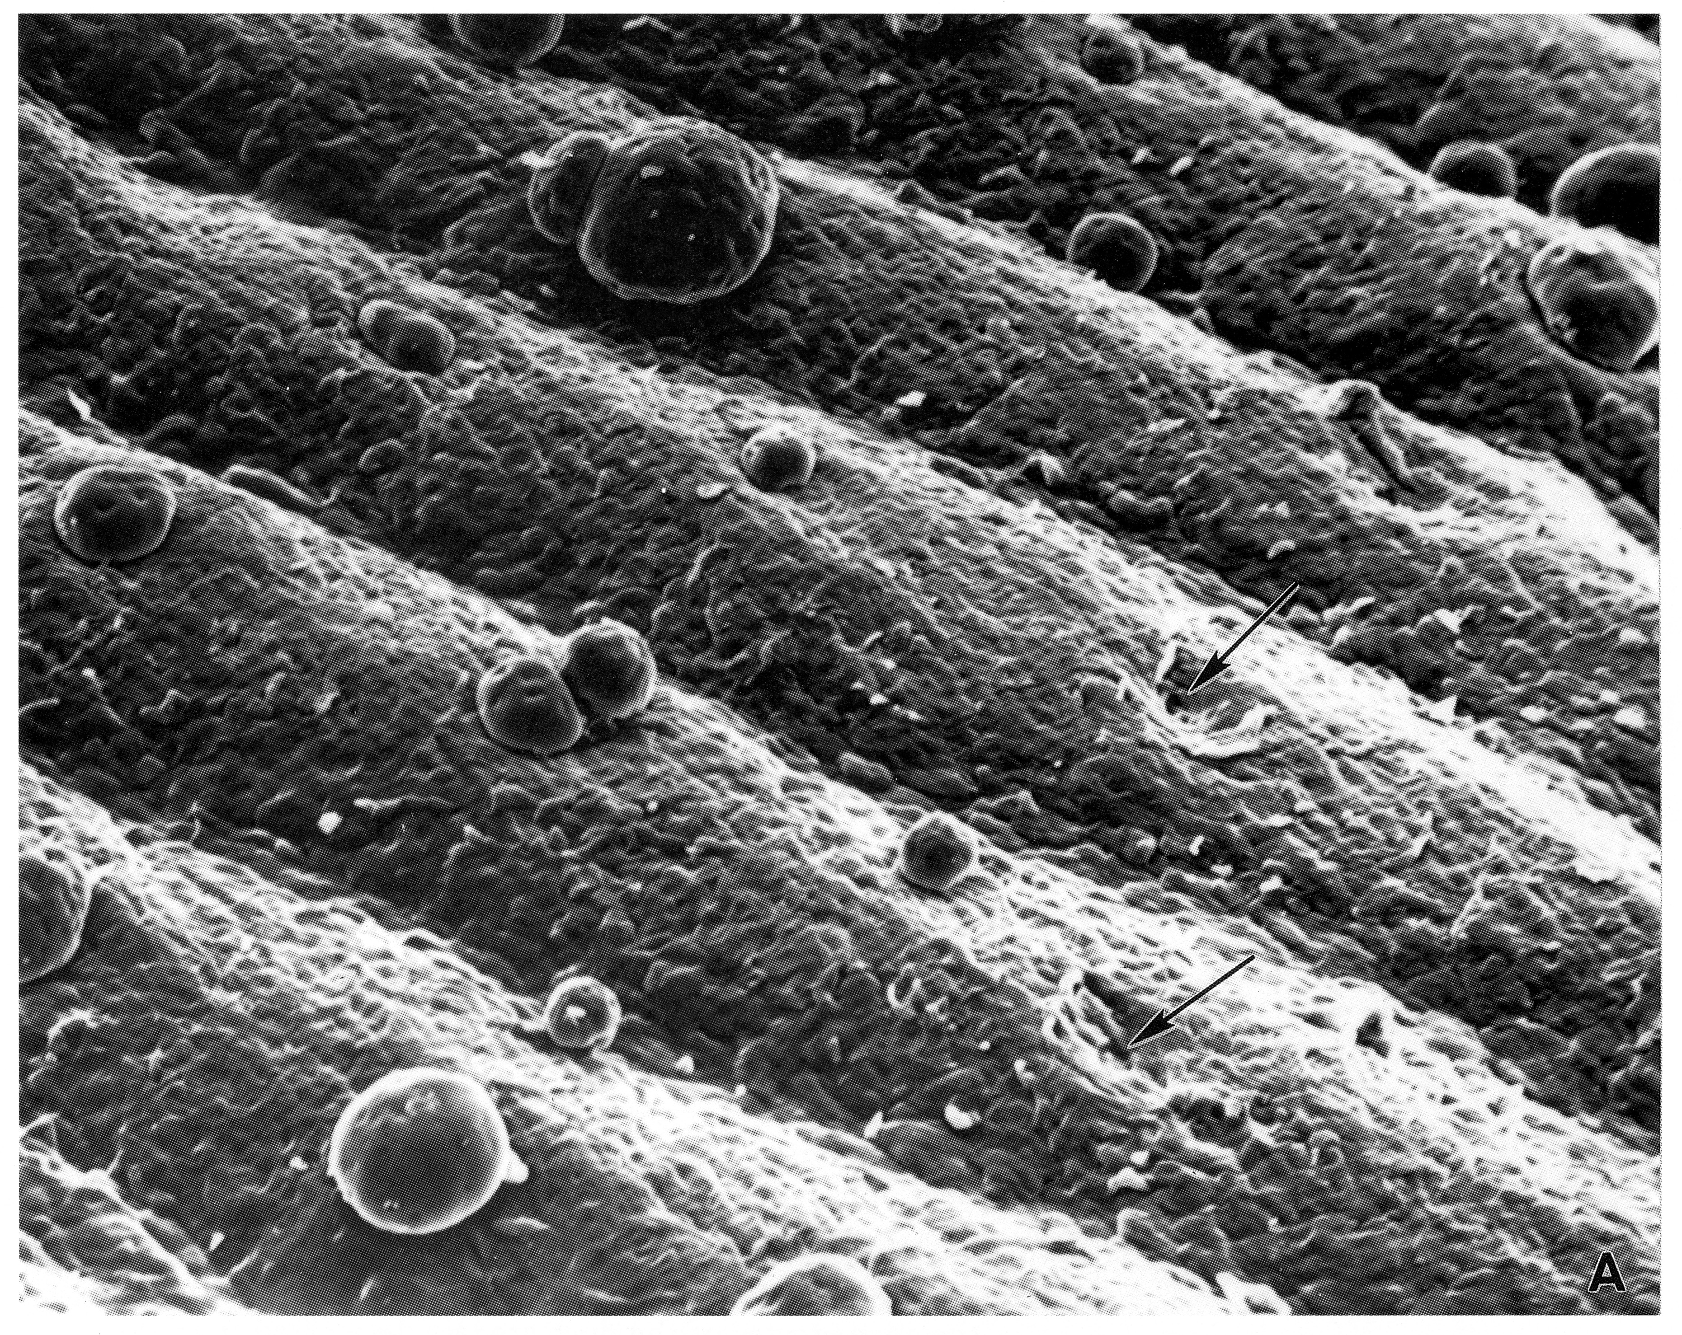
Thin (hairy) skin vs Thick (hairless)

Slide 8
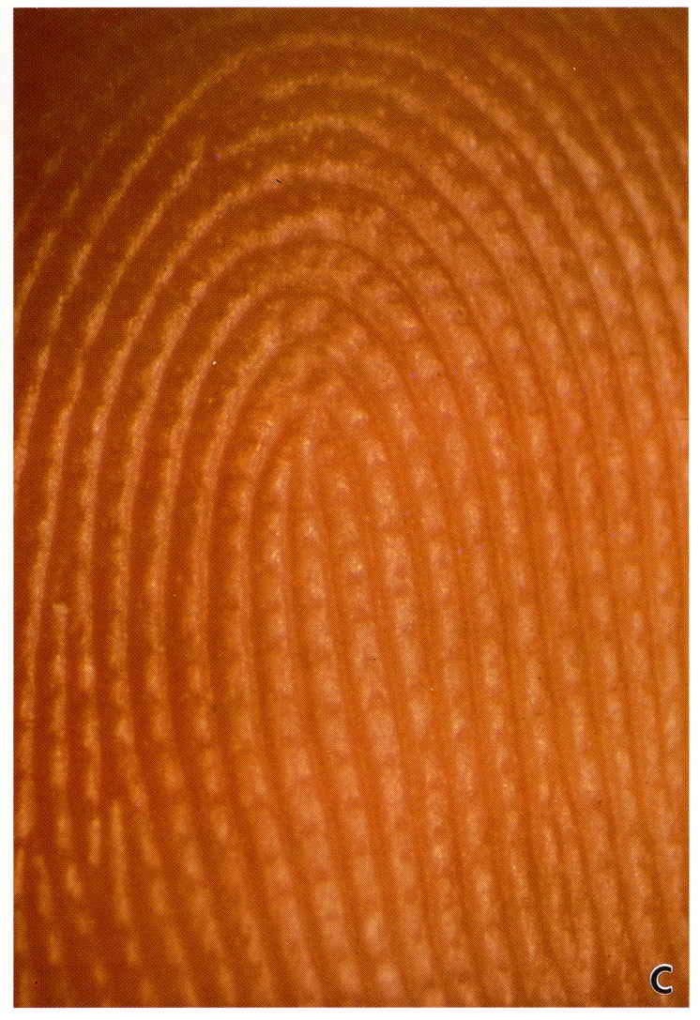
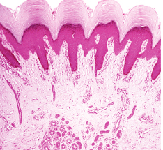
Papillary ridges of thick skin
Epidermis
Dermis

Slide 9
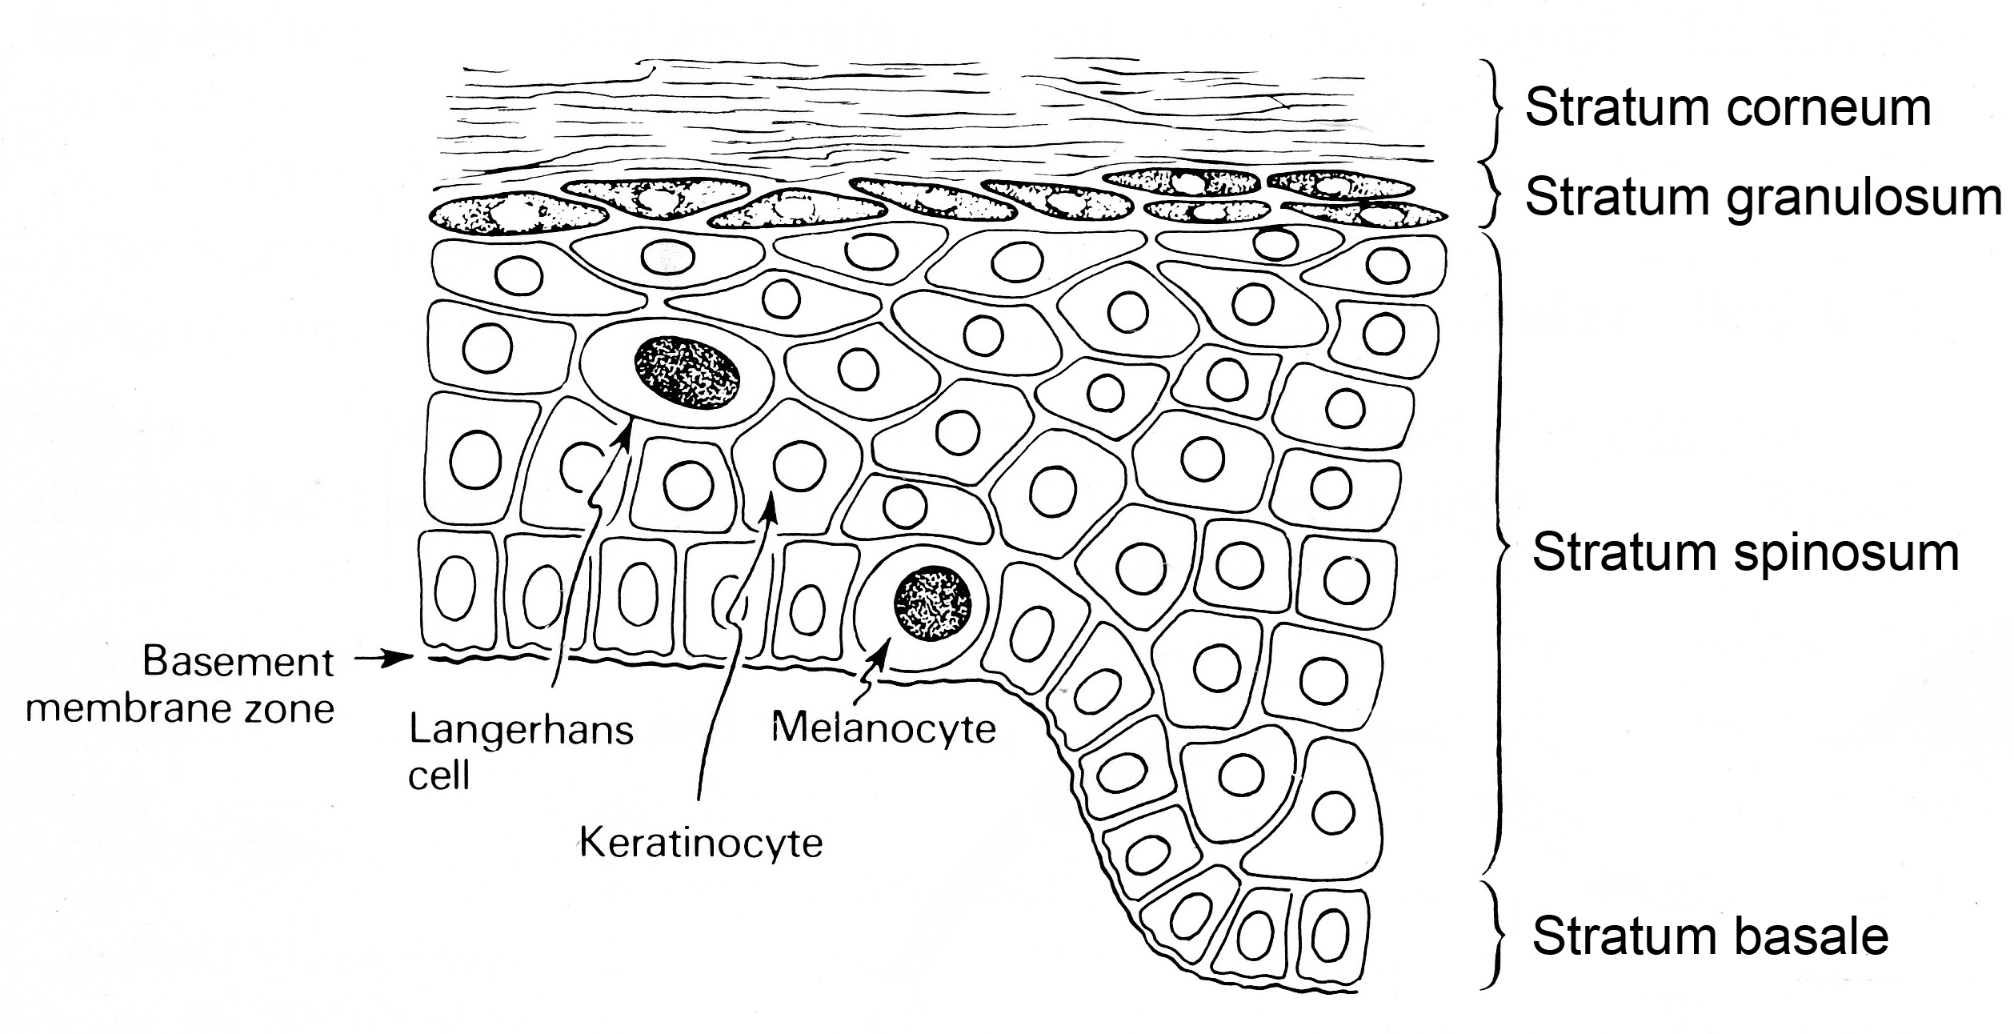
Layers of Epidermis

Slide 10
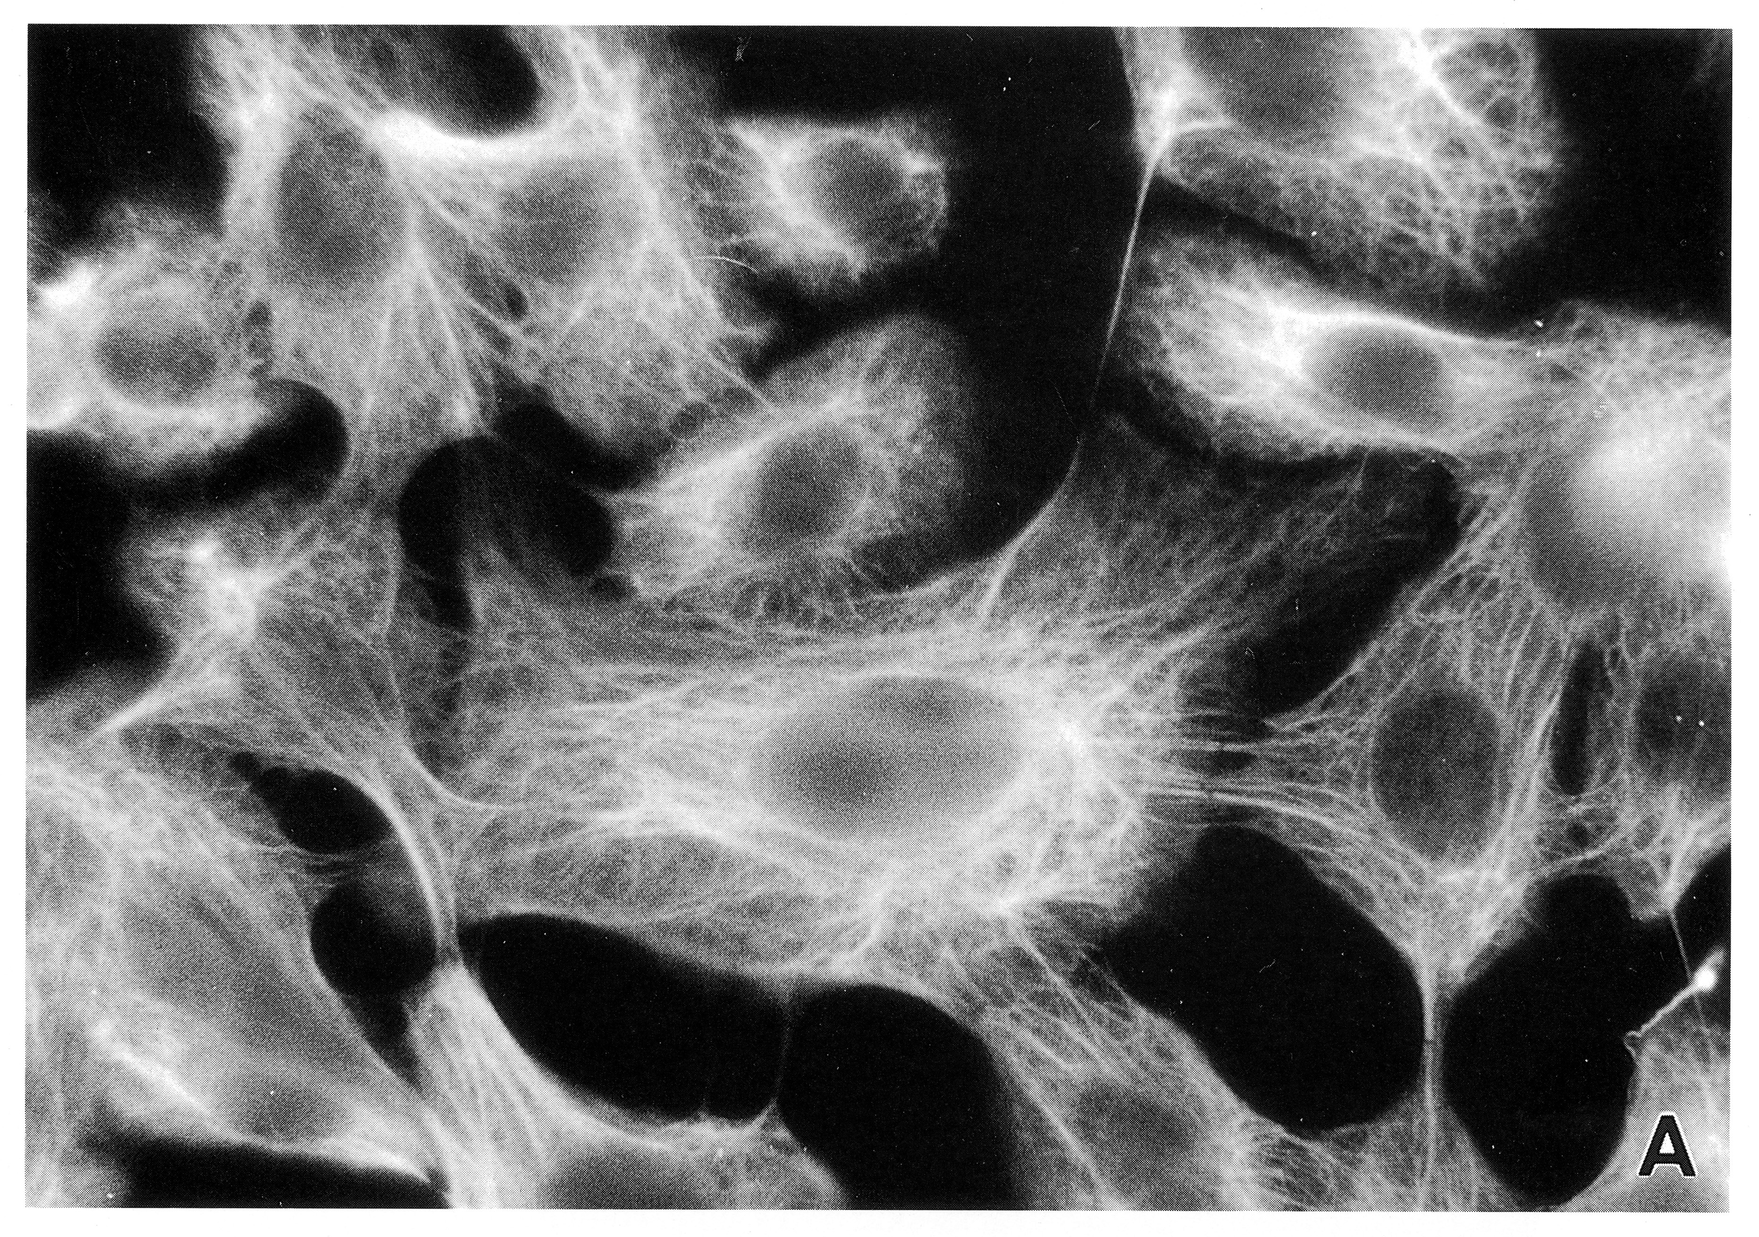
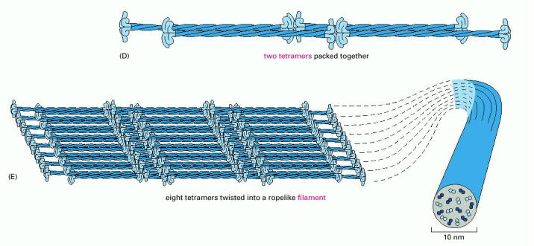
Keratinocytes
Hair and Nails: hard keratins

Slide 11
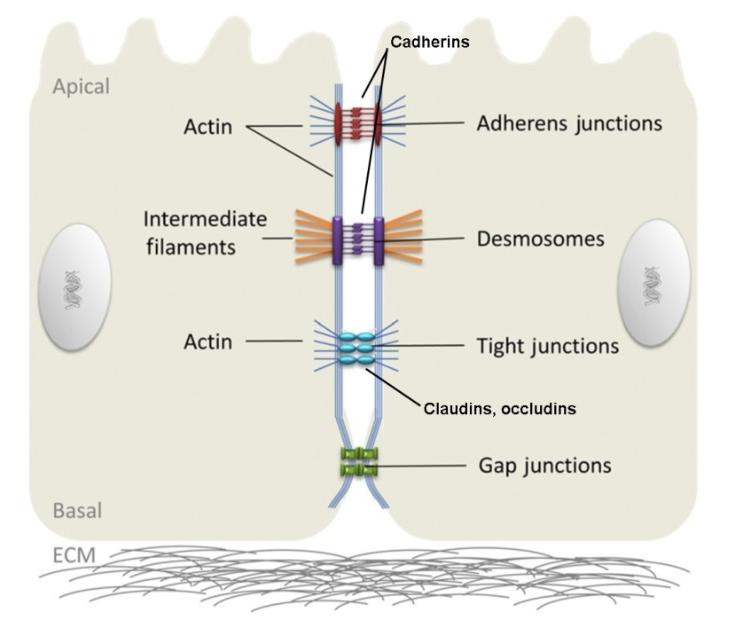
Cell Junctions
Wei and Huang, Int Rev Cell Mol Biol, 2013; 306:187-221

Slide 12
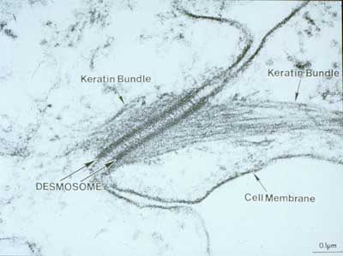
Desmosomes

Slide 13
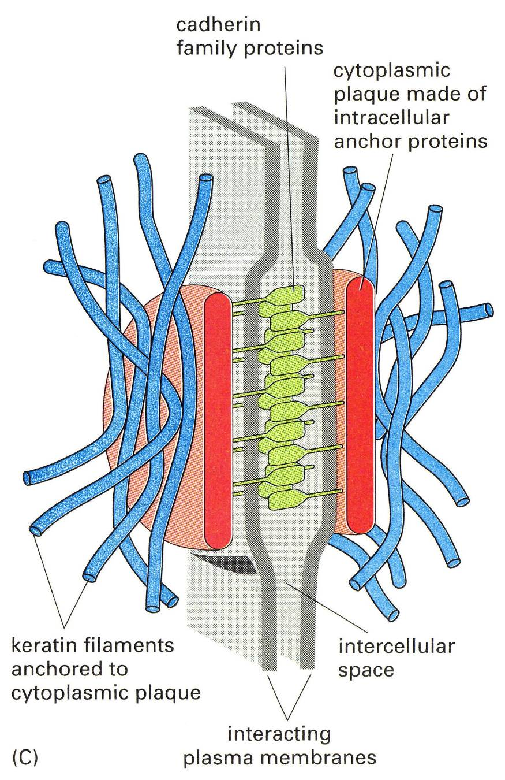
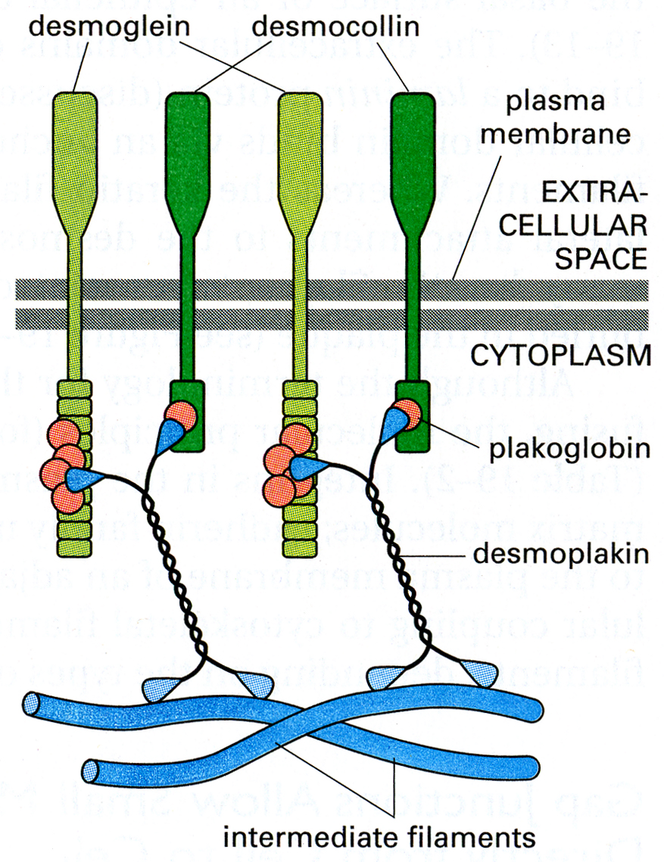
Desmosomes
also hemidesmosomes – integrins bind
ECM proteins

Slide 14
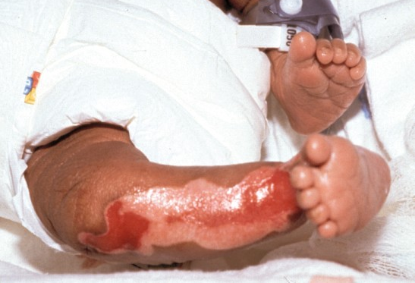
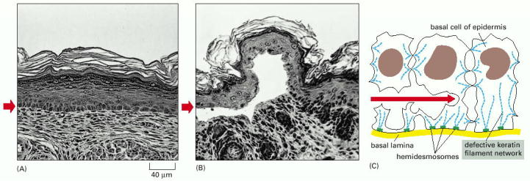
Epidermolysis Bullosa Simplex
mutation in keratin expressed
in basal cells of epidermis
another blistering disease
pemphigus – autoimmune
attack of desmosomal proteins

Slide 15
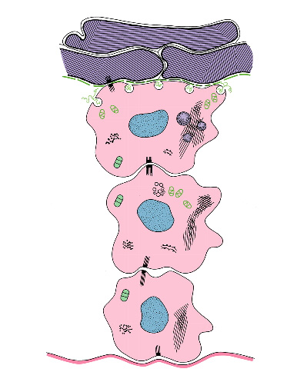
Layers of Epidermis
stratum corneum
at least several layers
lamellar
bodies
keratohyalin
granules
stratum granulosum
1-3 layers
keratin filaments
stratum spinosum
several layers
stratum basale
1 layer of cells
basal lamina

Slide 16
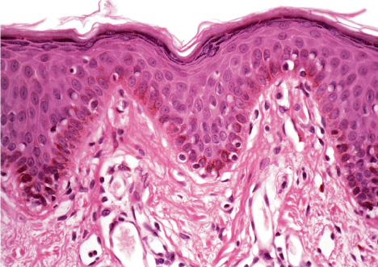
Layers of the epidermis

Slide 17
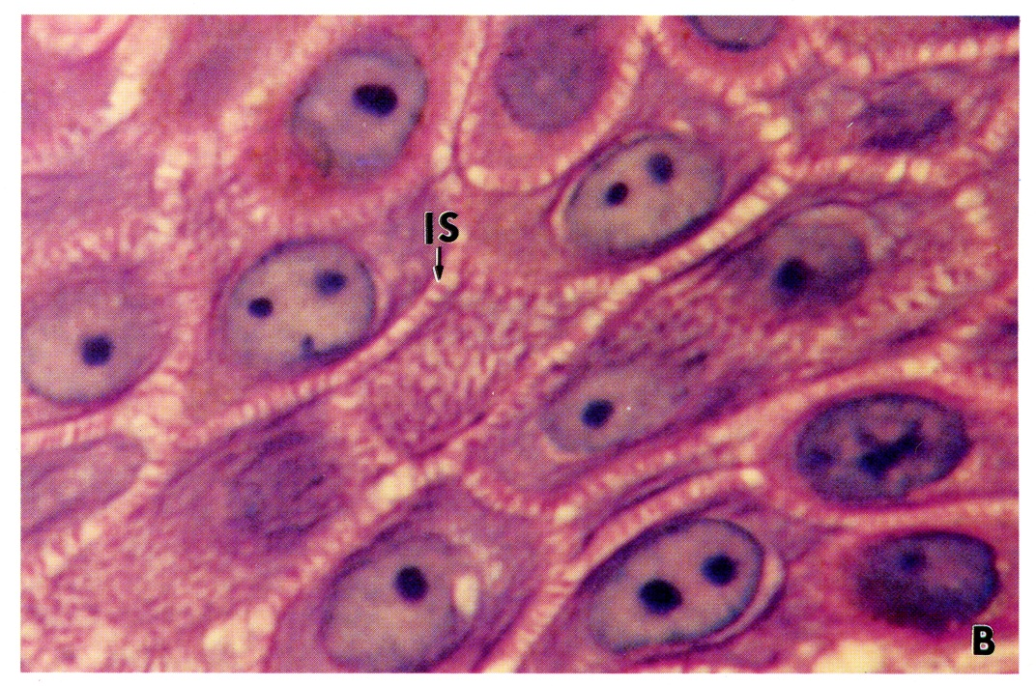
Keratinocytes in stratum spinosum

Slide 18
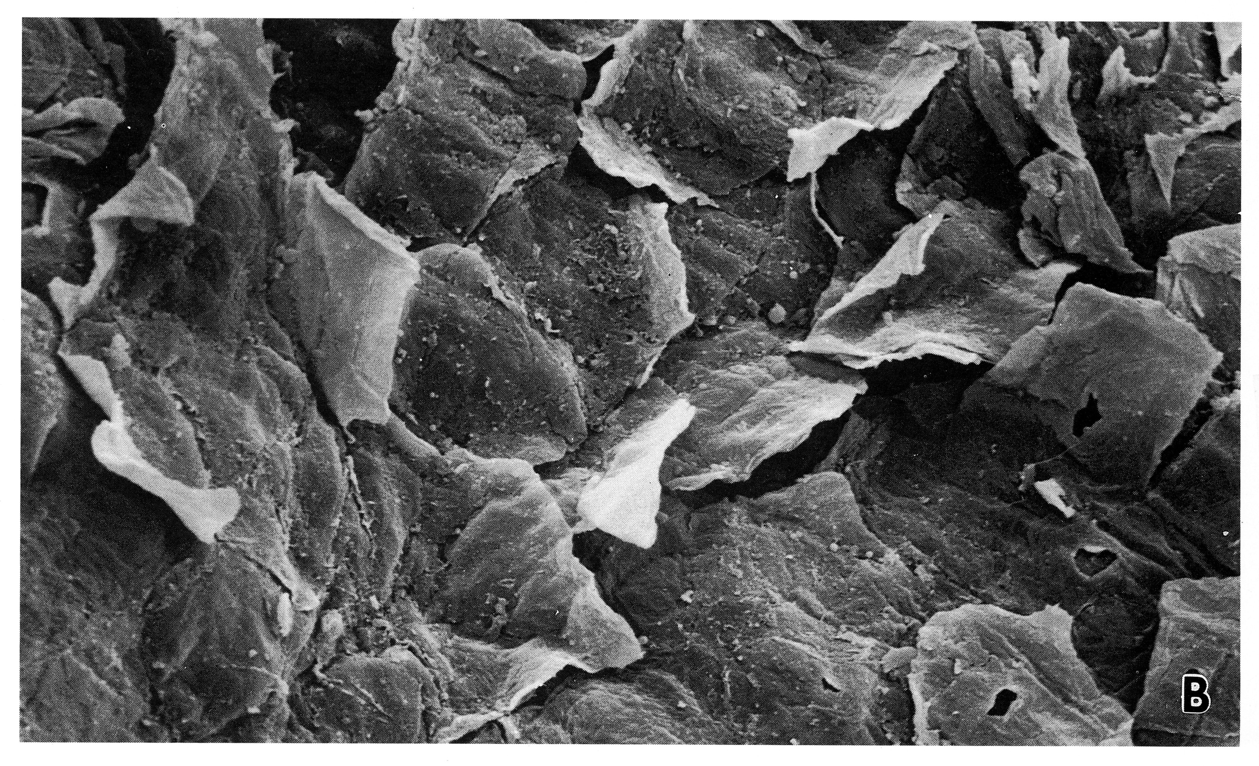
Detaching corneocytes
from stratum corneum
proteolysis of desmosomes
increases as pH decreases towards the surface

Slide 19
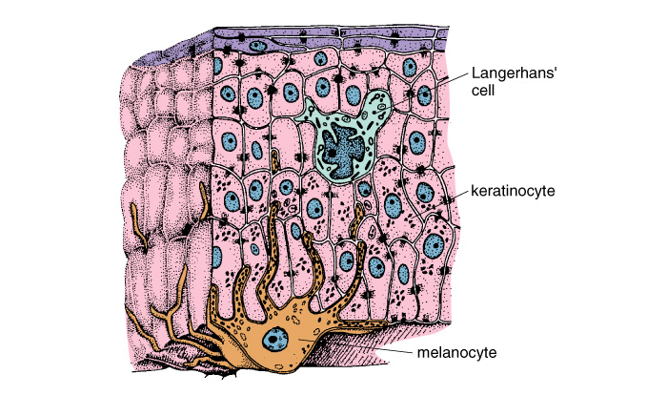
Other cells of epidermis:
Melanocyte in stratum basale
dendrites contain melanosomes filled with melanin
keratinocytes phagocytose exocytosed melanosomes or
dendrite tips

Slide 20
Melanocytes in stratum basale

Slide 21
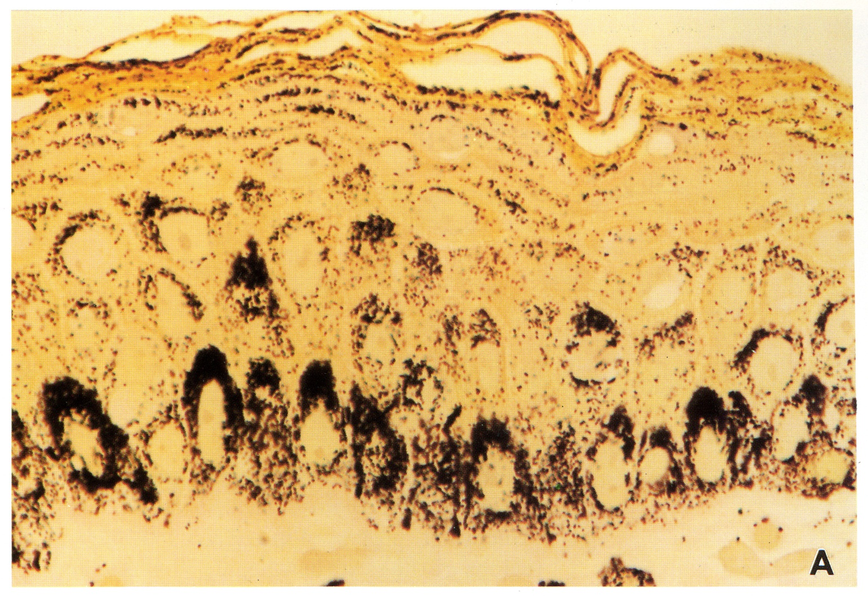
Melanosomes in epidermis
skin color – melanin degradation rate
melanin distribution (which layers of epi)
type of melanin (eumelanin vs. pheomelanin)

Slide 22
Other cells of epidermis:
Langerhans’ cell in stratum spinosum

Slide 23
Langerhans’ cells in stratum spinosum

Slide 24
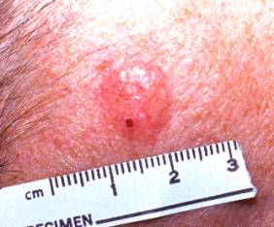
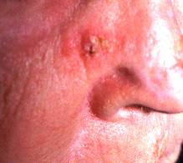
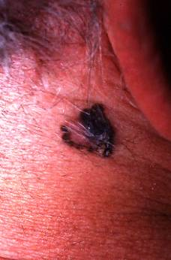
Skin Cancer
Basal Cell Carcinoma (basal cells) –
~150/100,000/year, <0.1% metastasize
Squamous Cell Carcinoma (keratinocytes) –
~40/100,000/year, ~1% metastasize
Malignant Melanoma (melanocytes) –
~17/100,000/year, ~15% metastasize
ABCD (asymmetry, border, color, diameter –
greater than 6 mm)

Slide 25
Major Points
Skin has a keratinized stratified squamous epithelium (epidermis)
The layers of the epidermis are formed by keratinocytes in
various stages of differentiation
The keratin network and desmosome cell junctions of keratinocytes
are crucial for the mechanical strength of skin
Melanocytes provide keratinocytes with melanin to protect
from UV light
Langerhans’ cells are antigen-presenting cells of the epidermis

Slide 26
Layers of Skin

Slide 27
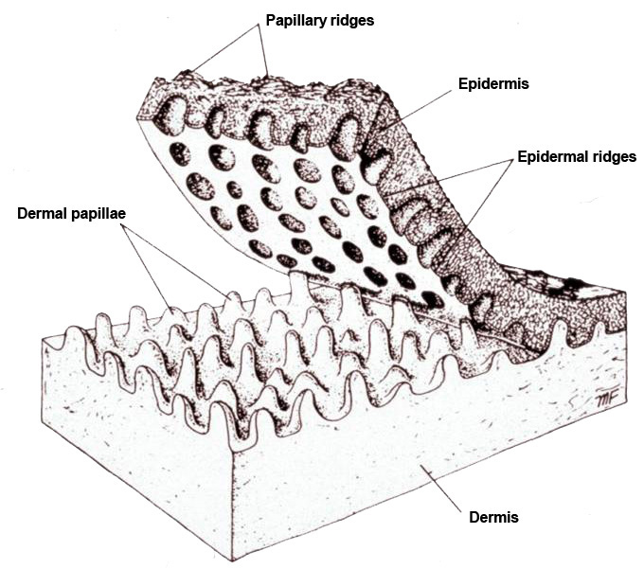
Dermal papillae
papillae contain
capillaries and
nerve endings

Slide 28
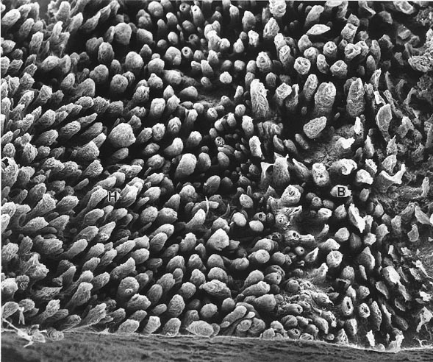
Dermal papillae

Slide 29
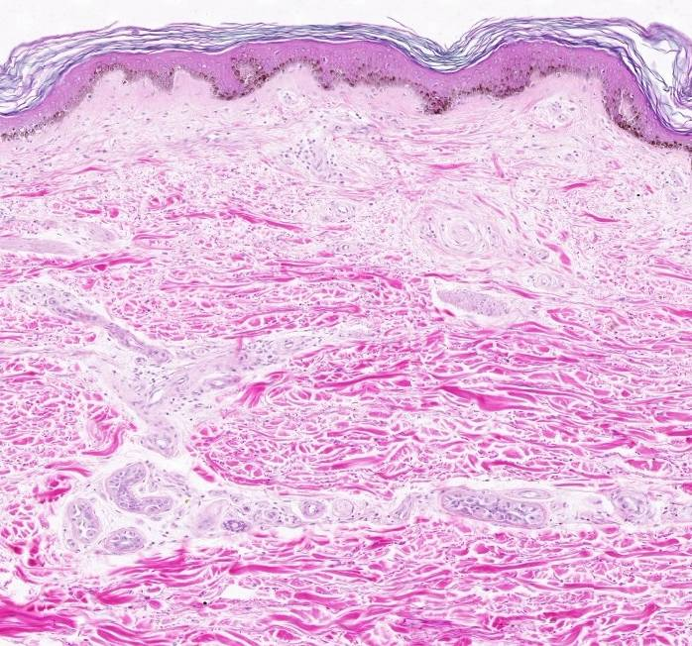
Layers of the dermis
Papillary layer
Reticular layer
collagen
determines
Langer’s lines

Slide 30
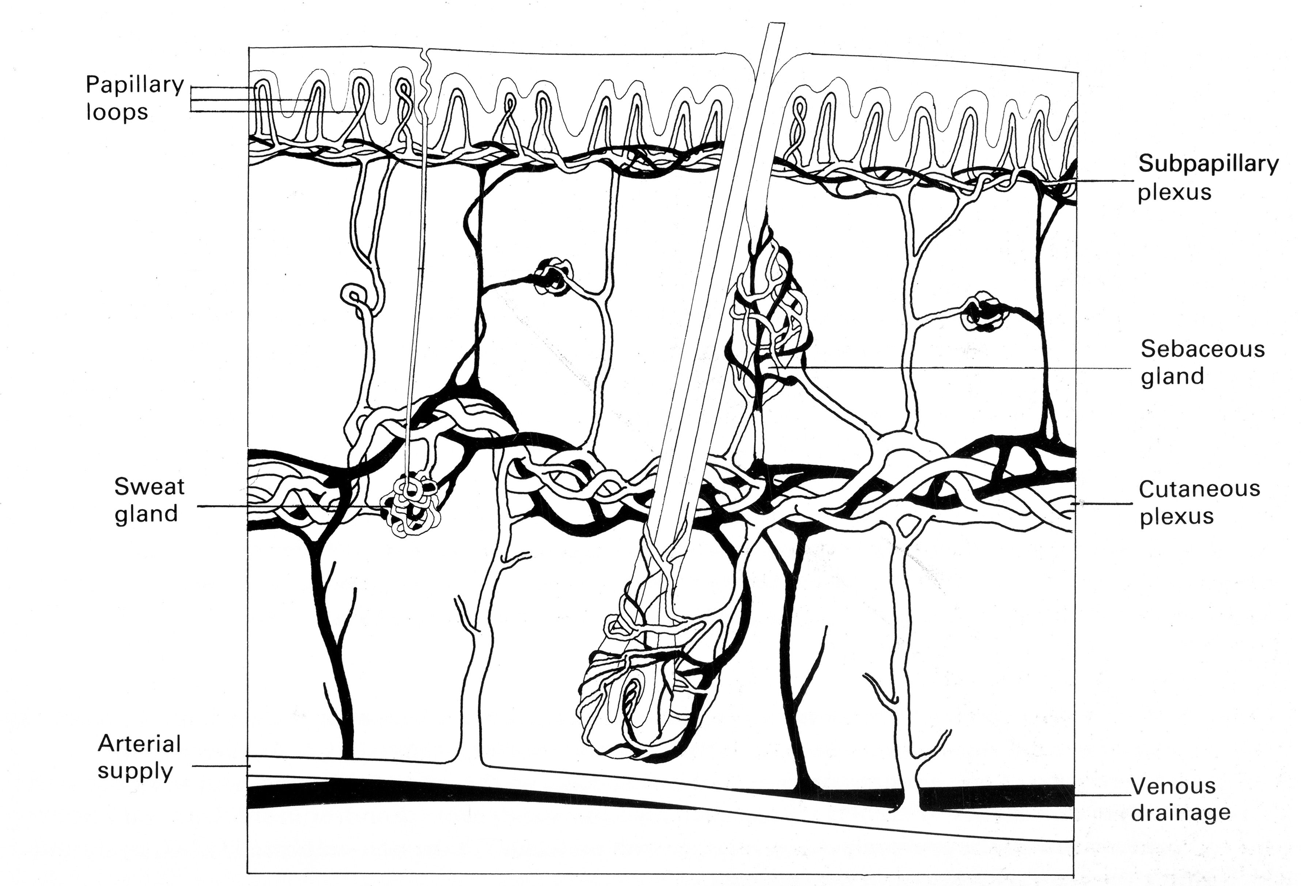
Blood Supply
Dermis
Hypodermis

Slide 31
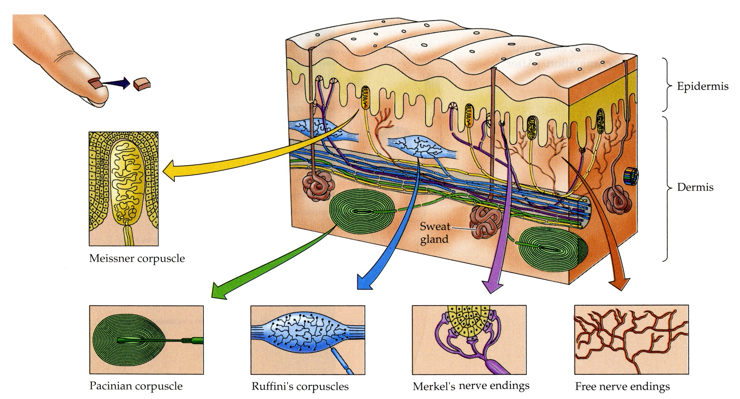
Nerve Endings
Movement
of objects
against skin
stretch
texture
temperature
pain
vibration

Slide 32
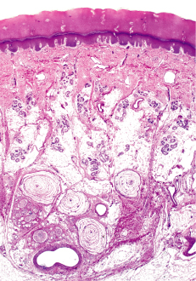
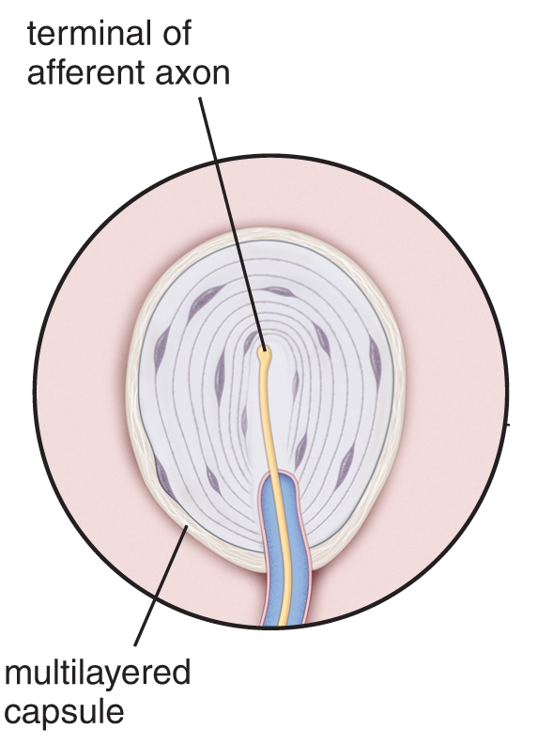
Pacinian Corpuscles

Slide 33
Pacinian Corpuscles and Fingerprints
role of fingerprints – grip, sense of touch, or both?
made a sensor that mimics skin with fingerprints
fingerprints amplify vibrations (~100X) with
frequencies that best stimulate Pacinian corp.
important for perception of texture
surface needs to slide perpendicular to ridges
may be why elliptical patterns on fingertips

Slide 34
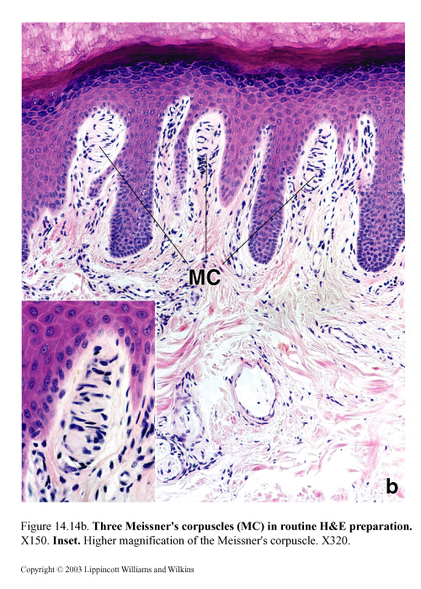
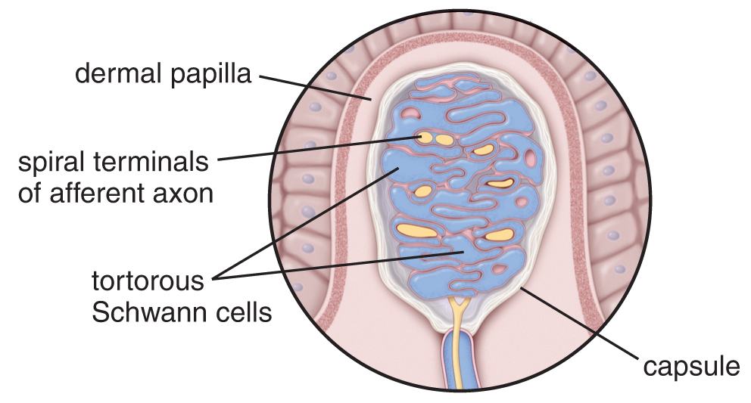
Meissner’s Corpuscles

Slide 35
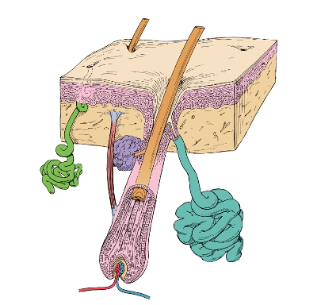
Epidermal Appendages
*also nails and
mammary glands
Eccrine
Sweat gland
Arrector pili
muscle
Apocrine
Sweat gland
Hair follicle
Sebaceous gland

Slide 36
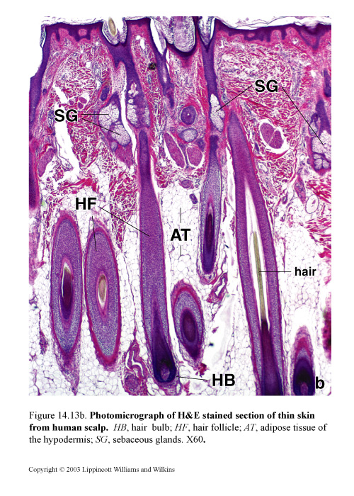
Hair Follicles

Slide 37
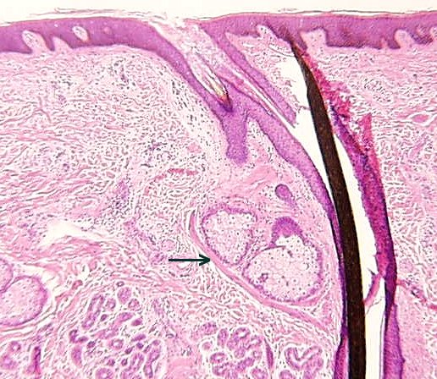
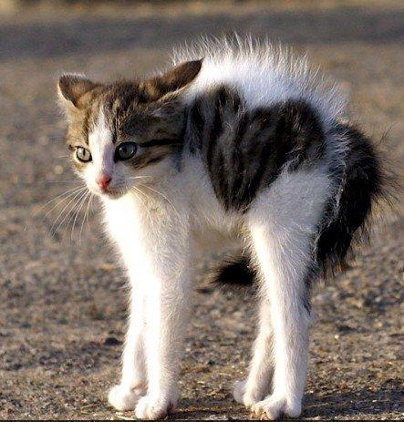
Arrector Pili Muscle

Slide 38
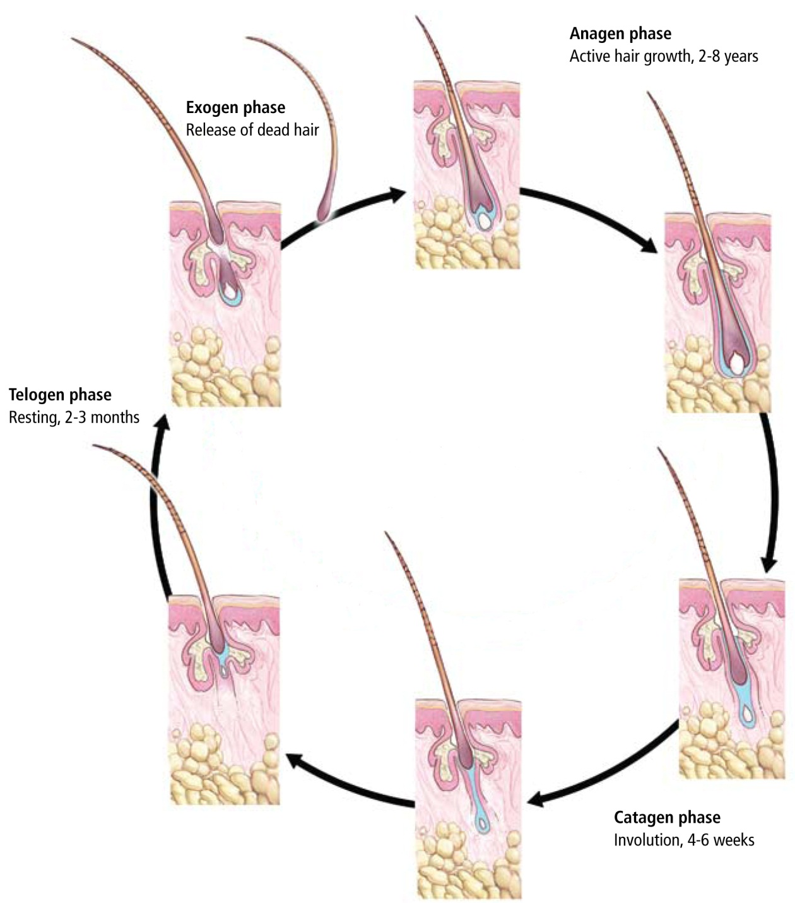
Hair Follicles

Slide 39
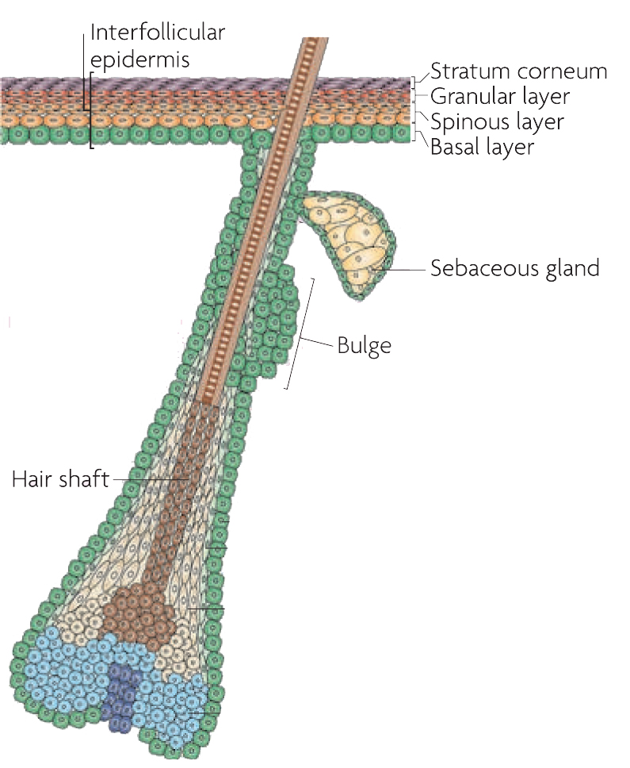
Hair Follicles
normal homeostasis
basal cells maintain epidermis
bulge cells maintain follicle
sebaceous gland stem cells too
wounding
stem cells of bulge are used to
repopulate epidermis, hair
follicles, and sebaceous glands
From Blanpain and Fuchs, Nature Reviews, 2009, 10:207-217

Slide 40
Epidermal Appendages
*also nails and
mammary glands
Eccrine
Sweat gland
Arrector pili
muscle
Apocrine
Sweat gland
Hair follicle
Sebaceous gland

Slide 41
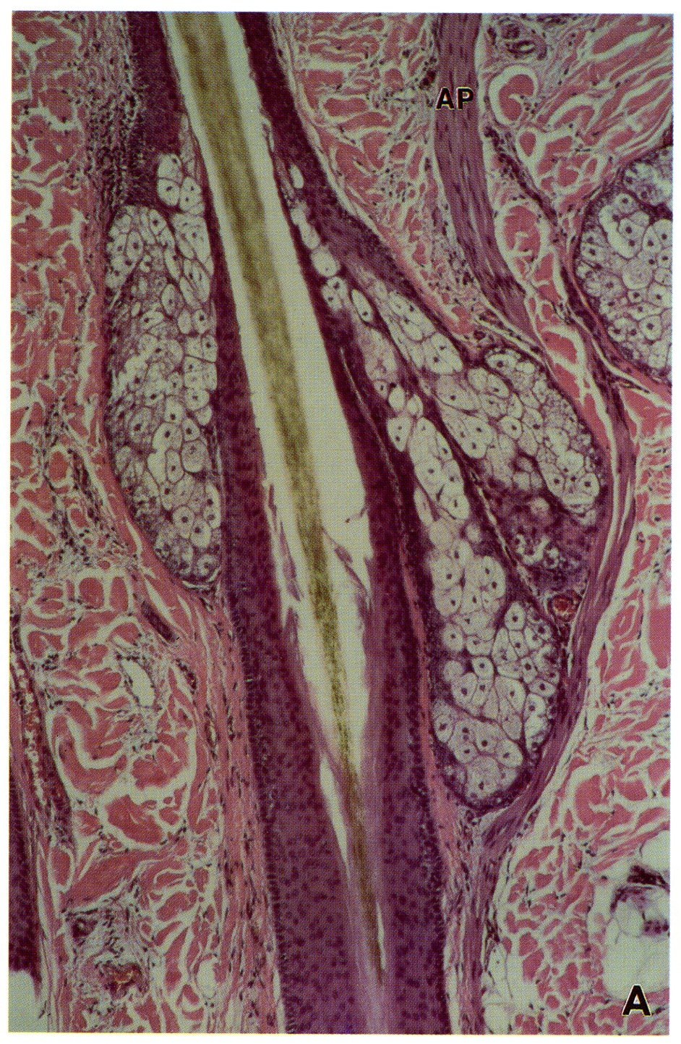
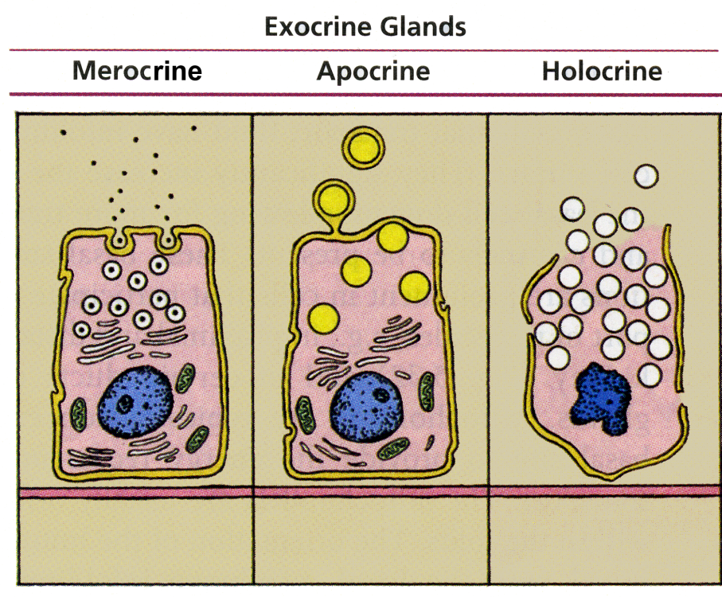
Sebaceous glands
sebocytes secrete sebum: triglycerides,
fatty acids, waxes

Slide 42
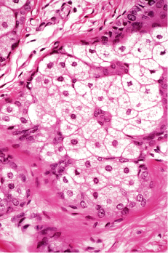
Sebaceous gland

Slide 43
Epidermal Appendages
*also nails and
mammary glands
Eccrine
Sweat gland
Arrector pili
muscle
Apocrine
Sweat gland
Hair follicle
Sebaceous gland

Slide 44
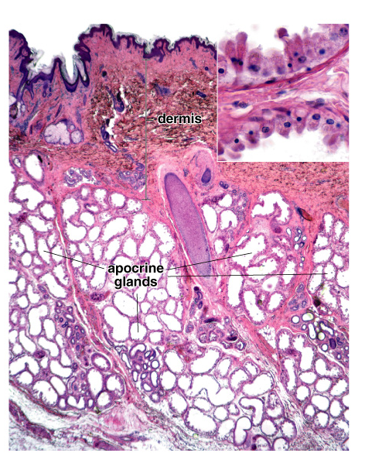
Apocrine Sweat Glands
secrete a mixture of carbs, lipids,
protein and ammonia
secrete in response to emotional
stimuli

Slide 45
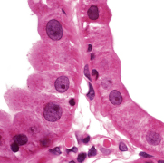
Apocrine Sweat Glands
simple cuboidal or columnar
secretory cells and
myoepithelial cells
ducts are str. cuboidal
ceruminous glands of ear
glands of Moll of eyelashes

Slide 46
Epidermal Appendages
*also nails and
mammary glands
Eccrine
Sweat gland
Arrector pili
muscle
Apocrine
Sweat gland
Hair follicle
Sebaceous gland

Slide 47
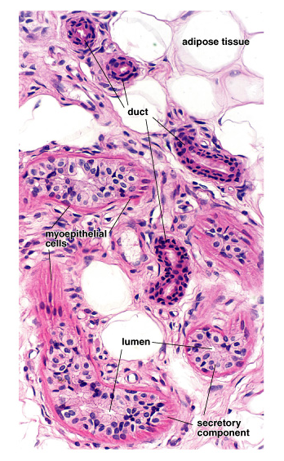
Eccrine Sweat Glands
secrete in response to increased
body temp or emotional stress
contains water, salt, lactate, urea, and
ammonia

Slide 48
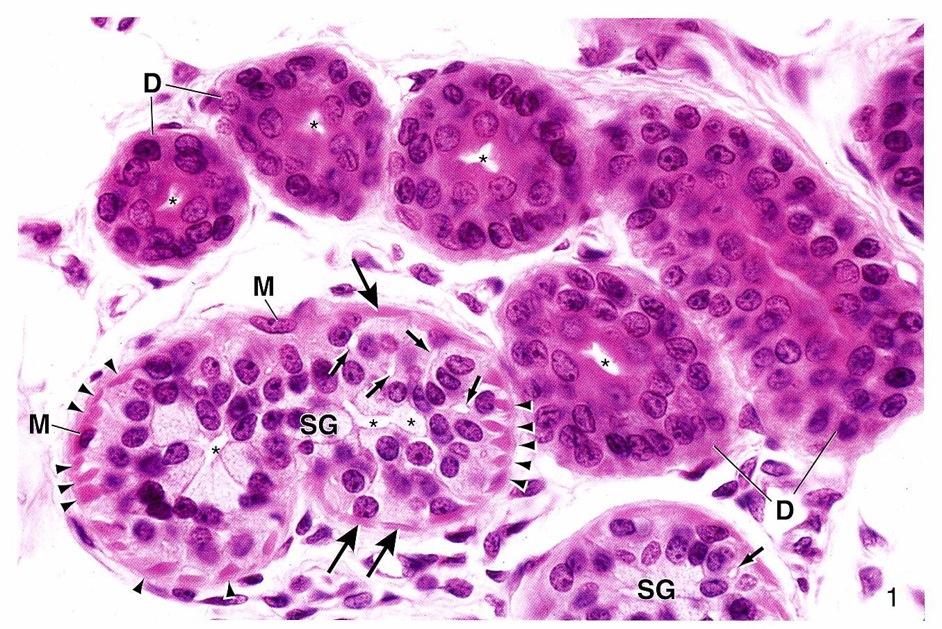
Eccrine Sweat Glands

Slide 49
Hypodermis

Slide 50
Hypodermis
Dermis
Hypodermis

Slide 51
Major Points
The dermis is a dense irregular connective tissue with dermal
papillae that contain capillaries
Many types of nerve endings are found in different parts of the
skin
Epidermal appendages are derived from the epidermis and include
hair follicles, apocrine sweat glands, eccrine sweat glands,
and sebaceous glands
The hypodermis is a fatty connective tissue layer that surrounds
some epidermal appendages

