Slide 1
Diseases of the Skin
J. Matthew Velkey, Ph.D.
matt.velkey@duke.edu
454D Davison, Duke South, Green Zone

Slide 2
Lecture Outline
Cutaneous wound healing
Healing by first intention
Healing by second intention
Wound strength changes
Pathologic aspects of repair
Acute Inflammatory Dermatoses
Urticaria
Acute Eczematous Dermatitis
Erythema Multiforme
Chronic Inflammatory Dermatoses
Psoriasis
Lichen Planus
Lichen Simplex Chronicus
Infectious Dermatoses
Bacterial skin infections
Fungal skin infections
Viral skin infections
Blistering (Bullous) Skin Disorders
Pemphigus
Bullous Pemphigoid
Dermatitis Herpetiformis
Benign & premalignant neoplasia
Seborrheic keratosis
Actinic keratosis
Malignant epidermal neoplasia
Squamous cell carcinoma
Basal cell carcinoma
Melanocytic neoplasia
Melanocytic nevi
Melanoma

Slide 3
Wound Healing
A complex but orderly process involving many of the chemical mediators previously discussed, along with many other growth factors and cell-matrix interactions.
Occurs in the following steps:
Injury induces acute inflammation
Parenchymal cells regenerate
Both parenchymal and connective tissue cells migrate and proliferate
Extracellular matrix is produced
Parenchyma and connective tissue matrix remodel
Increase in wound strength due to collagen deposition

Slide 4
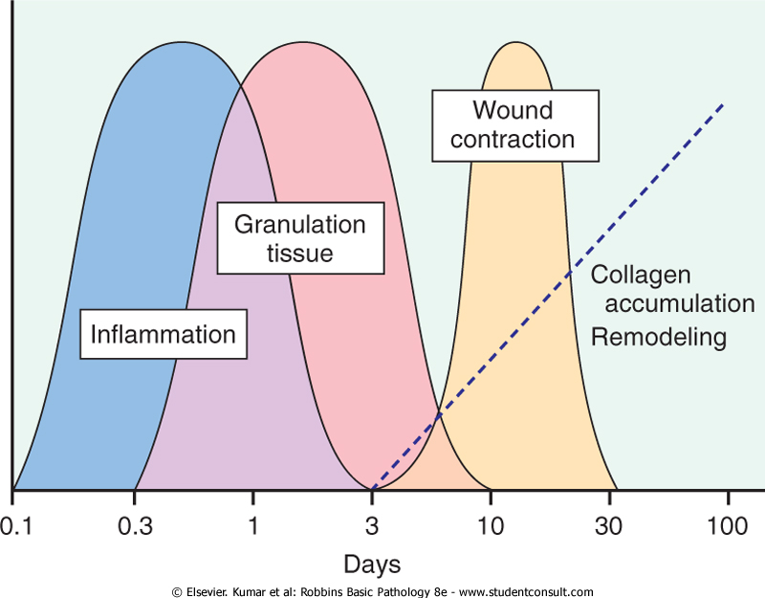
Wound Healing Time Course

Slide 5
Granulation Tissue
Hallmark of healing
Term comes from soft, pink, granular appearance when viewed from the surface of a wound
Histology: Proliferation of small blood vessels and fibroblasts; tissue often edematous

Slide 6
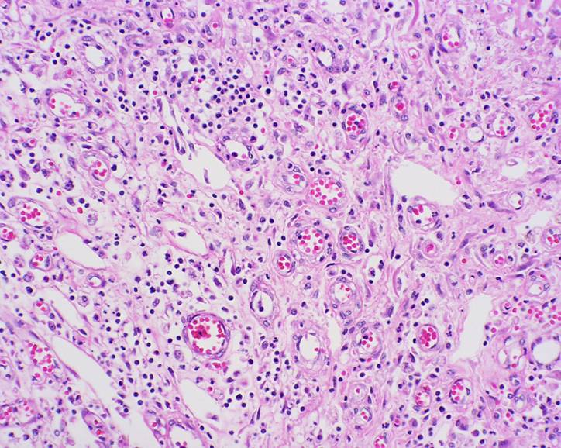
Granulation Tissue

Slide 7
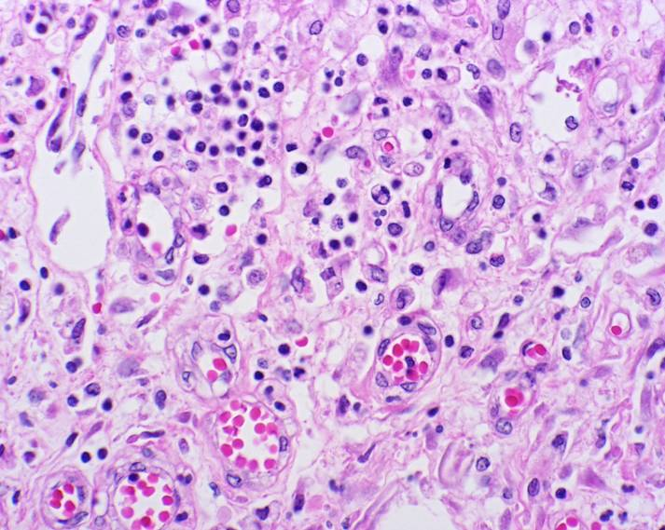
Granulation Tissue

Slide 8
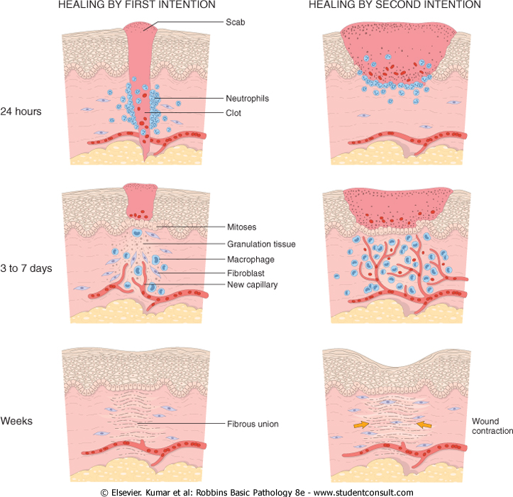
Healing by 1st intention vs. 2nd intention
By 1st intention:
“clean” incision
limited scarring or wound contraction
By 2nd intention:
ulcers or lacerations
often scarring and wound contraction

Slide 9
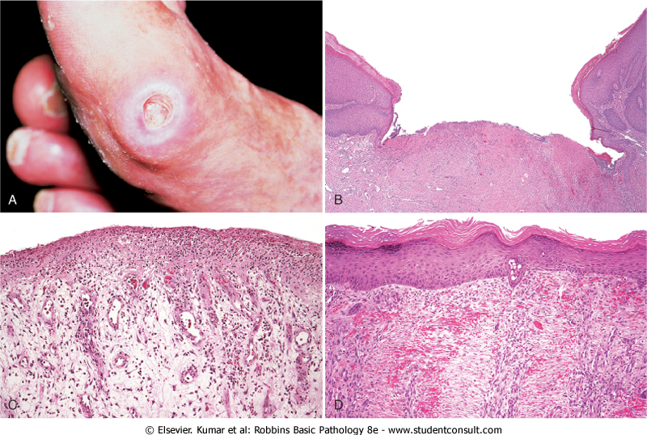
Ulcers: an example of healing by 2nd intention

Slide 10
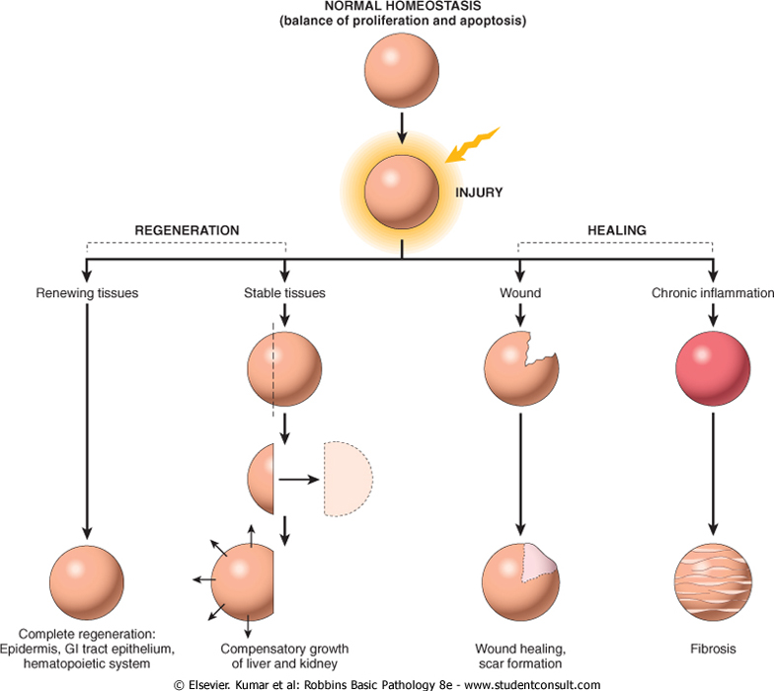
Resolution of Inflammation: “Regeneration” vs. “Healing”

Slide 11
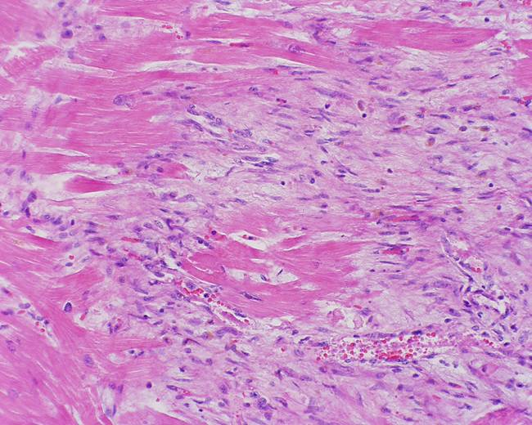
Myocardial Infarct: healing (aka “remote”)
Healing (remote) infarct
Notes:
P2050029.jpg

Slide 12
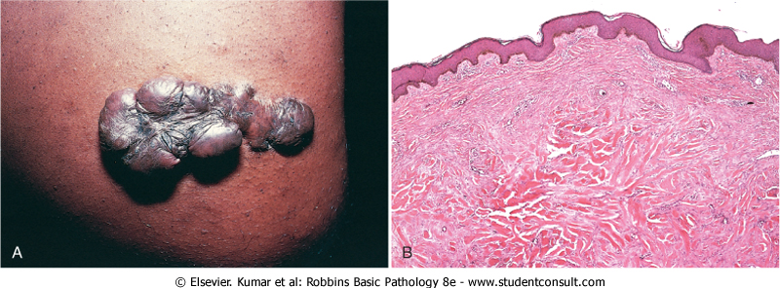
Variables affecting repair
Infection –prolongs inflammation, increases degree of tissue injury
Nutrition –protein or vitamin deficiency can impair synthesis of new proteins
Anti-inflammatory drugs –can impede fibrosis necessary for repair
Mechanical variables –tension, pressure, or the presence of foreign bodies can affect repair
Vascular disease –limits nutrient and oxygen supply required for repairing tissues
Tissue type –only tissues capable of renewing will regenerate, otherwise healing is by fibrosis
Degree of exudate removal –adequate removal of exudate allows RESOLUTION of the injury (general restoration of the normal tissue architecture); inadequate removal results in ORGANIZATION (abnormal, dysfunctional tissue architecture)
Regulation of cell proliferation –abnormal proliferation of connective tissue may inhibit re-epithelialization and/or raised scars (keloids)

Slide 13
Acute Inflammatory Dermatoses: Urticaria, aka “hives”
Very common condition, mediated by localized mast cell degranulation resulting in dermal capillary hyperpermeability
Pathogenesis:
Usually a hypersensitivity reaction (type I) mediated by IgE antibodies bound to mast cells
Upon exposure to antigen (allergen), bound IgE antibodies induce signal cascades that lead to degranulation of mast cells and release of histamine and other pro-inflammatory molecules that cause invasion of inflammatory cells from blood vessels into connective tissue
Results in wheals: erythematous (red), edematous (swollen), and pruritic (itchy) plaques
Clinical features:
Most common in 20-40 year olds, but can occur at any age
Can vary from small pruritic papules to large edematous plaques
Can be localized to areas specifically exposed to allergen or more widespread to sites exposed to pressure (waist, neck, wrists, ankles, ears)
Lesions usually develop and fade within hours of exposure to allergen, but can persist for days or even months (in instances where reaction causes more significant vascular damage)

Slide 14
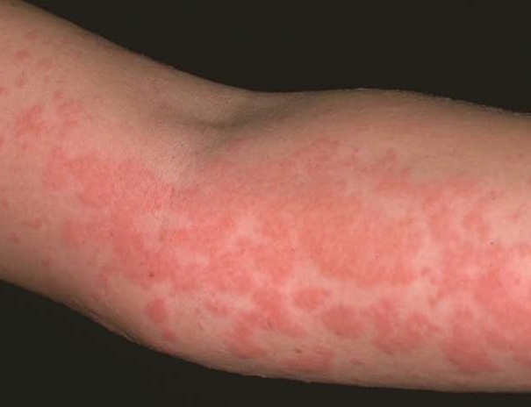
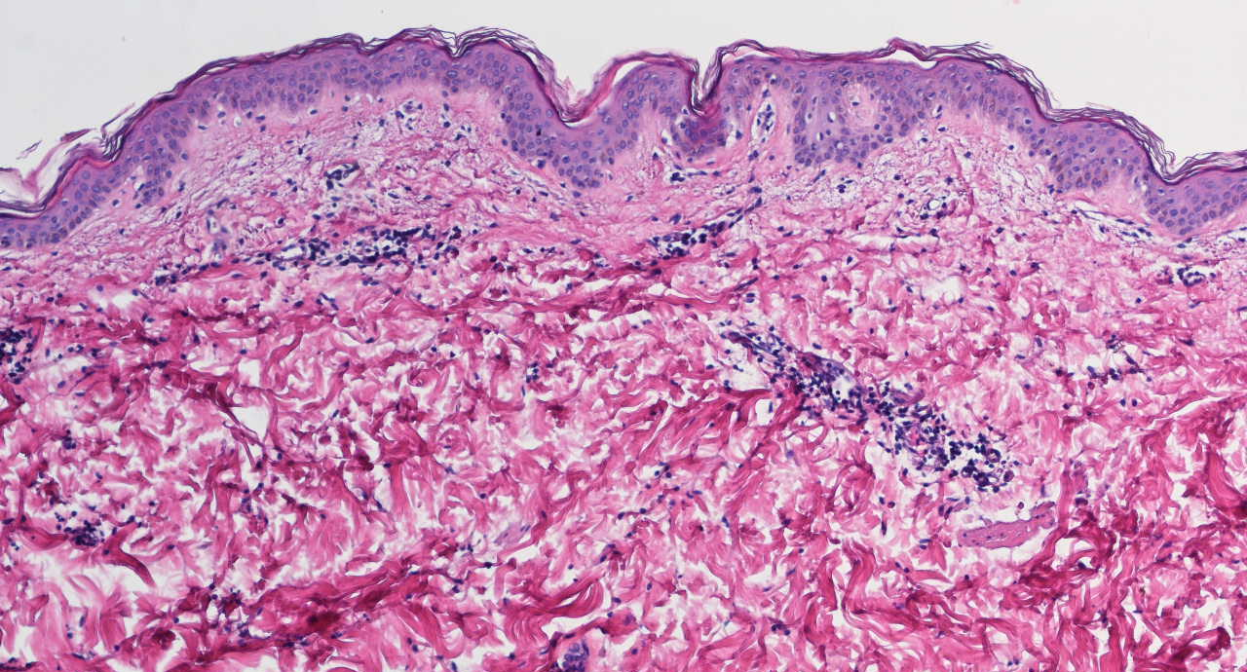
Urticaria
Wheals
Perivascular
inflammation

Slide 15
Acute Inflammatory Dermatoses: Acute Eczematous Dermatitis
Eczema: skin condition characterized by red, papulovesicular, oozing and crusted lesions that with time develop into raised, scaling plaques.
Pathogenesis:
Essentially a delayed-type, T-cell mediated (i.e. type IV) hypersensitivity reaction: Upon initial exposure to antigen, Langerhans cells process antigen and present it to T cells in lymph nodes to generate CD4+ T-cells sensitized to that antigen
Upon re-exposure to antigen, sensitized CD4 T-cells migrate to skin site and release pro-inflammatory factors leading to mast cell degranulation and local tissue damage
Clinical features:
Pruritic, edematous, oozing plaques, often w/ vesicles and bullae
Microscopically, fluid accumulation seen within the epidermis (spongiosis) along with perivascular inflammation, and sometimes local eosinophilia
With persistent exposure and irritation, plaques can become raised and scaly
Sub-types:
Allergic contact: most common type, reaction to topical antigens (e.g. poison ivy)
Atopic: unknown cause, but occurs more in those with asthma so auto-immune
Drug-related: reaction to systemically administered drugs (e.g. penicillin)
Photoeczema: reaction to UV light exposure
Primary irritant: non-immunologic reaction to chemical irritants

Slide 16
Acute Eczematous Dermatitis
Contact dermatitis (reaction to necklace)
Epidermal spongiosus

Slide 17
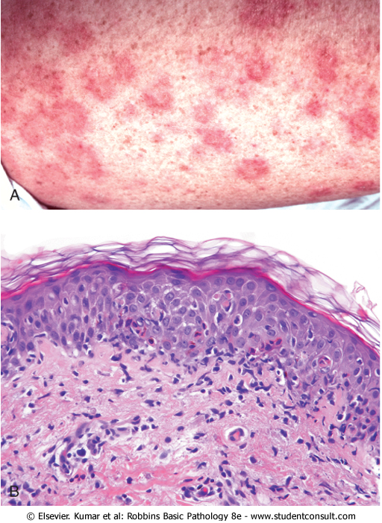
Acute Inflammatory Dermatoses: Erythema Multiforme
Hypersensitivity response to certain drugs and/or infections
Drugs: sulfonamides, penicillin, salicylates, antimalarials
Infections: herpes simplex virus, mycoplasma, fungi
Pathogenesis:
T-cell mediated reaction similar to eczema
Clinical features:
“target lesions” blister surrounded by red rim
Microscopically shows “margination” of lymphocytes at dermal-epidermal boundary and basal epidermal necrosis.
Broad range of serverity from minor (e.g. herpesvirus reaction) to severe (systemic drug reaction)
If severe can lead to loss of significant areas of epidermis

Slide 18
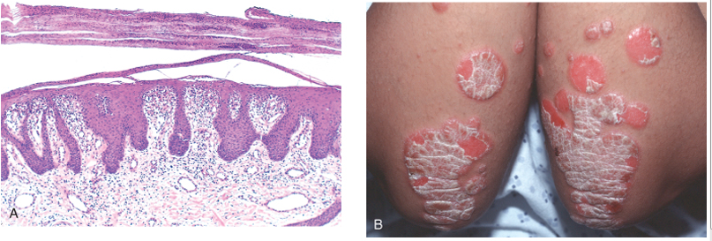
Chronic Inflammatory Dermatoses: Psoriasis
Rather common chronic inflammatory skin condition affecting 1-2% of people in U.S.
Pathogenesis:
Immunologic, but unknown whether antigens are self or environmental
CD4+ and CD8+ T-cell mediated; secrete factors that lead to keratinocyte hyperproliferation
Lesions often induced by local trauma and inflammatory response that then goes awry
Clinical features:
Most often affects elbows, knees, scalp, lumbosacral areas, intergluteal cleft and glans penis
Well-demarcated pink-colored plaques covered by sliver-white scale
Microscopically shows epidermal thickening (acanthosis), elongation of rete pegs, loss of stratum granulosum, and parakeratosis

Slide 19
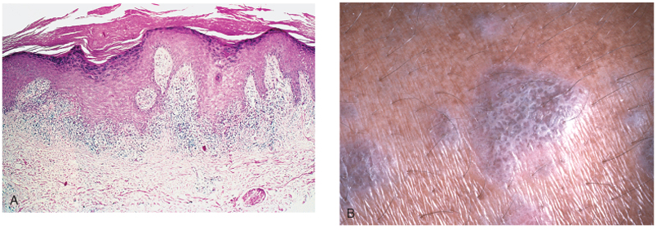
Chronic Inflammatory Dermatoses: Lichen Planus
Pruritic, purple, polygonal, planar papules and plaques; self-limited and resolving usually in 1-2 yrs
Pathogenesis:
Altered antigens (either due to drug treatment or viral infection) in basal cell layer causes CD8+ T-cells to elicit a cytotoxic immune response
Clinical features:
Pruritic, purple, flat-topped papules that may coalesce into larger plaques highlighted by white, netlike markings (Wickham striae)
Lesions may show hyperpigmentation due to melanin “leakage” into dermal layer
Microscopically shows intense accumulation of inflammatory cells at the basal cell layer (interface dermatitis), basal squamatization, and hypergranulosis

Slide 20
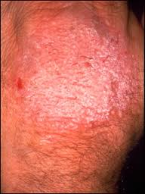
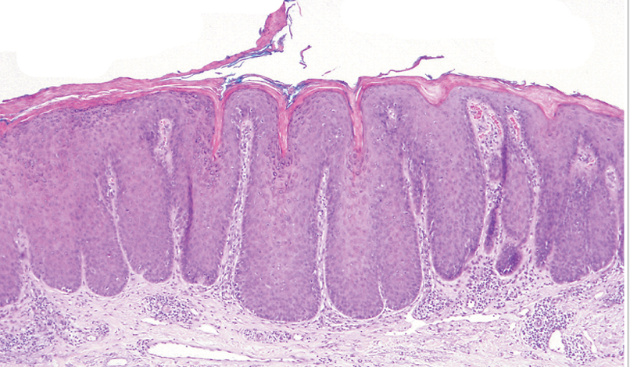
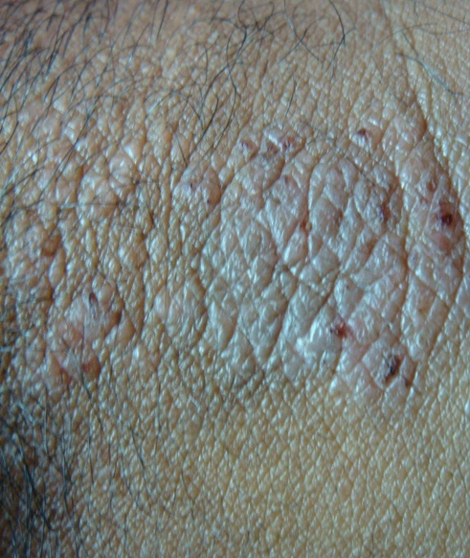
Chronic Inflammatory Dermatoses: Lichen Simplex Chronicus
Roughening of skin reminiscent of lichen on a tree
Pathogenesis:
Probably due to repeated trauma (e.g. repeated itching) inducing epithelial hyperplasia and dermal scarring
Clinical features:
Raised lesions with variable pigmentation and/or erythema
Microscopically shows stratum spinosum hyperplasia (acanthosis), hyperkeratosis, and hypergranulosis.

Slide 21
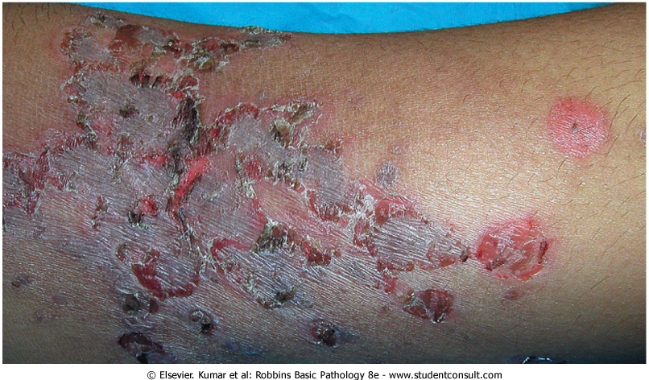
Infectious Dermatoses: Bacterial Skin Infections
Can range from superficial infections (impetigo) to deeper dermal abscesses
Superficial infection (impetigo)
Primarily seen in children
Usually caused by Staphylococcus and Streptococcus species
Generally begins with a single macule that then evolves into a larger, crusty lesion
Most often affects extremities, nose, and mouth
Dermal abscess
Usually caused by anaerobic species such as Pseudomonas aeruginosa
Often associated with puncture or surgical wounds

Slide 22
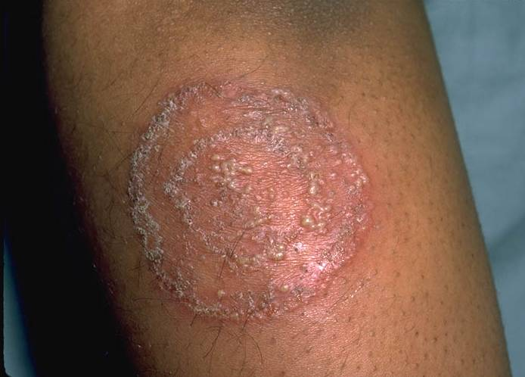
Infectious Dermatoses: Fungal Skin Infections
a.k.a “tinneas”
Superficial infections
Usually caused by Candida (yeast) species
Can mimic psoriasis, so any biopsy should include fungal stain
Deeper infections
Usually caused by filamentous species such as Aspergillus
Primarily seen in immuno-compromised hosts (post-transplant, elderly, HIV infection)
More tissue damage so generally erythematous and nodular

Slide 23
Infectious Dermatoses: Verrucae (warts)
Common lesions in children and adolescents, usually resolving in 6mo – 2yrs
Pathogenesis:
Most often cause by infection with some type of Human Papilloma Virus (HPV), which subverts cell cycle control and elicits epithelial hyperplasia
Some types of HPV (e.g. types 6, 16, and 18) are oncogenic; however, most warts are caused by non-oncogenic types (e.g. types 1, 2, 3, 4, 7, 8, 10, and 11)
Clinical features:
Generally characterized by undulant epidermal hyperplasia. Microscopically features cytoplasmic vacuolization (koilocytosis) in virus-infected cells in superficial epidermal layers. Infected cells may also show prominent keratohyaline granules and eosinophilic intracellular inclusions.
Generally classified into various types based on morphology and location:
Verrruca vulgaris: “common” wart, can occur anywhere, but usually on dorsum of hand, assoc. with HPV-2 and HPV-7
Verruca plana: “flat” wart; flat, smooth macules, assoc. with HPV-3, -8, -10
Verruca plataris/palmaris: occur on soles and/or palms, 1-2 cm in diameter, assoc. with HPV-1, -2, and -4
Genital warts: occur on genitalia, perineum, and perianal regions, assoc. with HPV-6, -11

Slide 24
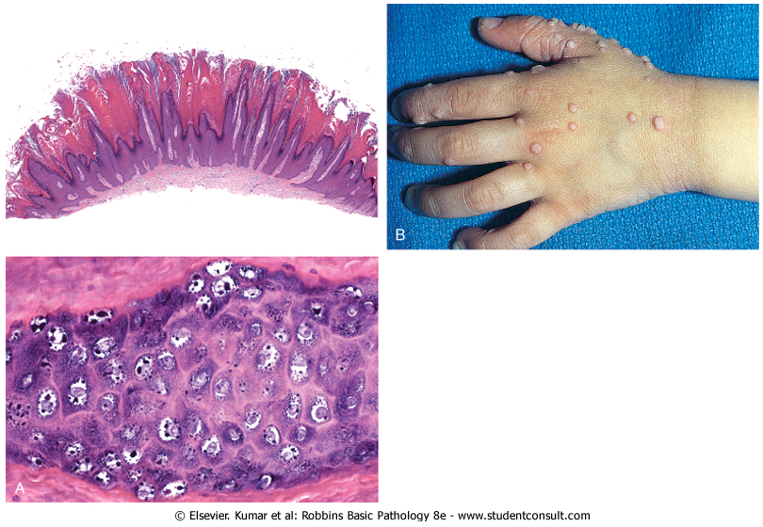
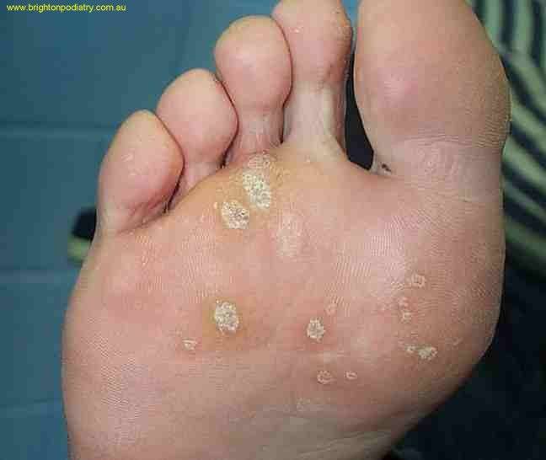
Infectious Dermatoses: Verrucae (warts)
common warts
koilocytosis
plantar warts

Slide 25
Blistering Disorders: Pemphigus
Loss of integrity within the epidermis
Pathogenesis:
Type II hypersensitivity reaction in which antibodies are produced against desmosomal proteins leading to auto-immune disruption of their function
Clinical features:
Generally characterized by loss of adhesion between cells within the epidermis (acantholysis) and variable dermal inflammation. The acantholysis can be more superficial (subcorneal) or deeper (suprabasal) depending on the type of pemphigus:
Pemphigus vulgaris: more common and, unfortunately, more severe type; involves mucosa and skin particularly on scalp, face, axilla, groin, trunk, and/or any pressure point; acantholysis is typically suprabasal and therefore more severe.
Pemphigus foliaceous: rare but more benign form, acantholysis typically more subcorneal

Slide 26
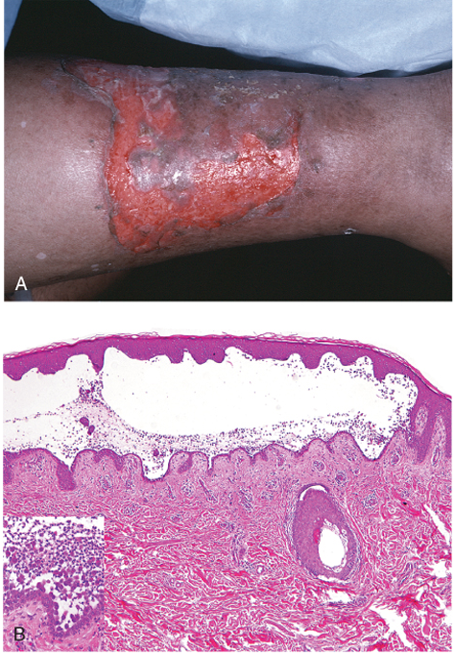
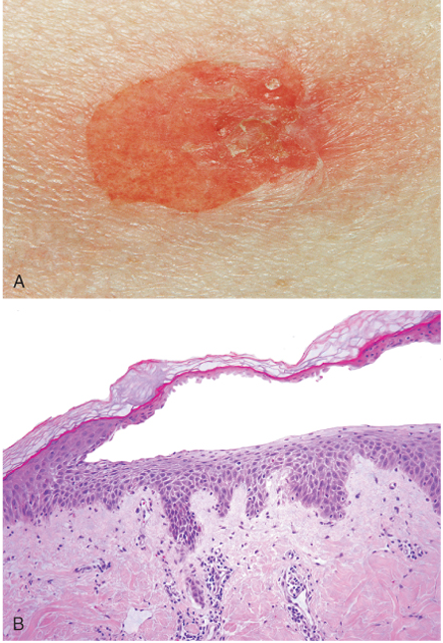
Pemphigus vulgaris
Pemphigus foliaceous

Slide 27
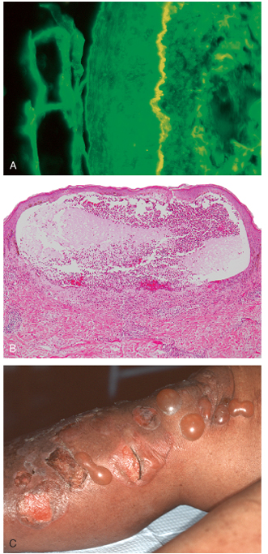
Blistering Disorders: Bullous Pemphigoid
hemidesmosome antibodies
Pathogenesis:
Type II hypersensitivity reaction in which IgG antibodies are produced against hemidesmosomal proteins leading to auto-immune disruption of their function
Antibody-antigen complexes also fix complement in region leading to local tissue destruction
Clinical features:
Entire epidermis separates from the dermis leading to the formation of tense, fluid-filled bullae that are more resistant to rupture compared to blisters seen in pemphigus
Generally affects elderly patients
Sites of occurrence include inner thighs, flexor surfaces of forearms, axilla, groin and lower abdomen.

Slide 28
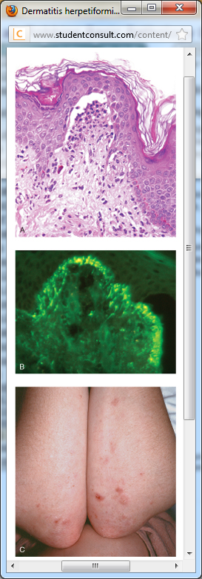
Blistering Disorders: Dermatitis herpetiformis
Rare disorder characterized by urticaria and grouped vesicles
Pathogenesis:
Associated with celiac disease: anti-gluten IgA antibodies cross react with epidermal anchoring fibril proteins leading to sub-epidermal blistering
Clinical features:
Extremely pruritic urticarial plaques
Microscopically shows fibrin and neutrophil accumulation at dermal papillae tips and separation of the epidermis from the dermis
Lesions are typically bilateral, symmetric, and grouped involving extensor surfaces, elbows, knees, upper back, and buttocks
Predominantly seen in males, 20-30 years old
anchoring fibril antibodies

Slide 29
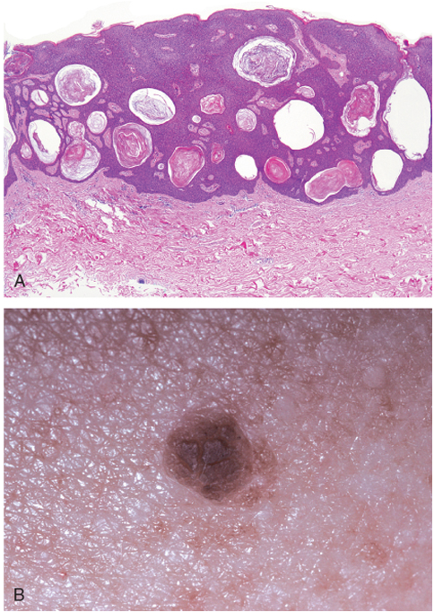
Benign & Premalignant Neoplasia: Seborrheic Keratosis
Common epidermal tumors seen in middle age and elderly.
Pathogenesis:
Most often associated w/ activating mutation in FGFR-3 leading to epidermal hyperplasia
Clinical features:
Round, flat, coin-like plaques millimeters to centimeters in diameter
Often tan to dark brown with velvety or granular surface
Microscopically consist of sheets of small cells with variable basal hyperpigmentation and hyperkeratosis at the surface leading to formation of keratin-filled cysts

Slide 30
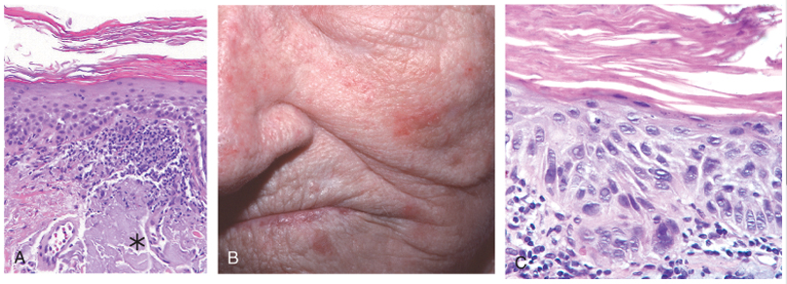
Premalignant Neoplasia: Actinic Keratosis
Premalignant lesion associated with sun exposure (actinic = “sun-related”)
Pathogenesis:
Often associated with mutation in p53, leading to defective apoptosis and hyperproliferation
Clinical features:
Lesions are generally <1cm in diameter, tan-brown, red, or skin-colored with rough sandpaper-like consistency
Microscopically shows cytologic atypia and basal cell hyperplasia and parakeratosis; dermis may show thickened, blue-gray elastic fibers (* in fig. A below)
More often found on sun-exposed areas (face, shoulders, back, arms)
Usually excised surgically or with local cryotherapy (freezing)

Slide 31
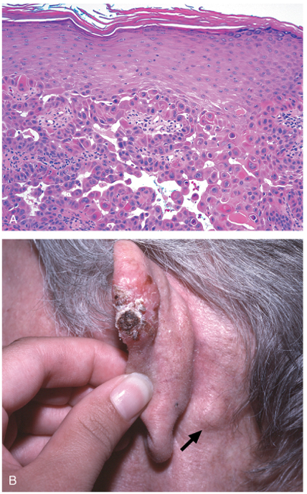
Malignant Neoplasia: Squamous Cell Carcinoma
Common tumor arising on sun-exposed sites in older people.
Pathogenesis:
UV light exposure with subsequent unrepaired DNA damage leads to loss of cell cycle control and hyperproliferation
Often associated with mutations in p53 and RAS oncogenes
Increased risk with UV B (tanning booth) exposure, HPV exposure, other carcinogens
Clinical features:
Red, scaling paques, often arising from actinic keratoses; more advanced lesions ulcerate
Microscopically consist of atypia throughout all layers with metastasis into dermis
Often discovered when small and resectable; <5% metastasize (usually to nearby lymph nodes as shown in fig. B)

Slide 32
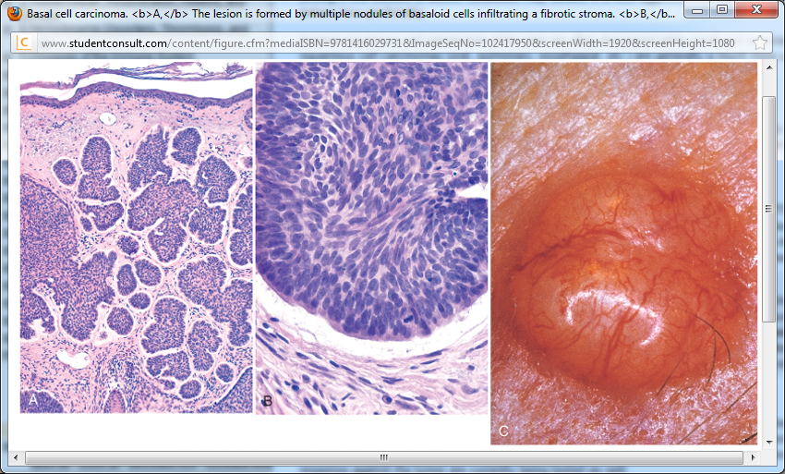
Malignant Neoplasia: Basal Cell Carcinoma
Most common cancer; also strongly correlated with sun exposure; slow-growing and rarely metastatic
Pathogenesis:
Often associated with mutations in Sonic Hedgehog-Patched pathway and/or mutations in p53, leading to aberrant growth factor response, defective apoptosis, and hyperproliferation.
Clinical features:
Lesions are generally pearlescent papules with prominent, dilated blood vessels and sometimes with hyperpigmentation. Advanced lesions may ulcerate.
Microscopically appear as multifocal or multinodular growth of basal cell layer into dermis with hyperchromatic, palisading nuclei
Usually excised surgically with little complication

Slide 33
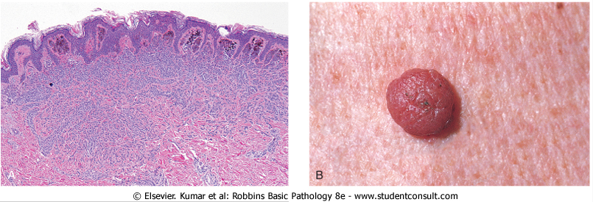
Melanocytic Neoplasia: Common Melanocytic Nevi
Pathogenesis:
Often associated with mutations RAS or downstream targets such as BRAF, leading to hyperproliferation of melanocytes and growth into underlying dermis; can progress to melanoma.
Clinical features:
Lesions are <5mm, tan-brown, uniformly pigmented elevated papules with well-defined, rounded borders
Microscopically appear as “nests” of melanocytes in various stages of maturation: peripheral cells are less mature, larger and more pigmented; deeper cells are smaller, more mature, and less pigmented
Usually excised surgically with little complication

Slide 34
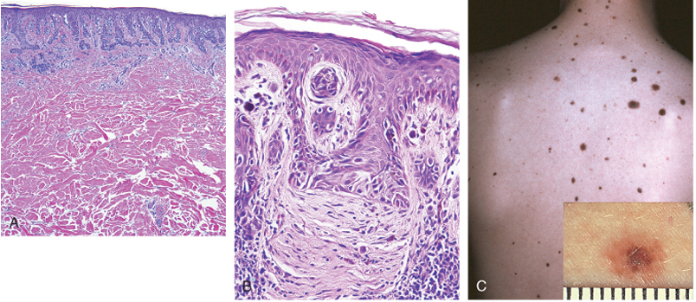
Dysplastic Melanocytic Nevi
May occur sporadically or in a familial form
Pathogenesis:
Also associated with mutations RAS or downstream targets such as BRAF, leading to hyperproliferation of melanocytes and growth into underlying dermis
Important to note that MOST melanomas arise de novo rather than from dysplastic nevi. Nonetheless they are still a good indicator of overall risk (those with dysplastic nevi are at higher risk)
Clinical features:
Usually >5mm and may occur as hundreds of lesions. Flat, raised macules with pebbly surface, irregular pigmentation, and irregular borders. Found in sun-exposed AND non-exposed areas.
Microscopically appear as “nests” of melanocytes with a high degree of atypia and a tendency to coalesce with adjacent nests; single nevus cells replace the normal basal cell layer of the epidermis and proliferate, producing so-called lentiginous hyperplasia

Slide 35
Melanoma
Less common than basal cell or squamous cell carcinoma, but much more deadly
Pathogenesis:
Associated with exposure to sunlight and loss of cell cycle control usually by loss of function of p16 or PTEN or activating mutation in NRAS or BRAF. Interestingly, p53 usually NOT mutated.
Initially radial or horizontal growth of melanocytes without metastasis before progressing to more aggressive, downward vertical growth into dermis
Probability of metastasis is correlated with depth of vertical invasion
Metastasis is both lymphatic and hematogenous, so can easily spread to liver, lungs, brain, etc.
Clinical features:
Lesions typically arise in skin, but can also occur in oral or anogenital mucosae, esophagus, meninges, or eye
Microscopically shows severe atypia with large nuclei and eosinophilic nucleoli; malignant cells may grow as nests within the epidermis in the “radial” phase or as expansile nodules within the dermis in the “vertical” phase
Lesions may be pruritic, but often asymptomatic; main signs of concern are:
Asymmetry – uneven appearance and texture
Border – irregular borders
Color – uneven color (black, brown, red, dark blue, or even gray)
Diameter – greater than 6mm in size
Evolution – change in size, shape and/or color of a lesion with time –MOST IMPORTANT SIGN

Slide 36
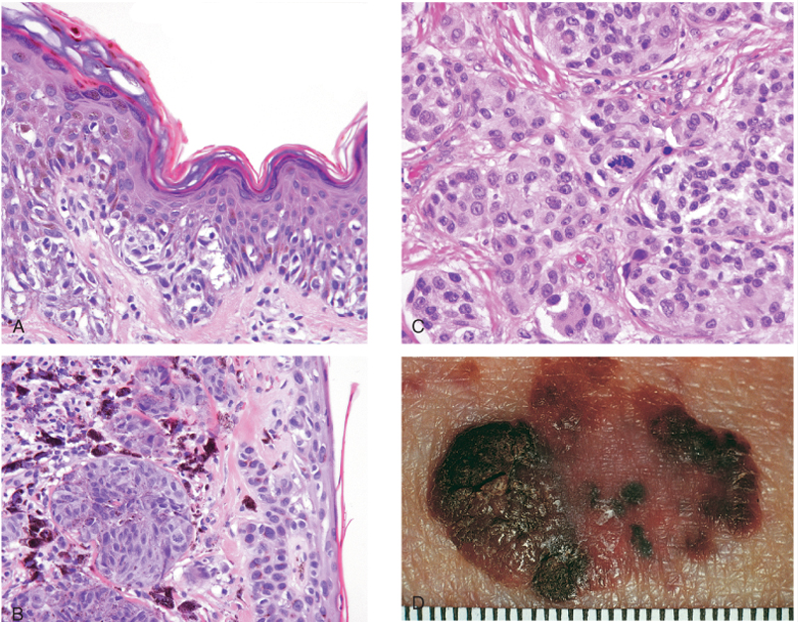
Melanoma
radial phase
severe atypia
vertical phase
asymmetry, irregularity

Slide 37
WEAR SUNSCREEN!!!!

