Slide 1
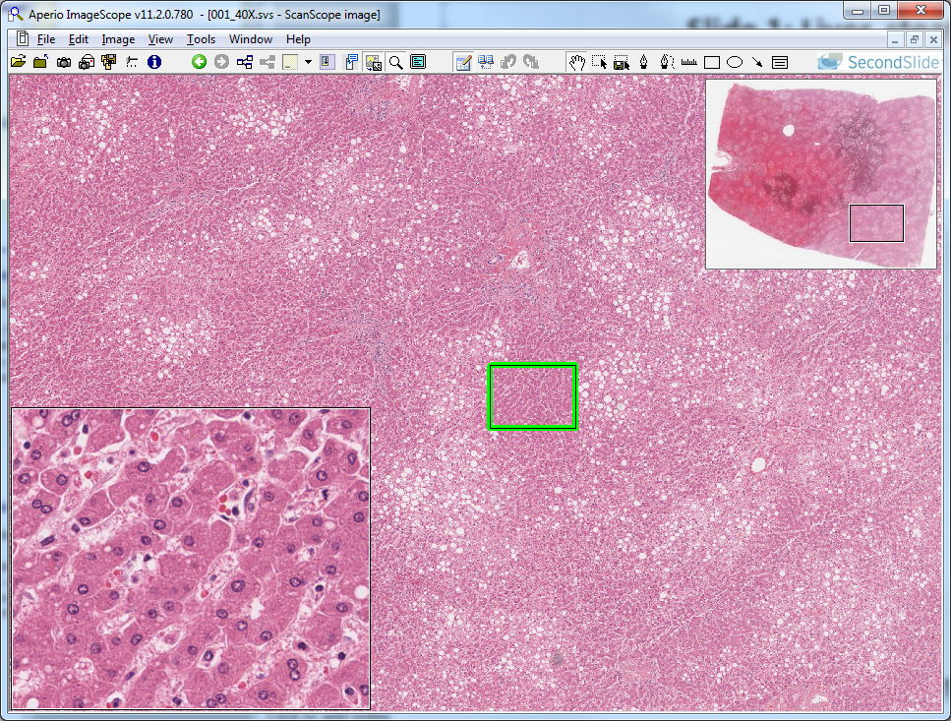
Slide 1: Liver, steatosis
“Normal” hepatocytes

Slide 2
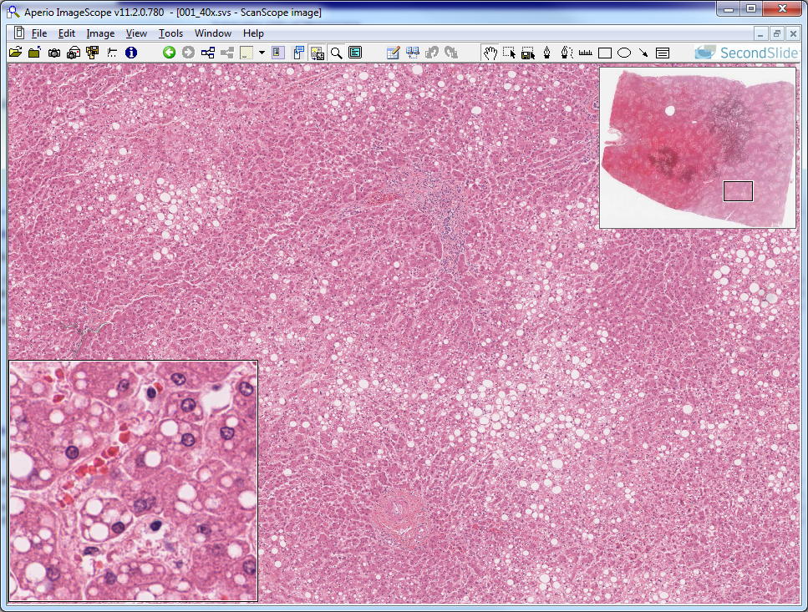
Slide 1: Liver, steatosis
“fatty” hepatocytes

Slide 3
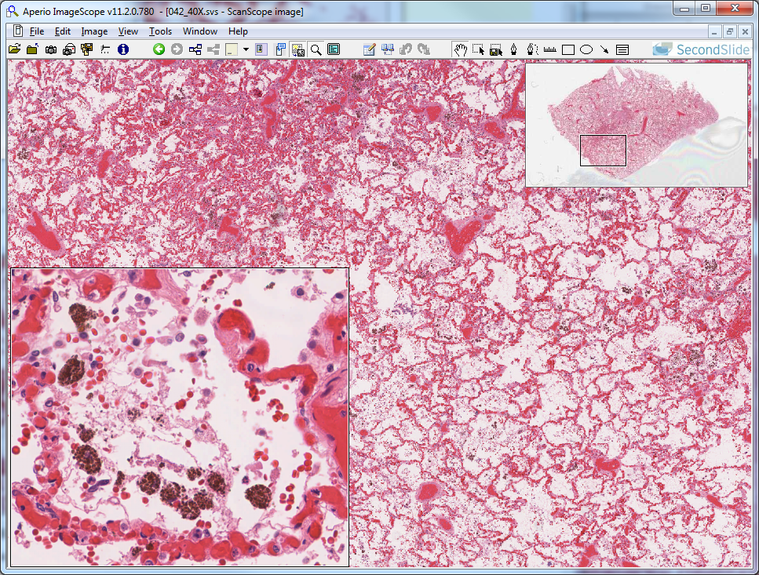
Slide 42: Lung, chronic congestion – hemosiderin pigment
lung alveolar
air space
hemosiderin-laden macrophages

Slide 4
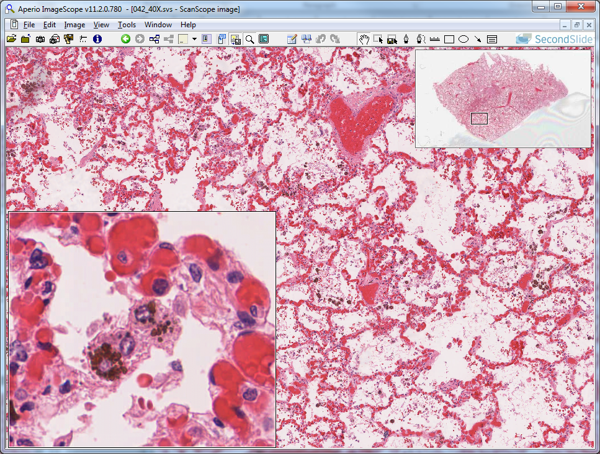
Slide 42: Lung, chronic congestion – hemosiderin pigment
hemosiderin

Slide 5
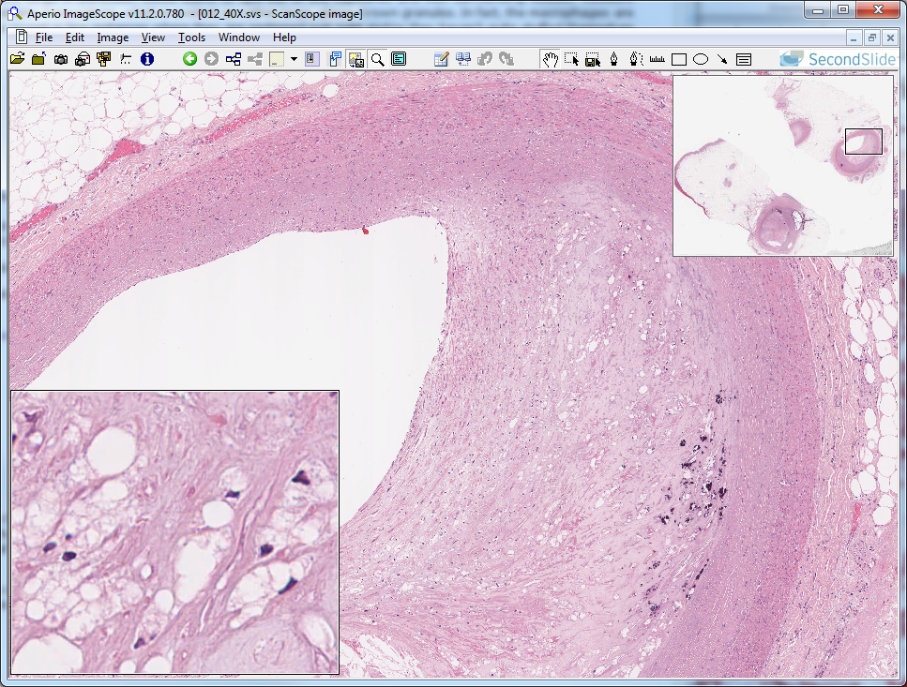
Slide 12: atherosclerosis – lipid inclusions in macrophages
simple sq. epith. lining
arterial lumen
lipid-laden macrophages

Slide 6
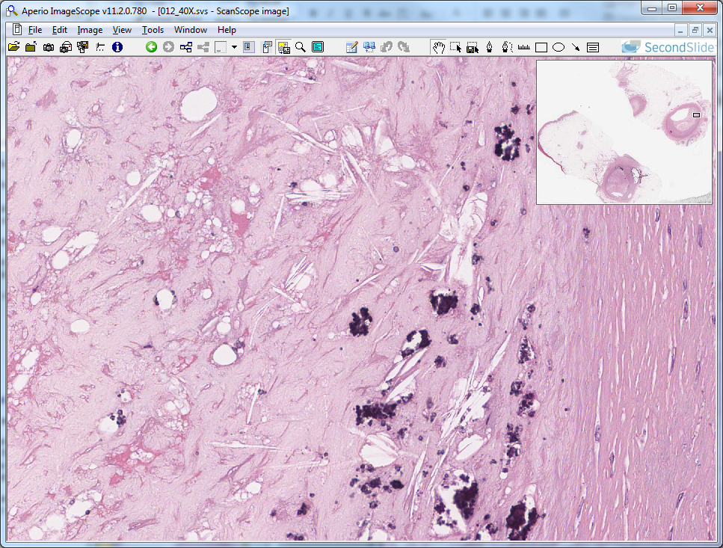
Slide 12: atherosclerosis – extracellular lipid and dystrophic calcification
cholesterol “cleft”
(extracellular accumulation)
dystrophic
calcification

Slide 7
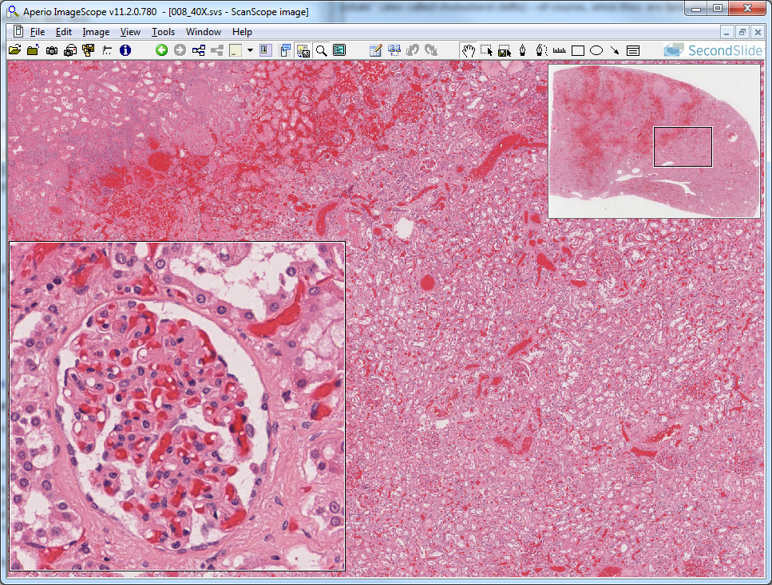
Slide 8: kidney infarction – wedge of dead tissue (healthy tissue shown here)
infarcted tissue
normal glomerulus
healthy tissue

Slide 8
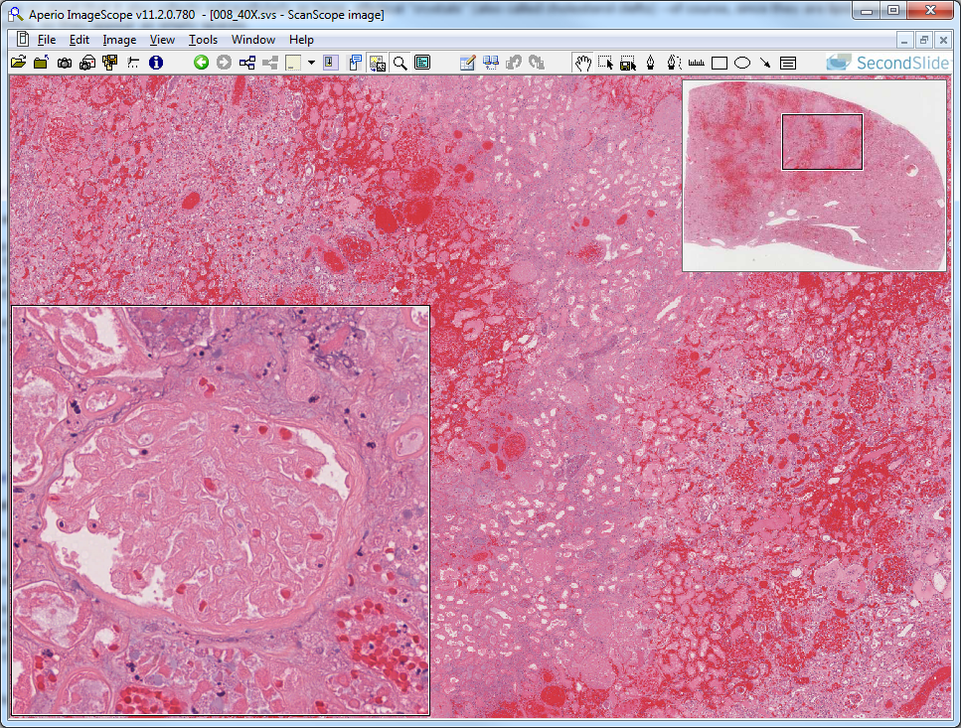
Slide 8: kidney infarction – wedge of dead tissue (dead tissue shown here)
infarcted glomerulus

Slide 9
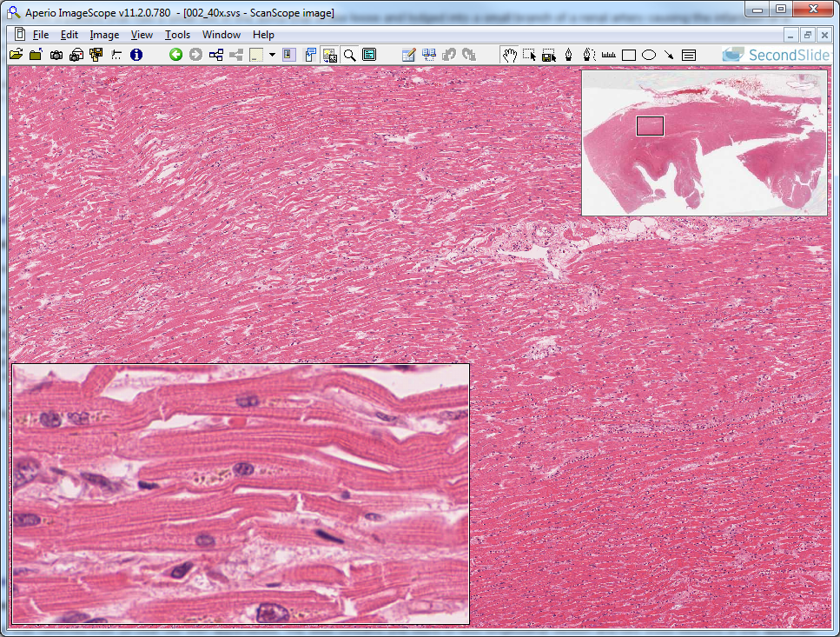
Slide 2: myocardial infarction – zone of dead tissue surrounded by healthy tissue (healthy tissue shown here)
lipofuschin pigment

Slide 10
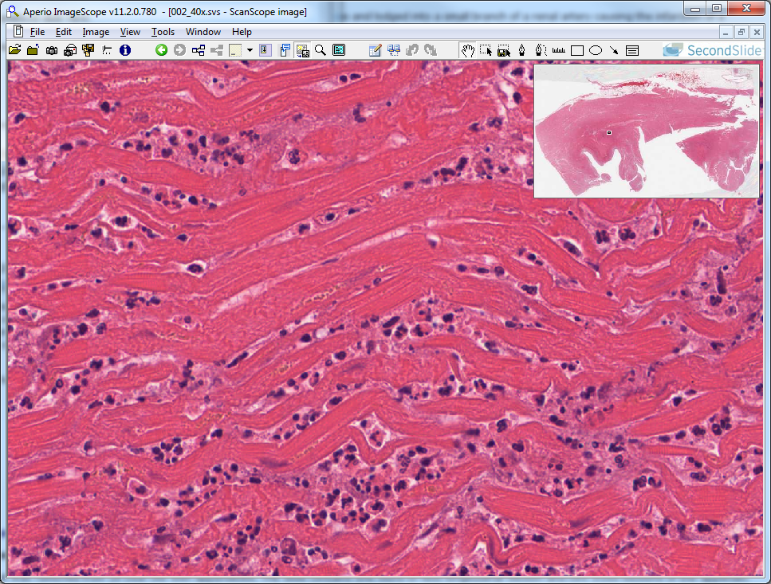
Slide 2: myocardial infarction – zone of dead tissue surrounded by healthy tissue (dead tissue shown here)
karyolytic nucleus
neutrophils

Slide 11
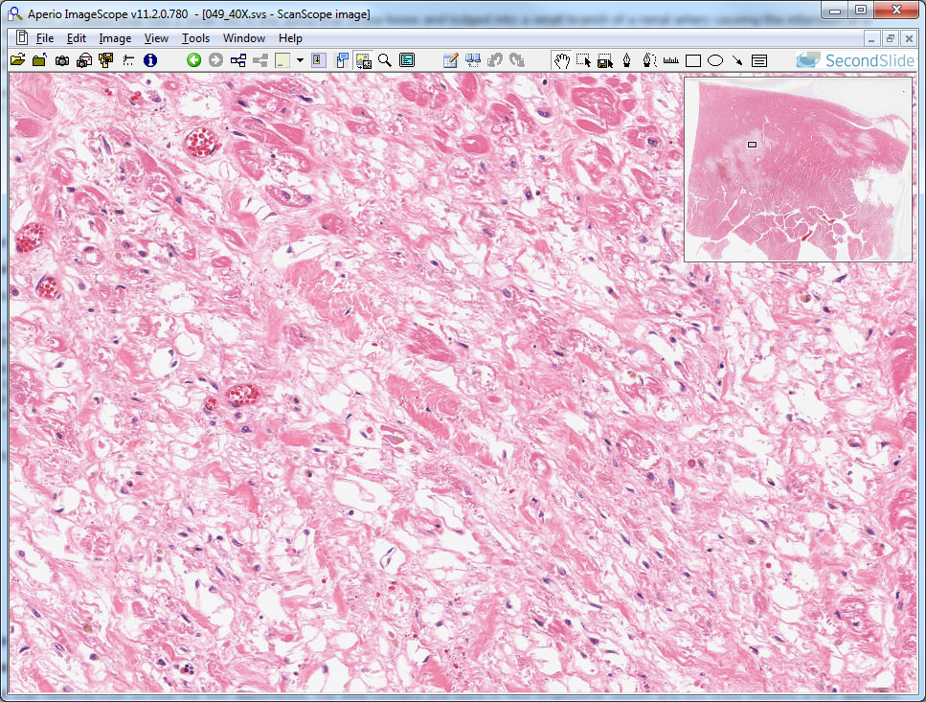
Slide 49: “remote” (old) myocardial infarction – scar tissue
collagen
cardiomyocyte ghost

Slide 12
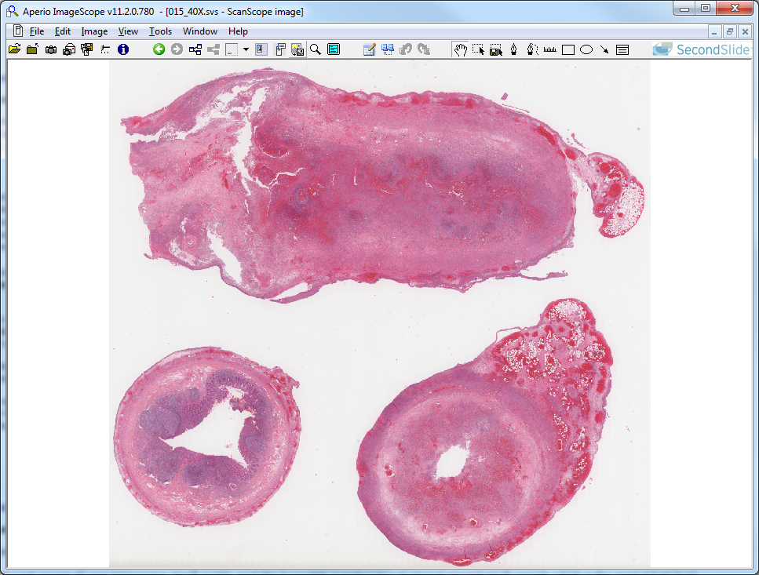
Slide 15: appendicitis – suppurative and fibrinopurulent inflammation
inflamed longitudinal section
healthy cross section
inflamed cross section

Slide 13
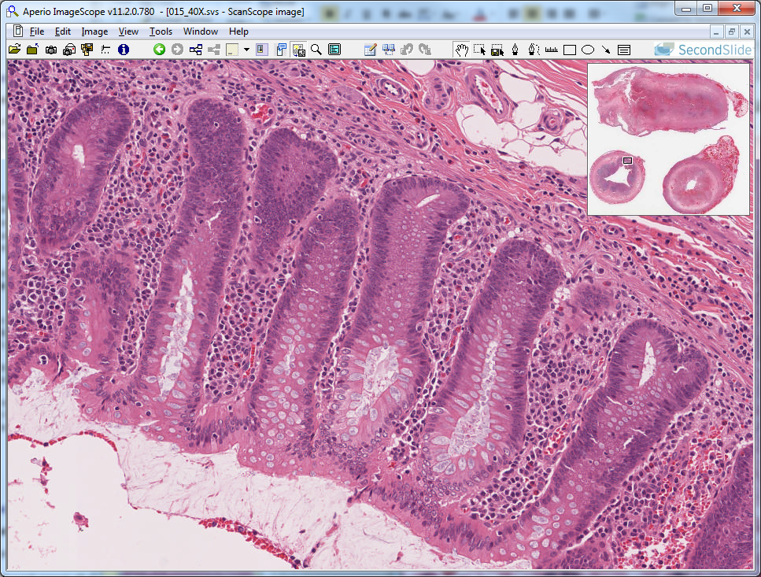
Slide 15: appendicitis – healthy epithelium

Slide 14
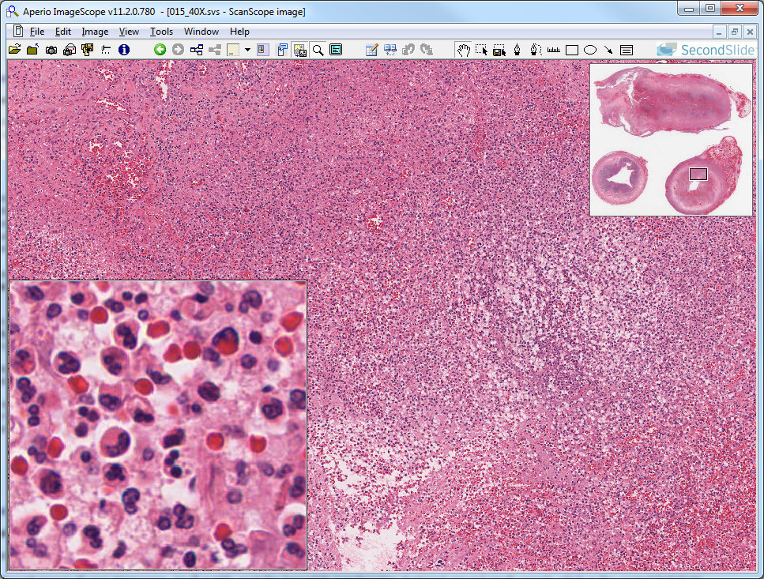
Slide 15: appendicitis – suppurative inflammation
neutrophils

Slide 15
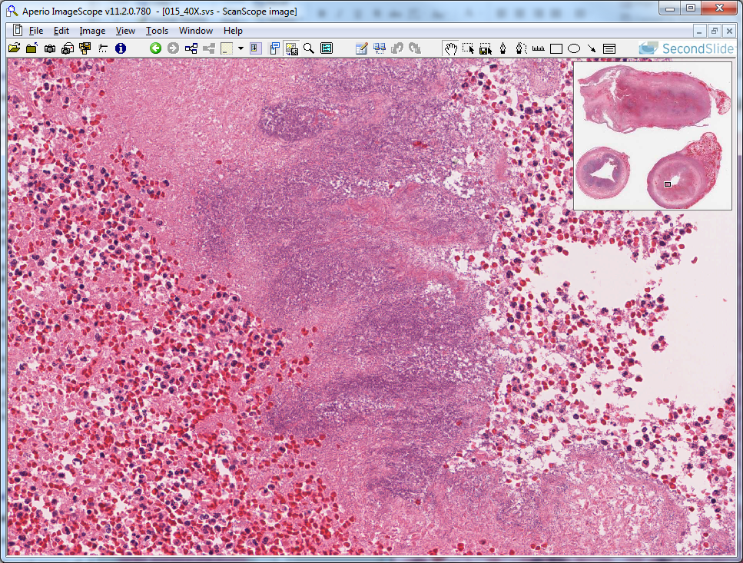
Slide 15: appendicitis – liquefactive necrosis
outline of dead epithelium

Slide 16
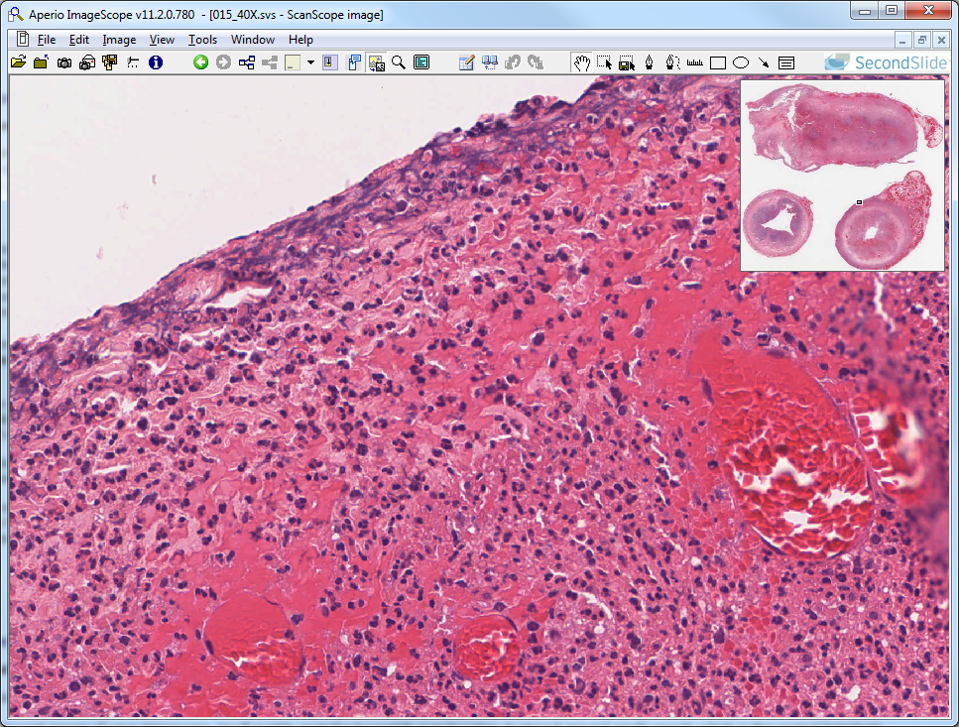
Slide 15: appendicitis – fibrinopurulent inflammation
fibrin (extravascular clotting)
with neurophils

Slide 17
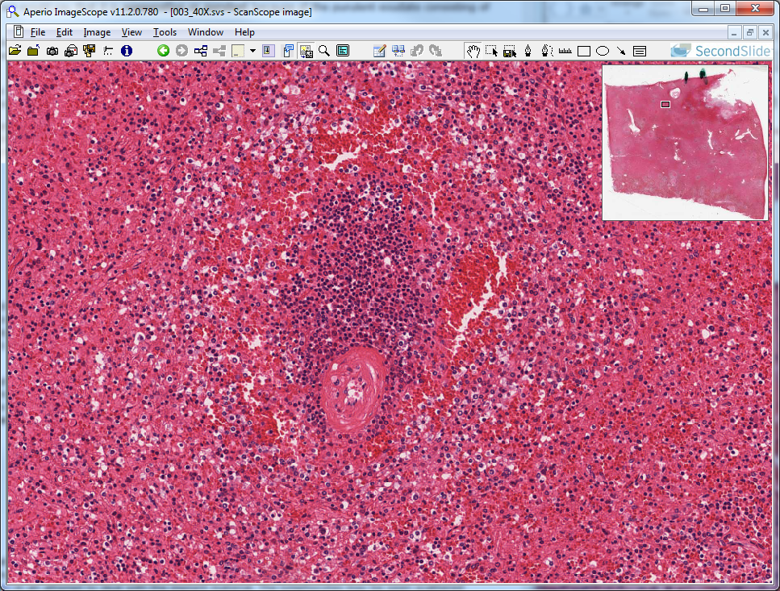
Slide 3: splenic tuberculosis infection – granulomatous inflammation & caseous necrosis (“normal” structure shown here)
lymphocyte aggregate
(normal)
blood vessel

Slide 18
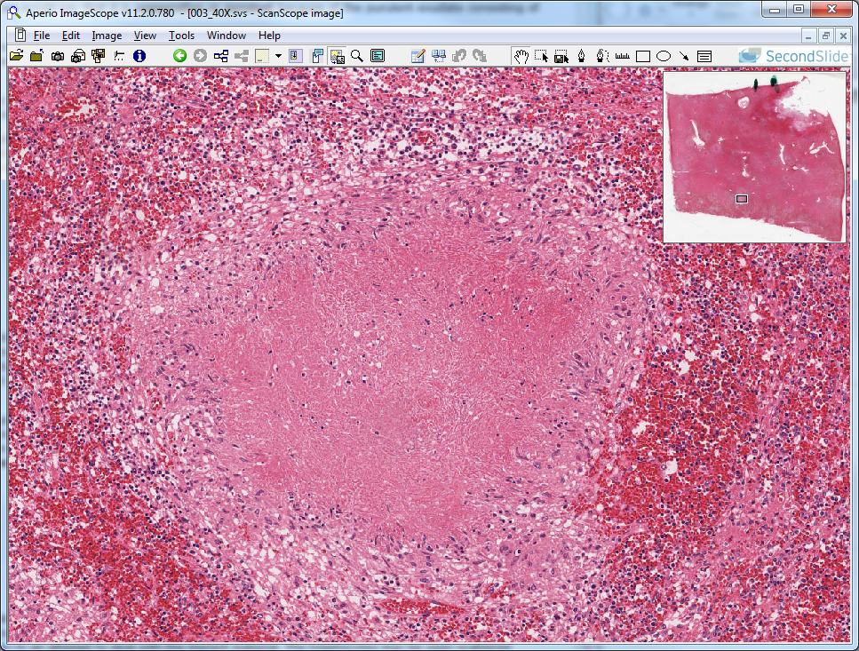
Slide 3: splenic tuberculosis infection – granuloma w/ caseous necrotic core
“epithelioid” macrophages
caseous necrosis

Slide 19
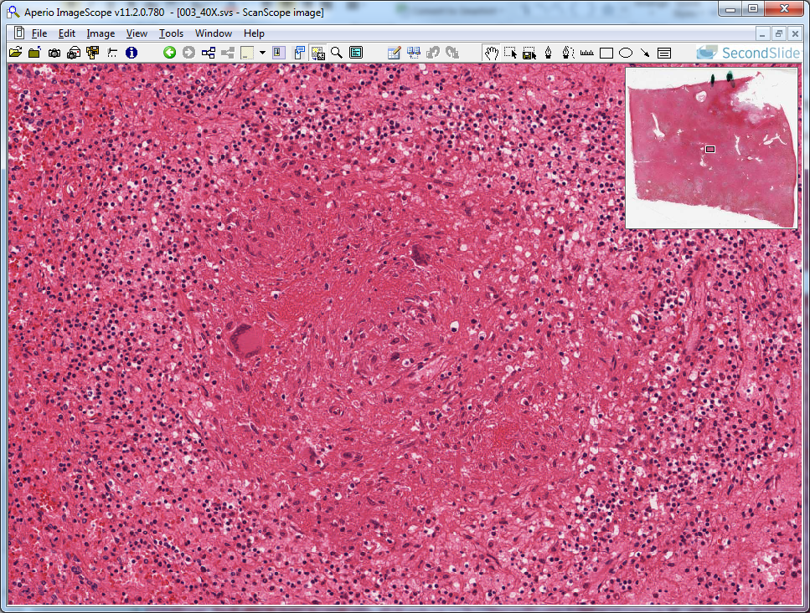
Slide 3: splenic tuberculosis infection – granuloma w/ giant cells
giant cells

Slide 20
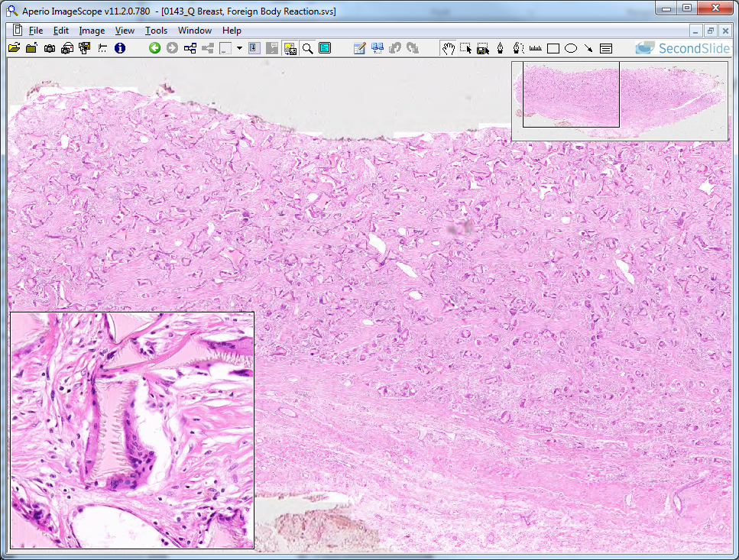
Slide 143: foreign body reaction – chronic inflammation
lymphocytes
giant cell

Slide 21
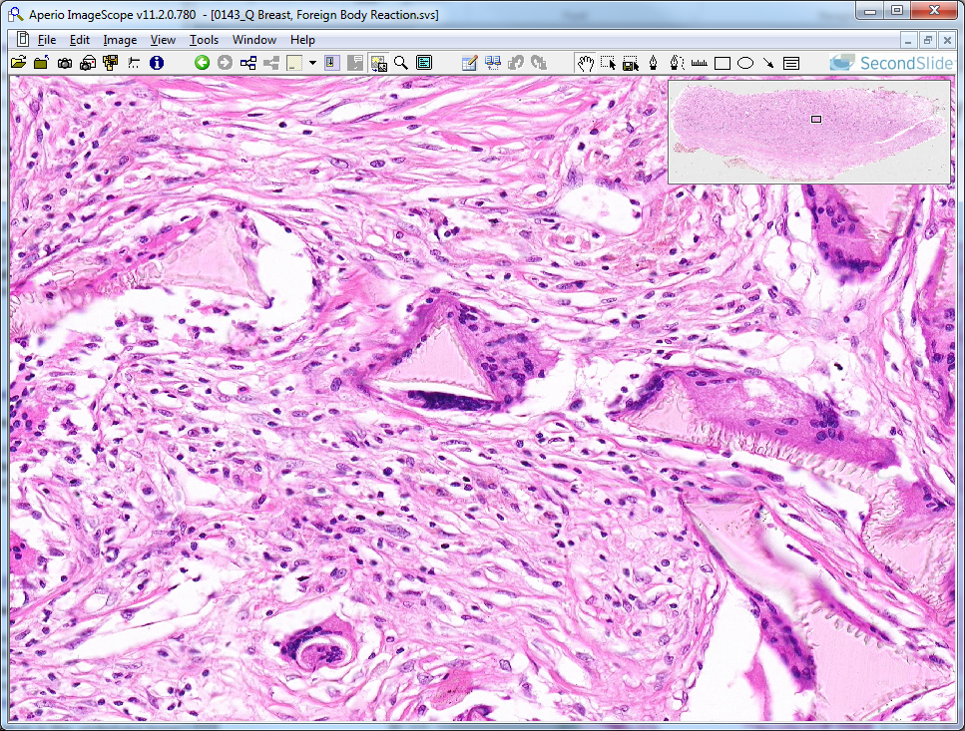
Slide 143: foreign body reaction – giant cells & lymphocytes
giant cells
lymphocytes

Slide 22
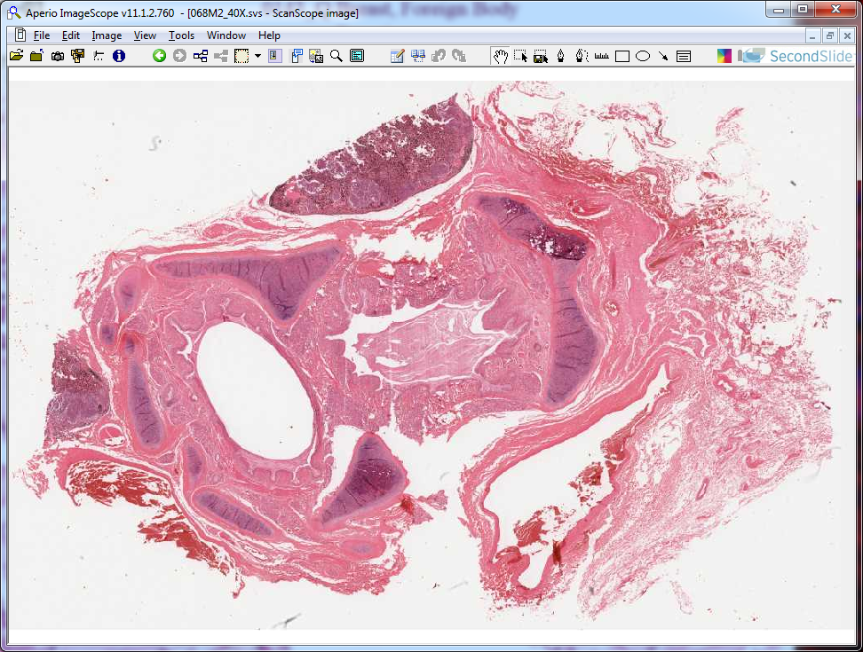
Slide 68: asthma – chronic inflammation
cartilage
airway (filled with debris)
airway (filled with less debris)
epithelium

Slide 23
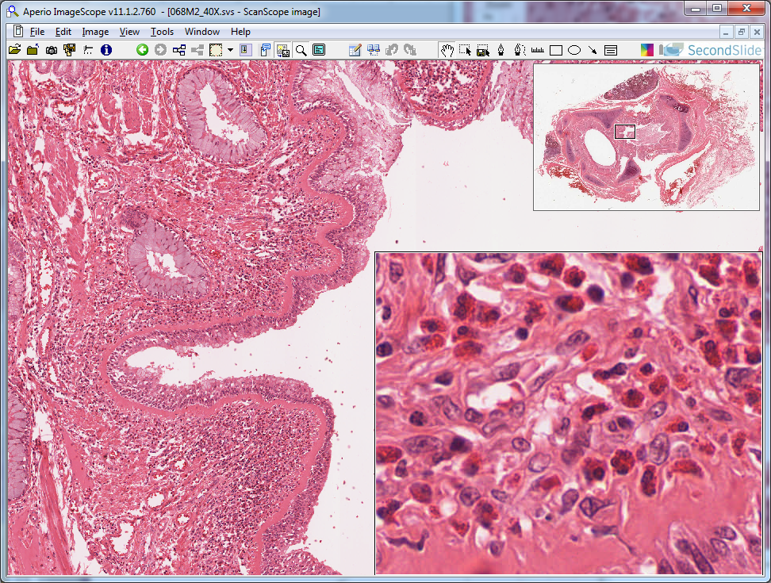
Slide 68: asthma – chronic inflammation
eosinophils
eosinophils
basement membrane
epithelium

