Slide 1
Respiratory System Histology Laboratory Orientation

Slide 2
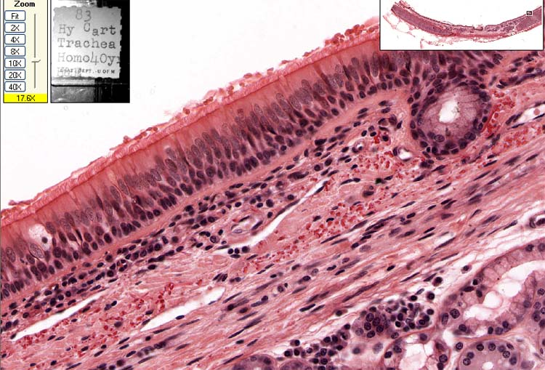
#40; Trachea
Basement membrane
Respiratory epithelium
Elastic fibers

Slide 3
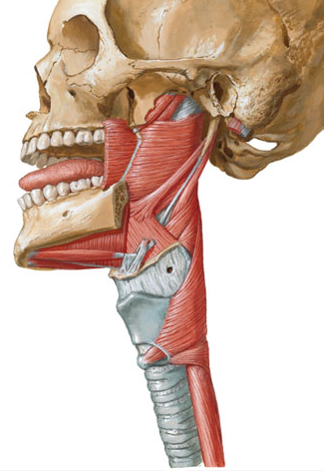
#126 Trachea Esophagus
trachea
Trachealis muscle
esophagus

Slide 4
#127 Trachealis Muscle (smooth)

Slide 5
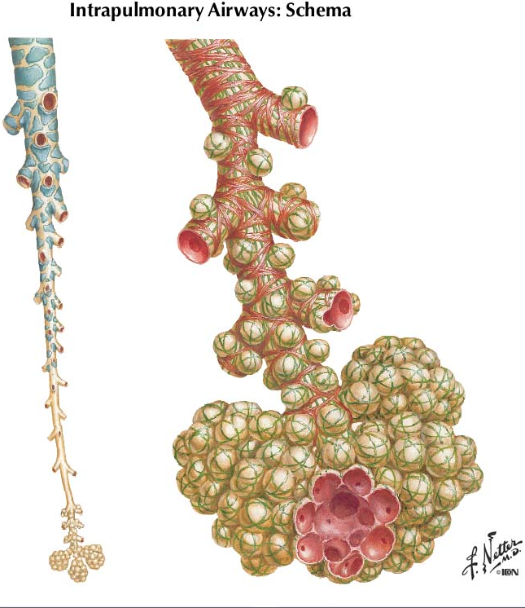
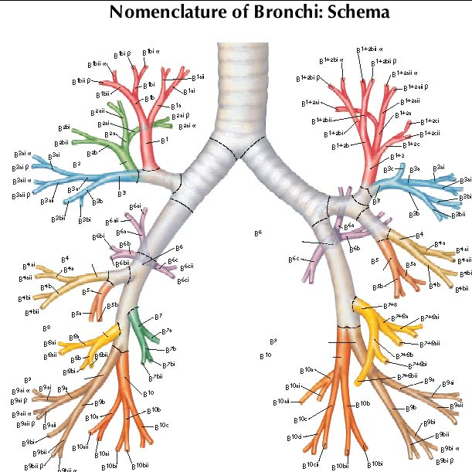
Bronchi
Bronchiole
Terminal bronchiole
Respiratory bronchiole
Alveolar sacs and ducts

Slide 6
#130-1 Lung
1?
Bronchus
2?
Pulmonary artery

Slide 7
#130-1 Lung
Pulmonary artery
Close to bronchial trees relatively thin wall (media) elastic laminae relatively wide lumen

Slide 8
#130-1 Lung
4?
3?
Bronchial vein
Bronchial artery
Only in the wall of large bronchi. Ordinary arteries with relatively thick media.
Bronchial cartilage

Slide 9
Bronchial Arteries
Right bronchial artery
Left bronchial arteries

Slide 10
#130-1 Lung
Bronchiole
Ciliated cells
non-ciliated cells
Ciliated and non-ciliated (Clara) cells No goblet cells Prominent sm. M.
Smooth muscle

Slide 11
#132-2 (Terminal) Bronchiole & Pulmonary artery
Smooth Muscle
P. A.
Bronchiole

Slide 12
#132 Lung
7?
P.A.
6?
Respiratory bronchiole
5?
Terminal bronchiole
Low cells
alveolar pocketing
Knobs of sm. muscle (arrows)

Slide 13
#129 Lung
Alveolar sac
Alveolar duct
8?
9?
alveoli

Slide 14
#130-1 Lung
10?
Type I Pneumocyte
12?
Macrophage
11?
Type II Pneumocyte (surfactant)

Slide 15
#130-1 Lung
Away from bronchial trees thin wall
Pulmonary vein
13?

Slide 16
#130-2 Lung
Pulmonary vein

Slide 17
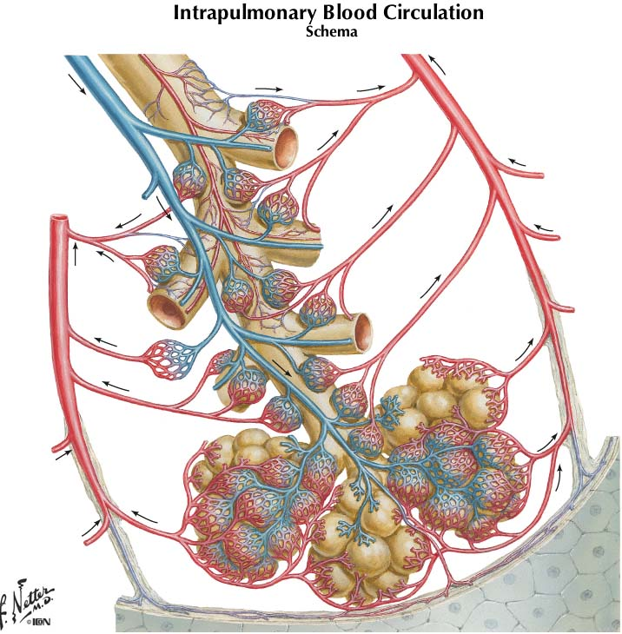
Intrapulmonary circulation
Pulmonary artery
Pulmonary vein
Pulmonary vein

Slide 18
#129 Lung
?
?
?

Slide 19
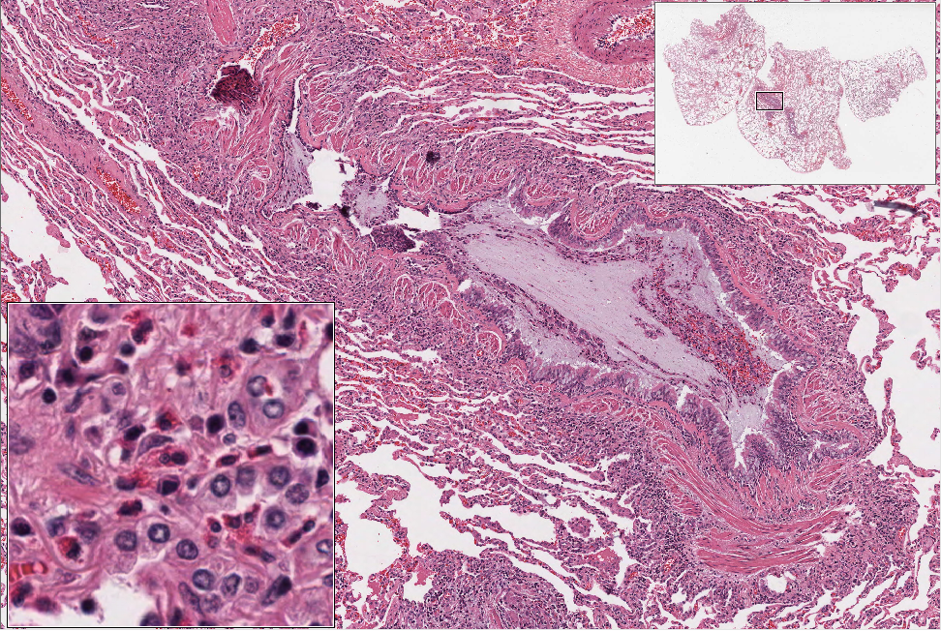
Slide 68
bronchiole lumen

Slide 20
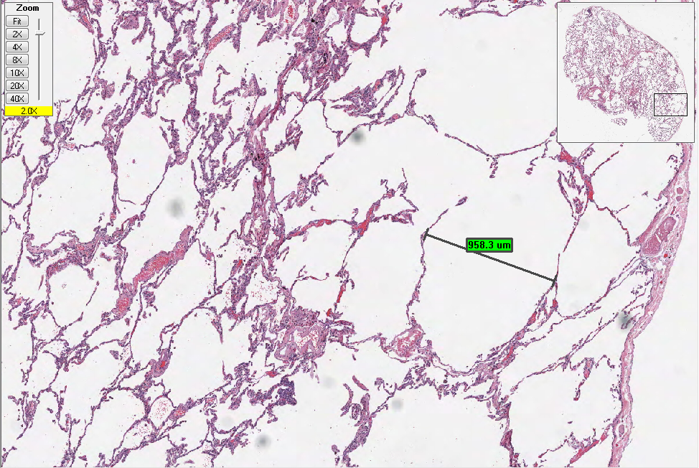
Slide 59

Slide 21
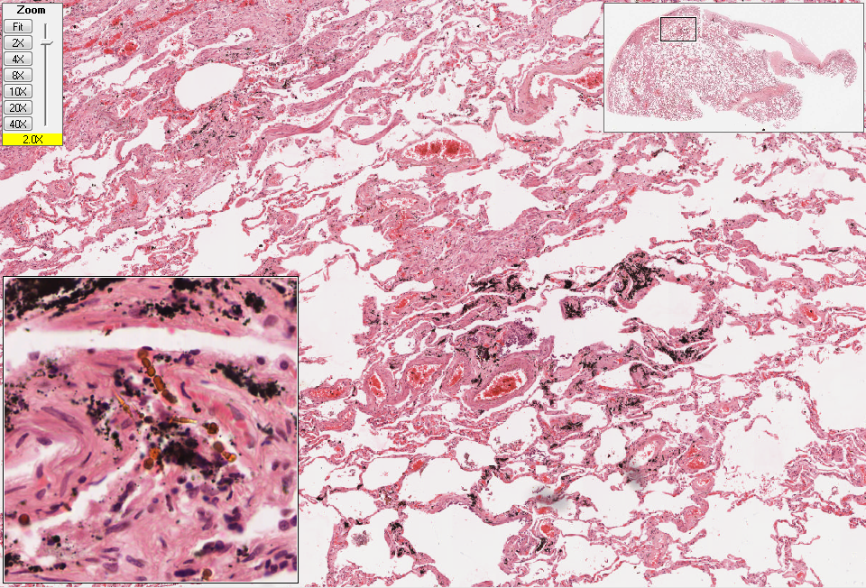
Slide 60

Slide 22
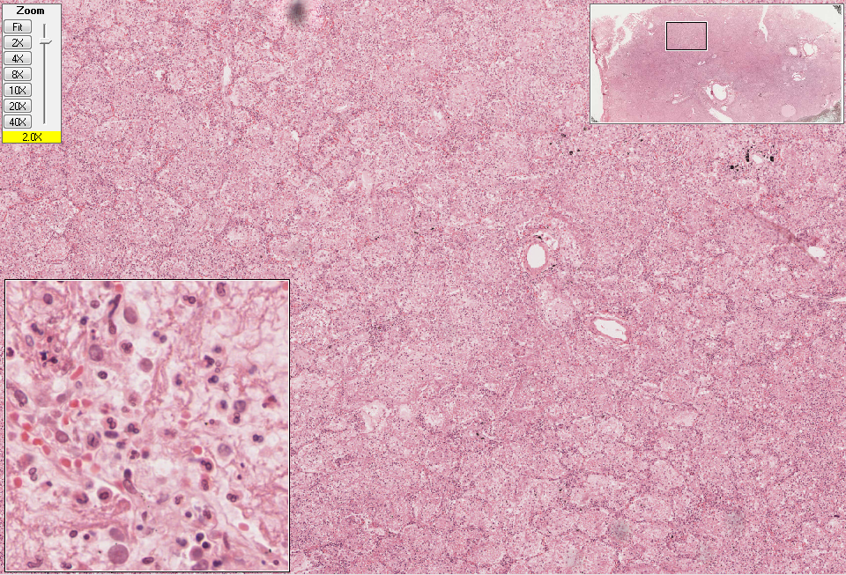
Slide 64

Slide 23
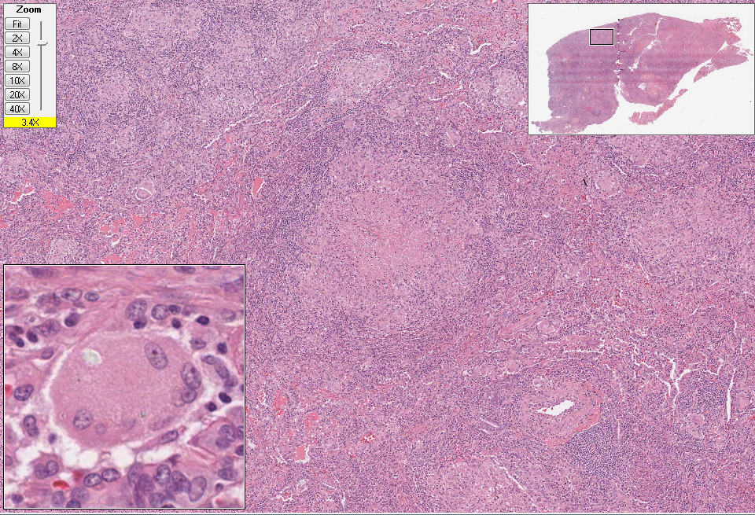
Slide 26 (lung)

