Slide 1
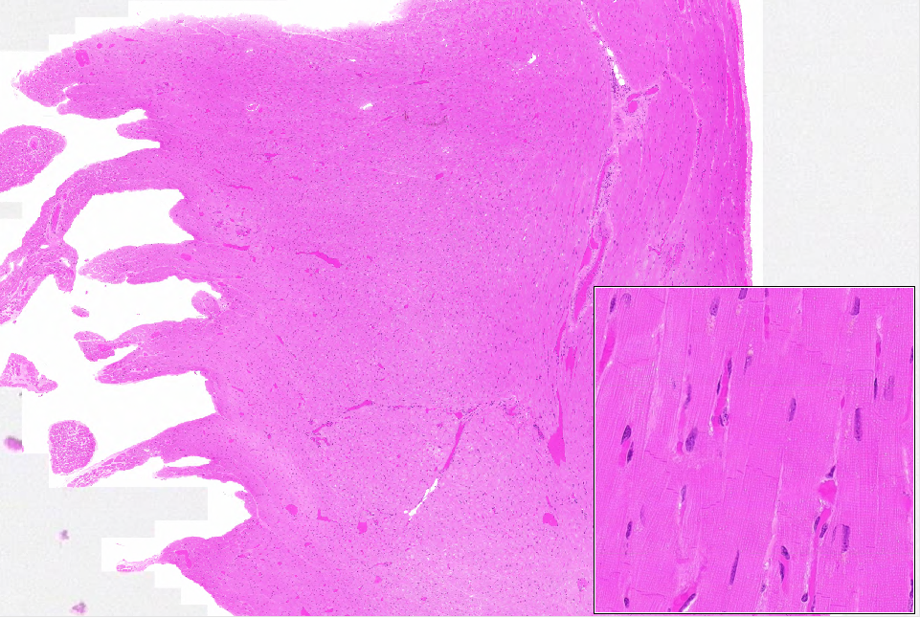
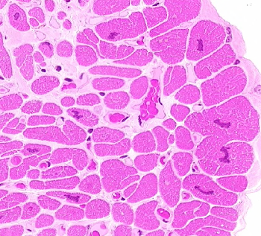
WebSlide 0026_B: cardiac muscle
bv
lc
epicardium
oc
xc
~100um
id
~25um
endocardium
Notes:
bv=blood vessel id=intercalated disk lc=long. sect. oc=oblique sect. xc=cross sect.

Slide 2
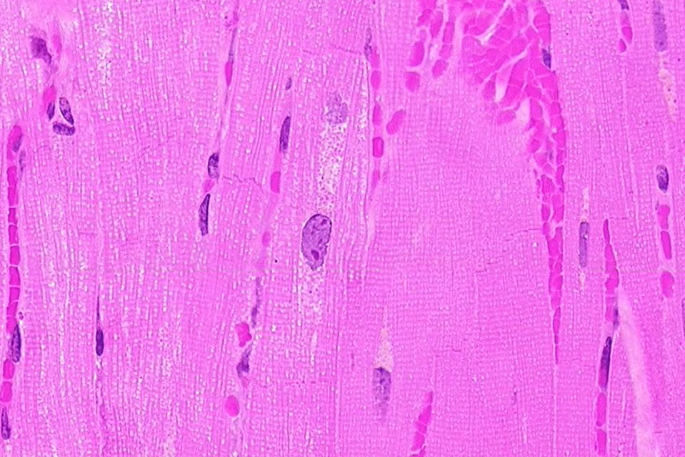
WebSlide 0026_B: cardiac muscle
id
mt
~25um

Slide 3
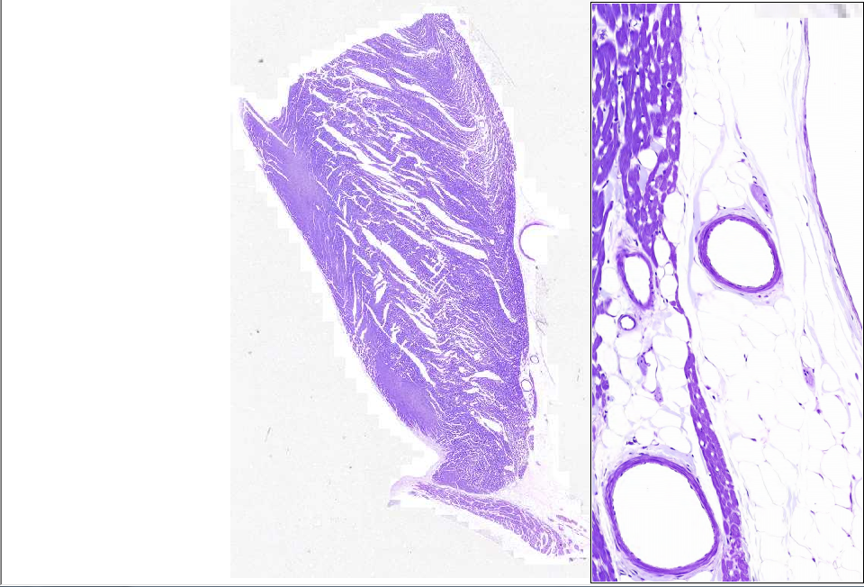
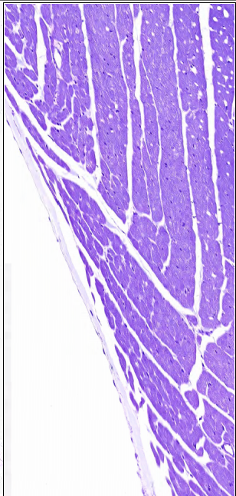
WebSlide 0024_B: AV valve & sulcus
myocardium
ventricular
myocardium
visceral pericardium
ventricular
myocardium
ca
epicardium
endocardium
atrial myocardium
ca

Slide 4
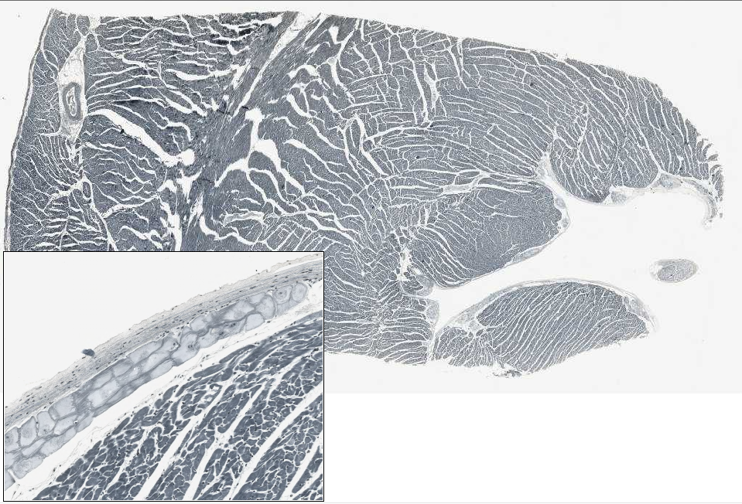
WebSlide 0033_B: heart, Purkinje fibers
epi-
ventricular
myocardium
endocardium
endocardium:
endothelium
subendothelial CT
subendocardium
Purkinje fibers
“subendocardium”
ventricular
myocardium

Slide 5
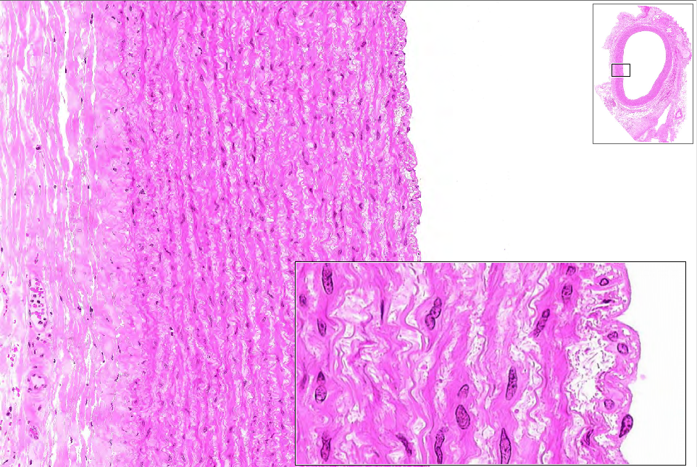
WebSlide 0022_B: aorta
intima
media
adventitia
vasa vasorum
SMC
SMC
elastic
lamella
intima
media
endo-

Slide 6
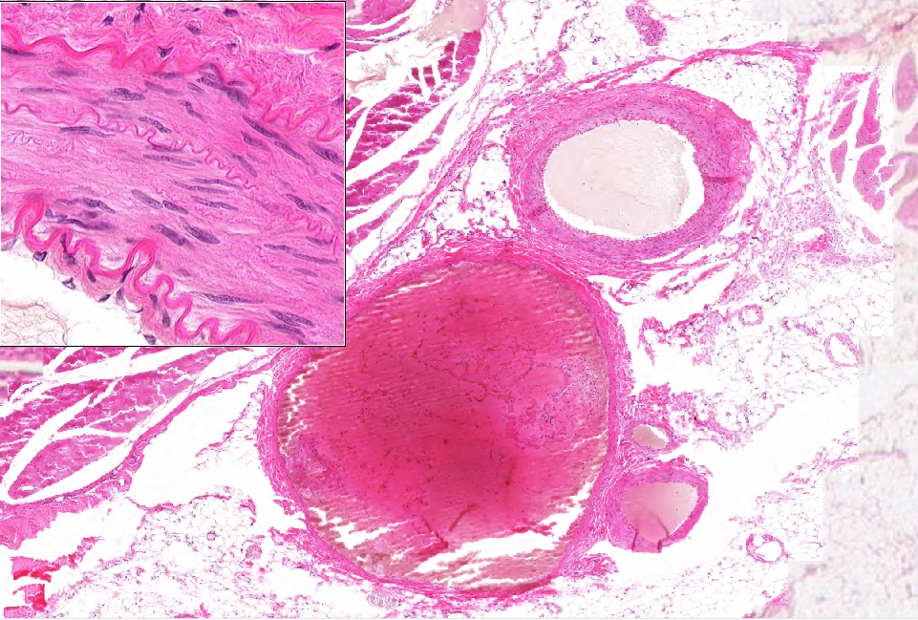
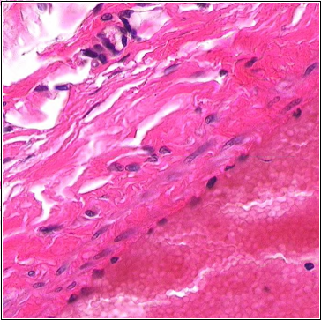
WebSlide 0174_B: artery & vein
adventitia
media
OEL
artery
IEL
intima
adventitia w/ vasa vasorum
vein
media
intima
RBCs in lumen
Notes:
IEL=internal elastic lamina EEL=external elastic lamina

Slide 7
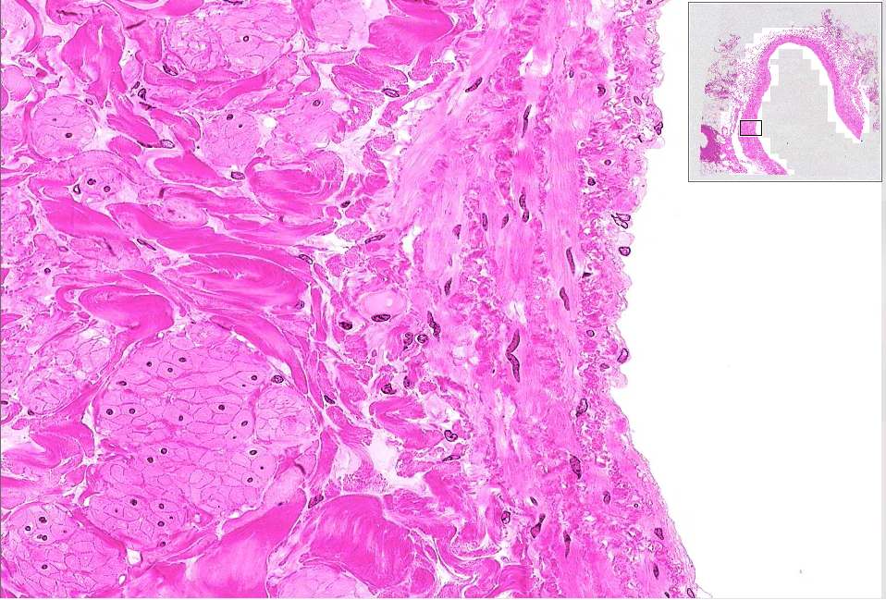
WebSlide 0023A_B: vena cava, cross sect.
adventitia
media
intima
SMC (longitudinal)
endothelium
SMC (longitdinal)
SMC (circular)
Notes:
SMC=smooth muscle cell

Slide 8
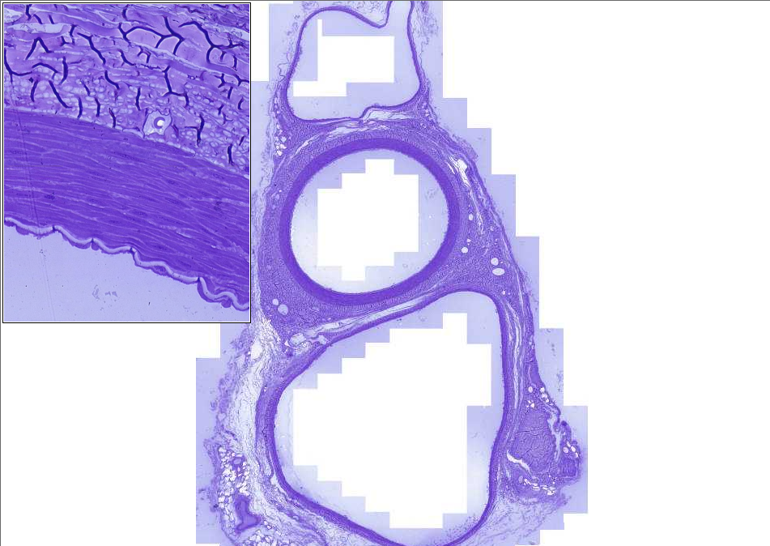
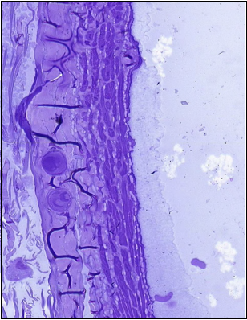
Slide 0004_B
adventitia
vein
vv
artifact
vein (below): Note the indistinct IEL and that the media has many fewer layers of SMC and is less organized. Some longitudinally-oriented SMCs can be seen.
media
artery
longitudinal SMC
iel
en
artery (above): Note the prominent IEL and many layers of circularly-arranged smooth muscle cells in the media.
en
vv
vv
vein
adventitia
media

Slide 9
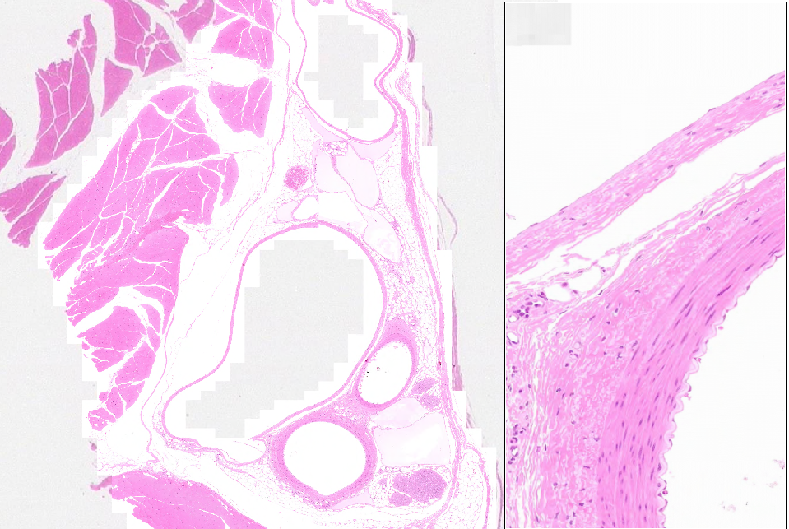
WebSlide 0013_B: femoral vessels & nerves
vein
lumen
vein
intima
media
skel. muscle
lymphatics
adventitia
vein
adventitia
artery
media
intima:
IEL
endothelium
artery
lymph
nerve
artery
lumen

Slide 10
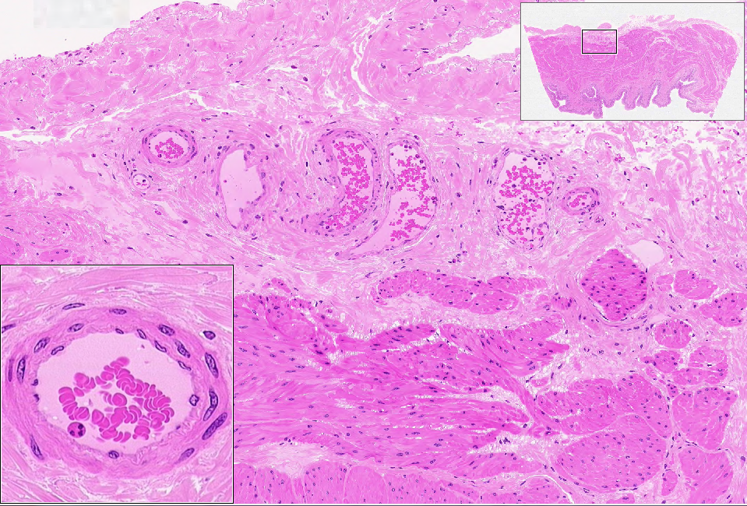
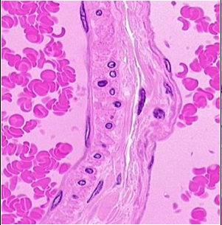
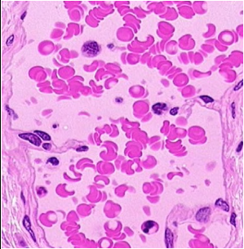
WebSlide 0098_B: urinary bladder
a
a
v
v
v
a
ARTERIOLE
ARTERIOLE
VENULE
VENULE
adventitia
SMC
media
endothelium
intima
(endothelium)
valve
endothelium
SMC

Slide 11
Extra Slides

Slide 12
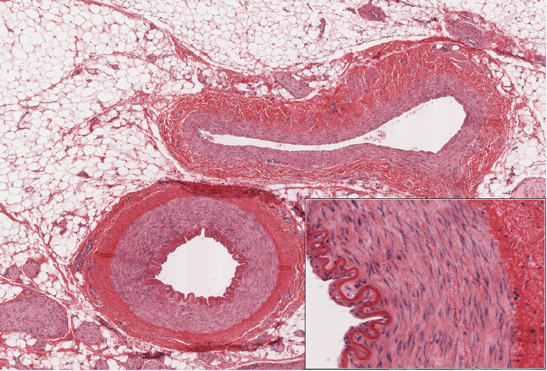
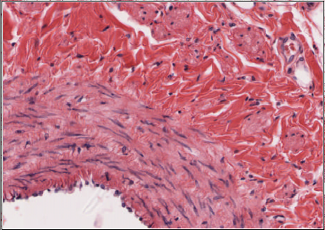
Slide UMich 042: mesentery (w/ arteries & veins)
smc
adventitia
media
vein
adventitia
media
artery
IEL
OEL
intima
intima

Slide 13
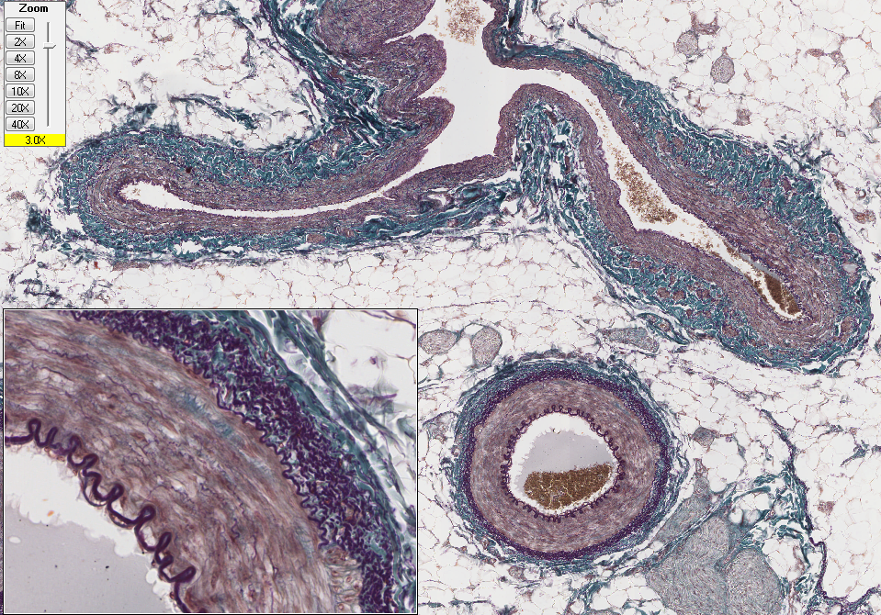
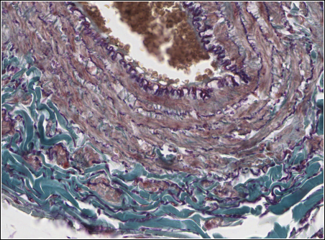
Slide UMich_09M: mesentery
media
adventitia
vein
smc
adventitia
artery
IEL
OEL
intima
media

Slide 14
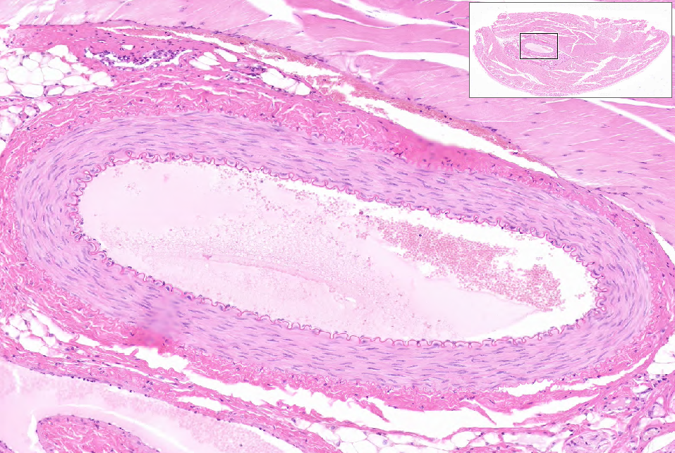
WebSlide 0001_B: artery (in skeletal muscle)
adventitia
media
IEL
intima
(endothelium + IEL)

Slide 15
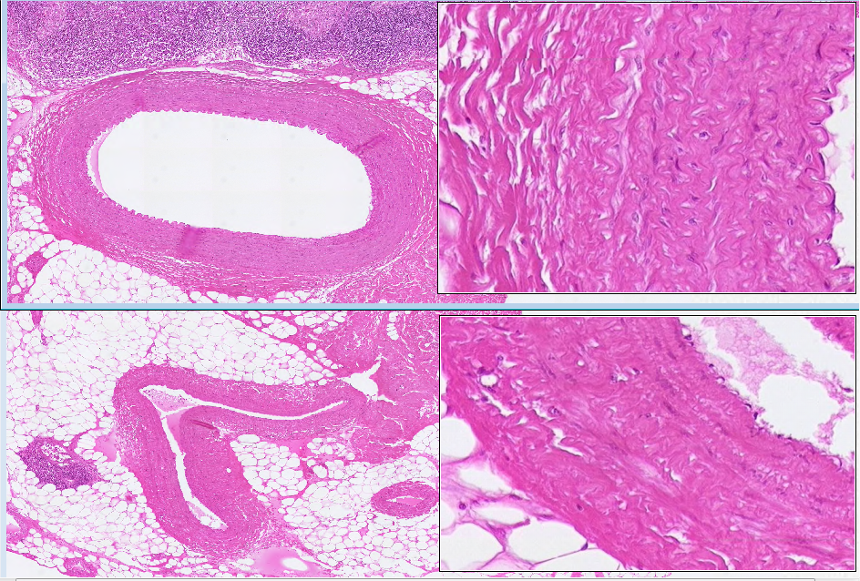
WebSlide 0002_B: artery & vein
lymph node
OEL
adventitia
media
intima
artery
IEL
RBCs in lumen
intima
vein
media
adventitia

Slide 16
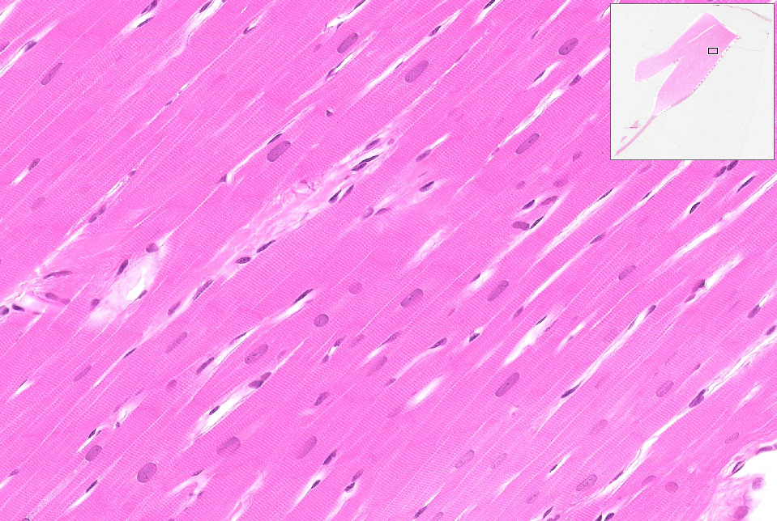
WebSlide 0025_B: papillary muscle & valve
valve (not in focus)
id

Slide 17
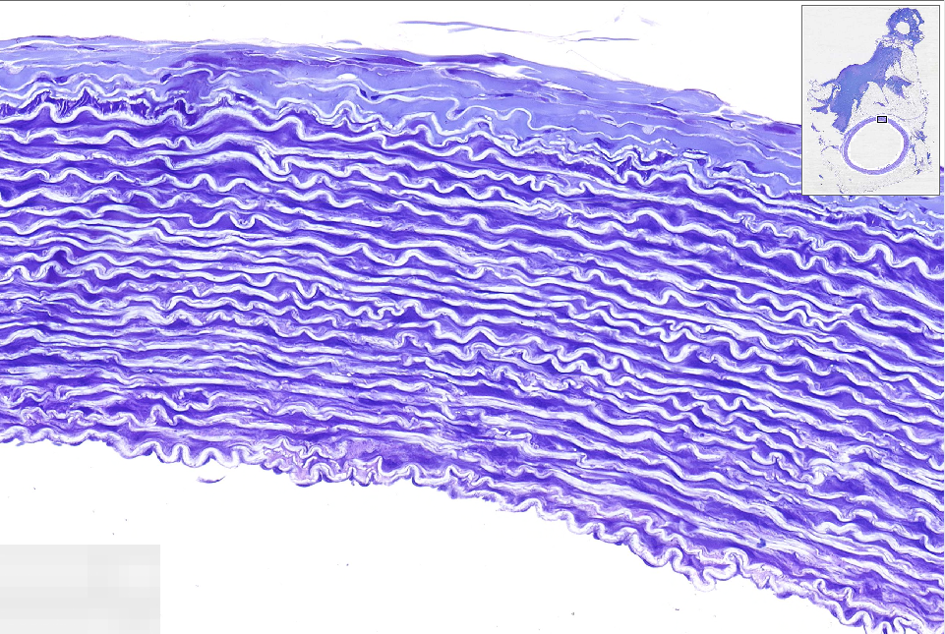
WebSlide 0150_B: aorta
adventitia
media
IEL
endothelium

Slide 18
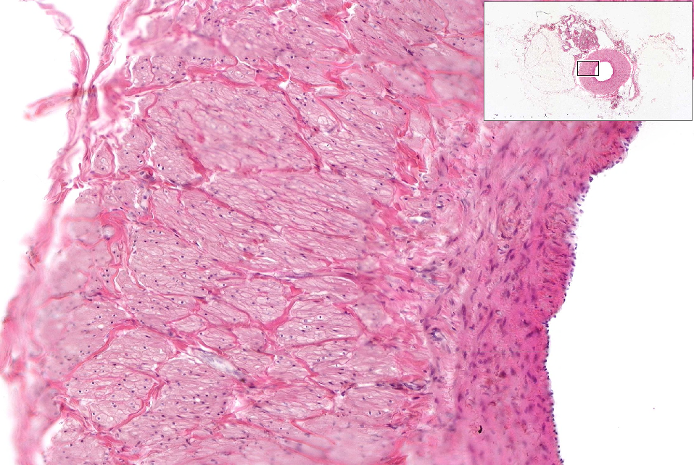
WebSlide 0175_B: abdominal vein
(thick section, so some areas are out of focus)
adventitia
(w/ longitudinal SMC bundles)
media
intima

