Slide 1
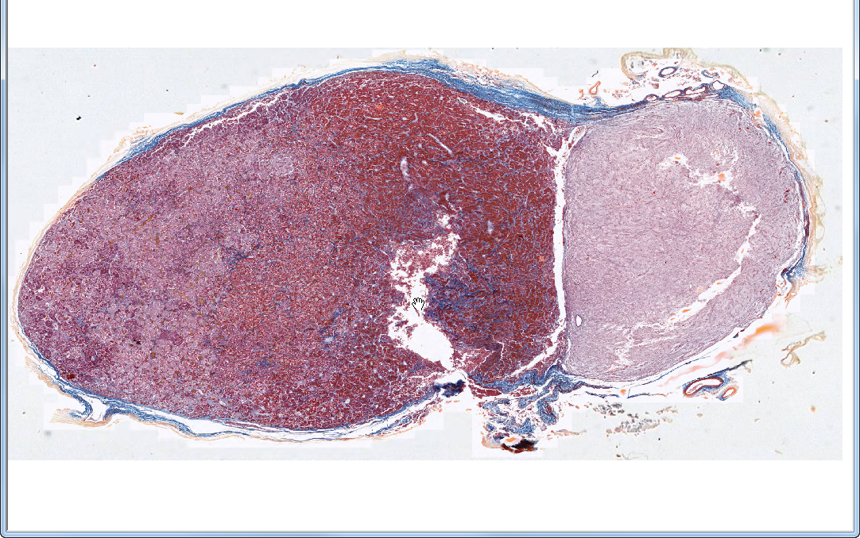
Slide 61: pituitary gland
neurohypophysis
“posterior lobe”
adenohypophysis
“anterior lobe”
Notes:
From Dr. Carbrey’s Notes:
Pituitary (hypophysis) – regulated by the hypothalamus
Anterior Lobe – Adenohypophysis (glandular)
pars distalis – cords of cells mixed with capillaries
acidophils (red) – growth horm. and prolactin (2 cell types)
basophils (blue) – ACTH, FSH & LH, TSH (3 cell types)
chromophobes (pale) – acidophils and basophils depleted of hormone
pars intermedia – between anterior and posterior lobes
basophils and chromophobes, may contain cysts
pars tuberalis – along infundibulum, mostly basophils
Posterior Lobe – Neurohypophysis –storage site for neurosecretions
pars nervosa – unmyelinated axons and nerve terminals from neurons in the hypothalamus, they release products near fenestrated capillaries (oxytocin and ADH)
infundibulum – stalk coming down from hypothalamus
Herring bodies –secretory vesicles in nerve terminals
pituicytes – glial cells that support unmyelinated axons

Slide 2
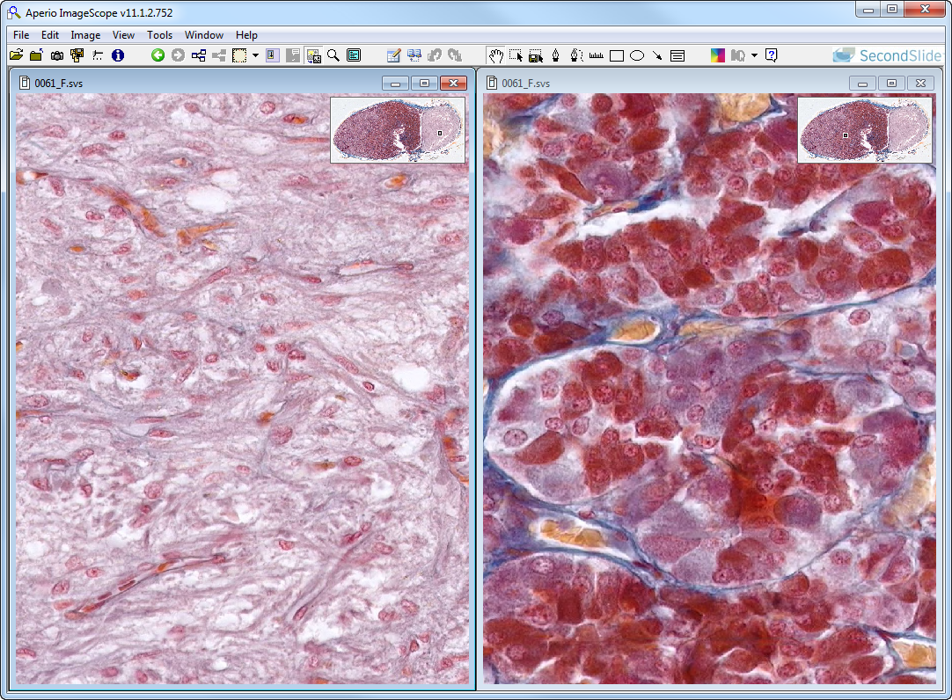
Slide 61: pituitary gland
neurohypophysis
adenohypophysis
pituicyte
B
C
A
Notes:
Arrows in neurohypophysis indicate capillaries (lined by endothelial cells)
A=acidophils (sommato- or mammotropes) ~40% B=basophils (cortico-, thyro-, or gonadotropes) ~10% C=chromophobes ~50%

Slide 3
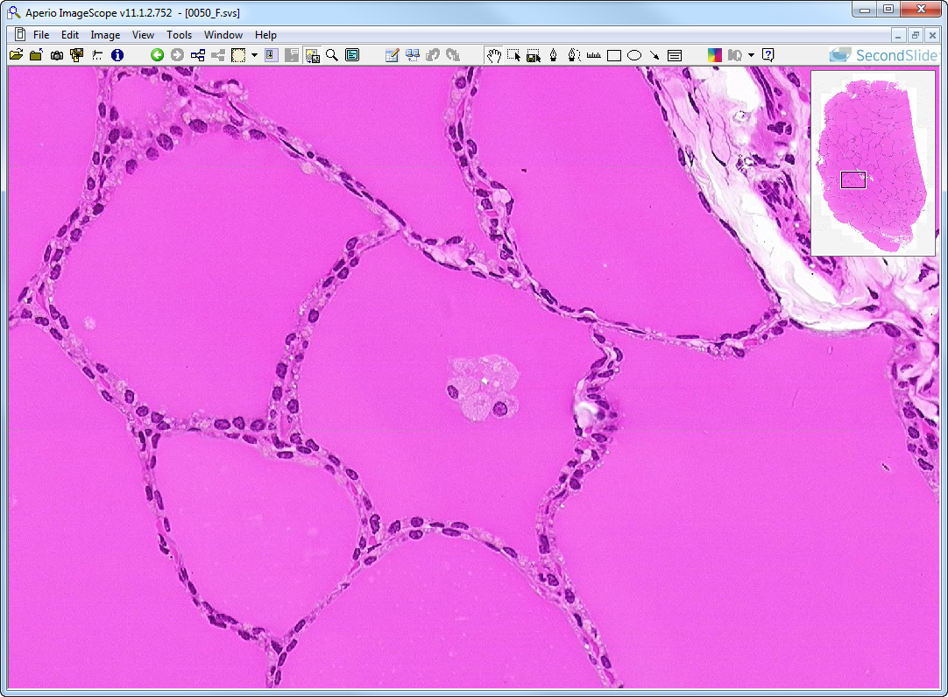
Slide 50: thyroid gland
Note: thyroid follicles typically contain colloid only; the presence of cells in the lumen of
some of the follicles in this particular specimen is likely a sectioning/preparation artifact
artifact
follicular cell
colloid
Notes:
From Dr. Carbrey’s Notes:
Thyroid
made up of follicles of cells filled with colloid
follicles are lined by simple sq. (inactive) to simple col. (active) epithelium
follicular cells – make thyroglobulin which is stored in follicles, T3 and T4 are cleaved from thyroglobulin inside the follicular cells, then the hormone leaves the cells and goes to capillaries
parafollicular cells or C cells – make calcitonin, are either outside of follicular cells or within lining of follicle

Slide 4
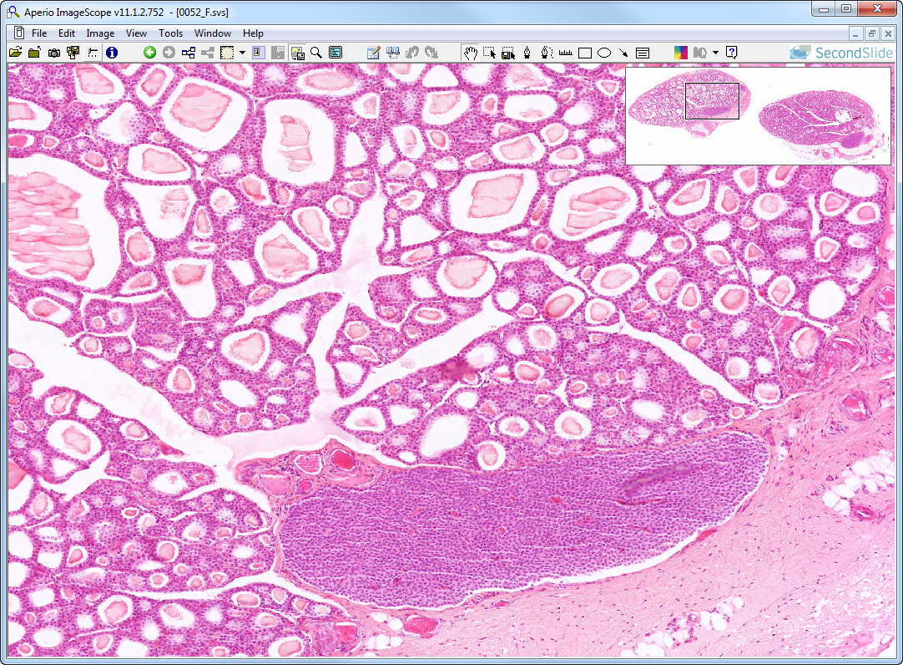
Slide 52: thyroid & parathyroid glands
thyroid
parathyroid

Slide 5
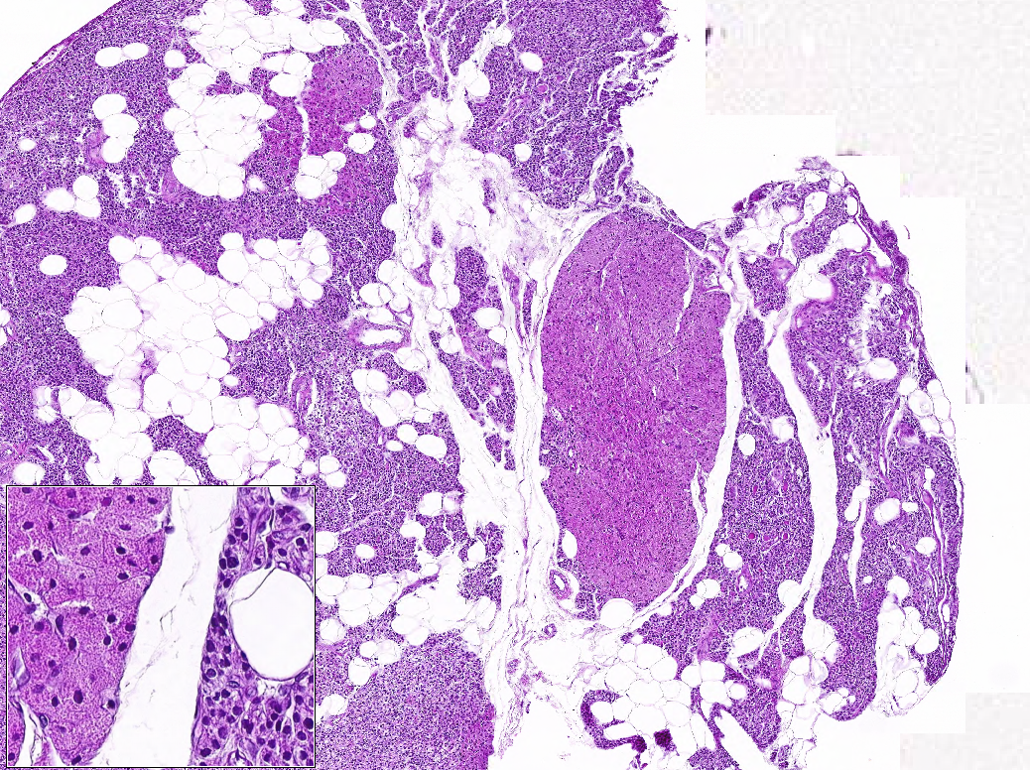
Slide 312 Parathyroid
adipose
oxyphil cells
chief cells
Notes:
From Dr. Carbrey’s Notes:
Parathyroid - attached to thyroid
parenchyma
chief cells – make PTH, more cytoplasm than lymphocytes –DO NOT CONFUSE WITH LYMPHATIC TISSUE!
oxyphils – minority of cells, usually in clusters, larger, more cytoplasm which is acidophilic, make some PTH

Slide 6
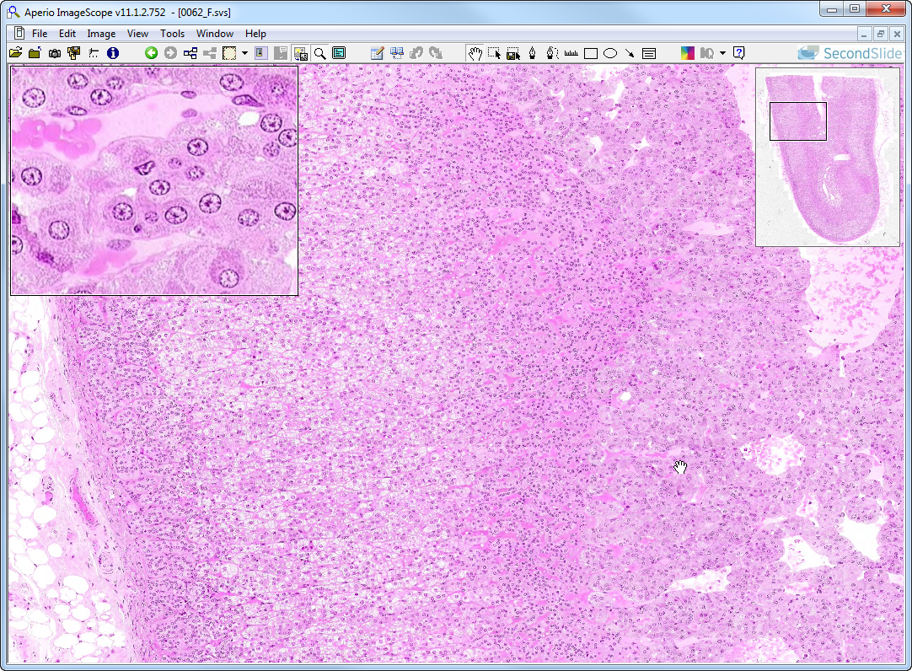
Slide 62: adrenal gland
Inset: medullary cells (note neuronal morphology & secretory granules
mv
ZG
mv
ZF
ZR
M
mv
mv
mv
Notes:
ZG=zona glomerulosa ZF=zona fasciculata ZR=zona reticularis M=medulla mv=medullary veins
From Dr. Carbrey’s Notes:
Adrenal gland
cortex – secretes steroids, 3 layers
zona glomerulosa (salt – aldosterone) balls of cells
zona fasciculata (sugar – cortisol) cords of cells, pale & foamy cells
zona reticularis (sex – DHEA) branching cords of cells
medulla – secretes epinephrine and norepinephrine
parenchyma – chromaffin cells that are stimulated to release hormones by nerves, two populations – one makes epi, one makes norepi

Slide 7
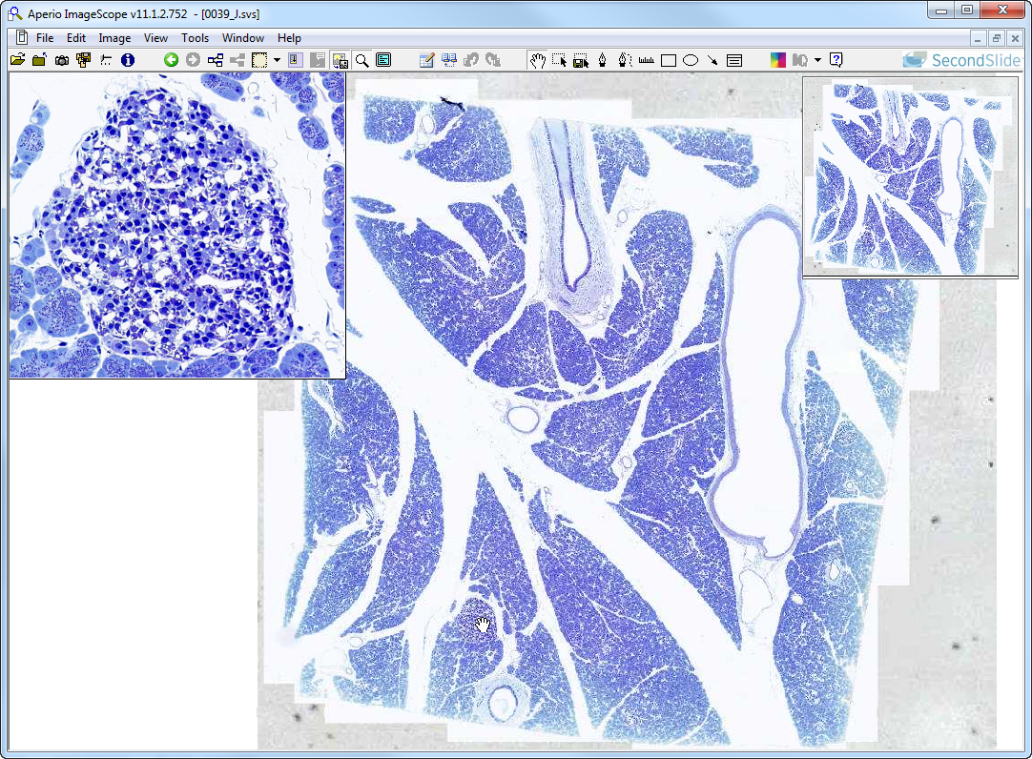
Slide 39: pancreas
Islet of Langerhans – contrast with surrounding acinar cells and note the rich capillary bed.
Notes:
From Dr. Carbrey’s Notes:
Pancreas
Exocrine pancreas – acini with serous cells that contain zymogen granules
ducts – begin with centroacinar cells that form the intercalated duct inside the acinus, squamous
intercalated ducts (s. sq), intralobular ducts (s. cub), interlobular ducts (low col), excretory (s. col with goblets)
Endocrine pancreas – islets of Langerhans
lighter staining, groups of cells with many capillaries
Type A and D tend to be on outside of islet
Type B tend to be towards center

Slide 8
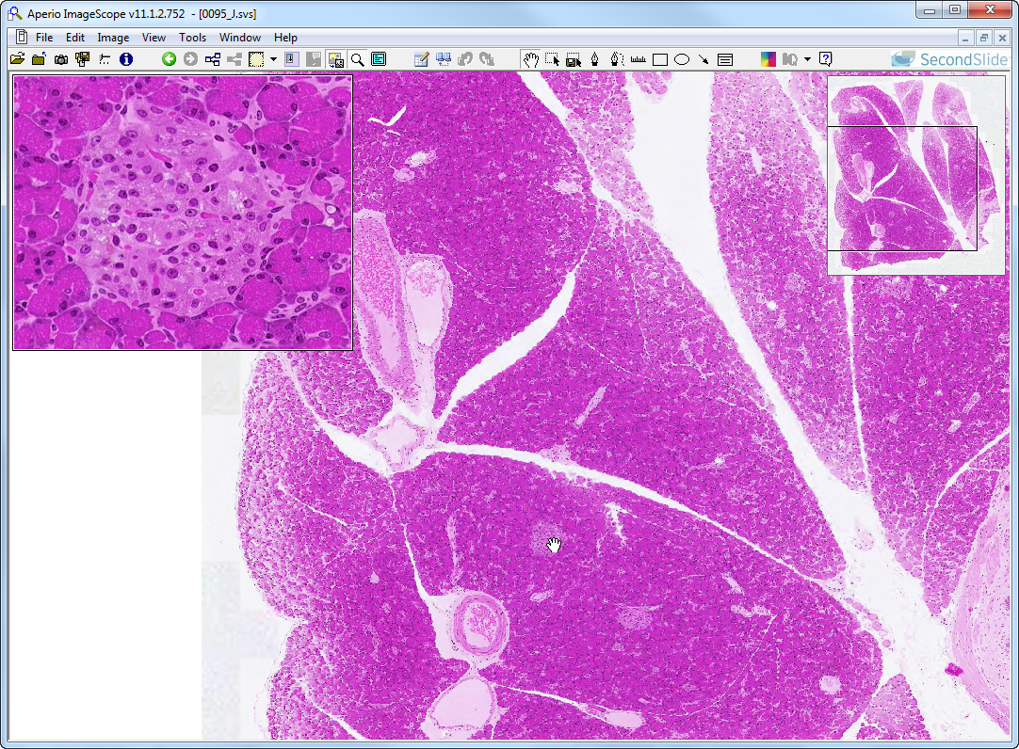
Slide 95: pancreas
Islet of Langerhans – contrast with surrounding acinar cells and note the rich capillary bed.

