Slide 1
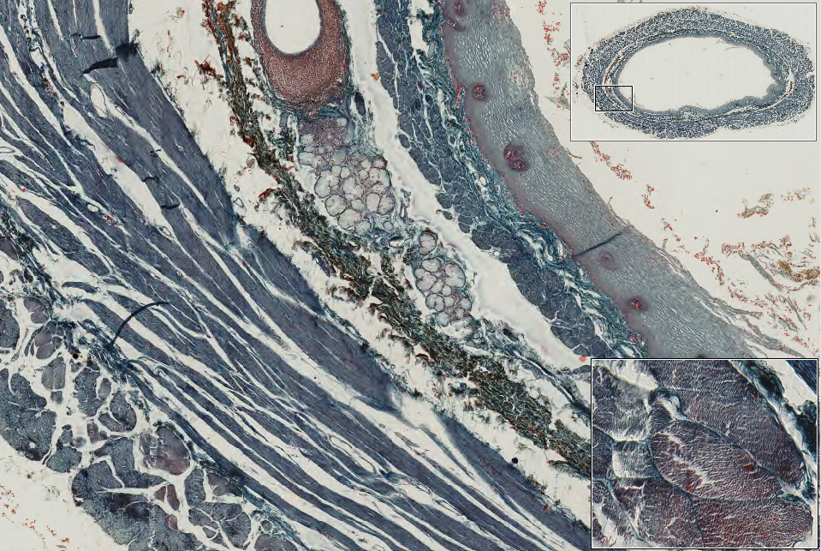
Slide 0078_J: Esophagus, human, Masson trichrome
duct
smg
mm
sse
sm
ic
skel muscle
ol
Notes:
ic=inner circular muscle mm=muscularis mucosae ol=outer longitudinal muscle
sm=submucosa smg=submucosl gland sse=strat sq epith

Slide 2
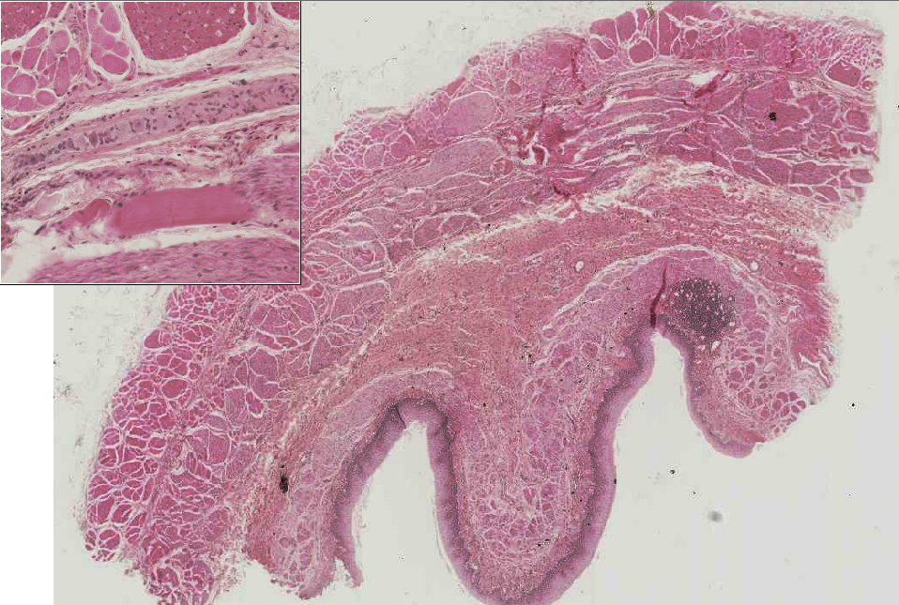
Slide 0078A_J: Esophagus, human, H&E
smooth m.
skel m.
myenteric plexus & ganglia
ol
skel m.
ic
smooth m.
sm
ly nodule
mucosa
mm
lp
sse
Notes:
ic=inner circular muscle lp=lamina propria mm=muscularis mucosae ol=outer longitudinal muscle
sm=submucosa smg=submucosl gland sse=strat sq epith

Slide 3
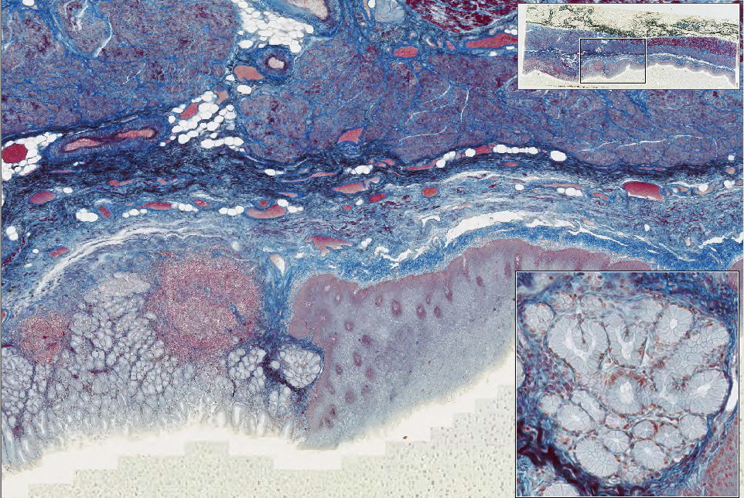
Slide 0054_J: gastro-esophageal junction, human, Mallory-azan
ic
sm
mm
lp
cardiac glands
ly nodule
cardiac glands
sse
gastric pits
stomach
esophagus
Notes:
ic=inner circular muscle mm=muscularis mucosae ol=outer longitudinal muscle
sm=submucosa smg=submucosl gland sse=strat sq epith

Slide 4
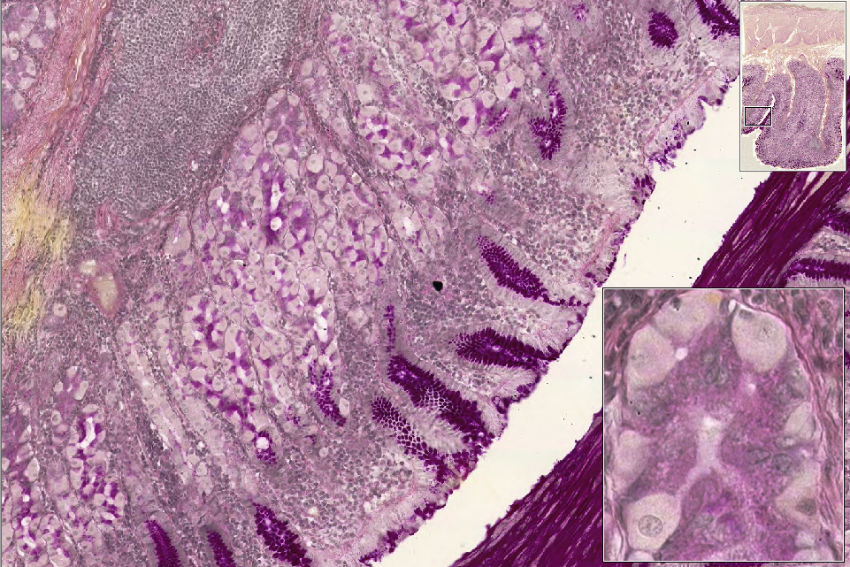
Slide 0079_J: stomach, fundus, human, PAS&H
musc
sub muc
lymph nodule
muc
fundic glands
mn
pit
cc
pc
Notes:
cc=chief cells pc=parietal cell mn-mucous neck cells
in thumbnail: muc=mucosa (folded into rugae) sub muc=submucosa (note that it extends into the rugae) musc=muscularis externa

Slide 5
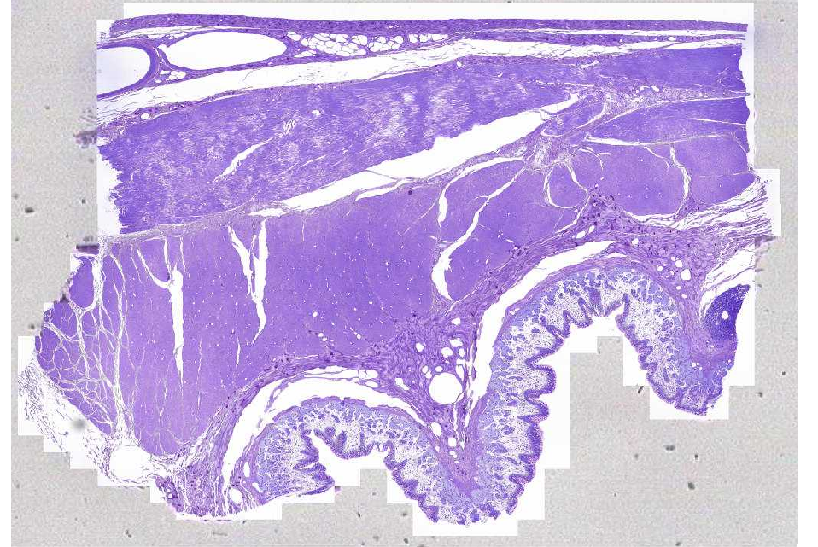
Slide 0036_J: stomach, corpus, monkey, AF-TB
serosa
ol
ic
mucosa
submucosa
glands
ruga
pits
Notes:
ic=inner circular muscle ol=outer longitudinal muscle

Slide 6
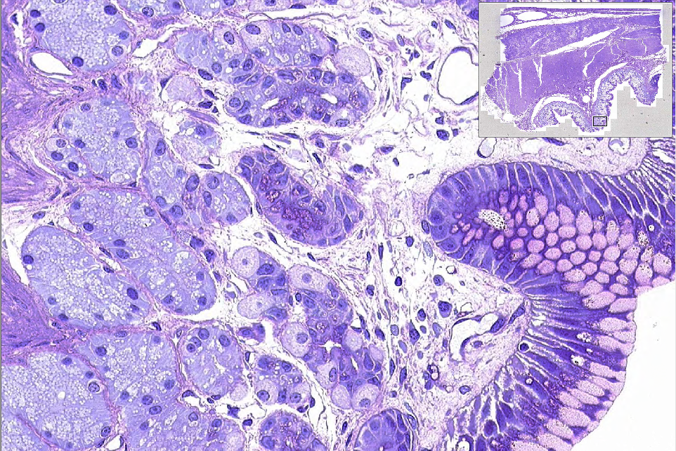
Slide 0036_J: stomach, corpus, monkey, AF-TB
mc
fundic glands
lamina propria
neck region
mnc
gastric pit
cc
plc
pc
eec
Notes:
cc=chief cells eec=enteroendocrine cell mc= mast cell (note GRANULES and stippled nucleus)
mnc=mucous neck cells pc=parietal cell plc=plasma cell (note agranular cytoplasm and clockface nucleus)

Slide 7
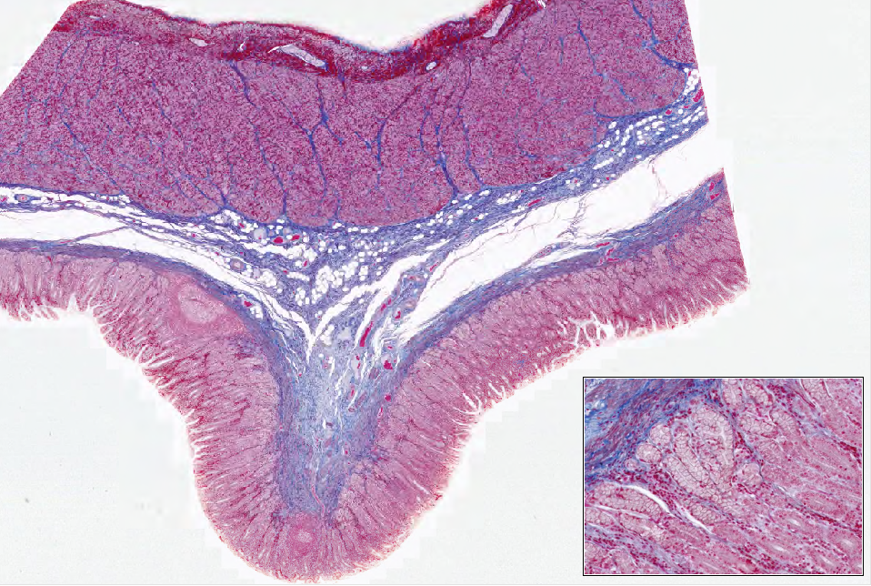
Slide 0080_J: stomach, pylorus, human, Mallory-azan
myenteric ganglia
ol
ic
submucosa
pyloric glands
pits
ruga
pyloric glands
pits
Notes:
ic=inner circular muscle ol=outer longitudinal muscle

Slide 8
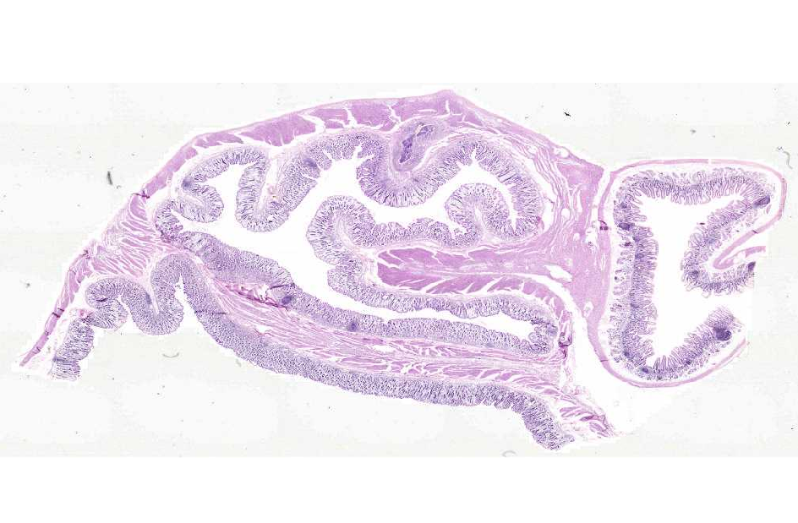
Slide 0081_J: pylorus & duodenum, monkey, H&E
pylorus
duodenum

Slide 9
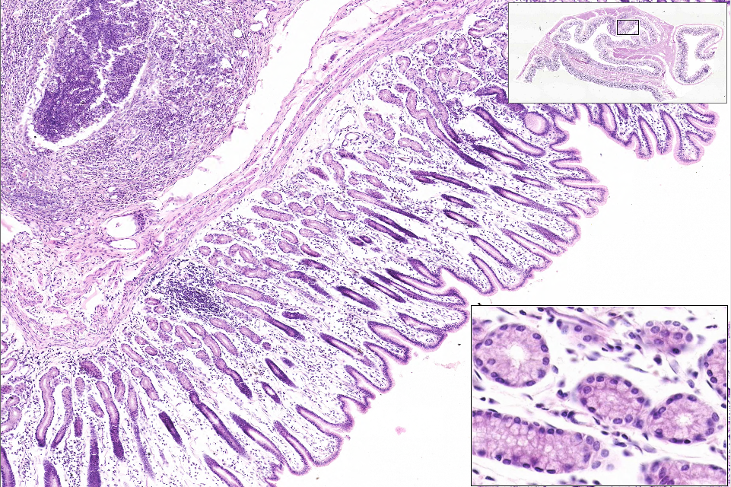
Slide 0081_J: pylorus & duodenum, monkey, H&E
mm
glands
pits
Notes:
mm=muscularis mucosae

Slide 10
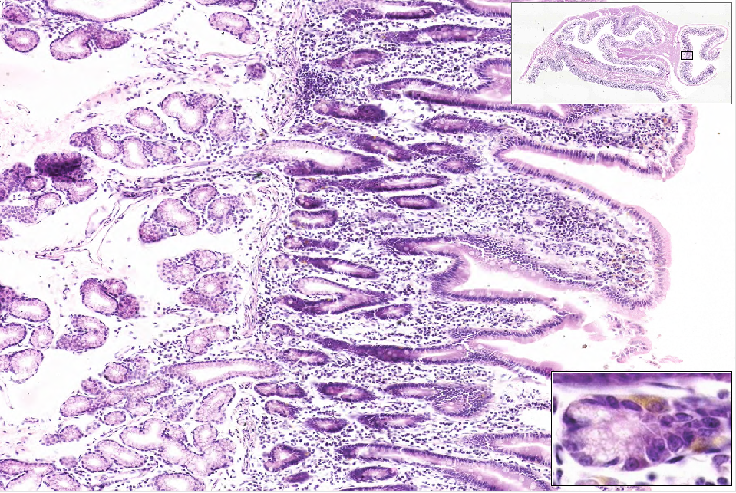
Slide 0081_J: pylorus & duodenum, monkey, H&E
submucosal glands
crypts
lp
villus
submucosa
mm
enteroendocrine cell
Notes:
lp=lamina propria mm=muscularis mucosae

Slide 11
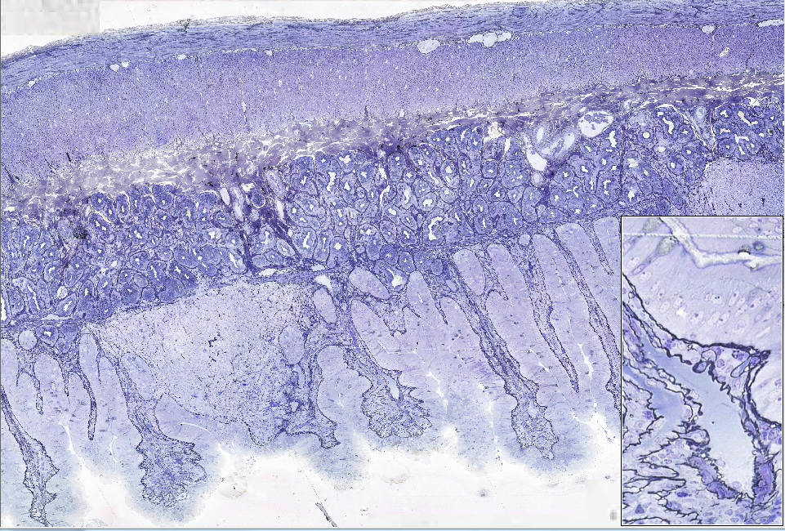
Slide 0010_J: duodenum, loris, AF-TB-reticulin (basement membranes stain BLACK)
serosa
ol
mp&g
ic
submucosa
smg
mm
crypts
ln
villi
lacteal
Notes:
ic=inner circular muscle ln=lymph nodule mm=muscularis mucosae
mp&g=myenteric plexus & ganglia ol=outer longitudinal muscle smg=submucosal glands (of Brunner)

Slide 12
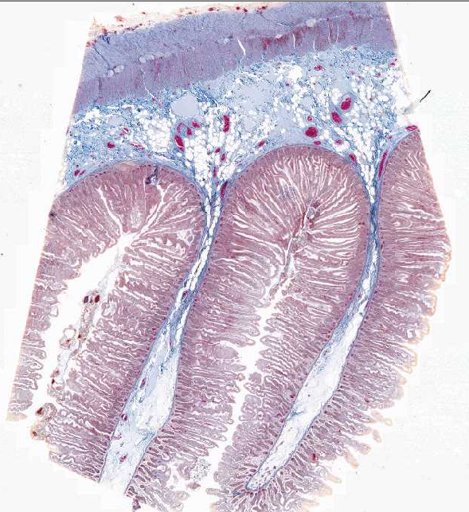
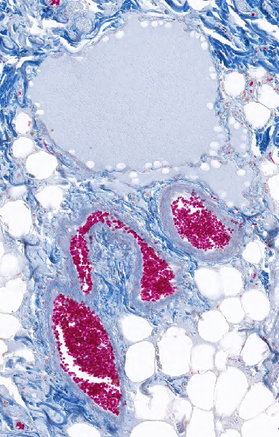
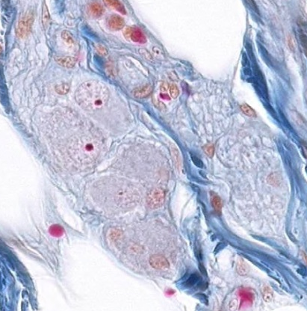
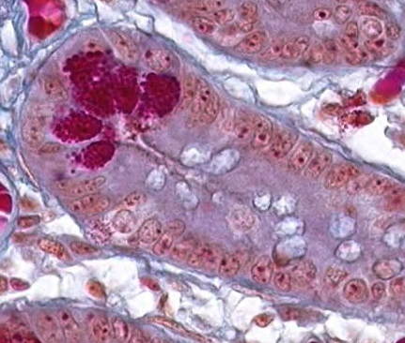
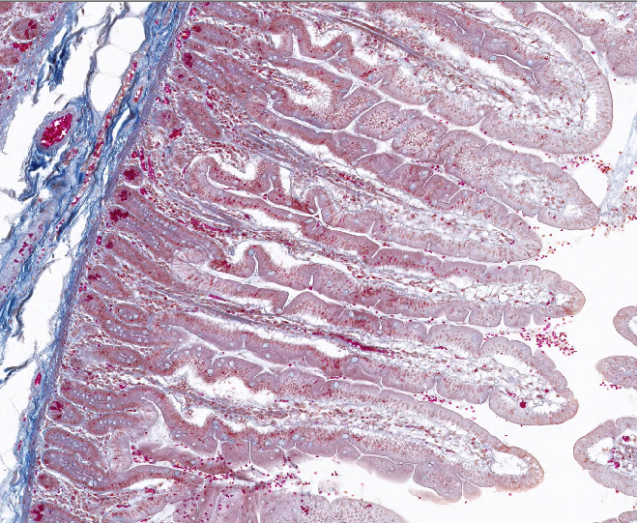
Slide 0053_J: jejunum, human, Mallory-azan
ol
mp&g
sm ganglion & nerve
lymphatic
vessel
ic
submucosa
Pc
crypt
eec
sm
mm
mucosa
plica (mucosal fold)
crypts
villi
Notes:
eec=enteroendocrine cell ic=inner circular muscle mm=muscularis mucosae
mp&g=myenteric plexus & ganglia ol=outer longitudinal mucle Pc=Paneth cells

Slide 13
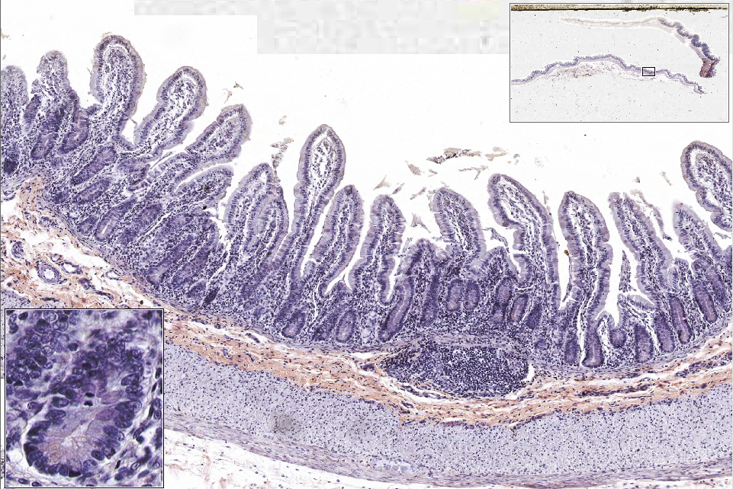
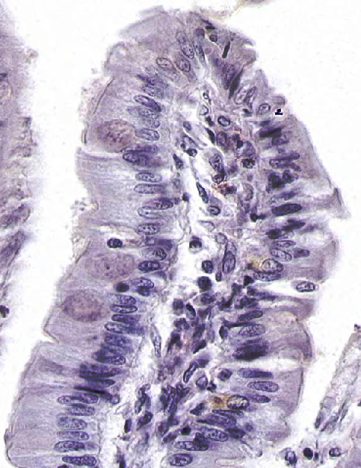
Slide 0060A_J: ileum, human, H&E (+chrome alum?)
villi
crypts
mitotic figure
mm
ly nodule
submucosa
gc
ic
eec
Pc
ol
mp&g
Notes:
eec=enteroendocrine cell ic=inner circular muscle mm=muscularis mucosae
mp&g=myenteric plexus & ganglia ol=outer longitudinal mucle Pc=Paneth cells

Slide 14
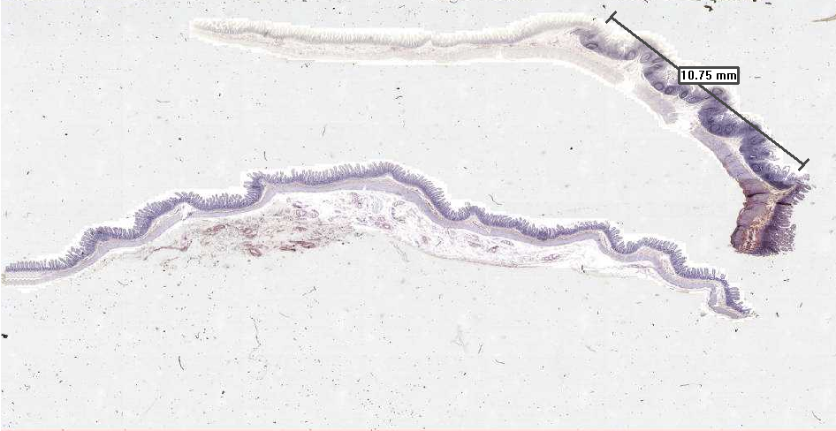
Slide 0060A_J: ileum, human, H&E (+chrome alum?)
Peyer’s patch

Slide 15
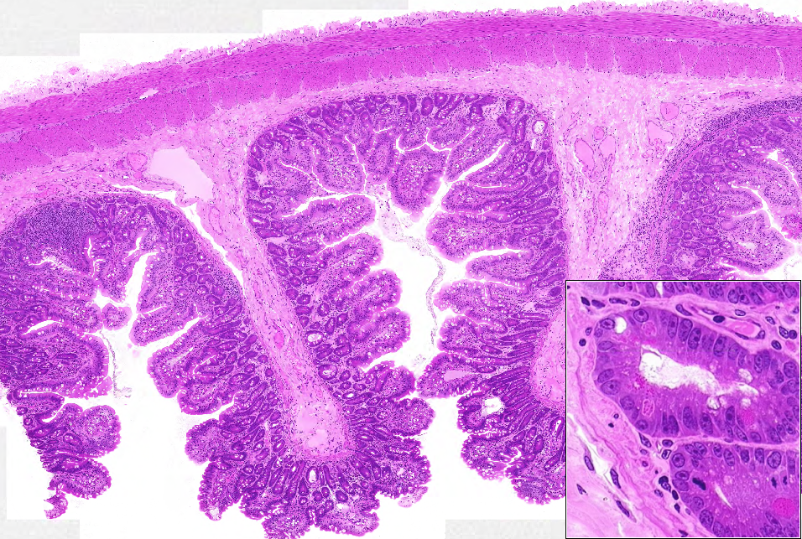
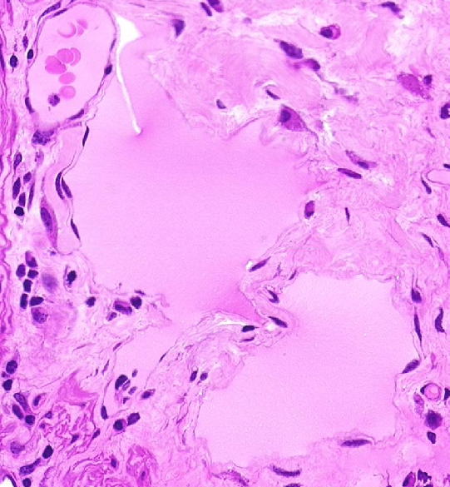
Slide 0032_J: ileum, monkey, H&E
serosa
ol
mp&g
ic
submucosa
lymphatic vessel
villus
crypts
lymphatic vessel
Pc
lymphatic vessel
mf
Notes:
ic=inner circular muscle mf=mitotic figure mm=muscularis mucosae
mp&g=myenteric plexus & ganglia ol=outer longitudinal mucle Pc=Paneth cells

Slide 16
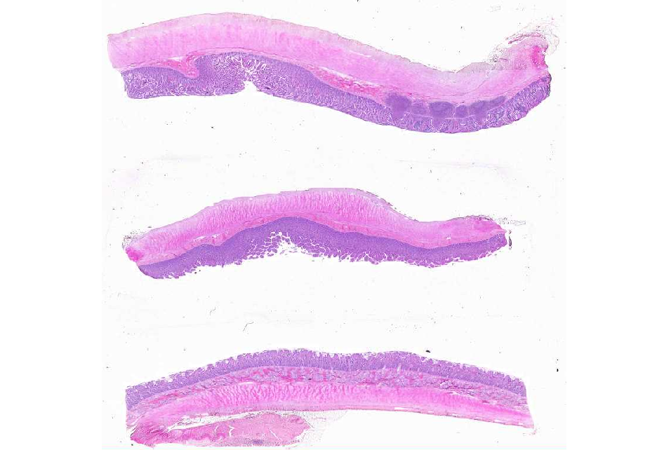
Slide 0096_J: duodenum, jejunum, ileum, human, H&E
?
?
?

Slide 17
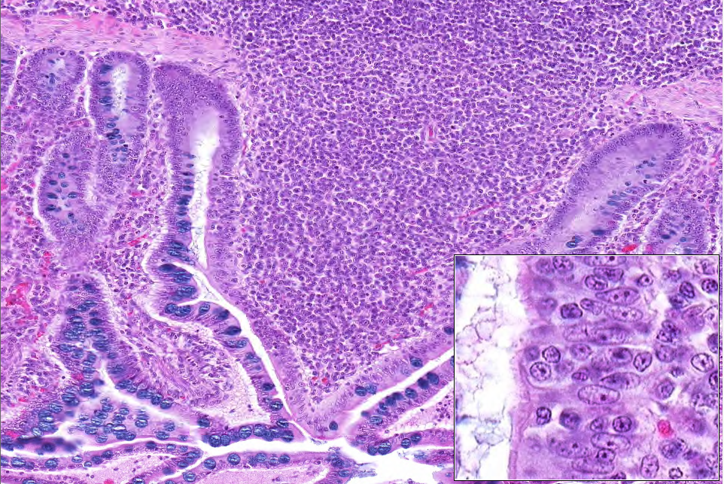
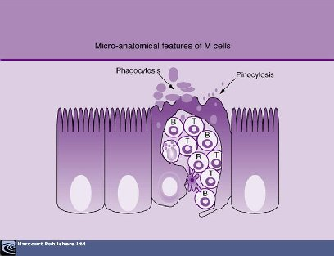
Slide 0096_J: duodenum, jejunum, ileum, human, H&E
mm
lymph nodule
M cell (outlined)
gc
Notes:
gc=goblet cell

Slide 18
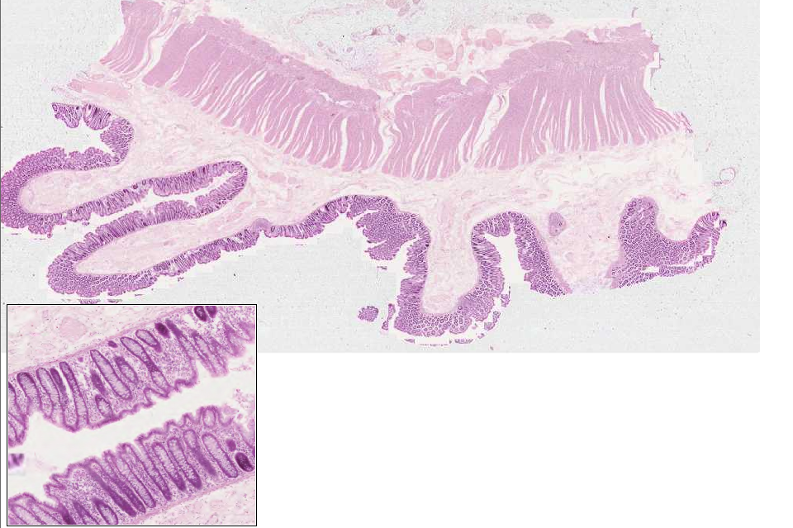
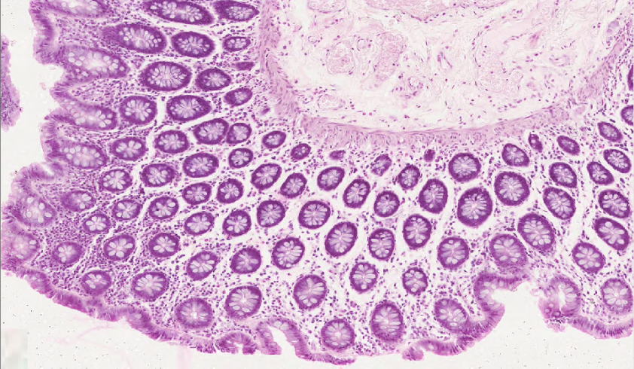
Slide 0303_J: colon, rat, H&E
mp&g
ol
ic
submucosa
mm
crypts
mm
crypts
crypts
mm
Notes:
ic=inner circular muscle mm=muscularis mucosae
mp&g=myenteric plexus & ganglia ol=outer longitudinal mucle

Slide 19
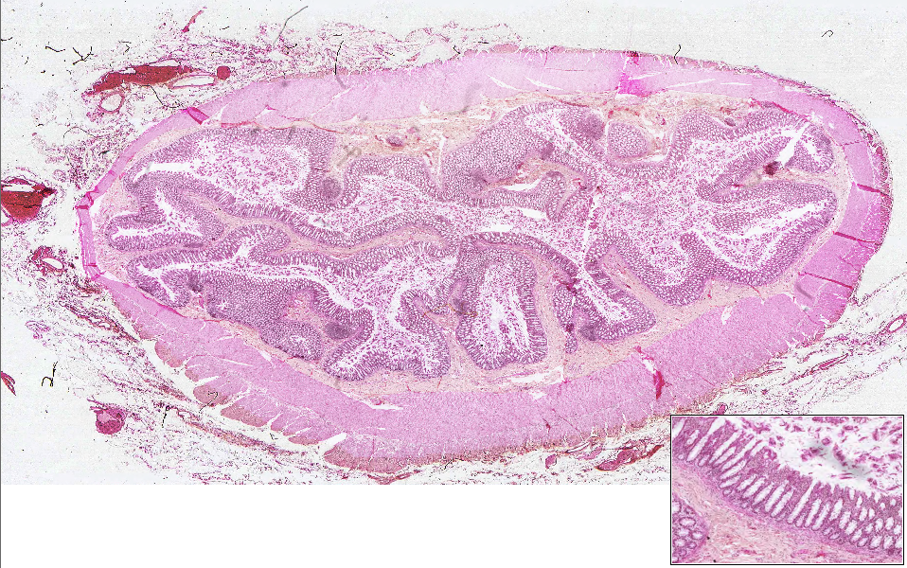
Slide 0082A_J: colon, human, H&E
(note: mucosa is not well preserved in this specimen)
ic
mucosa
submucosa
ic
mp&g
ol*
Notes:
ic=inner circular muscle mp&g=myenteric plexus and ganglia
ol=outer longitudinal muscle (note that this layer is attenuated in some areas and thickened in others, corresponding to the ‘taenia coli’ observed grossly)

Slide 20
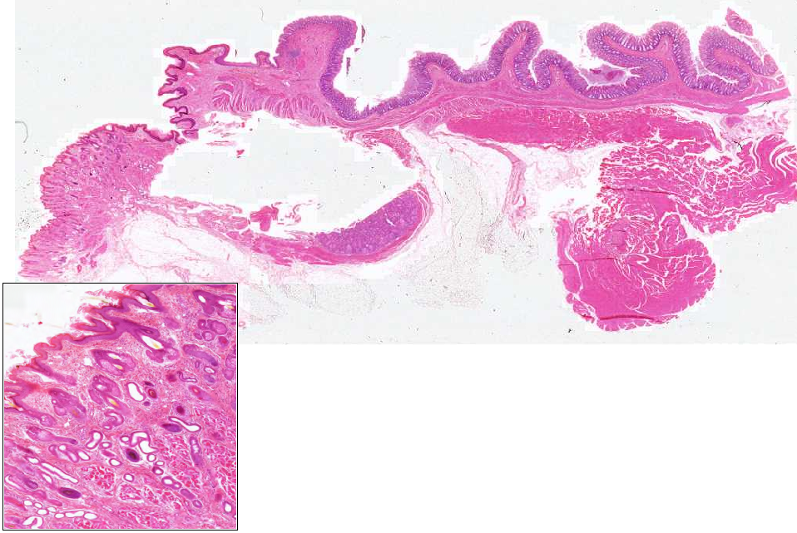
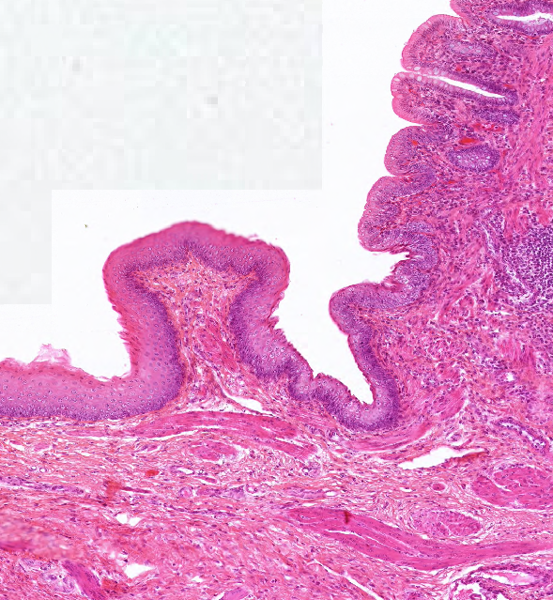
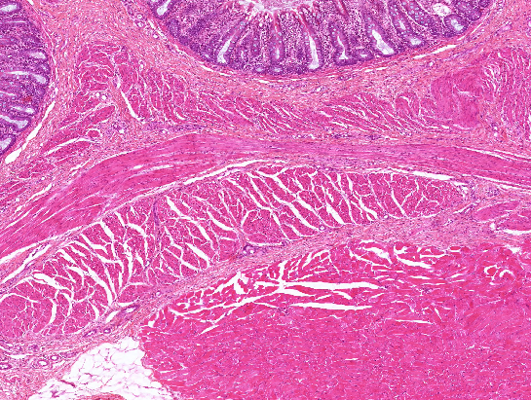
Slide 0093_J: Rectum and Anal junction, mammal, H&E
anus
rectum
fold of anal mucosa
sce
sske
hf&sg
hf&sg
ic
sse-nk
mp&g
ol
ias
hf
mm
apo
eas
hf
Notes:
apo=apocrine sweat glands eas=ext. anal sphincter (skel. musc.) sce=simple columnar epithelium hf=hair follicle
hf&sg=hair follicle & sebaceous gland ias=int. anal sphincter (sm. musc.) ic=inner circular muscle mm=muscularis mucosae
mp&g=myenteric plexus & ganglia ol=outer longitudinal muscle sse-nk=st. sq. epith. nonkeratinized sske=st. sq. epith. keratinized
Note: the tissue on the middle-bottom of the slide is a fold of anal mucosa viewed face-on –don’t worry trying to make too much sense of it (the main point is that it is NOT a specific gland or structure of interest in this region).

