Slide 1
Welcome to Normal Body
By the end of the course you’ll be able to distinguish the two following slides in a glance.

Slide 2
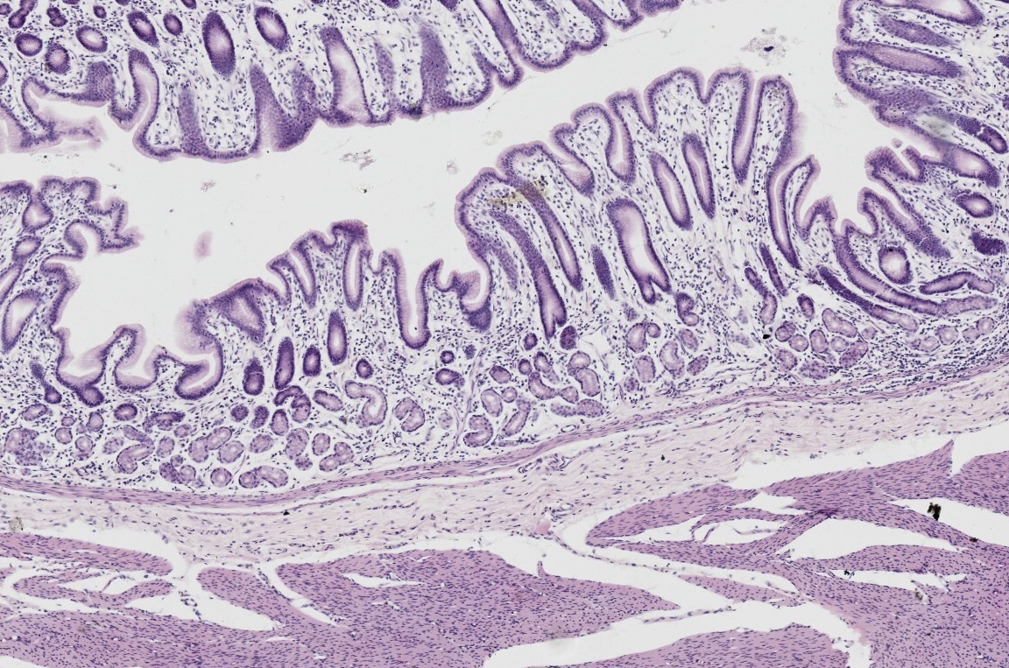
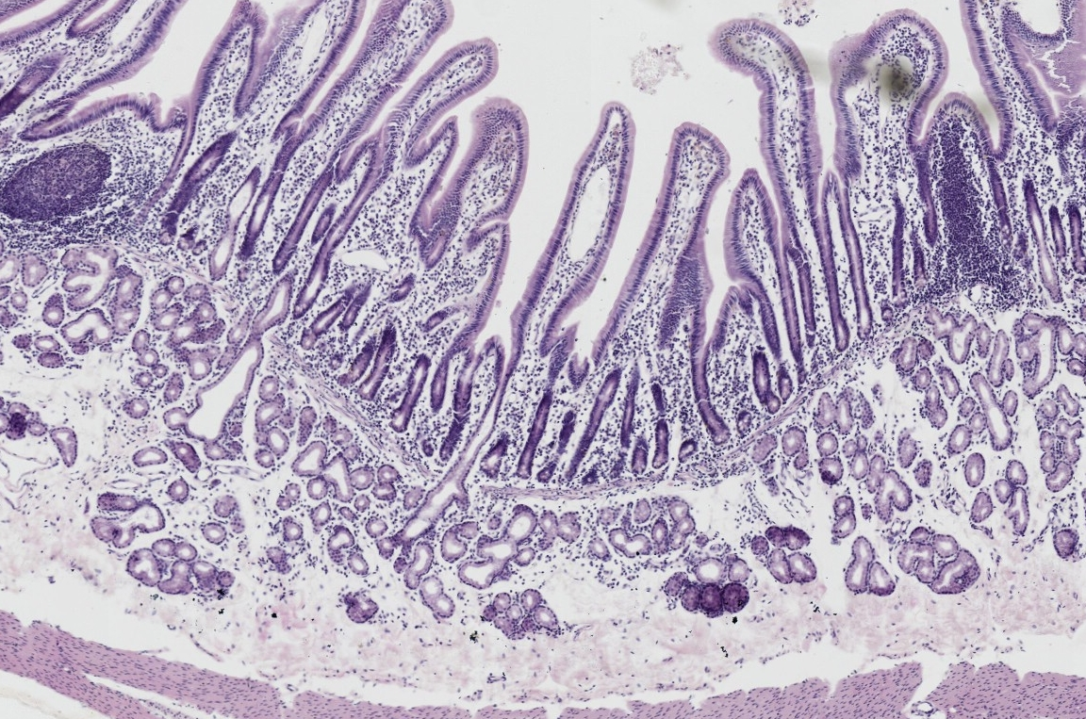
NB_Rev 065
NB_Rev 065

Slide 3
Welcome to Normal Body
Yes, they are two different organs.
Scared? You should be (but only a little bit).
You no longer have to justify anything covered in Molecules & Cell. For example, you can say you see a plate of hyaline cartilage, but don’t have to describe it or justify why it’s hyaline cartilage. (There isn’t any in the previous slides.)
You will spend much more time at low magnification examining the overall architecture, while sporadically swooping in at high mag to identify tissue types.
Exam questions are worth more, 10-15 points each. Final is cumulative!
Ever hear the phrase “drinking from a fire-hose?” You really don’t want to get behind in this class.
Some math: 0.8 x 0.8 = 0.64 = Fail. If you learned 80% of the Molecules and Cells material, and continue that trend, you risk failing Normal body. You must go back and master 100% of the M&C materials.
Any of the instructors will be happy to schedule one-on-one time with you if you are having trouble. Seek help early, rather than later.

Slide 4
Key to Organ ID
Solid (Compact) Organ?
OR
Hollow Organ (i.e. a Tube)?
Cortex/Medulla present?
Describe Layering (GI or not?)
Describe architecture/arrangement
Ascini, follicles, tubules, layered?
Describe epithelium
Describe epithelium
Describe organ-specific cell types
Describe organ-specific cell types
Describe organ-specific structures
Describe organ-specific structures
Note key identifying features,
And region of organ
Note key identifying features,
And region of organ

Slide 5
Example Identification
Tube, GI Layering: Serosa, Muscularis externa, Submucosa, Mucosa
Mucosa: villi and crypts, lamina propria and musc. mucosae
Simple columnar epithelium of enterocytes with brush border, and occasional goblet cells, and Paneth cells in crypts
Submucosa: dense irregular CT, BVs, Meisner’s plexus, mucous glands (Brunner’s = key feature) emptying into crypts
M. externa: inner circular, outer long., Auerbach’s plexus between layers
Serosa = simple squamous epi.
ID: Duodenum (Brunner’s glands)
Or: Illeum ( if Peyer’s patches present)
Or: Jejunum or illeum (no Peyer’s patches, no Brunner’s glands)
Tube, GI Layering: Serosa, Muscularis externa, Submucosa, Mucosa
Mucosa: Large-bore pits leading to narrow, coiled tubular glands, lamina propria and musc. mucosae
Simple columnar epithelium of mucous surface cells
Only mucous cells = cardiac region
Parietal and chief cells = corpus/fundus
Mostly mucous, few parietal = pyloric
Submucosa: dense irregular CT, BVs, Meisner’s plexus
M. externa: 3 poorly-defined layers
Auerbach’s plexus between layers
Serosa = simple squamous epi.
ID: Stomach (include region)

