Slide 1
Look-alikes and Review slides
R.J Perz-Edwards, 2012
Warning!
Some of these are intentionally tricky and potentially confusing.
Use at your own risk.
Views these in Presentation mode (Needed for the animations)
These are either look-alike pairs, or single organs to ID.
First slides are unlabeled images, both low and high magnification views as needed.
Key distinguishing features are identified in subsequent slides.
Final slide gives a fairly complete description of the organ with ID
Instructions:
At the first slide, jot down 2-3 potential candidates. If you can’t narrow the field down to less than a handful of possible organs, you are not ready for this review. Go back and study more.
Now ask yourself what key features you need to distinguish the candidates. I carefully chose these images to include those key features, so you should be able to identify them and determine what the organ is.
Still stuck? The next slide will explicitly point out the key features. These should be ringing bells for you. You should be able to write down a complete description of the organs now.
Still stuck? Look at the organ ID on the next slide, then go back and review that organ until you can write down the full description of that organ (without looking at my answer).

Slide 2

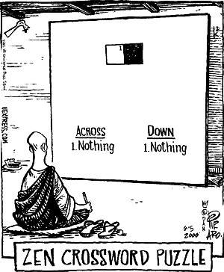
Resist the Urge to ID
This is a little paradoxical and very Zen.
You need to have some idea of what it is, so that you know what details to look for.
But don’t jump to conclusions or you will “see” thing that aren’t there.
You need to achieve the right balance of “knowing - not knowing” so that you are open to truly seeing what is in the slide and not projecting your assumptions onto it.
The same practice will apply to diagnosing patients throughout your career.

Slide 3
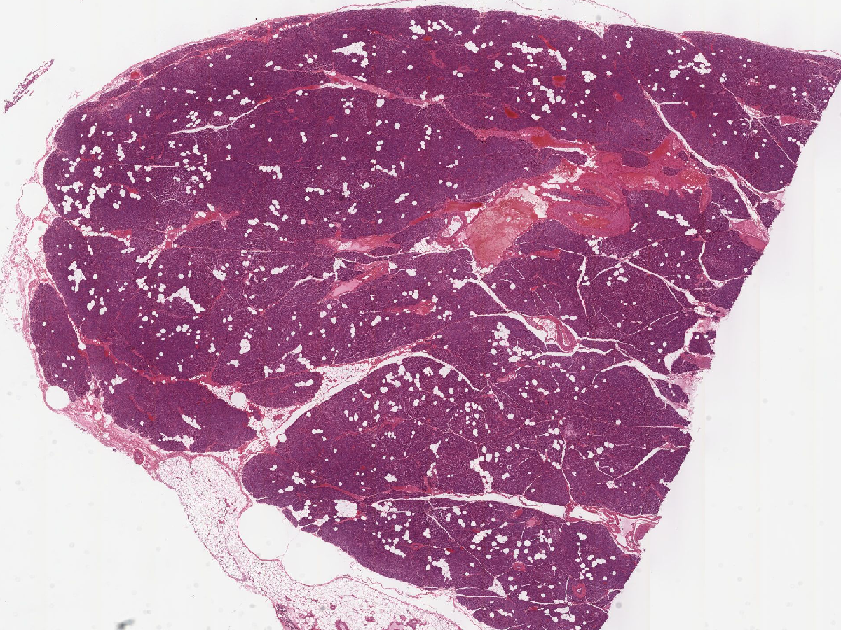
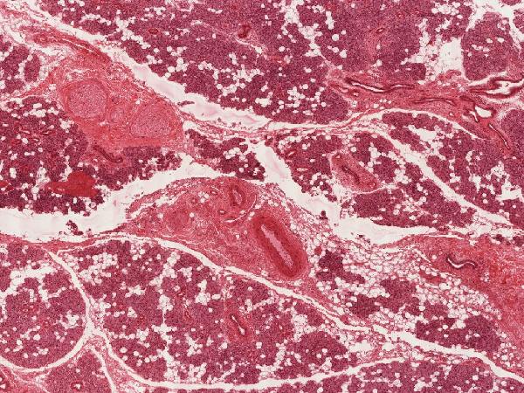
Pair 1
Low Magnification
UM 188
UM 180-1

Slide 4
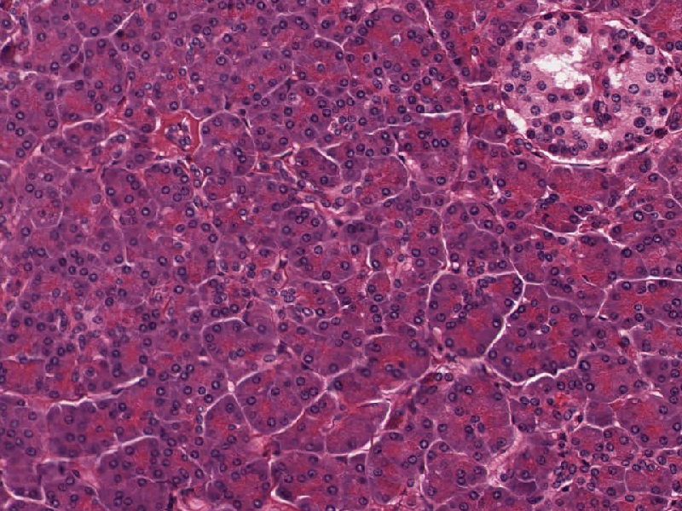
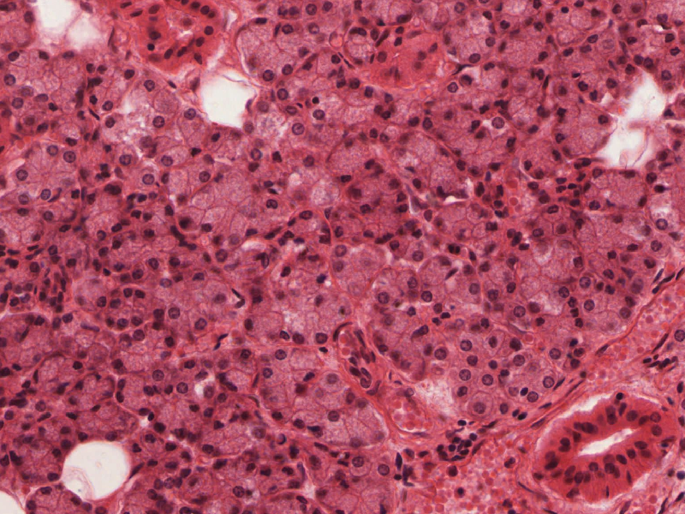
Pair 1
High Magnification
Key Features on Next Slide

Slide 5
Key Features
Islet of
Langerhans
High Magnification
Two-toned acinar cells
Red apex, blue base
Shared feature:
Serous acini
Myoepithelial cells
Striated Duct

Slide 6
Key Features
Serosa
Low Magnification
Ducts
Simple
Islets
(would need to confirm
at higher mag in virtual slide)
Ducts
Stratified
Nerves

Slide 7
Pancreas
Compact, lobulated organ, encapsulated with serosa
Serous acini with eosinophilic apical granules (zymogen), round basal nuclei
Centro-acinar cells
Intercalated ducts (simple squamous to low cuboidal) connect to…
Intra- and interlobular ducts (simple cuboidal to columnar) connect to…
Excretory ducts (simple columnar)
Islets of Langerhans: nests of pale-staining cells, highly vasularized = key feature.
ID: Pancreas
Parotid
Compact, lobulated organ, with adventitia
Serous acini (no mucous acini)
Intercalated ducts (simple squamous to low cuboidal) connect to…
Striated ducts = key feature, simple cuboidal/columnar with centrally-located nuclei and basal striations. Connect to...
Excretory ducts stratified cuboidal = key feature
Myoepithelial cells = key feature
All serous = parotid
Other features: fatty, big nerves (facial)
ID: Parotid

Slide 8
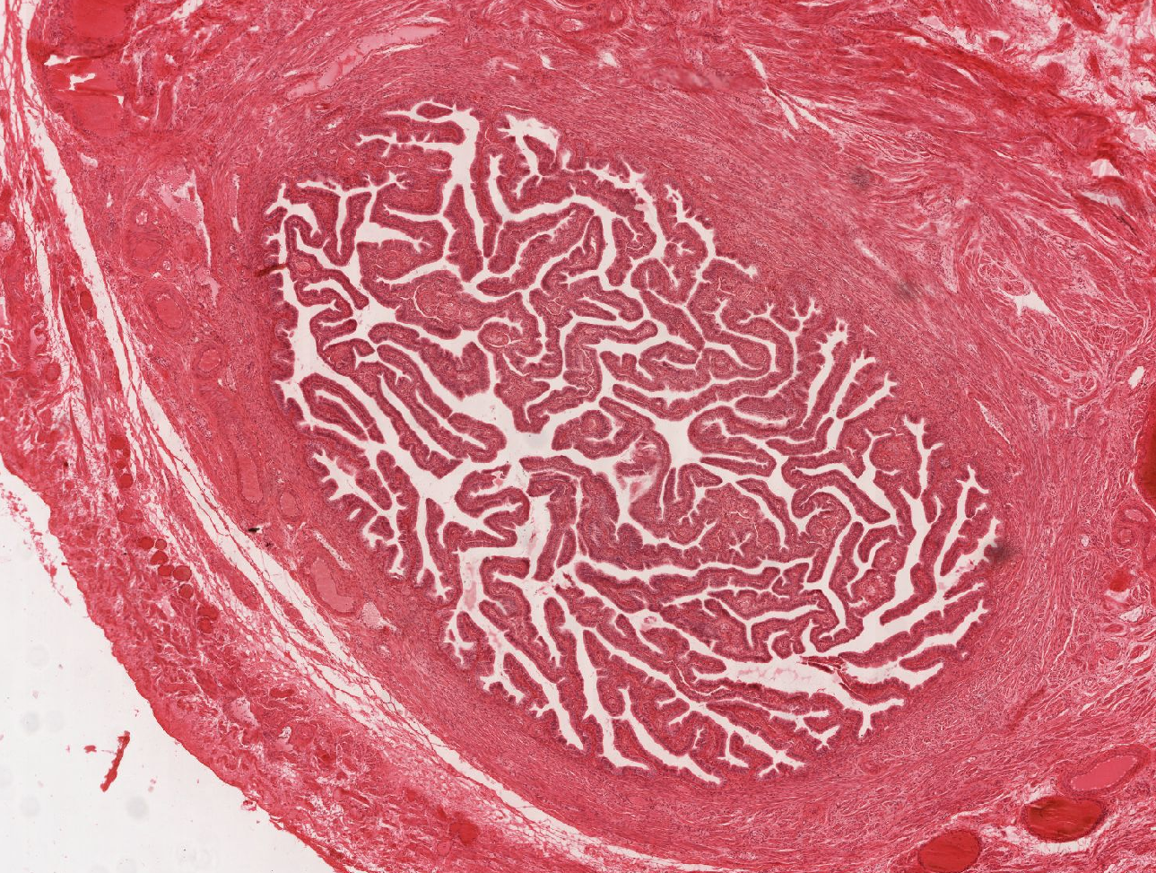
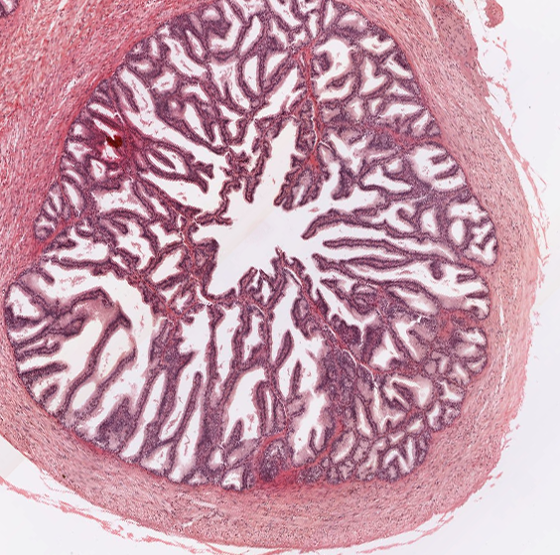
Pair 2
UM 240-2
UM 075

Slide 9
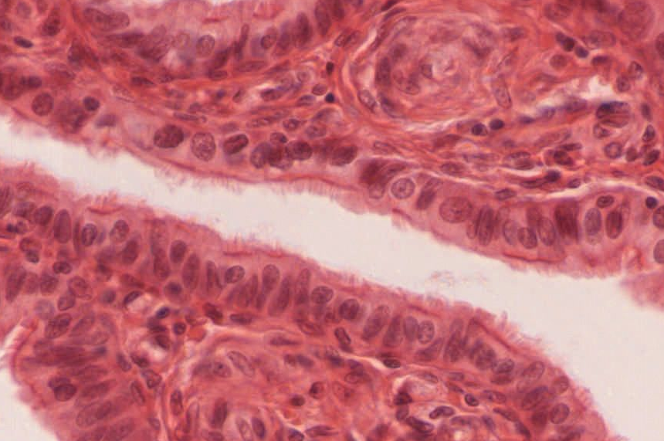
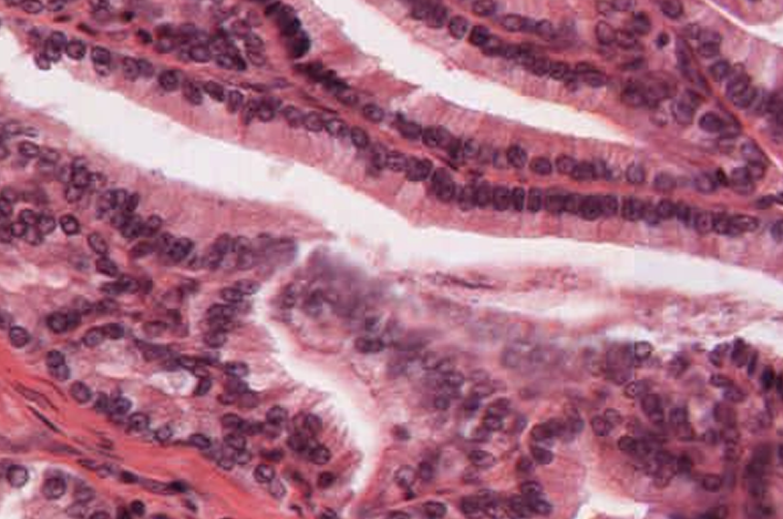
Pair 2
Key Features on Next Slide

Slide 10
Key Featues
Smooth Muscle
Peg cells
Smooth Muscle
Cilliated cells

Slide 11
Oviduct – Ampulla
Seminal Vesicle
Tube
Layers: Mucosa, Muscularis, Serosa
Muscularis: 2 poorly-defined layers, inner circular, outer longitudinal
Highly folded epithelium
Mucosa: simple columnar with cilliated cells and non-cilliated peg cells
Large lumen
ID: Oviduct - Ampulla
Tube
Layers: Mucosa, Muscularis, Adventitia
Muscularis: inner circular, outer longitudinal
Highly folded epithelium
Mucosa: psuedo-stratified columnar (although basal cells are scanty)
Smooth muscle seen directly under epithelium in places
Sacculated organ with multiple lumina (not seen in this image)
ID: Seminal vesicle
Notes:
Serosa/adventitia distinction not good diagnostic
Vas has 3 layers of muscularis

Slide 12
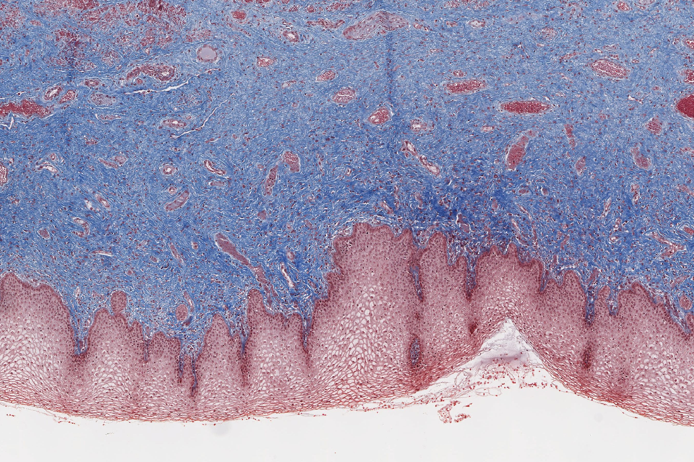
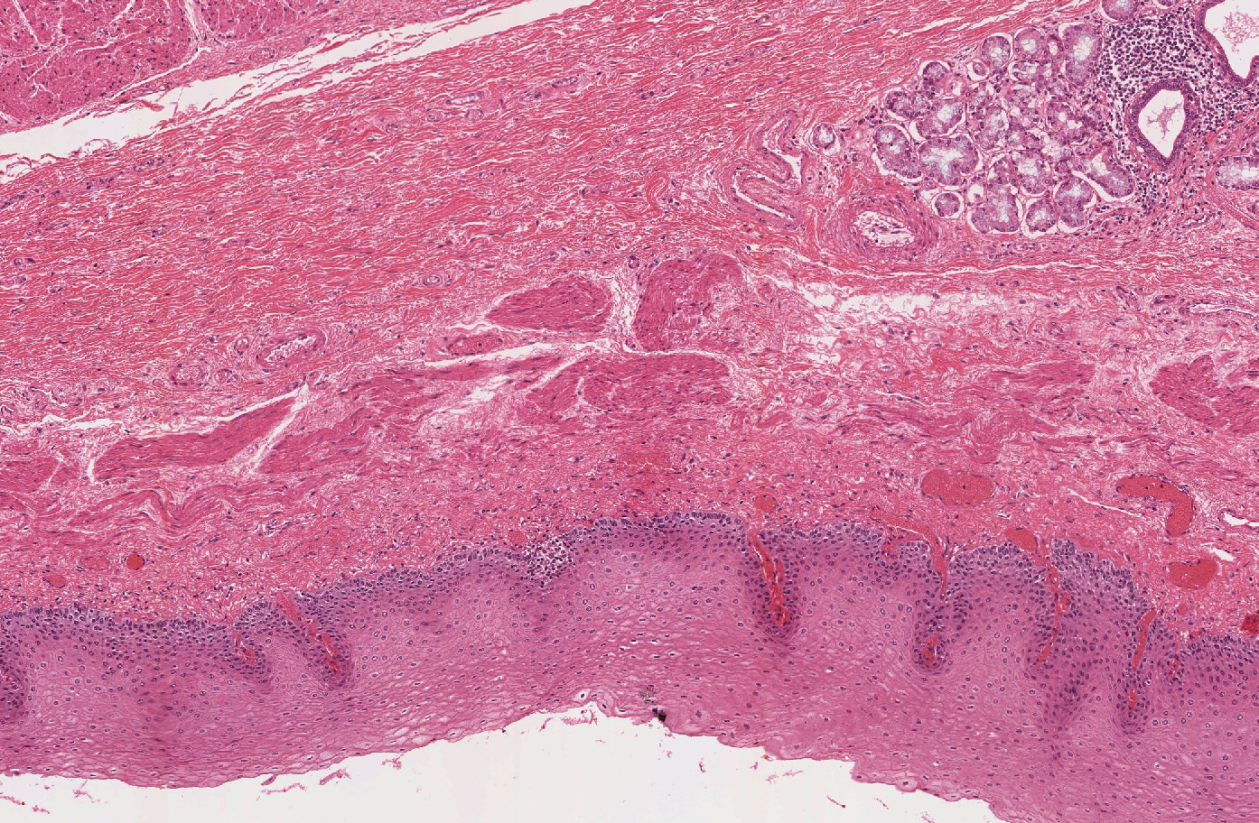
Pair 3
Key Features on Next Slide
UM 250-2
UM 153

Slide 13
Pair 3
Trichrome stain:
CT = blue
SmM = brown
UM 250-2
Shared Feature:
Stratified squamous,
non-keratinized epithelium
UM 153

Slide 14
Indistinct muscularis externa
Pair 3
Vascular, elastic submucosa
Key Features
Mucus glands
2-layered muscularis externa
Thick Muscularis mucosae

Slide 15
Vagina
Tube, no GI layering
Mucosa: stratified squamous, non-keratinized, pale cells (due to glycogen)
Lamina propria: thick, with two vague layers (celluar CT = LP, DICT = submuscosa), may see lymph nodules
Muscularis: 2 poorly-defined layers, inner circular, outer longitudinal
Adventitia: highly vascularized (erectile)
May see skeletal muscle (vestibule)
May see Bartholin’s glands (adventitia)
ID: Vagina
Esophagus
Tube, with GI layering
Mucosa: stratified squamous, non-keratinized epithelium, Lamina propria, thick muscularis mucosae = key feature
Sub-mucosa: DICT, with mucous glands = key feature
Muscularis: 2 well-defined layers, inner circular, outer longitudinal. Define region based on smooth/skeletal muscle
Adventitia: DICT, look for trachea,
May have serosa at distal end
ID: Esophagus – lower third
(look for GE junction)

Slide 16
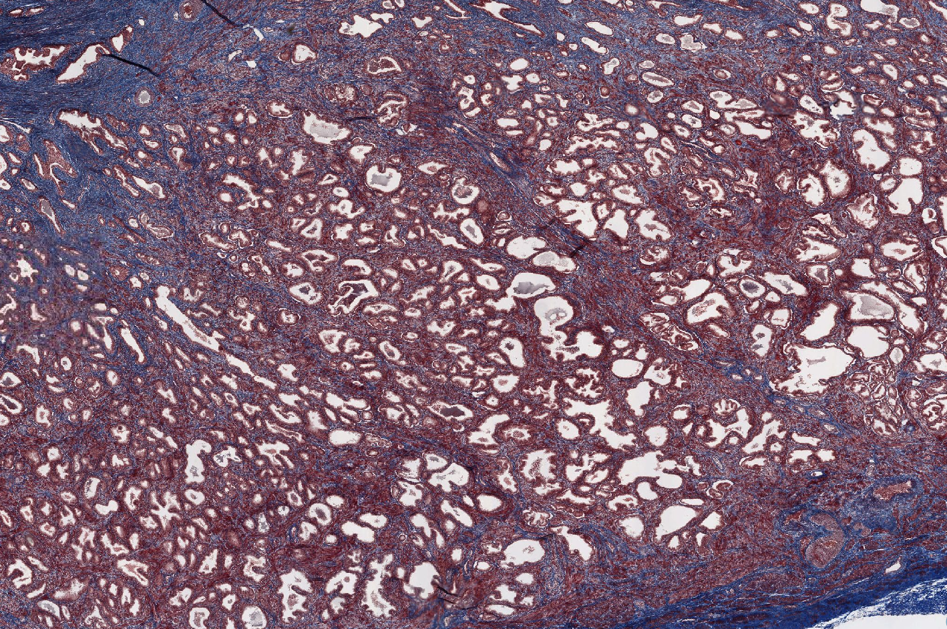
First Organ of Pair 4

Slide 17
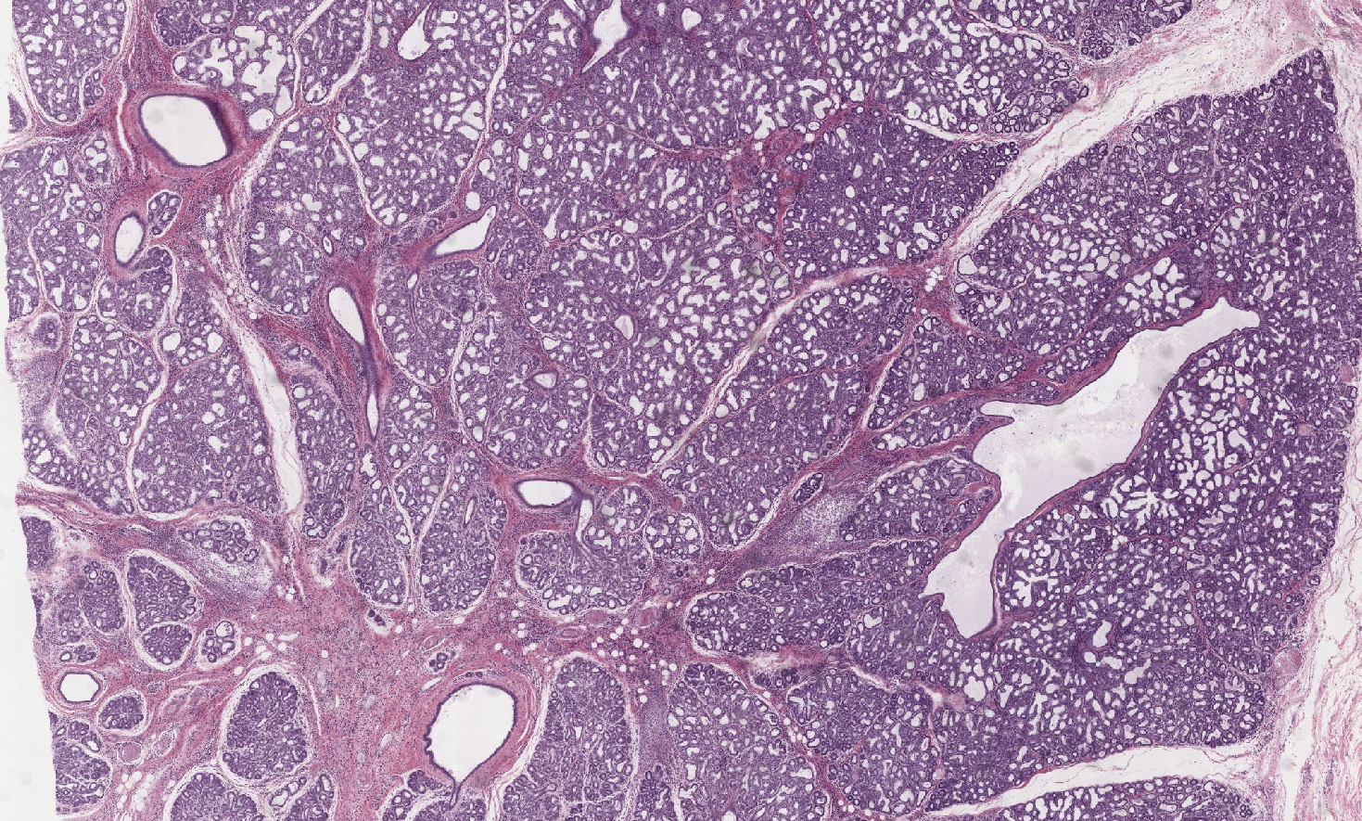
Second Organ of Pair 4

Slide 18
Pair 4
Key Features on Next Slide
UM 258
UM 281-1ex

Slide 19
Lobules
Ducts
Fibro-muscular Stroma
CT (blue) and SmM (brown)

Slide 20
Breast - Lactating
Lobulated organ
Lobules separated by CT septa with fat
Tubulo-alveolar glands, simple cuboidal, usually filled with colloidal & fatty secretions
Intralobular ducts
Excretory ducts in septa with stratified cuboidal epithelium = key feature
ID: Breast
Prostate
Solid organ
Fibromuscular stroma (interpenetrating smooth muscle and DICT)
Tubulo-alveolar glands
Simple/pseudostratified columnar epithelum
Lots of smooth muscle
May see prostatic concretions
May see ejaculatory ducts, utricle, or urethra
May see skeletal muscle
ID: Prostate

Slide 21
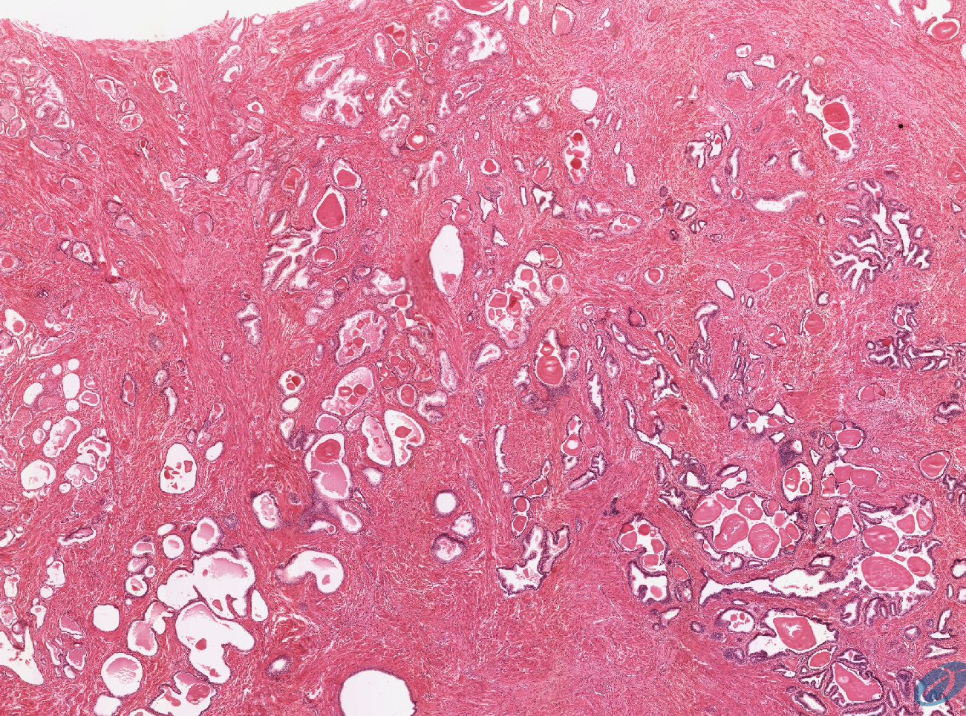
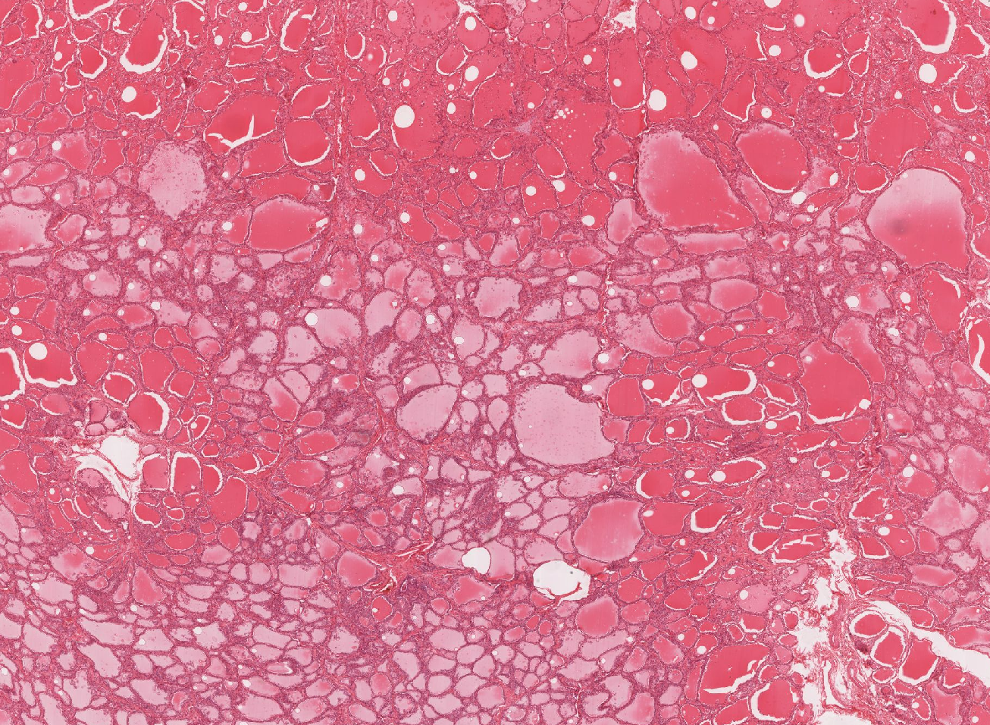
Pair 5
UM 282
UM 217

Slide 22
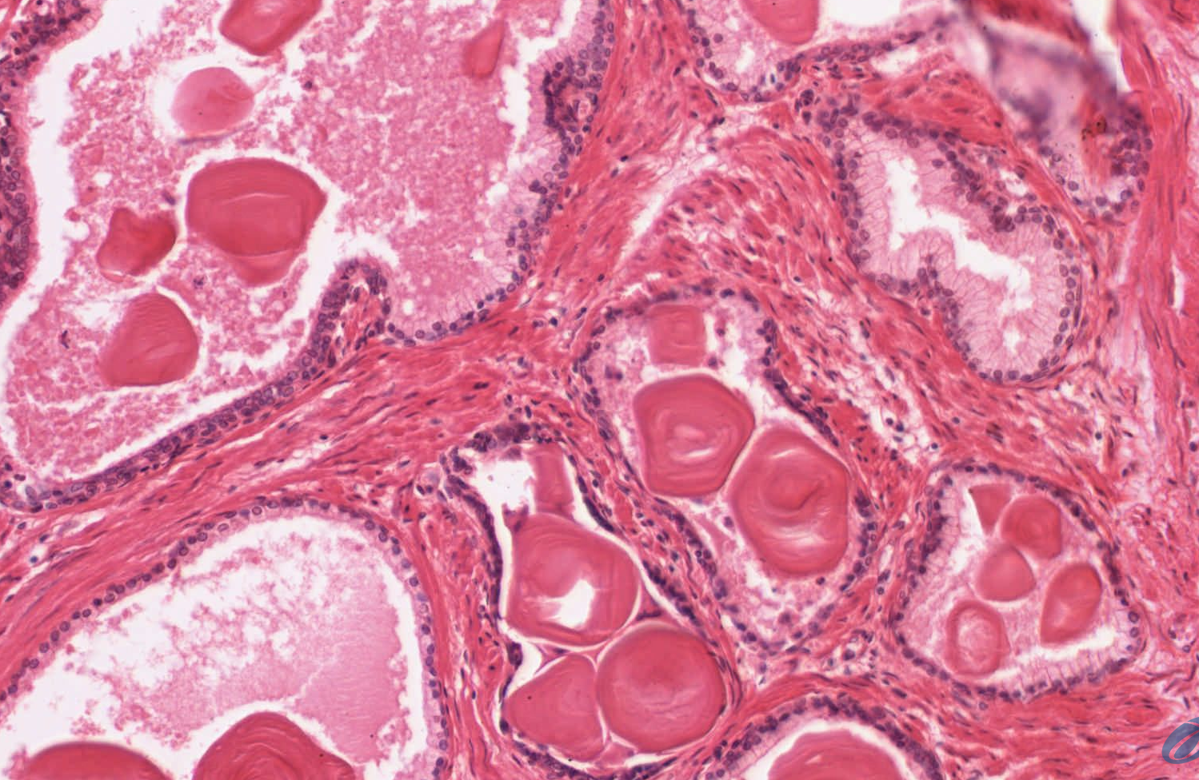
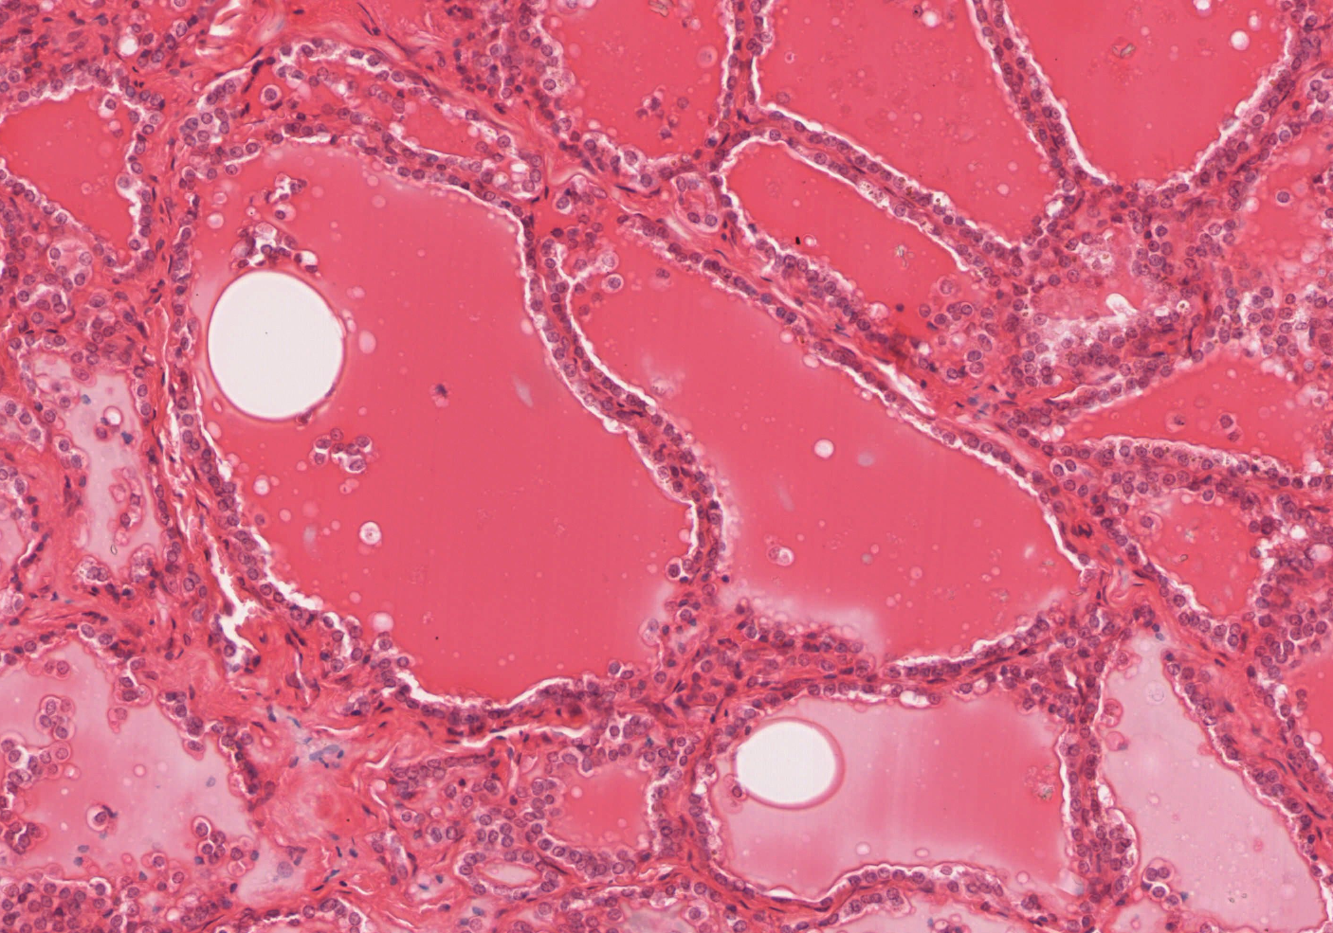
Pair 5
Key Features on Next Slide

Slide 23
Pair 5
Tubulo-alveolar
Follicles
Fibro-muscular stroma
Lamellar concretions
Uniform Colloid
Smooth Muscle

Slide 24
Prostate – Senile
Thyroid
Pair 5
Solid organ with CT capsule
Folicles (no longitudinal tubes) filled with colloid, ~cuboidal cells
Parafollicular C cells
Highly vascularized, no ducts = endocrine
May see adjacent parathyroid
ID: Thyroid

Slide 25
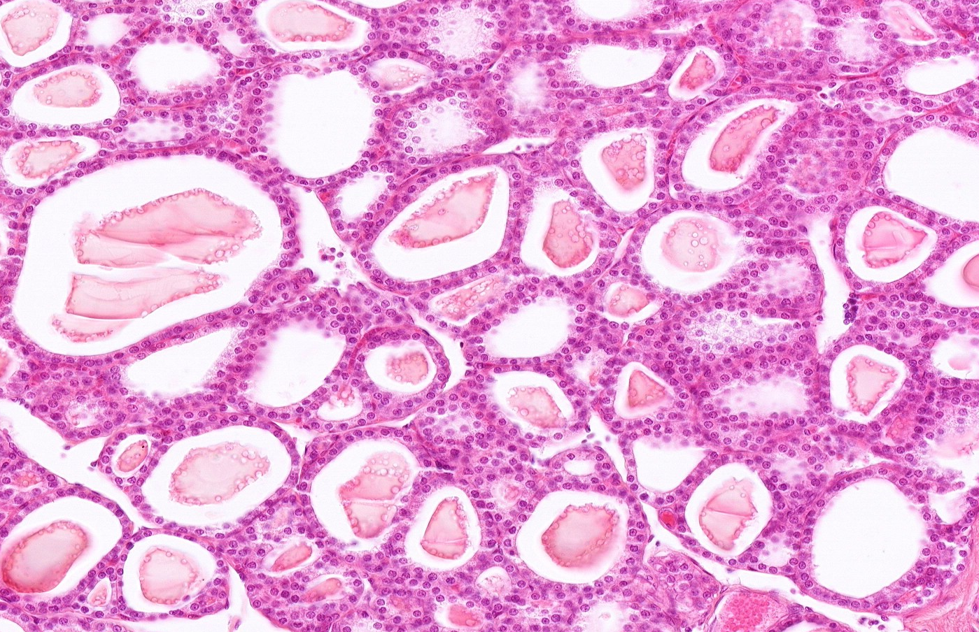
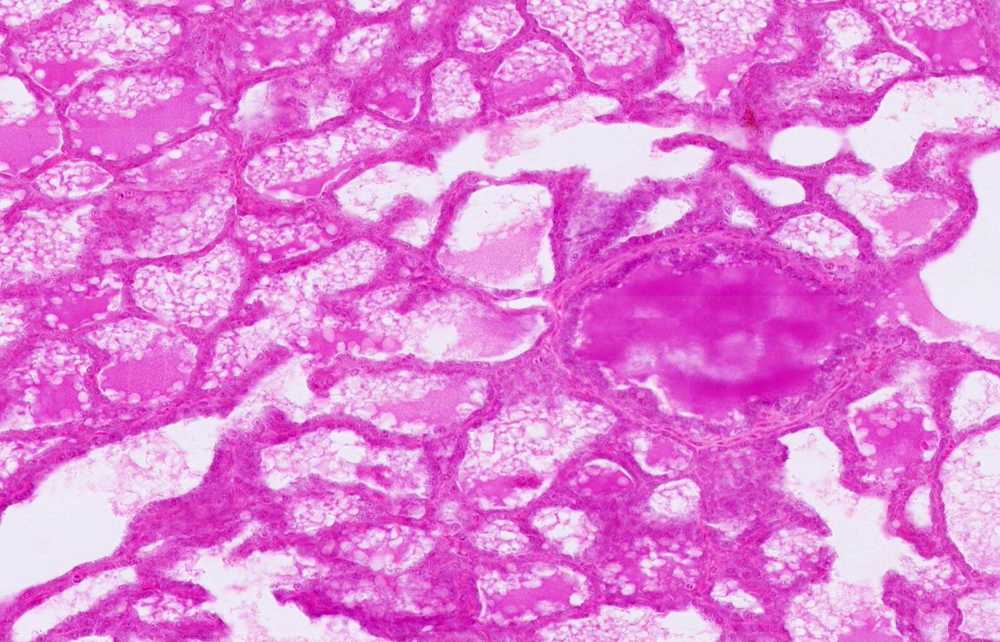
Pair 6
DU 052
NB_Rev 153
Key Features on Next Slide

Slide 26
Thyroid
Breast
Lipid-rich secretions
Colloid
(Protein)
Pair 6
Follicles
Tubulo-alveolar
Duct
ID: Thyroid (See previous slides for descriptions)
ID: Breast

Slide 27
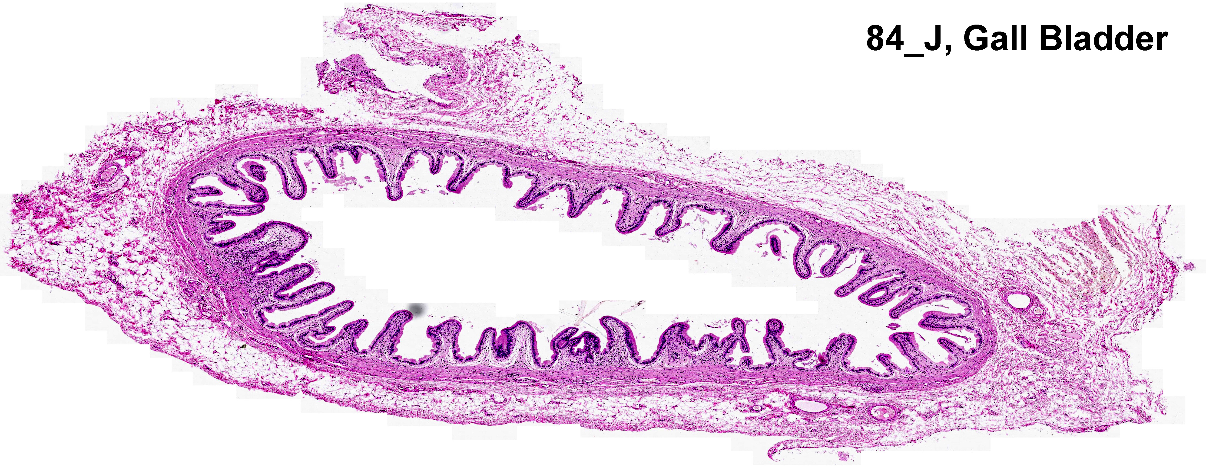
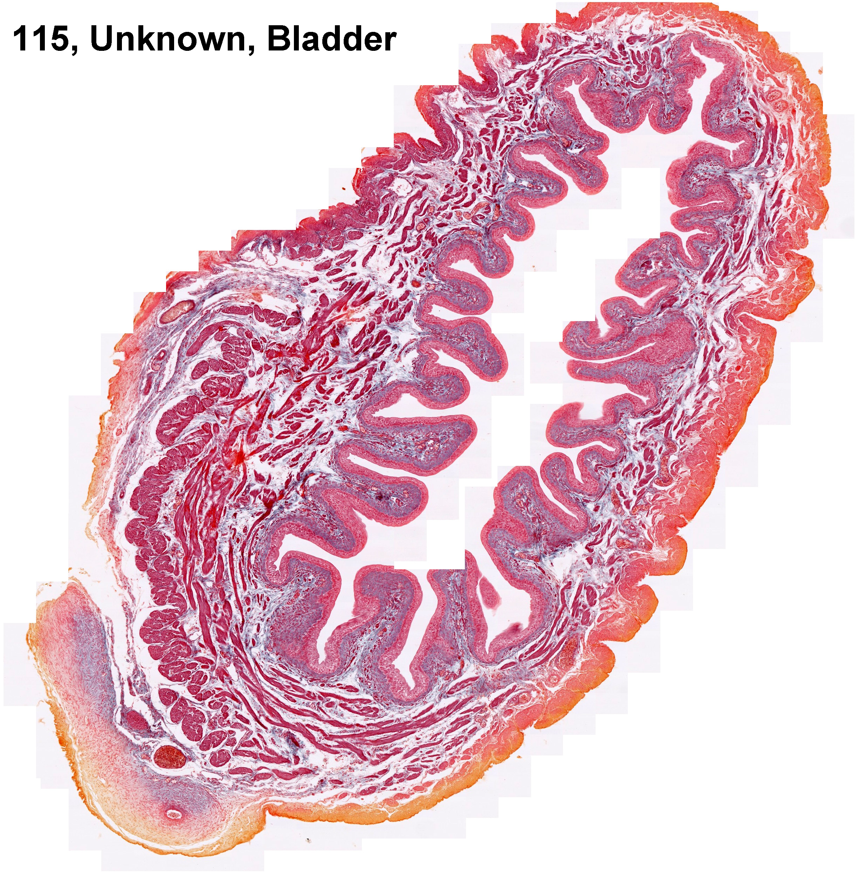
Pair 7
DU 084
NB_Rev 115

Slide 28
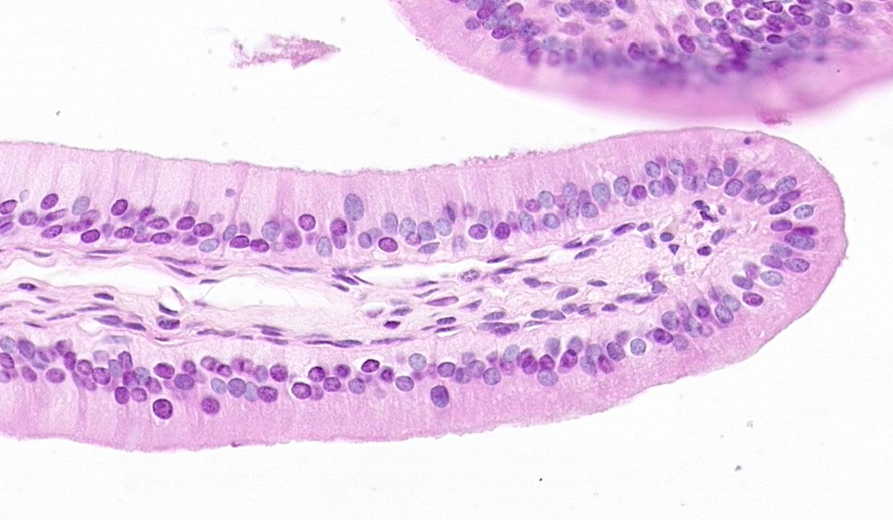
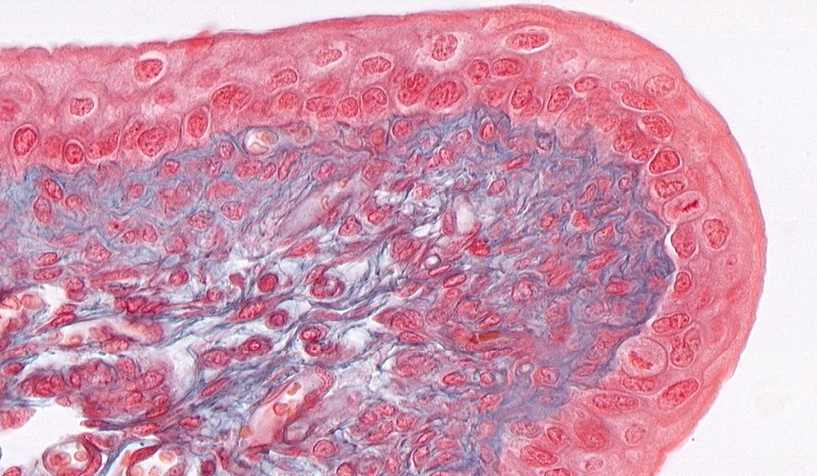
Pair 7
Key Features on Next Slide

Slide 29
Pair 7
Columnar
Epithelium
No Submucousa,
Lamina propria sitting on
Muscularis Externa
Transitional
Epithelium

Slide 30
Tube, no GI Layering: Mucosa, lamina propria, muscularis externa, adventitia/serosa
Mucosa: simple columnar with microvilli, highly involuted surface
Muscularis: thin, indistinct/random orientation
BVs in adventita
Look for liver
May see Rokitansky-Aschoff sinuses (= epithelial pouches penetrating muscularis
May see mucous glands (in neck, or in cholecystitis)
ID: Gall bladder
Pair 7
Gall Bladder
No GI Layering: Mucosa, lamina propria, muscularis externa, adventitia/serosa
Mucosa: Transitional epithelium = key feature
Muscularis: Mix of DICT and SmM in fascicles, 3 indistinct layers
Normally large lumen/wall
Entire wall folded = distensible
ID: Urinary bladder
Urinary Bladder

Slide 31
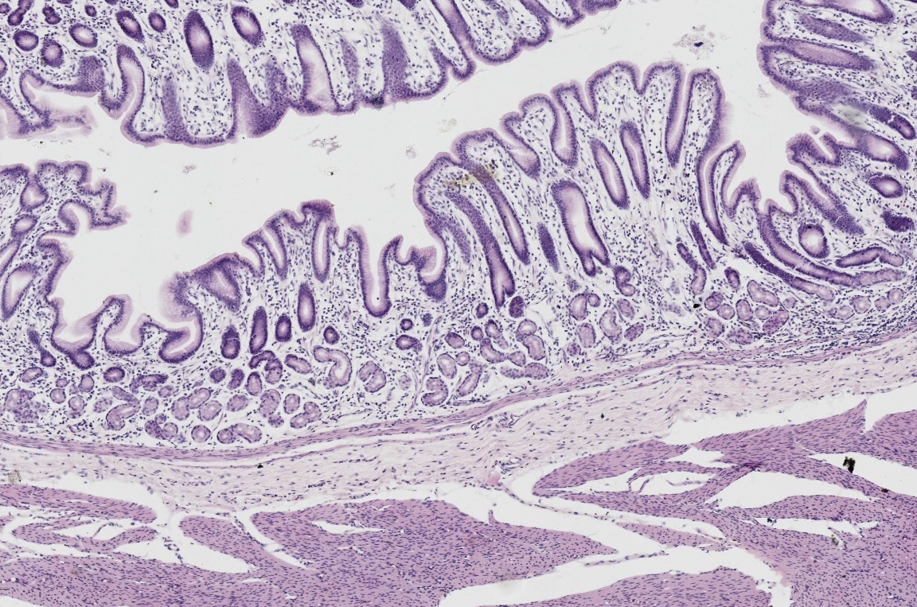
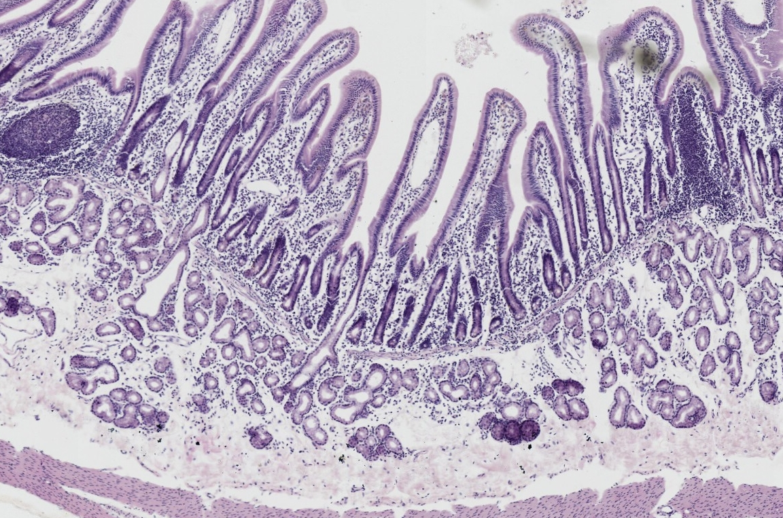
Pair 8
NB_Rev 065
NB_Rev 065

Slide 32
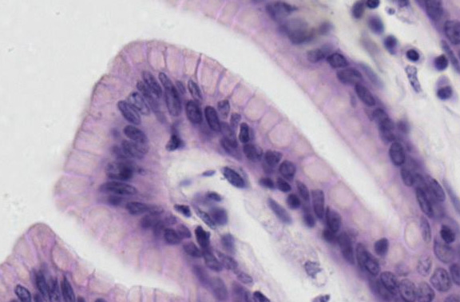
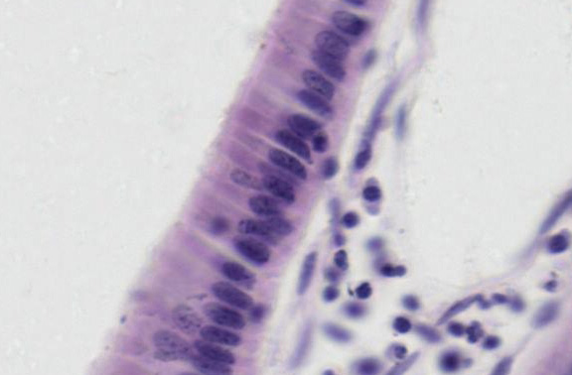
Pair 8
Key Features on Next Slide

Slide 33
Pair 8
Pits
Mucus Surface Cells
Glands
M. Mucosae
Villi
Sub Mucosal
Glands
Crypts
Enterocytes
M. Mucosae

Slide 34
Stomach
Pair 8
Tube, GI Layering: Serosa, Muscularis externa, Submucosa, Mucosa
Mucosa: villi and crypts, lamina propria and musc. mucosae
Simple columnar epithelium of enterocytes with brush border, and occasional goblet cells, and Paneth cells in crypts
Submucosa: dense irregular CT, BVs, Meisner’s plexus, mucous glands (Brunner’s = key feature) emptying into crypts
M. externa: inner circular, outer long., Auerbach’s plexus between layers
Serosa = simple squamous epi.
ID: Duodenum (Brunner’s glands)
Or: Illeum ( if Peyer’s patches present)
Or: Jejunum or illeum (no Peyer’s patches, no Brunner’s glands)
Tube, GI Layering: Serosa, Muscularis externa, Submucosa, Mucosa
Mucosa: Large-bore pits leading to narrow, coiled tubular glands, lamina propria and musc. mucosae
Simple columnar epithelium of mucous surface cells
Only mucous cells = cardiac region
Parietal and chief cells = corpus/fundus
Mostly mucous, few parietal = pyloric
Submucosa: dense irregular CT, BVs, Meisner’s plexus
M. externa: 3 poorly-defined layers
Auerbach’s plexus between layers
Serosa = simple squamous epi.
ID: Stomach (include region)
Duodenum

Slide 35
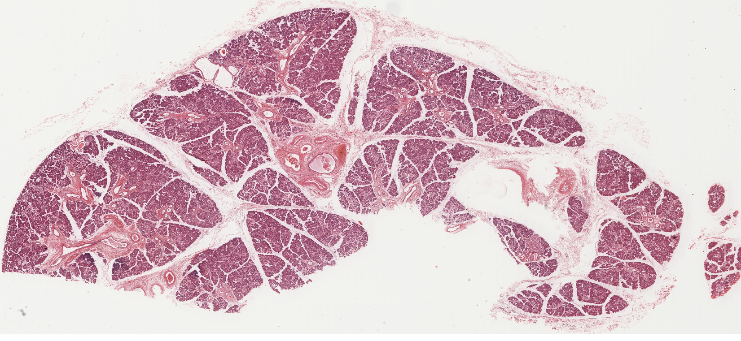
Organ 9

Slide 36
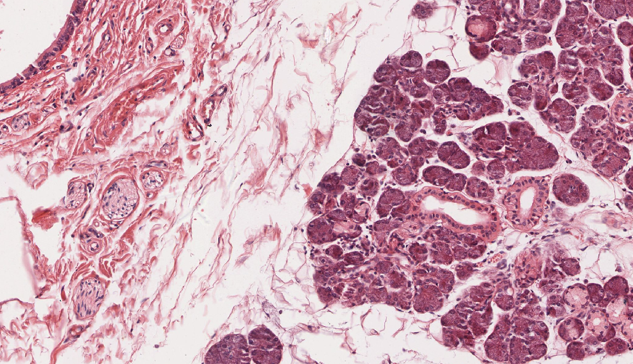
Organ 9
Key Features on Next Slide

Slide 37
Organ 9
Excretory Duct
Stratified Cuboidal
Serous Acini
Striated Ducts
Mucous Acini
Serous Demilune

Slide 38
Organ 9
Compact, lobulated organ, with adventitia
Serous and mucous acini = key feature
Serous demilunes
Intercalated ducts (simple squamous to low cuboidal) connect to…
Lots of striated ducts = key feature, simple cuboidal/columnar with centrally-located nuclei and basal striations. Connect to...
Excretory ducts stratified cuboidal = key feature
Myoepithelial cells = key feature
Mostly serous, some mucous = submandibular
ID: Submandibular gland

Slide 39
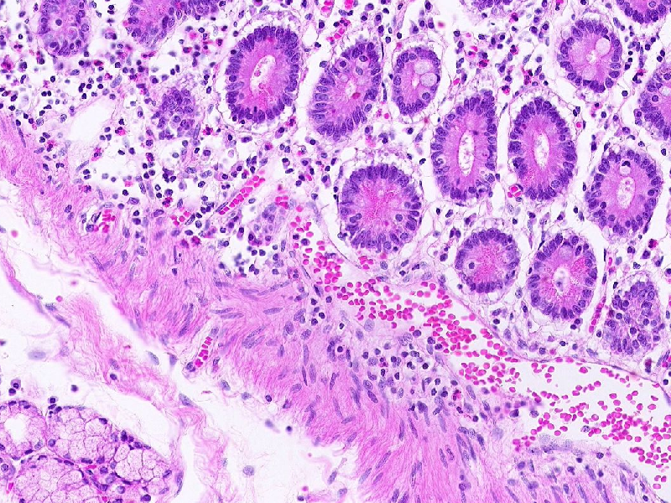
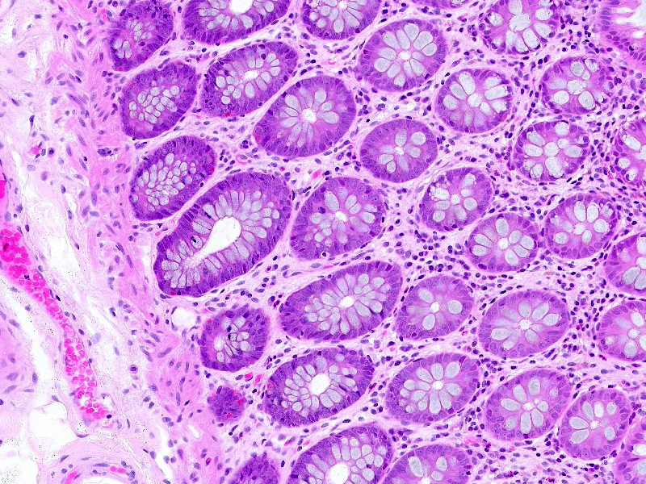
Pair 10
Key Features on Next Slide

Slide 40
Pair 10
Paneth Cells
Glands
Sub-mucosal glands
Muscularis mucosae
Many Goblet Cels

Slide 41
Duodenum
Pair 10
Paneth Cells
Sub-mucosal glands
Colon
Tube, GI Layering: Serosa, Muscularis externa, Submucosa, Mucosa
Mucosa: straight-bore crypts (glands), lamina propria and musc. mucosae
Simple columnar epithelium of absorptive cells with brush border and many goblet cells
Submucosa: dense irregular CT, BVs, Meisner’s plexus
M. externa: inner circular, outer long.
May see taenia coli
Auerbach’s plexus between layers
Serosa = simple squamous epi.
ID: Large intestine
ID: Duodenum (See Pair 8 for description

Slide 42
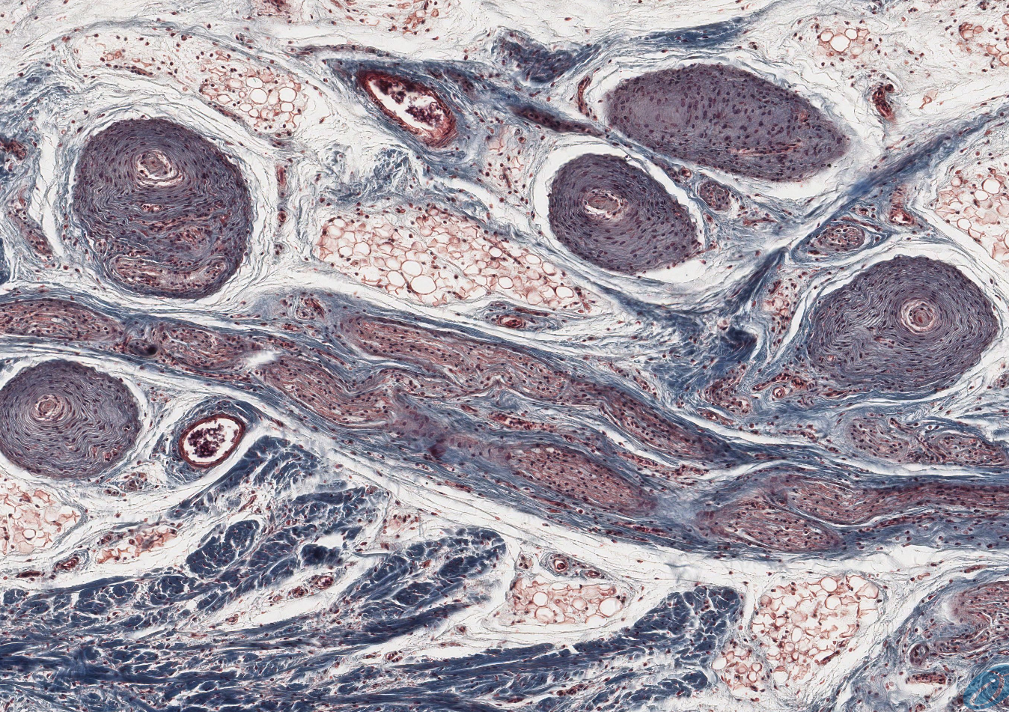
Organ 11

Slide 43
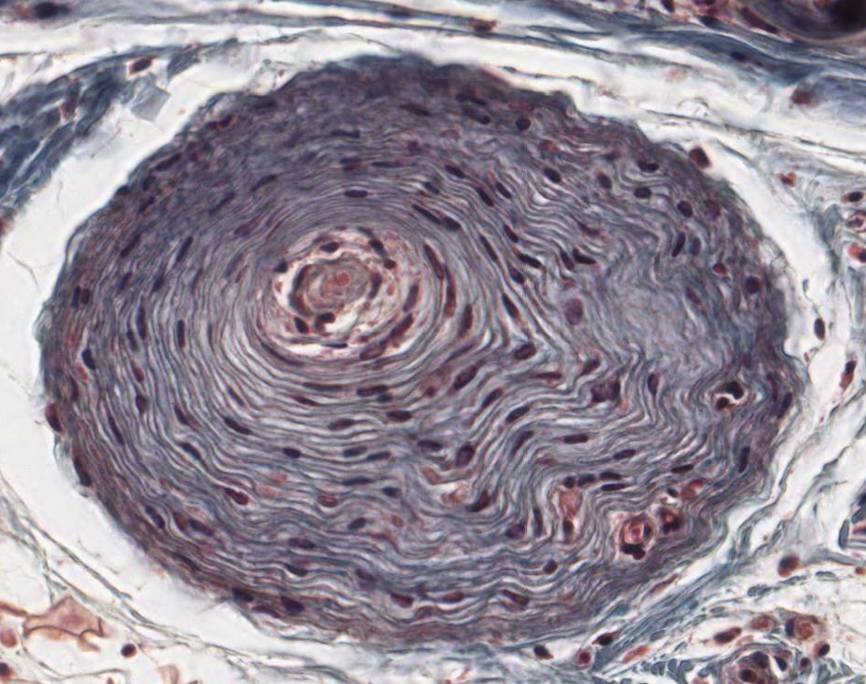

Slide 44
Large (~1 mm) ovoid structure
Inner core of of flattened Schwann cells surrounding a nerve ending
Surrounded by multiple lamellae of flattened endoneurial cells separated by fluid spaces
Adjacent nerves nearby
Found in skin, mesentery, and some solid organs
ID: Pacinian corpuscle
Pacinian corpuscle

Slide 45
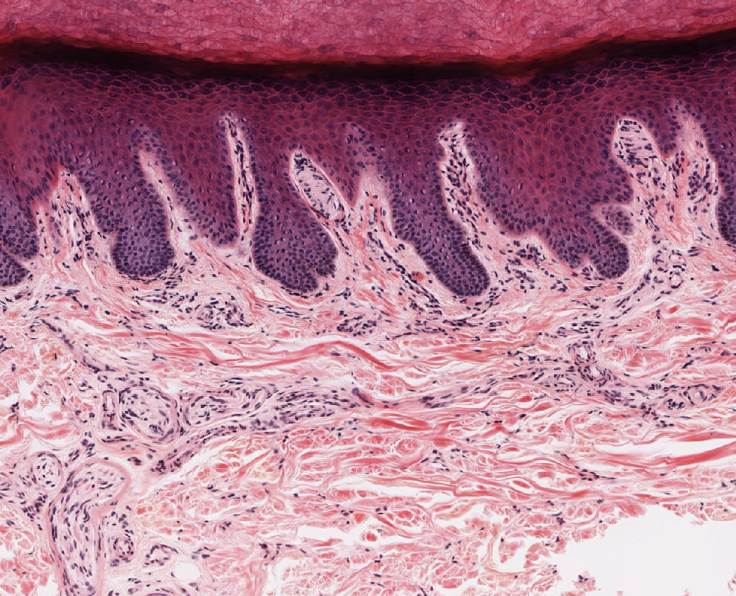
Organ 12

Slide 46
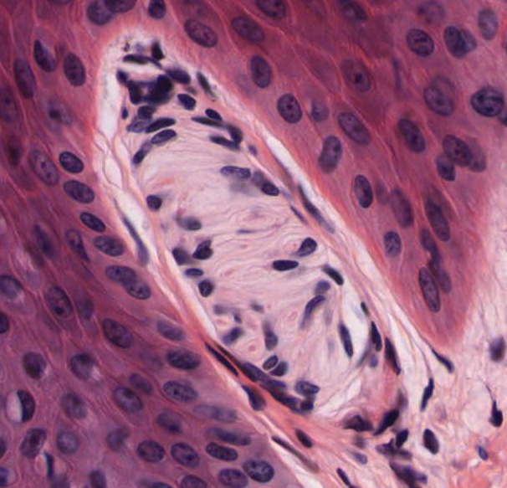
Organ 12

Slide 47
Organ 12
Oval structure, ~150 µm
Located in dermal papillae
perineurium
Swirled or stacked appearance due to irregular lamellae of Schwann cells
ID: Meissner’s corpuscle
Meisner’s corpuscle

Slide 48
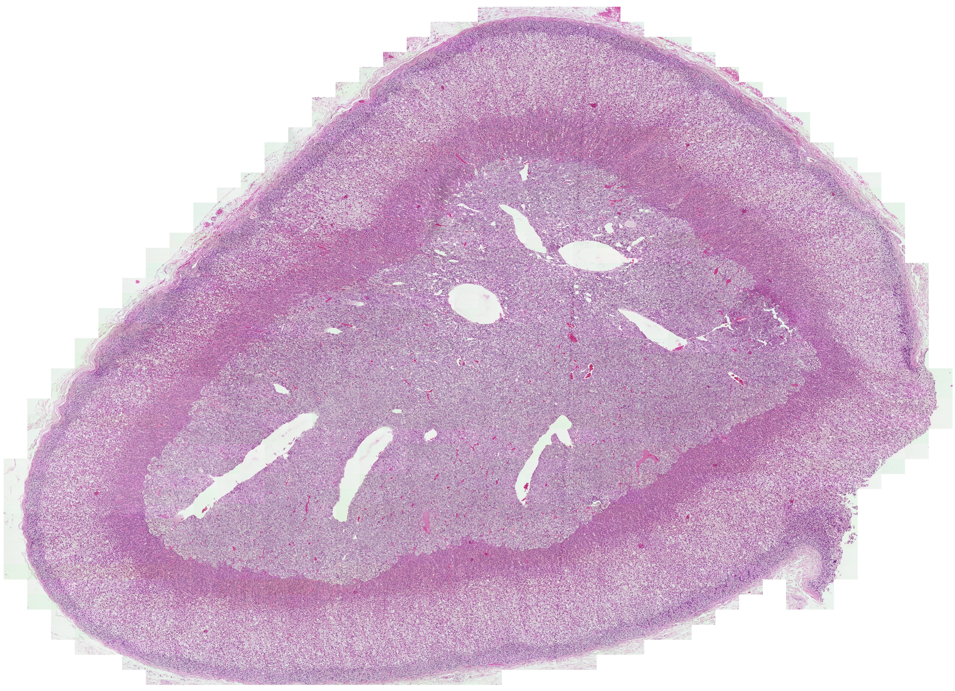
NB_Normals 011

Slide 49
A gimme: cortex/medulla with 3-layer cortex = key feature = adrenal
Dense CT capsule with adventitia
Highly vascularized, no ducts = endocrine
Cortex layers: zona glomerulosa (nests/balls of cells), fasciculata (cords, pale cells ) and reticularis (anastomosing networks)
Medullary sinusoids, adrenomedullary collecting veins (= large veins in medulla)
Medulla: large chromafin cells with round nucleus, prominent nucleolus and secretory granules
May see central vein with conspicuous longitudinal smooth muscle bundles in T. media
ID: Adrenal gland

Slide 50
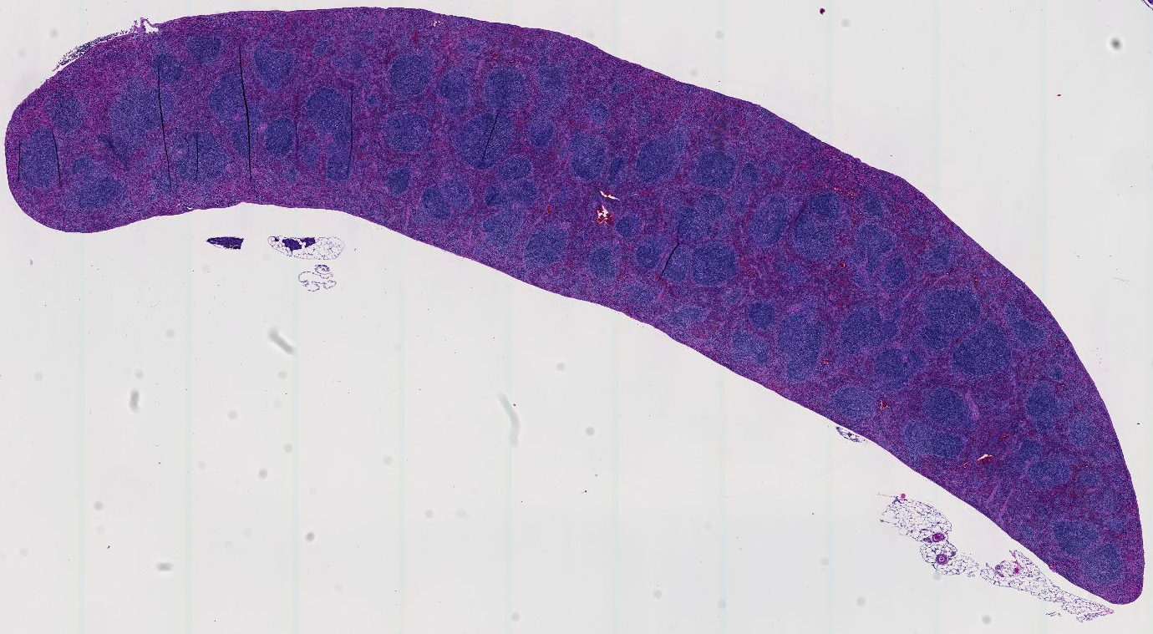

Slide 51
Spleen
A gimme: lymph nodules, NO cortex/medulla = key feature = spleen
Compact organ with serosa
Tongue-shape organ
Dense CT capsule with trabeculae extending into organ, composed of myofibroblasts
Parenchyma = lymphocytes
Lymph nodules throughout organ (raisin bread) with central arteries = key feature
Red pulp (splenic sinusoids and cords of Billroth) and white pulp (nodules)
ID: Spleen

Slide 52
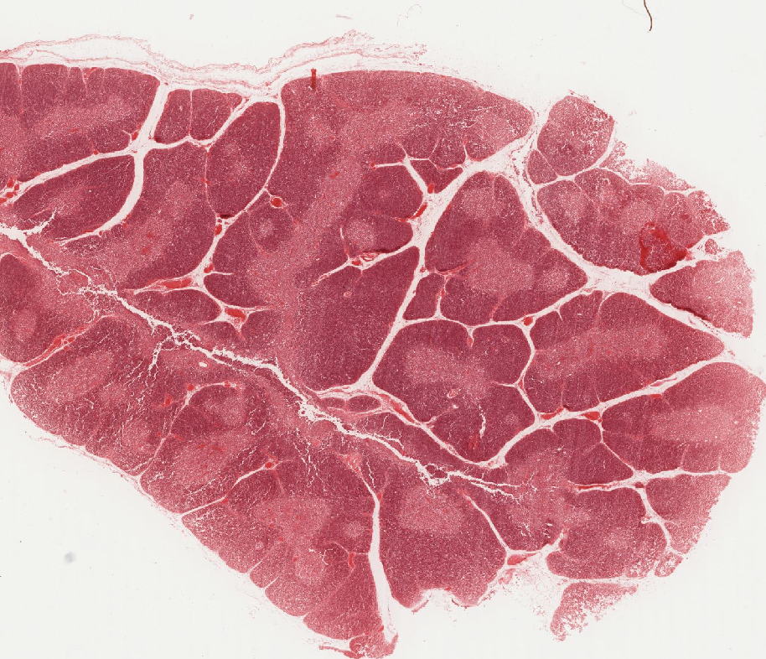

Slide 53
A gimme: Lobulated organ with cortex/medulla = thymus
Thin CT capsule with trabeculae extending into organ, surrounded by adventitia
Thymic lobules (not true lobules)
Parenchyma = lymphocytes (but no nodules) and
Epithelioreticular cells (large pale nucleus, eosinophilic cytoplasm)
Hassel’s corpuscles (medulla) = key feature = concentric swirl of cells with flattened nuclei, eosinophilic, may be keratinized
Senile organ may be involuted = parenchyma replaced with fat
ID: Thymus

Slide 54
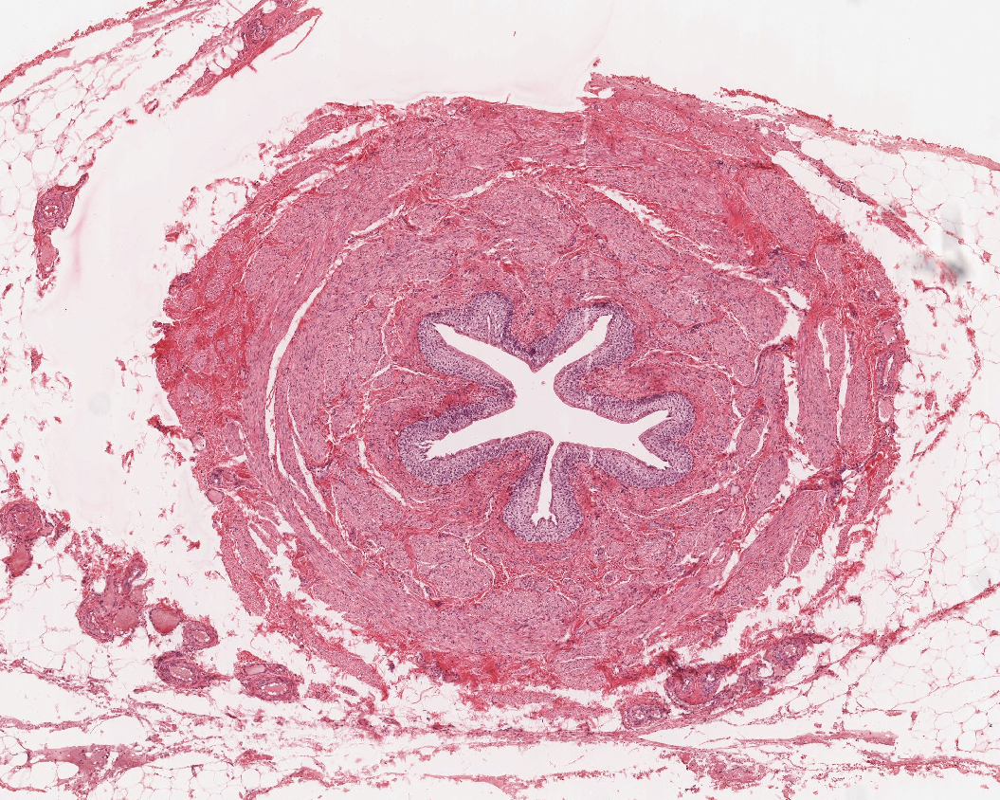

Slide 55
A gimme: a tube with star-shaped lumen = ureter
Layers: adventitia, muscularis, mucosa
Mucosa: transitional epithelium = key feature
Muscularis: inner longitudinal, outer circular (may see third outer longitudinal near bladder)
ID: Ureter

Slide 56
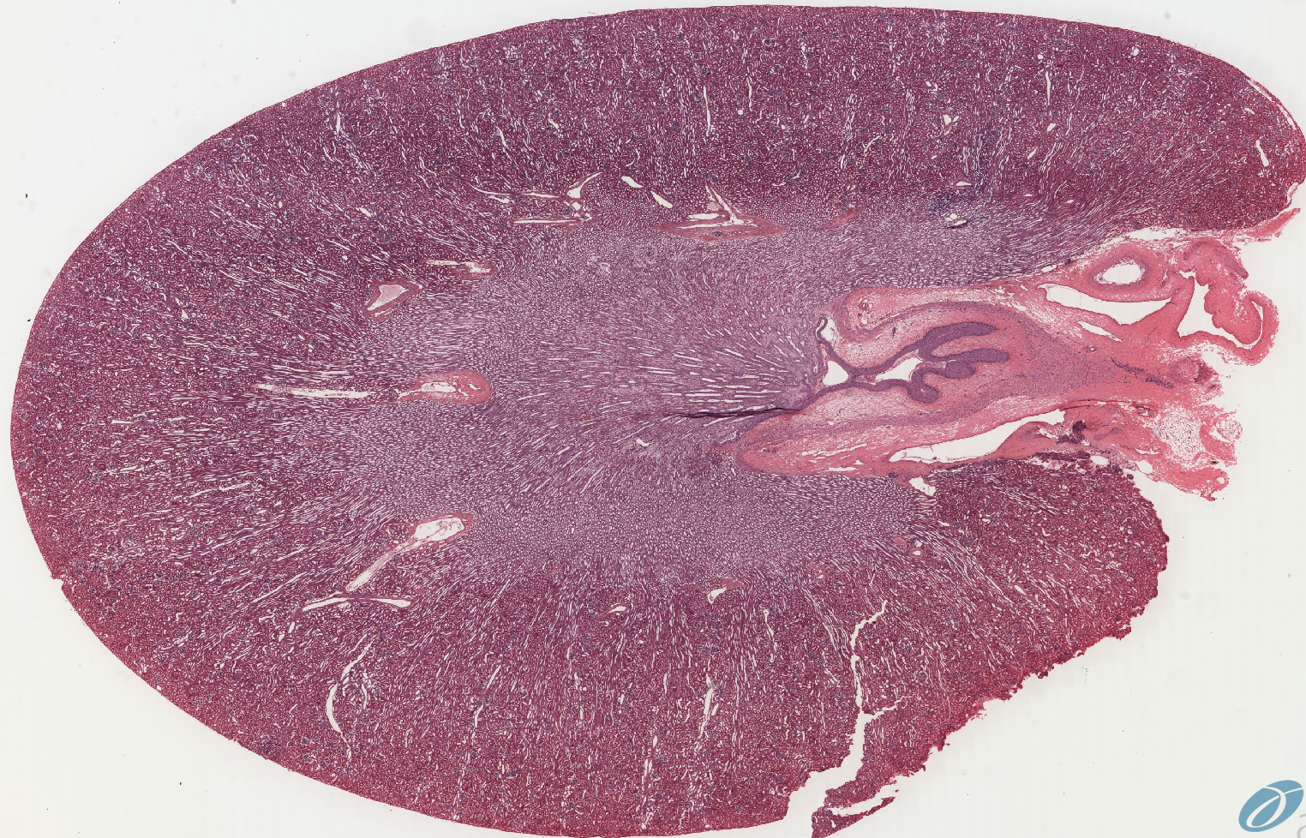

Slide 57
Bean-shaped compact organ with CT capsule covered by serosa
Cortex/medulla organization
Full of many tubules cut in cross and longitudinal section
Cortex:
  Round glomeruli with capillaries, simple squamous epithelium of Bowman’s capsule (visceral and parietal layers), podocytes and mesangial cells
  Proximal convoluted tubules = most prevalent, dark, simple cuboidal epi. with microvilli, may show basal striations
  Distal convoluted tubules = less prevelent, paler, simple cuboidal, no obvious microvilli, may show basal striations
  Medullary rays = parallel collecting ducts and straight tubules (thick ascending/descending limbs)
  May see macula densa = several tall, narrow cells crowded together in a DCT immediately adjacent to the vascular pole of renal corpuscle (glomerulus)
Medulla:
  Vasa recta = straight, parallel blood vessels
  straight tubules = thick ascending/descending limbs of loop of Henle with simple “cuboidal” epithelium with few nuclei and indistinct cell boundaries
  thin ascending/descending limbs with simple squamous epithelium
  Collecting ducts with simple cuboidal epithelium with distinct cell boundaries
Renal pyramid = ducts of Bellini penetrate renal papilla, empty into calyx (lined with transitional epi.)
Renal pelvis empties into ureter which passes through hilus of kidney
Whew!
ID: Kidney

