Slide 1
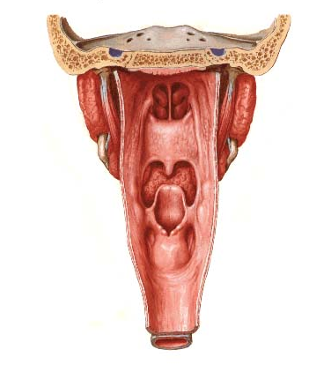
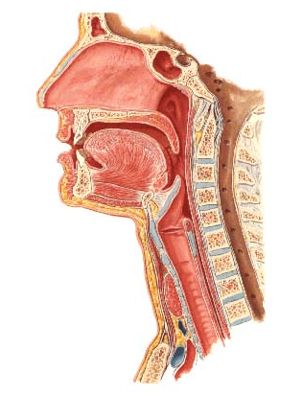
Nasal cavity, Pharynx and Larynx
Nasal cavity (septum)
Nasopharynx
chonchae
Oropharynx
Epiglottis
Laryngopharynx
Larynx
Esophagus
Trachea
Posterior view
slide courtesy of Dr. Sun-Kee Kim, University of Michigan

Slide 2
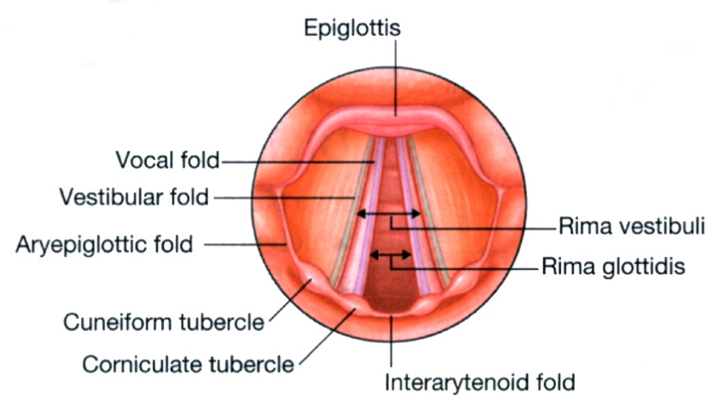
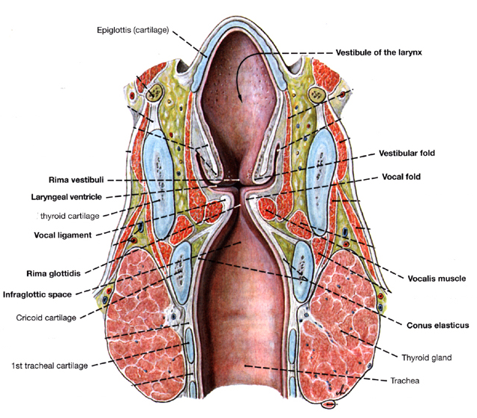
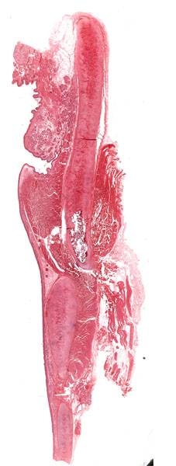
#307 Larynx
Gray’s p.956
Thyroid cartilage
Laryngeal ventricle
Clemente pl. 562
slide courtesy of Dr. Sun-Kee Kim, University of Michigan

Slide 3
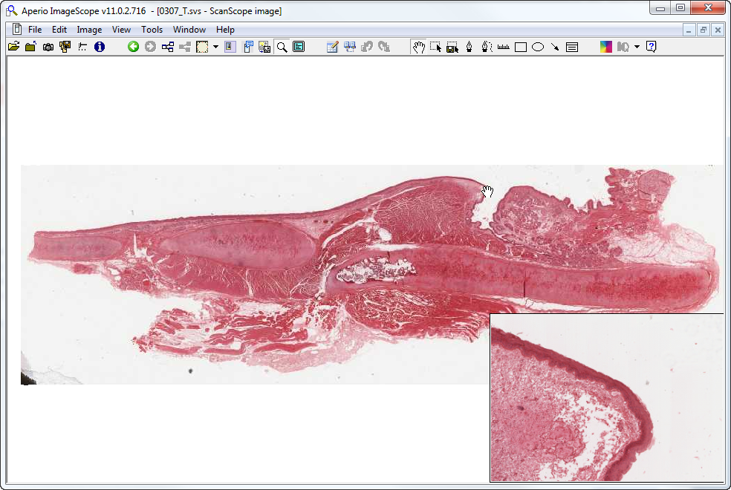
Slide 307: larynx
false vocal fold
aka vestibular fold
epiglottis
(elastic cartilage)
vocal fold
vocalis m.
cricoid cartilage
thyroid cartilage
St Sq Epith

Slide 4
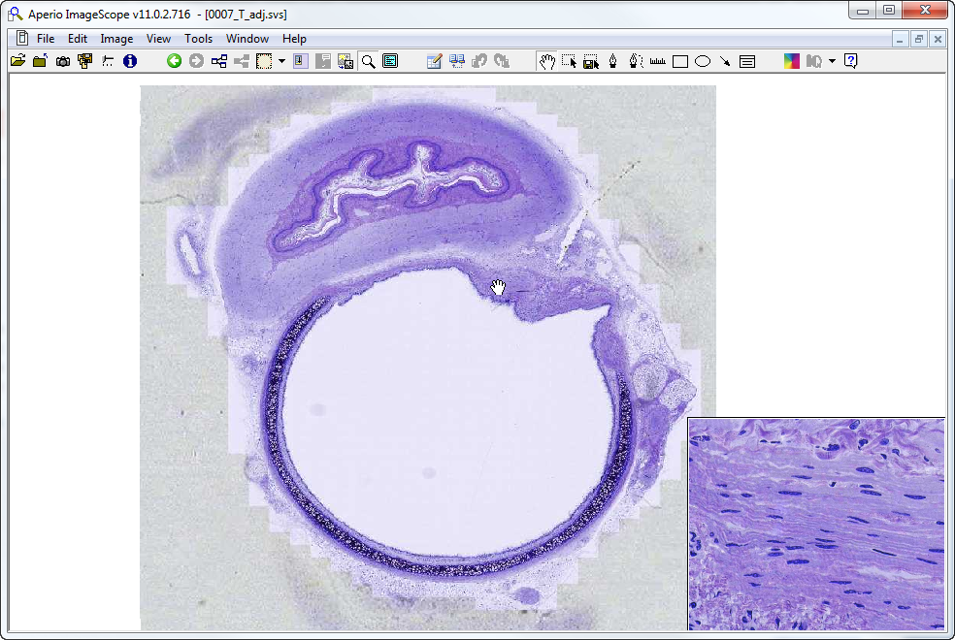
Slide 007 : esophagus & trachea
esophagus
trachealis muscle
neurovascular bundle
trachealis muscle
trachea
anterior

Slide 5
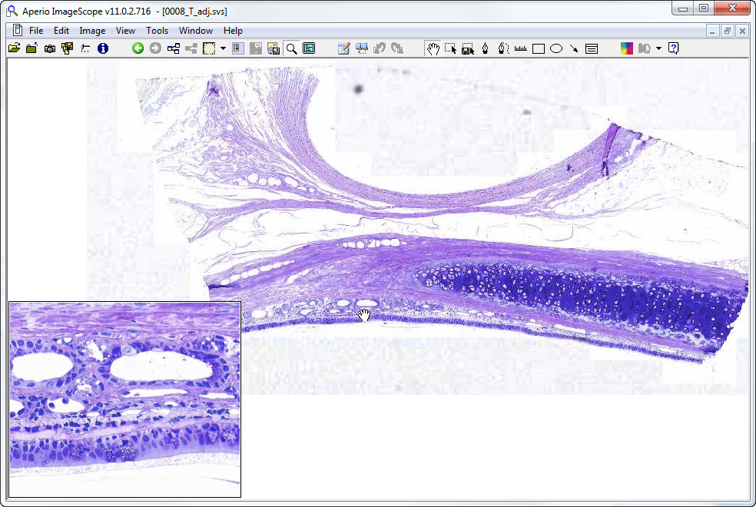
Slide 008: trachea
lumen of ?
adventitia
submucosa
gland
mucosa
gc
Notes:
Gc=goblet cell

Slide 6
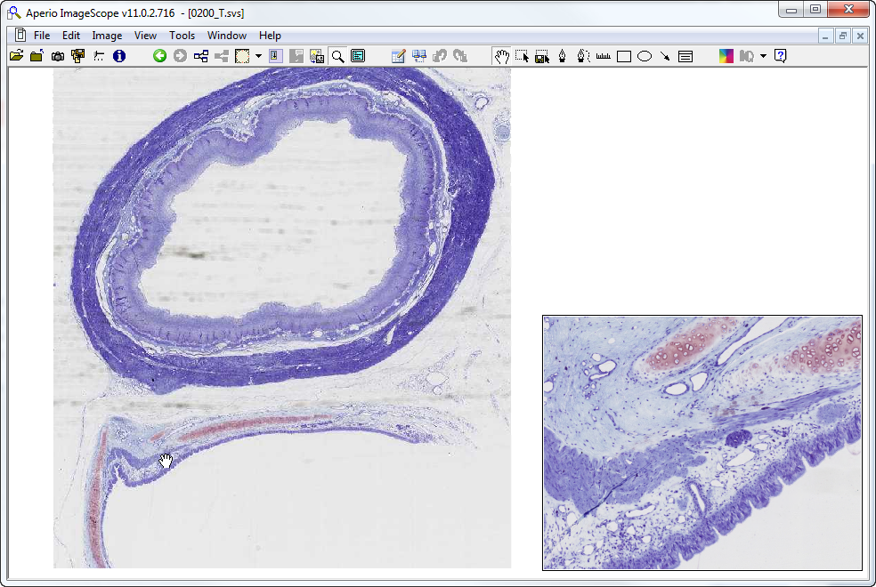
Slide 200: trachea & esophagus
esophagus
g
trachealis m.
sm
lp
d
mucosa
trachea
Notes:
d=duct g=gland lp=lamina propria

Slide 7
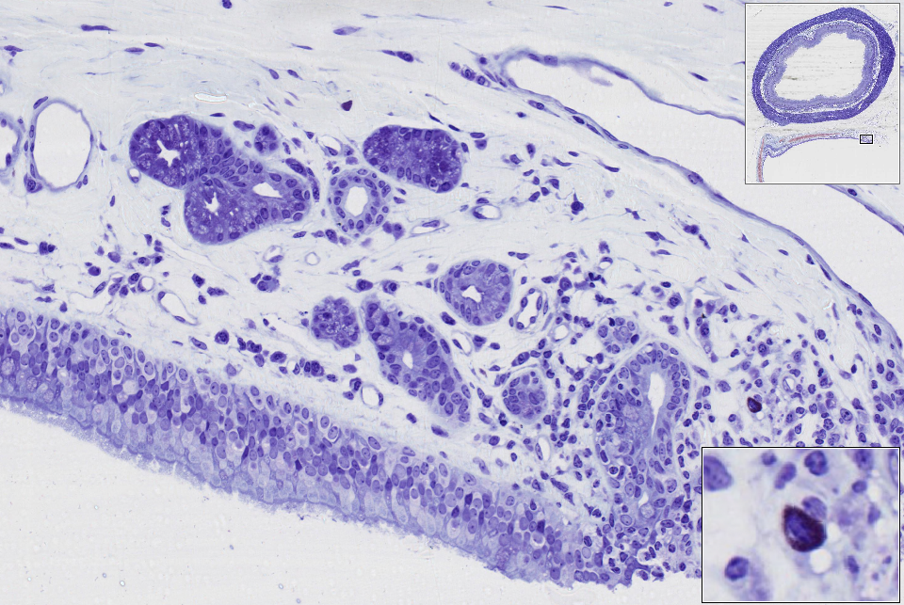
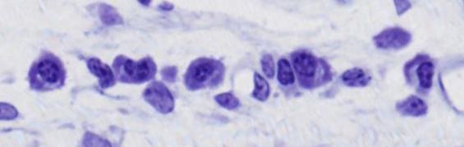
Slide 200: trachea & esophagus
g
SubM
d
LP
mucosa
plasma cells
mast cell
Notes:
d=duct g=submucosal glands LP=lamina propria SubM=submucosa
Mast cell granules react with toluidine blue and stain dark purple/black

Slide 8
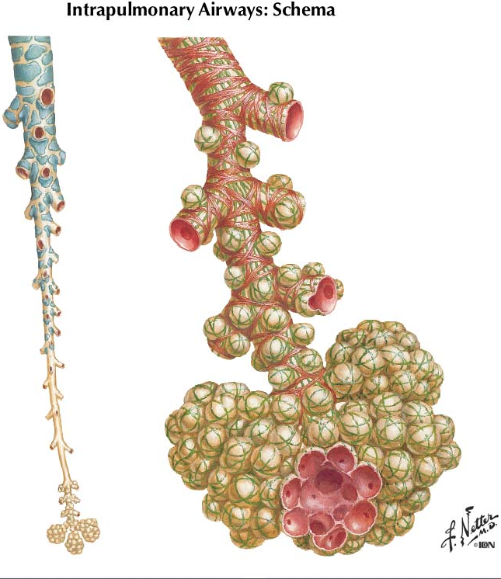
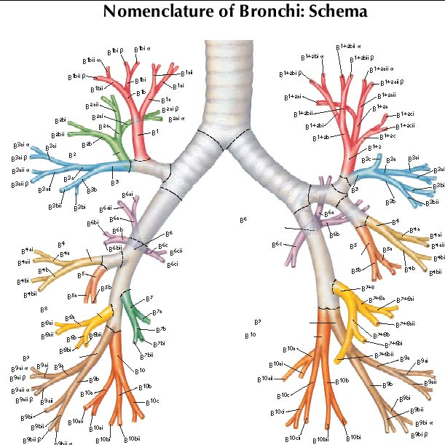
terminal bronchiole
respiratory
bronchioles
Bronchi
alveolar duct
Bronchioles
alveolar
sac
Terminal bronchiole*
Respiratory bronchiole
Alveolar ducts and sacs
slide courtesy of Dr. Sun-Kee Kim, University of Michigan
Notes:
*Note: You DO NOT need to be able to distinguish “terminal” bronchioles from other bronchioles. The “terminal bronchioles” are the very end of the conducting portion of the respiratory tree and lead to respiratory bronchioles, which are the beginning of the respiratory portion of the respiratory tree, so the only way to know for sure that you are looking at a terminal bronchiole is if you see if leading to a respiratory bronchiole.

Slide 9
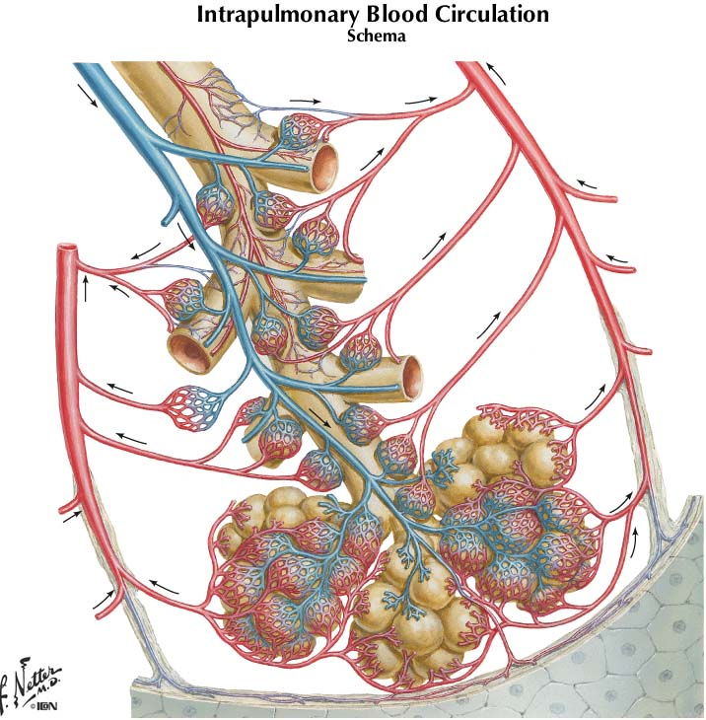
Intrapulmonary circulation
bronchial artery
Pulmonary artery
Pulmonary vein
Pulmonary vein
slide courtesy of Dr. Sun-Kee Kim, University of Michigan

Slide 10
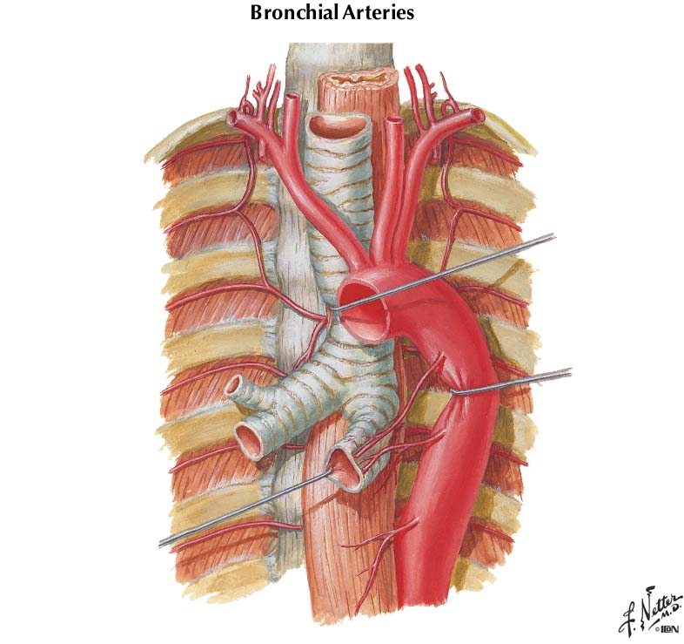
Bronchial Arteries
Right bronchial artery
Left bronchial arteries
slide courtesy of Dr. Sun-Kee Kim, University of Michigan

Slide 11
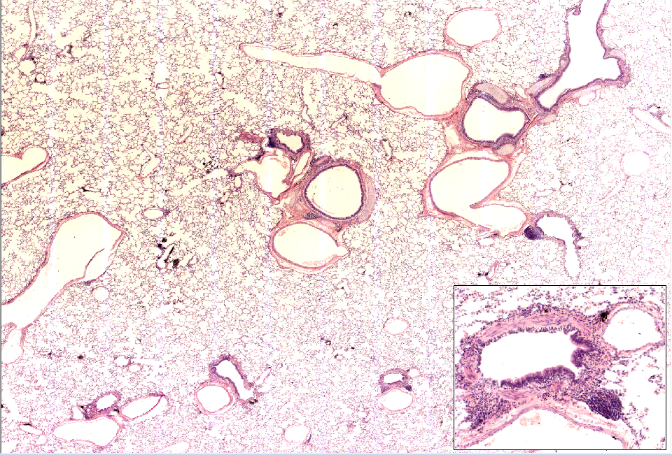
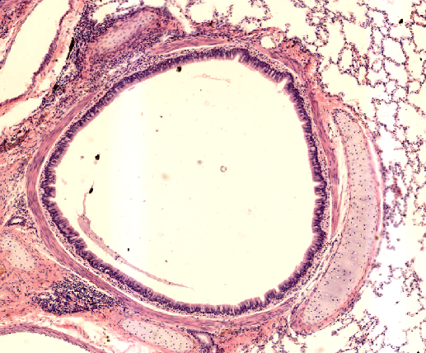
Slide 0315_T: Lung
ca
brl
pv
brcs
brcs
ca
brcs
smc
brl
pv
pa
ca
brcs
(This area is shown on next slide)
brl
pa
pv
rbrl
pv
smc
pa
brl
brl
brl
pa
brl
pa
pa
pa
pa
pv
Notes:
ca=hyaline cartilage brcs=bronchus brl=bronchiole smc=smooth muscle cells
pa=pulmonary artery (closely associated with resp. tree all the way out to bronchioles)
pv=pulmonary vein (in lung parenchyma and associated with larger branches of resp. tree; e.g. bronchi)

Slide 12
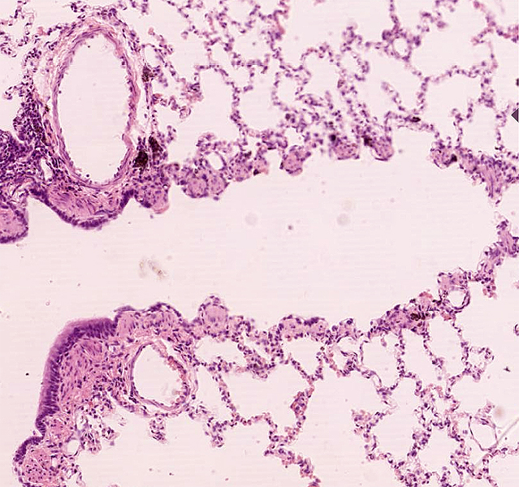
Slide 0315_T: Lung (image below is rotated 90° CCW from the VM slide)
P.A.
respiratory bronchiole
terminal bronchiole
Low cells,
alveolar pocketing,
knobs of sm. muscle (arrows)
slide courtesy of Dr. Sun-Kee Kim, University of Michigan

Slide 13
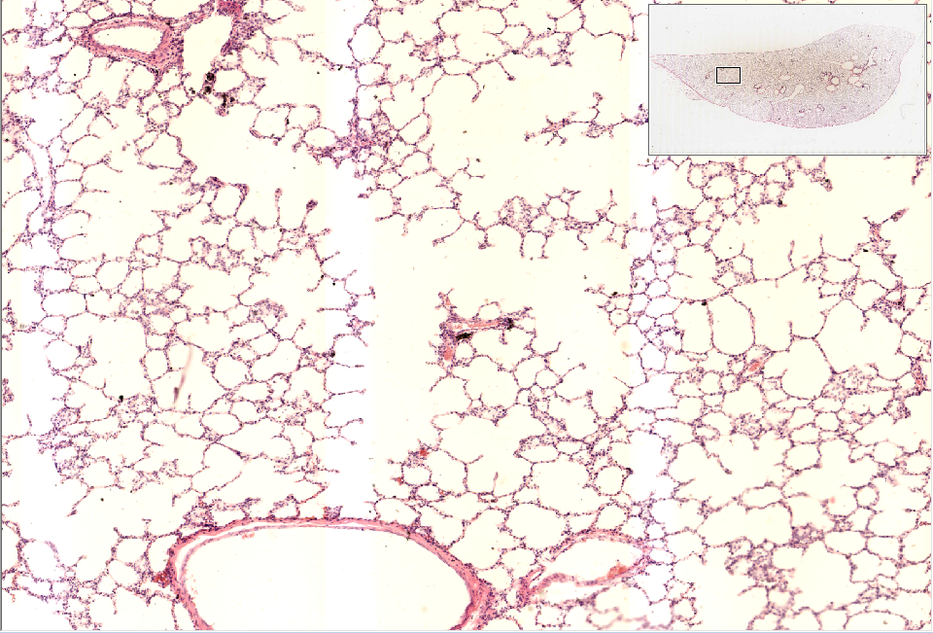
Slide 0315_T: Lung
AD
Notes:
AD=alveolar ducts

Slide 14
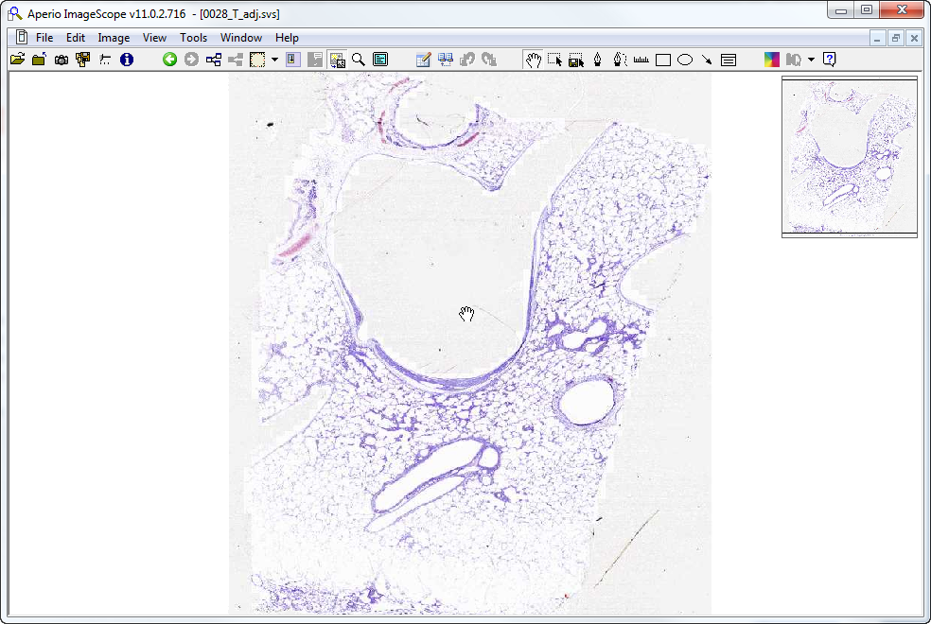
Slide 0028: lung
5?
4?
PV*
1?
6?
2?
3?
Notes:
The very large lumen is a pulmonary vein, note that some of the tunica media consists of cardiomyocytes, which can be present in the larger portions of the pulmonary veins in many species, including humans.
Numbers indicate structures you should try and identify. Then look at alveoli to find type I & II pneumocytes, endothelial cells, and interstitial mast cells

Slide 15
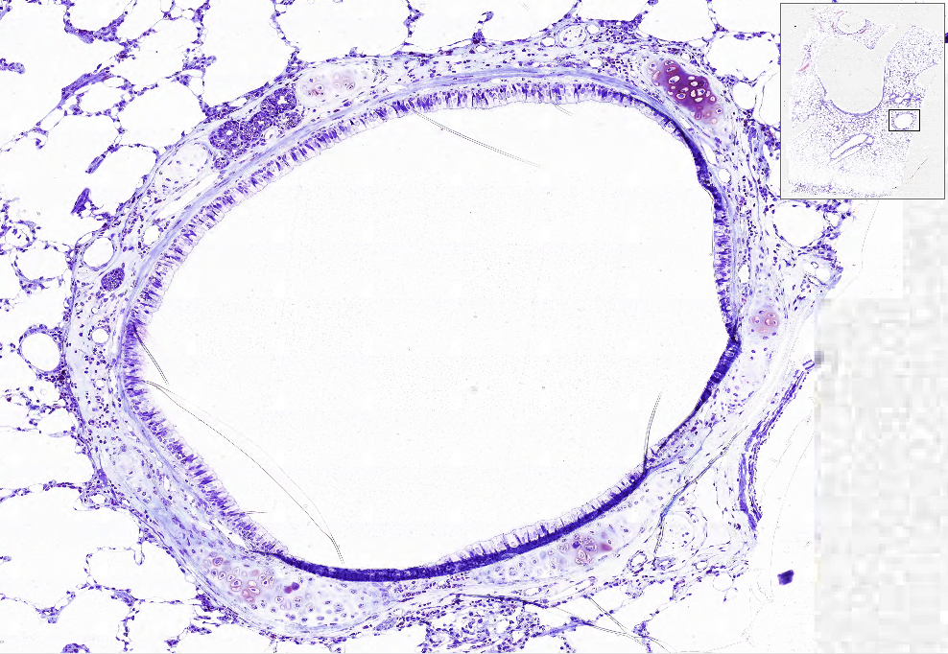
Slide 0028: lung
1?
surrounding tissue?
epithelium – simple? goblet cells?
cartilage?
smooth muscle? Arrangement?
glands?

Slide 16
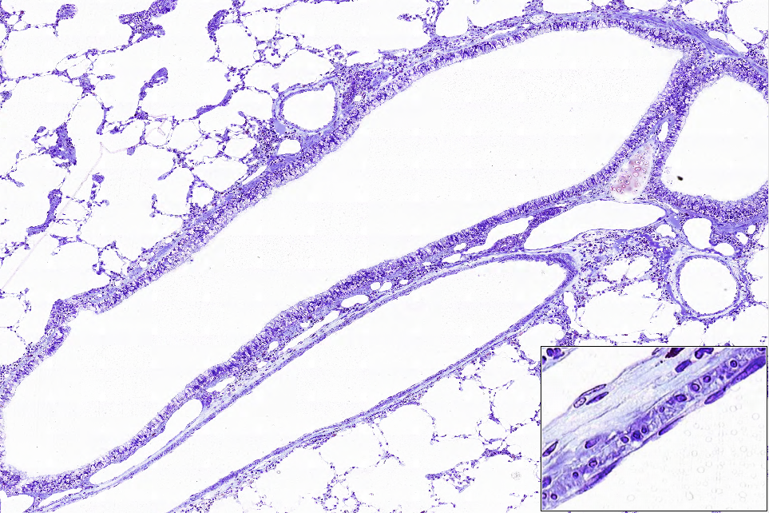
Slide 0028
2?
3?

Slide 17
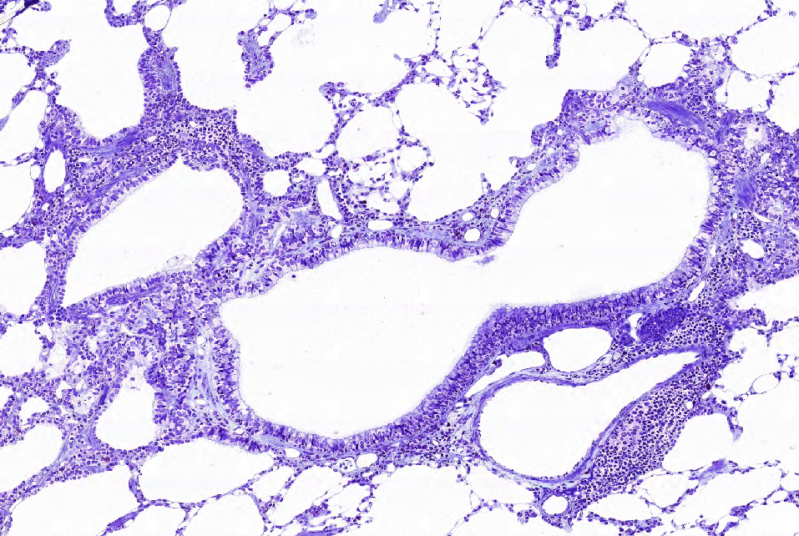
Slide 0028
5?
hint: what’s this?
4?

Slide 18
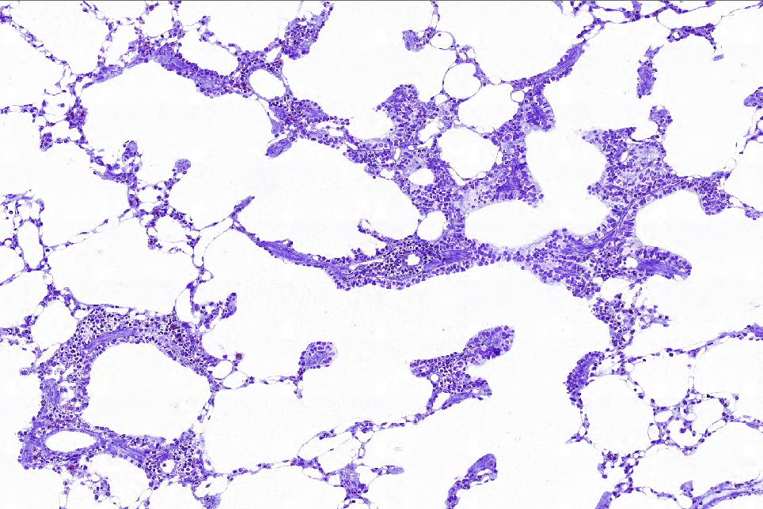
Slide 0028
6?

Slide 19
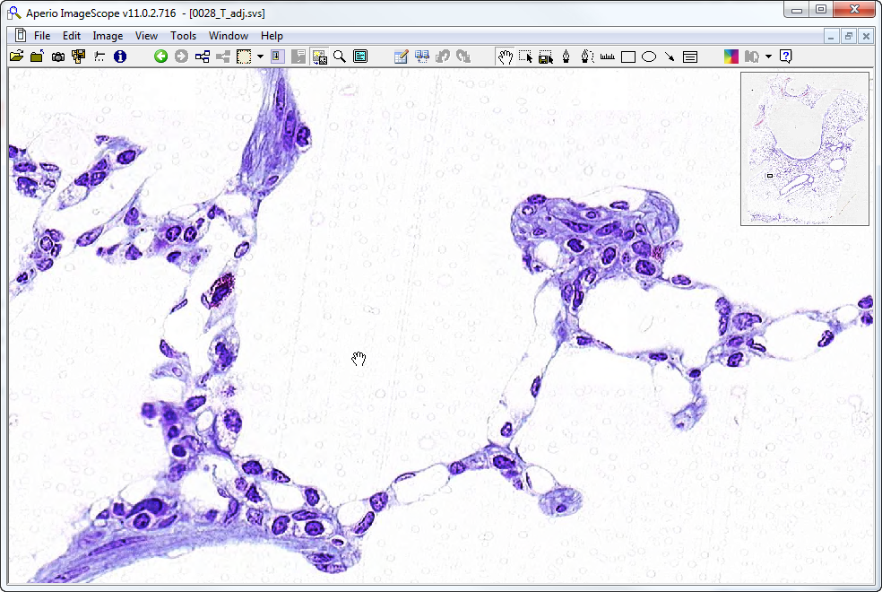
Slide 0028: lung
type I cell
mast cell
type II cells
type I cell
endothelial cell
endothelial cell

Slide 20
Respiratory System ‘Extra Slides’ Orientation Images

Slide 21
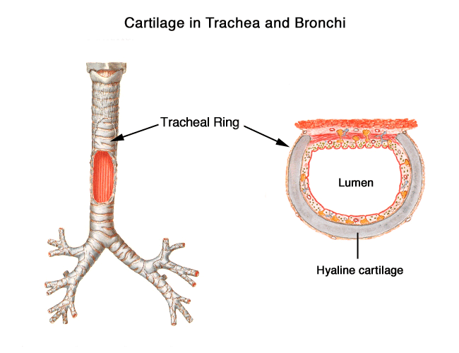
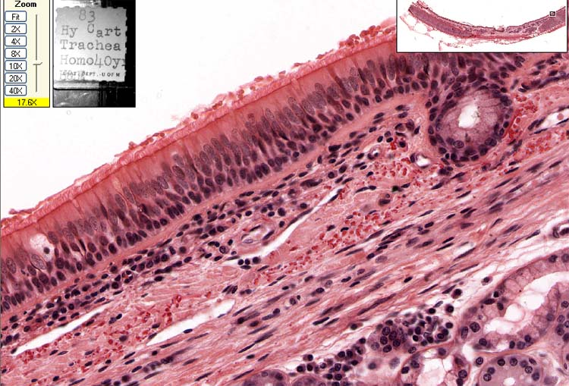
UMich #40: Trachea
Basement membrane
Respiratory epithelium
duct
lamina propria
a
v
elastic fibers
gland
v
v
slide courtesy of Dr. Sun-Kee Kim, University of Michigan
Notes:
a=arteriole v=venule

Slide 22
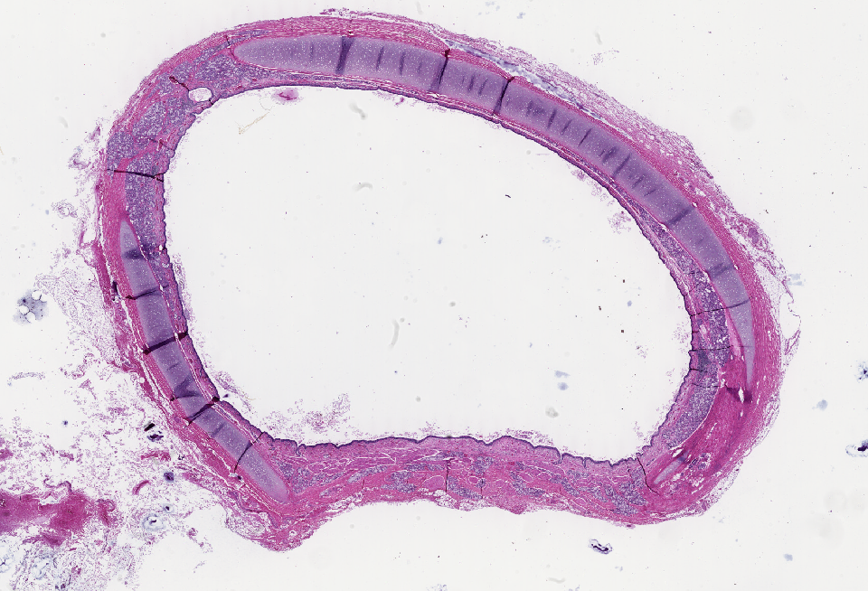
LSU slide B-20: trachea
glands
cartilage
epithelium (pseudo-strat columnar w/ goblet cells)
cartilage
bands of smooth muscle (trachealis muscle)
sero-mucous glands

Slide 23
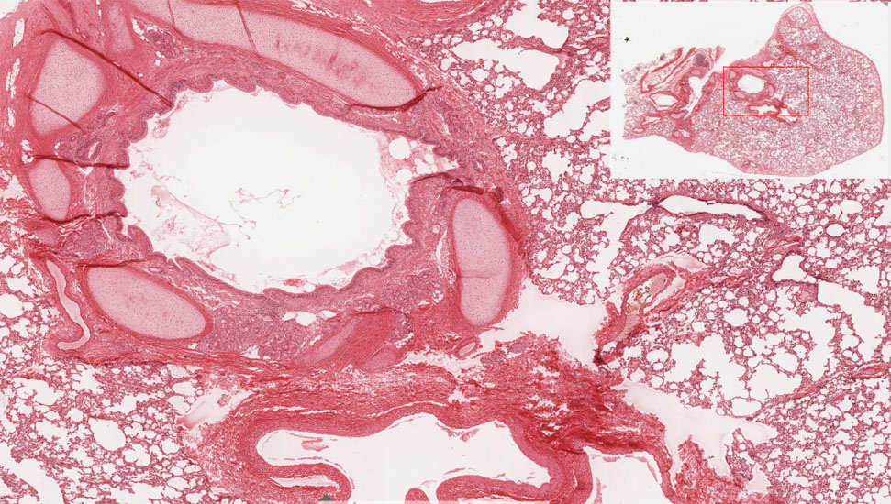
UMich #130-1: Lung
Bronchus
Pulmonary artery
slide courtesy of Dr. Sun-Kee Kim, University of Michigan

Slide 24
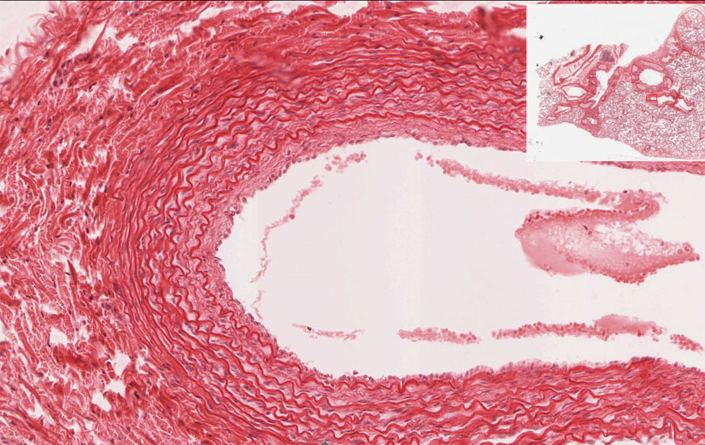
UMich #130-1: Lung
Pulmonary artery:
Close to bronchial trees, relatively thin wall (media), elastic laminae
slide courtesy of Dr. Sun-Kee Kim, University of Michigan

Slide 25
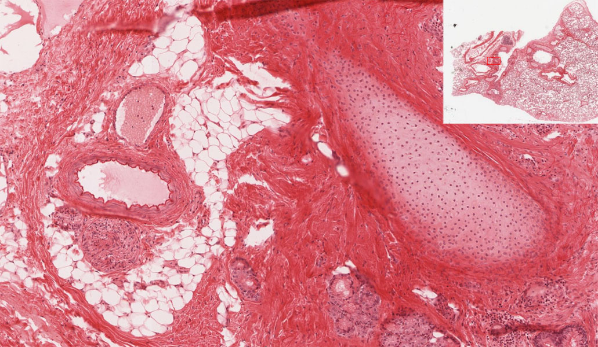
UMich #130-1: Lung
bronchial vein
bronchial artery
cartilage
glands
slide courtesy of Dr. Sun-Kee Kim, University of Michigan
Notes:
‘Bronchial’ vessels (arteries & veins) are systemic blood vessels in the walls of bronchi that will appear similar to arteries and veins elsewhere in the body. Bronchial arteries are branches of the aorta that supply oxygenated blood to the tissues of the bronchial wall. Bronchial veins drain that blood into the system circulation via the azygous veins.

Slide 26
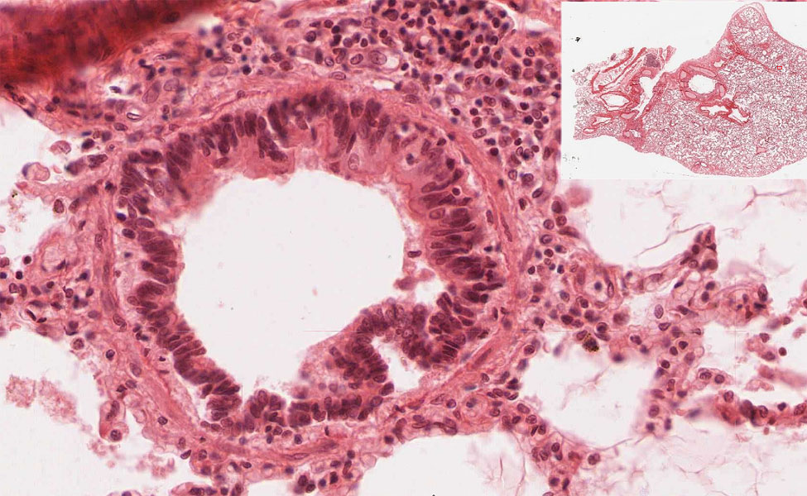
UMich #130-1: Lung
Bronchiole:
ciliated and non-ciliated exocrine “club” cells, no goblet cells, no cartilage, no glands
ciliated cells
non-ciliated “club” cells
smooth muscle
slide courtesy of Dr. Sun-Kee Kim, University of Michigan

Slide 27
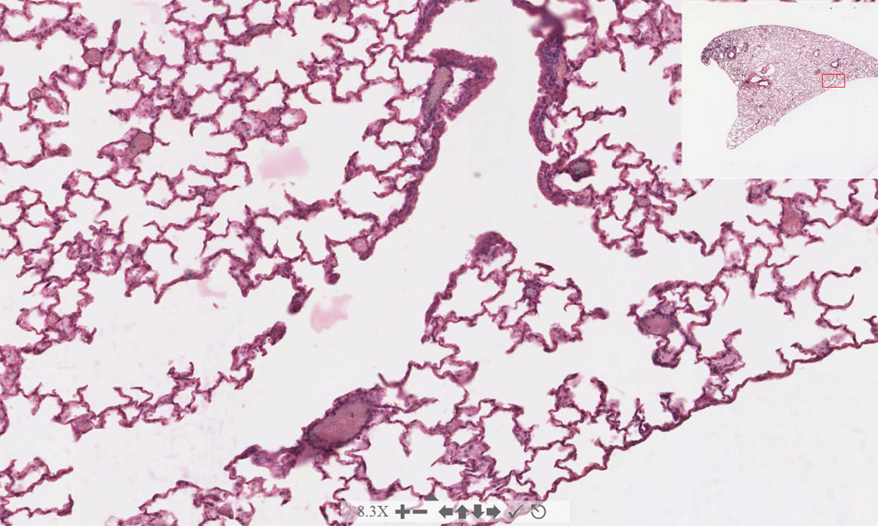
UMich #129: Lung
respiratory bronchiole
alveolar duct
alveolar duct
slide courtesy of Dr. Sun-Kee Kim, University of Michigan

Slide 28
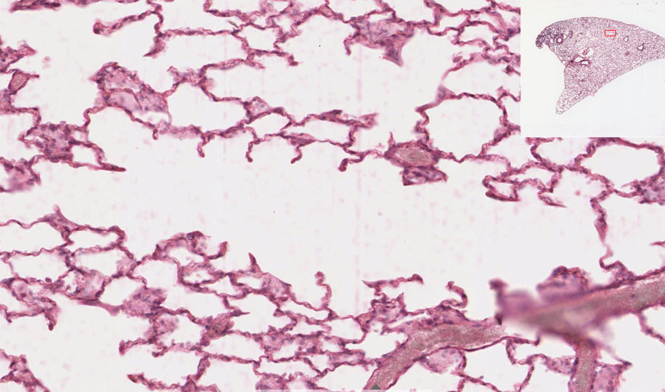
UMich #129: Lung
Alveolar duct
alveoli
slide courtesy of Dr. Sun-Kee Kim, University of Michigan

Slide 29
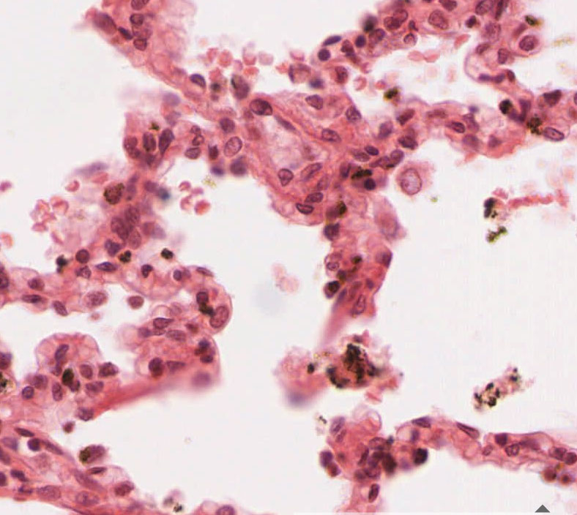
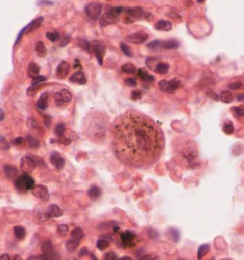
UMich #130-1 Lung
Type I Pneumocyte
Macrophage
Type II Pneumocyte
slide courtesy of Dr. Sun-Kee Kim, University of Michigan

Slide 30
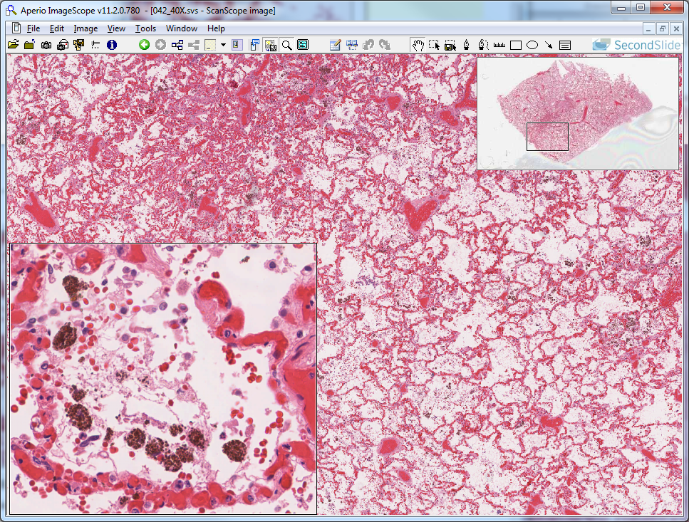
Slide UMich 42: Lung, chronic congestion – hemosiderin-laden macrophages
c
lung alveolar
air space
t2p
hemosiderin-laden macrophages
Notes:
c=distended capillary t2p=type II pneumocyte

Slide 31
Answers to “unknowns” on slide 28

Slide 32
Slide 0028: lung
1? - Bronchus
surrounding tissue –LUNG
epithelium – PSEUDOSTRAT W/ GOBLET CELLS
cartilage –PLATES OF CARTILAGE
smooth muscle –YES, SURROUNDING LUMEN
glands –YES

Slide 33
Slide 0028
2? –another bronchus
3? –pulmonary artery
Notes:
for #2 – surrounded by lung tissue; epithelium is pseudostratified with goblet cells; there is a single chip of cartilage and there are some submucosal glands, so it’s another bronchus
for #3 – epithelium is simple squamous

Slide 34
Slide 0028
5? - bronchiole
Seromucous gland
4? –yet another bronchus
Notes:
for #4 – surrounded by lung tissue; epithelium is pseudostrat. w/ goblet cells; no cartilage BUT there are glands (as shown by the “hint”), so it is yet another bronchus
for #5 – surrounded by lung tissue, epithelium is simple columnar ciliated w/ exocrine “club” cells

Slide 35
Slide 0028
6? –respiratory bronchiole
Notes:
for #6 – surrounded by lung tissue; epithelium is simple columnar to cuboidal with mostly exocrine “club” cells, interrupted by alveoli

