Slide 1
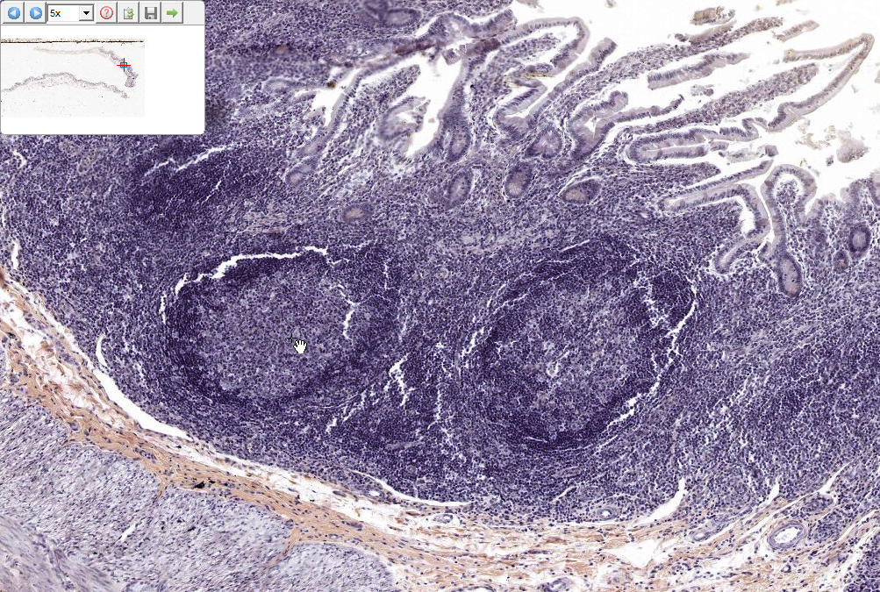
Slide 0060: Ileum
Secondary
nodule

Slide 2
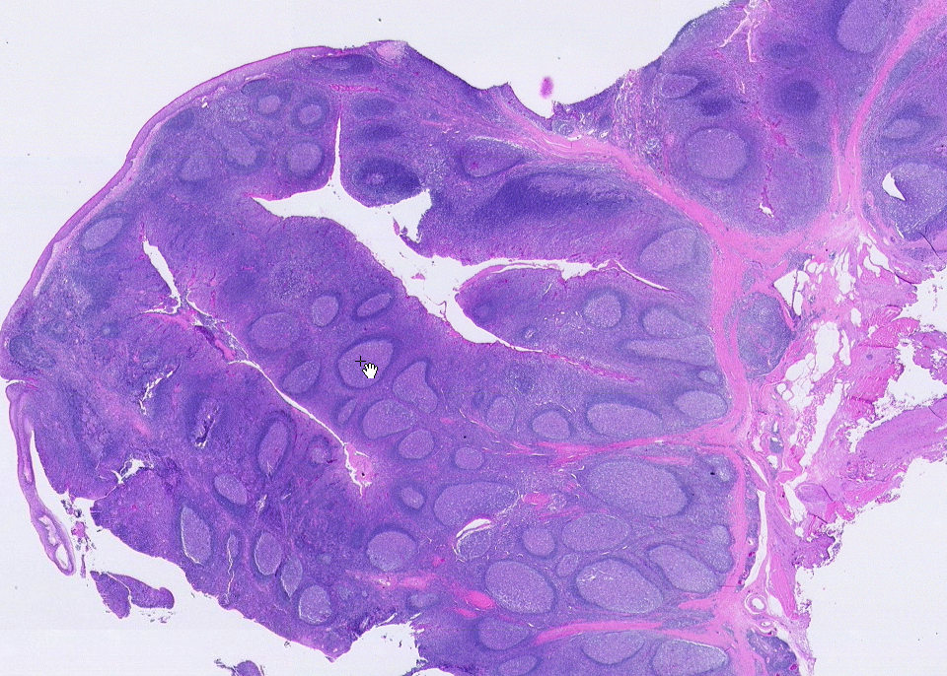
Slide 0034: Tonsil
strat. sq. epith.
partial CT capsule
SSE-lined crypt
lymph nodules

Slide 3
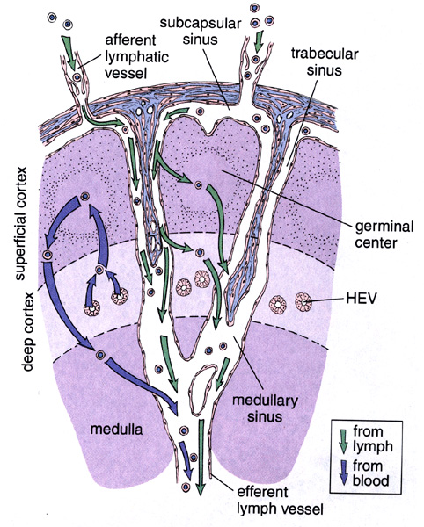
Direction of lymph flow through a lymph node
Afferent lymphatic vessel
Subcapsular sinus
Trabecular or perinodular sinus
Medullary sinus
Efferent lymphatic vessel
Thoracic duct
Left subclavian vein
General circulation
Ross and Pawlina, p. 419

Slide 4
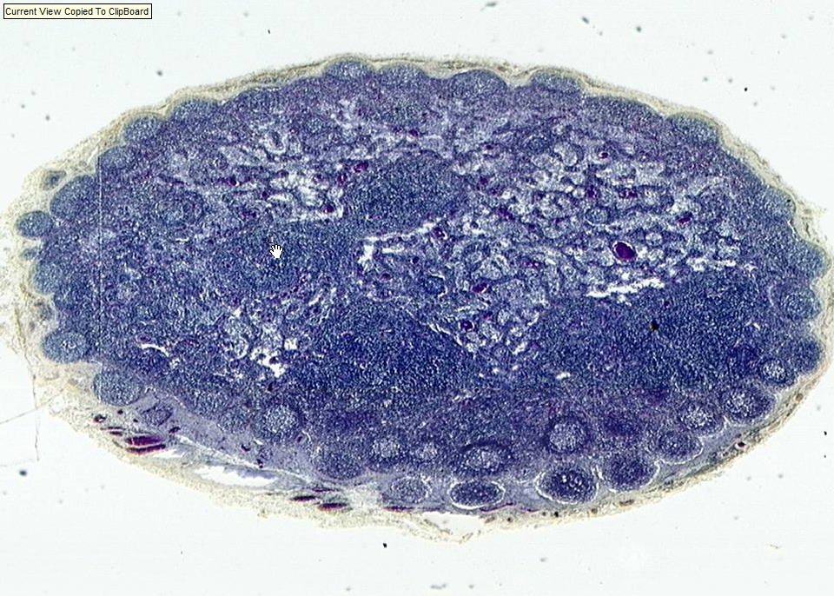
Slide 0077: lymph node
medullary cord (darker)
medullary sinus (lighter)
medulla
deep cortex
cortex
capsule
sub-capsular sinus

Slide 5
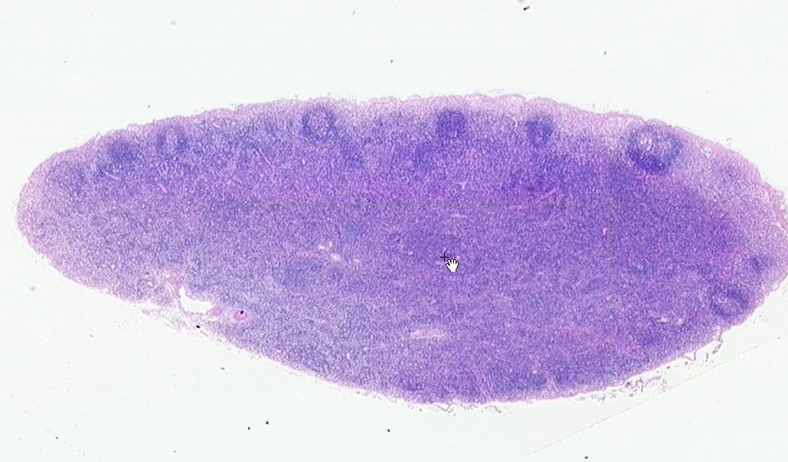
Slide 0029: lymph node
secondary follicle
capsule
cortex
deep cortex
medulla
hilus
s
c
Notes:
c=cord s-=sinus
(note: the cords and sinuses are not easy to see, but it’s probably easier to spot the cords, which will contain a higher density of cells –the sinuses contain fewer cells and surround the cords.)

Slide 6
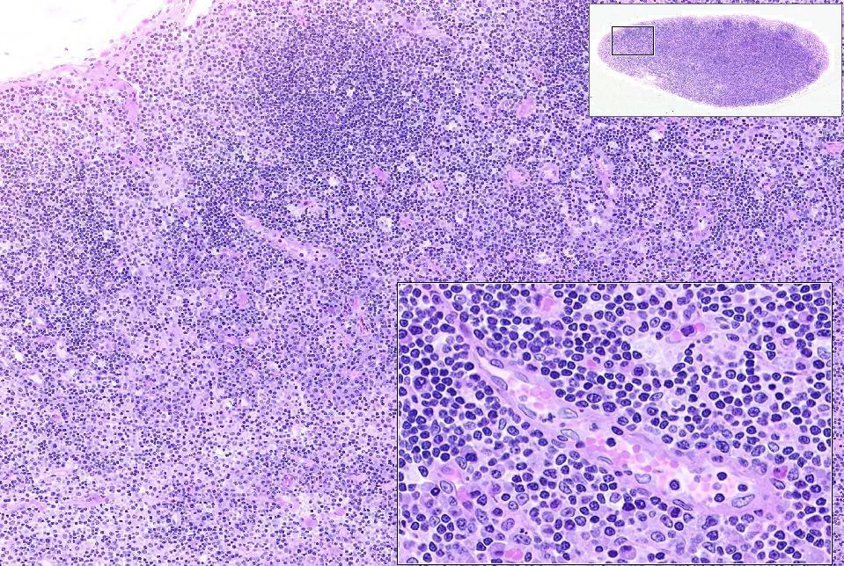
Slide 0029: lymph node
cortex
primary follicle
“deep” cortex (paracortex)
“high endothelial” venule
(postcapillary venule)

Slide 7
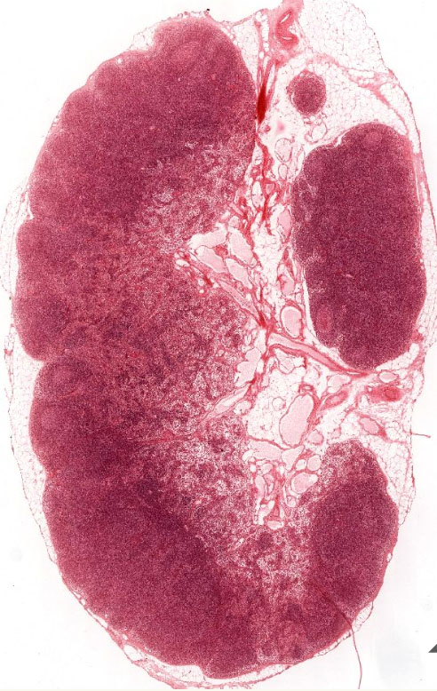
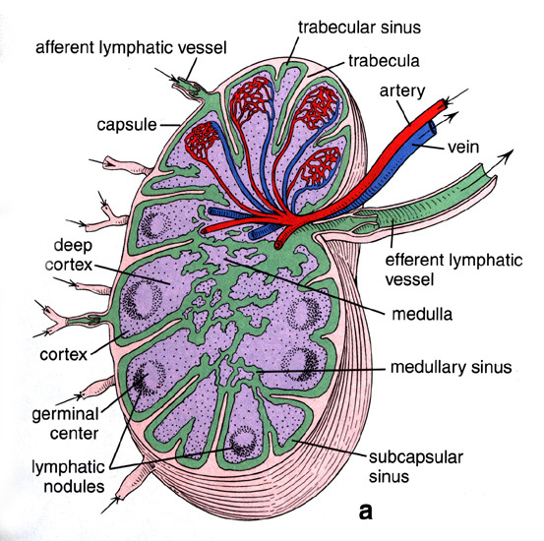
UMich Slide 27: lymph node
Ross and Pawlina, fig. 14.17
#27 Lymph node
Hilus
Cortex
Medulla

Slide 8
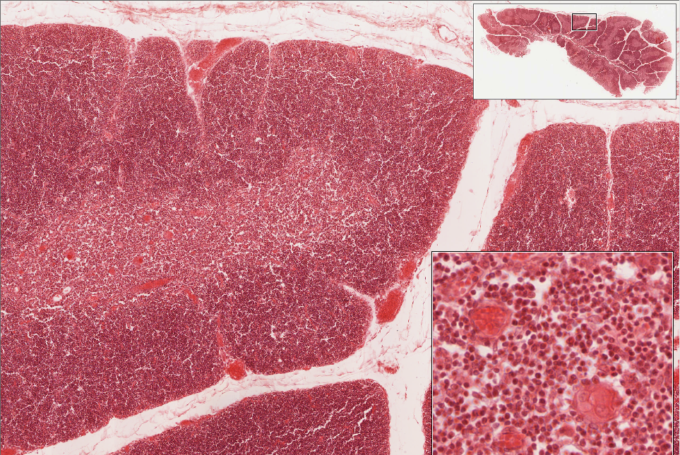
Slide 0311_E: neonatal thymus, H&E
septum
cortex
medulla
ERC
BV
HC
Notes:
BV=blood vessel ERC=epithelial reticular cell HC=Hassal’s corpuscle

Slide 9
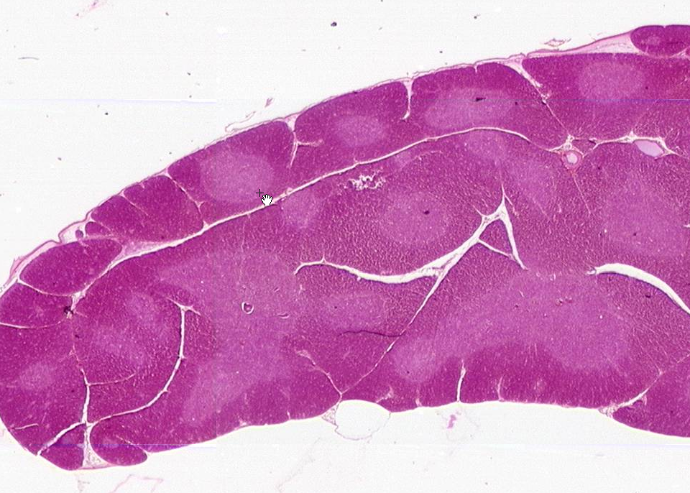
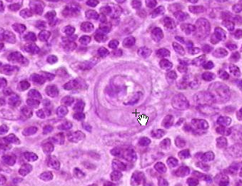
Slide 0046: young thymus
(not listed in online lab manual, but also a good example –access via the links below)
[ImageScope] [WebScope]
cortex
medulla
Hassal’s corpuscle in medulla
medulla
cortex

Slide 10
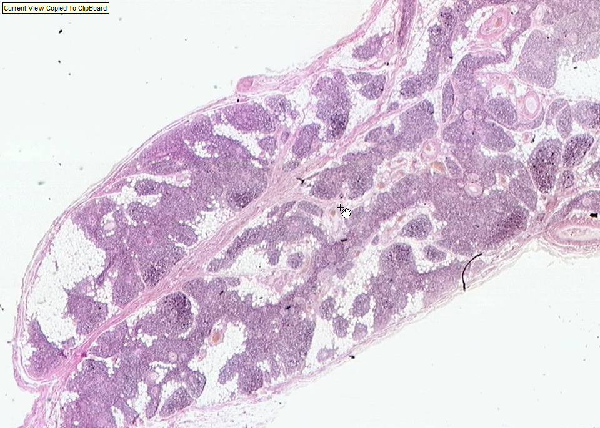
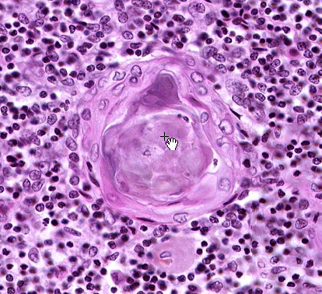
Slide 76: involuted thymus
Hassal’s corpuscle
medulla
cortex

Slide 11
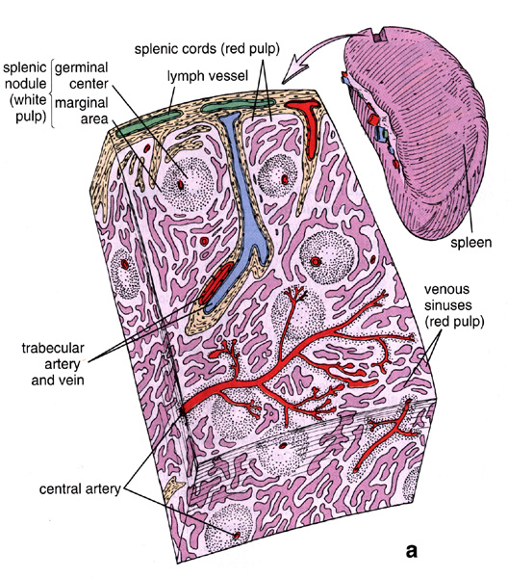
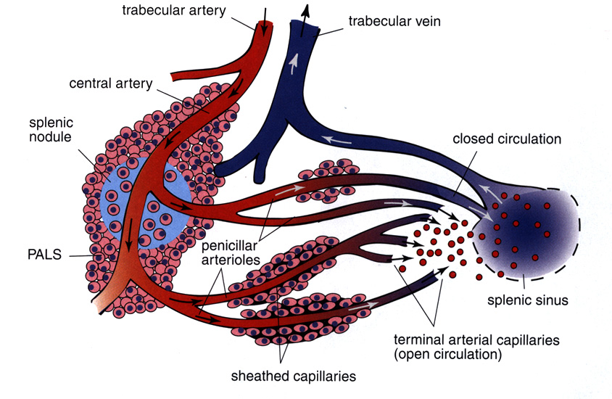
Splenic Circulation
Splenic artery
Splenic vein
PALS: Periarterial (periarteriolar) lymphatic sheath

Slide 12
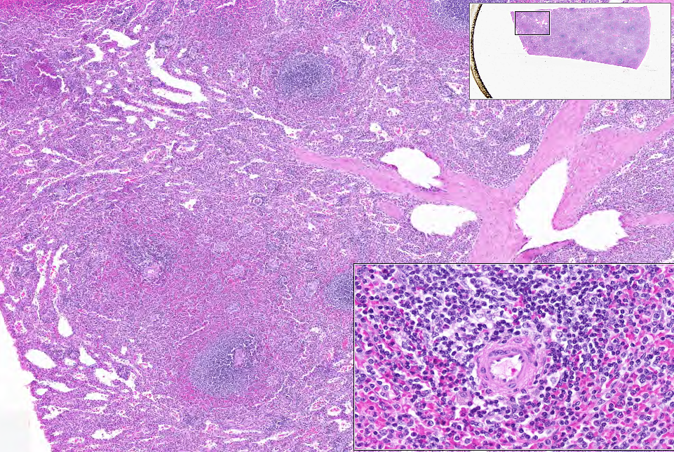
Slide 0003_E: Spleen, human, H&E
PALS
SS
CA
CB
trabecular
vein
trabecula
PALS
PALS
CA
CA
CA
PALS
Notes:
CB=Splenic cords (of Bilroth) PALS=periarterial lymphatic sheath SS=splenic sinus TV=trabecular vein

Slide 13
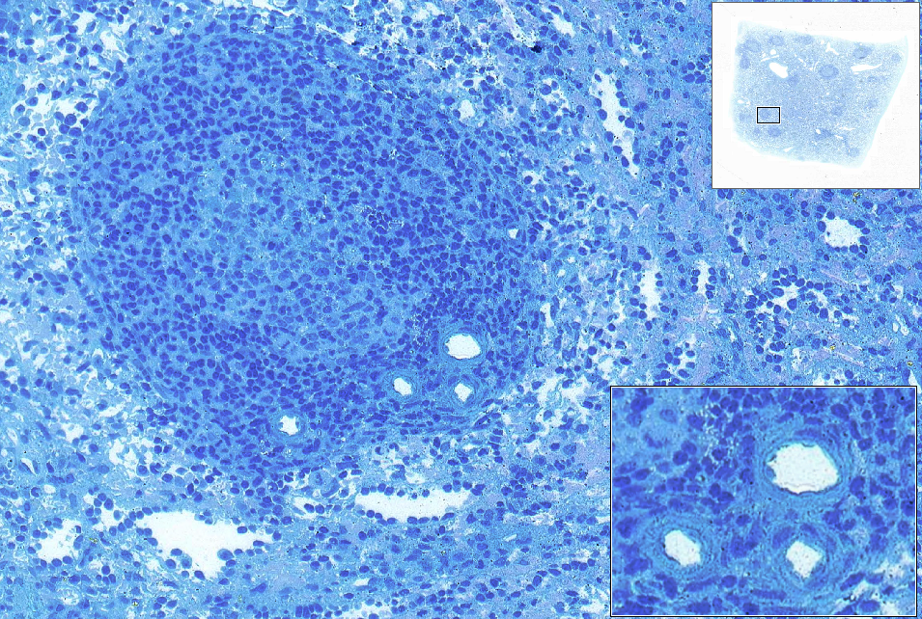
Slide 0025_E: spleen, AF-TB
GC
CA
CA
CA
Central Arteries
CA
SS
SS
CB
Notes:
CA=central artery CB=splenic cord (of Bilroth) GC=germinal center SS=splenic sinus

Slide 14
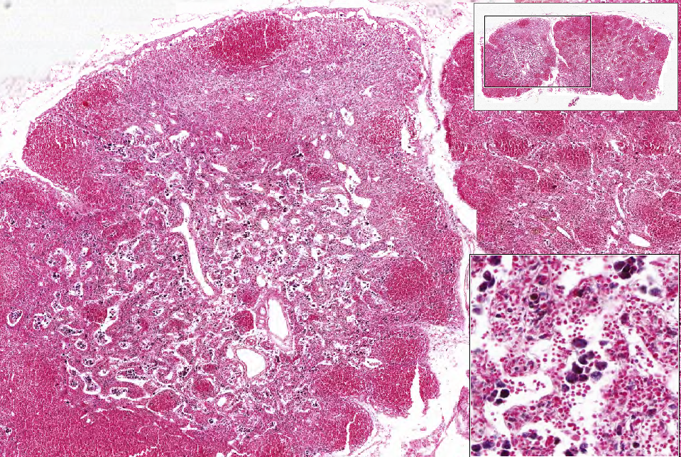
Slide 0073L_E: lymph node, rabbit, trypan blue infused
sc sinus
follicle
cortex
medulla
macrophages
MS
MC
Notes:
MC=medullary cord MS=medullary sinus

Slide 15
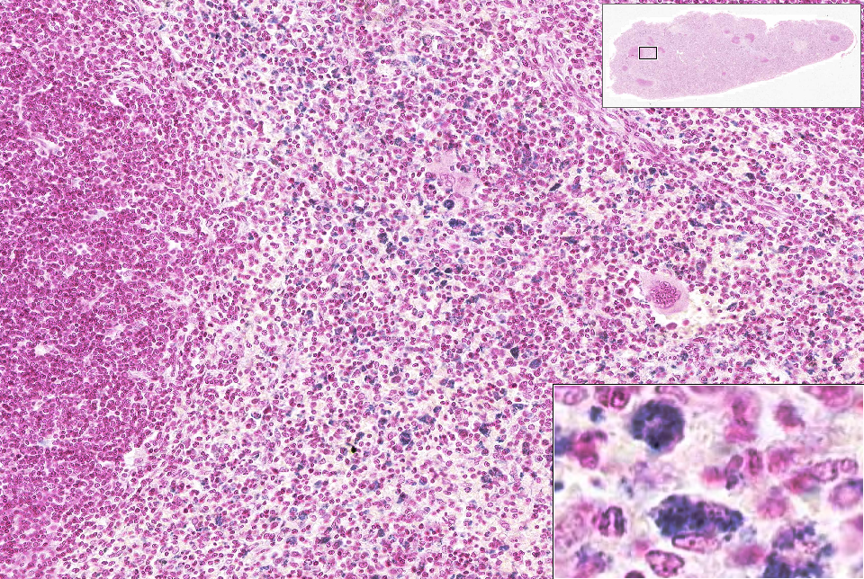
Slide 0073L_S: spleen, rabbit, Trypan Blue infused
red pulp
megakaryocyte
PALS
(white pulp)
“marginal zone”
macrophages

