Slide 1
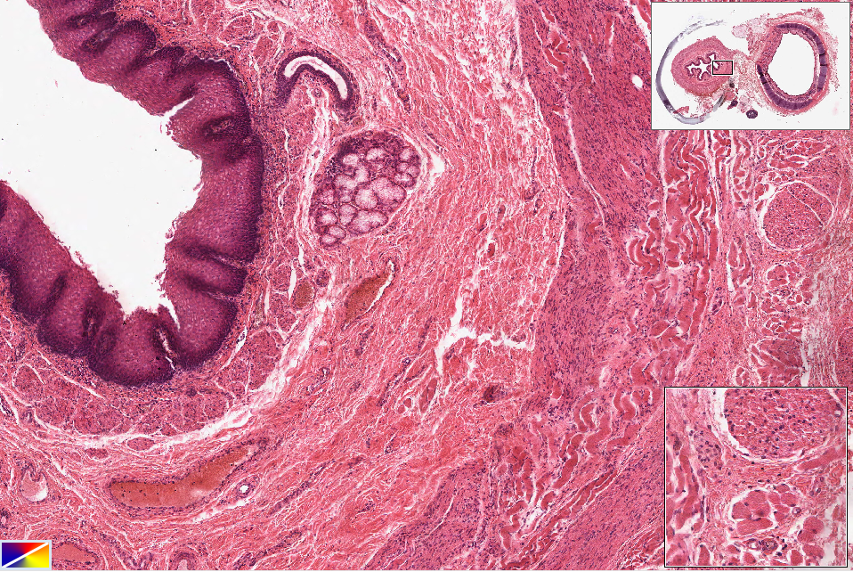
Slide UCinn_3788: Esophagus, human, Masson trichrome
duct
mm
smg
sse
sm
ic
ol
sm muscle
skel muscle
Notes:
ic=inner circular muscle mm=muscularis mucosae ol=outer longitudinal muscle
sm=submucosa smg=submucosl gland sse=strat sq epith

Slide 2
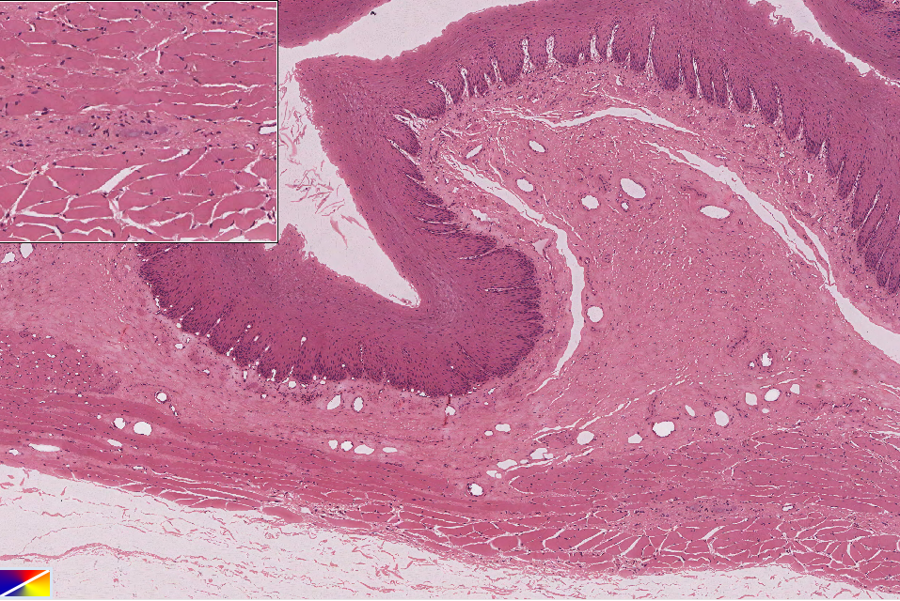
Slide VCU_106: Esophagus, human, H&E
skel m.
myenteric plexus & ganglia
skel m.
sm
sse
mucosa
lp
mm
ic
ol
Notes:
ic=inner circular muscle lp=lamina propria mm=muscularis mucosae ol=outer longitudinal muscle
sm=submucosa smg=submucosl gland sse=strat sq epith

Slide 3
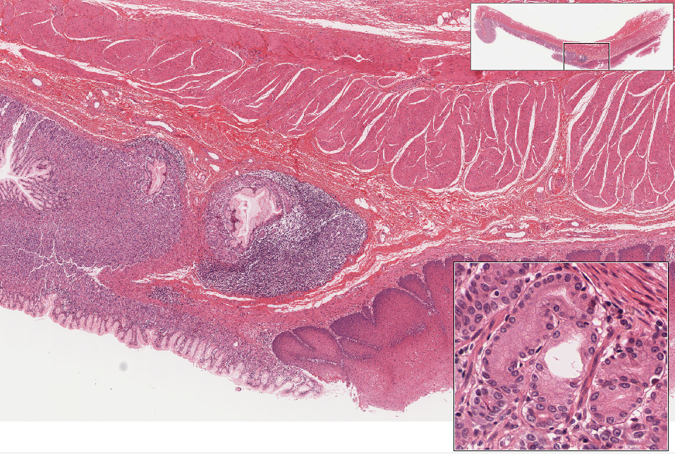
Slide UMich_155: gastro-esophageal junction, human, H&E
ol
ic
sm
ly nodule
cardiac glands
mm
lp
sse
gastric pits
stomach
esophagus
Notes:
ic=inner circular muscle mm=muscularis mucosae ol=outer longitudinal muscle
sm=submucosa smg=submucosl gland sse=strat sq epith

Slide 4
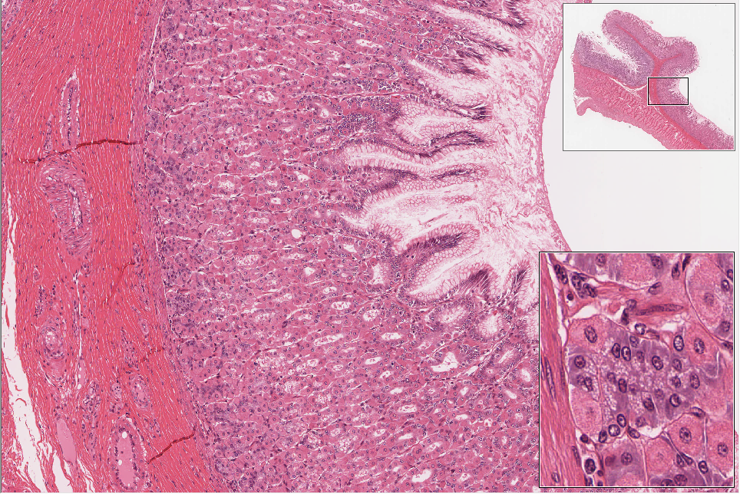
Slide UMich_156: stomach, fundus, human, H&E
sub muc
musc
muc
pit
fundic glands
cc
pc
Notes:
cc=chief cells pc=parietal cell
in thumbnail: muc=mucosa (folded into rugae) sub muc=submucosa (note that it extends into the rugae) musc=muscularis externa

Slide 5
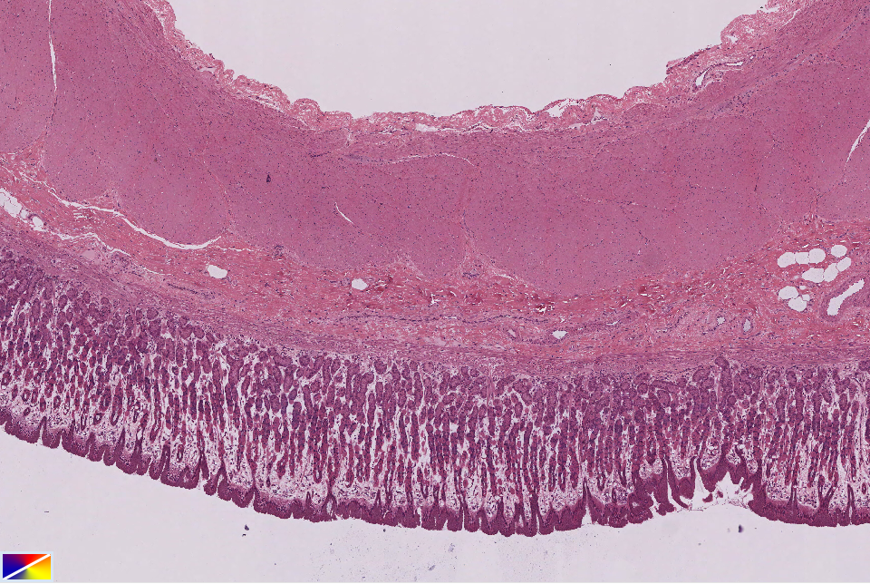
Slide VCU_113: stomach, corpus, H&E
serosa
ol
ic
submucosa
musc. mucosa
glands
mucosa
pits
Notes:
ic=inner circular muscle ol=outer longitudinal muscle

Slide 6
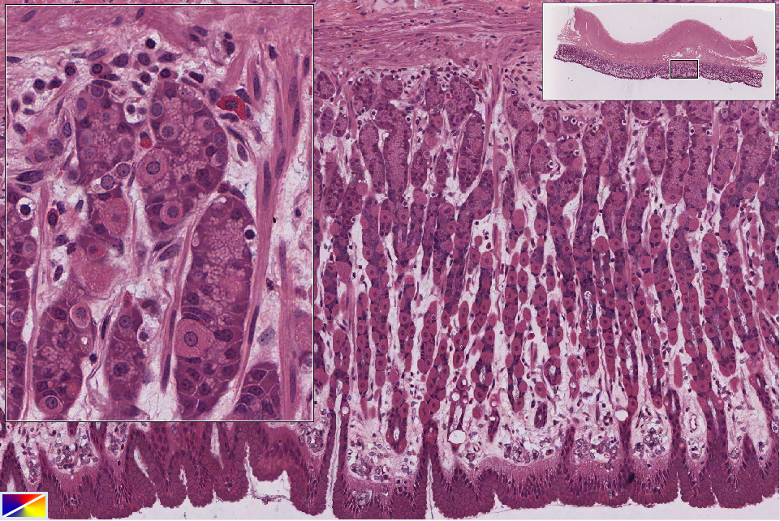
Slide VCU_113: stomach, corpus, H&E
plc
mc
fundic glands
cc
pc
eec
mnc
neck region
lamina propria
gastric pit
Notes:
cc=chief cells eec=enteroendocrine cell mc= mast cell (note GRANULES and stippled nucleus)
mnc=mucous neck cells pc=parietal cell plc=plasma cell (note agranular cytoplasm and clockface nucleus)

Slide 7
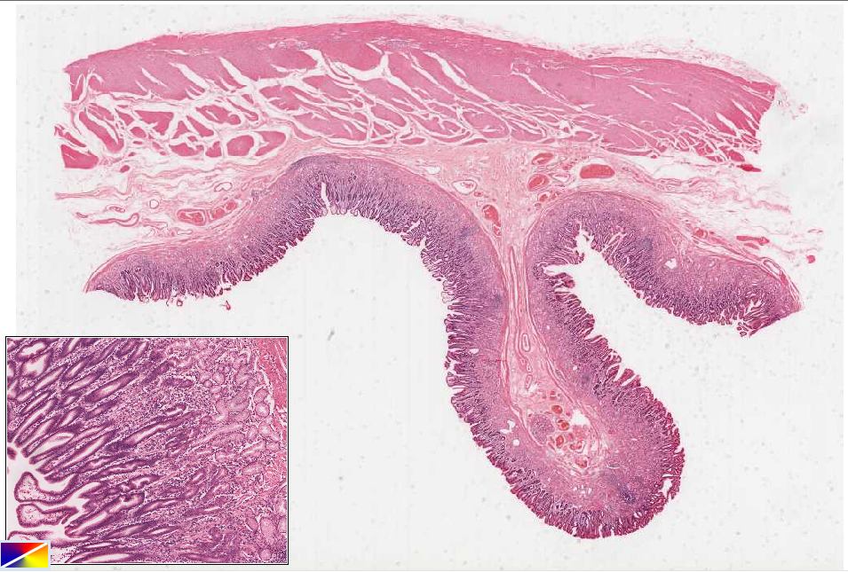
Slide 0080_J: stomach, pylorus, human, Mallory-azan
myenteric ganglia
ol
ic
submucosa
pyloric glands
pits
ruga
pyloric glands
pits
Notes:
ic=inner circular muscle ol=outer longitudinal muscle

Slide 8
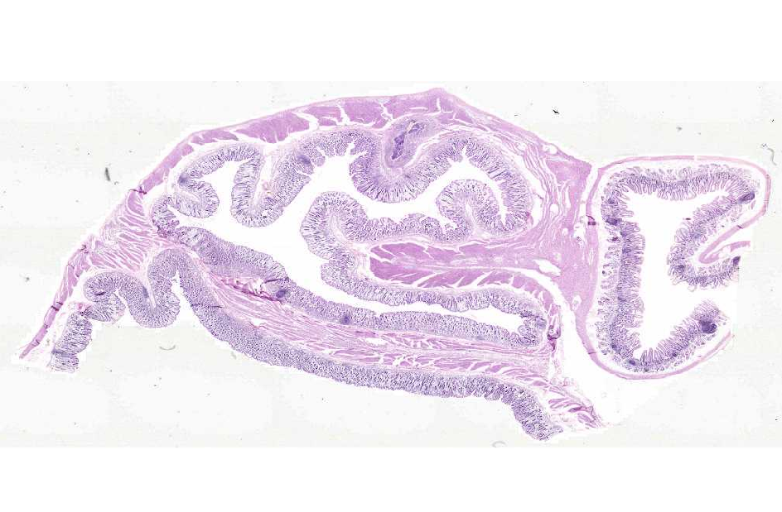
Slide 0081_J: pylorus & duodenum, monkey, H&E
pylorus
duodenum

Slide 9
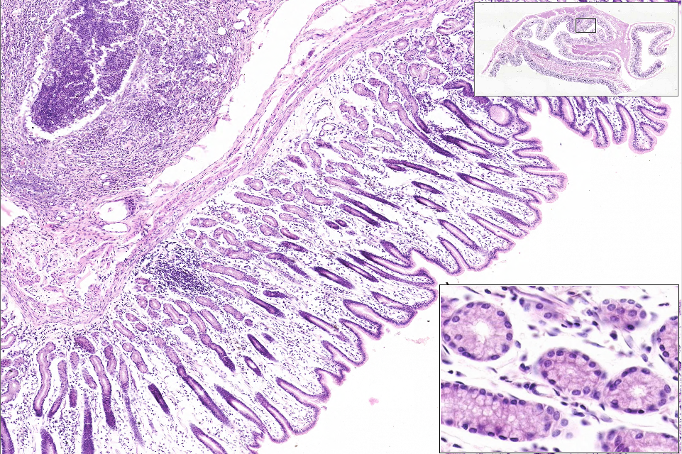
Slide 0081_J: pylorus & duodenum, monkey, H&E
mm
glands
pits
Notes:
mm=muscularis mucosae

Slide 10
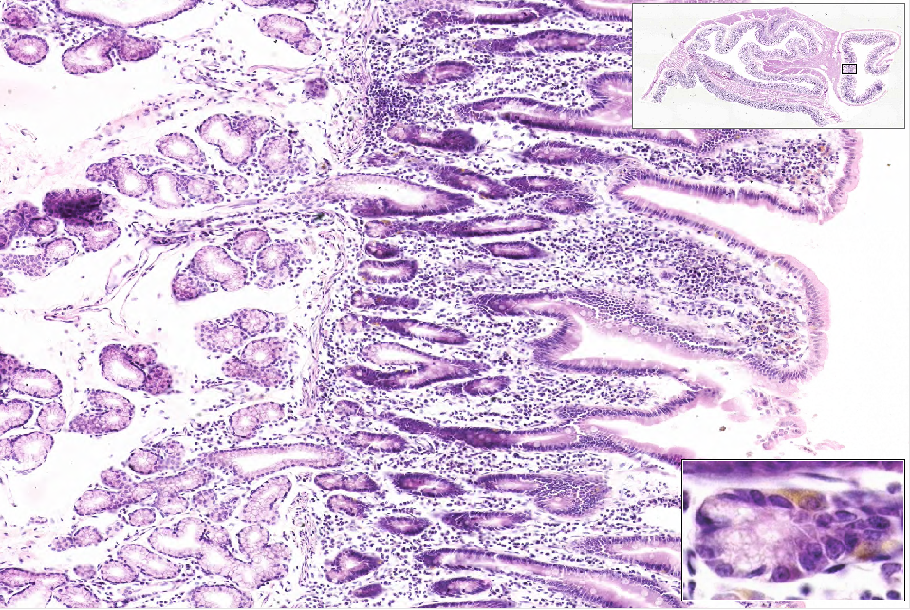
Slide 0081_J: pylorus & duodenum, monkey, H&E
submucosal glands
crypts
lp
villus
submucosa
mm
enteroendocrine cell
Notes:
lp=lamina propria mm=muscularis mucosae

Slide 11
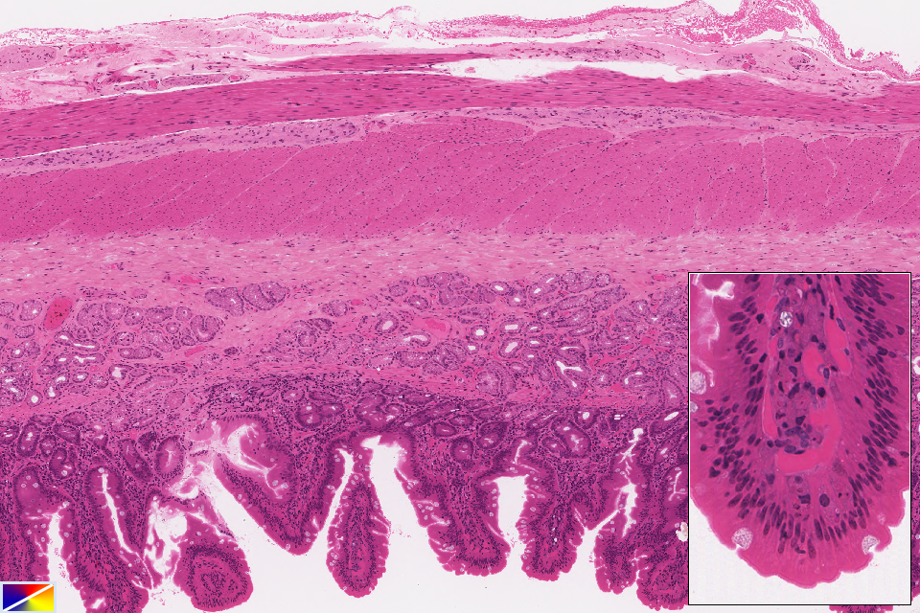
Slide UMiss_092: duodenum, H&E
serosa
ol
mp&g
ic
submucosa
smg
mm
lacteal
crypts
villi
Notes:
ic=inner circular muscle ln=lymph nodule mm=muscularis mucosae
mp&g=myenteric plexus & ganglia ol=outer longitudinal muscle smg=submucosal glands (of Brunner)

Slide 12
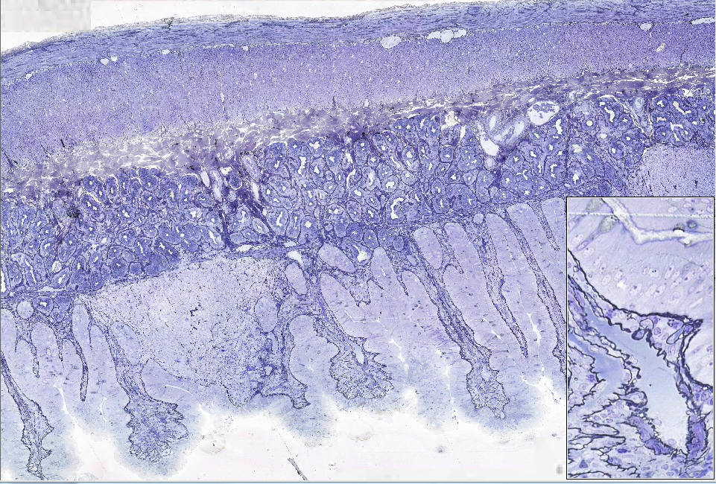
Slide 0010_J: duodenum, loris, AF-TB-reticulin (basement membranes stain BLACK)
serosa
ol
mp&g
ic
submucosa
smg
mm
crypts
ln
villi
lacteal
Notes:
ic=inner circular muscle ln=lymph nodule mm=muscularis mucosae
mp&g=myenteric plexus & ganglia ol=outer longitudinal muscle smg=submucosal glands (of Brunner)

Slide 13
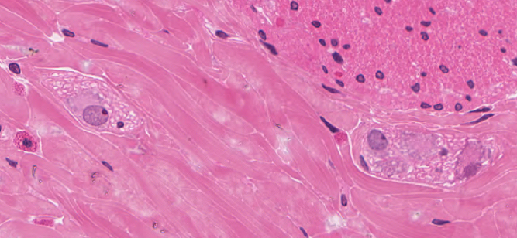
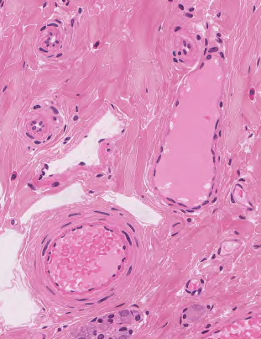
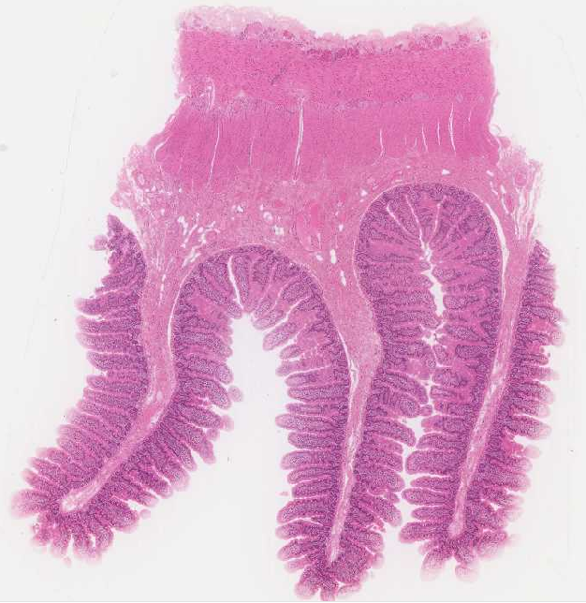
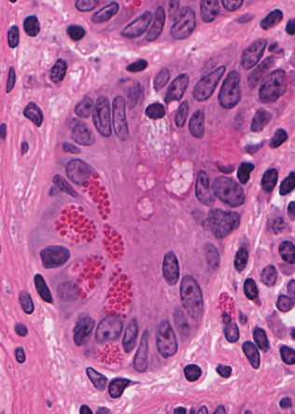
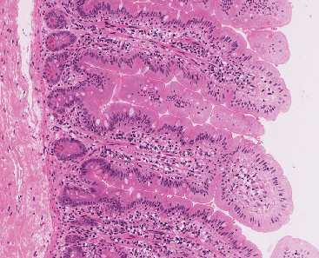
Slide UMiss_142: jejunum, H&E
sm plexus & ganglia
ol
lymphatic
vessel
mp&g
ic
submucosa
crypt
Pc
mucosa
eec
plica (mucosal fold)
crypts
sm
villi
mm
Notes:
eec=enteroendocrine cell ic=inner circular muscle mm=muscularis mucosae
mp&g=myenteric plexus & ganglia ol=outer longitudinal mucle Pc=Paneth cells

Slide 14
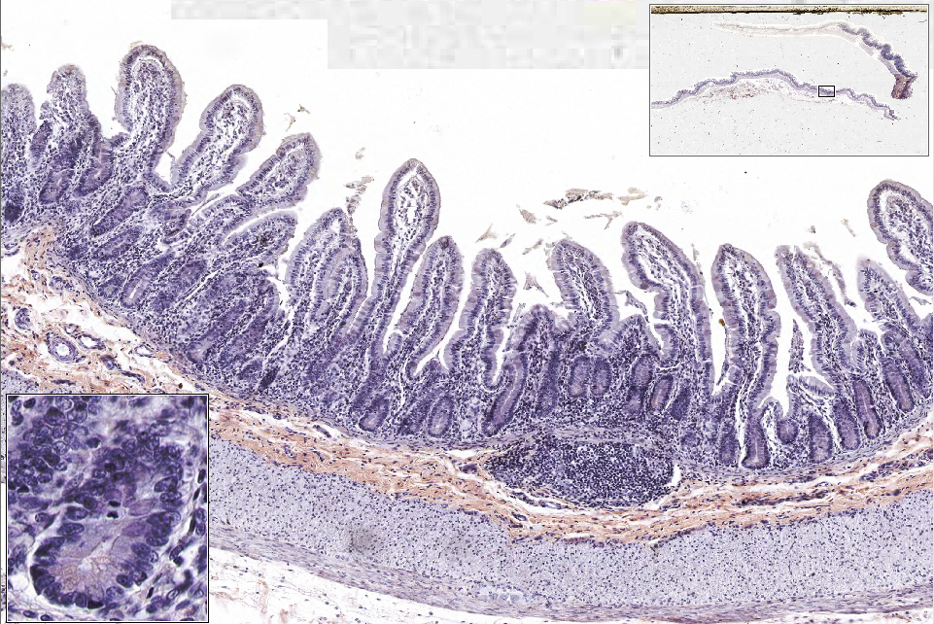
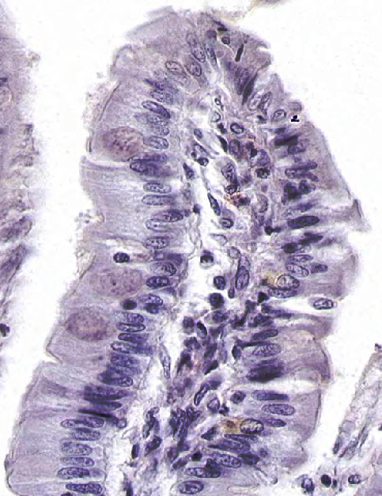
Slide 0060A_J: ileum, human, H&E (+chrome alum?)
villi
crypts
mitotic figure
mm
ly nodule
submucosa
gc
ic
eec
Pc
ol
mp&g
Notes:
eec=enteroendocrine cell ic=inner circular muscle mm=muscularis mucosae
mp&g=myenteric plexus & ganglia ol=outer longitudinal mucle Pc=Paneth cells

Slide 15
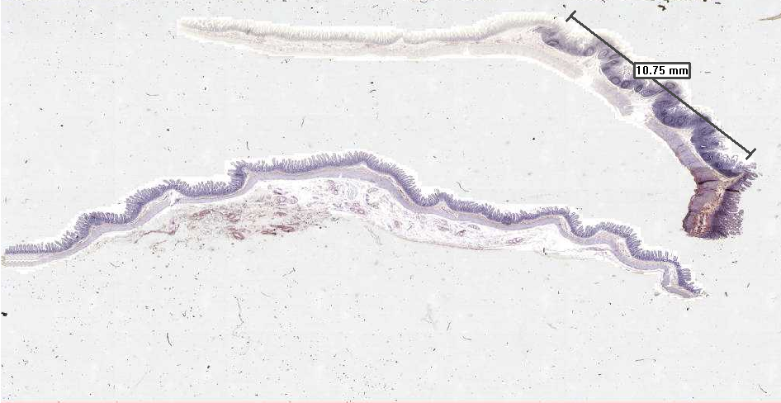
Slide 0060A_J: ileum, human, H&E (+chrome alum?)
Peyer’s patch

Slide 16
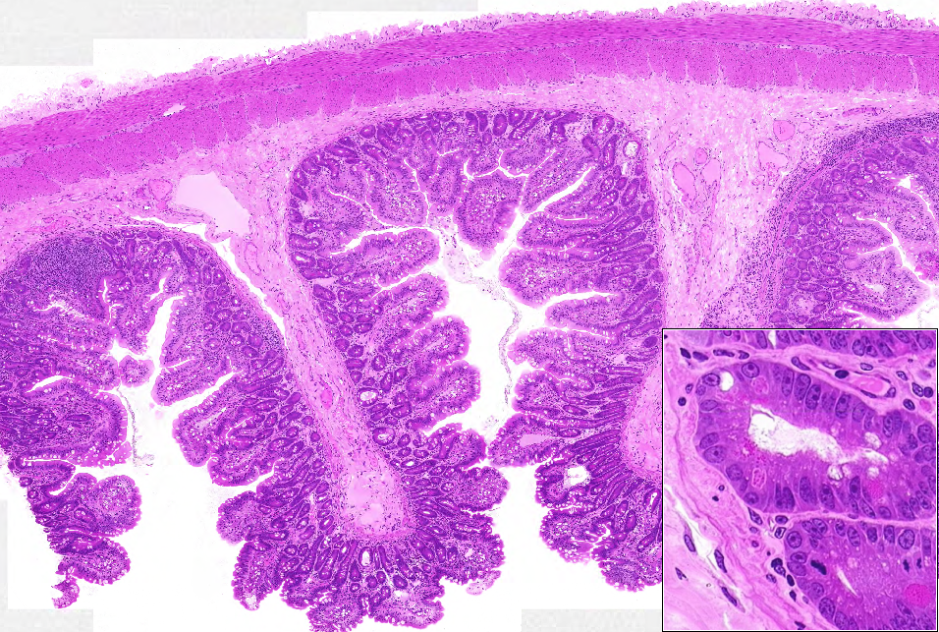
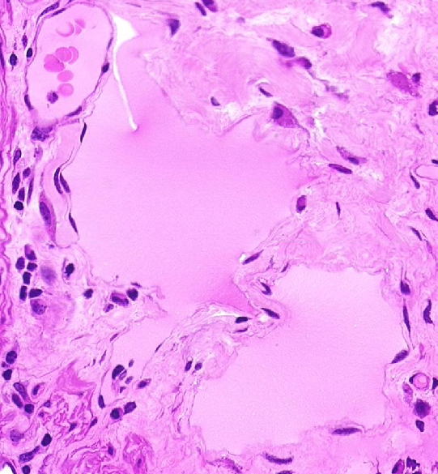
Slide 0032_J: ileum, monkey, H&E
serosa
ol
mp&g
ic
submucosa
lymphatic vessel
villus
crypts
lymphatic vessel
Pc
lymphatic vessel
mf
Notes:
ic=inner circular muscle mf=mitotic figure mm=muscularis mucosae
mp&g=myenteric plexus & ganglia ol=outer longitudinal mucle Pc=Paneth cells

Slide 17
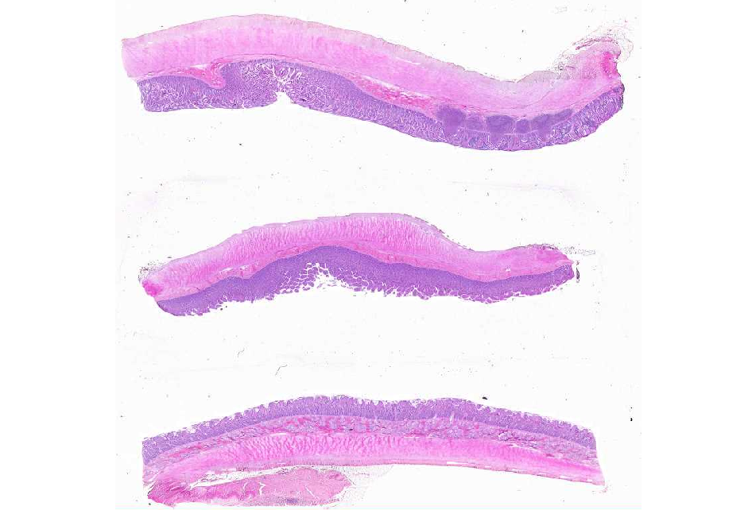
Slide 0096_J: duodenum, jejunum, ileum, human, H&E
?
?
?

Slide 18
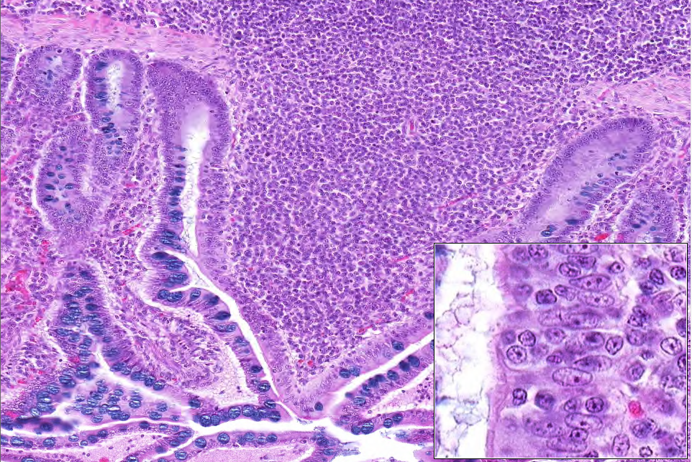
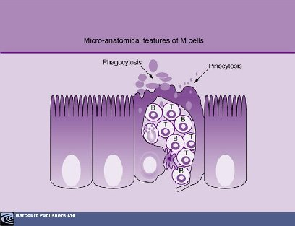
Slide 0096_J: duodenum, jejunum, ileum, human, H&E
mm
lymph nodule
M cell (outlined)
gc
Notes:
gc=goblet cell

Slide 19
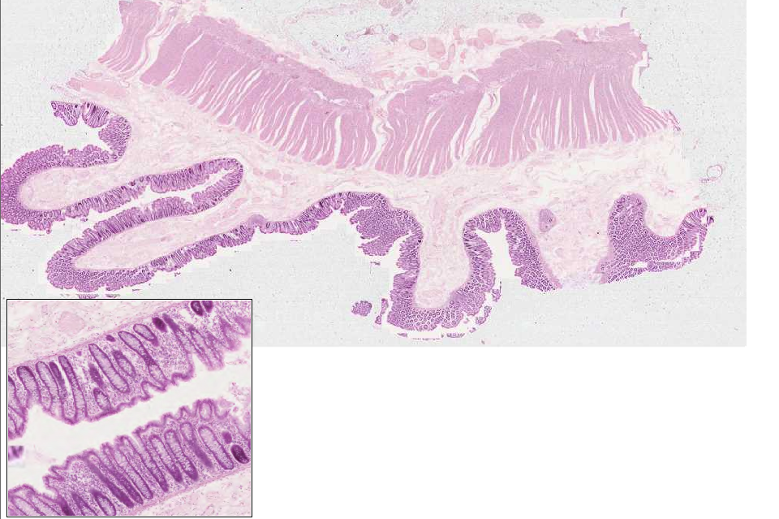
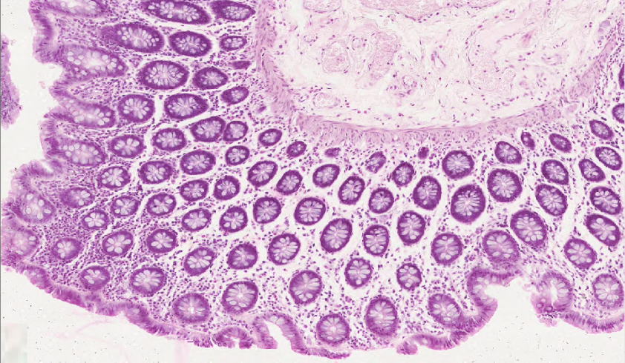
Slide 0303_J: colon, rat, H&E
mp&g
ol
ic
submucosa
mm
crypts
mm
crypts
crypts
mm
Notes:
ic=inner circular muscle mm=muscularis mucosae
mp&g=myenteric plexus & ganglia ol=outer longitudinal mucle

Slide 20
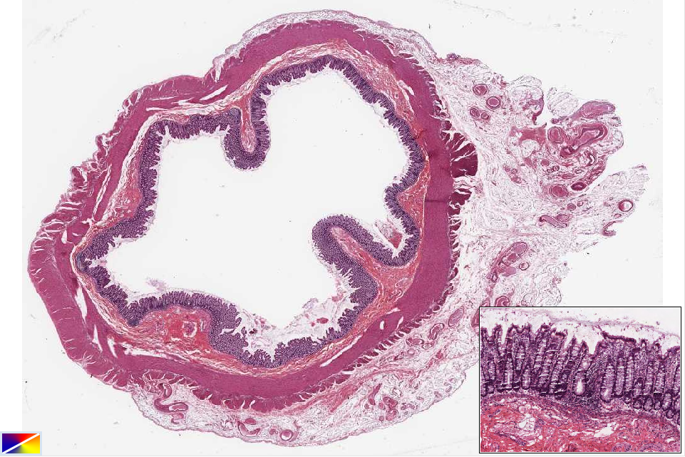
Slide 38548: colon, human, H&E
ol*
ic
ic
ol*
mucosa
submucosa
mp&g
Notes:
ic=inner circular muscle mp&g=myenteric plexus and ganglia
ol=outer longitudinal muscle (note that this layer is attenuated in some areas and thickened in others, corresponding to the ‘taenia coli’ observed grossly)

Slide 21
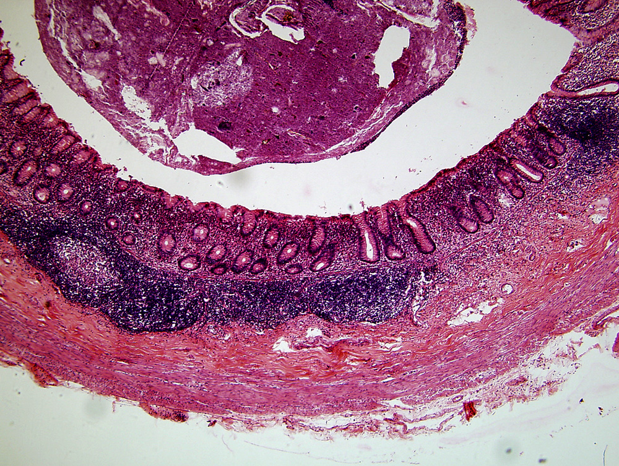
Slide UMich_175, appendix, H&E
debris in lumen
of appendix
epithelium and
lamina propria
muscularis mucosa
Lymph nodule (in submucosa)
submucosa
muscularis externa

Slide 22
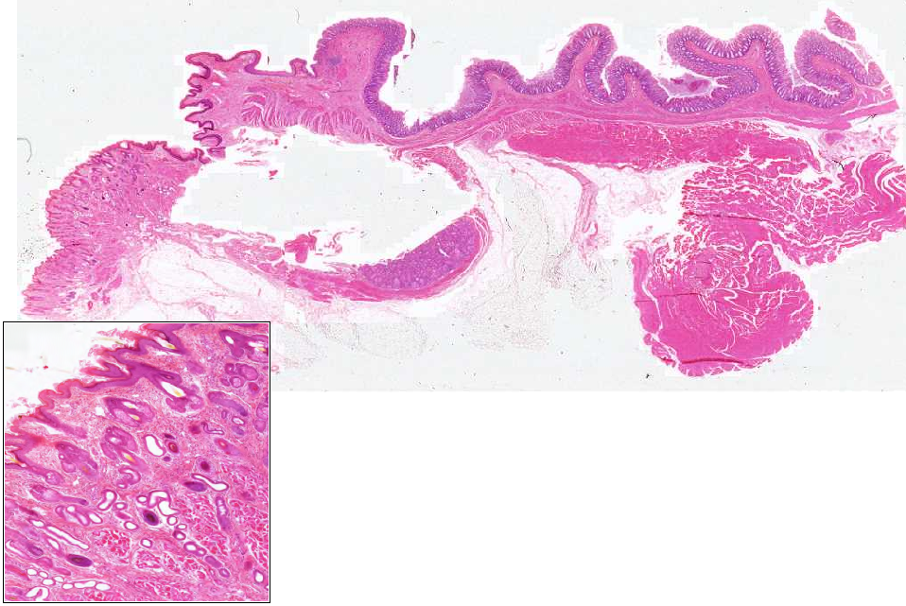
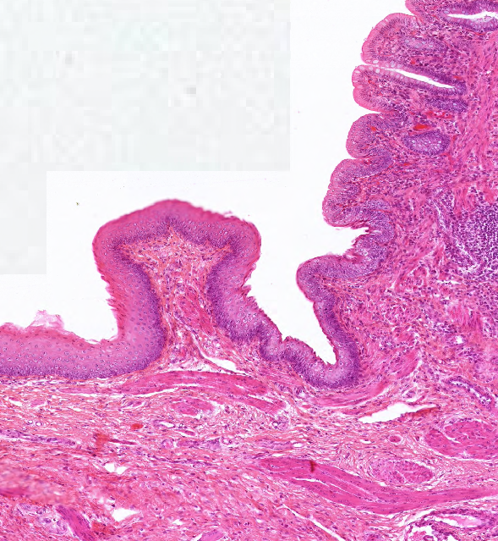
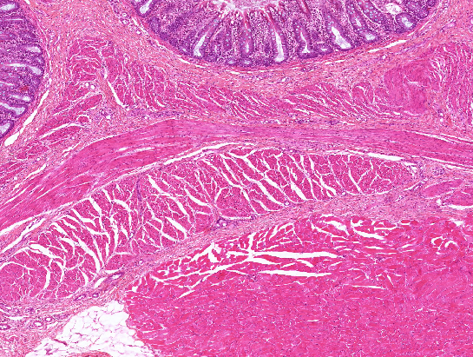
Slide 0093_J: Rectum and Anal junction, mammal, H&E
anus
rectum
fold of anal mucosa
sce
sske
hf&sg
hf&sg
ic
sse-nk
mp&g
ol
ias
hf
mm
apo
eas
hf
Notes:
apo=apocrine sweat glands eas=ext. anal sphincter (skel. musc.) sce=simple columnar epithelium hf=hair follicle
hf&sg=hair follicle & sebaceous gland ias=int. anal sphincter (sm. musc.) ic=inner circular muscle mm=muscularis mucosae
mp&g=myenteric plexus & ganglia ol=outer longitudinal muscle sse-nk=st. sq. epith. nonkeratinized sske=st. sq. epith. keratinized
Note: the tissue on the middle-bottom of the slide is a fold of anal mucosa viewed face-on –don’t worry trying to make too much sense of it (the main point is that it is NOT a specific gland or structure of interest in this region).

