Slide 1
Salivary Glands: Key Features
(from Dr. Carbrey’s notes)
Distinguished by the cell type in the acini
secretory cells surrounded by myoepithelial cells
plasma cells outside of acini
ducts:
  intercalated – lead from the acini, s. cuboidal
  striated – s. col., not found in sublingual
  excretory – lead out of gland, pseudo st. col, st. cub, or st. col
Parotid – serous acini, has fat and CT septae throughout gland
Submandibular (submaxillary) – mostly serous w/ some sero/mucous acini
Sublingual – mostly mucous acini but some sero/mucous acini
no striated ducts

Slide 2
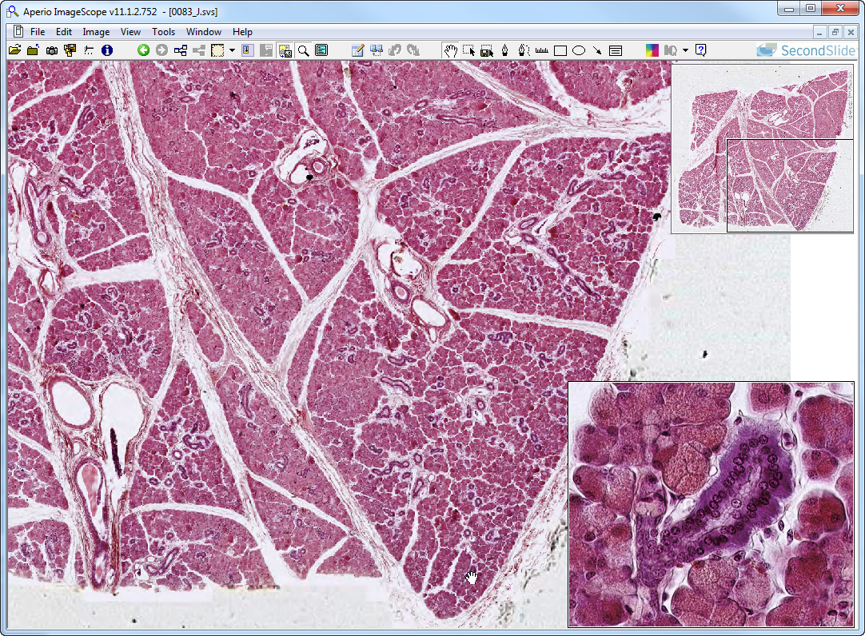
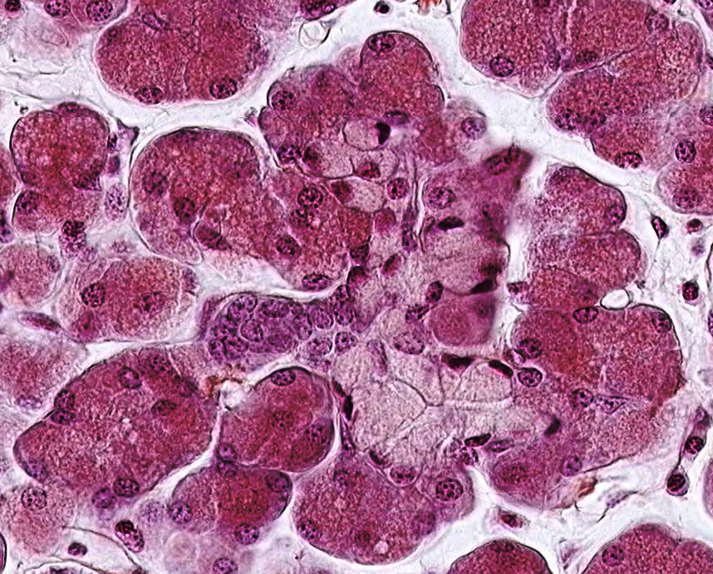
Slide 83: Submandibular gland, Mallory-PA-H
IELD
septum
lobule
Ser
ICD
StrD
Muc
ICD
Muc
Ser
Notes:
IELD=INTERlobular duct ICD=intercalated duct (intralobular) Muc=mucous cells Ser=serous cells
StrD=striated duct (intralobular)

Slide 3
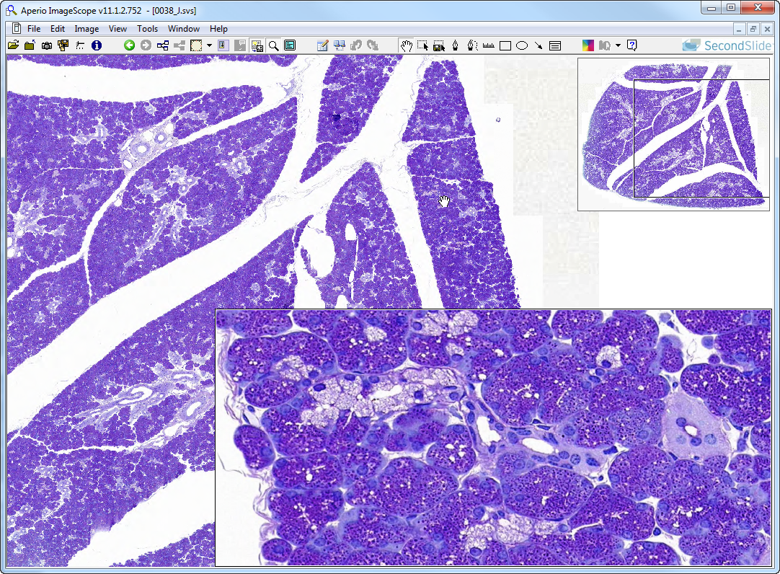
Slide 38: submandibular gland, AF-TB
IELD
lobule
septum
Muc
StrD
Ser
ICD
myoE
Notes:
IELD=INTERlobular duct ICD=intercalated duct (intralobular) Muc=mucous cells myoE=myoepithelial cell
Ser=serous cells StrD=striated duct (intralobular)

Slide 4
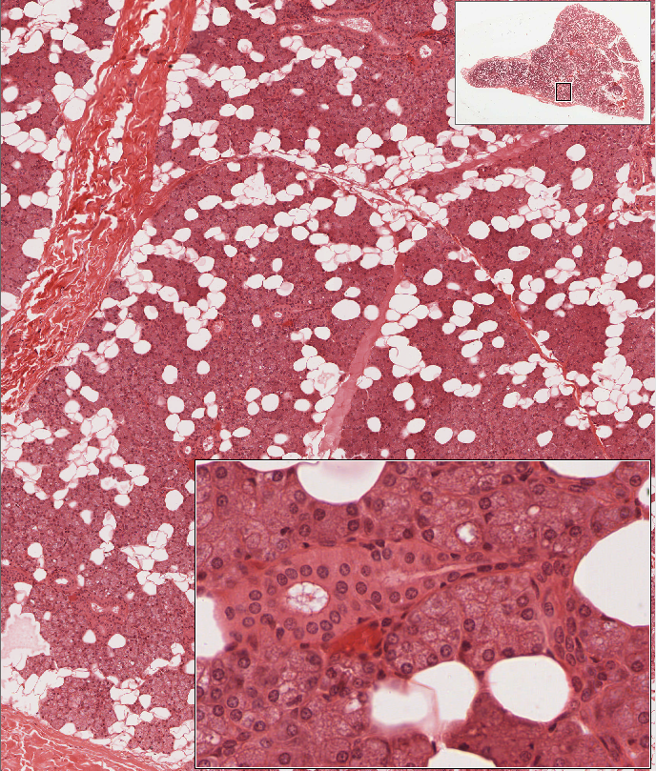
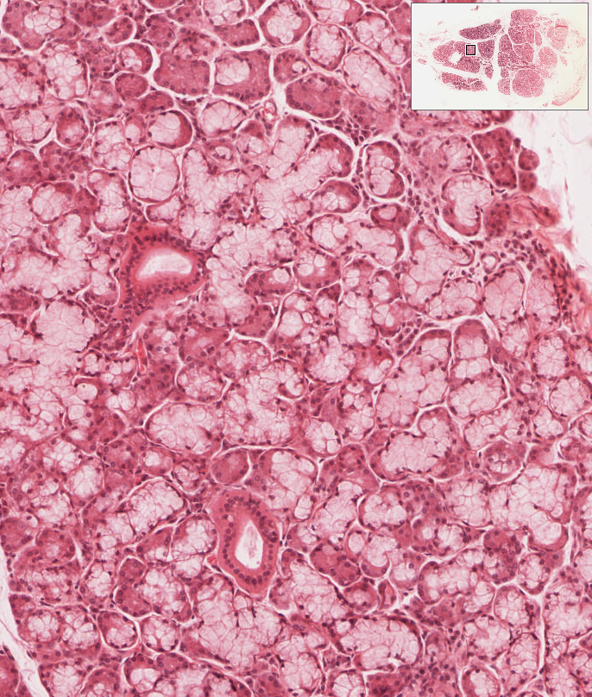
Salivary Gland “Extra Slides”
UMich 185-2, Sublingual Gland
mostly mucous acini (some pure mucous, some w/ serous demilunes); some serous acini
intercalated portion of intralobular ducts very short and therefore not seen very frequently; remaining portion of intralobular duct is striated.
UMich 180-2, Parotid Gland
lobules of purely serous acini mixed with fat cells
lobules separated by CT septa
intercalated and striated intralobular ducts
ser
sdl
septum
muc
s-m
IaD
icd
StrD
IaD
aci
fat
Notes:
Parotid gland: Sublingual gland:
aci=serous acinous IaD=intralobular duct (NON-striated)
icd=intercalated intralobular duct muc=mucous acinus
StD=striated duct sdl=serous demilune
ser=serous acinus
s-m=sero-mucous acini

Slide 5
Pancreas: Key Features
(from Dr. Carbrey’s notes)
Exocrine pancreas – acini with serous cells that contain zymogen granules
ducts – begin with squamous centroacinar cells that form the intercalated duct inside the acinus and progress as follows:
intercalated ducts (s. sq) → intralobular ducts (s. cub) →
interlobular ducts (low col) → excretory (s. col with goblets)
Endocrine pancreas – islets of Langerhans
lighter staining, groups of cells with many capillaries
Type A and D tend to be on outside of islet
Type B tend to be towards center

Slide 6
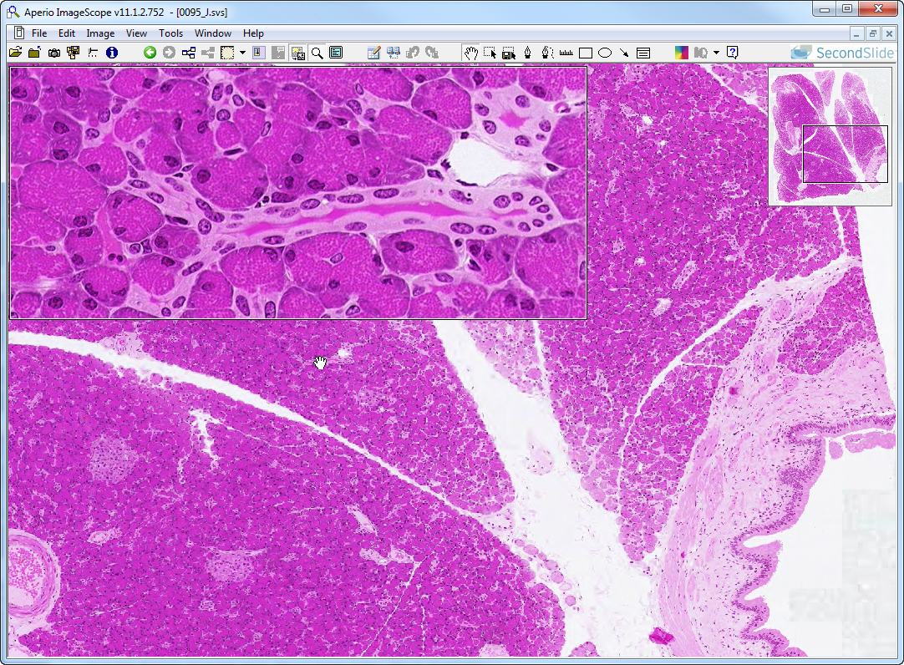
Slide 95: Pancreas, H&E
AC
ICD
CA
ICD
IsL
lobule
pancreatic
duct
IsL
Notes:
AC=acinar cells CA=centroacinar cells ICD=intercalated duct (intralobular) IsL=Islet of Langerhans

Slide 7
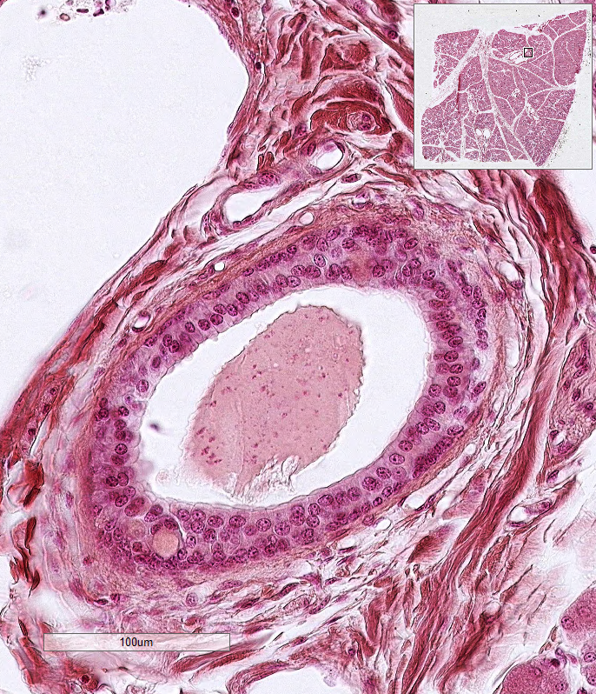
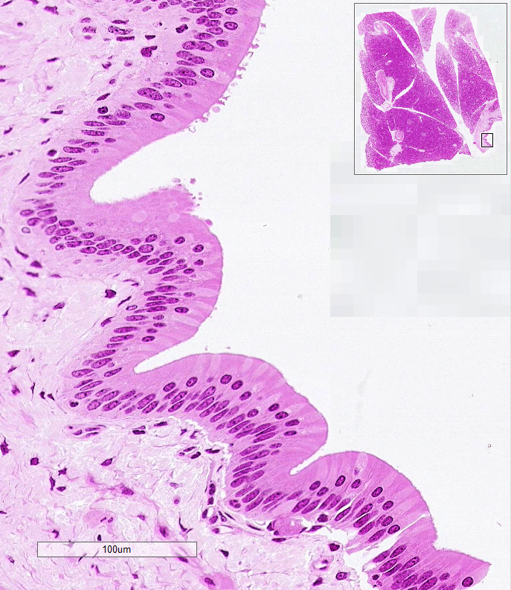
Comparing Excretory Ducts
Submandibular Gland
stratified cuboidal/columnar epithelium
Pancreas
simple columnar epithelium w/ goblet cells
Goblet Cells (nuclei are more apical, thus making the epithelium APPEAR stratified, but it is NOT.)

Slide 8
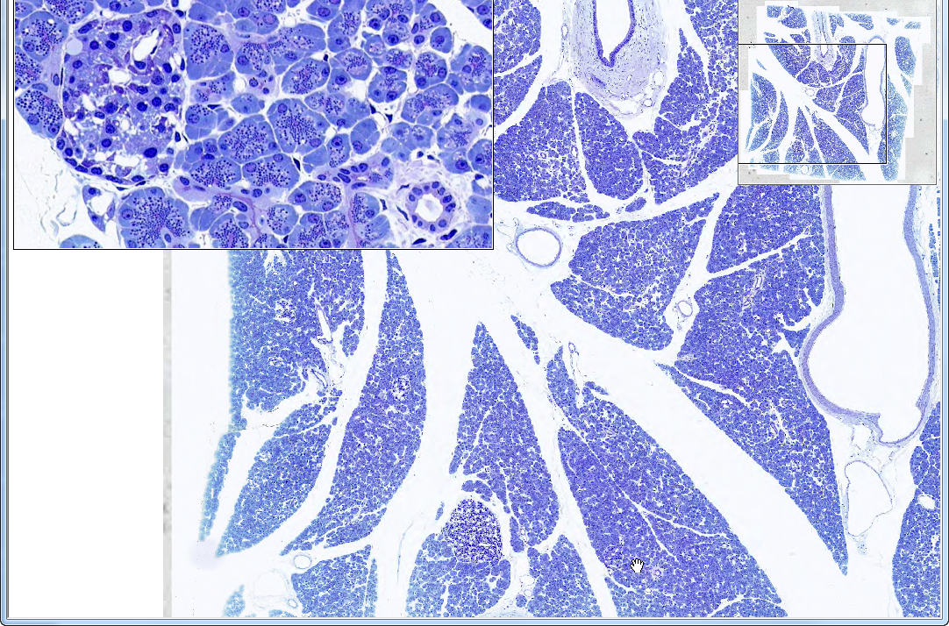
Slide 39: Pancreas, AF-TB
PD
IsL
ac
icd
ca
IaD
IELD
artery
IsL
lobule
Notes:
ac=acinar cells ca=centroacinar cells IaD=intralobular duct icd=intercalated duct (intralobular)
IELD=interlobular duct IsL=Islet of Langerhans PD=pancreatic duct

Slide 9
Liver: Key Features
(from Dr. Carbrey’s notes)
lobules that surround central vein with portal tracts along the periphery
portal tract – hepatic artery and portal vein supply blood, bile ducts (simple cub) take bile away, lymphatics
blood entering liver from portal tract enters sinusoids between the hepatocytes and drains into the central vein where it is gathered to leave liver through hepatic vein
stroma – CT
capsule (if present) – thin CT with serosa
parenchyma – hepatocytes in cords
space of Disse – between endothelial cells of sinusoids and the hepatocytes, contains stellate cells (store fat, vit A, fibrogenic)
sinusoids – discontinuous endothelium with Kupffer cells protruding into lumen

Slide 10
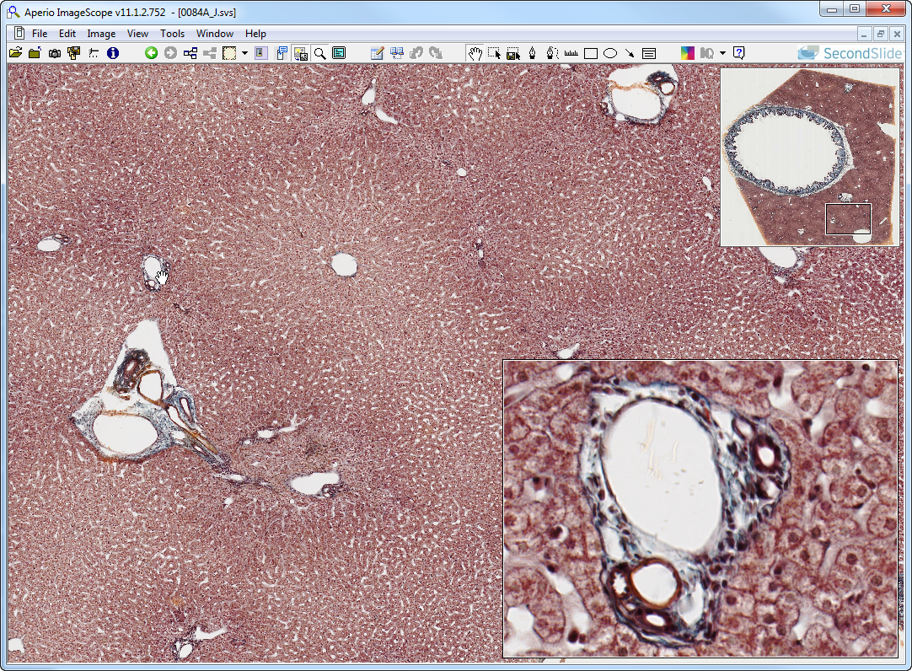
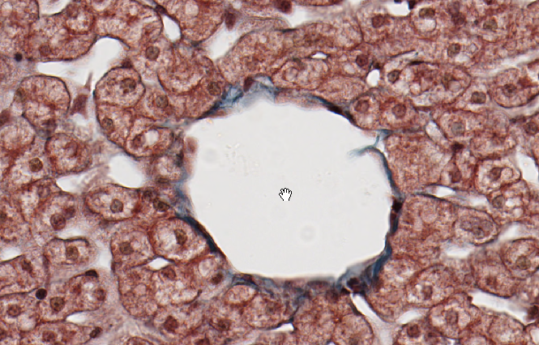
Slide 84: liver & gallbladder, trichrome
gallbladder
“classic”
lobule
Kc
Hep
v
d
cv
s
a
v
d
Notes:
a=branch of hepatic artery cv=central vein d=bile duct Hep=hepatocytes
Kc=Kupffer cell s=sinusoid v=branch of portal v.

Slide 11
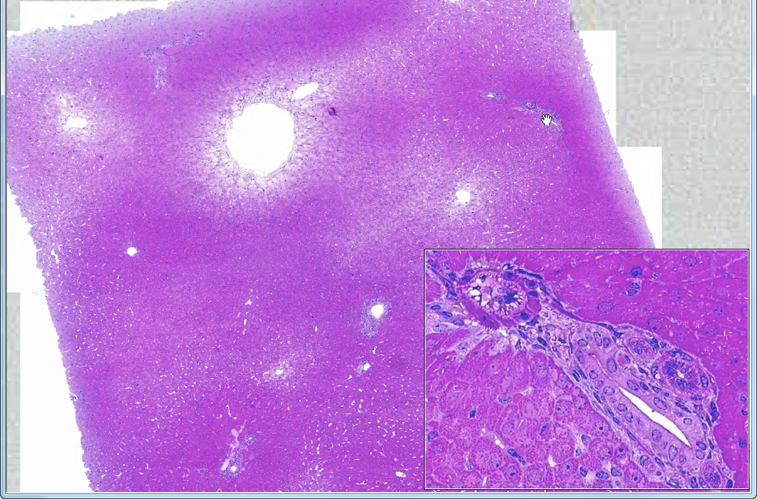
Slide 11: liver, H&E
pt
cv
sublv
cv
cv
v
pt
pt
a
d
pt
Notes:
a=branch of hepatic artery cv=central vein d=bile duct pt=portal tract
sublv=sublobular vein

Slide 12
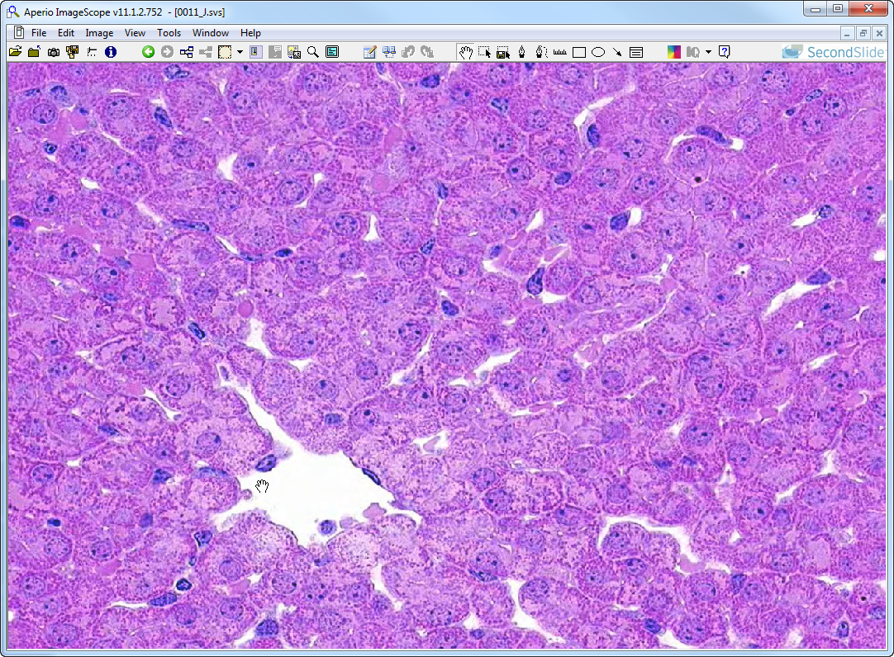
Slide 11: liver, H&E
bc
Kc
bc
s
bc
ec
cv
Notes:
bc=bile canaliculi cv=central vein ec=endothelial cell Kc=Kupffer cell
s=sinusoid

Slide 13
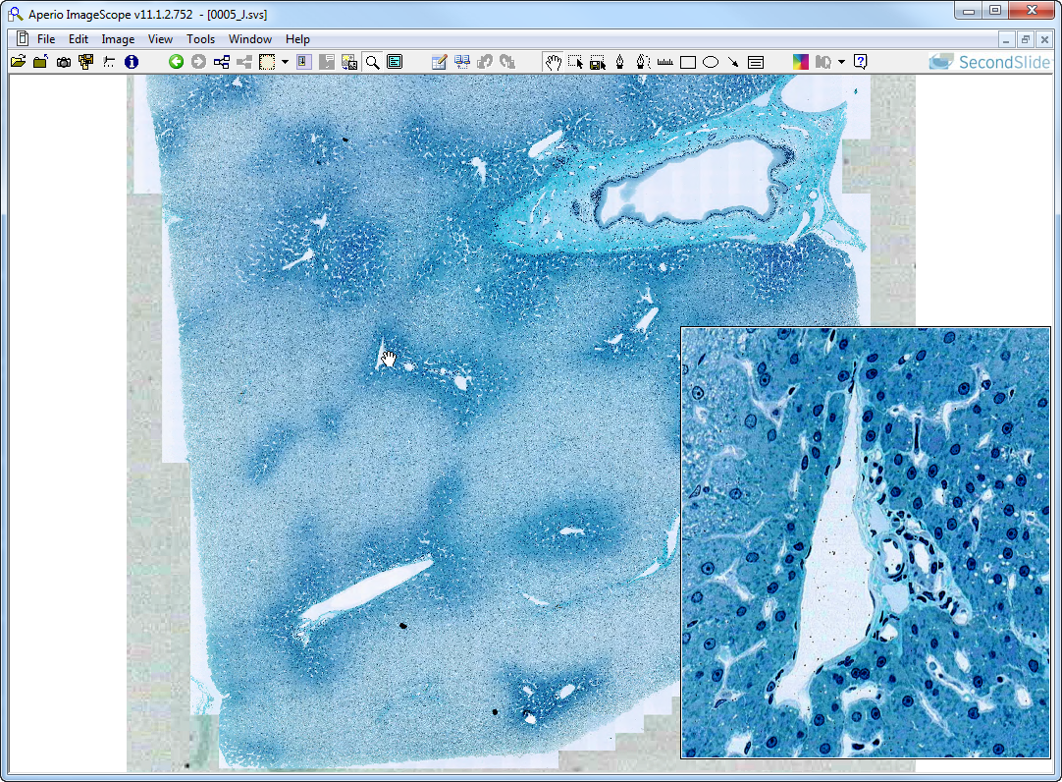
Slide 5: liver, PAS-H-FG
pt
cv
pt
BD
pt
pt
pt
pt
a
d
pt
v
cv
pt
Notes:
a=hepatic artery (branch) BD=larger bile duct cv=central vein d=bile duct
pt=portal tract
v=portal vein (branch)

Slide 14
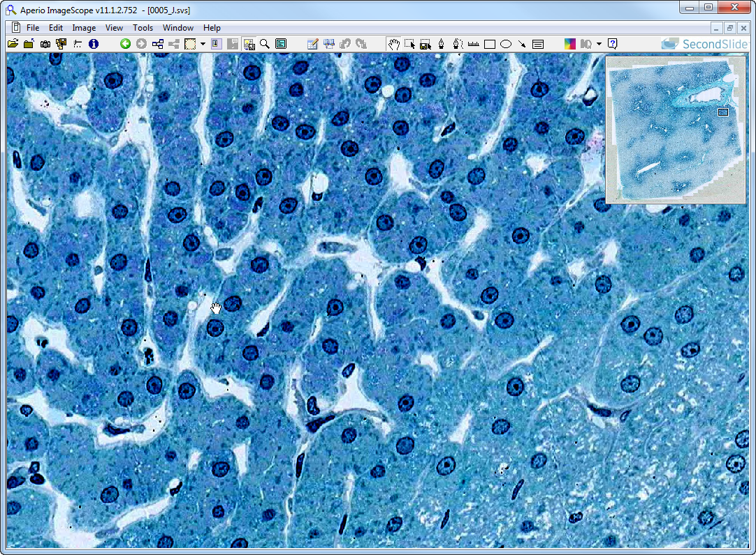
Slide 5: liver, PAS-H-FG
Kc
sD
bc
ec
bc
s
bc
Kc
Kc
Notes:
bc=bile canaliculus ec=endothelial cell Kc=Kupffer cell s=sinusoid
sD=space of Disse

Slide 15
Gall Bladder: Key Features
(from Dr. Carbrey’s notes)
stores and concentrates bile, empties into duodenum
Mucosa - simple col. epithelium with microvilli and lamina propria
highly folded when not full, lamina prop. may have mucous glands
No muscularis mucosa or submucosa
Muscularis externa - bundles of smooth muscle
Serosa (where it abuts liver) or adventitia (where it projects into body cavity)

Slide 16
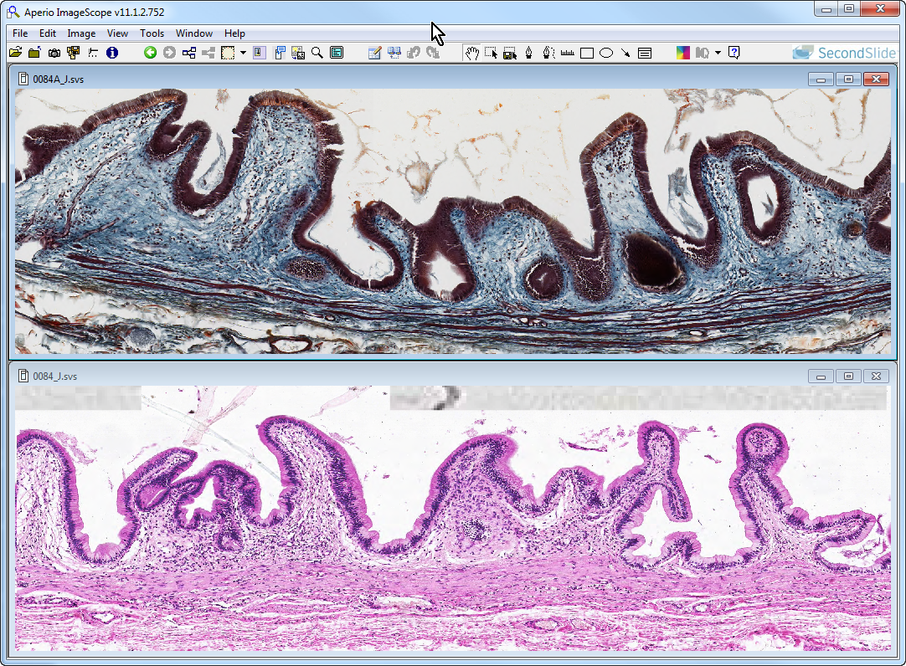
Slides 84 & 84A: gallbladder
epith
lamina
propria
muscularis externa
epith
lamina
propria
muscularis externa
adventitia / serosa
Notes:
Note: Epithelial lining is a uniform population of simple columnar cells with microvilli (no goblet cells). NO muscularis mucosae or submucosa; outermost layer is an adventitia where the gallbladder is applied to the liver and a serosa where the gallbladder faces the peritoneal cavity.

