Slide 1
Histology of the Urinary System Lab Orientation

Slide 2
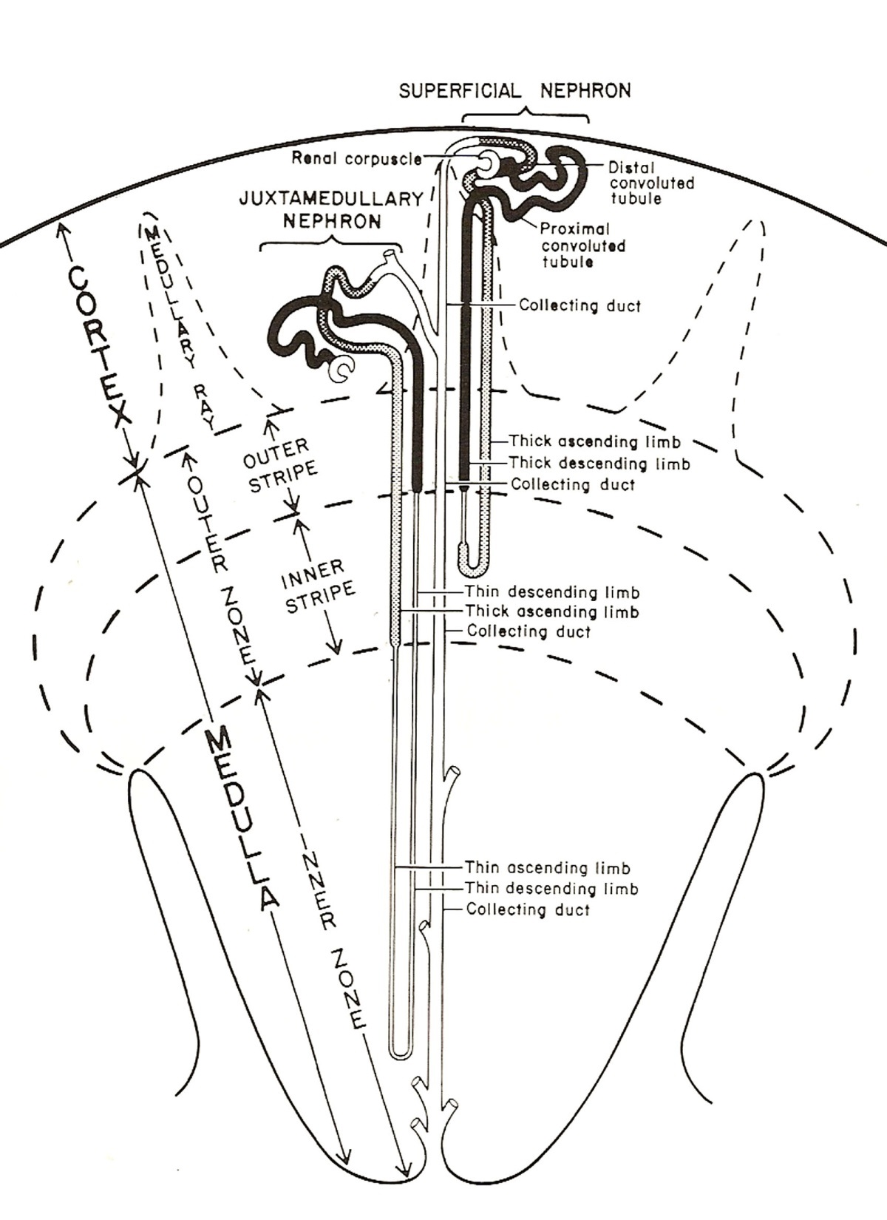
Key Features of the Kidney
(from Dr. Carbrey’s notes)
Kidney – surrounded by CT capsule, no mesothelium
Cortex - alternating medullary rays (CDs & straight tubules) and cortical labyrinths (renal corpuscles, conv. tubules)
can distinguish histologically: renal corpuscles , PCT, DCT, CD
renal corpuscles – glomerulus and Bowman’s capsule
glomerulus – capillaries
Bowman’s capsule – double-layered epithelial structure that surrounds glomerulus
Medulla - medullary pyramids bordered by renal columns
can see histologically: loop of Henle, thick asc. limb, CD, vasa recta
papillae with the area cribosa and ducts of Bellini (s. col. CD) projecting into the calyx (transitional epi)
Histology of Tubules:
PCT – s. cub., microvilli and basal striations, dark staining, few nuclei in sections of cells, stellate or occluded lumen, most numerous tubule in cortex, cortex only
Thick desc. limb (aka prox. straight tubules) – similar to PCT but in medullary rays and medulla.
DCT – s. cub., less microvilli, more nuclei in section, pale staining, usually has an open lumen, cortex only
CD – s.cub., no microvilli or basal striations, clear cell boundaries, nucleus in most sections of cells
thin segments of the loop of Henle – s. sq. with rounder nuclei than vasa recta, medulla only
Thick asc. Limb (aka distal straight tubules) – s. cub., not every section of cell has nucleus, no clear cell boundaries
DCT
PCT
Renal
Corpuscle
(Papillary Duct)
Minor Calyx

Slide 3
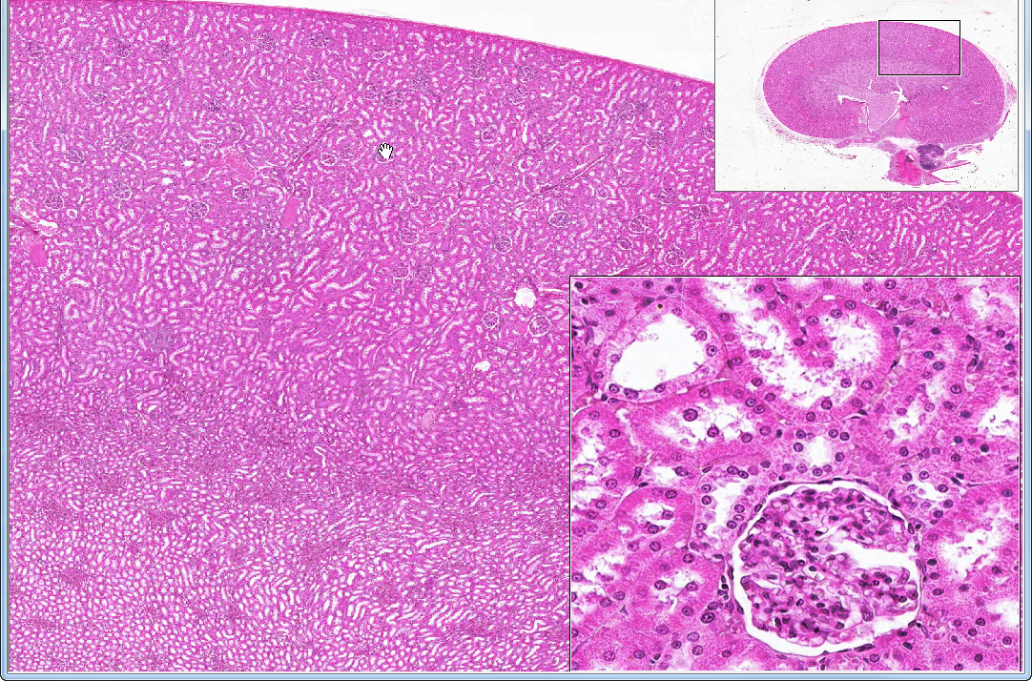
Slide 40: kidney
C
M
P
CORTEX
DCT
PCT
PCT
PCT
DCT
DCT
PCT
G
PCT
MEDULLA
PCT
Notes:
C=cortex DCT=distal convoluted tubule G=glomerulus M=medulla P=papilla
PCT=proximal convoluted tubule arrow=macula densa in a DCT

Slide 4
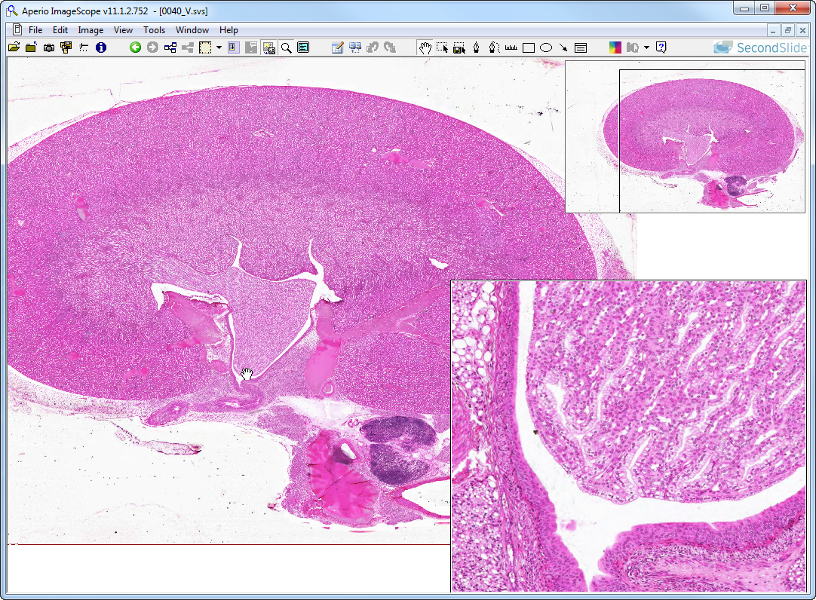
Slide 40: kidney
cortex
medulla
papilla
perirenal fat
(what type?)
calyx
trans. epith.
Notes:
Arrows indicate openings of collecting ducts (of Bellini) in the renal calyx at the “area cribrosa”

Slide 5
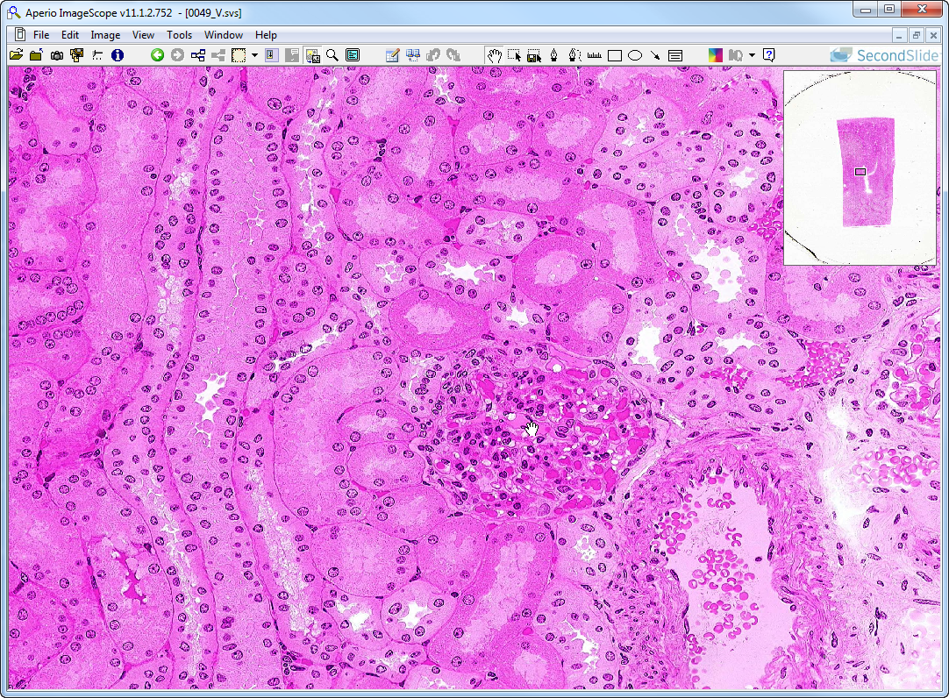
Slide 49: kidney (cortex)
pt cap
medullary ray
cortical labyrinth
(pars radiata)
(pars convoluta)
dct
pst
dct
dct
pct
dst
ct
dct
pct
pct
glomerulus
art
Notes:
Art=arcuate artery (near cortico-medullary junction) ct=collecting tubule (aka collecting duct)
dct=distal convoluted tubule dst=distal straight tubule (aka thick ascending limb)
pct=proximal convoluted tubule pst-proximal straight tubule (aka thick descending limb)
pt cap=peritubular capillary
Arrow=macula densa in a distal convoluted tubule
Note also the peritubular capillaries (with RBCs) surrounding all of the convoluted tubules.

Slide 6
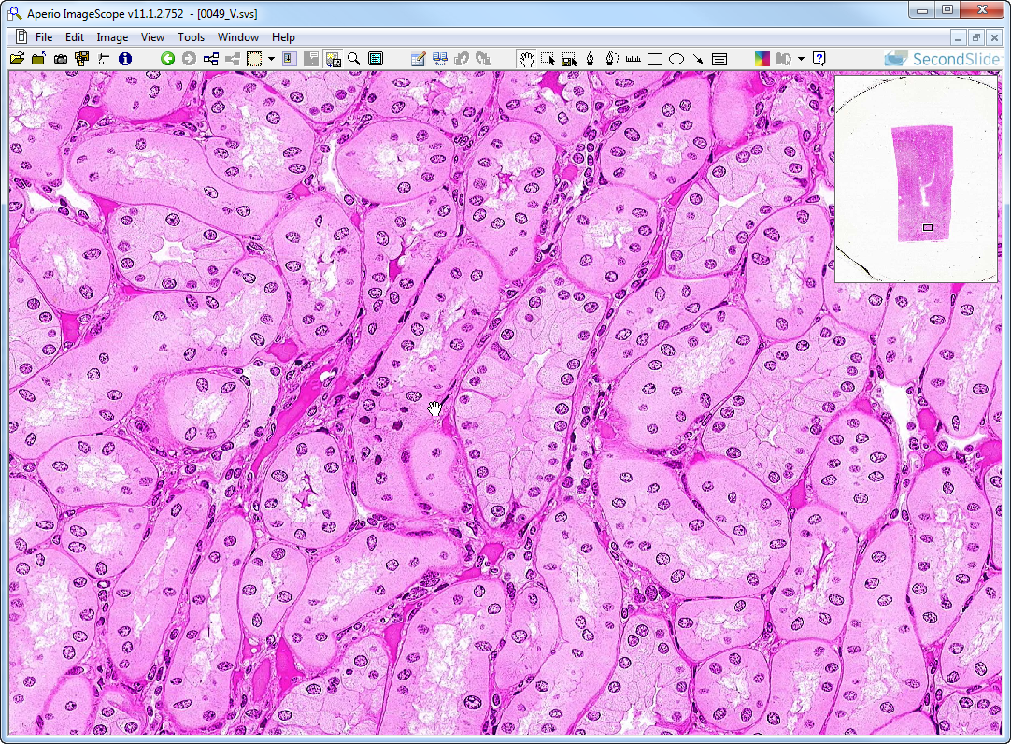
Slide 49: kidney (medulla)
atl
tl
cd
tl
vr
Notes:
Atl=ascending thick limb cd=collecting duct tl=thin limb (of Henle’s loop)

Slide 7
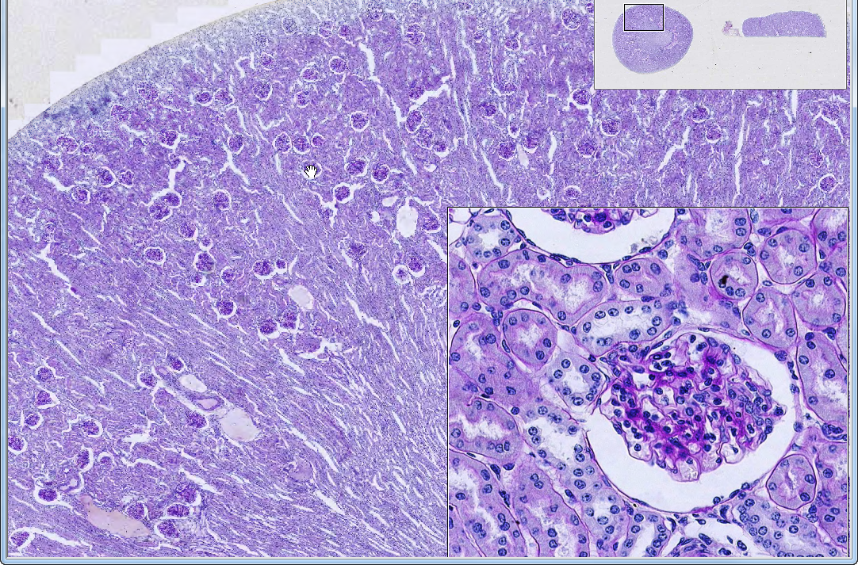
Slide 304: kidney, PAS
medullary ray
cortical labyrinth
p
medullary ray
p
d
d
medullary ray
medulla
Notes:
d=distal convoluted tubule p=proximal convoluted tubule
Note that PAS stain reacts with glycoproteins associated with basement membranes and brush borders.

Slide 8
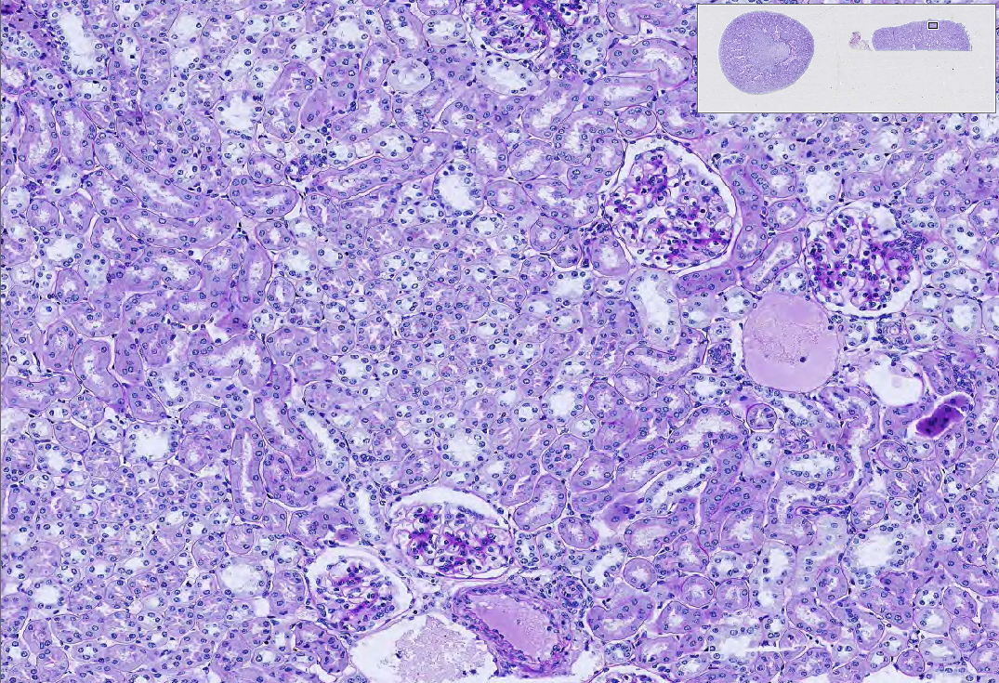
Slide 304: kidney, PAS, cortical section: medullary rays will appear as fascicles (like bundles of straws) amidst cortical labyrinth of coiled tubes and glomeruli
cortical labyrinth
medullary ray
cortical labyrinth
medullary ray
cortical labyrinth
itla
itlv
Notes:
itla=interlobular artery itlv=interlobular vein

Slide 9
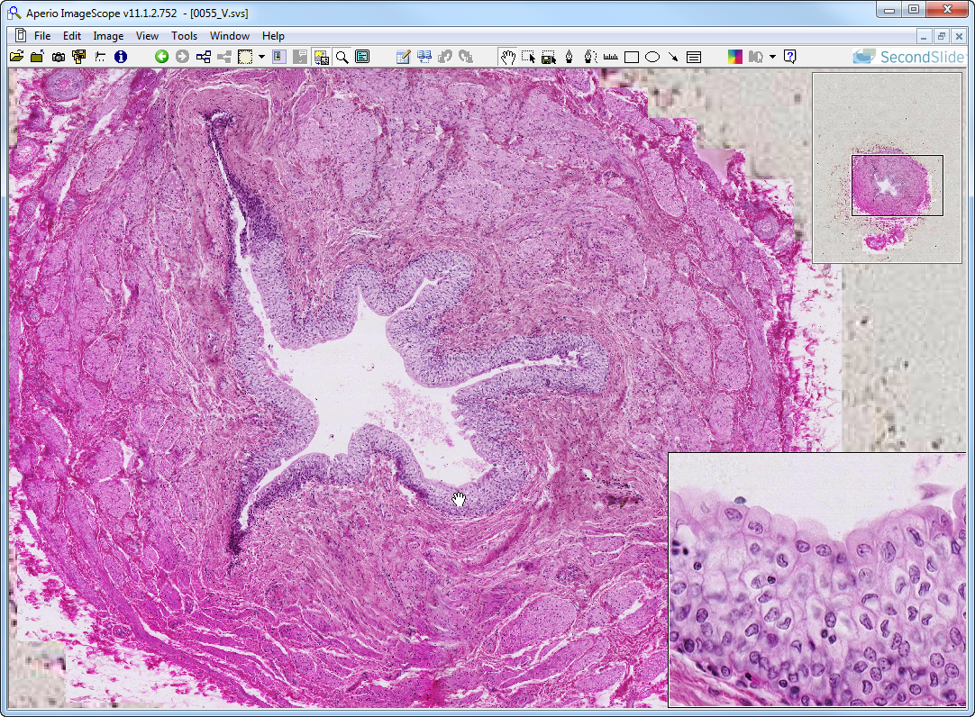
Slide 55: ureter
lm
lp
lm
lumen
epithelial lining of ureter
lm
cm
Notes:
cm=circularly oriented smooth muscle lm=longitudinally-oriented smooth muscle lp=lamina propria
Note that the muscle is roughly organized into an inner longitudinal layer and outer circular layer. Farther down the ureter, and additional coat of longitudinal muscle is added outside the circular layer, so the 3 layers at that point are:
inner longitudinal muscle
middle circular muscle
outer longitudinal muscle

Slide 10
Key Features of the Ureter (from Dr. Carbrey’s notes)
small lumen to wall thickness ratio compared to bladder
mucosa - transitional epithelium lines a star-shaped lumen, lam. prop.
muscularis - 2 layers of sm. muscle – inner long., outer circum. (opposite of GI)
last 1/3 of ureter gains a 3rd layer of s. muscle like bladder
adventitia

Slide 11
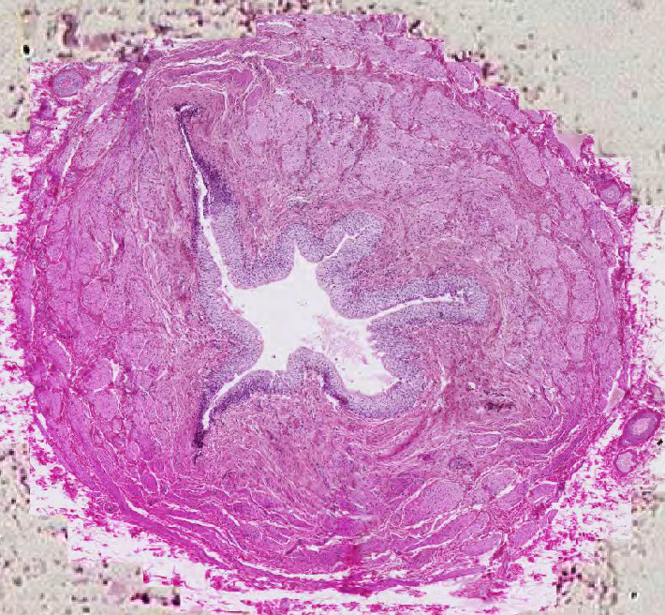
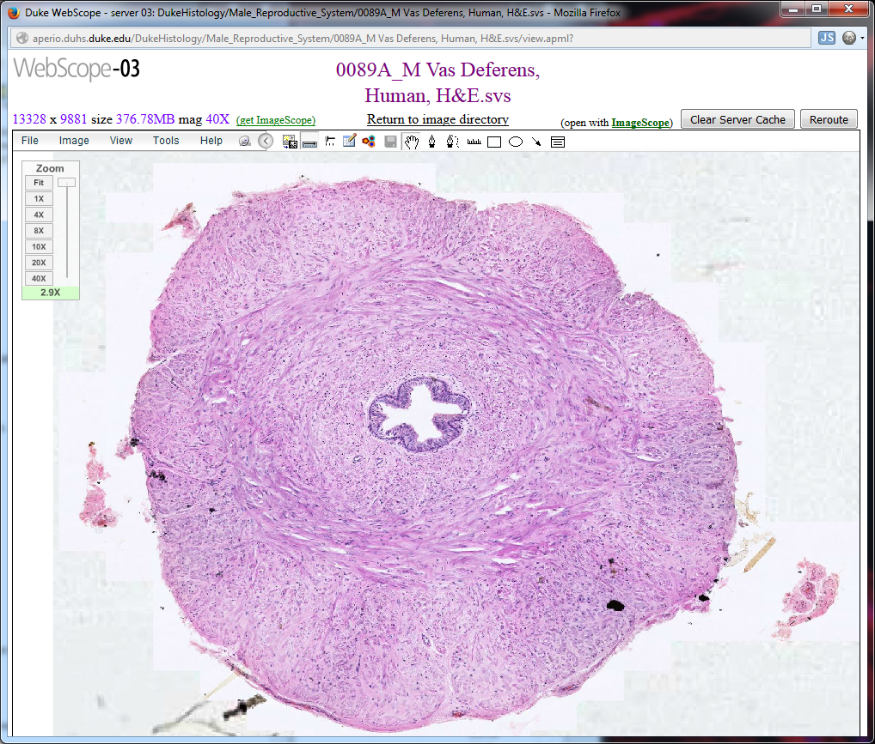
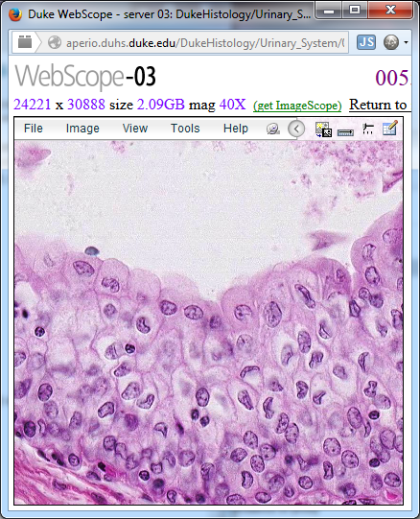
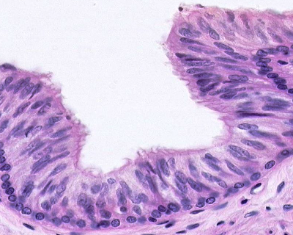
Ureter
Ductus Deferens
transitional epith.
i.l. / o.c. muscle (+o.l. m near bladder)
pseudostrat. col. epith.
i.l. / m.c. / o.l. muscle

Slide 12
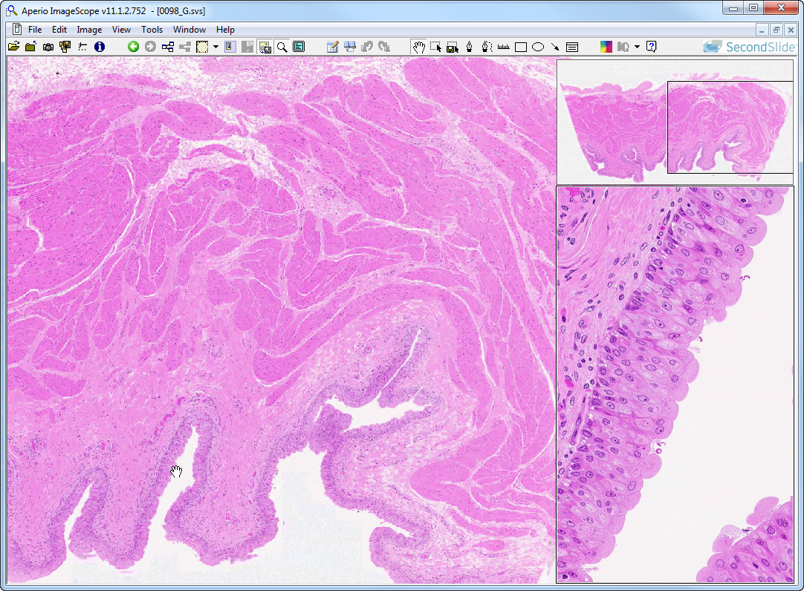
Slide 98: bladder
serosa
muscularis
epithelium
lamina propria

Slide 13
Key Features of the Bladder (from Dr. Carbrey’s notes)
large lumen to wall thickness ratio compared to ureter
mucosa - transitional epithelium and lamina propria
muscularis - 3 layers of smooth muscle – inner longitudinal, middle circular, outer longitudinal
mostly adventitia (where against body wall) but some serosa (where projecting into pelvic cavity)

Slide 14
‘Extra’ slides

Slide 15
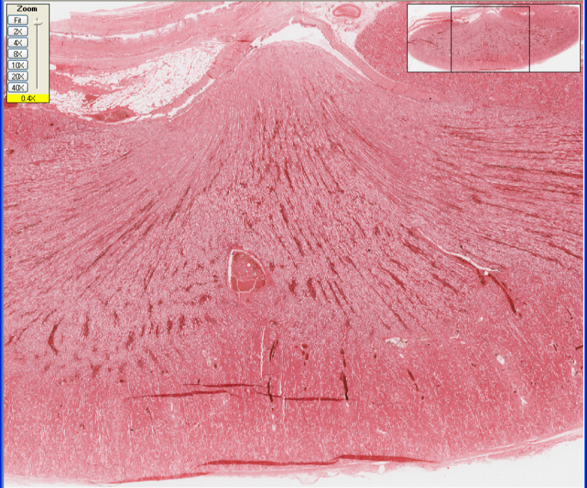
Minor Calyx of
the Renal Pelvis
Papilla
(TIP OF Pyramid)
Medullary Pyramid
Vasa Recta
(Straight
Tubules)
Cortico-Medullary
Junction
Cortex
(Convoluted Tubules
+ Medulary Rays)
Artifacts
(Tissue Folds)
Slide 204—Human Kidney
Notes:
Note that each renal papilla drains a ‘lobe’ (i.e. all of the nephrons and collecting ducts that empty at the apex of the pyramid) of the kidney

Slide 16
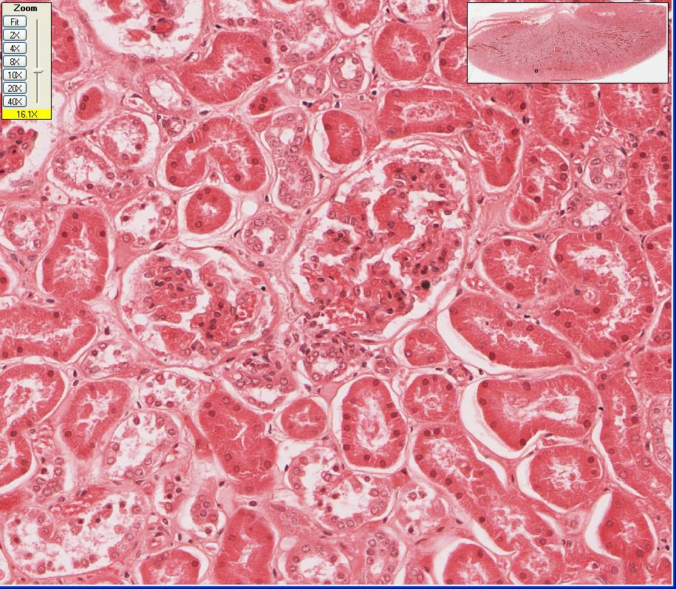
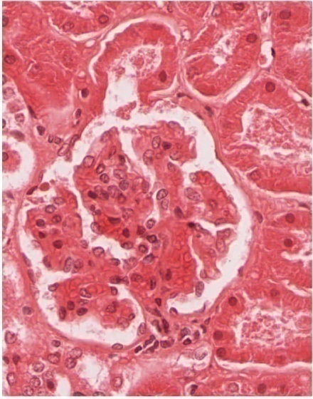
Slide 204 - Cortical Labyrinth
pct
dct
dct
pct
dct
pct
Renal Corpuscle:
glomerulus
Urinary Pole
Bowman’s Capsule:
(Urinary Space)
(Parietal Layer)
(Visceral Layer =
Podocytes)
Vascular Pole
Notes:
DCT=distal convoluted tubule PCT=proximal convoluted tubule

Slide 17
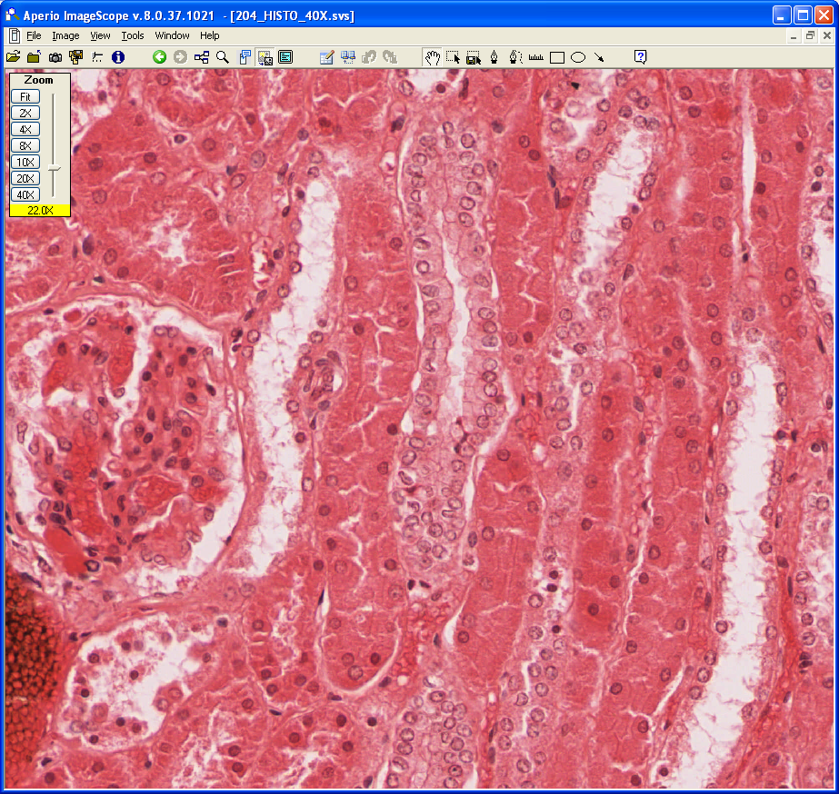
Cortical
Labyrinth
Medullary Ray
PCT
DST (atl)
DST (atl)
PST (dtl)
CT
Renal
Corpuscle
DST (atl)
PST (dtl)
PST (dtl)
PST (dtl)
Slide 204
Notes:
CT=collecting tubule DST=distal straight tubule (ascending thick limb)
PCT=proximal convoluted tubule PST=proximal straight tubule (descending thick limb)

Slide 18
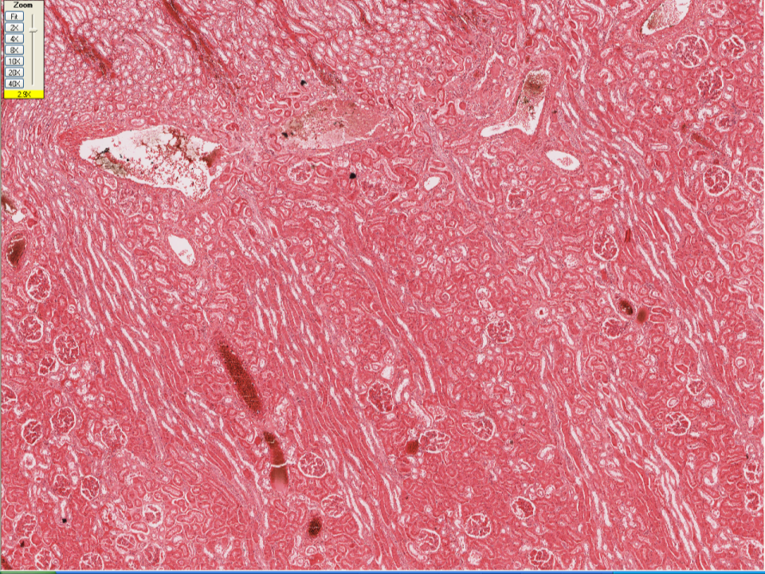
Cortico-Medullary Junction
Vasa Recta
Arcuate Artery
Arcuate Vein
Interlobular Artery
Interlobular Vein
Medullary Ray
Lobule
Slide 204 – blood supply

Slide 19
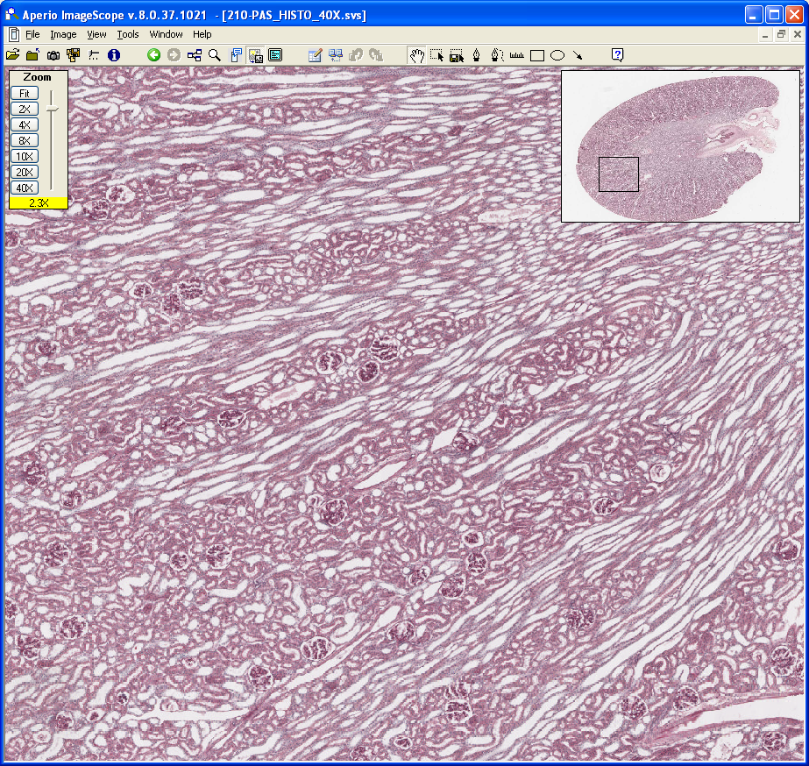
Cortex
Medulla
Cortex
Medulla
Cortico-Medullary
Junction
Kidney Lobule
Cortical Labyrinth
(convoluted tubules & glomeruli)
glomeruli
Medullary Ray
(Straight Tubules)
Slide 210-
Monkey Kidney
Notes:
Note that a ‘lobule’ is defined by a medullary ray and all of the nephrons that drain into it.

Slide 20
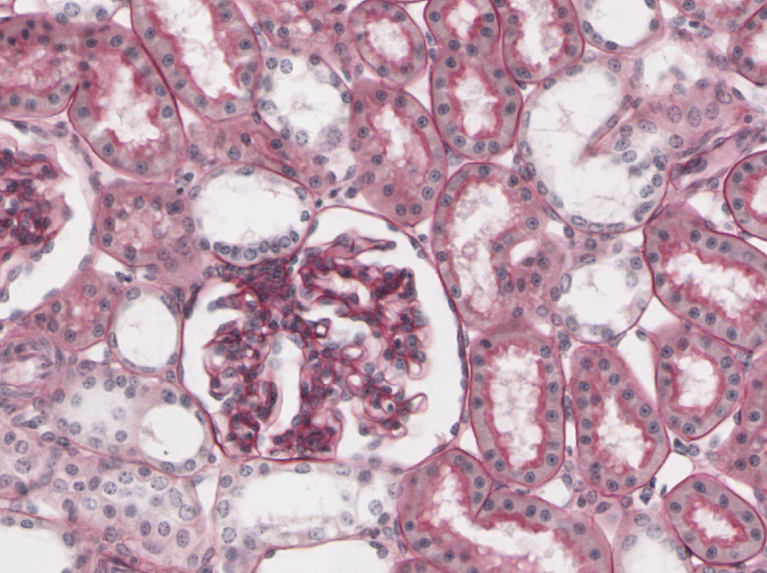
Slide 210 - PAS Stain
bb
PCT
bm
DCT
md
DCT
PCT

Slide 21
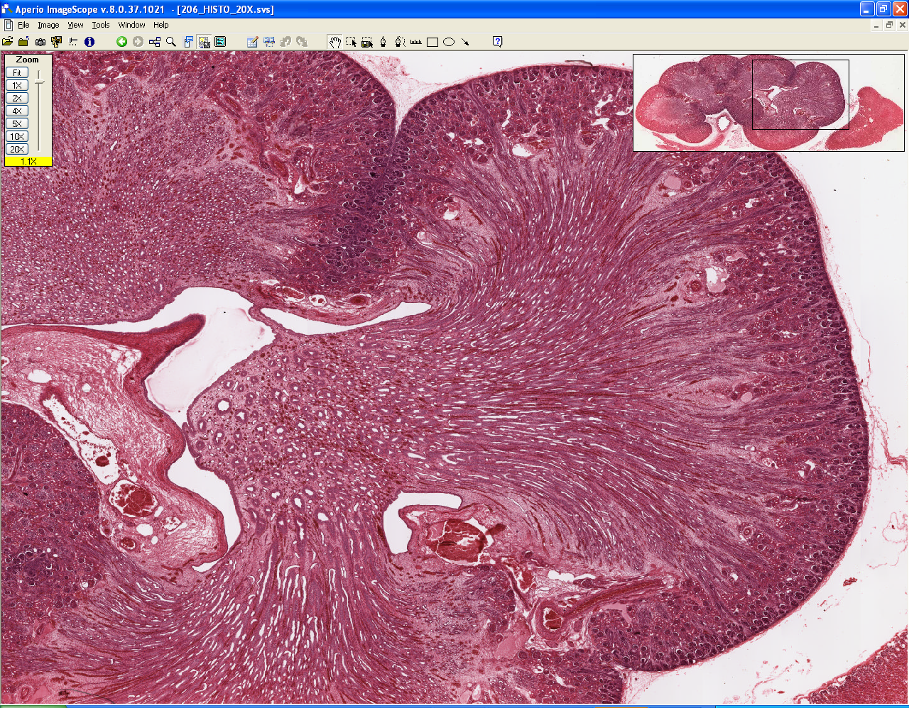
Slide 206 – fetal kidney (lobular)
Lobe
Minor Calyx
Papilla of
Medullary
Pyramid
Interlobar
Artery and Vein
Arcuate Artery
(and Vein)

