Slide 1
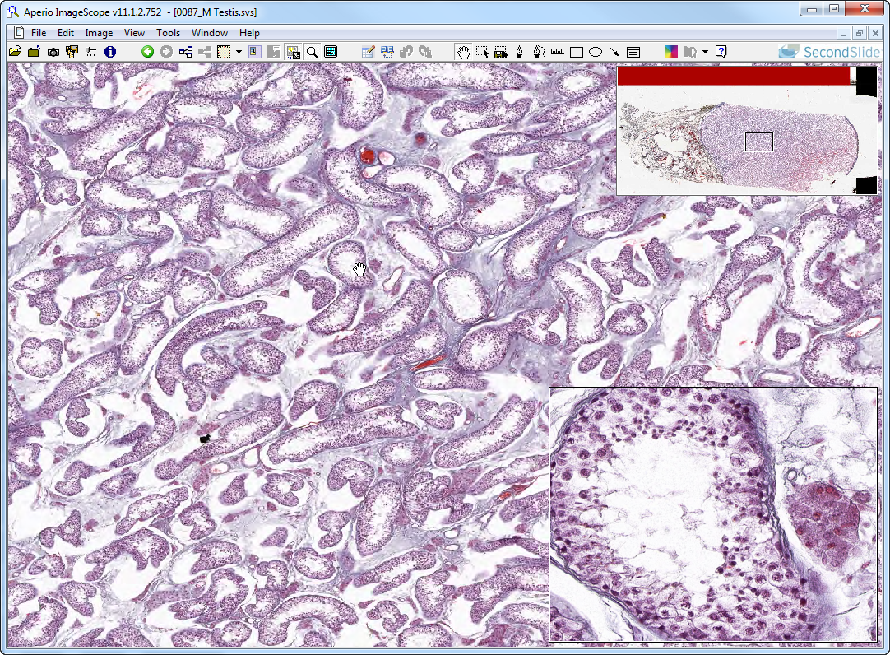
Slide 87: testis
rete testis (out of focus)
rete testis (in focus)
Leydig cells
seminiferous tubule
Notes:
Notes from Dr. Carbrey:
Testicle – contains testis, efferent ductules, and epididymis
Testis – seminiferous tubules, tubuli recti (straight tubules), and rete testis
covered by tunica albuginea and tunica vaginalis
septa divide the testis into lobules
each lobule contains 1-4 seminiferous tubules
Seminiferous tubules
seminiferous tubules begin and end in mediastinum area of tunica albuginea
as they get closer to the mediastinum they become straight (tubuli recti) and then they flow into the rete testis contained within the mediastinum where the tubules combine
contain the following cells:
Leydig cells (testosterone) are in the CT around tubules, large cells
myoid cells surround tubules
tubule epithelium contains columnar Sertoli cells (pale nuclei) and
spermatogenic cells (germ cells):
spermatogonia – small nucleus with chromatin at edges
spermatocytes – large nucleus with clumped chromatin and prominent nucleolus
early spermatids – small round nucleus, may have acrosomal caps
late spermatids – small elongated nucleus
sperm - elongated nucleus, flagellum
Tubuli recti – s. cub., only Sertoli cells, no germ cells, no myoid cells
Rete testis – s. cub. epithelium, no myoid cells, irregularly-shaped lumen

Slide 2
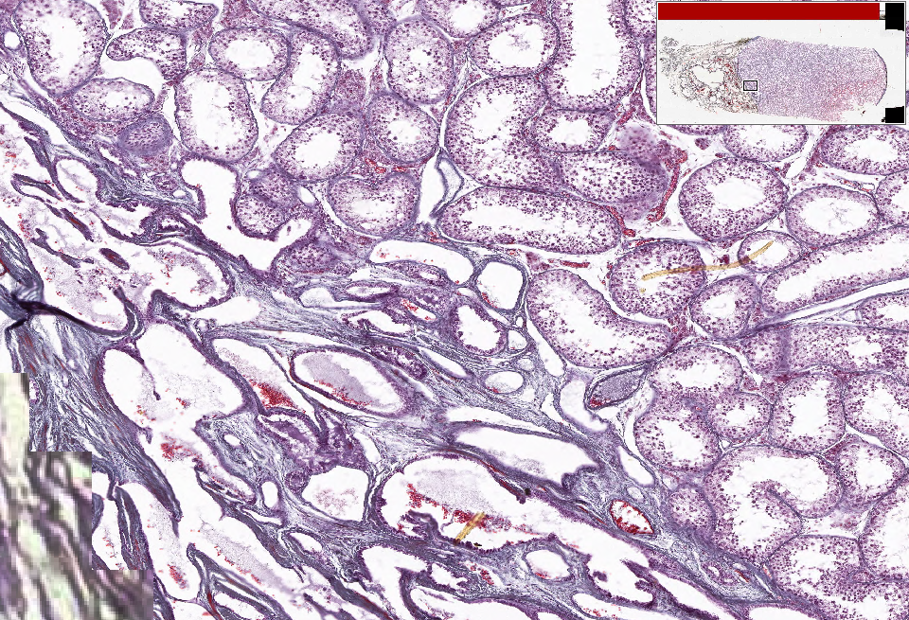
Slide 87: testis
SemT
TubR
Rete
TubR
Rete
Rete
Notes:
Rete=rete testis SemT=seminiferous tubules TubR=tubuli recti

Slide 3
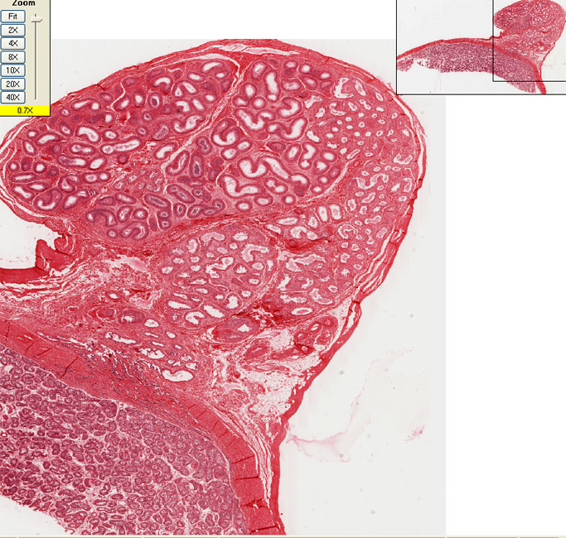
UMich Slide: 275 Mediastinum testis and Epididymis
Epididymis
Efferent ducts
Rete testis in mediastinum
Seminiferous tubules in testis
Notes:
Notes from Dr. Carbrey:
Testicle – contains testis, efferent ductules, and epididymis
Testis – seminiferous tubules, tubuli recti (straight tubules), and rete testis
covered by tunica albuginea and tunica vaginalis
septa divide the testis into lobules
each lobule contains 1-4 seminiferous tubules
Seminiferous tubules
seminiferous tubules begin and end in mediastinum area of tunica albuginea
as they get closer to the mediastinum they become straight (tubuli recti) and then they flow into the rete testis contained within the mediastinum where the tubules combine
contain the following cells:
Leydig cells (testosterone) are in the CT around tubules, large cells
myoid cells surround tubules
tubule epithelium contains columnar Sertoli cells (pale nuclei) and
spermatogenic cells (germ cells):
spermatogonia – small nucleus with chromatin at edges
spermatocytes – large nucleus with clumped chromatin and prominent nucleolus
early spermatids – small round nucleus, may have acrosomal caps
late spermatids – small elongated nucleus
sperm - elongated nucleus, flagellum
Intratesticular Ducts
Tubuli recti – s. cub., only Sertoli cells, no germ cells, no myoid cells
Rete testis – s. cub. epithelium, no myoid cells, irregularly-shaped lumen
Excurrent Ductal System
Efferent Ductules – go from rete testis to epididymis
s. col. or pseudostr. col epi with absorptive, basal and ciliated cells
sawtooth epithelium, smaller lumen than epididymis, less sm. muscle than epididymis
Epididymis – storage and maturation of sperm, 1 tube/testis s. col. or pseudostr. col epi with stereocilia
smooth muscle starts with 1 layer and ends with 3 layers towards the end

Slide 4
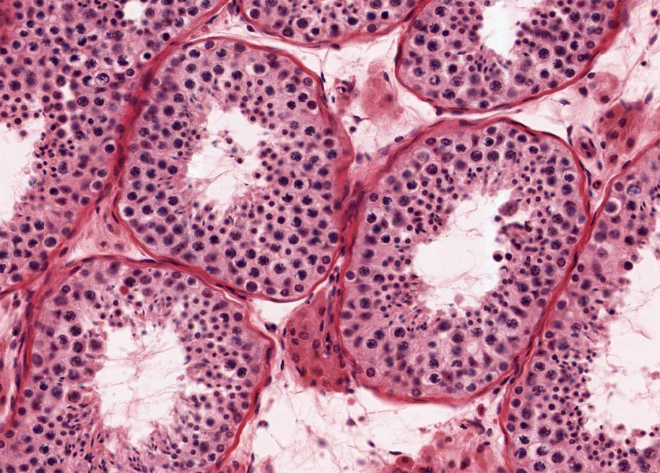
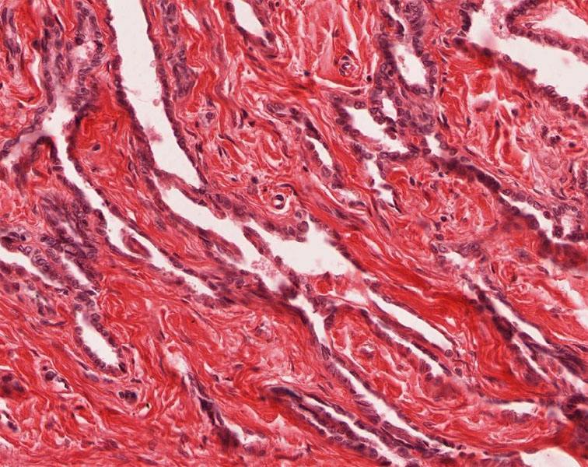
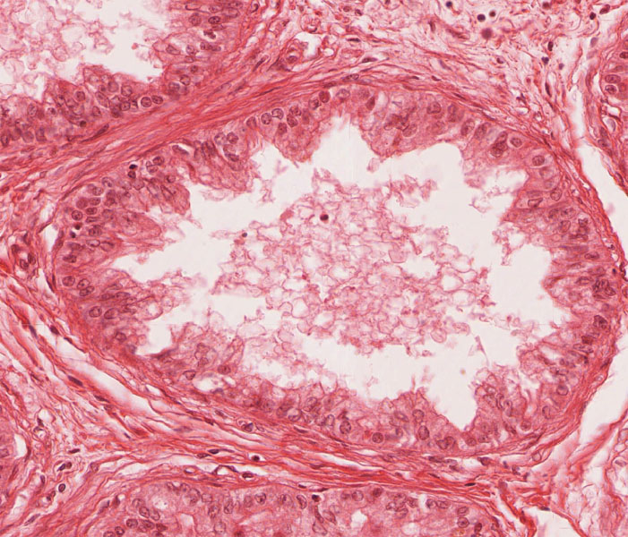
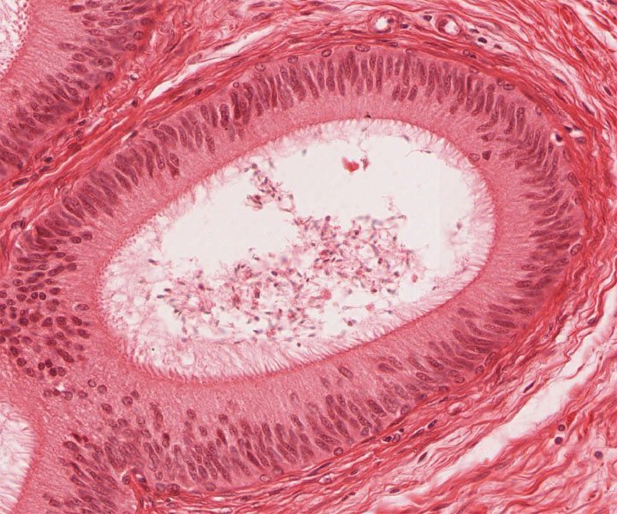
Rete testis (in mediastinum)
Seminiferous tubules
Efferent duct
Epididymis

Slide 5
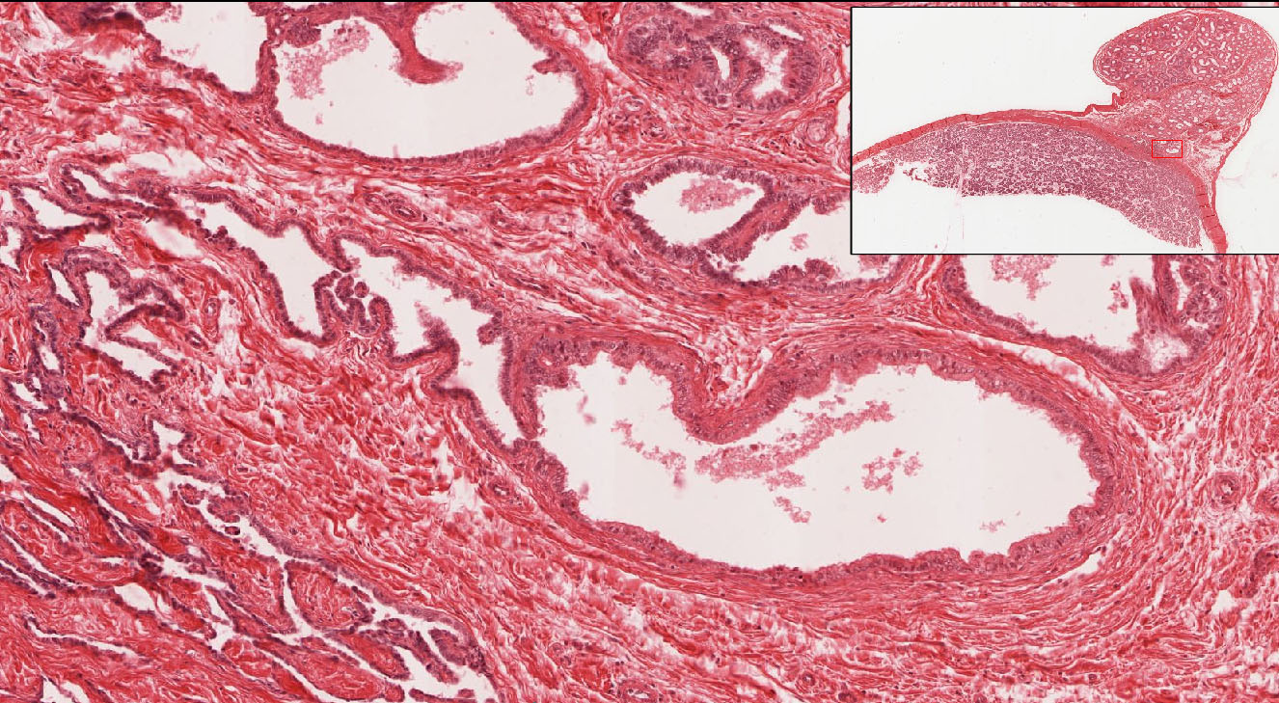
Slide 275: Transition from rete testis to efferent duct

Slide 6
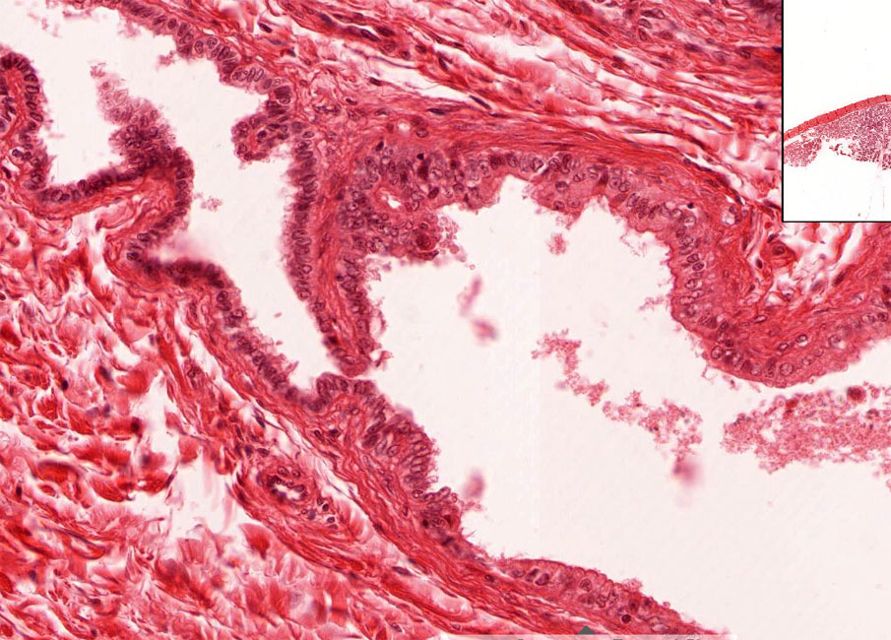
Slide 275: Transition from rete testis to efferent duct
Rete Testis
Efferent duct

Slide 7
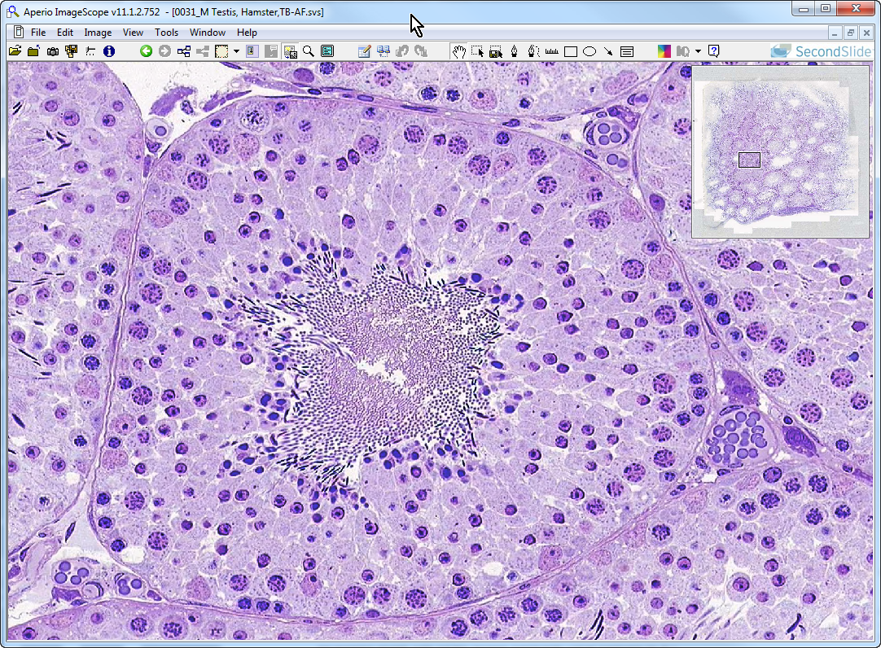
Slide 31: testis (hamster)
Leydig cells
late spermatids (closest to lumen)
Sertoli cell (nucleus)
spermatogonium
primary spermatocytes
early spermatids

Slide 8
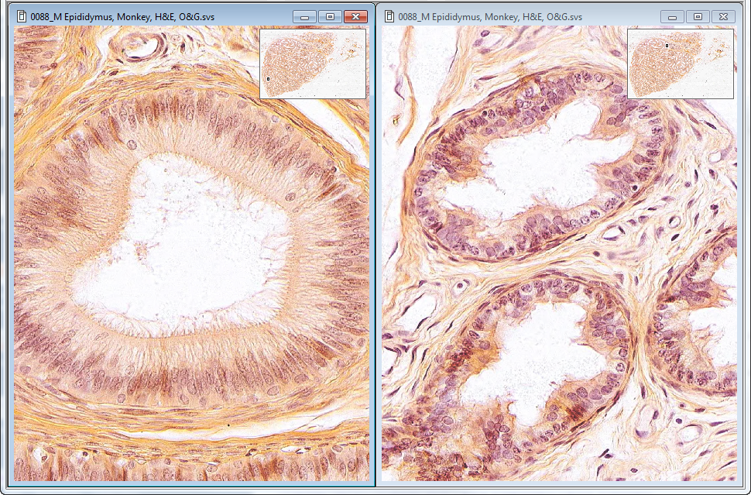
Slide 88: epididymis & efferent ducts
epididymis
efferent ducts
Notes:
Notes from Dr. Carbrey:
Excurrent Ductal System
Efferent Ductules – go from rete testis to epididymis
s. col. or pseudostr. col epi with absorptive, basal and ciliated cells
sawtooth epithelium, smaller lumen than epididymis, less sm. muscle than epididymis
Epididymis – storage and maturation of sperm, 1 tube/testis s. col. or pseudostr. col epi with stereocilia
smooth muscle starts with 1 layer and ends with 3 layers towards the end

Slide 9
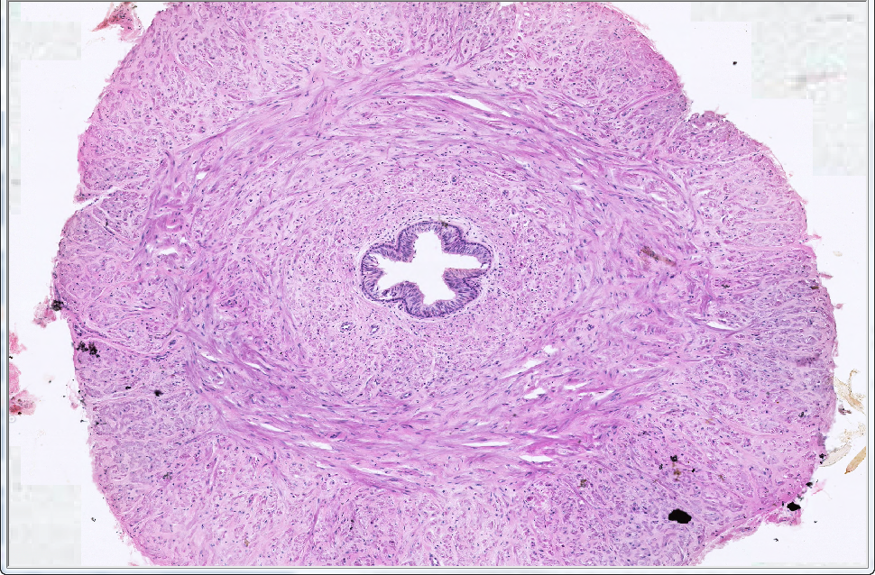
Slide 89A: vas deferens
OLM
MCM
ILM
lumen
Notes:
ILM=inner longitudinal muscle MCM=middle circular muscle OLM=outer longitudinal muscle
Notes from Dr. Carbrey:
Vas deferens – pseudostr. col. with stereocilia, lots of sm. muscle
changes over its length: smooth muscle decreases but epithelial folding increases as it heads towards the prostate gland

Slide 10
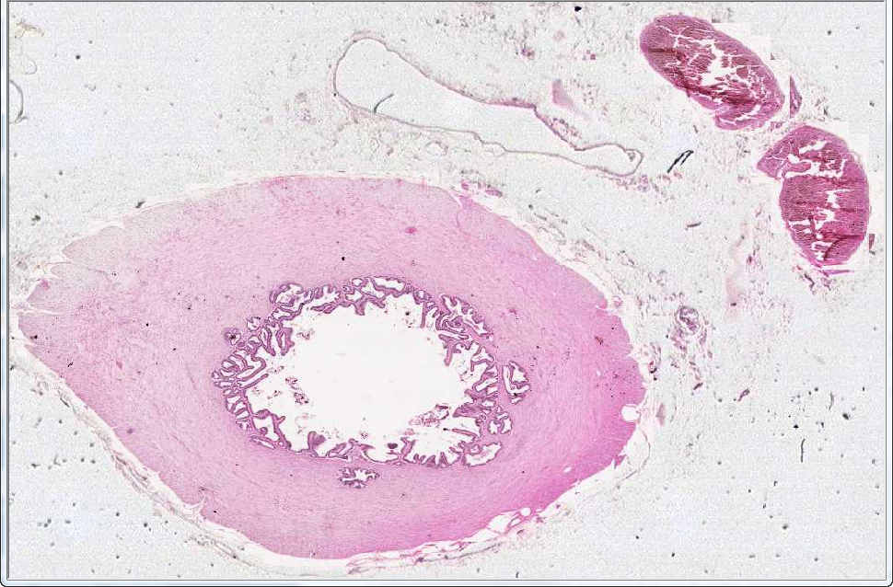
Slide 89B: vas deferens
pp
olm
pp
mcm
Ilm*
lumen
Notes:
ILM=inner longitudinal muscle MCM=middle circular muscle OLM=outer longitudinal muscle
pp=pampiniform plexus veins
Note lumen lined by highly folded simple columnar (low) epithelium

Slide 11
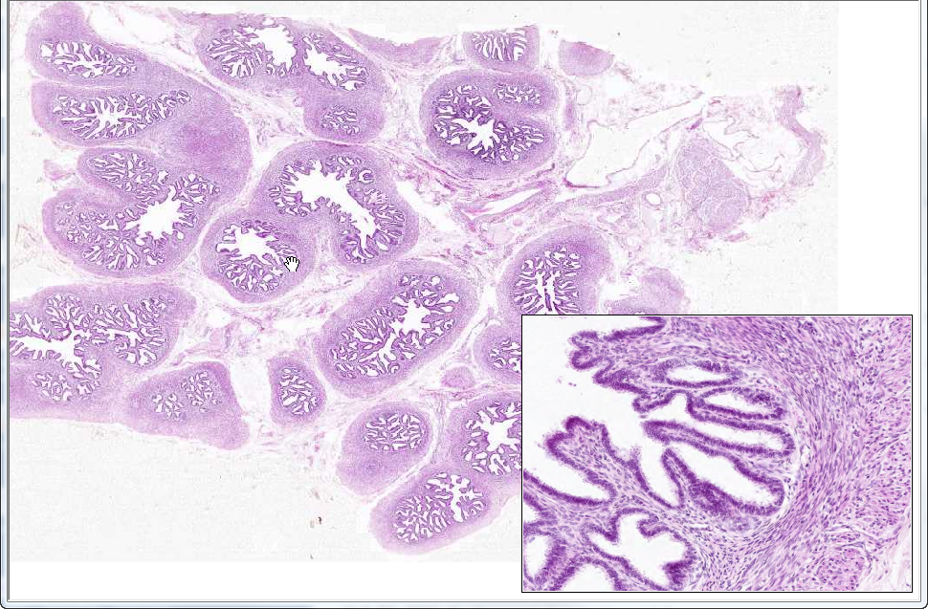
Slide 90: seminal vesicle
lumen
cm
lm
Notes:
cm=circular smooth muscle lm=longitudinal smooth muscle
Notes from Dr. Carbrey:
Seminal vesicle – produces components for seminal fluid, tubular gland that is highly folded, pseudostr. columnar / cuboidal epi.

Slide 12
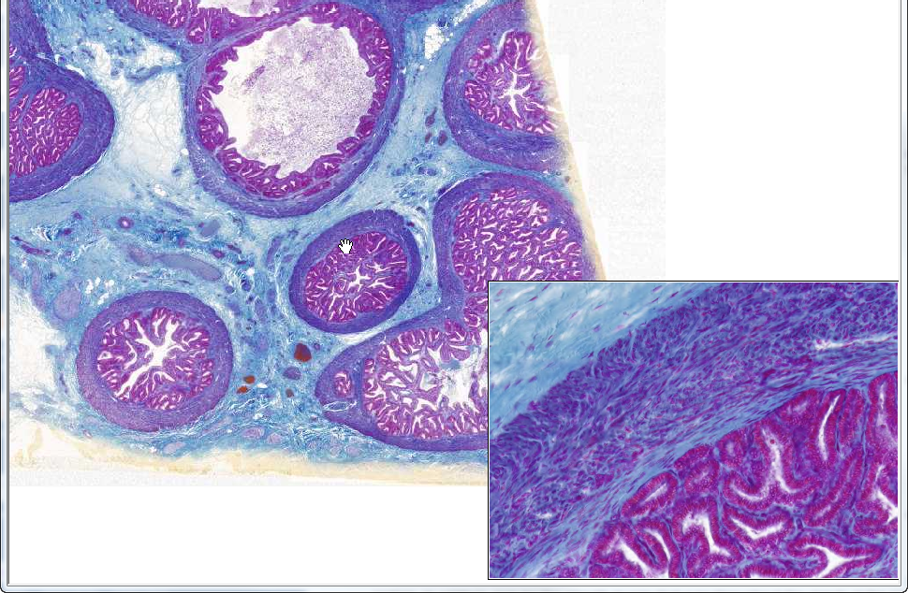
Slide 54: seminal vesicle, trichrome
lm
cm

Slide 13
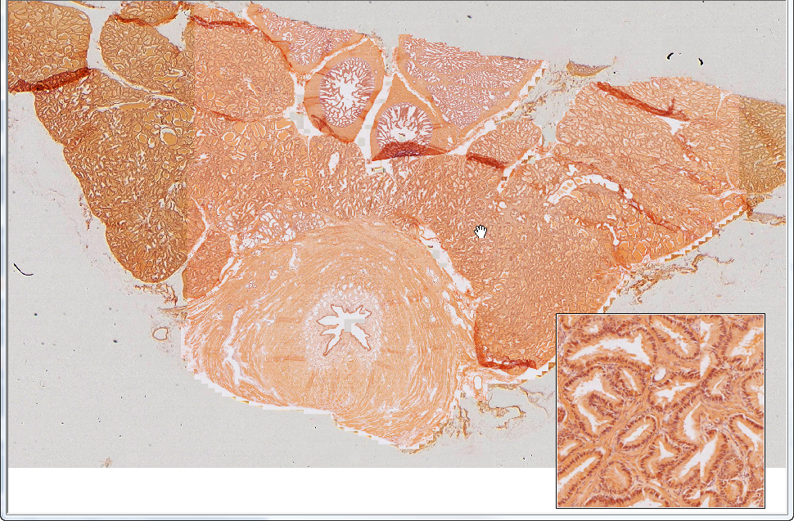
Slide 91: prostate, seminal vesicle
seminal
vesicle
seminal
vesicle
ejac.
duct
ejac.
duct
prostate
urethra
Notes:
Note tubuloalveolar glands surrounded by fibromuscular stroma (mixture of fibroblasts and abundant smooth muscle cells)
Notes from Dr. Carbrey:
Seminal vesicle – produces components for seminal fluid, tubular gland that is highly folded, pseudostr. col. epi.
Ejaculatory ducts – s. col. or pseudostr. col., extensions of the vas deferens that runs through the prostate and then merges with the urethra
Urethra – transitional epi. in prostate, becomes pseudost. col. and st. sq. in penis
Prostate – produces components for seminal fluid, tubular alveolar glands (generally simple columnar, but can be pseudostratified in some places) that can contain concretions and are surrounded by smooth muscle

Slide 14
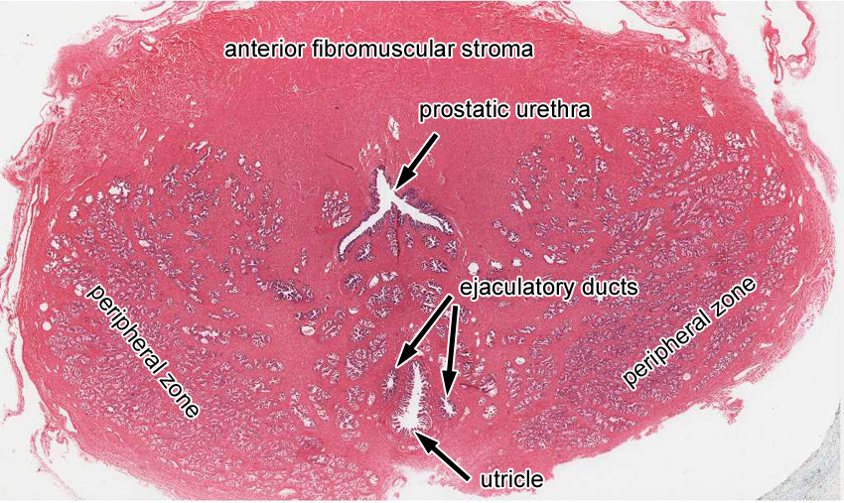
Extra Slide UMich 281: Prostate

Slide 15
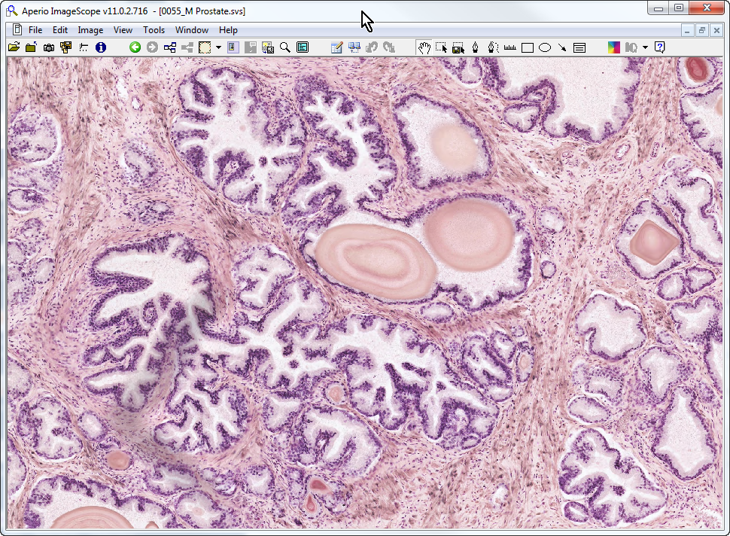
Slide 55: prostate
stroma
prostatic concretion

Slide 16
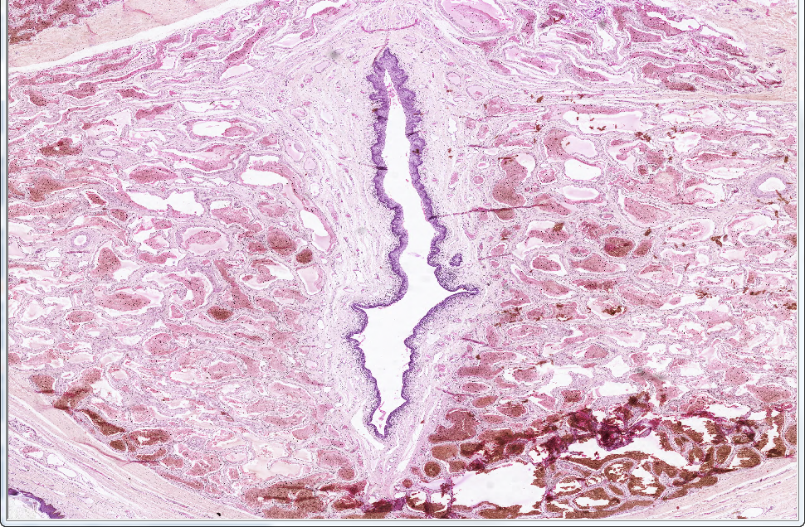
Slide 92: penis
corpus
spongiosum
corpus
spongiosum
urethra
Notes:
Note endothelial-lined venous sinuses within erectile tissue
Notes from Dr. Carbrey:
Penis – corpus spongiosum surrounds the urethra; 2 corpus cavernosa dorsal to corpus spongiosum (see extra slide UMich 286)

Slide 17
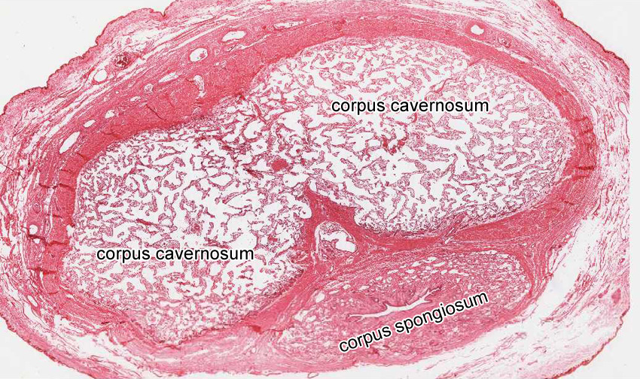
Extra Slide UMich 286: Penis

