Slide 1
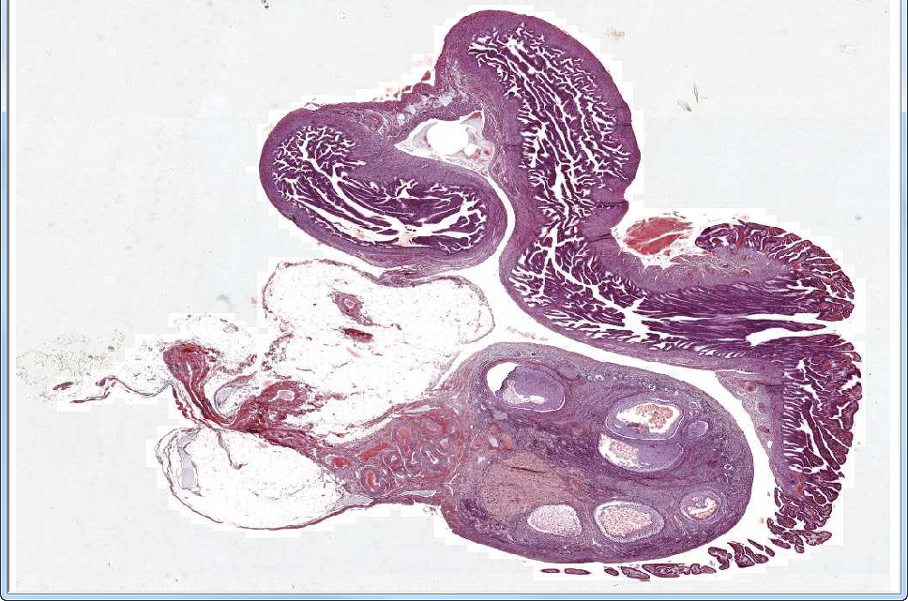
Slide 69: Ovary & Oviduct
infundibulum
mesovarium
ovary

Slide 2
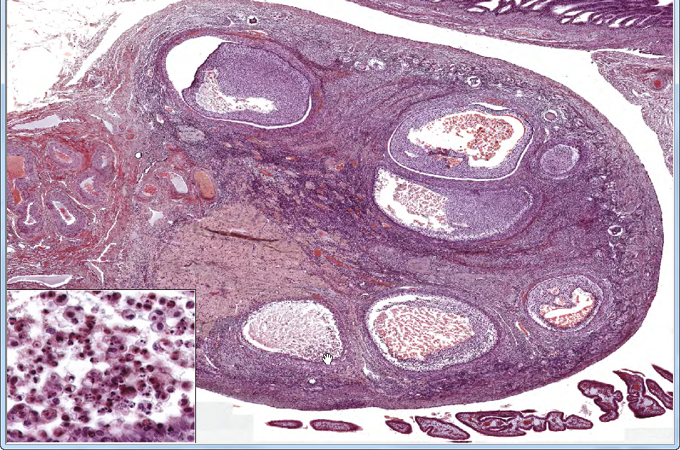
Slide 69: Ovary & Oviduct
2
2°
ep
ovarian
artery
hilus
1
4
3
pyknotic (dying) cells
atretic
Notes:
ep=epoophoron (mesonephric duct remnant) 2°=secondary follicle
Numbered boxes shown at higher magnification on next slide
Notes from Dr. Carbrey:
Ovary - mesothelium (germinal epithelium) - s. cub.
tunica albuginea – connective tissue layer
divided into cortex and medulla
Cortex – site of follicular development
Primordial follicles
oocyte – prominent nucleus, dispersed chromatin, can often see nucleolus
surrounded by s. sq. follicle cells
basal lamina surrounds outside of follicle cells
Primary follicles
key step – cub. or col. follicle cells
late 1°- when follicle cells become stratified then they are called granulosa cells (stratum granulosum)
zona pellucida starts to form
theca folliculi starts to form
Secondary follicles
key step – antrum starts to form
theca interna (contains capil. and cells that make hormones) and theca externa (connective tissue cells) are more distinguishable
corona radiata and cumulus oophorus start to form
Graafian follicle – mature
antrum gets large because of fluid production
cumulus oophorus is distinct
corona radiata becomes one or two layers
Atretic follicles – can see at any stage
gaps between oocyte and granulosa cells
granulosa cells in antrum
zona pelucida misshapen
basement membrane can look glassy
Corpus luteum – secretes hormones to prepare for pregnancy
granulosa lutein cells – big cells with a lot of cytoplasm, make hormones, originally were granulosa cells
theca lutein cells – smaller cells, darker staining, found in folds, make hormones, originally were cells from theca interna
Corpus albicans
connective tissue scar from degenerated corpus luteum
same general shape but without many cells

Slide 3
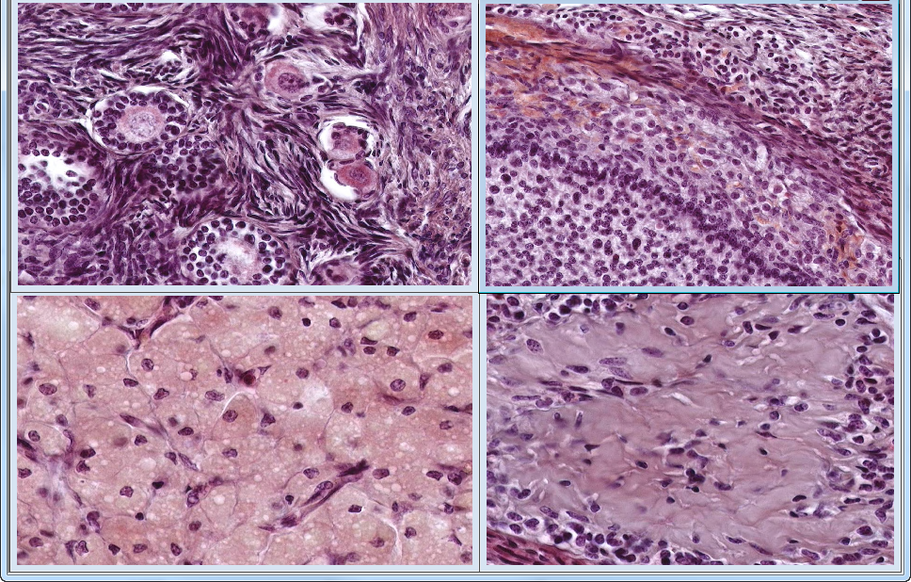
Slide 69: Ovary & Oviduct
1
2
p
te
1°
p
ti
p
gr
1°
3
4
corpus luteum
corpus albicans
Notes:
1°=primary follicle gr=granulosa cells p=primordial follicle te=theca externa ti=theca interna
Notes from Dr. Carbrey:
Ovary - mesothelium (germinal epithelium) - s. cub.
tunica albuginea – connective tissue layer
divided into cortex and medulla
Cortex – site of follicular development
Primordial follicles
oocyte – prominent nucleus, dispersed chromatin, can often see nucleolus
surrounded by s. sq. follicle cells
basal lamina surrounds outside of follicle cells
Primary follicles
key step – cub. or col. follicle cells
late 1°- when follicle cells become stratified then they are called granulosa cells (stratum granulosum)
zona pellucida starts to form
theca folliculi starts to form
Secondary follicles
key step – antrum starts to form
theca interna (contains capil. and cells that make hormones) and theca externa (connective tissue cells) are more distinguishable
corona radiata and cumulus oophorus start to form
Graafian follicle – mature
antrum gets large because of fluid production
cumulus oophorus is distinct
corona radiata becomes one or two layers
Atretic follicles – can see at any stage
gaps between oocyte and granulosa cells
granulosa cells in antrum
zona pelucida misshapen
basement membrane can look glassy
Corpus luteum – secretes hormones to prepare for pregnancy
granulosa lutein cells – big cells with a lot of cytoplasm, make hormones, originally were granulosa cells
theca lutein cells – smaller cells, darker staining, found in folds, make hormones, originally were cells from theca interna
Corpus albicans
connective tissue scar from degenerated corpus luteum
same general shape but without many cells

Slide 4
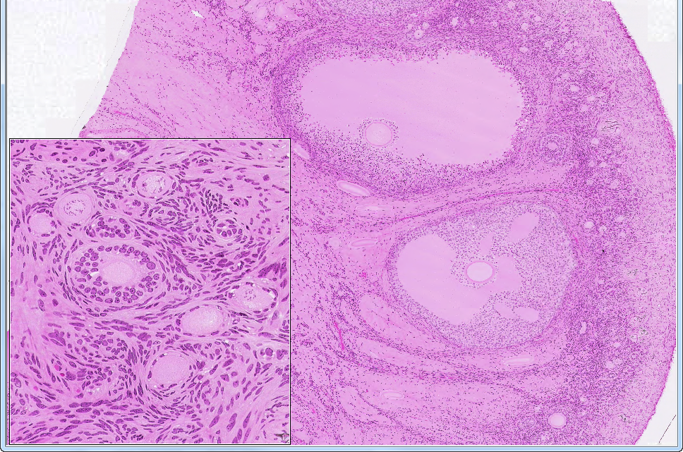
Slide 68: Ovary
2°(atretic)
1° and p
1°
2°
p
ca
ca
ca
Notes:
1°=primary follicle 2°=secondary follicle ca=corpus albicans p=primordial follicle
Notes from Dr. Carbrey:
Ovary - mesothelium (germinal epithelium) - s. cub.
tunica albuginea – connective tissue layer
divided into cortex and medulla
Cortex – site of follicular development
Primordial follicles
oocyte – prominent nucleus, dispersed chromatin, can often see nucleolus
surrounded by s. sq. follicle cells
basal lamina surrounds outside of follicle cells
Primary follicles
key step – cub. or col. follicle cells
late 1°- when follicle cells become stratified then they are called granulosa cells (stratum granulosum)
zona pellucida starts to form
theca folliculi starts to form
Secondary follicles
key step – antrum starts to form
theca interna (contains capil. and cells that make hormones) and theca externa (connective tissue cells) are more distinguishable
corona radiata and cumulus oophorus start to form
Graafian follicle – mature
antrum gets large because of fluid production
cumulus oophorus is distinct
corona radiata becomes one or two layers
Atretic follicles – can see at any stage
gaps between oocyte and granulosa cells
granulosa cells in antrum
zona pelucida misshapen
basement membrane can look glassy
Corpus luteum – secretes hormones to prepare for pregnancy
granulosa lutein cells – big cells with a lot of cytoplasm, make hormones, originally were granulosa cells
theca lutein cells – smaller cells, darker staining, found in folds, make hormones, originally were cells from theca interna
Corpus albicans
connective tissue scar from degenerated corpus luteum
same general shape but without many cellsry follicle 2°=secondary follicle ca=corpus albicans p=primordial follicle

Slide 5
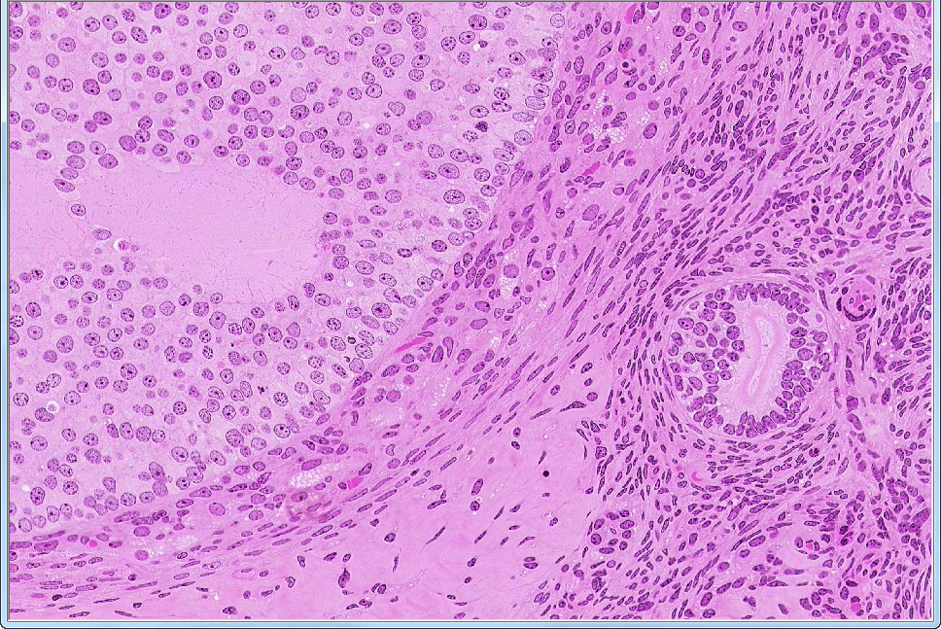
Slide 68: Ovary
2°
gr
ti
te
af
corpus
alibicans
Notes:
af=atretic follicle 2°=primary follicle (antrum) gr=granulosa cells te=theca externa ti=theca interna
Notes from Dr. Carbrey:
Primordial follicles
oocyte – prominent nucleus, dispersed chromatin, can often see nucleolus
surrounded by s. sq. follicle cells
basal lamina surrounds outside of follicle cells
Primary follicles
key step – cub. or col. follicle cells
late 1°- when follicle cells become stratified then they are called granulosa cells (stratum granulosum)
zona pellucida starts to form
theca folliculi starts to form
Secondary follicles
key step – antrum starts to form
theca interna (contains capil. and cells that make hormones) and theca externa (connective tissue cells) are more distinguishable
corona radiata and cumulus oophorus start to form
Graafian follicle – mature
antrum gets large because of fluid production
cumulus oophorus is distinct
corona radiata becomes one or two layers
Atretic follicles – can see at any stage
gaps between oocyte and granulosa cells
granulosa cells in antrum
zona pelucida misshapen
basement membrane can look glassy
Corpus luteum – secretes hormones to prepare for pregnancy
granulosa lutein cells – big cells with a lot of cytoplasm, make hormones, originally were granulosa cells
theca lutein cells – smaller cells, darker staining, found in folds, make hormones, originally were cells from theca interna
Corpus albicans
connective tissue scar from degenerated corpus luteum
same general shape but without many cells

Slide 6
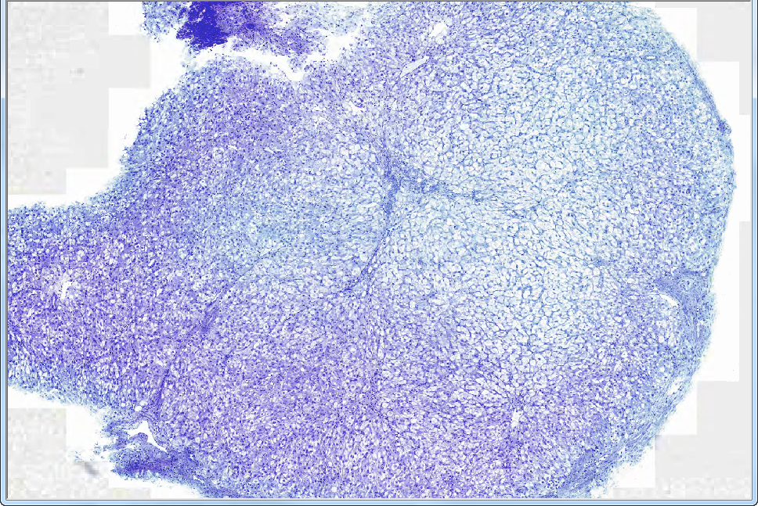
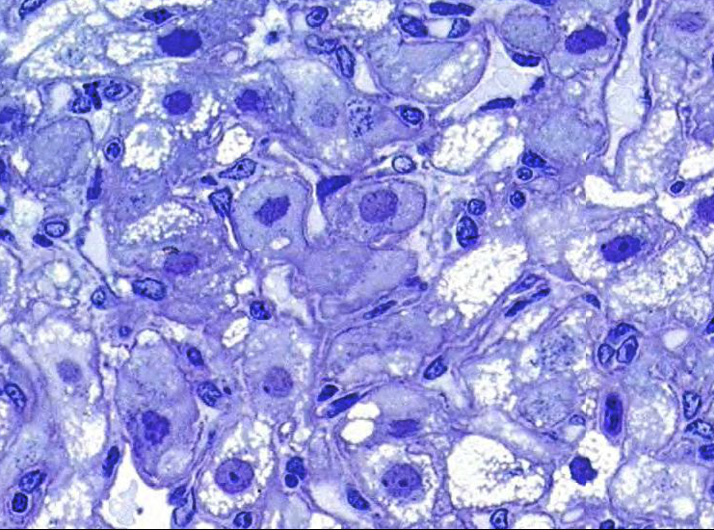
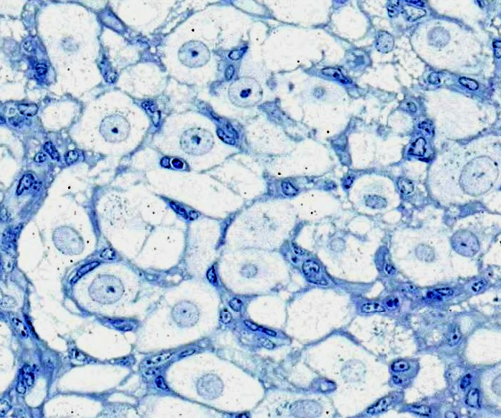
Slide 47: corpus luteum
(see also UMich slide 236a: WebScope ImageScope)
theca lutein
granulosa lutein
Notes:
Notes from Dr. Carbrey:
Corpus luteum – secretes hormones to prepare for pregnancy
granulosa lutein cells – big cells with a lot of cytoplasm, make hormones, originally were granulosa cells
theca lutein cells – smaller cells, darker staining, found in folds, make hormones, originally were cells from theca interna

Slide 7
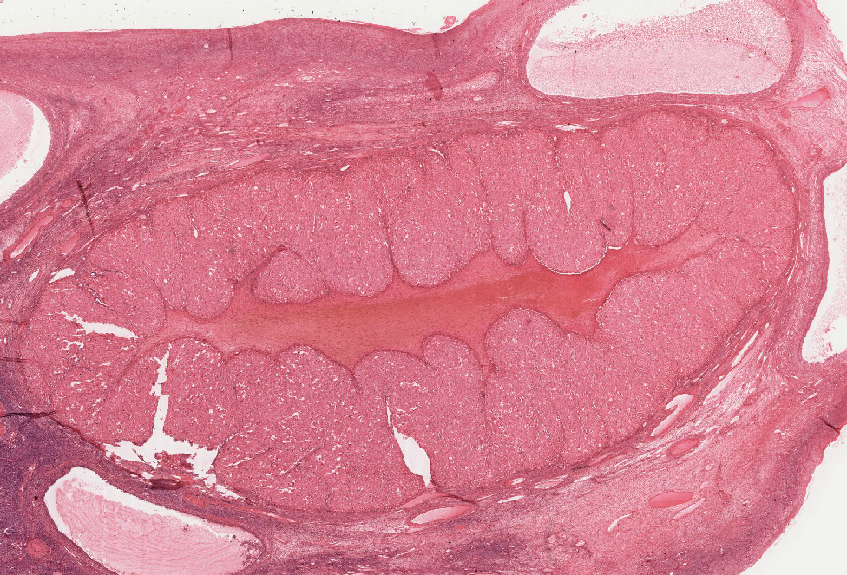
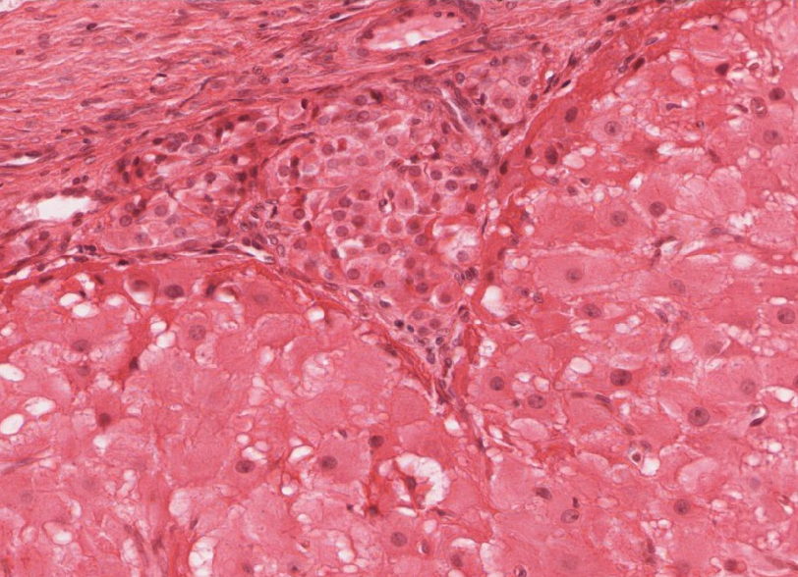
Extra slide UMich 236a: corpus luteum
theca lutein
granulosa lutein
Corpus Luteum: After ovulation, the follicle which housed the ovum collapses and becomes highly infolded and invaded by vessels, forming the corpus luteum [example] (yellow body). Examine slide 236a and observe that the corpus luteum appears pale and very folded. If the egg is fertilized and implants, the corpus luteum enlarges to become the corpus luteum of pregnancy. Examine the inner granulosa lutein cells [example] (formed from the remaining granulosa cells) and the outer theca lutein cells [example] which come from the remaining theca interna cells. Both cell types are polyhedral and filled with lipid droplets and have centrally located nuclei. The theca lutein cells are, however, considerably smaller, more darkly staining and have fewer lipid filled vacuoles than the granulosa lutein cells. They are found most prominently in the infoldings right up against the granulosa lutein layer. Granulosa lutein cells contain a pigment, lipochrome, which produces the yellowish color of the corpus luteum in an unfixed ovary. A central blood clot may be present in recently ovulated follicles.

Slide 8
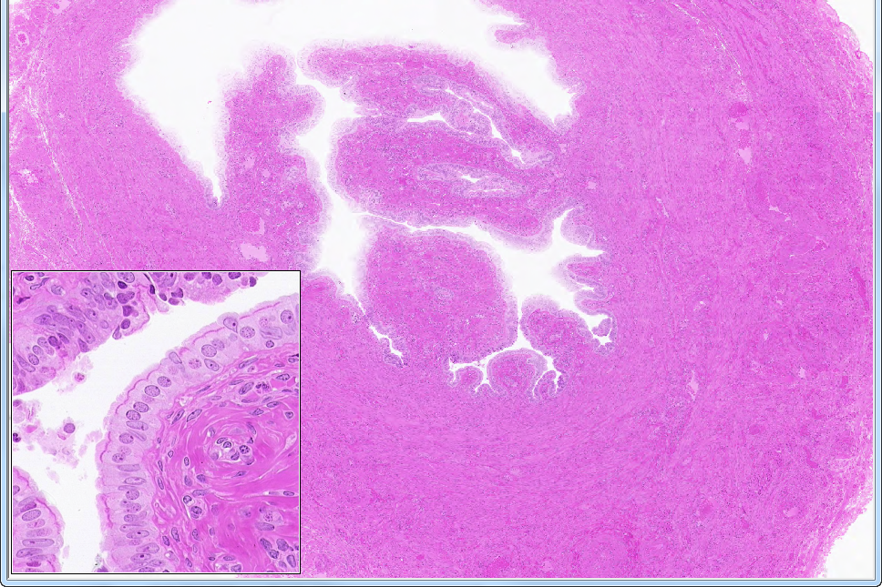
Slide 51: Oviduct, isthmus
(NOTE: adjust the brightness and contrast to examine the epithelial lining)
serosa
mucosa
ciliated
peg
icm
olm
Notes:
icm=inner circular muscle bundles olm=outer longitudinal muscle bundles
Notes from Dr. Carbrey:
Oviduct (fallopian tube) - 4 sections – infundibulum, ampulla, isthmus, intramural or uterine
mucosa – simple columnar epithelium, highly folded, folds reduce when get closer to uterus; consists of:
ciliated cells
non-ciliated “peg” cells (secretory)
lamina propria
muscularis - smooth muscle, inner circular, outer longitudinal
serosa

Slide 9
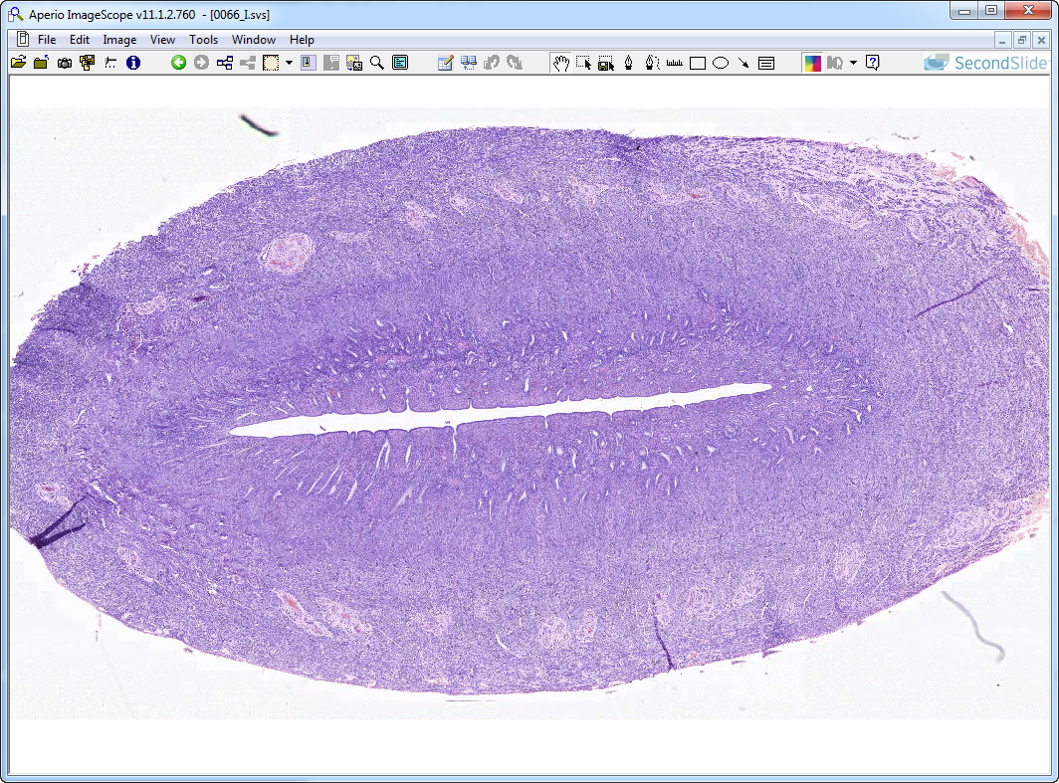
Slide 66: Uterus, proliferative
stratum basale
stratum functionale
endometrium
myometrium
perimetrium
Notes:
Notes from Dr. Carbrey:
Uterus - layers same as oviduct
endometrium – simple columnar epithelium, ciliated cells and peg cells
stratum functionale – sloughed off during menstruation
stratum basale
myometrium – muscularis, 3 layers (hard to distinguish) of whorled smooth muscle: inner and outer long., middle cir.
perimetrium – mostly serosa, some adventitia
endometrial changes – height of endom., gland shape, secretory state
proliferative phase – should see signs of mitosis in the bottom of glands endometrium short, straight glands, no glycogen
secretory phase – should see signs of secretion
early – corkscrew shaped glands, glycogen basal
late – sawtooth shaped glands, glycogen luminal
menstruation - functional layer sloughing off

Slide 10
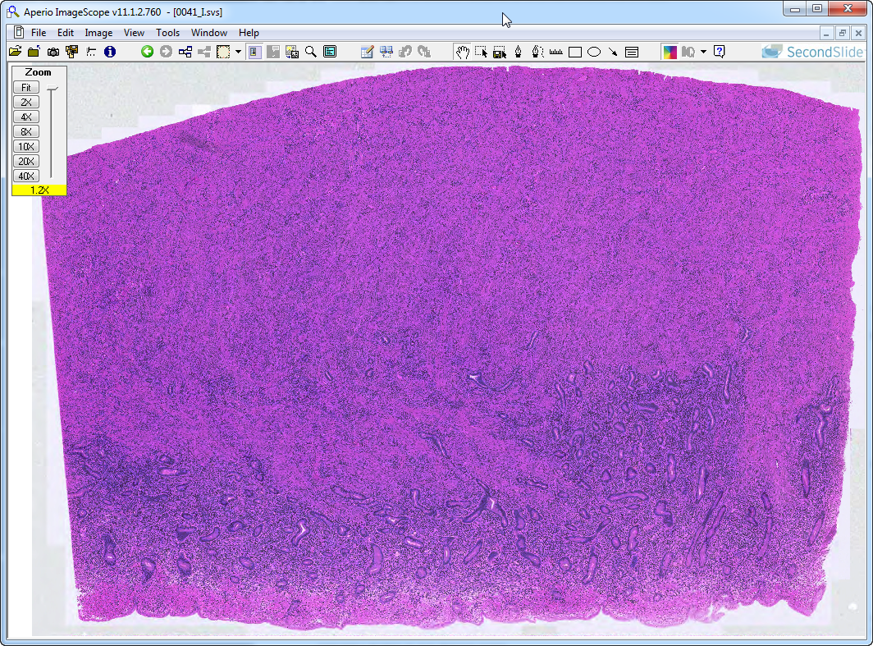
Slide 41: uterus, proliferative
myometrium
endometrium
Notes:
Notes from Dr. Carbrey:
Uterus - layers same as oviduct
endometrium – simple columnar epithelium, ciliated cells and peg cells
stratum functionale – sloughed off during menstruation
stratum basale
myometrium – muscularis, 3 layers (hard to distinguish) of whorled smooth muscle: inner and outer long., middle cir.
perimetrium – mostly serosa, some adventitia
endometrial changes – height of endom., gland shape, secretory state
proliferative phase – should see signs of mitosis in the bottom of glands endometrium short, straight glands, no glycogen
secretory phase – should see signs of secretion
early – corkscrew shaped glands, glycogen basal
late – sawtooth shaped glands, glycogen luminal
menstruation - functional layer sloughing off

Slide 11
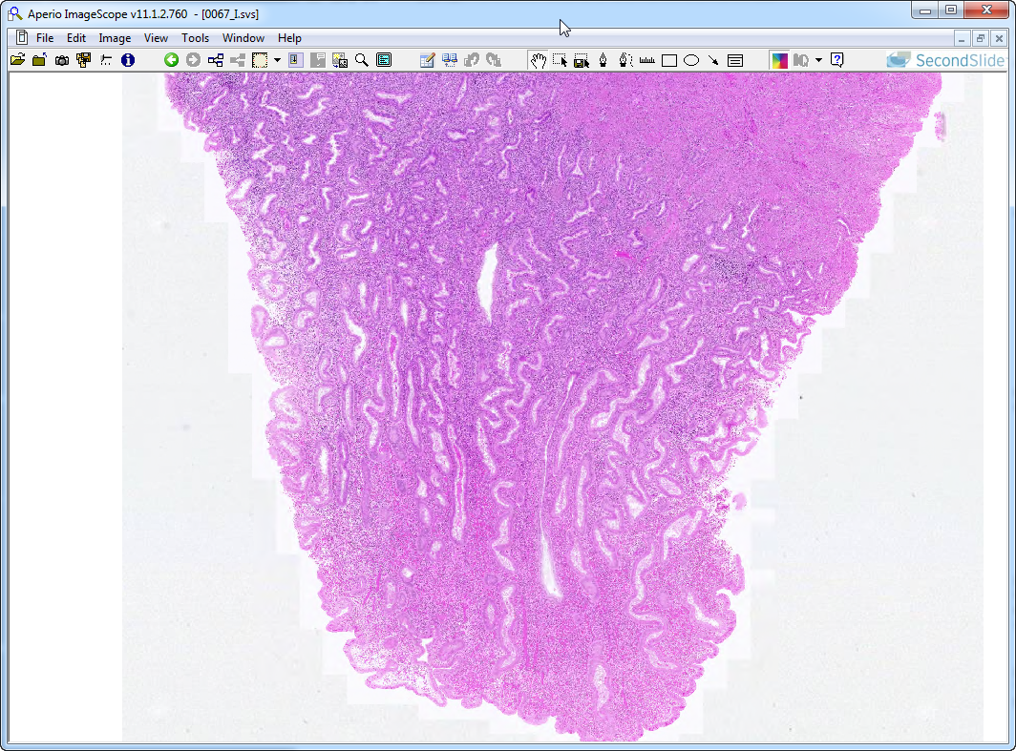
Slide 67: uterus, early secretory
myometrium
endometrium
luminal surface
Notes:
Notes from Dr. Carbrey:
Uterus - layers same as oviduct
endometrium – simple columnar epithelium, ciliated cells and peg cells
stratum functionale – sloughed off during menstruation
stratum basale
myometrium – muscularis, 3 layers (hard to distinguish) of whorled smooth muscle: inner and outer long., middle cir.
perimetrium – mostly serosa, some adventitia
endometrial changes – height of endom., gland shape, secretory state
proliferative phase – should see signs of mitosis in the bottom of glands endometrium short, straight glands, no glycogen
secretory phase – should see signs of secretion
early – corkscrew shaped glands, glycogen basal
late – sawtooth shaped glands, glycogen luminal
menstruation - functional layer sloughing off

Slide 12
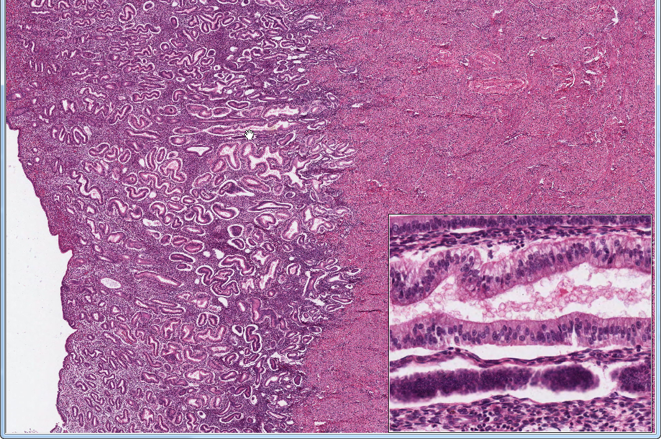
Slide 305: uterus, early secretory
endometrium
myometrium
uterine gland: note basal glycogen
Notes:
Notes from Dr. Carbrey:
Uterus - layers same as oviduct
endometrium – simple columnar epithelium, ciliated cells and peg cells
stratum functionale – sloughed off during menstruation
stratum basale
myometrium – muscularis, 3 layers (hard to distinguish) of whorled smooth muscle: inner and outer long., middle cir.
perimetrium – mostly serosa, some adventitia
endometrial changes – height of endom., gland shape, secretory state
proliferative phase – should see signs of mitosis in the bottom of glands endometrium short, straight glands, no glycogen
secretory phase – should see signs of secretion
early – corkscrew shaped glands, glycogen basal
late – sawtooth shaped glands, glycogen luminal
menstruation - functional layer sloughing off

Slide 13
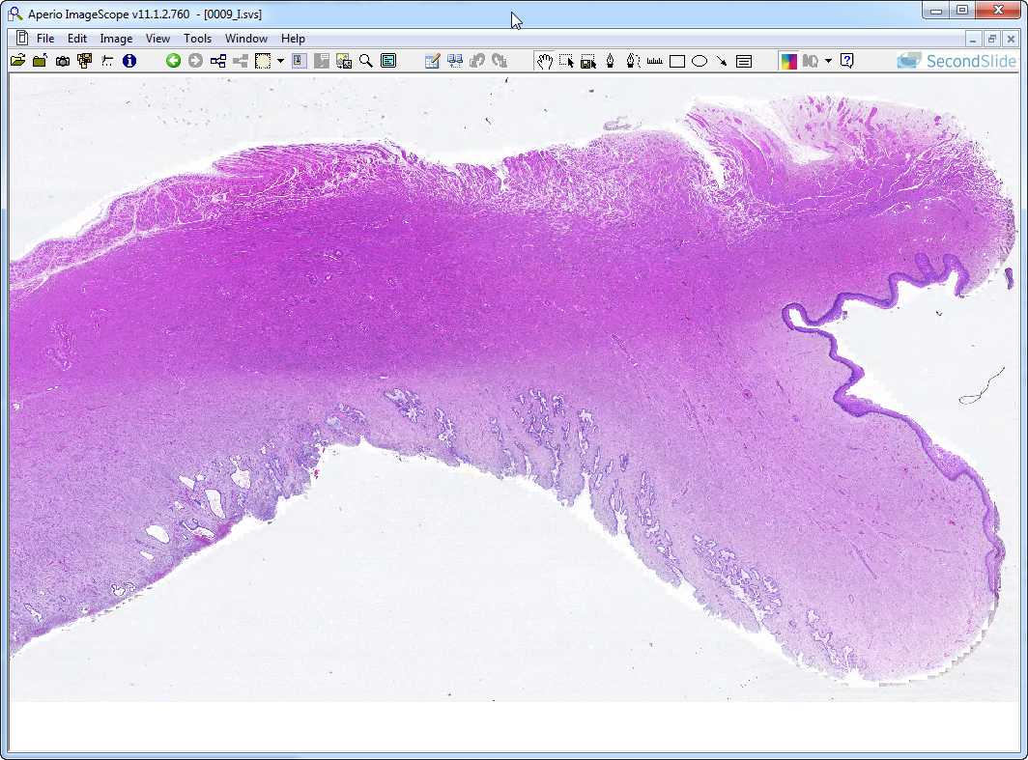
Slide 9: cervix
(see also UMich slide 249: WebScope ImageScope)
perimetrium
myometrium
vaginal
mucosa
cervical glands
endometrium
Notes:
Notes from Dr. Carbrey:
Uterus - layers same as oviduct
endometrium – simple columnar epithelium, ciliated cells and peg cells
stratum functionale – sloughed off during menstruation
stratum basale
myometrium – muscularis, 3 layers (hard to distinguish) of whorled smooth muscle: inner and outer long., middle cir.
perimetrium – mostly serosa, some adventitia
endometrial changes – height of endom., gland shape, secretory state
proliferative phase – should see signs of mitosis in the bottom of glands endometrium short, straight glands, no glycogen
secretory phase – should see signs of secretion
early – corkscrew shaped glands, glycogen basal
late – sawtooth shaped glands, glycogen luminal
menstruation - functional layer sloughing off
cervix – branched glands, mucous producing - pale staining epithelium, less smooth muscle
Vagina
mucosa – st. sq. nonkeratinized, no glands, glycogen produced, large folds (papillae), elastic fibers
muscularis – inner cir., outer long. – poorly defined
adventitia

Slide 14
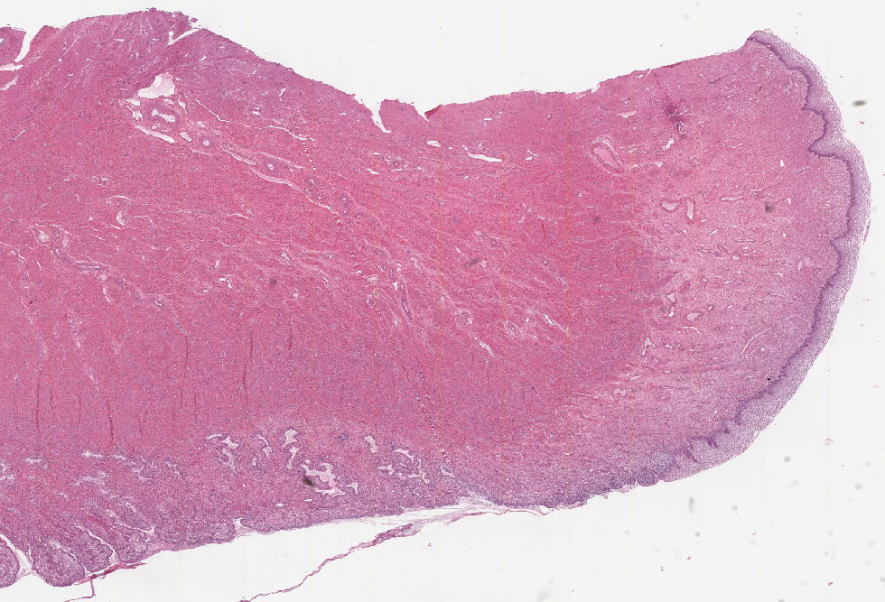
Extra slide UMich 249: Cervix
The uterine cervix shown in slide 249 is continuous with both the body of the uterus and the upper portion of the vagina. Note that the wall has considerable smooth muscle and much dense connective tissue. Note also the number of collagen fibers in the stroma. The mucosa is lined by a tall columnar mucus-secreting epithelium in its uterine portion, but note the abrupt change to stratified squamous epithelium at its vaginal face. This stratocolumnar junction which should be readily identifiable in both slide 249 [example] and is frequently the site of pre-neoplastic and neoplastic (cervical cancer) changes. The mucosa is thrown into deep irregular folds known as plicae palmitae (palmate folds). During the majority of the uterine cycle these glands secrete a highly viscous mucus forming a barrier to microorganisms, while at mid-cycle (ovulation) the mucus becomes more hydrated, which facilitates sperm entry.

Slide 15
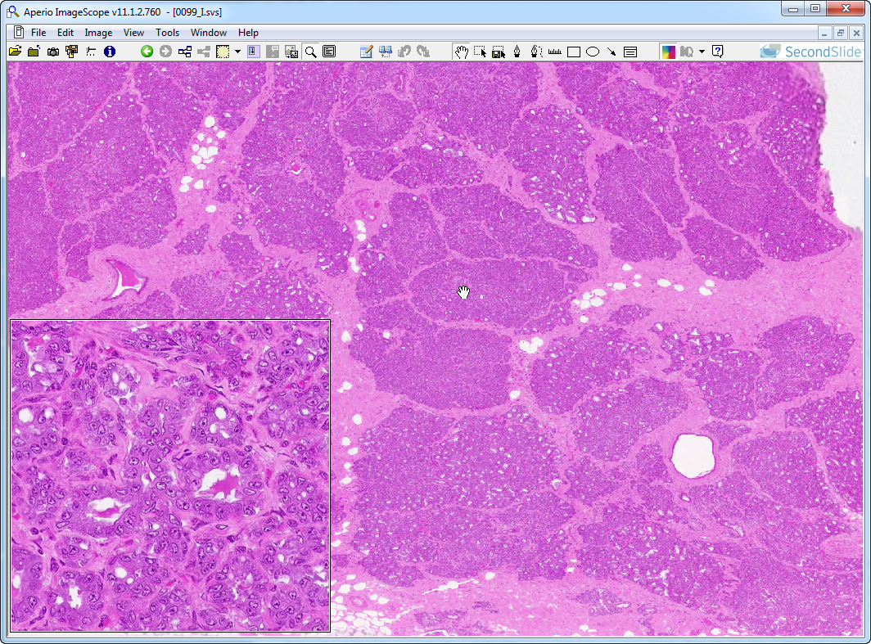
Slide 99: lactating mammary gland
ied
lobule
ied
iad
Notes:
iad=INTRAlobular duct ied=INTERlobular duct
Notes from Dr. Carbrey:
Mammary Gland
tubuloalveolar glands – s. cub. to s. col. epi., surrounded by myoepithelial cells
large ducts are stratified cuboidal (2 layers)
lactiferous ducts lead to surface – become st. sq.
depending on activity can contain a lot of connective tissue:
inactive – lots of inter and intralobular connective tissue
proliferative – more ducts, alveoli form, connective tissue compressed
lactating – can barely see connective tissue, colloid present

Slide 16
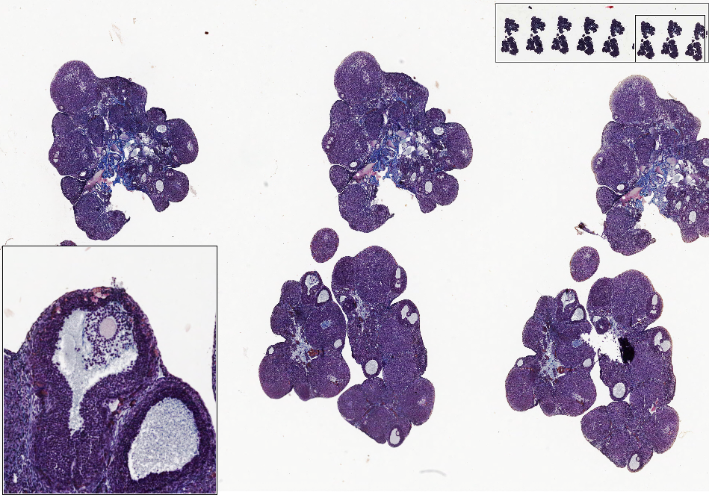
Slide 314: ovulating ovary, cat
ovulating follicle
o
cr
g

