Slide 1
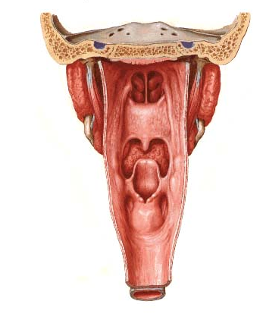
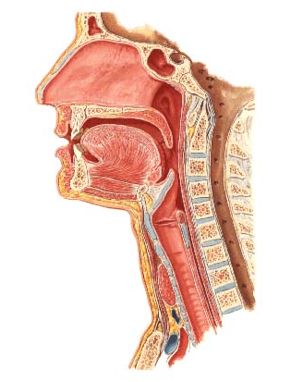
Nasal cavity, Pharynx and Larynx
Nasal cavity (septum)
Nasopharynx
chonchae
Oropharynx
Epiglottis
Laryngopharynx
Larynx
Esophagus
Trachea
Posterior view
slide courtesy of Dr. Sun-Kee Kim, University of Michigan

Slide 2
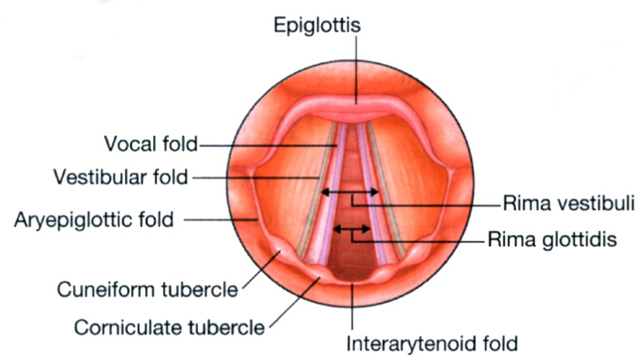
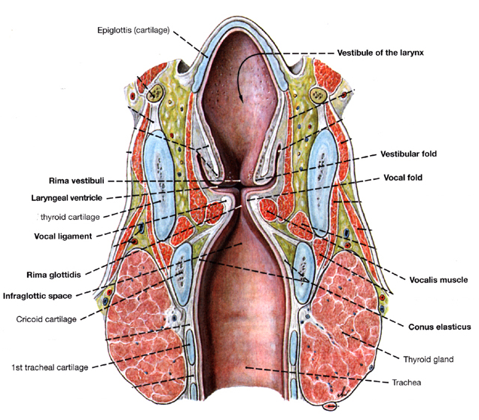
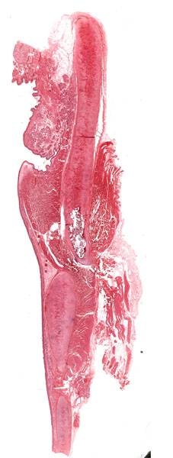
#307 Larynx
Gray’s p.956
Thyroid cartilage
Laryngeal ventricle
Clemente pl. 562
slide courtesy of Dr. Sun-Kee Kim, University of Michigan

Slide 3
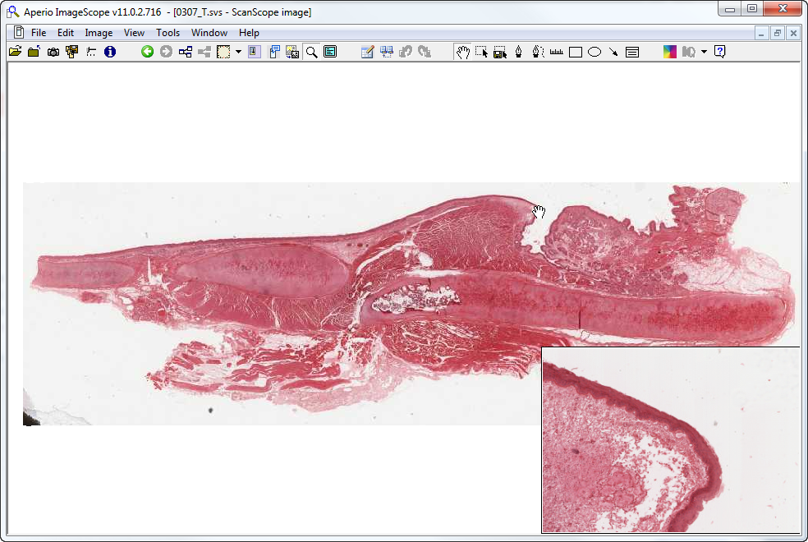
Slide 307 : larynx
false vocal fold
aka vestibular fold
epiglottis
(elastic cartilage)
vocal fold
vocalis m.
cricoid cartilage
thyroid cartilage
St Sq Epith

Slide 4
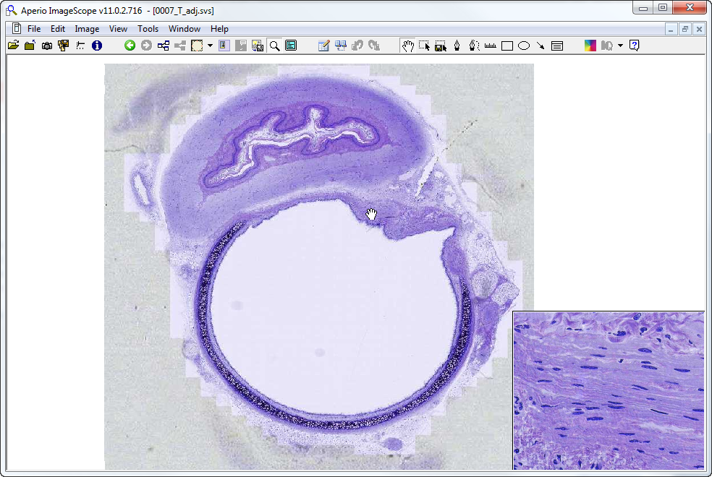
Slide 007 : esophagus & trachea
esophagus
trachealis muscle
neurovascular bundle
trachealis muscle
trachea
anterior

Slide 5
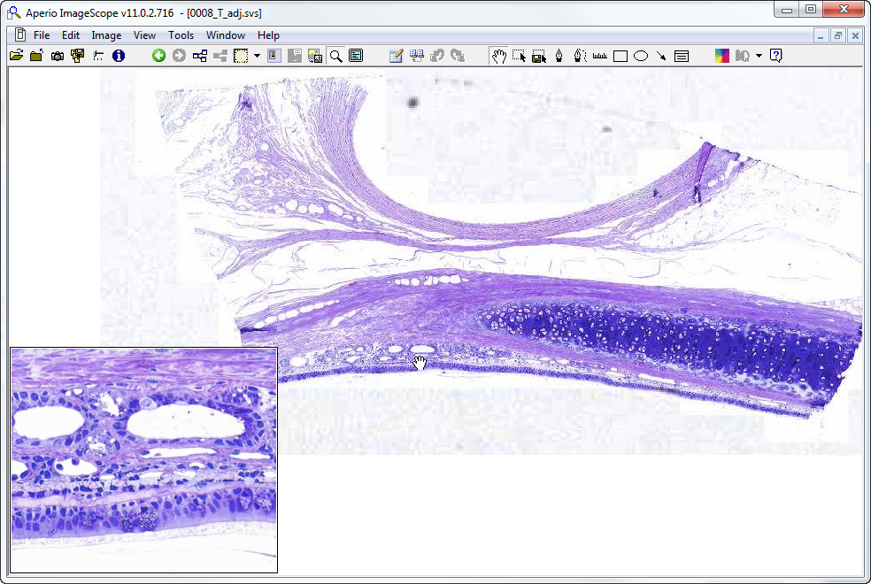
Slide 008: trachea
lumen of ?
adventitia
submucosa
gland
mucosa
gc
Notes:
Gc=goblet cell

Slide 6
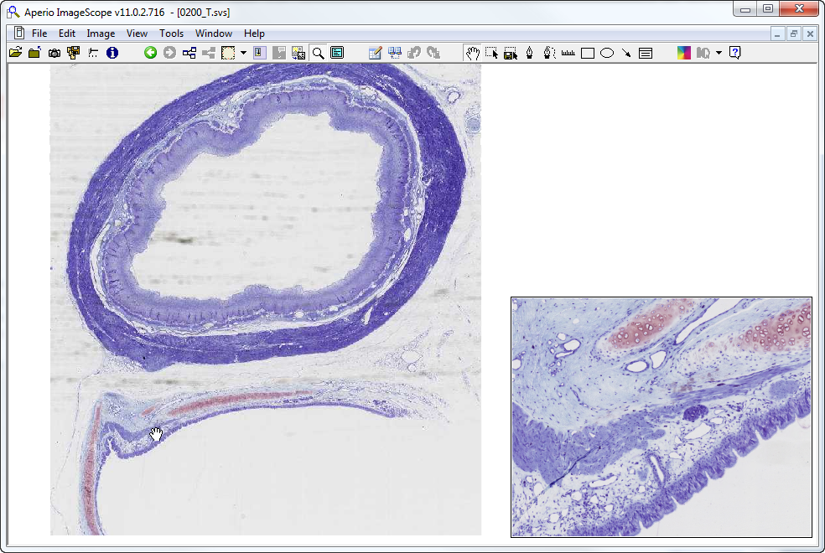
Slide 200: trachea & esophagus
esophagus
g
trachealis m.
sm
lp
d
mucosa
trachea
Notes:
d=duct g=gland lp=lamina propria

Slide 7
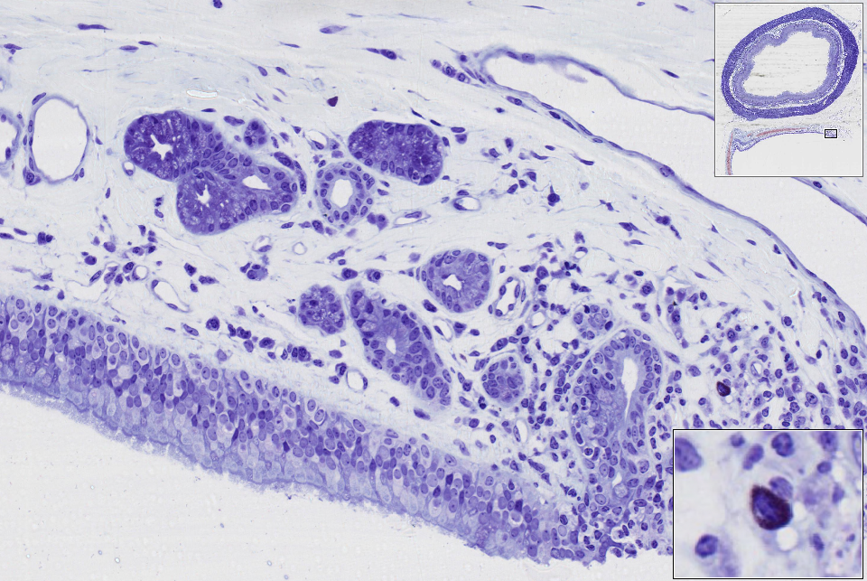
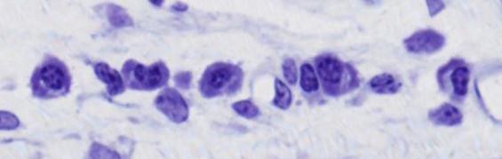
Slide 200: trachea & esophagus
g
SM
d
LP
mucosa
plasma cells
mast cell
Notes:
d=duct g=submucosal glands LP=lamina propria SM=submucosa
Mast cell granules react with toluidine blue and stain dark purple/black

Slide 8
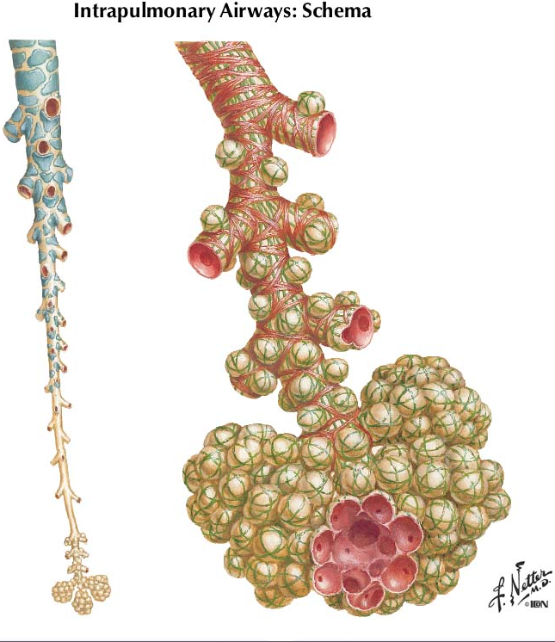
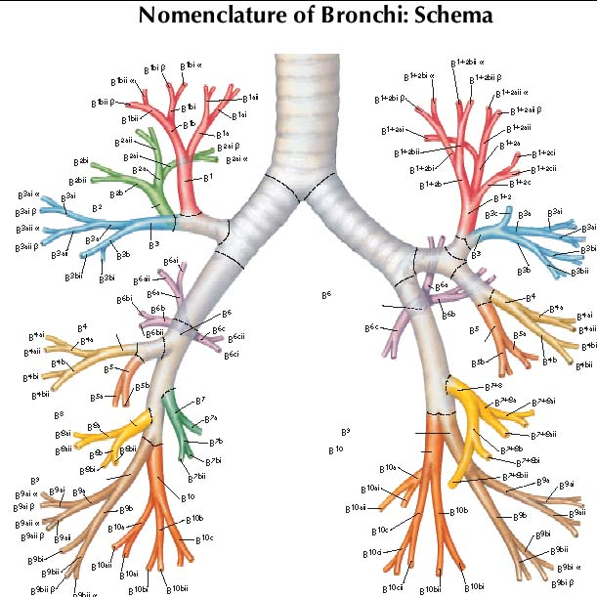
terminal bronchiole
respiratory
bronchioles
Bronchi
alveolar duct
alveolar
sac
Bronchioles
Terminal bronchiole
Respiratory bronchiole
Alveolar ducts and sacs
slide courtesy of Dr. Sun-Kee Kim, University of Michigan

Slide 9
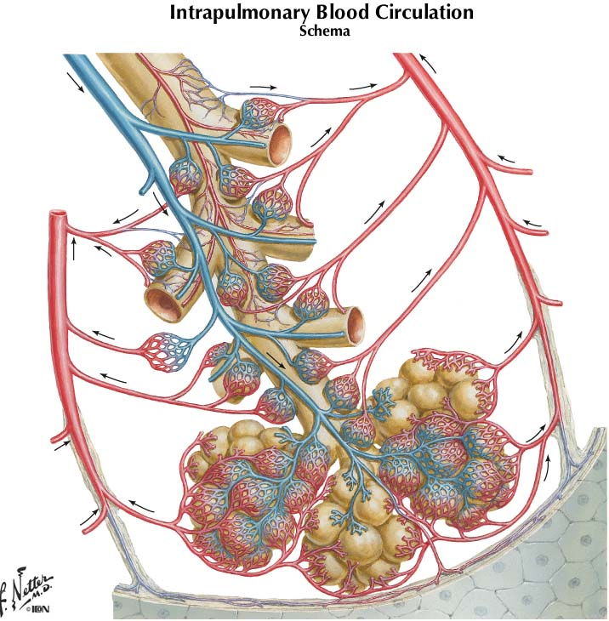
Intrapulmonary circulation
Pulmonary artery
Pulmonary vein
Pulmonary vein
slide courtesy of Dr. Sun-Kee Kim, University of Michigan

Slide 10
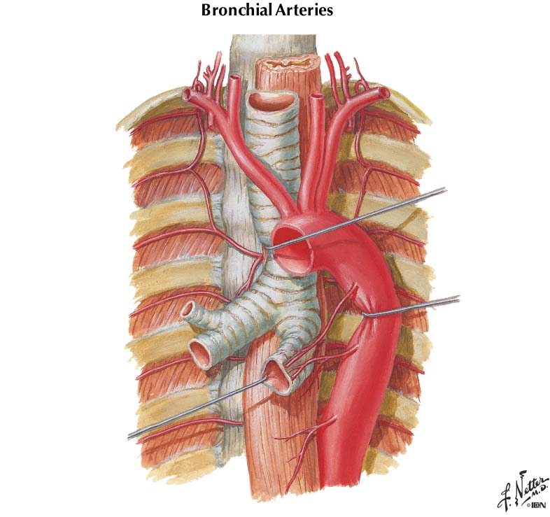
Bronchial Arteries
Right bronchial artery
Left bronchial arteries
slide courtesy of Dr. Sun-Kee Kim, University of Michigan

Slide 11
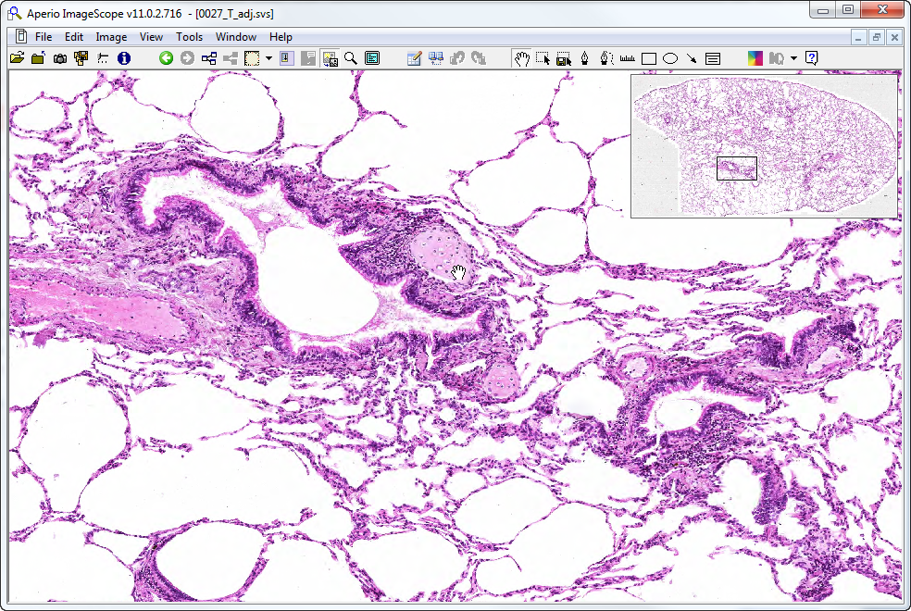
Slide 0027: lung
alveolus
bronchus
pa
br-iole
Notes:
Note the PRESENCE of cartilaginous plates in the wall of the bronchus
Br-iole=bronchiole (note ABSENCE of cartilage)
Pa=branch of pulmonary artery (follows respiratory tree)

Slide 12
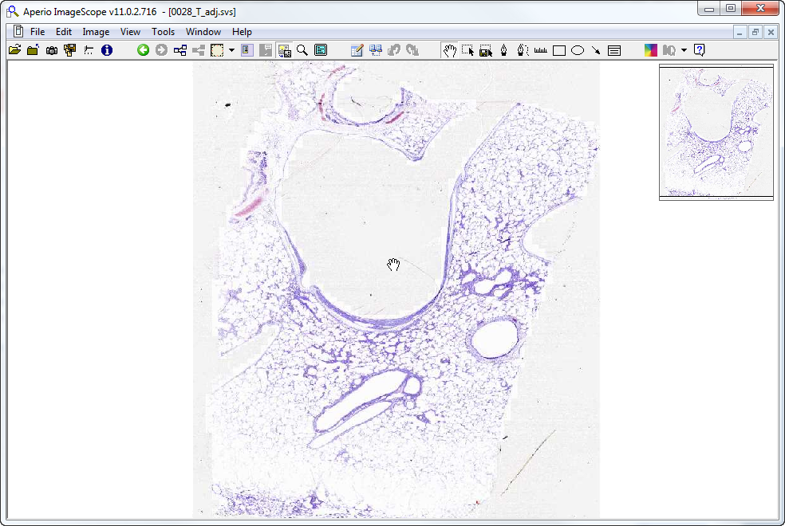
Slide 0028: lung
4?
3?
6?
1?
5?
2?
3?
Notes:
Numbers indicate structures you should try and identify. For number 6, identify the specific tissue type, then work out what organ it has to be.
Then look at alveoli to find type I & II pneumocytes, endothelial cells, and interstitial mast cells

Slide 13
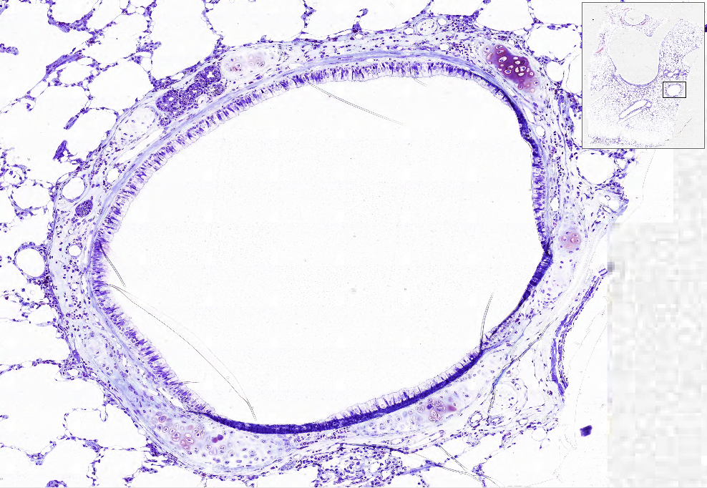
Slide 0028: lung
1?
surrounding tissue?
epithelium – simple? goblet cells?
cartilage?
glands?

Slide 14
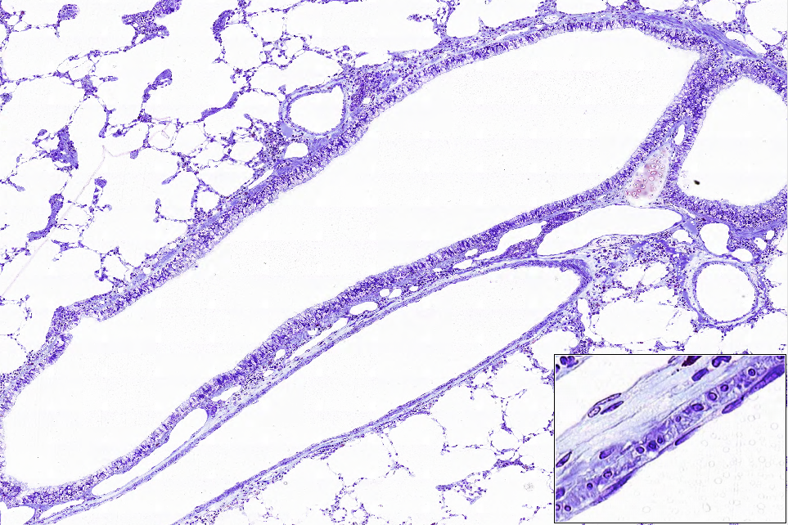
Slide 0028
2?
3?

Slide 15
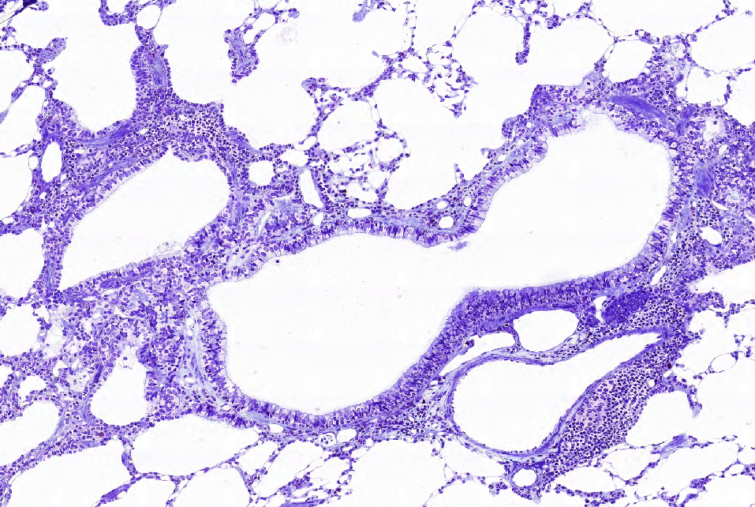
Slide 0028
4?
3?

Slide 16
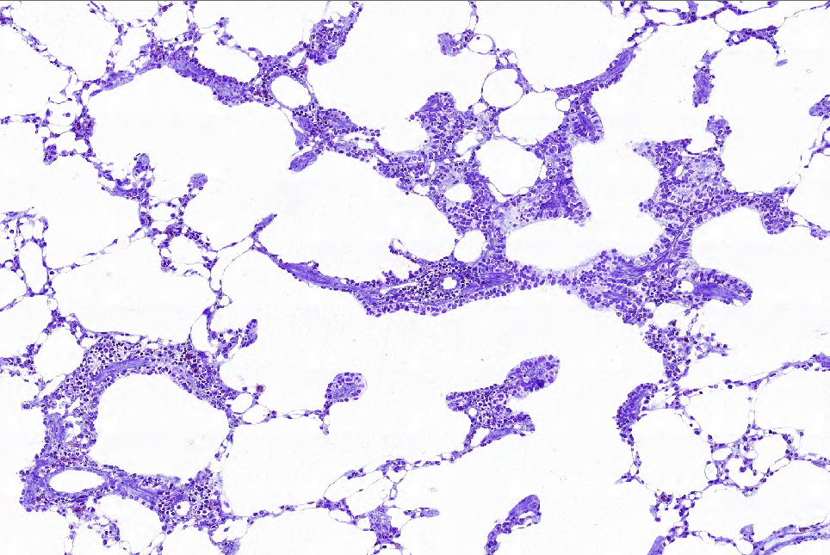
Slide 0028
5?

Slide 17
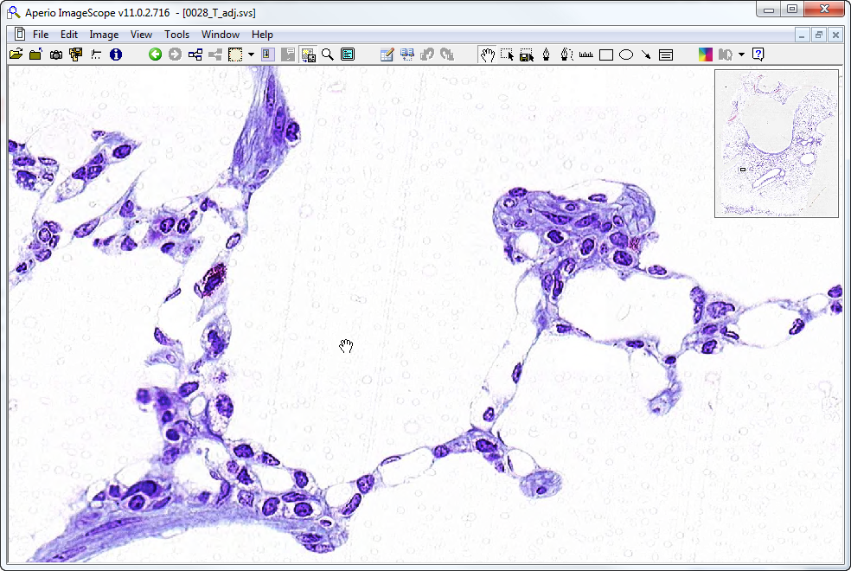
Slide 0028: lung
type I cell
mast cell
type II cells
type I cell
endothelial cell
endothelial cell

Slide 18
Respiratory System ‘Extra Slides’ Orientation Images

Slide 19
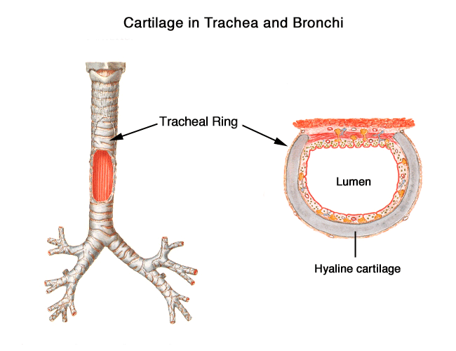
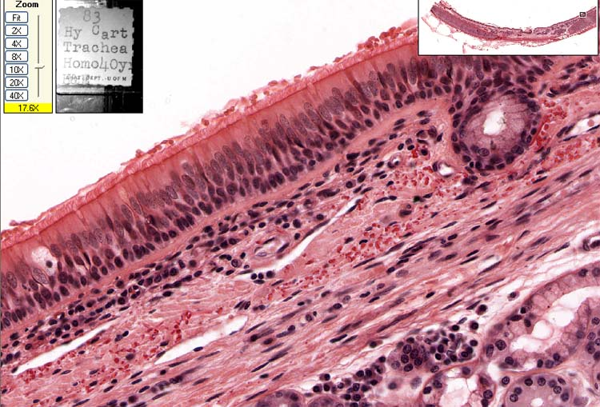
#40; Trachea
Basement membrane
Respiratory epithelium
Elastic fibers
slide courtesy of Dr. Sun-Kee Kim, University of Michigan

Slide 20
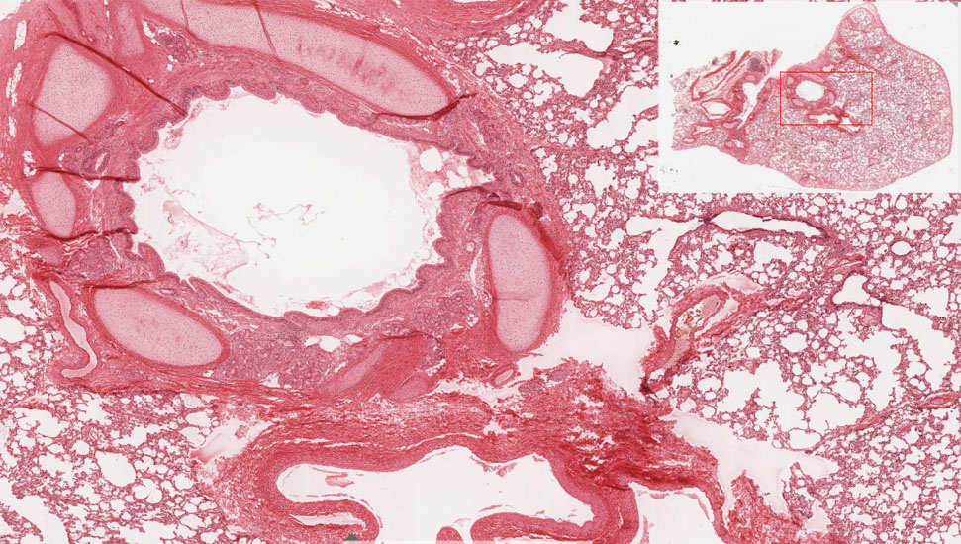
#130-1 Lung
1?
Bronchus
2?
Pulmonary artery
slide courtesy of Dr. Sun-Kee Kim, University of Michigan

Slide 21
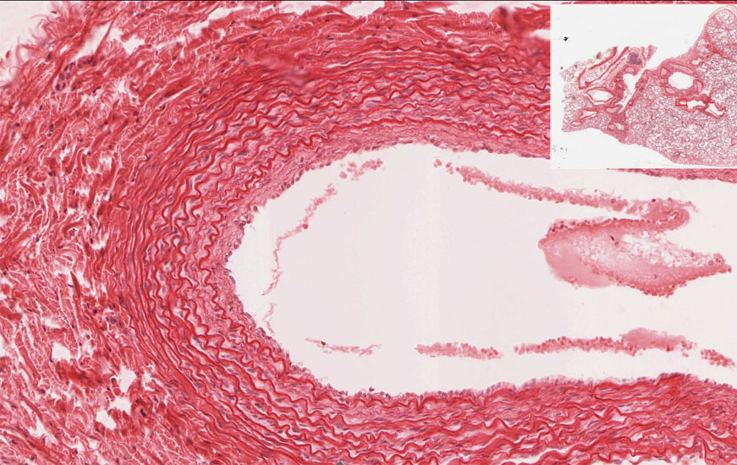
#130-1 Lung
Pulmonary artery
Close to bronchial trees relatively thin wall (media) elastic laminae relatively wide lumen
slide courtesy of Dr. Sun-Kee Kim, University of Michigan

Slide 22
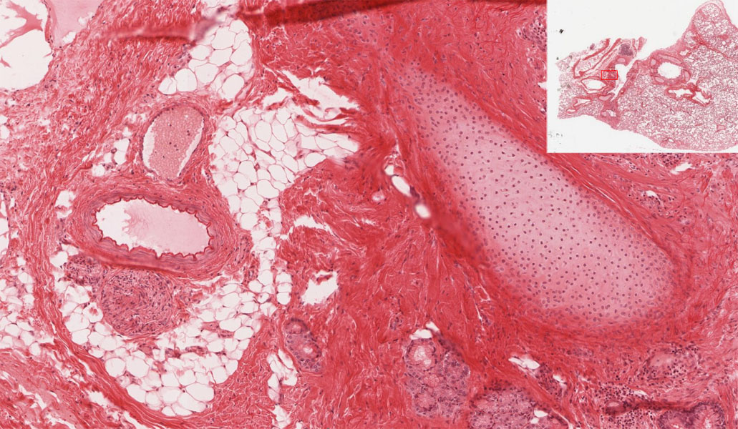
#130-1 Lung
4?
3?
bronchial vein
bronchial artery
bronchial cartilage
slide courtesy of Dr. Sun-Kee Kim, University of Michigan
Notes:
‘Bronchial’ vessels (arteries & veins) are systemic blood vessels in the walls of bronchi that will appear similar to arteries and veins elsewhere in the body. Bronchial arteries are branches of the aorta that supply oxygenated blood to the tissues of the bronchial wall. Bronchial veins drain that blood into the system circulation via the azygous veins.

Slide 23
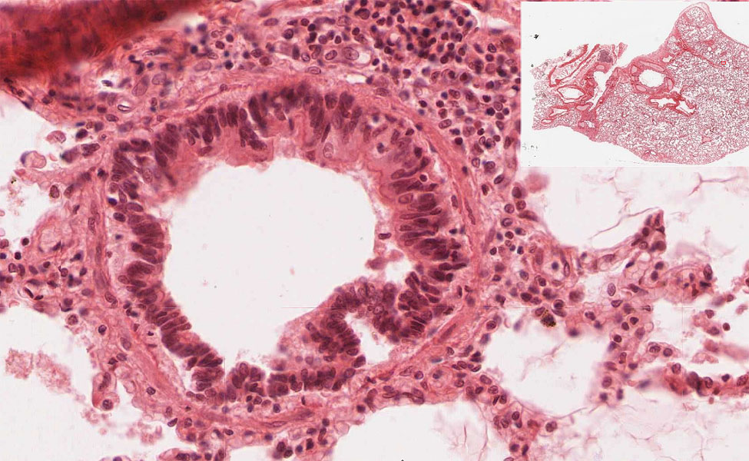
#130-1 Lung
Bronchiole
Ciliated cells
non-ciliated cells
Ciliated and non-ciliated (Clara) cells, no goblet cells, no cartilage, no glands
Smooth muscle
slide courtesy of Dr. Sun-Kee Kim, University of Michigan

Slide 24
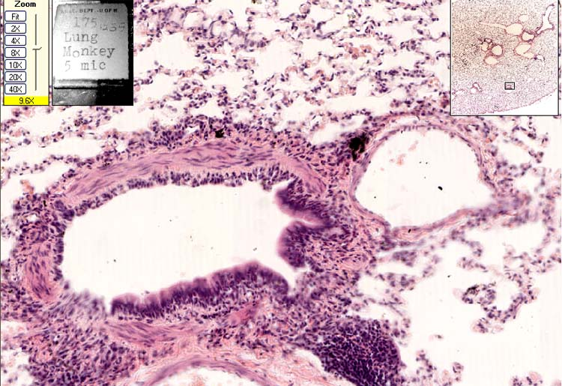
#132-2 (Terminal) Bronchiole & Pulmonary artery
Smooth Muscle
P. A.
Bronchiole
slide courtesy of Dr. Sun-Kee Kim, University of Michigan

Slide 25
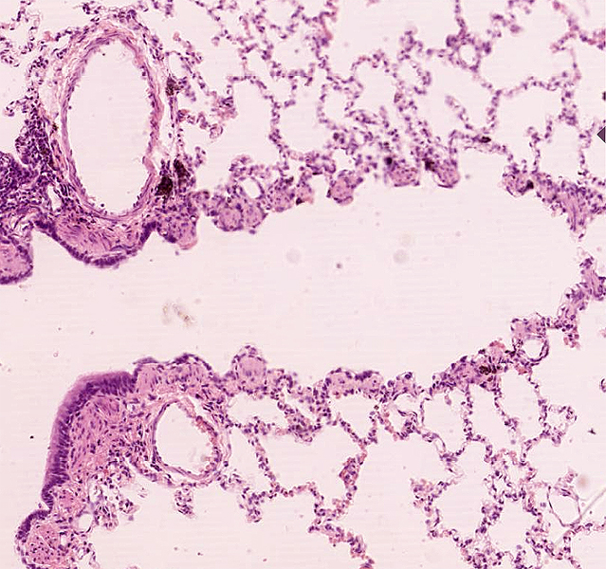
#132 Lung
7?
P.A.
6?
Respiratory bronchiole
5?
Terminal bronchiole
Low cells,
alveolar pocketing,
knobs of sm. muscle (arrows)
slide courtesy of Dr. Sun-Kee Kim, University of Michigan

Slide 26
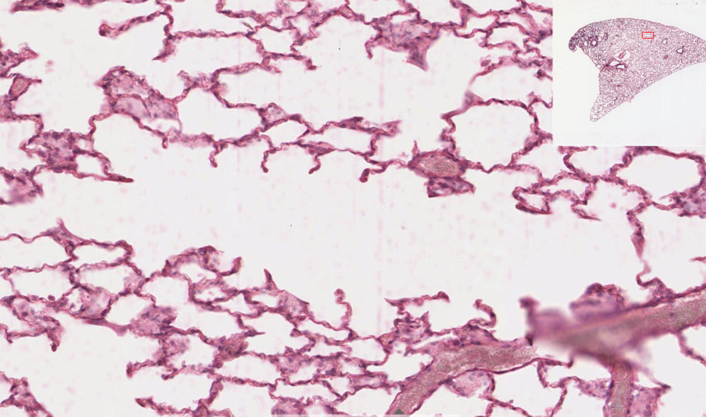
#129 Lung
Alveolar duct
8?
9?
alveoli
slide courtesy of Dr. Sun-Kee Kim, University of Michigan

Slide 27
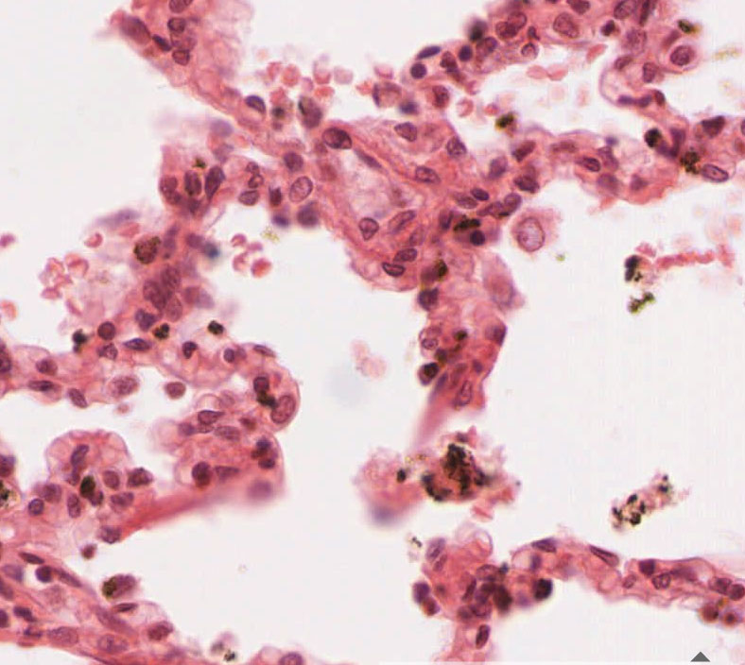
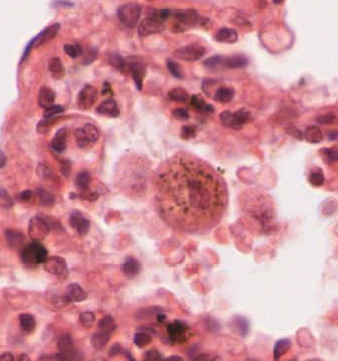
#130-1 Lung
10?
Type I Pneumocyte
12?
Macrophage
11?
Type II Pneumocyte (surfactant)
slide courtesy of Dr. Sun-Kee Kim, University of Michigan

Slide 28
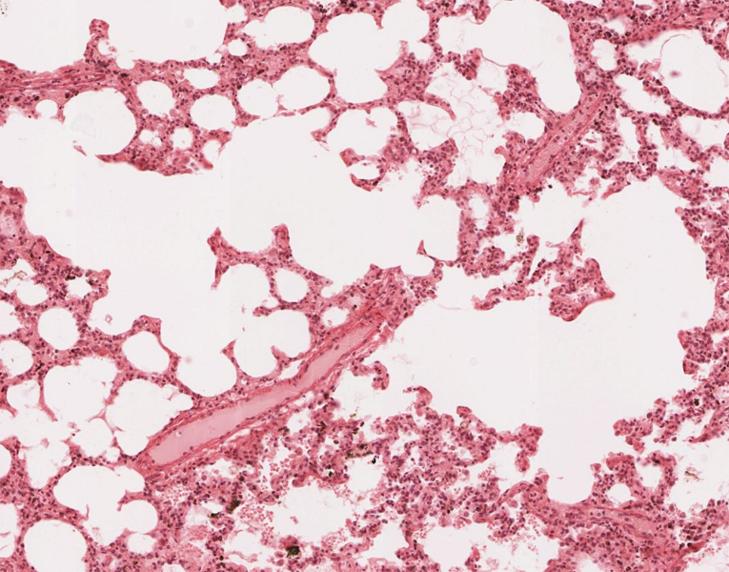
#130-1 Lung
not associated with bronchial trees, thin wall
Pulmonary vein
13?
slide courtesy of Dr. Sun-Kee Kim, University of Michigan

Slide 29
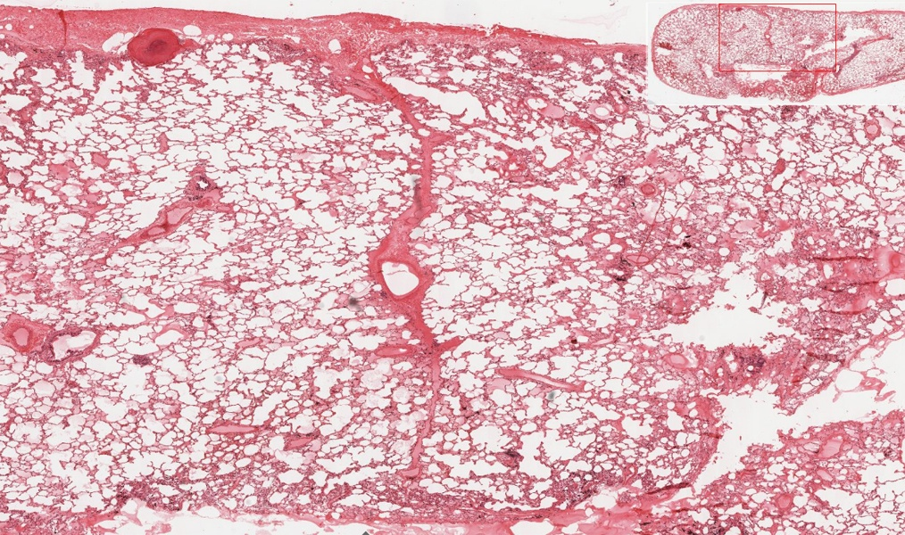
#130-2 Lung
Pulmonary vein
slide courtesy of Dr. Sun-Kee Kim, University of Michigan

Slide 30
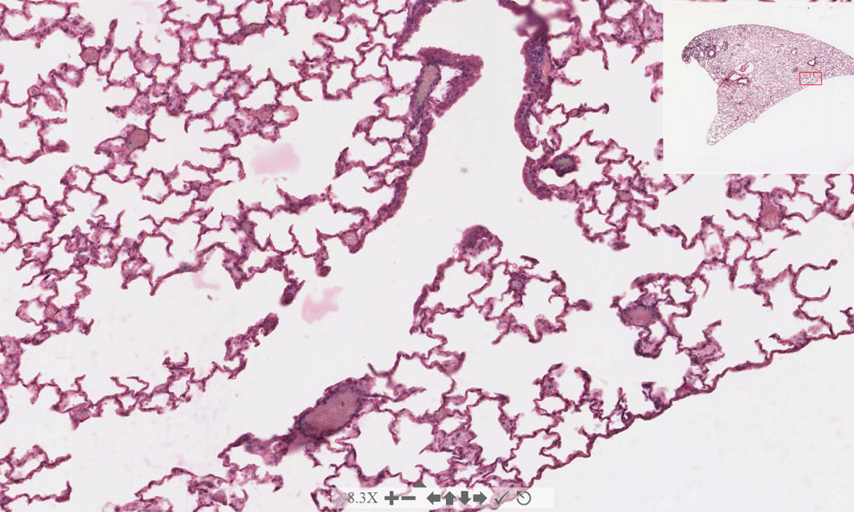
#129 Lung
?
?
?
slide courtesy of Dr. Sun-Kee Kim, University of Michigan

Slide 31
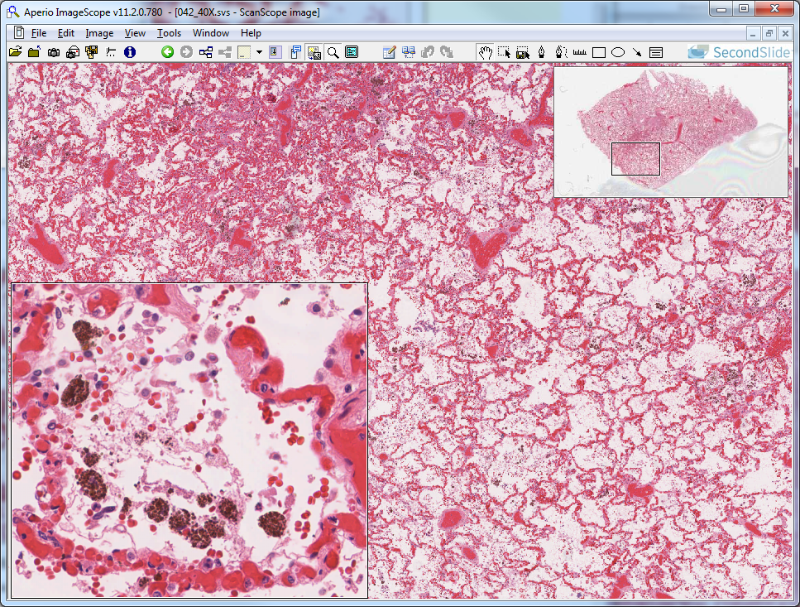
Slide 42: Lung, chronic congestion – hemosiderin-laden macrophages
c
lung alveolar
air space
t2p
hemosiderin-laden macrophages
Notes:
c=distended capillary t2p=type II pneumocyte

