Slide 1
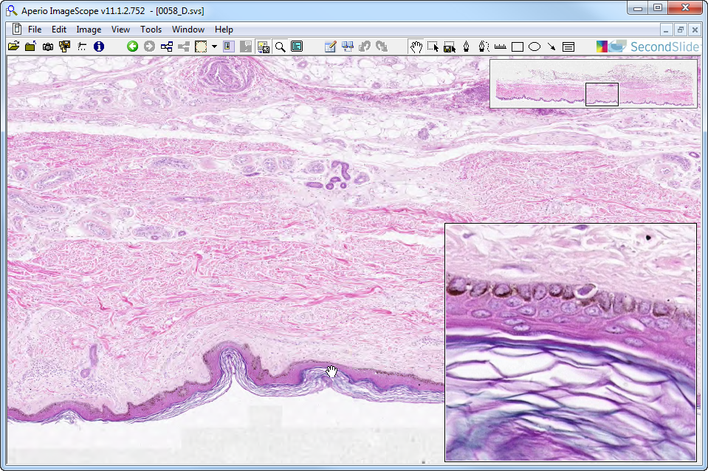
Slide 0058: thin skin
hypodermis
sweat glands
sweat duct
melanocyte
reticular dermis
sweat duct
papillary dermis

Slide 2
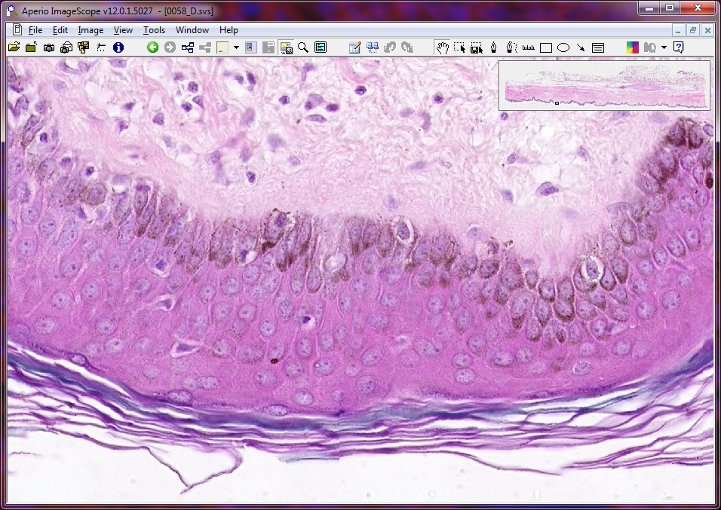
Melanocytes & Langerhans Cells
melanocytes
sb
sp
sg
sc
Langerhans cells
Notes:
sb=stratum basale sc=stratum corneum sg=stratum granulosum sp=stratum spinosum

Slide 3
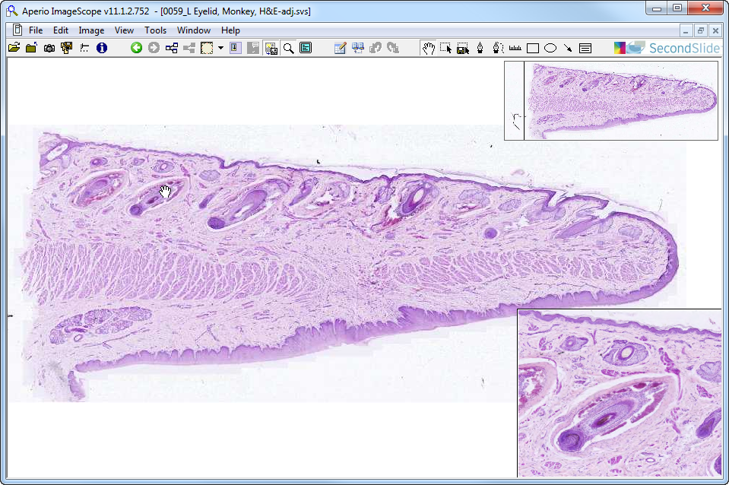
Slide 0059: Lip
slips of levator/depressor labii muscles
hair follicles & sebaceous glands
orbicularis oris
mucous gland
hair follicle

Slide 4
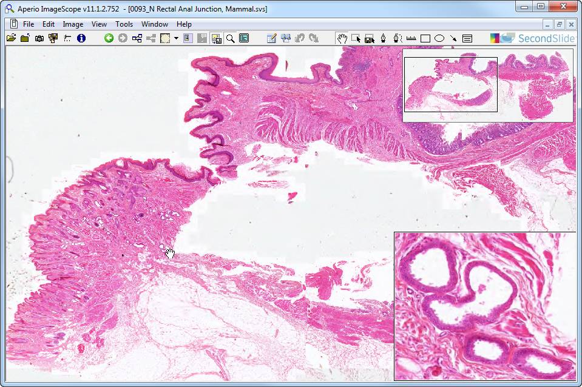
Slide 0093: rectoanal junction
Keratinized epith with hair follicles & sebaceous glands
apocrine gland

Slide 5
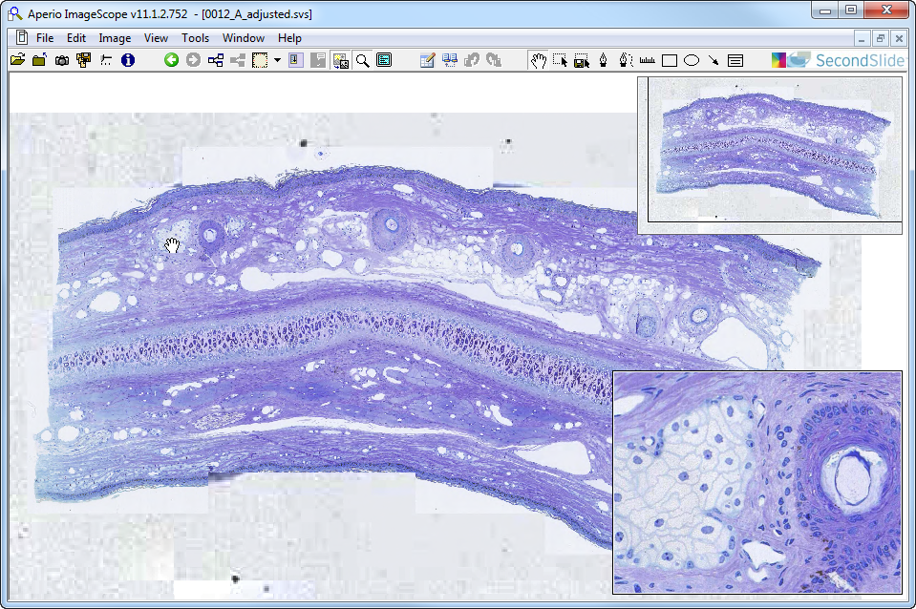
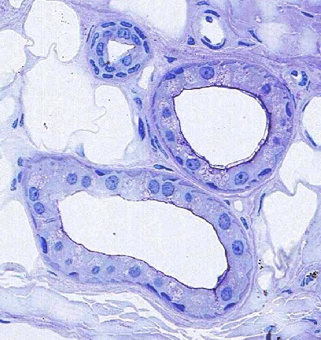
Slide 0012: pinna of ear
epi
hf
derm
hyp
SwG
d
g
hf
SebG
g
myoE
Notes:
Der=dermis d=sweat gland duct Epi=epidermis g=sweat gland
hf=hair follicle hyp=hypodermis myoE=myoepithelial cells SebG=sebaceous gland
SwG=sweat gland

Slide 6
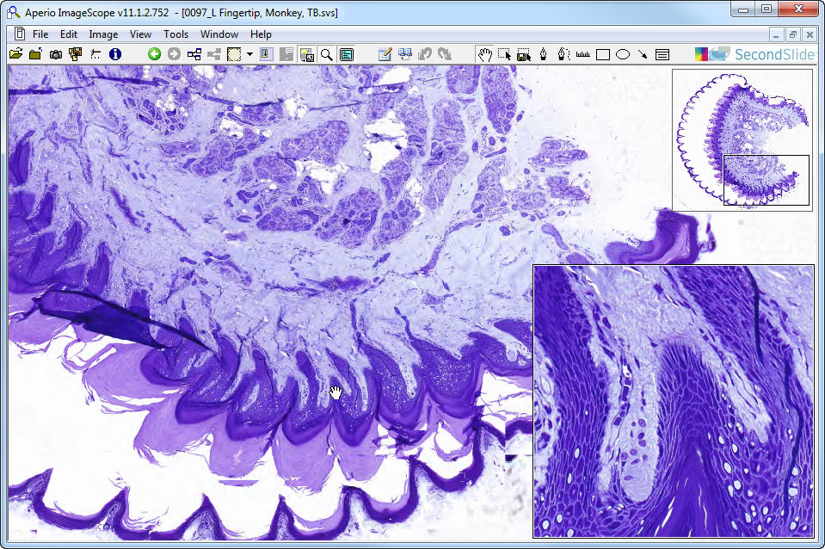
Slide 0097: Fingertip
SwG
dermis
SwD
“hd”
ss
epi
sc
mc
Notes:
Epi=epidermis hd=hemidesmosomes* mc=Meissner’s corpuscle
Sc=stratum corneum of epidermis ss=stratum spinosum SwD=sweat duct
SwG=sweat gland
*NOTE: you can’t actually SEE the hemidesmosomes, but you can see evidence of their presence by the spiny basal processes that seem to “insert” into the underlying connective tissue

Slide 7
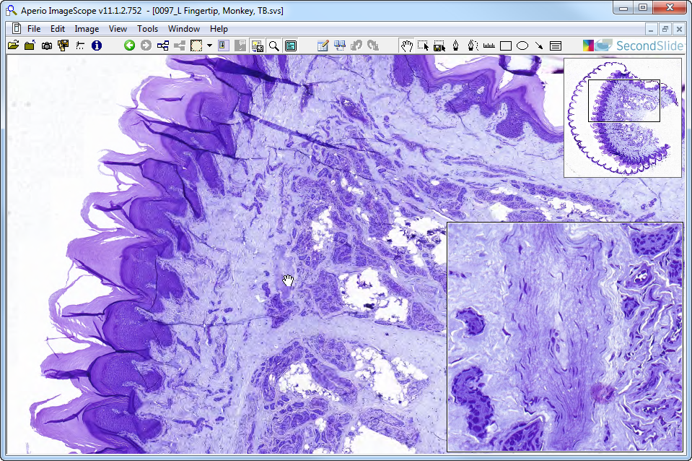
Slide 0097: Fingertip
dermis
sc
epi
pc
Notes:
epi=epidermis pc=Pacinian corpuscle sc=stratum corneum of epidermis

Slide 8
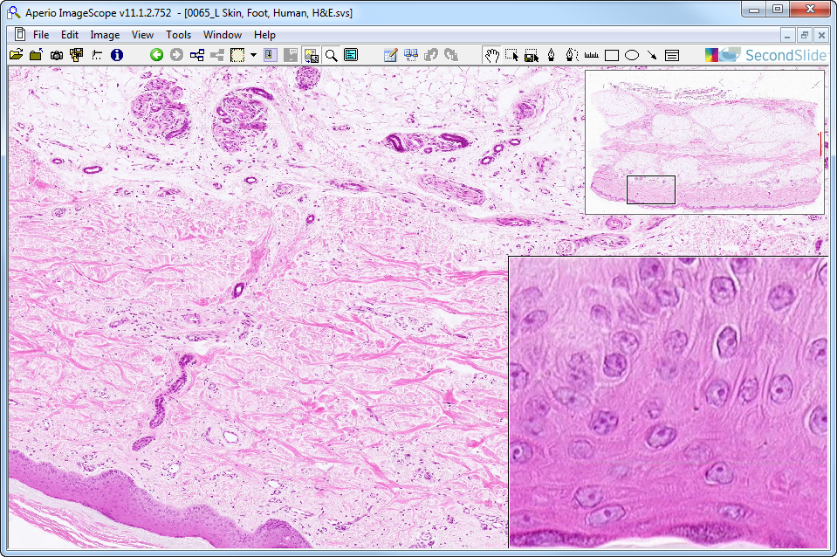
Slide 0065: Plantar skin
hypodermis
SwG
detail of stratum spinosum
SwD
reticular dermis
papillary dermis

Slide 9
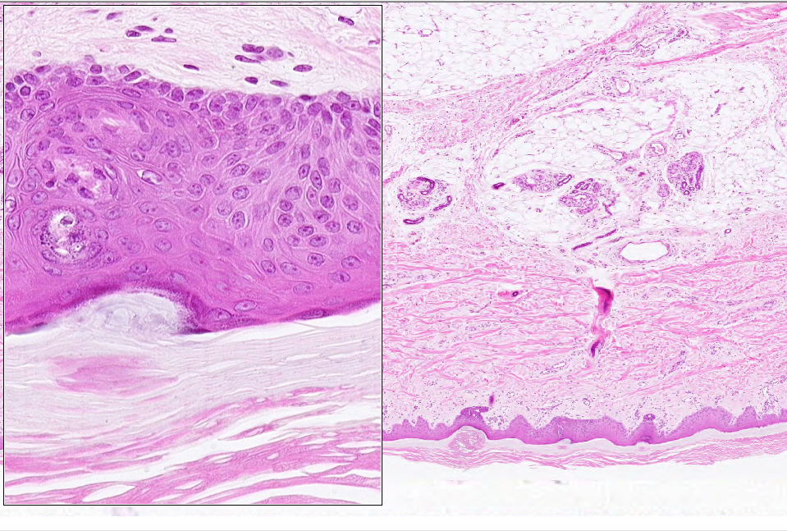
Slide 0065: Plantar skin
StB
hypodermis
SwG
StSp
SwD
SwD
dermis
StG
reticular dermis
SwD
“stratum lucidum”
papillary dermis
stratum corneum
Notes:
StB=stratum basale StSp=stratum spinosum StG=stratum granulosum
SwD=sweat gland duct SwG=sweat gland secretory portion

Slide 10
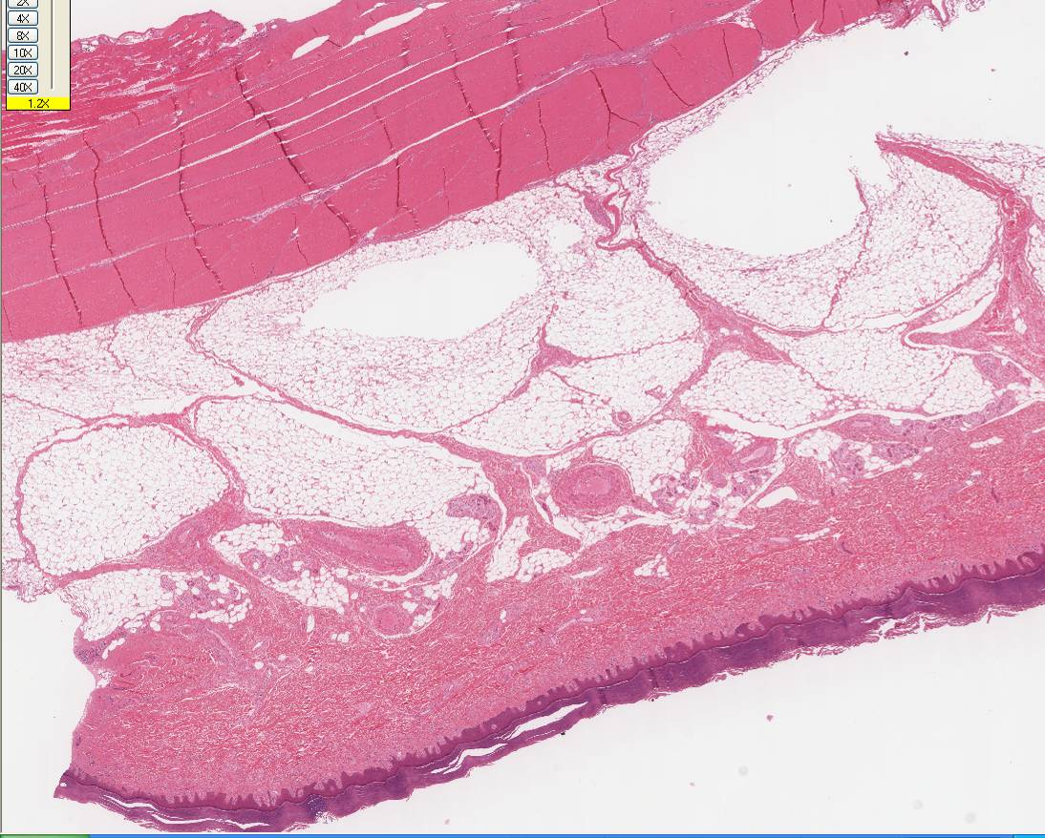
Slide 306 Plantar Skin
Tendon
Sweat Glands
Hypodermis
Blood Vessels
Dermis
Epidermis

Slide 11
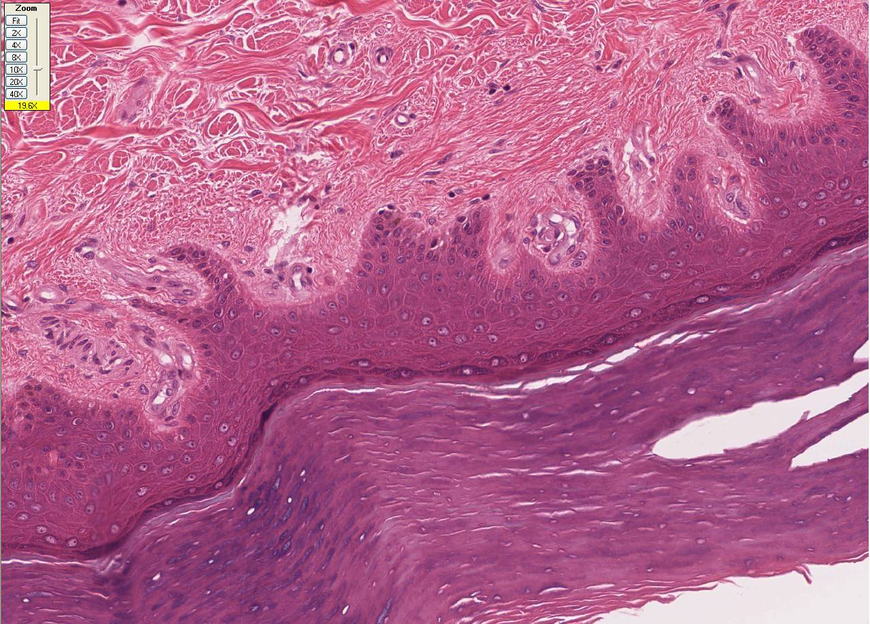
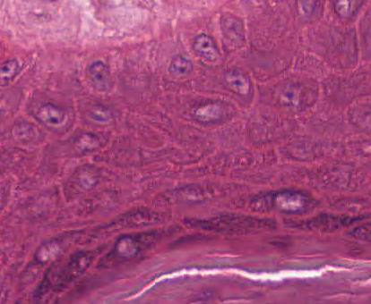
pd
reticular dermis
epidermal
ridges
Sb
basement membrane
dermal
papillae
Sp
Sg
papillary dermis
Sc
blood vessels
nerve
Sb
Sp
Sg
Meissner’s
corpuscle in
dermal papilla
Sc
Slide 306 Plantar Skin
Notes:
pd = papillary dermis Sb = stratum basale Sp = stratum spinosum
Sg = stratum granulosum Sc = stratum corneum

Slide 12
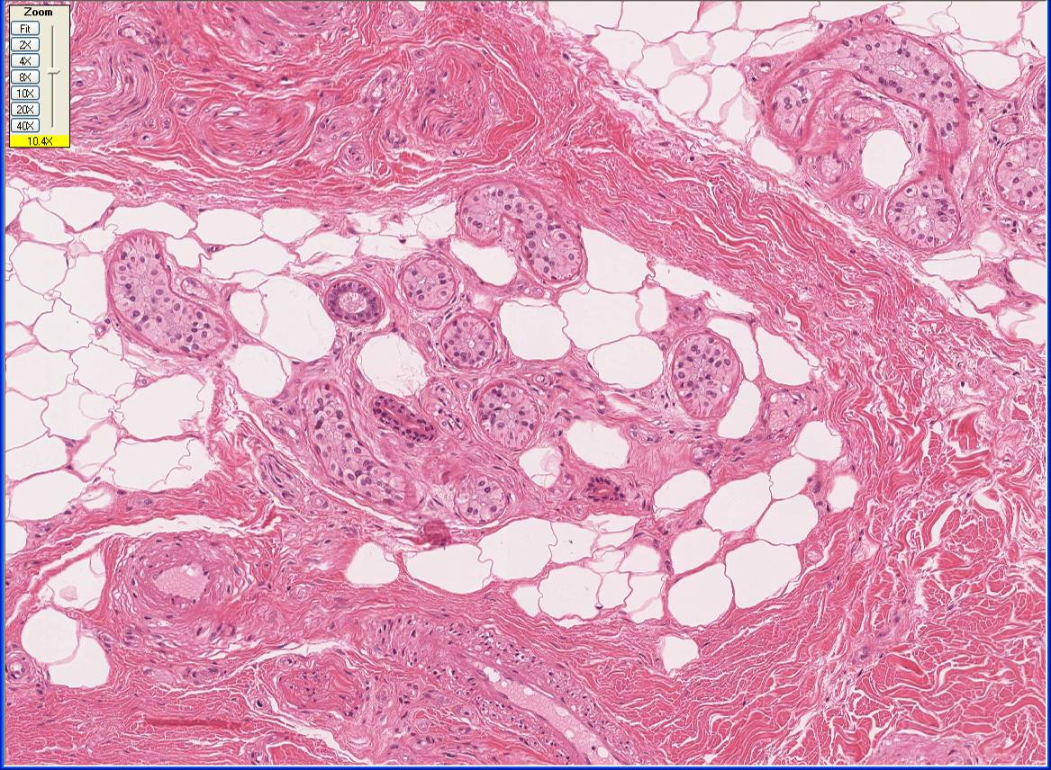
UMich slide 306: eccrine sweat glands
g
nerve
g
g
g
d
g
g
adipose
d
g
g
myoE (nucleus)
d
g
myoE (processes)
vessel
DICT
nerve
vessel
Notes:
d=sweat gland duct g=sweat gland

Slide 13
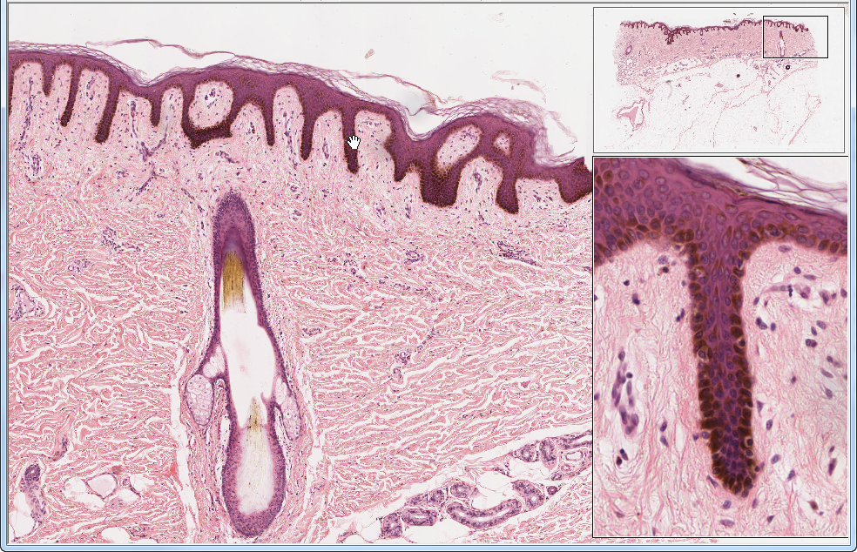
UMich slide 104-2: thin skin
pap. dermis
ret. dermis
hf
seb
g
sw g
melanocytes

Slide 14
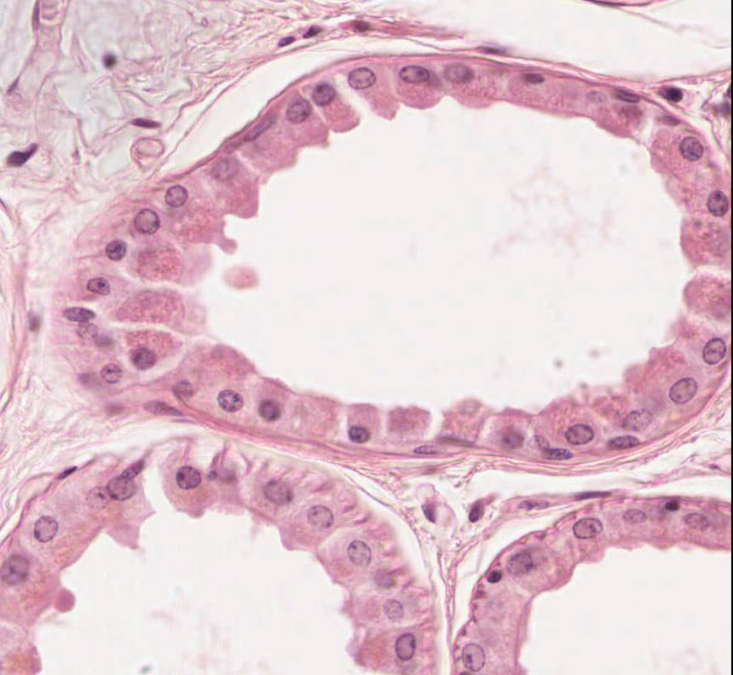
Apocrine Glands Slide 104-2
myoepithelial cell nuclei
apical secretory granules
secretory epithelial cells

Slide 15
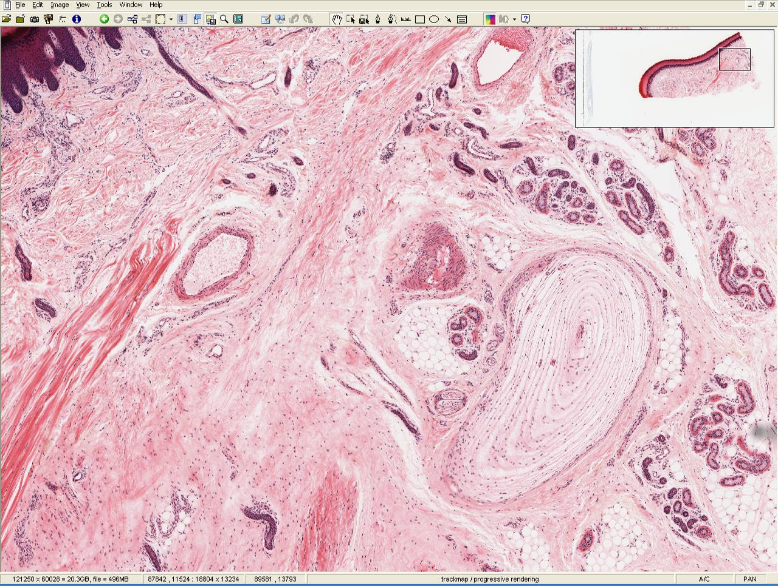
Slide UCSF_180: finger tip
epidermis
sweat glands & ducts
dermis
hypodermis
Pacinian
corpuscle

Slide 16
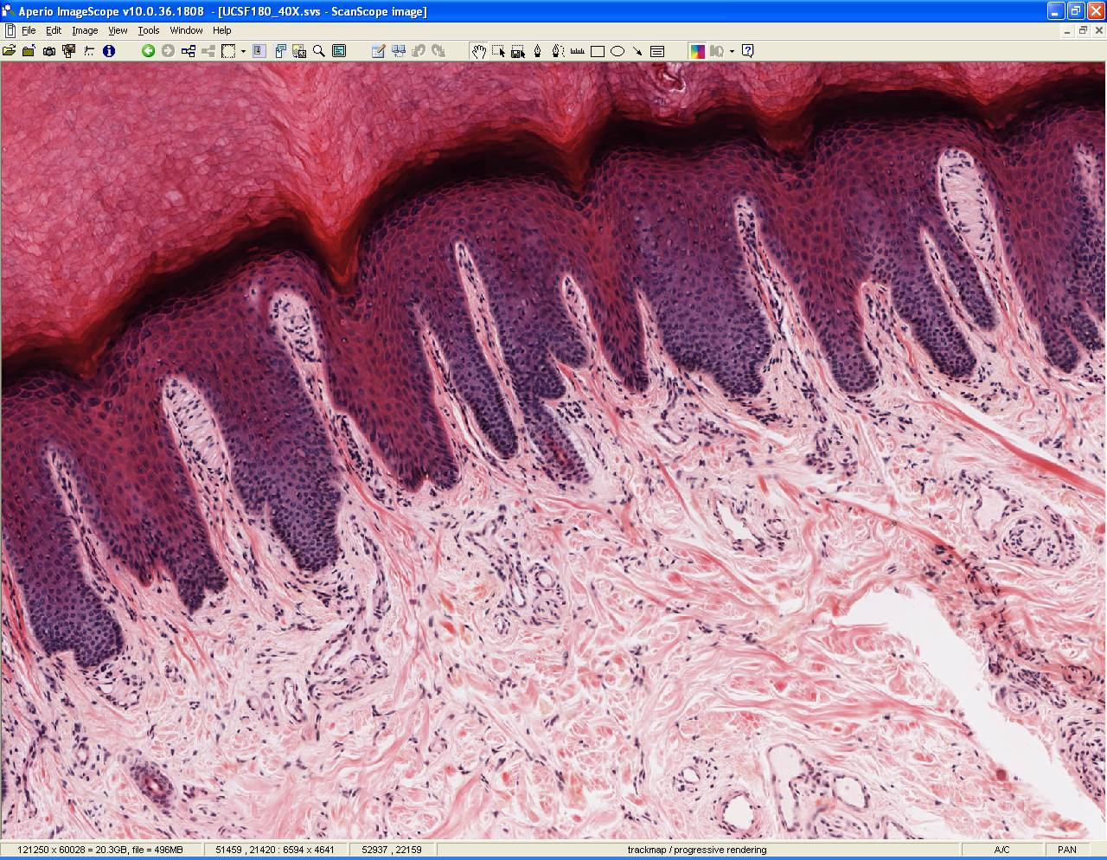
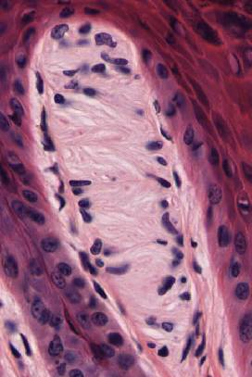
Slide UCSF_180: Meissner’s Corpuscle
mc
mc
dermal papillae
layers of flattened
Schwann cells
encasing nerve
fiber endings
mc
epidermal ridges
Notes:
mc=Meissner’s corpuscle

